Slide 1
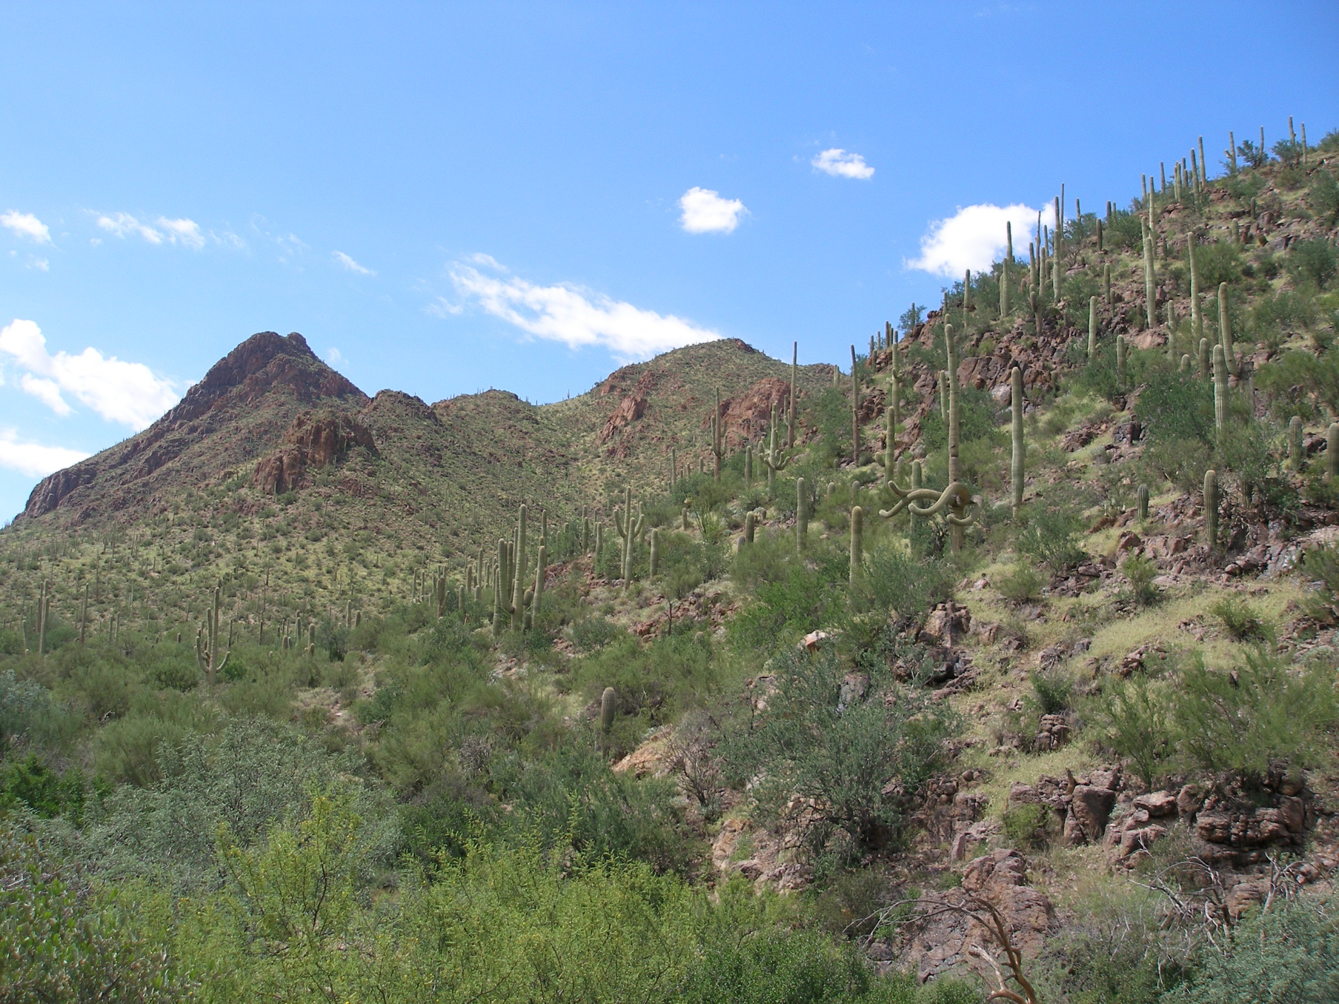
Arizona/Sonora Regional Workgroup Recent Accomplishments

Slide 2
Arizona/Sonora Regional Workgroup Co-chairs
United States
Jeff Scott, Director, Land Division, Environmental Protection Agency-Region 9 Office (EPA)
Amanda Stone, Southern Regional Office Director, Arizona Dept. of Environmental Quality (ADEQ)
Mexico
Jorge Suilo, Delegate, Secretariat for the Environment and Natural Resources (SEMARNAT)
Oscar Tellez, Commissioner, Commission of the Environment and Sustainable Development (CEDES)

Slide 3
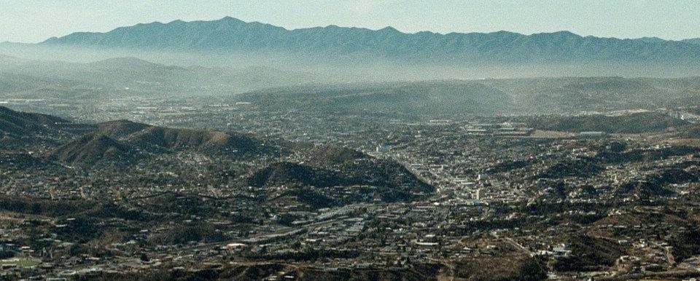
Goal 1- Reduce Air Pollution
Installation and operation of a PM10 monitor in Nogales, Sonora
Approved a PM-10 State Implementation Plan for Nogales, Arizona to reduce PM10 emissions
Upgraded the Arizona border air monitoring network with four new air quality monitors in Nogales, Yuma, and two in Douglas, AZ
Constructed a 16MW solar park (Tucson) that is displacing over 16,000 tons of CO2, 11 tons of NOx and 17 tons of SOx per year. The plant generates enough electricity to power 2100 homes.

Slide 4
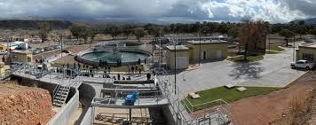
Goal 2- Improve Access to Clean and Safe Water
Connected 13,259 additional homes to wastewater service in Nogales and San Luis Rio Colorado, Sonora.
Installed a 1.5MW solar array at the Los Alisos Wastewater Treatment Plant in Sonora. The photovoltaic plant will displace approximately 1.76 million pounds of CO2/year.
Conducted energy audits at utilities in San Luis Rio Colorado, Sonora and Willcox, Arizona to identify energy savings opportunities. Identified over $140,000 in energy savings per year.

Slide 5
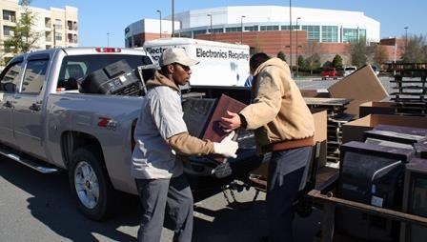
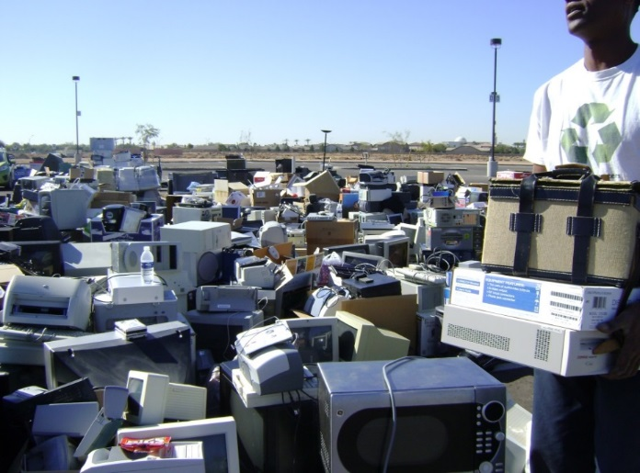
Goal 3- Promote Materials Management and Waste Management and Clean Sites
Collected over 398,000 liters of used oil in 103 sites and constructed three used oil collection centers in Nogales, Sonora; trained 280 people; and developed used oil institutional and infrastructure capacity
Collected over 60,000 lbs. of e-waste in communities in Arizona and Sonora and built municipal capacity to implement e-waste collection events and BMPs. Toolkit for communities to use is available on line in English and Spanish: http://azdeq.gov/environ/waste/p2/ewastetoolkit/index.html

Slide 6
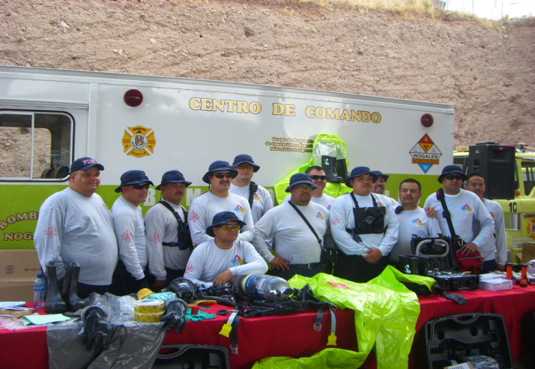
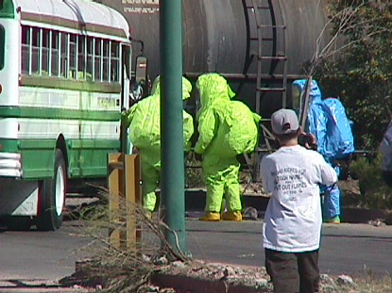
Goal 4- Enhance Joint Preparedness for Environmental Response
Equipped Bomberos in Sonora with Level A, B, and C suits and radiation monitors through a $200,000 donation by the State of Arizona
First Responder training and Table Top Exercises conducted in Rio Rico, Arizona and Agua Prieta, Sonora to improve binational emergency preparedness, including:
First Responder Awareness/Operations
Traffic Incident Management Systems
Train derailment and full scale gas line explosion drills

Slide 7
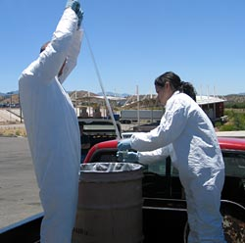
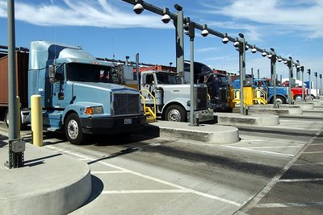
Goal 5- Enhance Compliance Assurance and Environmental Stewardship
Convened a two-day tri-national workshop to promote the exchange of information and improve understanding of each country’s respective compliance and information programs

Slide 8
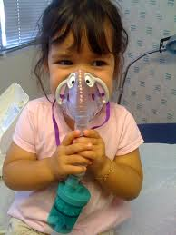
Environmental Health Fundamental Strategy
Building Environmental Health Capacity
Provided train-the-trainer education on pesticide safety and the Agricultural Worker Protection Standard in San Luis, AZ
Trained approximately 31 promotores on Healthy Home strategies and concepts in Tucson, AZ
Conducted workshop on air quality and asthma, pesticides exposure, lead, and climate change to approximately 40 promotores

