Slide 1

SPCC 40 CFR Part 112
Tier I Template Instructions
(for farms)
Insert Instructor Names
Insert HQ Office/Region
Insert Date

Slide 2
Today’s Agenda
SPCC/Qualified Facility Applicability
Tier I Qualified Facility SPCC Plan Template
Questions and Answers

Slide 3

Part I:
SPCC/ Qualified Facility Applicability

Slide 4
Notes:
SPCC Applicability

Slide 5
Qualified Facility Applicability
If the facility total aboveground oil storage capacity is 10,000 gallons or less …
And… | And the facility has… | Then the facility is a:
Within three years prior to the Plan certification date, or since becoming subject to the SPCC rule if in operation for less than three years, the facility has not had: A single discharge of oil to navigable waters or adjoining shorelines exceeding 1,000 gallons, or Two discharges of oil to navigable waters or adjoining shorelines each exceeding 42 gallons within any 12-month period.¹ | No individual aboveground oil containers greater than 5,000 gallons; | Tier I Qualified Facility: Complete and self-certify Plan template (Appendix G to 40 CFR part 112) in lieu of a full PE-certified Plan.
 | Any individual aboveground oil container greater than 5,000 gallons; | Tier II Qualified Facility: Prepare a self-certified Plan in accordance with all applicable requirements of §112.7 and subparts B or C of the rule, in lieu of a PE-certified Plan.
¹Not including discharges that are the result of natural disasters, acts of war, or terrorism. When determining the applicability of this SPCC reporting requirement, the gallon amount(s) specified (either 1,000 or 42) refers to the amount of oil that actually reaches navigable waters or adjoining shorelines not the total amount of oil spilled. EPA considers the entire volume of the discharge to be oil for the purposes of these reporting requirements.

Slide 6
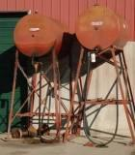
Examples of Oil
Gasoline
Off-road and on-road diesel fuel
Hydraulic oil
Lubrication oil
Crop oil
Vegetable oils from crops
Adjuvant oil
Milk*
* Milk and Milk product containers are now exempt from the SPCC capacity calculations and rule requirements

Slide 7
What is a “Reasonable Expectation of an Oil Discharge”?
Initial determination by the owner/operator based on geographical and location aspects of the farm
You may consider proximity to water, land contour, drainage
Exclude manmade features, such as secondary containment dikes around tanks and impoundments, in determination
Good idea to document determination
  Particularly if you conclude you are not subject to the rule
  Not a rule requirement
See Section 2.4 of SPCC guidance document
http://www.epa.gov/emergencies/docs/oil/spcc/guidance/2_Applicability.pdf

Slide 8
Part II:
Tier I Qualified Facility SPCC Plan Template

Slide 9
Doe’s Family Farm
(fictional scenario)
Doe’s Family Farm is comprised of multiple parcels of land totaling approximately 2,800 acres on which rice, corn and soybeans are grown on a rotational basis.
The farm is adjacent to an unnamed tributary of the White River.
The main operational area of the farm includes sheds to store equipment, a tractor repair and maintenance shop, fuel storage and transfer area, silos for storing corn, and a single-family residence.

Slide 10
Doe’s Family Farm
Spill History:
  The farm had the following discharges in the three years prior to the date that Mr. Doe certified his Plan (04/12/2011):
  August 12, 2009 - 50 gallons gasoline reached the White River;
  January 20, 2010 - 100 gallons diesel oil (25 gal. to the tributary to the White River);
  September 16, 2010 - 60 gallons diesel oil to secondary containment.

Slide 11
Facility Diagram
Notes:
Oil Container Inventory:
The following containers are subject to the SPCC rule:
Stationary aboveground bulk storage containers: (Stationary and mobile/portable aboveground oil storage containers are subject to the SPCC rule and count toward the Qualified Facility criteria threshold).
• 2,500-gallon off-road diesel AST
• 2,500-gallon on-road diesel AST
• 500-gallon gasoline AST
• 1,200-gallon slop oil AST
Total capacity = 6,700 gallons
Mobile/portable containers:
• Truck with two nurse tanks
- 500-gallon off-road diesel nurse tank mounted on a trailer
- 115-gallon on-road diesel nurse tank situated in the truck bed
• 250-gallon motor oil tote
• 250-gallon waste oil tote
• 55-gallon hydraulic oil drum
• 55-gallon lubrication oil drum
• 55-gallon adjuvant oil drum
Total capacity = 1,280 gallons
Completely buried storage tanks: (Completely buried tanks are subject to the SPCC rule but do not count toward the Qualified Facility criteria threshold).
• 500-gallon gasoline UST (which is not regulated by the UST rule and thus regulated by the SPCC rule)
Exempt containers do not count toward the facility total oil storage capacity and are not subject to any SPCC rule requirements (though the owner or operator must still prevent spills from these containers and report any spills that reach navigable waters or adjoining shorelines).
The following containers in this example are exempt from the SPCC rule:
• 2 - 250-gallon residential heating oil tanks
• 10-gallon onboard tank in a portable diesel generator
• 1,000-gallon tank on the pesticide groundboom sprayer
• 1,000-gallon pesticide mix tank mounted on a trailer
• All motive power containers, such as the fuel tanks on tractors, combines, trucks, and other vehicles, which are used primarily to power the movement of the vehicle including onboard oil-filled operational equipment
• Any bulk storage container or oil-filled operational equipment that has a capacity of less than 55 gallons (such as the 2.5-gallon containers of adjuvant oils, quart containers of turpentine, gallon containers of mineral spirit, and 5-gallon gas cans)
• 1,000-gallon LP gas tank associated with the corn dryer

Slide 12
Does the Doe Family Farm Need an SPCC Plan?
Is the facility or part of the facility considered non-transportation related?
  Yes, the facility stores, uses, and consumes oil – all non-transportation related activities.
Is the facility engaged in drilling, producing, gathering, storing, processing, refining, transferring, distributing, using, or consuming oil?
  Yes, the facility stores, uses, and consumes oil.
Could the facility reasonably be expected to discharge oil in quantities that may be harmful into navigable waters or adjoining shorelines?
  Yes, an oil spill from the facility could reach the tributary that leads to the White River.

Slide 13
Does the Doe Family Farm Need an SPCC Plan? (cont.)
Is the total aggregate capacity of aboveground oil storage containers greater than 1,320 gallons of oil; or is the total aggregate capacity of completely buried storage tanks greater than 42,000 gallons of oil?
  Yes, the aboveground oil storage capacity is 7,980 gallons.
CONCLUSION: An oil spill from the Doe Family Farm may reach a navigable waterway and the aboveground oil storage capacity is greater than 1,320 gallons. John Doe needs to develop an SPCC Plan.

Slide 14
Can John Doe Certify the SPCC Plan and Complete a Tier I Template?
Has the facility had any oil spills that reached navigable waters in the past three years?
  Yes, oil spills from this facility can and did reach navigable waters.
Were any of these oil spills larger than 1,000 gallons?
  No.
Was oil spilled to navigable waters more than once in a 12-month period?
  Yes, on August 12, 2009 and again on January 20, 2010.

Slide 15
Can John Doe Certify the SPCC Plan and Complete a Tier I Template? (cont.)
Did more than 42 gallons of spill oil reach navigable waters in both discharges?
  No. On January 20, 2010 only 25 gallons reached navigable waters. Although the farm had two discharges of oil to navigable waters, there was no single discharge of oil to navigable waters exceeding 1,000 U.S. gallons, nor two discharges of oil to navigable waters each exceeding 42 U.S. gallons within any twelve-month period.
Is the aboveground oil storage capacity 10,000 gallons or less?
  Yes, the Doe Family Farm is a qualified facility and John Doe can certify the SPCC Plan.

Slide 16
Can John Doe Certify the SPCC Plan and Complete a Tier I Template? (cont.)
Are any aboveground oil storage containers at the farm larger than 5,000 gallons capacity?
  No.
  CONCLUSION: The Doe Family Farm is a Tier I Qualified Facility and John Doe can complete the SPCC Plan template in Appendix G of the rule (as long as he does not deviate from any rule requirements).

Slide 17
Cover Page: Instructions
Can be completed electronically or handwritten on printed copy
  A hardcopy of the final Plan must be kept at facility
  Template covers all SPCC requirements for a Tier I qualified facility
  Becomes the facility’s SPCC Plan when fully completed
A checked box on the template indicates that the requirement has been adequately addressed
Not all items/sections of the template are applicable to all facilities.
  Non-applicable items can be identified/checked as “N/A”
Some sections require written descriptions and/or listings

Slide 18
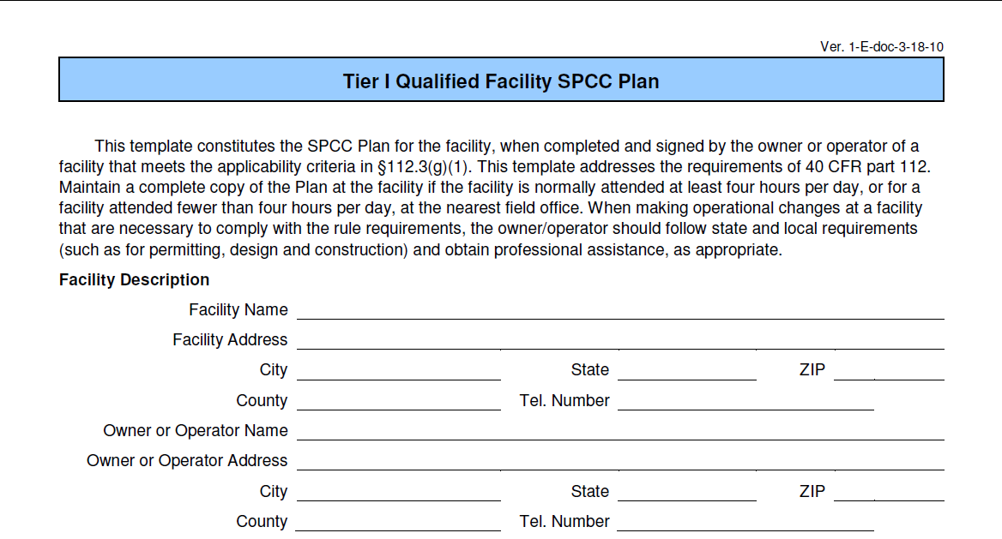
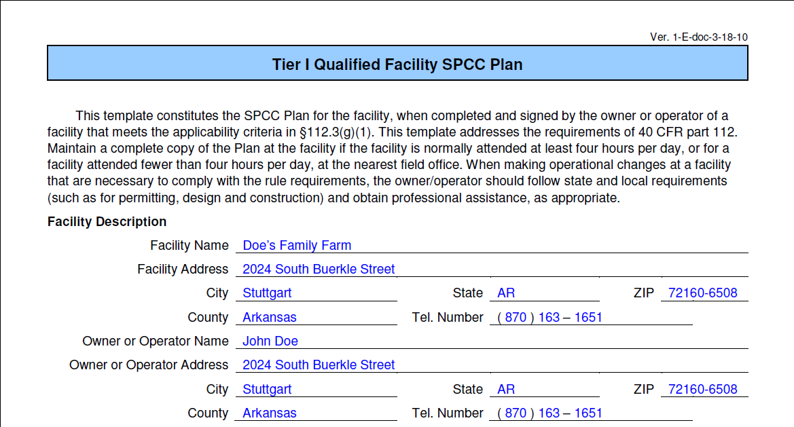
Notes:
Instructions:
Provide all requested information including:
Facility name, address, county and phone number
Owner/operator name, address, county and phone number

Slide 19
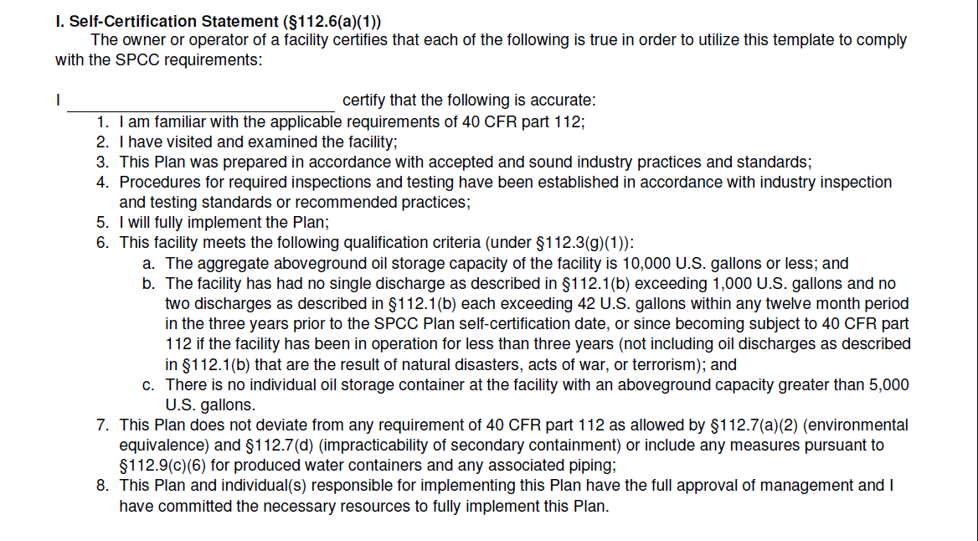
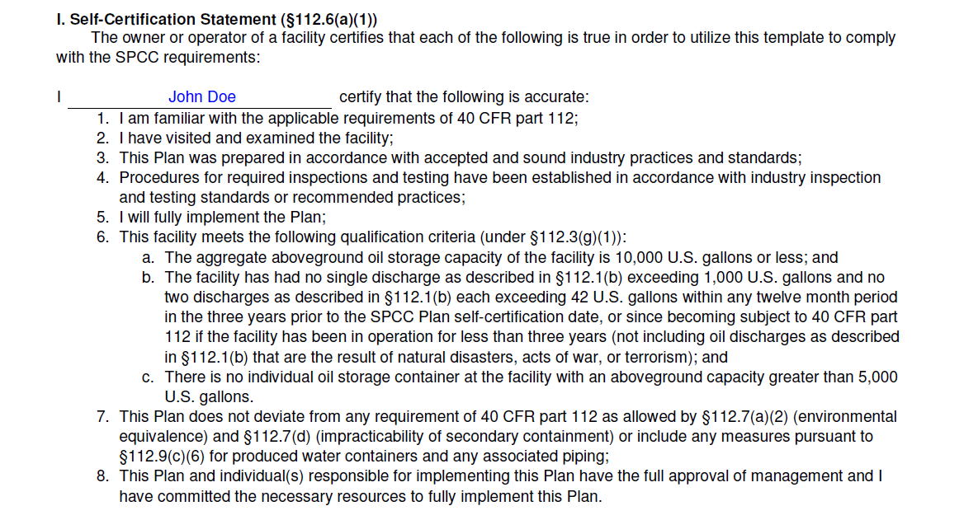
Need more information?
Each section highlights the rule requirements that apply
Notes:
Instructions:
As the facility owner/operator, you must certify that each of the statements in this subsection are true.
Write your name in the space provided
Read each statement in this subsection
Sign and write your name, and provide your title and the date to certify that you understand and are abiding by all applicable requirements

Slide 20
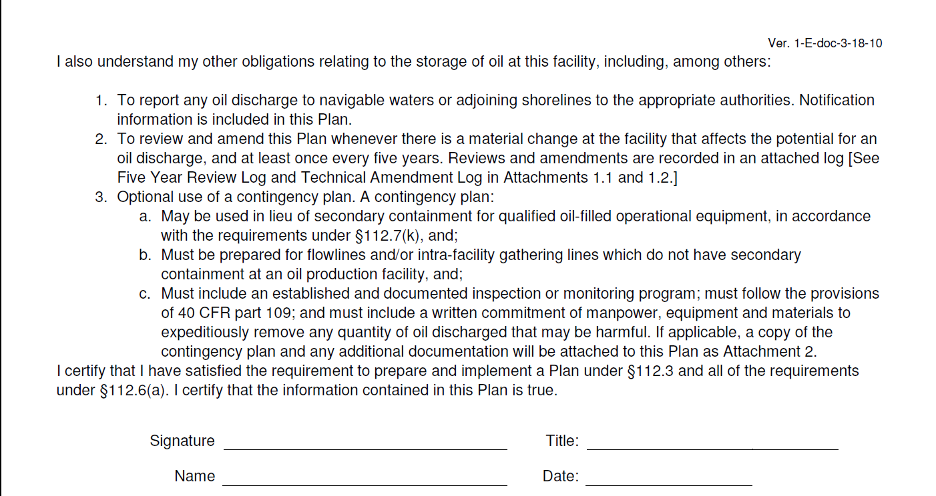
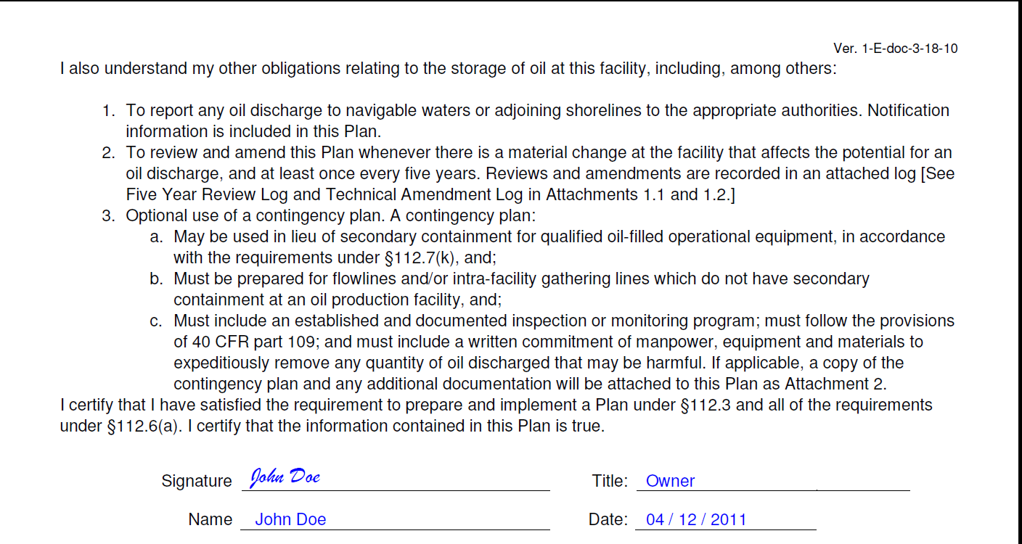
Notes:
(Cont.)
Instructions:
As the facility owner/operator, you must certify that each of the statements in this subsection are true.
Read each statement in this subsection
Sign and write your name, and provide your title and the date to certify that you understand and are abiding by all applicable requirements

Slide 21
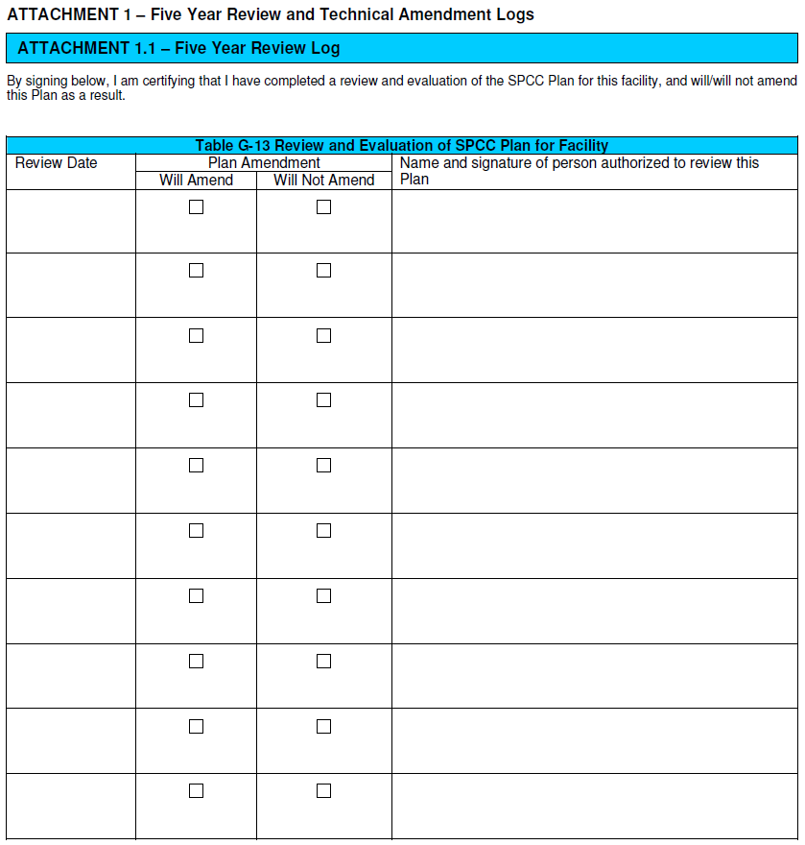
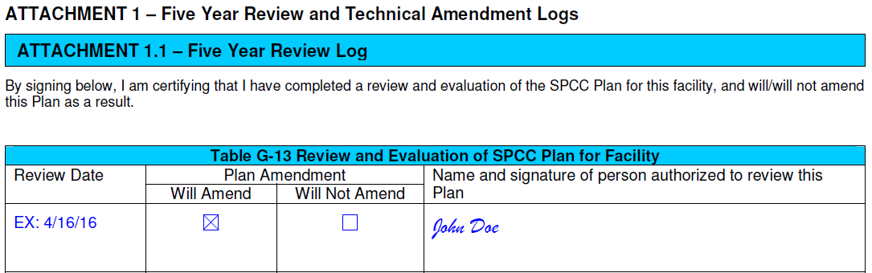
Table located as an attachment at the end of the template
Notes:
This attachment does not apply to the scenario, but an example is included.
Instructions:
Once a review is conducted, document the date the review occurred, if a plan amendment will or will not occur, and have the person authorized to conduct the review sign the log.
Supplemental Information:
An owner or operator must review and evaluate the SPCC Plan at least once every five years from the signature date of the Plan. A review of the Plan must also be completed whenever there is a change in the facility which affects the potential for a discharge of oil. In addition, the owner or operator has to amend the Plan within six months of review to include more effective prevention and control technology if the technology has been field-proven at the time of the review and will significantly reduce the likelihood of a discharge to navigable waters or adjoining shorelines. The owner or operator must implement any Plan amendment resulting from the review as soon as possible, but no longer than six months after the amendment.

Slide 22
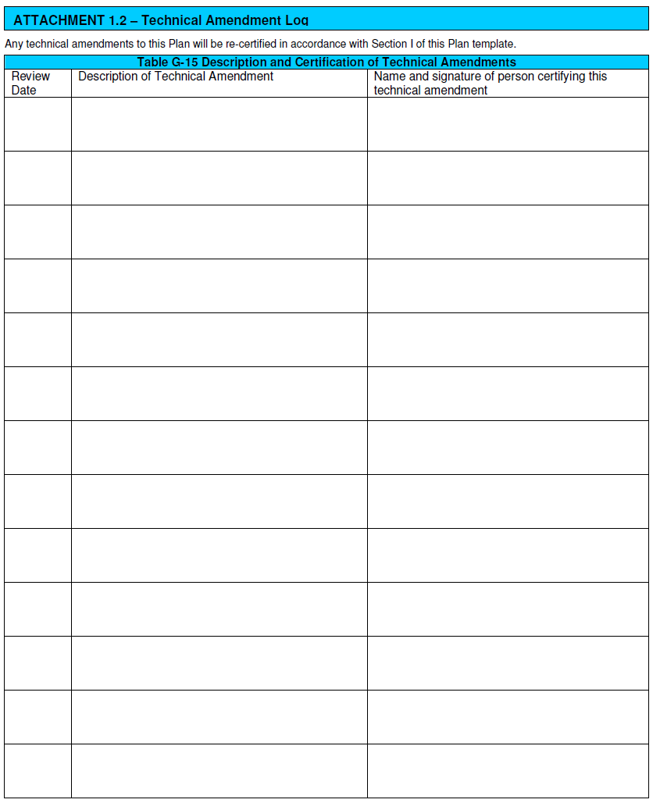
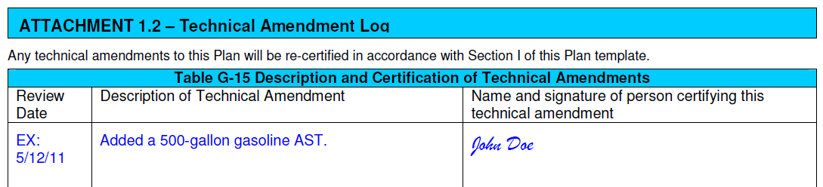
Table located as an attachment at the end of the template
Notes:
This attachment does not apply to the scenario, but an example is included.
Instructions:
When a technical amendment is made, fill out the table with the date the amendment is made, the description of the amendment and have the person certifying the amendment sign the log.
Examples of Technical Amendments:
Commissioning and decommissioning containers
Replacement, reconstruction, or movement of containers
Reconstruction, replacement, or installation of piping systems
Construction or demolition that might alter secondary containment structures
Changes in product or service
Revision of operating or maintenance procedures

Slide 23
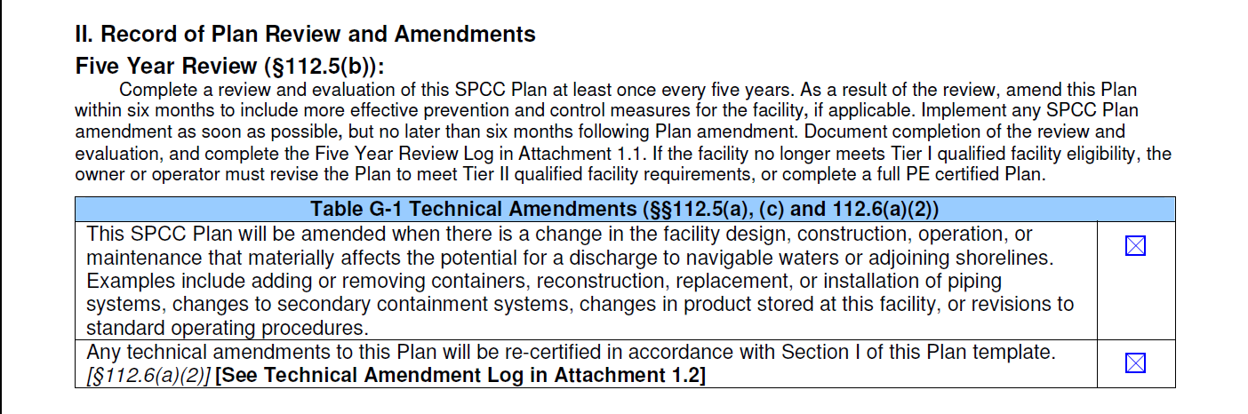
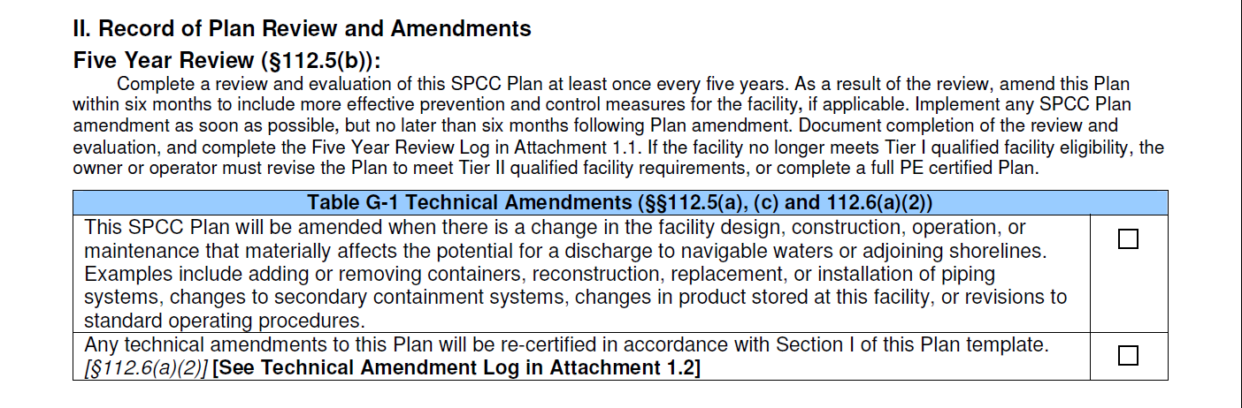
Notes:
Instructions:
Check the box to state that the SPCC Plan will be amended as necessary
Check the box to state that any technical amendments will be certified in accordance with Section I.

Slide 24
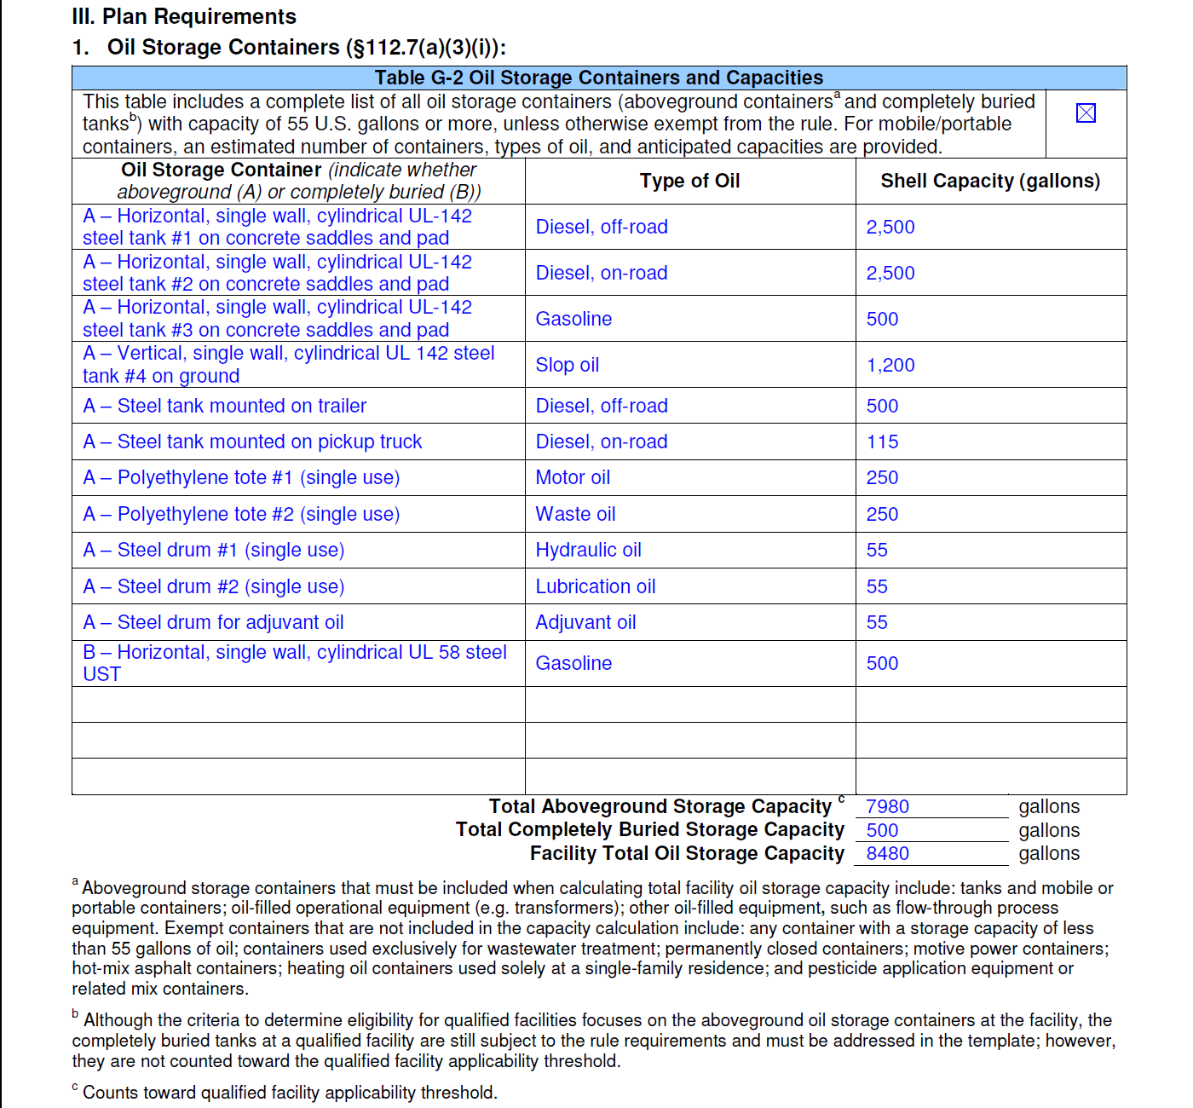
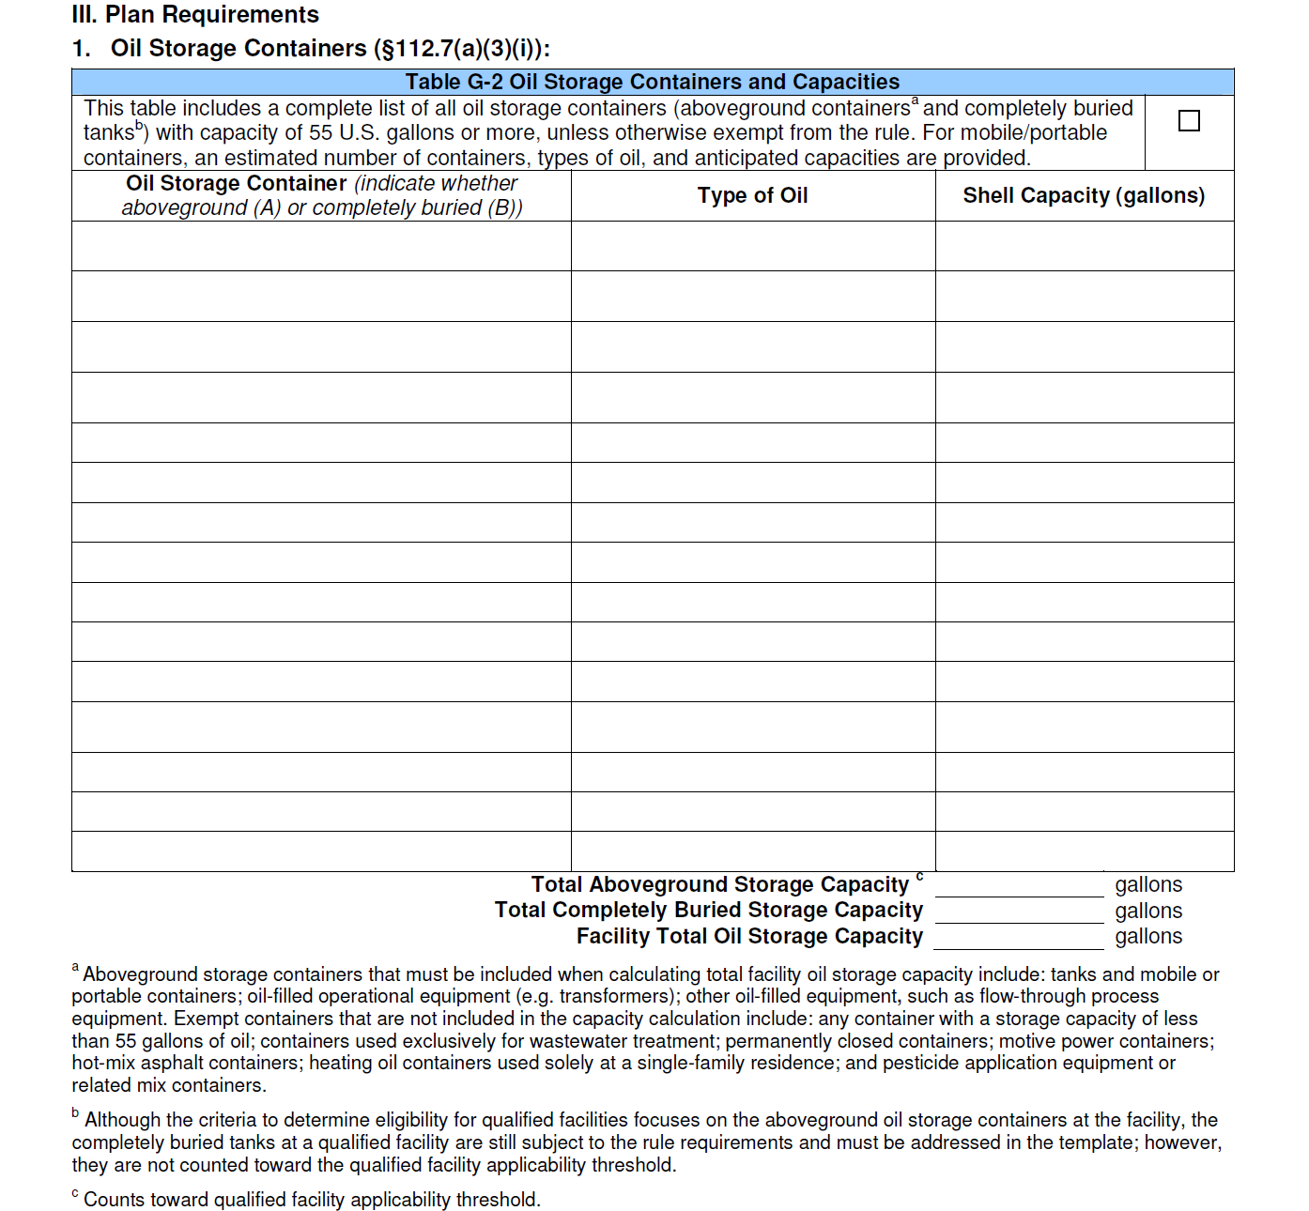
Notes:
Instructions:
1. Check the box to indicate that you have provided a complete list of all oil storage containers.
2. Fill out the table to include all oil storage containers, the type of oil the container is storing, and the shell capacity of the container in gallons. Indicate whether the tank is aboveground (A) or completely buried (B).
Supplemental Information:
Please note that the owner or operator is still responsible to respond to spills from exempt containers and report any spills that reach navigable waters; consequently, the owner or operator may want to consider providing secondary containment for these containers. Facilities with containers not subject to the SPCC rule should consult with local authorities or agencies to determine whether there are regulatory or code requirements, for instance fire and safety codes, that apply to the containers. Also, note that exempt containers and any other object stored in secondary containment structures, e.g., dikes and berm, for tanks regulated by the SPCC rule reduce their containment capacity, increasing the potential for a reportable oil discharge.

Slide 25
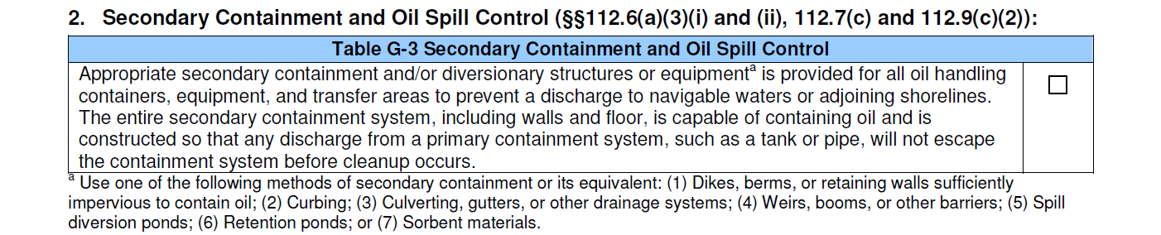
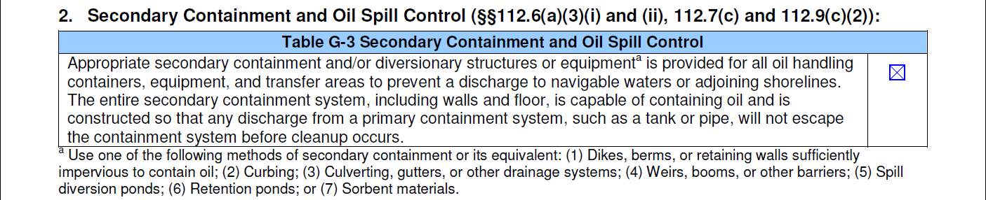
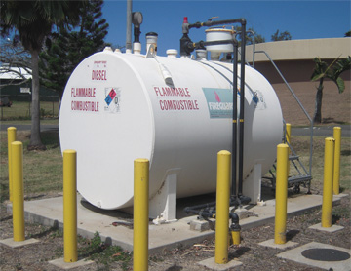
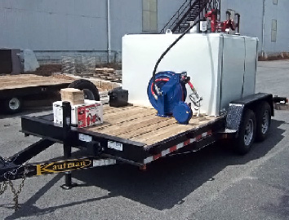
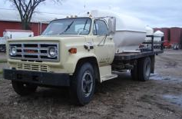
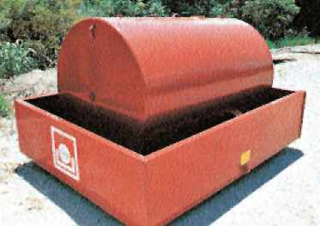
Notes:
Instructions:
Check the box to indicate that appropriate secondary containment is provided for all oil handling containers, equipment, and transfer areas.
Supplemental Information:
Secondary containment structures, e.g., dikes or berms, can be constructed with various materials such as: metal, concrete, earthen materials, liners, asphalt, and other coatings. Although different materials can be used, the material and containment construction must enable the secondary containment structure to prevent discharges to navigable waters or adjoining shorelines. For the secondary containment structure to serve this purpose, it must be able to contain the oil spill until it is cleaned up. Whether it can do this depends primarily on the ability of the containment material to slow down or prevent the flow of the spill through the material, (i.e., the material’s imperviousness to the spill). Note that the rule does not specify how to design the secondary containment system to meet the impervious standard. The facility owner or operator determines how best to provide secondary containment based on good industry practices, oil product properties, and other specific factors and conditions at the facility.
Note that EPA considers shop-fabricated double-walled tanks that employ overfill and leak detection measures and are constructed to industry standards as meeting the secondary containment requirements in the SPCC rule. This clarification can be found in EPA Memorandum, Subject: Use of Alternative Secondary Containment Measures at Facilities Regulated under the Oil Pollution Prevention Regulation (40 CFR Part 112), OSWER 9360.8-38, More detailed information on secondary containment, including design and construction, is available in the SPCC Guidance for Regional Inspectors, EPA 550-B-05-001, at http://www.epa.gov/emergencies/content/spcc/spcc_guidance.htm.
Photo Description:
From top left corner (clockwise): Double wall AST; 900 gallon nurse tank on trailer; nurse tank mounted on truck;UL142 tank.

Slide 26
Example Calculation:
Single Vertical Cylindrical Tank
Inside a Rectangular or Square Dike or Berm
Steps:
1. Determine the volume of the secondary containment, V_{SC}
2a. Determine the volume of the tank when the tank shell capacity is unknown, V_{Tank}
2b. Determine the volume of the tank when shell capacity is known, V_{Tank}
3. Determine the percentage of the secondary containment volume, V_{SC} to the tank volume, V_{Tank}
4. Determine whether the secondary containment can contain the entire tank shell capacity with additional capacity to contain rain.
Notes:
Steps 3 and 4 in the worksheet determines whether the volume of the secondary containment is sufficient to contain the tank’s entire shell capacity and rainfall (freeboard for precipitation) as required by the SPCC rule. Step 3 primarily determines whether the volume of the secondary containment is sufficient to contain the entire shell capacity of the tank. Step 4 is necessary to determine whether the secondary containment can also contain the expected volume of rainfall (both the volume of rain that falls into the containment plus the rain from the tank storage site).

Slide 27
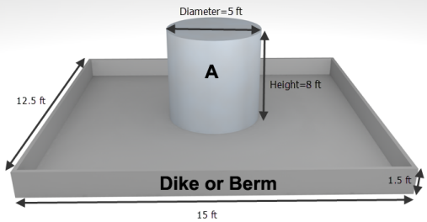
Tank shell capacity
In this example the tank is 1,200 gallons, the tank diameter is 5 ft, and tank height is 8 ft.
Secondary containment length, width, and height
See diagram for dimensions.
Rainfall amount
Rainfall can collect in the secondary containment; the selected rain event for the location is 7 inches.

Slide 28
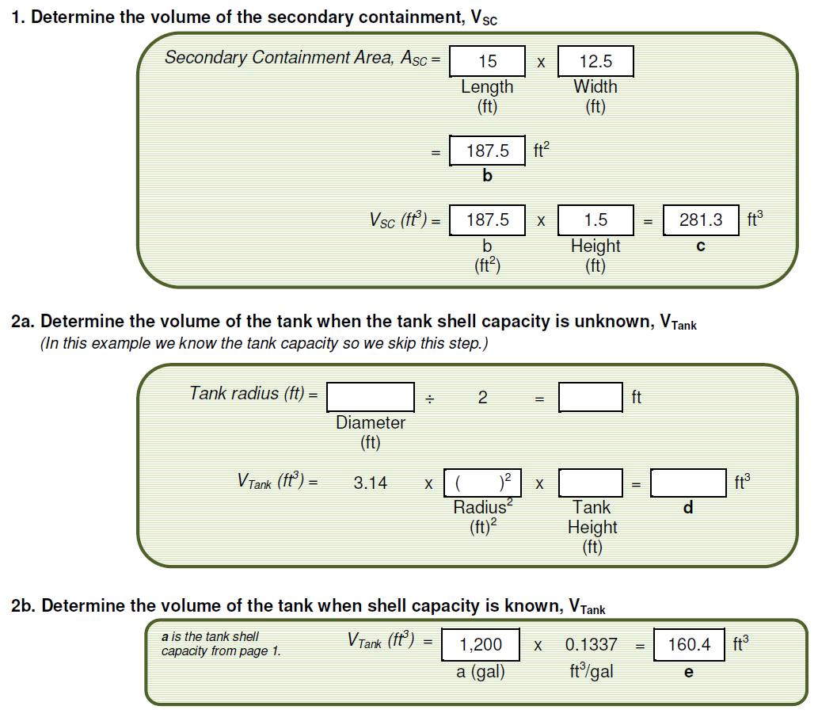

Slide 29
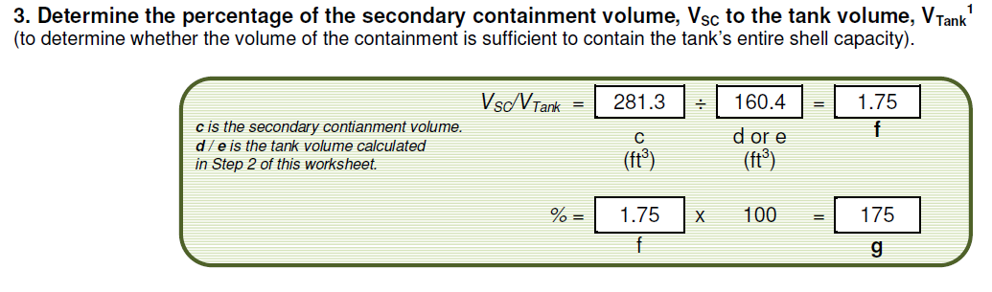
Notes:
Percentage, g, is 175% which is greater than 100%. The capacity of the secondary containment is sufficient to contain the shell capacity of the tank. However, we must also account for rain that can collect in the dike or berm. See Step 4.

Slide 30
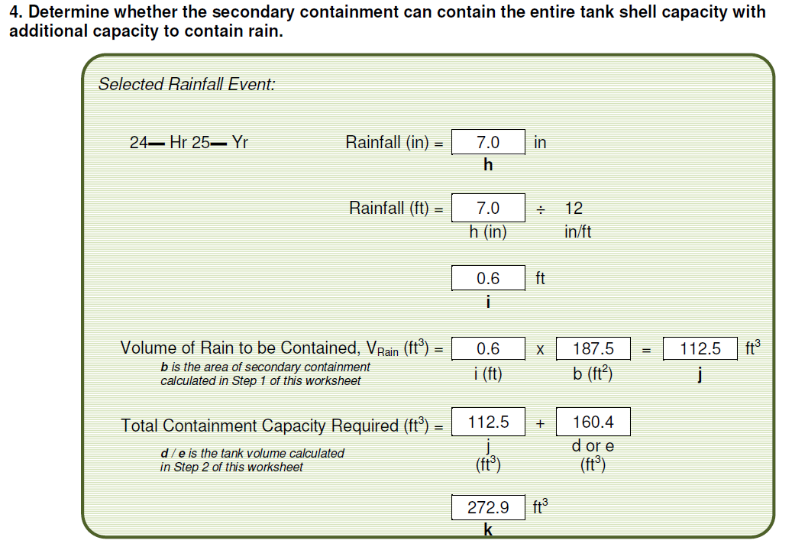
Notes:
The volume of the secondary containment in c is 281.3 ft³, which is greater than the required containment capacity in k (272.9 ft³). Therefore, the secondary containment is sufficient to contain the shell capacity of the tank and has sufficient additional capacity to contain a typical rainfall amount.
The percentage of the secondary containment volume to the tank shell capacity volume is 175% (g in Step 3). This percentage, which is greater than 100%, indicates that additional secondary containment capacity is available to contain rain as the containment is exposed to rain. Subtracting the tank shell capacity volume V_{Tank} of 160.4 ft³ (d or e in Step 3) from the containment volume V_{SC} of 281.3 ft³ (c in Step 3) yields 120.9 ft³ of additional containment capacity for rain. V_{Rain}, the volume of rain falling into the secondary containment in a 24-hour 25-year rainfall event that produces 7 inches of rain, is 112.5 ft³ (j in Step 4). V_{Rain} is less than the 120.9 ft³ of additional containment capacity by 8.4 ft³; consequently, the additional secondary containment capacity is sufficient to also contain the rain from the selected rainfall event. As concluded at the end of Step 4 in this example, the secondary containment is sufficient to contain the shell capacity of the tank and the selected typical rainfall amount.

Slide 31
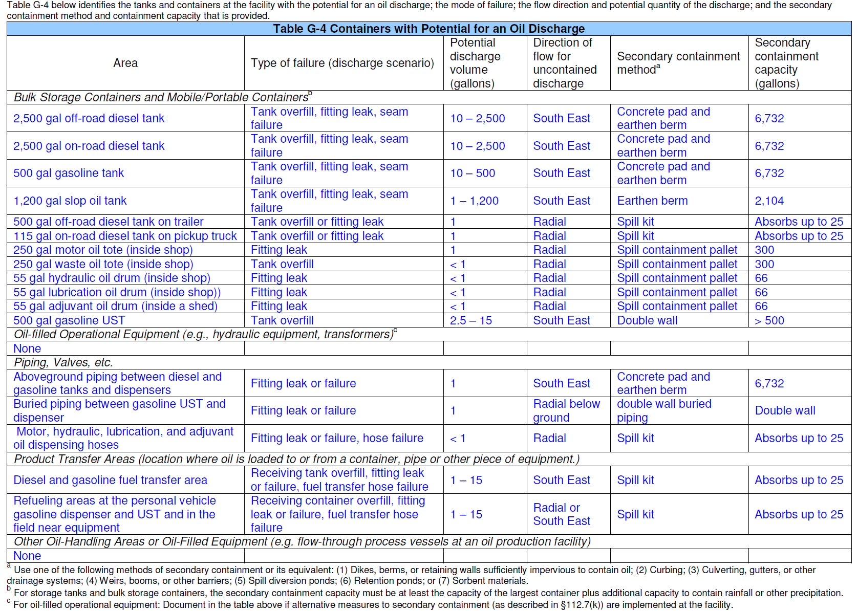
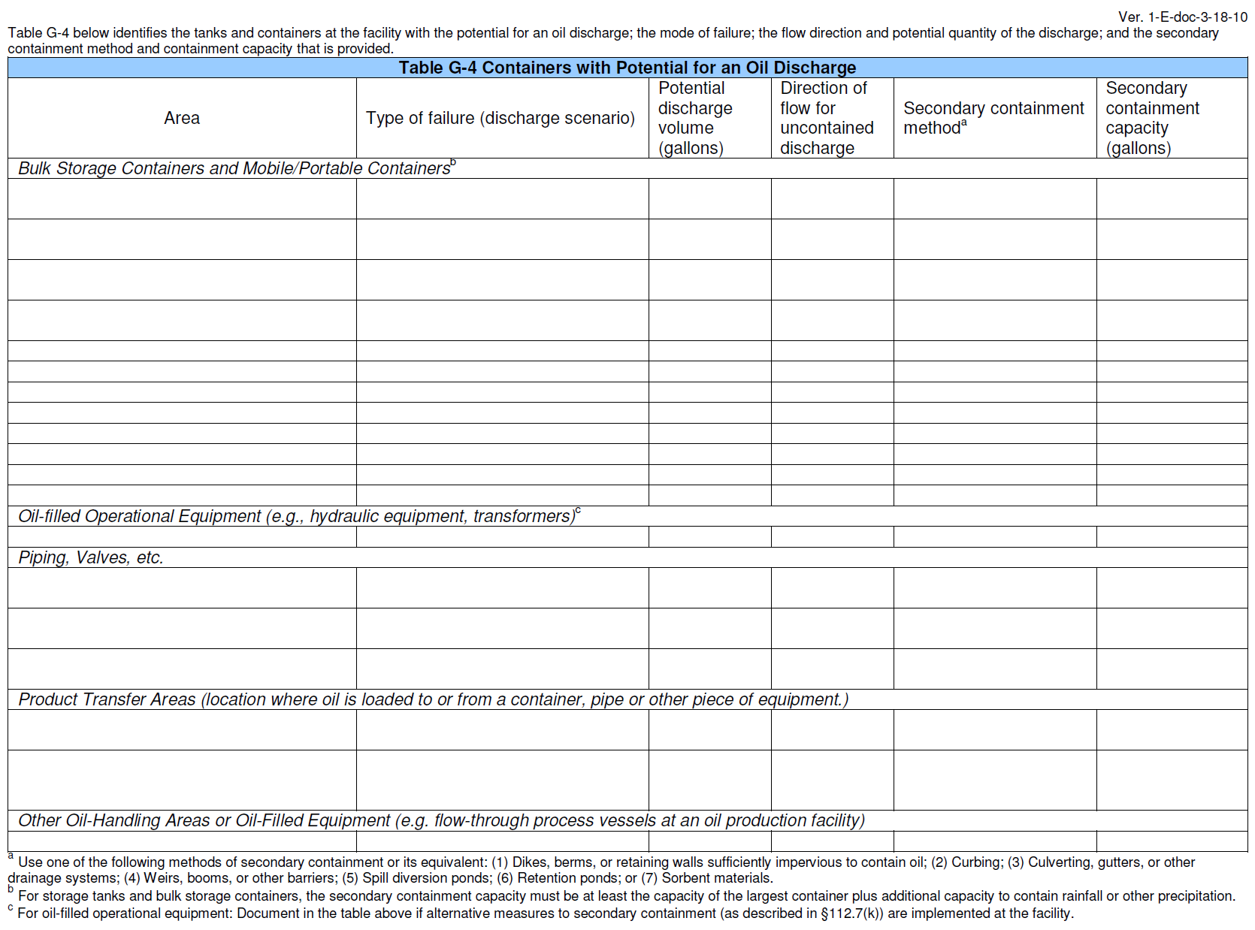
Notes:
Instructions:
Fill out the table to identify the tanks and containers at the facility with the potential for an oil discharge. Include where it is located, potential failures, potential discharge volume in gallons, direction flow of uncontained discharge, and secondary containment capacity in gallons.
Supplemental Information:
Examples of how to calculate the capacity of a secondary containment system are available separately.

Slide 32
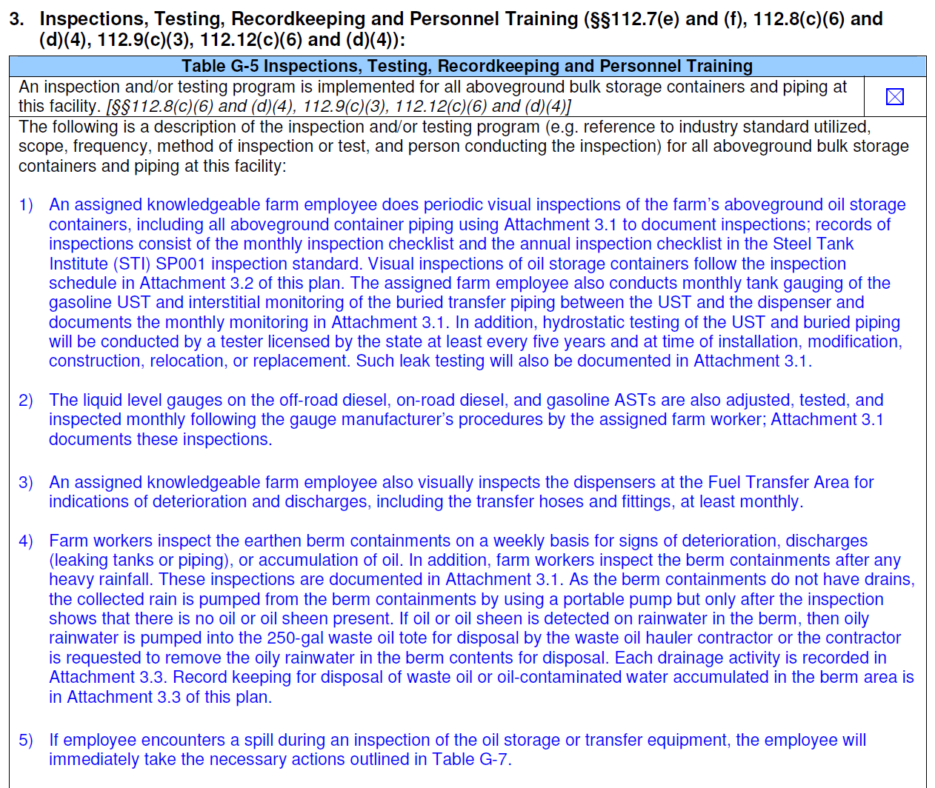
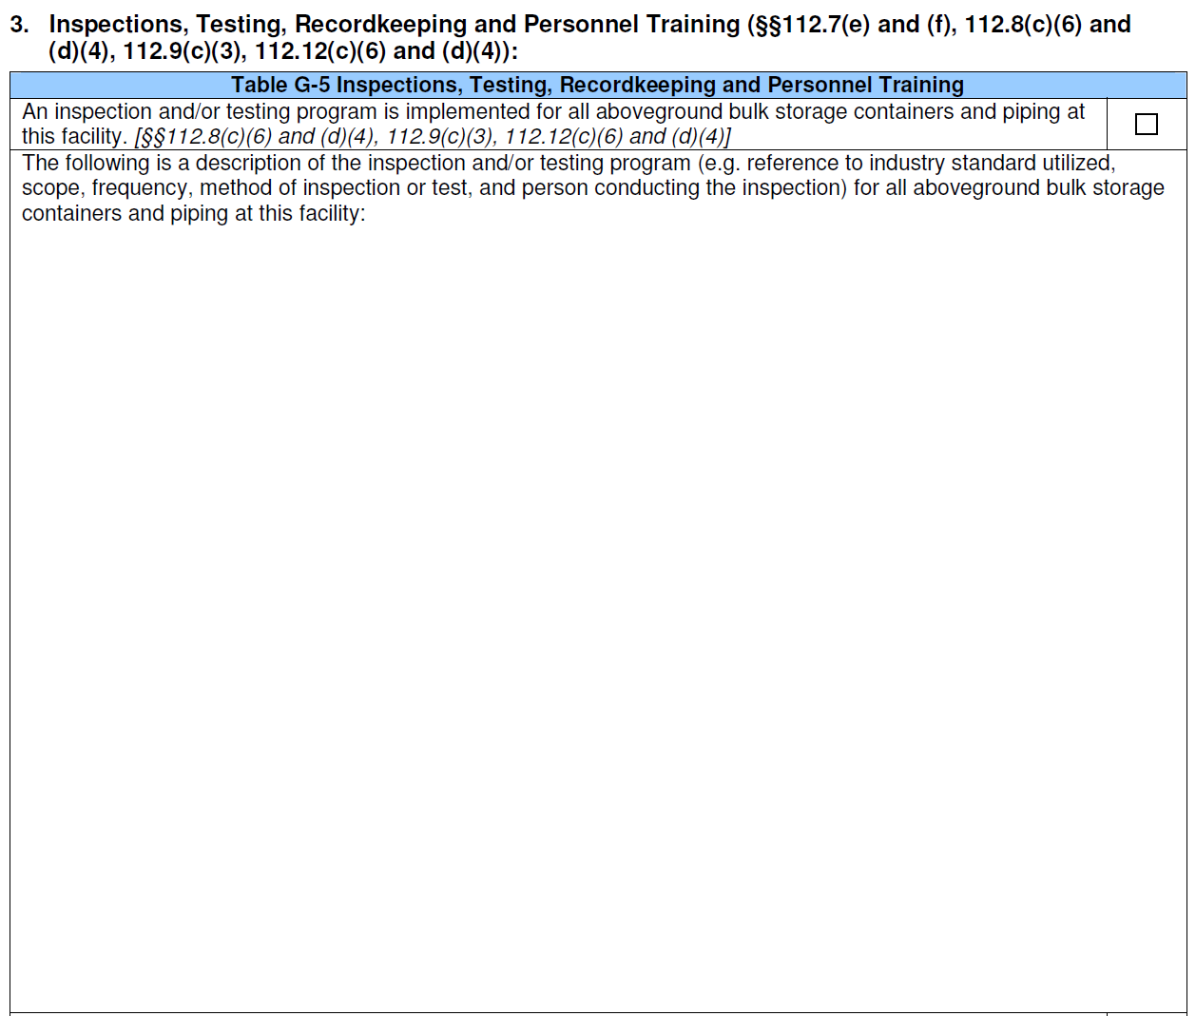
Notes:
Instructions:
Check the box to state that an inspection and/or testing program is implemented for all aboveground bulk storage containers and piping.
Provide a description of the inspection and/or testing program.

Slide 33
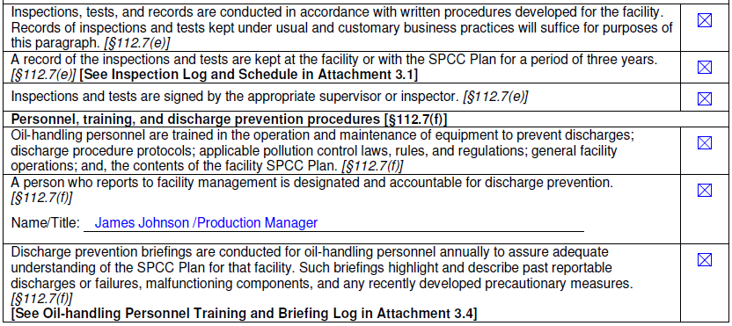
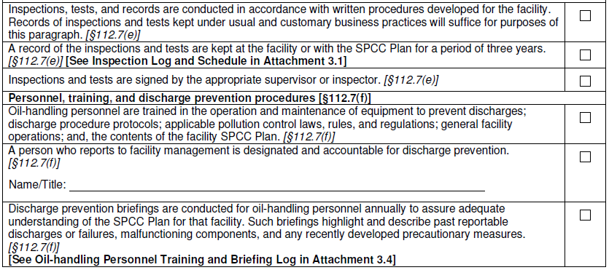
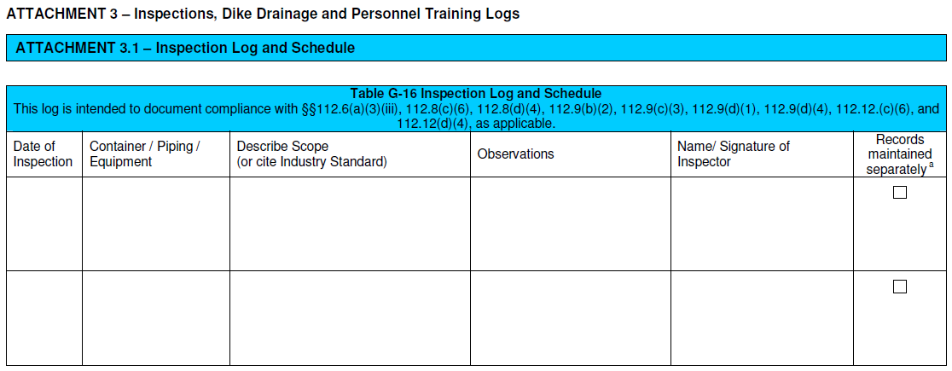
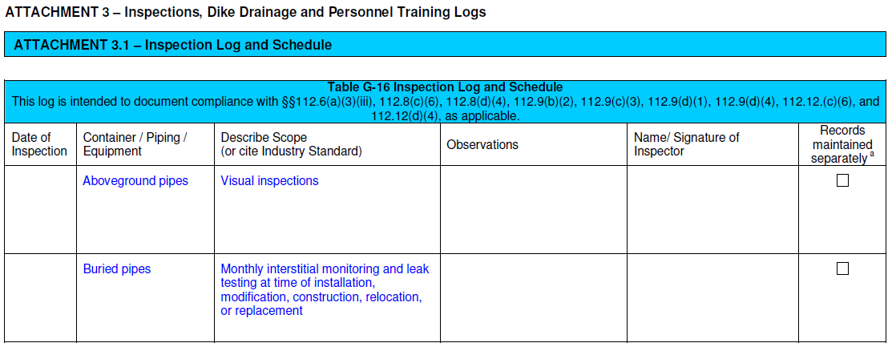
Table located as an attachment at the end of the template
Notes:
Instructions:
1. Check each box to indicate that you meet the requirements listed.

Slide 34
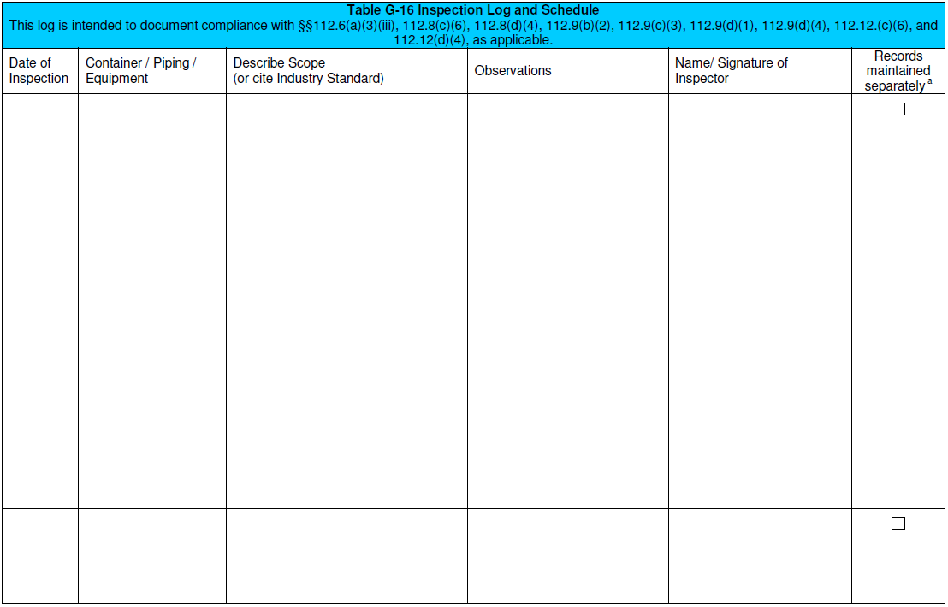
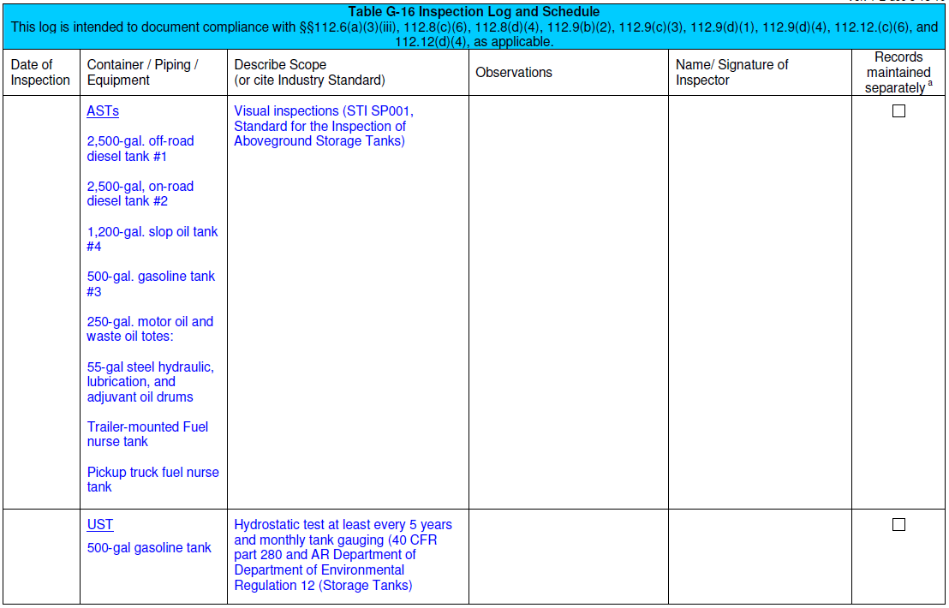
Table G-16 (cont.)
Table located as an attachment at the end of the template

Slide 35
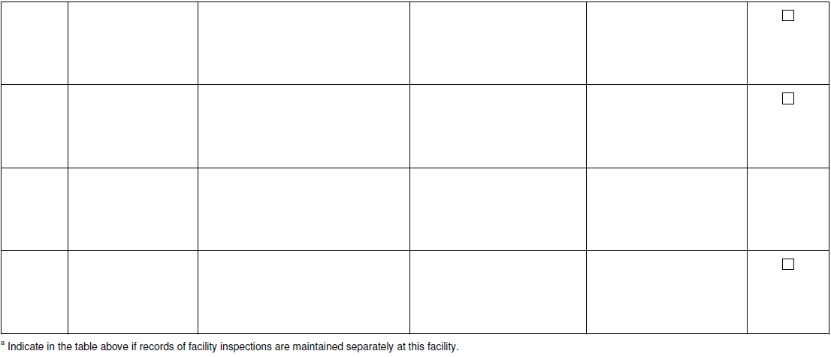
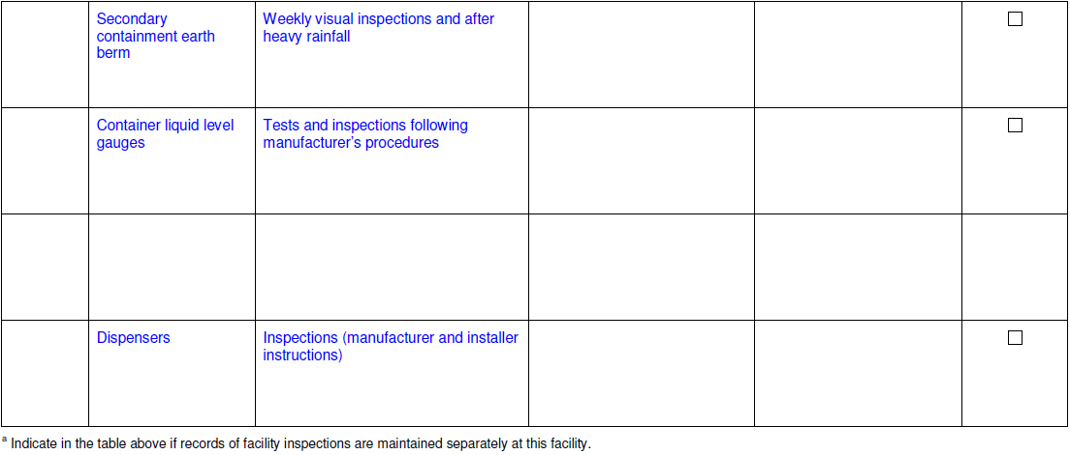
Table G-16 (cont.)
Table located as an attachment at the end of the template
Notes:
Supplemental Information:
The scope of STI SP001 Standard for the Inspection of Aboveground Storage Tanks by the Steel Tank Institute (STI) includes the inspection and testing of aboveground shop-fabricated tanks, small field-erected tanks, portable containers, and associated secondary containment. The standard is copyrighted. However, the periodic tank inspection checklists in Appendix C of the standard are not copyrighted. These checklists are attached to this example template SPCC Plan. Utilization of the checklists alone does not constitute compliance with the standard. The standard is available from STI at the following web address: https://www.steeltank.com/Publications/PublicationsIndex/tabid/108/Default.aspx.
In order to comply with the SPCC rule, conduct leak testing of completely buried metallic USTs in accordance with industry standards at a frequency sufficient to prevent leaks. For instance, testing following the standards specified in the UST regulation, 40 CFR part 280 or a state UST regulatory program approved under 40 CFR part 182 is acceptable for complying with the SPCC rule testing requirement. For this example SPCC Plan, the owner of the farm has opted to hydrostatic test the 500-gallon UST at least every five years together with doing monthly manual tank gauging per the release detection methods specified in 40 CFR part 280. In addition, the owner uses a state-licensed UST tester to do the hydrostatic testing as required by the state for USTs regulated by the state’s UST regulation.

Slide 36
Notes:
Instructions:
1. Check each box to indicate that you meet the requirements listed.

Slide 37
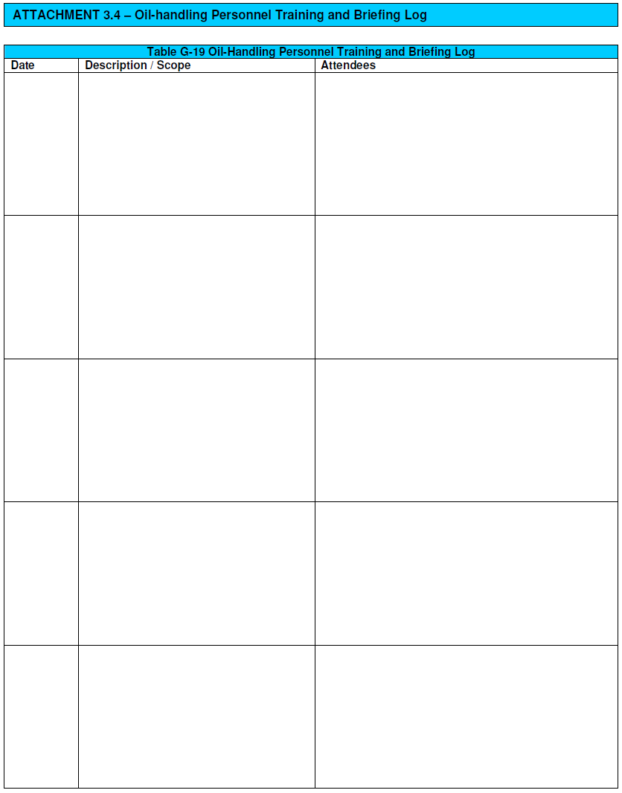
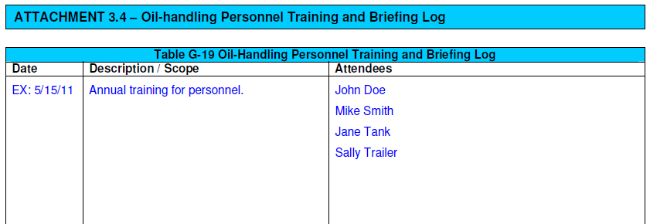
Table located as an attachment at the end of the template
Notes:
This attachment does not apply to the scenario, but an example is included.
Instructions:
Fill out Table G-19 for each training and briefing that occurs. Include the date, description of the training/briefing, and list attendees.

Slide 38
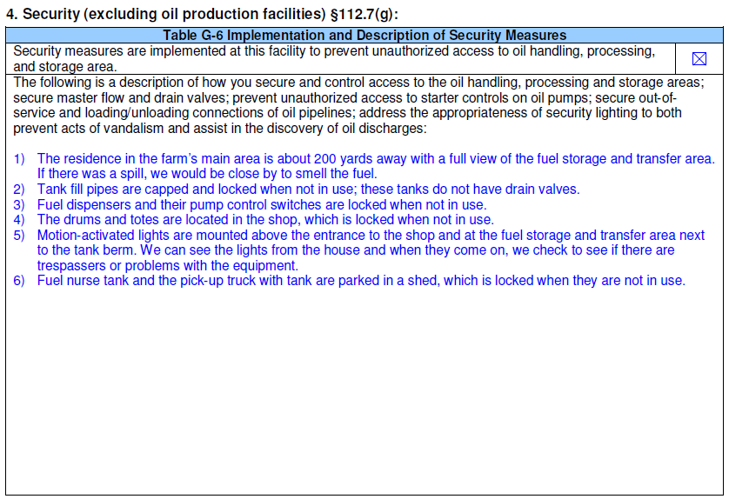
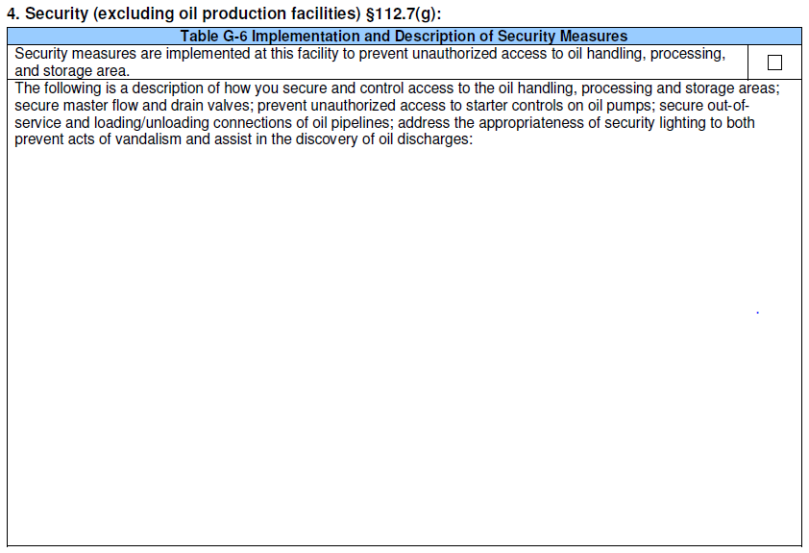
Notes:
Instructions:
Check the box to indicate that security measures are implemented to prevent unauthorized access.
Provide a description security measures in place.

Slide 39
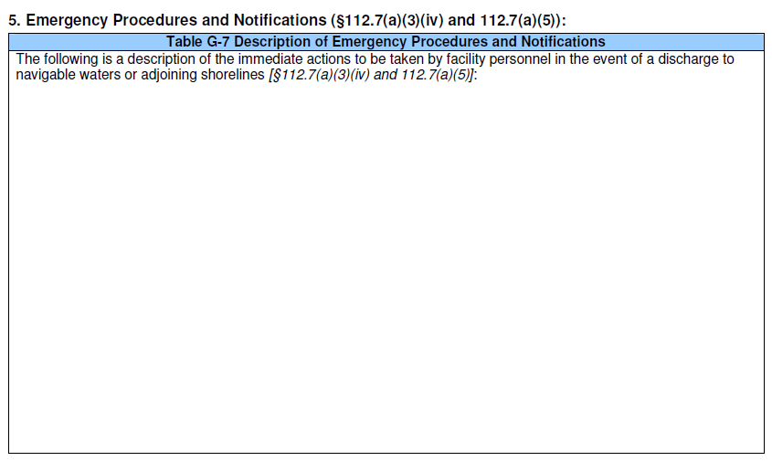
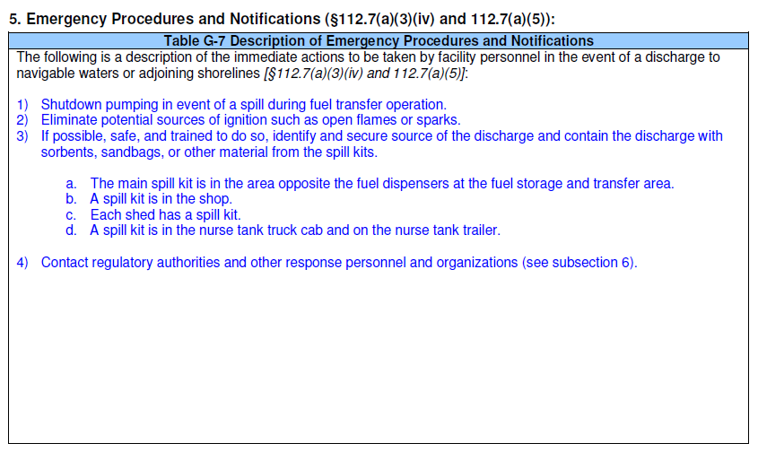
Notes:
Instructions:
1. Provide a description of emergency procedures and notifications in place in the event of a discharge to navigable waters or adjoining shorelines.

Slide 40
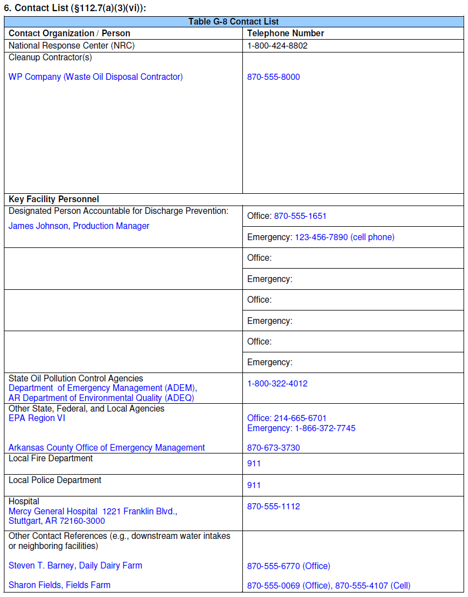
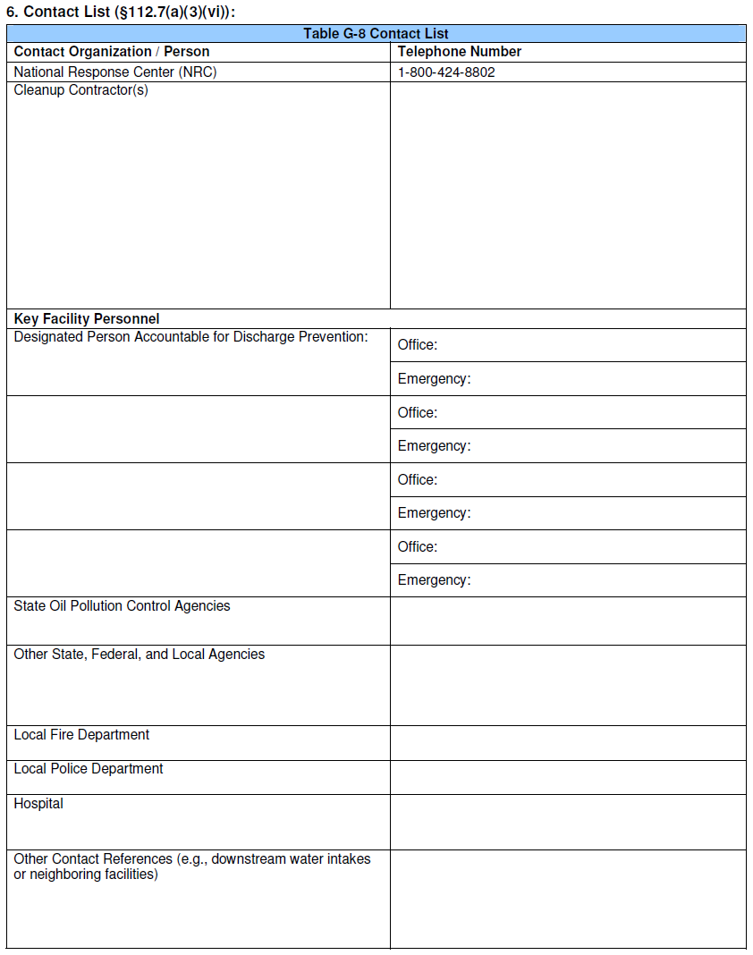
Notes:
Instructions:
Provide contact information for the cleanup contractors and key facility personnel.
Supplemental Information:
Owners or operators of SPCC-regulated facilities are not required to have signed contracts or agreements with cleanup contractors under the SPCC rule. Although no formal written agreement to respond is required by the SPCC rule, the owner or operator must identify phone numbers for the facility response coordinator, National Response Center, cleanup contractors with whom you have an agreement for response, and all appropriate Federal, State, and local agencies who must be contacted in case of a discharge to navigable waters or adjoining shorelines.

Slide 41
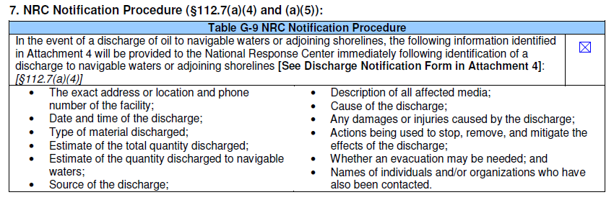
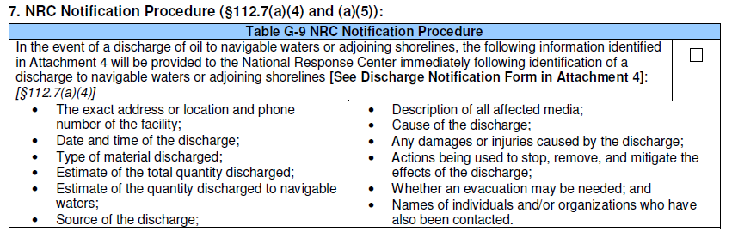

Slide 42
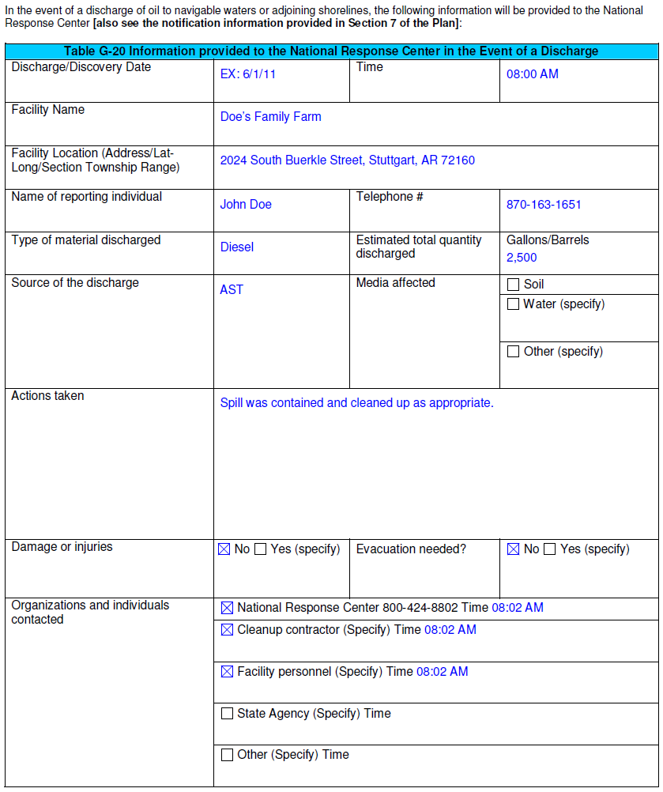
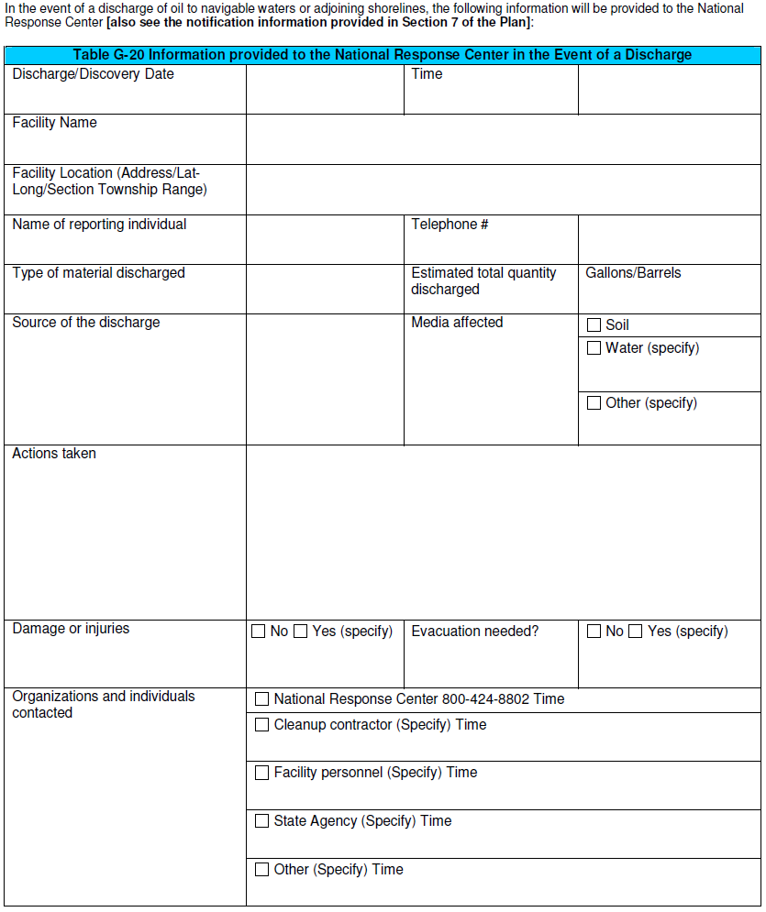
Attachment 4
Table located as an attachment at the end of the template
Notes:
This attachment does not apply to the scenario, but an example is included.
Instructions:
Fill out Table G-20 if a discharge occurs. This information will be provided to National Response Center.

Slide 43
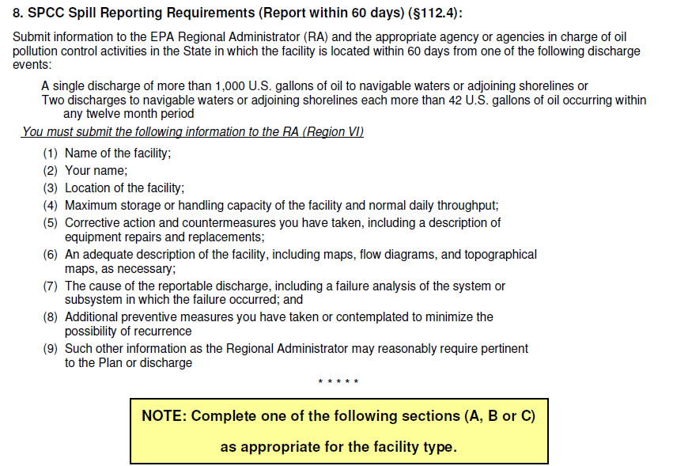
Note: only Section A applies to the farm in this scenario
Notes:
Supplemental Information:
Note that notifying the NRC of oil discharges and reporting specified oil spill information to the EPA Regional Administrator are two different requirements. 40 CFR part 110, Discharge of Oil regulation, requires any person in charge of a facility or vessel that discharges a reportable harmful quantity of oil to immediately notify the NRC of the discharge. The rule identifies a harmful quantity as one that violates applicable water quality standards; or causes a film or sheen upon or discoloration of the surface of the water or adjoining shorelines or cause a sludge or emulsion to be deposited beneath the surface of the water or upon adjoining shorelines (see subsection 7 above). In addition, a facility regulated by the SPCC rule must report specific discharge information to the EPA when the facility has certain types of reportable discharges as prescribed in the rule (see Item 8 above).
This sample plan only addresses Section A. Sections B and C are not applicable for most farms unless they also have oil production.
These sections are not applicable to the farm addressed in this sample plan.

Slide 44



Slide 45


Table located as an attachment at the end of the template
Notes:
Instructions:
Fill out the Dike Drainage Log as appropriate. Include the date, which activities occurred, observations and have the inspector sign the log.

Slide 47


Table located as an attachment at the end of the template
Notes:
Supplemental Information:
In this example, the farmer has elected to use STI’s SP001, tank inspection and testing standard; this standard is an example of an industry inspection standard that can be used to conduct inspections and formal tank testing. Under this standard, inspection and integrity test requirements depend on the spill risk posed by the tank; tanks posing higher spill risks have more inspection and integrity test requirements. In this example farm facility, a 1,200-gallon slop oil AST rests on the ground within an earthen berm. As the tank bottom is in direct contact with the ground, it is notlikely that a leak from the tank bottom would be seen. Note that a metal tank in direct contact with the ground soil is subject to corrosion. According to STI SP001, the earthen berm provides a method of spill control but not a method of continuous release detection due to the tank being in direct contact with the ground. This standard defines continuous release detection as a method that allows the facility operator to visually detect releases. Examples are double-wall or double-bottom ASTs with the space between the walls capable of being tested and monitored for releases. Other examples include ASTs that are raised above the ground with supports, grating or with release prevention barriers under the tank, such as liners, steel, and/or concrete. Consequently, the 1,200-gallon slop oil tank in this example facility poses a higher spill risk than a 1,200-gallon tank elevated on supports with a concrete pad underneath it in the berm. According to STI SP001, in addition to monthly and annual visual inspections in the standard, the example facility’s 1,200-gallon tank also requires formal external inspections by a certified tank inspector and leak tests by the facility every 10 years.

Slide 48



Slide 49

Note:
No contingency plan is required for the farm in this scenario
Notes:
Instructions:
Fill out Table G-15 if applicable.
Supplemental Information:
The facility does not have regulated oil-filled operational equipment, so the contingency plan is not applicable.
The SPCC Guidance for Regional Inspectors, EPA 550-B-05-001 provides further details on the use of the oil spill contingency plan to meet specific regulatory requirements and options.

Slide 50
Part III:
Questions and Answers

Slide 51
For More Information
EPA’s SPCC web page
  http://www.epa.gov/emergencies/content/spcc/index.htm
EPA’s SPCC for Agriculture web page
  http://www.epa.gov/osweroe1/content/spcc/spcc_ag.htm
EPA Oil Spill and Emergency Management web pages
  www.epa.gov/oilspill
  www.epa.gov/emergencies
HOTLINE: Superfund, TRI, EPCRA, RMP, and Oil Information Center
  (800) 424-9346 or (703) 412-9810
  TDD (800) 553-7672 or (703) 412-3323
  www.epa.gov/superfund/resources/infocenter

Slide 52
Available Tools
Available on EPA’s SPCC web page and EPA’s SPCC for Agriculture web page
  Tier I Template
  Example Tier I SPCC Plan
  Secondary Containment Calculation Worksheets and Examples

Slide 53

SPCC Contacts

Slide 54

SPCC Contacts

Slide 55
Questions?

