Slide 1

Application of Emission Inventories
in the Development of SIP
Control Strategies and Reconciliation with Air Quality Measurements
Henry Hogo
Assistant Deputy Executive Officer
Mobile Source Division
Science and Technology Advancement
2015 International Emission Inventory Conference
San Diego, CA
April 14, 2015

Slide 2
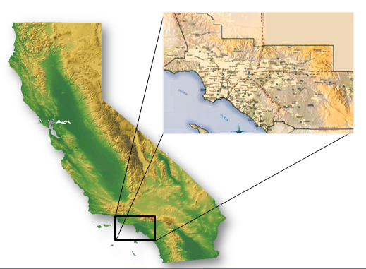
California’s South Coast Air Basin
Substantial Air Quality Progress, But Still Serious Health Impacts
Nation’s Largest Containerized Freight Gateway
      4-county Region
      16+ Million People
      261,000+ Diesel Vehicles
      11+ Million Gasoline Vehicles
2

Slide 3
National Ambient Air Quality Standards
Annual &
24-hr
PM2.5
Standards
New
Annual
PM2.5
Standards
2014
2020
2022
2023
2026
2029
2032
2035
2038
2041
1990 1-hr
Ozone
Standard
1997 8-hr
Ozone
Standard
2008 8-hr
Ozone
Standard
Future 8-hr
Ozone
Standard
3
Notes:
EV1 1996-1999
RAV4 EV 1997-2003
CAFCP started 1999
Who Killed the Electric Car (Dec 2006)

Slide 4
2023 VOC and NOx Emissions in the South Coast Air Basin
Total = 437.8
Total = 319

Slide 5



Top NOx Emissions Sources in 2014
NOx (tons/day)
* Ocean-going vessels = 35 tons/day
**RECLAIM: 320 largest stationary sources, including all refineries and power plants

Slide 6
Top NOx Emissions Sources in 2023
NOx (tons/day)
* Ocean-going vessels = 32 tons/day
**RECLAIM: 320 largest stationary sources, including all refineries and power plants

Slide 7
Top NOx Emissions Sources in 2032
NOx (tons/day)
* Ocean-going vessels = 29 tons/day
**RECLAIM: 320 largest stationary sources, including all refineries and power plants

Slide 8
Needed Pollution Reduction to Meet Ozone Air Quality Standards
Needed by 2023
Needed by 2032

Slide 9
Passenger Sector
Emission Contributions – NOx (tpd)
*
2014 Total: 485 tpd
*
2023 Total: 319 tpd
*
2032 Total: 276 tpd
* Others represent sources not related to passenger transportation
9

Slide 10
Goods Movement Sector
Emission Contribution to Total NOx (tpd)
*
2014 Total: 485 tpd
*
2023 Total: 319 tpd
*
2032 Total: 276 tpd
* Others represent sources not related to goods movement
10

Slide 11
Emission Reduction Scenarios
Baseline Emissions – 2023, 2032
Equal Share Reductions (Across-the-Board)
All Sources at Greatest Level of Control Based on Existing Emission Standards
Certain Emission Sectors with 90% Greater Reductions than Existing Emission Standards
11

Slide 12
Mobile Source NOx Emission Reductions to
Achieve 8-Hr Ozone Air Quality Standards (2023)
Baseline
Needed by 2023
100% Engines Meeting
Most Stringent Current Std.
All Sources
Reduced Equally
Aggressive Scenario
for Key Sectors*
*Key Sectors: On-Road HD Trucks, Locomotives, Marine Vessels at Berth, Harbor Crafts, Cargo Handling Equipment
12

Slide 13
Mobile Source NOx Emission Reductions to
Achieve 8-Hr Ozone Air Quality Standards (2032)
Baseline
Needed by 2032
100% Engines Meeting
Most Stringent Current Std.
Aggressive Scenario
for Key Sectors*
All Sources
Reduced Equally
*Key Sectors: On-Road HD Trucks, Locomotives, Marine Vessels at Berth, Harbor Crafts, Cargo Handling Equipment
13

Slide 14
Some Initial Observations
Not Likely to Reach “Equal Share” Levels
with Current Emissions Standards
Some Emission Sources May Not Reach
“Equal Share” Level – Need for Other Sources to Further Reduce Emissions
Potential to Reach “Equal Share” Levels of Emission Reduction with Greater Penetration of Zero- and Near-Zero Emission Technologies
14

Slide 15
Some Initial Observations
Need for Earlier Penetration of Zero- and
Near-Zero Emission Technologies (Commercialization/Deployment)
Priority Placed on Reducing Emissions
from Largest Contributors
(i.e., Sub-Categories of Emissions)
15

Slide 16
Examples of Using
Air Quality Measurements to Reconcile Emission Inventories

Slide 17
Ozone Air Quality Modeling
1994 Air Quality Management Plan – Air Quality Modeling Showed Low Levels of Ozone in the Eastern Region
March Air Force Base – Military Aircraft Emission Profiles Different from Commercial Aircraft
      Military Aircraft – Higher VOC Emissions,
      Lower NOx Emissions
      Commercial Aircraft Emissions – Mostly NOx
Revised Emission Profiles Resulted in Closer Levels of Ozone Compared with Monitoring Data
17

Slide 18
PM Air Quality Modeling
Use of Default AP-42 Factors May Not Be Applicable in Local Situations
  Entrained Road Dust – Factors Assumed Increased Dust with Increased VMT (No Limits)
  GIS Model Developed to Estimate Entrained Road Dust Limiting Amounts
18

Slide 19
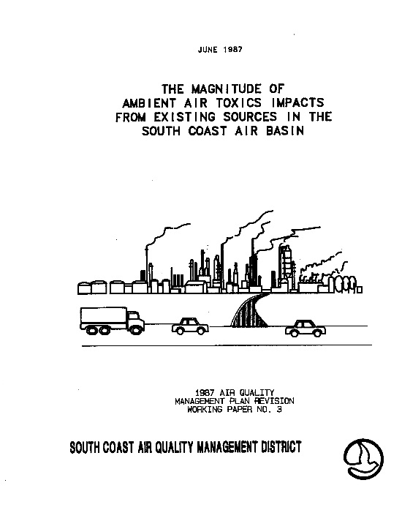
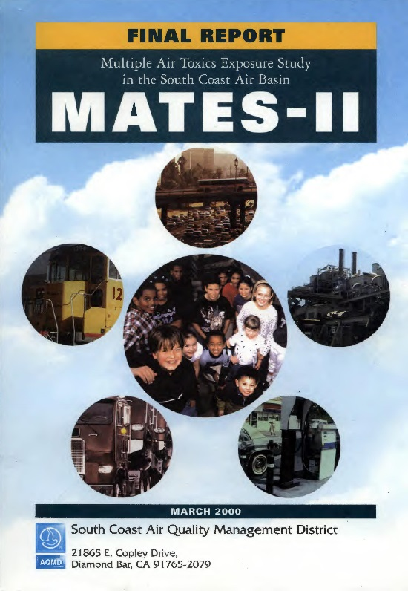

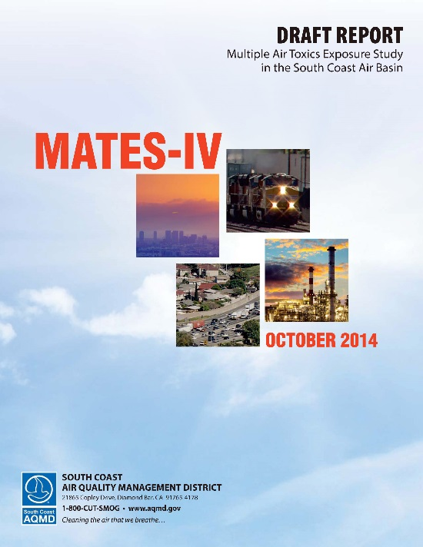
Multiple Air Toxics Studies
MATES I - 1987
MATES II – 1998-99
MATES III – 2004-06
MATES IV – 2012-13
19

Slide 20
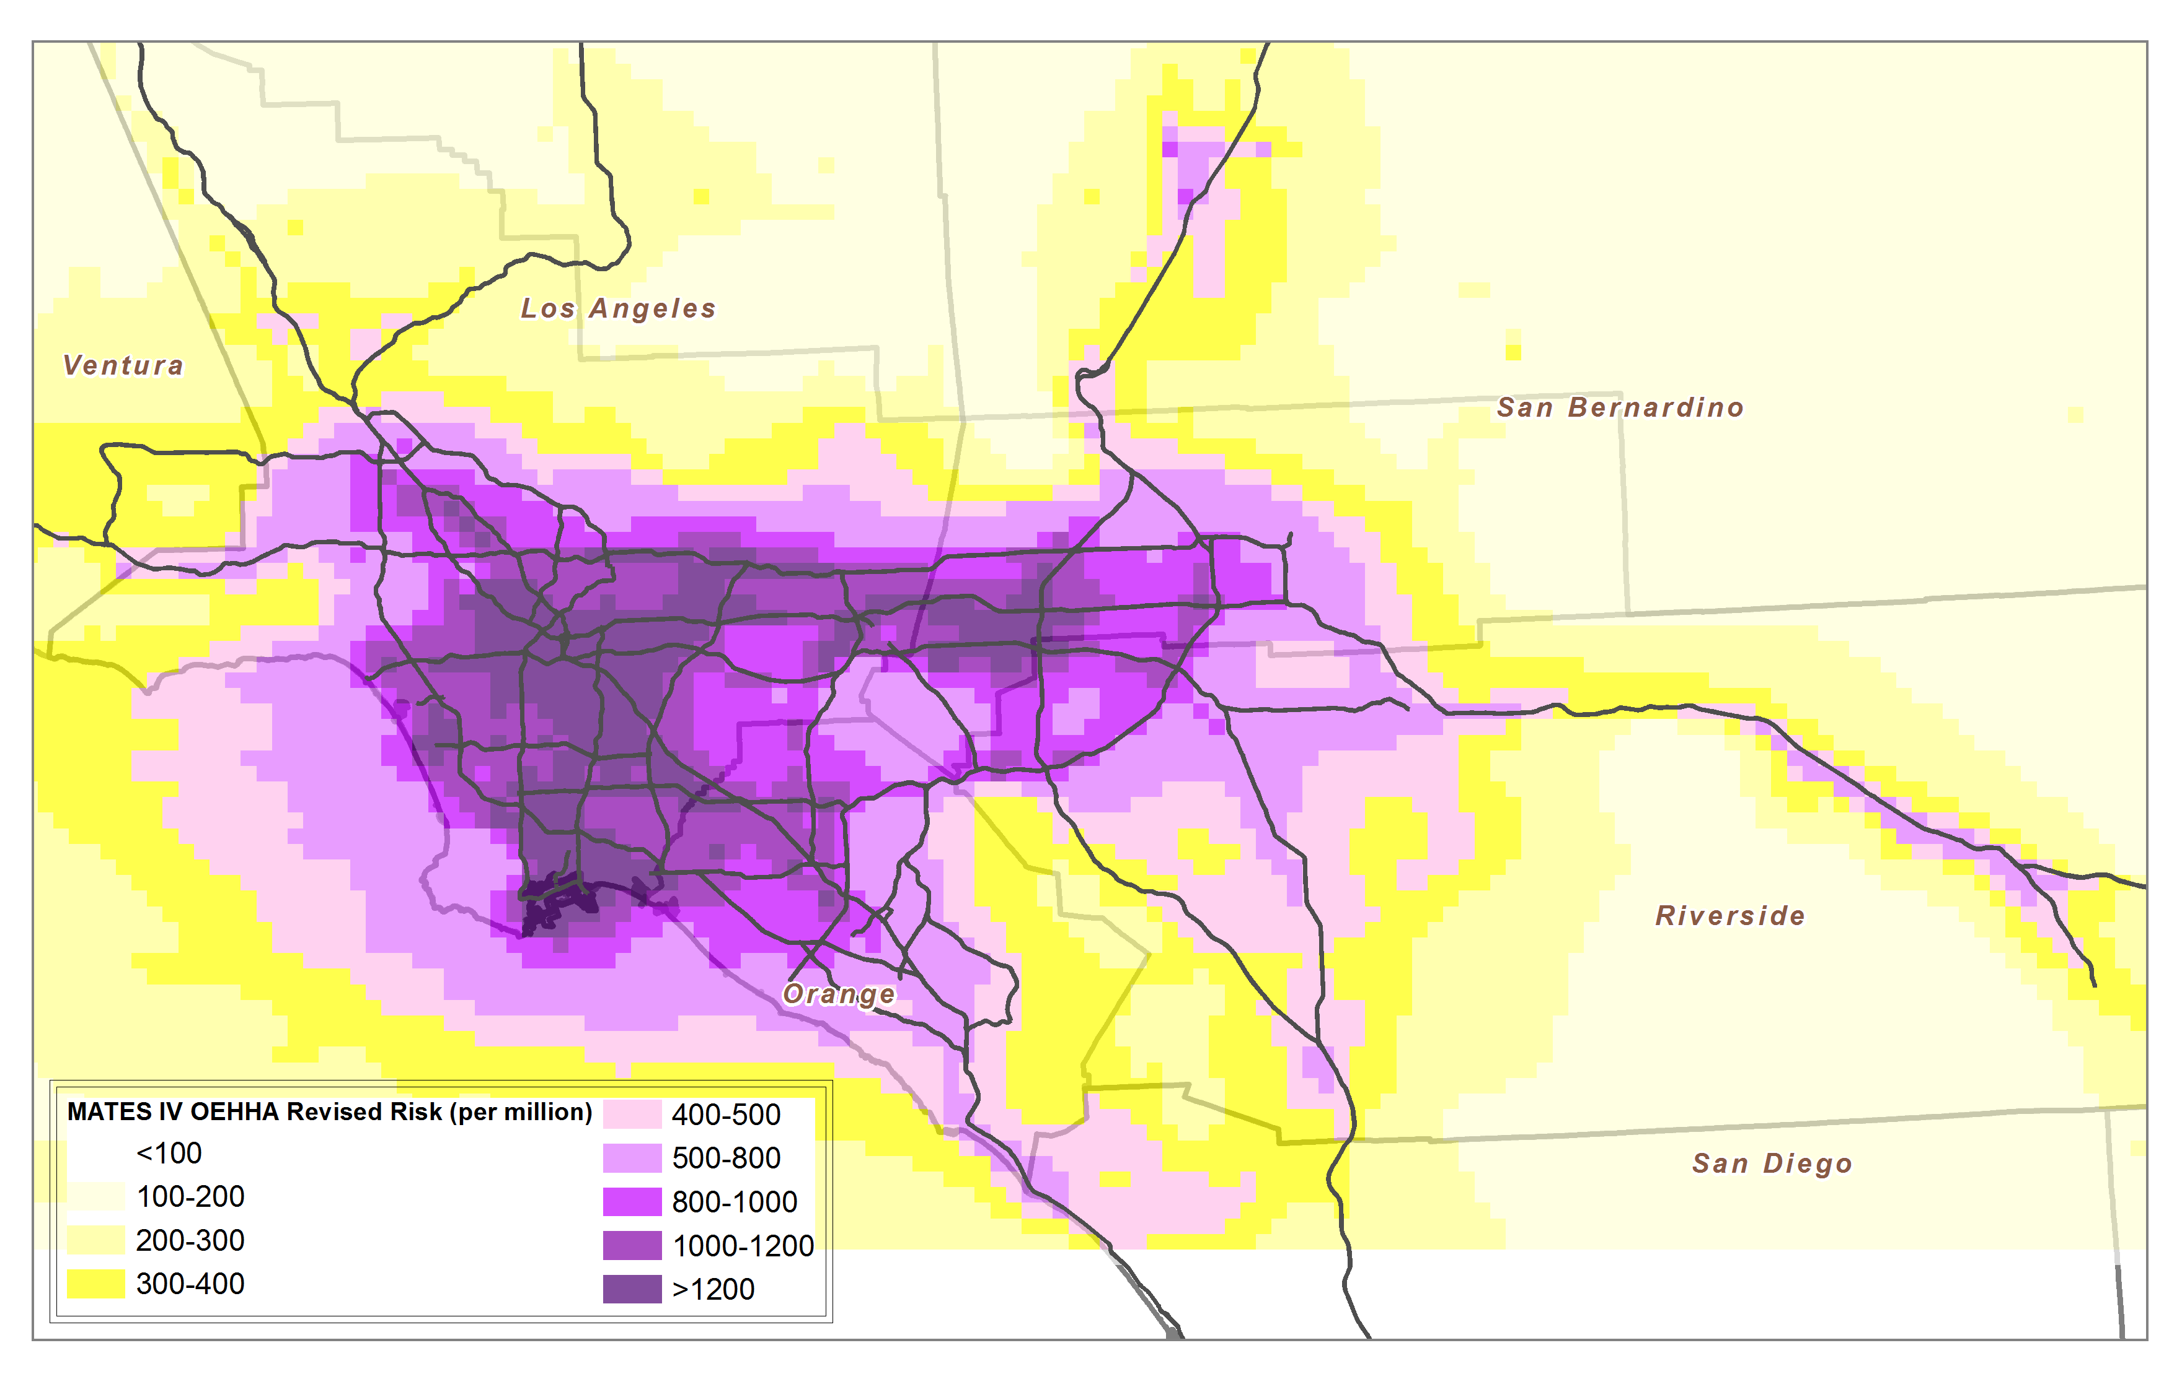
MATES Data Analysis
Air Monitoring Measurements of
~40 Chemicals
at 10 Fixed Sites
Computer Simulation Modeling to Show Estimated Risk Levels Throughout the Region
Computer Simulation Results Compared with Monitoring Data
20

Slide 21
Reconciliation
MATES-II
  Elevated Levels of Styrene Measured in Anaheim
  Model Did Not Predict High Levels
  Further Investigations Discovered Foam Plant Out of Compliance
MATES-III
      Elevated Levels of Hexavalent Chrome in Riverside Area, Not Predicted in Computer Modeling
      Further Investigations Discovered Elevated Levels of Chromium in Cement Manufacturing Operations
      Rule Amendments Were Adopted to Remedy Situation
21

Slide 22
Summary
Emissions Inventory Development Need to be Cross Checked with Real World Measurements Where Available
Air Quality Modeling –
Iterative Process Between Modeling Staff
and Emissions Inventory Staff
Control Strategy Development –
Iterative Process Between Planning Staff,
Emissions Inventory Staff, and
Air Quality Modeling Staff
22

