Slide 1

2015 National Emissions Inventory Conference
U.S. EPA Region 9
Deborah Jordan
Air Division Director
U.S. EPA Region 9
April 14, 2015

Slide 2
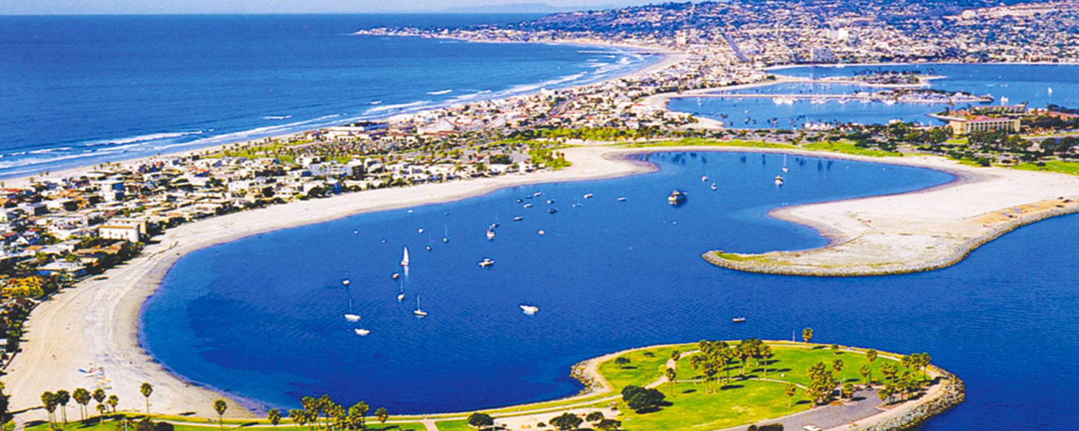
Notes:
San Diego, CA

Slide 3

Notes:
Golden Gate Bridge, San Francisco

Slide 4

Notes:
Whitebark and foxtail pines at Lone Pine Lake, CA

Slide 5
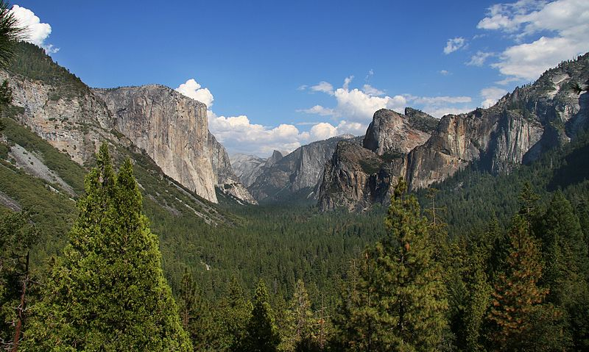
Notes:
Yosemite, CA

Slide 6
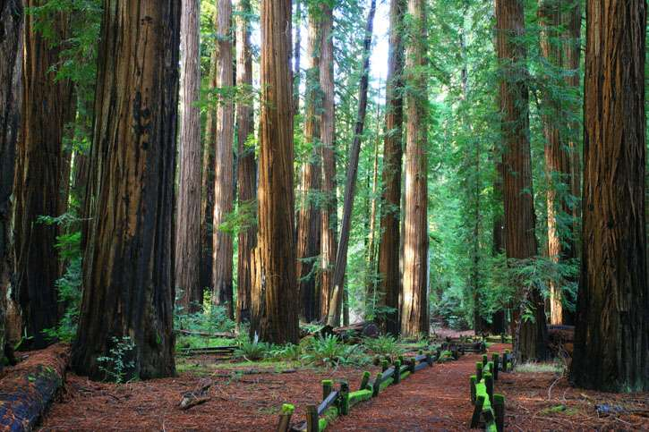
Notes:
Muir Woods National Park, Northern CA

Slide 7
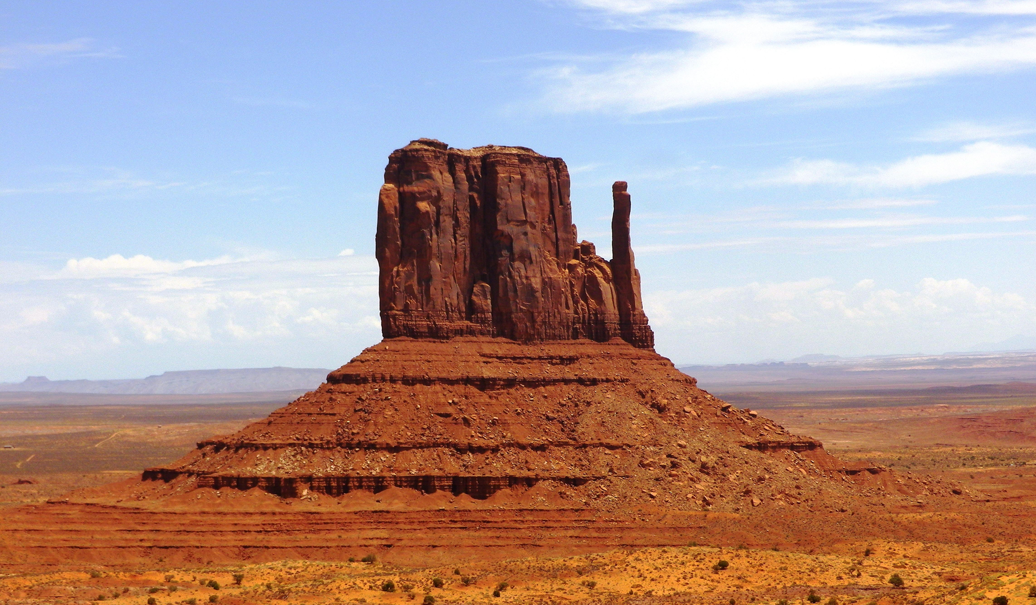
Notes:
Monument Valley, Navajo

Slide 8

Notes:
Valley of Fire State Park, Nevada

Slide 9

Notes:
Hawaii

Slide 10
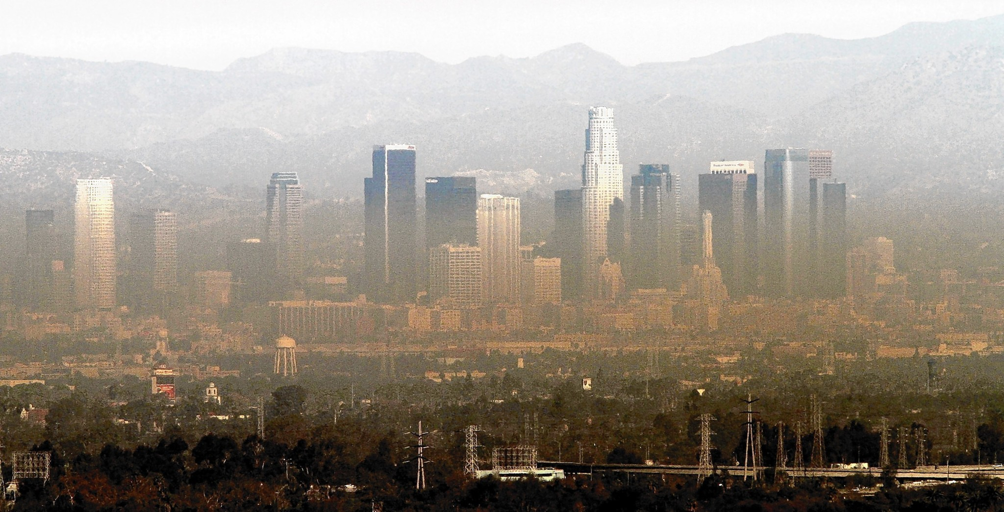
Notes:
Smoggy Los Angeles

Slide 11
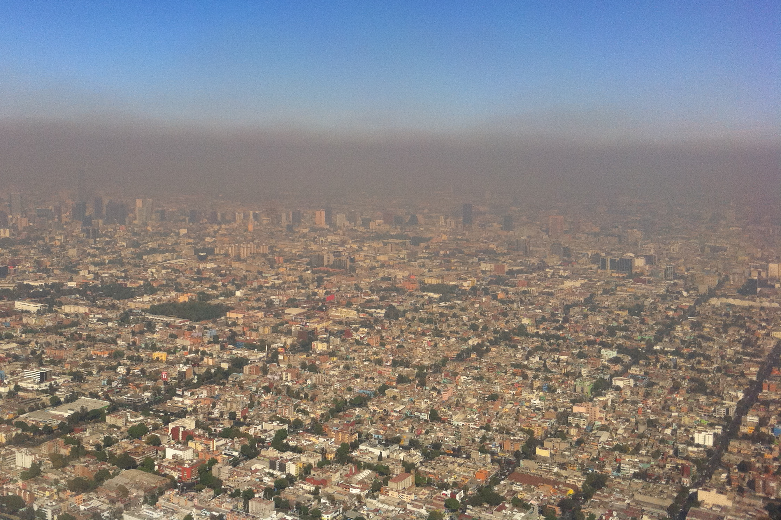
Notes:
Smoggy Los Angeles

Slide 12
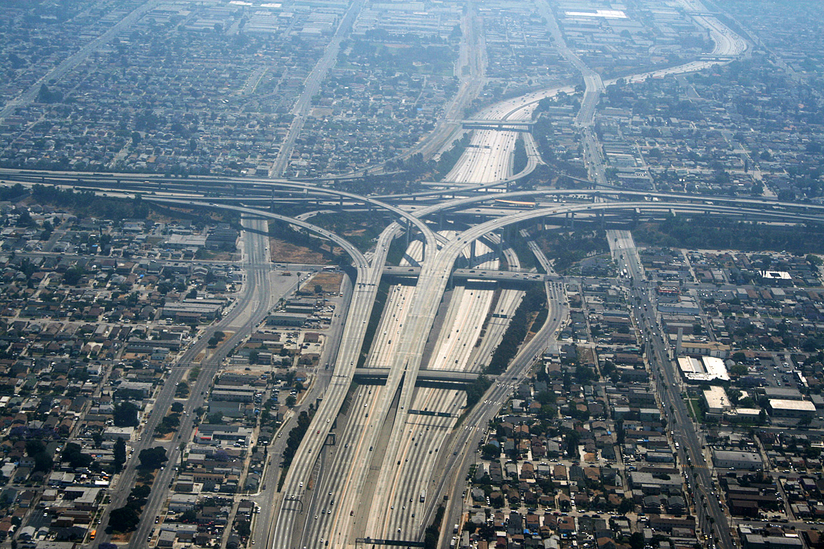
Notes:
Los Angeles, the I-105 and I-110 interchange

Slide 13
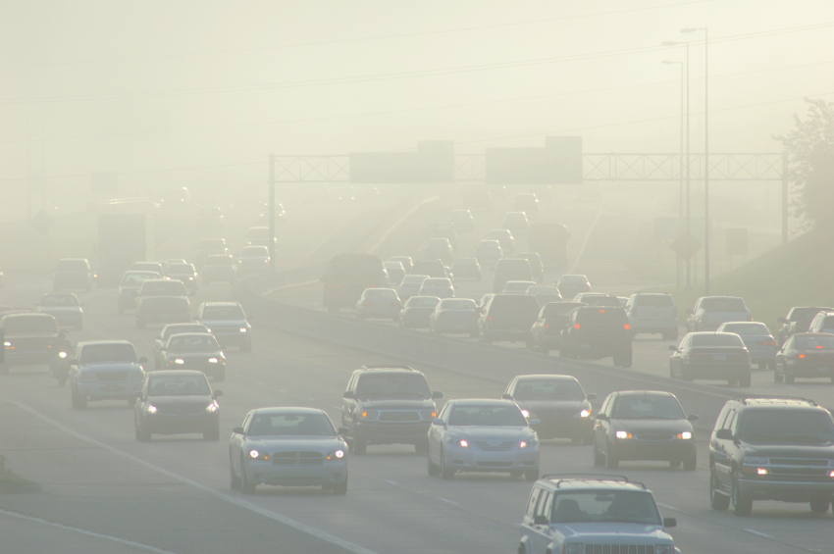

Slide 14
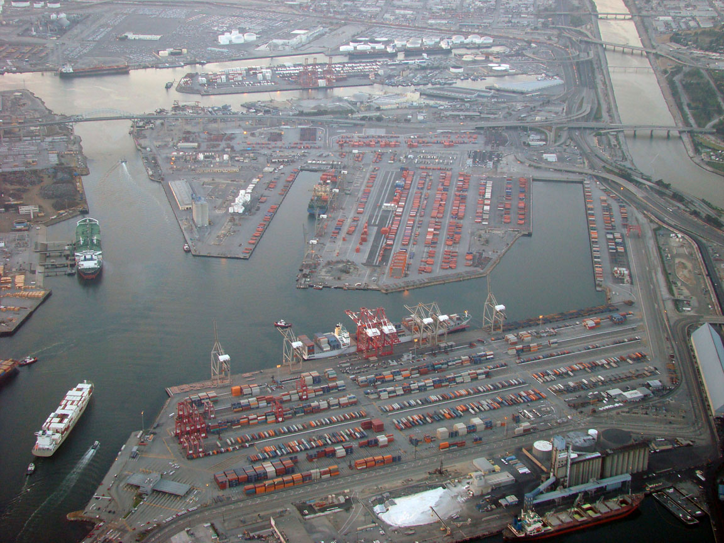
Notes:
Port of Los Angeles

Slide 15
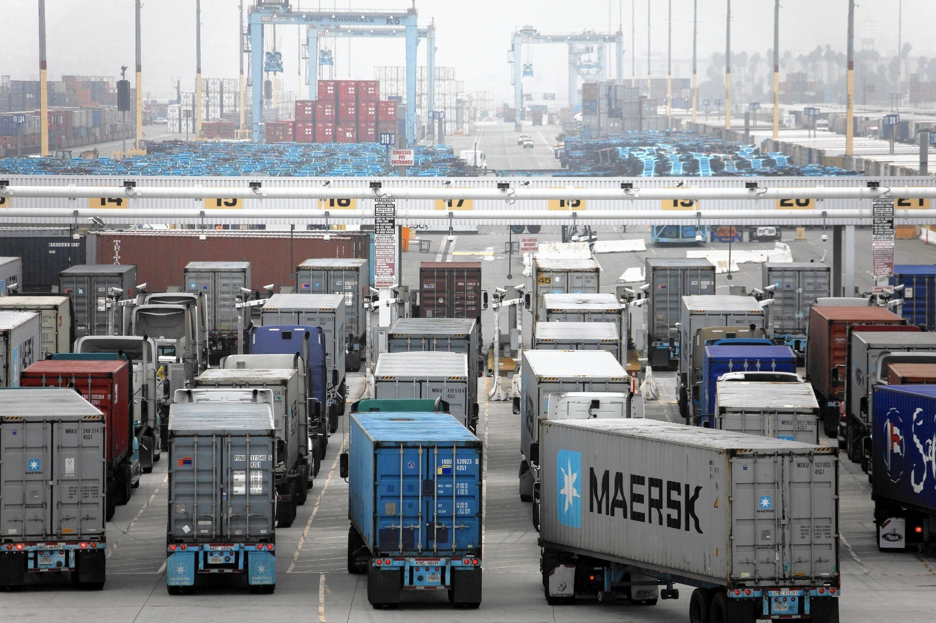
Notes:
Trucks – goods movement

Slide 16
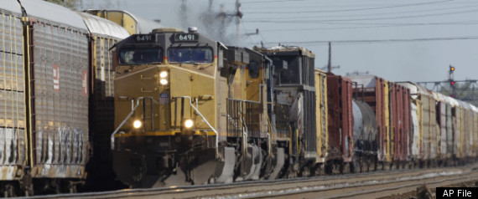
Notes:
Trains – goods movement

Slide 17
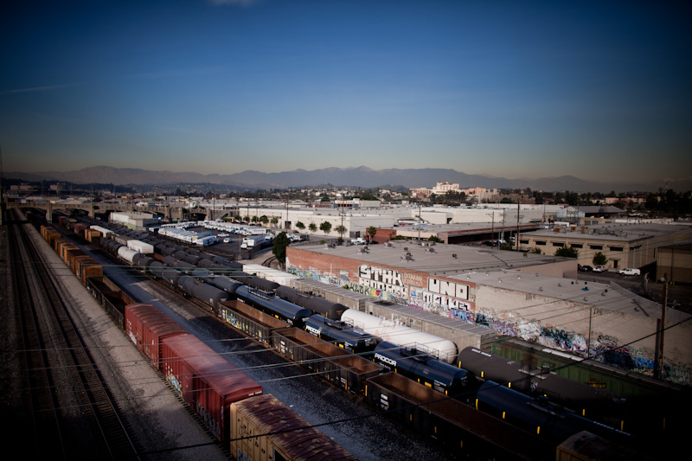
Notes:
Boyle Heights neighborhood in Los Angeles – residences next to rail yards.

Slide 18
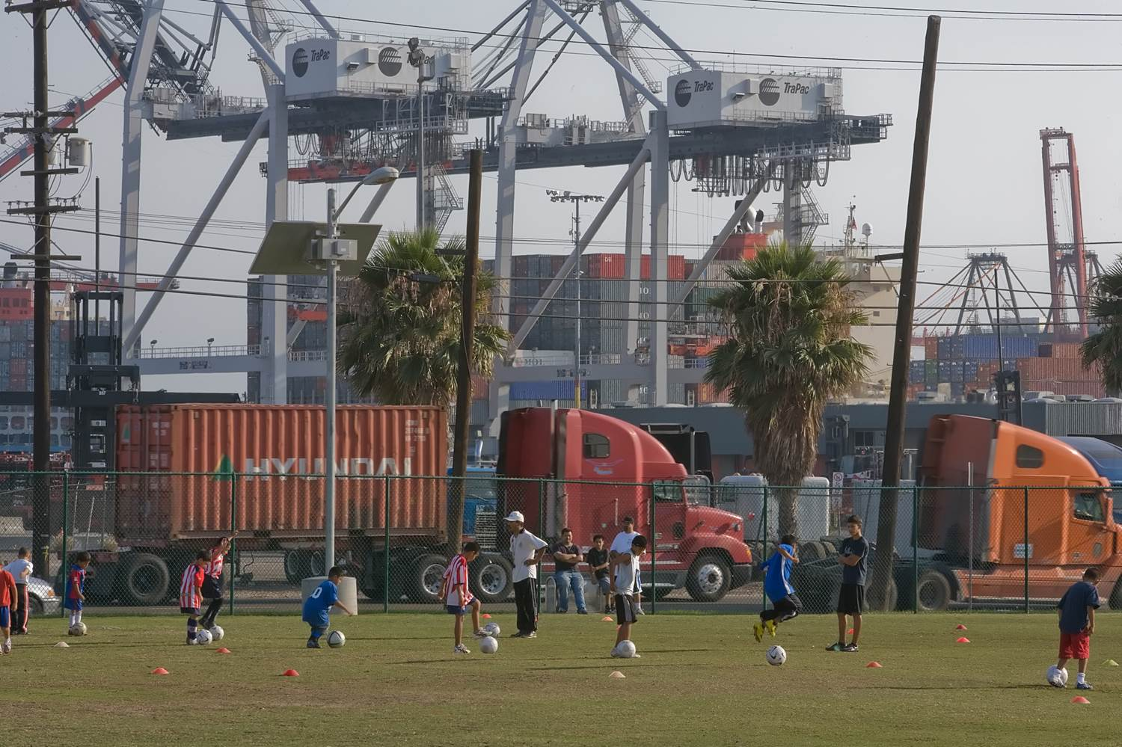
Notes:
West Oakland

Slide 19
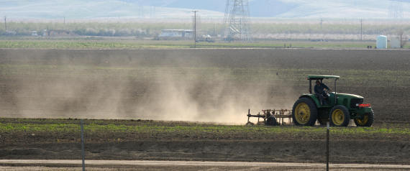
Notes:
San Joaquin Valley, CA

Slide 20
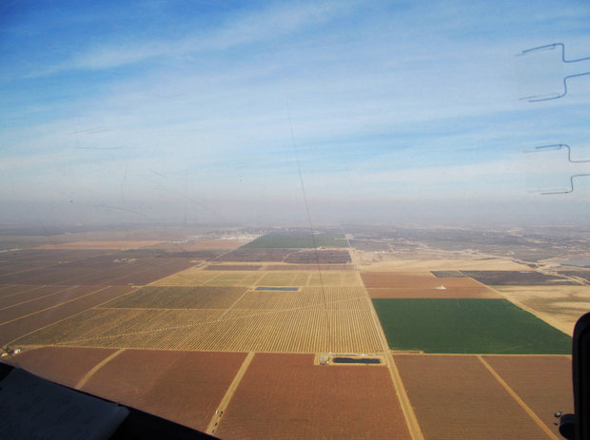
Notes:
San Joaquin Valley, CA

Slide 21

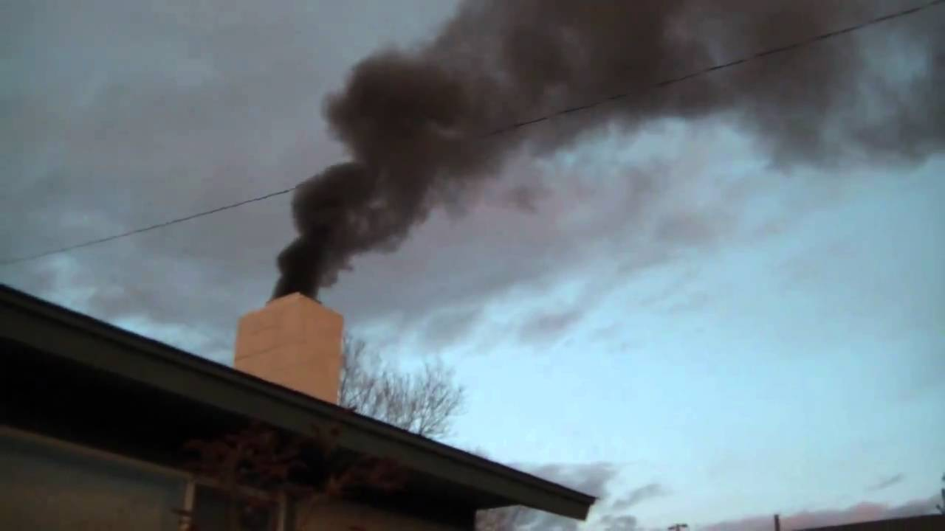
Notes:
Woodsmoke

Slide 22
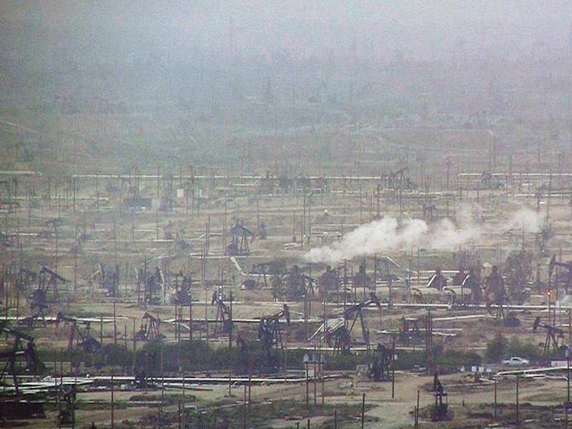
Notes:
Oil and gas field, Southern SJV (not positive about location)

Slide 23

Notes:
The red dashed line is the 24-hour PM2.5 standard, which was lowered from 65 ug/m3 to 35 ug/m3 in 2006.
Again, I’ll show a few focus areas:
Bay Area – was below the standard until we lowered the standard but then came below the new standard.
Sacramento – has been non-attainment for both standards and is just recently coming into attainment for the new standard.
LA – has made steady progress and is nearly attaining.
SJV – this is our most challenging PM2.5 area and is one of the highest in the country. Progress is not clear.
Show BA woodsmoke rules (July 2008)
Show Sac woodsmoke rules (October 2007 adopted)

Slide 24
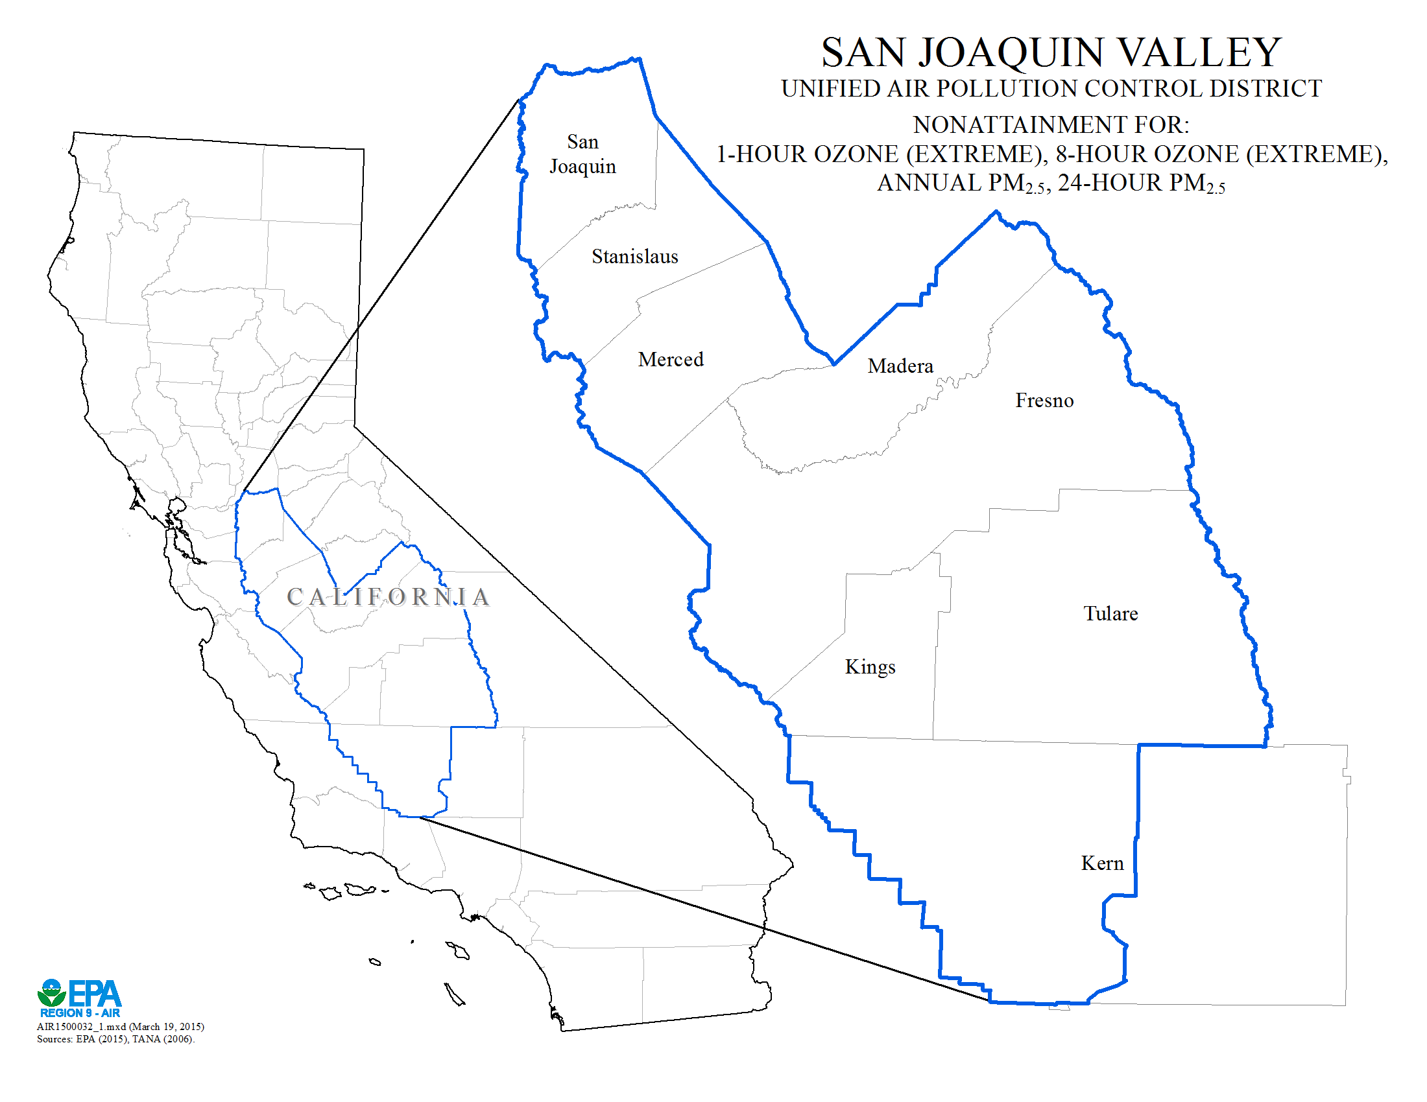
U.S. EPA Region 9

Slide 25
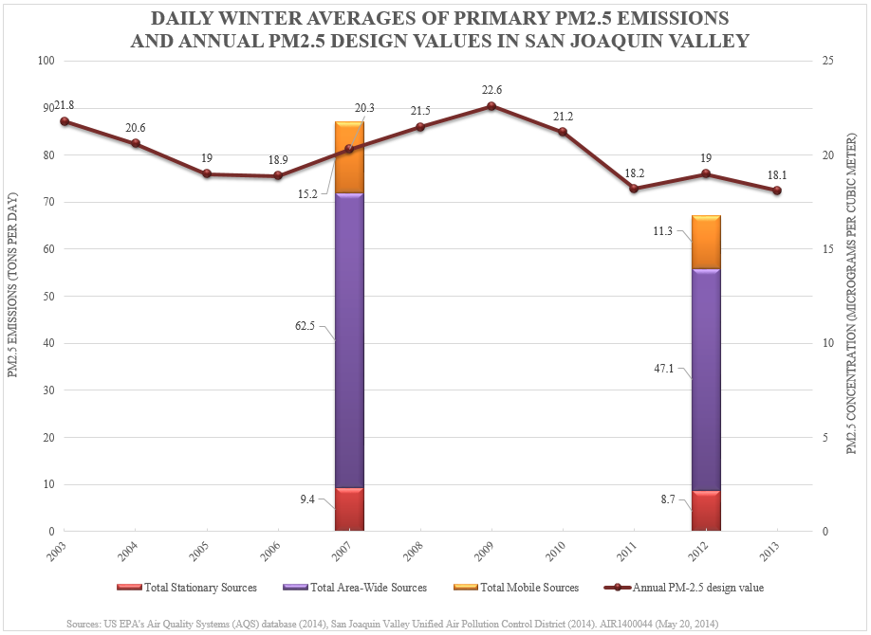
U.S. EPA Region 9
Bar graph shows emission inventory data. Line graph shows monitoring data.
Notes:
Emissions reported for direct PM2.5 show are significant decrease while concentrations show no decrease.
Average 2003-2007 annual DVs = 20.12 ug/m3.
Average 2008-2012 annual DVs = 20.5 ug/m3.
=>No reduction in concentrations for 5-years leading up to emissions reported.
2012 EI reports 23% reduction in direct PM2.5 emissions.

Slide 26

Notes:
San Diego, CA

