Slide 1


Overview and Progress to Date
U.S. Greenhouse Gas Reporting Program
Kong Chiu
Office of Atmospheric Programs
U.S. EPA
International Emissions Inventory Conference (NEI)
14 April, 2014
San Diego

Slide 2
Overview
Overview
Timeline, GHG Reporting Progress since Tampa
GHG Reporting Program key data and programmatic attributes
Spotlight on Oil & Gas Sector (Subpart W) including changes
State-EPA collaboration on GHG Reporting
International engagement on GHG Reporting and Data management
RY 2014 Data Milestones
Q&A

Slide 3
US GHGRP Timeline

Slide 4
U.S. GHGRP and The International Emissions Inventory Conference
April, 2009
18th Emissions Inventory Conference, Baltimore
- proposed mandatory reporting rule
September, 2010
19th Emissions Inventory Conference, San Antonio
- final rule (first 29 sources), technical revisions, data system development underway
August, 2012
20th Emissions Inventory Conference, Tampa
- launched e-GGRT, 12 more sources
- successfully collected & verified 1+ years of data

Slide 5
U.S. GHGRP and The Emissions Inventory Conference (cont’d)
April, 2015
21st Emissions Inventory Conference, San Diego
  Published 4 years of data (RY2010 - 2013)
  Collected RY2014 data
  Major changes/improvements since Tampa include:
    Collected data across all sources in one reporting period (RY12 and on)
    Implemented 100s of reg revisions (including W, Oil & Gas)
    Ingest and validate data directly from “smart” XLS spreadsheets
    Integrated data verification into GHG data system and
    Implemented “critical errors” to improve data quality
    Collected GHG equation inputs data retroactively
    Shifted to AR4 Global Warming Potentials
    Launched Inputs Verifier Tool to handle sensitive equation inputs

Slide 6
US GHGRP Basics

Slide 7
US GHG Reporting Program
Annual mandatory reporting of GHG :
  Rule covers 41 source categories for reporting, accounting for 85-90% of total U.S. GHG emissions:
  33 types of direct emitters
  6 types of suppliers of fuel and industrial GHG
  Facilities that inject CO2 underground for geologic sequestration, enhanced oil recovery, or any other purpose.
25,000 MTCO2e threshold for some sources
Direct reporting to EPA electronically
EPA verification of emissions data
Monitoring began in 2010 for most emission sources with first reports submitted to EPA in September, 2011
2010 to 2013 data now publicly available

Slide 8




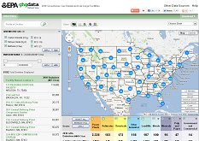
Electronic Reporting Workflow
EPA GHG Data System
EPA EnviroFacts:
Serviceable, searchable and separately hosted copy of non-CBI dataset.
Improve data quality before it is submitted to EPA
- Intuitive Interface
- Comprehensive Help
Real-Time Data Quality
Feedback
State-Specific Service
Oriented data flow using EnviroFacts
API
iVP
Downloadable XLS, XML & HTML Data Files & highlights
Data Verification
(EPA)
Reporters
Facilities and
Suppliers
GHGRP Data Publication Website (FLIGHT) (ghgdata.epa.gov)
e-GGRT, interactive web-based, data reporting tool
EPA
e-GGRT Datamart
Data Collection
Data Publication

Slide 9
U.S. GHGRP: Source Categories Covered
Power | Refining & Petrochem. | Other Chemicals | Combustion | Waste | Metals | Minerals | Pulp & Paper | High GWP Gases
Electricity Generation Electrical Equipment Mfg. - Use of Electrical Equip. | - Petroleum Refineries - Petrochem. Production | - Adipic Acid Ammonia Hydrogen Production - Nitric Acid - Titanium Dioxide - Phosphoric Acid | - Stationary Combustion | Municipal Landfills - Industrial Waste Landfills - Waste Water Treatment | - Aluminum - Ferroalloy - Iron & Steel - Lead - Zinc - Magnesium - Silicon Carbide | - Cement - Glass - Lime - Misc. Carbonate Use - Soda Ash Production | - Pulp & Paper | - Fluorinated GHG Prod. - HCFC-22 Prod./HFC-23 Destruction - Electronics Mfg. - Pre-Charged Equip. Imp./Exp. - Suppliers of Industrial Gases
Petroleum & Natural Gas Systems – Direct Emissions |  |  | Fuel Suppliers |  |  | Carbon Capture &Sequestration |  | Mining
- Onshore Production - Offshore Production - Natural Gas Processing - Natural Gas Transmission/Compression - Natural Gas Distribution - Underground Natural Gas Storage - Liquefied Natural Gas Storage - Liquefied Natural Gas Import/Export |  |  | - Coal based Liquid Suppliers - Petroleum Product Suppliers Natural Gas Distribution Companies Natural Gas Liquids Suppliers |  |  | - Suppliers of CO2 - Injection of CO2 - Geologic Sequestration of CO2 |  | - Underground Coal Mines
Direct Emitters
Suppliers
CO2 Injection

Slide 10
2013 Reporting Year Data (Direct GHG Emissions)

Slide 11
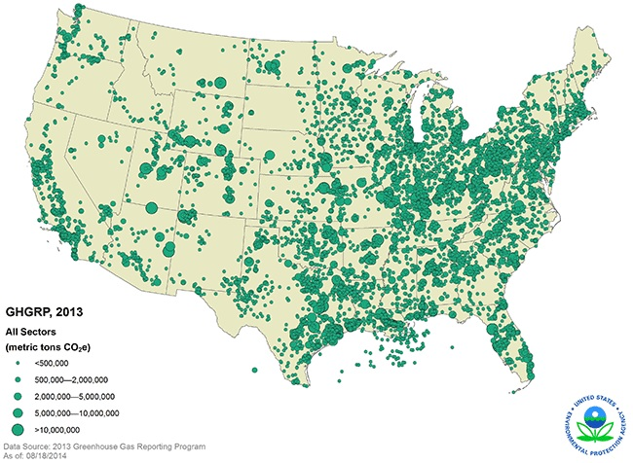
  GHGRP Coverage – Direct Emissions
In 2013, Reported Direct Emissions totaled 3.18 billion metric tons CO2e, about half of total U.S. greenhouse gas emissions.

Slide 12
GHGRP, GHG Inventory, NEI
Greenhouse Gas Reporting Program
GHGRP
(40 CFR Part 98)
National Inventory of Greenhouse Gas Emissions and Sinks
National Emissions Inventory
(NEI)

Slide 13
GHG Inventory, GHG Reporting Program
The U.S. GHG Inventory is a comprehensive top-down assessment of national GHG emissions and removals which presents emissions across multiple years starting in 1990.
  U.S. GHG emissions calculated using internationally-accepted methods and nationally appropriate statistics
  Generally, emissions estimates not provided at the geographic or facility level
    Gridded CH4 available soon
  Includes small industrial emitters, residential and commercial sectors
  Includes agriculture and land-use/forestry sectors
When compared in aggregate, some of the summary emissions totals for specific industries appear different in the Inventory and GHGRP.
  Different Source Category Definitions
  Inclusion of combustion emissions
  Reporting Threshold
  Lack of Disaggregated Data to Represent Certain Industries
  Use of Continuous Emissions Monitoring Technologies
  Differences in use of Default International Factors from Facility-Specific Methods

Slide 14
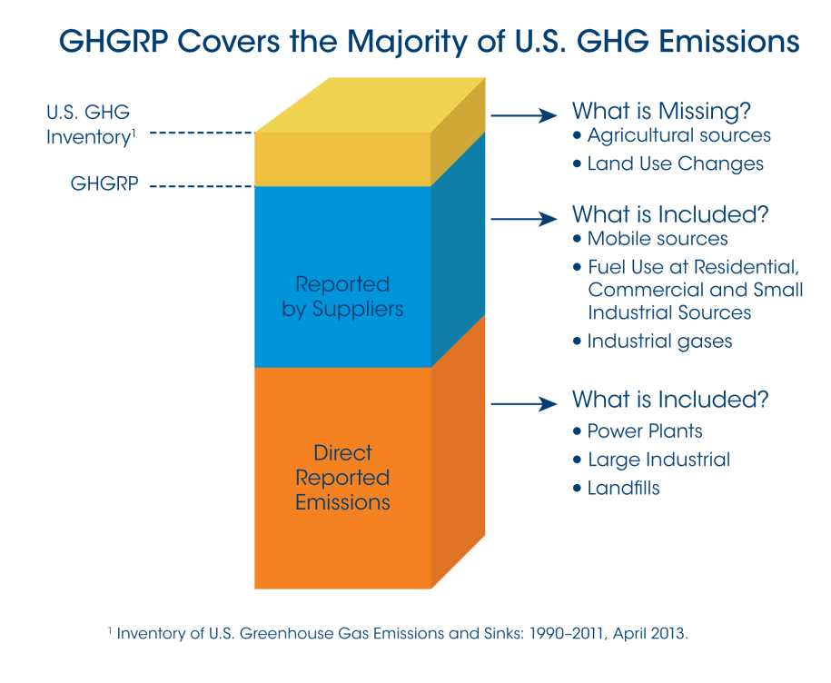

GHG Reporting Program vs. US GHG Inventory
Inventory of U.S. Greenhouse Gas Emissions and Sinks (Inventory) tracks total annual U.S. emissions across all sectors of the economy using national-level data
GHGRP collects detailed emissions data from large greenhouse gas emitting facilities in the United States
  GHGRP covers most, but not all, U.S. GHG emissions
  GHGRP does not include agriculture, land use, and small sources
Task | Inventory | Greenhouse Gas Reporting Program
Find total U.S. emissions
Review trend data for the past 20 years
Browse a map to find largest emitters in your area
Compare facility emissions across an industrial sector
Find reported emissions by state

Slide 15
Using GHG Reporting Program Data: US Inventory
Direct Use
Replace the entire estimate - e.g., categories where the Reporting Program has complete coverage
Indirect Use for Calculations (Non-CBI)
Semiconductor Manufacture, Magnesium Production and Processing, Refineries
Indirect Use for QA/QC
General QA/QC on a national estimate
Disaggregate national estimates to show more detail: Industrial sector fossil fuel combustion
Develop more accurate emission factors based on GHGRP data: Landfills, Wastewater Treatment (Industrial), Natural Gas Systems, Petroleum Systems
Develop updated activity data: Natural Gas Systems

Slide 16
Spotlight on Oil and Gas Data (Subpart W)

Slide 17
Oil and Gas GHG Data
Oil and Gas GHG estimates available in U.S. GHG Inventory (national/regional-level) and GHGRP (facility-level)
Enhancing the EPA GHG data on oil and gas is a key part of the White House Climate Action Plan Strategy to Reduce Methane Emissions
  EPA continues to refine GHG Inventory estimates to reflect the most robust information available
  EPA has proposed updates to GHGRP

Slide 18
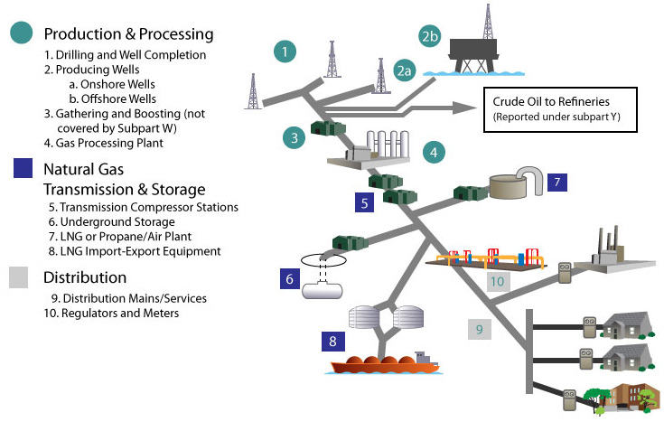
Petroleum and Natural Gas Systems in GHGRP (Subpart W)
Production and Processing
1. Onshore Production
2a, 2b. Offshore Production
3. Gathering and Boosting (not covered by Subpart W)
4. Natural Gas Processing
Transmission and Storage
5. Natural Gas Transmission
6. Underground Natural Gas Storage
7. LNG Storage
8. LNG Import-Export
Distribution
9, 10. Natural Gas Distribution
Not Covered
Emissions below 25,000 metric ton CO₂e threshold
Process emissions from gathering and boosting
Vented emissions from hydraulic fracturing of oil wells
Process emissions from transmission lines between compressor stations
Figure adapted from AGA and Natural Gas STAR

Slide 19
Reported GHG Emissions by Industry Segment
EPA received annual reports from over 2,000 facilities
Reported emissions totaled 224 Million Metric Tons (MMT) CO₂e
Largest segments in terms of reported GHG emissions were onshore production, natural gas processing, and natural gas transmission
Segment | Number of Facilities | 2013 Reported Emissions (Million Metric Tons CO₂e)
Onshore Production | 503 | 95
Offshore Production | 107 | 6
Natural Gas Processing | 433 | 59
Natural Gas Transmission | 487 | 23
Underground Natural Gas Storage | 48 | 1
Natural Gas Distribution | 173 | 15
LNG Import/Export | 8 | < 1
LNG Storage | 5 | < 1
Other Oil and Gas Combustion | 415 | 25
Total | 2,164 | 224
U.S. Greenhouse Gas Reporting Program data as of 8/18/14

Slide 20
Reported Emissions by Greenhouse Gas
Carbon dioxide (CO₂) emissions accounted for 150 MMT CO₂e and methane (CH₄) emissions accounted for 74 MMT CO₂e
Emissions from onshore production were primarily methane while emissions from natural gas transmission, natural gas processing, and other oil and gas combustion were primarily carbon dioxide
U.S. Greenhouse Gas Reporting Program RY2013 data as of 8/18/14

Slide 21
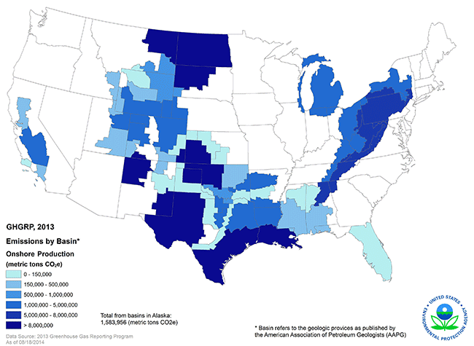
Onshore Production Basins
Emissions in onshore production are reported by basin
The map to the left shows reported emissions aggregated for all onshore production facilities by basin
The basins with highest reported emissions were:
  Williston Basin (12.8 MMT CO₂e)
  Gulf Coast Basin (12.6 MMT CO₂e)
  San Juan Basin (10.1 MMT CO₂e)
  Anadarko Basin (9.2 MMT CO₂e)
  Permian Basin (9.2 MMT CO₂e)
Note: For the onshore production segment, the “facility” includes all emissions associated with wells owned or operated by a single company in a specific hydrocarbon producing basin. A basin refers to a geologic region where sediment infilling has occurred. The GHG Reporting Program definition of basin refers to the geologic provinces as published by the American Association of Petroleum Geologists (AAPG).
U.S. Greenhouse Gas Reporting Program RY2013 data as of 8/18/14

Slide 22
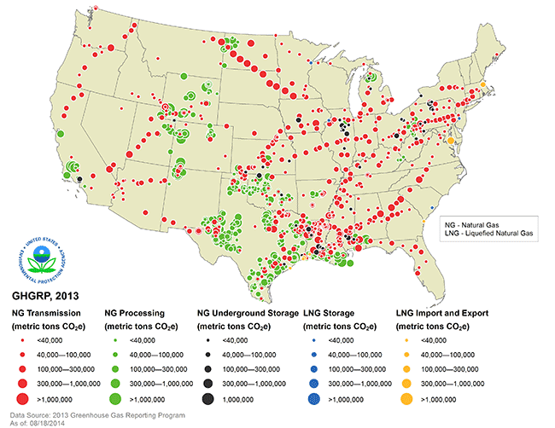
NG Processing, Storage, Transmission, LNG
U.S. Greenhouse Gas Reporting Program data as of 8/18/14

Slide 23
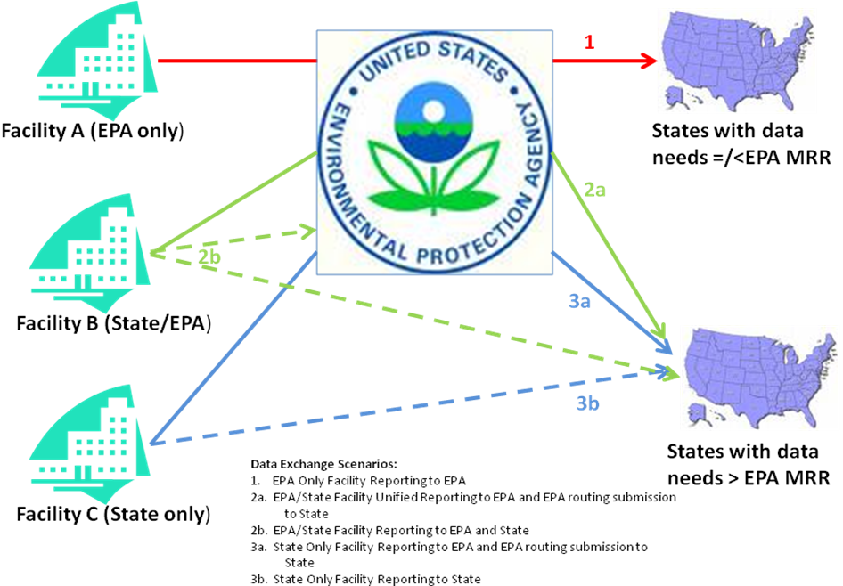
State Coordination
State - EPA Workgroup on GHG Data Collection and Exchange
  AZ , CA , CO (State co-chair), HI , IA , MA , MI, NC , NJ , NV , NM, OR , WA , WI
Courtesy of Rob Willis, Ross & Associates

Slide 24
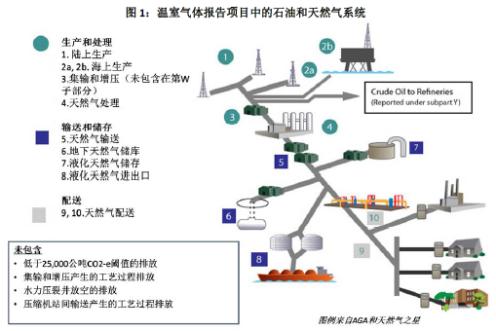
International Capacity Building
Improve greenhouse gas data measurement, reporting and verification
Improve accountability in Non Annex-1 Countries
  World Bank
  US-China Climate Change Working Group

Slide 25
GHGRP Reporting Year (RY) 2014 Milestones
Milestone | Schedule
Annual reports & deferred data reports due | March 31, 2015
EPA verification of submitted data | April – August 2015
2014 Data Publication (including deferred data) | October 2015
12/31/14 End of RY14
You
Are
Here
RY14 Data Publication
2014 (Reporting Year)
2015
3/31/15 RY14 Deadline
Data Verification

Slide 26
Thank you! For More Information…
Part 98 (U.S. GHG Reporting Rule) Info:
  www.epa.gov/ghgreporting
Published Data (FLIGHT):
  ghgdata.epa.gov
Published Data (Envirofacts):
  http://www.epa.gov/enviro/facts/ghg/search.html
Published Data (Highlights):
  http://www.epa.gov/ghgreporting/ghgdata/reportingdatasets.html

