Slide 1
Who Cares About 2011? The Policy, Science, and Timing of the National Emissions Inventory
Marc Houyoux
2015 International Emissions Inventory Conference
San Diego, California
April 13-16, 2015

Slide 2
Inventory Origins
Inventories
Policy
Science
Clean Air Act (CAA)
National Ambient Air Quality Standards
Air toxics
For regulation and decision making
As an input for modeling
To inform the public
For research sake
Desire to understand the environment
As an input for modeling
To inform the public

Slide 3
Different Origins Lead to Many Inventories
This Complexity Can Cause Confusion
National Emissions Inventory
Other EPA Inventories
Global Modeling Inventories
Research Inventories
State & Regional Inventories

Slide 4
At the Intersection of Policy and Science
The National Emissions Inventory (NEI) tries to meet many policy and science needs both inside and outside of the EPA
Meeting these multiple needs gives rise to one particular inventory that will be different from inventories meeting other needs
Including new science may mean diverging from previous policy-accepted method
Two Key Points to Explore:
The time needed to create inventories can cause challenges for meeting both policy and science needs
The different results among inventories can cause confusion

Slide 5
NEI Process
The NEI is on a 3-yr cycle (e.g. 2008, 2011, 2014)
Stationary point and nonpoint (county), mobile, fires, biogenic soil and vegetation
States, locals, and tribes (S/L/Ts) are required to submit CO, SO₂, NO_{X}, VOC, PM₁₀, PM_{2.5}, NH_{3,}and Lead.
Origin is the National Ambient Air Quality Standards (NAAQS) parts of the Clean Air Act
Hazardous Air Pollutants (HAPs) and GHGs can also be voluntarily submitted
Data required to be submitted one year after end of inventory year
EPA develops emissions methods and fills inventory gaps when needed
In collaboration with S/L/T air agencies, regional groups, other EPA programs, other federal agencies, and other researchers

Slide 6
Four Key NEI Goals
Complete
Represents the year of the inventory
Uses best available information
Transparent - includes the emissions origin (who provided, factor, activity, method)
What About Timing? The 2011 NEI as an example…
Notes:
Add – what about timely?

Slide 7
2011 NEI Timeline
S/L/Ts report
2011 v1 done
Public comment
2011 v2 done
2011 Emissions Occurring
2012
Gathering/
Methods
2013
Compiling & QA
2014
Using & Revising
2015
Using
High spring fire season Oil & gas production up
Economy improving
Then
Now
Worsening drought Oil prices falling
Economy keeps growing

Slide 8
Wildfires – 2011 Real World
Wet 2010 & dry early 2011 led to high spring wildfire season in TX, AZ, and NM
TX Jan-Apr 2011 burned 2.2 million acres
AZ Wallow Fire in May-June largest ever in state
NM Las Conchas fire in June-July largest ever in state

Slide 9
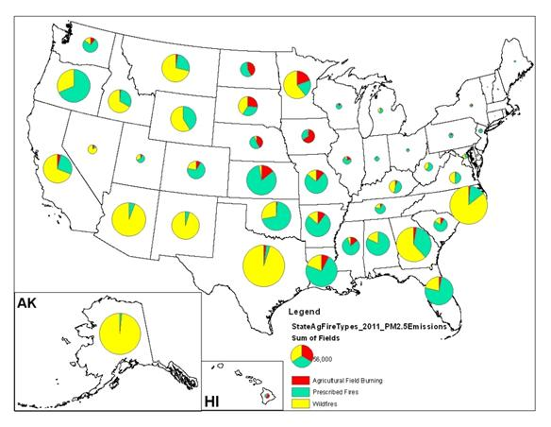
Wildfires – 2011 NEI
Graphic: NOAA, : https://www.ncdc.noaa.gov/sotc/fire/2011/13
Notes:
Get: 2014 info on wildfires
Remove Prescribed burning
If possible, winnow data down to shorter time period
And make legend more readable

Slide 10
Wildfires – 2014 Real World
Year | Fires | Acres
2014 | 63,312 | 3,595,613
2013 | 47,579 | 4,319,546
2012 | 67,774 | 9,326,238
2011 | 74,126 | 8,711,367
Source: NIFC, http://www.nifc.gov/fireInfo/fireInfo_stats_totalFires.html

Slide 11
Oil and Gas – 2011
2008 to 2011
Gas Production: up 14%
Oil Production: up 15%
Graphic: Aguilera and Radetzki, Oil and Gas Journal, December 2013.

Slide 12
Oil and Gas – NEI 2008 to 2011
NOx (million tons/year)
VOC (million tons/year)
Oil and Gas:
NOx increased 64%
VOC increased 62%
Partly due to improved characterization of emissions in the 2011 NEI

Slide 13
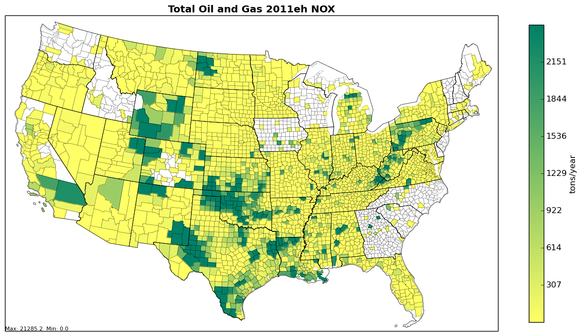
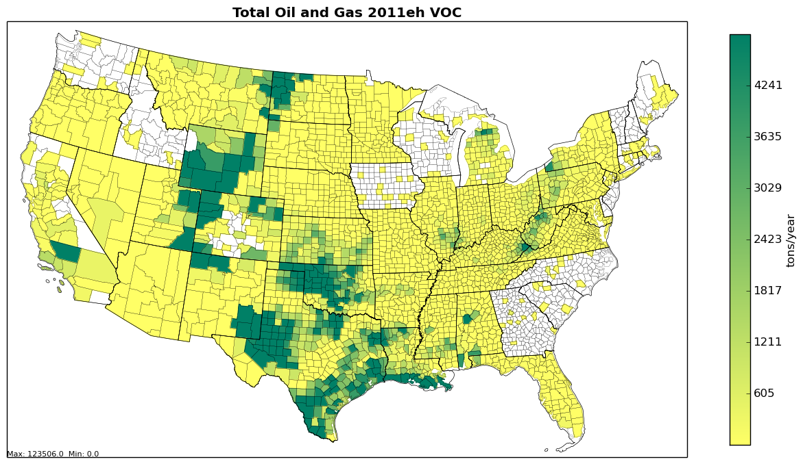
Oil and Gas – NEI 2011 v2 by county
NOx (tons/year) VOC (tons/year)

Slide 14
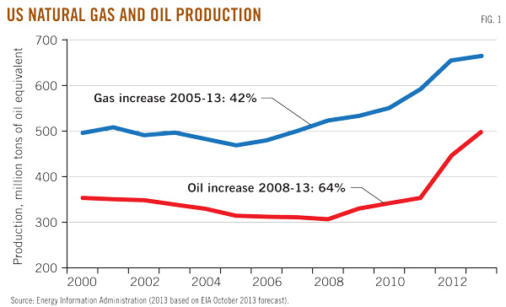
Oil & Gas – 2013 Real World
2011 to 2013
Gas Production: Up 12%
Oil Production: Up 42%
Graphic: Aguilera and Radetzki, Oil and Gas Journal, December 2013.

Slide 15
Why Care About 2011?
For policy purposes, the NAAQS process needs (and the CAA requires) a reference point
Nonattainment designations
Subsequent state implementation plan development (including air quality modeling)
Track progress in reducing emissions over time
Allow the time needed for the regulatory process to work with participation from many groups
For science purposes, research takes time and researchers cannot constantly adjust to a new inventory year

Slide 16
Why Care About Current and Consistent Inventories?
To inform the public, old inventories have many flaws
Do not reflect reductions from new regulation
Do not reflect reductions or increases from production changes
Do not reflect new underlying information (e.g., emissions tests)
Public expects up to minute information
Inconsistent inventories confuse and can undermine trust
Don’t the regulators know the amount of emissions?
Aren’t all emissions always measured?
Point source inventories are well suited for more current public information

Slide 17
E-Enterprise and Air Emissions
E-Enterprise for the Environment is jointly governed by states and the EPA to collaboratively modernize EPA business processes
To improve environmental results
To enhance services to the regulated community and the public by making government more efficient and effective
A “Combined Air Emissions” project has arisen from two similar proposals in the spring of 2014, made by Arizona and the EPA
In summer 2014, the E-Enterprise Leadership Council (senior level state and EPA members) selected five project for scoping and return-on-investment (ROI) analyses
Implementation depends on the results of the ROI and would include continued state-EPA collaboration

Slide 18
Air Emissions - Project Goals
Reduce industry burden
Improve timeliness and transparency of data
Create consistent information across air emissions programs
Improve data quality
Make data more accessible and useable

Slide 19
E-Enterprise Air Emissions Focuses on Point Sources
Focuses on four major air reporting programs (different policies & science)
Toxics Release Inventory
Greenhouse Gas Reporting Program
Compliance and Emissions Data Reporting Interface
National Emissions Inventory
Criteria pollutants and air toxics
Facilities report to S/L/T air agencies who report to the EPA
“Best” methods
Evolving program
Air Toxics
Emissions to all media
Many industries
“Best” methods
Direct facility
Mature program
Greenhouse Gases
Specific industries
Prescriptive methods
Direct facility
Young program
Largely air toxics focused
CAA Part 60 and 63 compliance – many industries
Stack test data
Direct facility
New approach

Slide 20
Air Emissions - Approach
Team with members from state and local agencies, ECOS, EPA from all four reporting programs, and others at the EPA
Starting fall 2014, developed a team charter, problem statement, and defined the scope of the project
Developed detailed information on the “As Is” or baseline case
Key variables are program costs, reporting facility burden, and time to access collected data
Developed detailed “value stream maps” (VSMs) for the four programs + the state NEI
A flow chart that shows connections of value-added steps and timing
Held a 3-day in person “lean” facilitated event (February 10-12), which identified a “To Be” solution
“Lean” is based on manufacturing concepts of identifying and eliminating inefficiencies
Involved industry stakeholders through Fall 2014 meeting and lean event in February 2015
Currently clarifying the “To Be” State and building ROI analysis

Slide 21
Air Emissions – “As Is” Value Stream Maps
Example of 2014 inventory year
January 2015
July 2015
January 2016
TRI
QA, Release, and Revise Data
CEDRI
Release Data
NEI - EPA
NEI - State
QA and Submit Data to EPA
GHGRP
QA, Release, and Revise Data
Industry
Compile Data
Submit and Revise Data
Prepare
Reporting Changes
Stakeholder Notification/ Outreach

Slide 22
Key Inefficiencies to be Eliminated
Duplicative and inconsistent facility info / facility matching
Duplicative data entry and revisions by facilities of data elements that are included in several separate emissions programs
Wait time caused by current state/EPA NEI process
Some duplicative post-submission QA by EPA and states
Inconsistent emissions data across programs and associated work (e.g. reconciliation)
NEI augmentation steps

Slide 23
Air Emissions – “To Be” Result
Previous emissions
TRI Database
CEDRI, Webfire/EFs
Portal
Attributes Entry
Emissions Entry
NEI Database
State Databases
Prepopulate facility attributes
Distribute data to programs
GHGRP Database
Shared data Roles for QA/QC
Shared Facility Attributes
System
Unified Data Public Access

Slide 24
“To Be” Shared Facility Attributes
Would include all details of facility needed for EPA and S/L/T air emissions systems such as name, address, latitude / longitude, units, processes, contacts, and controls
Facility information collected once and shared among EPA programs and state/locals
Could include S/L/T QA and/or a sign-off role where appropriate
Key potential benefits
One cross-program definition / understanding of “facility” generally and each facility specifically
Common IDs would eliminate cross-program data matching for facilities and sub-facilities
Key open issues
How to leverage existing systems (i.e., Facility Registry Services (FRS) and state systems)?
What is centrally maintained and what relies on appropriate state systems?
How to handle the regulatory and statutory definitions of facility?

Slide 25
“To Be” Single Data Entry Portal
Facilities would report attributes and emissions through a single portal
Seek to unify the submission experience (i.e., interface) for industry
Accommodate multiple reporting deadlines as needed
Allows coordinated communication to industry of changes to data submission forms
Shares pre-population (smart submission) across programs
Shares pre-submittal data validation
Key potential benefits
Simpler for industry
Makes NEI timeline much shorter
Eliminates many inconsistencies in emissions data

Slide 26
“To Be” Distributed and Connected Program Databases
Back-end emissions databases for programs (including states) remain separate
A single database solution was considered too unwieldy with the many different underlying programs, regulations, and purposes for the data
Post-submission QA roles would be defined across all programs (including states)
Previously identified roles for CEDRI relating to other programs fits nicely into this model
Key potential benefits
Allows for improving interconnectivity
Facilitates compliance test data for CEDRI to be used for emission factors and emissions
Eliminates duplicative QA and different programs asking the same questions to facilities; makes data better faster

Slide 27
The Future
E-Enterprise will set the stage for new ways of doing inventories
EPA, S/L/T agencies, the public, and industry share the common interest in accessing timely and accurate facility emissions data
How can we leverage this interest to improve the future?

Slide 28
“Real-Time” Emissions Inventory
For EPA’s risk modeling needs, the latest emissions information is crucial
This has been collected historically by Information Collection Requests because other sources of information (including TRI and NEI) were not sufficient
These are costly and time consuming, in part because of the issues that E-Enterprise seeks to fix
For the public, current and accurate information is expected
A “Real-Time” inventory could be updated on an ongoing bases using
Shared Facility Attributes, including the latest control information,
The most recent and applicable source tests (CEDRI),
Updated emission factors (Webfire), and
Current activity information (e.g., GHGRP)

Slide 29
A Vision for the Future
More timely and accurate inventories better meet policy needs, research needs, and needs of the public
With vastly improved, efficient inventory processes, all stakeholders focus most inventory work to improve underlying data
Emissions/field testing
New measurement and estimation methods
Better QA and error prevention
High quality underlying data and new efficient processes create consistent inventories across multiple programs
Better emissions information allows regulators, industry, environmental groups, and other stakeholders to more quickly achieve consensus on the data, moving the focus to lowering emissions

