Slide 1
LIABILITY OVERVIEW
Session 2
Carlyn Winter Prisk
U.S. EPA Region 3

Slide 2
What is a Potentially Responsible Party (PRP)?
“PRP” is often used interchangeably with “liable party” or “responsible party.”
PRP must satisfy criteria in CERCLA Section 107(a).
Statutory defenses and exemptions to CERCLA liability.

Slide 3
Liability Under CERCLA
Liability is defined in CERCLA Section 107(a).
A party is liable for response costs when:
There is a release or a threatened release;
Of a hazardous substance;
From a facility into the environment;
Which causes response costs to be incurred; and
The party is included in at least one class of persons described in CERCLA Section 107(a).

Slide 4
Section 107(a) defines liable parties as:
The current owner and operator of a facility;
Owner or operator of a facility at the time hazardous substances were disposed of;
Person who arranged for disposal or treatment of hazardous substances; and
Person who transported and chose the disposal location of hazardous substances.

Slide 5
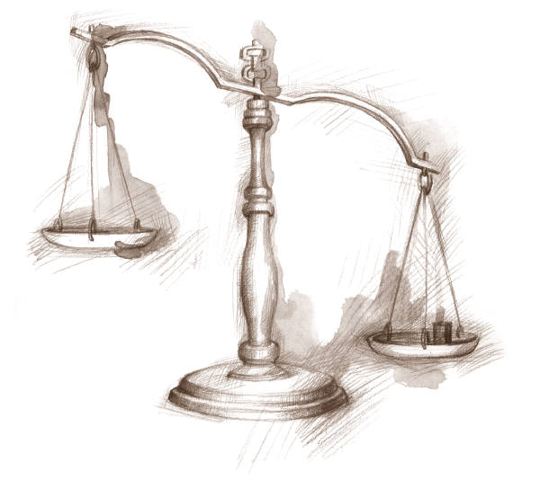
Statutory Defenses to CERCLA Liability
Section 107(b) provides that a party is not liable if a release was caused solely by an:
Act of God;
Act of war; or
Act or omission of a third party
(“third party defense”).

Slide 6
Third Party Defense
Defined in Section 107(b)(3):
Act or omission performed by someone other than the PRP;
Burden is on PRP to prove it;
PRP had no direct or indirect contractual relationship (defined in Section 101(35)) with the third party;
PRP exercised due care with respect to the hazardous substances; and
PRP took precautions against foreseeable acts or omissions of any such third party.

Slide 7
Statutory Exemptions from CERCLA Liability
Service Station Dealers
CERCLA Section 114(c);
Service station dealers that manage recycled oil;
Cannot be mixed with any other hazardous substances;
Managed in compliance with appropriate regulations or standards.
State and Local Governments
CERCLA Section 107(d);
State and local governments are not liable for costs or damages resulting from an emergency response;
Exception for negligence or misconduct.
Notes:
CERCLA also provides a exemption at Section 114(c) to owners of service stations that manage recycled oil. They are exempt from liability so long as the oil is now mixed with other hazardous substances and they are in compliance with other laws and regulations.
According to Section 107(d), states and local governments are not liable for their actions taken during an emergency response at a facility owned by another person, unless there was negligence or misconduct.

Slide 8
Statutory Exemptions from CERCLA Liability (cont’d)
Secured Creditors
CERCLA Section 101(20)(A) and (E);
Without participating in the management of a facility, holds “indicia of ownership” primarily to protect that person’s security interest in the facility.
Recyclers
Superfund Recycling Equity Act of 1999 (SREA);
CERCLA Section 127;
Exempt certain arrangers and transporters who “arrange for recycling of recyclable materials.”

Slide 9
2002 Brownfield Amendments Landowner Liability Protections
CERCLA Section 101(35)(a)(1) clarified “Innocent Landowner.”
CERCLA Section 107(q) added Contiguous Property Owner (CPO).
CERCLA Sections 101(40) and 107(r) added Bona Fide Prospective Purchaser (BFPP).

Slide 10
Innocent Landowner
Section 101(35) Contractual Relationship
“includes, but is not limited to, land contracts, deeds, easements, leases, or other instruments transferring title or possession, unless the real property on which the facility concerned is located was acquired by the defendant after the disposal or placement of the hazardous substance on, in, or at the facility, and one or more of the circumstances described in clause (i), (ii), or (iii) is also established by the defendant by a preponderance of the evidence…”

Slide 11
Innocent Landowner
At the time the party acquired the facility, the party did not know and had no reason to know of hazardous substances.
Government acquired facility through “involuntary” transfer or acquisition.
Party acquired the facility by inheritance or bequest.

Slide 12
Innocent Landowner
PLUS
Section 107(b)(3) – Third Party Defense;
Provide full cooperation, assistance, and facility access;
Be in compliance with any land use restrictions;
Not impede the effectiveness or integrity of any institutional controls.

Slide 13
Innocent Landowner
101(35)(A)(i) - Did not know and had no reason to know
carry out all appropriate inquiries….into previous ownership and uses of the facility
take reasonable steps to:
stop any continuing release;
prevent any threatened future release; and
prevent or limit any human, environmental, or natural resource exposure to any previously released hazardous substance.

Slide 14
Contiguous Property Owner
CERCLA Section 107(q);
Owner of property contaminated solely by a release from a contiguous property or similarly situated property owned by someone else is not liable if it:
Is not a PRP or affiliated with a PRP;
Did not cause, contribute, or consent to the release of hazardous substances; and
Conducts “all appropriate inquiries” prior to purchase and demonstrates that it did not know or have reason to know of contamination.

Slide 15
Bona Fide Prospective Purchaser
CERCLA Section 101(40);
Current owner is exempt from liability if disposal at the facility occurred prior to purchase, and the current owner:
Purchased the facility after January 11, 2002;
Is not a PRP or affiliated with a PRP;
Conducted all appropriate inquires into previous ownership and uses of the facility;
Took reasonable steps to stop continuing releases and threatened future releases;
Provides cooperation, assistance, and access to EPA; and
Complies with all land use restrictions and institutional controls affecting the property.

Slide 16
Other Statutory Exemptions from CERCLA Liability
Municipal Solid Waste (MSW)
CERCLA Section 107(p);
Conditional exemption for response costs incurred with respect to MSW disposed of at a facility on the NPL.
De Micromis Contributors
CERCLA Section 107(o);
Party contributed < 100 gallons of liquid materials or 200 pounds of solid materials containing hazardous substances.

Slide 17
EPA Enforcement Discretion
Orphan Share
De Minimis Settlements
Ability to Pay

Slide 18
Orphan Share Policy

Slide 19
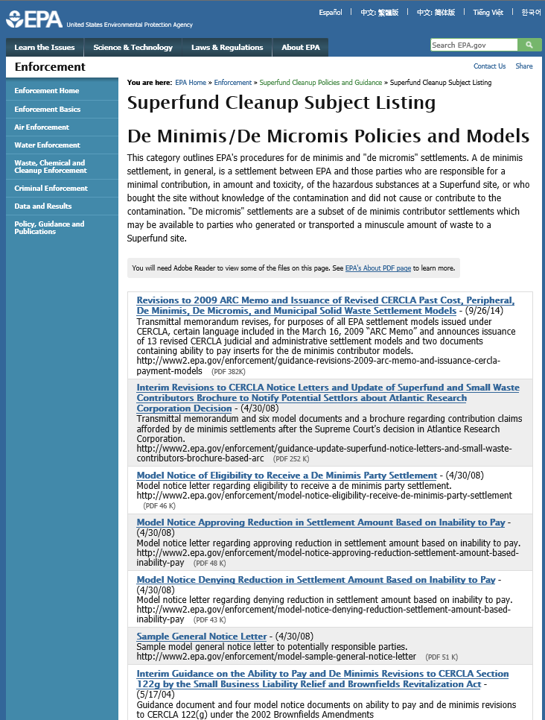
De Minimis Policy

Slide 20
EPA Enforcement Discretion (cont’d)
Owners of residential properties
Unless the residential homeowner’s activities led to a release or threatened release.
Owners of contaminated aquifers
Contamination of property solely as the result of subsurface migration in an aquifer from a source or sources outside the property.

Slide 21
CERCLA Enforcement Process
Where PRP search fits in;
“Enforcement First” policy;
Remedial and removal process timelines.

Slide 22
Settlement and Settlement Tools
Administrative settlements
Orders on consent;
Do not involve courts (except to enforce);
Typically used for removal and RI/FS.
Judicial settlements
Consent decrees.
Court-approved.

Slide 23
Cost Recovery
Statutory authorities.
Demand letters.
Referrals to DOJ.
Cost documentation.

Slide 24
References
CERCLA Lender Liability Exemption: Updated Questions and Answers http://www2.epa.gov/enforcement/fact-sheet-updated-questions-and-answers-cercla-lender-liability-exemption
Interim Guidance on the Municipal Solid Waste Exemption Under CERCLA Section 107(p) http://www2.epa.gov/enforcement/interim-guidance-municipal-solid-waste-exemption-under-superfund
Superfund Recycling Equity Act of 1999: Factors To Consider In A CERCLA Enforcement Case
http://www2.epa.gov/enforcement/guidance-superfund-recycling-equity-act-exemption-factors
Interim Enforcement Discretion Guidance Regarding Contiguous Property Owners
http://www2.epa.gov/enforcement/interim-guidance-enforcement-discretion-regarding-contiguous-property-owners
Interim Guidance on Orphan Share Compensation for Settlors
http://www2.epa.gov/enforcement/guidance-orphan-share-compensation-rdra-and-non-time-critical-removal-settlors
Orphan Share Reform Implementation Update
http://www2.epa.gov/enforcement/guidance-updates-implementation-orphan-share-reform

Slide 25
References (cont’d)
Interim Guidance on the Ability to Pay and De Minimis Revisions to CERCLA § 122(g) by the Small Business Liability Relief and Brownfields Revitalization Act
http://www2.epa.gov/enforcement/guidance-ability-pay-and-de-minimis-revisions-cercla-section-122g-2002-brownfield
General Policy on Superfund Ability to Pay Determinations
http://www2.epa.gov/enforcement/guidance-superfund-ability-pay-determinations
Policy Toward Owners of Residential Property at Superfund Sites
http://www2.epa.gov/enforcement/guidance-owners-residential-property-superfund-sites
Policy Toward Owners of Property Containing Contaminated Aquifers
http://www2.epa.gov/enforcement/guidance-owners-property-containing-contaminated-aquifers
EPA Negotiating Superfund Settlements Webpage
http://www.epa.gov/compliance/cleanup/superfund/negotiate.html
EPA Recovering Cleanup Costs Webpage
http://www.epa.gov/compliance/cleanup/superfund/recovercosts.html

