Slide 1
Gathering Information
Session 3
Cindy Brown
U.S. EPA Region 6
Notes:
Hi, and welcome to PRP Search Basic Training, Session 3 – Gathering Information.
My name is Cindy Brown, and I have been an Enforcement Officer in Region 6 for more than 10 years. In this session we are going to discuss the wide variety of resources that are available when gathering information about the Site and the potentially responsible parties who may be involved with the Site. My contact information will be available as part of this presentation and I encourage you to call or e-mail me or another member of the National PRP Search Enhancement Team with any questions about this presentation or other Potentially Responsible Party (PRP) Search Activities.
The objectives of information gathering and records management are to develop the site history, compile financial and corporate information, identify PRPs and document liability and viability.

Slide 2
What you Will Learn this Module
Information gathering is not a linear process
Type and size of site may affect your research
Sources of information
Types of information needed
History can play a big role
No 2 Sites are EVER the same
Notes:
It’s not linear in that, the size of the site, the number of times it has changed hands, the information that is readily available (or not) will all contribute to the gathering process.
The objective of this task is to locate and obtain copies of all records pertinent to the site and relevant to the PRP search.
If a site has changed hands many times, its going to make your search more difficult. As it will if the site has had a variety of businesses on the property. Every site is different, that’s what makes this job so interesting.

Slide 3
Questions To Ask before Starting
What information is needed now and what can wait until later?
How far back in time should you search?
What information do you or other EPA employees already have?
What information do other agencies have?
Notes:
Set your priorities to get moving in the right direction. What’s the suspected time frame of when the pollution happened.
Other divisions of your regional office could already be building a file on this site. Possibly the State or Tribe, the Railroad Commission, Bureau of Land Management, ATSDR etc., could have information which could be helpful. You just never know where the information trail is going to lead.
Maybe this is not the 1st time this location has been on our radar. It’s very possible that RCRA already has information on the location.

Slide 4
Site Size and Complexity Impact the Search
Small Sites
Limited number of properties
Limited number of owners
Limited contamination
Notes:
You could be looking at one small piece of property with only a short length of time for it’s pollution history, or a larger site that has changed hands numerous times with a variety of pollutants attributed to various owners throughout the history of the site. I am currently working on a site where the farther down we sampled, the pollutants changed significantly. I was also able to locate some old newspapers showing where a previous owner had been indicted in the 1940’s for dumping arsenic on the property.
This was very different from the contaminant on the surface and it helped us pull in additional PRPs.
Certainly the number of owners, and number of contaminants will effect your search criteria.

Slide 5
Large sites
Large geographic area (mining, sediment, or ground water contamination sites)
Many owners, operators, possibly generators and transporters (sediment, ground water, mining, landfill, waste treatment, or recyclers)
Multiple sources of contamination (sediment, ground water, landfill, or recyclers)
Notes:
In this slide of the Portland Harbor Cleanup, it exemplifies pretty well how complicated one cleanup site can become, with numerous sources of contaminants, numerous owners (previous and current), covering a large geographical area. Plus in this site your cleaning up groundwater, a landfill area, a waste treatment area, so just to get your arms around this type of site will take some time and certainly some strong organizational skills.

Slide 6
What Are You Looking for?
Names associated with site/facility (contact names, former employees)
Current and former owners
Violations
Descriptions of site operations
Mortgages and leases
Customers
Photographs and maps
Notes:
It’s always good to have in mind what type of information you are looking for, and which databases may more readily provide such information. But keep your options open, and just do some good old research. And don’t forget the States often have their own data bases, either through the Environmental Quality Department of the State, or by their online property and assessment records.

Slide 7
Internal Records Review
Search databases for the facility name, street address, or known corporate operator
EPA databases (Primavera, RCRAInfo, ECHO, and SEMS)
Many Superfund sites may have started out in the RCRA corrective action, air, or water programs
Notes:
There are numerous EPA data systems available that can really get you started on gathering information.
Primavera has data sharing capabilities that make it easy to find out if an individual or firm is already in the database, and maybe has been named a PRP at another site. In addition to basic information, of name, address, phone number, on all parties associated with a site, Primavera stores information on site enforcement history. It contains what response actions PRPs have undertaken or committed themselves to perform. You’ll also find information about correspondence issued by the Superfund program, such as 104(e) Information Request letters, General Notice letters and Special Notice letters.
Want to use the website here NO
I would like to warn you though, garbage in/garbage out. It’s up to all of us working in the Enforcement Officers area to put information into Primavera, and keep it up to date and accurate.The information you and your co-workers put into Primavera about PRPs and enforcement actions, will determine how useful the information is at a later date.

Slide 8
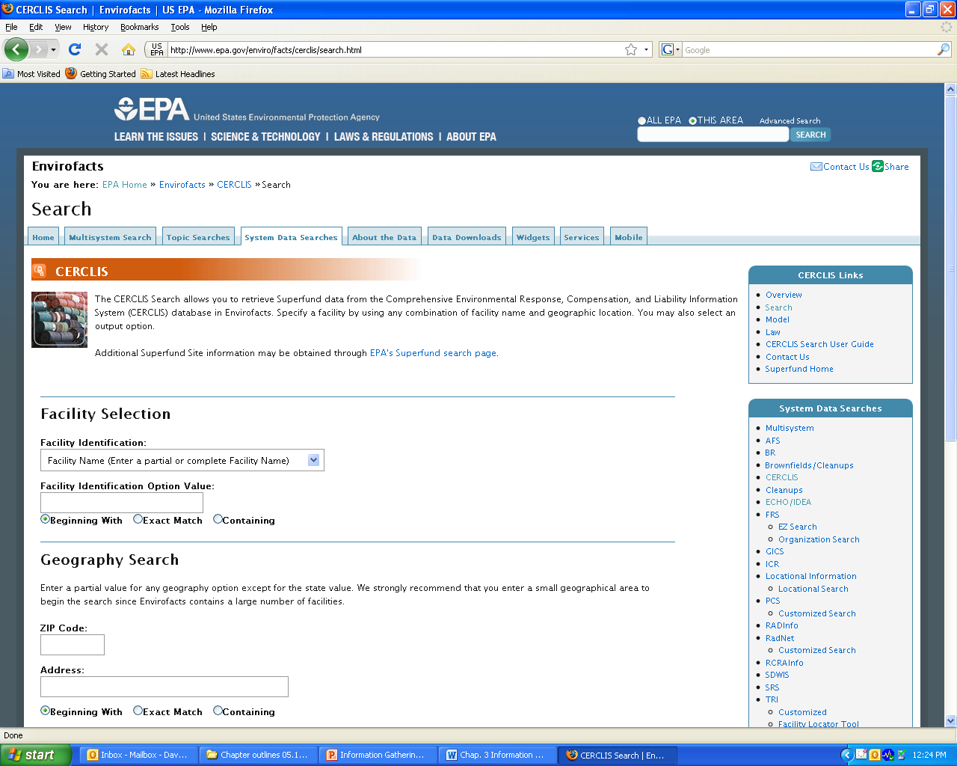
envirofacts
Notes:
Envirofacts is a single point of access to select U.S. EPA environmental data. This website provides access to several EPA databases to provide you with information about environmental activities that may affect air, water, and land anywhere in the United States. With Envirofacts, you can learn more about these environmental activities in a specific area. You can generate maps of environmental information and obtain facility information, including toxic chemical releases, water discharge permit compliance, hazardous waste handling processes, Superfund status, and air emission estimates.

Slide 9
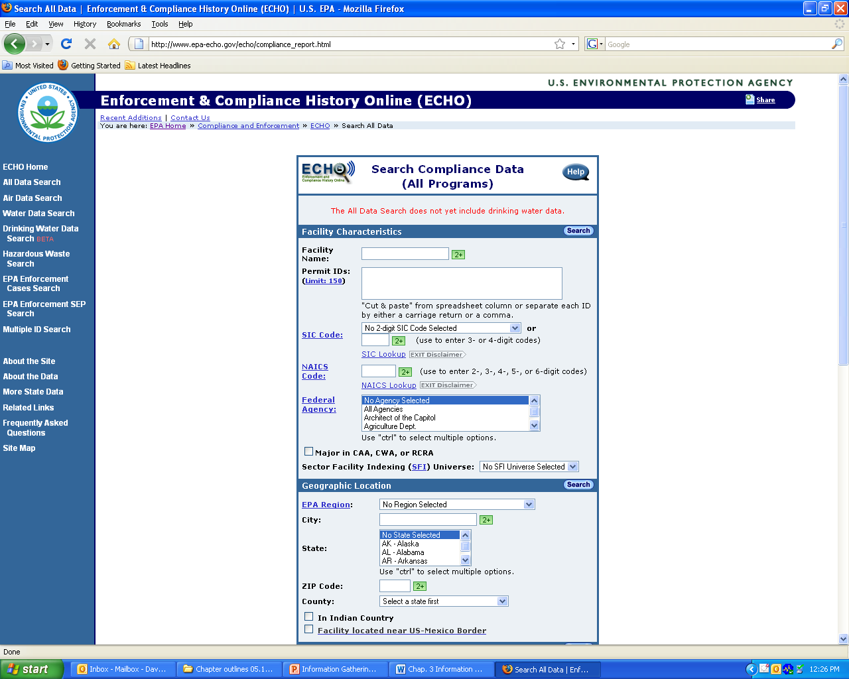
ECHO
Notes:
As mentioned earlier the ECHO system is used primarily by EPA Enforcement to gather information about a facilities compliance history for all programs, TRI, Air, Water, RCRA, etc. It has replaced the OTIS system, which is no longer functioning.
It’s where all of the combined data from EPA’s various databases is stored for the public. You can look up a facility and find violations, see what permitted facilities are in a certain location, find Superfund sites, etc.

Slide 10
TRACS – State of Texas
Notes:
This is an example of a system used by the State of Texas called TRACS. As you can hopefully see, it shows the entity that received the hazardous substances, and what it was that was received and the name of the company that sent the waste. This database of receiving entities, also gives the transporter information, the date received and the quantity of the substance received. etc.
I’m just bringing this up as an example. Many states have similar systems, which can provide you a lot of information especially on sites, where you are dealing with a lot of generators.

Slide 11
Local, State, and Other Federal Agencies as Sources
State enforcement actions, sister federal agency actions, health and fire department reports, local air and water authorities
Environmental investigations and/or permits
Notices of Violation
Complaints
Identify a pattern of non-compliance and hazardous practices
Helps build complete picture of environmental problems
Notes:
These are all good sources of information about a facility and the business that could very well be responsible for the pollution. I recently sent a 104(e) Information Request letter to an entity that I thought was a previous owner. It turns out they were able to prove they were not the previous owner, but were kind enough to provide the contact information for one of the major contributors of a very large site in my region. It was like a gift fell out on the sky onto my desk. All the information that was provided by the non-PRP proved to be exact and extremely helpful. Of course they were very happy to get EPA to turn their focus in another direction.

Slide 12
Invoices
Notes:
This is an example of an invoice from a company (a country club) who shipped used motor oil to an oil recycler. It gives details of what was shipped, from who, and to whom, give generator ID, and depending on the invoice design, it might also provide information on the transporter.
This type of information can be obtained through the 104(e) Information Request letter, or possibly by doing a site visit to review records.
This information can be useful to help build a waste in list for a specific facility.

Slide 13
Hazardous Waste Manifests
Notes:
This is a copy of a Hazardous Waste Manifest, and provides much of the same information as an invoice, and even a little more. It usually gives more information about exactly what was being delivered, it may even have a waste code, depending on how the state has designed their document.
Manifests are very useful to determine who sent what, and to where. They are very good for evidence when you are developing information for your General Notice and Special Notice letters.
It also provides transporter information.

Slide 14
County Records
County Clerk’s Office:
Deeds
Mineral Rights
Outstanding liens and mortgages
County Assessor’s Office:
Real estate tax amounts paid and unpaid
Identify abutting property owners
Provide parcel maps, plat maps
Notes:
From the County Clerk’s Office you’ll be able to get Deed and Title documents, information on Oil and Gas Mineral Rights
As well as information on outstanding liens and mortgages on the property.
The County Assessor’s Office helps in identifying real estate tax amounts paid and unpaid, and by whom. Plus the assessor’s office can help you Identify the owners of abutting property. This may be a good source of information about the PRP, plus the OSC often needs to contact the adjoining property owners.
The County Assessor Office also can provide parcel maps, plat maps, and maps of sub-divisions.

Slide 15
Corporate Information
Sources include the Secretary of State, Department of Revenue, and similar state agencies
Available Information may include corporate officers, percentages of ownership, registered agents, former names, etc.
Company websites
Notes:
There’s a lot of good corporate information available on State’s websites. Much of it is free. Just as this slide explains you can find names and addresses of corporate officers, registered agents. It can point you to previous names the company used, which can lead to possible a bigger net to throw out for your PRP search in the form of a 104(e) Information Request letter.
Some Secretary of State (SOS) websites charge for detailed information by county. So it’s always a good idea to find out if anyone else in your immediate office has accessed the website for the same county or parish. Perhaps the fee has already been paid for the year, and you can access the information under the ID established by the co-worker.
Recently a co-worked had a phone conversation with a PRP who said the company was in dire financial condition. However, when the individual put the Enforcement Officer on hold, there was a recording in the background telling of the companies international holdings and financial strength. After that the argument, didn’t hold water needless to say.

Slide 16
Historical Resources
Polk Directories
Sanborn Maps
Special collections at universities and colleges
Books on subject (use EPA’s library for inter-library loans)
Technical manuals (e.g., Army manuals on NIKE missiles)
Eckhart survey of chemical industry
Historical societies
State manufacturing register
Notes:
These are just some of the various resources that are readily available to EPA employees. You may have a fairly robust library in your regional office, or you may want to resort to the City’s public library or university library. I guess the one take away I want to be sure and emphasis is “think outside the box”. Most likely information about your site is out there, you just might have to dig to find it.
Polk directories have been a business icon for over 140 years and gathers information by State, City, type of business, containing an alphabetical list of business entities.
City directories and manufacturing directories can also provide historical information about what business was in operation at what address.
The Eckhart Survey is a compilation of waste site from the chemical industry. As a result of this responses to this survey, Congress was motivated to pass Superfund legislation (CERCLA) in 1980.

Slide 17
Polk Directories
City Directories where you can search by street name, type of business, and …..
Notes:
This is an example of a Polk Directory. The are city specific and include information regarding listings of businesses that were or are doing business and have an address in that particular city.

Slide 18
Examples of Research Websites
Local historical societies:
Museum of History and Industry in Seattle has nearly 4 million artifacts, photos, and archived files covering the Pacific Northwest
University of Idaho library also has a great website
Notes:
These are just a few examples of special collections. I’m sure your state and local society may be a good place to check.
MOHAI is the museum of History and Industry. The museum includes artifacts related to local businesses and industries, locally designed and invented products, recreational equipment, maritime objects. Again, this is just one example of information that is readily available.

Slide 19
Sanborn Maps
Fire insurance maps showing structures, fire hydrants, wells, construction date, etc.
Started in 1866 and updated about every 10 years
Now provides other digital services
Notes:
This is an example of a Sanborn map. As you can see it provides details of fire hydrants, walls and other construction.
It’s a publisher of historical and current maps of US cities and towns. These maps were initially created to estimate fire insurance risks.
The maps include outlines of each building and outbuilding; the location of windows and doors; street names; etc. .
Today, Sanborn maps are found primarily in the archives and special collections of town halls and public and university libraries, and remain a vital resource for people in many different fields.

Slide 20
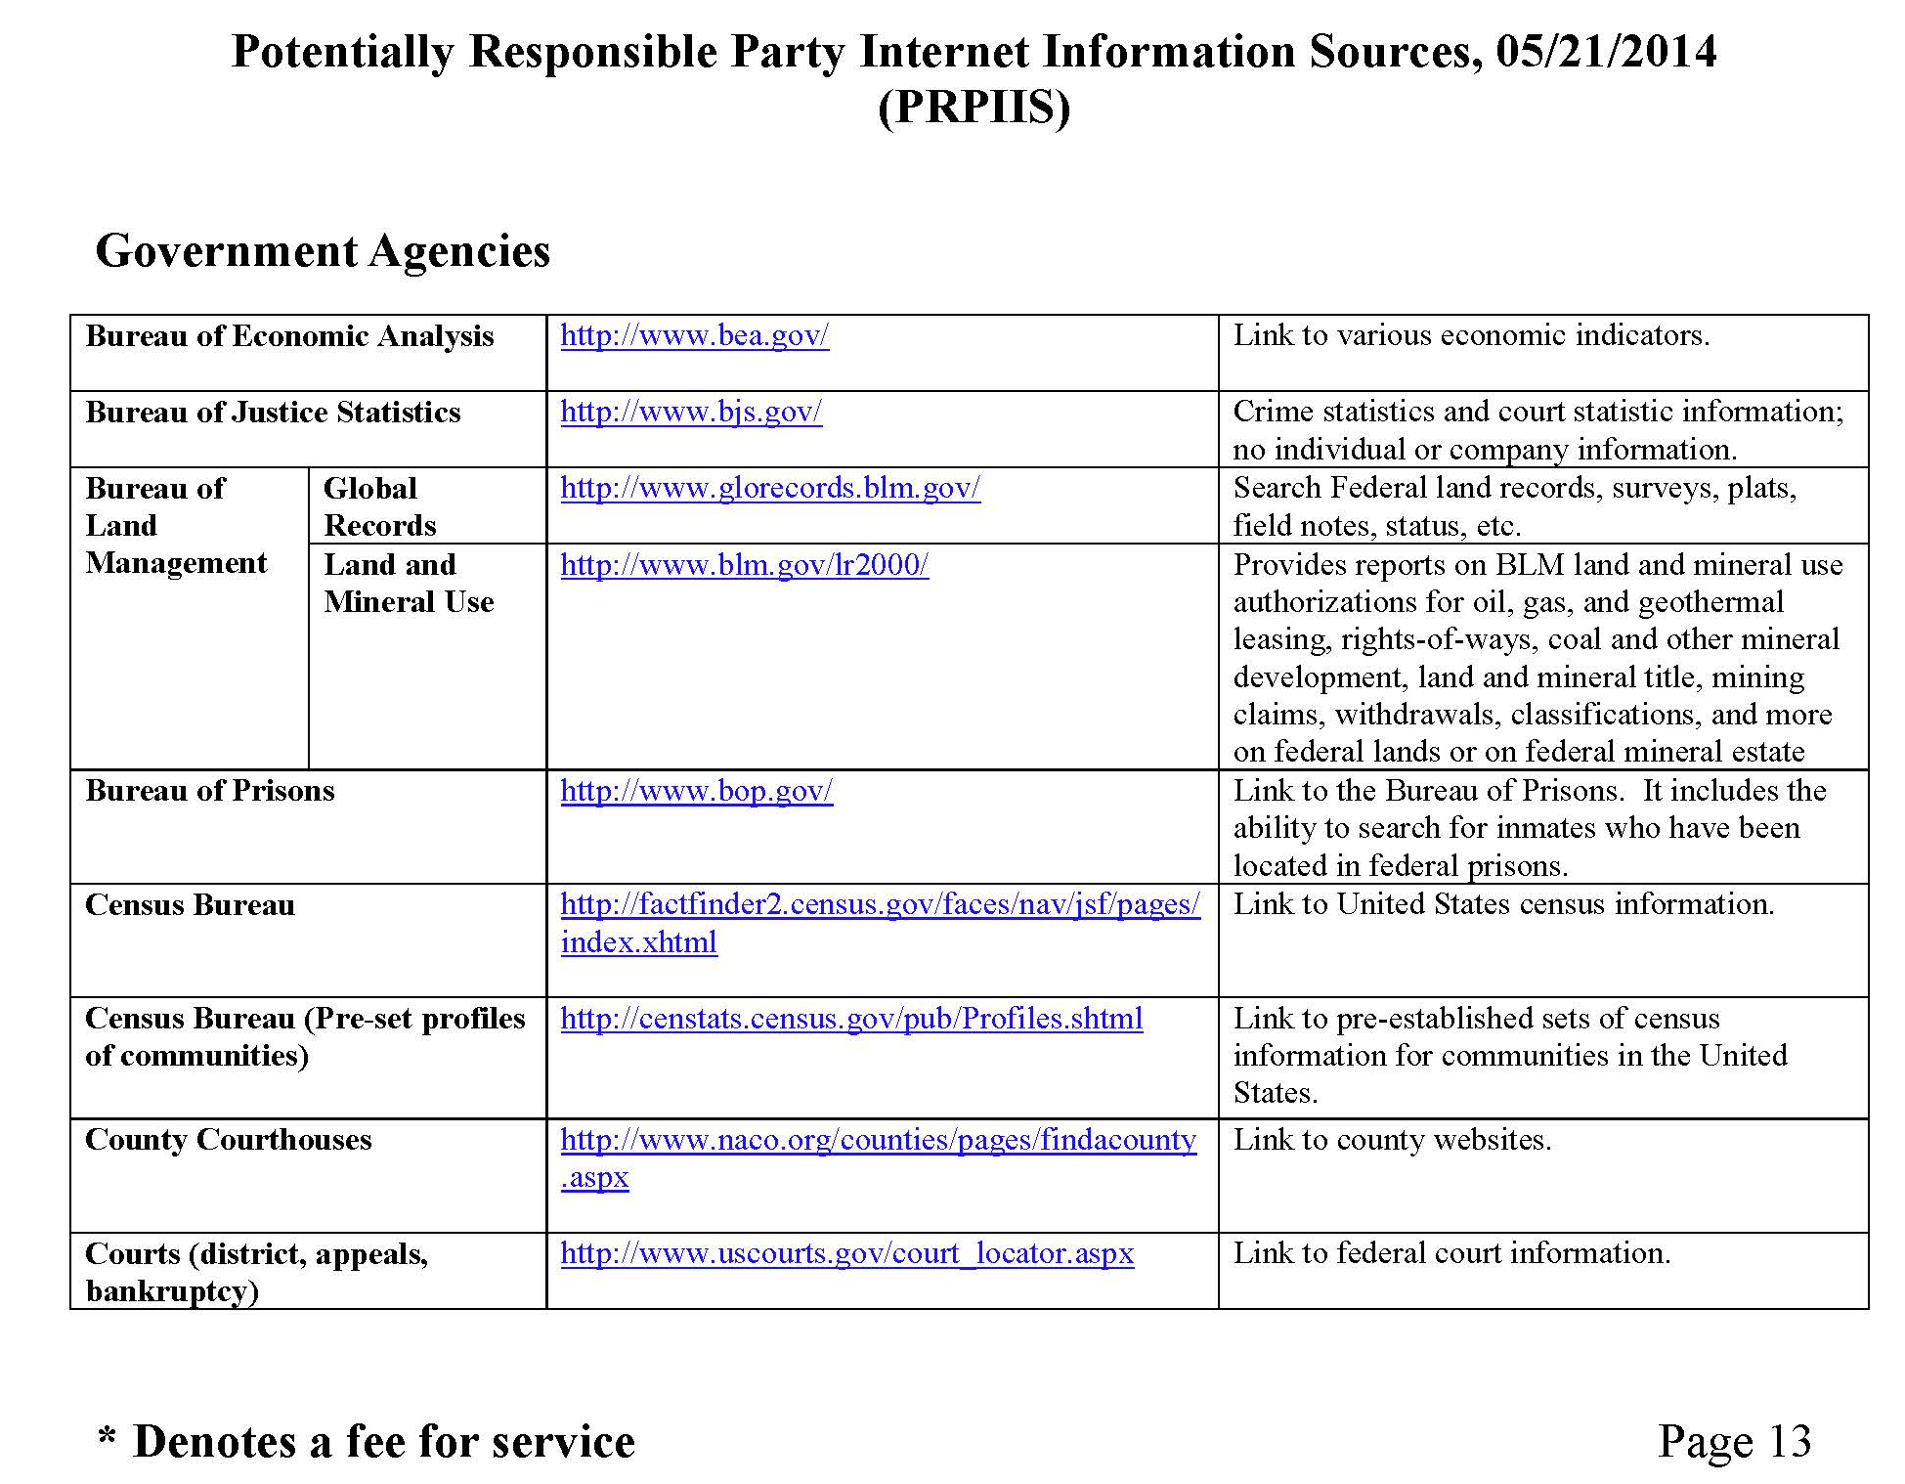
Other Sources
Notes:
This is a collection of websites that could greatly assist in your PRP information gathering. It includes website listings to help you research topics such as security and exchange filings, bankruptcy information, company profiles, corporate financial information, an administrative record data base, a copy of the National Priority Listing, the PRP search manual, Superfund enforcement guidance documents, government agency website addresses, the national criminal justice reference service, etc. It also includes a section on finding people, and the list goes on and on. I strongly recommend that you check out this listing and just at least be familiar with what’s available that you might need for future use.

Slide 21
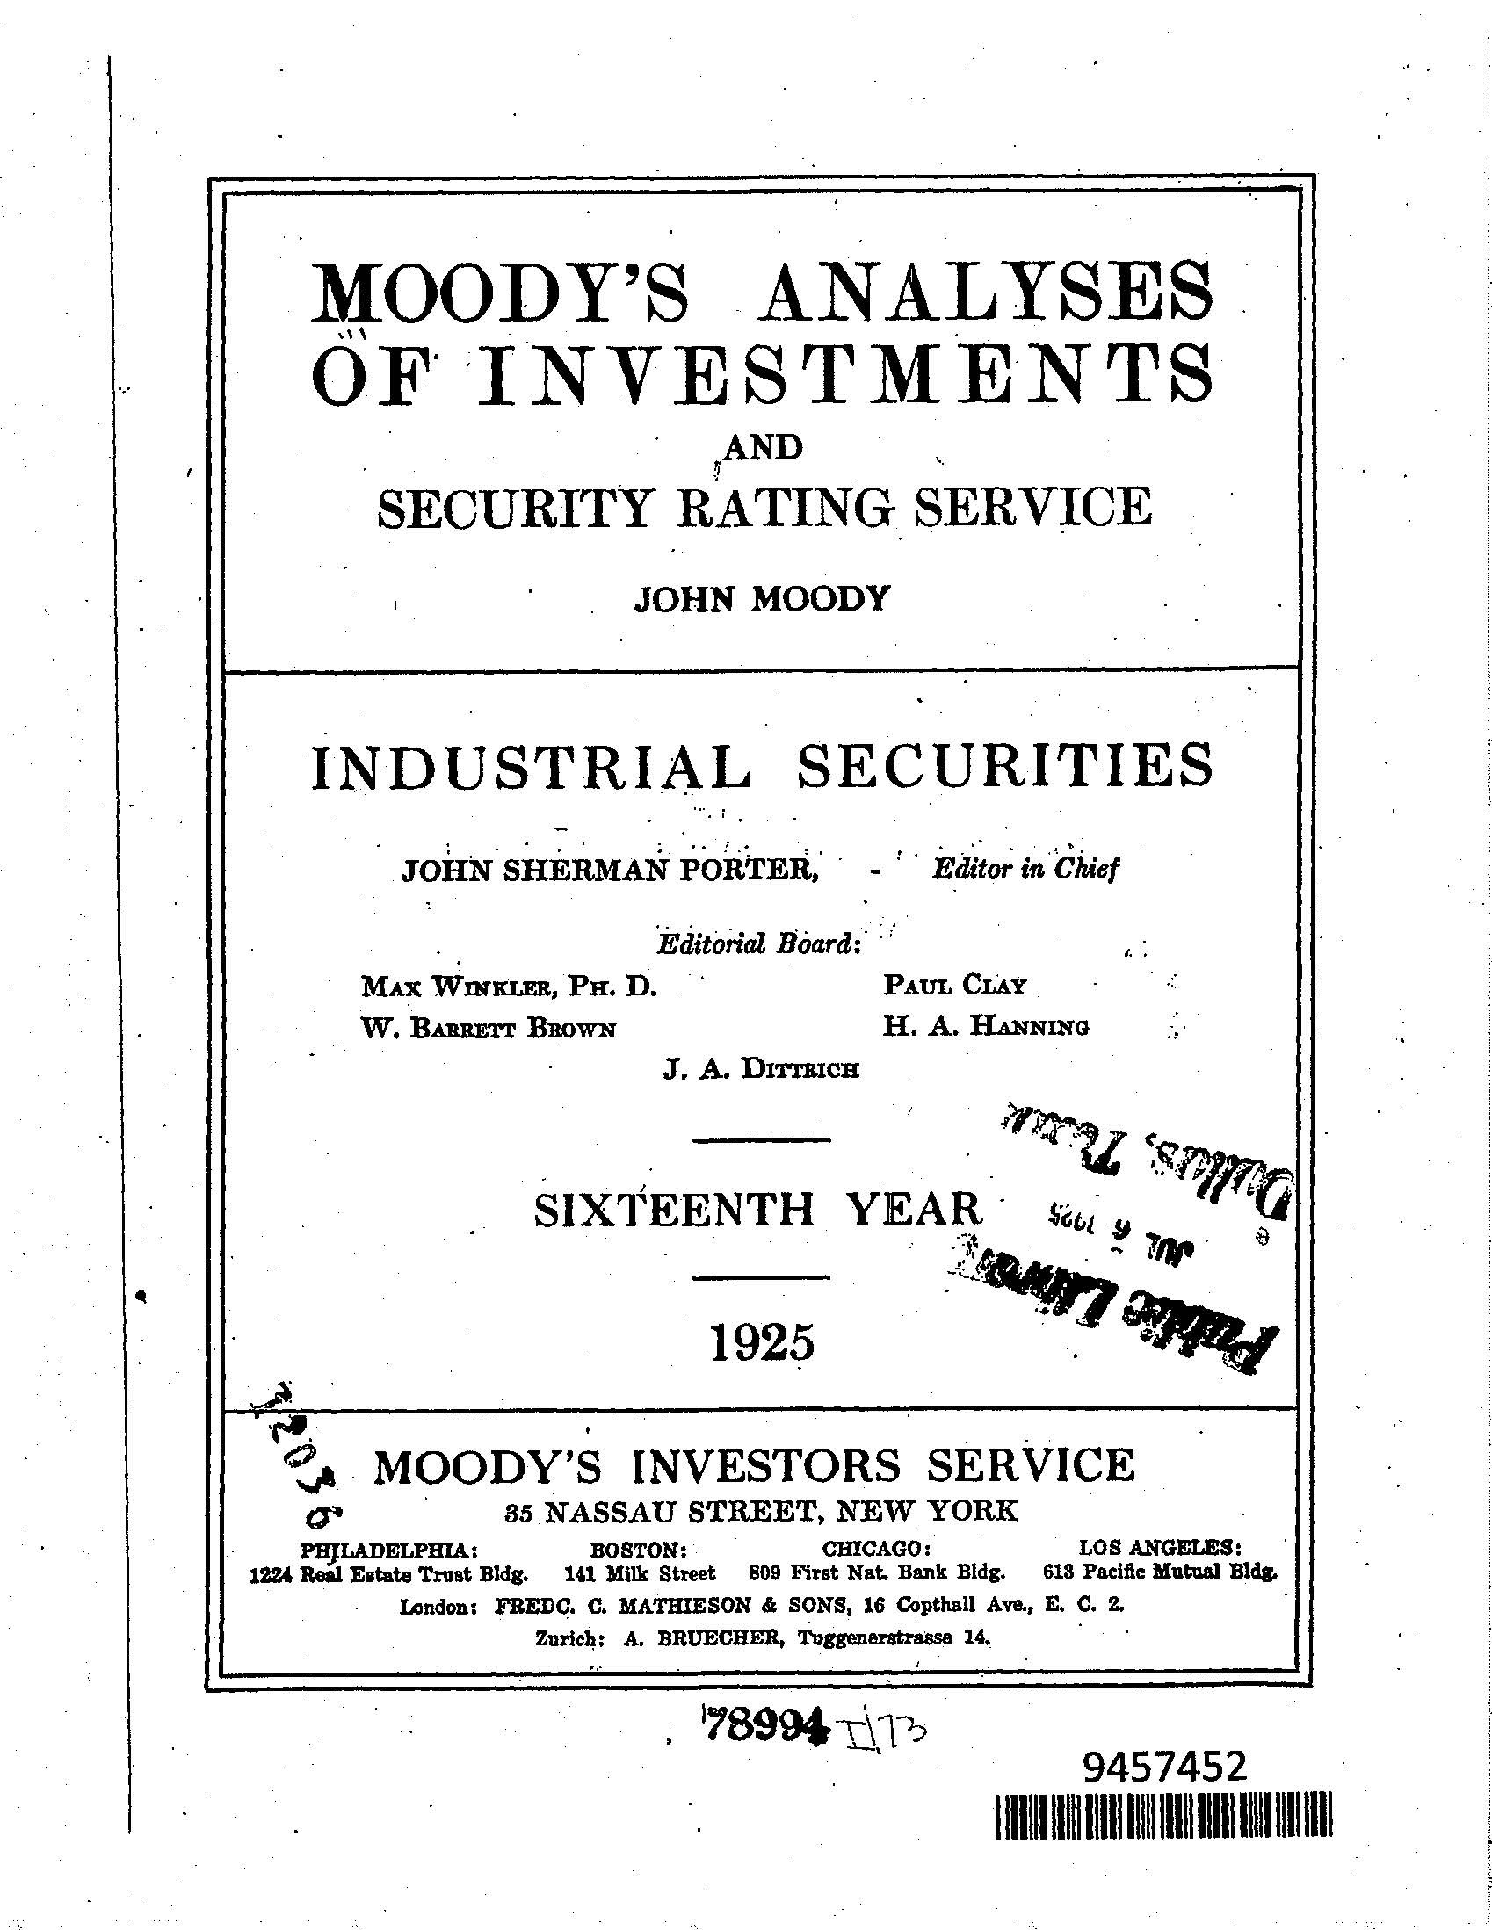
Moody’s Analyses
of
Investments
Notes:
Moody's Investors Service, often referred to as Moody's, is the bond credit rating business of Moody's Corporation, representing the company's traditional line of business and its historical name. Moody's Investors Service provides international financial research on bonds issued by commercial entities. It provides information about the company’s history, board members, stock issuances, etc.

Slide 22
Fee-for-Service Databases
CLEAR
PACER
LexisNexis
These databases allow for “global” searching across the nation
Notes:
There are a number of fee for service databases which can provide detailed information about a company.
CLEAR is an investigative research system that provides information about a person or business from proprietary sources and public records. Hopefully your region has a subscription to use this service.
PACER stands for Public Access to Court Electronic Records, and this is an electronic public access service that allows users to obtain case and docket information online from federal appellate, district, and bankruptcy courts, and the PACER Case Locator. PACER is provided by the Federal Judiciary in keeping with its commitment to providing public access to court information via a centralized service. This also is a Fee for Service database.
LexisNexis Group is a corporation providing computer-assisted legal research as well as business research and risk service solution.

Slide 23
Take advantage of the following free website
Historical-Photos.com
You can use this website with or as an alternative to procuring a historic photo analysis
Notes:
This website information can assist in determining the presence of current and former site features of interest, which is portrayed visually and verbally in an analysis report.
Other photos may be available from the Department of Interior, and from the EPA’s Environmental Photographic Interpretation Center.
They can help identify areas of contamination that can no longer be seen in more current photos and can help identify the nature and extent of contamination which is useful both for enforcement and future sampling reasons.

Slide 24
Examples of EPA Source Documents
CERCLA 104(e) Information Request letters
RCRA 3007 Information Request letters
Orders issued to PRPs
Permits issued to PRPs
Confidential Criminal Investigation Division Reports
Inspection reports, sampling data, enforcement actions
Notes:
These documents all represent great ways to obtain information about an entity, and should all be accessible in your office.

Slide 25
Local Government Resources
Fire Department
Police Department
City Hall
Notes:
These local organizations may all have information on an site, based on responses made to the location, or just general knowledge. More than once I have been in local offices trying to obtain information about a specific Superfund Site, when someone working behind the counter says, “Oh my Dad worked there for years,” or something similar. Often these people are more than willing to tell you what the company has left for the City to cleanup.

Slide 26
Potential Federal Sources
Dept of Interior - Maps
Environmental Photographic Interpretation Center -
Maps
Nuclear Regulatory Commission - licenses, permits
U.S. Geological Survey - groundwater data
U.S. Army Corps of Engineers - records at federally owned sites
Occupational Safety and Health Administration - health and safety incident reports
U.S. Coast Guard - incident response reports
Notes:
There’s a lot of information out there from other Federal Agencies. Oftentimes, people in your office, other Enforcement Officers, On-scene Coordinators, or attorneys, have a contact to help get you started.

Slide 27
Sources of Information Commonly in PRP Possession
Information on other PRPs
Hazardous material listings
Shipment manifests
Transporter records
Material Safety Data Sheets (MSDS)
Correspondence
Corporate records
Notes:
You’d be surprised what you can find at the Site location or through a 104(e) Information Request letter. Manifests and customer listings are two of the most fruitful, in my opinion for getting information on additional PRPs.

Slide 28
Organization
Large sites with many PRPs and a large volume of records spanning a number of years may require complex file organization. To choose the best method of organizing documents, the following factors should be considered:
Types of information needed from the documents
Volume of documents
Regional file structure
Capabilities of the organizer
Ease of document retrieval
Long-term tracking needs and capabilities
Potential document security issues
Unique site-specific needs
Nature and number of potential users
Time required to organize documents
Notes:
Organizing records
Does your region require specific file management procedures even on working documents? (filing information using the same format the Records Center requires, for example)
If there are no regional restrictions on working files, organize your records in a way that makes sense to you (e.g., by the agency where you got the documents, document type, company names, individuals associated with site). If you are really good on the computer, you can manage your electronic files the same way.
You need to know the agency record management system regardless and the definition of a record.

Slide 29
References
PRP Search Manual, Appendices B and C Checklists
http://www2.epa.gov/enforcement/report-prp-search-manual-2009-edition-2011-addendum
PRP Search Manual, Appendix F (“PRPIIS”)
http://www2.epa.gov/enforcement/report-prp-search-manual-2009-edition-2011-addendum
CLEAR
https://clear.thomsonreuters.com
Enforcement and Compliance History Online (“ECHO”)
http://echo.epa.gov
Envirofacts
http://www.epa.gov/enviro/
Environmental Data Resources: Sanborn Maps
http://edrnet.com/prods/sanborn-maps/

Slide 30
References (cont’d)
EPA Records Management Intranet Page
http://intranet.epa.gov/recordslindex.htm
Historical Photos
http://historical-photos.com
LexisNexis
http://www.lexisnexis.com/en-us/home.page
Moody’s Investors Service
https://www.moodys.com/Pages/atc002.aspx
Museum of History & Industry
www.seattlehistory.org
Public Access to Court Electronic Records (“PACER”)
https://www.pacer.gov/

Slide 31
References (cont’d)
RCRAInfo
http://www.epa.gov/enviro/facts/rcrainfo/search.html
University of Idaho
www.lib.uidaho.edu/special-collections
U.S. Securities and Exchange Commission
http://www.sec.gov/edgar.shtml

