Slide 1
Issuing Information
and
Site Access Requests
Session 4
Martha Bosworth
U.S. EPA Region 1

Slide 2
Introduction
CERCLA Section 104(e) authorizes EPA to seek information about sites containing hazardous substances. EPA uses many approaches to do this research, including the issuance of “information request letters.”
EPA may issue information request letters to any person (including business entities and government agencies) who may have information about a site, not just persons who may be PRPs.

Slide 3
104(e) Letters
  Under Section 104(e)(2) of CERCLA, a representative of the President may require any person who has or may have information relevant to any of the following to furnish information or documentation relating to them:
  The identification, nature, and quantity of materials which have been or are generated, treated, stored, or disposed of at a vessel or facility or transported to a vessel or facility
  The nature or extent of a release or threatened release of a hazardous substance or pollutant or contaminant at or from a vessel or facility
  Information relating to the ability of a person to pay for or perform a cleanup

Slide 4
104(e) Letters (Cont’d)
  Under Section 104(e)(3) of CERCLA, a representative of the President is authorized at reasonable times to enter any vessel, facility, establishment, or other place or property:
  where a hazardous substance or pollutant or contaminant may be or has been generated, stored, treated, disposed of, or transported from.
  from which or to which a hazardous substance or pollutant or contaminant has been or may have been released;
  where such release is or may be threatened; or
  where entry is needed to determine the need for response or the appropriate response or to effectuate a response action.

Slide 5
Site/PRP Information
  In planning for 104(e) Information Requests, the PRP search team should determine:
  What information is needed to identify PRPs (e.g., manifest data, names, addresses);
  What information is needed to determine PRPs’ liability (including possible defenses to liability); and
  What site information is needed for future investigations or response actions (e.g., physical characteristics of the site, historical data, sample data).

Slide 6

Develop a List of 104(e) Candidates
  Anyone with a connection to the site
  Addresses from documents discovered previously
  Business names and locations
  Internet research
  Neighboring properties

Slide 7

Prepare 104(e) Requests
Develop a mailing list of anticipated recipients of the 104(e) letter
Work with attorney and case team to develop appropriate questions
Mail letters in small groups to facilitate tracking

Slide 8
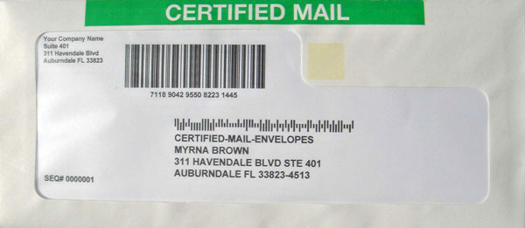
Tracking 104(e) Requests
  Information request letters should be sent via certified mail, priority mail, or air courier; request a return receipt so EPA can confirm that the letter was received.
  104(e) responses can be tracked using a database like Excel that can be set up to allow for real-time status information.

Slide 9

104(e) Request Follow-up
  Identity of recipients
  Delivery status
  Delivered
  Refused
  Undeliverable
  Response status
  No response
  Partial response
  Complete response

Slide 10
104(e) Request Follow-up (cont’d)
Review responses received to identify missing information or items that need clarification.
Send a follow up information letter to request missing information or clarify responses provided.
Be prepared to assist parties with routine questions.
Develop scripts to help answer basic questions.
Create a form for routine requests such as extension of the response due date.

Slide 11

104(e) Request Follow-up (cont’d)
Be prepared to deal with unsophisticated parties and their fears
Create user-friendly fact sheets and information updates
Streamline the process, if possible
Create abbreviated or
simplified requests where
appropriate

Slide 12
Information Request Follow-up
  Once the due date for response has expired and the responses have been reviewed, the PRP search manager should coordinate with an attorney on appropriate follow-up actions. These may include:
  Following up 104(e) letters to unresponsive PRPs
  Issuing administrative orders to compel compliance
  Initiating judicial action asking a court to compel compliance
  Sending 104(e) letters to additional persons based on analyzing the 104(e) responses

Slide 13
Analyzing Responses
  Analyzing responses is among the most important elements of the PRP search. Responses to information requests should be analyzed for:
  Information that links a party to the site
  Information establishing liability
  Information that establishes a PRP’s financial viability
  Leads that may provide the Region with additional information about a particular PRP, other parties, or site characteristics

Slide 14

Sensitivity/Confidentiality
  Files obtained from PRPs may be subject to CBI claim.
  Information that EPA requests may also be subject to a claim of privilege, the most common privileges being attorney work product, attorney-client, and deliberative process.

Slide 15
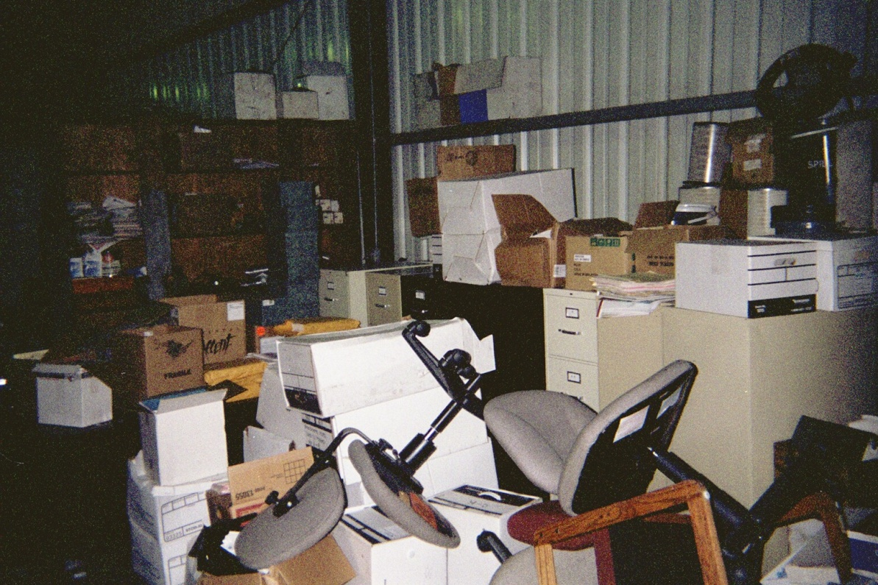
Site Records
  Try to visit the site as early as possible
  Have proper legal authority/access
  Look through filing cabinets, archive-type boxes, desk drawers, ledgers, etc.
  Be prepared to deal with a mess
  Investigate and plan for Health and Safety issues.

Slide 16

Visit the Site
  Safety considerations
  Slip, trip, and fall
  Contaminated records
  Structural issues

Slide 17
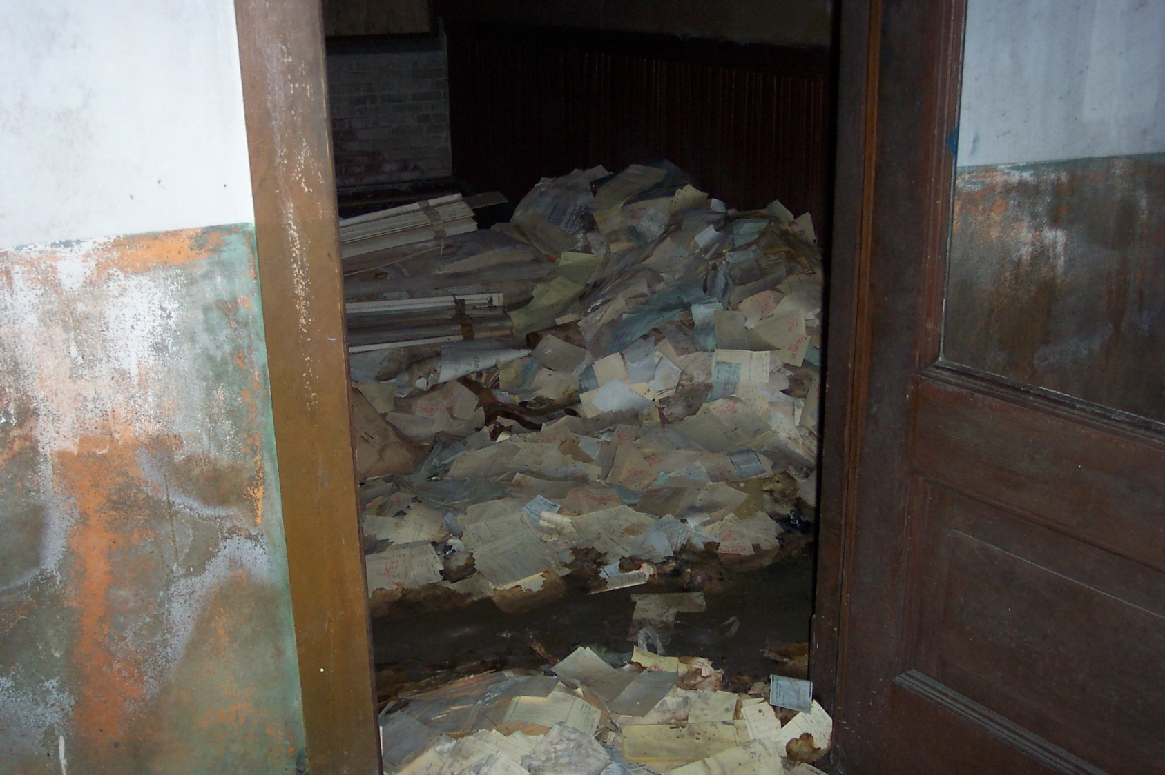
Visit the Site (cont’d)
Real records from a site in Region 1. You may need to make special arrangements to deal with situations like this.

Slide 18

Visit the Site (cont’d)

Slide 19
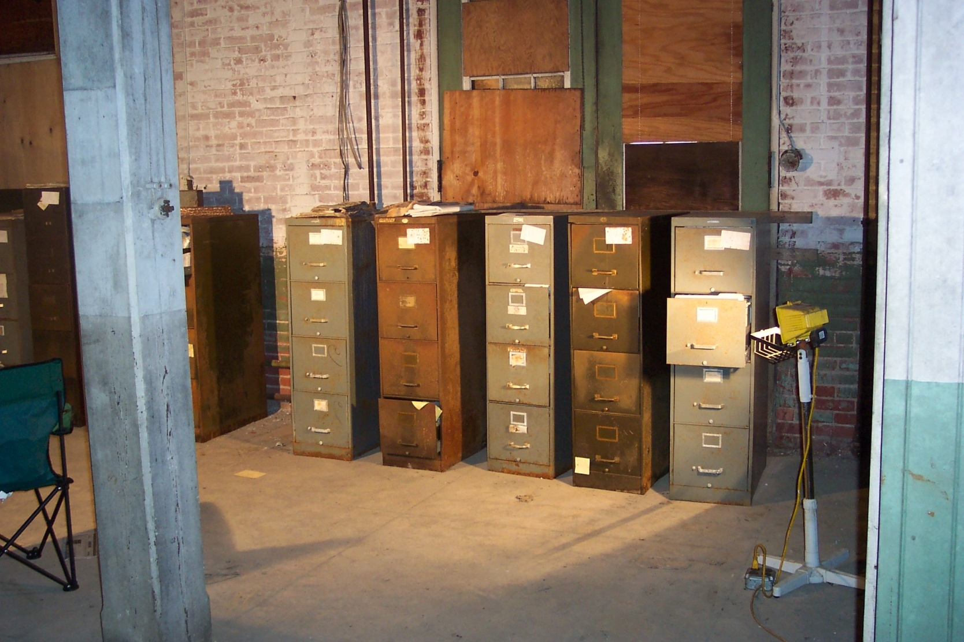
Visit the Site (cont’d)

Slide 20

Site Access
In order for EPA and It’s contractors to go on a site, written access must be granted by all owners of the property

Slide 21

Steps in Obtaining Site Access
Identify and determine the specific parcels
  Tax Assessor description
  Registry of Deeds book and page
  Physical address
  Owner(s) of Record

Slide 22
Access Request
Send request letter and agreement template via certified mail or hand delivery
Send to all owners of record or their agents
Give a specific time period to respond (usually 10-14 days).
Provide SASE for return of signed agreement

Slide 23
Contents of Access Agreement
The Agreement should describe EPA’s statutory authority and what activities EPA plans to conduct at the Site.
It should include a timeframe for access that will allow EPA enough time to complete work at the site, but access should not be open ended.

Slide 24

Contents of Access Agreement (Cont’d)
Offer the Site owner or their representatives to be present whenever EPA is at the Site
Offer to provide split samples to be analyzed by the owner at their own expense

Slide 25
Site Owner(s)
It is often helpful to contact the Site owner before sending a request for access. This provides the owner with notification that the agreement is coming and gives them an opportunity to ask questions.
More likely to get cooperation.

Slide 26
Uncooperative Site Owner(s)
First request not answered
  Send Follow –up request via certified mail
  Attempt hand delivery if possible
  CI or Process Server to secure signature in person
  Document all attempts to contact owner such as phone calls, e-mails, and letters

Slide 27

Uncooperative Site Owner(s) (Cont’d)
If all other attempts are unsuccessful EPA can petition the court to get a warrant for access.
This alternative is time consuming and should only be used as a last resort.

Slide 28
References
Information Requests – 104(e) Question Categories
http://www2.epa.gov/enforcement/superfund-information-request-letters
Transmittal of Guidance on Issuing CERCLA Section 104(e)(2) Information Requests to Federal Agencies at Privately-owned Superfund Sites
http://www2.epa.gov/enforcement/guidance-issuing-superfund-104e2-information-requests-federal-agencies-privately-owned
Transmittal of Sample Documents for More Effective Communication in CERCLA Section 104(e)(2) Information Requests
http://www2.epa.gov/enforcement/guidance-sample-documents-effective-communication-under-cercla-section-104e
Transmittal of Model Consent Decree for CERCLA Section 104(e) Information Request Enforcement Actions
http://www2.epa.gov/enforcement/model-cercla-section-104e-information-request-enforcement-actions-consent-decree

Slide 29
References (Cont’d)
Transmittal of Guidance on Use and Enforcement of CERCLA Information Requests and Administrative Subpoenas
http://www2.epa.gov/enforcement/guidance-use-and-enforcement-cercla-information-requests-and-administrative-subpoenas
PRP Search Manual Section 3.1.5 (“Special Planning Considerations”)
http://www2.epa.gov/enforcement/report-prp-search-manual-2009-edition-2011-addendum
Releasing Information to Potentially Responsible Parties at CERCLA Sites
http://www2.epa.gov/enforcement/guidance-releasing-information-prps-cercla-sites
Releasing Identities of PRPs in Response to FOIA Requests
http://www2.epa.gov/enforcement/guidance-releasing-prp-identities-foia-responses
EPA Regulations Governing Business Confidentiality Claims
(40 C.F.R. § 2.201-2.215; http://www.access.gpo.gov/nara/cfr/waisidx_01/40cfr2_01.html)

