Slide 1
Compiling PRP Data
and
Organizing Records
Session 7
Martha Bosworth
U.S. EPA Region 1

Slide 2

Introduction
  Types of documents
  Compiling data
  Organizing records

Slide 3

Types of PRP Documents
Hazardous waste manifests
Floating manifests
Pick-up notices
Invoices
Business records
Bank statements
Customer lists

Slide 4
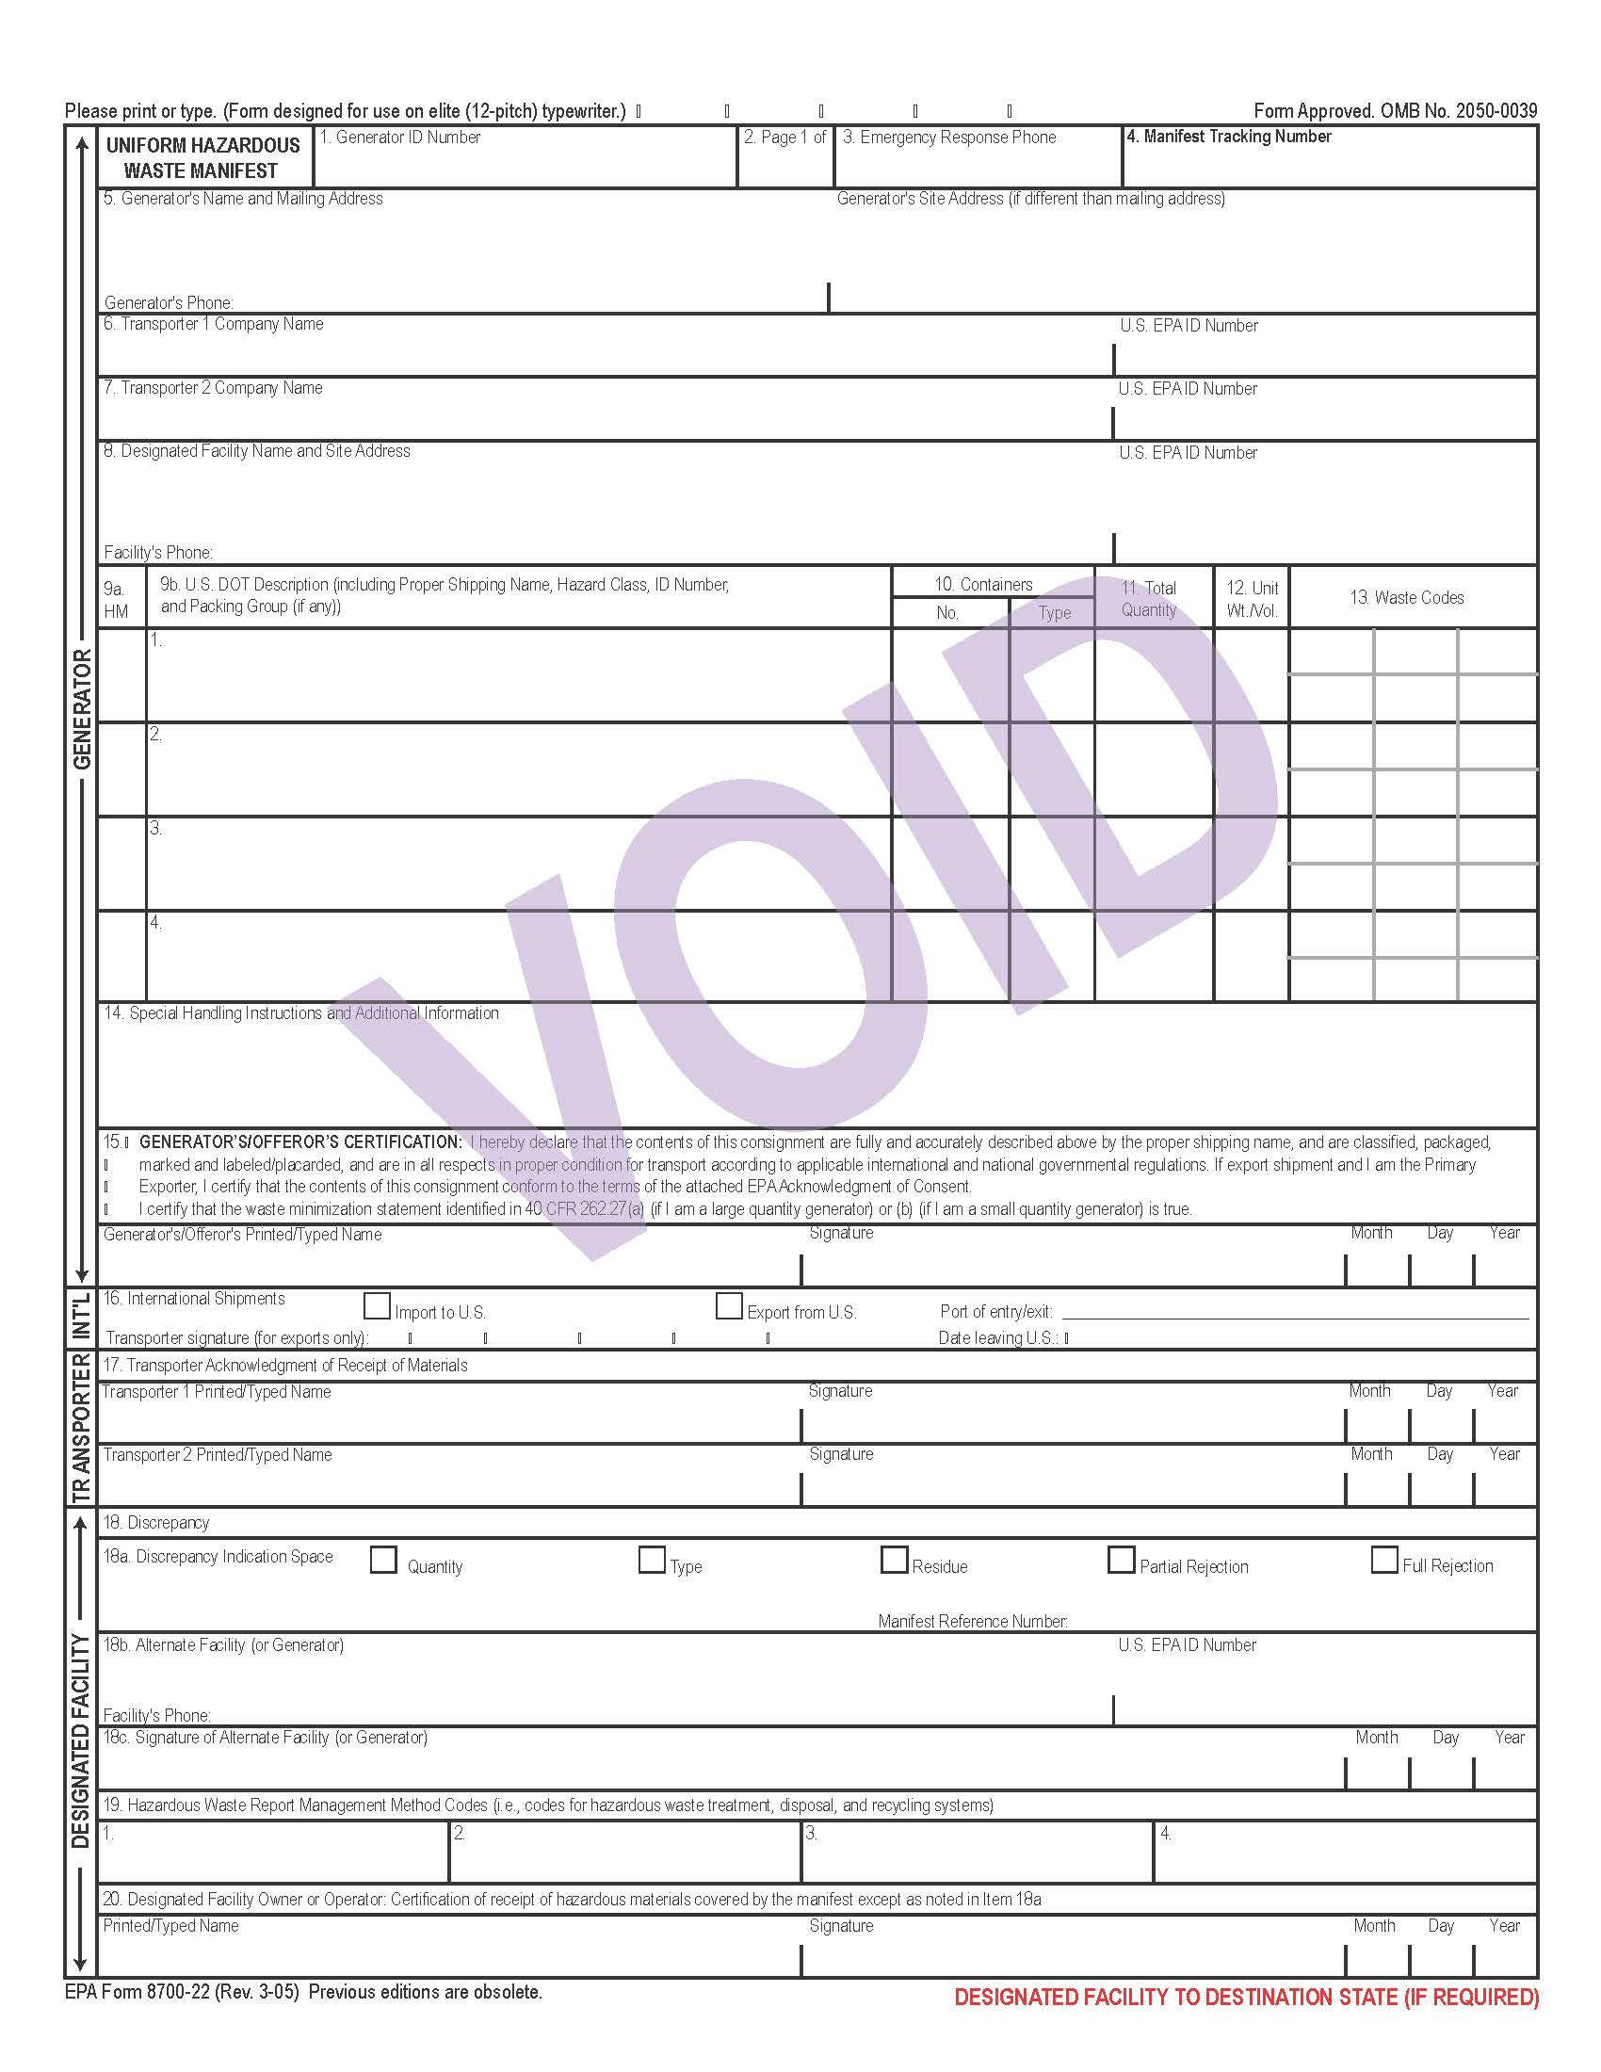

Slide 5

Compiling Data
Needed: a system to compile, track, and manipulate the information gathered
Spreadsheets
Database
Contractor products and support

Slide 6
Database Considerations
Nature and complexity of the information
Types of summaries and reports needed
Waste types to be tracked (how many?)
Database users
Resource requirements for development and maintenance
Contractor support needs and availability

Slide 7

Database Considerations (cont’d)
Expected term of use
Hardware and software compatibility
Ease of transition

Slide 8
Volumetric Data
Compile waste-in information:
Names and addresses of PRPs
Types and volumes of hazardous substances contributed
Dates of shipments
Transporter names
Evidence types
Other information to support assumptions

Slide 9

Volumetric Data (cont’d)
Create volumetric ranking:
Ranks PRPs in order by volume
Expresses each party’s contribution as a percentage of total volume of hazardous material at the site
Helps facilitate settlements

Slide 10
Financial Data
Compile PRP financial information:
Names and addresses of companies
Name changes, mergers, acquisitions
Dates of important financial transactions
Ability to Pay (ATP)

Slide 11

What is a Record? and Organizing Records
Recorded information, in any format, that is:
Created in the course of business,
Received for action, or
Needed to document EPA activities.
www.epa.gov/records/whatis/
Know your regional records requirements.
Know the Superfund records management requirements.

Slide 12
Managing Your Documents
Request electronic format
Hard copies take up space
Ensure CBI and PII are protected
Consider database to track/manage records
Get documents to Record Center ASAP
Working files can be organized to fit your style

Slide 13
Site Record Organization
Choose the best method of organizing documents by considering the following factors:
Types of information needed from the documents
Volume of documents
Regional file structure
Capabilities of the organizer
Ease of document retrieval
Long-term tracking needs and capabilities
Potential document security issues
Unique site-specific needs
Nature and number of potential users
Time required to organize documents

Slide 14
References
PRP Search Manual Section 3.8 (“Compile Waste-In Information”)
http://www2.epa.gov/enforcement/report-prp-search-manual-2009-edition-2011-addendum
PRP Search Manual Section 3.8.2 (“Waste-In Lists and Volumetric Rankings”)
http://www2.epa.gov/enforcement/report-prp-search-manual-2009-edition-2011-addendum
Final Guidance on Preparing Waste-in Lists and Volumetric Rankings for Release to Potentially Responsible Parties (PRPs) Under CERCLA ("Waste-in Guidance”) http://www.epa.gov/compliance/resources/policies/cleanup/superfund/guide-volumet-rpt.pdf

