Slide 1
Ozone NAAQS Overview
Intergovernmental Associations
November 6, 2014

Slide 2
Overview
  Provide a general overview of the National Ambient Air Quality Standard (NAAQS) review process;
  Describe the review of the current standard and where we are in the process;
  Update you on the status of the proposed implementation rule for the current (2008) ozone standards; and
  Discuss current air quality and monitoring information.

Slide 3
Overview of NAAQS Development
Tom Powers
Senior Policy Advisor
Office of Air and Radiation

Slide 4
Overarching Questions for NAAQS Reviews
Does the currently available scientific evidence and exposure/risk information support or call into question the adequacy of the protection afforded by the current primary and/or secondary standard(s)?
  Primary NAAQS protect public health, including the health of at-risk populations and lifestages, with an adequate margin of safety
  Secondary NAAQS protect public welfare from any known or anticipated adverse effects
What alternative standards, if any, are supported by the currently available scientific evidence and exposure/risk-based information, and are appropriate for consideration?

Slide 5
NAAQS Review Process
Workshop on science-policy issues
Integrated Review Plan (IRP): timeline and key policy-relevant issues and scientific questions
Peer-reviewed scientific studies
Integrated Science Assessment (ISA): evaluation and synthesis of most policy-relevant studies
Clean Air Scientific Advisory Committee (CASAC) review
Risk/Exposure Assessment (REA): quantitative assessment, as warranted, focused on key results, observations, and uncertainties
Public comment
Policy Assessment (PA): staff analysis of policy options based on integration and interpretation of information in the ISA and REA
EPA
proposed decisions on standards
Agency decision making and draft proposal notice
Interagency review
Public hearings and comments on proposal
Agency decision making and draft final notice
Interagency review
EPA final decisions on standards
5

Slide 6
Rulemaking
Notice of Proposed Rulemaking
  Propose decisions based on consideration of staff conclusions in Policy Assessment and CASAC advice/recommendations.
  Solicit public comment on proposed elements of NAAQS and alternatives, as appropriate.
  Public review process:
  Public comment period, including public hearing(s), follows publication of proposed rule.
Final Rulemaking Notice
  Final decisions take into account public comments on proposed rule.
  Response-to-Comments document prepared/finalized in parallel with final rule.
NAAQS rulemaking may be accompanied by or combined with rulemaking changes to monitoring, Air Quality Index (AQI), and/or implementation regulations.

Slide 7
NAAQS Reviews: Status Update
(as of November 2014)
 | Ozone | Lead | Primary NO₂ | Primary SO₂ | Secondary NO₂ and SO₂ | PM | CO
Last Review Completed (final rule signed) | Mar 2008 | Oct 2008 | Jan 2010 | Jun 2010 | Mar 2012 | Dec 2012 | Aug 2011
Recent or Upcoming Major Milestone(s)¹ | August 2014 Final REAs Final PA Dec 1, 2014 ² Proposed rule Oct 1, 2015 ² Final rule | May 2014 Final PA 2014 Proposed rule | June 2014 Final IRP Fall 2014 2nd Draft ISA | October 2014 Final IRP | Fall 2014 Draft IRP | Kickoff workshop for next review targeted for early 2015 | TBD³
Additional information regarding current and previous NAAQS reviews is available at: http://www.epa.gov/ttn/naaqs/
¹ IRP – Integrated Review Plan; ISA – Integrated Science Assessment; REA – Risk and Exposure Assessment; PA – Policy Assessment
² Bold and underlined dates indicate court-ordered or settlement agreement deadlines
³ TBD = to be determined

Slide 8
Ozone NAAQS Update
Erika Sasser
Director, Health and Environmental Impacts Division
OAQPS

Slide 9
Ozone NAAQS History
March 27, 2008: EPA revises primary and secondary ozone standards from 84 ppb to 75 ppb (8-hour average).
            In 2013, the D.C. Circuit remanded the secondary standard to the Agency for reconsideration because the Agency did not determine what level of protection was requisite to protect the public welfare.
January 19, 2010: EPA proposes to reconsider the 2008 ozone standard.
            Change primary standard to within range of 60 to 70 ppb.
            Change secondary standard to cumulative seasonal standard within range of 7 to 15 ppm-hours.
September 2, 2011: President asks EPA to withdraw its January 2010 proposal and focus on upcoming 5 year review.
June 19, 2013: Coalition of public health and environmental groups, including Sierra Club and ALA, file lawsuit in federal court asking court to set deadline for action on overdue ozone standards.
April 29, 2014: U.S. District Court in San Francisco orders EPA to issue new ozone standards (proposal by Dec.1, 2014, final by Oct.1, 2015).

Slide 10
NAAQS Statutory Requirements (CAA §109)
Primary (health-based) standards “shall be ambient air quality standards . . .which in the judgment of the Administrator “ are “requisite” to protect public health, including at-risk groups, with an “adequate margin of safety”
Secondary (welfare-based) standards: “…specify a level of air quality the attainment and maintenance of which” in the “judgment of the Administrator” is “requisite to protect the public welfare from any known or anticipated adverse effects”
An independent scientific review committee, the Clean Air Scientific Advisory Committee (CASAC), shall review the science and standards and “shall recommend to the Administrator any new . . . standards and revisions of existing . . . standards as may be appropriate”
In setting standards:
  EPA is required to engage in “reasoned decision making” to translate scientific uncertainty into standards.
  EPA may not consider cost. Rather, cost is considered in developing control strategies to meet the standards.

Slide 11
NAAQS Review Process
Workshop on science-policy issues
Integrated Review Plan (IRP): timeline and key policy-relevant issues and scientific questions
Peer-reviewed scientific studies
Integrated Science Assessment (ISA): evaluation and synthesis of most policy-relevant studies
Clean Air Scientific Advisory Committee (CASAC) review
Risk/Exposure Assessment (REA): quantitative assessment, as warranted, focused on key results, observations, and uncertainties
Public comment
Policy Assessment (PA): staff analysis of policy options based on integration and interpretation of information in the ISA and REA
EPA
proposed decisions on standards
Agency decision making and draft proposal notice
Interagency review
Public hearings and comments on proposal
Agency decision making and draft final notice
Interagency review
EPA final decisions on standards
11

Slide 12
Science-Based Conclusions on Primary Standard
CASAC concluded and EPA staff assessment agrees that:
Current evidence and exposure/risk information call into question the adequacy of public health protection provided by current standard (75 ppb).
It is appropriate to consider revising the standard to provide greater public health protection, with range of levels from 60-70 ppb, in conjunction with the current indicator (O₃), averaging time (8-hour), and form (3-year average of 4th highest daily maximum).
There is no bright line between 60-70 ppb. Lower levels provide incrementally greater health protection and reductions in risk, but there is more uncertainty.
A level set at the higher end of range provides additional protection beyond 75 ppb and reduces the number of days ozone levels will exceed the lower end of the range.
CASAC advice:
  “A level of 70 ppb provides little margin of safety for the protection of public health, particularly for sensitive subpopulations” and there is “substantial scientific evidence” that adverse effects occur at 70 ppb.
  Set the level of the standard lower than 70 ppb within a range down to 60 ppb, “taking into account your judgement regarding margin of safety.”

Slide 13
Science-Based Conclusions on Secondary Standard
Ozone has detrimental effects on vegetation, including both crops and trees.
  Plant response to ozone depends on both the level and cumulative nature of exposures over the growing season. Specialized metrics (such as W126 cumulative weighted index) are used to measure potential impacts on vegetation.
  There is little research available to inform judgments on the degree to which an impact should be considered adverse to public welfare.
CASAC concluded and EPA staff assessment agrees that current welfare effects evidence and exposure/risk information call into question the adequacy of public welfare protection by current 75 ppb standard. It is appropriate to consider revision of form, level and averaging time to increase public welfare protection.
CASAC advised that the secondary standard should be in terms of a cumulative, seasonal form (i.e., W126) set at a level within the range of an annual average of 7 to 15 ppm-hrs.
EPA staff concluded it is appropriate to consider a cumulative W126 standard from 7 to 17 ppm-hrs, averaged over 3 years.

Slide 14
NAAQS Review Process
Workshop on science-policy issues
Integrated Review Plan (IRP): timeline and key policy-relevant issues and scientific questions
Peer-reviewed scientific studies
Integrated Science Assessment (ISA): evaluation and synthesis of most policy-relevant studies
Clean Air Scientific Advisory Committee (CASAC) review
Risk/Exposure Assessment (REA): quantitative assessment, as warranted, focused on key results, observations, and uncertainties
Public comment
Policy Assessment (PA): staff analysis of policy options based on integration and interpretation of information in the ISA and REA
EPA
proposed decisions on standards
Agency decision making and draft proposal notice
Interagency review
Public hearings and comments on proposal
Agency decision making and draft final notice
Interagency review
EPA final decisions on standards
14

Slide 15
Ozone Proposal Coming Up …
The Administrator’s task is to decide whether the current ozone standards are adequate to protect public health and public welfare.
We have developed our proposal after a robust review of the science (1000+ new studies) and after considering CASAC’s recommendations and those of our staff scientists, bearing in mind the need to translate scientific uncertainty into regulatory standards.
We are on track to meet a court-ordered deadline for Notice of Proposed Rulemaking of December 1, 2014.
Interagency review is underway.
A public comment period and public hearings will follow the proposal.
Court-ordered deadline for final rule is October 1, 2015.

Slide 16
If NAAQS is Revised: Implementation
Key implementation milestones if NAAQS is revised
  Area designations promulgated by October 2017
  State infrastructure plans (i-SIPs) due October 2018
  Attainment plans and demonstrations due 2020/2021 (only Moderate and above areas)
  Attainment dates 2020-2037 (primary standard only)
Implementation-related proposals for next ozone NAAQS
  Intend to include proposals on limited grandfathering of PSD permit applications and process deadlines for ozone-related exceptional events demonstrations with NAAQS review proposal.
  Also, intend to seek early input on implementation-related issues and challenges.

Slide 17
Proposed SIP Requirements Rule for the 2008 Ozone NAAQS
Scott Mathias
Associate Division Director
Air Quality Policy Division

Slide 18
Timeline
Proposal signed by Administrator May 29, 2013
Published in the Federal Register June 6, 2013 (78 FR 34178)
  Official title: “Implementation of the 2008 National Ambient Air Quality Standards for Ozone: State Implementation Plan Requirements”
Public comment period began June 6, 2013
  Comment period ended September 4, 2013
  54 comment letters received
  Docket number: EPA–HQ–OAR–2010–0885
Final rule package was entered into regulatory review at OMB on October 11, 2014.

Slide 19
Purposes of the Rulemaking
Provide states with clear rules and guidance for planning to meet the 2008 ozone NAAQS in designated nonattainment areas.
Translate ozone implementation requirements contained in the 1990 Clean Air Act Amendments (written specific for the 1-hour standard) into meaningful requirements for the 2008 8-hour ozone NAAQS.
Revoke the 1997 8-hour ozone NAAQS in order to provide additional flexibility to areas still working to complete the control requirements of that NAAQS.

Slide 20
Related Rulemakings
Nonattainment area classification scheme and initial area designations were completed in separate rulemakings.
Classifications and Attainment Deadlines
  Signed by Administrator April 30, 2012.
  Published in Federal Register May 21, 2012 (77 FR 30160).
  Established end-of-calendar-year attainment dates.
  Rulemaking also revoked the 1997 NAAQS for purposes of transportation conformity to alleviate dual planning requirements.
Initial Area Designations
  46 initial nonattainment areas.
  Signed by Administrator April 30, 2012 (May 31, 2012 for Chicago).
  Published in Federal Register May 21, 2012 (77 FR 30088)
  Effective date July 20, 2012.

Slide 21
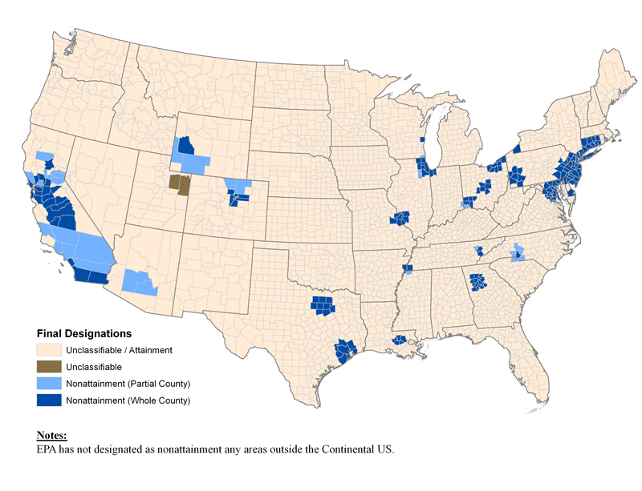
Area Designations for 2008 Ozone NAAQS
(Effective July 20, 2012)
Sheboygan
Greater Connecticut
Upper Green River Basin
Jamestown
Tuscan Buttes
Allentown
Dukes MA
Sacramento
Chico
Nevada Co
Chicago
Cleveland
Reading
New York
Columbus
Lancaster
Philadelphia
San Francisco
Calaveras Co
Uintah Basin
Pittsburgh
Seaford DE
Mariposa Co
Denver
Washington DC/VA
Baltimore
San Joaquin Valley
St. Louis
Cincinnati
San Luis Obispo
E. Kern Co
Ventura Co
West Mojave
Knoxville
Charlotte
LA-South Coast
Morongo Tribe
Pechanga Tribe
Riverside Co
Memphis
San Diego
Imperial Co
Phoenix
Atlanta
Dallas
Houston
Baton Rouge

Slide 22
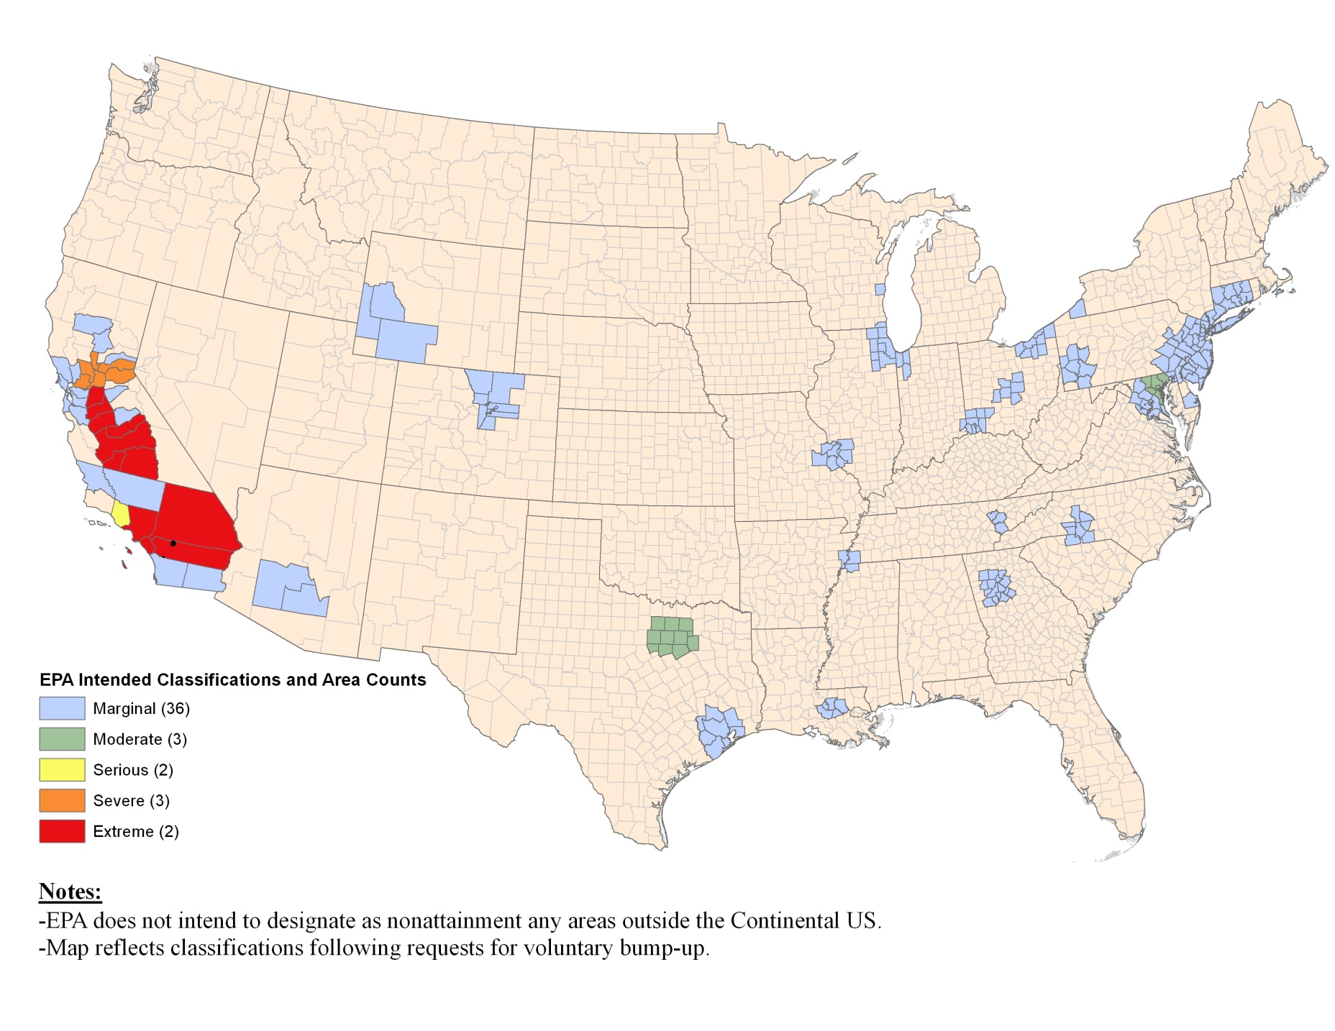
Nonattainment Areas for 2008 Ozone NAAQS by Classification
(Effective July 20, 2012)
X
Morongo Tribe
Pechanga Tribe
EPA Final Classifications and Area Counts
EPA did not designate as nonattainment any areas outside the Continental U.S.
Map reflects classifications following requests for voluntary “bump-ups”

Slide 23
Preamble Outline of Ozone SIP Requirements Rule
Nonattainment area SIP deadlines
Modeling and attainment demonstration requirements
RFP requirements
RACM and RACT requirements
Vehicle I/M
Transportation conformity
General conformity
Contingency measures
NSR
Emission inventory and emission statement requirements
Ambient monitoring requirements
1-year attainment deadline extensions
Transport of ground-level ozone for rural nonattainment areas, multi-state nonattainment areas, and international transport
Section 182(f) NOx provisions
Emissions benefits of energy efficiency/renewable energy programs, land use planning, and travel efficiency
Multi-pollutant approach to developing SIPs
Tribes
Ozone Transport Regions (OTRs)
Additional requirements related to enforcement and compliance
Emergency episodes
Clean Data Policy
Assistance
Section 185 penalty fee provision for Severe and Extreme areas

Slide 24
CAA Nonattainment Area SIP Submittal Deadlines
The CAA establishes maximum statutory deadlines for submitting various SIP elements (from effective date of designation).
  Emission inventories and emission statement SIPs are due from states with Marginal and higher areas no later than 2 years (July 20, 2014).
  Reasonably Available Control Technology (RACT) SIPs are due from Moderate and higher areas, and all states no later than the Ozone Transport Region (OTR), within 2 years (July 20, 2014).
  15% Reasonable Further Progress (6-year RFP) SIPs are due no later than 3 years (July 20, 2015).
  Attainment plan with Reasonably Available Control Measures (RACM) and attainment demonstration SIPs due no later than 3 years (Moderate) or 4 years (Serious and higher) (July 20, 2015 or July 20, 2016)
  RFP SIPs showing an average of 3% reductions in emissions per year after the initial 6-year period are due no later than 4 years for Serious and higher areas (July 20, 2016).
  §185 penalty fee program SIPs are due for Severe and Extreme areas no later than 10 years (July 20, 2022).
If EPA determines that an area attains before SIPs are due, the planning SIP submittal requirements can be suspended for as long as the area attains (Clean Data Policy).

Slide 25
Proposed SIP Due Dates
For Moderate and higher areas, EPA proposed two options for deadlines for certain nonattainment area SIPs (RACT SIPs, attainment demonstration SIPs, and RFP SIPs):
  Option 1: staggered timeframes provided by statute.
  Option 2: states may choose to submit SIPs by the staggered deadlines provided by statute, or they may submit a combined submittal of emissions inventory, emission statement, RACT, RFP, attainment plan (RACM), and attainment demonstration SIPs within 30 months (November 20, 2014).
Serious and above areas would have the CAA maximum of 4 years to develop attainment demonstration (RACM) and RFP SIPs.
  This proposal, while consistent with the CAA, differs from the 3-year deadline provided for the 1997 ozone NAAQS.

Slide 26
Modeling Attainment Demonstrations
Serious and above areas (and multi-state Moderate areas) are required to use photochemical grid modeling to demonstrate attainment.
    Moderate areas are required to use photochemical modeling as well. However, an alternative approach can be used for Moderate areas if the Administrator determines that it is at least as effective.
Model results are used to determine the amount of VOC and/or NOx emission reductions that are needed for the area to attain the NAAQS.
EPA has specified approved models and has issued guidance.
  http://www.epa.gov/scram001/guidance/guide/final-03-pm-rh-guidance.pdf.
The preamble directs the reader to the current modeling guidance.
  The guidance addresses how high electricity demand days (HEDDs) can be characterized.
  EPA is in the process of updating the guidance for the 2008 ozone NAAQS.

Slide 27
Reasonable Further Progress (RFP) Proposals
Proposed to specify 2011 as the base year for RFP.
  Corresponds to periodic emissions inventory submission year closest to the 2012 designation year.
Proposed to allow areas to also choose 2012 (the designation year), or another year prior to 2011.
  Allows areas that began early reductions in 2008 when standard was set to take credit for those reductions in RFP plans.
  In exchange for flexibility, areas need to provide additional 3% per year RFP for each year that is prior to 2011 (e.g., a 2008 baseline year would require 15% + 3x3% = 24% reduction for years 2009 through 2017).
  Consistent with approach taken for the 1997 ozone NAAQS.
Proposed to allow credit for reductions from sources within the same nonattainment area.
  We requested specific comment on a legal basis for crediting reductions from outside the nonattainment area toward RFP under CAA subpart 2.
Eliminate “pre-1990 adjustments” calculation for RFP.
  Proposed that states no longer need to calculate and deduct emissions related to pre-1990 motor vehicle, RVP, and vehicle I/M program corrections (per CAA section 182(b)(1)(D)).
  The calculations are tedious and the emissions are de minimis.

Slide 28
Options for 15% VOC Reduction for First 6 Years (RFP)
15% reduction plan is required for Moderate and above areas and all areas of the OTR.
  CAA requires these reductions to be VOC-only, even though NOx reductions are now known in some cases to be more effective at reducing ozone.
  Additional VOC reductions could be difficult to achieve for some long-standing nonattainment areas.
  Serious and higher are also required to achieve an average of 3%/year reduction in emissions (can be VOC, NOx or a combination) starting 6 years after designation until the attainment date.
Proposed flexibility would allow states to substitute NOx for VOC in an area’s 15% SIP
  1997 ozone rules allowed this approach for areas that previously had an approved 15% RFP plan for the 1-hour NAAQS.

Slide 29
Vehicle Requirements
Vehicle inspection and maintenance programs are required in all Moderate and above ozone nonattainment areas with a population over 200,000 (or over 100,000 for OTR).
  There are currently no new I/M areas for the 2008 ozone NAAQS.
In this proposal, EPA solicited comment on aligning the I/M SIP deadline with the attainment SIP deadline.
EPA also notes ability to approve alternative mobile source controls getting equivalent reductions in place of I/M.
Lastly, EPA identifies implementation flexibilities for I/M programs made possible by predominance of onboard diagnostics (OBD) in current fleet.

Slide 30
Revoking 1997 NAAQS and “Anti-backsliding” Requirements
Proposed revocation of the 1997 ozone NAAQS effective on the date the final SIP Requirements Rule is published in the Federal Register.
Areas still designated nonattainment for the 1997 NAAQS on that date will be subject to anti-backsliding requirements.
  Will also apply to areas that were nonattainment for the 1-hour NAAQS when it was revoked on June 15, 2005.
Proposed that any interstate transport control requirements associated with a prior NAAQS would continue to apply.

Slide 31
Anti-backsliding Summary
Proposed requirements reflect D.C. Circuit decisions on anti-backsliding and would codify approaches we use now in implementing 1-hour NAAQS anti-backsliding.
  All prior control requirements and associated triggering mechanisms would be retained.
  Would include section 185 fee programs, contingency measures for failure to make RFP or attain, and nonattainment NSR provisions associated with the prior classification.
Proposed two valid paths for completing fulfillment of anti-backsliding requirements:
  Redesignation to attainment for the 2008 ozone NAAQS, or
  EPA approval of a ‘redesignation substitute’ for the revoked NAAQS.

Slide 32
When/How Anti-backsliding Applies
Designation for 2008 NAAQS | Designation for previous NAAQS (at time of revocation) | Proposed NSR/PSD obligations | Other proposed transition obligations
1. Attainment | Attainment/ Maintenance | PSD remains in effect | - Area remains subject to existing section 175A maintenance plan for the previous ozone NAAQS and requirements already in the SIP, subject to revision consistent with sections 110(l) and 193 - Section 175A maintenance plan satisfies maintenance requirement under section 110(a)(1).
2. Attainment | Nonattainment for 1997 ozone NAAQS only; or nonattainment for 1997 and 1-hour NAAQS | Nonattainment NSR in effect until revocation of the 1997 ozone NAAQS; then PSD applies | - Area remains subject to measures to meet nonattainment requirements already in its adopted SIP. Removable only with a section 110(l) demonstration and a section 193 demonstration if applicable. - Two alternatives to address section 110(a)(1) maintenance provision: a) Area’s approved PSD SIP satisfies section 110(a)(1) maintenance provision, or b) additional maintenance showing under section 110(a)(1)
3. Nonattainment | Attainment/ Maintenance | Nonattainment NSR applies based on 2008 ozone NAAQS classification | - Area remains subject to existing section 175A maintenance plan for the previous NAAQS and requirements already in the SIP, subject to revision consistent with sections 110(l) and 193
4. Nonattainment | Nonattainment for 1997 ozone NAAQS only; or nonattainment for 1997 and 1-hour ozone NAAQS | Nonattainment NSR applies based on highest applicable classification | - Area subject to all applicable anti-backsliding requirements for 1-hr and/or 1997 NAAQS - Anti-backsliding obligations lifted when the area either a) is redesignated to attainment for the 2008 ozone NAAQS, or b) the EPA approves a redesignation substitute for the revoked 1-hour or 1997 NAAQS - EPA solicits comment on additional options for lifting anti-backsliding obligations.

Slide 33
Current Air Quality / Monitoring Information
Chet Wayland
Director, Air Quality Assessment Division

Slide 34
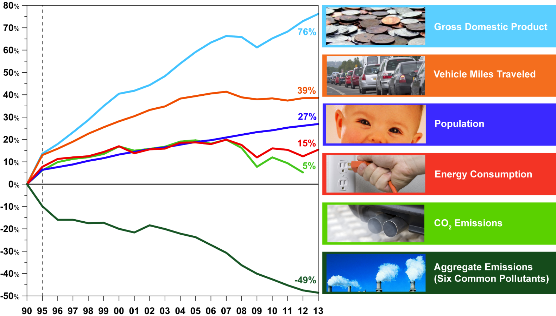
Environmental Progress Continues

Slide 35
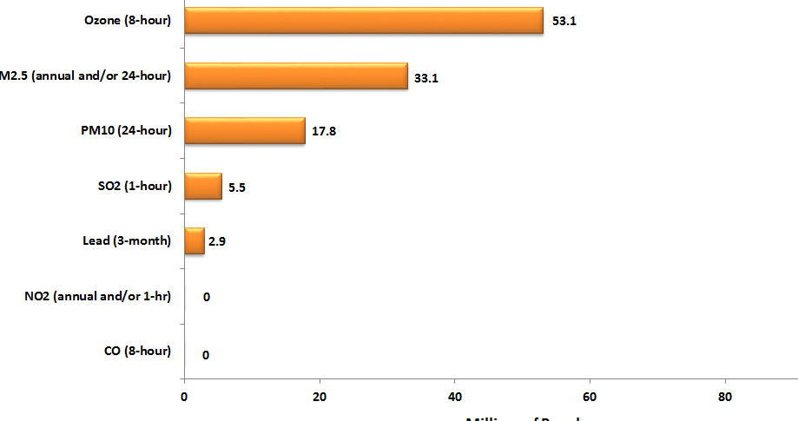
Air Quality Where People Live
Number of People Living in Counties with Air Quality Concentrations
above NAAQS in 2013

Slide 36
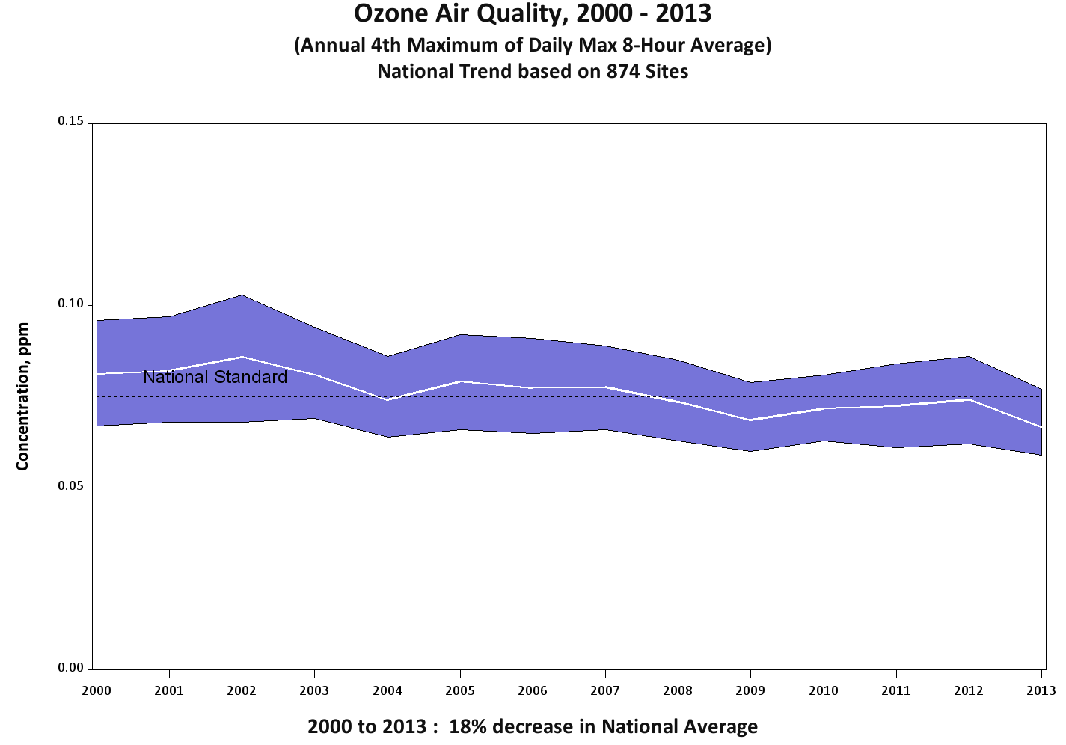
Nationwide Ozone Improvement
Ozone improvement seeing a slow march downward
Driven by meteorology
Since 2000: 18% decrease

Slide 37
Design Value Update: Ozone
Ozone DVs decreased by an average of 1.6 ppb from 2012 to 2013
68% of ozone monitors showed decreases in DVs, compared with only 17% showing increases
2008 8-hour O3 NAAQS (0.075 ppm)
  11 of 46 areas designated nonattainment for 2008 NAAQS are now meeting standard
  155 counties are violating NAAQS, down from 216 in 2012
  55 counties outside of nonattainment areas violated NAAQS in 2013, compared with 84 in 2012
1997 8-hour O3 NAAQS (0.08 ppm)
  11 of 113 areas originally designated nonattainment continue to violate standard, down from 15 violating areas in 2012
1-hour O3 NAAQS (0.12 ppm)
  3 areas continue to violate: LA South Coast, San Joaquin Valley, NYC
  Houston attained 1-hour ozone NAAQS for first time

Slide 38
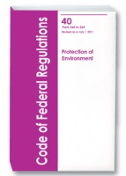
Overview of Most Recent Monitoring Proposal:
Revisions to Ambient Monitoring QA and Other Requirements
Proposes revisions to ambient air monitoring requirements for criteria pollutants to provide clarifications to existing requirements to reduce the compliance burden of monitoring agencies operating ambient networks.
  Clarifies the annual monitoring network plan public notice requirements
  Simplifies and reduces data reporting and certification requirements
  Reduces network design criteria for nonsource lead monitoring
  Reorganizes and clarifies quality assurance requirements for SLAMS and PSD
Published September 11, 2014 at 79 FR 54356-54395
Public comment period open for 60 days at Docket ID No. EPA-HQ-OAR-2013-0619 until November 10, 2014

