Slide 1
PERFORMING
TITLE SEARCHES
Session 5
Courtney Kudla
U.S. EPA Region 6

Slide 2

Why Conduct a Title Search?
Identify current and past owners/operators
Identify adjacent property owners

Slide 3
What Is the Definition of a Title Search?
An examination of public records to determine and confirm a property's legal ownership, and identify what claims are on the property.

Slide 4
Parts of a Title Deed
Document # (Book and Page, Reception #)
Type of document
Parties to transaction
Dates (execution, recording, notarized)
Habendum clause
Legal description

Slide 5
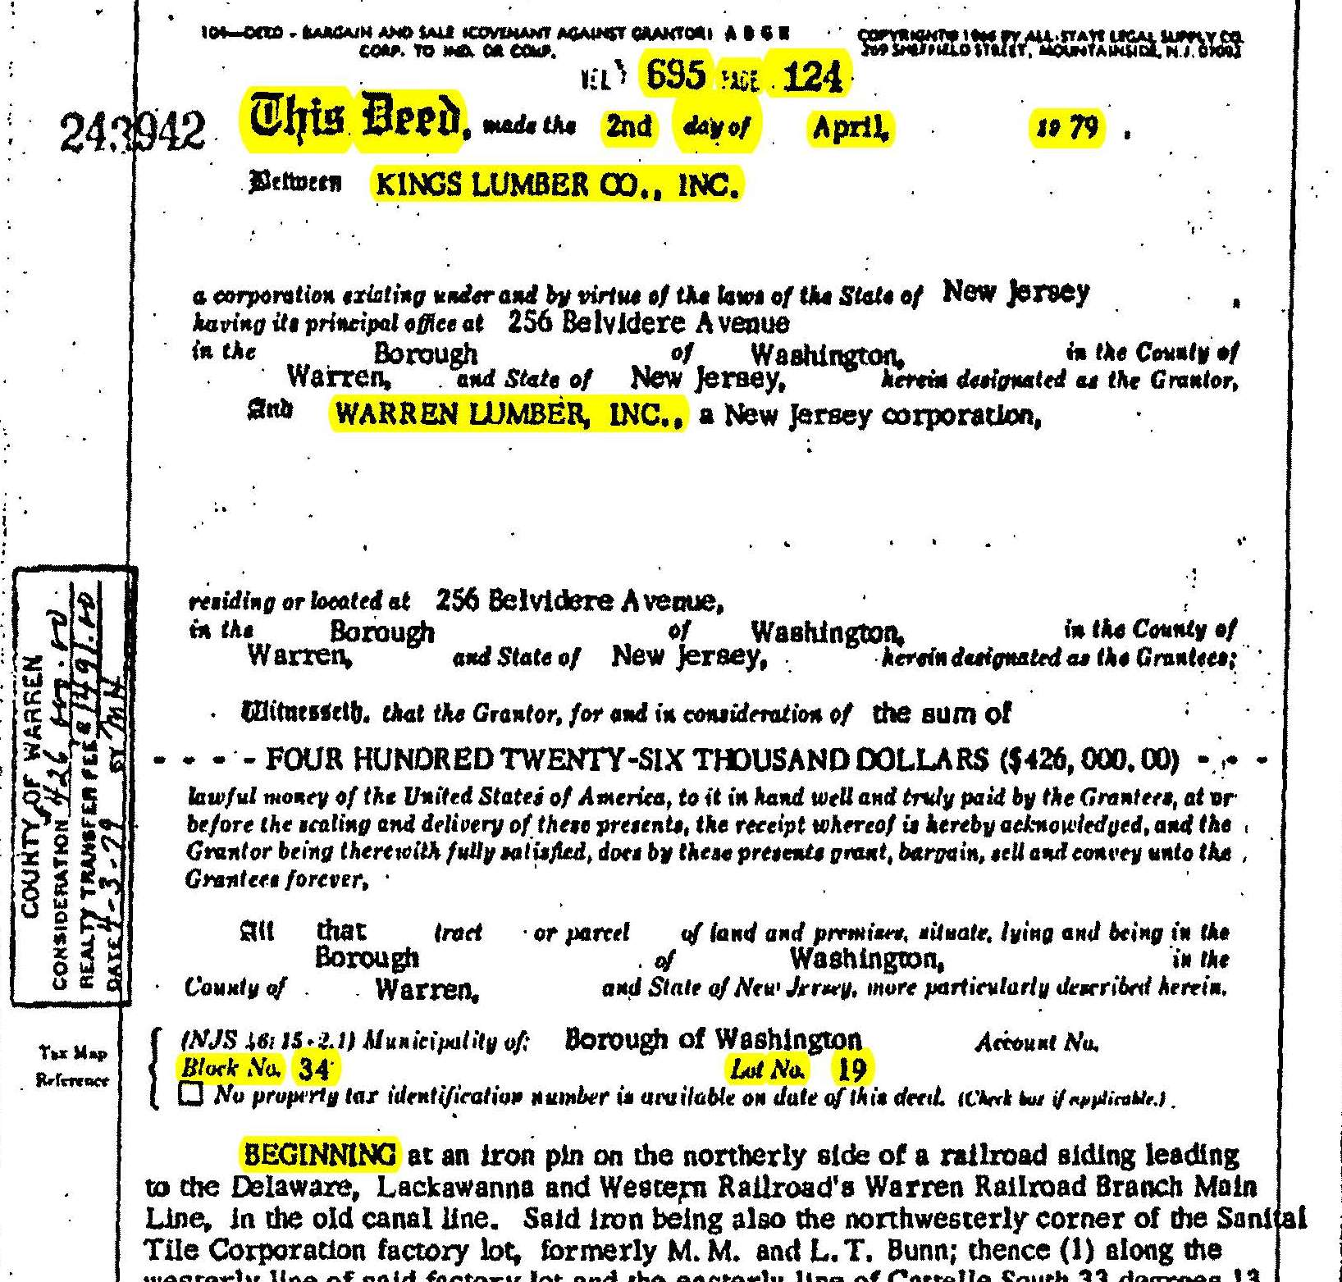

Slide 6
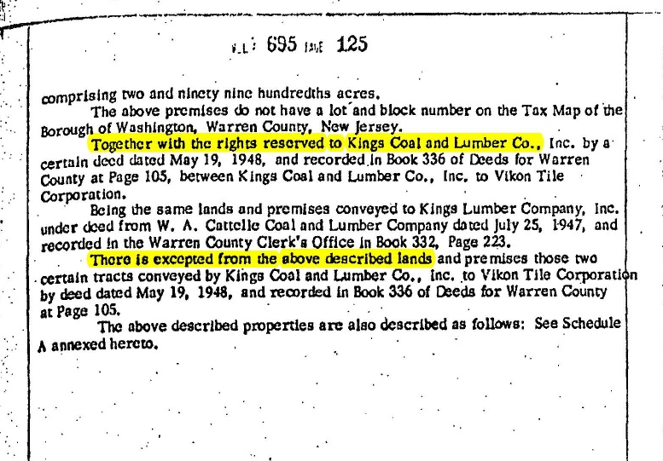

Slide 7
Types of Title Documents
Warranty Deeds
Quitclaim Deeds
Tax Deeds/Sheriff Deeds
Mortgages/Deeds of Trust
Leases
Property Plats
Administrator’s/Executor’s/ Trustee’s Deeds
Patents
Deeds of Reconveyance
Financing Statements
Judgments and Lis Pendens
Real Estate Contracts
Agreements
Mineral Leases
Oil and Gas Leases
Plat Maps of Subdivisions
Easements
Mining Claims

Slide 8
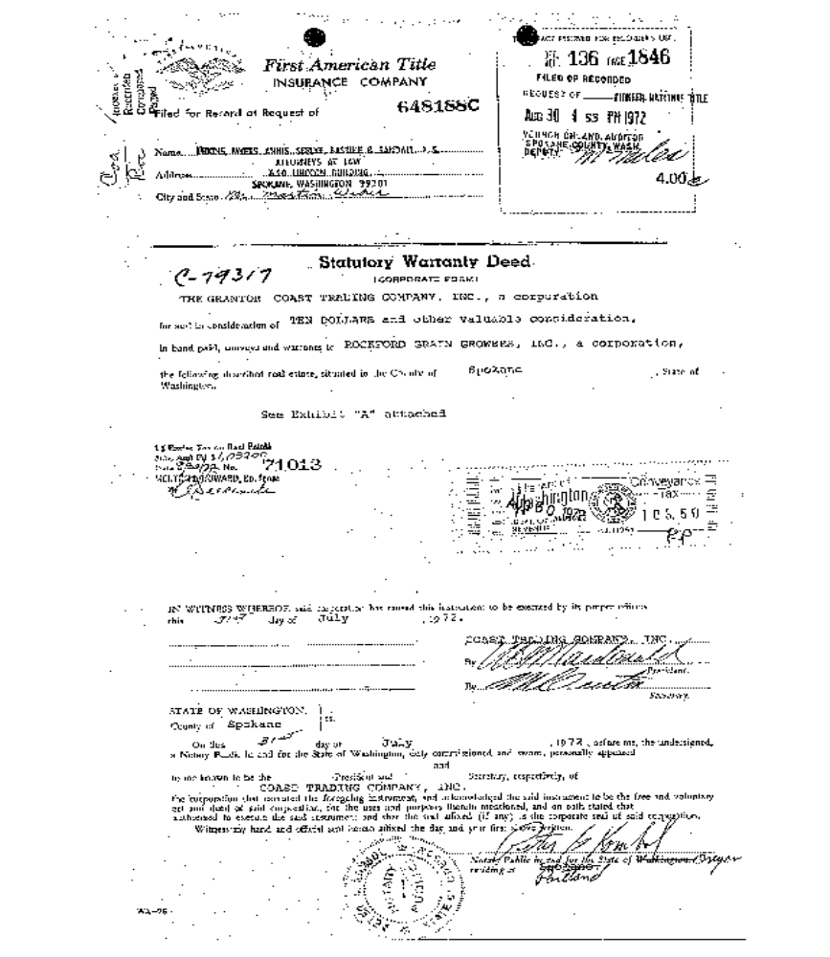
Warranty Deed
Seller warrants that he/she has clear title to the property.

Slide 9
Quitclaim Deed
Seller conveys whatever interest he/she has.
There may be other interest holders.

Slide 10
Legal Description
Describes what is being conveyed (sold).
Legal descriptions can be:
Metes and bounds
Reference to certain lot or lots in recorded plat
Fractions of sections (Public Land Survey System, PLSS)
Parcel number
Deed reference
Can be combination of above

Slide 11
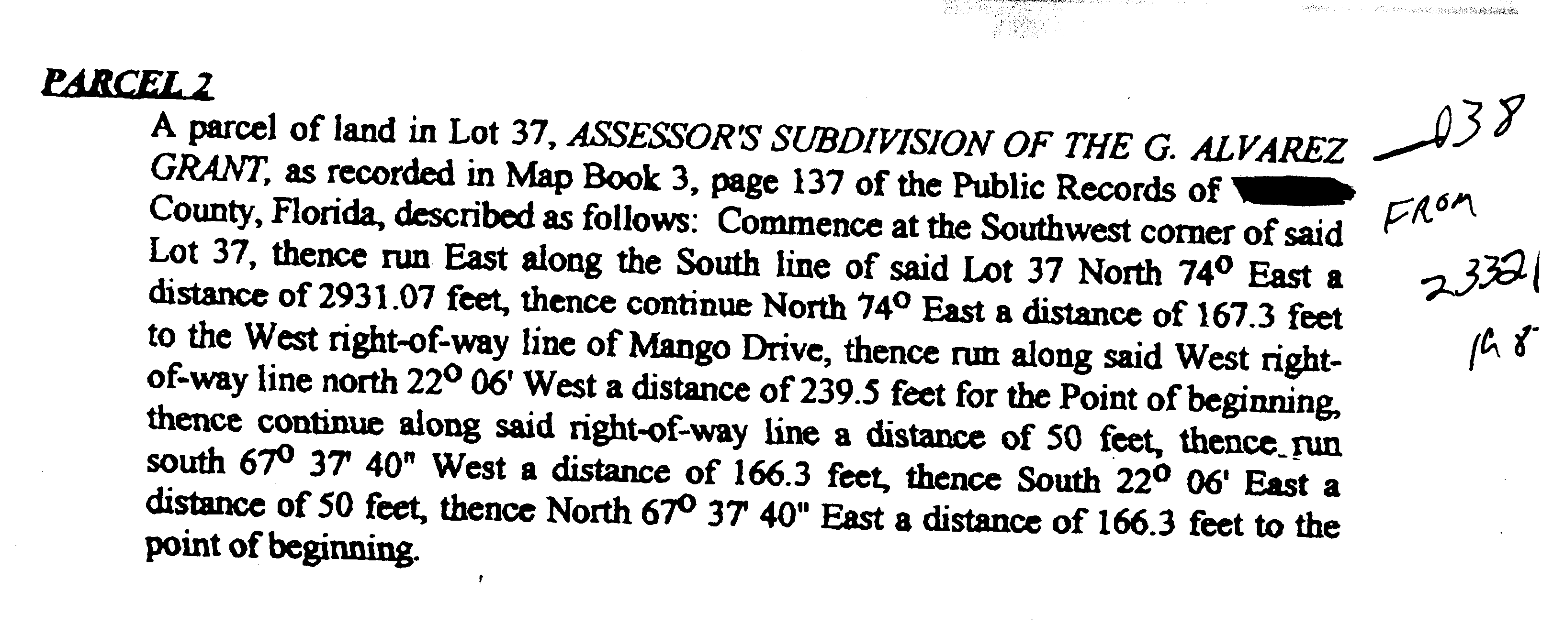
Example – Metes and Bounds

Slide 12
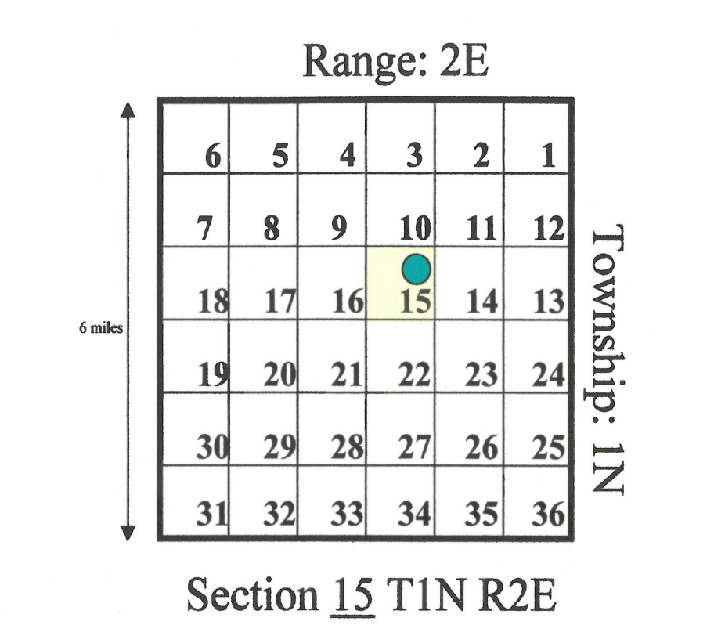
Public Land Survey System (PLSS):
Range and Township

Slide 13
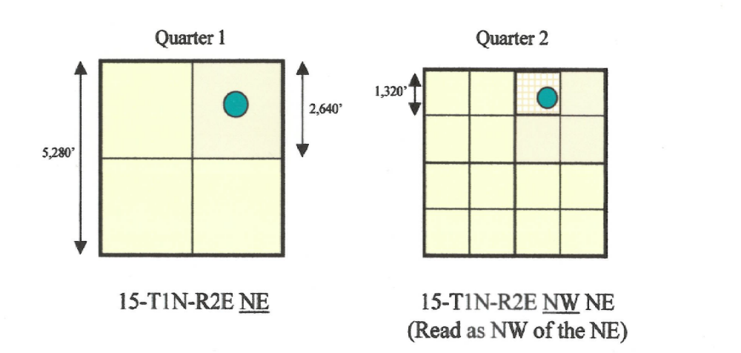
Public Land Survey System (PLSS):
Quarter 1 and Quarter 2

Slide 14
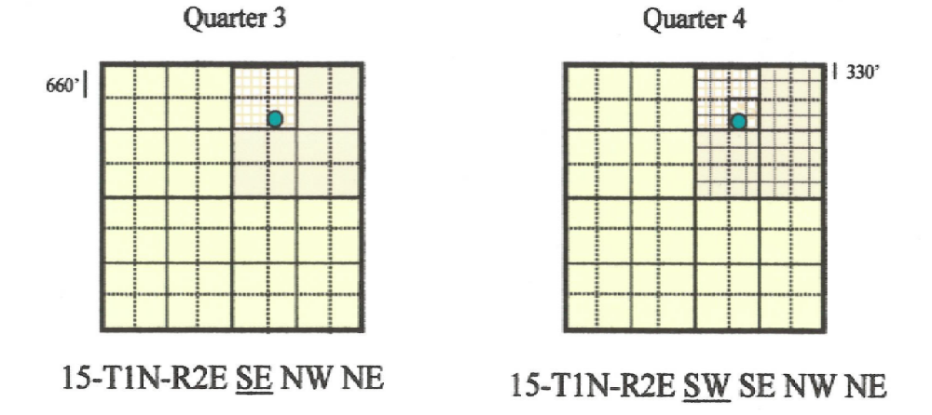
Public Land Survey System (PLSS):
Quarter 3 and Quarter 4

Slide 15
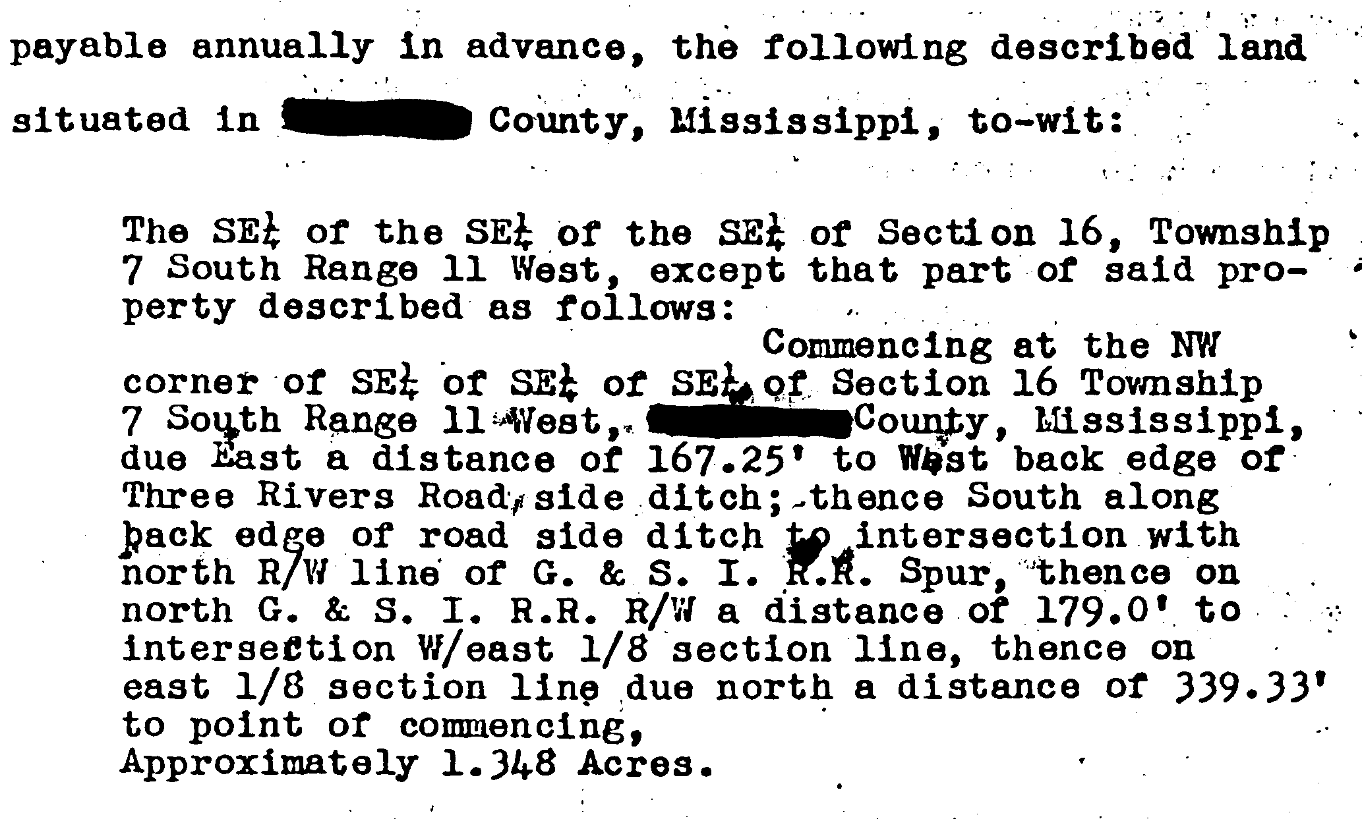
Example - Fractions of Sections
(Townships contain 36 Sections)

Slide 16

Chain of Title
C - D
B - C
A - B
The links of chain are transactions by which a parcel of land is conveyed from owner to owner.

Slide 17

Gaps in the Title chain
A - B
A - B
X - C
Break in chain of assignment (wild deed)
Irregularity in legal description
Failure to transfer property rights
Unrecorded inheritance-related docs

Slide 18

How to Conduct a Title Search
Gather available information from Site Assessment, OSC, and RPM:
  Location and county
  Address
  Owners

Slide 19
How Do You Begin a Title Search?
  Tax Assessor can provide a lot of information such as:
  Owner name
  Owner address
  Property location/address
  Parcel ID number
  Deed reference
  Good source for locating owner for initial access
  Information may not be updated as the title documents are filed.

Slide 20
Title Search
  Before you travel, you should obtain the following information about the Deed Record Room and Tax Assessor:
  Address
  Directions
  Hours
  Any special rules
  How to pay for copies
  Make sure your site is in that county

Slide 21

Purchasing Title Documents
  Bring cash -- at least $100, or more if you know from experience that you will need it.
  Copies cost from $ 0.25 to $5.00;
  Certified copies usually cost more.
  Purchase card checks, credit cards or travel voucher expense

Slide 22
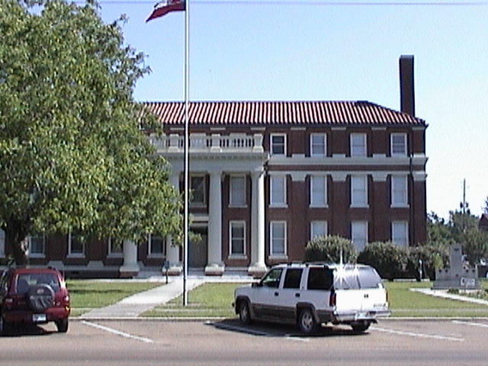
First Stop: Tax Assessor’s Office
May be in a different building from the Deed Room
Other possible names:
Property Appraiser
Real Property
Appraiser

Slide 23

Current Deed Reference
Obtain current deed reference starting with one or more of these:
    Owner name
    Property address
    Parcel ID number
    Location on tax map
At the Tax Assessor’s Office, you can get copies of:
  Tax map
  Property card, Assessor’s card

Slide 24
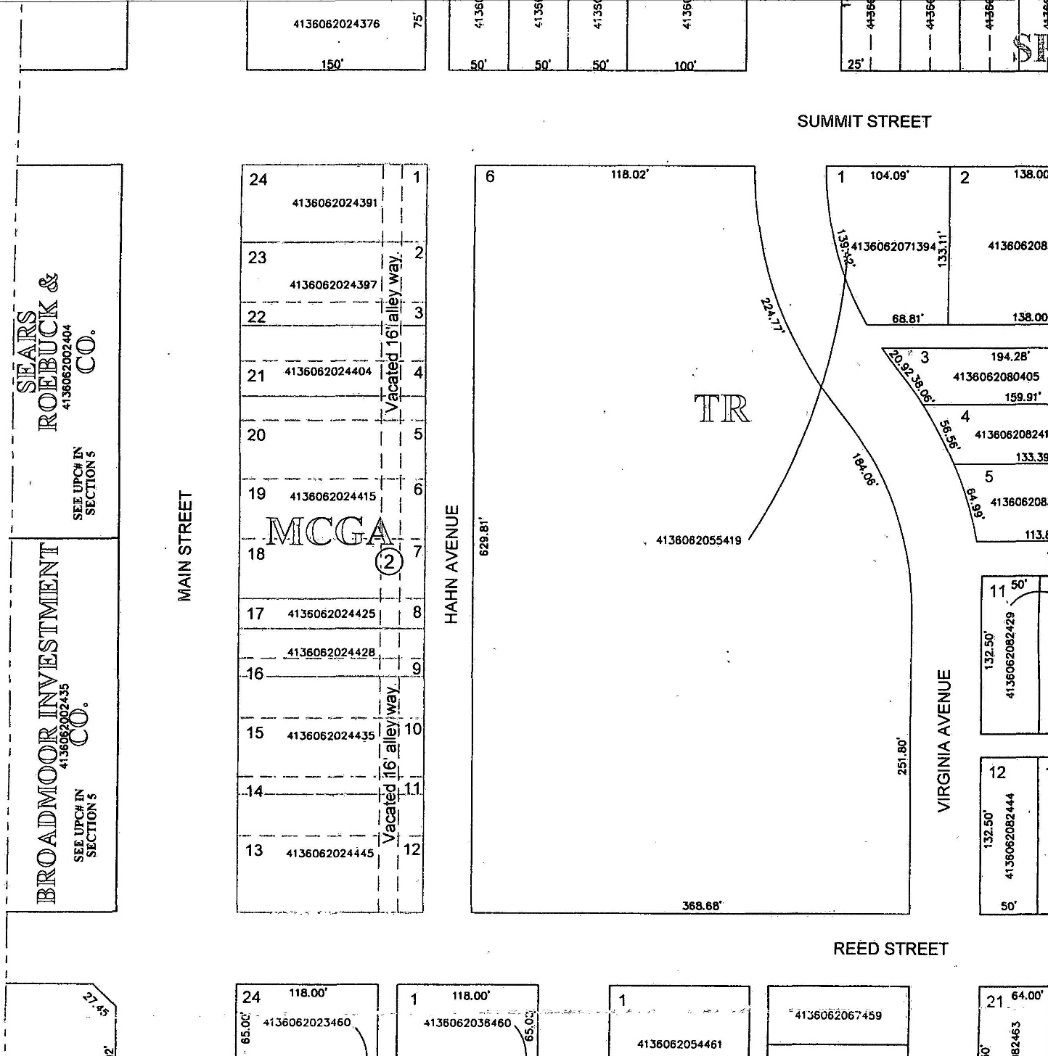
Tax Map

Slide 25
Adjacent Property
Obtain tax map and keep it for future reference
Use lot numbers to identify adjacent property
Consider conducting a title search on the adjacent property to:
Identify possible witnesses for interviews
Determine if properties were once one parcel

Slide 26
Property Card
Parcel number
Owner name
Mailing address
Property location or address
Acres
Valuation; improvements
Current deed reference – Book/Page/Date
Old photos, drawings of the structures
Previous deed references – Book/Page/Date
Sales history
Sales prices
Truncated legal description

Slide 27
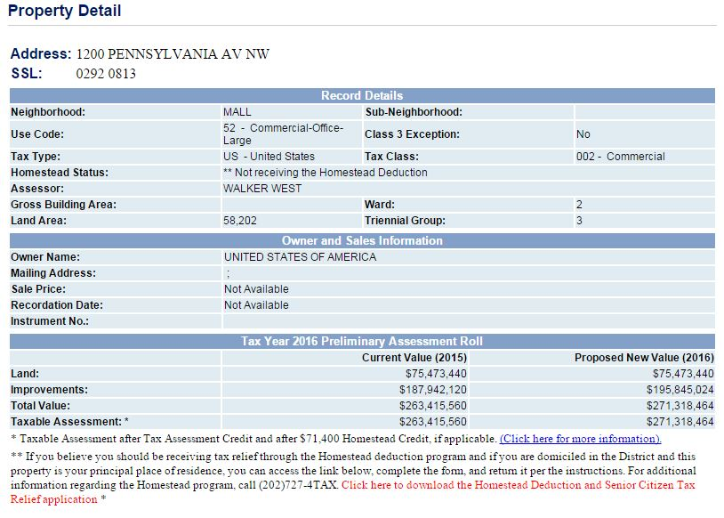
Property Card

Slide 28
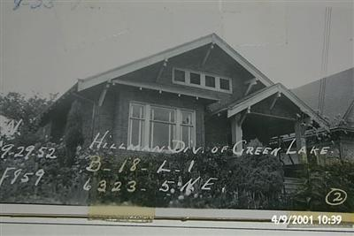
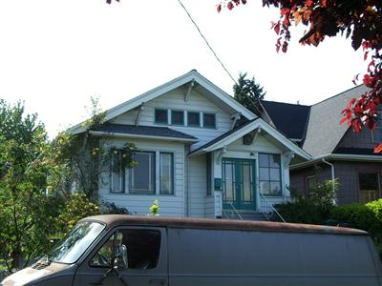
Historical Information Found on Property Record Cards
Tax Assessor’s Photo 2013
Tax Assessor’s Photo
1952

Slide 29

Delinquent Taxes
Determine delinquent tax status and amounts from tax collector or Tax Assessor.
Property may be about to be sold for taxes.
Find out local tax sale procedures.
If property is about to be sold, talk with team and possibly place a lien on the property ASAP.

Slide 30
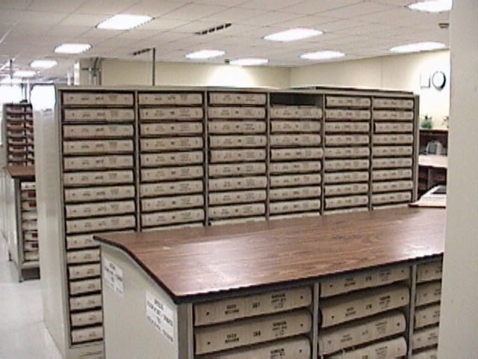
Next Stop: Deed Record Room
Other possible names for Deed Record Room:
Register of Deeds
Chancery
Clerk’s Office
Recorder’s Office

Slide 31
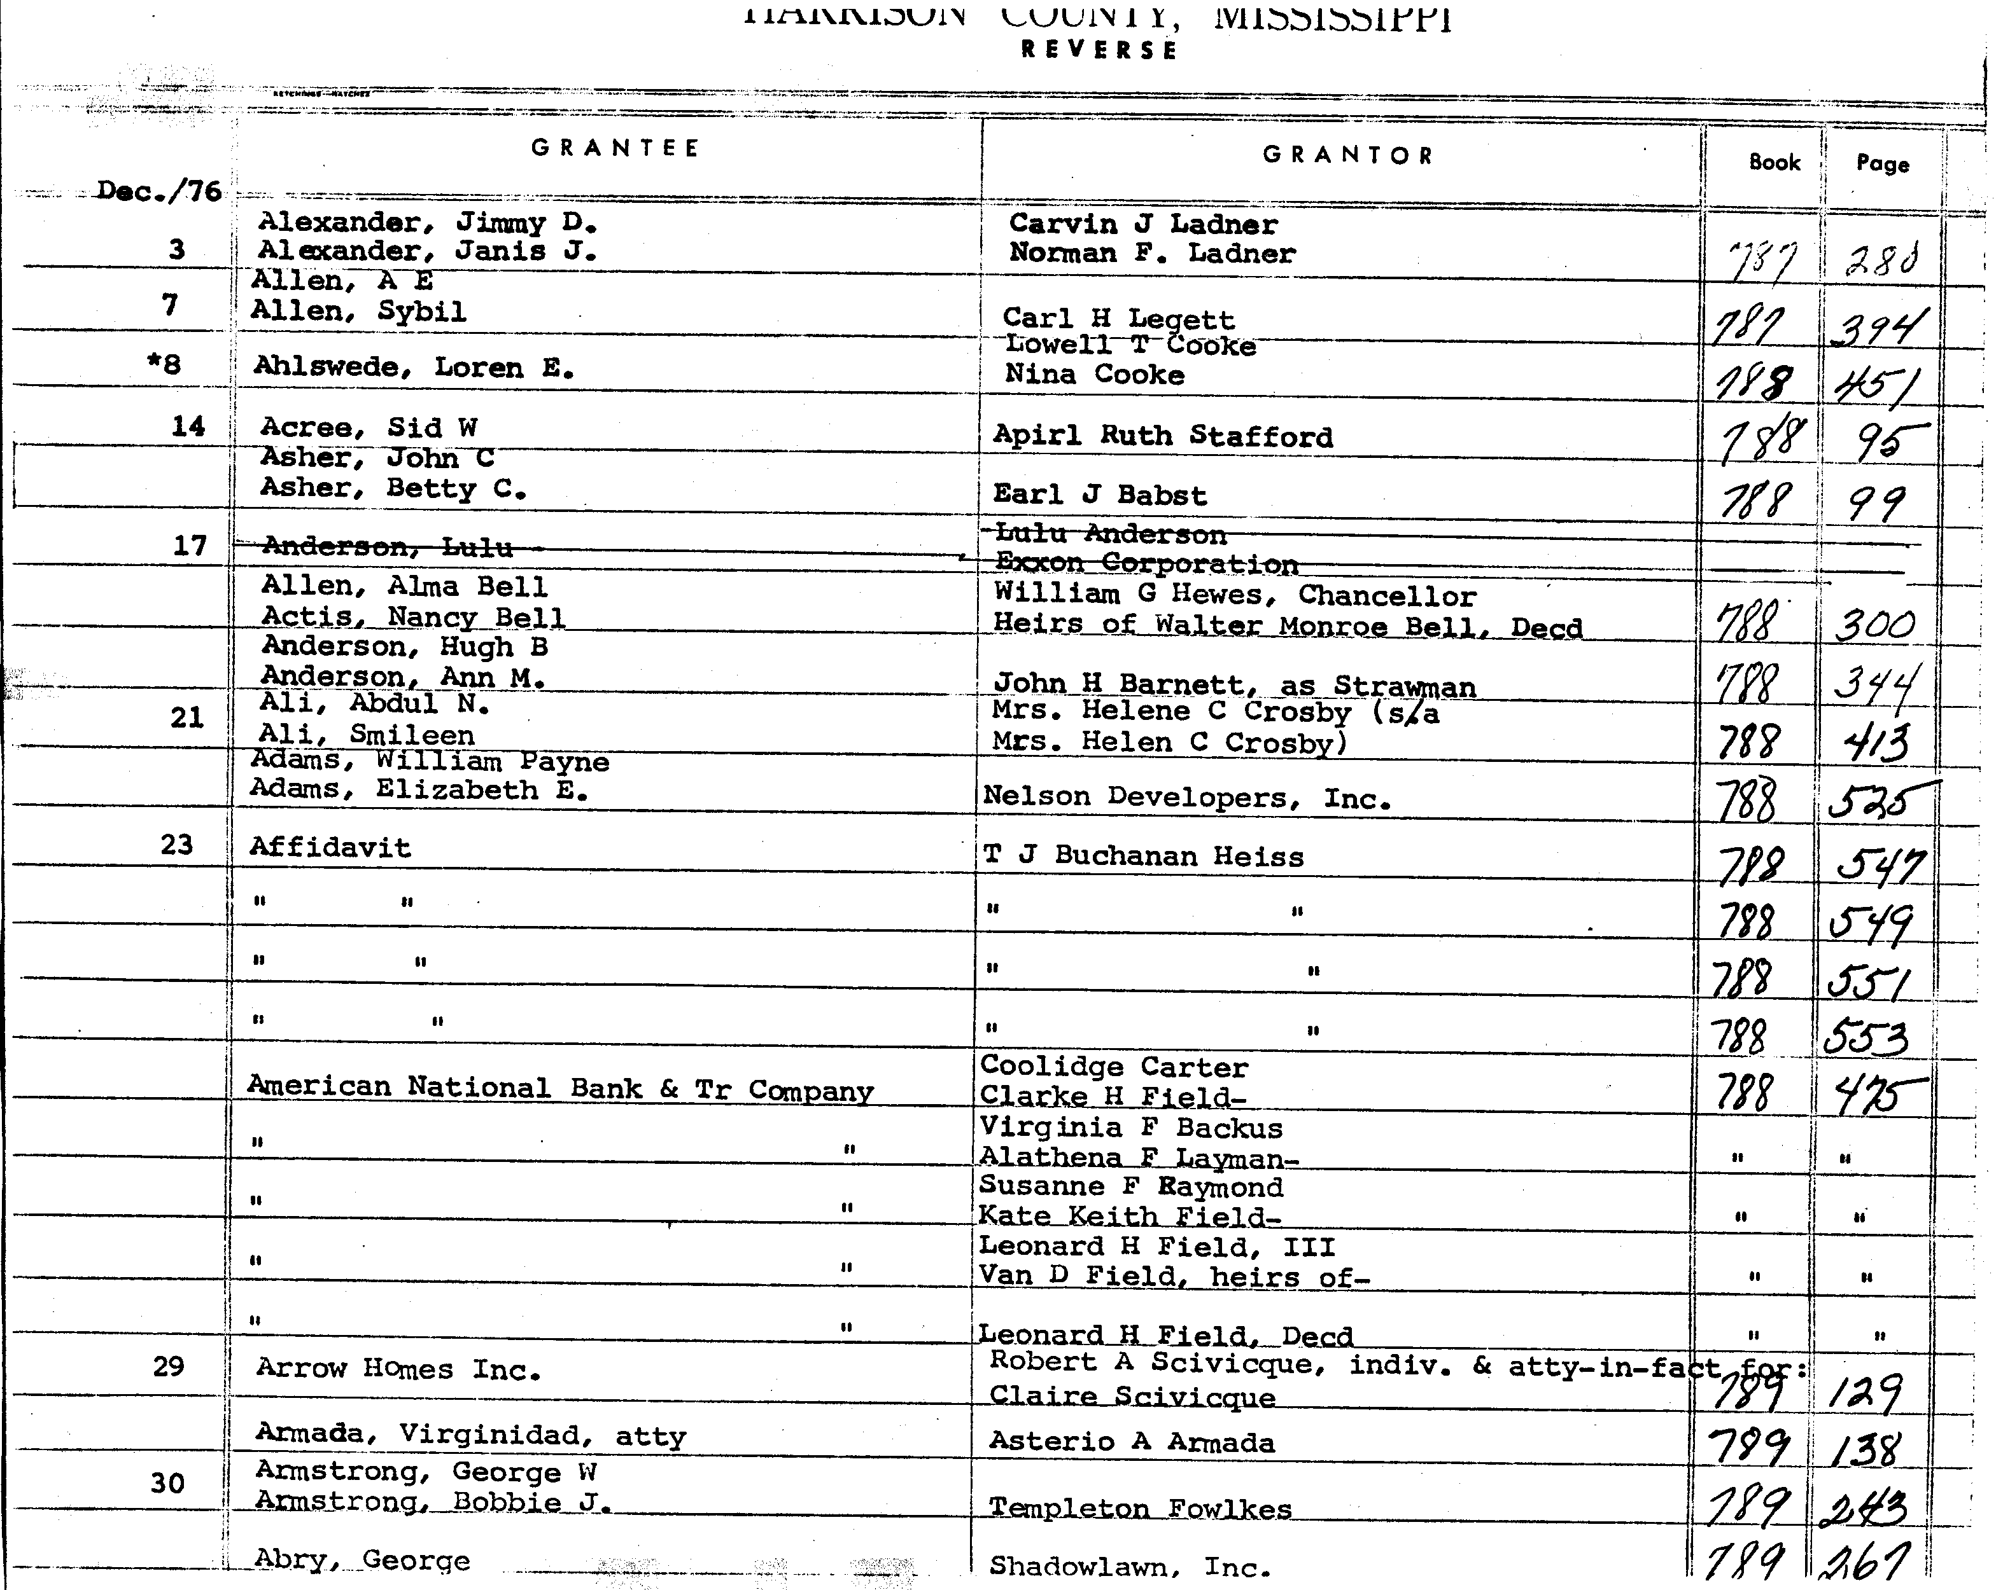
Index Books
Alphabetical
Chronological
Grantor and Grantee are usually indexed separately.

Slide 32
Search Forward
Then Search backward
Starting with the Tax Assessor’s current deed reference, search forward in the Grantee Index Book for the grantee listed on the deed reference to see if property has been sold since the Tax Assessor last updated their records.
Then search backward, using the Grantee Index Book for the grantor listed on the deed reference.

Slide 33

Search back / Where to Stop
How far back depends on site
  First industrial use
  Date developer acquired property from individuals
  First known release

Slide 34
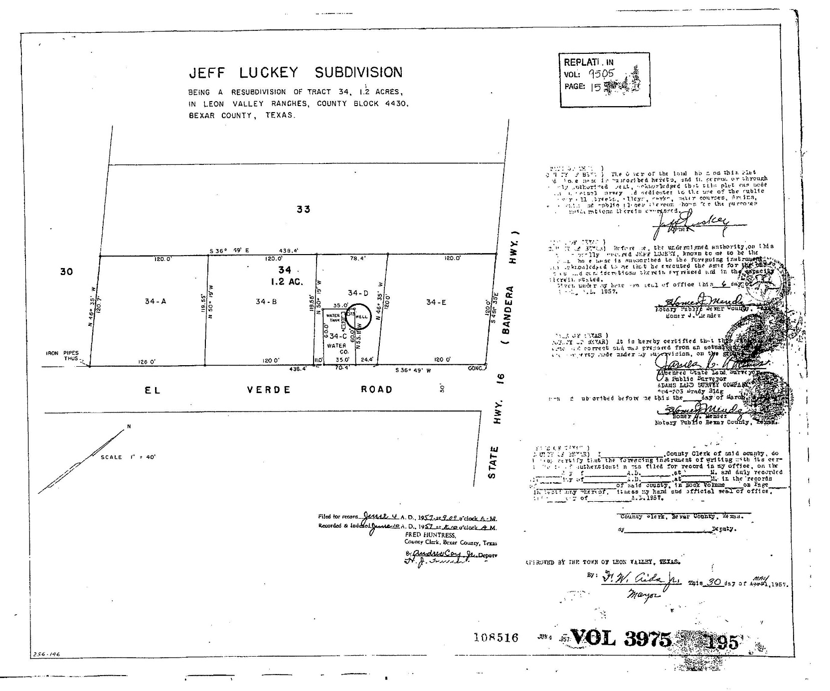
Plat Map

Slide 35
Other County Records Useful in
Determining PRP Viability
Assets:
  Other real property owned by PRP
Liabilities:
  Encumbrances such as mortgages, liens
Other county departments--building permits, violations

Slide 36
Encumbrances
Search Index
Grantor = Owner/Buyer
Grantee = Lender/Creditor
Have encumbrances been satisfied?
Include outstanding mortgages/liens in title search report

Slide 37
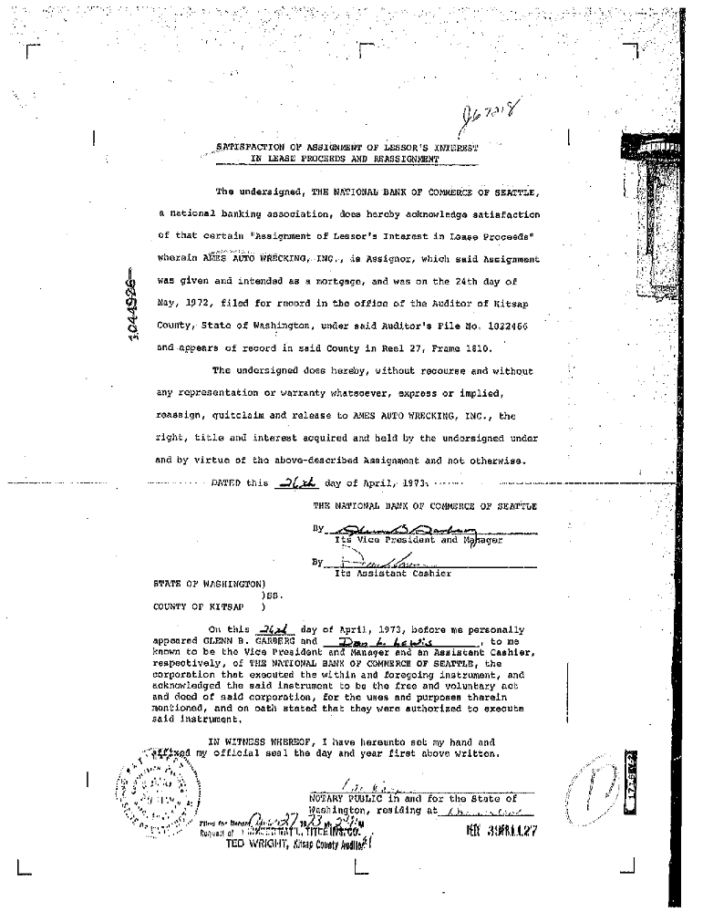
Example
“Satisfied”

Slide 38
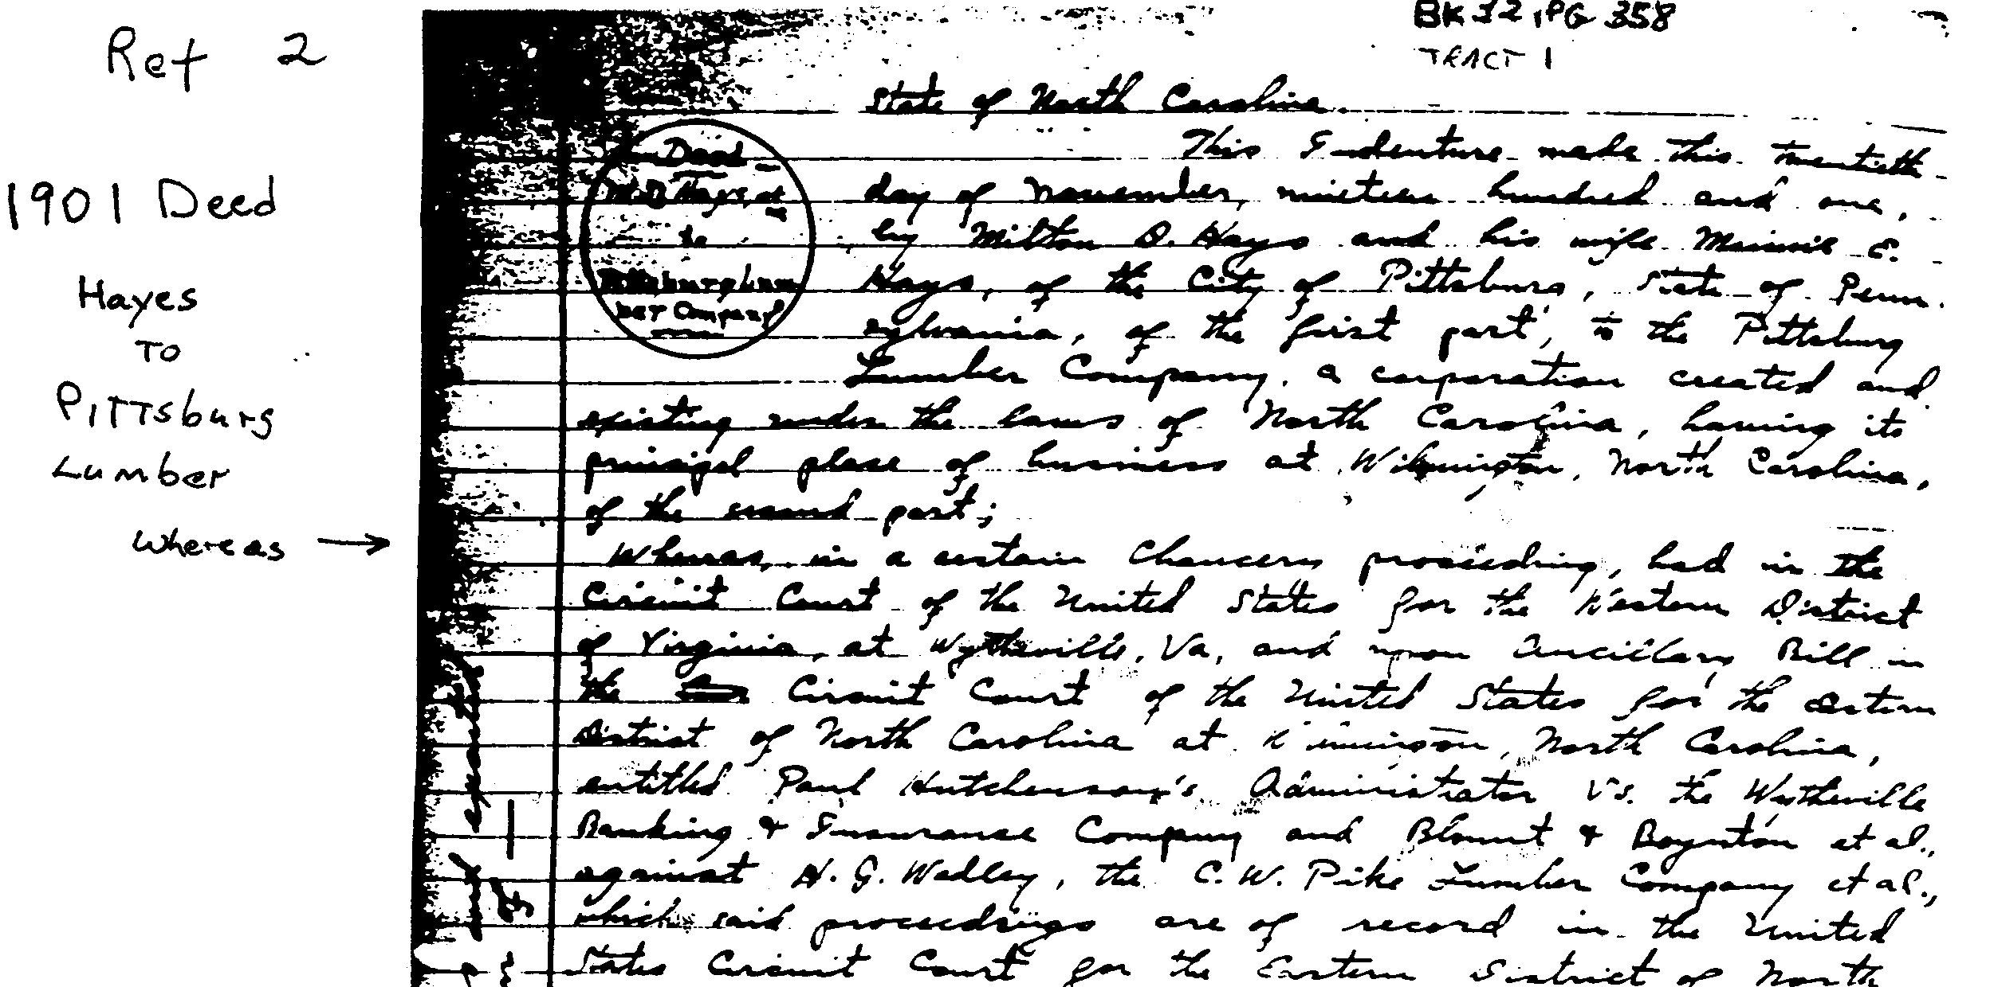
Copies
Ask staff about procedures and rules.
Copy deeds of interest.
Be sure the book number and page are on the copy.

Slide 39
Chain of Title in PRP Report
Date | Grantor | Grantee | Document #
3/30/2000 | Hopton Technologies Inc (n/k/a Molecular Technologies & Trade Inc.) | Hopton Technologies Int LLC | 1097/587
3/7/2001 | Hopton Technologies Int LLC | EKA Chemicals Inc. | 1160/128
9/7/2001 | Wyman-Gordon Titanium Castings LLC | Pacific Cast Technologies Inc. | 1214/246 (ATI property listed as exemption in property description)
2/7/2002 | EKA Chemicals Inc. | EKA Chemicals Inc. | 1262/930
6/28/2004 | EKA Chemicals Inc. | Capital Acquisitions LLC | 1596/896
7/26/2006 | Capital Acquisitions LLC | Absorbent Technologies Inc. | 2006-18191
7/26/2006 | Absorbent Technologies Inc. | Farouk H. Al-Hadi, an undivided ½ interest & David L. Ellis and Pamela L. Ellis, husband and wife, an undivided ½ interest | 2006-18192
2/18/2014 | Farouk H. Al-Hadi, an undivided ½ interest & David L. Ellis and Pamela L. Ellis, husband and wife, an undivided ½ interest, all as tenants in common | Pacific Cast Technologies, Inc. | Warranty Deed- Statutory Form 2014-01760 (a portion paid to a facilitator pursuant to an IRC 1031 Tax Deferred Exchange)

Slide 40
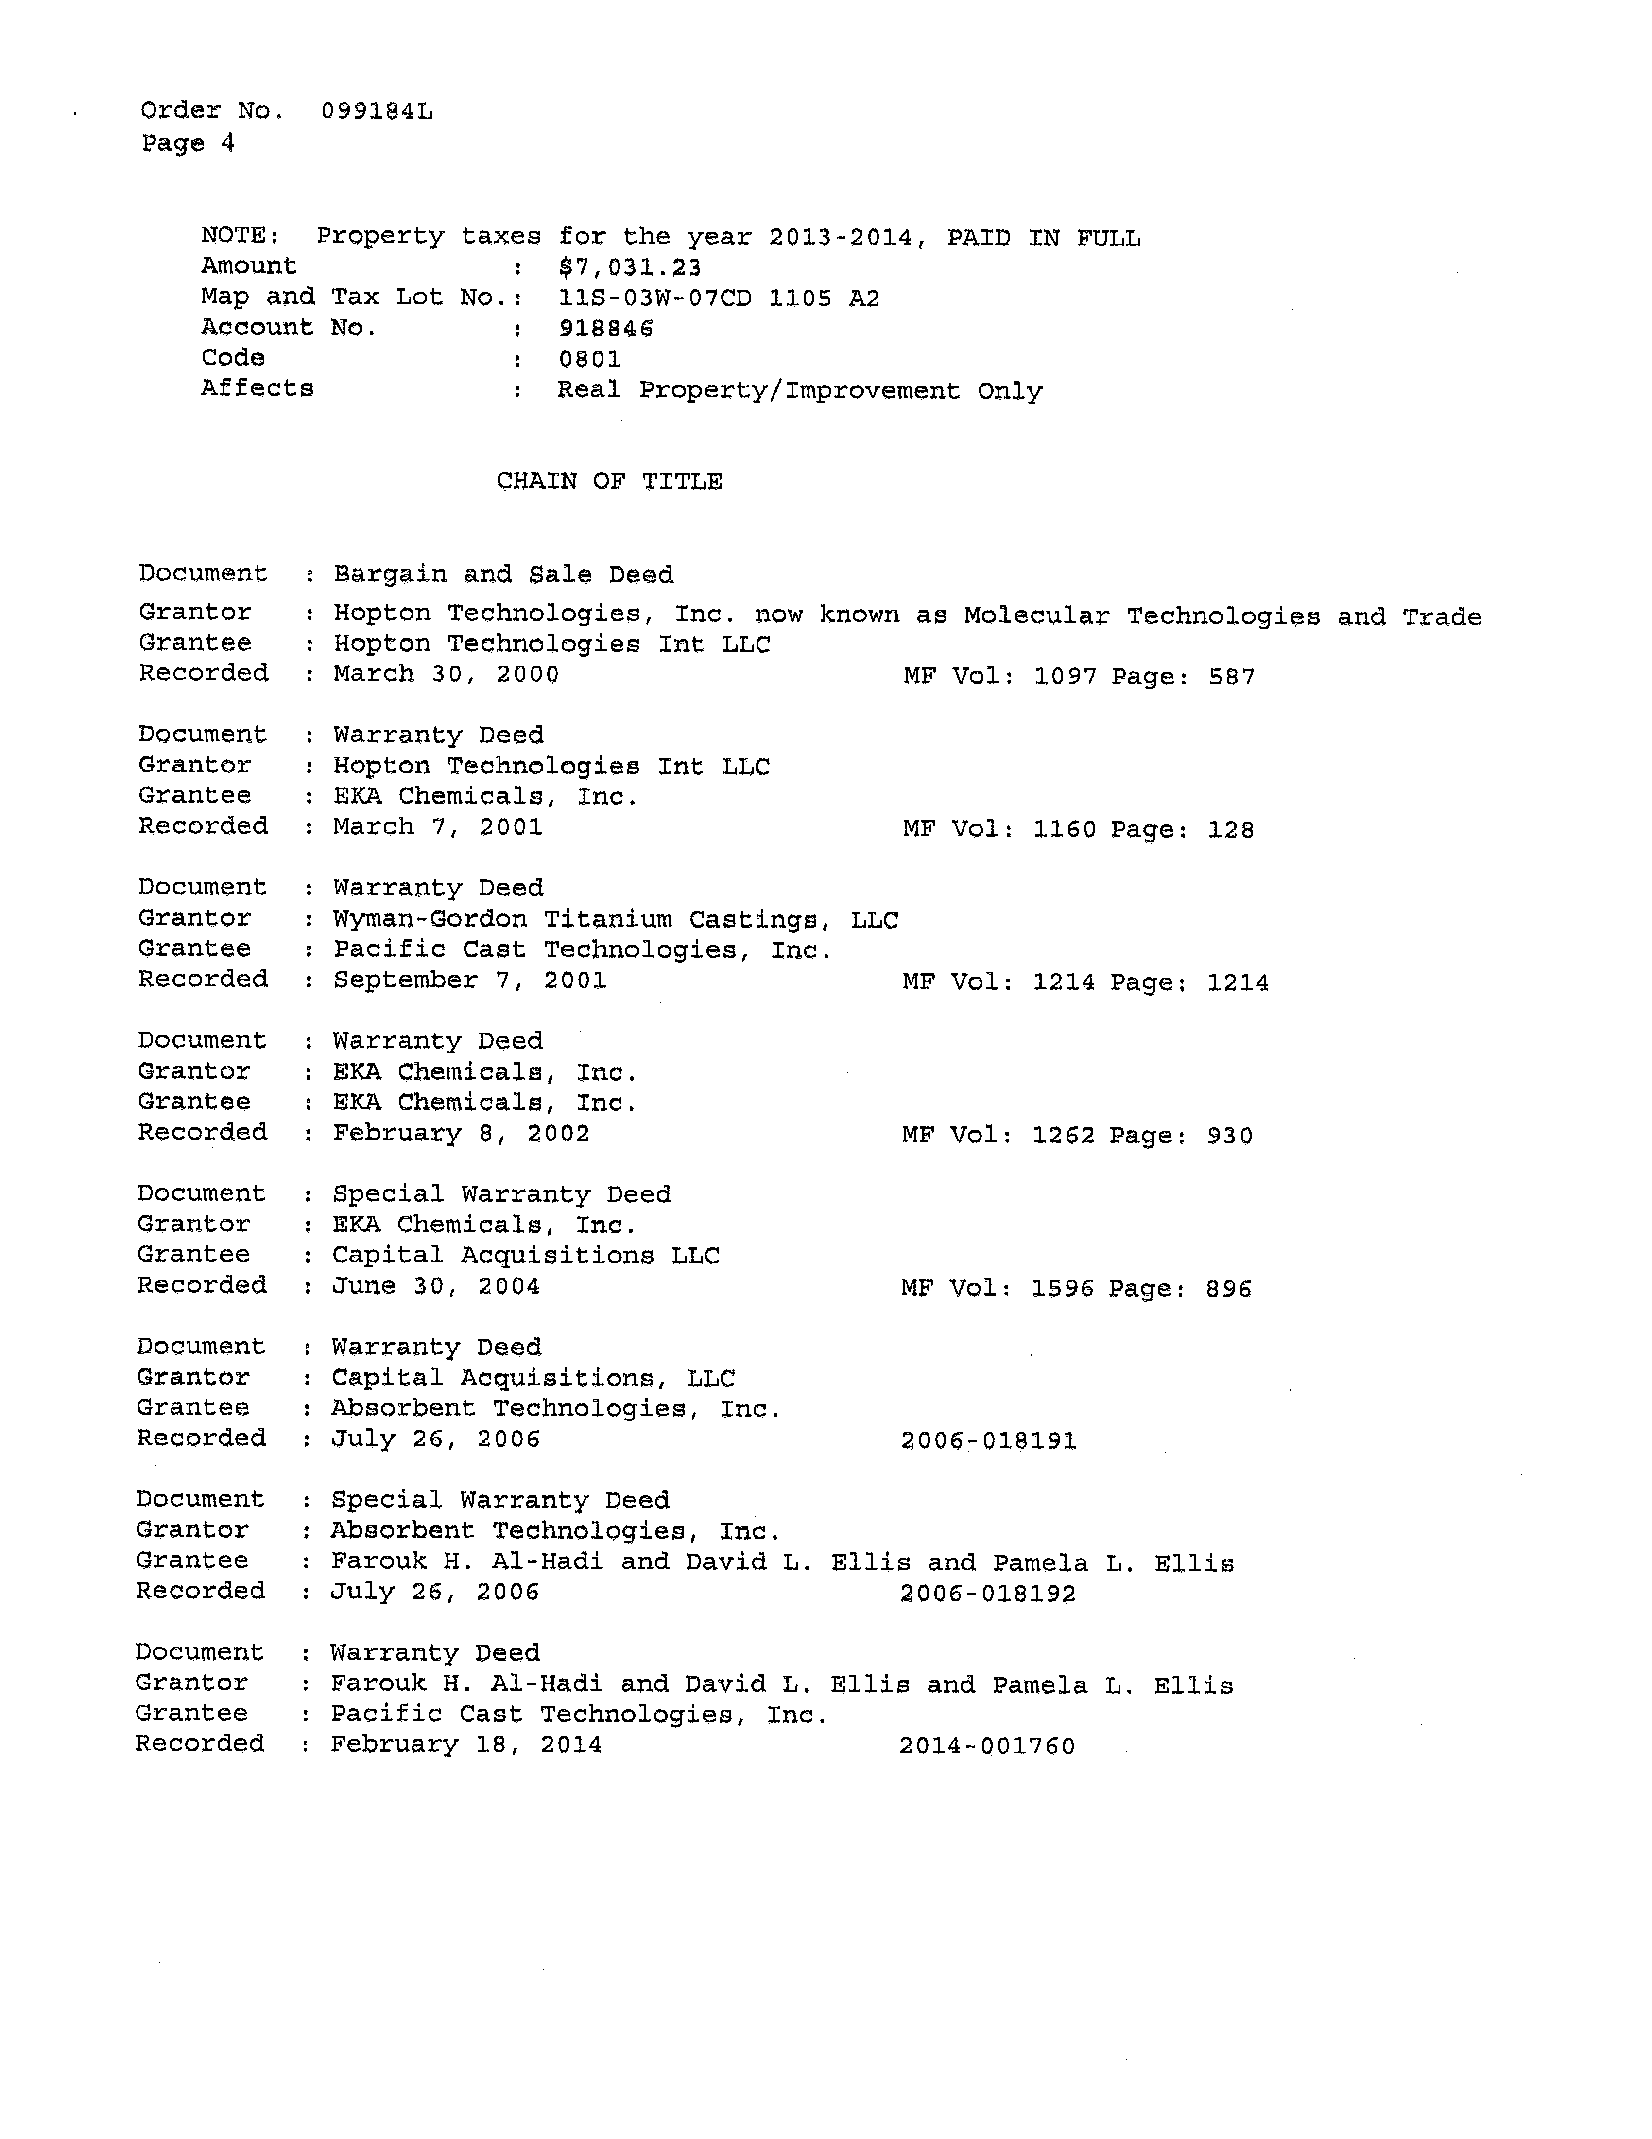
Chain of Title

Slide 41
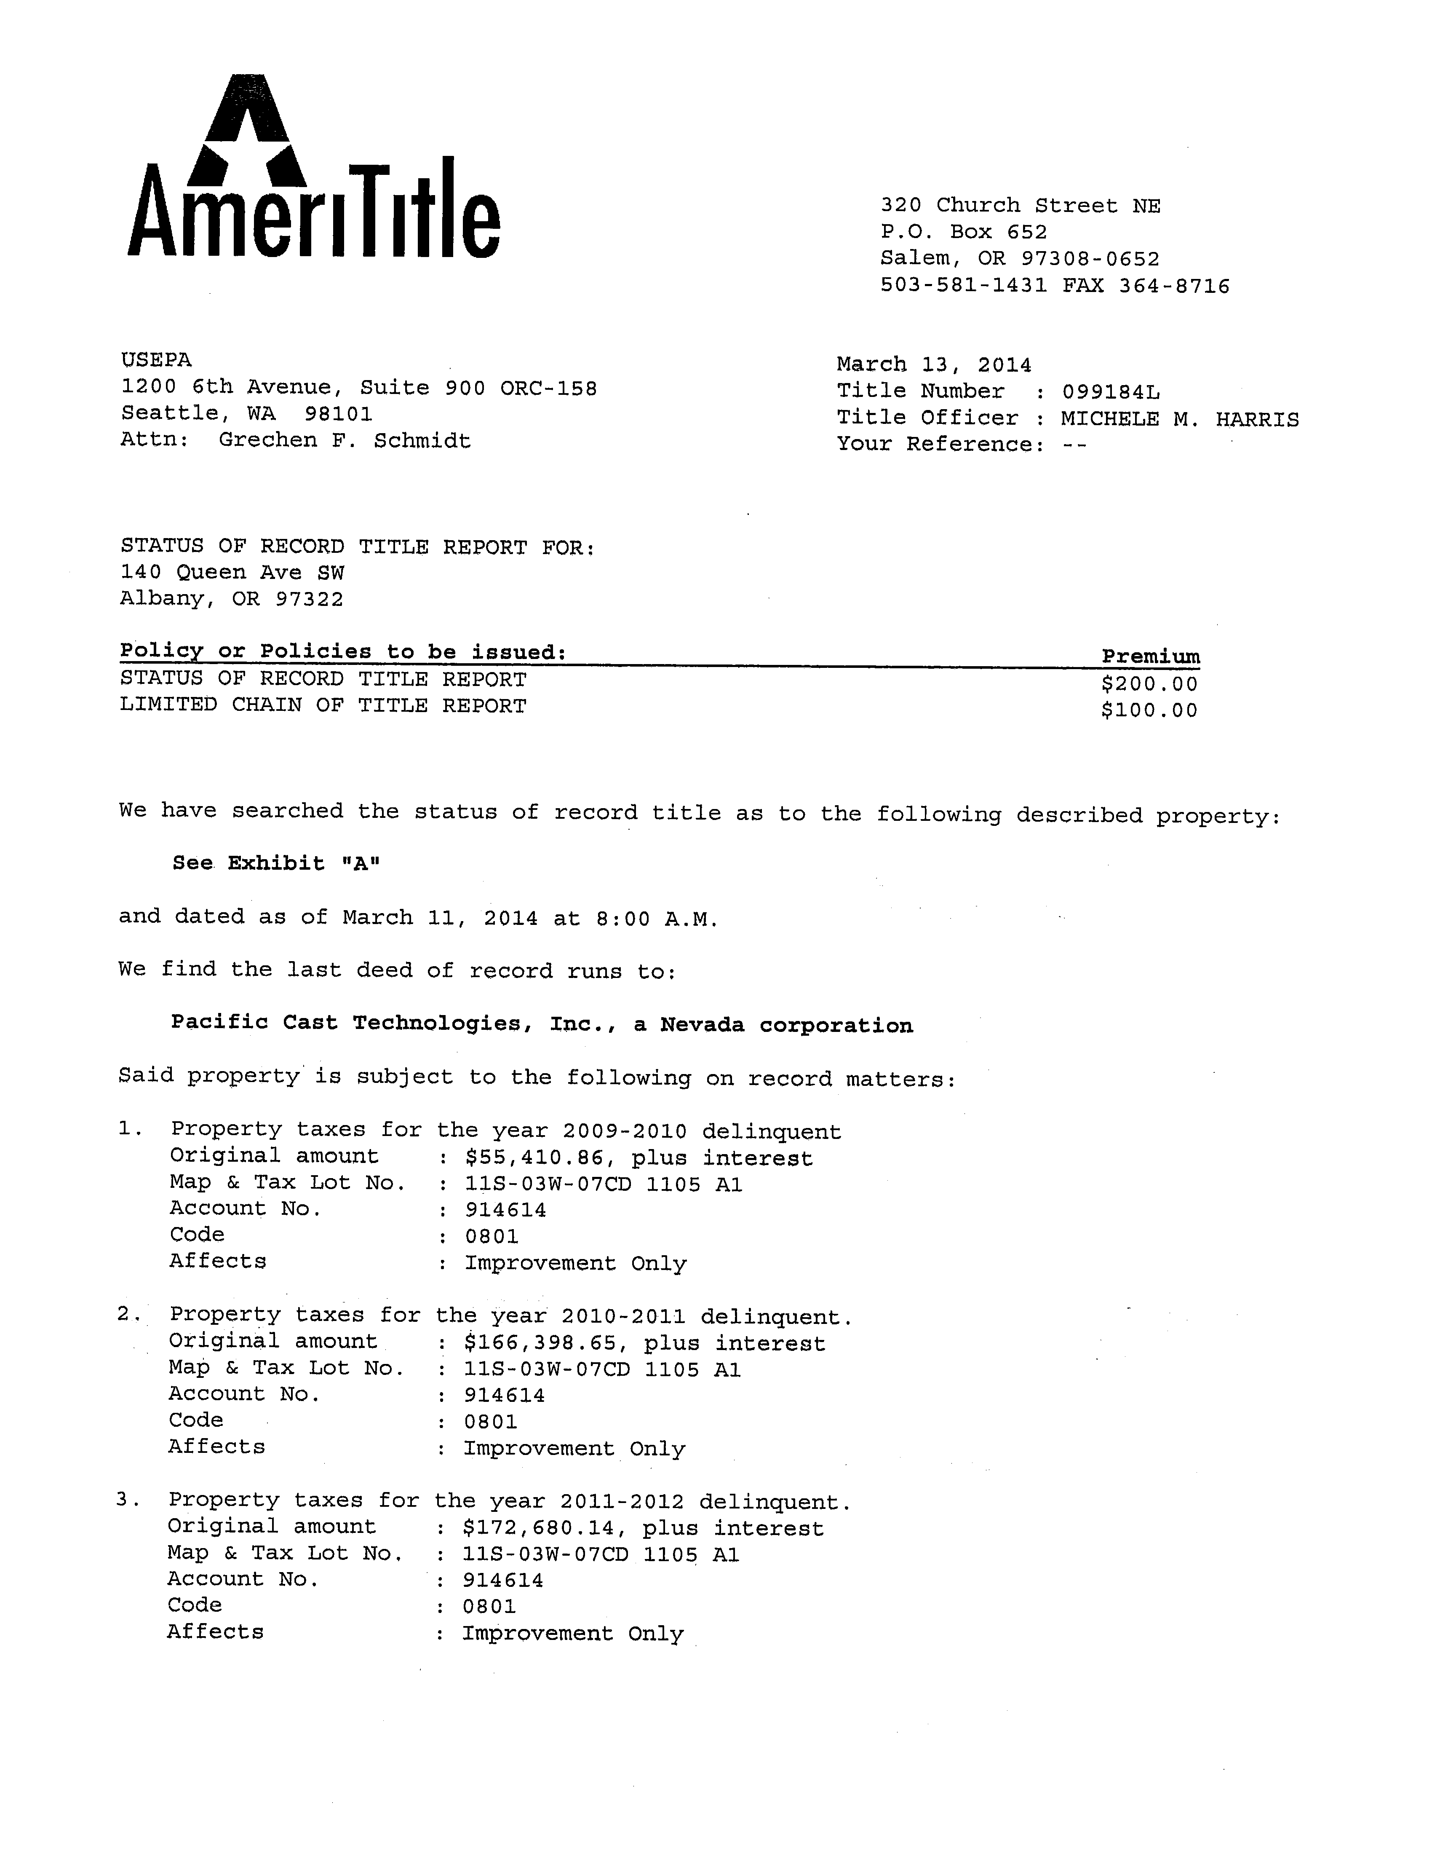
Title Search Report

Slide 42
Using a title company
Is using a title company more cost-effective?
  Does your region have a contractor for this work?
  Is there someone in your region who could pay for the title search (i.e. bankcard holder)?
Many title companies are willing to give you an estimate before you commit to having them do the work.
Many title companies will give the current (vesting deed) without charge—just ask.

Slide 43
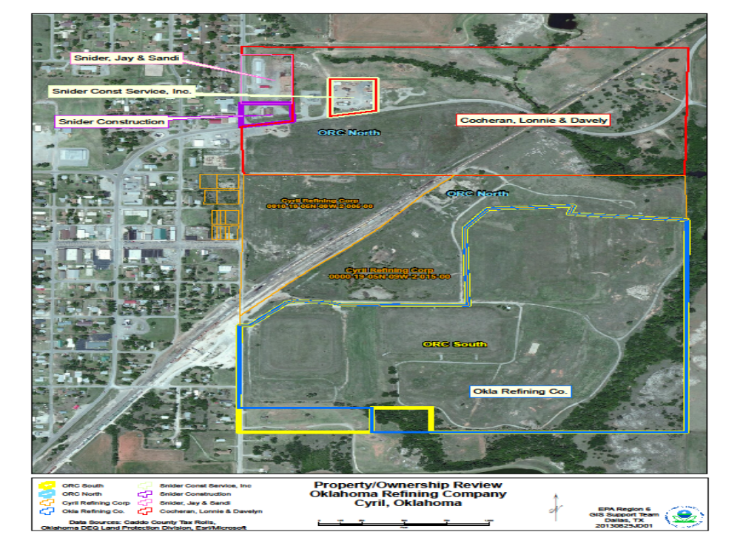
GIS Map

Slide 44
References
PRP Search Manual, Section 3.5 (“Perform Title Search”)
https://www.epa.gov/enforcement/report-prp-search-manual-2009-edition-2011-addendum
Potentially Responsible Party Internet Information Sources (“PRPIIS”) (PRP Search Manual, Appendix F)
https://www.epa.gov/enforcement/report-prp-search-manual-2009-edition-2011-addendum

