Slide 1
Flood Resilience:
A Basic Guide for Water and Wastewater Utilities
US EPA Draft Training Materials
Revised April 2015
Notes:
Welcome to Training on a new tool from US EPA, Flood Resilience: A Basic Guide for Water and Wastewater Utilities
The easy-to-use Guide specifically designed for small- and medium-size water and wastewater utilities
It has already been used successfully by several utilities
Encourage to use the guide
Additional resources (for presenter reference only)
CREAT is a software tool to assist drinking water and wastewater utility owners and operators in understanding potential climate change threats and in assessing the related risks at their individual utilities. http://1.usa.gov/1vnPjVq There is also link to CREAT in the Flood Resilience Guide.
VSAT assists water and wastewater utilities of all sizes with determining vulnerabilities to both man-made and natural hazards and with evaluating potential improvements to enhance their security and resiliency. VSAT 6.0 is easier to use. http://1.usa.gov/1xE8II1
WHEAT assists drinking water and wastewater utility owners and operators in quantifying human health and economic consequences for a variety of scenarios that pose a significant risk to the water sector. http://1.usa.gov/1P2K5dP

Slide 2
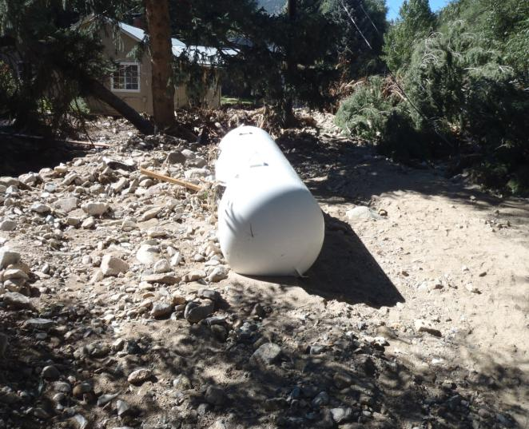
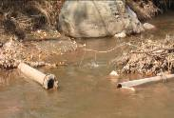
Notes:
Flooding most common hazards in US, causes more damage than other weather-related event.
Flooding ongoing challenge for drinking water and wastewater utilities as more frequent/intense storms and sea levels rise.
Drinking water and wastewater utilities are particularly vulnerable to flooding
Often located in low lying areas, floods can
inundate a facility
damage equipment
disconnect chemical tanks
break distribution lines
Power outages are also a common during floods
The overall result can be severely disrupted operations
It is never a pleasant situation to have a boil water order or a sewage bypass condition

Slide 3
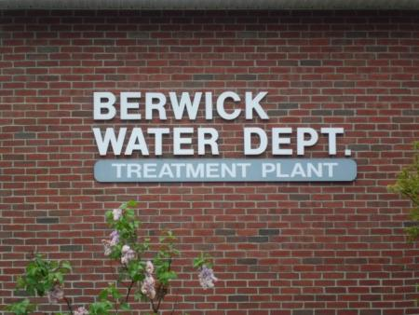
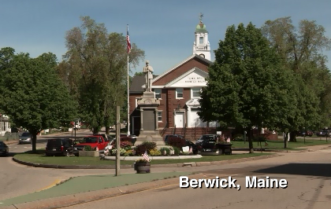
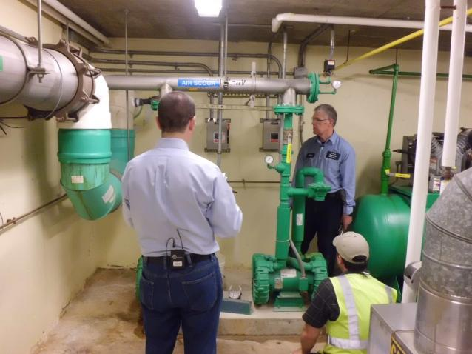
Flood Resilience Guide Overview
Notes:
The catalyst for the Flood Resilience Guide actually came from a small drinking water utility, in Berwick, Maine who approached EPA and said, “I’m know I vulnerable to flooding, but I don’t know where to start”
EPA conducted a pilot project working with the Berwick Water Department, and the state primacy agency
These agencies conducted a site visit, evaluation, and provided recommendations to the utility
Knowing that there are many other flood-prone utilities out there, we used the same approach used in Berwick and broadened it to become our new tool, Flood Resilience: A Basic Guide for Water and Wastewater utilities

Slide 4
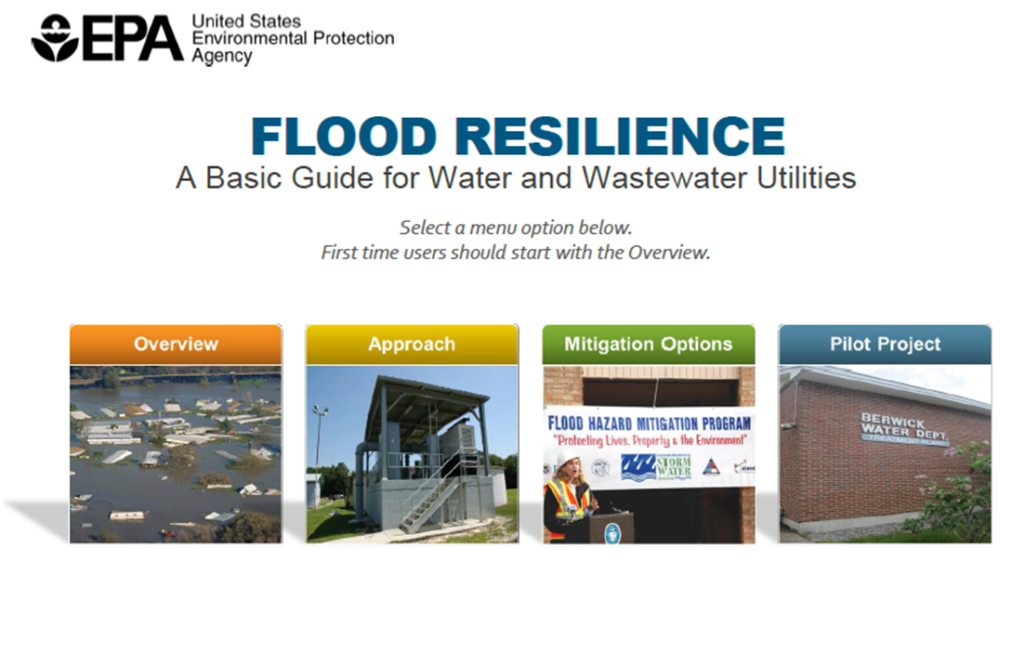
http://water.epa.gov/infrastructure/watersecurity/emerplan
Notes:
The is what the homepage looks like
The guide was specifically geared to small and medium water and wastewater utilities.
It is designed to be easy to use with interactive worksheets, instructional videos, and flood maps
Now demo guide. Train using PowerPoint slides, but it will give you the look and feel of clicking through the guide. Web address for guide is on slide (also send out flyer to Guide with web address)
Four selections Overview, Approach, Mitigation Options, Pilot Project…… let’s start with
Click on “Overview”

Slide 5
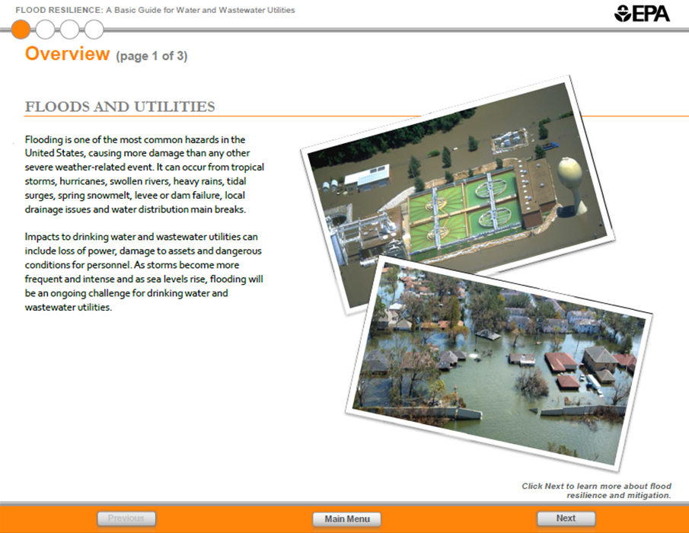
Notes:
There are 3 pages in the overview
On the first page, you can read about the dangers of floods for water/wastewater utilities
Note way to navigate through Guide at bottom; Previous, Main Menu, and Next.
Click Next

Slide 6
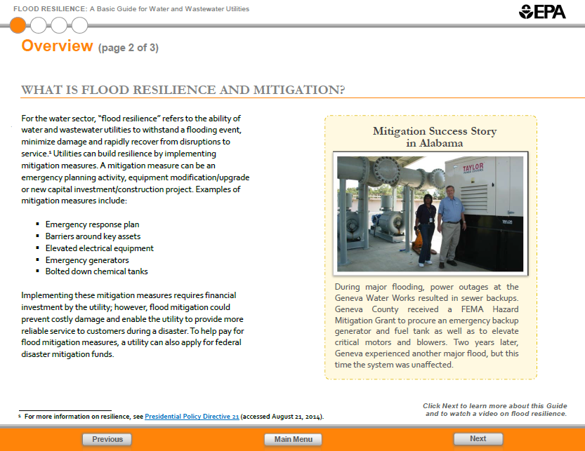
Notes:
On 2nd page, “resilience” and “mitigation” are defined
For water sector, "flood resilience" is the ability of water and wastewater utilities to withstand a flooding event, minimize damage, and rapidly recover from disruptions to service
Utilities can build resilience by implementing “mitigation measures”
A mitigation measure can be an
emergency planning activity
equipment modification
new capital construction project.
We’ll talk more about these mitigation measures later
Also we included a mitigation success story

Slide 7
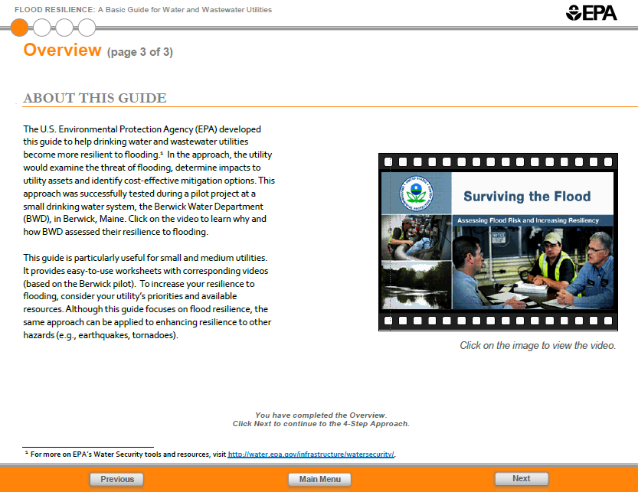
Notes:
On final page of the Overview, you learn how to use the guide
Tells that the Guide is based on the experience of a small drinking water utility in Berwick, Maine that didn’t know what to do about flooding
Includes link to video that reiterates concepts of flood resilience and mitigation and shows how the Berwick utility followed a 4 step process to be more flood resilient
Return to menu by clicking “Main Menu”

Slide 8
Notes:
The next menu selection is “Approach”

Slide 9
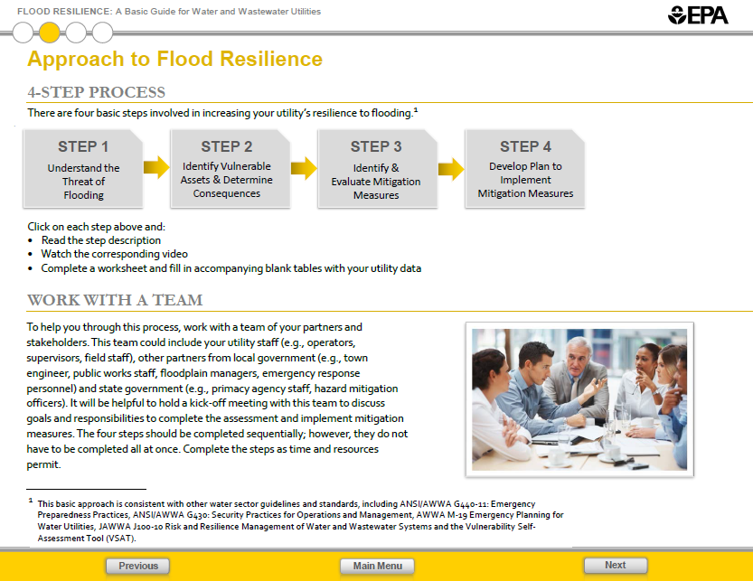
Notes:
Basic steps in approach to flood resilience:
Step 1 – Understand the threat of flooding
Step 2 – Identify vulnerable assets and determine consequences
Step 3 – Identify and evaluate mitigation measures
Step 4 – Develop plan to implement mitigation measures
Each of these steps is clickable
Click on Step 1

Slide 10
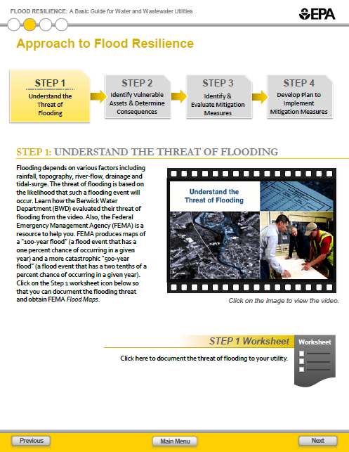
Notes:
See layout of Step 1 with short description of step 1 with definitions of terms including 100 year and 500 year floodplain
You can see a short video; shows how the Berwick Maine water utility began to understand their threat of flooding including using FEMA flood maps
To understand the threat of flooding at your own utility, you are given a worksheet Click the worksheet icon.

Slide 11
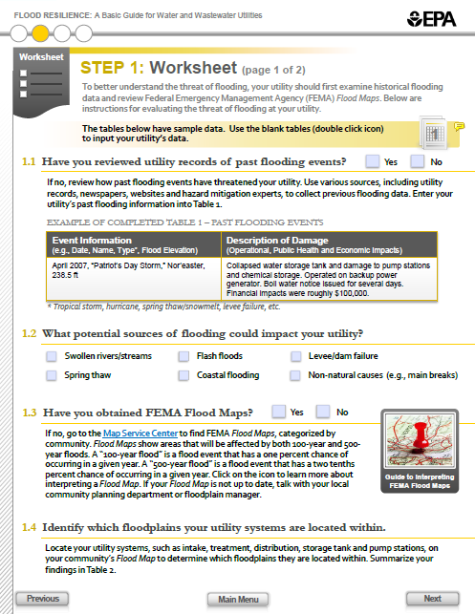
Notes:
The worksheet has a list of key activities to complete and tables to fill out
One key activity in 1.1 is to review your utility records on past flooding events
You’ll notice that they have tables filled in with sample data of past flooding events
This helps you understand the types of information to include in the tables
There are blank tables for you to fill in with your own utility data. You get the blank tables by:
Double clicking on icon at top right (the icon is labeled 1 because this is worksheet 1)
You will see a similar icon in every step

Slide 12
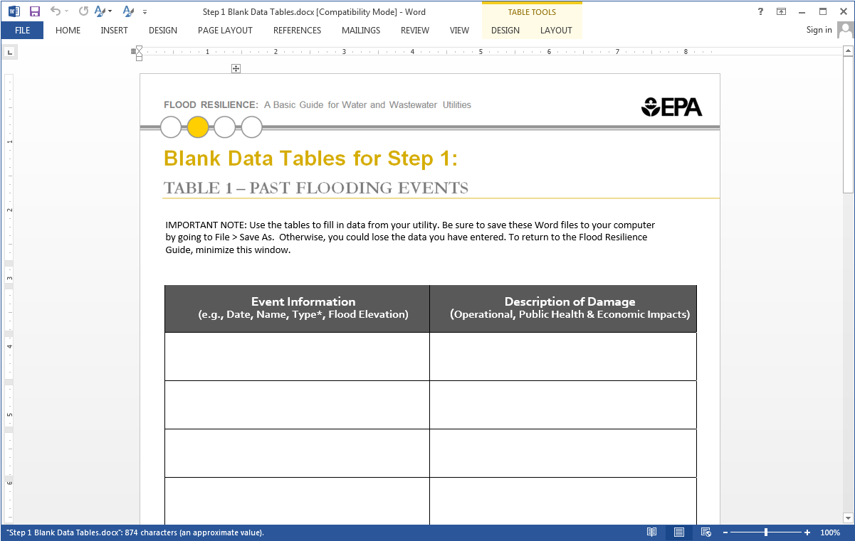
April 2007, “Patriot’s Day Storm,” Nor’easter, 238.5 ft
Collapsed water storage tank and damage to pump stations and chemical storage. Operated on backup power. Boil water notice issued.
Notes:
Brings up the blank worksheet in Word.
Can fill it in and save to your computer

Slide 13
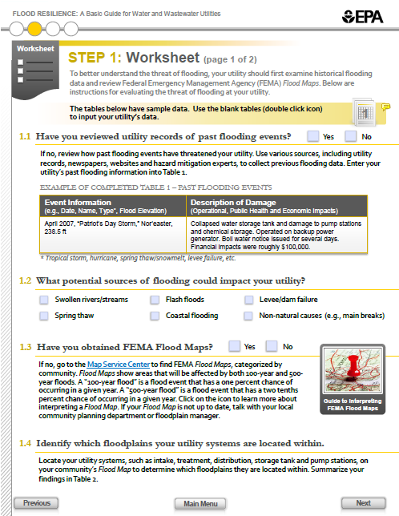
Notes:
Another activity 1.3 is to obtain FEMA Flood maps
This tells you how to find the flood map from FEMA for your location
You would simply Click on the blue “Map Service Center” and type in your address (just point to Map Service Center link)
To understand the flood map, here we have an icon that is a Guide to Interpreting FEMA Flood Maps

Slide 14
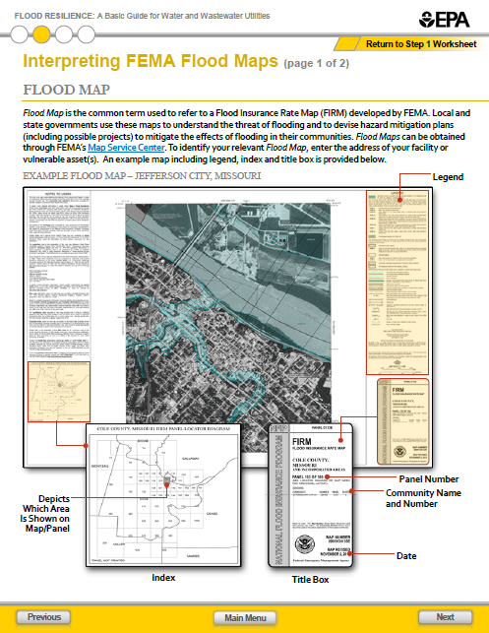
Notes:
If you did that, you would get a map like this
You can use this page to learn how to interpret the map information such as if you are in a 100-year or 500-year floodplain
Option to define these terms as stated on Worksheet 1 under activity 1.3
Important decision in this step is to decide what elevation do you want to protect your facility to: 100 year? 500 year? Guide provides suggestions.
Keep in mind elevations in new Federal Flood Risk Management Standard
Applies when Federal funds are used to build, or significantly retrofit or repair, structures and facilities in and around floodplains to ensure that those structures are resilient, safer, and long-lasting.
Federal agency given flexibility to use one of three approaches for establishing the flood elevation
“Best-available, actionable climate data”
For critical infrastructures like water/wastewater - three feet above the 100-year floodplain or
500-year floodplain
Return to the other steps by clicking “previous” and move to Step 2

Slide 15
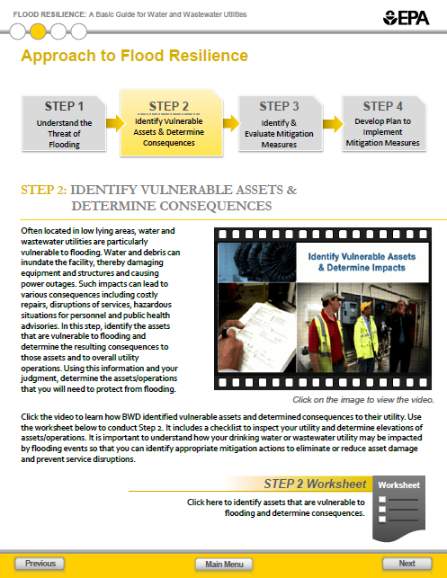
Notes:
Step 2 is to identify vulnerable assets and determine consequences
Again, you see a short description, video and worksheet (click worksheet)

Slide 16
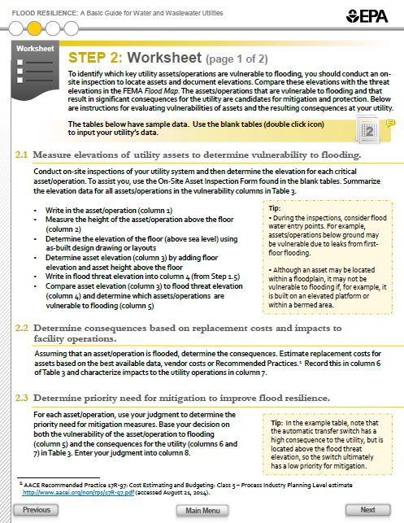
Notes:
The worksheet guides you to
walk around your utility
measure elevations of utility assets (such as pumps)
determine if these assets will be underwater in a flood
identify how it may impact your utility
The goal of this step is to identify which assets have a priority need for flood mitigation
All this information is captured on a table

Slide 17
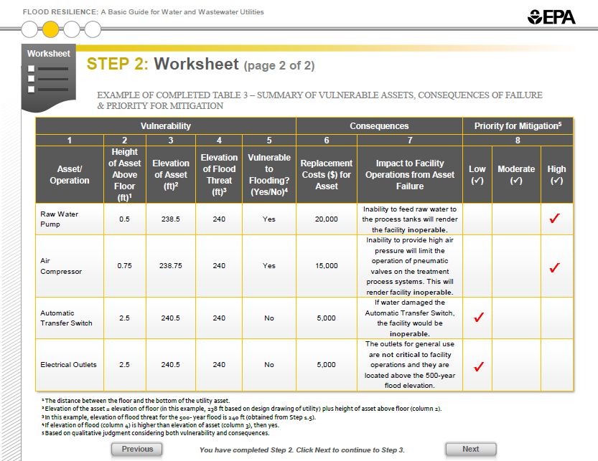
Notes:
Option to walk through table stating that
column 1 is the asset
columns 2-5 have elevation data and determine if the asset is vulnerable to flooding
columns 6 &7 indicate the consequence of the flooding
the cost to replace the damaged asset and
the effect of damaged asset on the operational capability of the utility.
column 8 is your judgment whether the asset is high priority for flood mitigation efforts. (could trace through rows)
Next look at Step 3 description (click “previous”)

Slide 18
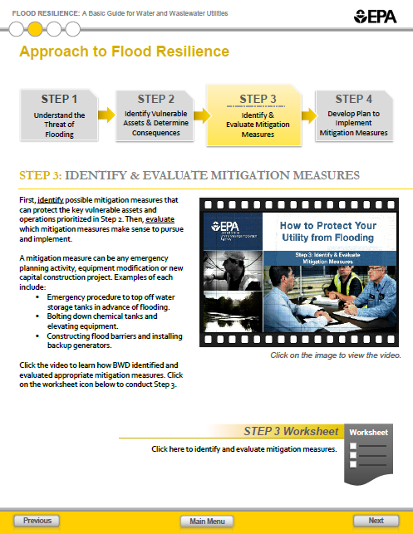
Notes:
Step 3 is about both identifying and evaluating mitigation options

Slide 19
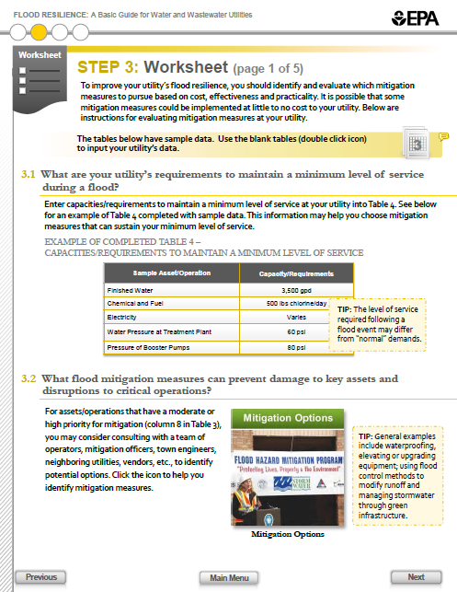
Notes:
The worksheet asks you to identify mitigation measures (activity 3.2)
In the worksheet, there is an icon to guide you to various mitigation measures
Say “remember the picture on the icon – you will see it later”

Slide 20
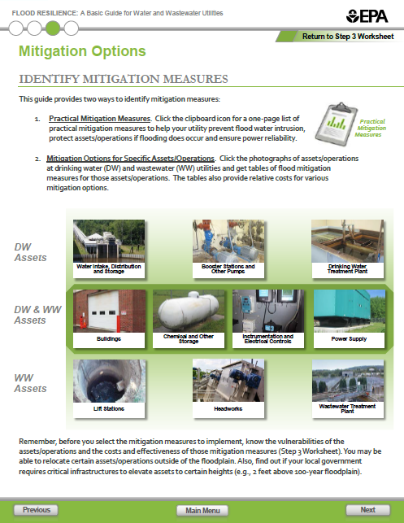
Notes:
One way to identify mitigation options is by asset
You see picture of various water and wastewater assets that could be vulnerable to flooding (recite assets in pictures if helpful)
By clicking on an image, you will be able to view a listing of mitigation options specific to that asset
Click on “Chemical and Other Storage”

Slide 21
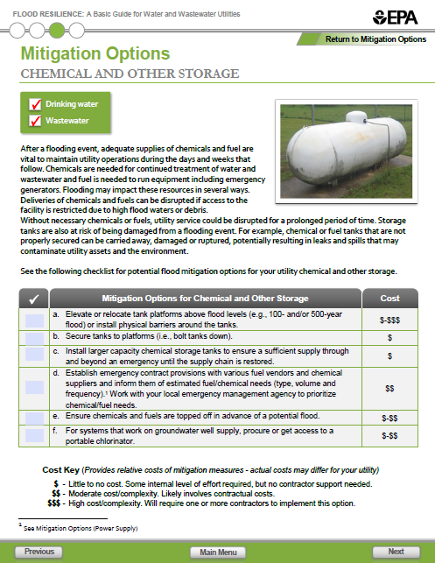
Notes:
See table of mitigation options to address chemical storage issues
One mitigation option is to elevate tank platforms above flood levels
Another option is to secure (bolt down) tanks to platforms
Corresponding price ranges are included in last column; there is a key to what they mean
Click “Previous” to go to Step 4

Slide 22
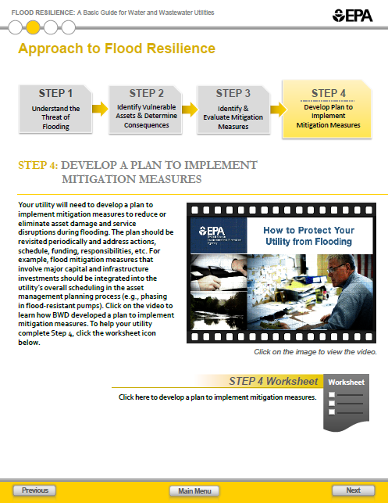
Notes:
Step 4 helps you develop a plan to implement the mitigation measures that you selected in Step 3

Slide 23
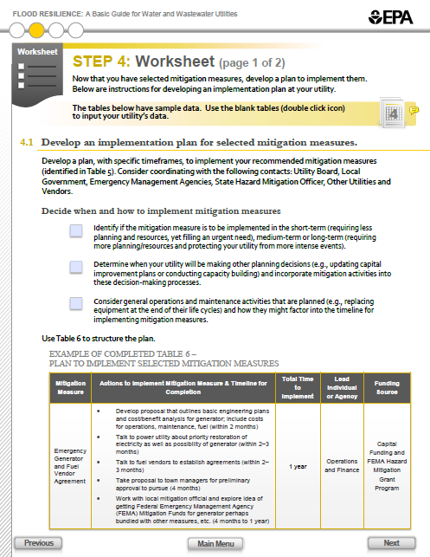
Notes:
This step gives guidance on how to structure the plan and identify leads and funding sources
Heart of plan is the table at bottom. Briefly walk through example in table.
Go to 2nd page of worksheet and bring up issue of funding

Slide 24
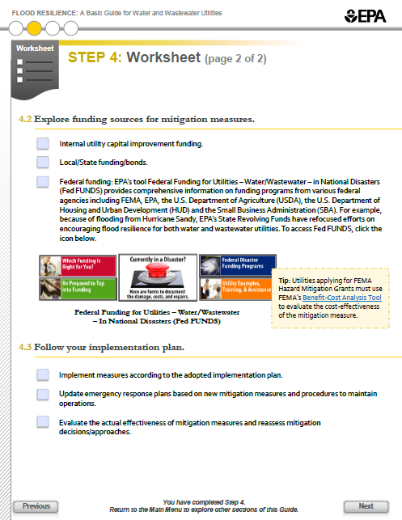
Notes:
Say that timing to replace asset with flood resilient asset or timing for investment in equipment to protect asset should be incorporated into your asset management system
Mention possible funding through utility, or from state, or federal
Show icon for another tool (Fed FUNDS)
Explain Fed FUNDS shows how to get federal money for mitigation measures
Click “Previous”

Slide 25
Notes:
Click on “Mitigation Options”
Emphasize the button is the same as the one saw earlier during from the previous steps

Slide 26
Notes:
Gets you to same mitigation page as shown in the previous step
Can access directly from the main menu
Return to menu by clicking “Main Menu”
So if utility didn’t want to go through Approach, can go directly to Mitigation Options

Slide 27
Notes:
Click final selection Pilot Project.

Slide 28
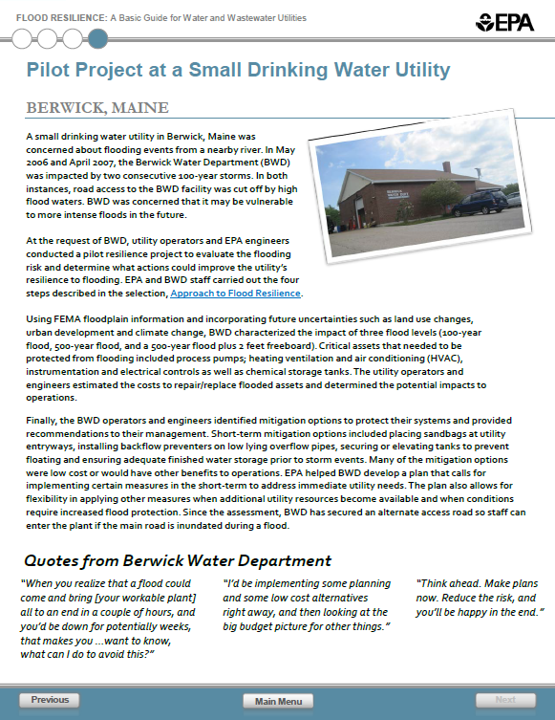
Notes:
This section summarizes how the Berwick Water Department examined their flood risk and how they took actions to protect their facility and assets

Slide 29
http://water.epa.gov/infrastructure/watersecurity/emerplan
Notes:
End of demonstration
Again, see web address to guide.
Conclusion: Use Guide.

