Slide 1
How to Develop a Green Freight Program:
Training Session Delivered by [Name of Presenter, Date]
Created by the U.S. Environmental Protection Agency to support organizations and build capacity in the development of green freight programs.

Slide 2
Modules at a Glance
Orientation for Training
Module I: Drivers for Green Freight Initiatives
Module II: Build Program Foundation
Module III: Create Program
Module IV: Launch and Implement Program
Module V: Evaluate, Refine, Enhance, and Expand
Appendices

Slide 3
introduction
Welcome
Housekeeping
Goals
Why is freight transport so
important?
The importance of impartial and
accurate information and data
SmartWay’s approach and its
principal elements
Orientation for Training

Slide 4

Welcome
Welcome, everyone!
Introductions
  Participants
  Trainer(s)
  Assistant trainers
  Guest speaker(s)
  Observers
  VIPs
Orientation for Training
Notes:
Trainer should tailor this slide
Key Points:
Introduce yourself and others present. Ask participants to introduce themselves one by one.
Establish ground rules for participation.
Conduct an ice-breaker if time permits.
Go over important logistics, such as bathroom locations and schedule for breaks.

Slide 5
HOUSEKEEPING
Schedule
  Start time
  Guest speaker
  Morning break
  Lunch
  Study tour
  Afternoon break
  Adjourn
  Networking reception
Logistics
  Security
  Internet access
  Coat room
  Bathroom locations
  Device protocols
  Other
Orientation for Training
Notes:
Trainer should tailor this slide
Key Points (continued):
Introduce yourself and others present. Ask participants to introduce themselves one by one.
Establish ground rules for participation.
Conduct an ice-breaker if time permits.
Go over important logistics, such as bathroom locations and schedule for breaks.

Slide 6
GOALS for this training
Goals for this training include learning about:
  Green freight programs and their impacts
  How to set up and launch a green freight program
  Resources to help initiate and expand upon your program
After this training, you will be able to:
  Organize, grow, and improve upon your program
  Link to other programs
  Find resources to help in program development
Orientation for Training
Notes:
Key Points:
Give participants a big picture perspective on the importance of freight movement and green freight programs.
It is critical to businesses, consumers, and the world economy.
It is responsible for local and global environmental impacts.
The freight industry needs better performance data to measure and manage its impacts and participate in carbon accounting and reporting efforts.

Slide 7
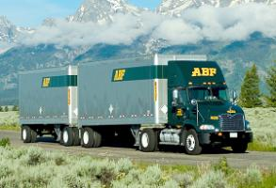
Why is freight so important?
Benefits our economy and society:
  Freight moves vital materials and
  products, benefitting consumers,
  manufacturers, and economies
Impacts the global environment:
  CO₂ from the freight sector is growing faster than emissions from the passenger sector
  19% of global black carbon comes from freight
  Diesel trucks emit the largest share of NO_{x} and PM among transportation sources
Orientation for Training
Notes:
Key Points (continued):
Give participants a big picture perspective on the importance of freight movement and green freight programs.
It is critical to businesses, consumers, and the world economy.
It is responsible for local and global environmental impacts.
The freight industry needs better performance data to measure and manage its impacts and participate in carbon accounting and reporting efforts.

Slide 8

The IMPORTANCE OF impartial and ACCURATE information
Freight industry and customers
need reliable data to:
  Better measure and manage
  emissions and costs
  Contribute to and participate in
  global carbon accounting efforts
  Confirm emission reduction and
  performance claims of
  technologies and practices
Orientation for Training
Notes:
Key Points (continued):
Give participants a big picture perspective on the importance of freight movement and green freight programs.
It is critical to businesses, consumers, and the world economy.
It is responsible for local and global environmental impacts.
The freight industry needs better performance data to measure and manage its impacts and participate in carbon accounting and reporting efforts.

Slide 9
IMPORTANT PROGRAM DESIGN ELEMENTS
A voluntary, market-based program design
Build public-private collaboration and partnerships
Share best practices and key information
Verify and label proven technologies
Provide public recognition and incentives, build brands,
and communicate successes
Identify financing opportunities to facilitate investments in
fuel-saving and emission-reducing technologies
Orientation for Training
Notes:
Key Points:
SmartWay’s program design offers lessons for those looking to develop their own green freight programs.
SmartWay’s program elements (which appear on the slide) can be relatively easily adapted or replicated.
While unified program elements can help with global adoption, successful programs do not need to be just like SmartWay! But they will benefit from sharing common programmatic elements, such as accounting tools and methods, so that stakeholders working internationally can more easily participate.

Slide 10
Module I: Drivers for Green Freight Initiatives
Local and global impacts of the freight industry
Current and prospective regulatory drivers
Freight customer needs and industry challenges
Creating your green freight program
Module I: Drivers for Green Freight Initiatives
I-1

Slide 11
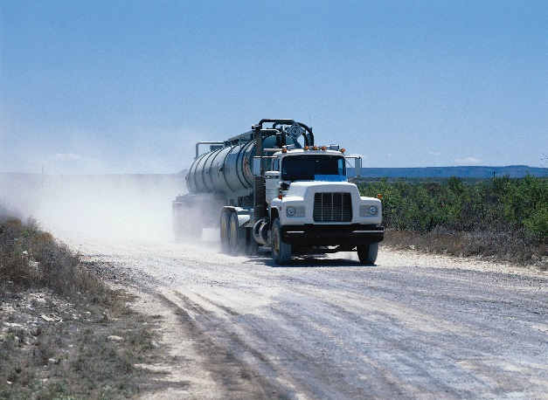
A. Local and Global Impacts of the Freight Industry
Energy and environmental impacts
  1 liter of diesel = 2.7 kg of CO₂ + black carbon/PM and NO_{x}
  In India, trucks make up only 5% of vehicles, but they:
    Consume 46% of transport fuel
    Generate 63% of CO₂
    Emit 59% of particulate matter,
    including black carbon
Module I: Drivers for Green Freight Initiatives
I-2 – I-7
Notes:
Key Points:
Energy and environmental impacts of freight movement include black carbon and greenhouse gas emissions, which contribute to climate change.
Benefits of green freight programs include:
Improved public health from reduced air pollution
Improved health conditions for vulnerable populations
Reduction in climate change emissions
Improved energy security from fuel efficiency gains
Social and economic benefits: lower transportation fuel costs, fewer infrastructure/congestion problems, improved roadway safety, technological innovation, local economic development
Make sure to adapt these issues to the host country’s context as appropriate. Let participants know that their
input will be solicited during the exercise.

Slide 12
Group Exercise
(15 min)
Identify the impacts of freight
How does the freight industry affect the
environment and economy of your country?
Module I: Drivers for Green Freight Initiatives
I-7

Slide 13
Group Exercise
(continued)
Freight Impacts Framework
Type of Impact | Energy/ Environmental | Public Health | Social | Economic | Other
Positive
Negative
Module I: Drivers for Green Freight Initiatives
I-7

Slide 14
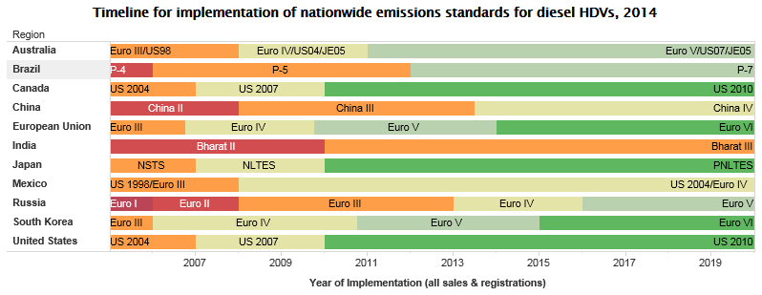
B. Current and Prospective regulatory drivers
Heavy-duty
diesel truck
emissions
standards
are becoming
more stringent
in the U.S. and Europe
Fuel economy standards are rising in the U.S. and other countries (Canada, Japan, China)
Data from green freight programs can help inform the development of these regulations
Source: http://transportpolicy.net/index.php?title=Global_Comparison:_Heavy-duty_Emissions
Module I: Drivers for Green Freight Initiatives
I-7 – I-13
Notes:
Key Points:
Globally, regulation of heavy-duty vehicle fuel efficiency and CO2 emissions is not yet widespread, but it is becoming more common.
Data from green freight programs can inform regulatory efforts.
NOx and PM limits for diesels have been tightening over time in the United States, the EU, and elsewhere.
Advanced exhaust controls require simultaneous reductions in fuel sulfur levels. The disproportionate fraction of emissions attributable to trucks at the pre-2010 EPA emissions standards highlights the need for green freight programs to address legacy fleets.
If time permits, review the U.S. challenge of legacy vehicles described in the text box on page I-13.

Slide 15
B. Current and Prospective regulatory drivers
CO₂/fuel economy standards
  Promise net savings after initial investment
NO_{x}/PM exhaust standards
  Advanced standards require accompanying low-sulfur fuel standards
  Net cost to operator
Standards address new vehicles only
Retrofits, clean fuels, and operational strategies to address the in-use (legacy) fleet
Module I: Drivers for Green Freight Initiatives
I-7 – I-13
Notes:
Key Points (continued):
Globally, regulation of heavy-duty vehicle fuel efficiency and CO2 emissions is not yet widespread, but it is becoming more common.
Data from green freight programs can inform regulatory efforts.
NOx and PM limits for diesels have been tightening over time in the United States, the EU, and elsewhere.
Advanced exhaust controls require simultaneous reductions in fuel sulfur levels. The disproportionate fraction of emissions attributable to trucks at the pre-2010 EPA emissions standards highlights the need for green freight programs to address legacy fleets.
If time permits, review the U.S. challenge of legacy vehicles described in the text box on page I-13.

Slide 16
Group Exercise
(15 min)
The regulatory context for green freight
What regulatory factors affect
the freight industry in your country?
Module I: Drivers for Green Freight Initiatives
I-12

Slide 17

C. Freight Customer Needs and Industry Challenges
Shippers are looking for ways
to account for and report on
their global carbon footprint
Freight industry needs
  Harmonized performance
  benchmarks, standardized
  reporting requirements, transparency
  Ways to address new and legacy fleets
  Strategies that pair fuel savings with emission reduction strategies to defray costs
Module I: Drivers for Green Freight Initiatives
I-14 – I-19
Notes:
Key Points:
The freight industry is increasingly being asked to report CO2 emissions (“carbon accounting”)
Customers, clients, and shareholders are starting to demand transparency, accountability, and disclosure.
Companies are also seeking to incorporate additional environmental performance data (such as supply chain energy use, PM and NOx emissions) in corporate social responsibility reporting.
To help freight customers choose “greener” options, the industry needs harmonized standards for quantifying, benchmarking, and reporting fuel/carbon efficiency.
New vehicles and the legacy fleet need to be addressed simultaneously.
Fuel-/cost-saving strategies need to be packaged with PM and NOx reduction strategies in order to defray costs (e.g., a truck would have fuel savings features as well as additional exhaust controls).

Slide 18
Group Exercise
(15 min)
The value of green freight
What are the reasons why your country
would benefit from a green freight program?
Module I: Drivers for Green Freight Initiatives
I-18

Slide 19

d. Creating your green freight program
Advantages of using a voluntary
partnership approach
  Partner-driven
  Low startup and operation costs
  Complements regulations
  Can help shape national standards
Module I: Drivers for Green Freight Initiatives
I-19 – I-22
Notes:
Key Points:
Both regulatory and voluntary approaches can be successful and can complement each other.
In a voluntary approach, partners commit to benchmarking, monitoring, and reporting as well as taking Verifiable actions beyond “business as usual.”
The partnership approach is relatively fast and effective, especially for legacy fleet vehicles—it can spark action without legislation, regulations, or civil penalties (mention SmartWay as case study, pages I-18 to I-19).
The partnership approach can help shape national standards (mention EPA/NHSTA example, page I-21).

Slide 20
Group Exercise
(15 min)
The value of using a voluntary approach
Discuss benefits of using a voluntary partnership
program approach for green freight in your country.
Module I: Drivers for Green Freight Initiatives
I-22

Slide 21
Module II: Build Program Foundation
Assess state of freight industry, technologies, and practices
Identify leaders in industry, non-governmental organizations (NGOs), government agencies, and academia
Establish administrative resources for the program
Develop program performance goals
Establish budget and secure funding
Module II: Build Program Foundation
II-1

Slide 22

A. Assess State of Industry, Technologies, and Practices
Define market (country, region, state, other?)
Determine:
  Number and size of shippers
  and carriers
  Projected growth of freight activity
  Predominant operation types
  and transportation modes
  Vehicle and operational characteristics
  Emission and fuel efficiency standards
  Fuel quality
  Availability and market penetration of technology and retrofits
Module II: Build Program Foundation
II-2 – II-10
Notes:
Key Points:
To design an effective green freight program, it is important to understand how freight carriers and shippers operate in the region.
Factors to consider include cost of operations, projected growth, and prevalence of added-value services.
Baseline industry statistics (listed on the slide) should inform program goals and quantify progress.
Resources for this information include trade associations, vehicle registries, government, academic institutions, emissions models, online data sources, and private data sources.

Slide 23

A. Assess State of Industry, Technologies, and Practices
Some helpful resources:
  Trade associations
  Vehicle registries
  Government sources
  Academic institutions
  Transportation models
  Emissions models
  Online sources
  Private sources
Module II: Build Program Foundation
II-11 – II-12
Notes:
Key Points (continued):
To design an effective green freight program, it is important to understand how freight carriers and shippers operate in the region.
Factors to consider include cost of operations, projected growth, and prevalence of added-value services.
Baseline industry statistics (listed on the slide) should inform program goals and quantify progress.
Resources for this information include trade associations, vehicle registries, government, academic institutions, emissions models, online data sources, and private data sources.

Slide 24
Group Exercise
(15 min)
Assess the freight industry in your country
What freight issues, challenges, opportunities,
and technologies are most relevant?
Module II: Build Program Foundation
II-12

Slide 25
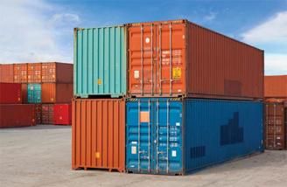
B. Identify INDUSTRY AND OTHER Leaders
Seek out organizations to serve as members of steering, outreach, and technology committees, as well as charter partners, such as:
  Large shipping companies and freight carriers
  Major logistics companies
  Equipment/vehicle manufacturers
  and vendors
  Trade associations and business
  organizations
  Environmental, health, economic,
  labor NGOs
  Academics
  Government agencies
Organize committees and assign responsibilities
Module II: Build Program Foundation
II-14 – II-17
Notes:
Key Points:
Stakeholders who become involved at the beginning (e.g., as charter partners, advisors, and allies) are more likely to participate in and advocate for the program.
It is useful to have stakeholders from a variety of industry perspectives provide feedback and insights during the initial planning stages.
Include representatives from both the “push” and “pull” perspectives—carriers on the one hand, the shippers and logistics companies they work for on the other.
Specialized committees (e.g., oversight/steering, technology, outreach) are an effective way to organize the work of stakeholders.

Slide 26
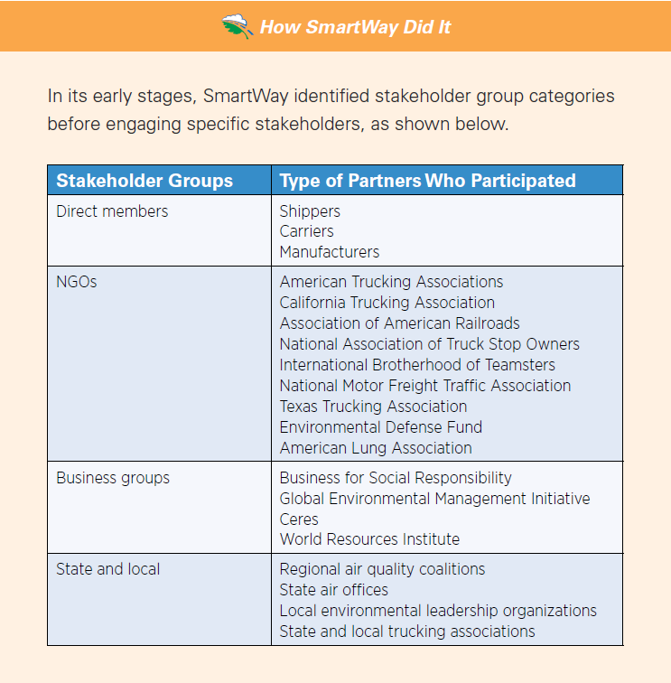
Group Exercise
(15 min)
Brainstorm stakeholders
Make a list and show their potential responsibilities and interrelationships.
Module II: Build Program Foundation
II-15

Slide 27
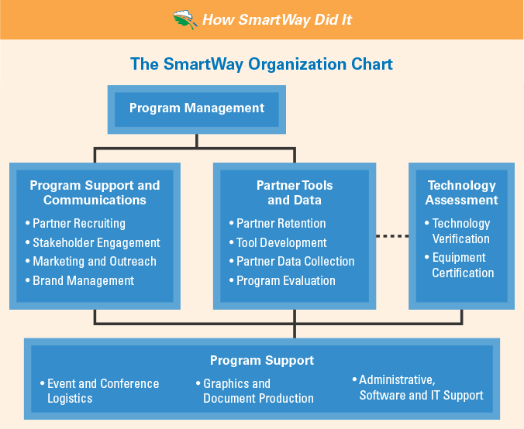
C. Establish administrative Infrastructure
Set up an internal
organization around
your program’s goals
and resources
  Identify roles and
  responsibilities; include
  stakeholders
Module II: Build Program Foundation
II-17 – II-19
Notes:
Key Points:
The administrative structure should:
Be set up within a government agency (ideally).
Clearly and simply define the lines of communication and responsibilities, reflecting your program’s goals and resources.
Account for the following roles and how they work together: program manager, recruiting team, stakeholder engagement team, tools and technologies team, marketing and outreach team, evaluation and assessment team.

Slide 28
Group Exercise
(15 min)
Outline program administrative structure
Create an organizational chart
that reflects your vision.
Module II: Build Program Foundation
II-18

Slide 29
D. Develop Program Performance Goals
Identify “low-hanging fruit” for initial program to create momentum and credibility
Aim for clear, measurable goals, such as:
  x MMTCO₂ reductions per year
  x million liters of fuel saved per year
  x% improvement in grams CO₂/tonne-km per year
  x% improvement for partners relative to fleet average performance levels
  x partners participating by year y
  x certified technology retrofits by year y
  Reduce black carbon by x tons per year
Module II: Build Program Foundation
II-19 – II-20
Notes:
Key Points:
Establishing program goals will help recruit funding sources and participants.
While you may have multiple goals, public outreach and recruiting is often more effective when you focus on one.
Pick goals that are easy to achieve to build momentum and credibility.
Realistic primary goals could include emissions reductions (described in million metric tons), fuel savings (in gallons or liters), and efficiency performance.
Secondary goals could include partnership participation (x carriers or shippers in first year and in five years), and technology targets (y retrofits by a certain year).

Slide 30
Group Exercise
(15 min)
Program goal setting
Make a list of goals for first and subsequent
years; include steps needed to reach them.
Module II: Build Program Foundation
II-20

Slide 31
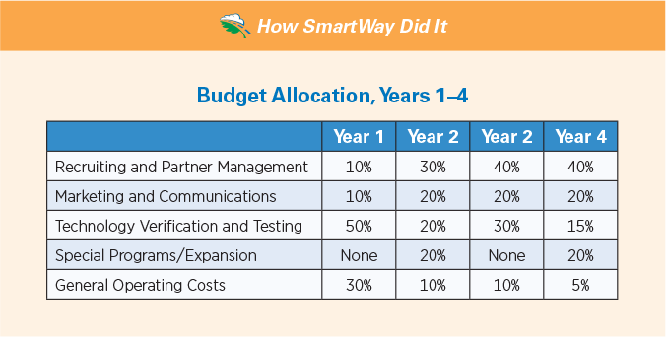
E. Establish Budget and Secure Funding
Create budget to cover some/all:
  Market research
  Development of program goals and administrative structure
  Initial tool and database development
  Marketing and communications
  Recruiting and partner management
  Financing program, which can
  include grants and/or loans
  Technology verification and testing
  General operations
Module II: Build Program Foundation
II-21 – II-22
Notes:
Key Points:
To help allocate limited funds, list budget categories that might help in tracking spending and anticipating future needs (see pages II-21 and II-22 in the Manual). Also suggest assigning a percentage of funding to each category, recognizing that adjustments are likely.
Develop a funding plan.
Most freight programs rely on a combination of support from government agencies from different levels of national, regional, and local sources.
Funders and investors will want to understand the return on their investment.
Develop a collaborative process with stakeholders to explore funding options.
Consider creative cost structures such as membership fees, in-kind contributions, sponsorship for dedicated activities, etc.
Diversifying funding sources reduces risks over the long term.

Slide 32

e. Establish Budget and Secure Funding
Strategies to secure funding
  Research all reasonable
  sources—private and public
  Frame program benefits
  in monetized terms
  Involve stakeholders
  Consider alternative
  funding resources, such
  as membership fees and
  in-kind contributions
Module II: Build Program Foundation
II-23 – II-24
Notes:
Key Points (continued):
To help allocate limited funds, list budget categories that might help in tracking spending and anticipating future needs (see pages II-21 and II-22 in the Manual). Also suggest assigning a percentage of funding to each category, recognizing that adjustments are likely.
Develop a funding plan.
Most freight programs rely on a combination of support from government agencies from different levels of national, regional, and local sources.
Funders and investors will want to understand the return on their investment.
Develop a collaborative process with stakeholders to explore funding options.
Consider creative cost structures such as membership fees, in-kind contributions, sponsorship for dedicated activities, etc.
Diversifying funding sources reduces risks over the long term.

Slide 33
Group Exercise
(15 min)
Brainstorm funding sources
List possible sources and brainstorm
strategies to approach them.
Module II: Build Program Foundation
II-24

Slide 34
Module III: Create Program
Partnership program design and development
Partner tools and database
Brand development, marketing, and outreach
Technology verification and labeling
Module III: Create Program
III-1

Slide 35
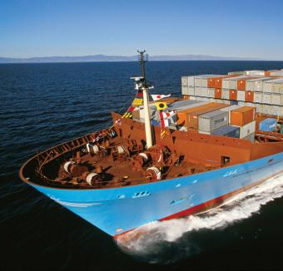
A. Partnership Program Design and Development
Develop program goals
  Understand the difference
  between “goal” and “strategy”
  What impact will your goals have
  on your country’s freight industry?
  Goals should address the needs
  of the freight industry
  Identify some strategies to help
  reach the goals
Module III: Create Program
III-2
Notes:
Key Points:
Program goals can be developed by envisioning how the program can impact the freight industry over time, such as a five- to 10-year period.
Strategies are specific, measurable steps for achieving these goals.
Companies need to understand how the program can add value to their operations (“value proposition”) if they are to invest in becoming partners.

Slide 36
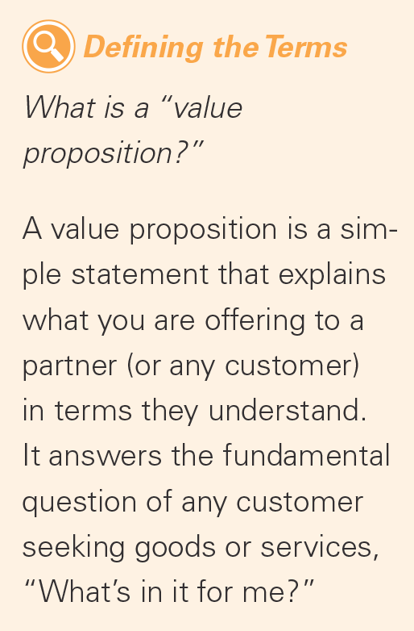
A. Partnership Program Design and Development
Define your program’s value
proposition
  What are you offering to your
  partners?
  Describe it in terms they will
  understand
Module III: Create Program
III-3 – III-4
Notes:
Key Points (continued):
Companies need to understand how the program can add value to their operations (“value proposition”) if they are to invest in becoming partners.
Carriers get: info on new technologies and strategies to save fuel & reduce costs
Shippers get: access to quality data to benchmark supply chain performance , improve efficiency, demonstrate and report results
All get: recognition for commitments and achievements, branding, marketing and visibility

Slide 37
Group Exercise
(20 min)
Developing program goals
Brainstorm possible program goals and strategies
that could help you reach your goals.
Module III: Create Program
III-2

Slide 38
A. Charter partners, staffing needs, and green freight financing
Find organizations and individuals to serve as charter partners
  Companies implementing efficiency strategies and technologies
  Representatives from shippers, carriers, and logistics providers
Group staffing needs by program areas and grow expertise over time
  Add partner account managers (PAMs) and recruiters
Define partner categories by size and type
Module III: Create Program
III-3 – III-9
Notes:
Key Points:
Charter partners—industry leaders who can “anchor” the program—can help define the value proposition.
New programs might consider focusing initial partner recruiting efforts on larger carriers and shippers, and then on other categories of interest thereafter.
Staffing needs, which will grow over time, include professionals with expertise in program management, partner management and recruiting, technical support, developing new initiatives, and marketing, branding, and education.
An optional green freight financing program can help partners overcome such barriers as high upfront costs for fuel economy improvements and emissions reduction technologies.

Slide 39
A. Charter partners, staffing needs, and green freight financing
Develop program guidelines for funding, including:
  Funds from public or public-private partnerships
  Structure that decides terms of loans, grants or rebates
  Eligibility requirements for financial assistance
  Terms of loans and consequences
Collect information on other funding options
Module III: Create Program
III-9 – III-10
Notes:
Key Points (continued):
Charter partners—industry leaders who can “anchor” the program—can help define the value proposition.
New programs might consider focusing initial partner recruiting efforts on larger carriers and shippers, and then on other categories of interest thereafter.
Staffing needs, which will grow over time, include professionals with expertise in program management, partner management and recruiting, technical support, developing new initiatives, and marketing, branding, and education.
An optional green freight financing program can help partners overcome such barriers as high upfront costs for fuel economy improvements and emissions reduction technologies.

Slide 40
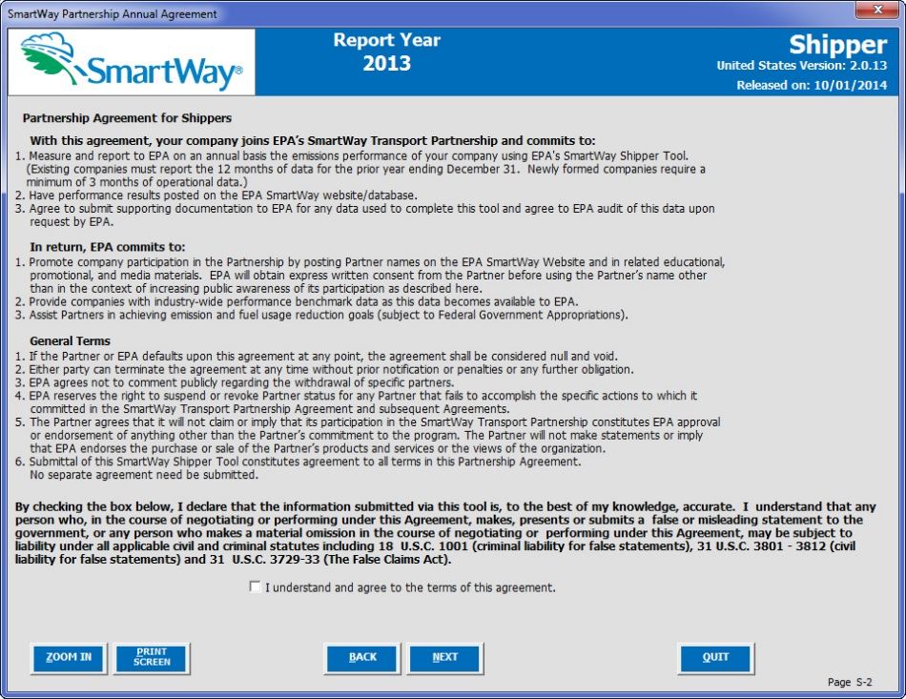
B. Partner Tools and Database
Define terms for partner agreements
  What are the reporting
  requirements for partners
  to remain in good standing?
  What information, if any, will
  remain confidential?
  What is the legal status of
  the agreement (binding/
  non-binding)?
Module III: Create Program
III-11
Notes:
Key Points:
Partner Agreements define the requirements for partners, including deadlines and data submittals.
Performance metrics should be easy to understand and clearly linked to the program’s value proposition.
Performance metrics may need to evolve over time to accommodate changing partner demands and new data sources.
Calculation tools should balance simplicity and user friendliness with needs for precision and accuracy.
Consider which performance measurement approach (1.0, technology-based; 2.0, activity-based) is most appropriate for your region, considering stage of program development, partner needs, and available resources.

Slide 41
B. Partner Tools and Database
Measuring your program’s performance
  Data should be easy to obtain/calculate, reliable, and demonstrative of performance. Possibilities include:
    Grams/km
    Grams/ton-km
    Grams/volume-km
    Total mass emissions
    Relative “emissions scores”
  Chose performance metrics that are:
    Appropriate for target freight modes (e.g., g/km for truckload freight, g/volume-km for container ships)
    Consistent with other established green freight program methodologies
Module III: Create Program
III-11 – III-14
Notes:
Key Points (continued):
Partner Agreements define the requirements for partners, including deadlines and data submittals.
Performance metrics should be easy to understand and clearly linked to the program’s value proposition.
Performance metrics may need to evolve over time to accommodate changing partner demands and new data sources.
Calculation tools should balance simplicity and user friendliness with needs for precision and accuracy.
Consider which performance measurement approach (1.0, technology-based; 2.0, activity-based) is most appropriate for your region, considering stage of program development, partner needs, and available resources.
SmartWay Partner Tools - http://www.epa.gov/smartway/forpartners/index.htm

Slide 42
B. Partner Tools and Database
Measuring performance—two common approaches
  “SmartWay 1.0”
    Performance scores based on carrier technology adoption
    Simple benefit calculations
    May be preferred in early program stages
  “SmartWay 2.0”
    Activity-based inputs (e.g., gallons, km, tonne-km)
    Accurate emission footprints for shippers and carriers
    Preferred for mature programs
Module III: Create Program
III-11 – III-14
Notes:
Key Points (continued):
Partner Agreements define the requirements for partners, including deadlines and data submittals.
Performance metrics should be easy to understand and clearly linked to the program’s value proposition.
Performance metrics may need to evolve over time to accommodate changing partner demands and new data sources.
Calculation tools should balance simplicity and user friendliness with needs for precision and accuracy.
Consider which performance measurement approach (1.0, technology-based; 2.0, activity-based) is most appropriate for your region, considering stage of program development, partner needs, and available resources.
SmartWay Partner Tools - http://www.epa.gov/smartway/forpartners/index.htm

Slide 43
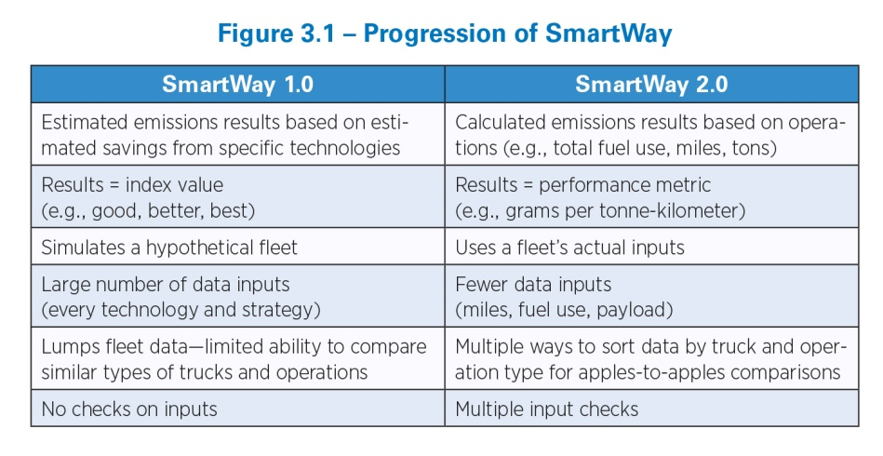
Group Exercise
(10 min)
Identify program metrics
Identify appropriate performance metrics consistent with program goals.
Module III: Create Program
III-12

Slide 44
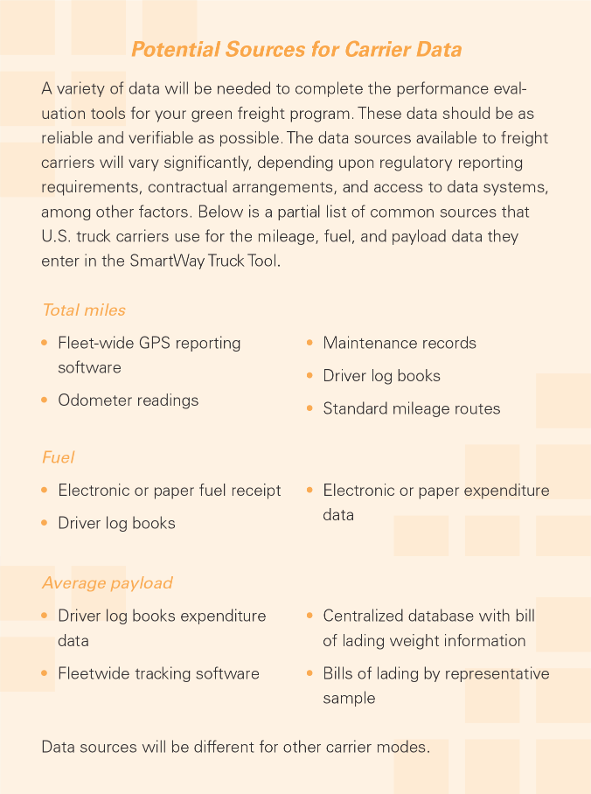
SECTION B. SUPPLEMENTAL MATERIAL
SMARTWAY Partner Tools, INPUTS, AND DATA FLOW PROCESS
Develop partner tools
  What data sources can be used?
    Identify readily available, reliable,
    and verifiable data sources
  The more detailed the data, the
  more accurate the outputs but
  the more complicated the tool.
  Strive for balance!
  Engage stakeholders to review
  the tools before you finalize, and
  periodically after launch
Module III: Create Program
III-18 – III-19
Notes:
Key Points:
Carrier tools outputs are used as inputs in Shipper/Logistics tools for carrier ranking and/or emission footprints.
The program host coordinates collection and validation of partner data and may share performance information among carriers and their customers, ensure data quality, monitor partner satisfaction, and facilitate the evaluation of the program’s overall performance.

Slide 45
SECTION B. SUPPLEMENTAL MATERIAL
SMARTWAY Partner Tools, INPUTS, AND DATA FLOW PROCESS
Common carrier tool inputs
  Operation type (e.g., 90% truckload/dry van, 10% drayage)
  Fuel type and volume (e.g., liters of diesel)
  Activity (km, average payloads, idle hours)
  Engine size/age
  Truck class
  NO_{x}/PM controls
Module III: Create Program
III-24 – III-25
Notes:
Key Points (continued):
Carrier tools outputs are used as inputs in Shipper/Logistics tools for carrier ranking and/or emission footprints.
The program host coordinates collection and validation of partner data and may share performance information among carriers and their customers, ensure data quality, monitor partner satisfaction, and facilitate the evaluation of the program’s overall performance.

Slide 46
SECTION B. SUPPLEMENTAL MATERIAL
SMARTWAY Partner Tools, INPUTS, AND DATA FLOW PROCESS
CO₂ estimates based on fuel consumption
NO_{x}/PM estimation more complicated—depends on km, engine characteristics, idle hours, etc.
  Use emission factor models (e.g., MOVES)
  Account for local conditions (fuel, avg. speed, etc.)
Carrier tools automatically calculate:
  Emissions estimates
  Performance metrics (g/km, g/tonne-km, g/TEU-km)
Module III: Create Program
III-27 – III-28
Notes:
Key Points (continued):
Carrier tools outputs are used as inputs in Shipper/Logistics tools for carrier ranking and/or emission footprints.
The program host coordinates collection and validation of partner data and may share performance information among carriers and their customers, ensure data quality, monitor partner satisfaction, and facilitate the evaluation of the program’s overall performance.

Slide 47
SECTION B. SUPPLEMENTAL MATERIAL
SMARTWAY Partner Tools, INPUTS, AND DATA FLOW PROCESS
Different inputs for shippers/logistic companies
  Identify carriers, use (e.g., tonne-km or TEU-km hauled)
  Tool combines activity + carrier-specific performance metrics
  Tool rates carrier performance to help identify lowest emitters
Tool calculates
  Emission footprints
  Performance score/value based on carrier selection
Tool validates inputs based on typical industry values
Module III: Create Program
III-28 – III-30
Notes:
Key Points (continued):
Carrier tools outputs are used as inputs in Shipper/Logistics tools for carrier ranking and/or emission footprints.
The program host coordinates collection and validation of partner data and may share performance information among carriers and their customers, ensure data quality, monitor partner satisfaction, and facilitate the evaluation of the program’s overall performance.

Slide 48
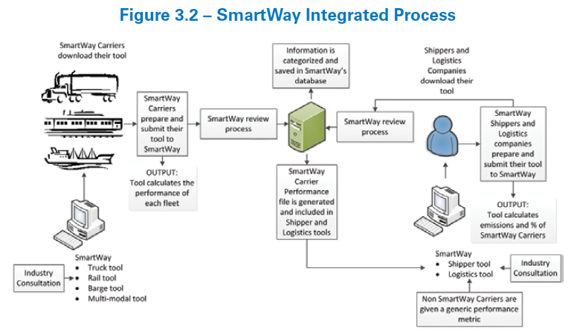
SECTION B. SUPPLEMENTAL MATERIAL
SMARTWAY Partner Tools, INPUTS, AND DATA FLOW PROCESS
Module III: Create Program
III-20
Notes:
Key Points (continued):
Carrier tools outputs are used as inputs in Shipper/Logistics tools for carrier ranking and/or emission footprints.
The program host coordinates collection and validation of partner data and may share performance information among carriers and their customers, ensure data quality, monitor partner satisfaction, and facilitate the evaluation of the program’s overall performance.

Slide 49
Supplemental Group Exercise
(30 min)
Download the SmartWay Truck and Shipper Tools
Review the example tools found at:
www.epa.gov/smartway/forpartners/index.htm
Module III: Create Program
III-25 – III-31

Slide 50
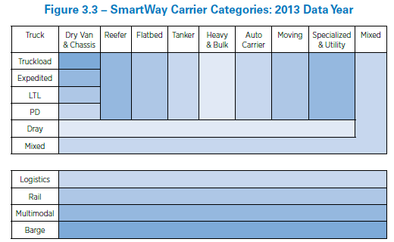
SECTION B. SUPPLEMENTAL MATERIAL
PARTNER Categories AND Performance
Carrier performance varies greatly depending on operation and body type, commodity, etc.
Break carriers into sub-categories to allow for “apples to apples” comparisons
Set the number of categories to:
  Provide fair comparisons
  Maintain an adequate number of
  carriers in each category
SmartWay truck carrier categories
are based on operation/body-type
intersections (see figure)
Module III: Create Program
III-18 – III-21
Notes:
Key Points:
Develop clear guidelines for assigning partners to specific program categories such as shippers, logistics companies, truck carriers, multi-modal carriers, etc.
Define truck carrier sub-categories to allow “apples to apples” comparisons (e.g., truckload dry van, flatbed, heavy-haul)
Carrier performance can be presented in a variety of ways. Identify presentation formats that are both acceptable to your carriers and useful to their customers.

Slide 51
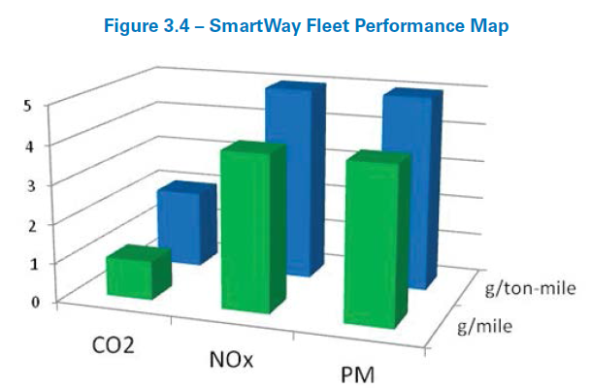
SECTION B. SUPPLEMENTAL MATERIAL
PARTNER Categories AND Performance
Under a SmartWay 2.0 approach, carrier performance can be reported by:
  Pollutant (CO2, NOx, PM, etc.)
  Metric (g/km, g/tonne-km, g/volume-km, etc.)
Performance may also be:
  Carrier-specific (if not considered confidential)
  Binned (e.g., ranked 1 through 5, with
  quantified ranges/midpoints,
  for example Bin 1 = 900–1,100 g/km)
An example carrier “performance map”:
Module III: Create Program
III-22
Notes:
Key Points (continued):
Develop clear guidelines for assigning partners to specific program categories such as shippers, logistics companies, truck carriers, multi-modal carriers, etc.
Define truck carrier sub-categories to allow “apples to apples” comparisons (e.g., truckload dry van, flatbed, heavy-haul)
Carrier performance can be presented in a variety of ways. Identify presentation formats that are both acceptable to your carriers and useful to their customers.

Slide 52
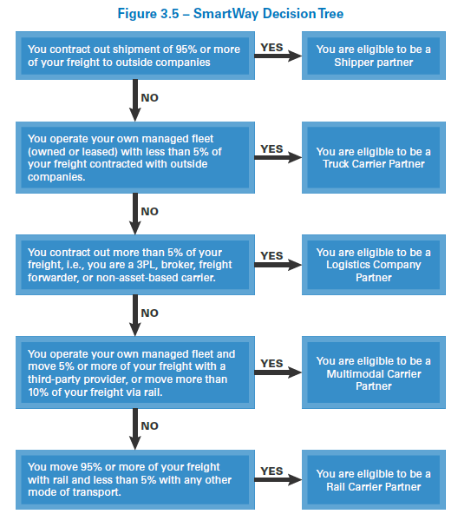
SECTION B. SUPPLEMENTAL MATERIAL
PARTNER Categories AND Performance
Freight operations are complex and
partner type assignments may not
be straightforward
Develop clear guidance to help
partners determine which tool to use
Example decision tree for SmartWay:
Module III: Create Program
III-24
Notes:
Key Points (continued):
Develop clear guidelines for assigning partners to specific program categories such as shippers, logistics companies, truck carriers, multi-modal carriers, etc.
Define truck carrier sub-categories to allow “apples to apples” comparisons (e.g., truckload dry van, flatbed, heavy-haul)
Carrier performance can be presented in a variety of ways. Identify presentation formats that are both acceptable to your carriers and useful to their customers.

Slide 53
Supplemental Group Exercise
(30 min)
Review Truck Tool
Review example reports
presented in worksheets.
Module III: Create Program
III-25 – III-28

Slide 54
B. Partner Tools and Database
Develop the partner management database to:
  Capture and store partner company, contact, and fleet information
  Validate and quality-assure incoming data
  Generate outputs and reports to measure program performance
Module III: Create Program
III-31 – III-34
Notes:
Key Points:
Your database should be designed to meet multiple needs including partner benchmarking, customer relations management, data quality assurance, and program performance evaluation.
Data quality checks should be integrated at all phases of data collection, review, and dissemination.

Slide 55
B. Partner Tools and Database
Provide best data quality assurance and quality control (QA/QC) practices
  Partners must enter data into tools
  accurately and completely!
  Encourage partners to perform data
  quality checks throughout data
  collection and reporting process
  Encourage third-party audits

Module III: Create Program
III-34 – III-37
Notes:
Key Points (continued):
Your database should be designed to meet multiple needs including partner benchmarking, customer relations management, data quality assurance, and program performance evaluation.
Data quality checks should be integrated at all phases of data collection, review, and dissemination.

Slide 56
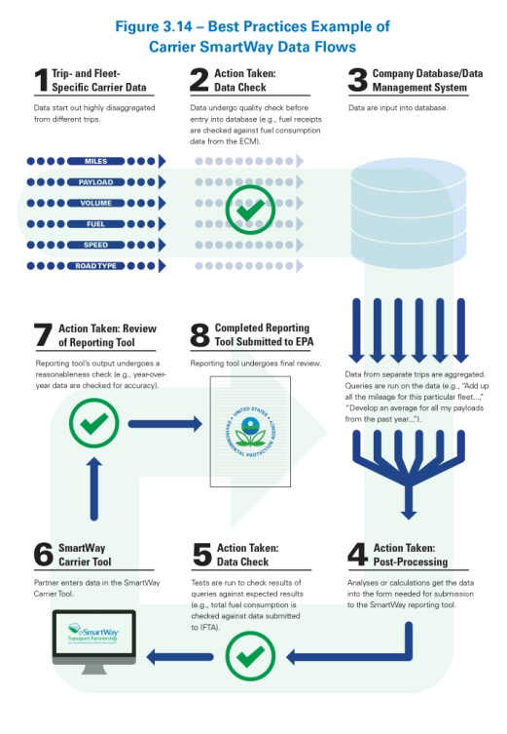
SECTION B. SUPPLEMENTAL Material
SMARTWAY DATA FLOWS and best qa/qc practices
Partners must enter data into the tools
accurately and completely so that partner
and program benefits can be accurately
determined
Partners should conduct their first QA/QC
checks when they collect and upload
disaggregated, trip-specific information into
their company’s data management system
Module III: Create Program
III-34 – III-37
Notes:
Key Points:
Partners should check their operations data for internal consistency and against known benchmarks where possible.
Partners should perform data quality checks at multiple points in the submission process, such as when they collect and organize disaggregated data, when they enter aggregated data into the tool, and when they review the completed tool.
Program administrators, or PAMs, should also perform quality checks, using automated range checks within the tools and program database and via reasonableness checks.

Slide 57
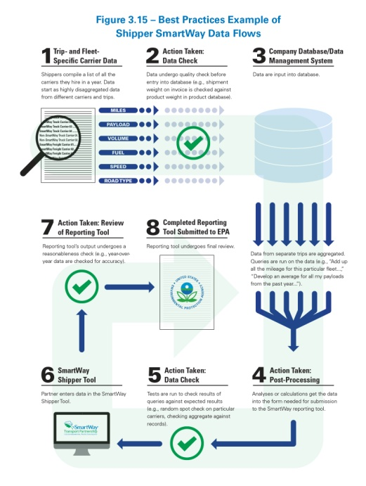
SECTION B. SUPPLEMENTAL Material
SMARTWAY DATA FLOWS and best qa/qc practices
Partners should perform a second set of
data checks when preparing their data for
the tools; at this stage, data are aggregated
across routes and trips to calculate total
distance traveled, ton-mileage hauled,
average payloads, etc.
Use tools to compare inputs, emissions,
and performance results with those from
prior years and to set validation ranges
PAMs should perform final reasonableness
checks once the data are in the database
Module III: Create Program
III-34 – III-37
Notes:
Key Points (continued):
Partners should check their operations data for internal consistency and against known benchmarks where possible.
Partners should perform data quality checks at multiple points in the submission process, such as when they collect and organize disaggregated data, when they enter aggregated data into the tool, and when they review the completed tool.
Program administrators, or PAMs, should also perform quality checks, using automated range checks within the tools and program database and via reasonableness checks.

Slide 58

C. Brand Development, Marketing, and Outreach
Branding and marketing
  Develop a single brand to quickly convey
  program value, purpose, strengths, and
  attributes
  Obtain input from key stakeholders/
  founding partners
Module III: Create Program
III-40 – III-45
Notes:
Key Points:
A brand will unify the program under an easily recognizable symbol, distinguish it from other programs, and communicate its offerings.
Effective branding and logo development can be complex; consider obtaining help from outside consultants.
Be sure to involve key stakeholders and founding partners in branding and logo development, as the brand is critical to establishing and communicating the program’s mission and identity.

Slide 59
Group Exercise
(30 min)
Create a brand platform
Consider the questions listed in the Manual on page III-41;
develop a one- to two- page “program brand” document.
Module III: Create Program
III-41

Slide 60
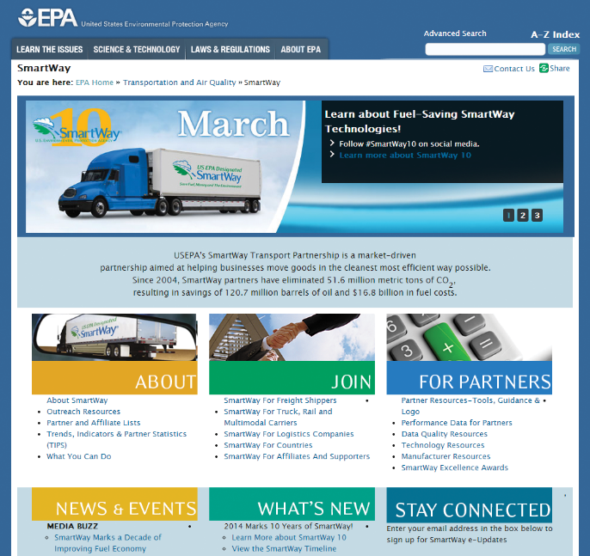

C. Brand Development, Marketing, and Outreach
Create initial marketing materials
  Basic program brochure
  Program website
  Letter to stakeholders
  Background information
Tip: Use program branding and
logo on all materials!
Module III: Create Program
III-45 – III-47
Notes:
Key Points:
Initial marketing materials should be program-branded and include an easy way to obtain more information about the program.
Websites of several green freight programs are listed on page B-1 in Appendix B of the Manual. These have many examples of program-branded materials. Links to and examples of SmartWay-specific branded materials are in Appendix C of the Manual.

Slide 61
Group Exercise
(10 min)
Partner outreach and support tools
Prioritize the types of
outreach tools you will need first.
Module III: Create Program
III-47

Slide 62

C. Brand Development, Marketing, and Outreach
Leverage media, events, and public recognition opportunities
  Author and submit articles to trade
  publications
  Find your audience on their social
  media platforms (e.g., Twitter,
  LinkedIn) and post timely and
  useful content
  Arrange for advertising space in carefully selected media
  Research and attend events where your target audience gathers
Module III: Create Program
III-47 – III-51
Notes:
Key Points:
Media outreach should be multifaceted (social as well as traditional media, paid and well as public service announcements).
Conferences, events, expos, and forums where the target audience gathers can offer key opportunities for reaching potential partners and other stakeholders.

Slide 63
Group Exercise
(10 min)
Create a targeted list of conferences and events
Identify potential conferences and trade shows for your
program to attend. List by industry sector and priority.
Module III: Create Program
III-51

Slide 64

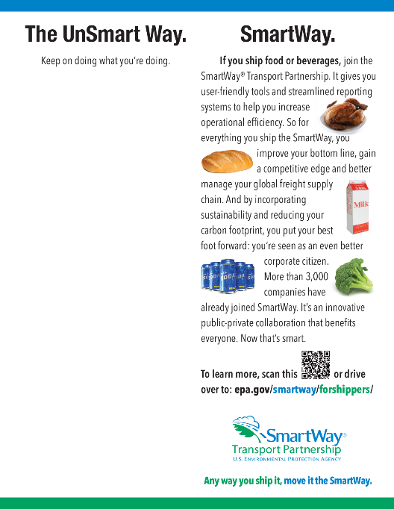
C. Brand Development, Marketing, and Outreach
Ways to provide partners with
public recognition
  Positive media coverage via
  paid or PSA ad campaign(s)
  Logo usage
  Excellence awards
Module III: Create Program
III-52
Notes:
Key Points:
Voluntary programs rely heavily on positive public recognition of Partners who achieve program goals. A range of options can be used to confer this recognition, from logo use to high-profile awards ceremonies.
Programs can also create incentives for partners to take action. For example, program logo use can be reserved for Partners who submit data within a certain timeframe or who achieve certain levels of performance or efficiency in their operations.

Slide 65
Group Exercise
(20 min)
Identify outreach and Partner support tools
Prioritize outreach tools and
estimate resources needed.
Module III: Create Program
III-47

Slide 66
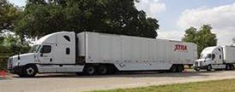
D. Technology Verification and Labeling
Performance testing and verification
helps show which technologies and
strategies work for different truck
types and use patterns
Labeling helps partners identify
reliable, cost-effective technologies and practices
Consider leveraging existing verification programs
Start by focusing on “low-hanging fruit” (will vary by region/fleet types)
  Driver training
  Basic logistics improvements
  Idle reduction strategies
Module III: Create Program
III-58 – III-73
Notes:
Key Points:
Technology strategies vary greatly in terms of cost, effectiveness, and applicability depending upon vehicle operation patterns, age, body types, and other area-specific characteristics.
Strategies may be implemented through retrofits or new vehicle purchases.
Strategies like driver training and logistics enhancements complement technology efforts and can improve efficiency in the near term while technology verification efforts are being developed.
Unique operating conditions and fleet characteristics may warrant test protocols tailored to each region/country.
Use other certifications (e.g., SmartWay, CARB) where reasonable and locally appropriate to help reduce costs and conserve technical resources.
More comprehensive training on technology verification is available. Look for new resources and opportunities.

Slide 67
D. Technology Verification and Labeling
SmartWay Strategies: Cost vs. Fuel Savings
Source: Cascade Sierra Solutions
Module III: Create Program
III-58 – III-73
Notes:
Key Points (continued):
Technology strategies vary greatly in terms of cost, effectiveness, and applicability depending upon vehicle operation patterns, age, body types, and other area-specific characteristics.
Strategies may be implemented through retrofits or new vehicle purchases.
Strategies like driver training and logistics enhancements complement technology efforts and can improve efficiency in the near term while technology verification efforts are being developed.
Unique operating conditions and fleet characteristics may warrant test protocols tailored to each region/country.
Use other certifications (e.g., SmartWay, CARB) where reasonable and locally appropriate to help reduce costs and conserve technical resources.
More comprehensive training on technology verification may be available soon. Look for new resources and opportunities.

Slide 68
Group Exercise
(20 min)
Discuss area-specific factors influencing technology adoption
What technologies are common in your region?
How is their adoption blocked or encouraged?
Module III: Create Program
III-61 – III-69

Slide 69
Group Exercise (continued)
(20 min)
Barriers Influencing Technology Adoption
Potential Barrier | Suggestions to Overcome Barrier
Technology Availability
Technology Verification
Financing
Regulatory
Institutional
Education & Training
Other barriers?
Module III: Create Program
III-61 – III-69

Slide 70
Module IV: Launch and Implement Program
Launch charter partners
Recruit partners
Train Partner Account Managers (PAMs)
Launch database
Launch program tools
Launch finance program
Begin marketing activities, hold inaugural launch event
Module IV: Launch and Implement Program
IV-1

Slide 71

A. Launch Charter Partners
You are ready to go—
tell your charter partners!
Plan a special recognition
event
Invite media, provide
quotes
Establish a pilot period
Module IV: Launch and Implement Program
IV-2
Notes:
Key Points:
Program managers need to communicate with charter partners before launching the program to get permissions and buy-in.
A special, media-friendly launch event with high-ranking officials will pay off.
Upfront planning is important and will help ensure that:
Charter partners are on board and comfortable with their special status.
The event is timed and placed to encourage attendance of representatives from the media, government agencies, and leadership of the charter partners.
Charter partner certificates carry symbolic weight:
They are official symbols of third-party recognition.
Ceremonial presentation of certificates can be made into a newsworthy event.

Slide 72
Group Exercise
(10 min)
Identify new partners
Prioritize list to help allocate
initial recruiting resources.
Module IV: Launch and Implement Program
IV-3

Slide 73

B. Recruit Partners
Use proven techniques to recruit
  Leverage current relationships
  Use industry resources
  Develop new strategic
  relationships
  Attend conferences, expos,
  and events
  Hold face-to-face meetings
  Place cold calls and send
  direct mailings
Module IV: Launch and Implement Program
IV-3 – IV-5
Notes:
Key Points:
To recruit successfully, participants should use such successful techniques as:
Leverage current relationships; ask stakeholders you know if they know prospective partners. Use industry resources; these will help you identify leaders and innovators.
Develop strategic relationships; network through industry associations; national trade groups, related public and nonprofit sector organizations, etc., to find groups with similar goals.
Review tips on the effectiveness of face-to-face meetings, finding and talking to the appropriate person in the company, and recognizing when prospects are just not interested.
If time permits, ask participants to discuss other creative recruiting strategies and techniques that they would recommend using, given their knowledge of the industry and local culture.

Slide 74
Group Exercise
(10 min)
Evaluate industry resources
What resources will provide
information on prospective partners?
Module IV: Launch and Implement Program
IV-5

Slide 75

C. Train Partner Account Managers
Assign and train PAMs to
  Help with database use and
  reporting
  Respond to questions from
  the helpline
  Assist partners, cultivate
  relationships
  Assist with marketing the program
  Collect feedback
Module IV: Launch and Implement Program
IV-6 – IV-9
Notes:
Key Points:
PAMs are essentially personal program consultants to partners. They are customer service agents and program ambassadors. Their role will vary depending on your program’s particular setup, but overall they are the face ofthe program for partners.
PAMs need training and specific assignments to succeed and best serve the program. Talk about their responsibilities (listed on the slide) and the training and tools they will need to do their jobs.
Ask participants to discuss what types of people and skill sets would make good PAMs and what their specific responsibilities would entail.

Slide 76
Group Exercise
(10 min)
Create a PAM framework
How will PAMs be assigned?
Module IV: Launch and Implement Program
IV-9

Slide 77
D., E., & G. Launch Database, Tools, AND KICK OFF!
For database and tools, confirm that:
  They are ready for users to enter and export data, etc.
  PAMs and database administrators are trained to review
  and approve partner tools
  Backup, security, and validation procedures and checks
  are in place
Hold high-visibility event to officially kick off program!
  Recognize charter partners, demo tools and technologies, hold
  press conference
Module IV: Launch and Implement Program
IV-10 – IV-13
Notes:
Key Points:
Program tools, including database and reporting tools, must be tested by selected industry partners and ready before
the program launches.
Partners need clear instructions and training on how to use the tools and database.
Celebrate with a high-profile kickoff event.

Slide 78
Group Exercise
(30 min)
Download the SmartWay Truck Tool
Review the process of filling out
and completing the tool.
Module IV: Launch and Implement Program
IV-12

Slide 79

F. LAUNCH FINANCE PROGRAM
Finance program will help partners
overcome a significant barrier to
participation: high upfront costs of
retrofit technologies and engine
replacements
Launch your finance program with
the main elements of your green
freight program to maximize press
Module IV: Launch and Implement Program
IV-12
Notes:
Key Points:
A finance program can help partners overcome a significant barrier to participating in your program—high upfront costs of retrofit and/or new vehicle technologies.
Coordinate launch of the finance component with the rest of the program to maximize interest in both.
Provide user-friendly tools to help identify investments with quick payback.
Provide clear information on available financing options, including grant/loan terms, payment details, etc.

Slide 80
Group Exercise
(10 min)
Outline your finance program
Identify your preferred structure
and funding needs.
Module IV: Launch and Implement Program
IV-12

Slide 81
Module V: Evaluate, Refine, Enhance, and Expand
Collect partner feedback
Compile, process, and evaluate data
Refine and add new elements to enhance and expand program
Module V: Evaluate, Refine, Enhance, and Expand
V-1

Slide 82
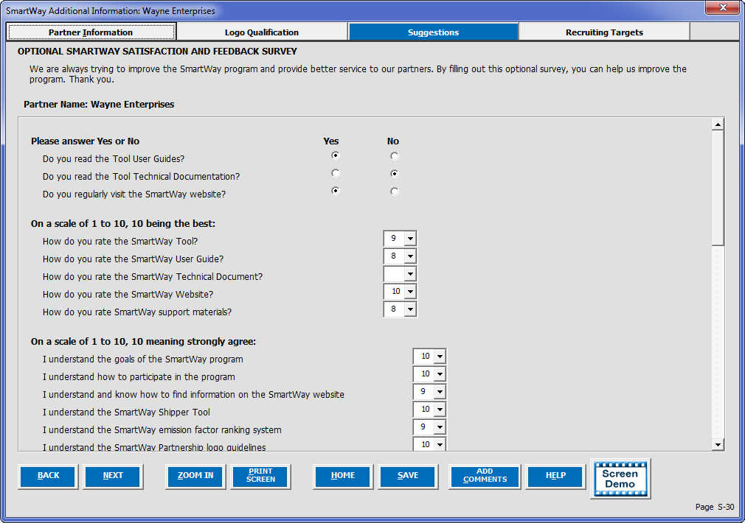
A. Collect Partner Feedback
Partners are great resources for ideas and feedback that will help you set and achieve goals
  Times to collect feedback
  Questions to ask
  Tools and techniques to
  collect feedback
Module V: Evaluate, Refine, Enhance, and Expand
V-2 – V-6
Notes:
Key Points:
All partners, whether they are charter partners, longstanding or newly recruited, can provide valuable perspectives on different aspects of the program.
Third-party stakeholders can also provide “big picture” feedback on the program’s overall impact.
Tailor questions to the experiences of the stakeholders you are collecting feedback from.
Consider the capabilities of your stakeholders and the feedback you seek when determining tools and techniques to use.
Not all feedback will be realistic for the program at the time that it is received. Program resources and strategic priorities will limit the actions you can take.

Slide 83
Group Exercise
(15 min)
Develop a feedback plan
Brainstorm five questions for partners
and how to collect responses.
Module V: Evaluate, Refine, Enhance, and Expand
V-6

Slide 84

B. Compiling, Processing, and Evaluating Data
Use feedback and partner performance data to improve the program and estimate overall program benefits
  Find opportunities for incremental
  improvements to the tools/database
  as well as system-wide improvements
  Use data to inform development of
  new standards, policies, and regulations
Module V: Evaluate, Refine, Enhance, and Expand
V-7
Notes:
Key Point:
Collecting feedback and partner data should be a continuous process throughout every stage of program development and implementation.
Continuous evaluation and improvement will strengthen the program over the long term (provide examples from other programs as available).
Partner performance data will be useful for both evaluating program success and assessing the state of the freight industry as a whole:
Academics and other stakeholders can use the data to identify opportunities for system-wide improvements.
Regulatory agencies can use the data to inform regulatory development of fuel efficiency and emission control standards.

Slide 85
Group Exercise
(15 min)
Examine an example benefits calculation
Review of SmartWay’s TIPS pages.
Module V: Evaluate, Refine, Enhance, and Expand
V-7

Slide 86

C. Refine and Add New Elements to Enhance Program
Ideas for mature green freight
programs
  Recruit smaller carriers
  Develop Web-based tools
  Expand to other modes
  Incorporate operational strategies
  Develop Affiliate Program
Module V: Evaluate, Refine, Enhance, and Expand
V-8 – V-12
Notes:
Key points
Developing special incentives and allowances to meet the needs of small “owner-operator” carriers, such as low-/no-interest loans or subsidies for retrofits and streamlined reporting forms, can encourage their participation.
Develop tools to help quantify the benefits associated with improved operations (e.g., drop-and-hook strategies).
Web-based tools can provide added value to partners by:
Minimizing the difficulties of relying on an Excel-based reporting tool.
Providing access to partner data and industry averages.
Enabling partners to calculate costs of efficiency improvement options.
Providing access to key documents.
Create an Affiliate Program to enable organizations that support your goals but cannot participate as partners, such as nongovernmental agencies, trade associations, and universities, to help create awareness and expand your program.

Slide 87
Group Exercise
(10 min)
SmartWay Partner Portal
View examples demonstrating year-to-year
and inter-partner comparisons.
Module V: Evaluate, Refine, Enhance, and Expand
V-12

Slide 88





C. Refine and Add New Elements
Other ideas
  Expand to include new pollutants, such as black carbon
  Coordinate and harmonize with regional programs or global carbon accounting systems, such as Green Freight Asia and GLEC
Module V: Evaluate, Refine, Enhance, and Expand
V-13 – V-14
Notes:
Key points:
Once trucks, shippers, and logistics companies are accounted for in a green freight program, consider expanding to other modes such as rail/intermodal, inland marine, ocean-going marine, and air freight carriers. (Emphasize the modes of freight that are dominant in your country.)
Additional modes of freight have different operating characteristics and require special consideration to be brought into a green freight program. (Provide examples based on modes of freight that are dominant in your country.)
Including additional pollutants, like black carbon, in a green freight program can reduce other greenhouse gas and climate-changing emissions and is easy to do with activity estimates already developed.
Globalization has led to an increase of shippers with global multimodal supply chains. Bringing your green freight program toward a standardized accounting system is a significant benefit, as global shippers are increasingly asking their carriers to use one.

Slide 89
Group Exercise
(10 min)
Program expansion areas
Explore modes, sectors, pollutants, and other needs
that could be addressed in your country.
Module V: Evaluate, Refine, Enhance, and Expand
V-14

