Slide 1
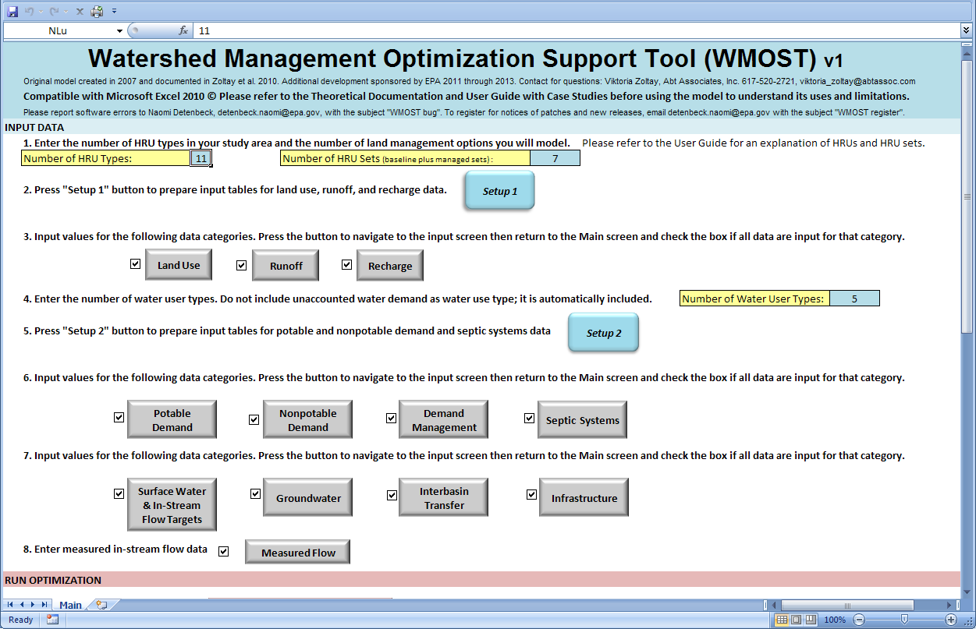
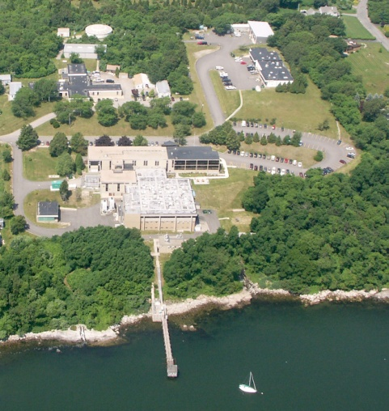
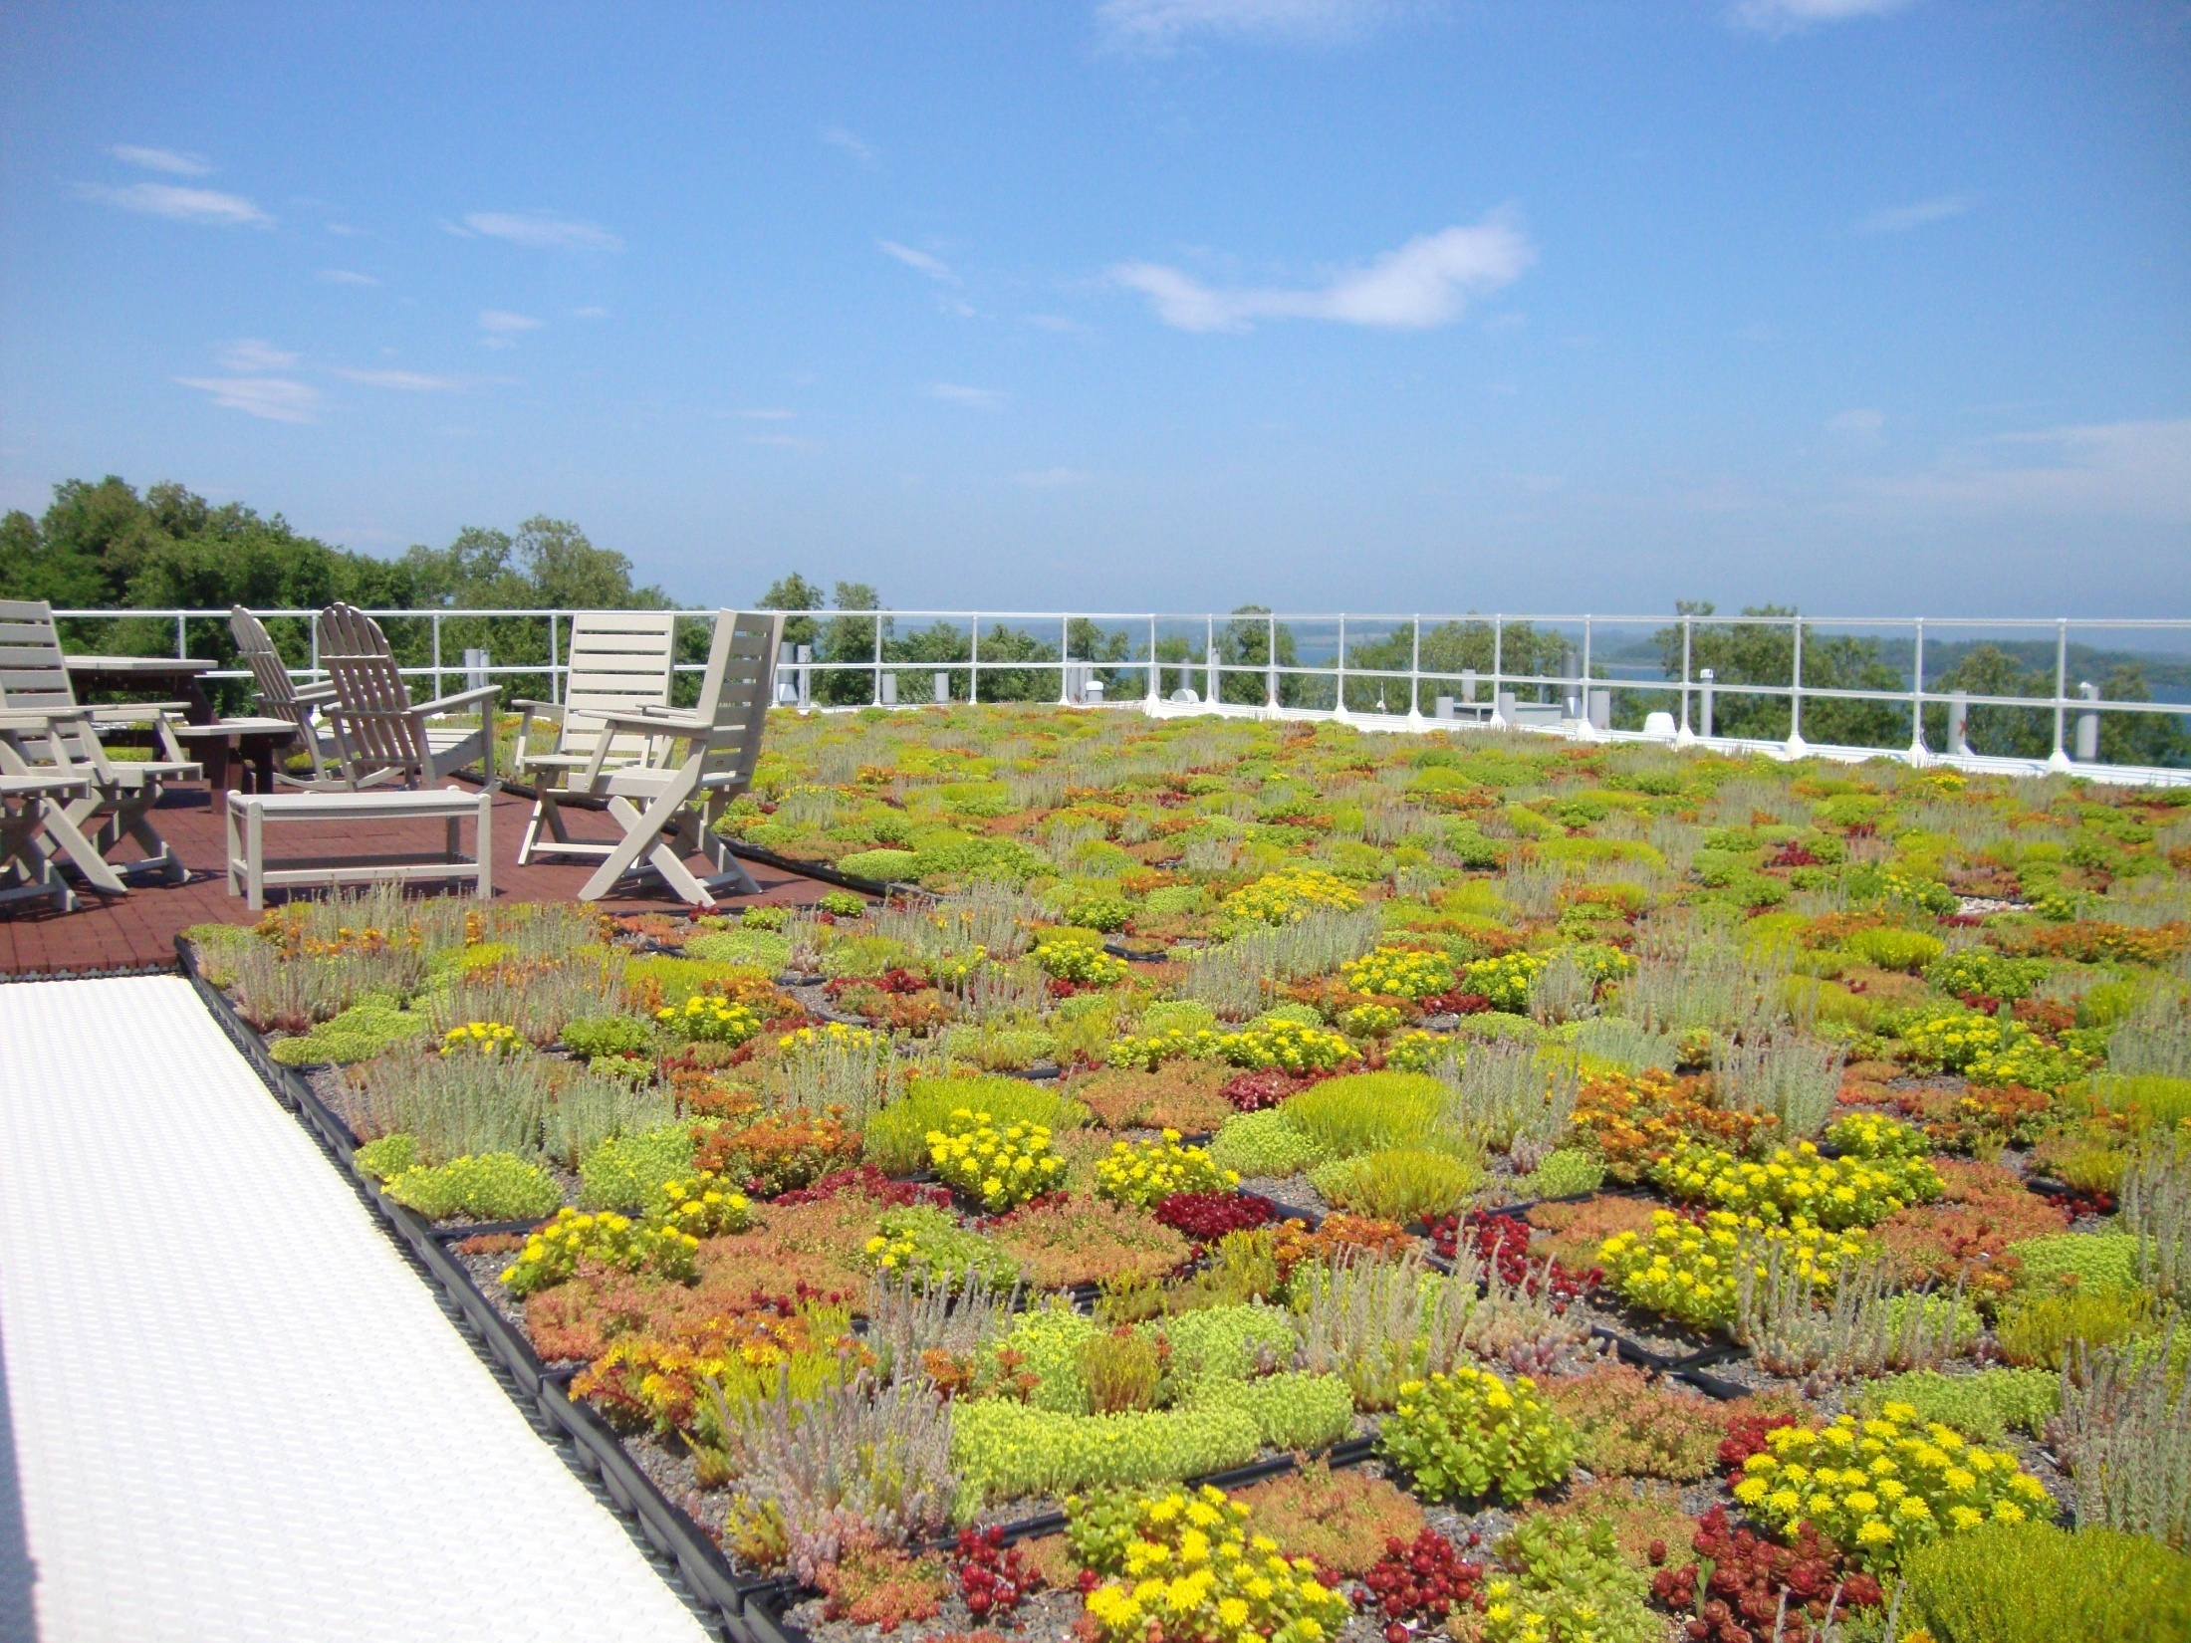
Managing Watersheds with WMOST
(Watershed Management Optimization Support Tool)
Dr. Naomi Detenbeck
US EPA ORD/NHEERL/Atlantic Ecology Division
Safe and Sustainable Water Resources Program Webinar Series
January 22, 2014

Slide 2

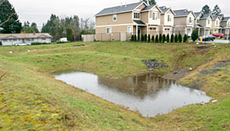
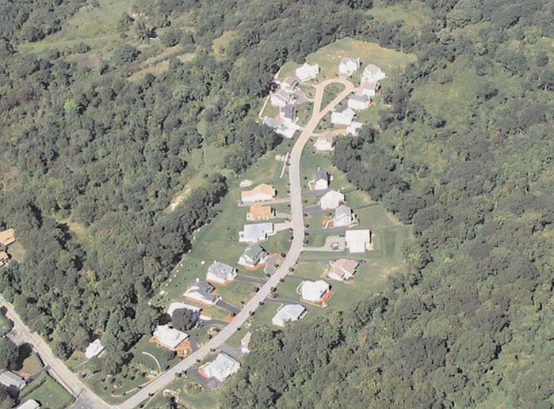
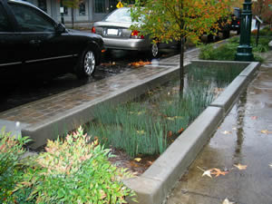
Topic 4 Maintaining and Improving Natural and Engineered Water Systems
Green Infrastructure (GI) for Stormwater Management
Office of Research and Development
19 April 2012

Slide 3
Overview
Why did we develop WMOST?
How did we engage stakeholders?
What are the fundamental components of WMOST?
What does a basic model run look like?
What did we find in our initial case studies?
What are the future development needs identified by stakeholders?
How can you obtain a copy of WMOST?

Slide 4
Impetus for WMOST
EPA Office of Water support for GI and Integrated Planning (stormwater, wastewater)
At municipal scale, opportunities for application of green infrastructure to solve water resource problems are under-utilized (ARRA, SRF)
States face challenge of developing balanced approaches for equitable and predictable distribution of water resources to meet both human and aquatic life needs
  MA Sustainable Water Management Initiative (SWMI)
  RI Water Resources Board Strategic Planning

Slide 5
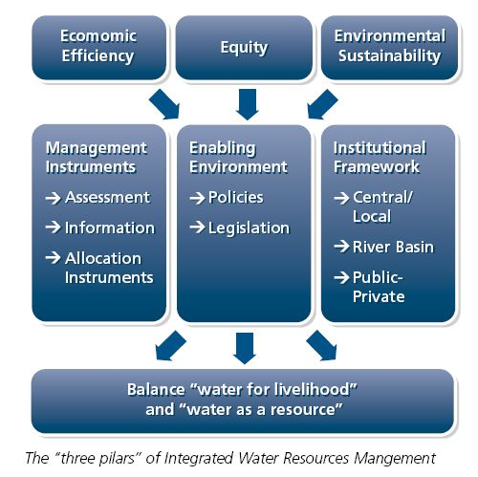
Integrated Water Resources Management for problem-solving
Limited resource
Framework for problem – solving in an integrated fashion
  Drinking water
  Wastewater
  Stormwater (GI BMPs)
  Land-use (LID)
Optimize solutions within defined set of constraints
  Benefits/Co-benefits
  Costs
  Tradeoffs

Slide 6
WMOST Development Team
Tool Developers
Abt Associates, Inc.
  Viktoria Zoltay, Lauren Parker, Becky Wildner, Isabelle Morin
Subcontractors
  Nigel Pickering (Horsley Witten Group), Richard Vogel (Tufts University)
Development Team
US EPA NHEERL Atlantic Ecology Division
  Naomi Detenbeck, Marilyn ten Brink, Alisa Morrison (student contractor)
US EPA Region 1
  Ralph Abele, Jackie LeClair
US EPA NERL Ecosystems Research Division
  Yusuf Mohamoud

Slide 7
Project Timeline
Technical Advisory Group
Prioritized changes
WMOST Beta
Case studies
Workshop
Research
Model
WMOST v1.0
Recommendations for future enhancements and expansion

Slide 8
Technical Advisory Group
  Kathy Baskin / MA EOEEA
  Mark Clark / North Reading, MA
  Steven Estes-Smargiassi / MWRA
  Scott Horsley / Horsley & Witten
  Greg Krom / Topsfield, MA
  James Limbrunner / HydroLogics
  Jay Lund/ UC Davis
  Yusuf Mohamoud / EPA
  Rosemary Monahan / EPA
  Nigel Pickering / Horsley & Witten
  Dave Sharples / Somersworth, NH
  Hale Thurston / EPA
  Richard Vogel / Tufts University
  Peter Weiskel / USGS
  Kirk Westphal / CDM Smith

Slide 9
WMOST Development Objectives
Refine an existing tool to facilitate integrated watershed management at the municipality scale
  Screen management practices for water and water-related resources within a watershed context for an optimal mix
  Water supply, wastewater, stormwater, in-stream conditions, groundwater, land use
  Provide insight on costs, benefits and trade-offs
Special considerations
  New England municipalities (and beyond)
  Low impact development (LID)/green infrastructure(GI)
  Support evaluation of GI/LID use and provide information for SRF application to implement GI/LID
Notes:
New England municipalities → will guide initial decisions on model development

Slide 10
Existing WMOST Model Objective
What is the optimal set of actions to achieve water quantity related management goals at least cost?
  Meet demand for water or wastewater services
  Maintain minimum in-stream flows to protect aquatic life use
  Considers only costs and revenues, therefore, shadow prices reflect ‘replacement cost’
  Does not yet include valuation of in-stream flow benefits, i.e., ecosystem services
Notes:
US FWS ABF because at the time that was the “default” standard used in many places in NE. The model has the ability to use different streamflow targets such as those developed for SWMI

Slide 11
Optimization Tool
Elements
Desired Characteristics
Natural hydrologic cycle
Human hydrologic system
Comprehensive & Integrated Framework
Interaction points and
processes
Management practices
Optimization Capabilities
Familiar, Accessible Software
Decision support system
Generic
Output Support

Slide 12
Model Schematic

Slide 13
Management Practices
Stormwater
  Bioretention basin, Infiltration basin, horizontal wetland
  Design depth of 0.60” and 2.00” rain event
Land conservation
Demand management via pricing
Change use of existing infrastructure
Increase capacity of existing infrastructure
Repair infrastructure
Build new infrastructure
Interbasin transfer of water or wastewater

Slide 14
WMOST Framework
User interface (Excel, MS Office 2010)
  Guided, flexible
Model builder (VB)
  Custom-built optimization model
Solver (Lp_solve)
  Linear programming solver
  Free, non-proprietary
  Seamlessly integrated
Output display
Notes:
1.Hard-coded excel cells & numerous worksheet tab to navigate → High level of user orientation
2. Flexible: Time step and period, Number of water users, land use, and stormwater practices
3. ~$2,000 per license, Optimization setup requires user adjustment; WMOST→ customization without user interaction or re-setting

Slide 15
Case Study Example
Danvers-Middleton, MA
(MA SWMI* Pilot)
* Sustainable Water Management Initiative

Slide 16
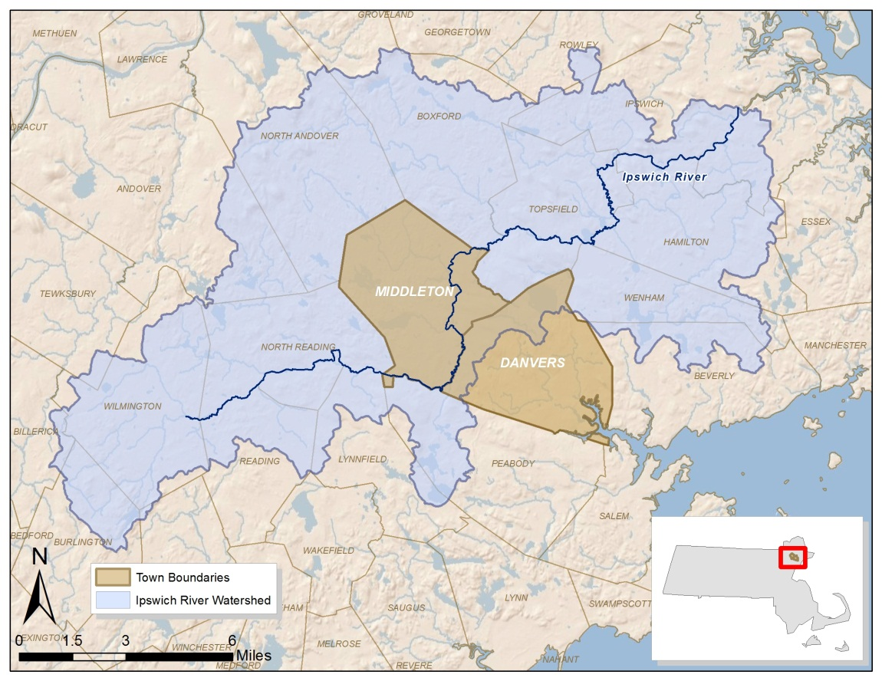
Case Study: Danvers and Middleton, MA
 | Danvers | Middle-ton
Area | 14 sq miles | 14 sq miles
Land use | ~25% developed in 2005
Drainage Area to IR | 28% | 100%
Population (2010) | 26,493 | 8,987
Water | mainly SW 3 reservoirs (710 MG) 2 wells | 56% from Danvers
Wastewater | 99% sewered and exported | mainly septic

Slide 17
Main Screen
HRU = Hydrologic Response Unit, unique combination of soil type and land-use
Number of management scenarios including baseline
#1
#2

Slide 18
Main Screen
#1
#2
Track progress
#3
Initialize input tables
#3a-c

Slide 19
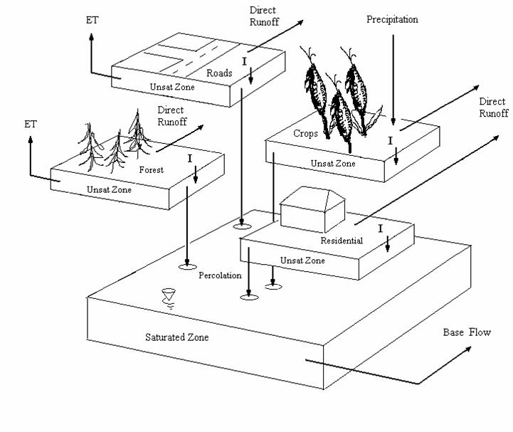

Hydrologic Response Units
Runoff
Runoff and recharge rates:
Baseline
Runoff
Runoff
Runoff
Recharge
Recharge
HRU 1
Recharge
Recharge
Adapted from Limbrunner et al., 2005
Notes:
[Animation: 1. “Each HRU (unique combination of land use, soil, etc) has own runoff and recharge rate based on existing or baseline conditions”
2. Add detention basin: “Each HRU also has R and R rate modified for a BMP that user wants to consider such as detention basin”
3. Add swales: “or vegetated swales as illustrated here”]
Only the runoff and recharge data are taken from watershed simulation model (i.e., not precip or ET)
Baseline RRR: Use watershed model (SWAT, HSPF)
Managed rates: BMP-DSS V2 for ArcGIS 9.3. Originally developed by TetraTech for Prince George’s County and then adapted for EPA Region 1’s performance curve study

Slide 20
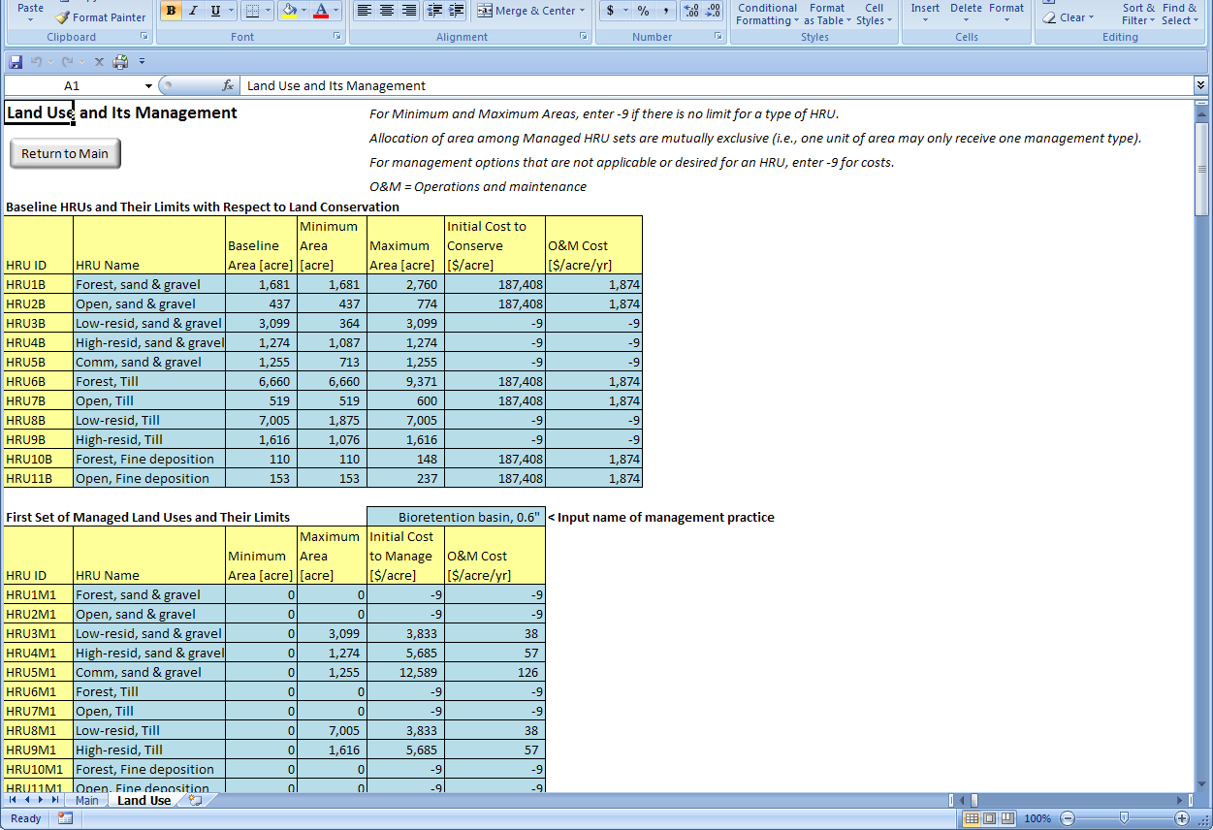
Land conservation options

Slide 21
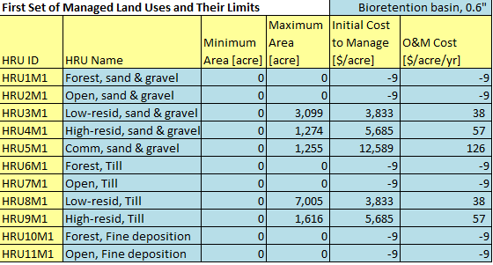
Specifying Stormwater Practices
Add a “managed land use set” for each practice
Practice = structural BMP, multiple structural BMPs, LID (e.g., lower IS), LID + BMP
Feasible land area
BMP description
Costs
Initial = all inclusive implementation cost
O&M = annual upkeep through lifetime
BMP is not permitted on undeveloped land uses
Notes:
Costs are annualized over lifetime and BMP replaced if modeling period is greater than lifetime
Initial cost is all inclusive, e.g., plan, design, permit, and build

Slide 22
Runoff and Recharge Rates (RRR)
Runoff
Runoff and recharge rates:
Baseline
Detention pond*
Swale*
Runoff
Runoff
Runoff
Recharge
Recharge
HRU 1
Recharge
Recharge
*Managed rates: BMP-DSS V2 for ArcGIS 9.3. Originally developed by TetraTech for Prince George’s County and then adapted for EPA Region 1’s performance curve study
Adapted from Limbrunner et al., 2005
Notes:
[Animation: 1. “Each HRU (unique combination of land use, soil, etc) has own runoff and recharge rate based on existing or baseline conditions”
2. Add detention basin: “Each HRU also has R and R rate modified for a BMP that user wants to consider such as detention basin”
3. Add swales: “or vegetated swales as illustrated here”]
Only the runoff and recharge data are taken from watershed simulation model (i.e., not precip or ET)
Baseline RRR: Use watershed model (SWAT, HSPF)
Managed rates: BMP-DSS V2 for ArcGIS 9.3. Originally developed by TetraTech for Prince George’s County and then adapted for EPA Region 1’s performance curve study

Slide 23
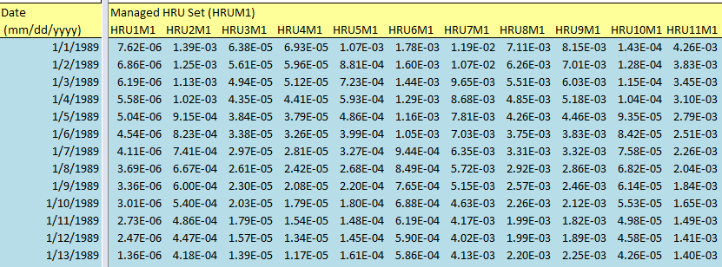
Time Series of RRRs
Time series of runoff and recharge rates (e.g., inches per day)
For HRUs where practice is permitted
Notes:
one “managed land use set”

Slide 24
Sources of RRR
Output from watershed or other hydrologic model
  SWAT – Soil Water Assessment Tool
  HSPF – Hydrological Simulation Program-Fortran
  Stormwater Calculator
  SWMM – Storm Water Management Model
  GWLF – Generalized Watershed Loading Function
Models exist for numerous watersheds

Slide 25
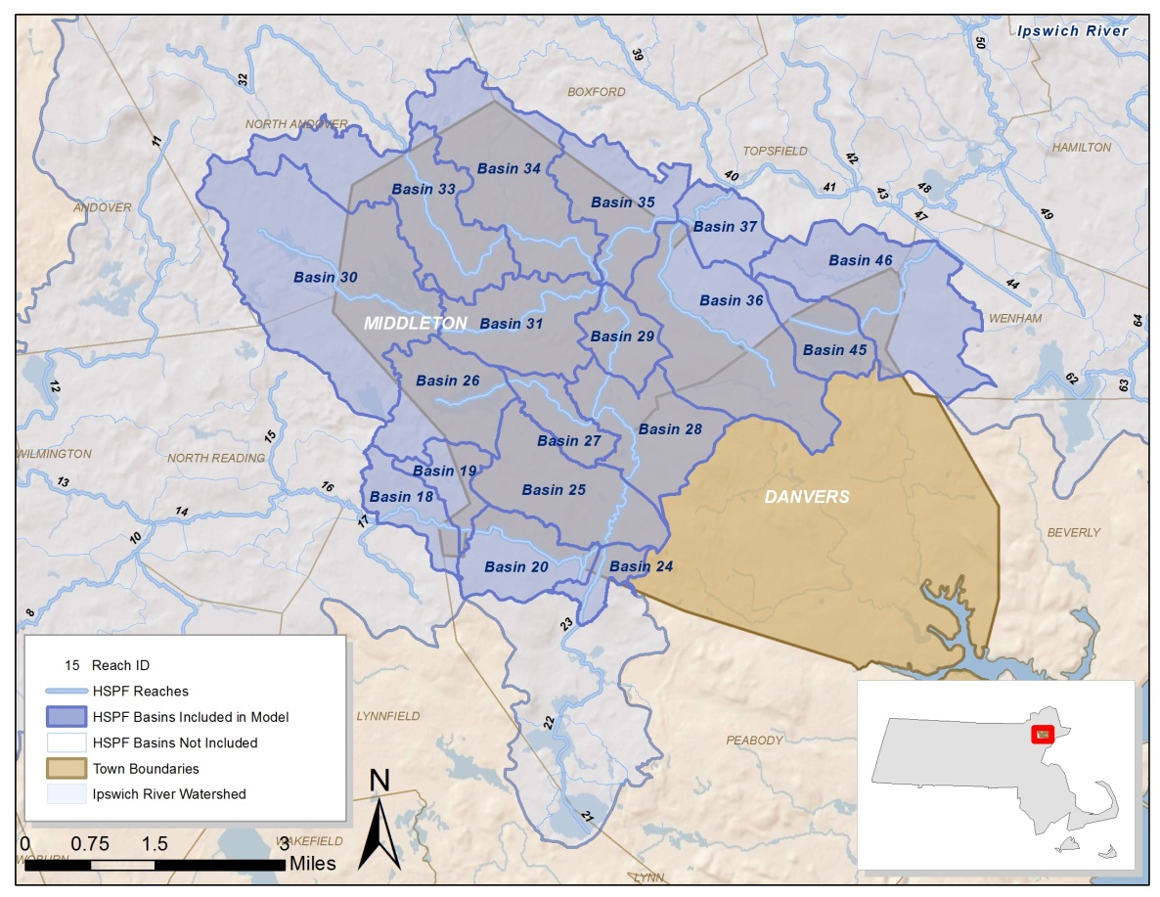
DM Case Study: Use of HSPF Model
1989-1993
11 Land uses (land cover and surficial geology)
Runoff rate
Recharge rate (interflow and recharge)
Withdrawals
Aquifer characteristics
Streamflow (upstream inflow, outflow as ”measured”)
Notes:
USGS HSPF model
For hydrology: all subbasins overlapping with DM
For management practices: DM area draining to IR only
Mainly affects LU areas, RRRs, stormwater management, septic
**wetlands not modeled as land area but as reaches therefore were not

Slide 26
DM Case Study:
Available Management Practices
  Stormwater
    Bioretention basin, Infiltration basin, horizontal wetland
  Design depth of 0.60” and 2.00” rain event
Land conservation
Demand management
  Pricing
  Rebates for water efficient appliances
Infrastructure
  Change use of, repair and/or increase capacity of existing
  Construction of new
Interbasin transfer of water or wastewater
Notes:
Infrastructure: WTP, WWTP, distribution system, collection system, WRF, ASR, nonpotable distribution system
IBT: Water – MWRA
Wastewater – SESD
Switch to model, show interface and run

Slide 27
Main Screen
#1
#2
#3
#3a-c
#4
#5
#5a-d

Slide 28
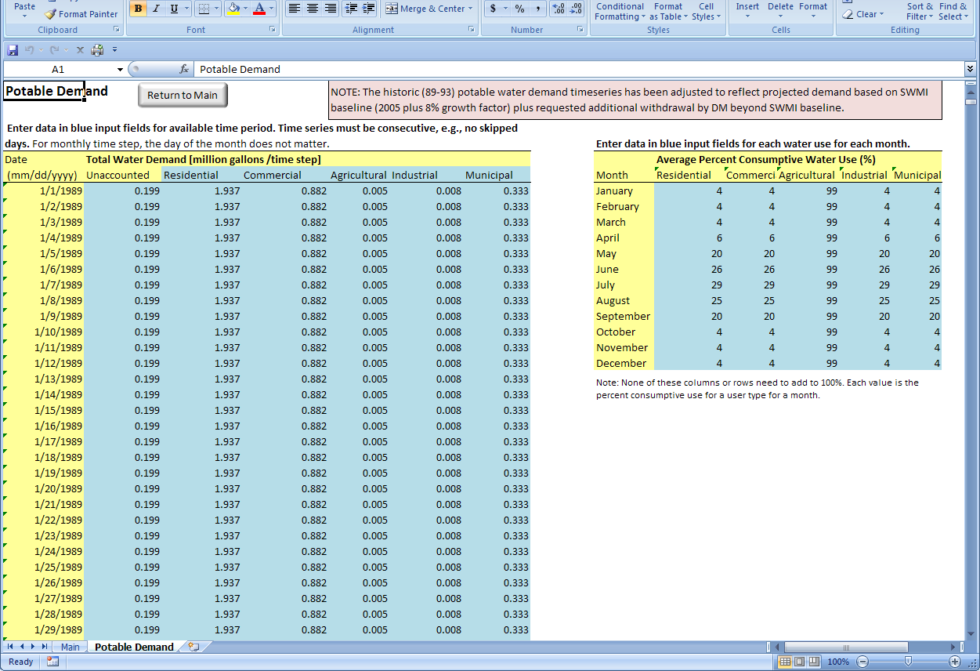
Potable Demand
Water withdrawal and demand and consumptive use data may be available from state or regional sources. For example, in Massachusetts the Department of Environmental Protection receives such data in the form of Annual Statistical Reports from water utilities.

Slide 29
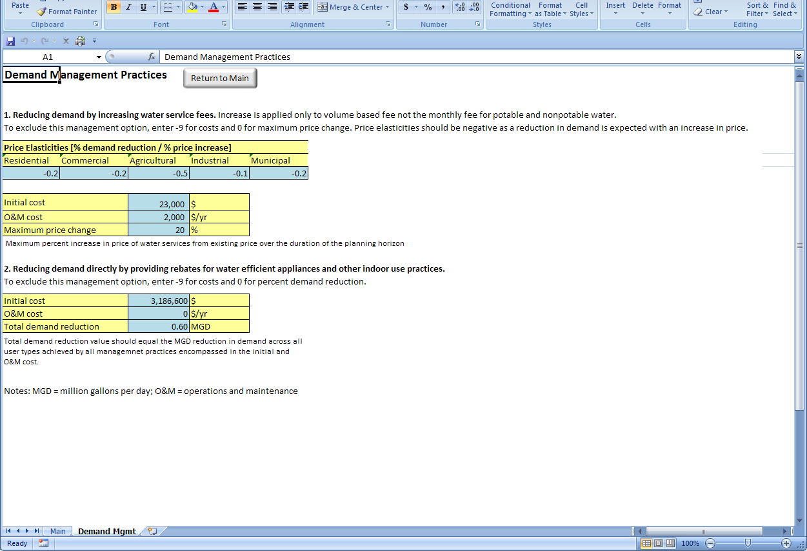
Demand Management
The first option is reducing demand by increasing the price of water services. Specify the price elasticity – percent change in water use divided by percent change in price – for each type of water user. The initial cost may reflect the cost of a study to determine effective pricing structure and values, billing frequencies, changes in billing logistics, and consumer outreach to convey the importance of efficient use of water resources and the planned change in pricing. O&M costs may reflect smaller studies to re-evaluate pricing every year or five years.
The second option is direct demand reductions which may be achieved using rebates for water efficient appliances, changing building codes, educational outreach and other practices.*
* See EPA’s WaterSense website for more info ( http://www.epa.gov/watersense/our_water/start_saving.html#tabs-3 ).

Slide 30
Main Screen
#1
#2
#3
#3a-c
#4
#5
#5a-d
#6
#7
#8
#9

Slide 31
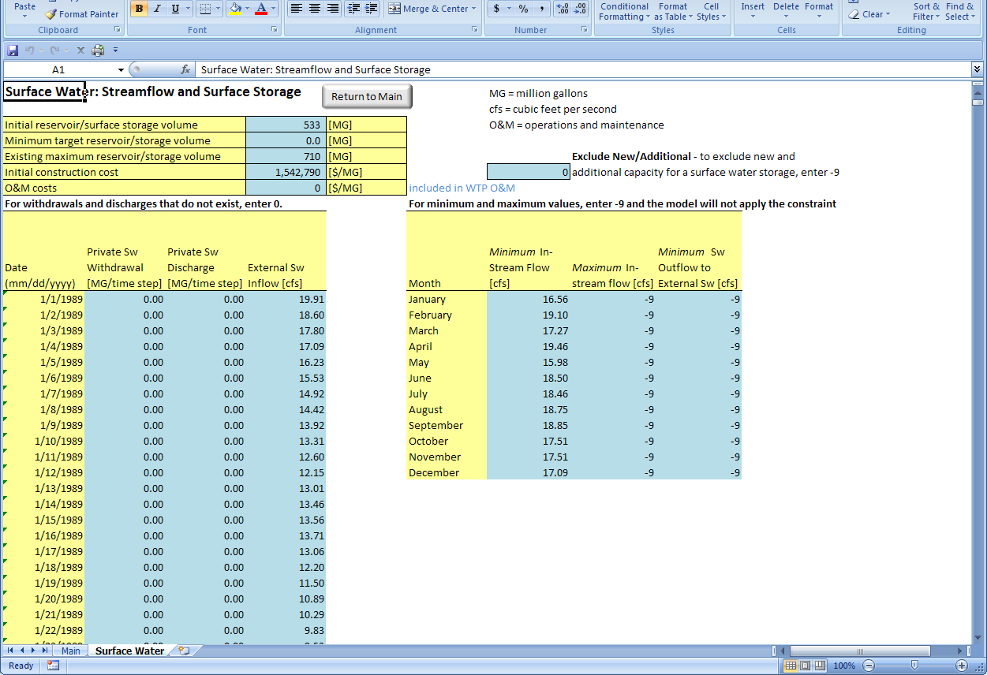
Surface Water Characteristics
Storage
Stream flow targets
Stream flow in

Slide 32
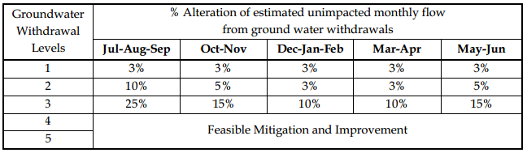
DM Case Study:
Streamflow Criteria
Massachusetts Sustainable Water Managemnet Initiative (SWMI) Framework
  Methodology for defining Safe Yield in Massachusetts’ 27 watersheds
  Methodology for application of streamflow criteria by the Department of Environmental Protection when issuing Water Management Act permits
http://www.mass.gov/eea/air-water-climate-change/preserving-water-resources/sustainable-water-management/

Slide 33
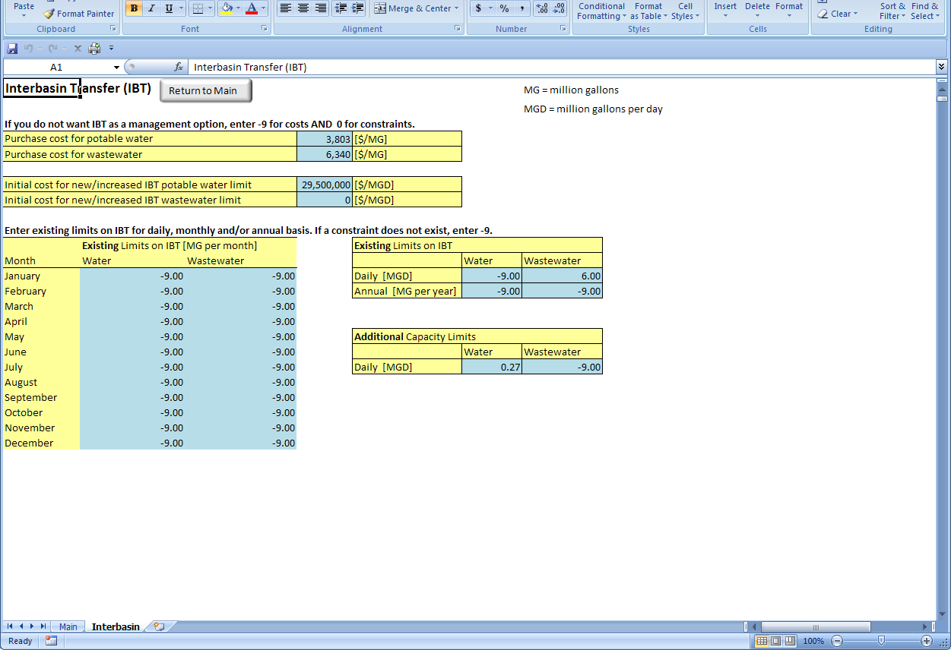
Why is IBT so important?
Consider these trends:
In the late 1800’s, before the first sewers were built in Ipswich River communities, most of the water withdrawn from the watershed was returned as wastewater to the basin. In 2002, it is estimated that about 80% of the total wastewater produced in the basin (about 8.8 billion gallons per year) is exported out of the basin.
The Ipswich River’s all-time low-flow record of 0.1 cubic feet per second, set in 1957, was tied or broken on 18 days in 1997, with a new low of 0.05 cubic feet per second being set in September of 1997. That record was broken in 2002, with a new extreme of 0.04 cubic feet per second.
On average, water use doubles (or worse) in many communities in the Ipswich River Watershed in summer. This means that the most water is used when the River’s flows are naturally lowest.
Primarily due to low flows, almost 50% of the native river fish species have been eliminated from the river, or greatly reduced in numbers.
(From http://ipswich-river.org/low-flows-floods/)

Slide 34
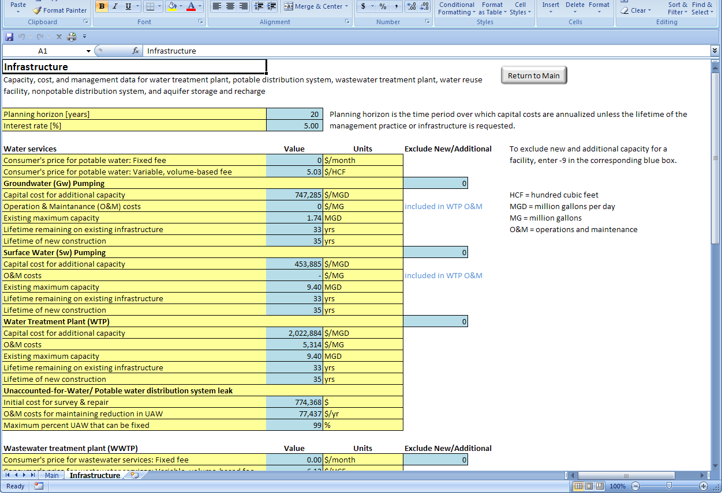
Infrastructure
Capacity, cost, and management data for water treatment plant, potable distribution system, wastewater treatment plant, water reuse facility, nonpotable distribution system, and aquifer storage and recharge

Slide 35
DM Case Study:
Additional Input Data
20-year planning period based on withdrawal permit
Human demand: adjusted HSPF daily data
  Danvers projected need
  Disaggregated to five user types based on DEP ASR data
Built-out land use
  2005 LU, zoning, and protected areas
Infrastructure – capacities and costs
  town websites for water and wastewater O&M costs and customer rates
  SWMI reports for usable capacity of reservoirs
Literature values
  consumptive water user, nonpotable water use
  most capital costs, some O&M costs, infrastructure lifetime

Slide 36
Main Screen
#1
#2
#3
#3a-c
#4
#5
#5a-d
#6
#7
#8
#9
#10

Slide 37
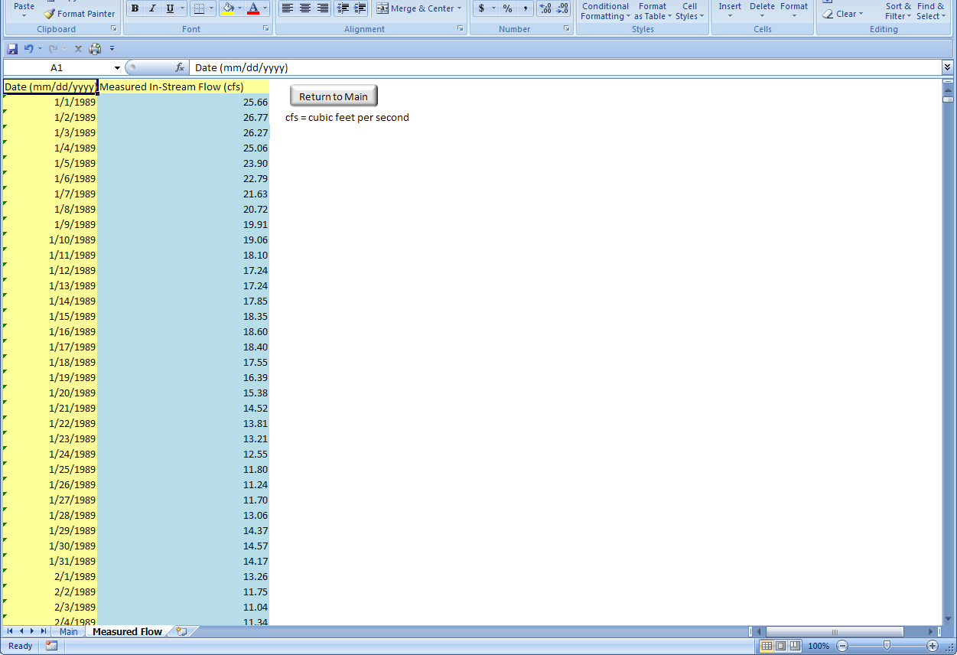
Measured Flow
Outflows from USGS gaging station or model

Slide 38
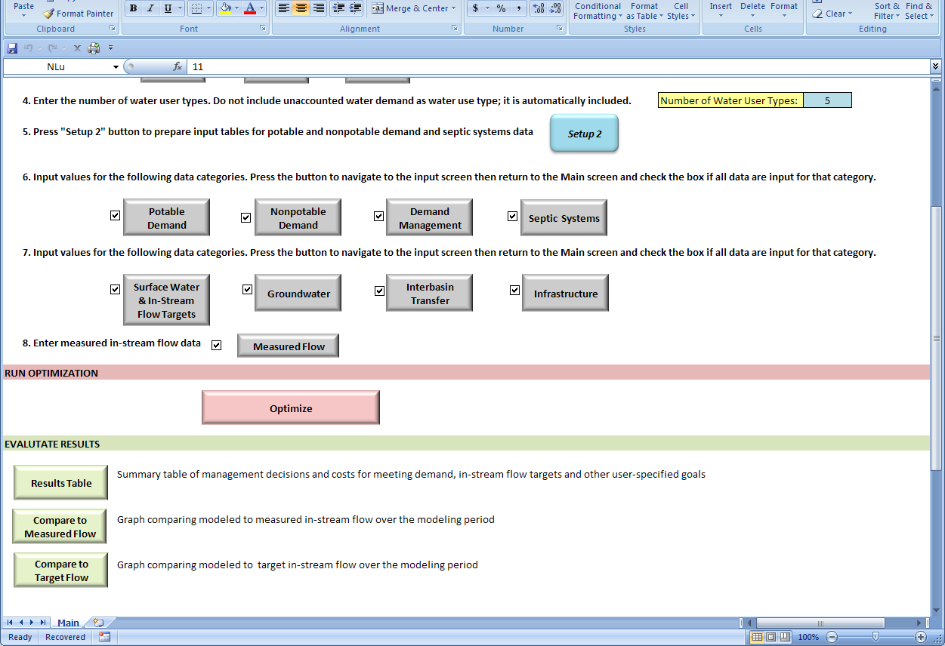

Optimize!

Slide 39
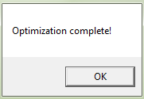
Custom Optimization
Five years, daily time step
Write 71,449 equations
Determine values for 69,505 decision variables
Perform 42,014 iterations
~6 minute run time

Slide 40
DM Case Study: Optimization
Objective: Minimize cost to meet projected human demand and in-stream flow criteria
  Human demand: projected need for 20 new year permit
  In-stream flow criteria: adjusted MA SWMI Category 3

Slide 41
DM Case Study: Base Scenario
Comparison to Measured Flow

Slide 42
DM Case Study: Base Scenario
Comparison to Flow Criteria

Slide 43
DM Case Study:
Base Scenario Results
 | Total Annual Cost |  | $13.4 | million
 | Water Revenue |  | $10.2 | million
 | Wastewater Revenue |  | $10.3 | million
MANAGEMENT PRACTICES | UNITS | Number of Units | Total Annual Sub-Costs (incl. O&M)
Consumer Rate Change | % | 20 | $3,846
Direct Demand Reduction | MGD | 0.60 | $255,701
Additional WTP Capacity | MGD | 0.00 | $6,721,130
Potable Distribution System Repair | % of Leaks | 99 | $138,179
Additional IBT - Wastewater | MGD | 0.00 | $6,271,870
Note: Where there is no additional capacity needed, there is still an annual operating expense. In addition, there is a replacement cost for existing infrastructure if the remaining lifetime exceeds the planning horizon.

Slide 44
DM Case Study: Increasing In-Stream Flow Criteria
 |  | In-stream Flow Criteria
 |  | 125% |  | 150% |  | 175% |  | 200%
MANAGEMENT PRACTICES | UNITS | Number of Units | Total Annual Sub-Costs (incl. O&M) | Number of Units | Total Annual Sub-Costs (incl. O&M) | Number of Units | Total Annual Sub-Costs (incl. O&M) | Number of Units | Total Annual Sub-Costs (incl. O&M)
Consumer Rate Change | % | 20 | $3,846 | 20 | $3,846 | 20 | $3,846 | 20 | $3,846
Direct Demand Reduction | MGD | 0.60 | $255,701 | 0.60 | $255,701 | 0.60 | $255,701 | 0.60 | $255,701
Additional WTP Capacity | MGD | 0.00 | $6,721,130 | 0.00 | $6,721,130 | 0.00 | $6,721,130 | 0.00 | $6,721,130
Potable Distribution System Repair | % of Leaks | 99 | $138,179 | 99 | $138,179 | 99 | $138,179 | 99 | $138,179
Additional IBT - Wastewater | MGD | 0.00 | $6,271,870 | 0.00 | $6,255,920 | 0.00 | $6,259,650 | 0.00 | $6,208,070
Infiltration basin, 0.6" | Acres |  |  | 1,255 | $570,206 | 1,255 | $570,206 | 1,255 | $570,206
Additional WWTP Capacity | MGD |  |  | 0.75 | $706,592 | 0.75 | $701,921 | 0.75 | $766,399
Additional ASR Capacity | MGD |  |  | 0.71 | $534,736 | 5.04 | $3,815,700 | 9.49 | $7,853,070
Additional WRF Capacity | MGD |  |  | 0.06 | $44,680 | 0.01 | $8,871 | 0.20 | $140,575
Total Cost millions |  |  | $13.4 |  | $15.2 |  | $18.5 |  | $22.7
Water Revenue millions |  |  | $10.2 |  | $10.2 |  | $10.2 |  | $10.2
Wastewater Revenue millions |  |  | $10.3 |  | $10.3 |  | $10.3 |  | $10.3
Notes:
Infiltration basin – commercial land use with sand & gravel surficial geology

Slide 45
DM Case Study: Increasing In-Stream Flow Criteria
 |  | In-stream Flow Criteria
 |  | 125% |  | 150% |  | 175% |  | 200%
MANAGEMENT PRACTICES | UNITS | Number of Units | Total Annual Sub-Costs (incl. O&M) | Number of Units | Total Annual Sub-Costs (incl. O&M) | Number of Units | Total Annual Sub-Costs (incl. O&M) | Number of Units | Total Annual Sub-Costs (incl. O&M)
Additional IBT - Wastewater | MGD | 0.00 | $6,271,870 | 0.00 | $6,255,920 | 0.00 | $6,259,650 | 0.00 | $6,208,070
Infiltration basin, 0.6" | Acres |  |  | 1,255 | $570,206 | 1,255 | $570,206 | 1,255 | $570,206
Additional WWTP Capacity | MGD |  |  | 0.75 | $706,592 | 0.75 | $701,921 | 0.75 | $766,399
Additional ASR Capacity | MGD |  |  | 0.71 | $534,736 | 5.04 | $3,815,700 | 9.49 | $7,853,070
Additional WRF Capacity | MGD |  |  | 0.06 | $44,680 | 0.01 | $8,871 | 0.20 | $140,575
Total Cost millions |  |  | $13.4 |  | $15.2 |  | $18.5 |  | $22.7
Water Revenue millions |  |  | $10.2 |  | $10.2 |  | $10.2 |  | $10.2
Wastewater Revenue millions |  |  | $10.3 |  | $10.3 |  | $10.3 |  | $10.3
Notes:
Infiltration basin – commercial land use with sand & gravel surficial geology

Slide 46
DM Case Study: Trade-Offs

Slide 47
DM Case Study: Final Scenario
Exclusion of Interbasin Transfer of Wastewater; Double in-stream flow criteria
 | Total Cost |  | $28.2 | million
 | Water Revenue |  | $10.2 | million
 | Wastewater Revenue |  | $10.3 | million
MANAGEMENT PRACTICES | UNITS | Number of Units | Total Annual Sub-Costs (incl. O&M)
Consumer Rate Change | % | 20 | $3,846
Direct Demand Reduction | MGD | 0.60 | $255,701
Additional WTP Capacity | MGD | 0.00 | $6,721,130
Potable Distribution System Repair | % of Leaks | 99 | $138,179
Additional IBT - Wastewater | MGD | NA | NA
Additional WWTP Capacity | MGD | 5.52 | $12,938,300
Infiltration Repair | % of Leaks | 99 | $38,337
Infiltration basin, 0.6" | Acres | 1,255 | $570,206
Additional ASR Capacity | MGD | 9.27 | $7,231,130
Additional WRF Capacity | MGD | 0.44 | $344,822

Slide 48
DM Case Study:
Specific Lessons Learned
Highest priority/ most cost effective
  Demand management via pricing
  Direct demand reduction via rebates
  Repair of leakage from potable distribution system
  Repair of I/I to sewer collection system
Stormwater management, local wastewater treatment and discharge, ASR and WRF (selected as Instream Flow requirements increased)
Never selected: nonpotable use, purchase of water from MWRA (à MWRA capital cost reduced by more than 75% then becomes cost effective practice)

Slide 49
DM Case Study:
General Lessons Learned
Refinement of input data
  Use of HSPF data to represent wetlands
  Maximum feasible capacity for ASR
  O&M costs for water and wastewater
Additional WMOST capabilities needed
  I/I even if interbasin transfer rather than local WWTP
  Sensitivity module especially for costs
  Simple calibration module for few, key parameters
  Module to simplify simulation
  Output table of all flows

Slide 50
What Did We Accomplish?
No-cost, accessible, user-friendly tool for IWRM, focusing first on water quantity issues
  Costs and benefits of GI vs other mgt options
  Interaction of stormwater, wastewater, drinking water and land management decisions
  Planning tool for future scenarios
Framework for organizing data for decision-making
Greatly increased management options under consideration, esp. with respect to GI/LID
Modular design will facilitate adding new functionality

Slide 51
WMOST Future
Development Needs
Additional modules
  Automate baseline model and validation
  Automate BMP effects estimation
  Sensitivity analysis
  Generate Pareto trade-off curves
  Flooding risk/costs
  Water quality
  Climate scenarios
  Additional ecosystem services
Additional and refined management options

Slide 52
Future: Providing RRRs
Baseline Hydro module:
  Determine generic HRUs (e.g., predominant land use, soil and slope combinations)
  Pre-process HRU runoff and recharge rates for a Region
Stormwater Hydro module: automate modification of “baseline” runoff and recharge
  Export baseline data from existing model or use default data from baseline module
  Provide option to select one or more pre-designed practice (i.e., managed set)
  Run baseline values through SWMM to provide managed runoff and recharge sets

Slide 53
Obtaining WMOST
EPA’s Science Inventory
U.S. EPA. 2013a. Watershed Management Optimization Support Tool (WMOST) v1: Theoretical Documentation. US EPA Office of Research and Development, Washington, DC, EPA/600/R-13/151 (http://cfpub.epa.gov/si/si_public_record_report.cfm?dirEntryId=261780)
U.S. EPA. 2013b. Watershed Management Optimization Support Tool (WMOST) v1: User Manual and Case Study Examples. US EPA Office of Research and Development, Washington, DC, EPA/600/R-13/174 (http://cfpub.epa.gov/si/si_public_record_report.cfm?dirEntryId=262280)
Or EPA CEAM web site
http://www2.epa.gov/exposure-assessment-models/wmost-10-download-page
CEAM website

Slide 54
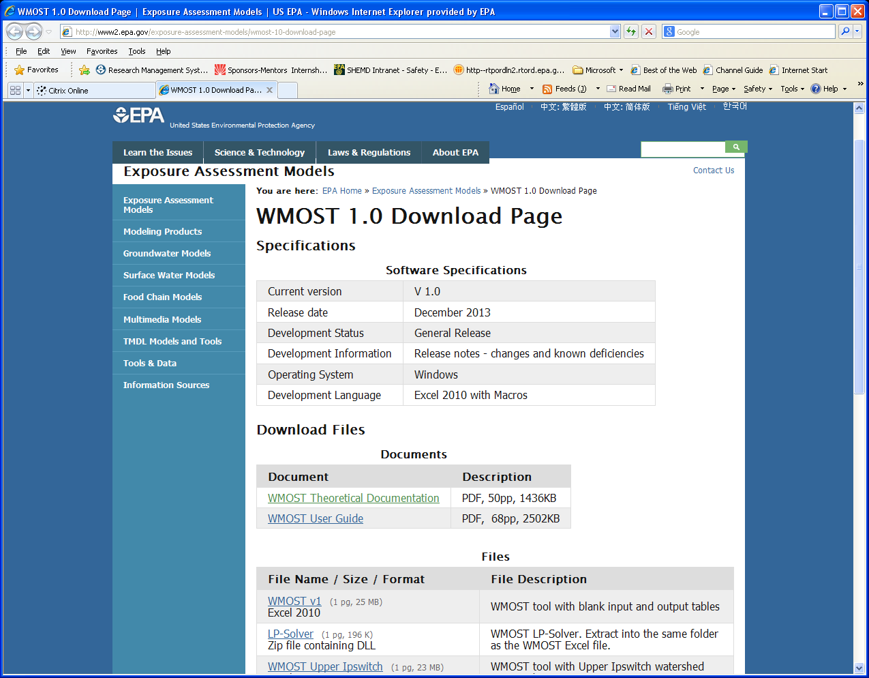

Slide 55
Communications
To report bugs or to be added to a user list for WMOST updates, send an email to
Detenbeck.naomi@epa.gov
Put in subject line either
  WMOST Bugs
  WMOST Register

