Slide 1
AQS Support and Help

Slide 2
Where to Find AQS Help
From Within AQS
User Support
AQS Regional Contacts
AQS Documentation
Online Training
Teleconference Training

Slide 3
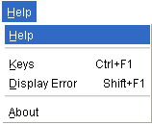
From Within AQS
“Help” From the Menu
Topics
Short-Cut Keys
Display Error

Slide 4
From Within AQS
Field-Level Help
Mouse over a Fill Box
At the bottom of the application

Slide 5
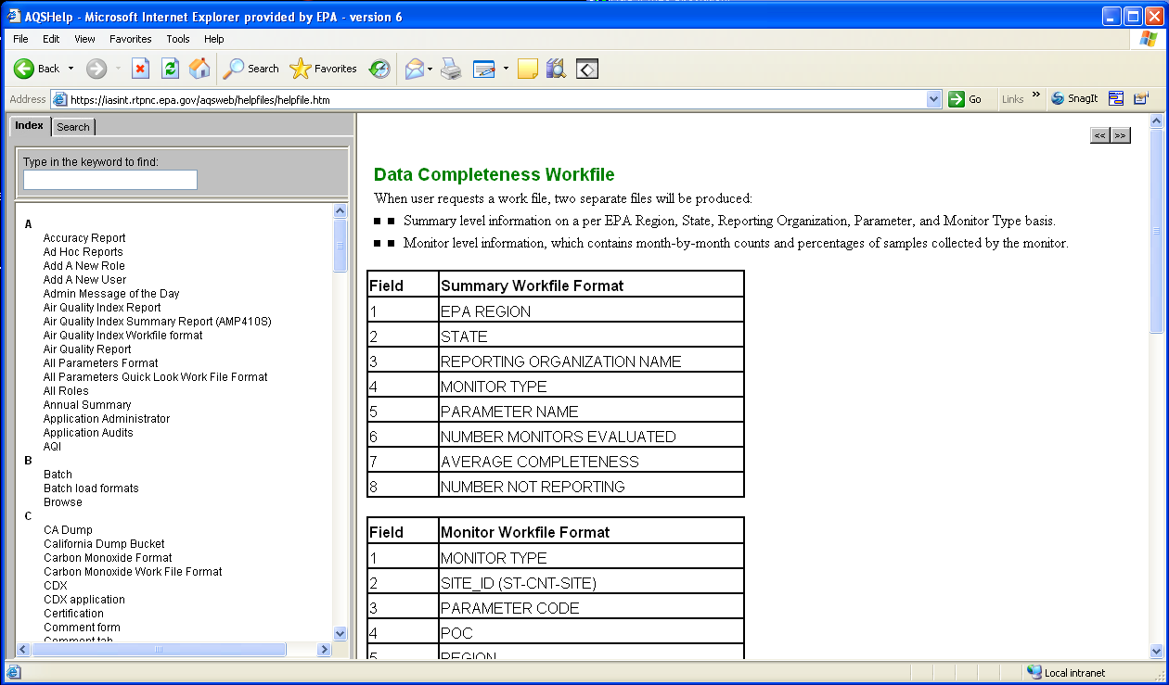
From Within AQS

Slide 6
User Support
EPA Helpdesk
1-866-411-4372
epacallcenter@epa.gov
2 “Levels” of Support
Level 1: Reset Passwords
Level 2: AQS Specific Issues
ENSC Helpline
1-888-890-1995
nodehelpdesk@epacdx.net

Slide 7
AQS Regional Contacts
Mary Jane Cuzzupe (I)
(617) 918-8383
Henry Feingersh (II)
(212) 637-3382
Pauline DeVose (III)
(215) 814-2186
Darren Palmer (IV)
(404) 562-9052
Jesse McGrath (V)
(312) 886-1532
Trisha Curran(VI)
(214) 665-8245
James Regehr (VII)
(913) 551-7167
Joshua Rickard (VIII)
Fletcher Clover (IX)
(415) 972-3991
Chris Hall (X)

Slide 8
AQS Documentation
Manuals and Guides: https://www.epa.gov/aqs/aqs-manuals-and-guides
AQS XML Format Documentation
AQS Transaction Formats
AQS Data Coding Manual (Link on the main page)
AQS User Guide (Link on the main page)
AQS Data Dictionary (Link on the main page)
AQS Acronyms and Abbreviations
Table A-2 Appendix A to Part 58
Quick Look Work File Formats
AMP 350WF Raw Data Work File Formats
AQS Design Value Report for SO₂
Loading Data in AQS

Slide 9
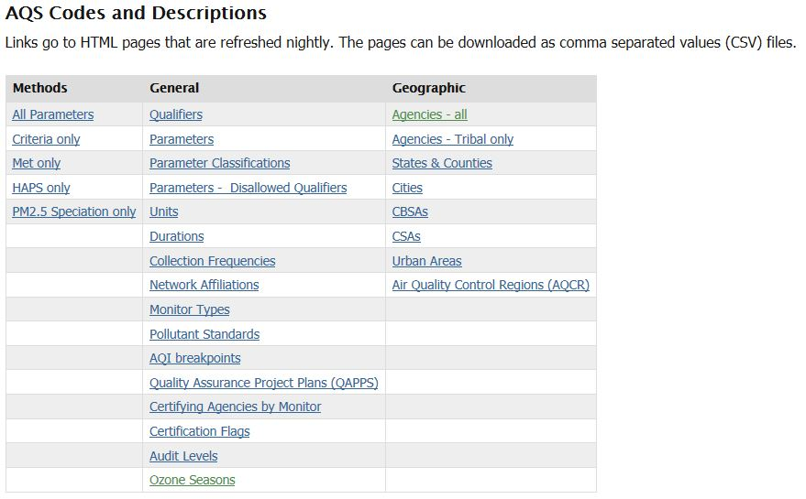
AQS Documentation
AQS Code Lists:
https://www.epa.gov/aqs/aqs-code-list

Slide 10
Online Training
Video Training: https://www.epa.gov/aqs/aqs-training
How to set the Regional Office Concurrence Flag for Exceptional Events
How to Log into AQS
Loading Files in AQS
ENSC Login Instructions
Submitting Data through ENSC
Understanding Batch Submissions
AQS Batch Form Overview

Slide 11
Online Training
Documentation Training:
https://www.epa.gov/aqs/aqs-training
Agency Roles and Access Control
AQS Data Access Presentation
AQS Data Handling
AQS Support and Help Presentation
Data Certification in AQS
Obtaining AQS Data (Discoverer Replacement)
Exceptional Events in AQS
QA Transactions and Reports (Monitoring QA)
AQS Site Monitor Configuration
Data Certification
Known Issues
PQAO Criteria Met
FAQs

Slide 12
Teleconference Training
New User Orientation
Monthly on the 3rd Wednesday
Walk-Through Basic Functions
Tribal Q&A
Bi-Monthly on the 2nd Wednesday

