Slide 1

NPDES Electronic Reporting Rule
40 CFR part 127
An EPA Resource to Assist States in Rule Implementation
[STOCK PRESENTATION]

Slide 2
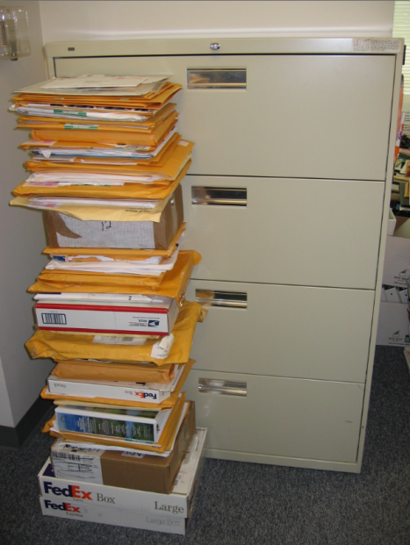


Overview of NPDES eRule
The 2015 NPDES Electronic Reporting rule (NPDES eRule) helps EPA and states clean up the nation’s waters through:
  Automation
    Shifting from paper to electronic reporting.
  Time Savings
    Time and resources for the regulated community and states can be shifted to other program areas.
  Improved Transparency
    Serves to elevate the importance of data and environmental performance.
  Cutting Edge Technology
    Tools increase data accuracy, timeliness, completeness, and consistency for the NPDES program.
  EPA in partnership w/ states developed and enhanced two electronic reporting tools for implementation: NetDMR (Phase 1 – 12/21/16) & NeT (Phase 2 – 12/21/25).
Pretreatment Program Annual Reports in EPA Region 9

Slide 3
Scope of NPDES eRule:
NPDES-Regulated Entities
.
Note: The “General Permit Covered Facilities” category also counts facilities included in other categories (e.g., CAFOs).

Slide 4
Reports and Data for Electronic Submissions
Submissions from Permittees | 40 CFR
Discharge Monitoring Reports (DMRs) – Phase 1 | 122.41(l)(4)(i)
General Permit Reports (NOI, NOT, NECs, LEWs) – Phase 2 | 122
Biosolids Annual Program Reports – Phase 1 (EPA only) & Phase 2 (9 states w/ auth.) | 503
CAFO Annual Program Reports – Phase 2 | 122.42(e)(4)
MS4 Program Reports – Phase 2 | 122.34(d)(3), 122.42(c)
Pretreatment Program Annual Reports – Phase 2 | 403.12(i)
Industrial User Compliance Reports in Municipalities Without Approved Pretreatment Programs – When EPA or State is Control Authority – Phase 2 | 403.12(e) & (h)
Sewer Overflow/Bypass Event Reports (CSOs, SSOs, Bypass events) – Phase 2 | 122.41(l)(4), (6), (7), (m)
CWA 316(b) Annual Reports (Federally Listed Threatened or Endangered Species) – Phase 2 | 40 CFR 125 Subpart J
Submissions from States and EPA Regions | 40 CFR
Require electronic reporting by NPDES-authorized states, territories, tribes, and Regions of program implementation information (permits, inspections, violations, and enforcement actions) | 123.41 & 123.43
Eliminate state reporting requirements for the annual state biosolids annual report, semi-annual statistical summary report, and annual noncompliance report (ANCR), and quarterly noncompliance report (QNCR). The new NPDES noncompliance report (NNCR) is issued by EPA to show Category I and Category II noncompliance. | 123.45, 501.21

Slide 5

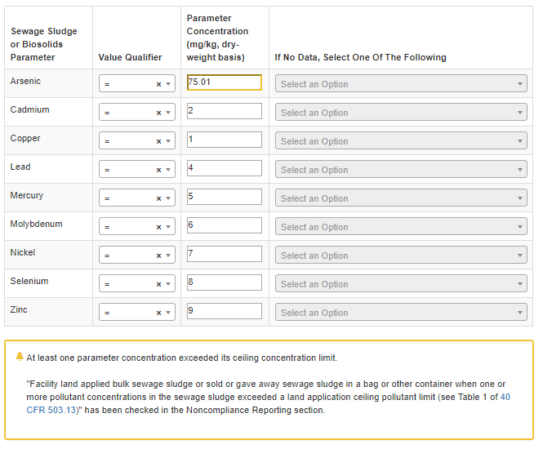
Example Benefit of Electronic Reporting
Implementing NPDES electronic reporting can help automate violation detection. Below is an example from the biosolids annual report.
Today
(EPA’s NeT-Biosolids automatically detects pollutant ceiling limit violations)
Before Electronic Reporting
(Approximately 2,400 paper biosolids annual report submissions to EPA)

Slide 6
Partnering with States: Implementation
Implementation Schedule
Phase 1 – DMR Submissions & Biosolids Reports (21 Dec 2016)
EPA works with states to ensure that their data sharing rates are above 90% through:
  Training and assistance for states to implement EPA’s electronic reporting tools (NetDMR and NeT-Biosolids) and data exchange protocols.
  Submission of Biosolids Annual Program Reports are in Phase 1 where EPA runs the Federal biosolids program (41 states and all territories and tribal lands).
Phase 2 – General Permits and Program Reports (21 Dec 2025)
EPA works with states to develop electronic reporting tools, data sharing protocols, and noncompliance reporting:
  EPA is collaborating with states to build electronic reporting applications for states that elect to use EPA’s NPDES Electronic Reporting Tool or “NeT.”
  EPA collaborated with states and deployed new data sharing protocols for Phase 2 data. See ICIS Data Submission service website for details.
  EPA collaborated with states on the features and format for the NPDES Noncompliance Report (NNCR).

Slide 7

Implementation Strategy
Building Capacity for Electronic Reporting
Strengthening and Expanding NPDES Program Data Sharing
Collaborating and Coordinating EPA and State Activities
Creating Insight and Transparency on Noncompliance

Slide 8
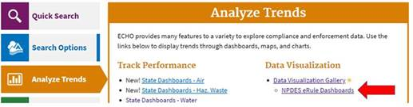
Tracking NPDES eRule Implementation
EPA has developed a set of dashboards to help EPA Regional and state staff track NPDES eRule implementation and identify issues that require resolution.
These dashboards are available through EPA’s Enforcement Compliance History Online (ECHO) website.
  See: https://echo.epa.gov/trends/data-viz?filters=erule.
You will need to log into “ECHO Gov” for access to some of these dashboards. (Note: ECHO Gov is a resource for EPA and states)
Unless otherwise noted, data are updated each weekend from EPA’s national NPDES data system (ICIS-NPDES).

Slide 9
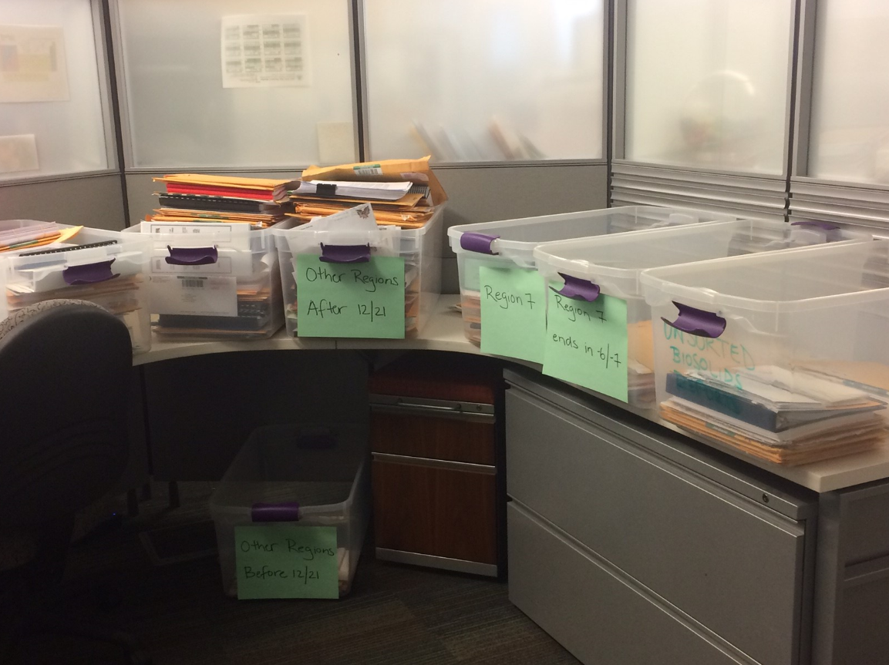
Phase 1 Progress: Biosolids Annual Reports
Federal Biosolids Annual Reports – 40 CFR 503
(EPA Biosolids Center of Excellence, Region 7)
2014
Before Electronic Reporting
(Approximately 2,400 paper submissions)
2017
1st Year of Electronic Reporting
(2,183 electronic submissions with
640 paper submissions)

Slide 10
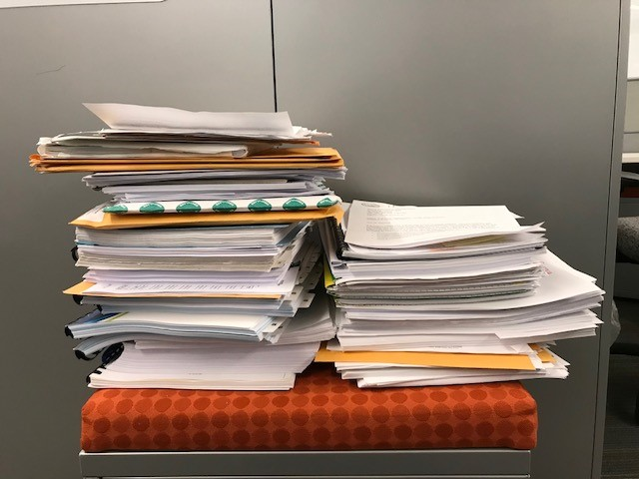
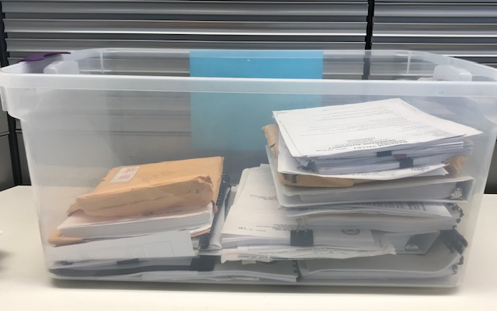
Phase 1 Progress: Biosolids Annual Reports - Year 2 and 3
Federal Biosolids Annual Reports – 40 CFR 503
(EPA Biosolids Center of Excellence, Region 7)
2018
2nd Year of Electronic Reporting
(2,245 electronic submissions with
94 paper submissions)
2019
3rd Year of Electronic Reporting
(2,290 electronic submissions with
52 paper submissions)

Slide 11
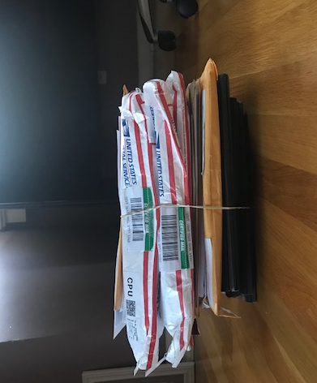
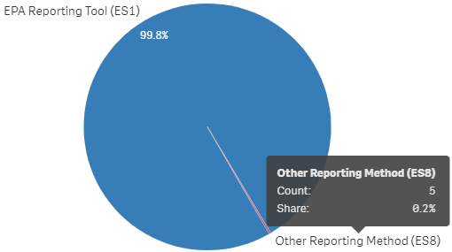
Phase 1 Progress: Biosolids Annual Reports - Year 4 and 5
Federal Biosolids Annual Reports – 40 CFR 503
(EPA Biosolids Center of Excellence, Region 7)
2020
4th Year of Electronic Reporting
(2,260 electronic submissions with
14 paper submissions)
2021
5th Year of Electronic Reporting
(2,369 electronic submissions with
5 paper submissions)

Slide 12
Phase 1 Progress
NetDMR usage increased dramatically since promulgation of the 2015 NPDES eRule.
This trend will continue as more and more facilities are trained and registered with NetDMR.
States are also making tremendous progress in transitioning DMR filers to state electronic reporting tools and sharing these data with EPA.
Nationwide, approximately 95% of all DMRs from individually permitted facilities are submitted electronically.
Source: EPA’s national NPDES data system (ICIS-NPDES, 31 May 2024)

Slide 13
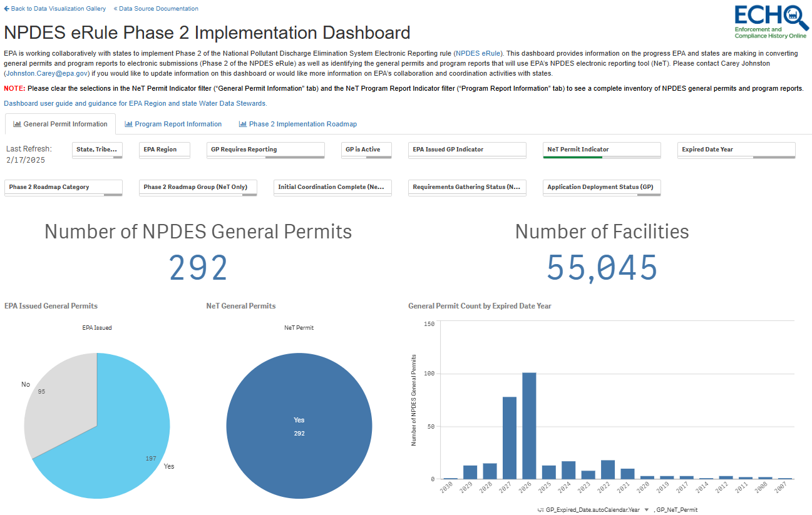
Phase 2 Progress
The NPDES eRule Phase 2 Implementation Dashboard provides EPA and states with a high-level tracking of EPA and state progress for Phase 2.
  This public dashboard provides an inventory of general permits and program reports and identifies for each general permit or program report if the state has elected to use EPA’s NeT as well as the deployment status and initial deployment date.
  States regularly share information with EPA to maintain the completeness and accuracy of this dashboard.
See: https://edap.epa.gov/public/extensions/eRule_Phase2/eRule_Phase2.html

Slide 14
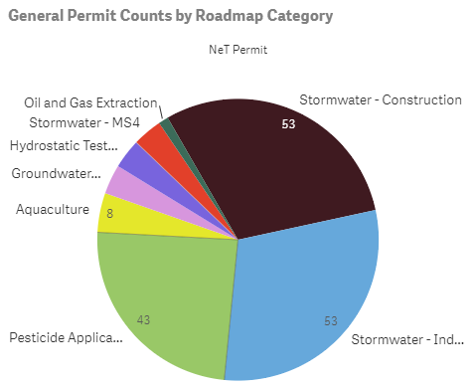
Phase 2 Progress – Current EPA NeT Development Activities
EPA deployed NeT applications for eight general permit categories that cover approximately 38,000 facilities.
These NeT applications cover EPA Regional and state issued general permits (CT, DE, ID, IL, MD, NE, RI, SD, TX, UT, and VI).
EPA deployed NeT applications for four program reports (biosolids, sewer overflow, MS4, and pretreatment programs) that cover approximately 12,800 facilities.
These NeT applications cover EPA Regional and state issued program reports (AZ, DE, IL, IN, LA, MD, ME, MS, NE, RI, SD, TX, UT, and VI).
See: https://edap.epa.gov/public/extensions/eRule_Phase2/eRule_Phase2.html

Slide 15
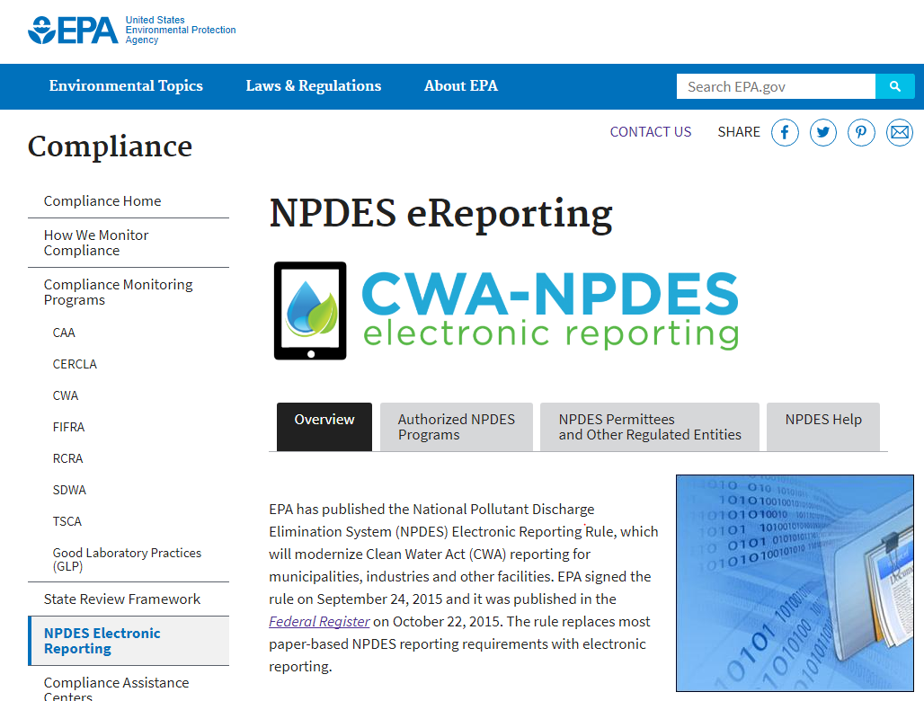
Phase 2 Data Sharing: Technical Papers
As part of Phase 2 implementation, EPA and states collaborated via technical workgroups to define the reference values, business rules, and other data standards for the minimum set of NPDES program data (App. A, 40 CFR 127).
EPA-state technical workgroups include: Biosolids, Pretreatment, Sewer Overflows, Concentrated Animal Feeding Operations, Stormwater (Urban, Industrial, and Construction), CWA Section 316, and General Permits.
These workgroups produced technical papers that are now posted on the NPDES eRule website.
EPA and states should use the technical papers as a basis to identify the data that must be collected and shared.
EPA and states used these technical papers to develop and deploy data sharing protocols. See ICIS Data Submission webpage.
See: https://www.epa.gov/compliance/npdes-ereporting

Slide 16
NPDES Violation Data Sharing Requirements
The NPDES Electronic Reporting rule requires authorized NPDES programs to share NPDES violation data on all facilities (major and non-major).
However, this requirement does not include NPDES violations found through construction stormwater inspections where the regulatory authority did not take a formal enforcement action.
As noted in preamble to the final rule, EPA made this distinction based on the large number of facilities in this segment of the NPDES universe (approximately 200,000 new construction sites each year). See 22 October 2015; 80 FR 64079.
Prior to the final rule, states only had to share violation data [including Single Event Violations (SEVs)] from majors with EPA’s national NPDES data system (ICIS-NPDES).
EPA published Data Sharing Guidance for NPDES Deficiencies and Single Event Violations in January 2025.

Slide 17
NPDES Noncompliance Report (NNCR)
NPDES eRule requires EPA to produce online noncompliance reports (NNCR) that show all NPDES violations for:
  December 21, 2022 (Phase 1 data); and
  December 21, 2026 (Phase 2 data) or earlier as data become available.
The Quarterly NNCR must include a list of all violations that occurred within the quarter, details about the violations, enforcement actions taken in response to the violations, and include any violations from previous quarterly reports not been documented as being corrected.
The Annual NNCR is a summary of compliance monitoring and enforcement activities within each state, tribe, and territory.
On 22 February 2023 EPA made the NNCR publicly available on ECHO after a year of testing by EPA Regions and states.

Slide 18
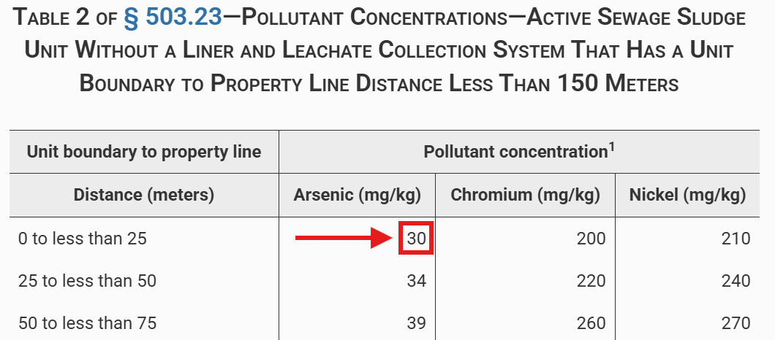
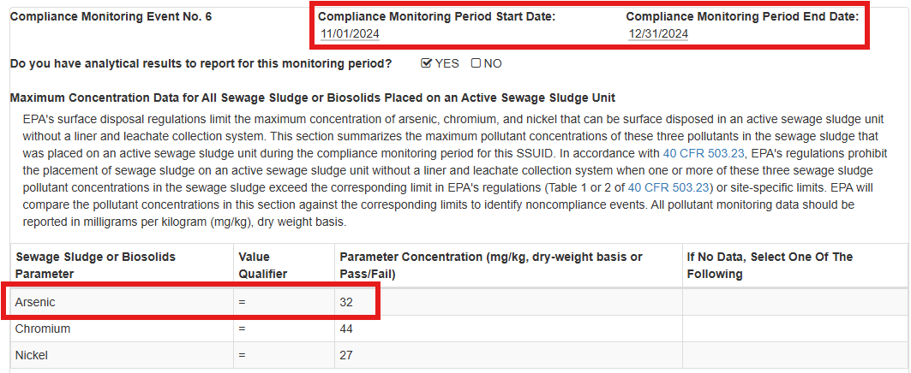
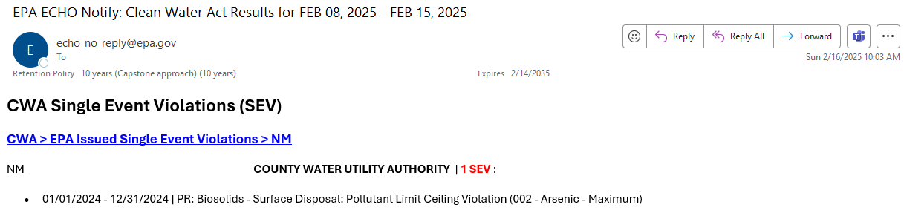
Access to Phase 2 Data via ECHO
EPA is working with states to provide access to the Phase 2 data through the ECHO. ECHO currently shows violations detected through Phase 2 compliance monitoring reports. These violations are displayed on the ECHO Detailed Facility Report and available through ECHO Notify.
National Standards for Sewage Sludge (503.23)
Biosolids/Sewage Sludge Annual Report Submission
Violation Display on ECHO Detailed Facility Report
ECHO Notify Email

