Slide 1

Community Chemical Safety
Climate Change Preparedness
funding Provided by US EPA P2 Grant Program
Rich Bizzozero
Director, Massachusetts Office of Technical Assistance (OTA)
rich.bizzozero@state.ma.us, 617-626-1080
@Mass_OTA
Notes:
Need to add a slide or note that this project is made possible by funding EPA FY 2015 P2 Grant Program

Slide 2
Massachusetts Office of Technical Assistance (ota)
Toxics Use Reduction Act (TURA)
  MassDEP (Regulatory – Reporting & Planning)
  TURI (Research & Grants & Planner Training)
  OTA (Compliance & Technical Assistance)
Non-Regulatory State Agency
Work with Massachusetts Toxics Users
Free & Confidential Technical Assistance Consultations

Slide 3
Goals of US EPA Grant
Toxics Use Reduction and P2
Climate Change Resiliency Planning
Decrease in Chemical Accidents

Slide 4
Why Climate Change & Chemical Safety?
Climate Change
Floods
Extreme Heat
Extreme Cold
Storms
Chemical Releases
Chemical Spills
HVAC Failure
Explosion Risks
Temperature
Power Outages
HVAC Failure
Chemical Releases
Power Outages
HVAC Failure
Infrastructure Failure
Chemical Releases
Notes:
Can we

Slide 5
Regional Planning Agencies
Very competent in GIS / maps
Concerned with railroad and transportation risks
Protecting water supplies & critical infrastructure
Not familiar with toxics in communities
Companies not yet involved in emergency planning (LEPCs & REPCs)
Environmental Justice
Notes:
Do we have from the grantee applications - the regulatory reference concerning the need to consider EJ in their regional planning - this is a recent, I believe federal revision?

Slide 6
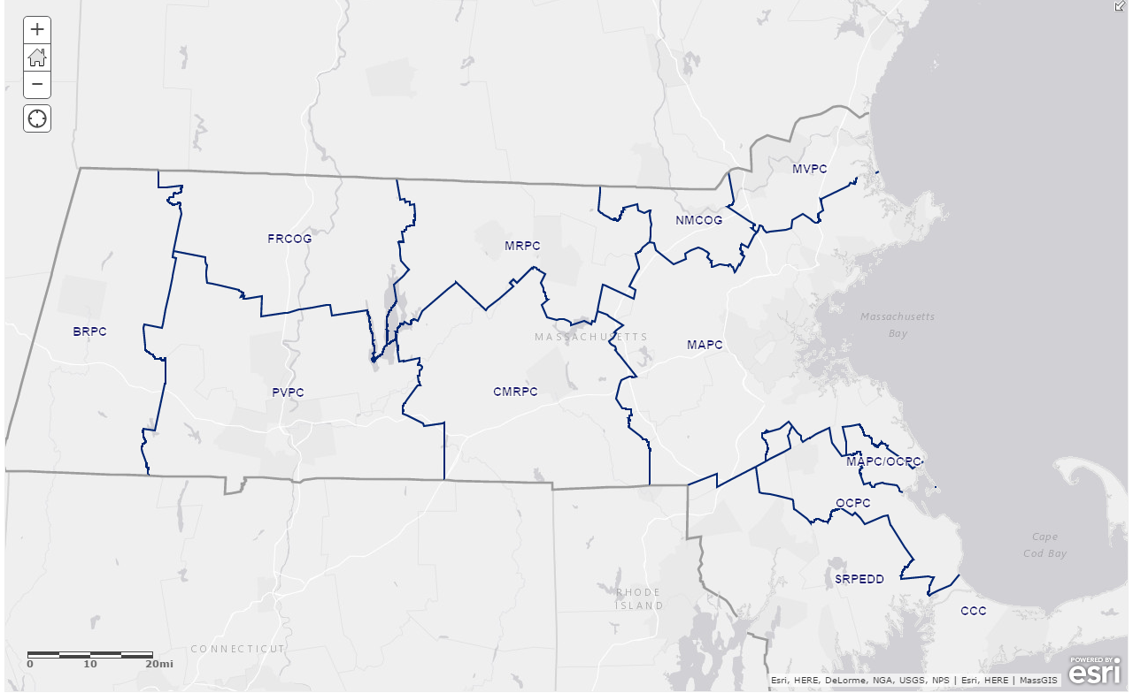
REGIONAL PLANNING AGENCIES (rpa)

Slide 7
Identifying Ma toxics USERS
TURA Toxics Use Reduction Act | TRI Toxic Release Inventory | TIER II Chemical Inventory Reporting
Applies to Massachusetts businesses only (MassDEP) | Applies to businesses nationwide (US EPA) | Applies to Large quantity Chemical Storage (US EPA) State Emergency Response Commission
Works on the front end to reduce unnecessary chemical use and prevent waste | Information on waste management activities and environmental releases | Information on on-site chemical storage
Reports chemical use and waste generation | Reports chemical environmental releases | Reports on-site chemical storage
Notes:
These are similar but not the same lists. Tier 2 largely unavailable in a user friendly format to community leaders, stakeholders and first responders.

Slide 8
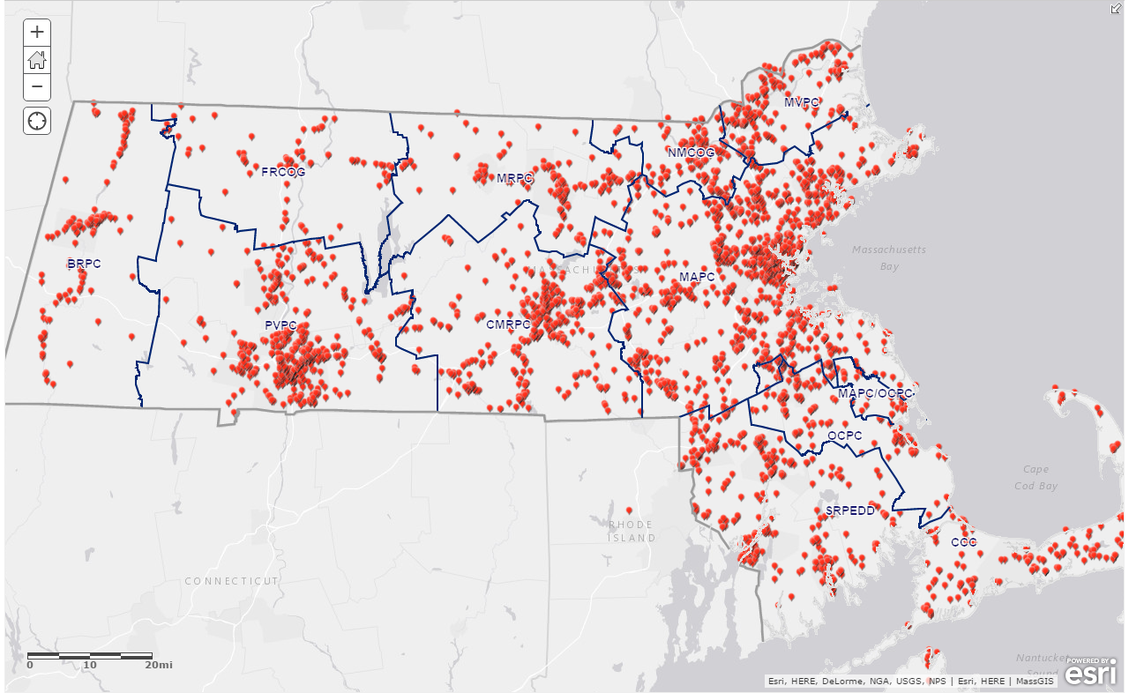
Toxics Release Inventory (TRI) Data

Slide 9
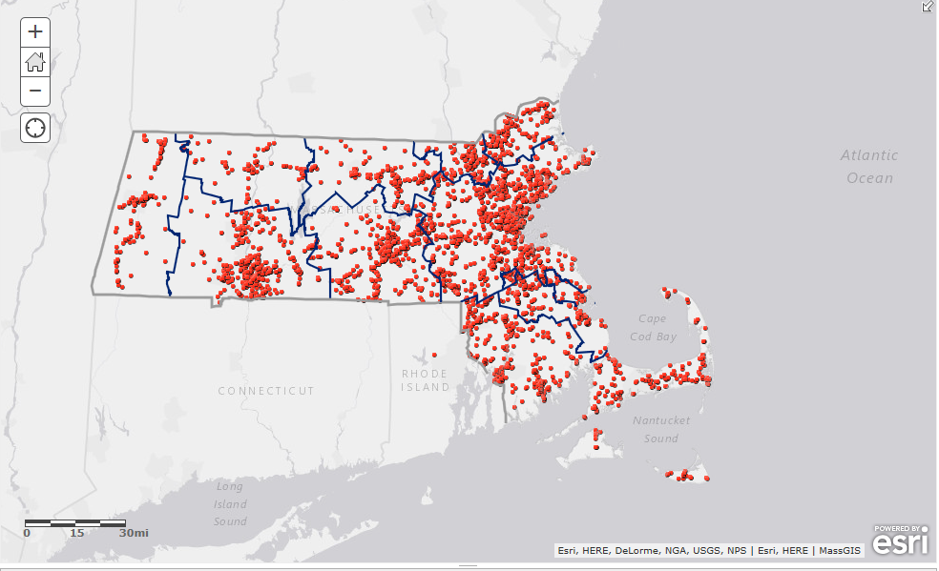
Tier 2 data

Slide 10
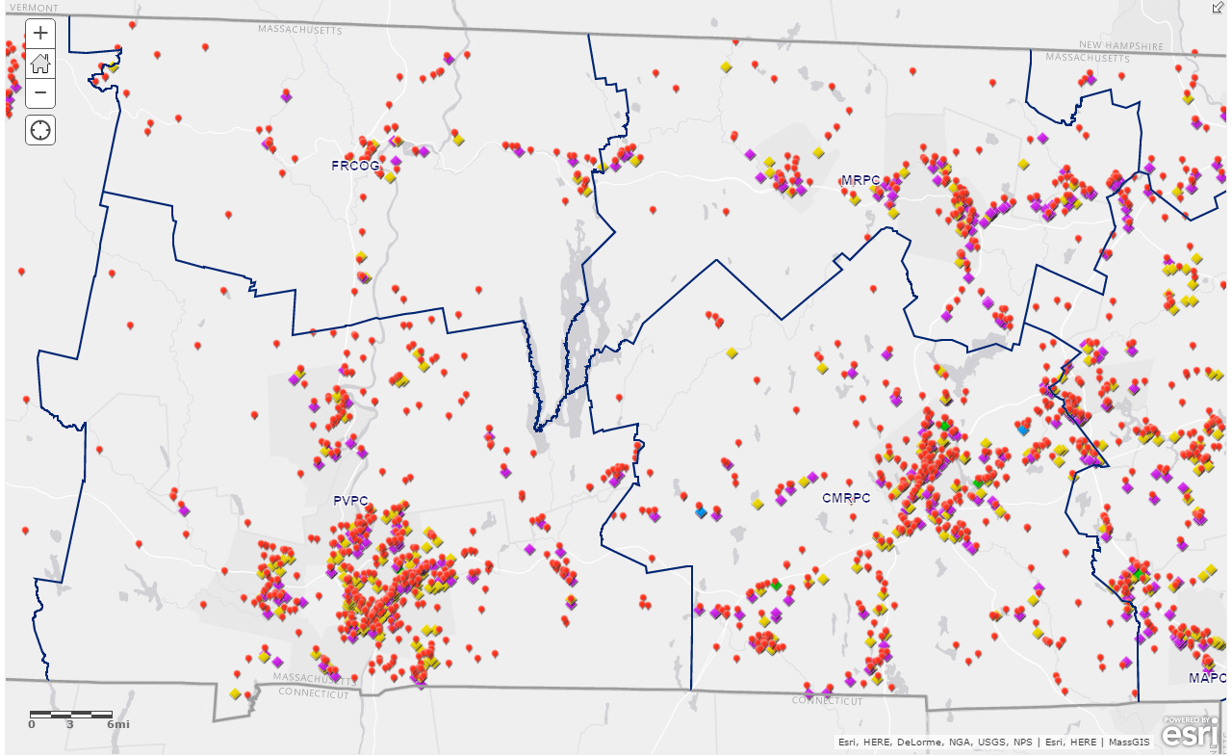


Toxics users & TRI releases
Notes:
TURA Reporters
Haz waste recyclers
Haz waste treatment
Haz waste storage / disposal

Slide 11
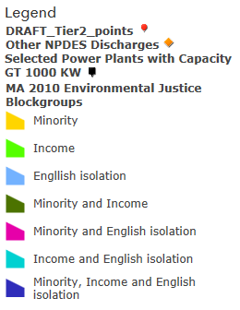
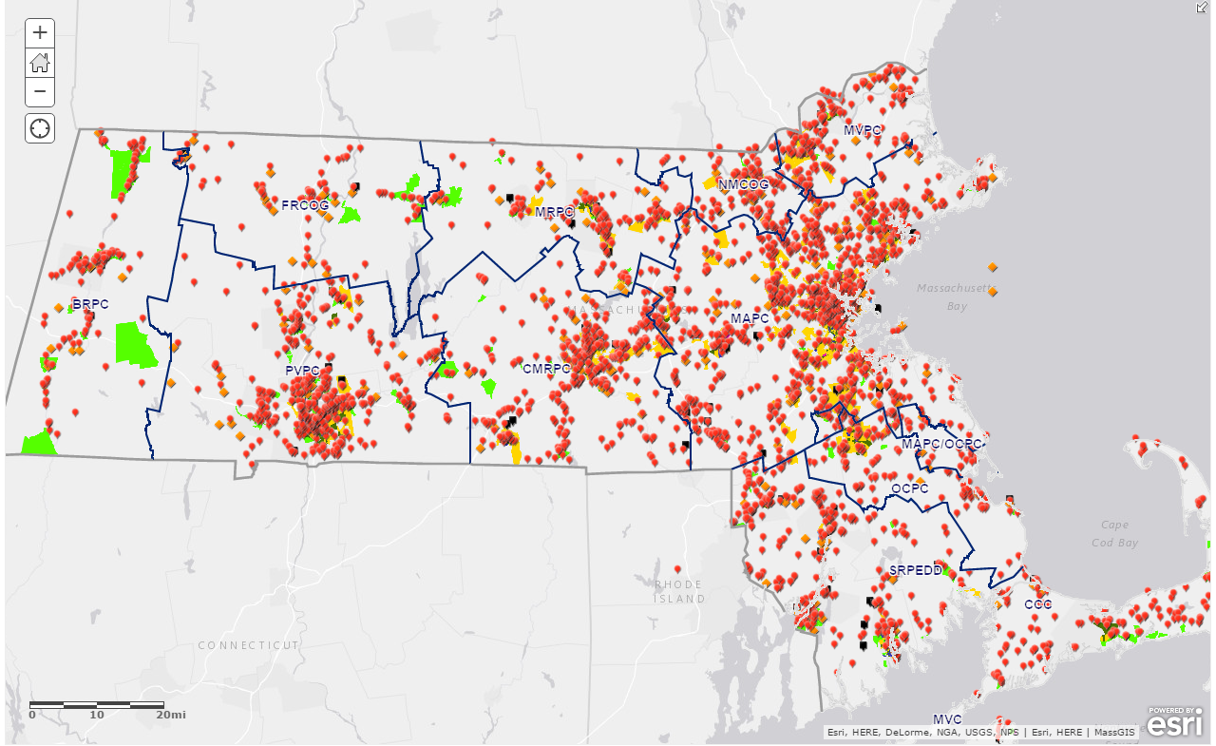
The whole picture
Notes:
Waste Water treatment plants
NPDES discharges
Underground Storage Tanks
Active Railways
Dams
Power Plants
Selected land uses (Junk yards / Golf Courses / Etc.)
Worst Case Hurricane Surge Inundation Zones
FEMA Flood Hazards
Environmental Justice Areas (Minority / Income / English Isolation)

Slide 12
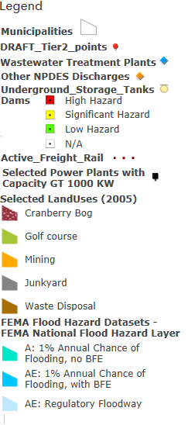
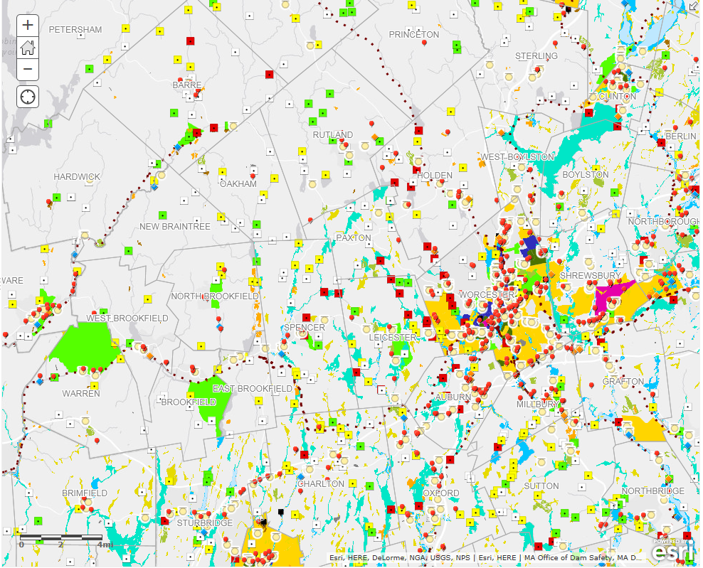
The whole picture

Slide 13
What is Missing?
Asthma ER visits?
Cancer Rates?
What Else?

Slide 14
Community Resilience and Chemical Safety
US EPA grant funding for Regional Planning Agencies to host two chemical safety trainings
Local Emergency Planning Councils and Community Stakeholders
Toxic Users and First Responders

Slide 15
Training 1 – LePC / Stakeholders
Identify Toxics Users
Provide Expertise on Regulations
Provide Expertise on Chemical Hazards
Recruit LEPCs / Stakeholders
Host training
Educate Stakeholders on Incorporating Toxics Use Reduction into Emergency Planning
OTA
(consultant)
RPA

Slide 16
Training 2 – Toxics Users
Recruit Toxics Users
Provide Expertise on Regulations & Toxics
Recruit Toxics Users
Host Training
Educate Facilities on Local Regulations & Emergency Planning
OTA
(consultant)
RPA

Slide 17
Evaluation & Sustainability
Provide Site Visits to Businesses
Businesses Reducing Toxics
Businesses Engaging in Climate Change Preparedness
Businesses Reducing Energy Use
Case Studies
Conduct Surveys
Refer Businesses to OTA
Business Compliance
Enforcement Actions (Last Resort)
Toxics Use Reduction Incorporated into Climate Change Resiliency Planning
Case Studies
OTA
RPA

Slide 18
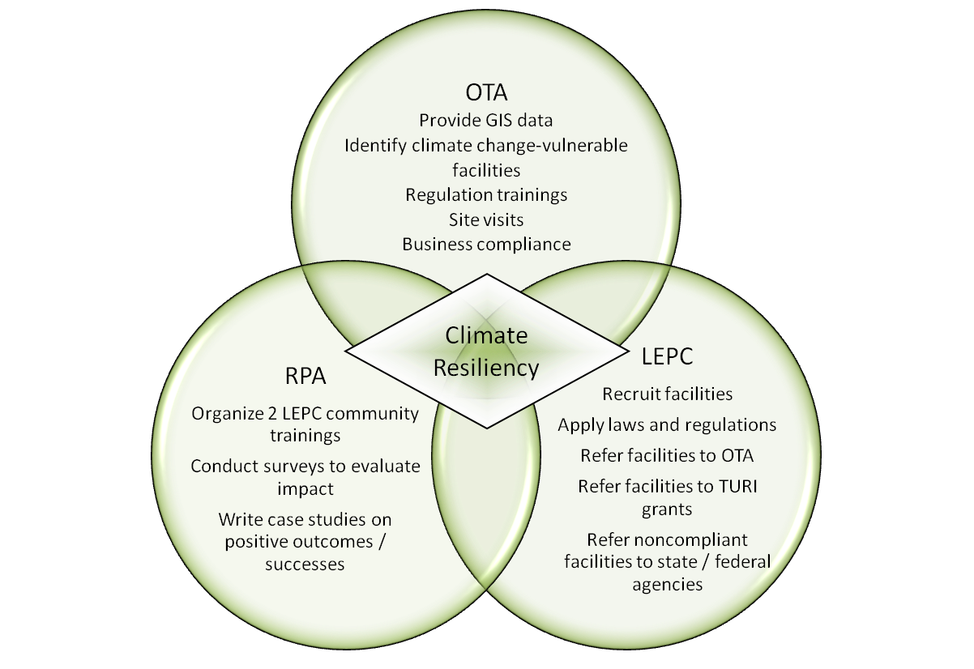
Agency Roles

Slide 19

Providing GIS data on Toxics Users and Climate Change Vulnerable Areas
Ensuring That Toxics Users in Your Community are in Compliance with Regulations
Accepting Referrals from RPAs, LEPCs, Health Departments and First Responders to Toxics Users
Engaging Businesses in Toxics Use Reduction, Safer Chemical Storage, and Best Practices
Providing Expertise & Training on State and Federal Environmental Regulations
Providing Expertise and Training on Toxic Chemicals

Slide 20
Finished Product
RPA s/ LEPCs
OTA
Model for Incorporating TUR & P2 into Climate Change Planning
Toxics Users

Slide 21
Thank you!
Questions?
Rich Bizzozero
Director, Massachusetts Office of Technical Assistance (OTA)
Rich.Bizzozero@state.ma.us, 617-626-1080
@Mass_OTA

