Slide 1

Case Studies
Notes:
Unless otherwise noted, all images are courtesy of EPA or Renaissance Planning Group. All images in this presentation may be used in presentations adapted for individual communities.
This presentation was developed as part of the U.S. Environmental Protection Agency’s Local Foods, Local Places Toolkit: A Guide to Help Communities Revitalize Using Local Food Systems. The complete toolkit is available at https://www.epa.gov/smartgrowth/local-foods-local-places-toolkit.

Slide 2
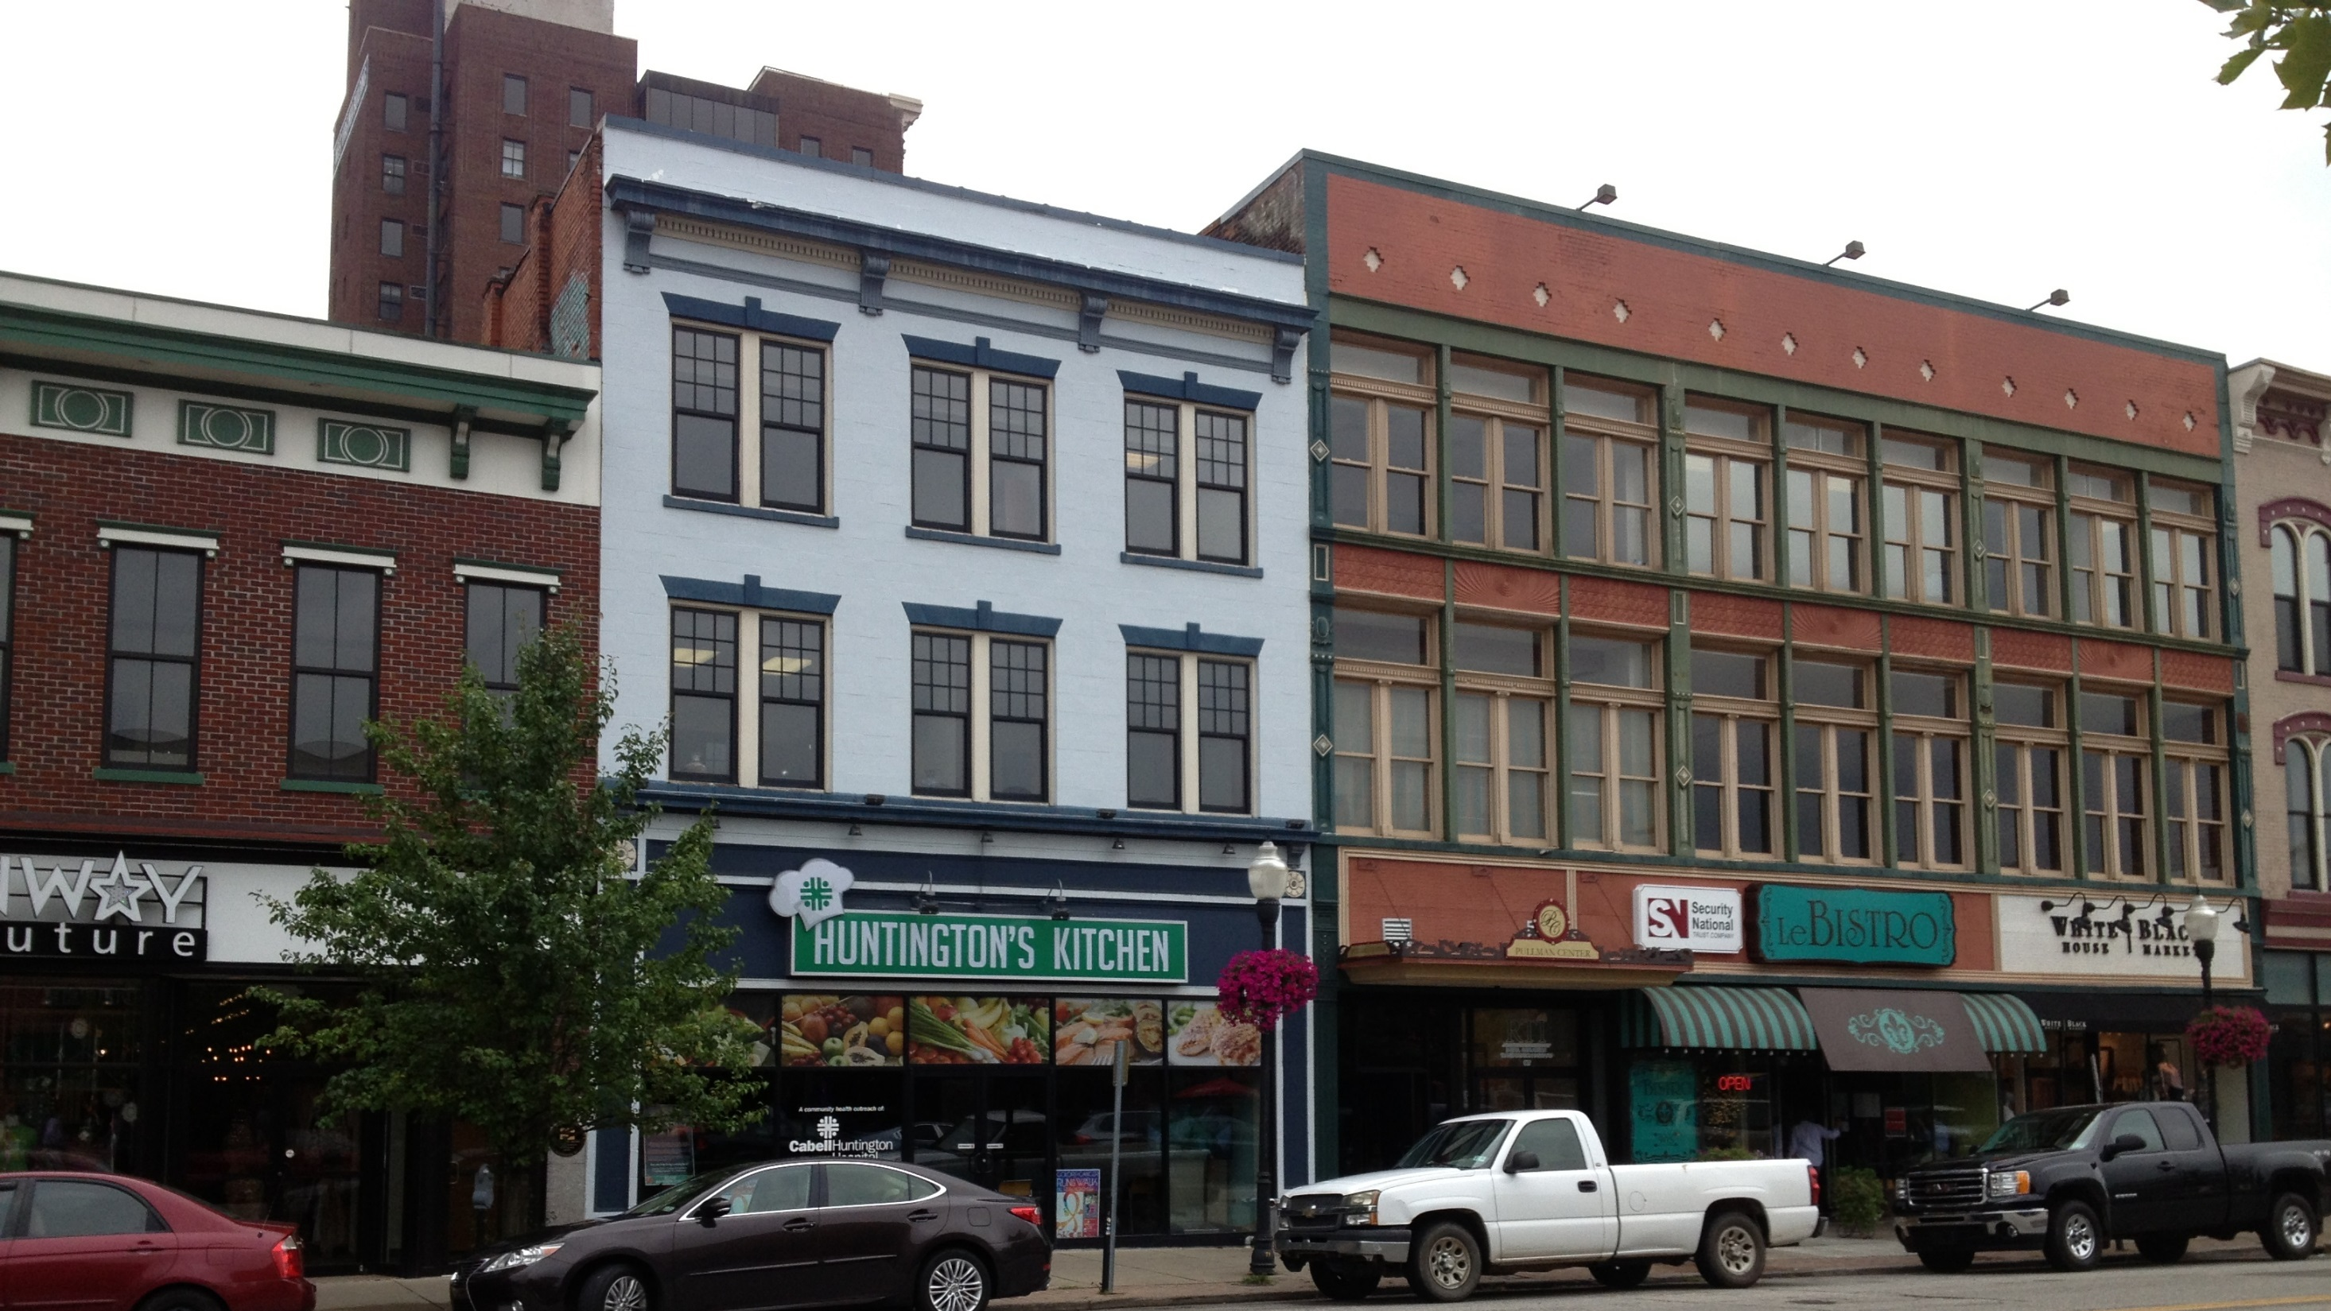

HUNTINGTON, WEST VIRGINIA: THE WILD RAMP
Notes:
Huntington, West Virginia, is a city of about 49,000 people, down significantly from its peak of more than 80,000 in the 1950s. It is an industrial city on the Ohio River, with an economy that was based primarily on the steel industry through the 1970s.

Slide 3
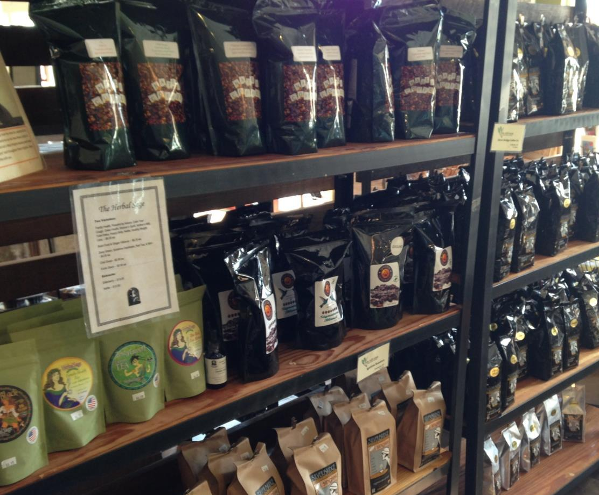
BACKGROUND
Huntington residents and nonprofits sought to open a local foods market.
They used Create Huntington, a local support network, to explore ideas and build support.
A separate steering committee formed, using social media to continue to build momentum for the project.
Notes:
In 2012, a group of Huntington residents and nonprofit organizations began discussions about opening a local foods market to provide an economically viable outlet for local producers and improve access to healthy, local food. To organize community support and input they used weekly “chat-n-chews,” which were established by Create Huntington, a grassroots support network, to provide a place where residents interested in positive change could gather and explore ideas for improving the city. Soon a steering committee formed focused on a new market, and the committee used Facebook to gather additional input, announce events, and generate community support for the idea.

Slide 4
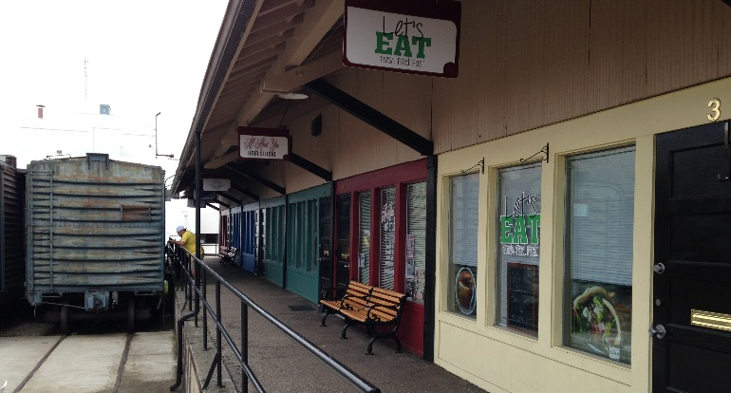
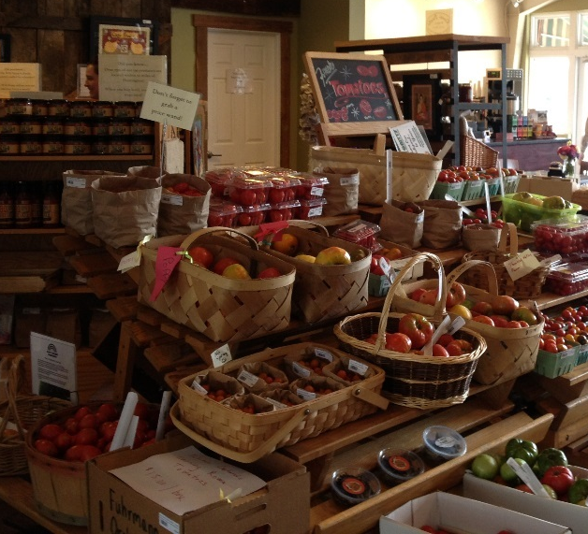
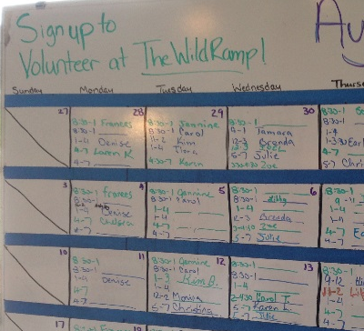
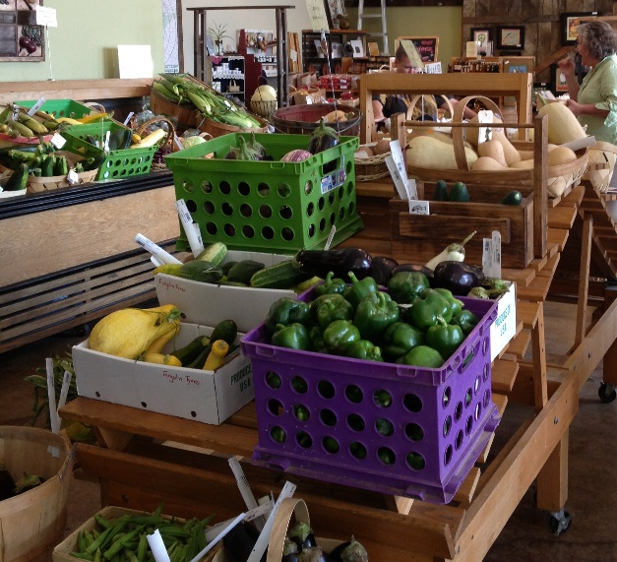
TIMELINE
January 2012: Planning began.
July 2012: The Wild Ramp opened, giving producers the ability to sell on consignment.
2014: The Wild Ramp outgrew its downtown space and with the encouragement and support of the city moved to Old Central City, a historic commercial corridor in Huntington.
Notes:
In less than a year after planning began, The Wild Ramp opened, offering local producers the chance to sell on consignment. They credit the quick opening to the help of Local Roots Market & Cafe in Wooster, Ohio. The Wild Ramp paid them for their time and now helps other markets that are just getting started.
By 2014, the Wild Ramp outgrew the space at its first location and moved into a new 2,500 square foot building along a historic commercial corridor in the part of town known as Old Central City. The city of Huntington helped pay for the move as part of an initiative to reduce crime and blight and help rejuvenate the neighborhood.

Slide 5
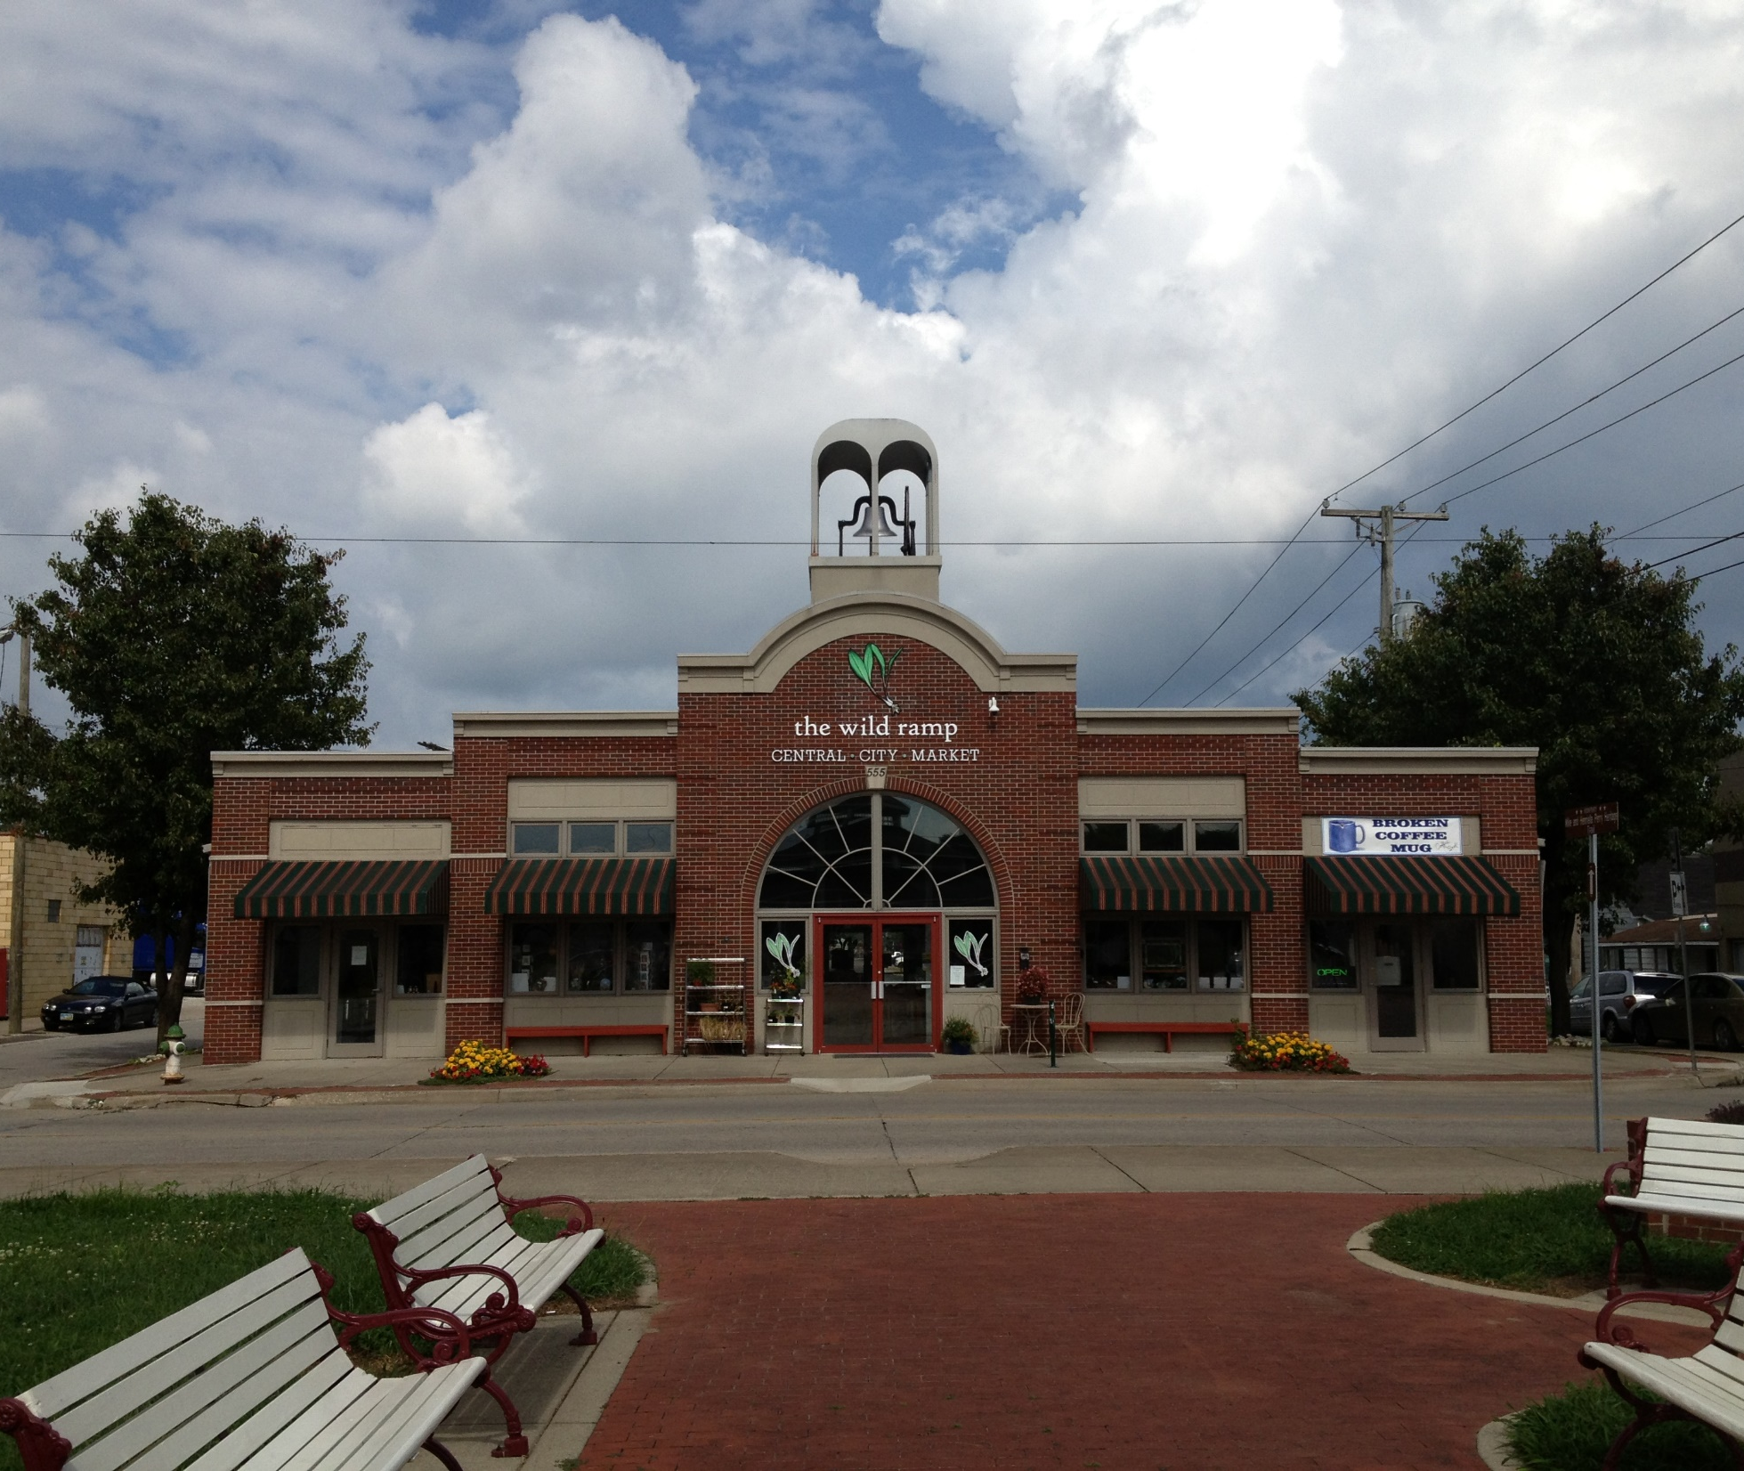
ORGANIZATION
Producers set their own prices and stock their own displays.
Producers keep 80% of proceeds; the market keeps 20% to fund operations.
The market has three paid staff members.
Volunteer board of 11 people plus large cadre of volunteers collectively work 500 hours/month.
Notes:
Producers set their own prices and stock their own displays, keeping 80 percent of the proceeds, with the market using the remainder to fund operations. Three paid staff members and a volunteer board of 11 people operate the market with the help of a large cadre of volunteers who collectively work about 500 hours per month.

Slide 6
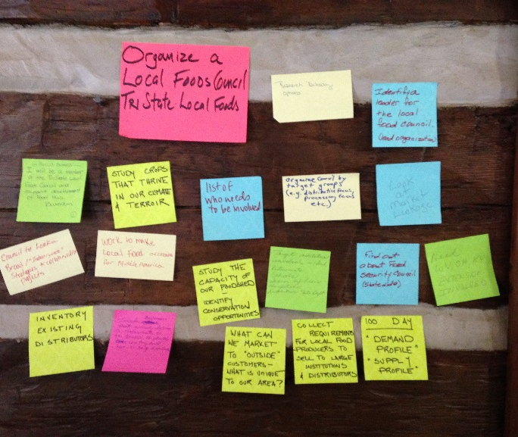
FUNDING/BENEFITS
  The city of Huntington helped pay for the move to Old Central City to help rejuvenate the neighborhood.
  The market brings foot traffic to the corridor and improves access to fresh, local food.
  The market was able to expand to three times its former size, with space for a small commercial kitchen that can support cooking classes, workshops, and other events.
Notes:
The city of Huntington was looking for an organization to operate a local foods market in a new 2,500-square-foot building along a historic commercial corridor in the part of town known as Old Central City. The city selected the Wild Ramp’s proposal and helped pay for the move, recognizing the market would help advance the city’s goals to reduce vacancies, prioritize development in existing commercial corridors, and promote commercial uses that serve residents’ needs. The market brings new foot traffic to the corridor while providing much-needed access to fresh, local food for neighborhood residents. The Wild Ramp, in return, was able to expand to nearly three times its size, allowing space for a small commercial kitchen, cooking classes, agricultural workshops, sustainability programs, and other community events.

Slide 7
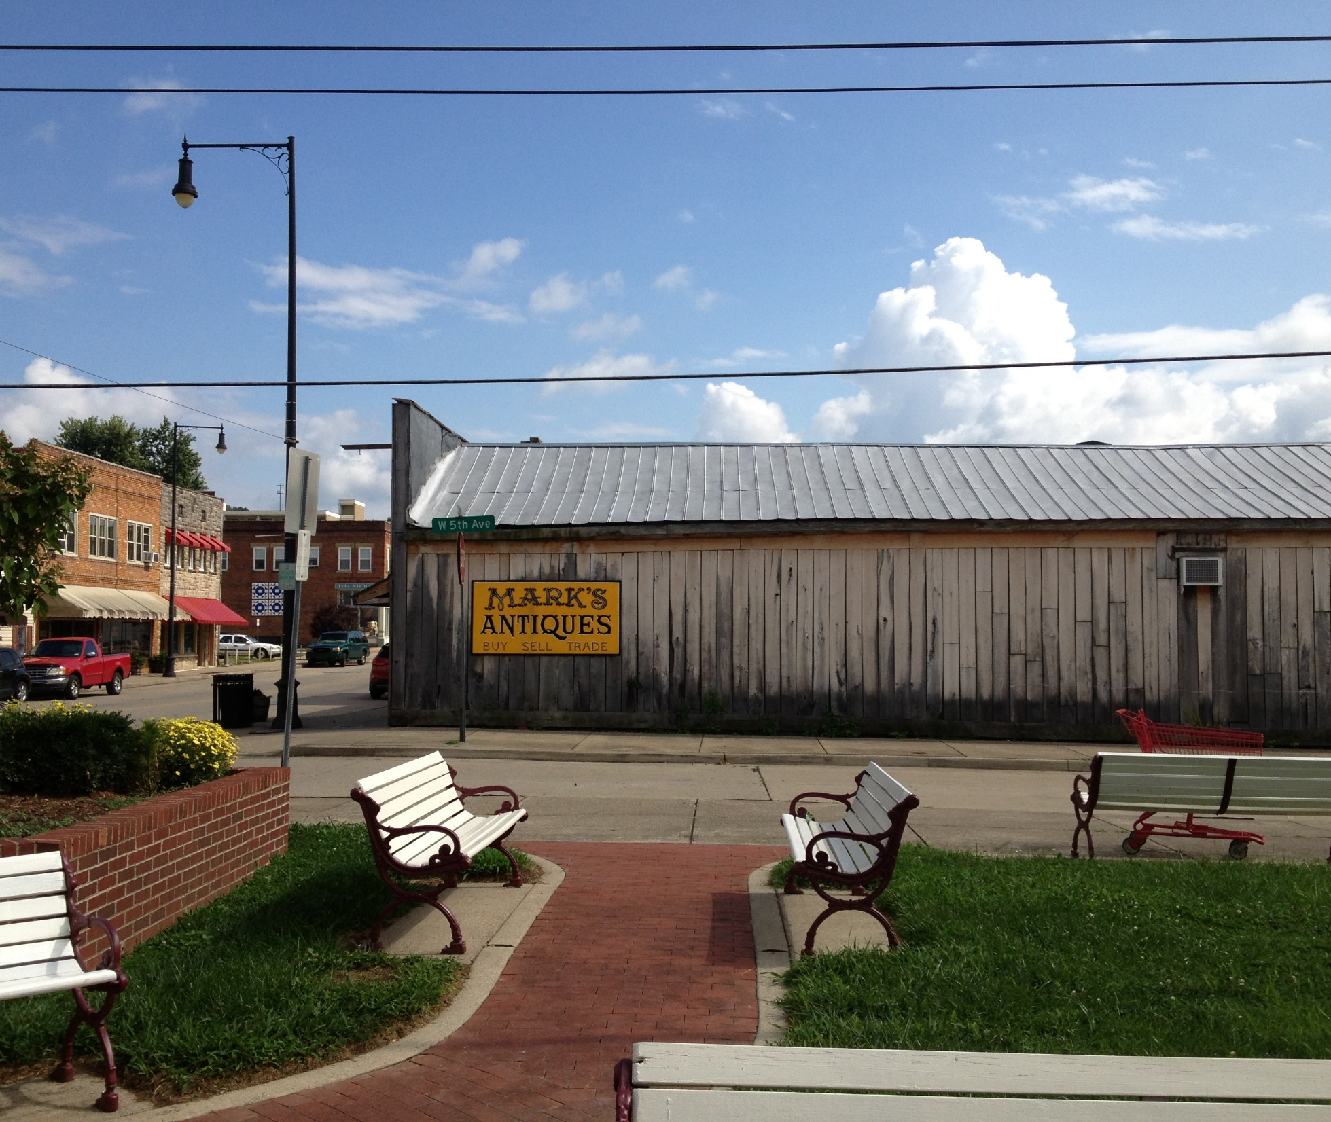
ACCOMPLISHMENTS
In the first five years of operation more than 225 producers and artisans have earned $1.3 million in sales.
The Wild Ramp has been part of Old Central City’s renaissance as a tourist destination filled with antique stores and mom and pop shops.
Notes:
In the first five years of operation, more than 225 producers and artisans have earned $1.3 million from sales at the Wild Ramp. In addition, the Wild Ramp has been part of Old Central City’s renaissance as a tourist destination filled with antique stores and mom and pop shops.

Slide 8
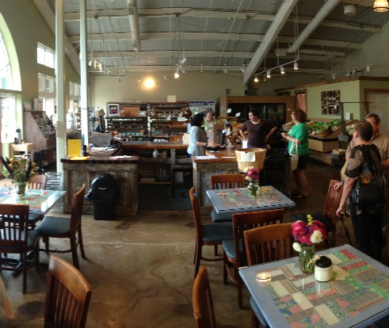
LESSONS LEARNED
Early community input and buy-in generated enthusiasm that has sustained the effort.
Volunteer labor and the city’s financial support were critical to the market’s success.
Location on a commercial corridor benefits the store and other businesses.

Slide 9
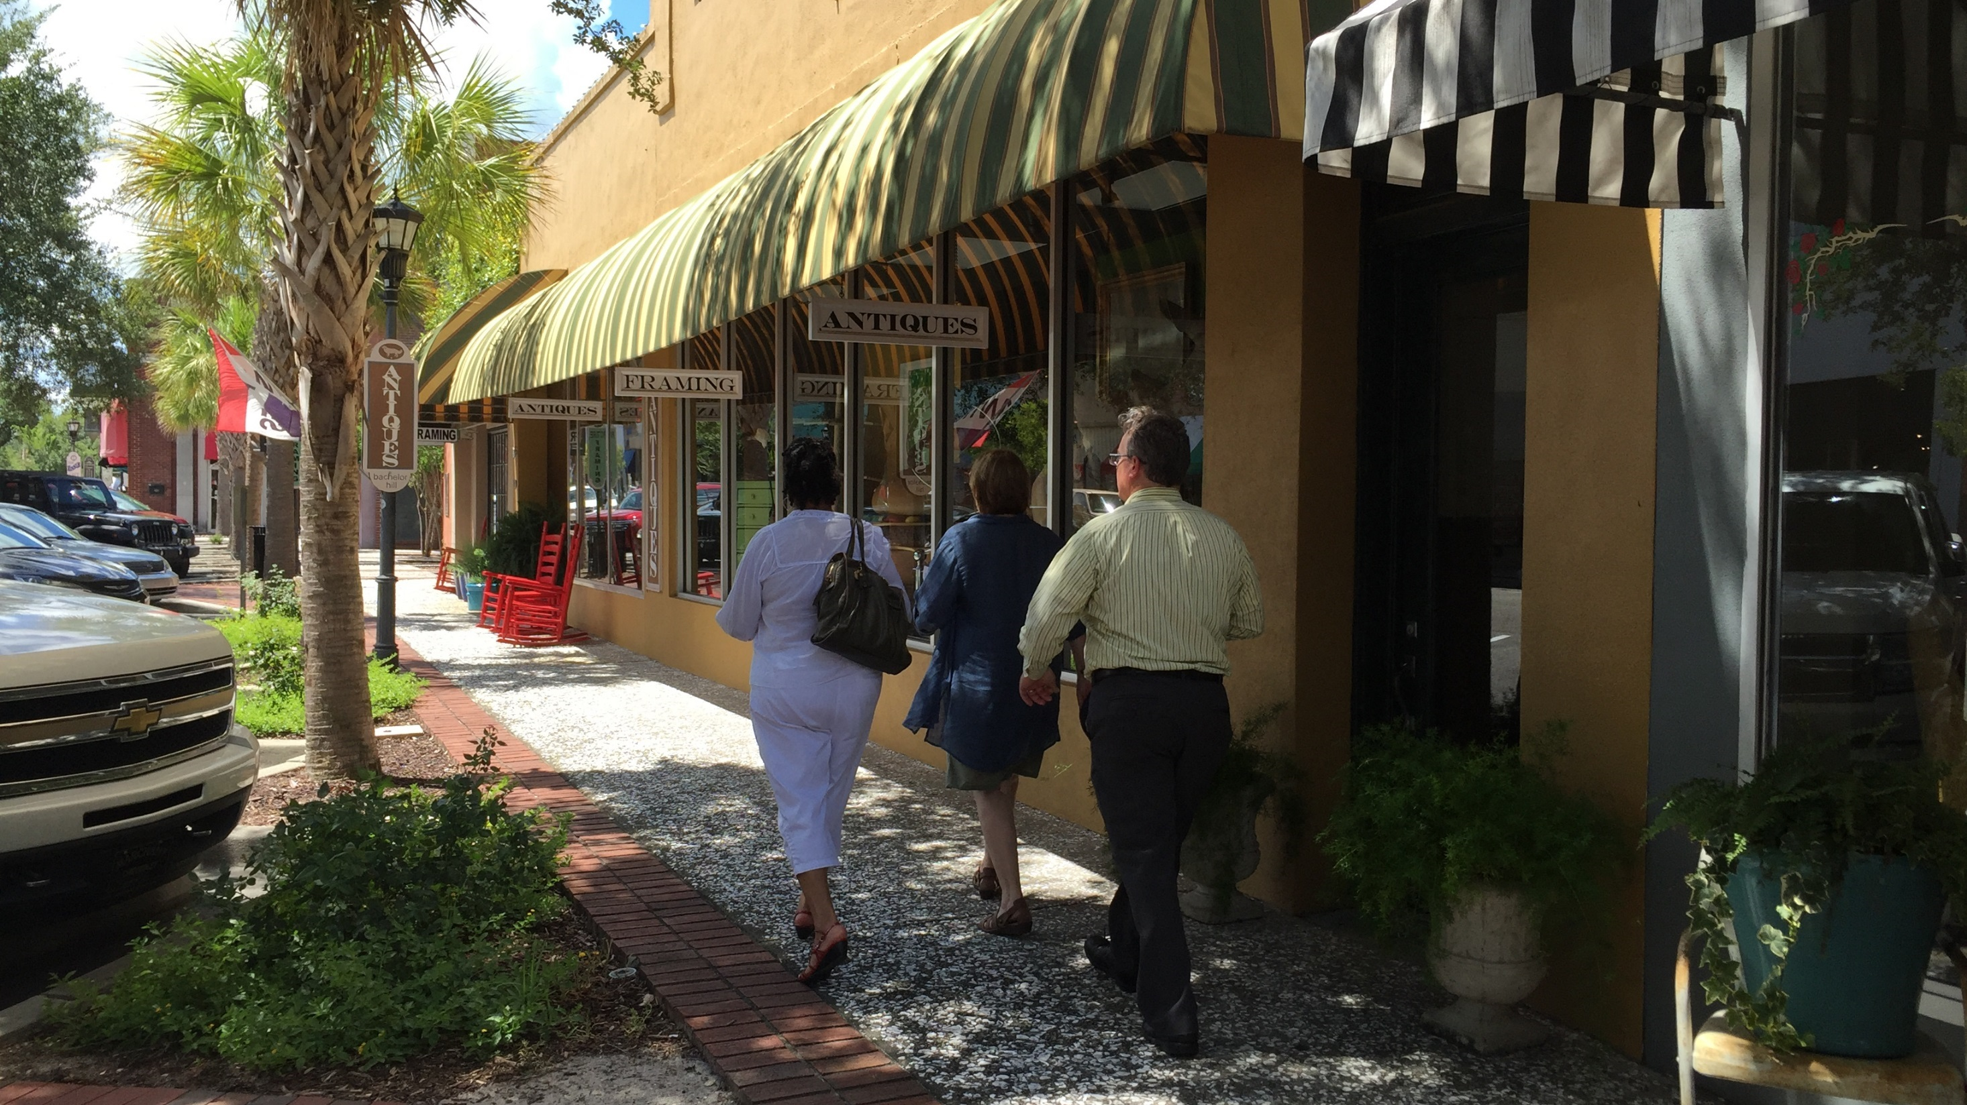
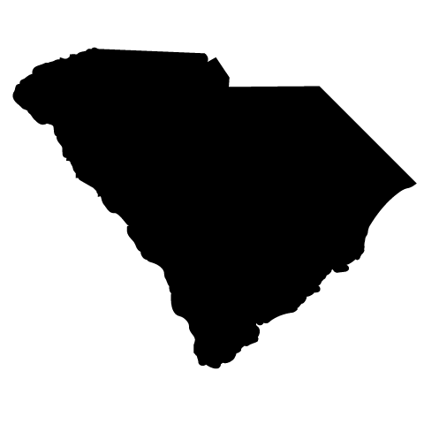
WALTERBORO, SOUTH CAROLINA: COLLETON COMMUNITY KITCHEN
Notes:
Walterboro, South Carolina, was founded in 1783 as a summer retreat for low country rice plantation owners. It grew over time, and today has a population of a little more than 5,000.

Slide 10
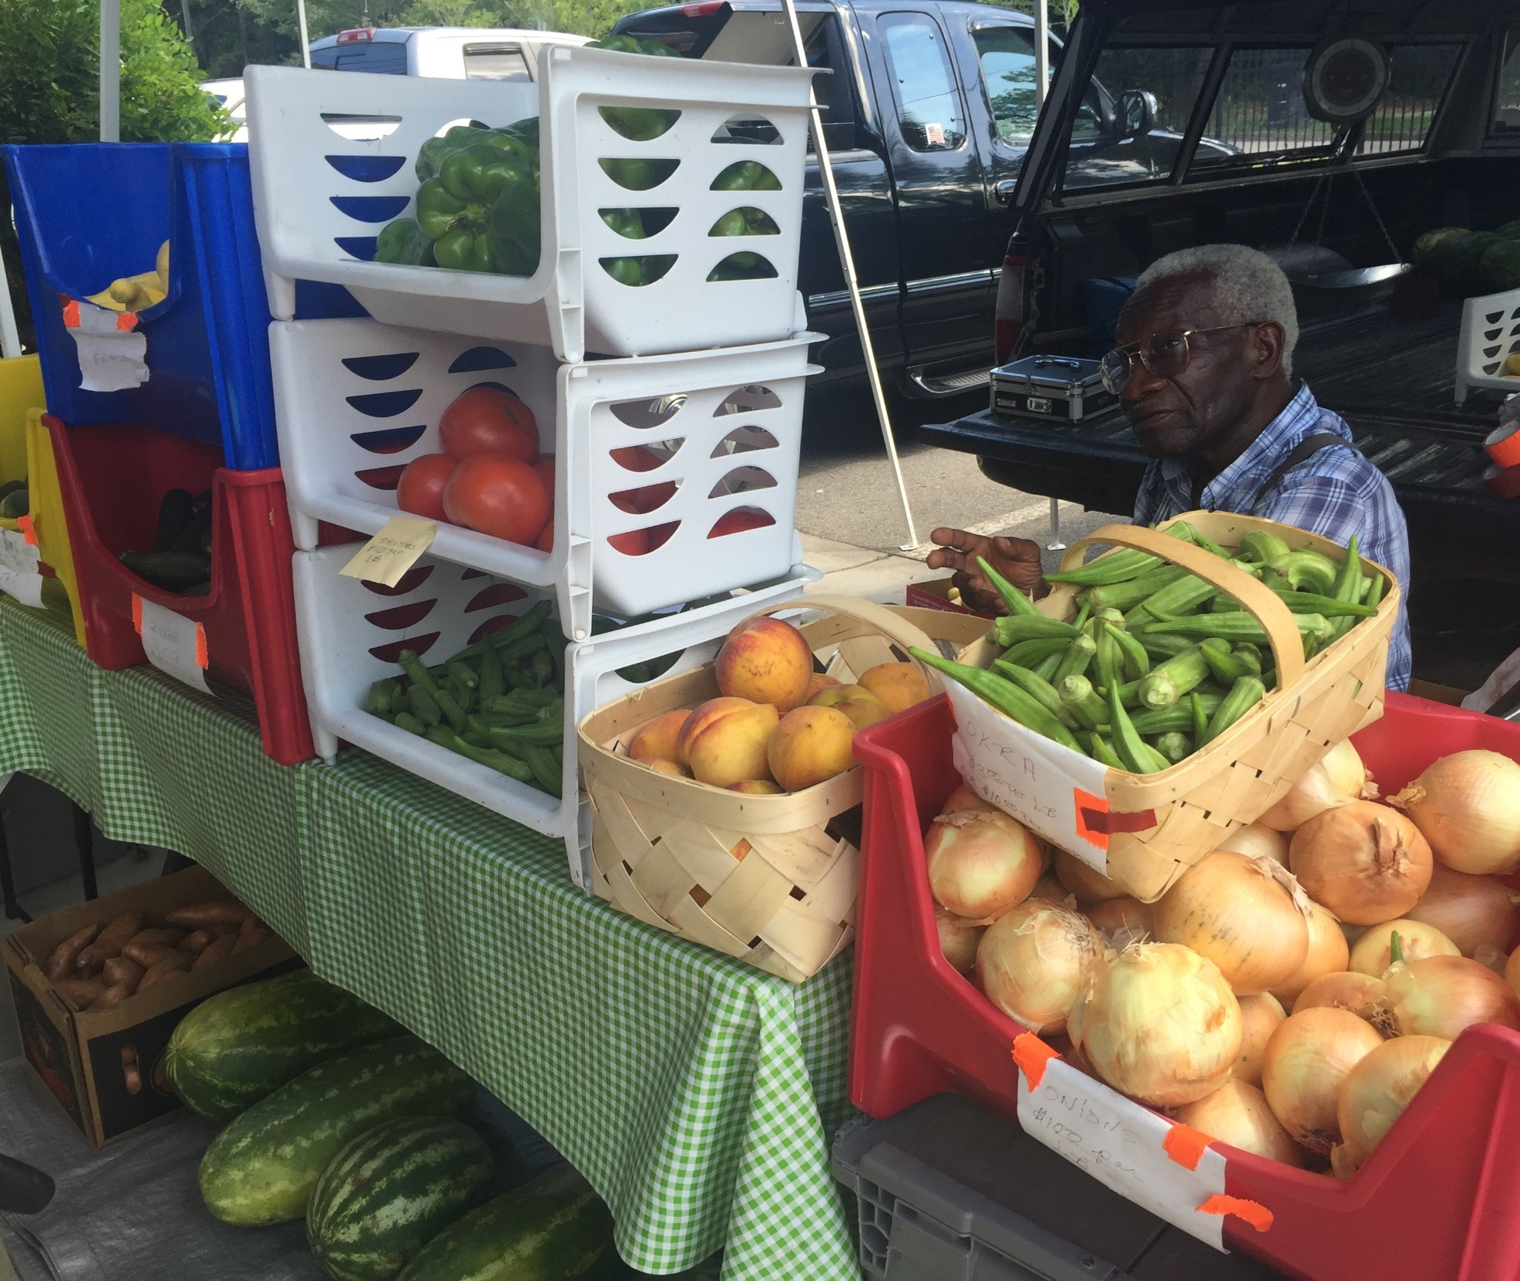
BACKGROUND
Operators of the downtown farmers market wanted to create a low-cost commercial kitchen space that would:
Help market vendors create value-added products.
Provide regulatory support and small business development training.
Help the local foods culture of the low country region.
Notes:
The operators of the downtown farmers market in Walterboro, South Carolina, were looking for a way to support market vendors in need of low-cost, commercial kitchen space in which they could create value-added products, learn how to navigate regulatory requirements, receive small business development training, and help develop the local foods culture of the low country region.

Slide 11
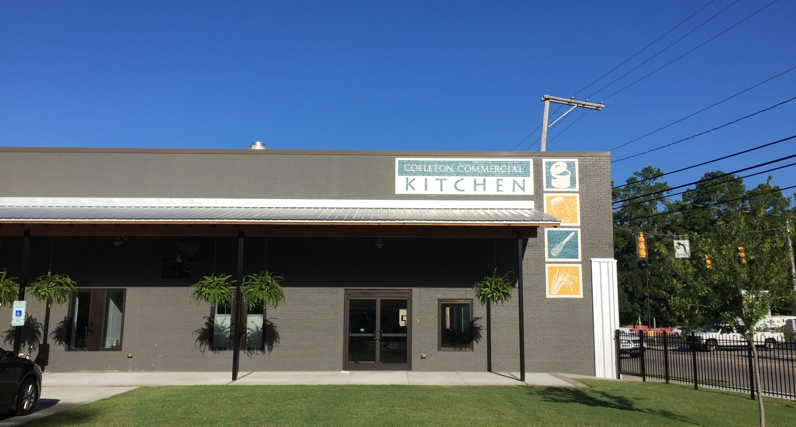
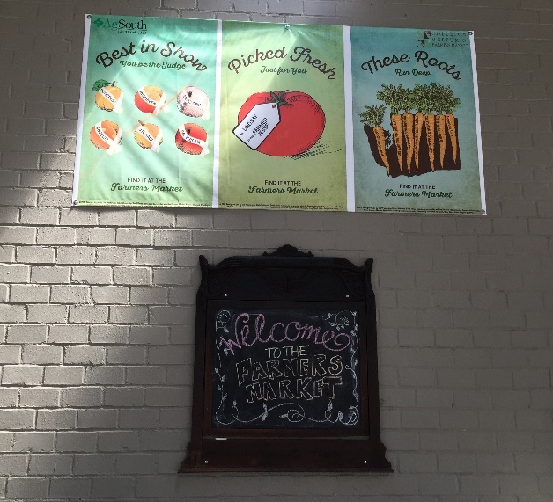
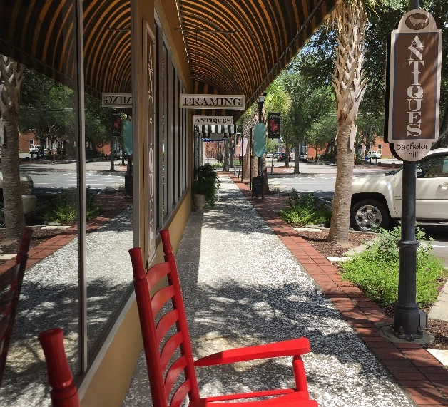
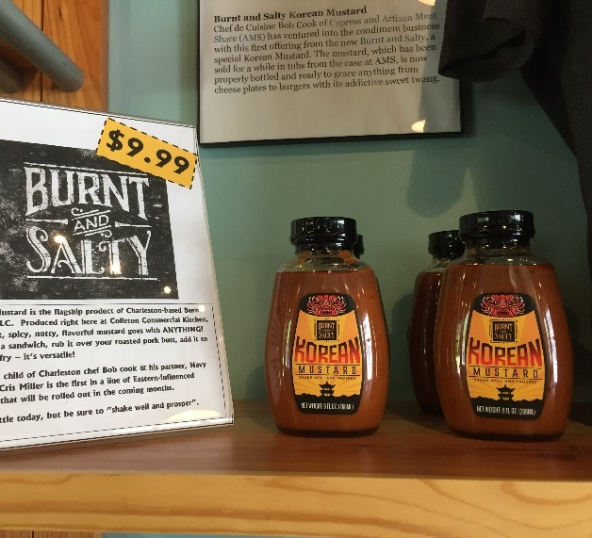
TIMELINE
2013 – Idea for a commercial kitchen develops. Applied for funding.
January 2014 – Plans finalized, bidding process initiated.
May 2014 – Construction begins.
June 2015 – Final approval for operation.
September 2015 – First user.
August 2016 – Wins South Carolina Association of Counties award for “most innovative project undertaken to improve the lives of citizens in that county.”
March 2017 – 10 users.
Notes:
The idea for a commercial kitchen first began to take hold in 2013. Most of the first year was spent applying for funding (which we’ll go into on the next slide). By January 0f 2014, plans were finalized and the construction bidding process began, with construction itself beginning in May of 2014. In June the South Carolina Department of Health and Environmental Control granted final approvals for the kitchen so operation could begin. The first person to use the kitchen did so in September of 2015, and less than a year later, the kitchen won the South Carolina Association of Counties award for “most innovative project undertaken to improve the lives of citizens in that country. As of March 2017, the kitchen had 10 users.

Slide 12
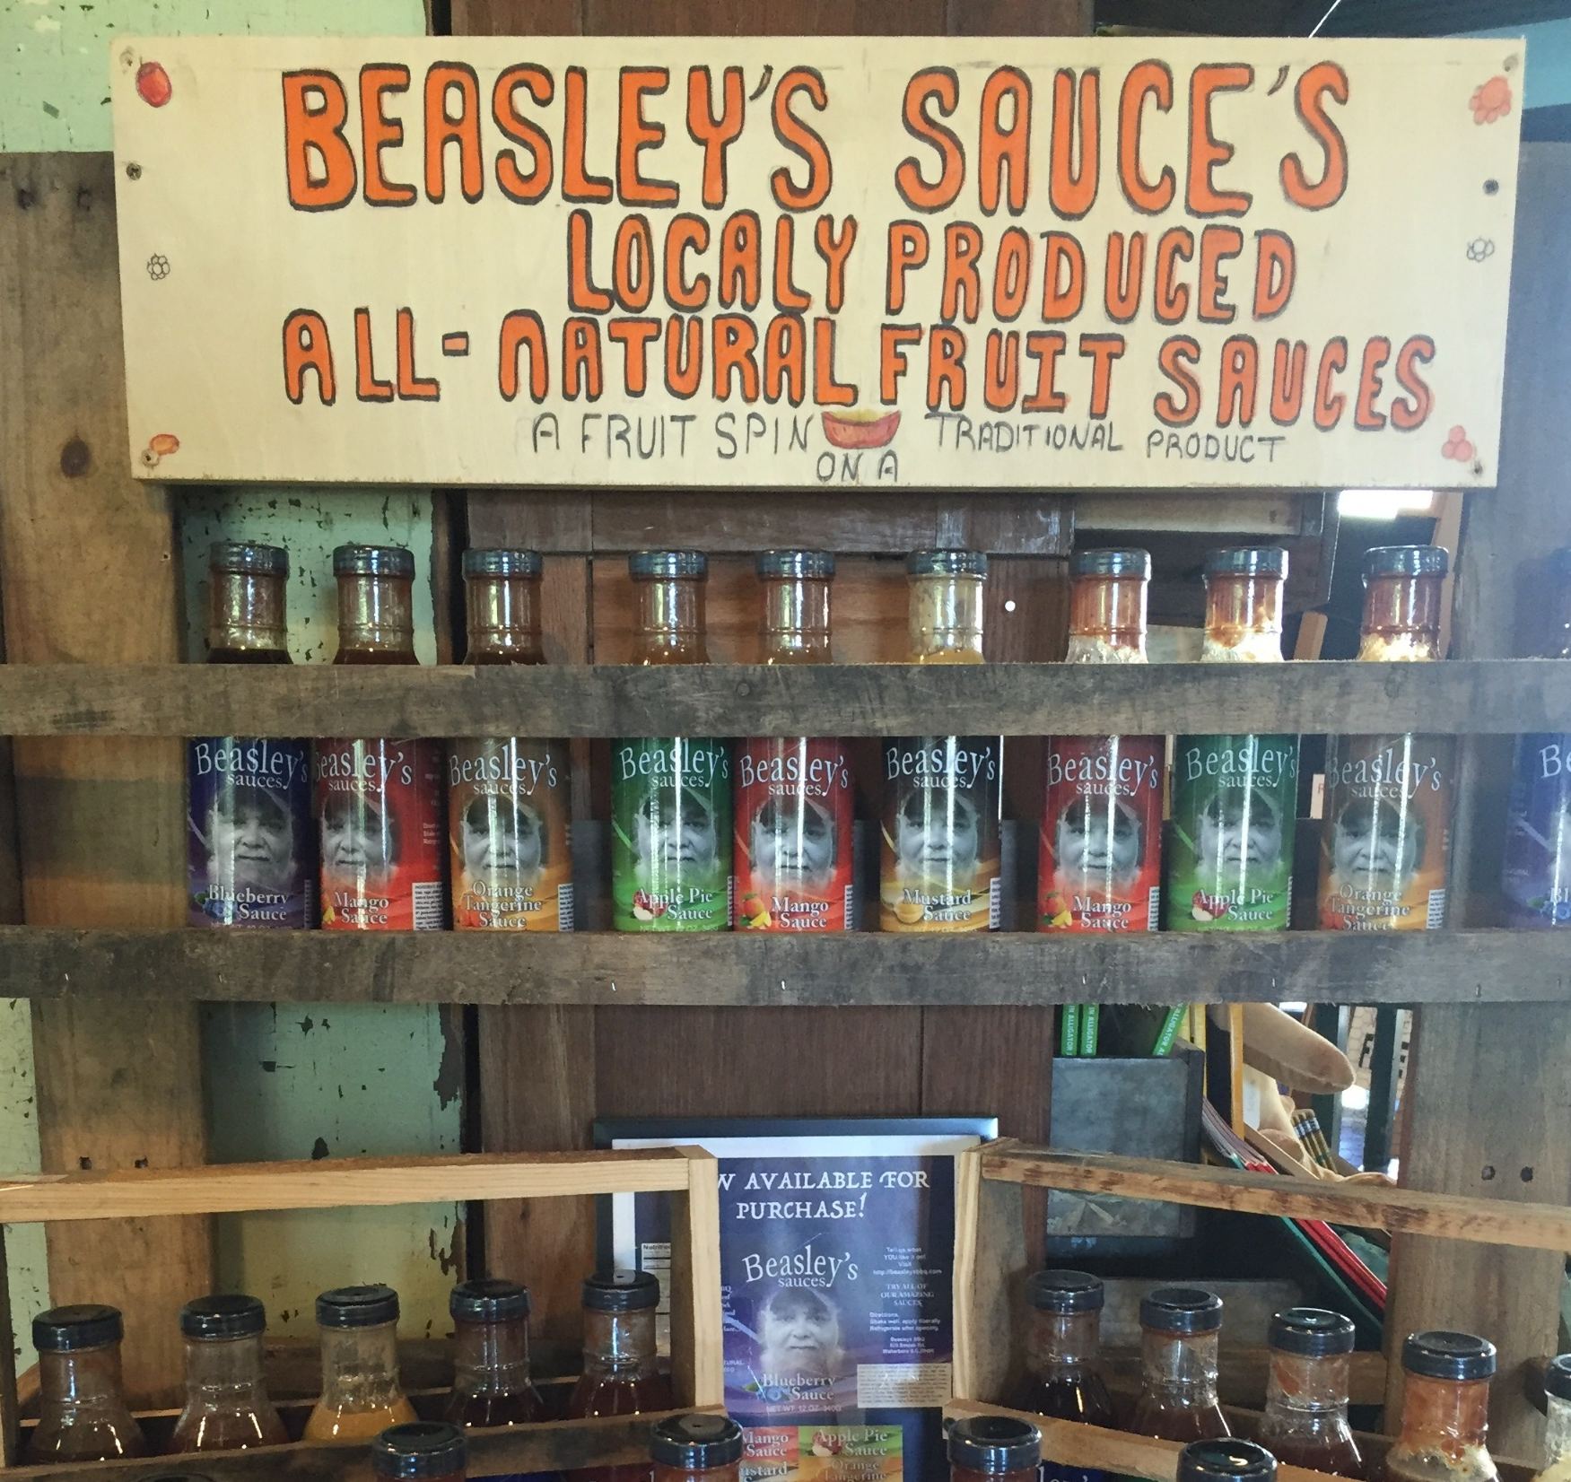
  USDA’s Rural Economic Development Loan and Grant Program provides funds to local utility sponsors, which use the funds to support local projects that will create and retain jobs in rural areas.
  Through the program, the Palmetto Rural Telephone Cooperative gave Colleton County a zero-interest, $1 million loan.
  The county used the loan to redevelop a vacant downtown building into the Colleton Commercial Kitchen and physically connect it to the Colleton Museum and Farmers Market.
  The county uses project revenues to repay the loan, backed up by hospitality tax revenue.
FUNDING
Notes:
Colleton County was able to secure a zero-interest, $1 million loan for a commercial kitchen from the Palmetto Rural Telephone Cooperative through the USDA’s Rural Economic Development Loan and Grant Program. The program provides funds to local utility sponsors, which use the funds to support local projects that will create and retain jobs in rural areas. Using this loan, the county redeveloped a vacant building into the Colleton Commercial Kitchen and connected it to the Colleton Museum and Farmers Market.

Slide 13
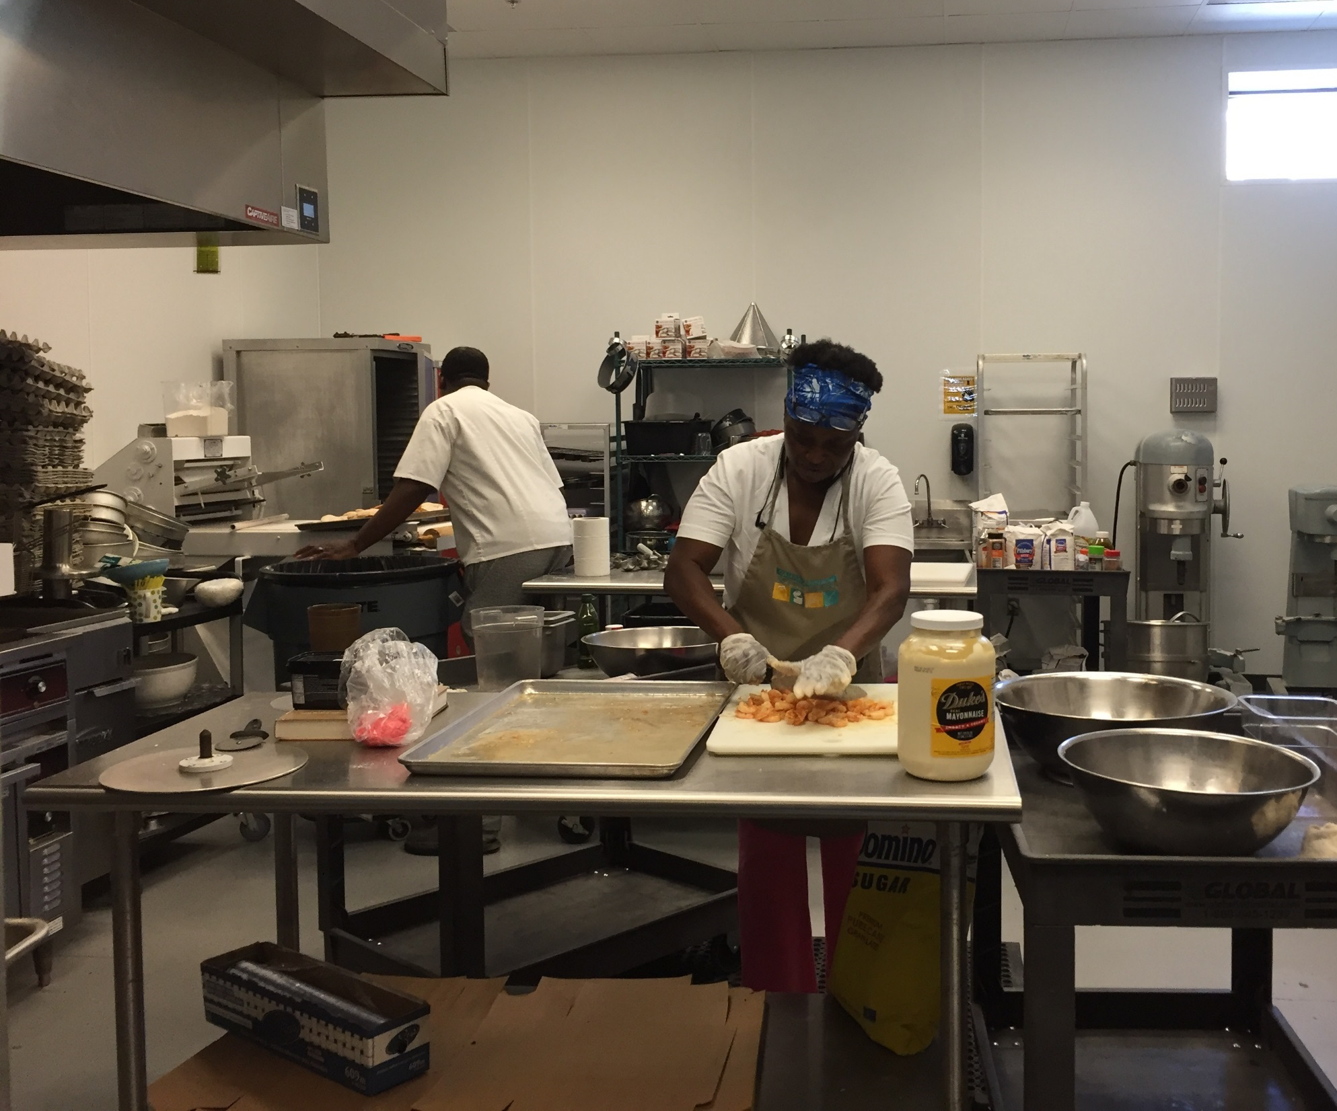
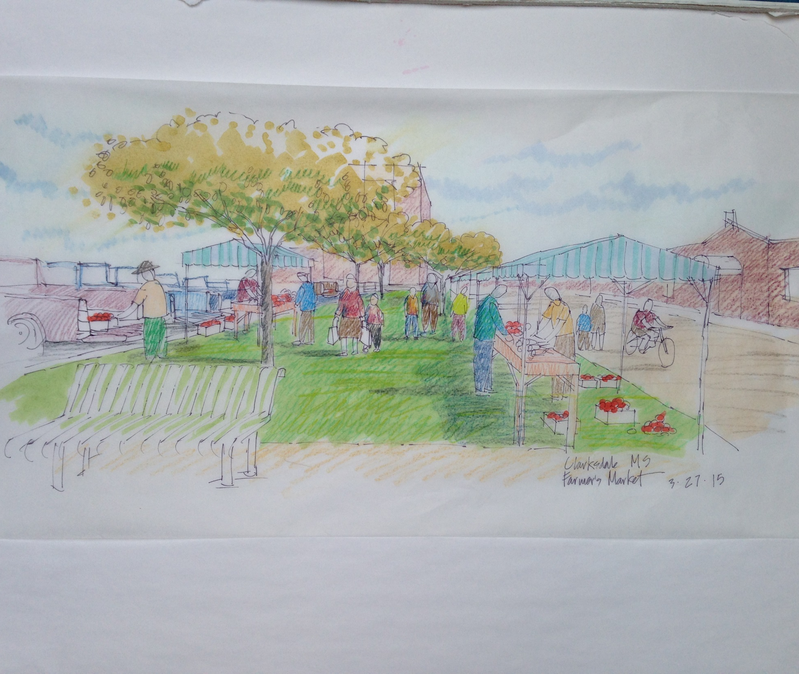
ORGANIZATION
The Colleton Commercial Kitchen provides:
A food production facility for lease by the hour.
Small business training.
A retail café and market.
Notes:
The Kitchen offers a food-production facility that can be leased by the hour, small business training, and a retail café and market in which kitchen users can sell their products.

Slide 14
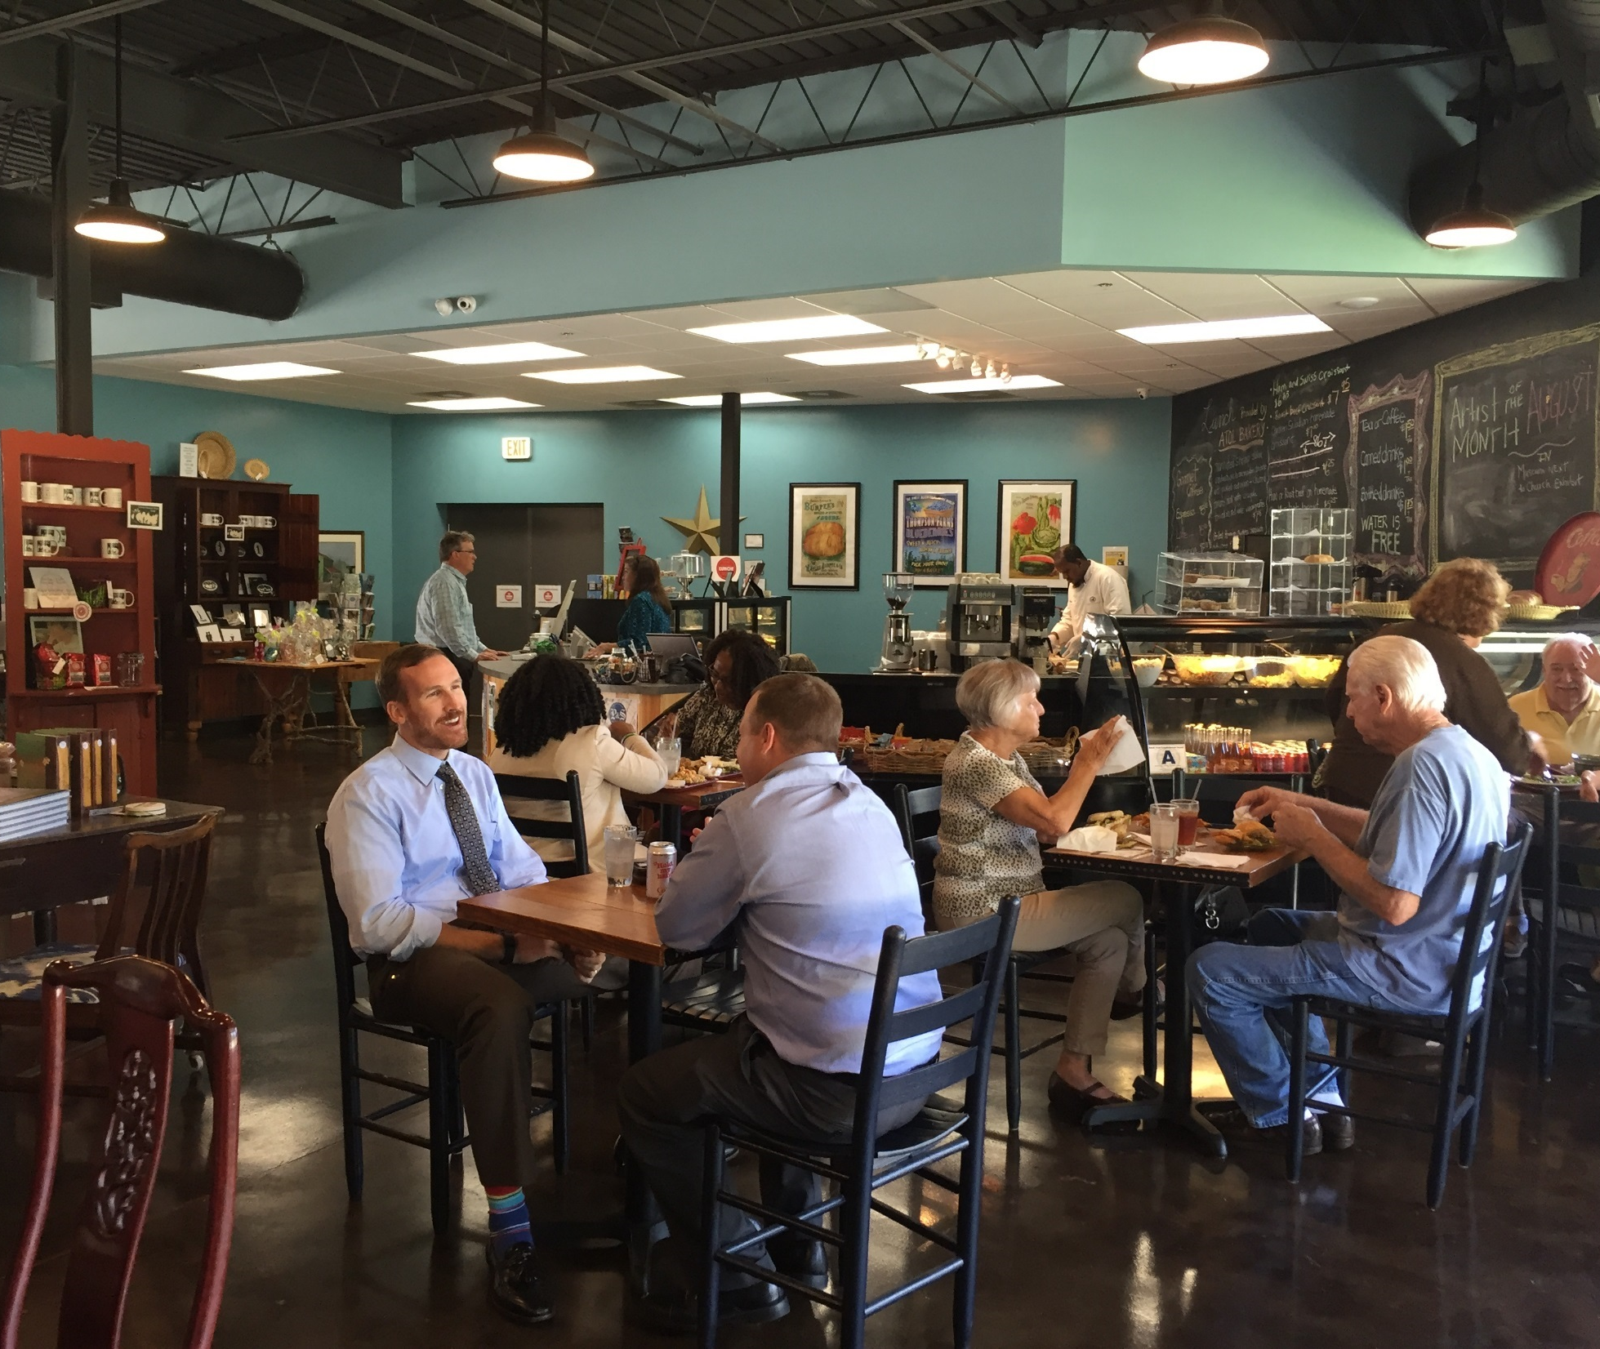
ACCOMPLISHMENTS
In less than two years of operation, the kitchen:
Created 12 new businesses.
Created 60 new jobs.
Produced 120,000 oz. bottled sauces.
Produced 18,000+ bakery items.
Certified 280 food professionals.
Prepared 200,000 meals for after-school and summer feeding programs.
Rented facility to public for 40+ events.
Spurred redevelopment on vacant and deteriorating parcels in the vicinity.
Notes:
In less than two years of operation, the kitchen achieved a number of successes in helping to create new entrepreneurial opportunities, reduce food insecurity, and ensure its long-term viability. Beyond the success of the kitchen itself, the building renovation and creation of a retail café along with street beautification and landscaping improvements have contributed to downtown’s vitality and spurred redevelopment on the parcels in the immediate surroundings. Several existing businesses and an apartment building have been renovated, and a new gym and new law offices opened in vacant buildings nearby.

Slide 15
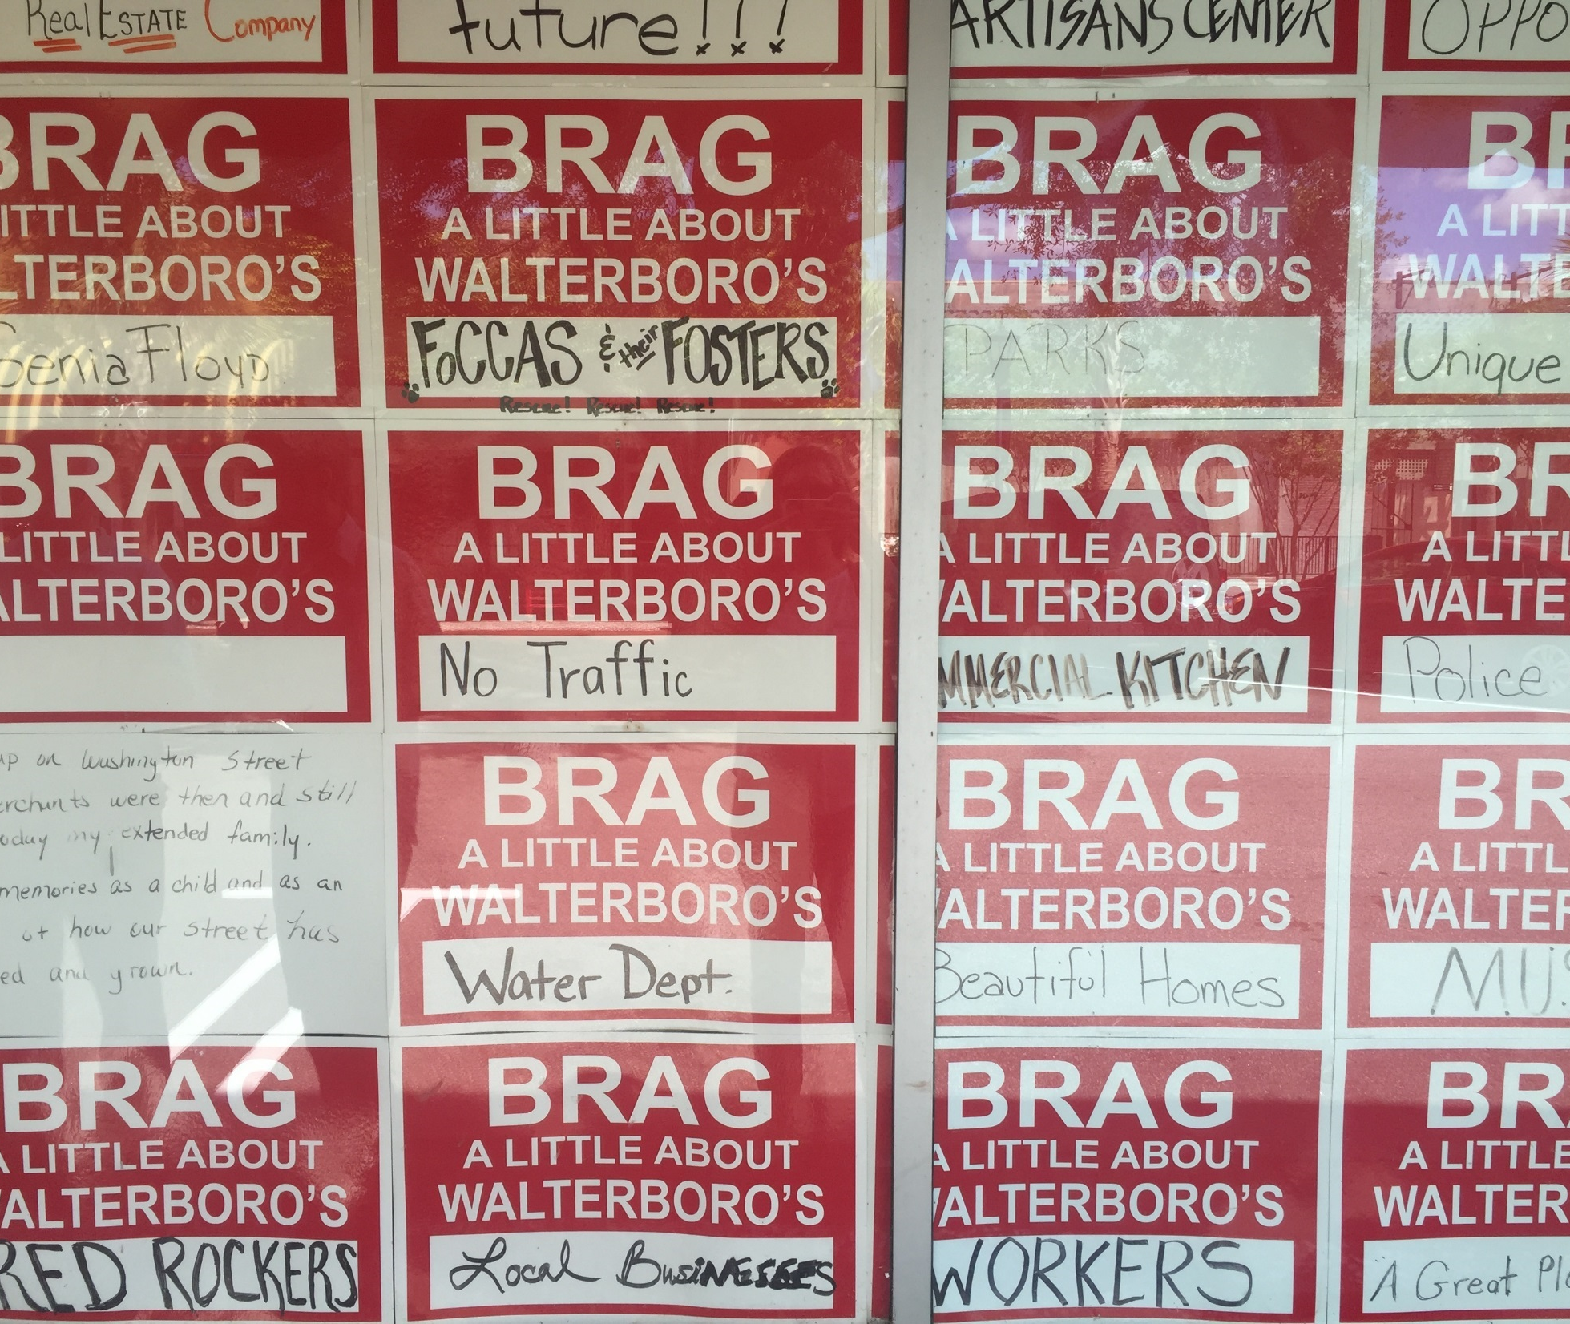
LESSONS LEARNED
Being the only facility of its type, size, and operation in South Carolina has helped ensure sufficient demand for the services offered.
The market and café provide a ready outlet for new entrepreneurs to sell their products.
The investment in the kitchen yielded dividends for the entire downtown because of its central location.

Slide 16
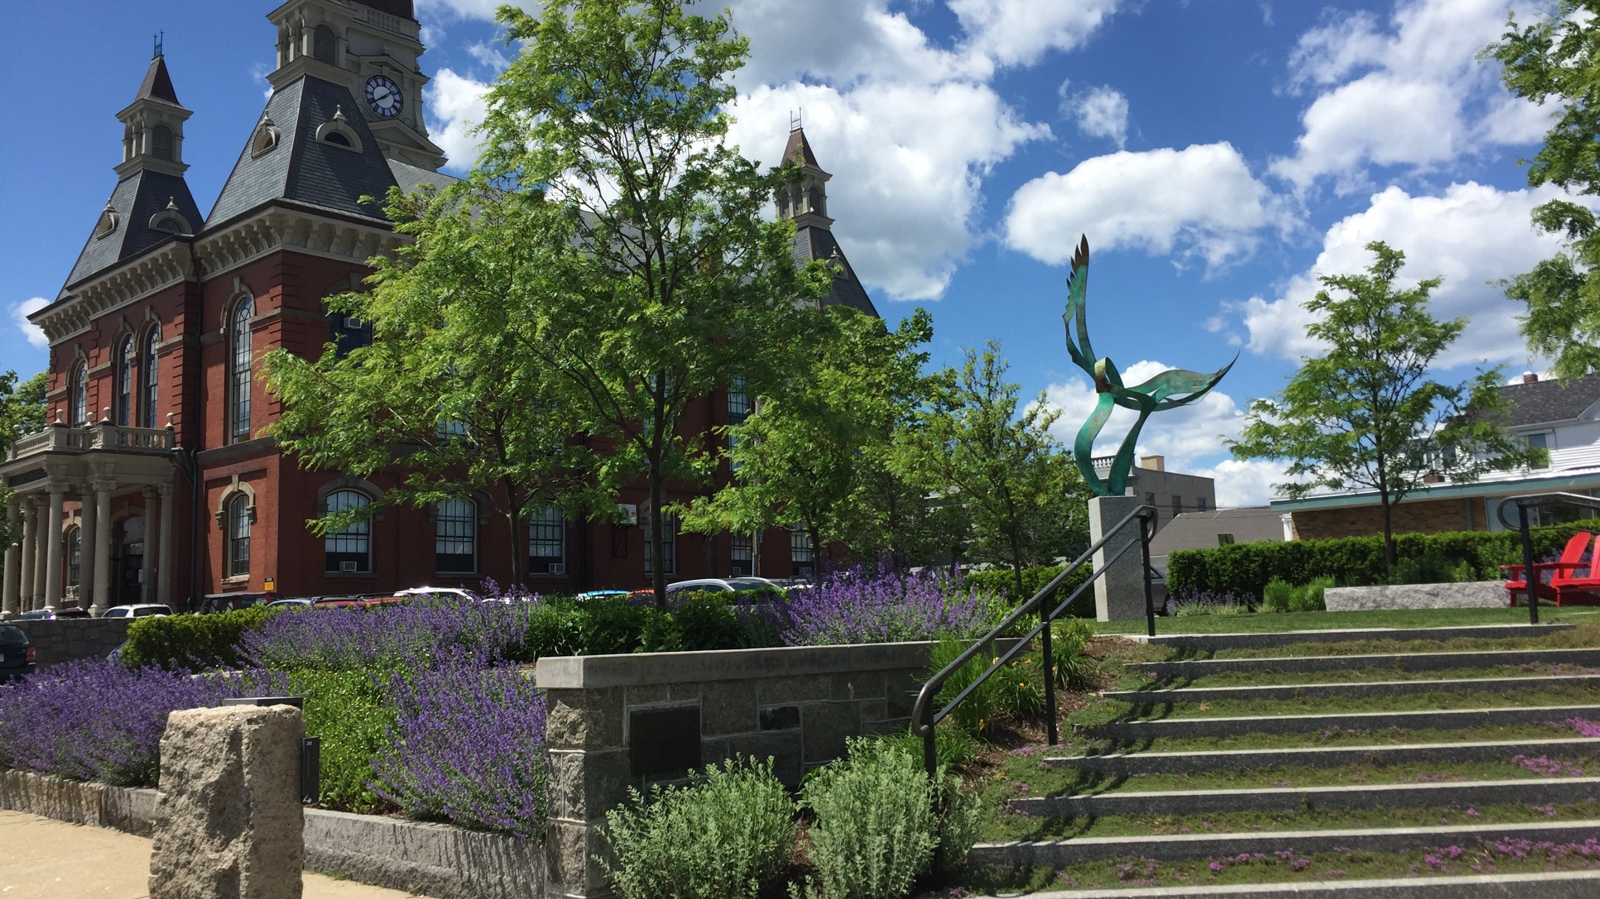

GLOUCESTER, MASSACHUSETTS: LOCAL FOOD PROMOTION
Notes:
Gloucester, Massachusetts is a town of around 30,000 people on the eastern end of Cape Ann. Its population grew from around 8,000 people in 1850 to around 26,000 in 1900 as Portuguese and Italian immigrants came to work in the growing fishing industry.

Slide 17
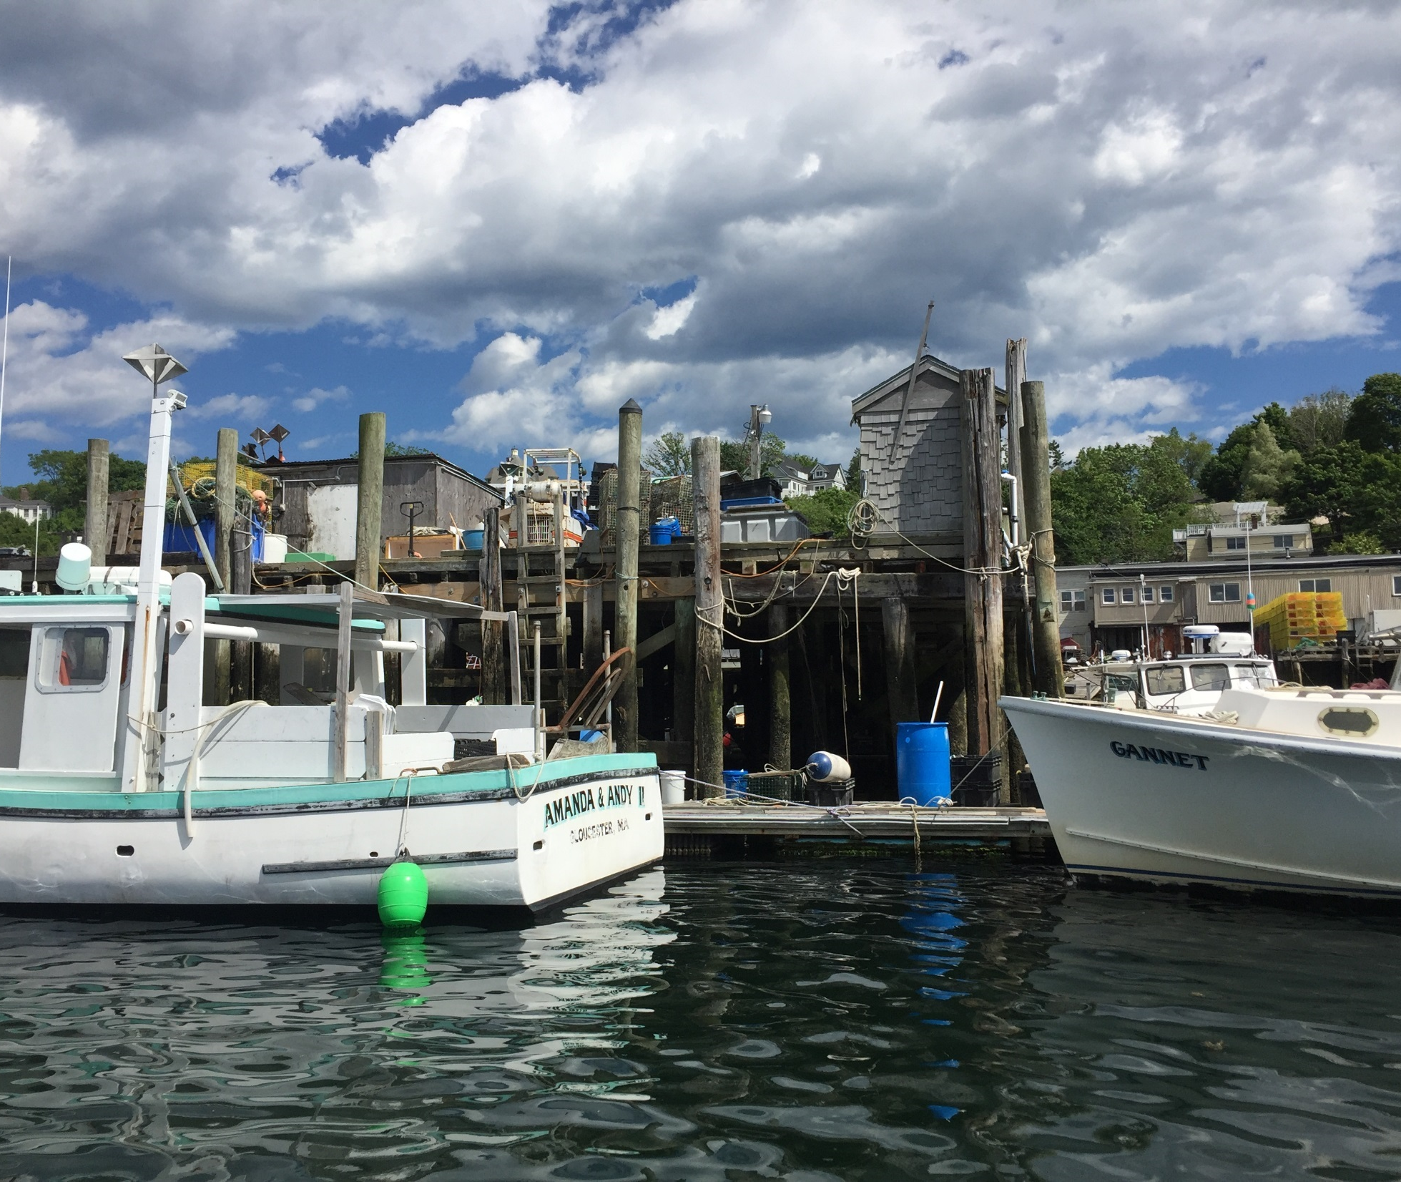
BACKGROUND
The seafood industry has defined Gloucester’s identity and economy since the 1600s.
The city was historically the principal hub for the New England fishing industry.
Current challenges hit smaller-scale operations particularly hard:
  Low prices
  Catch limitations
  Seasonal nature of the industry
Notes:
Since the 1600s, Gloucester’s rich maritime heritage has defined its identity and economy. The port of Gloucester is the oldest in the country, and the city has historically served as a principle hub for the New England fishing industry. However, multiple challenges threaten the local fishing industry, including low prices, catch limitations, and the seasonal nature of the industry, which are especially difficult for the smaller-scale fishing operations and boats of Gloucester’s day fleet.

Slide 18
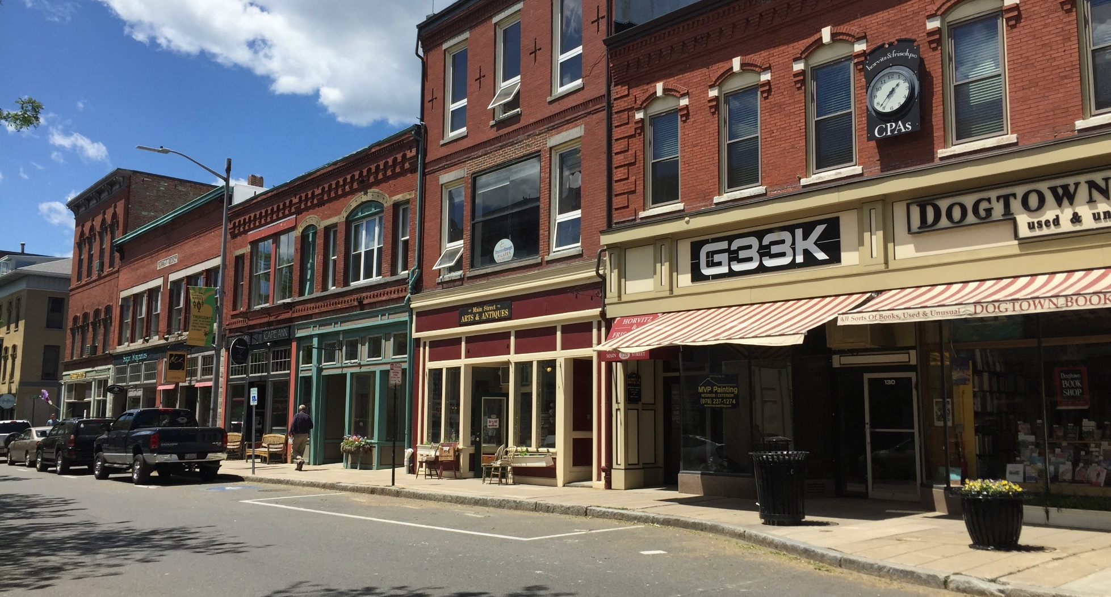
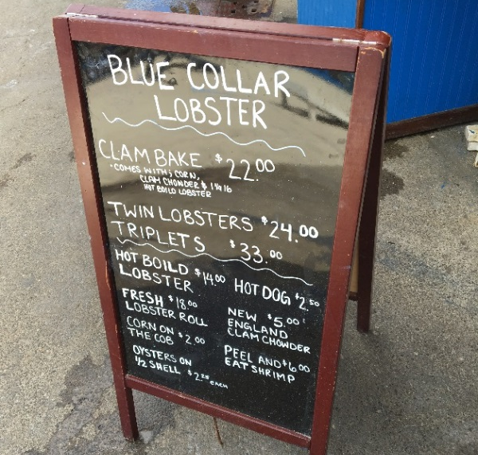
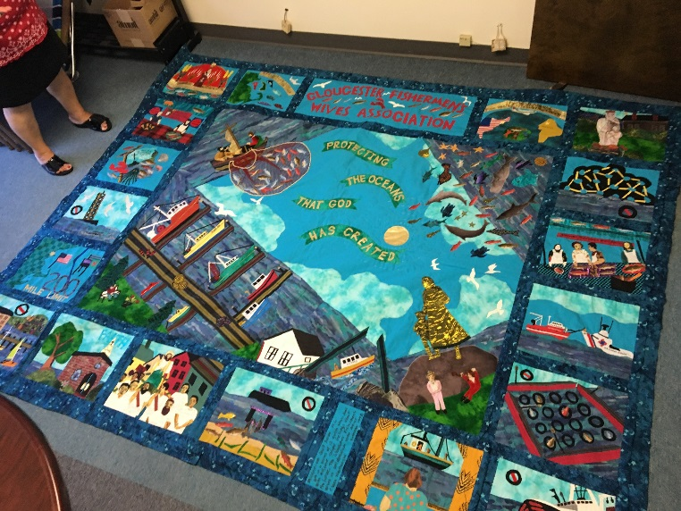
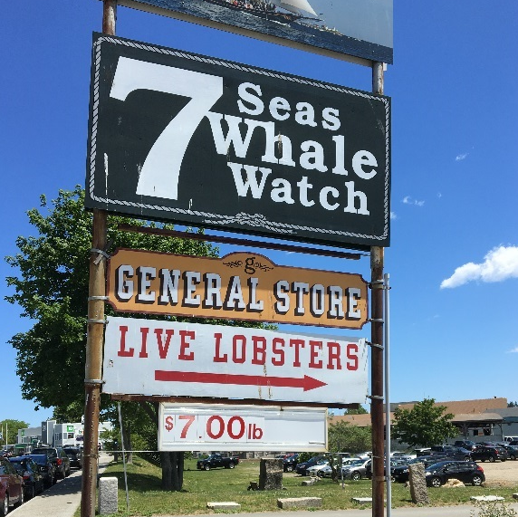
GLOUCESTER FISHERMEN’S WIVES ASSOCIATION
Has worked to promote the New England fishing industry since 1969.
Advocates for a clean, healthy, sustainable ocean.
Educates the wider community about fisheries issues.
Works with local fishermen on market-based approaches to earn a living while sustaining the fisheries.
Notes:
The Gloucester Fishermen’s Wives Association (GFWA) is a nonprofit organization founded in 1969 to raise awareness of and address problems facing the New England fishing industry.
See: http://gfwa.org/.

Slide 19
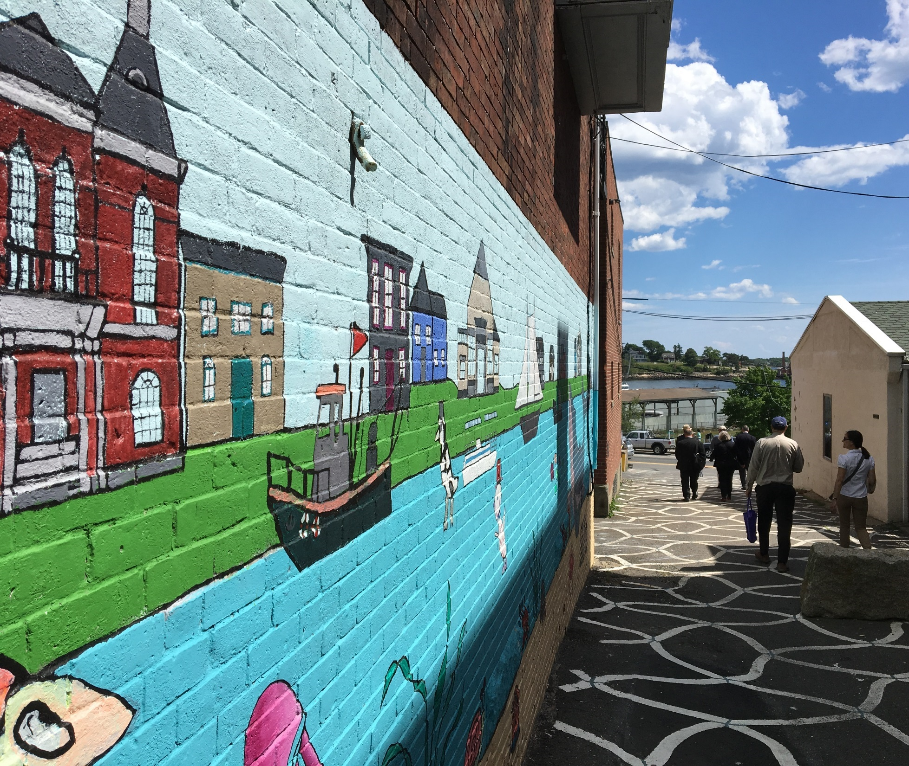
CAPE ANN FRESH CATCH
Community-supported fishery.
Members buy shares to receive fresh seafood throughout the season.
Recipes help members get to know lesser-known species that would otherwise go to waste.
Notes:
Gloucester has responded with a multi-pronged approach to cultivate local support for the city’s seafood industry. Cape Ann Fresh Catch is a community supported fishery that has been in operation since 2008. Following the community supported agriculture (CSA) model, members purchase shares at the beginning of the season that entitle them to weekly allotments of fresh seafood that are picked up from designated sites across the city. Members get fresh, high-quality seafood, while fishermen have a reliable market for their product. Including recipes helps customers know how to prepare the lesser-known species that might otherwise be discarded, as traditional grocery outlets sell just a small number of the species that are caught.

Slide 20
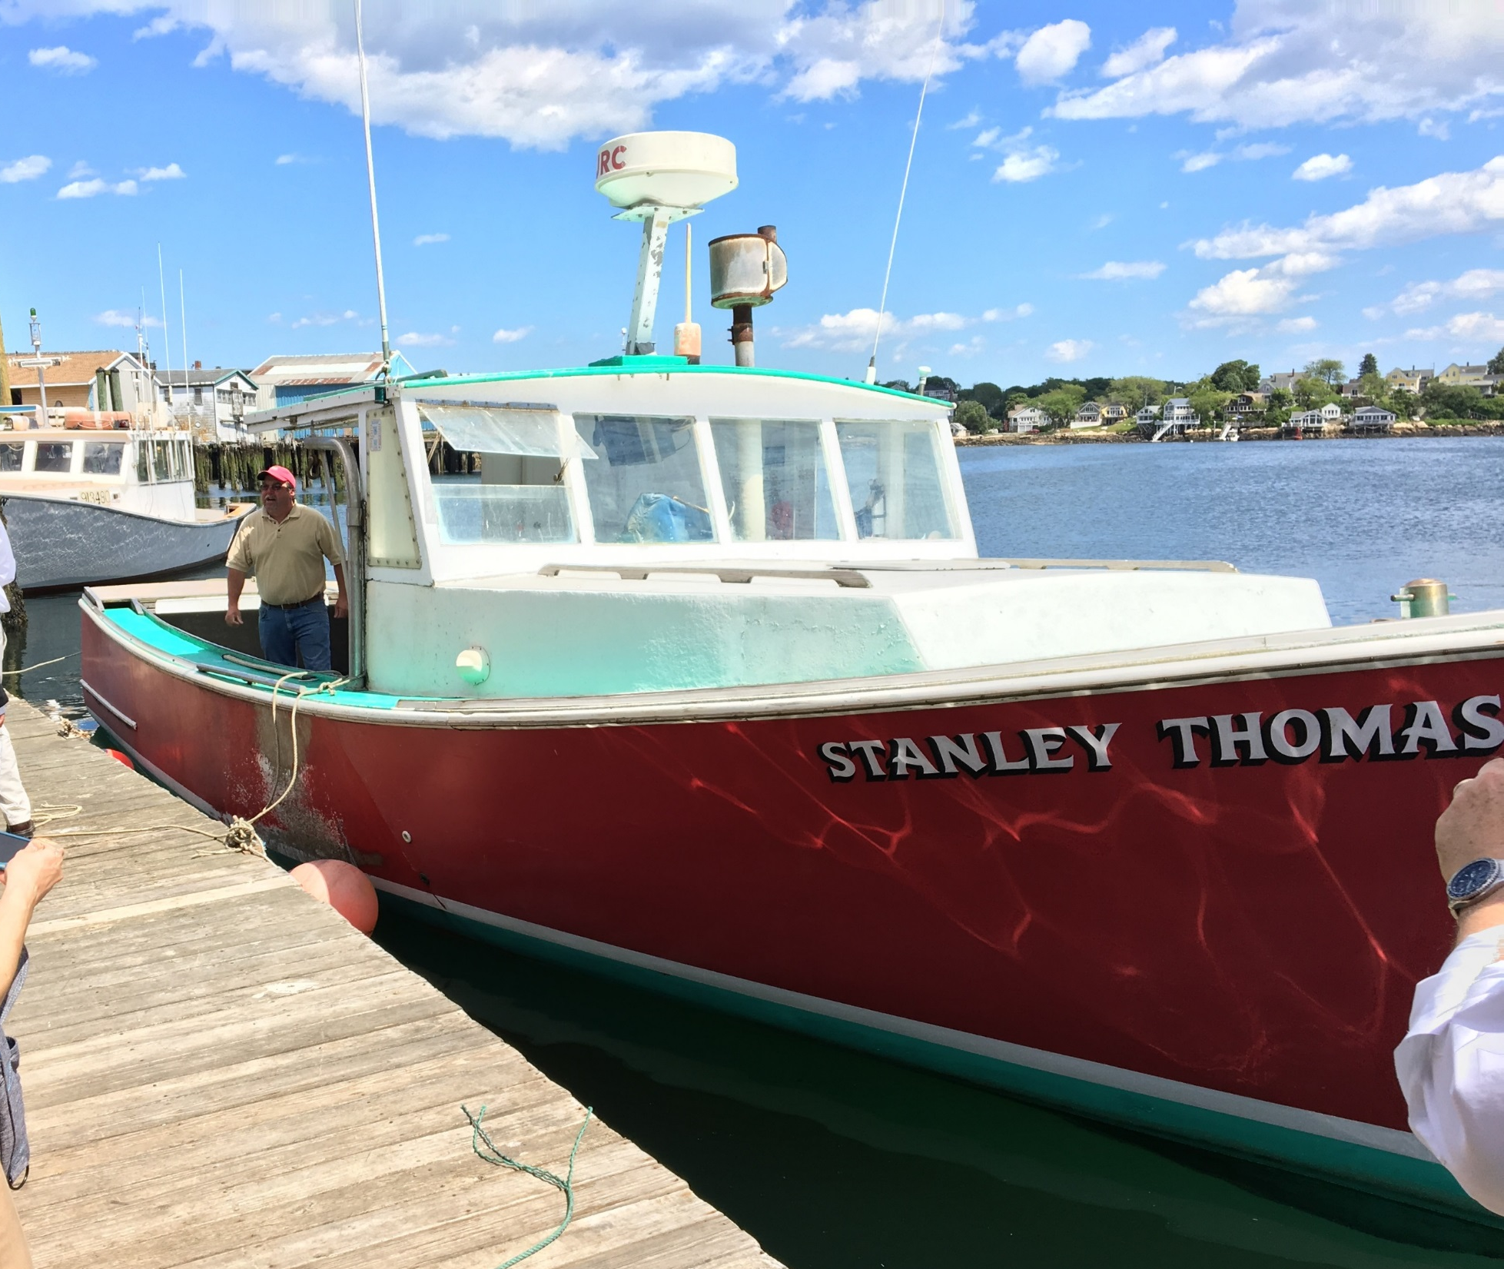
GLOUCESTER FRESH
  Funded by a $151,000 state economic seaport grant to the city.
  Supports exhibitions, branding, and marketing.
  New England chain of restaurants agreed to serve city-branded fish at more than 100 locations.
  Additional $20,000 USDA Rural Business Development grant will fund a demonstration kitchen to showcase underused species.
Notes:
Building on this success is the Gloucester Fresh initiative, which aims to sustain and improve the local seafood industry. Funded by a $151,000 state Economic Seaport Council grant, the program supports participation in exhibitions, development of a branding campaign, and establishment of contracts with restaurants to serve Gloucester seafood. Among its first successes, the Ninety-Nine Restaurant and Pub agreed to serve city-branded fish at its more than 100 locations across New England. The restaurants feature haddock, a species that is more plentiful and sustainable than others like cod that are under tight catch limitations. In 2017, Gloucester Fresh received a $20,000 USDA Rural Business Development grant to build a demonstration kitchen that can help showcase the benefits of other local, underused species.
See: www.gloucesterfresh.com.

Slide 21
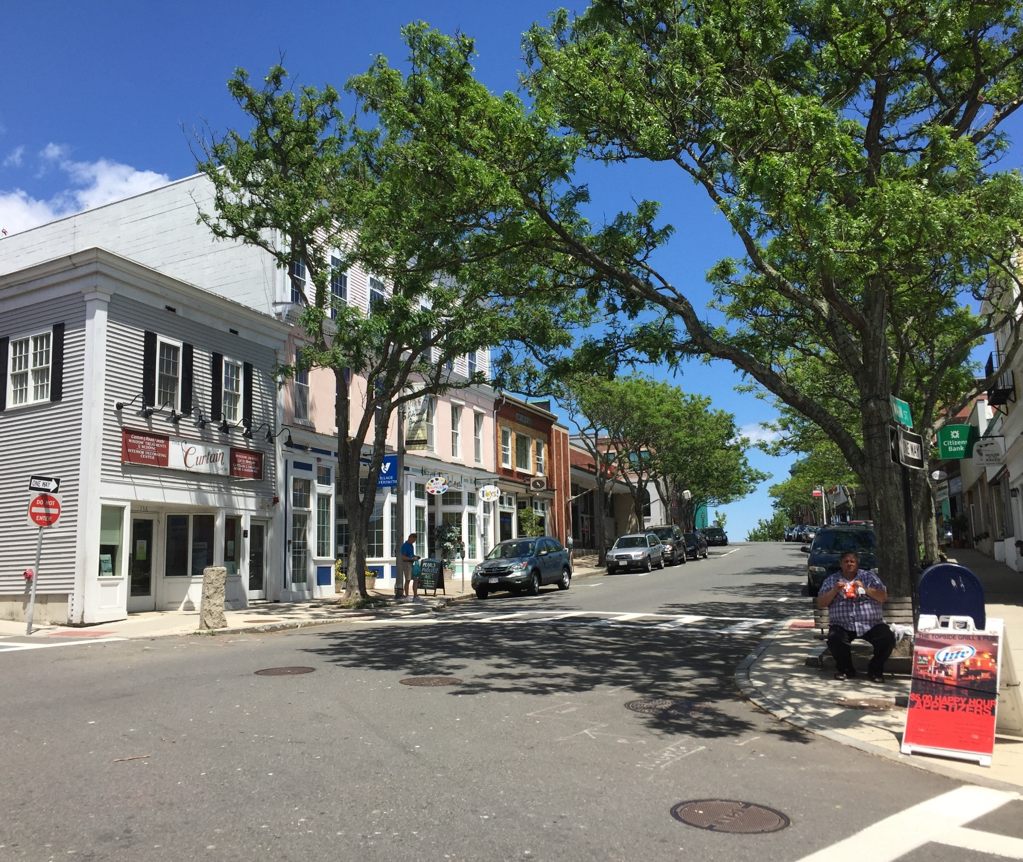
Success is built from many small initiatives instituted over time, not one silver bullet.
Changing perceptions and attitudes about local food is a slow but important process.
The local food industry is integral to the city’s sense of place and as worthy of preservation as any local asset.
LESSONS LEARNED

Slide 22
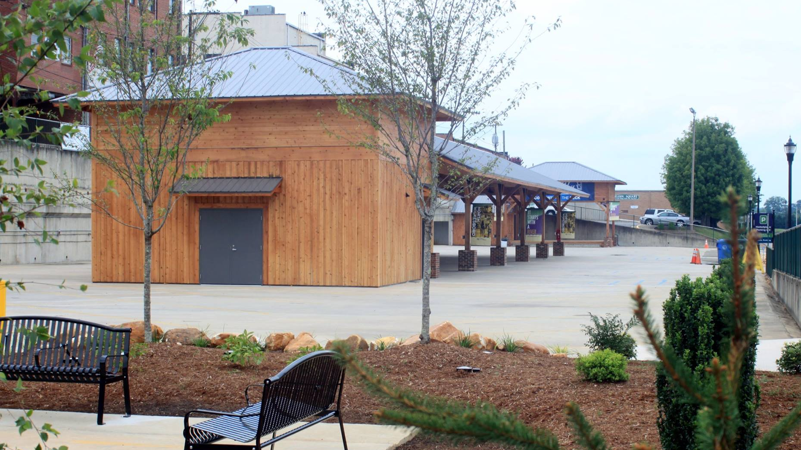
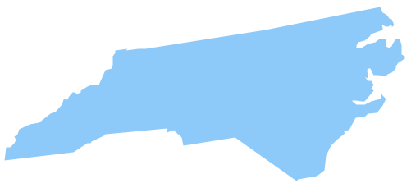
NORTH WILKESBORO, NORTH CAROLINA: WILKES COUNTY FARMER’S MARKET
Notes:
North Wilkesboro was founded in 1891 with the construction of railroad lines into Wilkes County. The town’s economy has suffered since the closing of the textile and furniture factories in the 1990s. As of 2016, it had a population of about 4,000, near its historical high.
All North Wilkesboro photos courtesy of Brooke Horn.

Slide 23
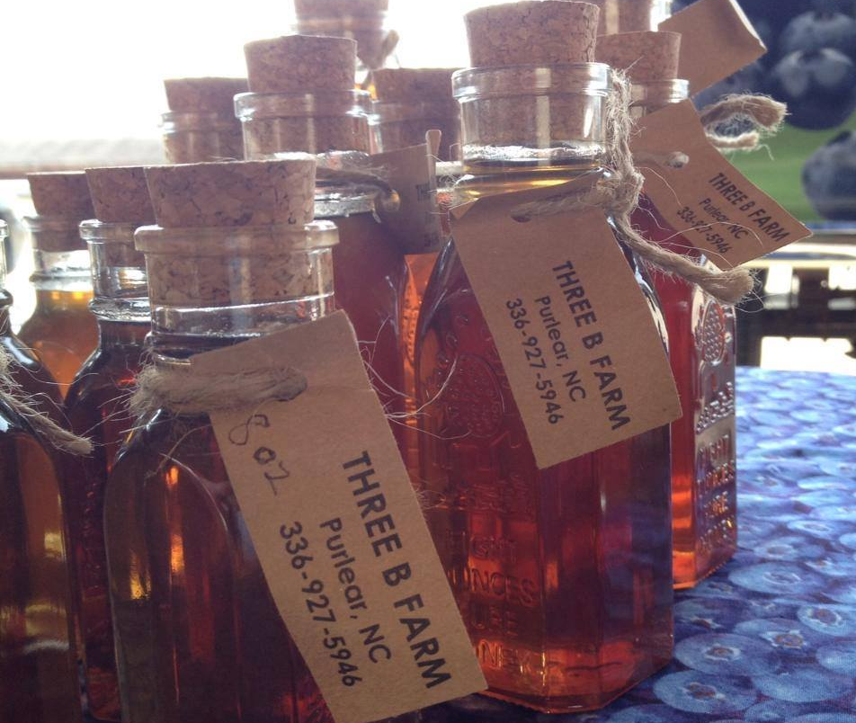
BACKGROUND
North Wilkesboro looked to create an anchor for a more vibrant downtown by moving the county farmers market downtown to a new, permanent structure.
During a public workshop, participants identified ways to:
Improve connections between the new location and Main Street.
Activate the market every day of the year.
Make downtown more walkable and attractive.
Notes:
In an effort to create an anchor for a vibrant downtown filled with successful local businesses, North Wilkesboro decided to move the Wilkes County Farmers Market to a permanent structure in the heart of downtown and expand it with new programs and offerings under the Yadkin Valley Marketplace name.
During a public workshop in 2014 under the federal Livable Communities in Appalachia program, participants identified ways to improve a future downtown market’s connection with Main Street, activate the market every day of the year, and make downtown more walkable and attractive to residents.

Slide 24
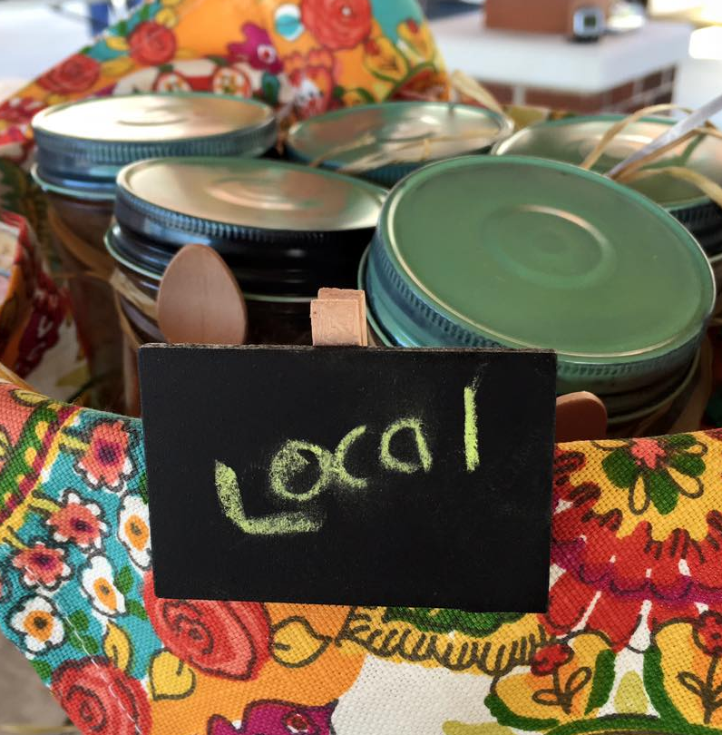
FUNDING
Source | Amount | Purpose
NC Department of Commerce Underserved and Limited Resource Communities Grant | $50,000 | Yadkin Valley Marketplace
Lowes Hometown Grant | $50,000
North Carolina Small Towns Economic Prosperity Program | $65,790
Health Foundation of Wilkes | $25,000
Town of North Wilkesboro | $157,813
Wilkes EDC/Katherine Ann Greene Foundation | $10,000
Downtown North Wilkesboro Partnership | $5,000
Appalachian Regional Commission | $20,000 | Marketplace design and engineering
Cooperative Extension, Wilkes Communications, Wilkes County Health Dept. | In-Kind | Wi-Fi, internet, EBT/WIC/SNAP equipment, signage
Appalachian Regional Commission Emerging Opportunities Grant | $50,000 | Downtown streetscape improvements
Town of North Wilkesboro | $200,000
Notes:
With clear goals and an action plan, North Wilkesboro was able to raise $633,000 from multiple sources for construction of a permanent structure for the market and other downtown improvements.

Slide 25
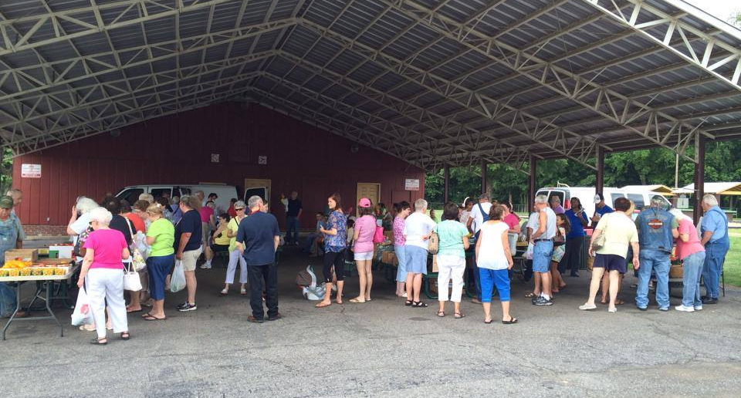
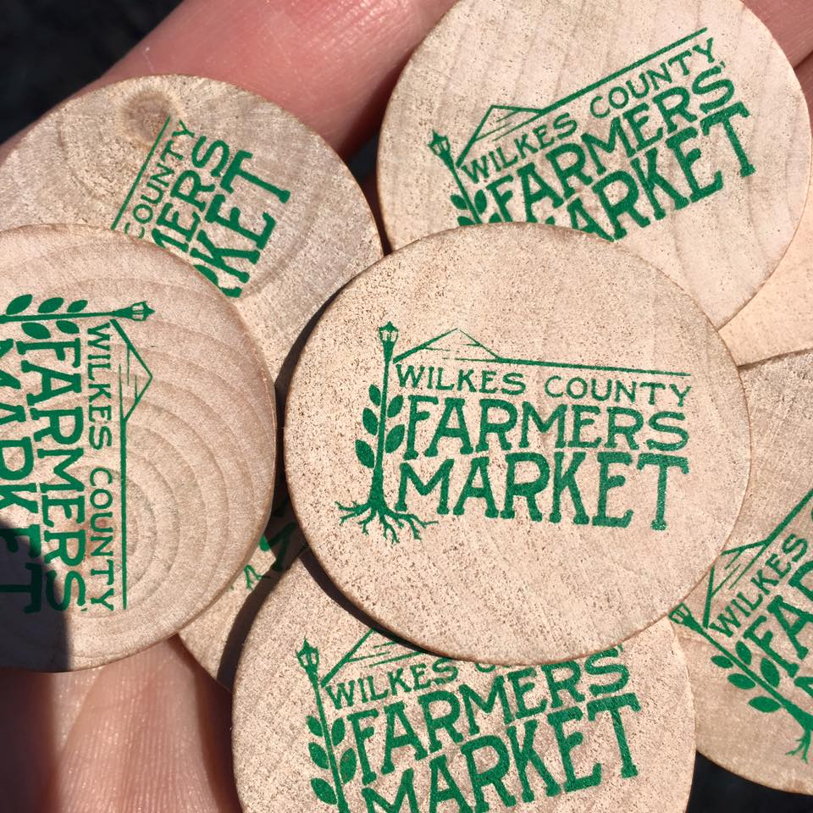
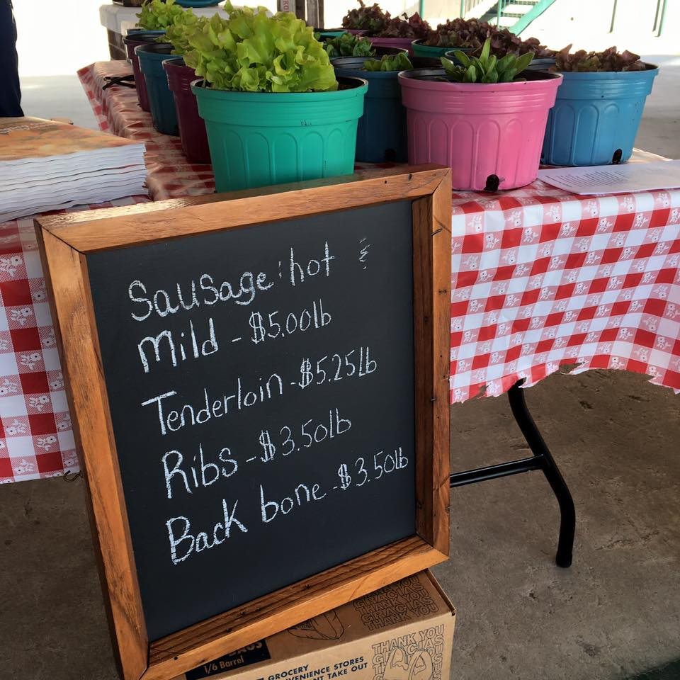
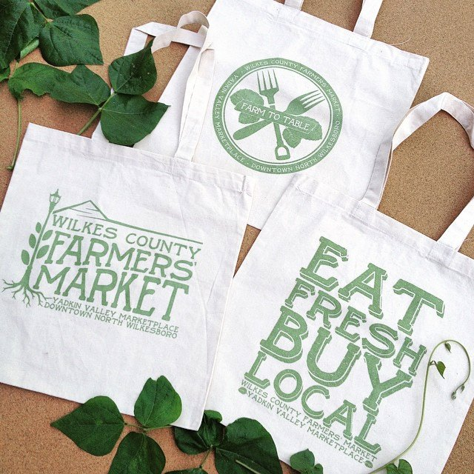
TIMELINE
September 2014: Workshop under the Livable Communities in Appalachia program
June 2015: New market ribbon cutting
2017: Streetscape improvements begun
Notes:
Less than a year after the 2014 workshop, the town celebrated the grand opening of the Yadkin Valley Marketplace at a ribbon cutting ceremony on June 27, 2015. Two years after that, streetscape improvements began.

Slide 26
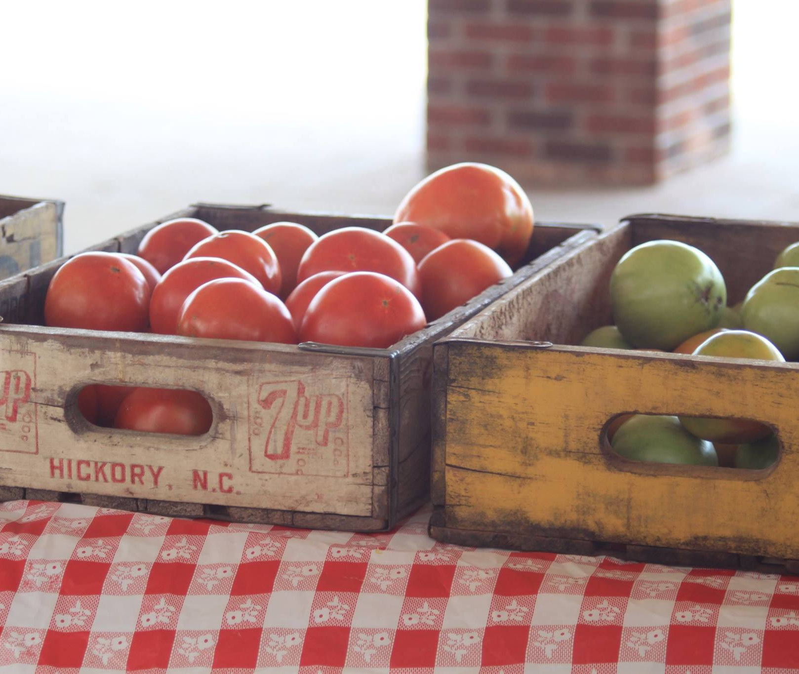
RESULTS
New Marketplace:
Stage and dance floor for monthly summer concerts
Annual Brushy Mountain Apple Festival
Downtown Streetscape Improvements:
Upgrades to pedestrian alleys connecting Main Street to the marketplace
Curb extensions
Flower pots
Benches
Planters
Trees
Decorative streetlights
Notes:
Aside from hosting the farmer’s market, the Marketplace features a stage and dance floor for monthly summer concerts and houses the annual Shine to Wine, Brew, and Spirits Festival.
Downtown improvements included upgrades to the pedestrian alleys that connect Main Street to public parking lots and the Marketplace, curb extension to make crosswalks safer, and streetscape improvements, including flowerpots, benches, planters, trees, decorative streetlights, and signage directing people to key destinations in the historic downtown.

Slide 27
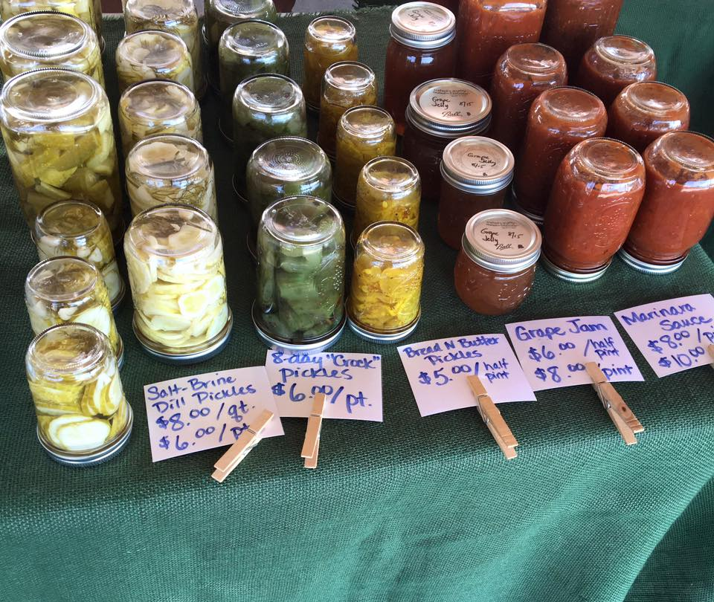
The marketplace’s popular events draw regular crowds downtown.
Several new businesses have opened, including a farm-to-table restaurant.
“Any time you’re able to get your strongest and brightest partners and stakeholders to the table it certainly brings forth a better product.”
— Samuel Hinnant, North Wilkesboro Planning and Community Development Director
ACCOMPLISHMENTS
Notes:
The Marketplace’s popular events draw people downtown on a recurring basis, which has attracted several new businesses to open downtown, including a farm-to-table restaurant.

Slide 28
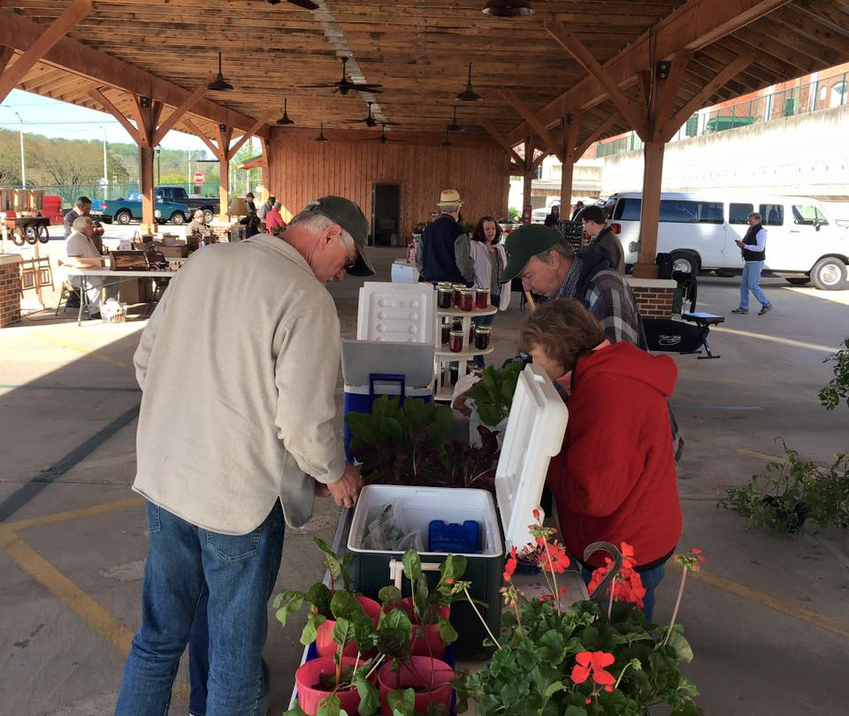
LESSONS LEARNED
Clear goals and a community-developed action plan helped North Wilkesboro attract construction funding.
No one funding source was sufficient; multiple sources were needed.
Coordinated infrastructure improvements around the marketplace increased its overall impact for downtown.

Slide 29
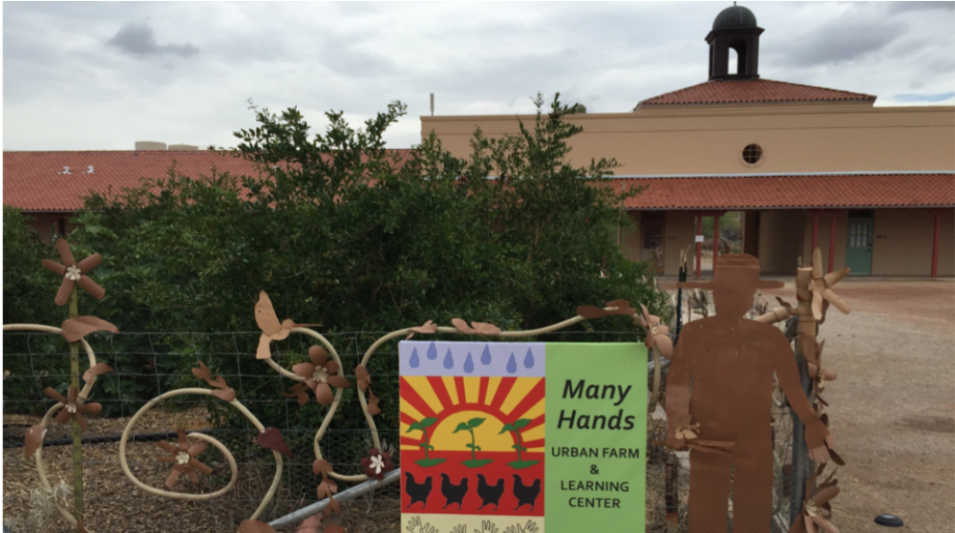

AJO, ARIZONA: AJO CENTER FOR SUSTAINABLE AGRICULTURE
Notes:
Ajo, Arizona, is located just 43 miles from the Mexican border. Ajo boomed as a copper-mining town at the turn of the 18th century, and the mine ended production in 1985. As of 2015, Ajo had a population of less than 4,000.

Slide 30
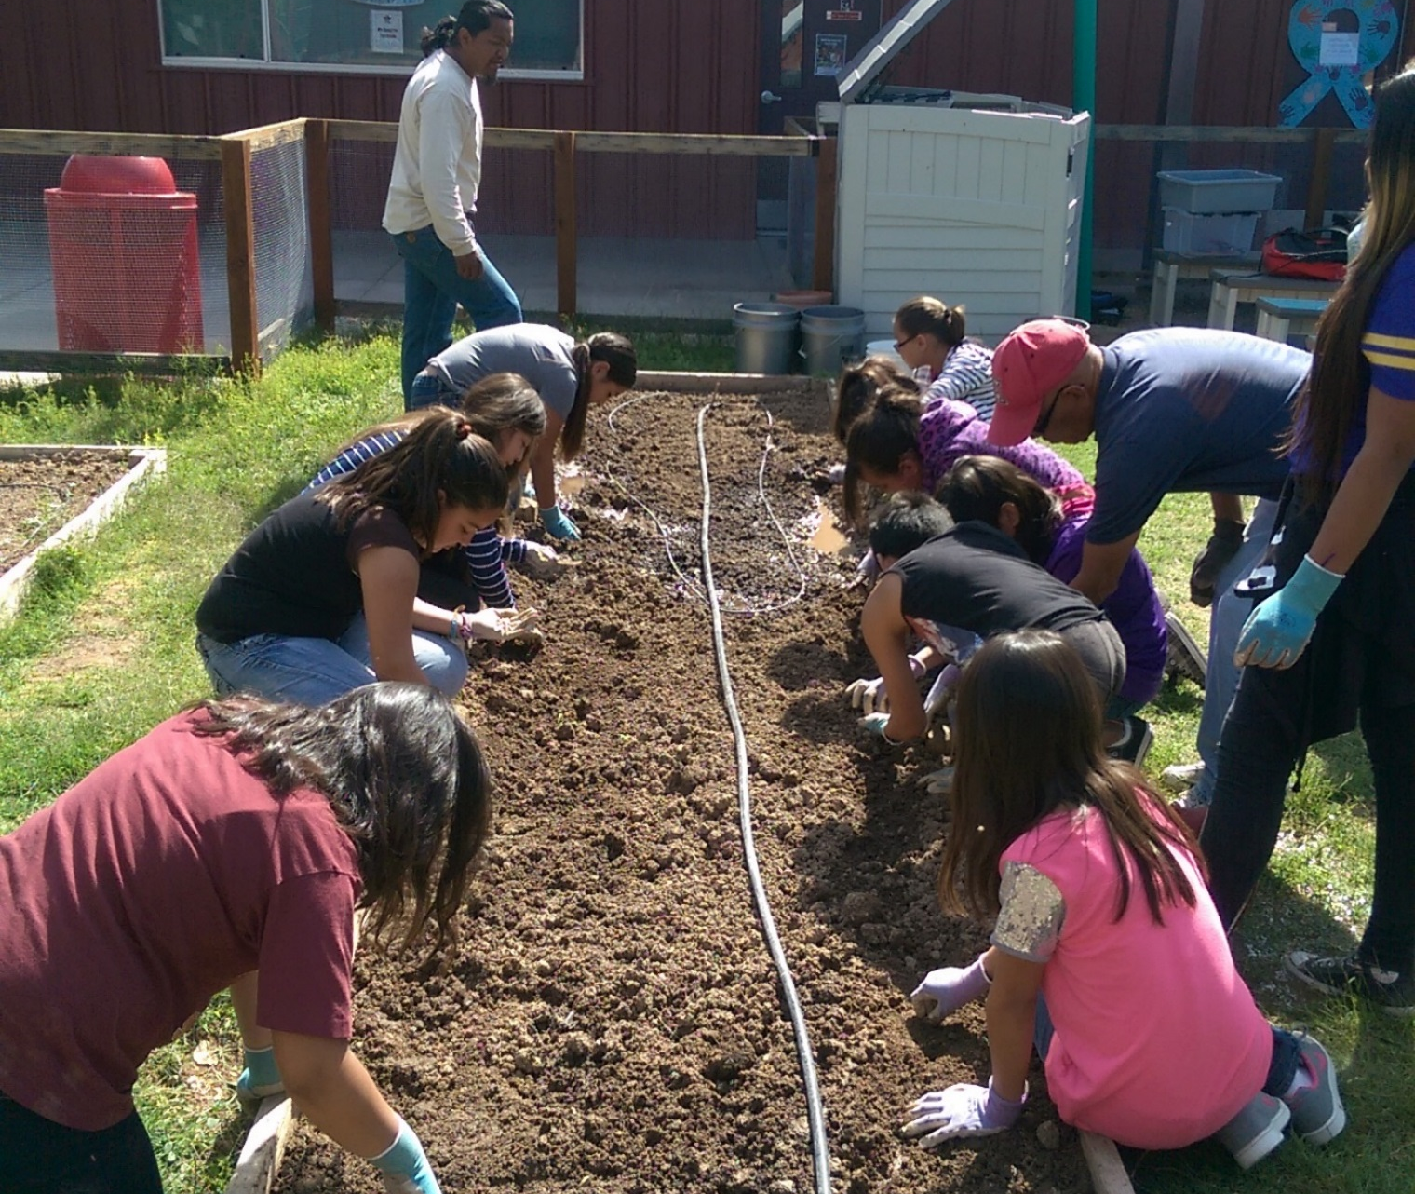
BACKGROUND
Ajo Regional Food Partnership formed in 2009:
Ajo Center for Sustainable Agriculture
The Ajo Community Garden Consortium
The Ajo Unified School District
The Desert Senita Community Health Center
Pima County Parks and Recreation
Loma Bonita Garden and Orchards
Kawyu Apedag Wapkia Oidagkam
The International Sonoran Desert Alliance
Pima County Library
Notes:
The small, rural community of Ajo, Arizona, in the middle of the Sonoran Desert, might seem an unlikely place for a local food system to form the basis of community revitalization. However, in 2009, the Ajo Regional Food Partnership formed, aiming to enhance the health, well-being, and food security of residents. The diverse group of partners includes the Ajo Center for Sustainable Agriculture, the Ajo Community Garden Consortium, the Ajo Unified School District, the Desert Senita Community Health Center, Pima County Parks and Recreation, Loma Bonita Garden and Orchards, Kawyu Apedag Wapkia Oidagkam, the International Sonoran Desert Alliance, and Pima County Library. The group began virtually from ground zero, with nutrient-poor, contaminated soils in an area that sees little rainfall and had no prior history of agriculture.
Photo Credit: Ajo Center for Sustainable Agriculture

Slide 31
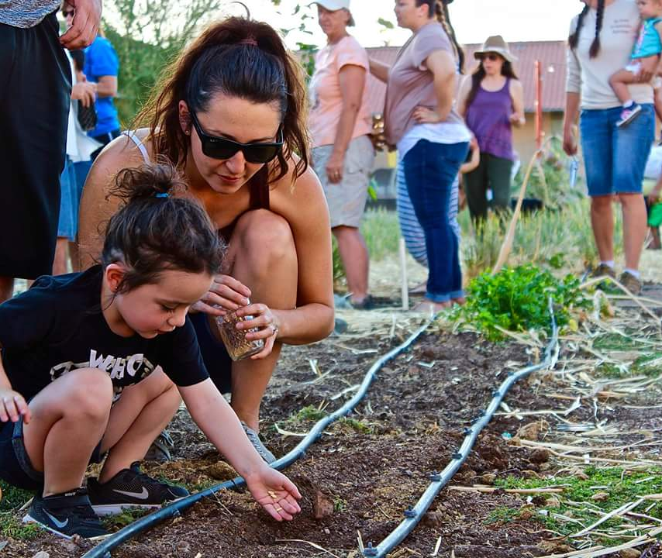
Network of distributed local food sources:
  Backyard gardens
  Community gardens and farms
  Farmers markets
  Grocery stores
  Restaurants
  Food pantries/banks
Hub: nonprofit Ajo Center for Sustainable Agriculture’s Many Hands Learning Center and Urban Farm
  Gardens
  Orchards
  Chicken coop
  Kids at the Farm programming
APPROACH
Notes:
The partnership’s approach to its local food system is creating a network of distributed local food sources under the stewardship of many individuals and groups. This network includes backyard gardens, community gardens and farms, farmers markets, grocery stores, restaurants, and food pantries/banks.
The hub for many of these activities is the nonprofit Ajo Center for Sustainable Agriculture’s Many Hands Learning Center and Urban Farm, where the community had a hand in creating the center’s gardens, orchards, and chicken coop. All of the Center’s growing areas serve as demonstration sites and growing sites for Sonoran Desert heirloom crops such as drought-resistant tepary beans, yellow-meated watermelon, and Tohono O’odham 60-day corn. Heirloom crops are preserved through a grassroots citizen participation seed conservation program called “Adopt-A-Sonoran-Desert-Crop.” The Center also hosts after-school Kids at the Farm programming, where 50 children and their families grow their own garden area and learn about preparing healthy foods.
The Ajo Center for Sustainable Agriculture is situated on the property of the Sonoran Desert Inn and Conference Center. The Inn’s renovation in 2015 served the community by creating a job-training site for community residents. A commercial kitchen was added a year later to serve the inn, provide space for cooking classes and demonstrations, and give market vendors a place to create prepared foods and value-added products.
At the start of building the gardens, contaminated soils were one of the most pressing issues to resolve. The community initially began by exploring several testing options, but soon a local mining company, Freeport McMoran, started a testing all lots in Ajo as a part of their Superfund remediation plan. If a lot showed higher levels of arsenic, lead, or other minerals, Freeport McMoran replaced the top two 2 feet of the soil. In cases where the owner wanted to install a garden, they would replace it with garden-friendly soil (bedding sand instead of gravel). The Ajo Center for Sustainable Agriculture also developed methods to boost organic matter and biological life in the soils using resources available locally to the highest extent possible, e.g., cardboard, cattle and horse manure, mesquite leaves and pods, straw, plant materials, pit moss, vermiculate, coffee grounds, food scraps, and compost. They designed a cropping plan focusing on locally adapted plants for the first season (and up to 3 years) using legumes and grasses to "make" the soil and ensure any remaining contamination was removed. The methods are taught and demonstrated at the Ajo Center for Sustainable Agriculture's sites such as the Many Hands Learning Center, Dolce Vita Market Garden and dry-land fields.
Photo credit: Ajo Center for Sustainable Agriculture

Slide 32
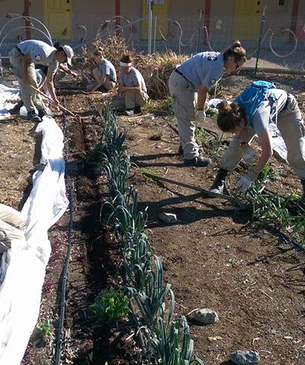
The International Sonoran Desert Alliance on behalf of the Ajo Regional Food Partnership received:
Community Foundation for Southern Arizona grant and technical assistance for system impact model and partnering (2009-2015)
USDA Community Food Projects grant for youth gardening internship (2011)
USDA Hunger Free Communities grant for a community food assessment (2012)
The Ajo Center for Sustainable Agriculture on behalf of the Ajo Regional Food Partnership received:
USDA Farmers Market Promotion Program grant for expanding the Ajo farmers market (2014)
USDA Farmers Market SNAP Support grant for introducing SNAP into the market (2015)
Pima County Community Development Block Grant funding for expanding the Ajo Gardeners Network, Many Hands Learning Center, and Adopt-A-Sonoran-Desert-Crop program (2015, 2016)
Freeport McMoRan Foundation grant for expanding the farmers market, food-based entrepreneurship internship, Arizona Small Scale Producers Forum, and food hub planning (2015, 2016, 2017)
FUNDING
Notes:
Funding sources include federal, county and private.
No funding dollars were ever spent on sustaining the partnership itself (e.g., partnership administrators, grant writers, etc.).
Photo credit: Ajo Center for Sustainable Agriculture

Slide 33
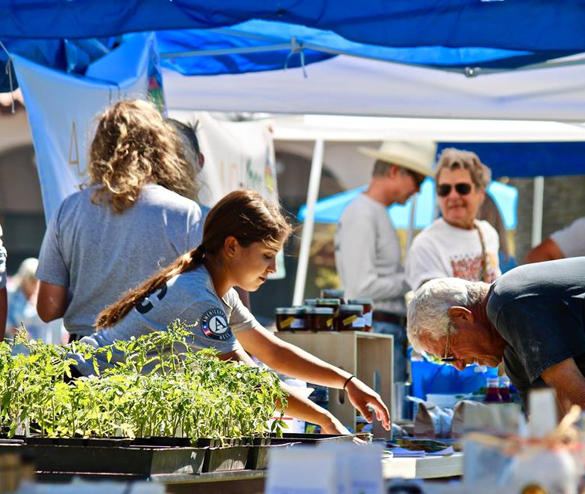
Food-producing land in Ajo increased fourfold and food production increased eightfold in 6 years.
More than a quarter of all Ajo households were involved with growing, selling, processing, and/or buying local foods.
Authentically Ajo Farmers Market has incubated 70 food vendors and attracts 400 customers weekly, increasing sales for nearby businesses.
Annual Ajo Food Festival attracts over 1,000 visitors.
ACCOMPLISHMENTS
Notes:
The partnership’s efforts increased the amount of food-producing land fourfold, from 10,000 to 40,000 square feet in just 6 years while food production expanded eightfold, from 1,000 to 8,000 pounds per year. Overall in 2016, at least 500 local families (more than a quarter of all Ajo households!) were involved with growing, selling, processing, and/or buying local foods. However, the benefits have extended far beyond food. The Authentically Ajo Farmers Market serves as a community gathering space and has incubated 70 food vendors in a town with extreme poverty and few job opportunities. The market and the Many Hands Learning Center and other gardens have been instrumental in revitalizing and greening the town while fostering hope for the future. The farmers market held in the town Plaza attracts around 400 customers weekly on average during the height of the season and has helped increase sales in the Plaza businesses. In addition, the annual Ajo Food Festival attracts over 1,000 visitors, including from Phoenix and Tucson, and has become the largest community festival of any kind.
Photo credit: Ajo Center for Sustainable Agriculture

Slide 34
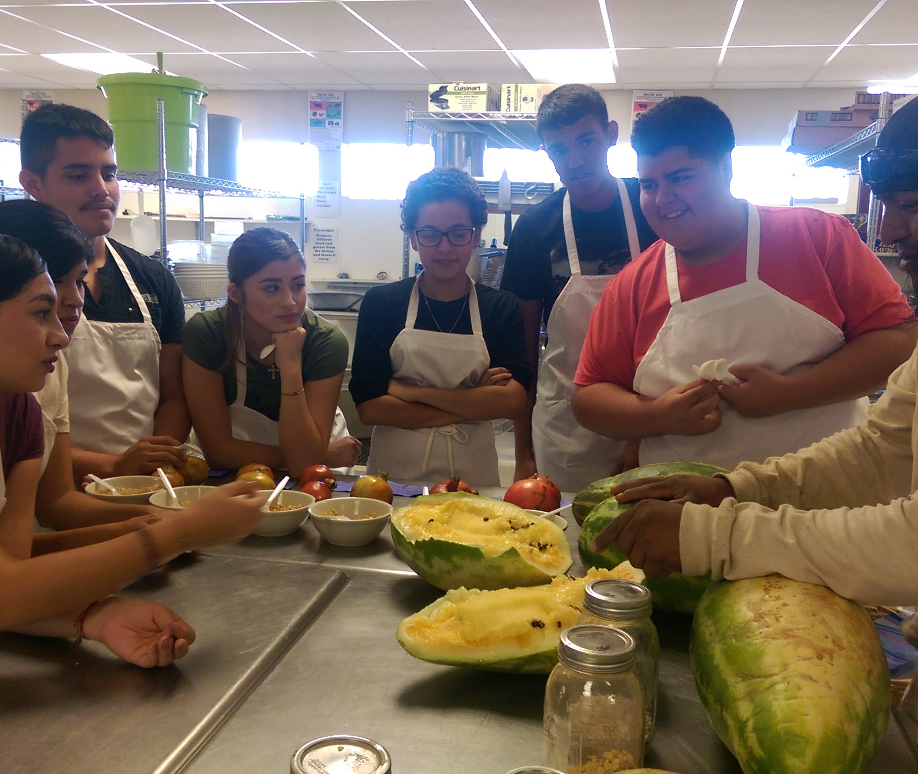
LESSONS LEARNED
Local food can be the basis for community revitalization in all types of climates.
A diverse partnership allowed the effort to reach deep into the community and achieve multiple community goals.
Community participation in building backyard and community gardens has generated support to sustain the partnership’s efforts.
Notes:
Photo credit: Ajo Center for Sustainable Agriculture

