Slide 1

[Community Name]
[Date]
Day 1
Notes:
Unless otherwise noted, all images are courtesy of EPA or Renaissance Planning Group. All images in this presentation may be used in presentations adapted for individual communities.
This presentation was developed as part of the U.S. Environmental Protection Agency’s Local Foods, Local Places Toolkit: A Guide to Help Communities Revitalize Using Local Food Systems. The complete toolkit is available at https://www.epa.gov/smartgrowth/local-foods-local-places-toolkit.

Slide 2
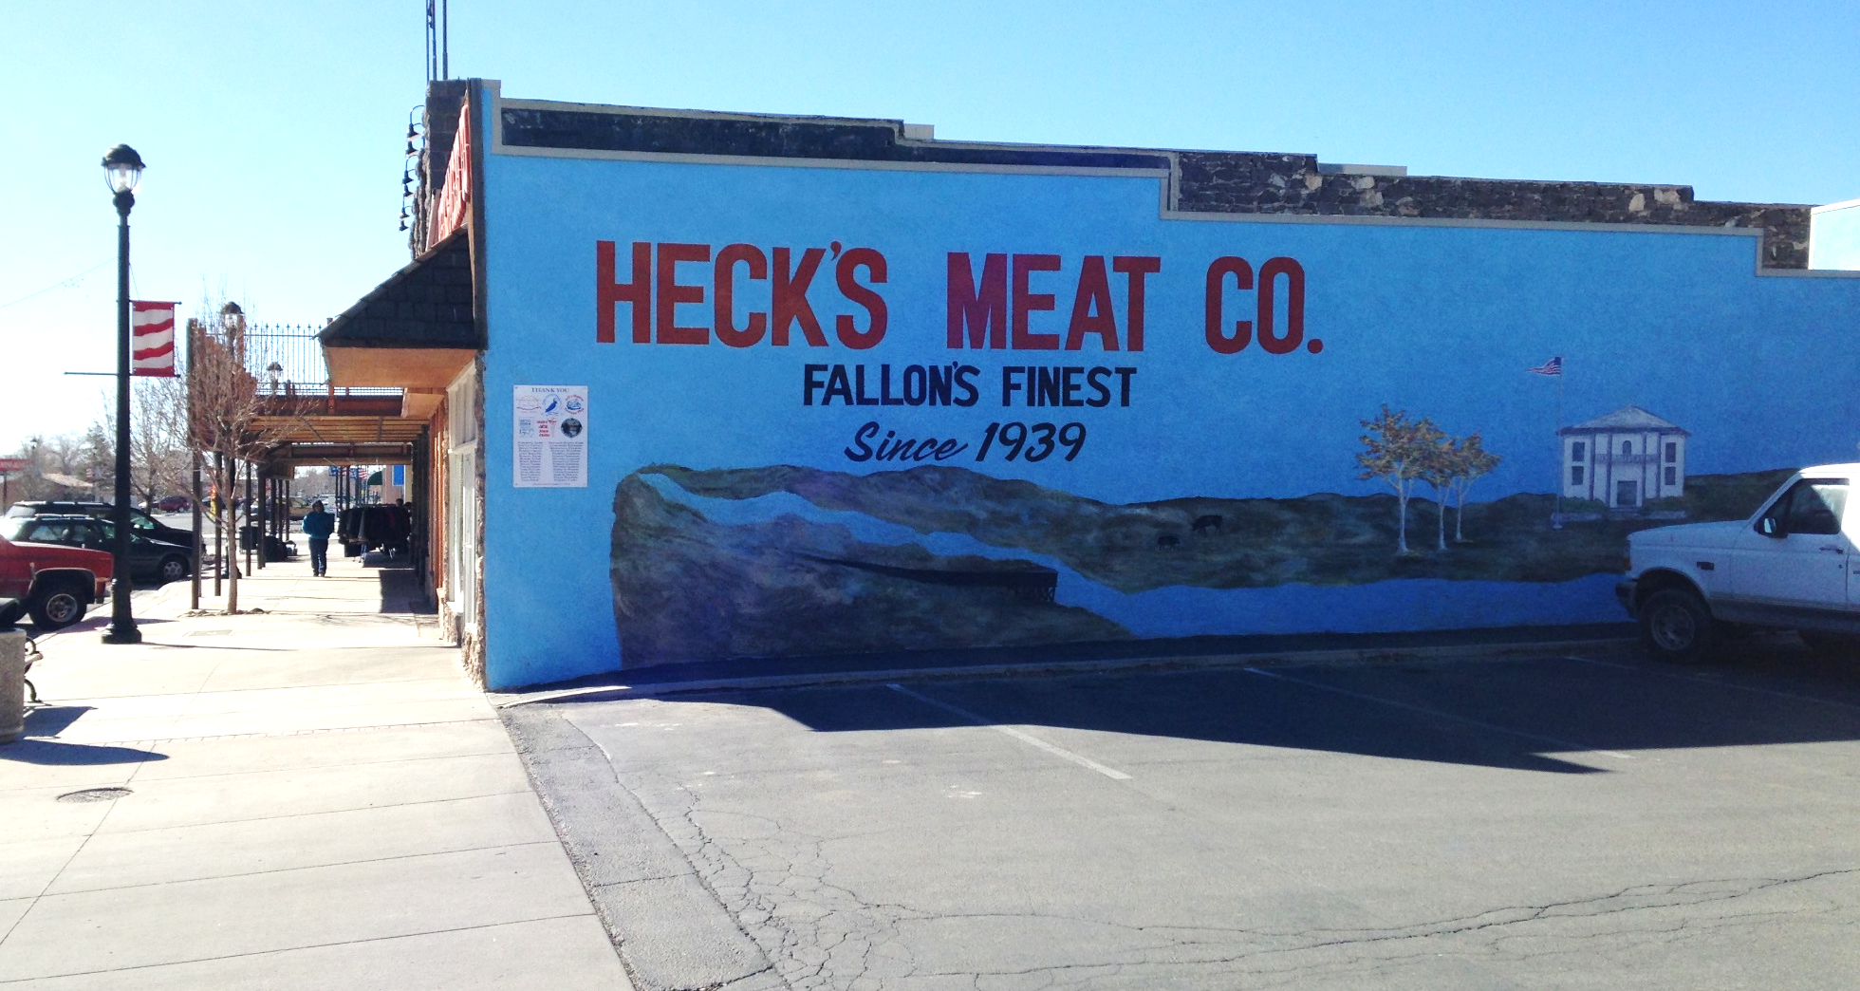
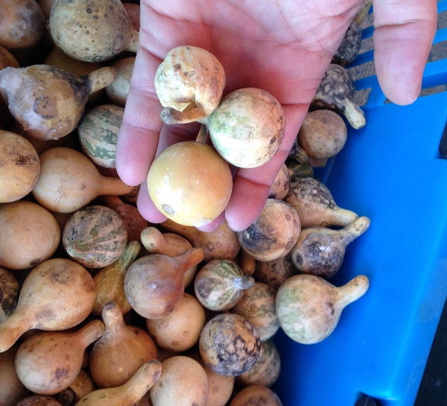
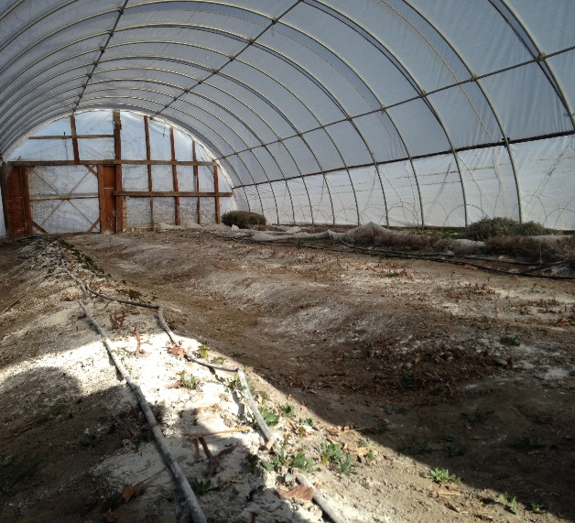
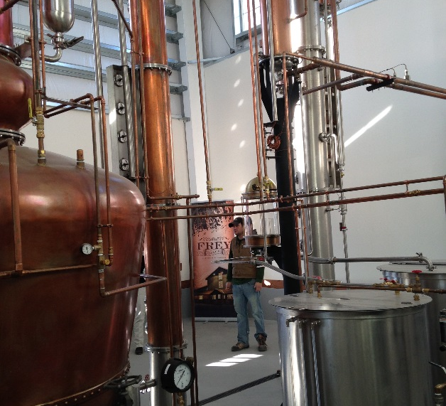
PROGRAM PURPOSE
Desired Outcomes
Economic opportunities for local farmers and businesses
Access to healthy, local food, especially among disadvantaged groups
Revitalized downtowns, Main Streets, and existing neighborhoods
End Products
New connections among people to build capacity for success
An action plan with goals and strategies for achieving these outcomes
Notes:
The Local Foods, Local Places process aims to increase economic opportunity, improve access to healthy foods, and revitalize downtowns and existing neighborhoods. It helps accomplish this by creating connections that make a stronger local food system and linking that food system to place-based investments in existing communities.

Slide 3
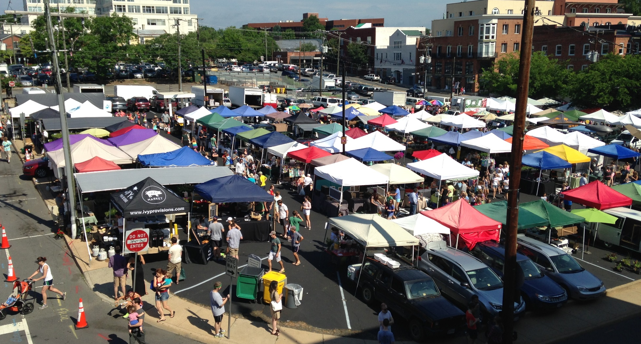
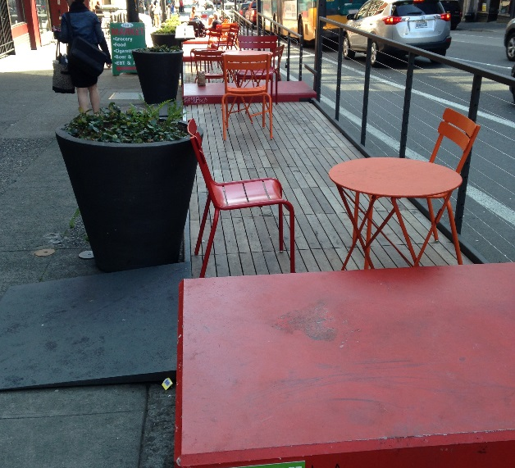
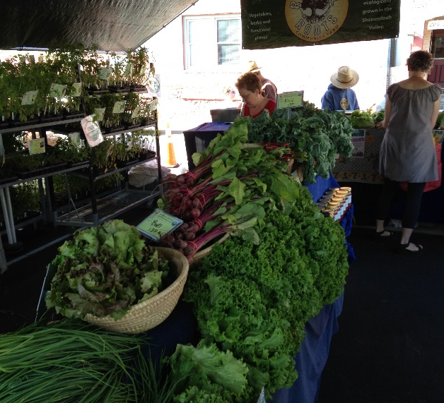
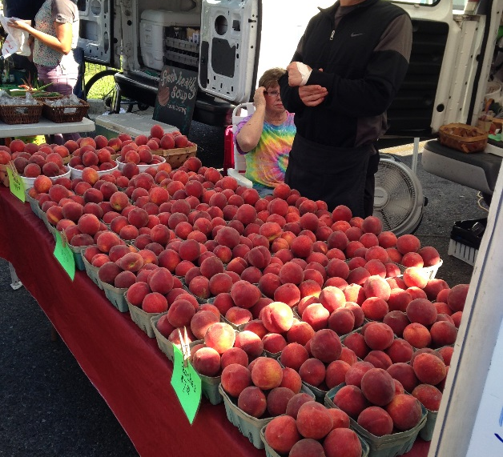
ECONOMIC OPPORTUNITIES
Local production
Local farmers markets
Food entrepreneurs
Other local business growth
Notes:
Local Foods, Local Places helps communities create economic opportunities for local farmers and businesses, including through expanded local production, local farmers markets, cultivating food entrepreneurs, and supporting other local business growth.

Slide 4
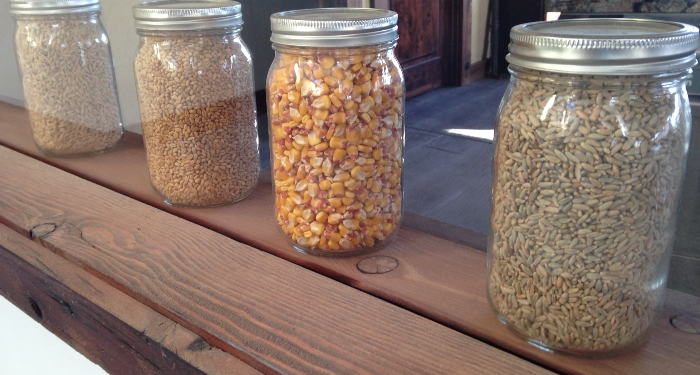
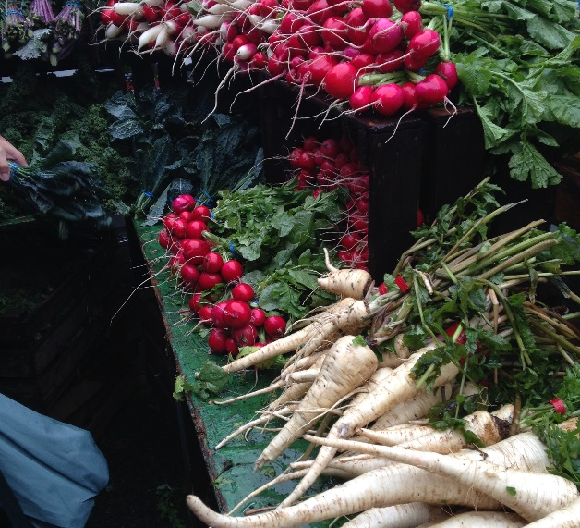
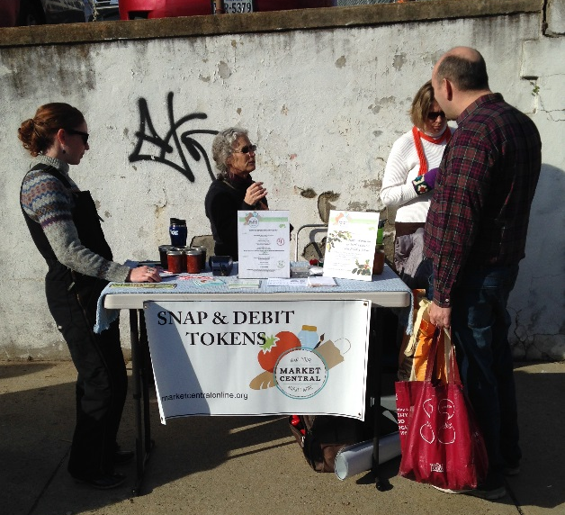
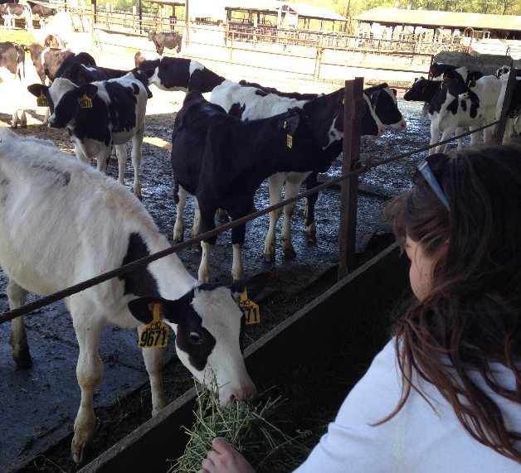
Innovative retail outlets
Education:
  Production
  Preparation
  Consumption
Healthy neighborhoods initiatives
IMPROVE ACCESS TO HEALTHY, LOCAL FOOD
Notes:
The program helps communities that want to improve access to fresh, nutritious food, especially among disadvantaged groups, whether through new types of retail outlets that can meet a community’s unique challenges and needs; education on how to produce, prepare, and make healthy food choices; or initiatives to make it easier to be physically active outside.

Slide 5
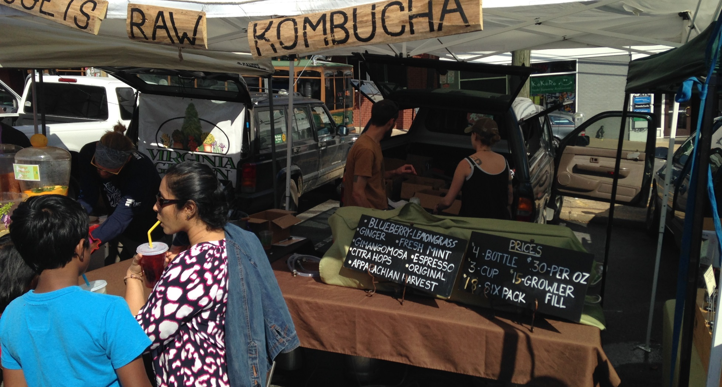
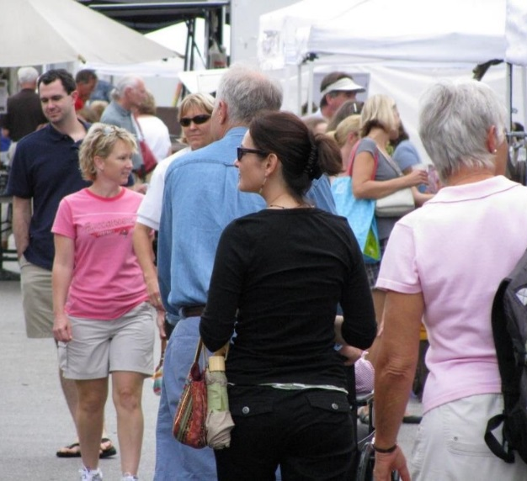
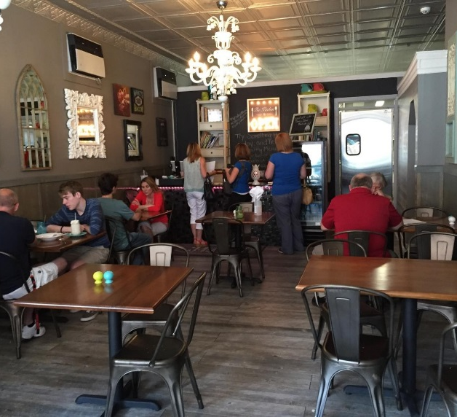
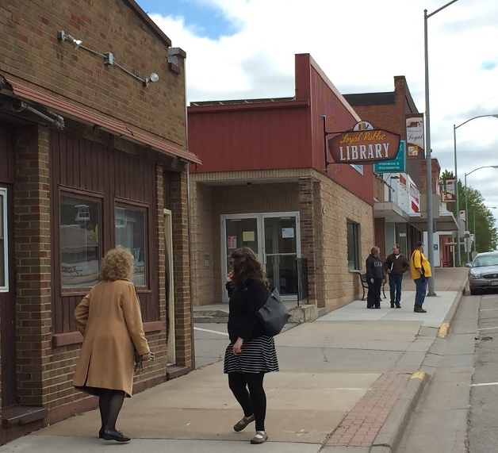
REVITALIZE EXISTING NEIGHBORHOODS
Bring people downtown and to mixed-use commercial corridors.
Offer local foods in restaurants, retail outlets, and farmers markets.
Improve access to local foods through public investments that improve walking, biking, and transit options.
Notes:
The program helps revitalize existing neighborhoods by working in places where there is renewed momentum and interest in bringing people downtown and to mixed-use commercial corridors, offering local foods in neighborhood businesses and farmers markets; and improving access to local foods through public investments that improve walking, biking, and transit options.

Slide 6
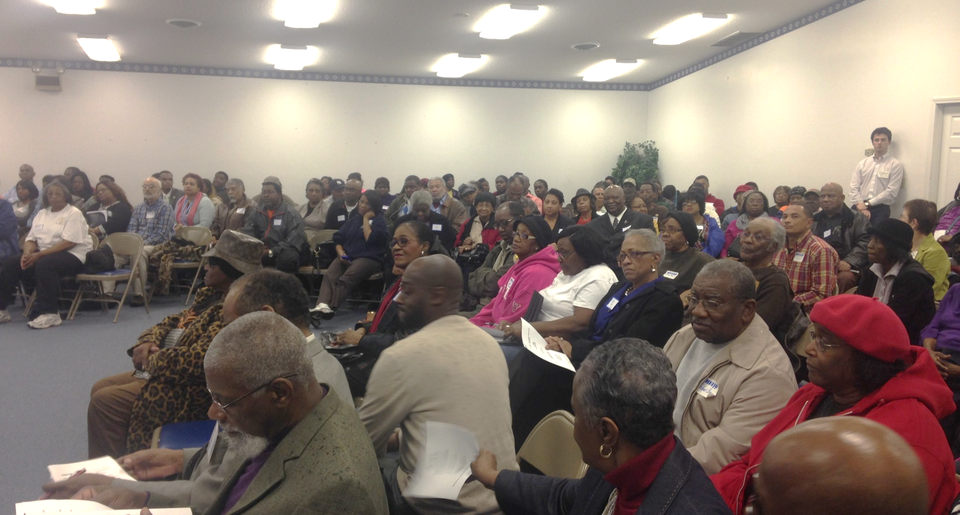
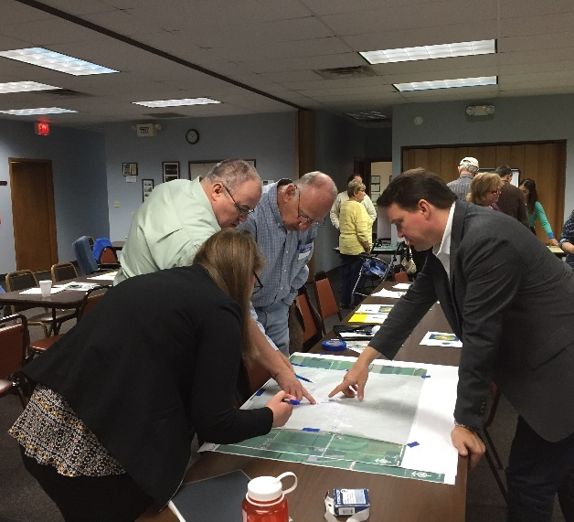
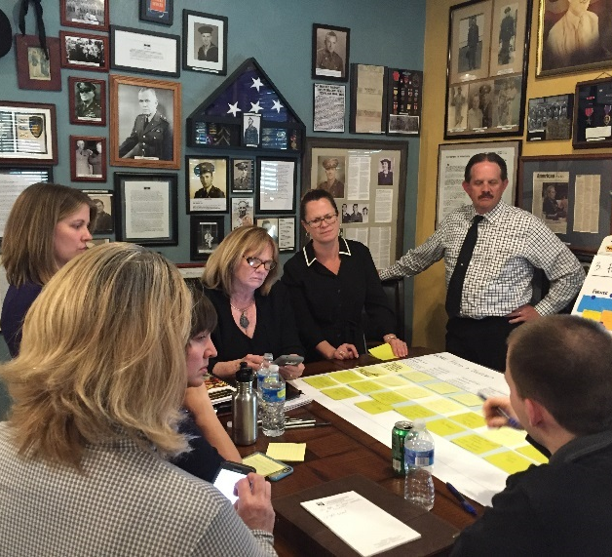
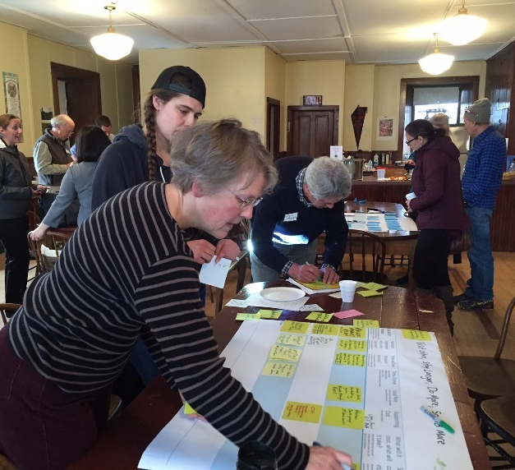
DAY 1
Community Values, Vision, and Goals
DAY 2
Action Brainstorming:
Assess what exists now and what can be strengthened or improved.
Action Planning:
Identify priorities, roles, and responsibilities to move forward.
WORKSHOP OVERVIEW
Notes:
This is a process that starts with the big picture–with the community’s values, vision, and goals–and results in the framework of an action plan by the end of the day tomorrow. We’ll go through action brainstorming to assess what assets the community has now and what is missing or could be strengthened or improved. Some case studies from other communities will help set the stage for those exercises. Then we’ll move into action planning to help identify priorities, roles, and responsibilities for moving forward.

Slide 7
FOOD SYSTEMS AND LOCAL FOOD
Notes:
First let’s look at what we mean when we speak about a food system and local food.

Slide 8
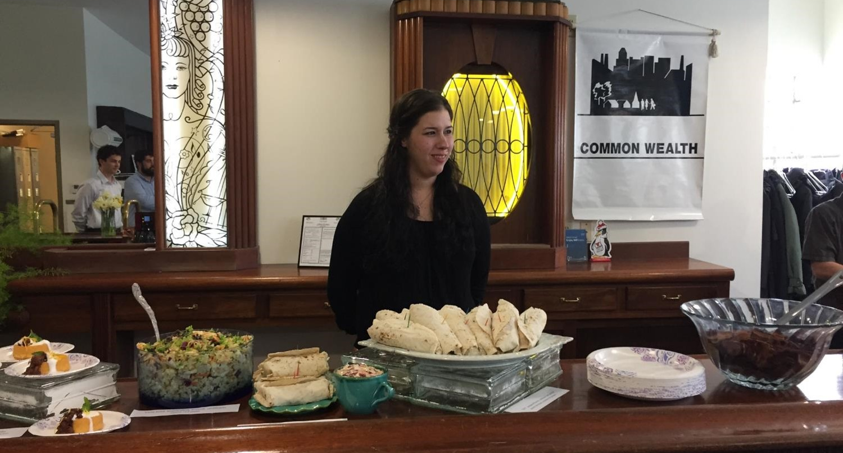
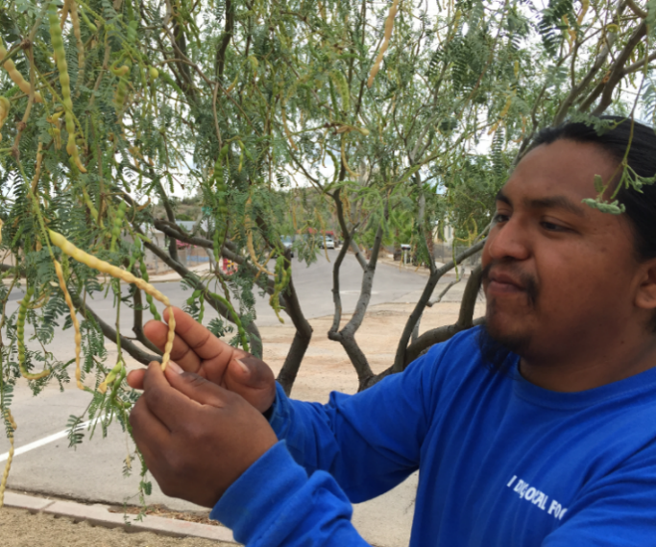
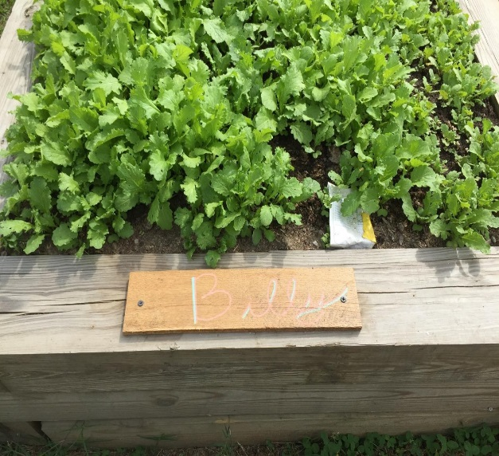
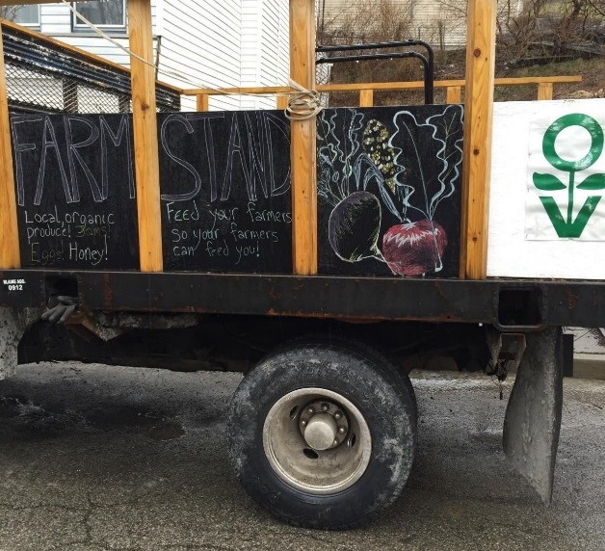
DEFINING LOCAL FOOD
  Food produced, processed, and distributed within a particular geographic boundary that consumers associate with their own community
Source: USDA Economic Research Service
Notes:
The term “local food system” will be familiar to some people in the audience. But it may be a new concept for others. There is no single definition of local foods. This definition comes from USDA and is a good starting point. How you define local foods for the purposes of this workshop is up to you.
Source: USDA Economic Research Service. Local Food Systems: Concepts, Impacts, and Issues. https://www.ers.usda.gov/publications/pub-details/?pubid=46395. 2010.

Slide 9
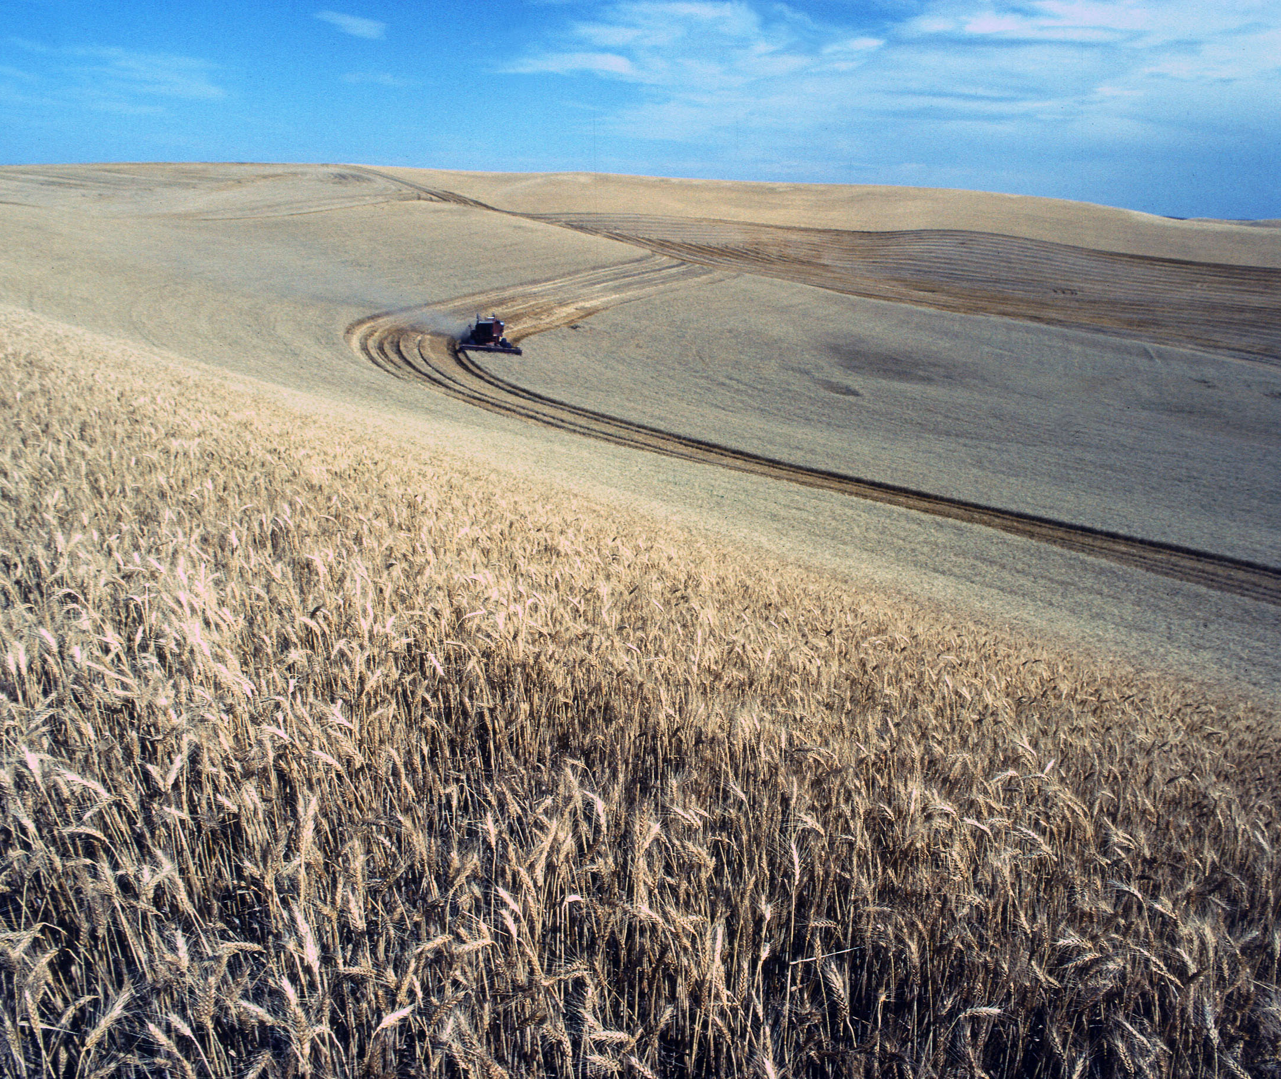
GLOBAL FOOD SYSTEM
The global food system is the dominant model we are familiar with.
The goal of developing a local foods system is to supplement the global system, not to replace it.
Notes:
We are all familiar with the dominant food system, which is global in nature and delivers food efficiently to supermarkets. The purpose of our work is not to replace this system, but instead to supplement the global system, reaping the economic, health, and environmental benefits that come along with a strong local food system.
Photo source: USDA

Slide 10
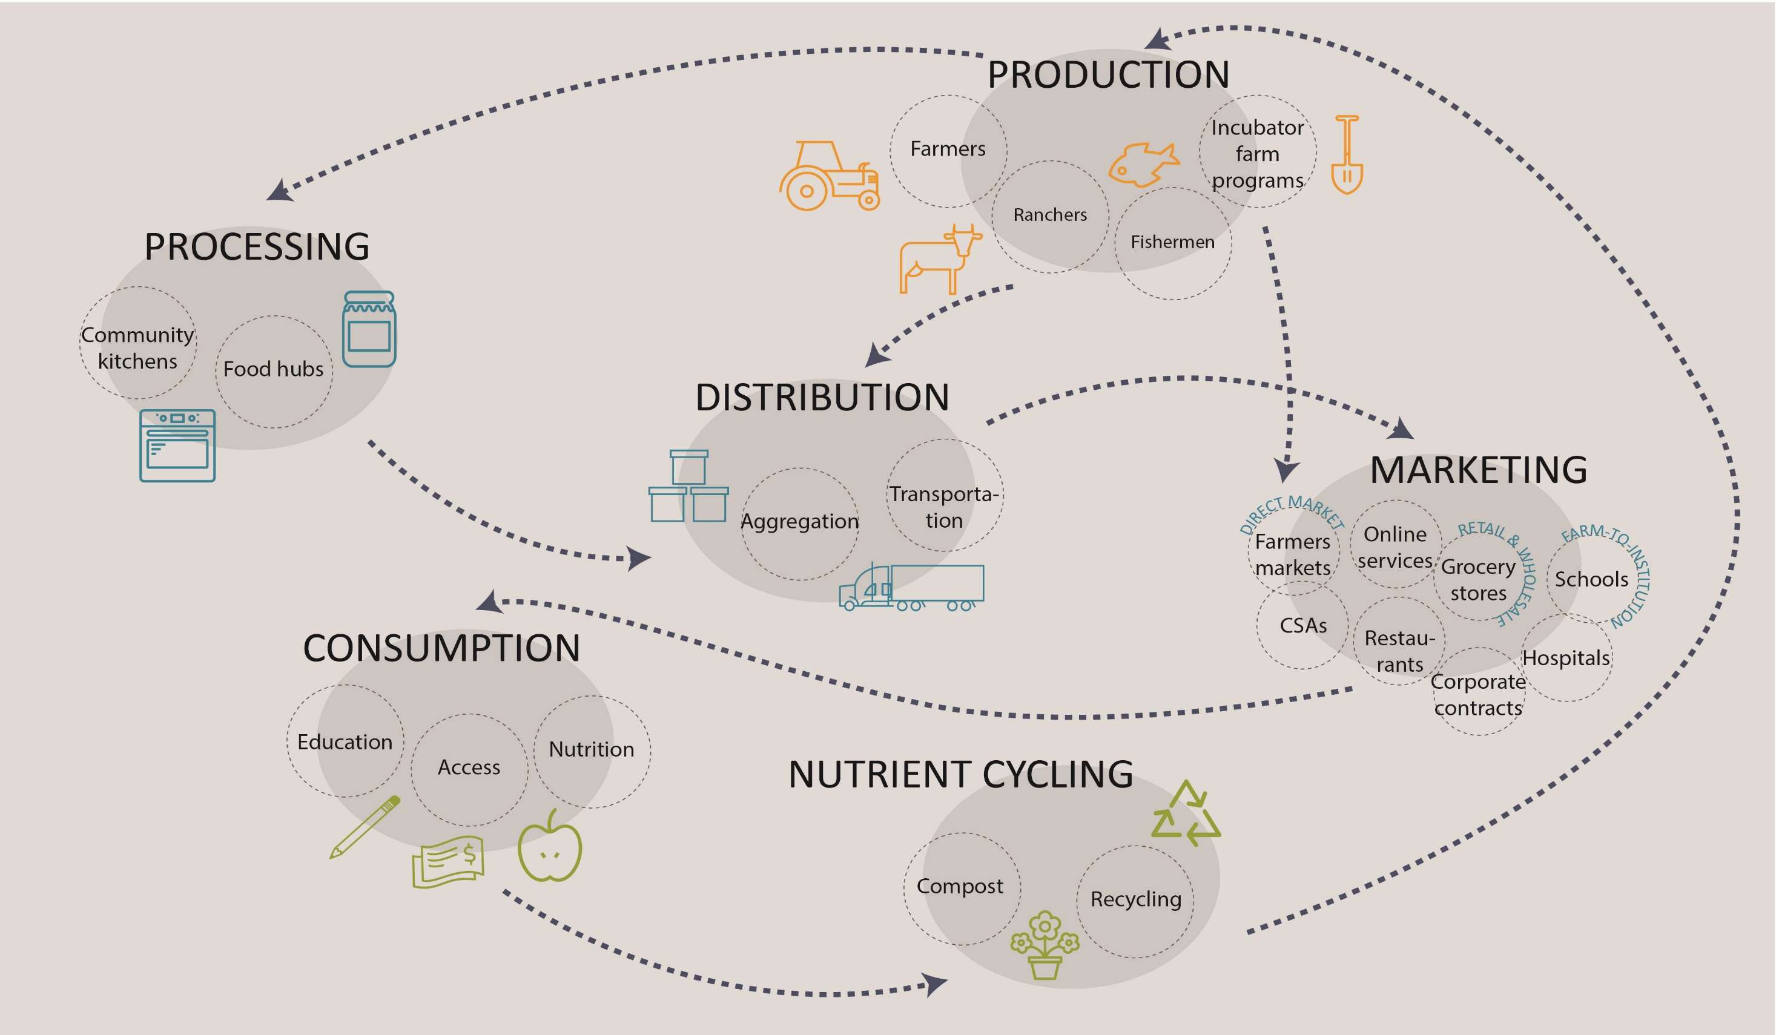
LOCAL
FOOD SYSTEM
Source: Renaissance Planning
Notes:
A local food system comprises everything involved in taking food from the grower to the consumer – processing facilities, distribution systems, the places where people buy or consume the food, and ultimately what happens to food waste.
Local food systems are different from the global food system because they connect the grower more directly with the consumer and can better match local supply and demand. Much of the economic benefit of local food purchases goes to people living and working in the community. Retail outlets like farmers markets and farm-to-table restaurants have other benefits too. They can become magnets for other small businesses, helping to strengthen the entire community. In addition, opportunities to learn where food comes from, and not just purchase but even grow your own food in school or community gardens can give people greater access to fresh, nutritious food and help to build an overall culture of health.

Slide 11
LOCAL FOOD SYSTEMS ARE GROWING RAPIDLY
Source: USDA
Source: USDA Economic Research Service
Notes:
Local food systems are growing all over the country. Farmers markets, food hubs, and farm-to-school programs—all key strategies for connecting supply with demand—are growing rapidly.
The number of farmers markets nearly tripled between 2000 and 2014.
Farm-to-school programs went from just six to more than 4,000 in a little more than 10 years.
Food hubs grew almost six-fold. They help connect farmers with institutional buyers and end consumers by offering aggregation, distribution, and marketing services.
Sources:
USDA Economic Research Service. Local Food Systems: Concepts, Impacts, and Issues. 2010. https://www.ers.usda.gov/publications/pub-details/?pubid=46395.
USDA Economic Research Service. Trends in U.S. Local and Regional Food Systems: Report to Congress. 2015. https://www.ers.usda.gov/publications/pub-details/?pubid=42807.

Slide 12
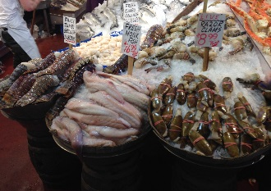
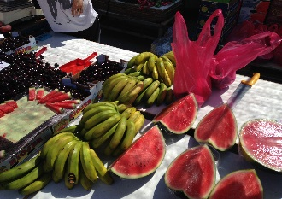
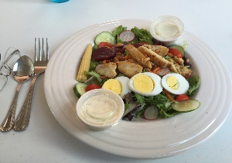
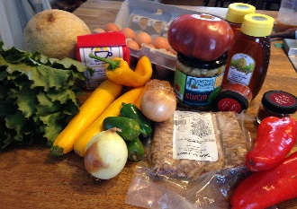
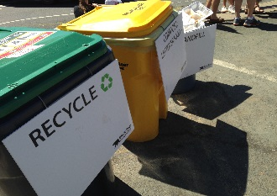
DINERS WANT LOCAL OPTIONS: TOP RESTAURANT TRENDS FOR 2016
#1: Locally sourced meats and seafood
#3: Locally grown produce
#4: Hyper-local sourcing
#5: Natural ingredients/minimally processed food
#6: Environmental sustainability
Source: National Restaurant Association. “2016 Culinary Forecast.”
Notes:
This growth is driven by consumer preferences and attitudes towards food. Restaurants for several years in a row have identified local foods as a top trend to which they are responding.
This list reveals that five of the six top trends are related to local foods according to a survey of 1,575 chefs nationwide.
Source: National Restaurant Association. What’s Hot – 2016 Culinary Forecast. http://www.restaurant.org/Downloads/PDFs/News-Research/WhatsHot2016.

Slide 13
ROOM TO GROW
Direct-to-consumer sales are growing faster than all agricultural sales.
  1997: $551 million
  2007: $1.2 billion
  2012: $1.3 billion
  2015: $3.0 billion
However, they accounted for only 0.3% of U.S. agricultural sales in 2012.
Sources: USDA Economic Research Service and National Agricultural Statistics Service
Notes:
Despite the rapid growth in local food systems and the desire for local foods, direct-to-consumer sales are still a very small percent of all agricultural sales. An important caveat is that these data include edible farm products (not flowers or nursery crops) sold through on-farm stores, farmers markets, roadside stands, community-supported agriculture, on-line, pick-your-own, and mobile markets—but do not include local foods that are sold through intermediary channels, such as grocery stores. Still, local products are a small share of the food mix and there is considerable room to grow.
Sources:
USDA Economic Research Service. Local Food Systems: Concepts, Impacts, and Issues. 2010. https://www.ers.usda.gov/publications/pub-details/?pubid=46395.
USDA National Agricultural Statistics Service. Farmers Marketing. 2014. https://www.agcensus.usda.gov/Publications/2012/Online_Resources/Highlights/Farmers_Marketing/Highlights_Farmers_Marketing.pdf.
USDA National Agricultural Statistics Service. Direct Farm Sales of Food. 2016. https://www.agcensus.usda.gov/Publications/2012/Online_Resources/Highlights/Local_Food/LocalFoodsMarketingPractices_Highlights.pdf.

Slide 14
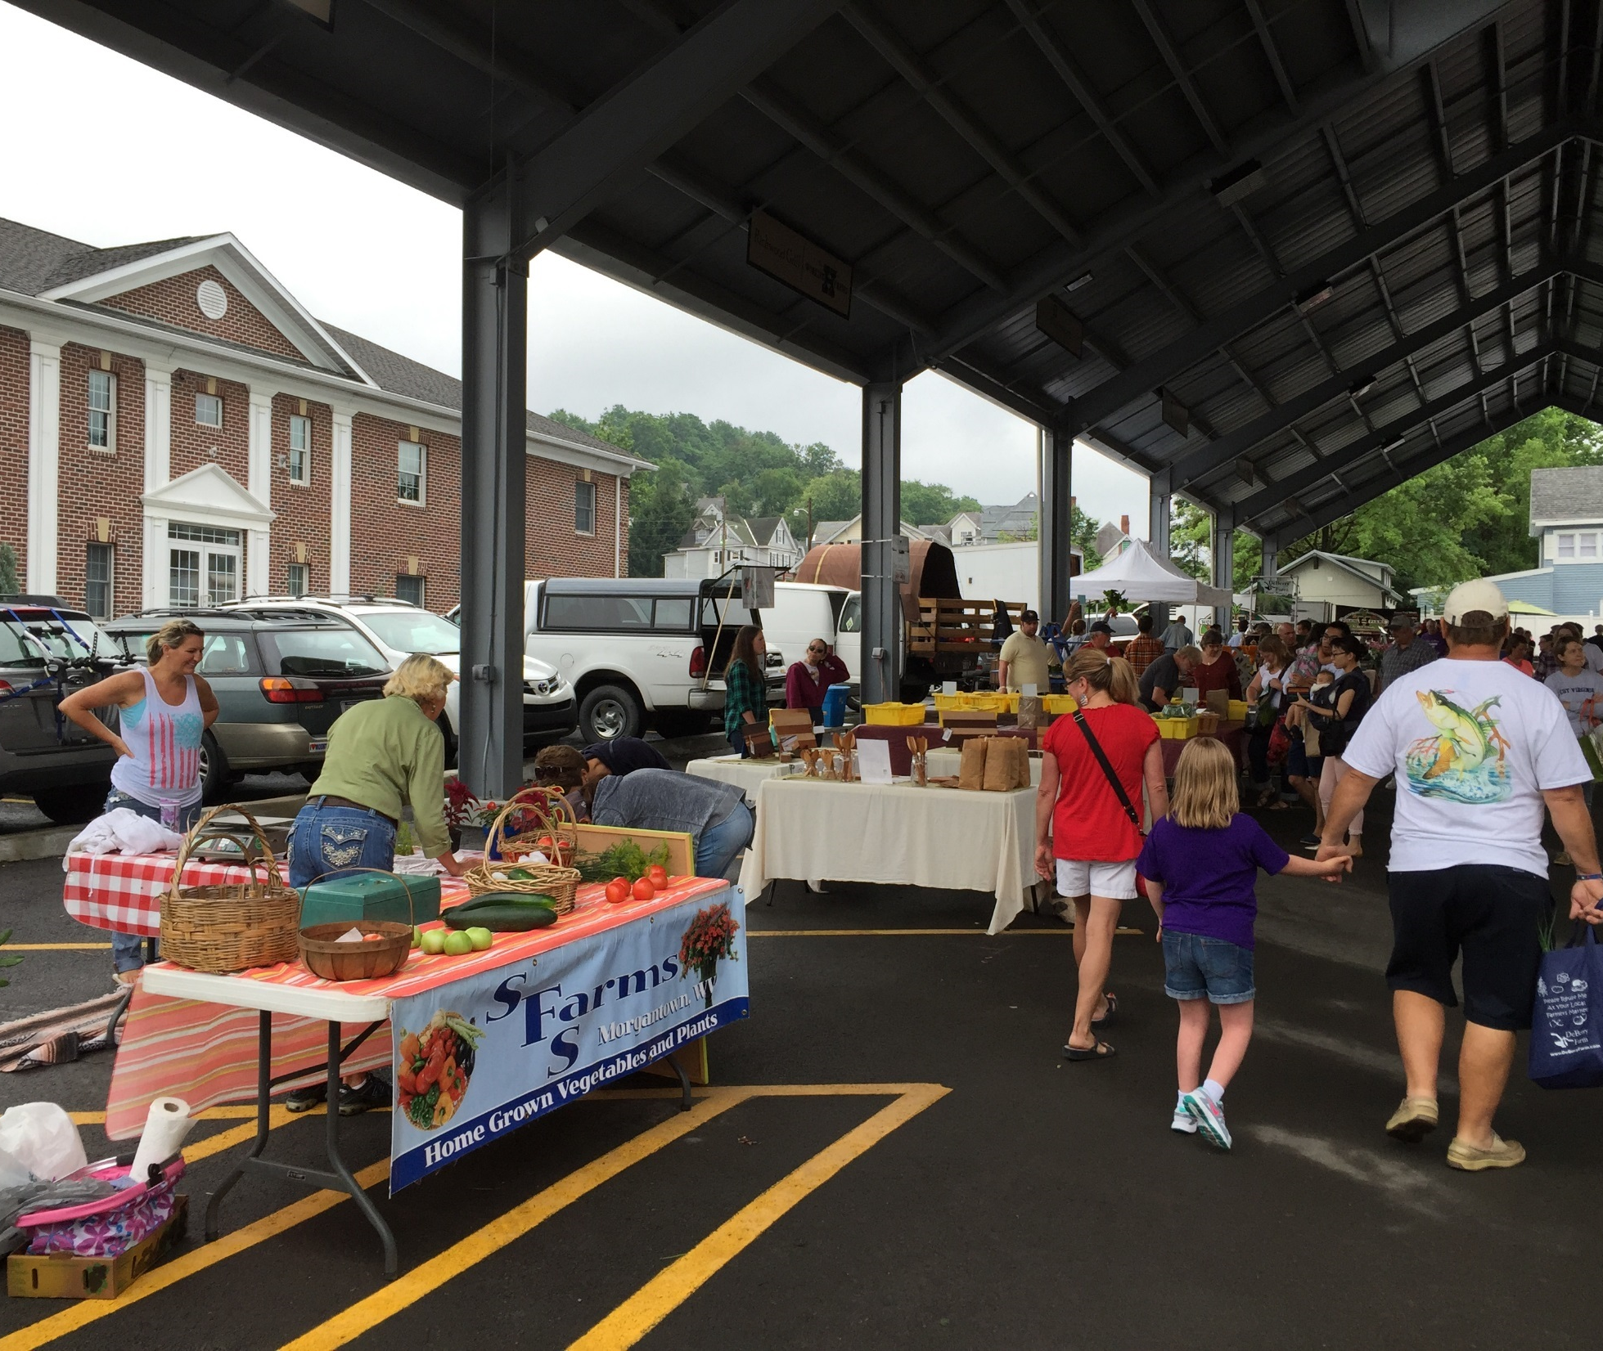
MANY PEOPLE NEED BETTER FOOD ACCESS
2.3 million U.S. households live more than 1 mile from a supermarket and do not have access to a vehicle.
The ability to safely and comfortably walk, bike, or take transit to affordable healthy food retailers is critical to community health.
Source: USDA Economic Research Service
Notes:
Access to affordable, nutritious food is a challenge for at least some households in many communities. Households without access to a vehicle, including many low-income and senior households, have the hardest time reaching full-service grocery stores or other outlets that sell fresh, healthy food.
2.3 million U.S. households (2.2 percent) live more than a mile from a supermarket and don’t have access to a vehicle. Another 3.4 million live between one-half and one mile and don’t have access to a vehicle. Improving ways for people to get around is thus an important piece of improving food access. In addition to increasing the number of retail outlets for fresh, nutritious food, improving walkability, bikeability, and public transit can also improve food access.
Source: USDA Economic Research Service. Access to Affordable and Nutritious Food: Measuring and Understanding Food Deserts and Their Consequences: Report to Congress. 2009. https://www.ers.usda.gov/publications/pub-details/?pubid=42729.

Slide 15
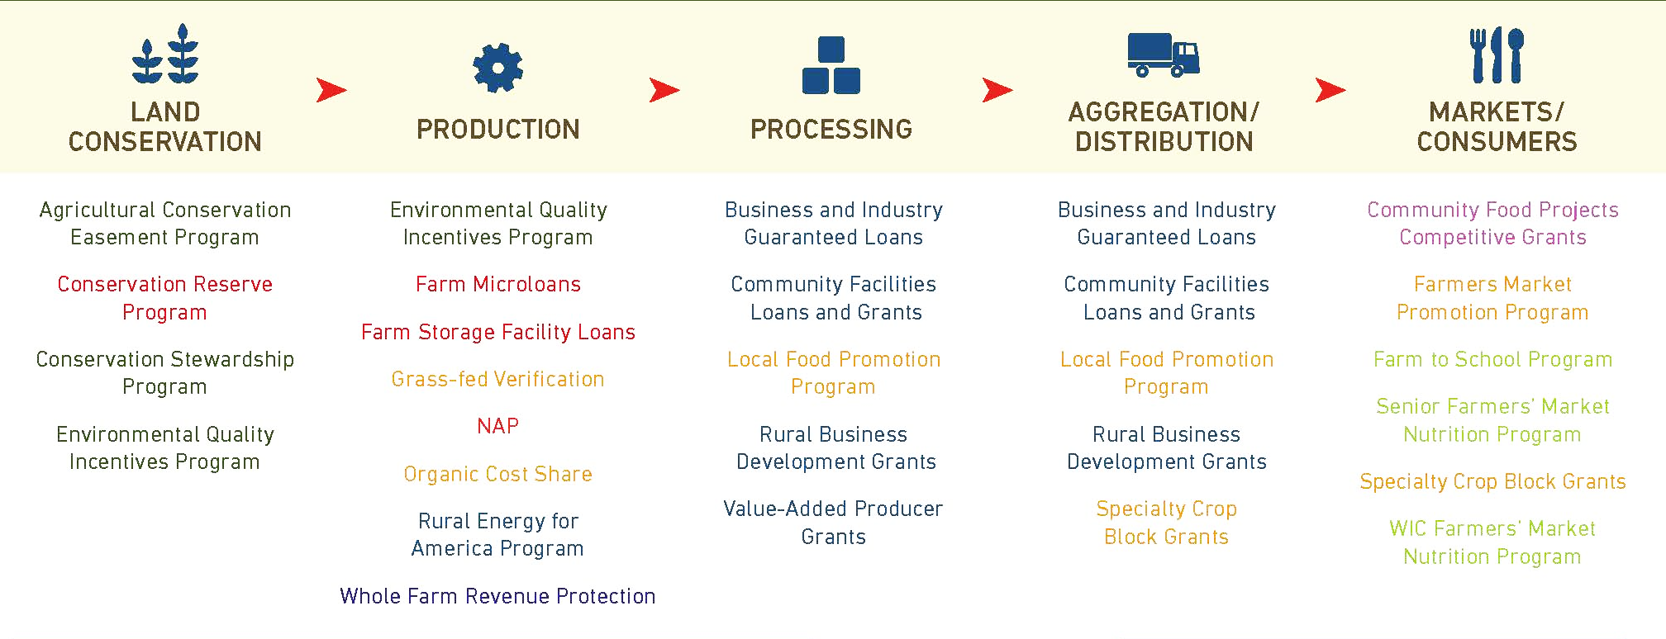
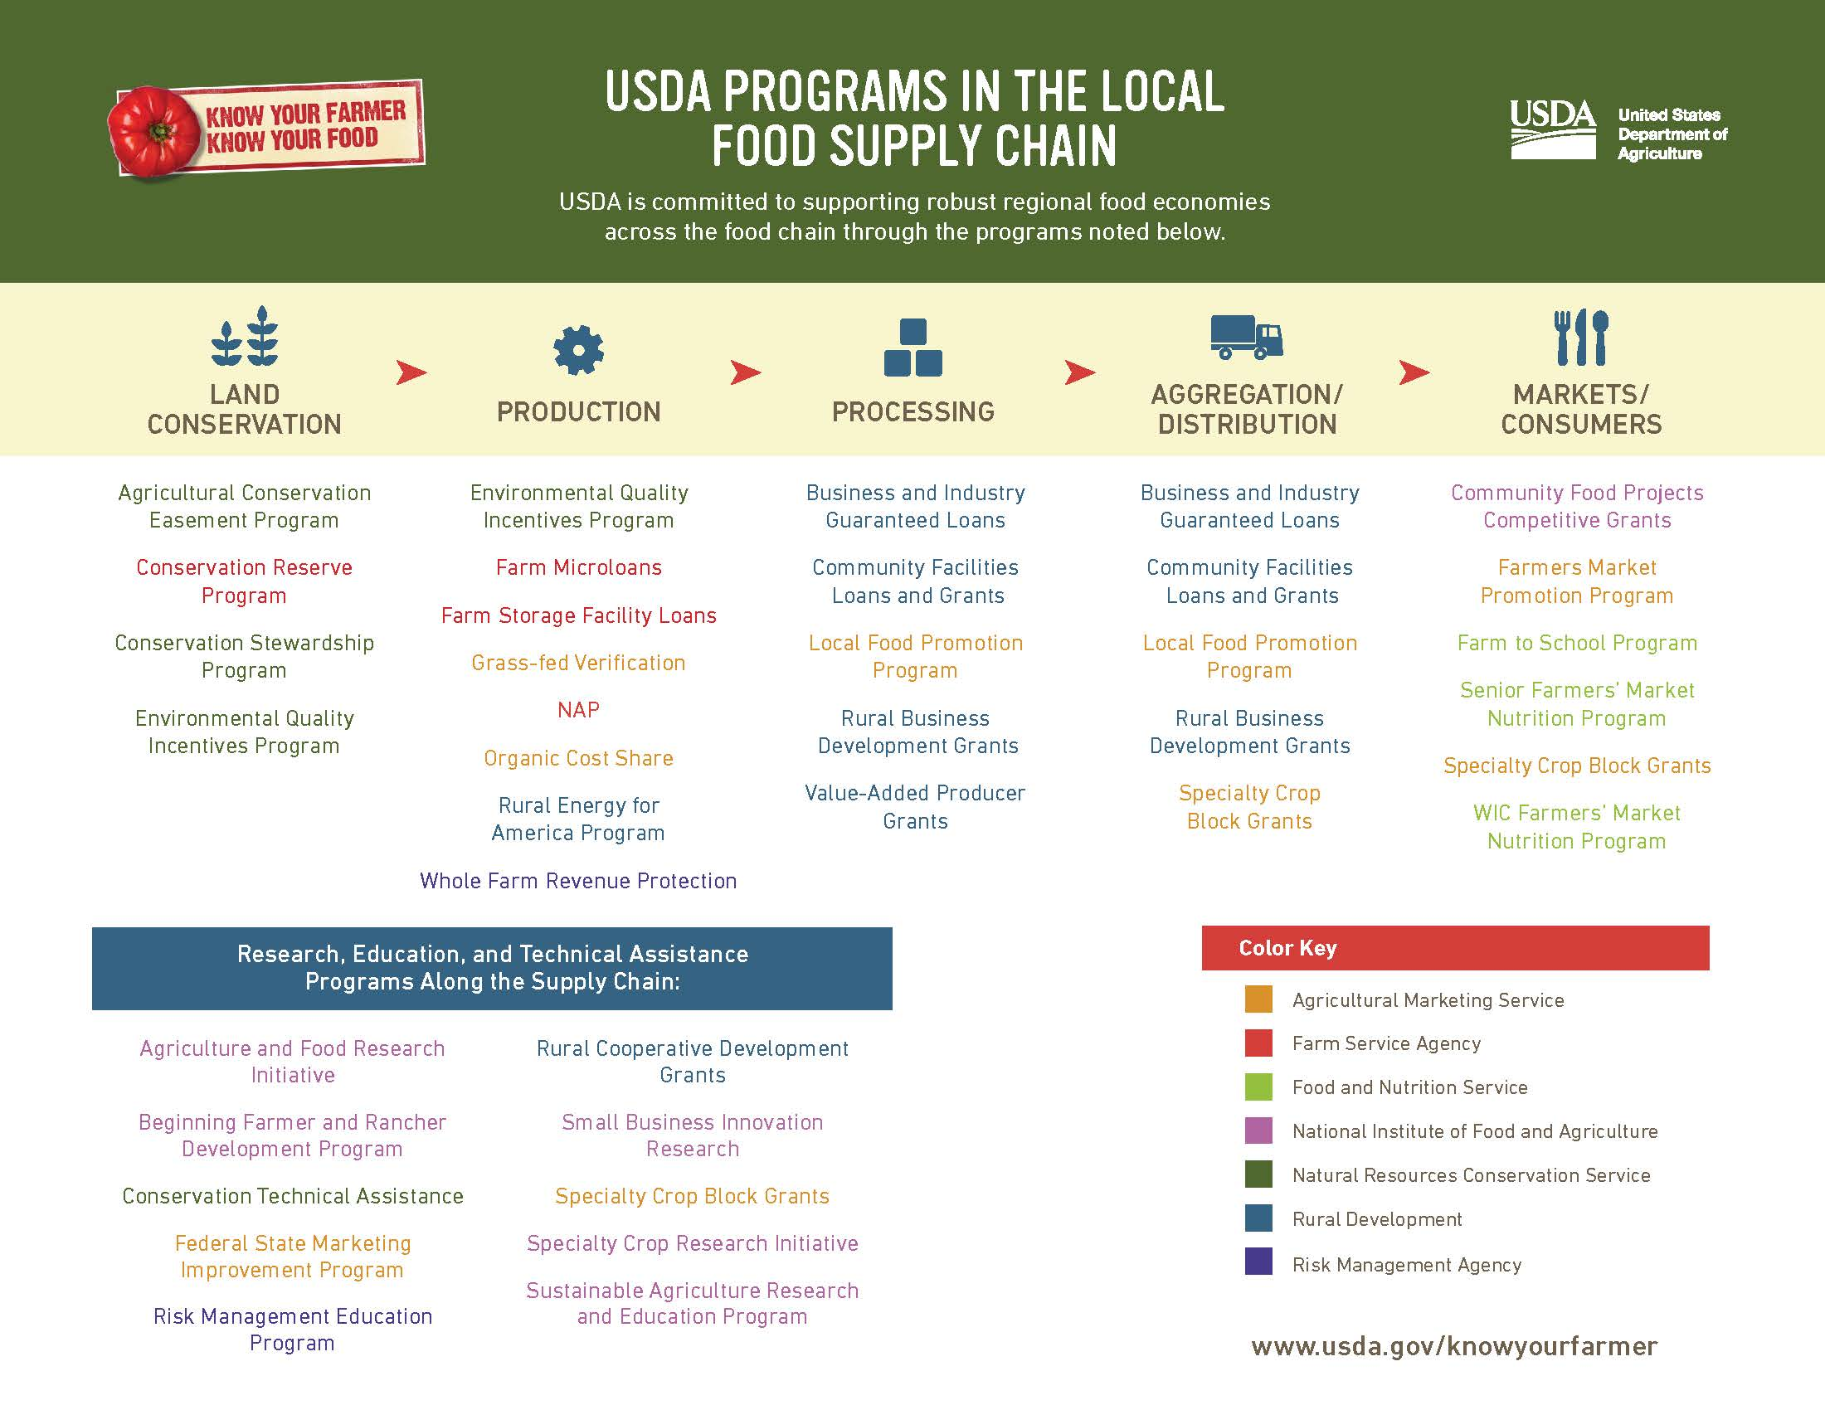
USDA PROGRAMS IN THE LOCAL FOOD SUPPLY CHAIN
Notes:
There is federal funding available to help improve access to local food. The 2014 Farm Bill increased funding for programs that support local foods. This graphic from the USDA shows the various actors in the local food system and some of the programs that are available to support each.
Source: USDA. USDA Programs in the Local Food Supply Chain. https://www.usda.gov/sites/default/files/documents/FoodSupplyChain_v8.pdf.

Slide 16
A GROWING INTEREST IN LOCAL FOODS
Notes:
What is driving the growing demand and interest for local foods? The next few slides explore some of the concerns people have, and some of the benefits a community can realize when more people are eating local and communities use the development of a local food system to help revitalize downtowns and neighborhoods.

Slide 17
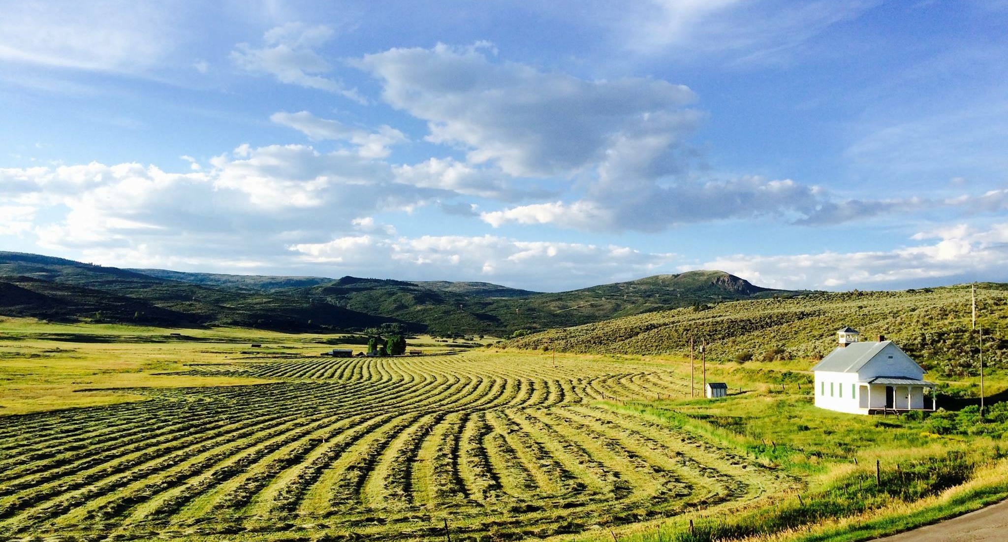
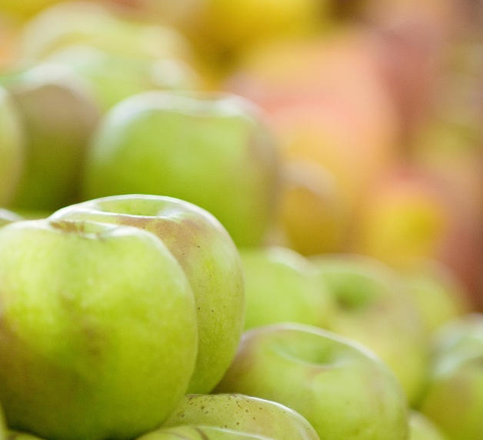
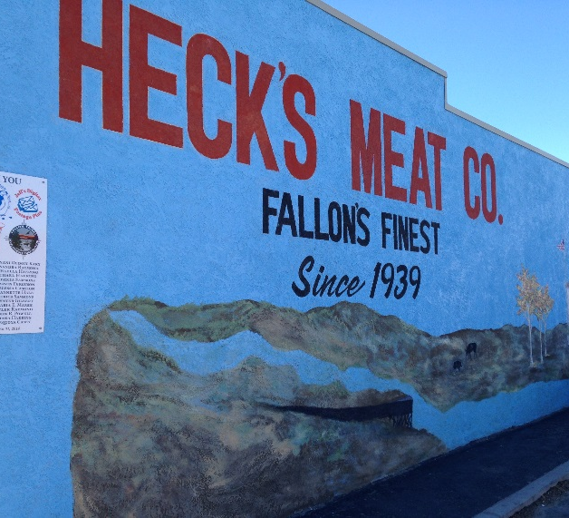
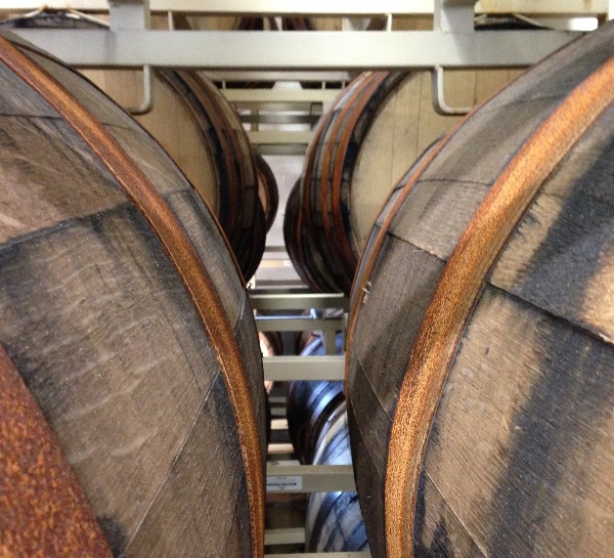
SHOPPERS WANT LOCAL OPTIONS
66% believe local foods help local economies.
60% believe local foods offer a better and broader assortment of products.
45% believe local foods are healthier.
Source: A.T. Kearney. “Buying into the Local Food Movement.”
Notes:
Customers are also looking for local foods at the grocery store. The consulting firm A.T. Kearney looked at the top reasons people are buying local foods. These include that buying local helps the local economy, gives you a better and broader assortment of products, and is a healthier choice.
Next we’ll go into some of these reasons in a little more detail.
Source: James Rushing and Jens Ruehle. “Buying into the Local Food Movement.” 2013. A.T. Kearney. https://www.atkearney.com/documents/10192/709903/Buying+into+the+Local+Food+Movement.pdf/68091049-b5c2-4d2a-a770-ee5b703da8fd.

Slide 18
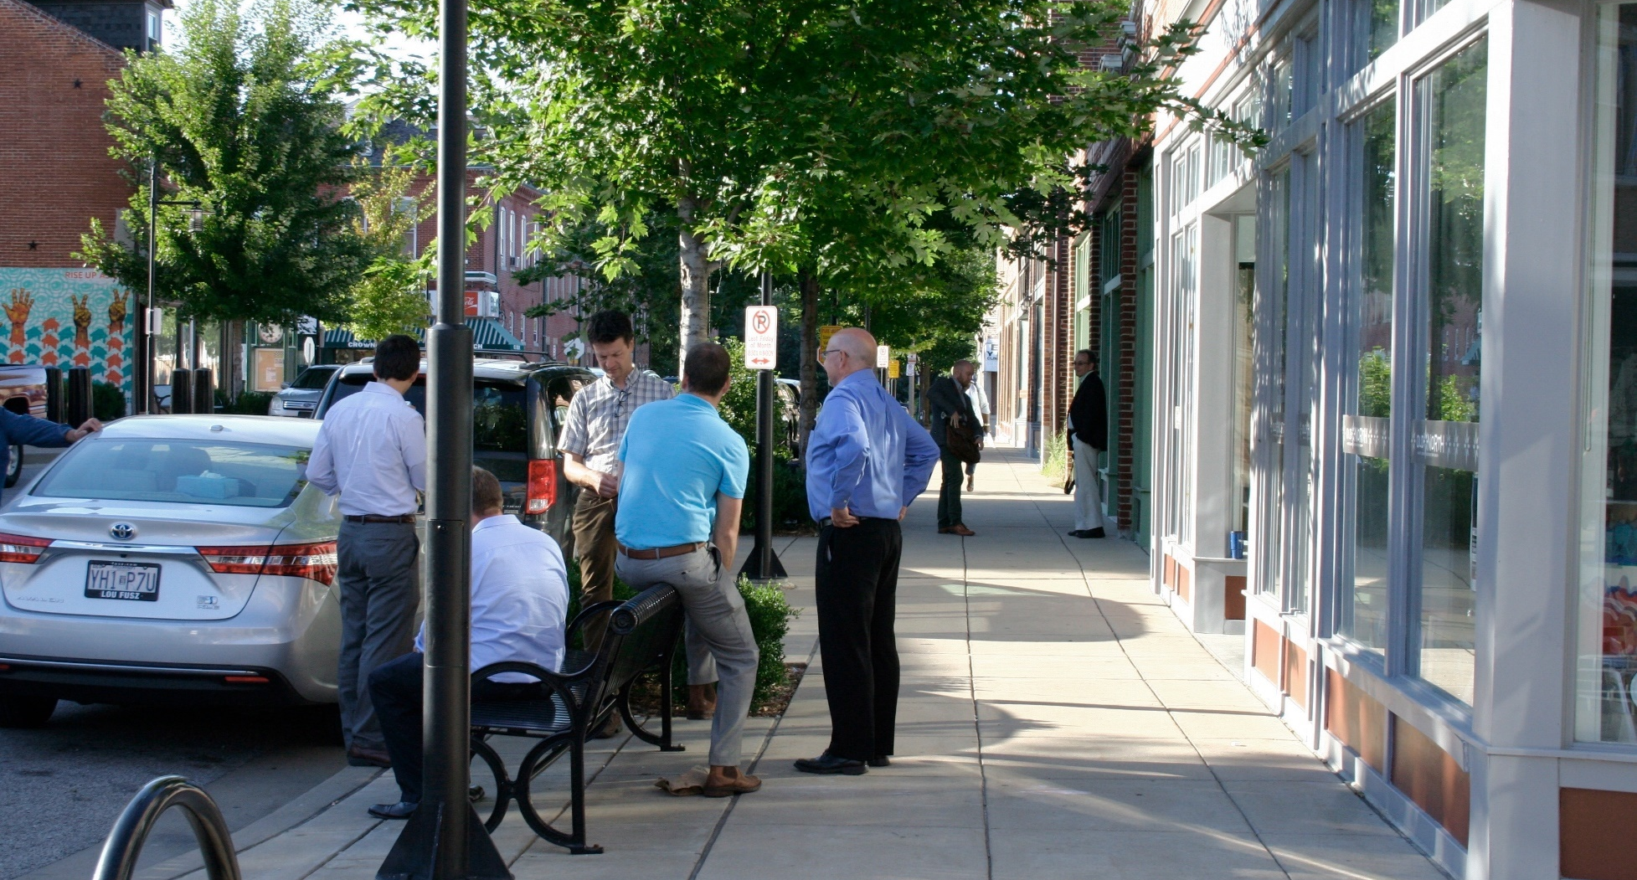
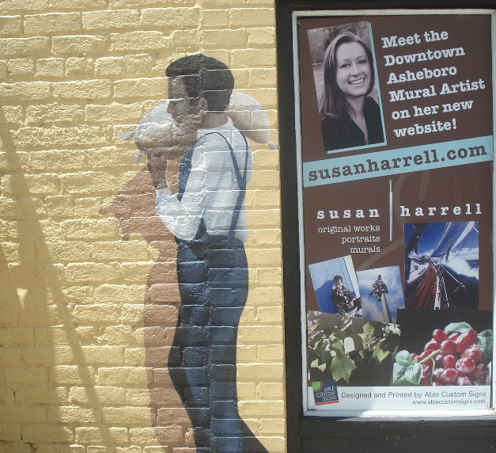
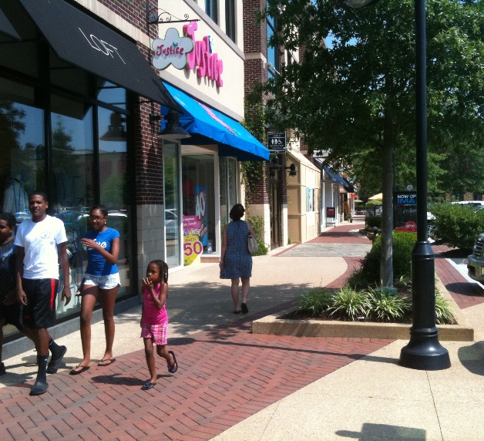
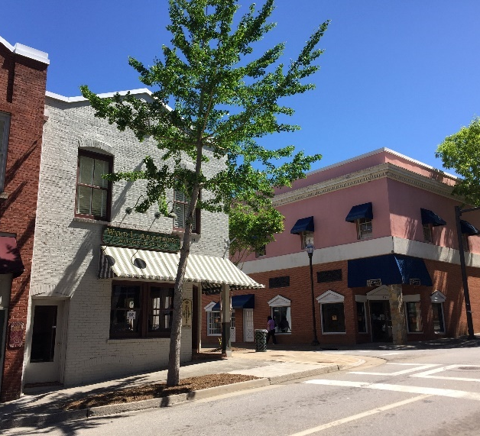
ECONOMIC BENEFITS
Money spent in local businesses is more likely to be reinvested in the community.
Downtown local food businesses can help fill vacant space in areas with existing infrastructure, reinvigorating the heart of the community.
Notes:
Many communities have economic concerns, like the loss of local businesses that make places unique, especially in the downtown area, slow job growth or stagnant wages, and leakage of local dollars to national retailers. Local food systems can help address these concerns.
Local food businesses like farmers markets and restaurants that serve local foods, along with food hubs, commercial kitchens, and other entities that support local foods entrepreneurs create opportunities for people to spend their dollars in places where that money is more likely to be reinvested it in the community.
When these local foods businesses are located in downtowns, they not only help fill a possibly vacant space where there is existing infrastructure, they help enliven the heart of the community, generate traffic for neighboring businesses, and help improve the community’s overall economic outlook. In other words, the location of local foods enterprises is key to getting the greatest benefit out of those investments.
New Albany, Mississippi is a good example of how local foods can support the downtown and local economy. Downtown businesses saw a 25% uptick in business on the 2nd Saturday of each month, when the downtown farmers market adds music and arts vendors.
Source: American Independent Business Alliance. “The Multiplier Effect of Local Independent Businesses.” https://www.amiba.net/resources/multiplier-effect/. Accessed May 24, 2017.

Slide 19
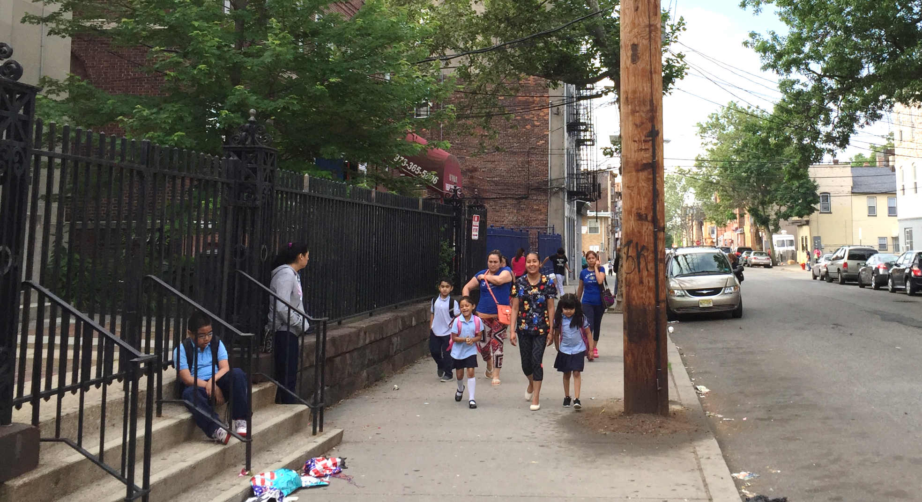
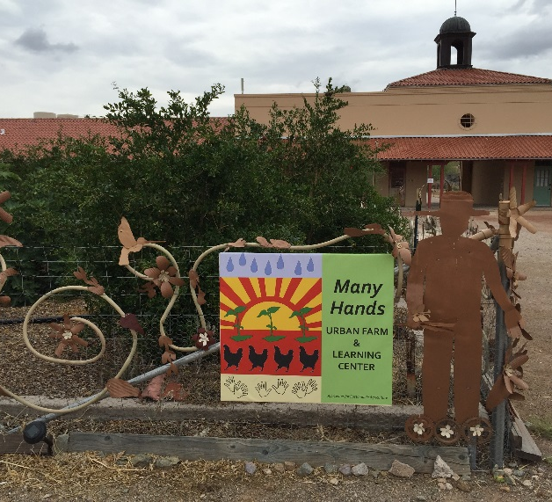
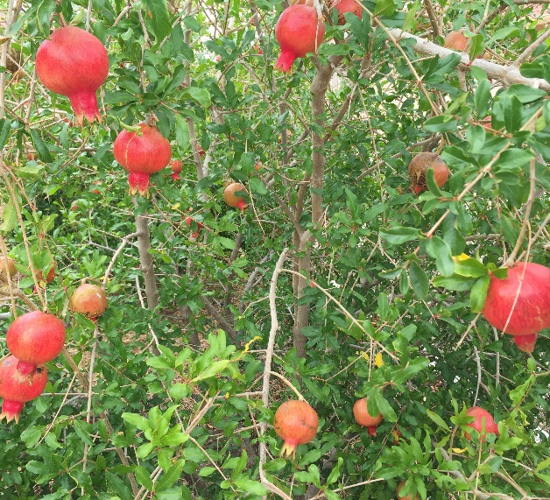
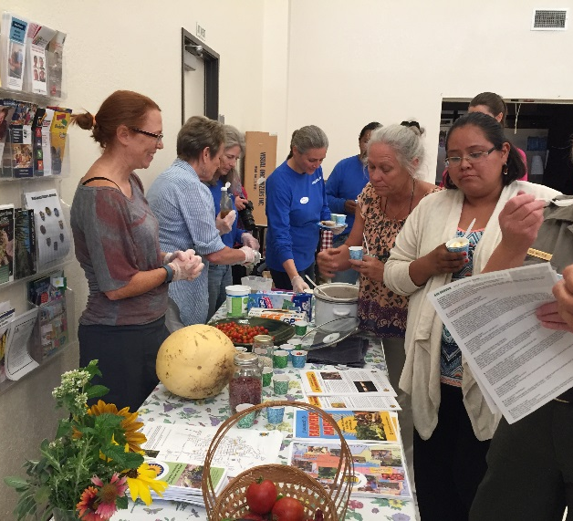
HEALTH BENEFITS
Residents with greater access to healthy food consume more healthy food.
Access to healthy food is associated with lower risk of obesity and diet-related chronic diseases.
Source PolicyLink and The Food Trust. “The Grocery Gap.”
Notes:
Health is a major concern in the United States. Obesity has risen dramatically in recent decades and brought with it many related health problems such as diabetes, high blood pressure, and heart disease.
Lack of access to affordable, healthy food and safe places to walk, bike, and recreate are important contributors to this problem. Developing new healthy food outlets and ensuring people can get there safely and comfortably by walking or biking creates a healthier community.
Sources:
Centers for Disease Control and Prevention. “Overweight & Obesity.” http://www.cdc.gov/obesity/data/adult.html. Accessed September 14, 2016.
Treuhaft, Sarah and Allison Karpyn. The Grocery Gap: Who Has Access to Healthy Food and Why it Matters. The Food Trust. 2010. http://thefoodtrust.org/uploads/media_items/grocerygap.original.pdf.

Slide 20
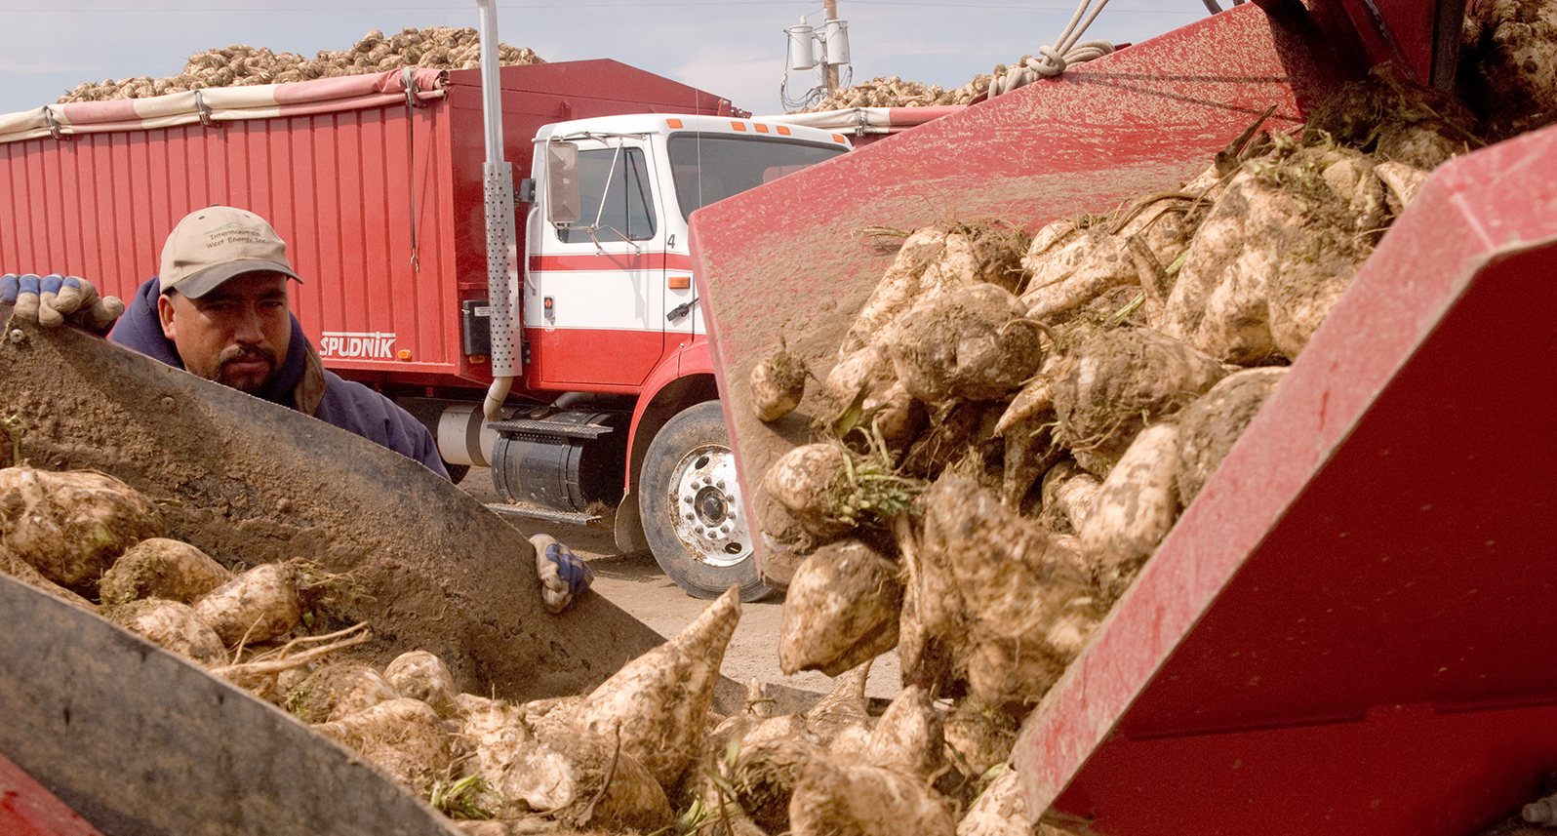
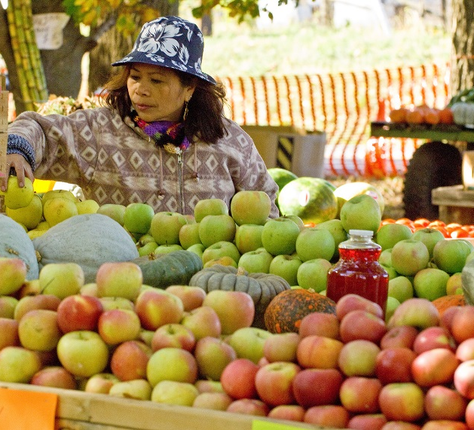
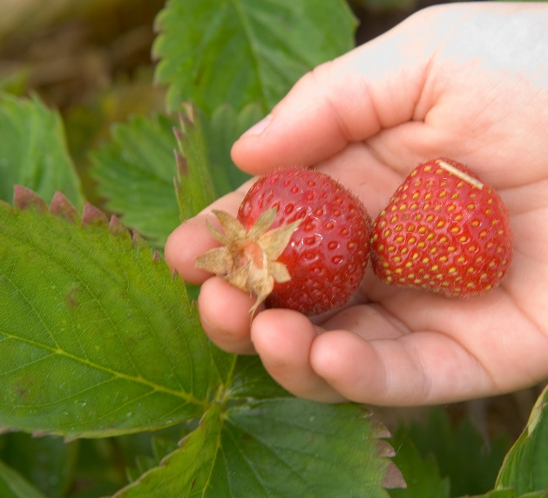
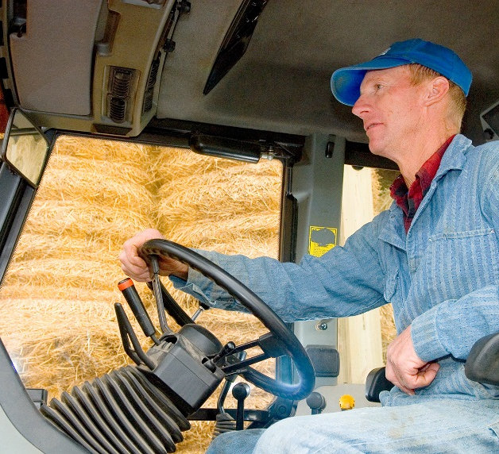
ENVIRONMENTAL BENEFITS
Knowing the farmer who produces your food allows consumers to get the information they need to make informed choices that are better for the environment.
Notes:
Environmental concerns about farming practices, loss of farmland and open space, and agriculture’s contribution to climate change have also led many consumers to want to understand more about how their food is produced. Knowing the farmer who produces your food AND having direct conversations about the practices used give consumers confidence that they can make informed choices that are better for the environment.

Slide 21
COMMUNITY PROFILE
Notes:
Where do you fit in with these trends?

Slide 22
Insert community-specific infographics here
Notes:
[Provide information about the community that illustrates some of the economic, health, and environmental challenges local foods might help address. Also note key assets that could be used as a starting point from which to grow.]

Slide 23
EXAMPLES FOR INSPIRATION
Notes:
The next few slides will show some images from communities that carried out a similar process through the federal Local Foods, Local Places technical assistance program. These brief introductions to strategies other communities have used are intended to inspire some creativity among everyone here as we brainstorm approaches that might work here.

Slide 24

ACCESS TO HEALTHY, LOCAL FOOD
WILLIAMSON, WEST VIRGINIA: COMMUNITY GARDEN OF EATIN’
Notes:
Williamson, West Virginia, wanted to increase access to healthy, local foods, especially for lower-income residents. This image shows the resulting Community Garden of Eatin’, sited on a formerly vacant lot between a railyard and housing for lower-income and disabled people.
Details:
The garden is a collaboration of the Williamson Redevelopment Authority, Central Appalachian Sustainable Economies, West Virginia University Extension, and the Wildwood Garden Club.
The mayor provided city property for the garden.
Intentionally located next to Williamson Towers, a low-income housing development.
Many gardeners live at the Towers and are disabled or elderly.
Includes 30 raised beds that allow those in wheelchairs to garden.
Three high tunnels allow for a longer growing season.
Profits from sales at the city’s farmers market support the gardens.
See: Grow Appalachia. “Williamson Health & Wellness Center.” https://growappalachia.berea.edu/portfolio-items/sustainable-williamson/. Accessed Sep. 28, 2017.

Slide 25

ACCESS TO HEALTHY, LOCAL FOOD
WHEELING, WEST VIRGINIA: GROW OHIO VALLEY
Notes:
The nonprofit organization Grow Ohio Valley has a wide-ranging set of programs to increase access to healthy, local food; increase prosperity; and help downtown Wheeling thrive. They operate greenhouses on vacant lots in the city where the organization grows food for its farm stands, mobile farmers market, and community-supported agriculture (CSA) program. The organization’s next project is an urban orchard on an abandoned and unbuildable hillside just a short walk from downtown.
See: Grow Ohio Valley. http://www.growov.org/. Accessed August 12, 2016.

Slide 26

ECONOMIC OPPORTUNITIES
DUFFIELD, VIRGINIA: APPALACHIAN HARVEST FOOD HUB
Notes:
A strong local food system also brings economic benefits to producers and businesses. The Appalachian Harvest Food Hub in Southwest Virginia grew out of a desire to help struggling tobacco farmers transition to certified organic crop production. It provides aggregation and distribution services that allow small farmers to reach large institutional and retail buyers.
Details:
The hub provides services for 40-50 low-resource farmers.
It is one of the longest-running food hubs in the country, operating since 1995.
Gross sales in 2013 were nearly $1.5 million.
See:
Crum, Sylvia. “Appalachian Harvest: The story of a food hub in Appalachia.” Health & Wellness Magazine. http://tnhealthandwellness.com/appalachian-harvest-the-story-of-a-food-hub-in-appalachia/. Accessed August 12, 2016.
Appalachian Sustainable Development. “Appalachian Harvest.” http://asdevelop.org/ah/. Accessed August 12. 2016.
Photo source: Appalachian Sustainable Development

Slide 27

ECONOMIC OPPORTUNITIES
YOUNGSTOWN, OHIO: IRON ROOTS URBAN FARM
Notes:
The Youngstown Neighborhood Development Corporation operates the Iron Roots Urban Farm on 1.7 acres in the city. It is a teaching farm for urban growing techniques to encourage healthy lifestyles and provide residents with the skills to start small businesses. At the site’s training center, participants learn how to purchase land; select, grow, harvest, and clean crops; and market the final product. Iron Roots’ produce is for sale at local farmers markets and through a community supported agriculture (CSA) program.
See:
Youngstown Neighborhood Development Corporation. “Iron Roots Urban Farm.” http://www.yndc.org/programs/iron-roots-urban-farm. Accessed August 12, 2016.
Vivian, Goodman. “Youngstown gardeners growing produce for sale.” WKSU Public Radio. July 5, 2013. http://wksu.org/news/feature/quickbites/36015.

Slide 28

ECONOMIC OPPORTUNITIES
YOUNGSTOWN, OHIO: COMMON WEALTH KITCHEN INCUBATOR
Notes:
The community development corporation Common Wealth opened their Kitchen Incubator in 2013. It provides licensed, commercial kitchen facilities to food vendors along with training in entrepreneurship, business planning, and marketing. A co-op café next door lets entrepreneurs sell their creations.
See:
Common Wealth. “Common Wealth Kitchen Incubator.” http://www.cwkitchenincubator.org/. Accessed Aug. 12, 2016.
Wood, Andrea. “Kitchen Incubator Grows the Urban Food Economy.” The Business Journal. Oct. 14, 2013. http://archive.businessjournaldaily.com/economic-development/kitchen-incubator-grows-urban-food-economy-2013-10-14.

Slide 29


ECONOMIC OPPORTUNITIES
LAFAYETTE, LOUISIANA: HIGH SCHOOL MEAT PROCESSING CLASS
Notes:
Students at Acadiana high school in Lafayette, Louisiana, can become certified meat processors that create local Cajun specialties. Students make their own seasonings and market the products themselves, with proceeds going to support the program.
See: KATC.com. “Meat Processing Class Helps High School Students Get Certified.” Mar. 3, 2015. http://www.katc.com/story/28252944/meat-processing-class-helps-high-school-students-get-certified.

Slide 30

ECONOMIC OPPORTUNITIES
AJO, ARIZONA: MANY HANDS URBAN FARM AND LEARNING CENTER
Notes:
The Many Hands Urban Farm & Learning Center is part of the nonprofit Sonoran Desert Conference Center, which also includes teaching and demonstration space, a commercial kitchen, and overnight accommodations. The facility serves an important function as a hub for local food activities and supports tourism. The farm helps educate residents about techniques for growing food in the harsh climate of southern Arizona. The initiative is leading to shared knowledge of how to grow common vegetables and other crops as well as traditional, native crops that have been a part of the region’s culture for a long time. Traditional and new uses for cactus, corn, and mesquite wood and beans are examples.
See: Fallows, Deborah. “Farming in the Desert: A Small Town in The Desert Grows a Thriving Food Scene.” The Atlantic. Jun. 1, 2016. http://www.theatlantic.com/national/archive/2016/06/farming-in-the-desert/484292/.

Slide 31

REVITALIZE DOWNTOWNS AND MAIN STREETS
PIKEVILLE, TENNESSEE: STREETSCAPE OVERHAUL AND FARMERS MARKET
Notes:
In addition to providing health benefits and economic opportunities, local foods can be used to help catalyze investment and revitalization in downtowns, Main Streets, and older mixed-use neighborhoods. Pikeville, Tennessee, has done this with success.
The Tennessee Department of Transportation built a bypass around Pikeville in the mid 2000s, which diverted traffic off of Main Street. To counteract the resulting loss of business, the town combined several sources of funding to redesign its Main Street to make it more walkable and inviting and constructed a farmers market pavilion on a vacant lot next to the courthouse, in the heart of its downtown. It intends for the market to tie together the revitalization efforts with plans for a community kitchen.
See: Farmer│Morgan. “Pikeville Main Street Project.” http://farmermorgan.com/recent-projects/main-street-project-pikeville-tn/. Accessed Aug. 12, 2016.

Slide 32

REVITALIZE DOWNTOWNS AND MAIN STREETS
NEW ALBANY, MISSISSIPPI: NEW RETAIL ON THE TANGLEFOOT RAIL TRAIL
Notes:
Combining local foods with investments that make better places can create a lot of positive energy and momentum, as shown in New Albany, Mississippi.
The Tanglefoot Trail is a 44-mile rail-trail with a terminus in downtown New Albany. In the first two years of operation, at least 10 new businesses opened along the trail, and tourism tax revenue grew by 20 percent. The building on the left/top is a bike shop while the building on the right/bottom is now home to a coffee shop after being vacant for decades.
See: Stark, Laura. “Mississippi’s Tanglefoot Trail.” Rails to Trails Conservancy Blog. Aug. 12, 2015. http://www.railstotrails.org/trailblog/2015/august/12/mississippi-s-tanglefoot-trail/.

Slide 33
VALUES PAVE THE WAY FORWARD: EXERCISES
Notes:
So we see there is potential to grow your local foods economy in ways that reap multiple community benefits. Let’s now move into a couple of exercises that will help establish the values, vision, and goals that you all have for food and place-making.

Slide 34

On the front of a notecard, complete the sentence, “I believe that my community…”
On the back of the notecard, complete the sentence, “I believe that my community’s local food system…”
THIS I BELIEVE…
Notes:
Jot down on a notecard how you would complete the sentence, “I believe that [insert city name]…” On the back of the notecard, complete the sentence, “I believe that the local food system in [insert city name]…”
[Once everyone has completed writing their thoughts down, ask everyone to stand up. Participants then share their beliefs about their city one-by-one, sitting down afterwards. Once everyone is seated, the room again stands and repeats the exercise, sharing beliefs about their local food system. Take notes and collect the cards from participants for inclusion in the final report.]

Slide 35

OUR FUTURE COMMUNITY
Write an aspirational headline for the front page of the local newspaper that will be published in 10-20 years.
What happened?
Who made it happen?
What are the results?
Notes:
Write on a notecard an aspirational headline for the front page of the local newspaper that will be published in 10-20 years. Imagine what you would like to see happen. Who made it happen? What are the results?
[Once everyone has completed writing their thoughts down, participants then share their ideas with the group. Take notes and collect the cards from participants. Listen for commonly used words, ideas, and images, taking note of whether these are reflected in the draft goals that will be open for discussion on day 2.]
Illustration credit: Poiesis Design and Planning

Slide 36

ASSETS/OPPORTUNITIES, BARRIERS/CHALLENGES
Write down what you see as the city’s main assets, opportunities, barriers, and challenges.
Share your ideas with the group.
Notes:
Quietly spend a few minutes taking notes on what you see as the city’s main assets and opportunities and the main barriers and challenges to achieving success.
[After everyone has had a chance to brainstorm independently, small groups should discuss their thoughts and report out to the larger group on what are the most common or most significant ideas that emerged. Capture the ideas presented on flip charts that can be referred to the next day during the review of goals and the action planning process.]

