Slide 1

[Community Name]
[Date]
Day 2
Notes:
Unless otherwise noted, all images are courtesy of EPA or Renaissance Planning Group. All images in this presentation may be used in presentations adapted for individual communities.
This presentation was developed as part of the U.S. Environmental Protection Agency’s Local Foods, Local Places Toolkit: A Guide to Help Communities Revitalize Using Local Food Systems. The complete toolkit is available at https://www.epa.gov/smartgrowth/local-foods-local-places-toolkit.

Slide 2
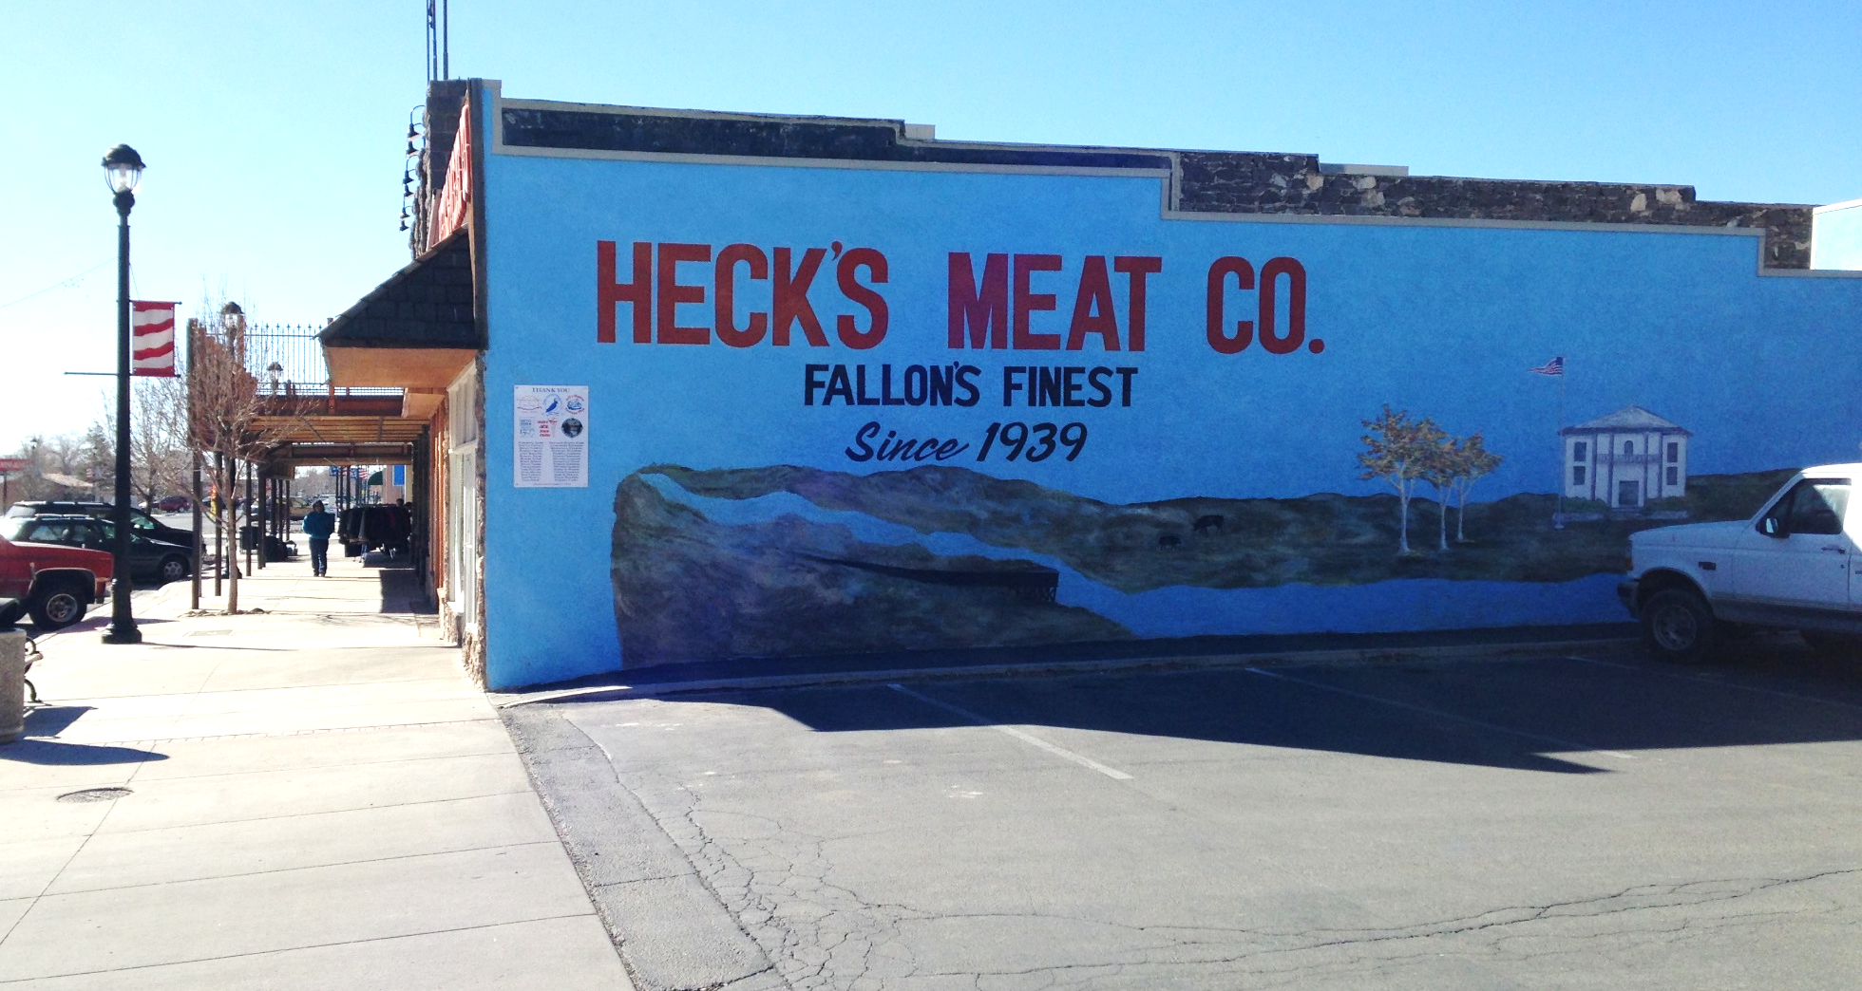
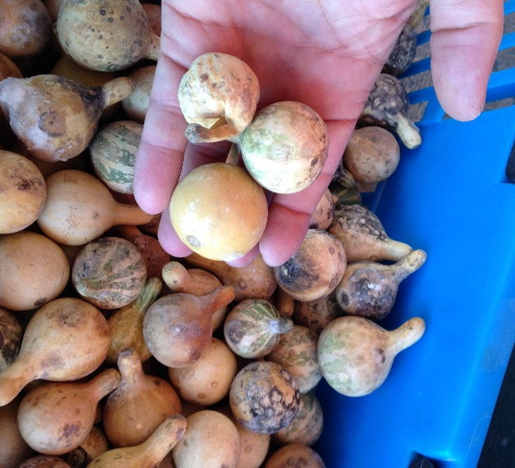
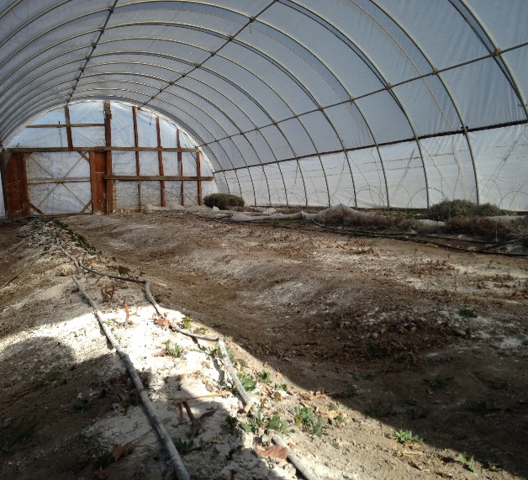
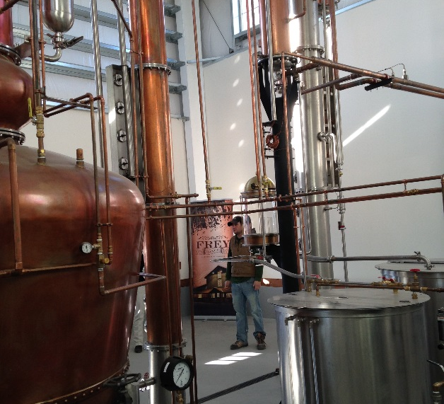
PROGRAM PURPOSE
Desired Outcomes
Economic opportunities for local farmers and businesses
Access to healthy, local food, especially among disadvantaged groups
Revitalized downtowns, Main Streets, and existing neighborhoods
End Products
New connections among people to build capacity for success
An action plan with goals and strategies for achieving these outcomes
Notes:
The Local Foods, Local Places process aims to increase economic opportunity, improve access to healthy foods, and revitalize downtowns and existing neighborhoods. It helps accomplish this by creating connections that make a stronger local food system and linking that food system to place-based investments in existing communities.

Slide 3
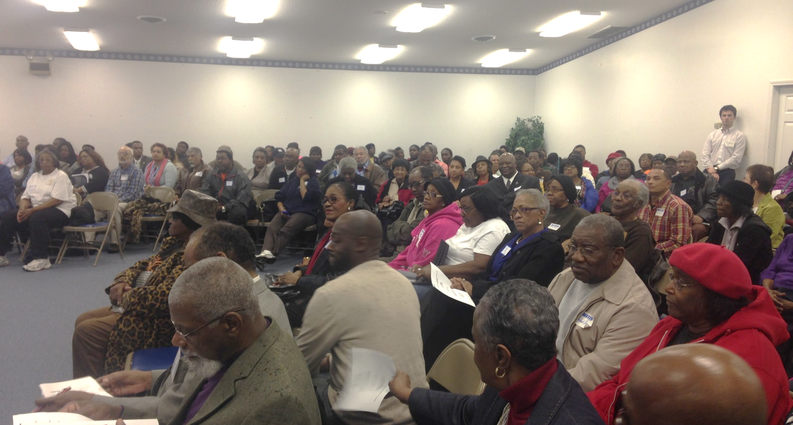
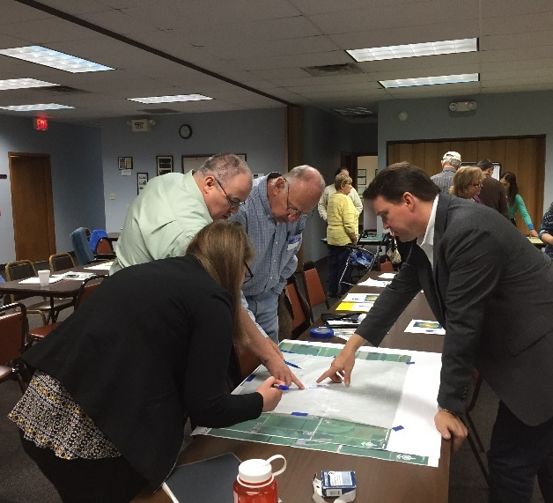
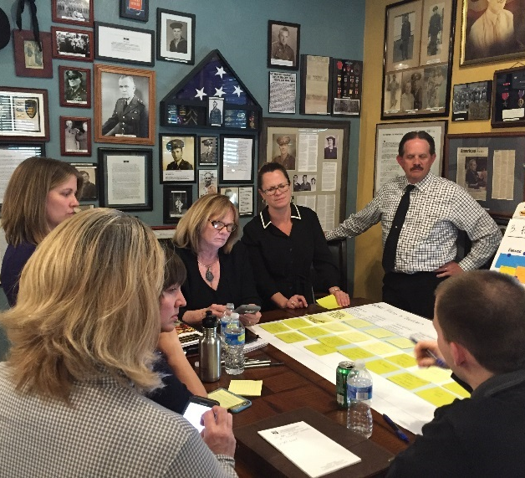
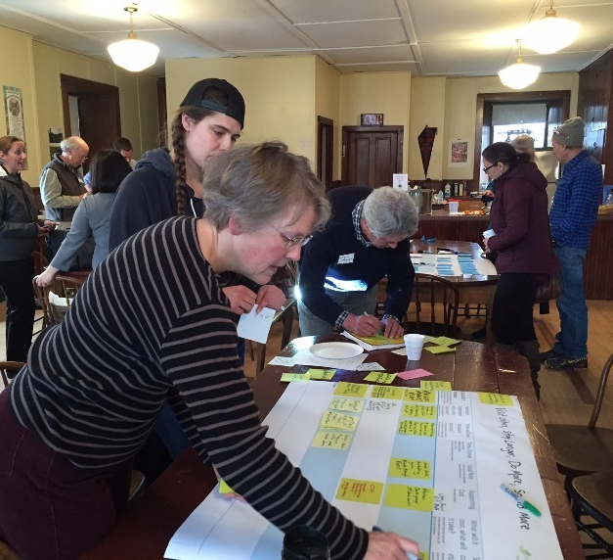
DAY 1
Community Values, Vision, and Goals
DAY 2
Action Brainstorming
Assess what exists now and what can be strengthened or improved.
Action Planning
Identify priorities, roles, and responsibilities to move forward.
WORKSHOP OVERVIEW
Notes:
This is a process that starts with the big picture–with the community’s values, vision, and goals–and results in the framework of an action plan by the end of the day tomorrow. Last night we explored the community’s values, vision, and goals. This morning we’ll start getting some thoughts flowing, and this afternoon, we’ll nail down some concrete actions to achieve the community’s goals.

Slide 4
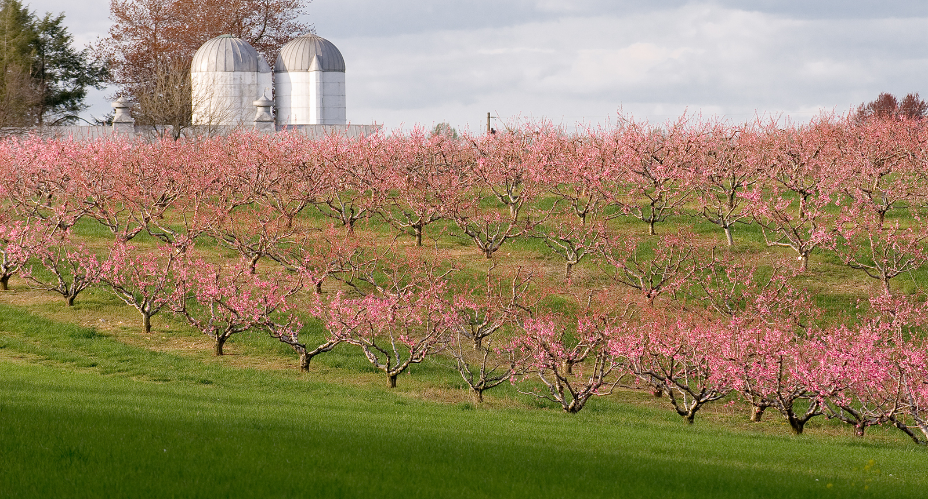
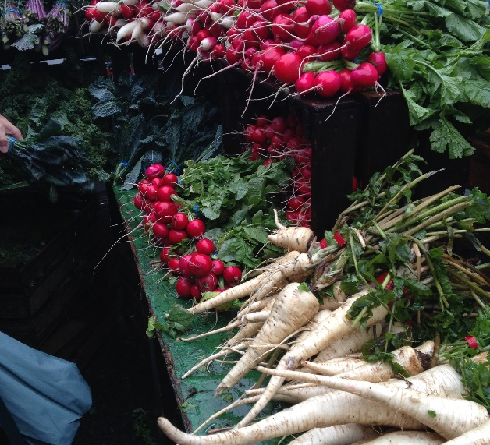
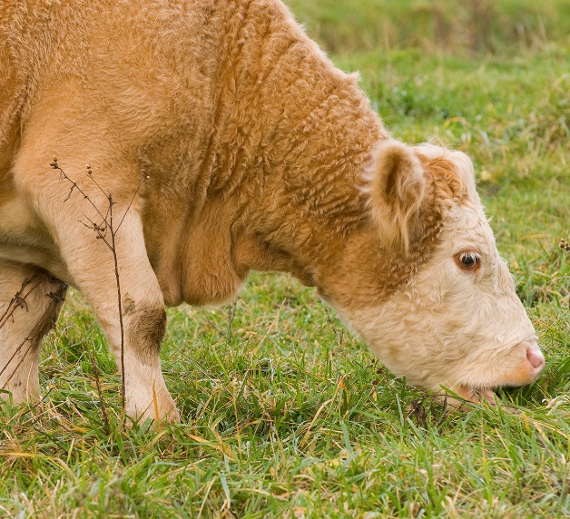
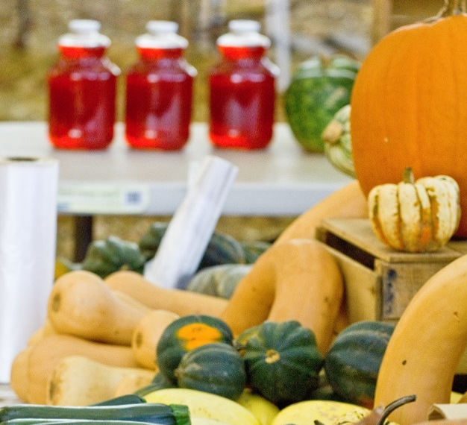
Introductions
Recap of last night
Case studies presentation
Food system asset mapping
Break
Review goals
Lunch
THIS MORNING: ACTION BRAINSTORMING
Notes:
Here’s more detail about what we’ll do this morning. First we’ll do introductions again since there are some new faces in the room. Then I’ll briefly summarize what we heard last night. Then I’ll present some case studies of places that have invested in local foods that I hope will be inspiring. After that we have an exercise to explore what local food assets you already have in place. Then after a short break, we’ll talk about the goals the steering committee developed in advance of the workshop and see if we need to make any changes before this afternoon’s work.

Slide 5
VALUES PAVE THE WAY FORWARD: SESSION 1 RECAP
Notes:
Last night as participants shared their thoughts about the community and the local food system, we learned a lot. Going over some of that will help refresh everyone’s memory and fill people in who weren’t with us last night.

Slide 6
THIS I BELIEVE…
[Enter feedback from community and insert community-specific photo.]
Notes:
[Insert quotes or a word cloud graphic to illustrate feedback on topics critical to the community. See
www.wordle.net for word cloud creation.]

Slide 7
OUR FUTURE COMMUNITY…
[Enter feedback from community and insert community-specific photo.]
Notes:
[Insert example headlines from the previous night’s exercise.]

Slide 8
OPPORTUNITIES AND ASSETS
Enter feedback from community (quotes, maps, photos, etc.) relating to assets & opportunities.
[Insert a location-specific photo(s) from tour.]
Notes:
[Identify opportunities and assets that participants raised during the previous night’s exercises.]

Slide 9
CHALLENGES AND BARRIERS
[Enter feedback from community relating to challenges and insert a location-specific photo.]
Notes:
[Identify challenges and barriers that participants raised during the previous night’s exercises.]

Slide 10
CASE STUDIES & DISCUSSION
Notes:
[Insert relevant case study slides following this section divider.]

Slide 11
INSERT CASES STUDY SLIDES HERE OR GO TO OTHER PPT

Slide 12
UNDERSTANDING YOUR FOOD SYSTEM EXERCISES
Notes:
Now we’ll begin a set of interactive exercises to help gain a common understanding of the local food system.

Slide 13
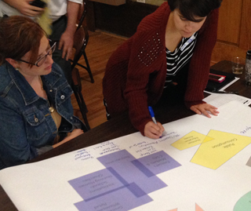
Use one color to write down existing food system components and another to record things that are missing or could be strengthened.
Depict existing relationships with solid lines and use dotted lines for relationships that could be strengthened.
FOOD SYSTEM DIAGRAMMING
Notes:
In this exercise, you’ll work in small groups using a diagramming template that includes processors, aggregators, distributors, grocery stores, institutions, restaurants, markets, nutrition education and access, public consumption, recycling and composting, and farmers and ranchers. Use one color to write down existing components and another color to record things that are missing or could be strengthened. Use solid lines to depict existing relationships and dotted lines to depict relationships that do not yet exist or could be strengthened.

Slide 14
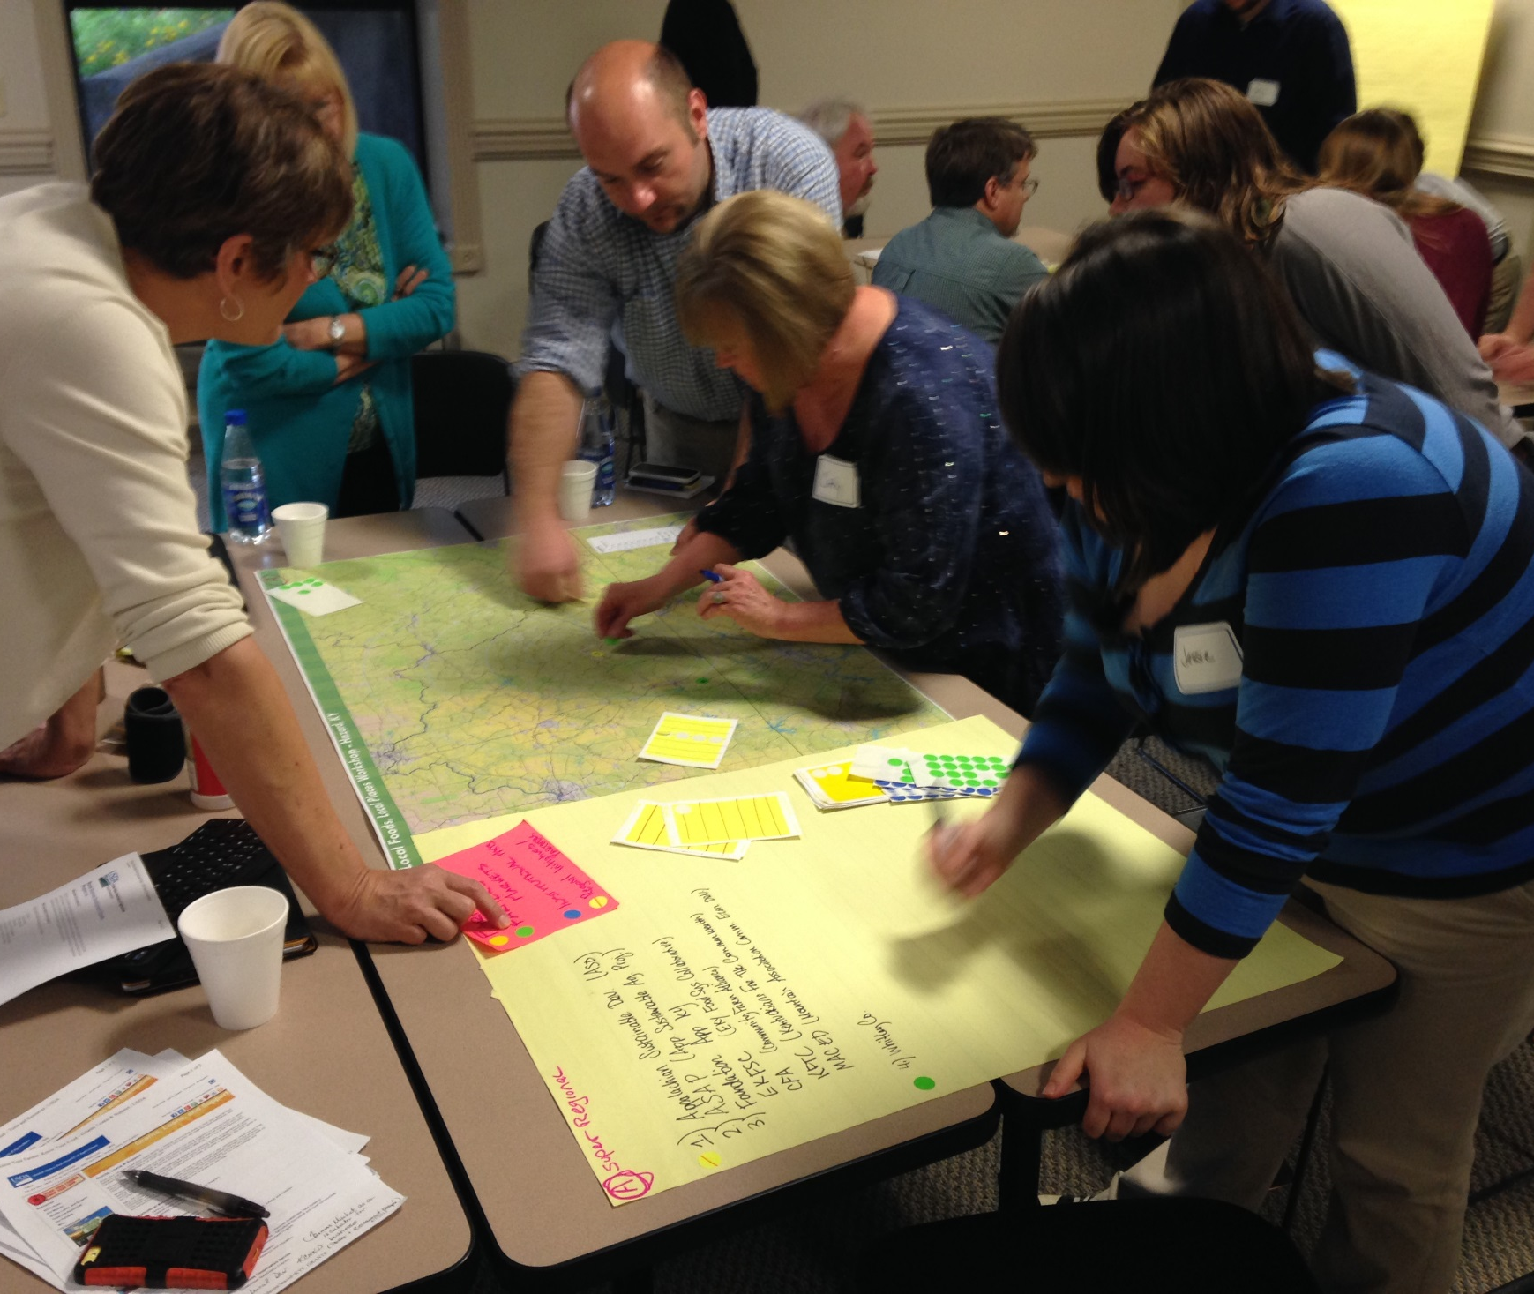
Place a colored dot on the map to identify:
  Farms (BLUE)
  Markets and other retail outlets (GREEN)
  Potential customers, e.g., institutions, senior centers, schools (YELLOW)
  Partner organizations (RED)
Number the dot and write the name on a sheet of paper.
FOOD SYSTEM MAPPING
Notes:
In this exercise, you’ll work in groups to identify the components of the local food system on local and regional maps. Use different colored dots to identify farms, retail outlets, major food purchasers (hospitals, schools), and partner organizations.
[One or more groups might map areas for improvement in the neighborhood around a point of focus for the workshop, such as missing or damaged sidewalks, needed bike parking, or empty/missing treeboxes (see next slide).]

Slide 15
Place a colored dot on the map to identify:
  Key asset—work to grow and support (BLUE)
  Opportunity for jobs, new asset (GREEN)
  Needs immediate help and attention (RED)
  Local food system element (YELLOW)
Number the dot and write the name on a sheet of paper.
NEIGHBORHOOD MAPPING
Notes:
In this exercise, you’ll work in groups to identify revitalization needs and priorities on local and regional maps. Use different colored dots to identify key assets, opportunities, areas needing attention, and local food system elements.
[The entire room can do the food system mapping (prior slide) or neighborhood mapping, or both exercises can occur simultaneously with participants selecting which to work on.]

Slide 16
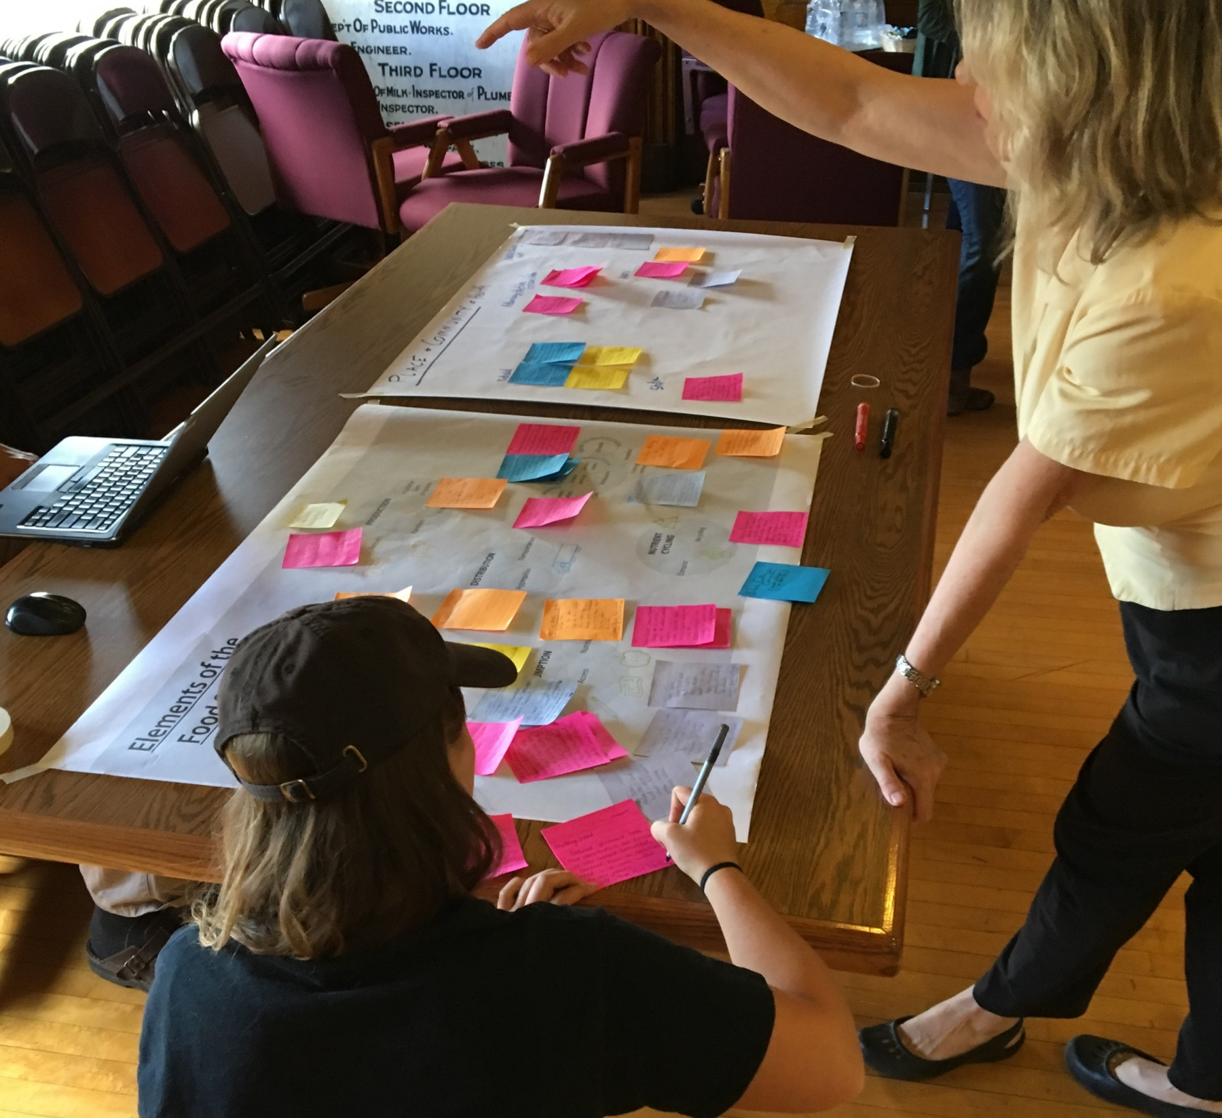
Who’s Who - Networking
Write on a 4x4 sticky note:
One organization, program, or initiative, including a contact person
A short description of the organization’s role and potential contribution
When finished, place on the wall/poster under the appropriate grouping.
Notes:
In this exercise use sticky notes to write down organizations, programs, or initiatives relevant to the local food system (one per note), including a contact person and a short description of what they do and what they might contribute. Add your note to a set of posters to group similar organizations.
[The facilitator might create some potential groupings ahead of time, while also working on the fly to create new groupings as appropriate.]

Slide 17
WHAT WE’VE HEARD: GOALS
[List here the 3-5 goals for review.]
Notes:
Before the action planning session, we want to agree on the set of goals we’ll address here at the workshop. These goals are draft goals that the steering committee developed during the course of workshop planning [modified based on what we’ve heard during the workshop so far].
[Allow workshop participants to offer new goals or refinements to existing goals, and facilitate the discussion to ensure general group consensus around 3-5 goals. Discourage goals from becoming overly specific during the discussion. For example, a goal might be to increase the number of residents who regularly visit the farmers market. Some residents might suggest changing the goal to “Increase the number of residents who regularly visit the farmers market by offering places to sit, music, and cooking demonstrations.” If participants suggest specific actions, note them on a poster board and use them to seed the discussion during the afternoon’s action planning session (e.g., create places to sit, music, and cooking demonstrations at the farmers market). Be flexible and consider new ideas as they are raised and engage in a discussion about priorities to limit the number of goals to a manageable number.]

Slide 18
DAY 1
Community Values, Vision, and Goals
DAY 2
Action Brainstorming
Assess what exists now and what can be strengthened or improved.
Action Planning
Identify priorities, roles, and responsibilities to move forward.
WORKSHOP OVERVIEW
Notes:
Now that we’ve explored some case studies from around the country and done some exercises to better understand the local food system, we’re going to move into the action planning part of the agenda. This is where we start putting pen to paper to identify what needs to happen to move the community toward its goals.

Slide 19
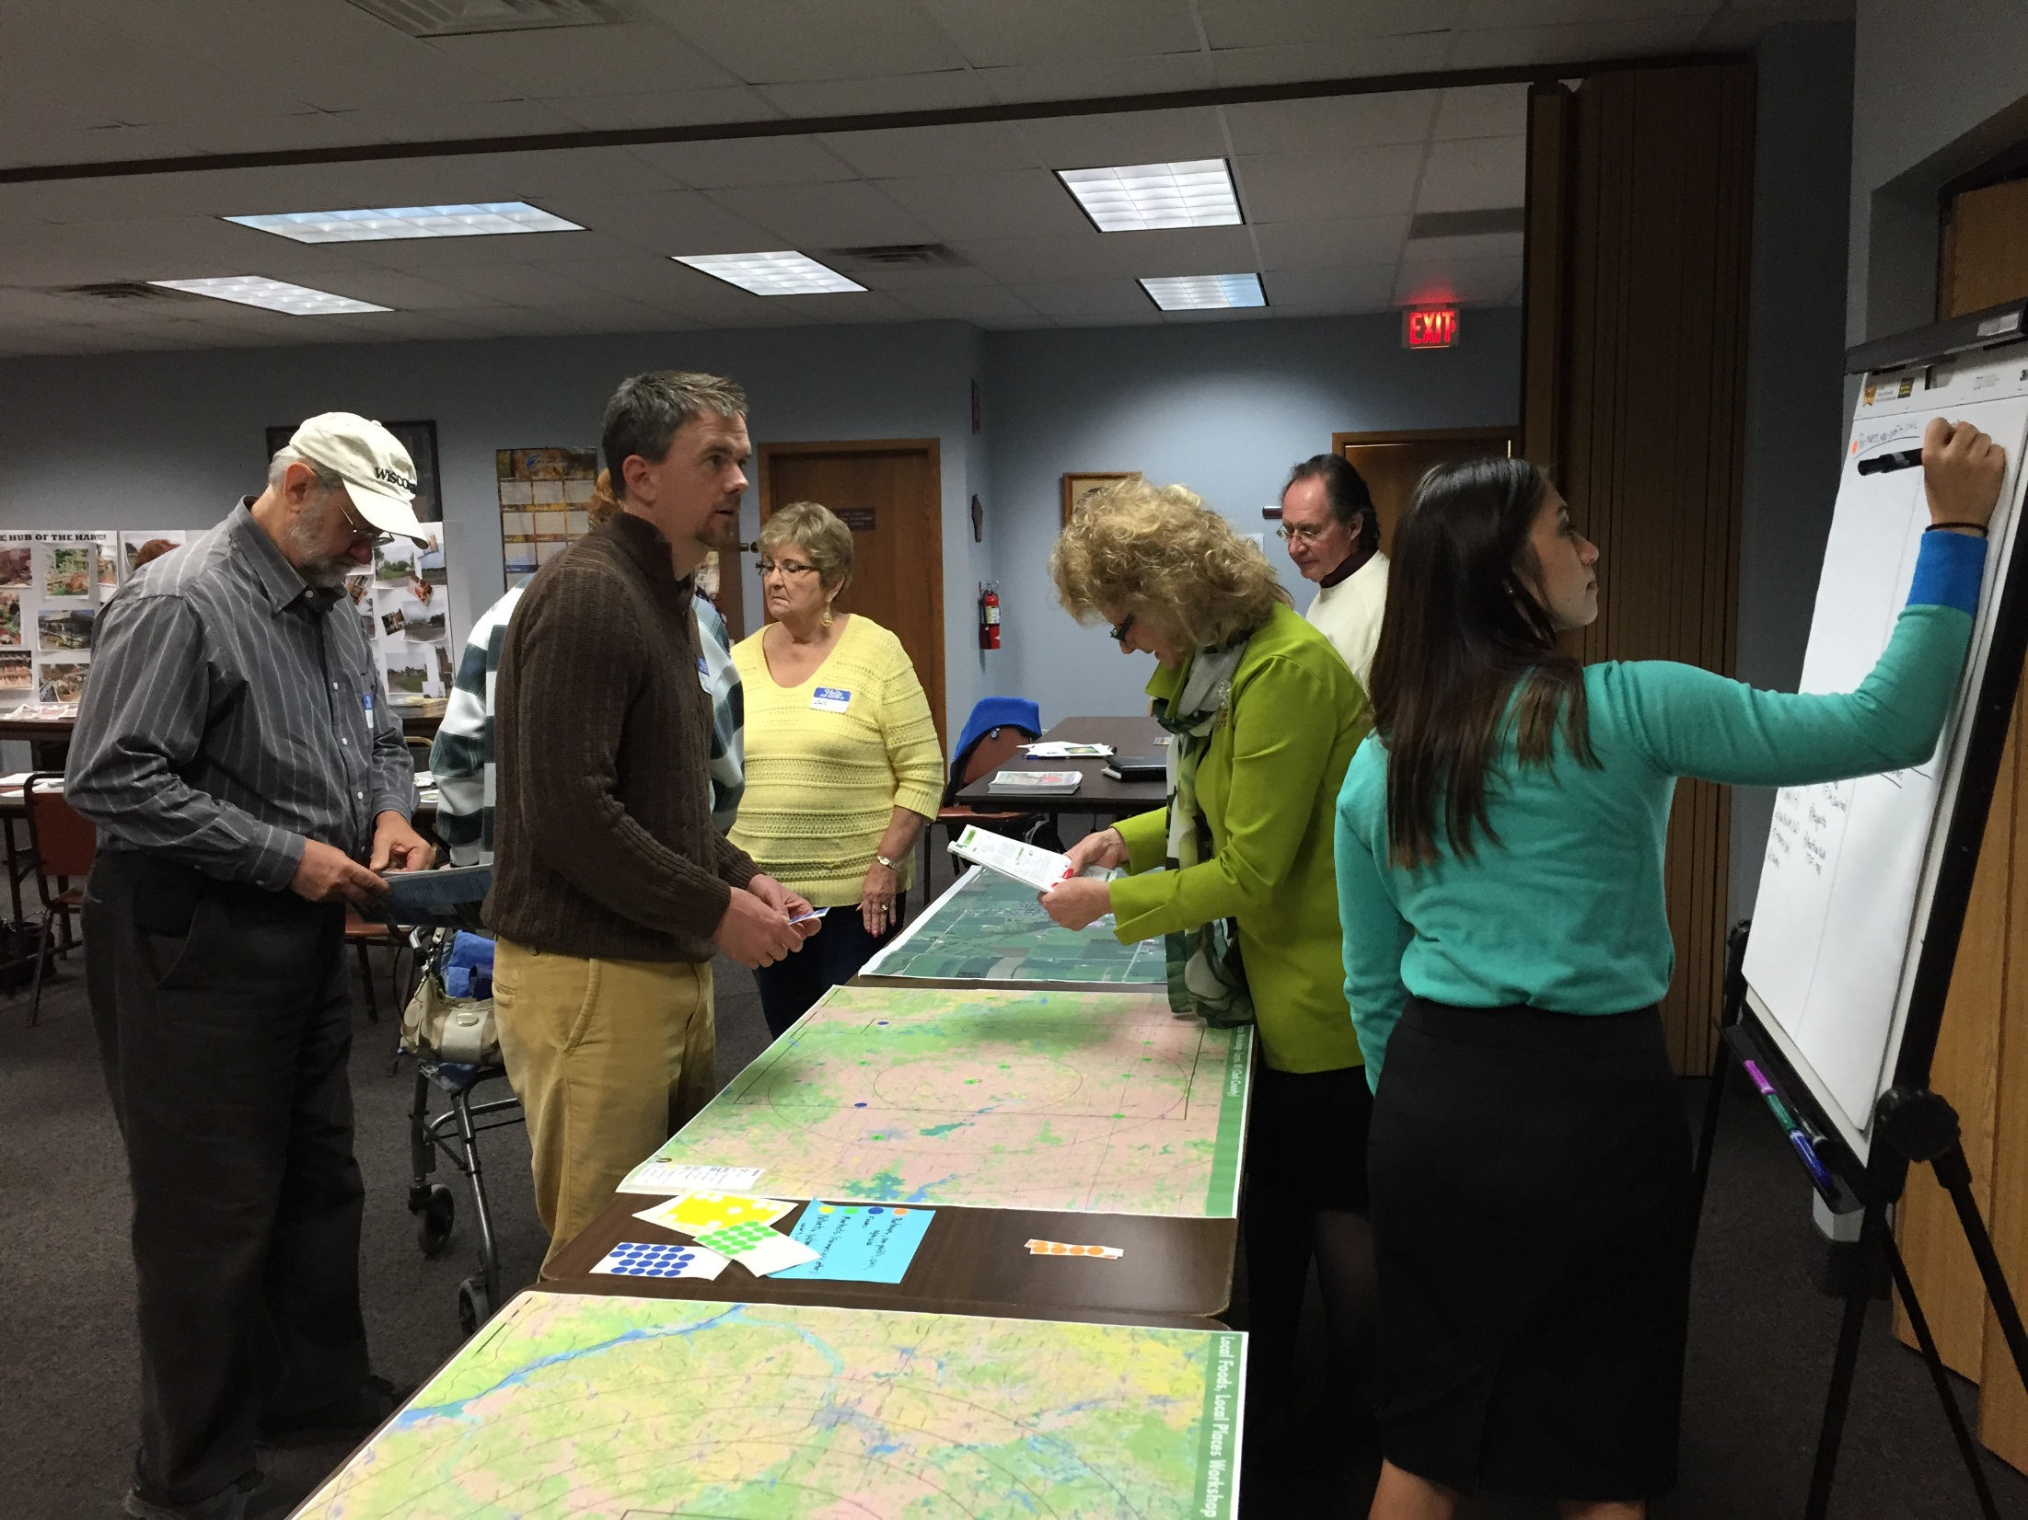
ACTION BRAINSTORMING
Try to identify one or two key actions per goal.
Examples of actions:
  [INSERT COMMUNITY-SPECIFIC EXAMPLES (WITH THE APPROPRIATE LEVEL OF DETAIL) THAT HAVE BEEN BROUGHT UP DURING THE WORKSHOP THUS FAR.]
Notes:
The first activity of the third session is to brainstorm potential actions that go along with each of the goals as determined in the morning session.
[Invite participants to suggest actions under each of the goals one-by-one. This exercise works best if there are two volunteers to help. One serves as a note-taker who records the actions on large post-it notes. A second volunteer transfers the post-it notes to a flip chart as the discussion proceeds (one sheet per goal), grouping similar ideas together as much as possible to facilitate the following action prioritization exercise. For example, if someone suggests an annual community festival and someone later suggests an annual music festival, overlapping the post-it notes can help suggest their relationship. Such grouping can help avoid overly narrow actions that could complicate interpretation of the action prioritization results.]

Slide 20
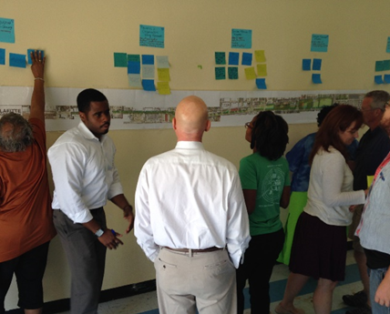
ACTION PRIORITIZATION
Move around the room, using your stickers to mark the ideas you think should be the highest priority.
It is not necessary to evenly distribute your votes among goal areas.
Multiple votes for a single action are allowed.
Notes:
[To prioritize actions, arrange the flip chart paper around the room. Give each participant 10 stickers that they can place on their favorite ideas from the action brainstorming process.]

Slide 21
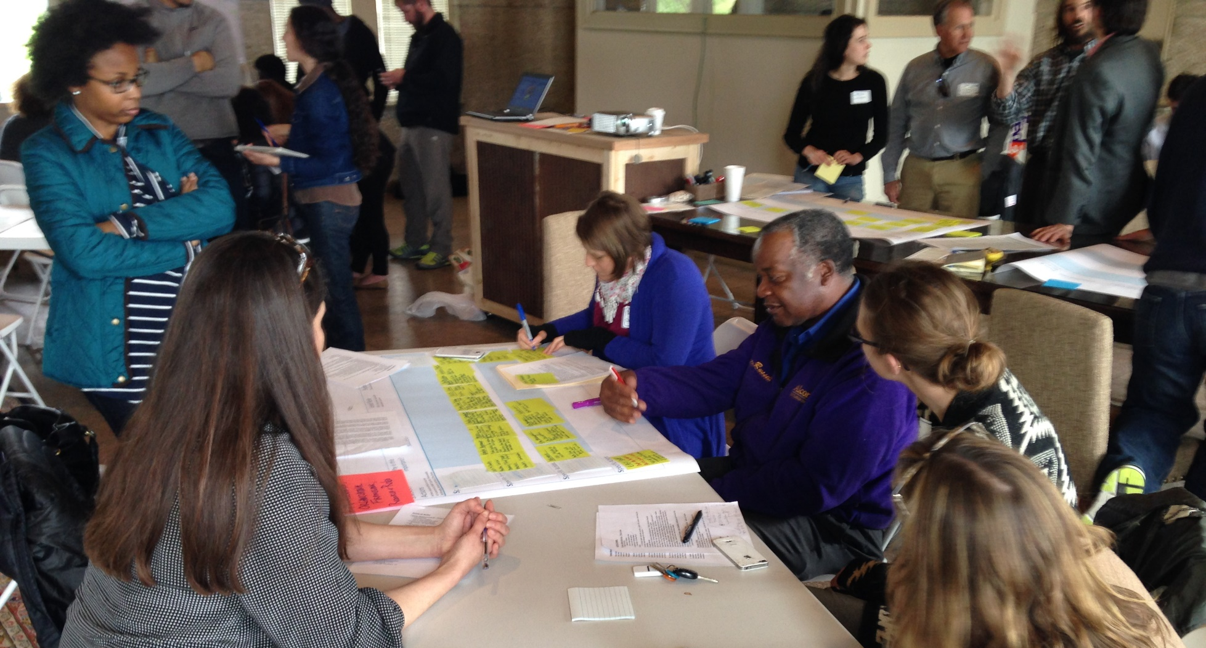

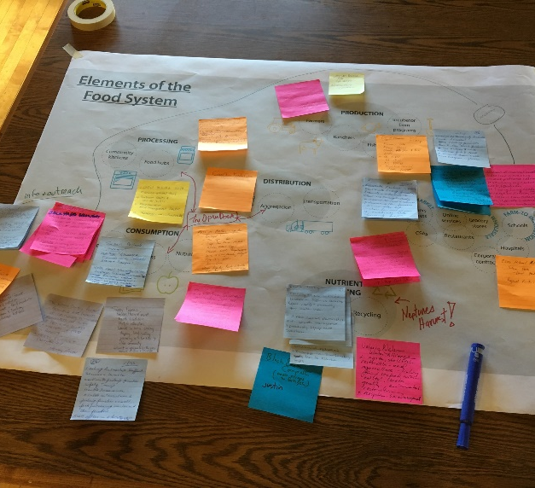
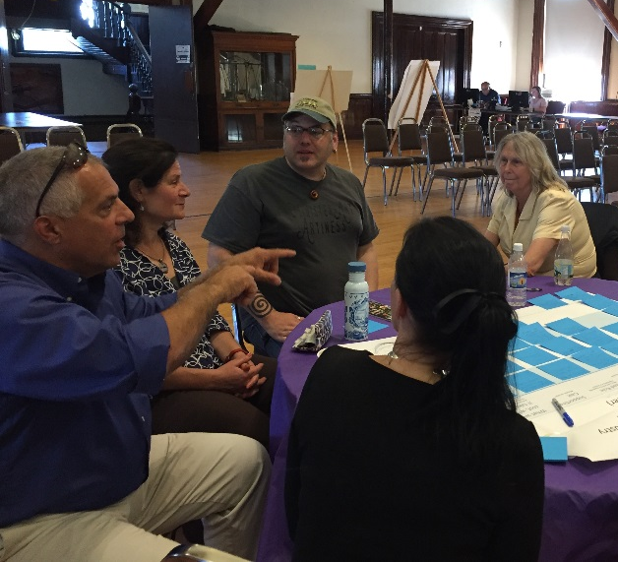
ACTION PLANNING
Choose one goal area to focus on first, but feel free to move among groups.
The group should decide on 3-5 actions to complete in the action planning tables based on the prioritization exercise.
Notes:
[Ask participants to self select into groups (one for each goal area) beginning with the goal they feel most closely tied to and moving among the groups to participate in as many as desired. The first task of each group is to look at the distribution of stickers and decide on 3-5 actions that group members feel best represent the prioritization of all workshop participants. Encourage groups to use their discretion in selecting the final actions for action planning. For example, if several ideas got relatively few votes but are very similar and have a majority of votes when combined, participants could choose an action that best captures the spirit of the idea they believe participants were voting on. Encourage groups to refine the initial action ideas to be as clear and specific as possible. For example, “install and improve gateway entrances to the farmers market through landscaping, plantings, and new signage” is preferable to simply “improve gateways.” People who did not participate in the workshop should be able to understand the intention behind each action. After each group settles on the set of actions to prioritize, each group works together to complete an action planning table, using post-it notes so information can be changed, reordered, and added to by others. Guide the group through an example as part of a plenary discussion.]

Slide 22
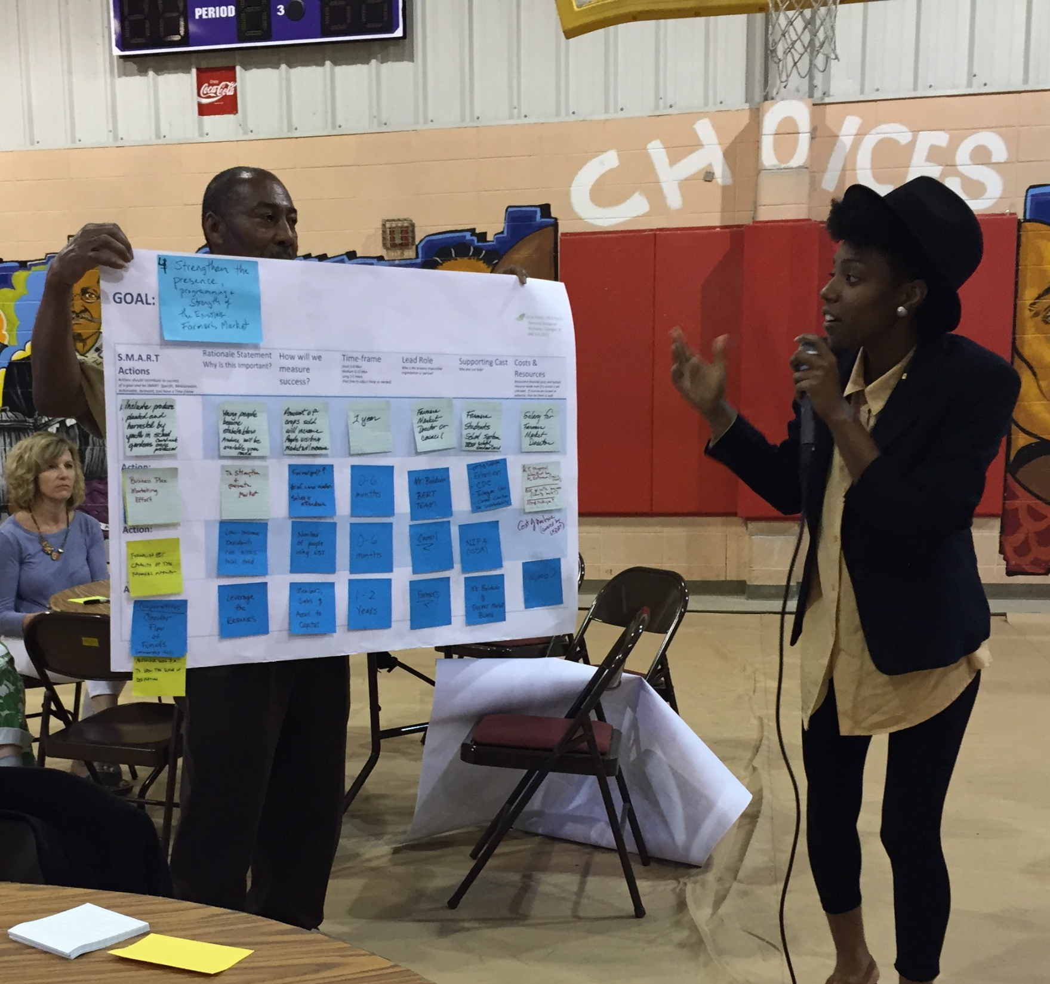
REPORT OUT
Identify each action that the group prioritized for inclusion in the action table.
Share overarching ideas that emerged, e.g.,:
  Are there any patterns (the same lead actor or funding source)?
  Any major challenges or unknowns?
  Any surprising connections or resources?
Notes:
[Ask a volunteer from each group to report out to the larger group about the completed action table. The volunteer should go through what each of the actions are, describing how the group decided on the “winning” actions they worked on. Encourage each volunteer to then talk about overarching ideas that arose during the discussion rather than reading verbatim everything on the chart. For example, did any patterns emerge, such as the same group of lead actors or funders? Did the group struggle with anything in particular? Where there any major unknowns or challenges identified? Were there any surprising connections or resources identified? Is this a relatively easy goal area or more difficult, and why?]

Slide 23
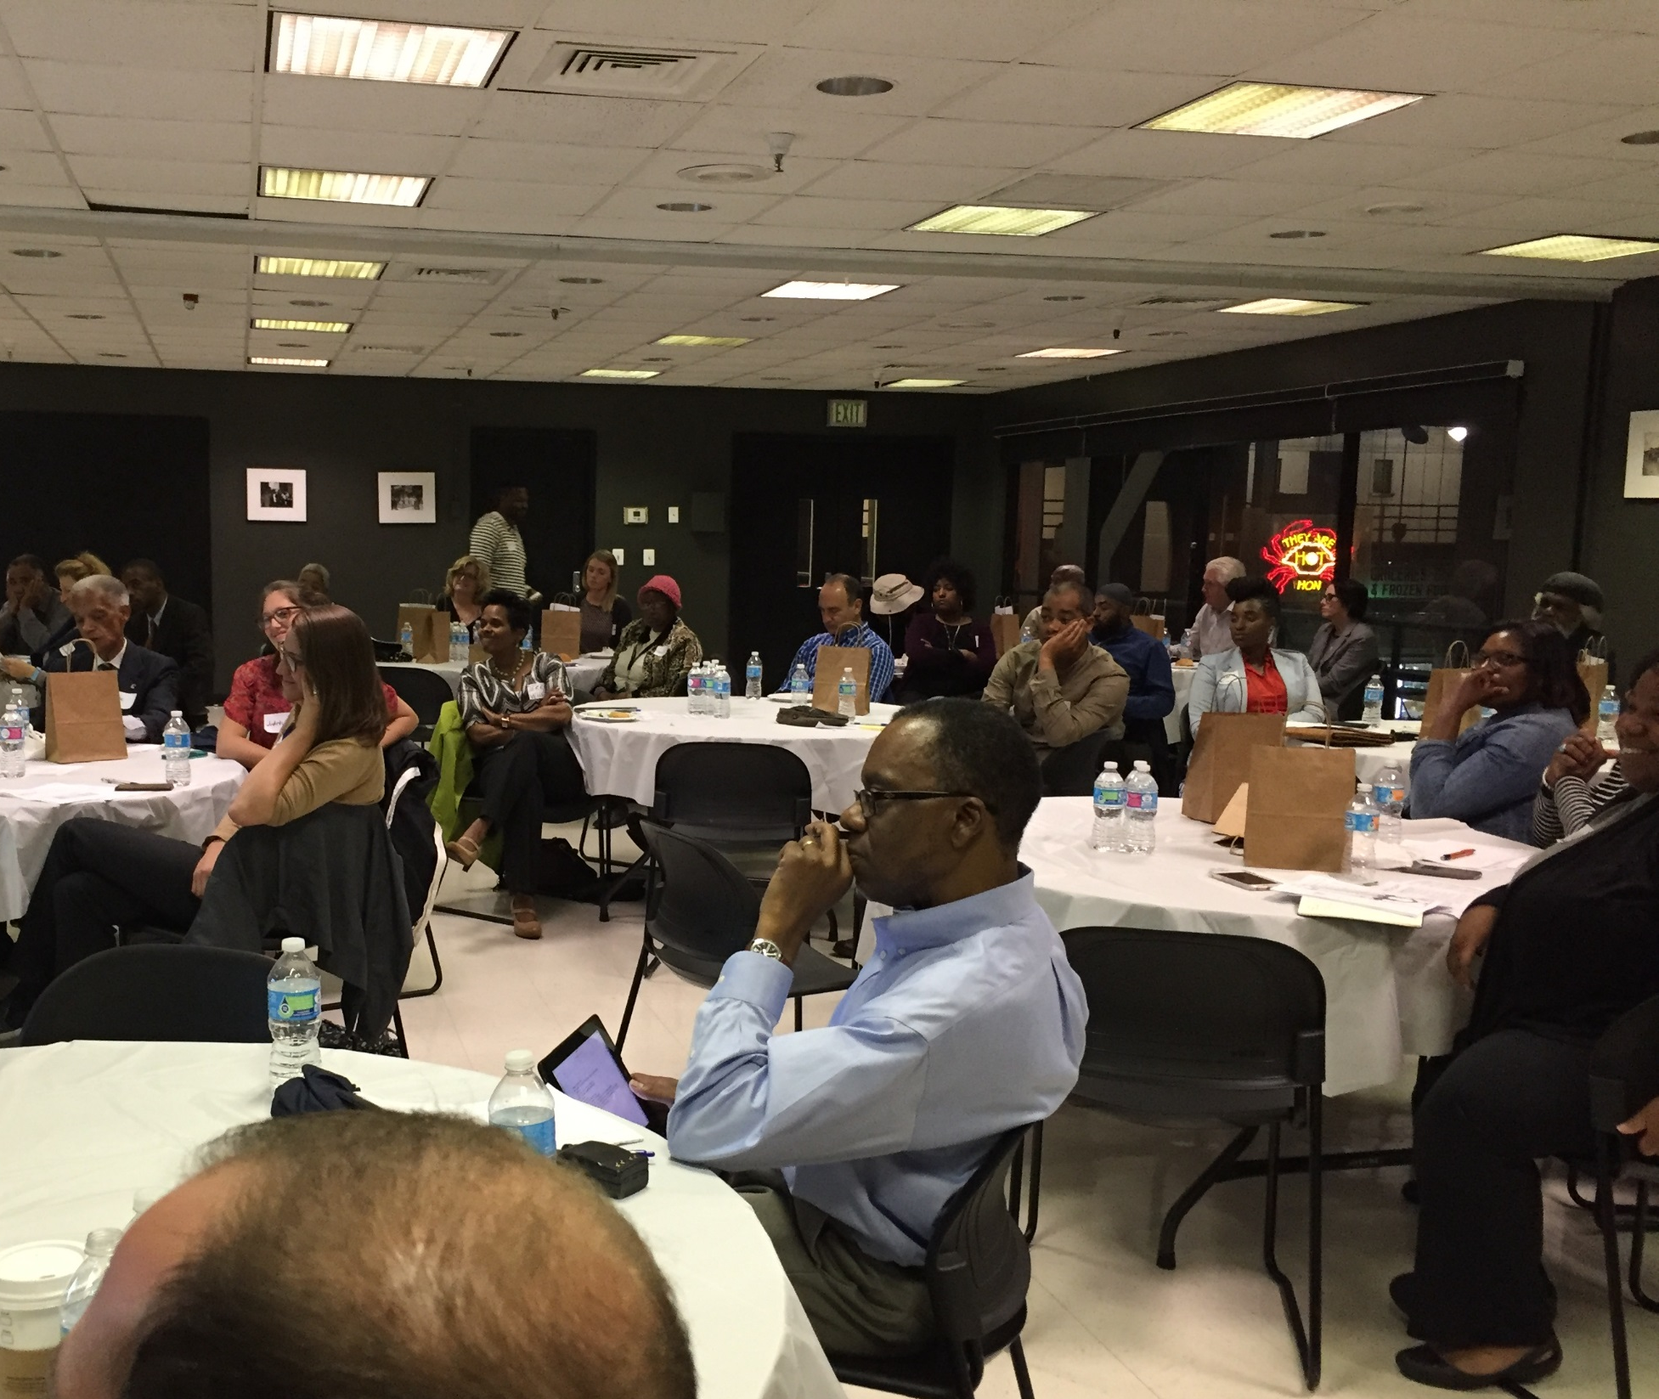
COMMITMENTS
Write on a notecard at least one thing you can personally commit to doing in the next 100 days.
Notes:
[Ask everyone to write on a notecard at least one thing they can personally commit to in the next 100 days. Then go around the room and ask participants to share. Reassure participants that commitments don’t need to be monumental or considered a game of one-upmanship. Simply encourage statements that are simple, earnest, and achievable. For example, “I commit to creating and launching the farmers market Facebook page,” or “I commit to working on the market place funding proposal.”]

