Slide 1
Exchange Network Grant Program FY 2018 Solicitation Notice Webinar
A Guide for Preparing Quality
Applications

Slide 2
Overview
FY 2018 Grant Program Basic Information
What’s New (or Different) Since FY 2016?
What’s New (or Different) This Year?
Other Key Elements
Reusable Component Service (RCS)
Tips and Tricks for Preparing a Successful Grant Application
Application Instructions
Grants.gov Workspace
Common Pitfalls
Successful Applications
RCS Demo
Questions
Contacts

Slide 3
FY 2018 Grant Program Basic Information
EPA expects to award about $6 million in assistance agreements in FY 2018
Projects must be related to opportunities outlined in the Priorities section of the Solicitation Notice (I-E) or Appendices A, B and D
Must commit to completion of an activity
Completion means fully implementing a data flow, deploying a web service, deploying a data publishing application/website, or finishing capacity building activities as outlined in Appendix D, etc.
States, federally recognized tribes and territories are eligible to apply
Non-eligible entities can partner with an eligible one; eligible partner must be the lead applicant
Applications due January 26, 2018
Selection notices (not official) sent out late June to July 2018
Awards made July through September 2018
EPA may partially fund proposals

Slide 4
What’s New (or Different) Since FY 16?
Exchange Network Program Priorities (Section I-E)
Tiers removed – all opportunities listed as individual or partnership
No separate funding or priorities for e-Enterprise projects
Exchange Network projects that support e-Enterprise are fundable
Threshold Criteria for Funding Goals (Section III-B)
Applications from applicants with more than four active Exchange Network grants are ineligible
Application Submission (Section IV and Appendix E)
Requirement to submit applications through grants.gov
Exceptions only available through a waiver process; instructions for alternate submission method included in waiver

Slide 5
What’s New (or Different) This Year?
Exchange Network Program Priorities (Section I-E)
Aligns with Exchange Network Phase 2 goals and strategy
General Information (Section II-A)
New funding thresholds for individual and partnership applicants
$200,000 for individual applicants
$400,000 for partnership applicants
Application Submission (Section IV and Appendix E)
New Workspace feature on grants.gov
Notes:
Down from $300,000
Down from $500,000

Slide 6
What’s New (or Different) This Year?
Exchange Network Evaluation Criteria (Section V-A)
Criterion 1, Project Outputs and Outcomes Leading to Environmental Results, 15 points, should be consistent with EPA’s current priorities
Criterion 2, Project Feasibility and Approach, reduced to 12 points and includes sub-criteria
Criterion 3, Exchange Network Priorities, increased to 48 points and includes sub-criteria on shared services
Criterion 4, Budget, Resources, and Key Personnel, includes budget description of why proposed costs are appropriate
Criterion 5, Past Performance, reduced to 10 points and includes sub-criteria
Excessive unliquidated obligations are now an “other evaluation factor” for EPA’s selection official

Slide 7
What’s New (or Different) This Year?
Standard Format and Cost Estimates for Appendices A & B
Programmatic Data Exchange Opportunities (Appendix A)
Updated by EPA Program Offices that manage these exchanges
Foundational EN Shared Services (Appendix B)
Strengthening Partner Information Management Capabilities (Appendix D)
Highlights the importance of EN Partner information management capacity for the sustainability of the EN
Shared Services
Virtual Exchange Service (VES) | Substance Registry Services (SRS)
Shared CROMERR Services (SCS) | E-Enterprise Portal
Enterprise Identity Management Bridge | Laws and Regulations Services (LRS)
Facility Registry Service (FRS)

Slide 8
Other Key Elements
Activities ineligible for funding
Expansion of a data flow (e.g., new parameters, adding historical data)
Developing and deploying a physical node
Applicants encouraged to pursue Virtual Exchange Services
Operations and Maintenance
Operations and Maintenance is the phase of an asset in which the asset is in operations and produces the same product or provides a repetitive service. Operations and Maintenance (O&M) is synonymous with “steady state.”
Maintenance excludes activities aimed at expanding the capacity of an asset or otherwise upgrading it to serve needs different from or significantly greater than those originally intended.
Notes:
Mention verbally they should look into minimum requirements for VES, if they do not meet these, explore the Exchange Network Service Center

Slide 9
Reusable Component Services (RCS)
RCS is EPA’s central catalog of reusable schema/programming code/web services
EPA is placing greater emphasis on reusing EN tools/services and registering new tools/services
Applicants must:
Start of Grant: Search RCS for any existing project-appropriate resources/services and identify which they intend to use (Criterion 3.F)
End of Grant: Explicitly commit to registering new resources in RCS (Criterion 2.C)
An RCS widget will soon be available on the EN Grants Program web page
EPA will evaluate if the applicant has registered resources in RCS as a result of previous EN Grants (Criterion 5.C)

Slide 10
Application Instructions – Appendix E
Submit via grants.gov, or use an existing waiver or apply for a waiver (follow waiver instructions)
If submitting through grants.gov – you must receive the second confirmation email that your application was received
Required documents (checklist in Appendix H)
Page limit with font and margin specifications – page E-3
Project narrative is the most important element – read guidelines on page E-3
If you have not received a confirmation email that EPA received your application by 2/28, call us [202-566-0466] – please do not wait

Slide 11
Grants.gov Workspace
Beginning January 1, 2018, all grant applicants must use Workspace to submit applications through Grants.gov.
On December 4th EPA’s Office of Grants and Debarment hosted a training webinar for all applicants. This webinar included a demo of the system.
A replay of this presentation is available at https://www.epa.gov/grants/epa-grantsgov-workspace-training-grant-applicants-and-recipients.
The next webinar for tribal applicants will take place Monday, December 11, 2017, from 2-3:30 PM EST. To attend the webinar, registration is not required, please click here to enter the Grants.gov Workspace Training and Demo.

Slide 12
Tips and Tricks for Preparing a Successful Grant Application
Read Solicitation Notice carefully
Note all requirements for a complete application
Solicitation Notice includes a checklist in Appendix H
Note in cover letter the type of assistance agreement being sought
Stand alone grant vs. PPG, etc.
Direct funding vs. in-kind services
Traditional grant vs. cooperative agreement
Individual vs. partnership
Write to the evaluation criteria
Make this easy for reviewers – take the guesswork out
Use our language (eg. goals, outputs, outcomes)
Review the application to make sure it is complete

Slide 13
Common Pitfalls
Applications
not related to EN technology
not aligned with priorities
devoid of a concrete proposal
that do not propose to build and deploy a completed product or service
Goals, outputs and outcomes not well organized or described or terminology is not used correctly
Budgets not broken down by goal
Applications that include ineligible activities (e.g., physical node development, O&M)
Project narratives that exceed 10 pages
Partnerships in the same state

Slide 14
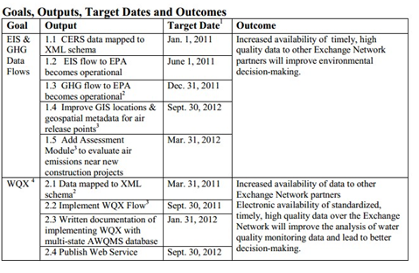
Successful Applications
Aligned with EN and FY 2018 SN priorities and associated services
Goals, outputs, and outcomes well organized and clearly described (Appendix F)
Budgets broken down by goal

Slide 15
Reusable Component Services Demo
How to meet this grant requirement:
Start of Grant: Search RCS for any existing project-appropriate resources/services and identify which they intend to use (Criterion 3.F)
Demo:
Fictitious Applicant: NY Department of Environmental Conservation
Project Narrative from Application Package: Develop a new Radon Test Result Data flow. Interest for Radon Mitigation data was indicated by several agencies, including CDC. NYDEC proposes drafting a schema definition and developing a new OpenNode2 plug-in, and sharing the schema with other interested states and/or EPA for continued development. Coordinate and mapping facility data will be included.
Key Words: Radon, Radon XML Schema, Facility Registry System (FRS)

Slide 16
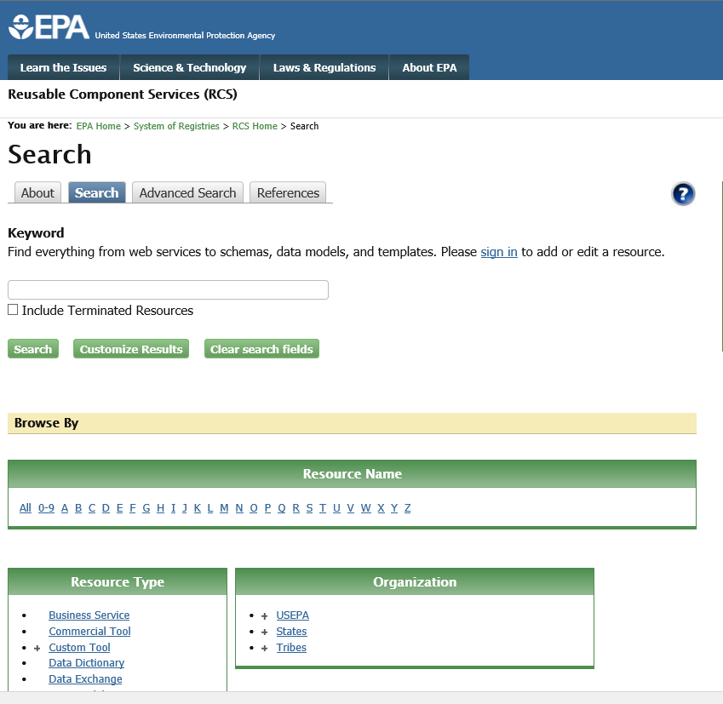
Reusable Component Services Demo
RCS Search Web page: http://www.epa.gov/rcs

Slide 17
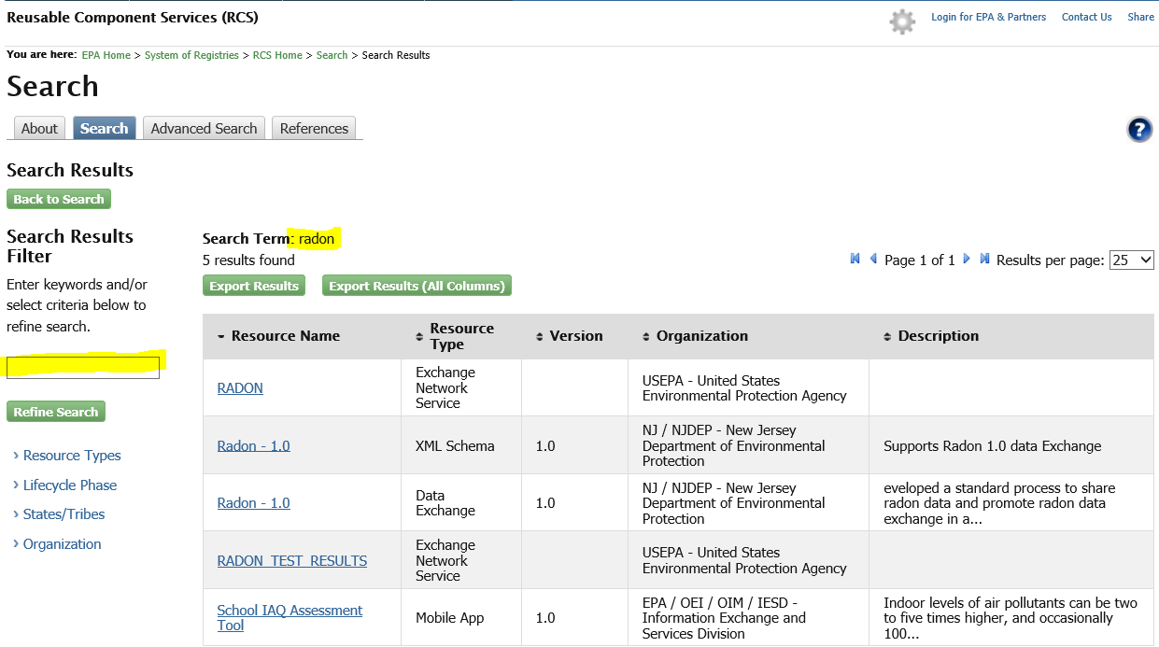
Reusable Component Services Demo
RCS Key Word: radon

Slide 18
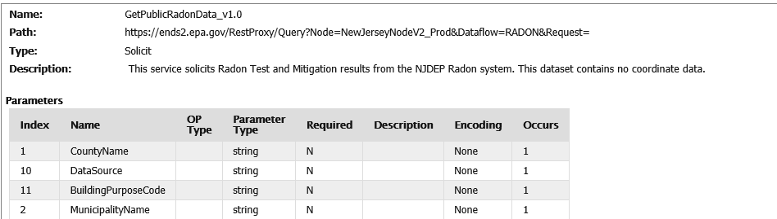
Reusable Component Services Demo
RCS Search results:

Slide 19
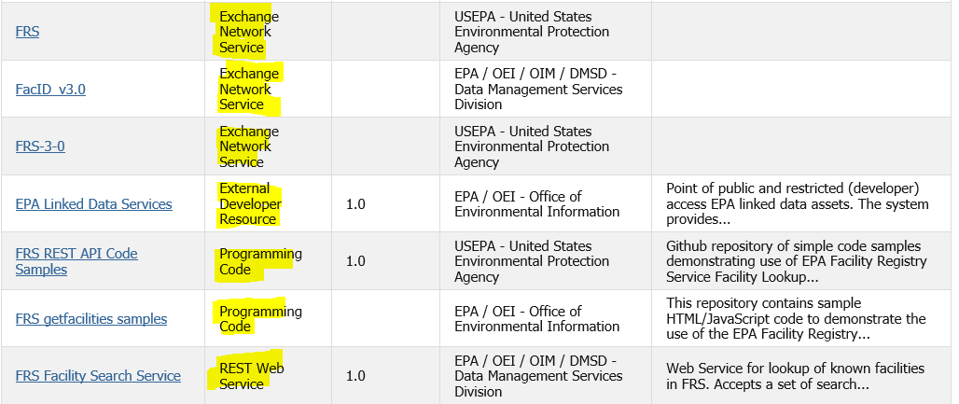
Reusable Component Services Demo
Key Words: Facility Registry System (FRS)
Key Resource Types:
Exchange Network Service: These are services that are currently available in CDX.
REST/SOAP Services: These are API that have been already developed by a grantee.
Programming Code: Source code to add specific API web services.

Slide 20
Questions? Contacts
Salena Reynolds
Exchange Network Grants Program Manager
reynolds.salena@epa.gov; 202-566-0466
Wendy Blake-Coleman
Chief, Information Exchange Partnership Branch
Blake-coleman.Wendy@epa.gov; 202-566-1709
Website: https://www.epa.gov/exchangenetwork/exchange-network-grant-program

