Slide 1
Collaboration with EPA - SharePoint
What is SharePoint
  Collaboration and Document Management Tool
    Central location for team documents and information by means of web portals
    Centralized repository for shared documents
  Cloud-based service
  Available through desktop or mobile devices
  Allows for simultaneous editing of a single document, saving previous versions and tracking updates.
Notes:
SharePoint is a collaborative tool which EPA uses for, not only internal projects, but also for projects which include participants from outside EPA such as state/local and tribal air agencies.
SharePoint is cloud based and allows for simultaneous editing of a single document.
This course will pertain to the Emission Inventory and Analysis Group’s NOMAD workgroup but could be used as a reference for other SharePoint collaborations.

Slide 2
Getting started
You must first setup a “Microsoft account”
Receive an invitation email
  Sent from owner of SharePoint site
  Click link contained in the email
  Do not attempt to login to SharePoint
If you have SharePoint where you work:
  Sign out of your SharePoint account from your browser
  In your browser cut and paste
    https://usepa.sharepoint.com/sites/oar_Work/NEI
    Click on link “Sign in with a Microsoft account” at the bottom
    Enter your Microsoft login and password
Book mark the SharePoint website!
Notes:
In order to gain access to an EPA workgroup SharePoint site, you will need to have established a Microsoft account.
Initially you will receive an invitation email from the SharePoint owner (EPA) with a link. You will not be able to use this SharePoint site without the link provided in this invitation. Select the link rather then logging into SharePoint.
If you agency uses SharePoint, make sure that you log out of your SharePoint, cut and paste the link above into your browser. Select “Sign in with a Microsoft account” at the bottom of the page and use your Microsoft login and password.
Once you have gained access to the SharePoint site make sure that you bookmark for easier access the next time you login.

Slide 3
What is a Microsoft Account?
A Microsoft Account is any login/password that you use to sign into Skype, Outlook, or OneDrive.
If you do not have a Microsoft account:
  In your browser go to https://login.live.com/ and select Create one!
Notes:
If you have a logon and password for Skype, Outlook, or One Drive, then you already have a Microsoft account.
If you do not, then you will need to create one at the link provided.

Slide 4
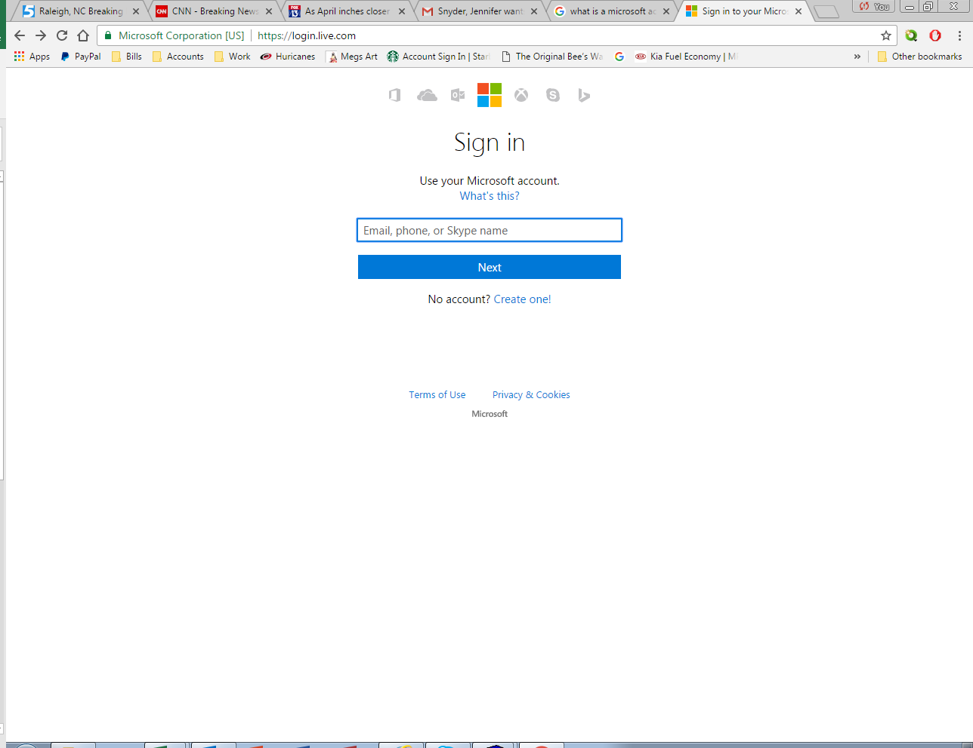
Microsoft – Don’t have an account?
Don’t have a Microsoft account?
https://login.live.com/
Notes:
Select “Create One”

Slide 5
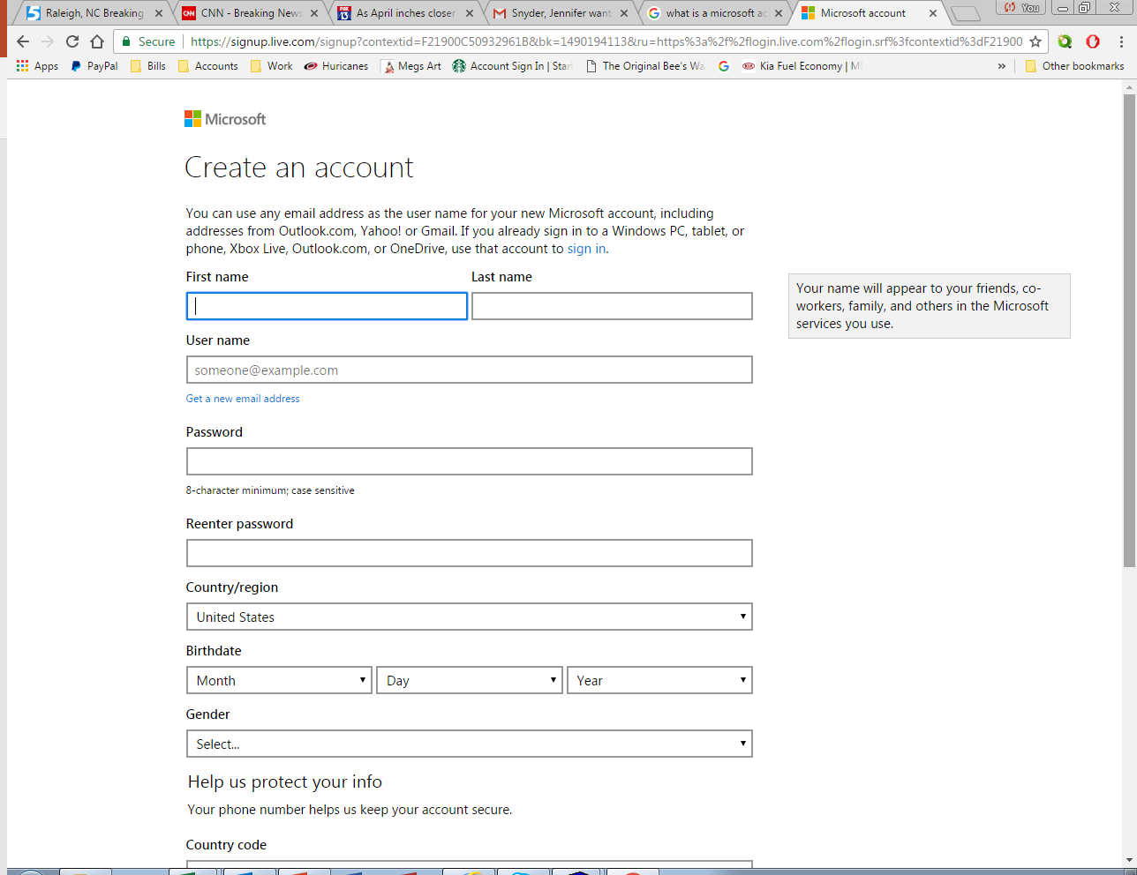
Microsoft – Create Account
Complete the form and select “Create Account” at the bottom of the page.

Slide 6
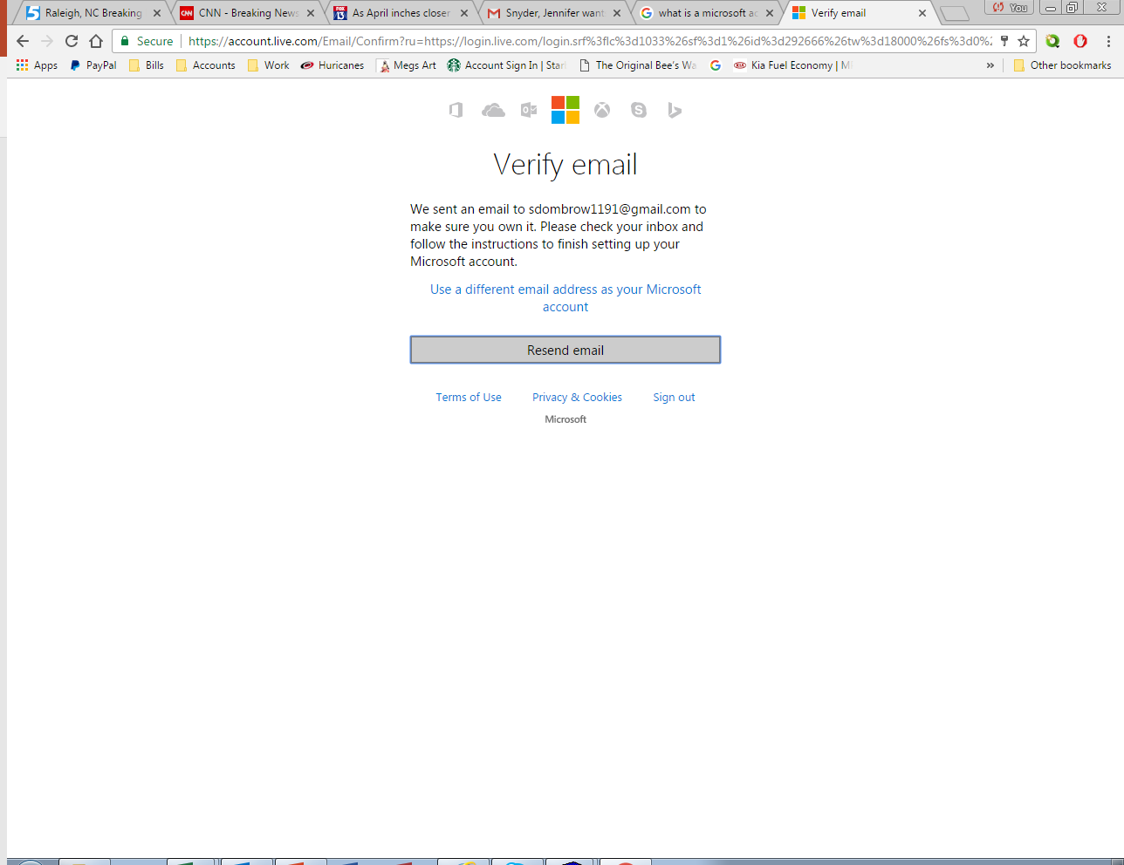
Microsoft - Verification of email notification
You will receive an
email with instructions
to verify your email.

Slide 7
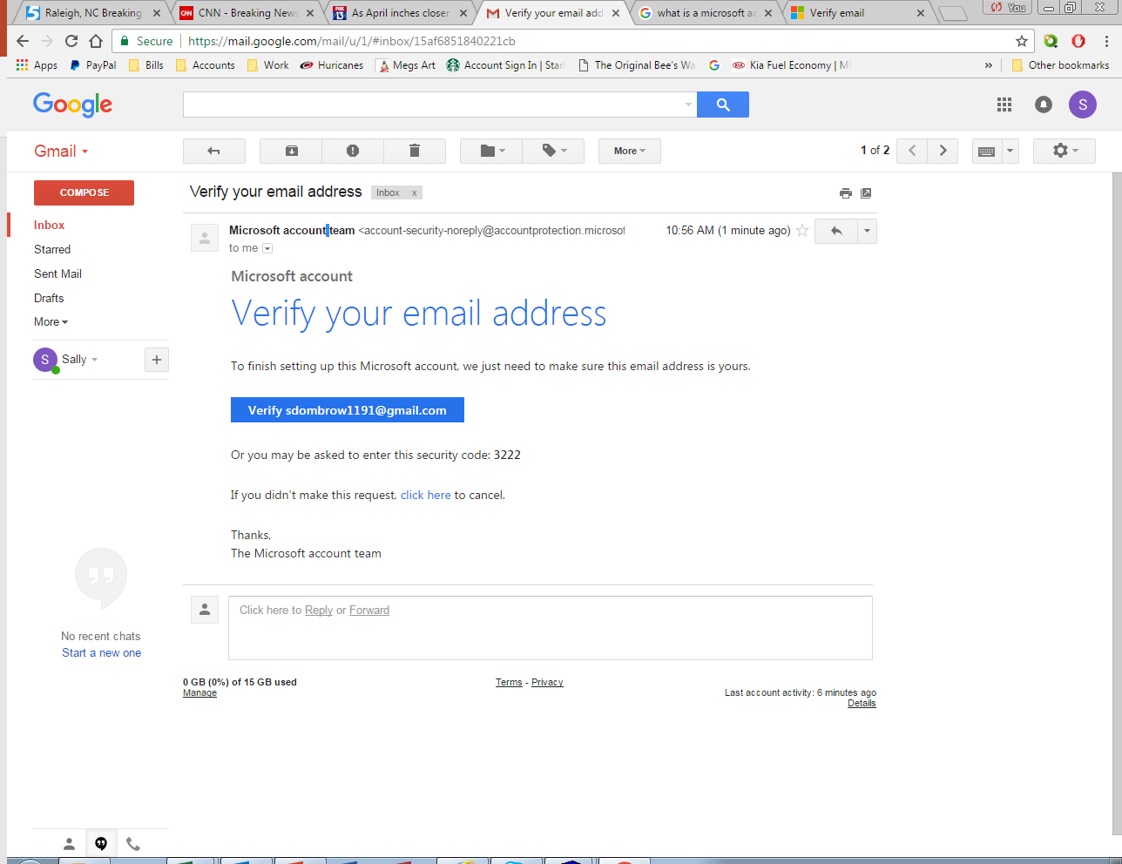
Microsoft – Verifying Your Email
Select link to verify.

Slide 8
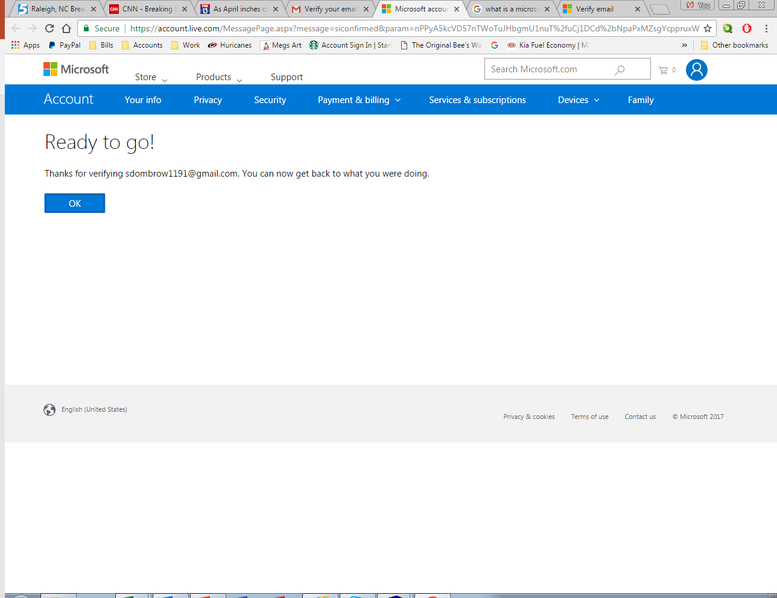
Microsoft – Email verification.
Select OK and return to the
original invitation email.

Slide 9
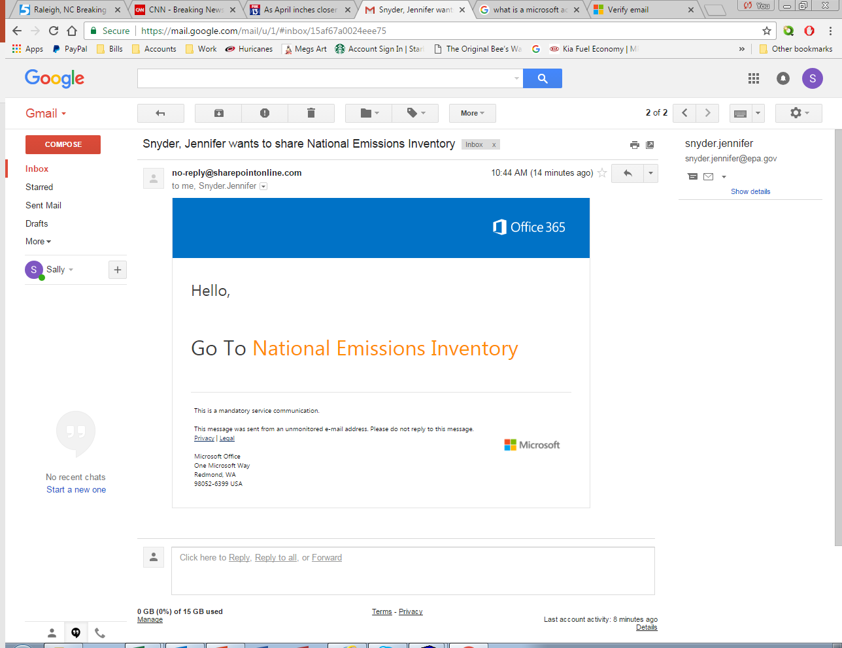
SharePoint Invitation
The invitation email.
Select the link provided
Notes:
This is an example of the invitation email which you will receive from the EPA SharePoint owner. Remember to use the link and not logon to SharePoint directly.

Slide 10
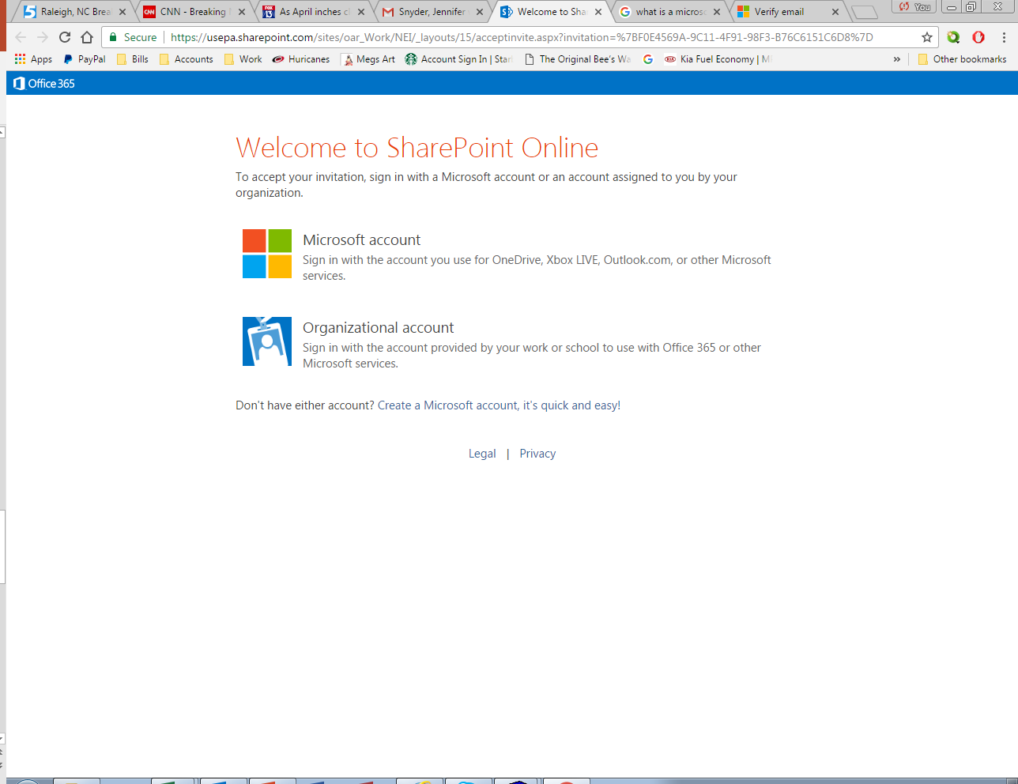
Welcome to SharePoint Online
Select Microsoft account.
Notes:
Sign in using your Microsoft account email and password.

Slide 11
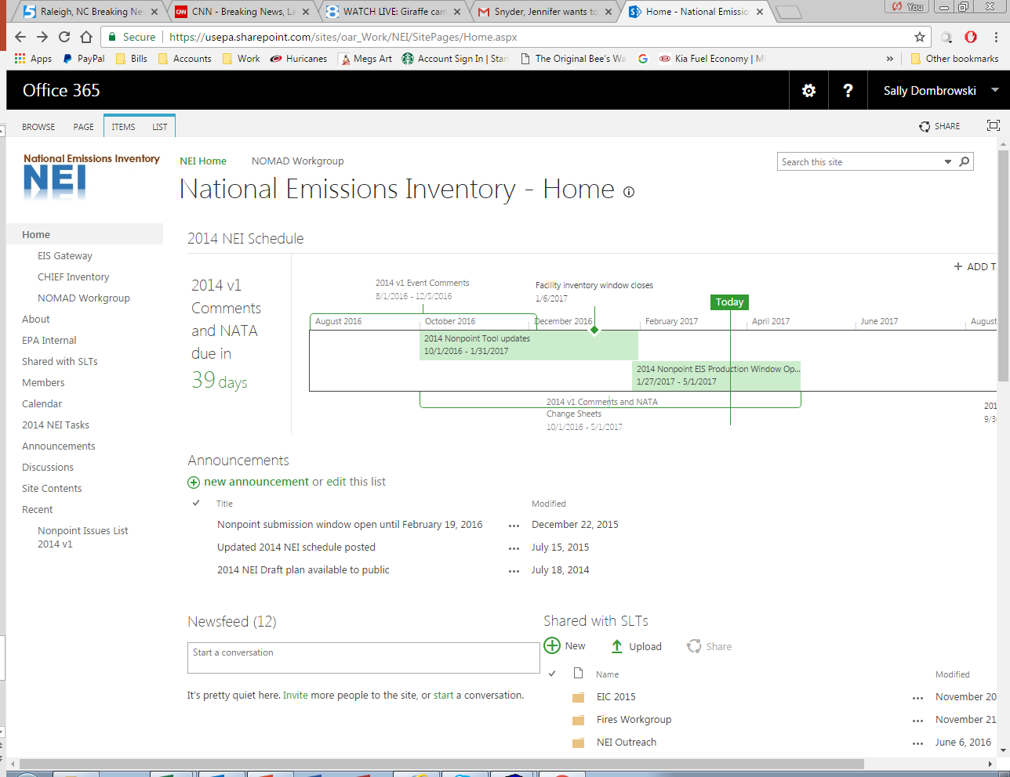
NEI SharePoint Site
Create a bookmark!
Notes:
Once you sign into SharePoint, you will land on the NEI SharePoint site. At this point remember to bookmark the site to make it easier to return in the future.

Slide 12
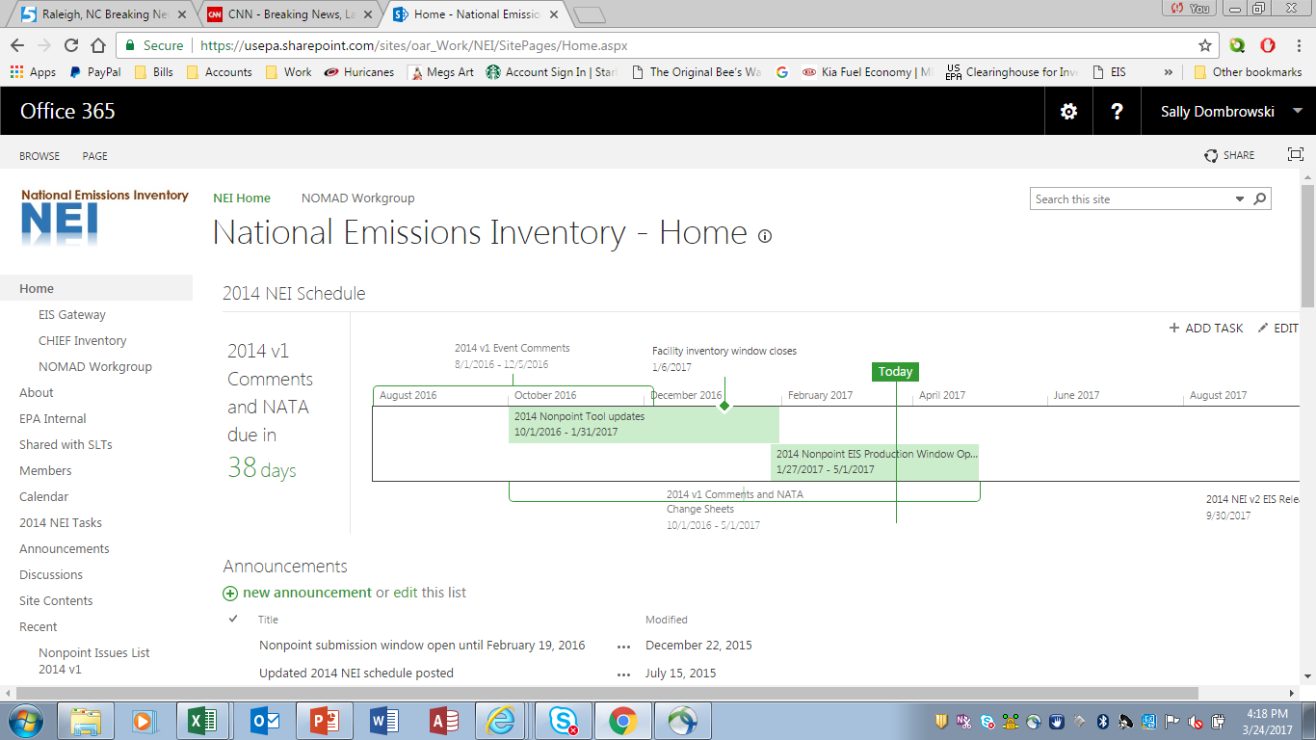
NEI Sharepoint – Schedule and Announcements
Notes:
Let’s look at what is on this site. At the top of the page is a schedule for any given project. In this example, the schedule is for the 2014 v1 and NATA comments.
Under the schedule will be announcements with regard to the NEI.

Slide 13
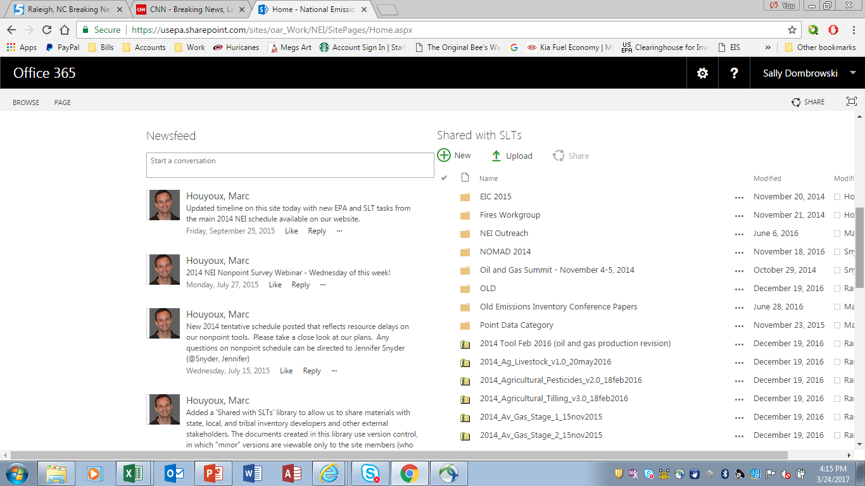
SharePoint – Newsfeed and Shared Files
Notes:
At the bottom of the site there is a Newsfeed which will display messages about changes to the site.
Also, there is a directory which contains files which are shared with state/local and tribal air agencies. We will get into how to use these files later in the course.

Slide 14
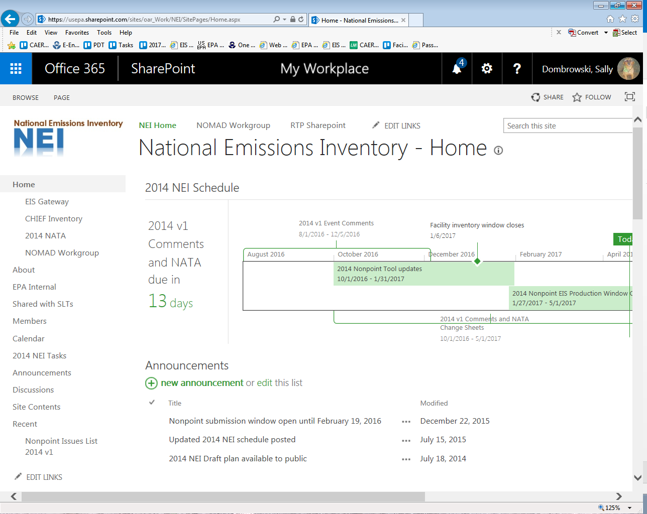
SharePoint – Schedule and Announcements
Notes:
Let’s go to the NOMAD Workgroup site by clicking on the link on the left hand sidebar.

Slide 15
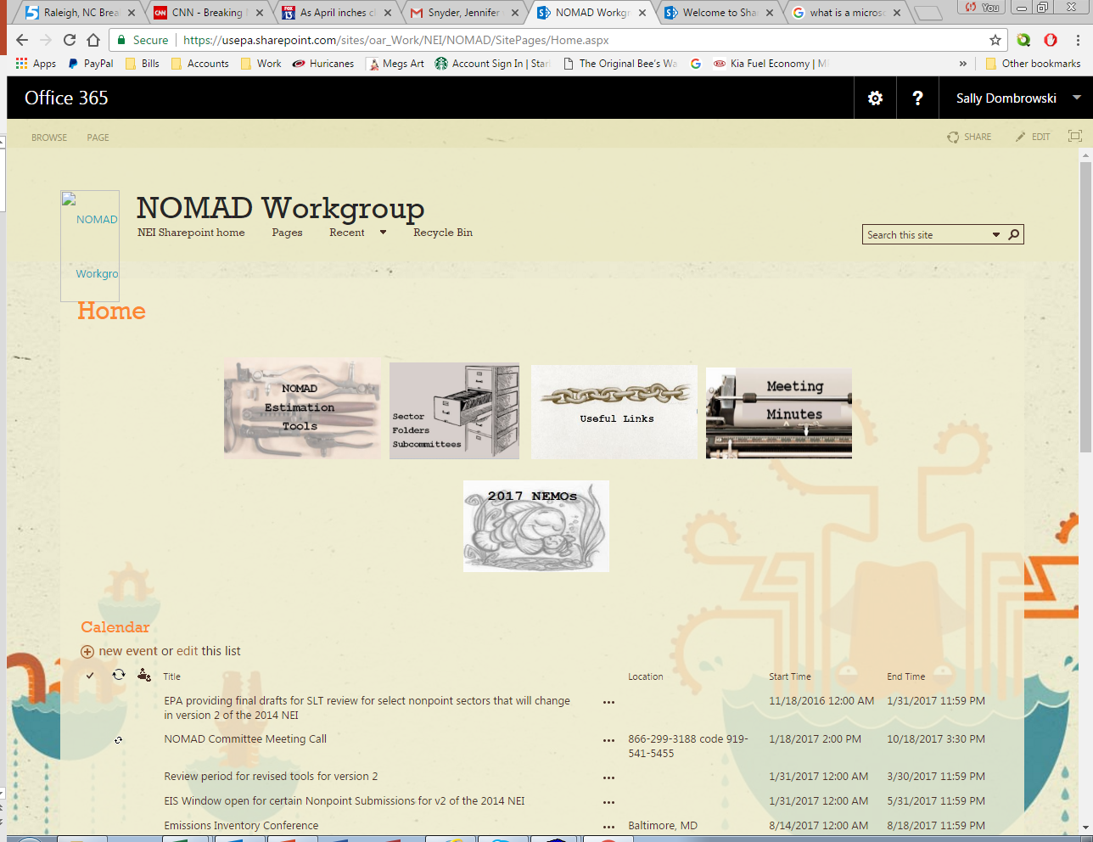
NOMAD SharePoint – Tools and Calendar
Notes:
The NOMAD site contains several links to additional information such as NOMAD estimation tools, documents from sector subcommittees, useful links, meeting minutes, the NEMOs and a Calendar of Events. NEMOs are the Nonpoint Emissions Methodology and Operation instructions.
Lets look at the NOMAD estimation tools.

Slide 16
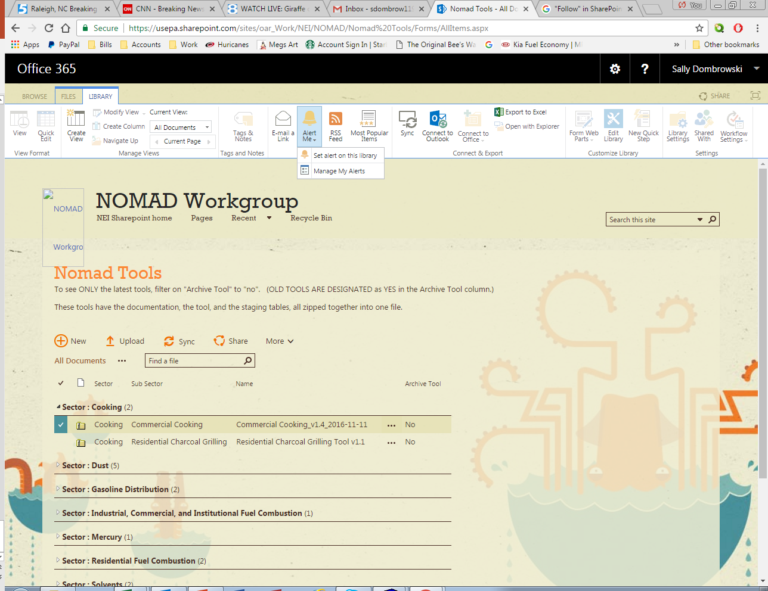
Nomad – Setting Alerts
Notes:
At the top of the page there will be three links, Browse, Files, Library. When these three links appear on the top of the page, you have the capability of setting an alert for this page. This alert will advise you when a document changes or is altered.
Select “Library”, then select “Set Alert on this Library”.

Slide 17
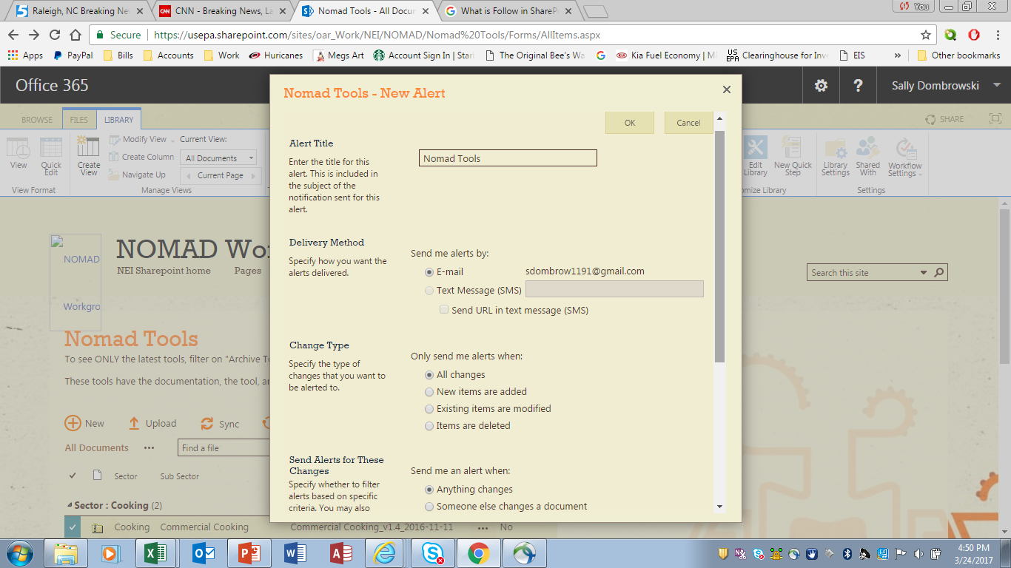
NOMAD – Setting Alert Preferrences
Notes:
Once you have selected “Set Alerts” you will get a menu to customize your alerts from the delivery method to only receiving notifications when new documents have been uploaded.

Slide 18
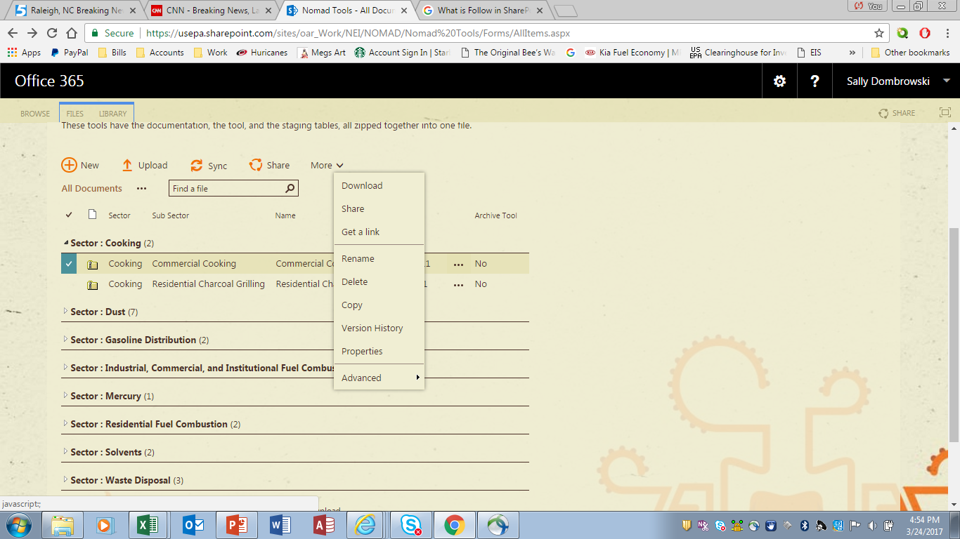
NOMAD – Document Download
Notes:
To download a specific tool or document, select the elliptical for options and select “Download”.

Slide 19
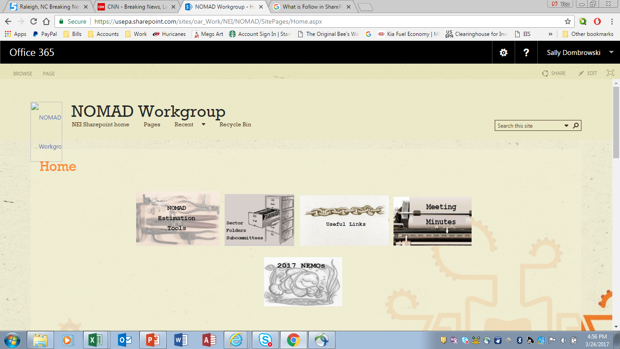
NOMAD – Sector Subcommittees
Notes:
Now let’s look at the Sector Folders.

Slide 20
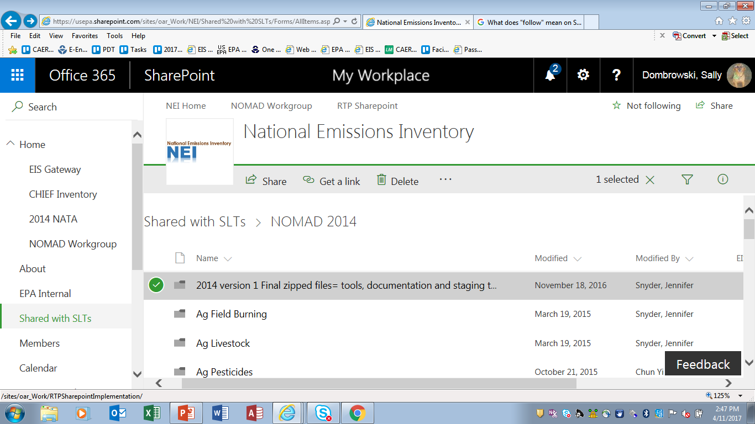
NOMAD – Following a document
Notes:
The first thing that you will notice is the Browse, File, Library selection is not available on this page. Instead there is a indicator to “Follow”. Following a document lets you: see updates in your newsfeed related to other's activities, such as editing or sharing the document.
A green arrow is displayed when you select a directory. Double click and the directory will open. You cannot download the full directory.

Slide 21
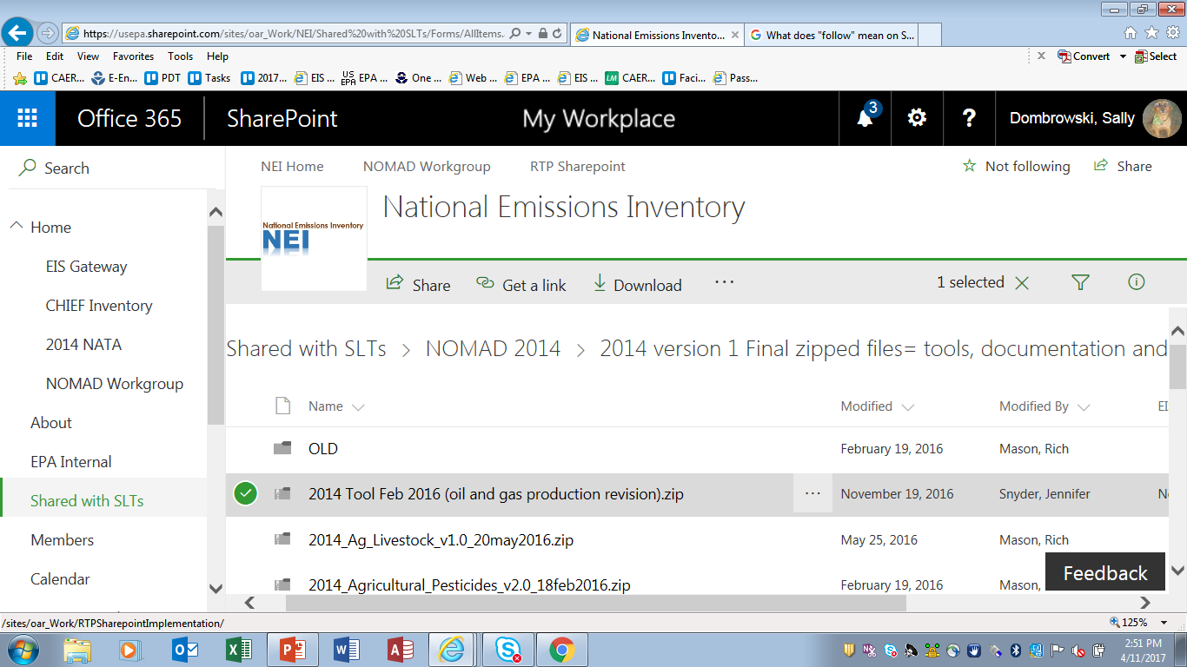
NOMAD – The Elliptical
Notes:
Again, if you want to download this document, select the elliptical and select “Download”.

Slide 22
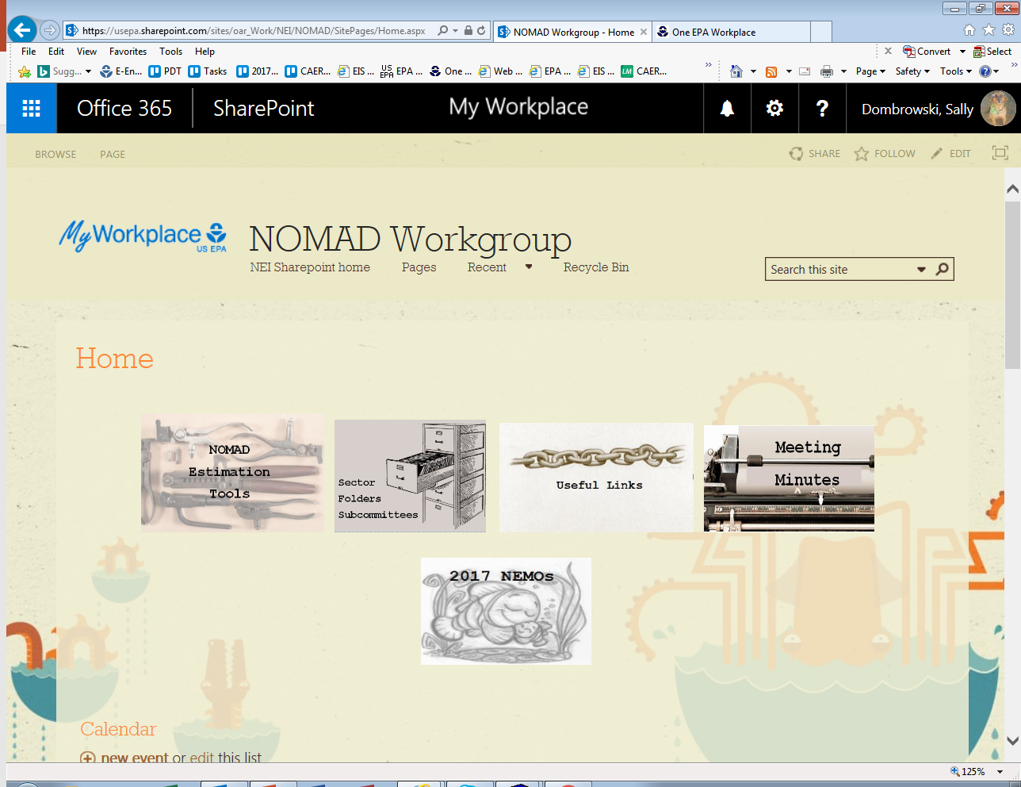
NOMAD – Useful Links
Notes:
Next let’s look at “Useful Links”.

Slide 23
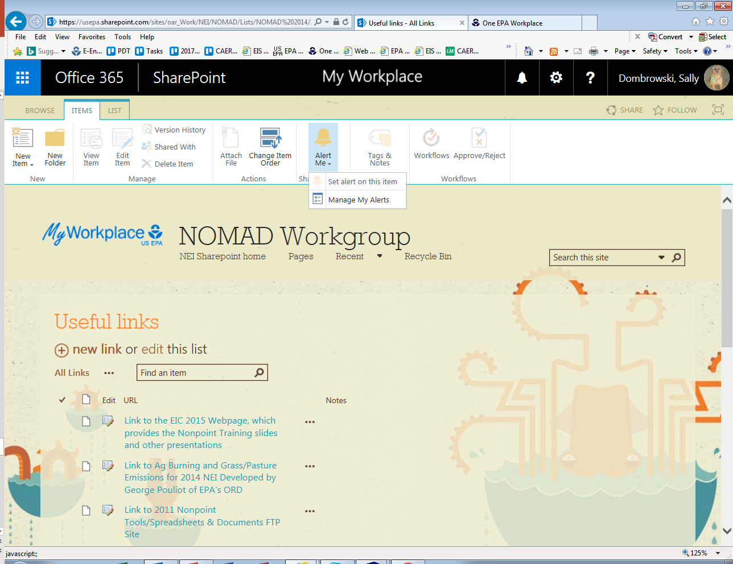
NOMAD – Useful links descriptions
Notes:
Each link has a short description.

Slide 24
NOMAD – Meeting Minutes
Notes:
Meeting Minutes are next.

Slide 25
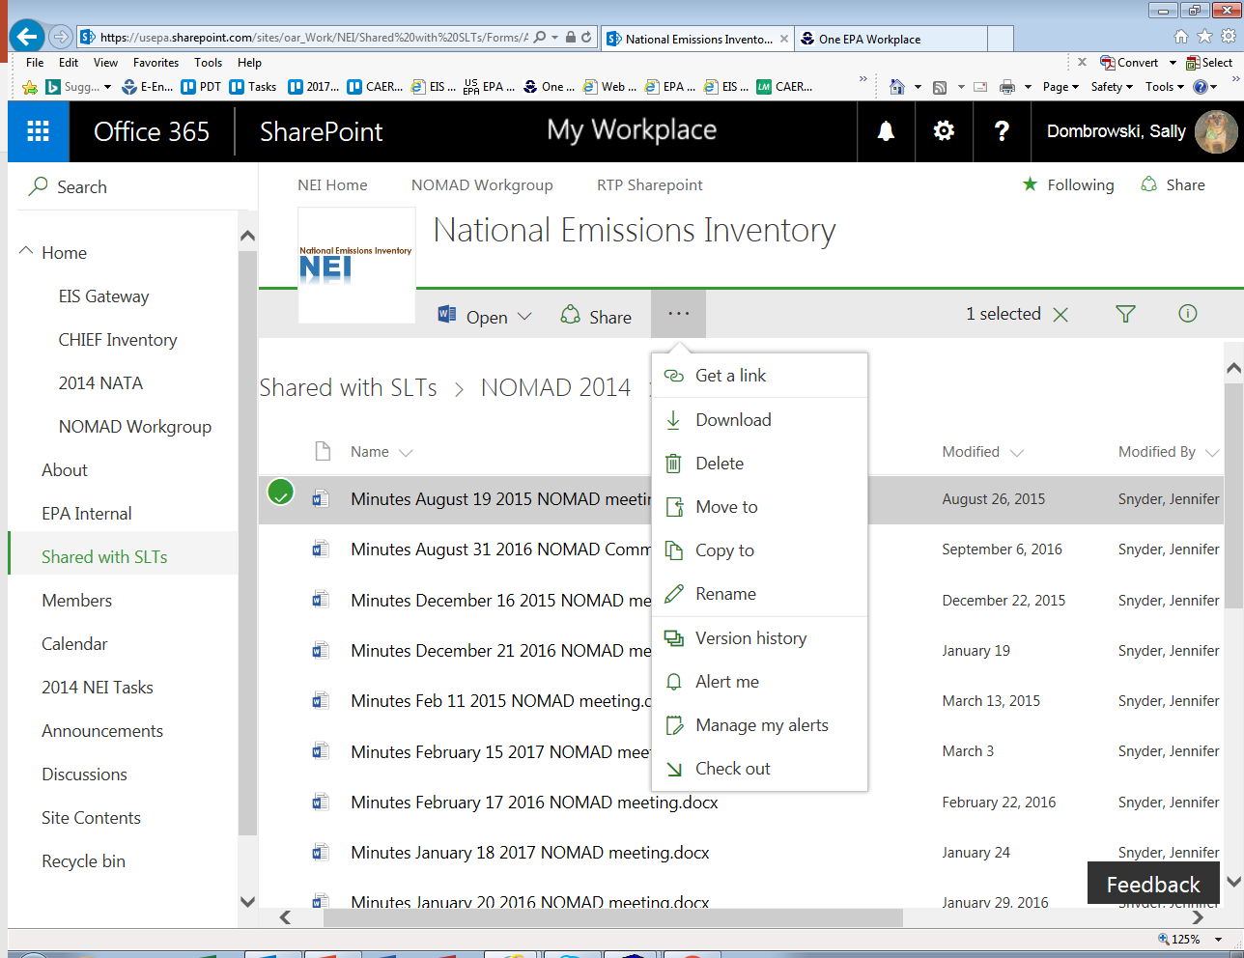
NOMAD – Meeting Minutes Download
Notes:
The meeting minutes from each of the past NOMAD meetings is available for download by selecting the elliptical.
If you just want to read the document, instead of download, click the document and it will open in Word Online.

Slide 26

NOMAD – National Emission Methodology and Operations (NEMOs)
Notes:
Next’s lets look at the 2017 National Emission Methodology and Operations instructions or NEMOs.

Slide 27
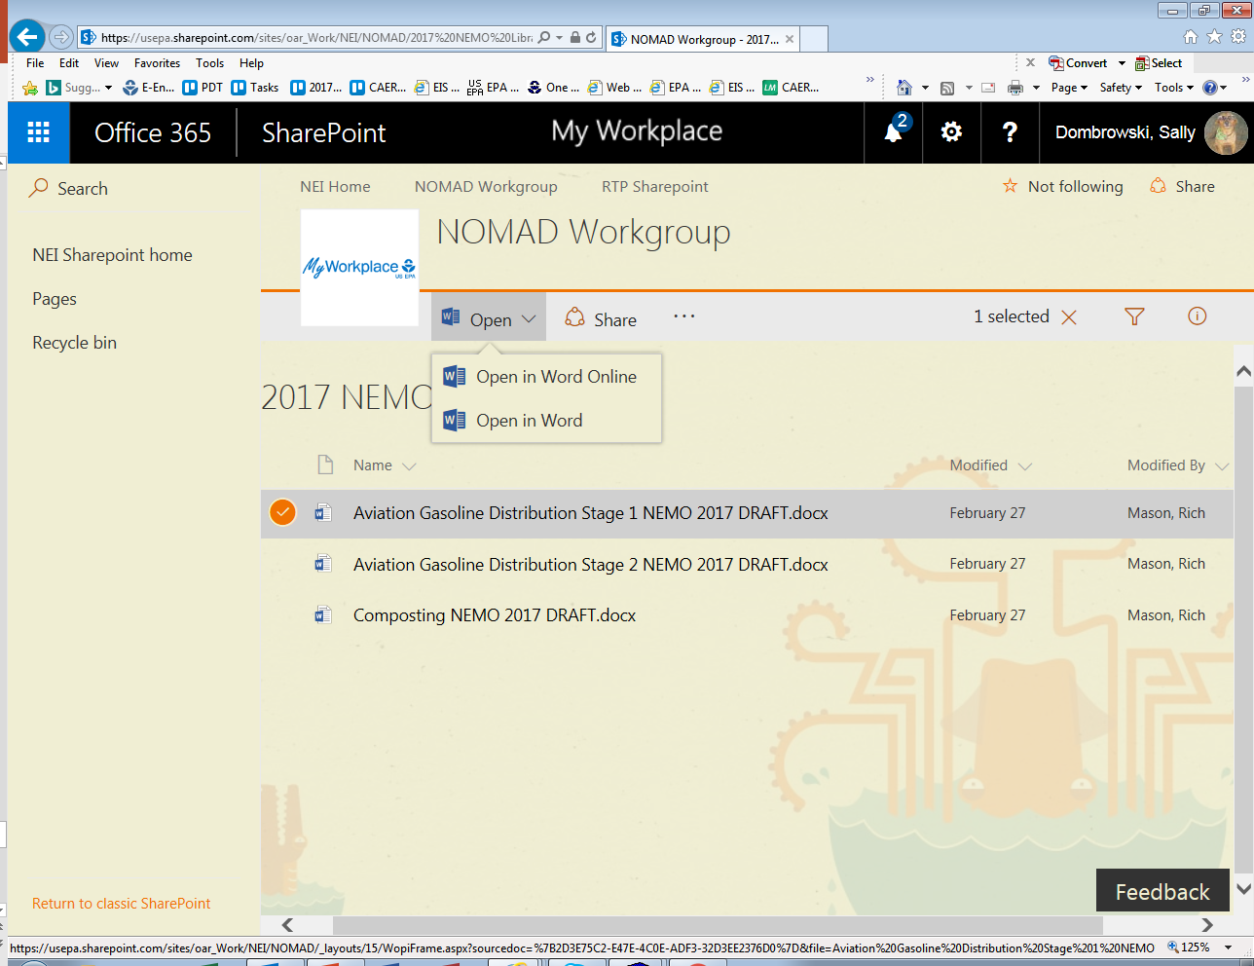
NOMAD – Document Comments
Notes:
Opening a document can be done in one of two ways.
Use the OPEN drop down which allows you to open a document in either WORD ONLINE or in your desktop version of WORD.
The second way to open the document is just to click the document. This will open the document in WORD ONLINE.

Slide 28
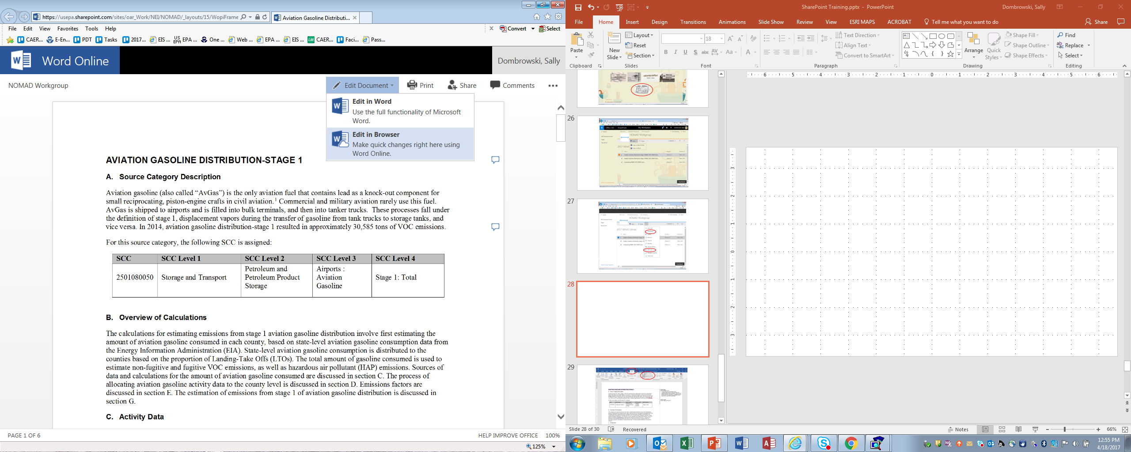
NOMAD – Open Document for Comment
Notes:
The document opens in WORD ONLINE. Select “Edit Document”. There are two options.
EDIT IN WORD – Recommended. This will open the document in your desktop WORD.
EDIT IN BROWSER – You can use this option for one or two comments but this method can be slow and may not work with your individual system.

Slide 29
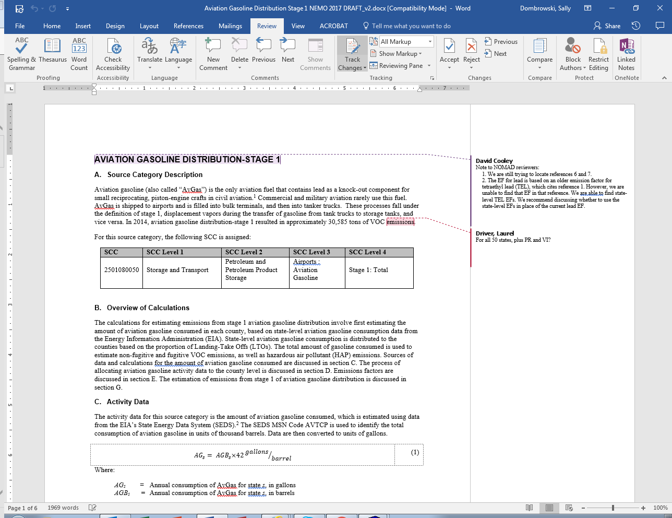
NOMAD – Track Changes and Save
Save
Notes:
We have selected the recommended option and opened the document in our desktop WORD.
Select “Review” and “Track Changes”. When you have completed your comments or edits select the “Save” icon. Once saved, you can close the document and your comments and edits will be captured in SharePoint.

Slide 30
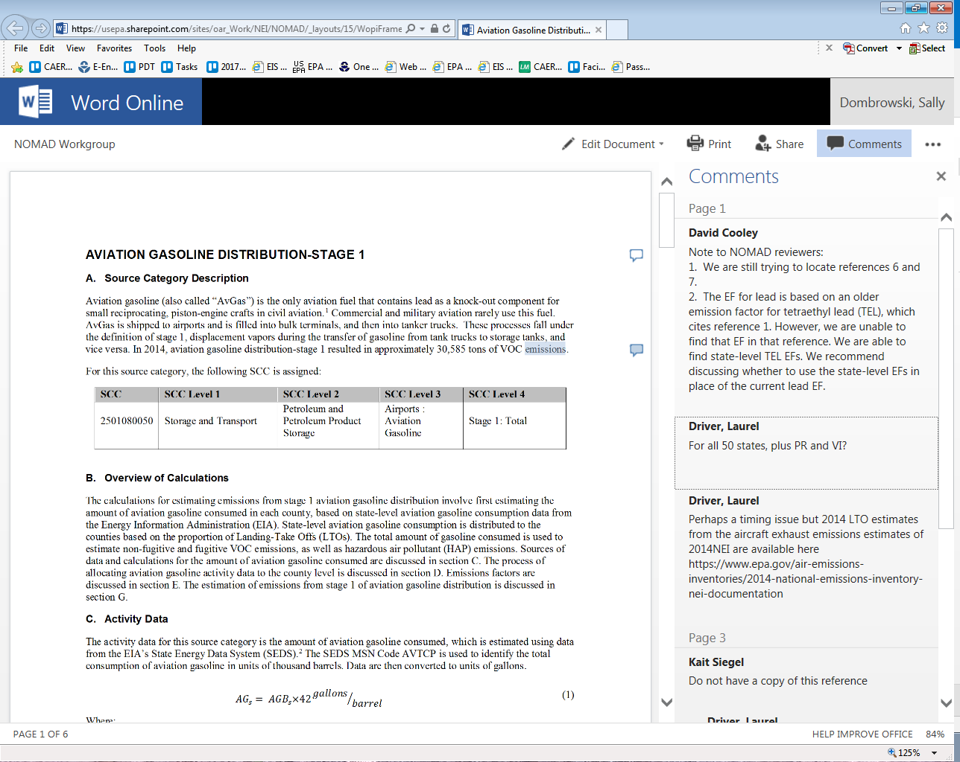
NOMAD – View document comments
Notes:
Once you have saved your comments/edits in WORD, you can return to SharePoint and select “Comments”. This will display comments/edits from all participants.

