Slide 1
Annual Air Monitoring Data Certification Webinar – March 28, 2019
Notes:
Welcome _ Annual Air Monitoring Data Certification webinar.
Intro - Stuart Gray, NADG/OID?OAQPS in RTP.
Phone rules – no place on hold
Questions – post in chat room/write down/ Q&A
Experts - Michael Brooks,(NADG) and Greg Noah, acting point of contact for QA, and Trish Curran from Region 6, both from (AAMG).
During the Q&A portion of the presentation I will unmute the webinar attendees and ask the conference line folks to unmute their lines.
Posting powerpoint to AQS webpage following webinar presentation with notes included.

Slide 2
Agenda
Who, What and Why of Certification
1
The 3 Step Process of Certification
2
Screen Shots and Questions
3
Notes:
Today’s agenda has only three parts. In the first part we’ll cover the Who, What and Why of Certification, followed by a breakdown of the process and finally some screen shots and answer some questions.

Slide 3
Data Certification
What is Data Certification?
1
Who certifies the data?
2
Why do you certify our data?
3
When do you certify our data?
4
How do you certify our data?
5
Notes:
Let’s talk about Data Certification, the What , Who, Why, When and How. Let’s answer those questions.

Slide 4
1.) What is Data Certification?
Formal statement attesting to ambient data completeness and accuracy
Submitted by certifying agencies to EPA on annual basis
Process that combines a required action by the PQAO followed by an EPA review and concurrence
Notes:
Let’s start with “What is Data Certification?”. Data Certification is a process where the certifying agencies certify their prior year’s air monitoring data to EPA.
This is required once a year.
If data “validation” has been thorough and is performed every quarter, data certification is a quick, easy process.
EPA does not “validate” the data submitted by the agency, that is the responsibility of the agency, EPA concurs on the data.

Slide 5
2.) Who certifies the data?
The State, or where appropriate the Local or Tribal agency, certifies their annual air monitoring data to the Regional Administrator
Notes:
As part of the process, the signature of the “certifying official” for the agency is required on the AMP600 report. This is submitted to the EPA Regional Administrator for concurrence.
It is recommended that whenever technically feasible, PQAOs be set up as “Certifying Agencies” because the PQAO is the person in charge of and responsible for the data.
Run the Monitor Description Report (AMP390) to check your monitors to ensure you have a “Certifying Agency” designated. Ideally you should designate a Certifying Official when you set up your monitor initially.
Primary Quality Assurance Organization (PQAO) – a monitoring organization or a group of monitoring organizations is a “State, local or other monitoring organization (i.e., tribes) responsible for operating a monitoring site for which quality assurance regulations apply”.

Slide 6
3.) Why do you certify your data?
§ 58.15 Annual air monitoring data certification.
(a) The State, or where appropriate local, agency shall submit to the EPA Regional Administrator an annual air monitoring data certification letter to certify data collected by FRM, FEM, and ARM monitors at SLAMS and SPM sites that meet criteria in appendix A to this part from January 1 to December 31 of the previous year. ... The annual data certification letter is due by May 1 of each year.“
(b) Along with each certification letter, the state shall submit to the Regional Administrator an annual summary report of all the ambient air quality data collected by FRM, FEM, and ARM monitors at SLAMS and SPM sites. …”
(c) Along with each certification letter, the State shall submit to the Regional Administrator a summary of the precision and accuracy data for all ambient air quality data collected by FRM, FEM, and ARM monitors at SLAMS and SPM sites. …”
Notes:
Why do we certify?
Because the regs require you to certify. The regs require you to conduct and complete ambient air quality monitoring and QA as per 40 CFR Part 58 and certify and submit all relevant data to AQS.

Slide 7
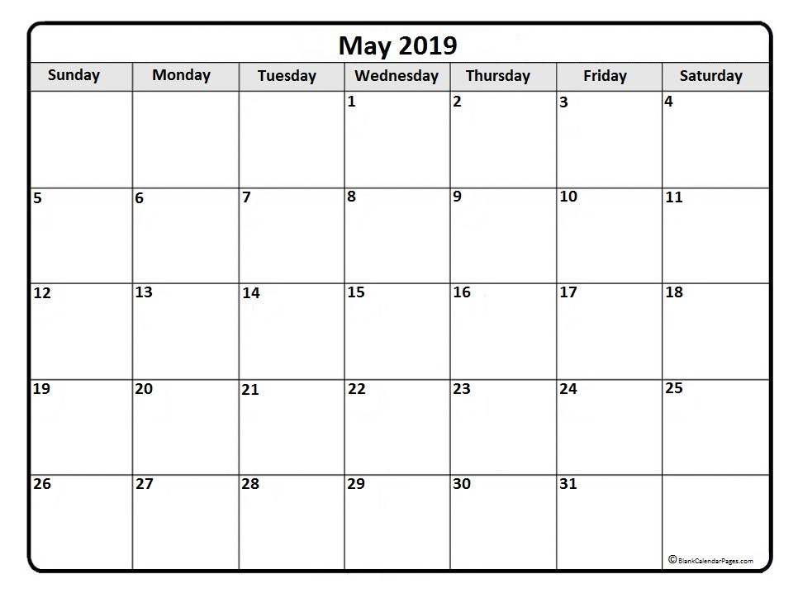
4.) When - do - you - certify?
When do you certify your data?
Certification and submittal of annual air monitoring data are due by May 1st of the following year.
Notes:
All the air monitoring data collected from Jan 1, 2018 thru Dec 31, 2018 would need to be submitted and certified by May 1, 2019. This data should be loaded (submitted) quarterly at a minimum and checked and validated quarterly as well.
(User has 180 days from the end of the quarter to submit quarterly data.)

Slide 8
5.) How do you certify?
Log into AQS and run the AMP600 report
Ensure the information is complete and correct, if not make corrections and rerun
Print out the report
Have the PQAO official or delegated official sign where indicated and submit to EPA Regional Administrator for concurrence before May 1, 2019.
Notes:
How do we certify? The basics…
The first item is logging in and running the AMP600 report aka the Certification, Evaluation and Concurrence Report. You must do this first because you will use the report to review your data for correctness and completeness. You should be doing this quarterly at a minimum and checking and validating data
Checking your information and if all is in order, you want to print out the report and have the certifying official sign and submit the form/letter to the EPA Regional Administrator for concurrence. (Next slide)

Slide 9
Certification involves submitting the following…
- a signed certification letter,
- a signed AMP600 -Data Evaluation and Concurrence Report Summary, (This report includes an annual summary report of all the collected ambient air quality data and a summary of the precision and accuracy (QA) data.
- an AMP450NC for 5-min SO₂ data.
- and, if applicable, an AMP450NC for PM10- 2.5 data (NCore),
This should not be the time when an agency is “validating” their data in AQS.
Notes:
This is a list of the submittals that should be sent to the Regional Administrator for concurrence.
Let’s look at some of the resources available to help you through the process…

Slide 10
Resource: Data Certification Information On AMTIC (Ambient Monitoring Technology Information Center)
Notes:
The Ambient Monitoring Technology Information Center (AMTIC) website provides additional information on data certification. On the website under Quality Assurance, click on the link………..(Can be found by googling US EPA AMTIC or using link on AQS webpage(future))

Slide 11
Resource: Data Certification Information On AMTIC (Ambient Monitoring Technology Information Center)
The AMTIC website for data certification and Validation is located at https://www3.epa.gov/ttn/amtic/qacert.html
Notes:
The webpage includes these three links,
1.) Frequently asked questions,
2.) a list of Data Certification Flag values and
3.) the Additional Guidance on the Data Certification Process for Calendar Year 2018 Data,
I’d recommend users go to the “Ambient Air Monitoring Data Certification” link and review the list of questions on there.
Also, if you have any questions on the flag values, the second link, Data Cert Flag values will take you to this….

Slide 12
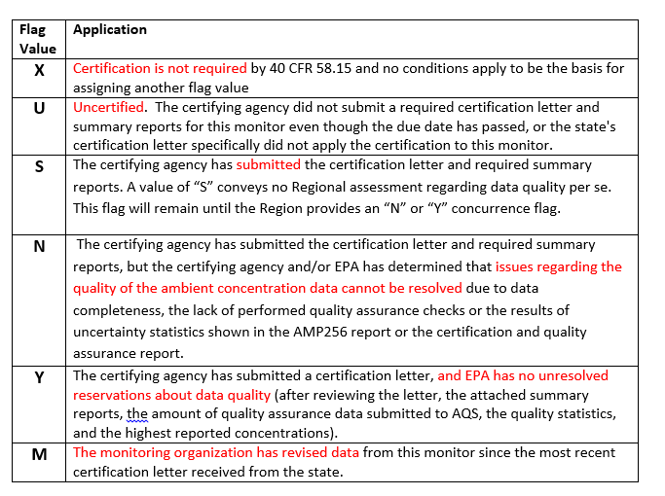
Resource: Data Certification Flags Values
Notes:
…where you will see this chart. The chart identifies the different flag values used on the AMP600 report. The flag values you will most usually see, the Y or N flags, (red arrows) are used to indicate AQS and EPA recommendation on whether or not to accept (concur on) the data certification.

Slide 13
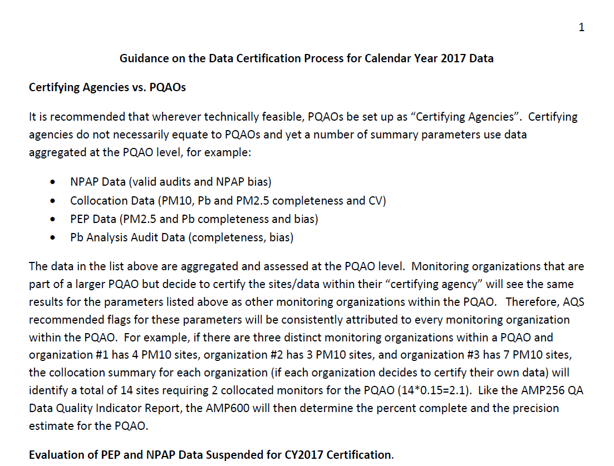
Resource: Annual Guidance on Data Certification Process
Notes:
Clicking on the third link will bring you to the “Additional Guidance Related to the 2017 AMP600 Data Certification Process” document found on the AMTIC website. The document provides updated guidance on the Data Certification Process and identifies any changes made since last year. It also explains how QA and completeness data are evaluated to determine if AQS recommends flags for monitors for (‘Y’) or against (‘N’) concurrence.

Slide 14
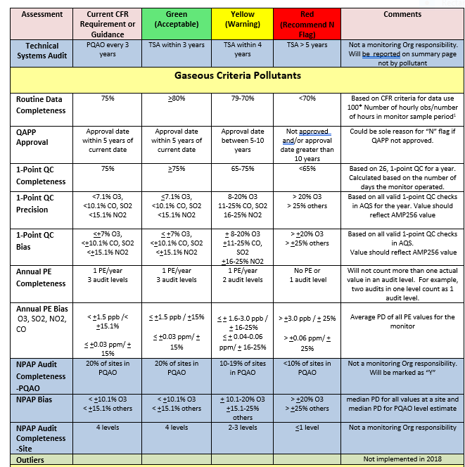
Resource: Criteria that Generate Green (Acceptable) Warning (Yellow) and “N” Qualifiers (Red)
Check guidance
annually
for changes
Notes:
This color coded table is found in the “Additional Guidance Related to the 2018 AMP600 Data Certification Process” document found on the AMTIC website. The table describes the flags and how they relate to each category in more detail.

Slide 15
Data Certification Process
Step 1: Run Reports
Step 2: Verify and Correct Data
Step 3: Data Certification
Notes:
This is a flow chart of the certification process. Three very simple steps.

Slide 16
Step 1: Run Reports
Run the Certification Evaluation and Concurrence Report (AMP600) - This will calculate a recommended certification flag for each monitor-year based Part 58 criteria, and will display the results for all monitors and PQAOs associated with the Certifying Agency.
Run the AQS Monitor Description Report (AMP390) – This will show all Agency Roles for each monitor. Need to ensure there is an assigned Certifying Agency role designated for each monitor and compare against Monitoring Network Plan. Use AQS (Batch MD transaction or Maintain>Monitor) to correct any discrepancies.
Run the QA Data Quality Indicator Report (AMP256) – This will give you a more detailed look at the QA data. Use the guidance document to check QA. Use guidance doc to check QA.
Notes:
We’ve broken it down into 3 steps. In Step 1…
First, run the AMP600 , aka “Certification Evaluation and Concurrence Report”. You should be checking looking at this report and considering how to change any red flags or sometimes yellow flags into green flags.
Second, it’s a good idea to run an AMP390, aka “AQS Monitor Description Report” and compare it to your monitoring network plan. You should check the agency role on each of your monitors to ensure that you have a “Certifying Agency Role” designated for each of your monitors, that the information is correct, and make any necessary corrections.
Third, it is also a good idea to run an AMP256 aka “QA Data Quality Indicator Report” to ensure the data you are collecting meets the minimum QA requirements. There is more QA detail on the QA Data Quality Indicator report than the AMP600.
The AMP600 report gives you some data points for completeness and QA, but these other two reports give you more detailed information.
We recommend running each of these reports on a quarterly basis to ensure no surprises in the final AMP600 report.
You should think of certification like doing your taxes. They recommend you don’t wait until the last minute to file, same goes here. This should be a lot less painful than doing your taxes, so we recommend not waiting until the end to check your data.
Let’s look at how to run an AMP600….

Slide 17
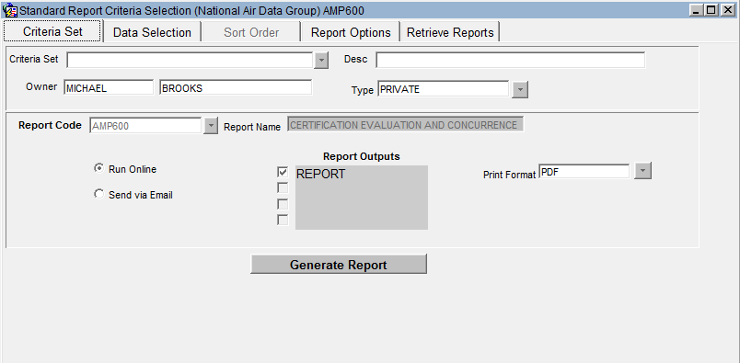
Requesting an AMP600 or Certification Evaluation and Concurrence Report
Notes:
This is a screen shot from AQS. To run the AMP600 or Certification Evaluation and Concurrence Report, log into AQS, go to Retrieval>Standard Report Selection from the LOV, and you0’ll get this screen. On the Criteria Set tab (purple arrow), from the LOV in the Report Code field, choose AMP600 (red ellipse), then click on the second tab labeled Data Selection (orange arrow) which will take you to this page…

Slide 18
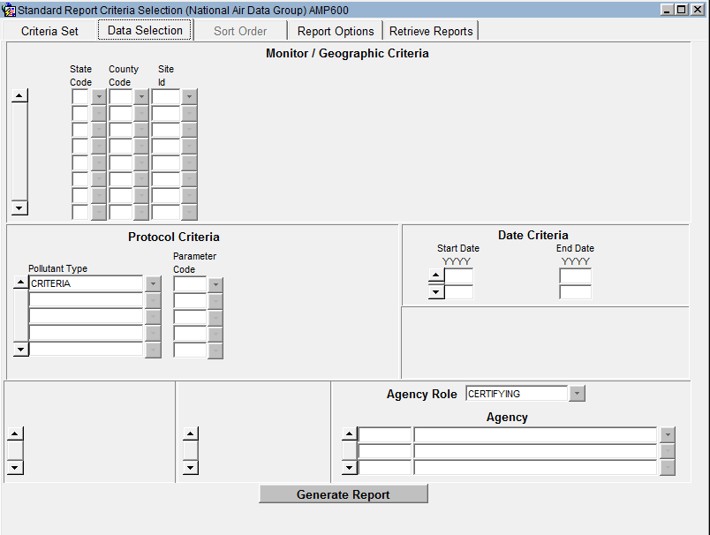
Request Criteria
Notes:
…on this screen, at a minimum, in the “Protocol Criteria” block under “Pollutant type”, from the LOV choose Criteria, place a Start and End Date in the “Date Criteria” block, and an Agency Code and the Agency Name in the “Agency Role” block. (You will not need any Site ID information because we are talking about all the data submitted by the agency) Then click the Generate Report button (lower red ellipse).

Slide 19
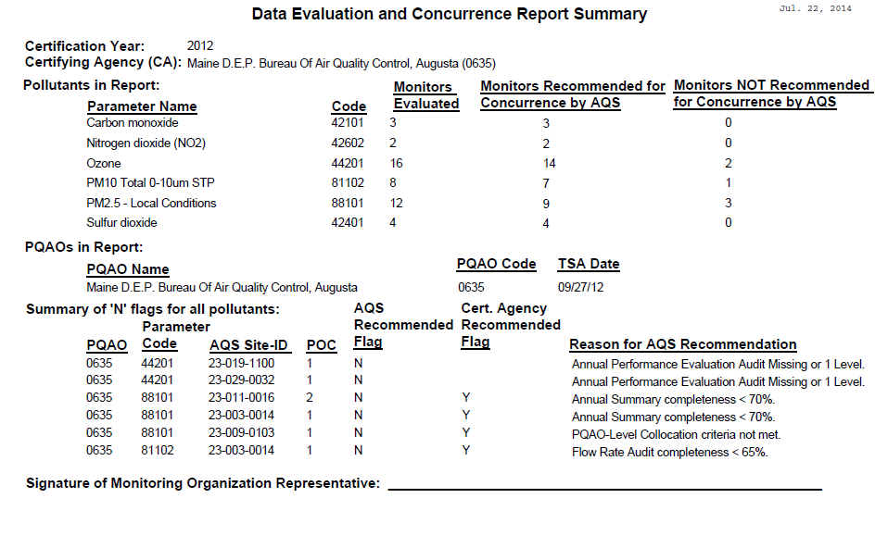
AMP600 Summary Report
Before Certifying Agency Certification
Notes:
The AMP600 has 3 pieces:
cover page,
summary page,
detailed pages of monitor information.
This is an example of the summary page of an AMP600 – Certification Report. It shows a count of the number of monitors that AQS recommends for or against concurrence by pollutant, and it shows all the monitors where AQS recommends against concurrence, indicated by an “N” and the reason.
This allows the user to review their data and make needed corrections prior to certifying. You will notice a summary of all the monitors “not recommended for Concurrence by AQS” that have been flagged with an “N” listed at the bottom of the form with the reason for the AQS recommendation.

Slide 20
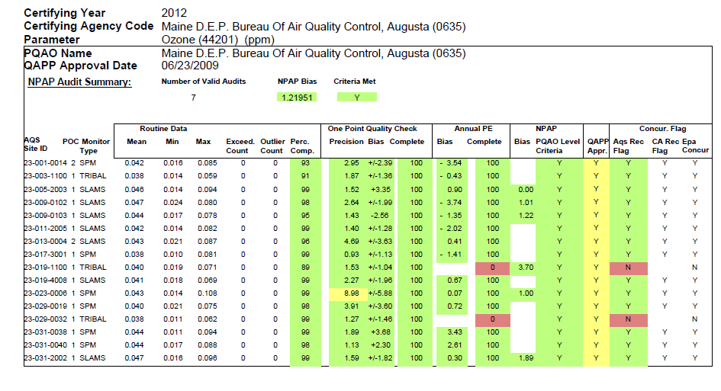
AMP600- Ozone
Before Certification
No
v
alues
Notes:
Following the “summary” pages are the “detail” pages that provide the details on each monitor by parameter.
This is one of the “detail” pages for Ozone, where you can see the statistics that are evaluated for each monitor, along with the classification (Green, Yellow, or Red qualifiers) for each statistic, and the monitor as a whole.
For a monitor, AQS recommends against concurrence if any statistic is Red, or if there are three or more Yellow statistics. If everything is green you are good to go, if not, you need to review those “not green” and make any necessary changes

Slide 21
Step 2: Data Review and Correction
Review the AMP600 report. For ‘N’ recommendations of Flags:
Has any ambient monitoring data not yet been submitted?
Has any QA/QC data (QA transactions) not been submitted?
Should any ambient monitoring data be invalidated and removed from AQS based on QA/QC results?
-To make changes to the AQS recommended flags on the AMP600 Report, use the AQS Certification Form to accept or override the AQS recommended value (flag).
-Running AMP256 and AMP390 will give you more detail on the data.
Notes:
Step 2 of the process is to review all the data and make necessary corrections.
This task will be simplified by running these reports quarterly and reviewing and correcting the data each quarter. You will want to make sure that all your air quality monitoring and QA data have been submitted to AQS.
Running the AMP600 Report will calculate a recommended certification flag for each monitor-year based on Part 58 criteria and display the results for all monitors and PQAOs associated with the Certifying Agency.

Slide 22
Use the Certification Form
Notes:
For the few anomalies that the agency has before certification, they should use this form to recommend a different “flag value”, and add their comments explaining why they believe a change is warranted. Following that, the region will recommend a value and presumably make a comment as well.
Here’s how you get to the Certification Form, log into AQS and use the Certification Form,(red circle) clicking on that will bring you to the next screen….

Slide 23
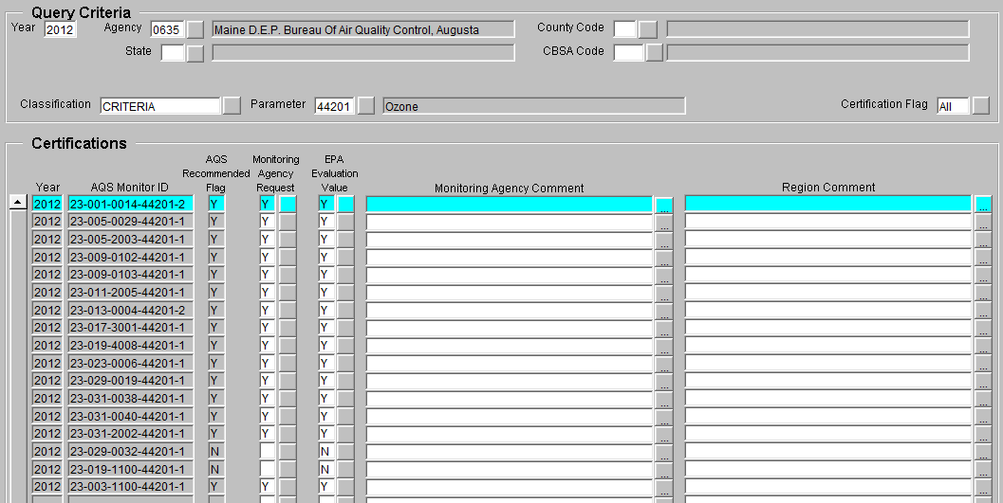
Certification Form for
Certifying Agency
If certifying this data, the Region will not concur without a Certifying Agency comment
Notes:
…here is where the certifying agency can recommend a flag different from the flag that AQS recommended.
The agency must provide a comment to justify their own recommendation.
As an example, if the AQS Recommended flag was N, the Agency could recommend a Y and provide their reason, (i.e., forest fire) If the certifying agency provides a comment, EPA will review and may or may not provide a comment as well. Where the certifying agency does not supply a recommended flag in the Monitoring Agency Request column, EPA will assume that the certifying agency did not wish to certify the data from those particular monitors where the field was left blank and will not concur on those monitors, the EPA Evaluation Value field will be left blank or may enter a U flag indicating the monitoring/certifying agency did not submit a certification for this monitor's data. Once a monitoring agency enters a flag it will trigger the EPA Evaluation Value to become an "S" to indicate that the certifying agency has submitted certification but EPA has not finalized their assessment.
Remember to hit SAVE after making any changes.
On July 1st a script will be run and it will change the Monitoring Agency Request from blank to “U” meaning EPA did not receive a certification for those monitor's data.

Slide 24
Step 3: Data Certification
Rerun certification report (AMP600) and verify results are final
Sign cover letter and AMP600, and submit along with other documentation
Note: Additional detail about QA statistical values can be obtained by running the QA Data Quality Indicator Report (AMP256)
Notes:
In the previous steps of the process:
(Step 1) you’ve run all three reports, the AMP600, the AMP256, and the AMP390,
(Step 2) you’ve made corrections to the data and used the Certification Form to make changes to the recommended flags, trying to turn all red flags into green ones, and now you’re ready to certify.
For Step 3, to certify, rerun the AMP 600, review and verify, then sign cover letter and AMP 600 report and submit along with other documentation mentioned earlier. (See slide 9)
(An example of an anomaly is if the monitor was down for a period of time and the agency had spoken with the region who determined the data would count. If they receive an “n” flag value on the AMP600 report, you should be going in and correcting any related data.) (The AMP600 must be run before this report because it is the values in the AMP600 report that populates these fields.) Once the report is run, the agency should review the certification report (AMP600). Note: When making changes to the form or adding information to the form remember to save any changes.

Slide 25
AMP600 Summary
After Certifying Agency Certification
Notes:
On this slide we’ve pulled up an AMP600 report, this is the summary section of the report. You’ll notice on the bottom of the screen (gold box) where the Certifying Agency did not request or indicate a flag value.

Slide 26
AMP600
After Certifying Agency Certification
Notes:
Again this is one of the detail pages from an AMP600 report. The page displays records where the Certifying Agency did not request a value. (gold box) Again, where they did not recommend a flag, EPA is assuming the Certifying Agency did not wish to certify the data from those monitors.

Slide 27
AMP600
After EPA Regional Concurrence
27
Notes:
This slide displays a detail page from an AMP600 report before July 1st, after EPA has placed an ‘N’ value in the EPA Concur field. If the AQS Recommended Flag is an “N” and the Certifying Agency does not record a flag value, and if EPA places an “N” in the EPA Concur column, it means the data from that monitor does not meet the completeness or QA requirements needed.

Slide 28
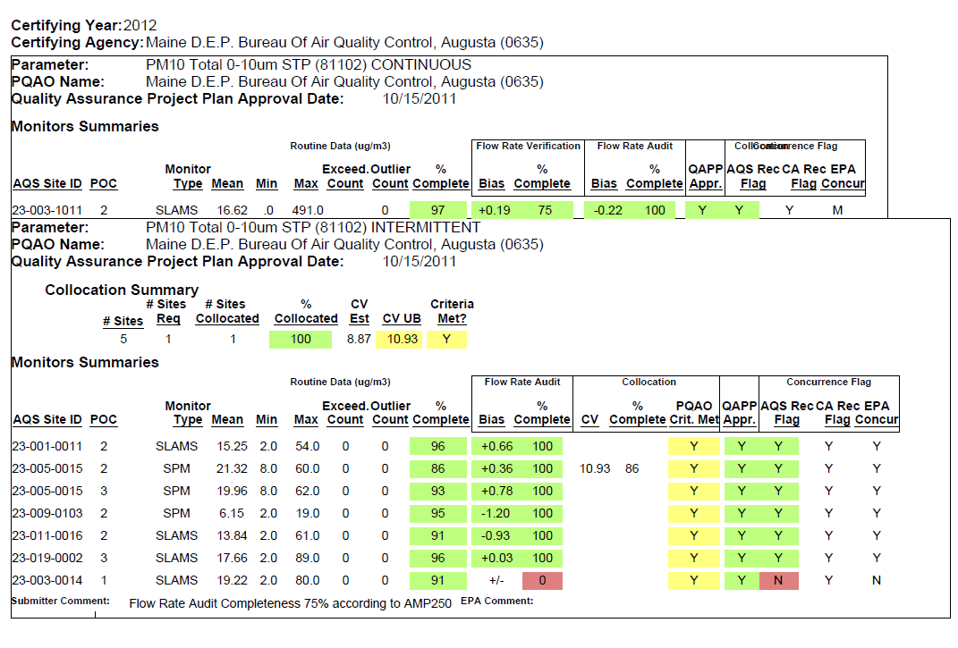
AMP600
After EPA Regional Concurrence
Data changed after certification
Comment required if Cert Agency changes AQS Recommended Flag
Notes:
This slide shows two conditions that can occur on the AMP600 report. Again this is the summary page of the AMP600 report:
The first condition on the top part of the slide displays where the EPA concurrence flag will be automatically changed to ‘M’ if the data for a monitor is changed after it was certified.
The second condition (at the bottom of the slide) indicates if the Certifying Agency requests a Certification Flag that is different than the AQS recommended value, they must provide a justification. That can be accomplished using the Certification Form.
NOTE: An important point to remember is EPA recommends going through this exercise at least quarterly and not to wait until the end of the year to make the final effort easier.

Slide 29
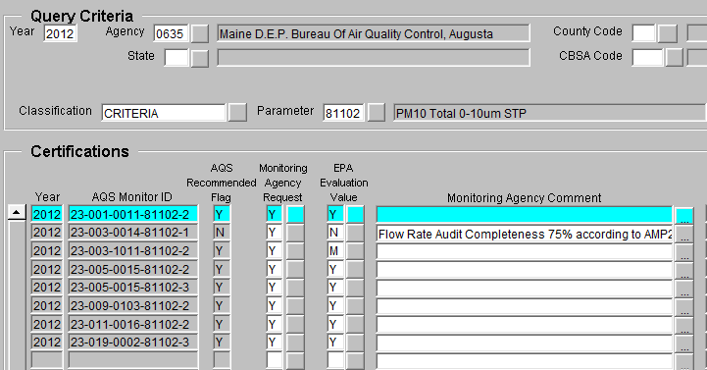
Certification Form
Since the only value that shows up in AQS is the EPA concurrence flag, any change in data by the Monitoring Organization will show up as “M” for modified
Notes:
Again, another example, if you see an M flag in the form it means the data has been modified since the most recent cert letter was received from the certifying agency. AQS will automatically reset the certification flag to “M” if any deletion, revision, or addition of concentration data causes a change in the value of a summary statistic.
The agency would need to recertify this changed/modified data.
The monitoring agency should repeat the normal procedure of submitting a signed certification letter, including submission of a new signed AMP600. This will allow the Regional Office to repeat their review and reset the certification flag to an appropriate value. EPA may also request an explanation of the changes which can be included in the certification letter.

Slide 30
How the AMP600 Works
(Found On AMTIC webpage)
PQAO Level Flags
For Collocation and PEP, AQS Recommended flags are generated at the PQAO level and then “transfered” back to each site
PEP PQAO Critera based on Bias estimate, not completeness
See “additional Information Related to AMP600 Certification Process” at http://www.epa.gov/ttnamti1/qacert.html
Notes:
This slide displays an example of how the Primary Quality Assurance Organization (PQAO) evaluation criteria affects every monitor for the PQAO. The PQAO CV statistic was evaluated to be “Yellow”, so every monitor for the PQAO is evaluated to be “Yellow”.
If the PQAO evaluation criteria had failed (“Red”) then all of its monitors would have been “Red”.

Slide 31
Review: What Monitoring Data must have Monitoring Agencies Certified on May 1, 2017?
Only data collected by FRM, FEM, and ARM monitors at SLAMS and SPM monitoring stations that meet Appendix A must be certified¹. In practice this refers to monitoring data for CO, NO₂, SO₂ (hourly and 5-minute average data), Ozone, Lead, PM₁₀, PM_{10-2.5}, and PM_{2.5}.
¹ Data certification requirements may also be included in auxiliary agreements such as MOA’s between states and operators of industrial networks, for example, SO₂ monitors being installed to comply with the Data Requirements Rule.
Notes:
Keep in mind that the only monitors that will show up on your AMP600 report will be regulatory monitors. Anything the regs allow to be excluded will not be on the AMP600 report.
As a reminder: PM Coarse (10-2.5) and 5 min SO2 data will not be on the AMP600, that is why we mentioned the AMP450NC report.

Slide 32
Certification Process: Thoughts and Steps Forward
Use it often
Don’t wait till May to run the report
It can run on a partial year based on the date the report is run. This may not be perfect but can help.
By the time data is in AQS it may be too late
Internal QC is critical
Notes:
As an example of “too late”: 1-PT QCs must be run every two weeks and achieve at least 75% completeness to pass. If you wait until the end of the year to check that you have the correct number of 1-pt QC checks it may be too late. So, if you enter your data quarterly and run the report and notice no 1-pt QC data, you have a chance to correct and get the needed data the final 3 quarters and receive 75% passing completeness.

Slide 33
Questions and Answers
Questions?/Problems?
Call EPA Enterprise IT Service Desk @ 1-866-411-4372, option 9, or
Email EISD@epa.gov

