Slide 1
Improving the Search User Experience: Migrating from GSA to Fusion at the EPA
Lucidworks Fusion 3.x and 4.x

Slide 2
Notice:
This presentation reflects the view of the author.

Slide 3
Google Search Appliance
Used for 8 years
Abrupt end of product and no replacement
Inexpensive and easy to maintain
  Not configurable
  Not much customization

Slide 4
Decided to Move Forward
Decided to move to a modern search engine
  More future proof
  Use AI capabilities
  Government mandate to use open source products (LucidWorks Fusion is value added SOLR)
  Lot of connectors including Sharepoint and Drupal.

Slide 5
Open Source Options
Set up two demos with limited content
  Apache SOLR
  Elastic (Lucene-based, AWS & .Net implementation)
EPA content is mostly unstructured, a strength of Apache Solr
Clear that Apache Solr was a better fit
Notes:
Elastic is good for data crunching, ingesting data

Slide 6
We Had Problems
Big giant learning curve
EPA preference to use internal servers
Had a choice of 4.0 or 3.1
  Picked older version because of stability.
  Still had a known bug that wasn’t fixed.
Notes:
Didn’t have time to learn a new search engine from the bottom up in the short time we had to implement.

Slide 7
Why Lucidworks
Lucidworks provided a framework
  Didn’t start from very beginning
  Had tools built in
  Required less technical expertise to manage index than other choices

Slide 8
Current Search Engine History
Intranet – February – July 2018
  Fusion 3.8
Public Search July, 2018 – Jan 5, 2019
  Fusion 4.1
  More features
    Spell check
    Autocomplete
    FAQs
    Faceted search
Notes:
Yes, during the shutdown. Implemented because our GSA contract was going to end. Not as tested as it would have been if we had not shutdown.

Slide 9
Testing Fusion for Release
Relevance
  Precision – search engine returned more relevant than irrelevant documents, quality of results.
  Recall – search engine returned all relevant documents, completeness of results.

Slide 10
Testing Fusion for Release
Query test set
  Top queries
      Internal query reports and Google Analytics reports
      Some best bets (key match) from GSA
  Also used some queries from the long tail of queries.
Conducted two types of tests
  Relevance testing – depth of best document
  Precision testing – evaluation of top results

Slide 11
Relevance Testing
Automated test with quantitative results we could compare to GSA.
Already had identified best documents/URLs for top queries = best bets from the GSA.

Slide 12
Relevance Testing –
Different Boost Configurations
Ran iterations of test with different boost configurations
      Title
      Description
      Keywords
      Mimetype boosts - html pages, web area home pages
      Signals

Slide 13
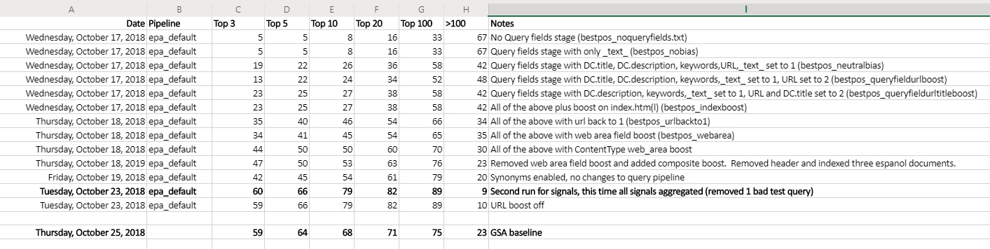
Relevance Testing
Results

Slide 14
Precision Testing
After identifying best boost configurations based on depth of best document test results, we did a couple iterations of precision testing
Non-automated

Slide 15
Precision Testing
Used scaled-down version of depth of best document test set
Librarians analyzed top 5 results
Rated results according to relevance: relevant, near relevant, irrelevant, misplaced.
Assigned number according to how many fell into each category

Slide 16
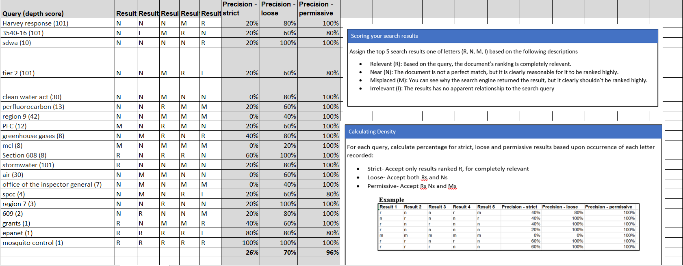
Precision Testing Results

Slide 17
Limited Stakeholder Testing
Stakeholder testing
  Collected and evaluated general comments/impressions of search results using queries of tester’s choice.
Limited testing due to release date

Slide 18
Entity Extraction – Why?
Multiple platforms
  Different representations for same semantic value
Entity extraction combines
  Explicit metadata coded in document metatags
  Derived metadata from context/location
Used for
  Faceted search
  Results filtering

Slide 19
Sample Explicit Metadata
<meta name="DC.language" content="en" />
<meta name="DC.Subject.epachannel" content="Laws &amp; Regulations" />
<meta name="DC.type" content="Collections and Lists" />
<meta name="DC.date.created" content="2014-09-26" />
<meta name="DC.date.modified" content="2018-09-13" />
<meta name="DC.date.reviewed" content="2019-09-13" />
<meta name="DC.creator" content="US EPA,OW" />
<meta name="WebArea" content="Impaired Waters and TMDLs" />
<meta name="WebAreaType" content="Microsite" />
<meta name="ContentType" content="Web Area" />

Slide 20
Sample Derived Metadata Rules
Rules to exclude kids content from professional and regulatory content
exclusive DC.title all these words kids specialcollection_s Professional exclusive URL all these words kids specialcollection_s Professional

Slide 21
Entity Extraction with GSA
Regular expression (pattern) based
Two entity dictionary flavors, metadata/URL
  Joined by metadictionaries
Glaring deficiencies
  No NOT operator
  No AND/OR or group syntax
  Required reindex when dictionary changed

Slide 22
Fusion Entity Extraction – How?
Wrote our own
Regular expression based (PCRE)
Support for exclusions (NOT), groups, AND/OR, multiple comparison operators
Examples
  exclusive URL phrase www3.epa.gov/recyclecity specialcollection_s Professional
  Inclusive WebArea Impaired Waters specialcollection_s Water

Slide 23
Entity Extraction - Next
Look for Fusion entity extraction tool
Completely rethink how we look at organizing search results

Slide 24
Filtering Search Results Using Metadata
EPA has hundreds of “websites”
Content owners can code HTML search forms to filter their results
Example search form code
  <input type=“hidden” name=“inmeta” value=“WebArea=Impaired Water”/>
  <input type=“hidden” name=“inmeta” value=“WebArea=Waters of the US”/>
  <input type=“hidden” name=“inmeta” value=“DocType=pdf”/>
Creates this query: (WebArea=“Imparied Water” OR WebArea=“Waters of the US”) AND DocType=pdf

Slide 25
Best Bets - Why
Google Search Appliance Terminology
Librarian curated best URLs for queries
Fusion Landing pages didn’t satisfy need
Signals tend to train Fusion to boost these documents over time
Periodic review
  The Best Bet is removed if in the top 5 without it

Slide 26
Public Search
Released Jan 5, 2019
Still adding our features
Future goals
  Improve search with the new tools and less custom code
  Use AI to improve search
  Use connectors to add more EPA content into the index

Slide 27
Improving the user experience
We review our combined google analytics/Foresee survey data quarterly
We review our top 50 search terms monthly

Slide 28
Summary
It was a hard transition
We are happy with the product and the advantages that it will give us in the future

Slide 29
Questions?
Contact
Judy Dew
Information Management Specialist
USEPA, Office of Mission Support
Dew.judy@epa.gov

