Slide 1

GASIFICATION EXPERIENCE WITH BIOSOLIDS

Slide 2


Who is Aries Clean Energy?
Thompson Machinery’s outstanding 75-year history of providing equipment solutions to the construction, power generation, forestry and agricultural industries through engineering and product support excellence.
Franklin, Tenn, based Aries Clean Energy develops turnkey gasification projects and provides manufacturing, installation and ongoing service for gasification technologies, processes, and equipment.

Slide 3

What is Gasification?

Slide 4
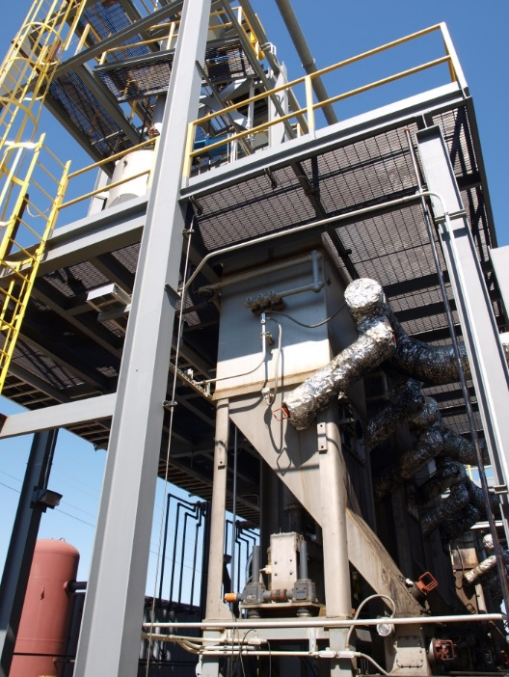
What is Gasification?
“The clean, efficient conversion of biomass into a synthetic gas in an oxygen-starved environment”
BENEFITS INCLUDE:
Green renewable energy
Reduction of greenhouse gases
Beneficial biochar
Reduce landfill volumes
Biosolids disposal
Scalable Systems
Readily permitted
NOT Incineration.
More oxygen than pyrolysis
Less oxygen than incineration
Only biochar remains

Slide 5
Downdraft Gasification
Fixed Bed, Downdraft
Downdraft*
Updraft
Feedstocks
Woodchips
Green waste
Ag waste
Size ¼” to 3”
Ash content: < 10%
Moisture content: , 30%
Minimum bulk density: 14 lbs/ft 3
Energy Production
Electricity
Steam
Direct Thermal
Combustion

Slide 6
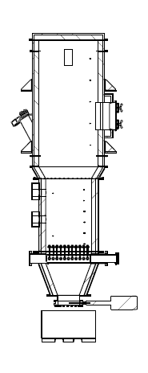

Fluidized Bed Gasification
  Fluidized Bed
  Bubbling*
  Circulation
  Feedstocks
  Biosolids
  Food waste
  Size <1”
  Moisture content: < 30%
PRODUCER GAS OUTLET
Energy Production
Electricity
Steam
Direct Thermal
Combustion
FREEBOARD
BED MATERIAL MAKE-UP
Freeboard
thermocouples
Process Flow
FEEDSTOCK INLET
Bed
thermocouples
FLUIDIZED BED
AIR INLET
FLUIDIZATION AIR DISTRIBUTION GRID
ASHLOCK
CHAR/ASH BIN
Selected by the Bay Area Biosolids Coalition as one of two preferred technologies for Biosolids Disposal in 2014

Slide 7
Mass and Energy
Feedstock = 0.24 MDG of Liquid Biosolids
Mass Flowrate = 1000 tons/day
Solids Content = 2%
Heat value = 7000 Btu/LB (dry basis)
Ash Content = 25%
Volatile Solids = 60-70%
Mass Reduction
Compared to Liquid Biosolids
{(1000 tpd – 5 tpd)/1000 tpd} * 100% = 99.5% Reduction
Compared to Dewatered Biosolids at 16%
{(80 tpd-5tpd}/125 tpd}* 100% = 93% Reduction
DE-WATERING
Available Energy
1.1 MW
(Low Grade)
Recycled Energy
1.9 MW
80 tons/day
25% solids
3 MW
Energy
Produced
DRYING
4 truck loads
22 tons/day
90% solids
GASIFICATION
*Energy value dependent on fuel quantity and quality
(i.e. volatile solids, ash content, calorific value)
Biochar = 5 tons/day

Slide 8

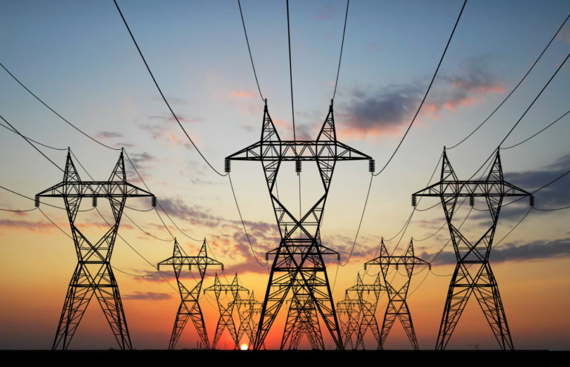
Gasification Process Flow
Feedstock
GASIFIER
EMISSIONS CONTROL
Air Emissions Equipment
Feed System
Gasifier
Cyclone
Process Heater
ENERGY RECOVERY
Heat Exchanger
Char
(10-15%)
Electrical Generation to Grid (ORC)

Slide 9
Regulatory Review
California SB 1383- How does it apply to biosolids?
According to CalRecycle and the California Air Resource Board biosolids are considered organic waste for SB 1383 (SLCP Organics presentation by CalRecycle)
Use of organic waste as Alternative Daily Cover (ADC) at a landfill creates methane and constitutes disposal. (per CalRecycle)
An estimated 70% of biosolids are still being land applied in California
CalRecycle recognized there is not adequate recovery/conversion facilities to meet 2025 diversion requirements
Sec.2 39730.5 (a) C allows for “Potential for new innovation in technology, energy, & resource management practices”

Slide 10
Regulatory Review
Aries Clean Energy has successfully passed the permitting process in California
Technology was submitted to for a 3 MW generation system
System would utilize 14 tons per day of dry sludge and 136 tons per day of wood waste for feedstock
CEQA was approved by BAAQMD
Second project being developed in the Central Valley
Air Permits have been submitted to San Joaquin Air Pollution Control District
System is designed for agricultural waste (165 tons per day) to generate 3 MW of electricity
Biosolids will be tested in the down draft system

Slide 11
Sanford, FL, Fluidized Bed System

Slide 12
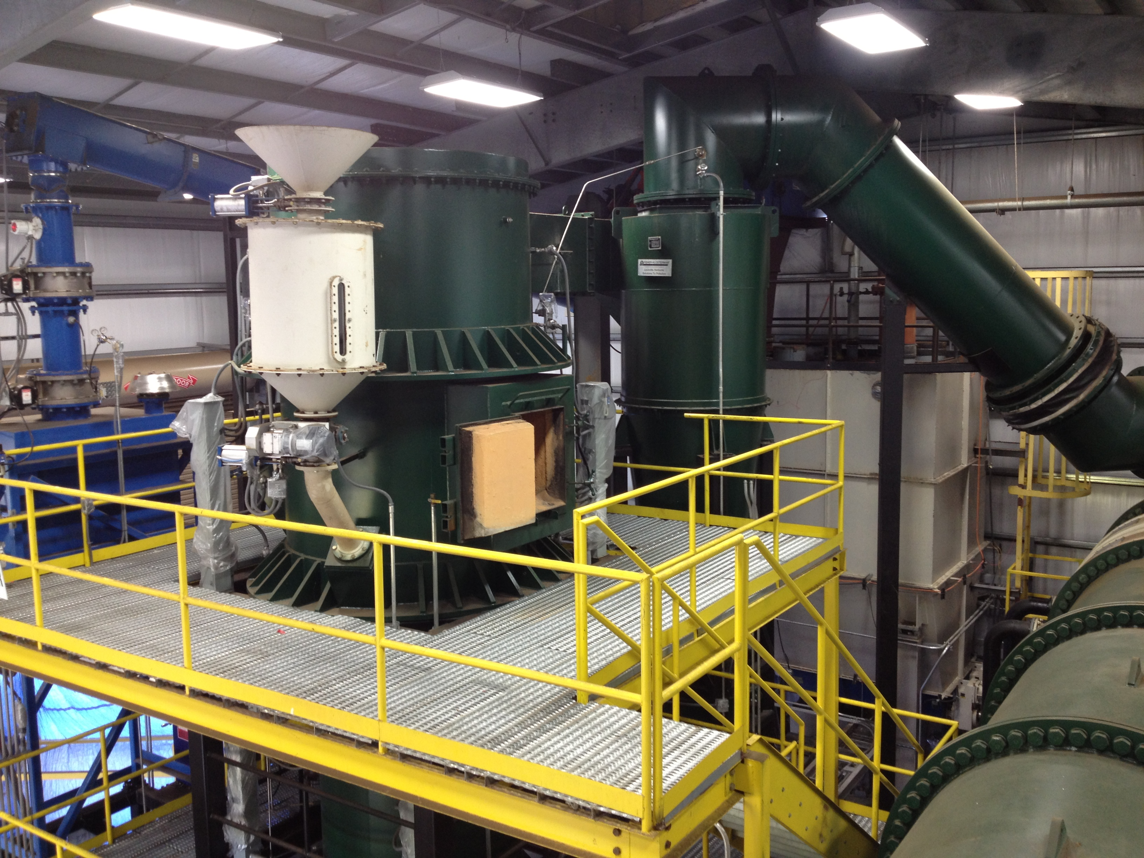
Project Partners
City Sanford WWTP
  70 WTPD (25% moisture)
Aries Clean Energy (Formerly MaxWest)
  - Technology provider
  - Build, Own and Operate

Slide 13
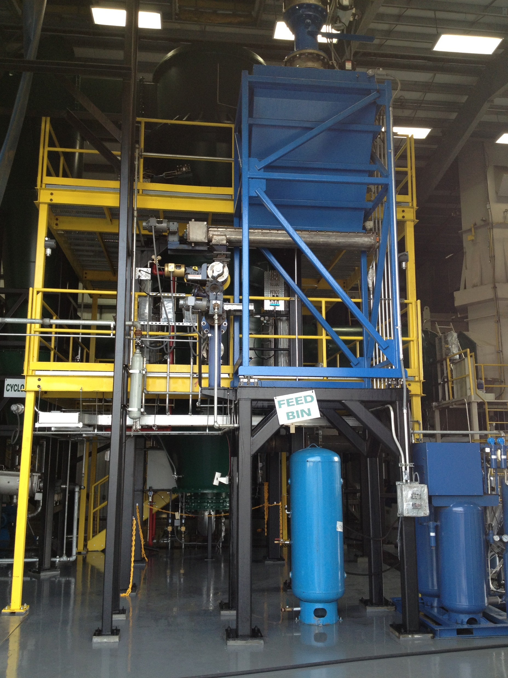
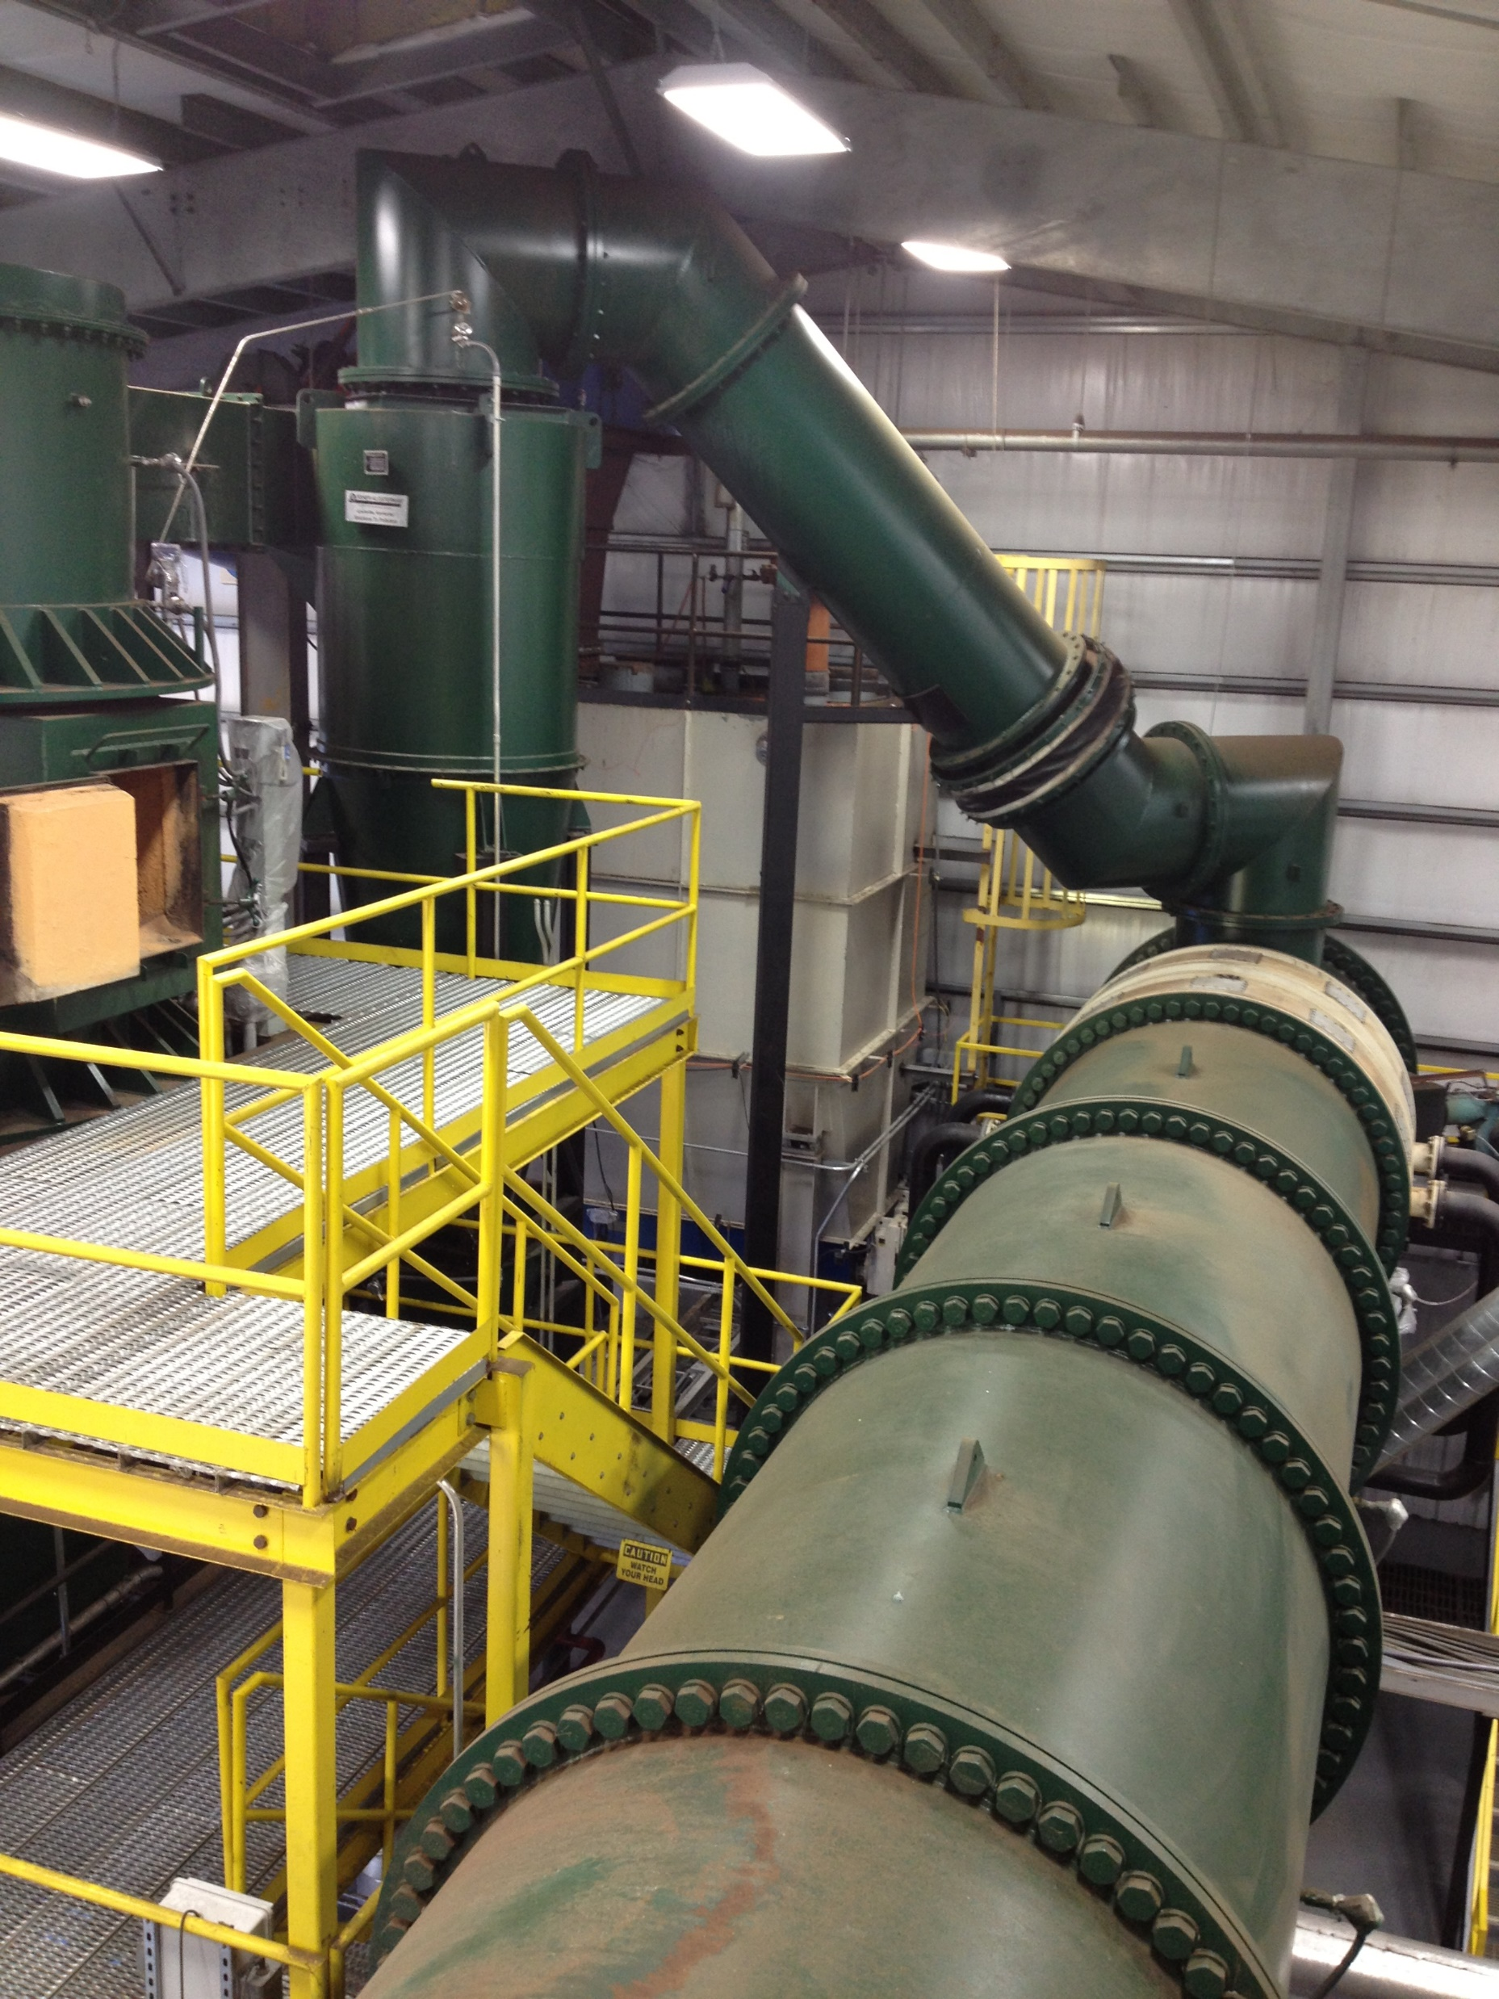
Sanford Operational Information
Commercial operations began December 2012
Processed biosolids from several local WWTP
Processed both undigested and digested biosolids
18 months of commercial operations
24/4 operating schedule based on biosolids availability

Slide 14
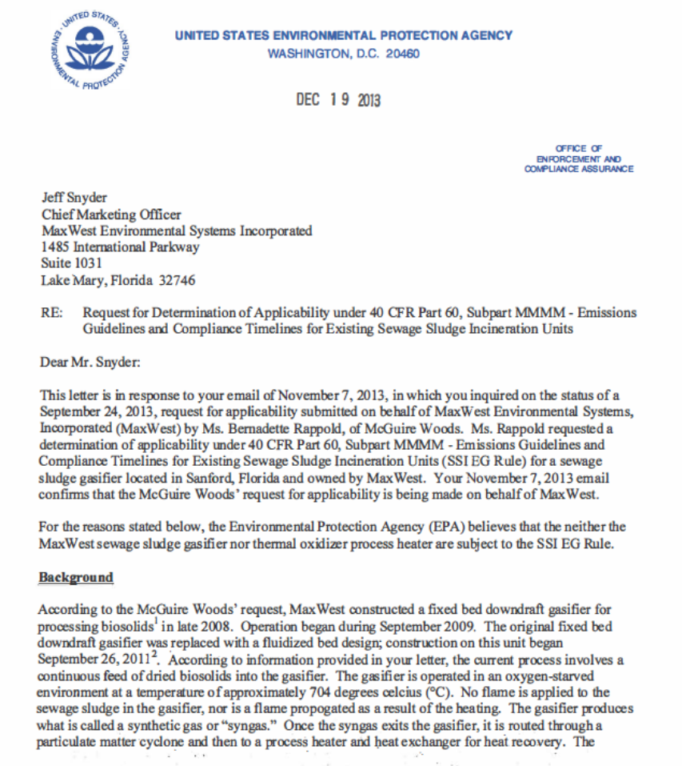
Not Incineration
12/16/13 the EPA Ruled that both fluidized bed gasification and the thermal oxidizer is NOT a sewage sludge incinerator, and would not be regulated under the SSI rule.
Typically process does not require supplemental heat other than startup.
“…we do not believe the gasifier is a sewage sludge incinerator…”

Slide 15
Lebanon, TN Downdraft System

Slide 16
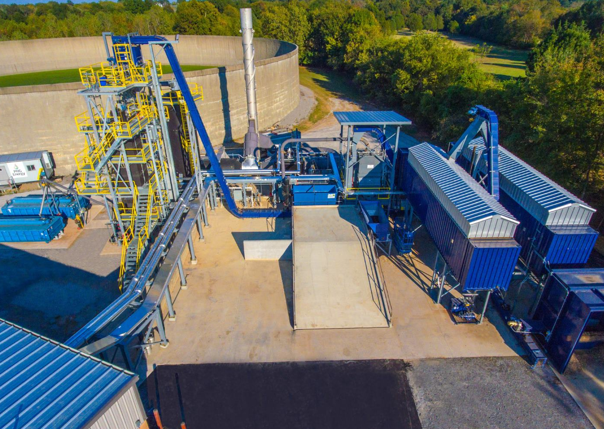
Project Partners
City of Lebanon
  Own and operate the facility
  4MGD Avg Daily flow WWTP
Aries Clean Energy
  - Technology provider
  - General contractor
Rockwood
  - Wood waste processing

Slide 17
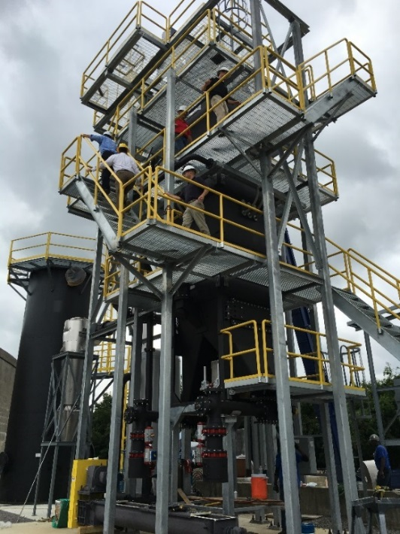
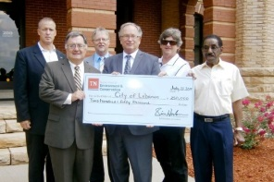
Lebanon Waste-to-Energy Project
Operating Parameters:
32 TPD material processed (Up to 45 TPD)
3 tons sludge, 28 tons wood waste
300 kW (net) electrical production
3 TPD of high-quality Biochar

Slide 18
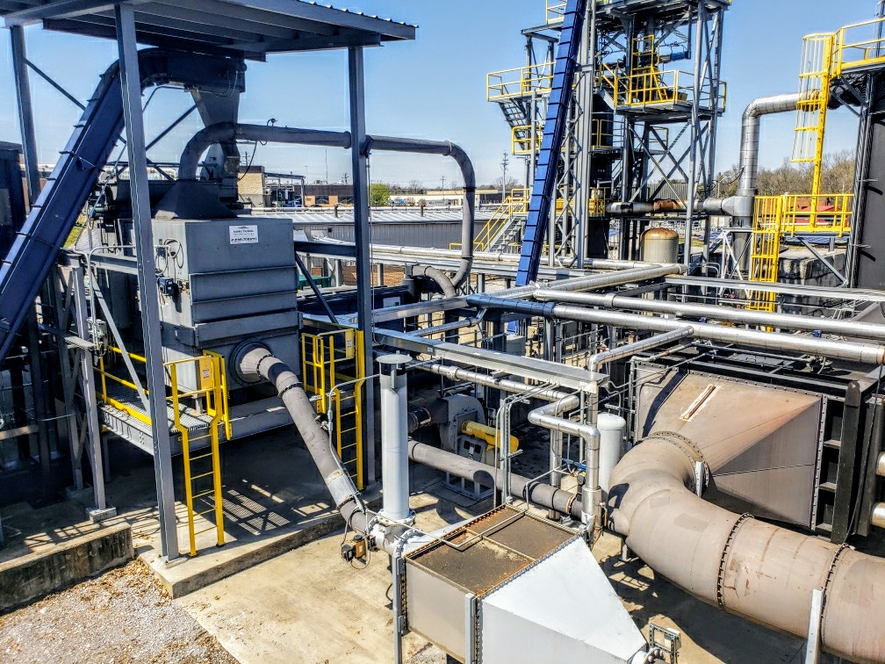
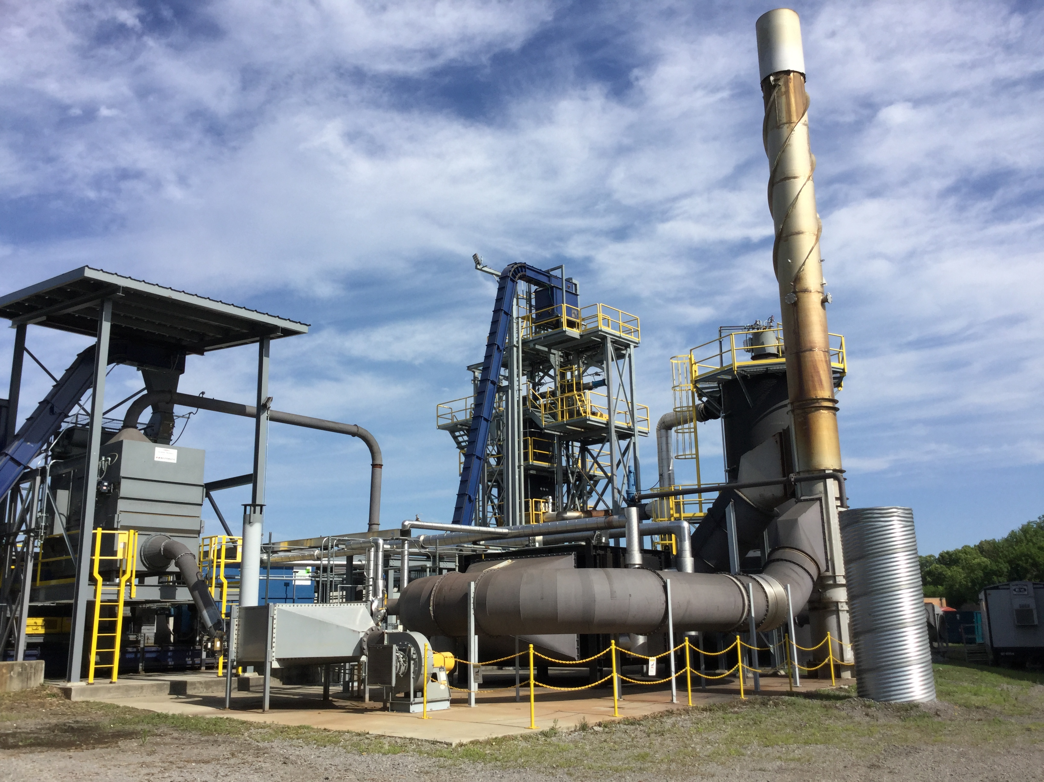
Lebanon Operational Information
January 2017 commercially operational
Over 8000 operational hours
Achieved 100 continuous operational days
Over 80% up time

Slide 19
Linden, New Jersey
Lost Hills, California

Slide 20
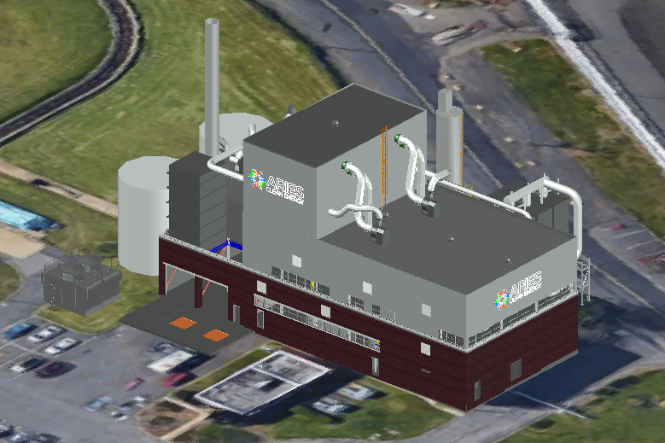
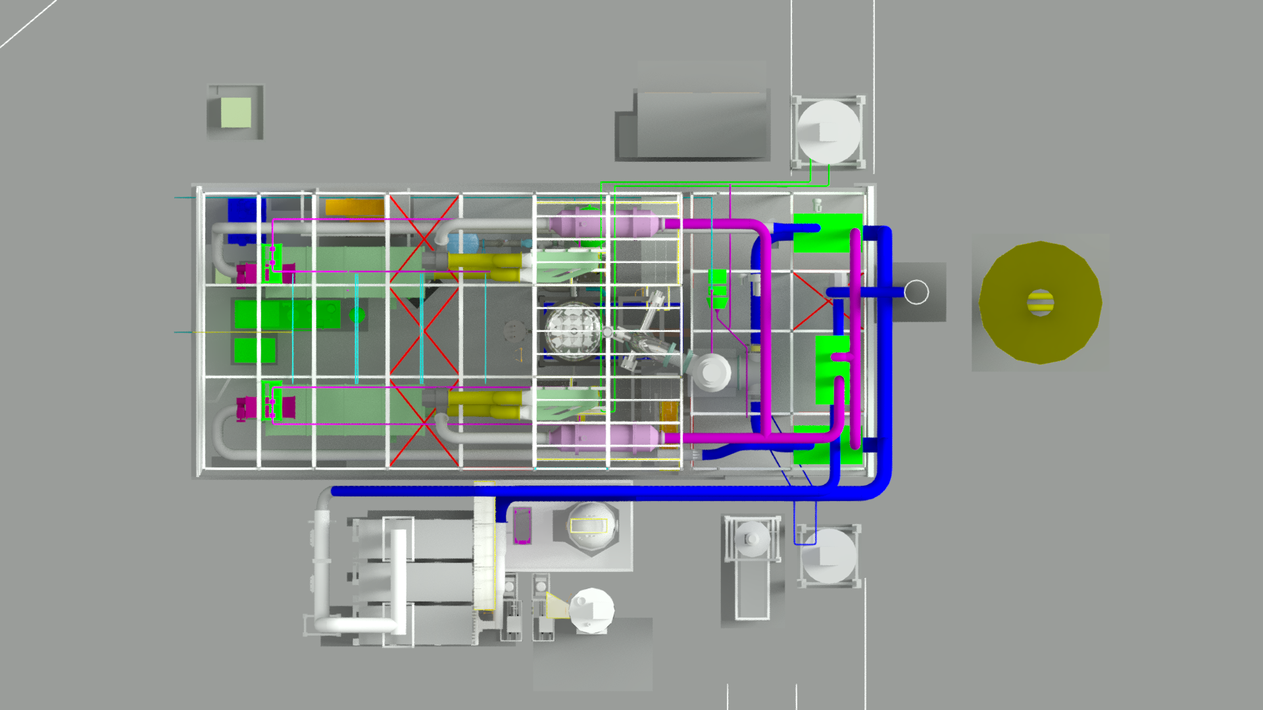
Aries Linden Biosolids Gasification Facility
Local Benefits
Diverts 130,000 tons of biosolids from landfills annually
Lowest cost option for biosolids disposal in NY/NJ Metropolitan area
System is carbon negative and captures methane (with a global warming impact 23 times greater than CO2) that would otherwise be released into the atmosphere
Reduce Greenhouse Gases due to reduction in trucking miles of conventional disposal methods
Aries Clean Energy Build-Own-Operate model provides no financial risk to Linden Roselle Sewerage Authority
Host Community Benefits to City of Linden
Project Snapshot
State of the art, patented fluidized bed facility located in a re-purposed building within the Linden Roselle Sewerage Authority complex
Process 400 tons per day of biosolids
Producing 23 tons of beneficial biochar daily
Closed-loop system requires no fossil fuels during operations
Construction begins Q3 2019
Full operations in Q4 2020

Slide 21
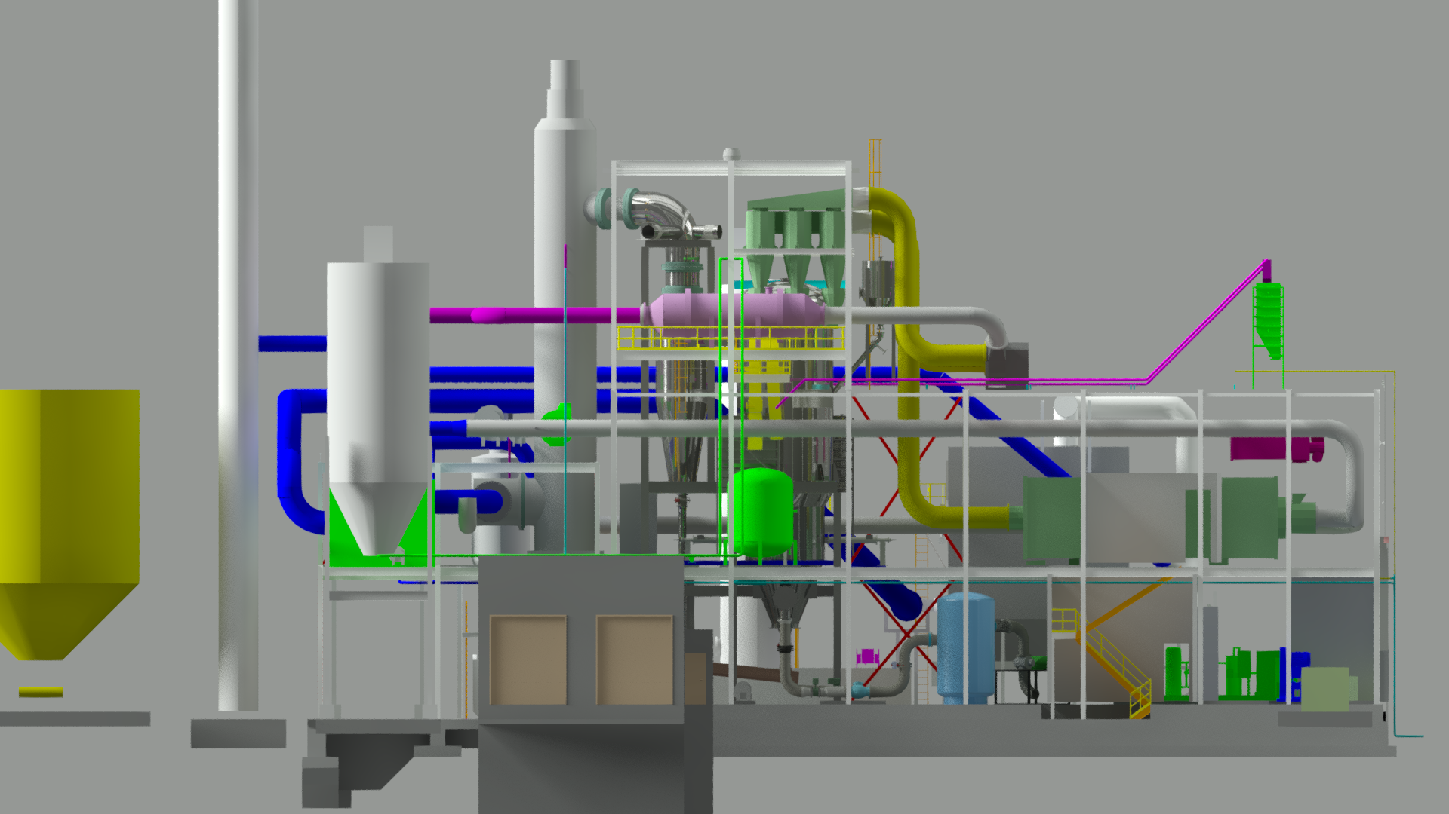
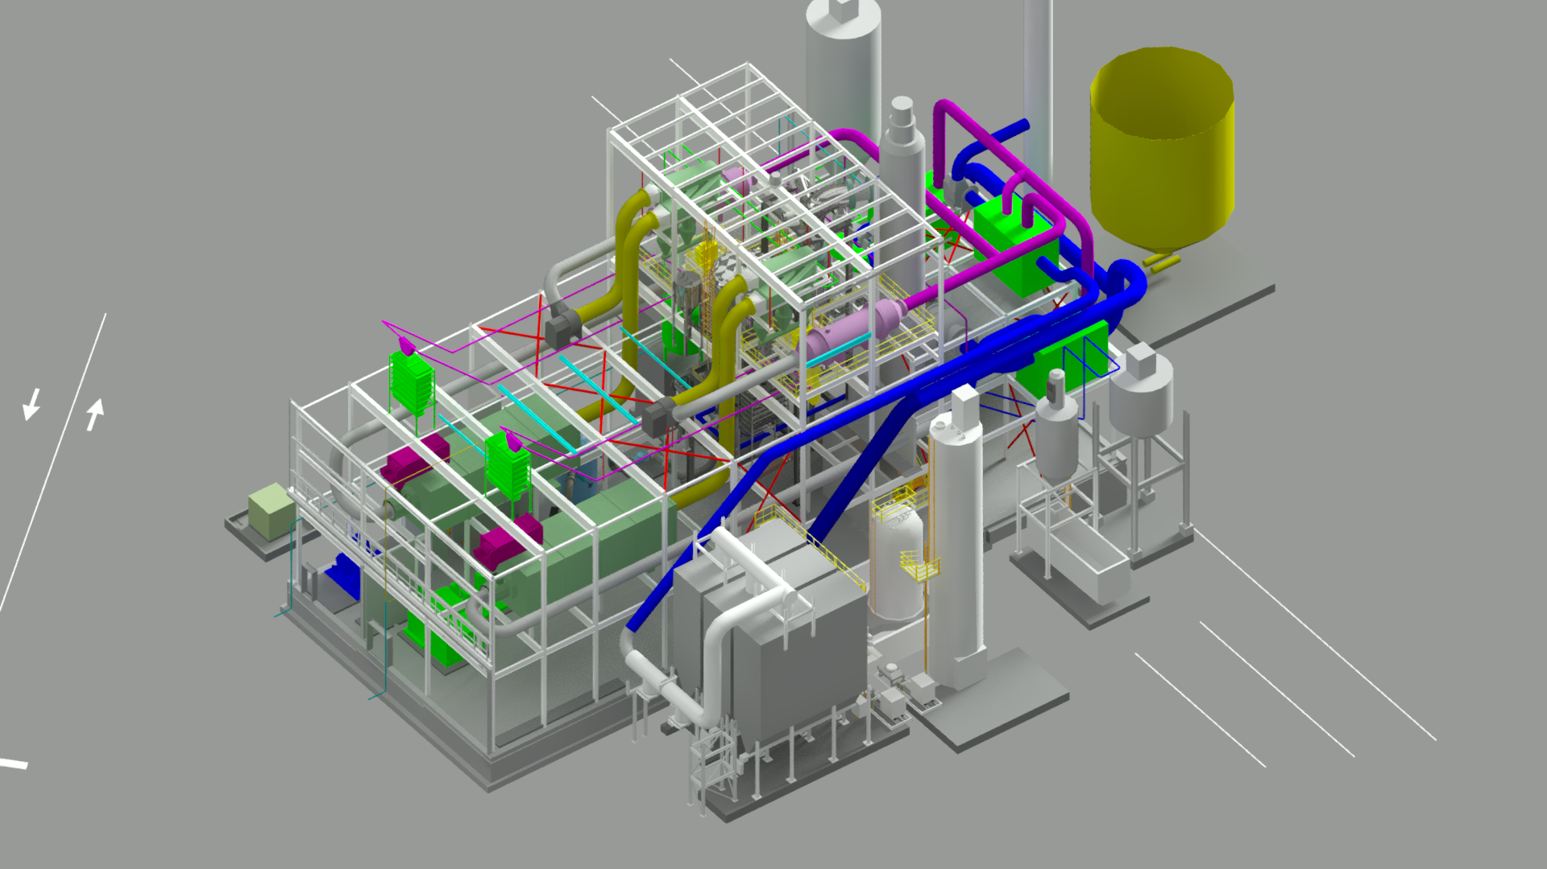
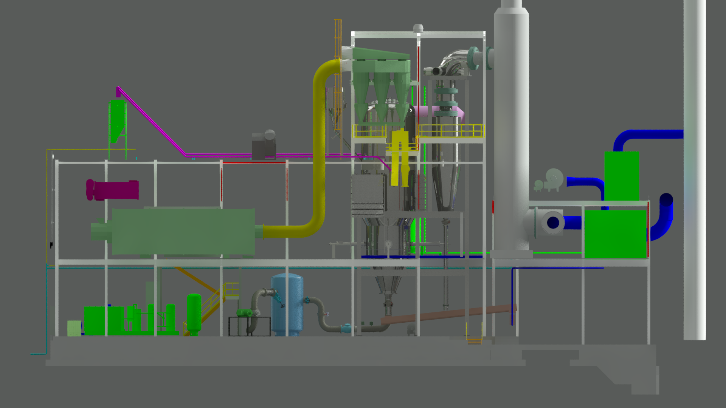
Aries Linden Biosolids Gasification Facility

Slide 22
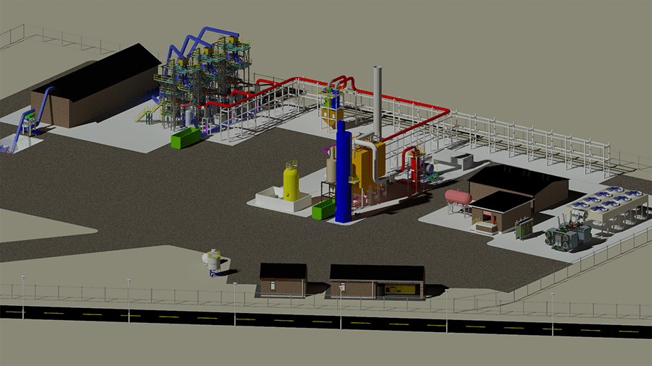
Aries Holloway Bioenergy Facility
Project Snapshot
Aries patented downdraft gasifiers
Process 165 tons of agricultural biomass Generates 86 MW of electricity daily; 72 MW to the grid
Produces 5000 TPY of biochar that will be used as a soil amendment
Construction start Q2 2020; Full operations in Q3 2021
Five-acre site to house gasifiers, feedstock prep, biochar collection
Project qualifies under SB 1122 CAT BioMAT programs
Gasification is an approved method of using agricultural waste to generate electricity. This project will help meet California’s Renewable Energy goals.
Local Kern County Area Benefits
Reduction of fossil fuels & greenhouse gas emissions associated with current disposal methods
Reduces or eliminates open burning
Effective conversion of biomass waste to renewable energy
Biochar will improve soil quality

Slide 23

PFAS

Slide 24
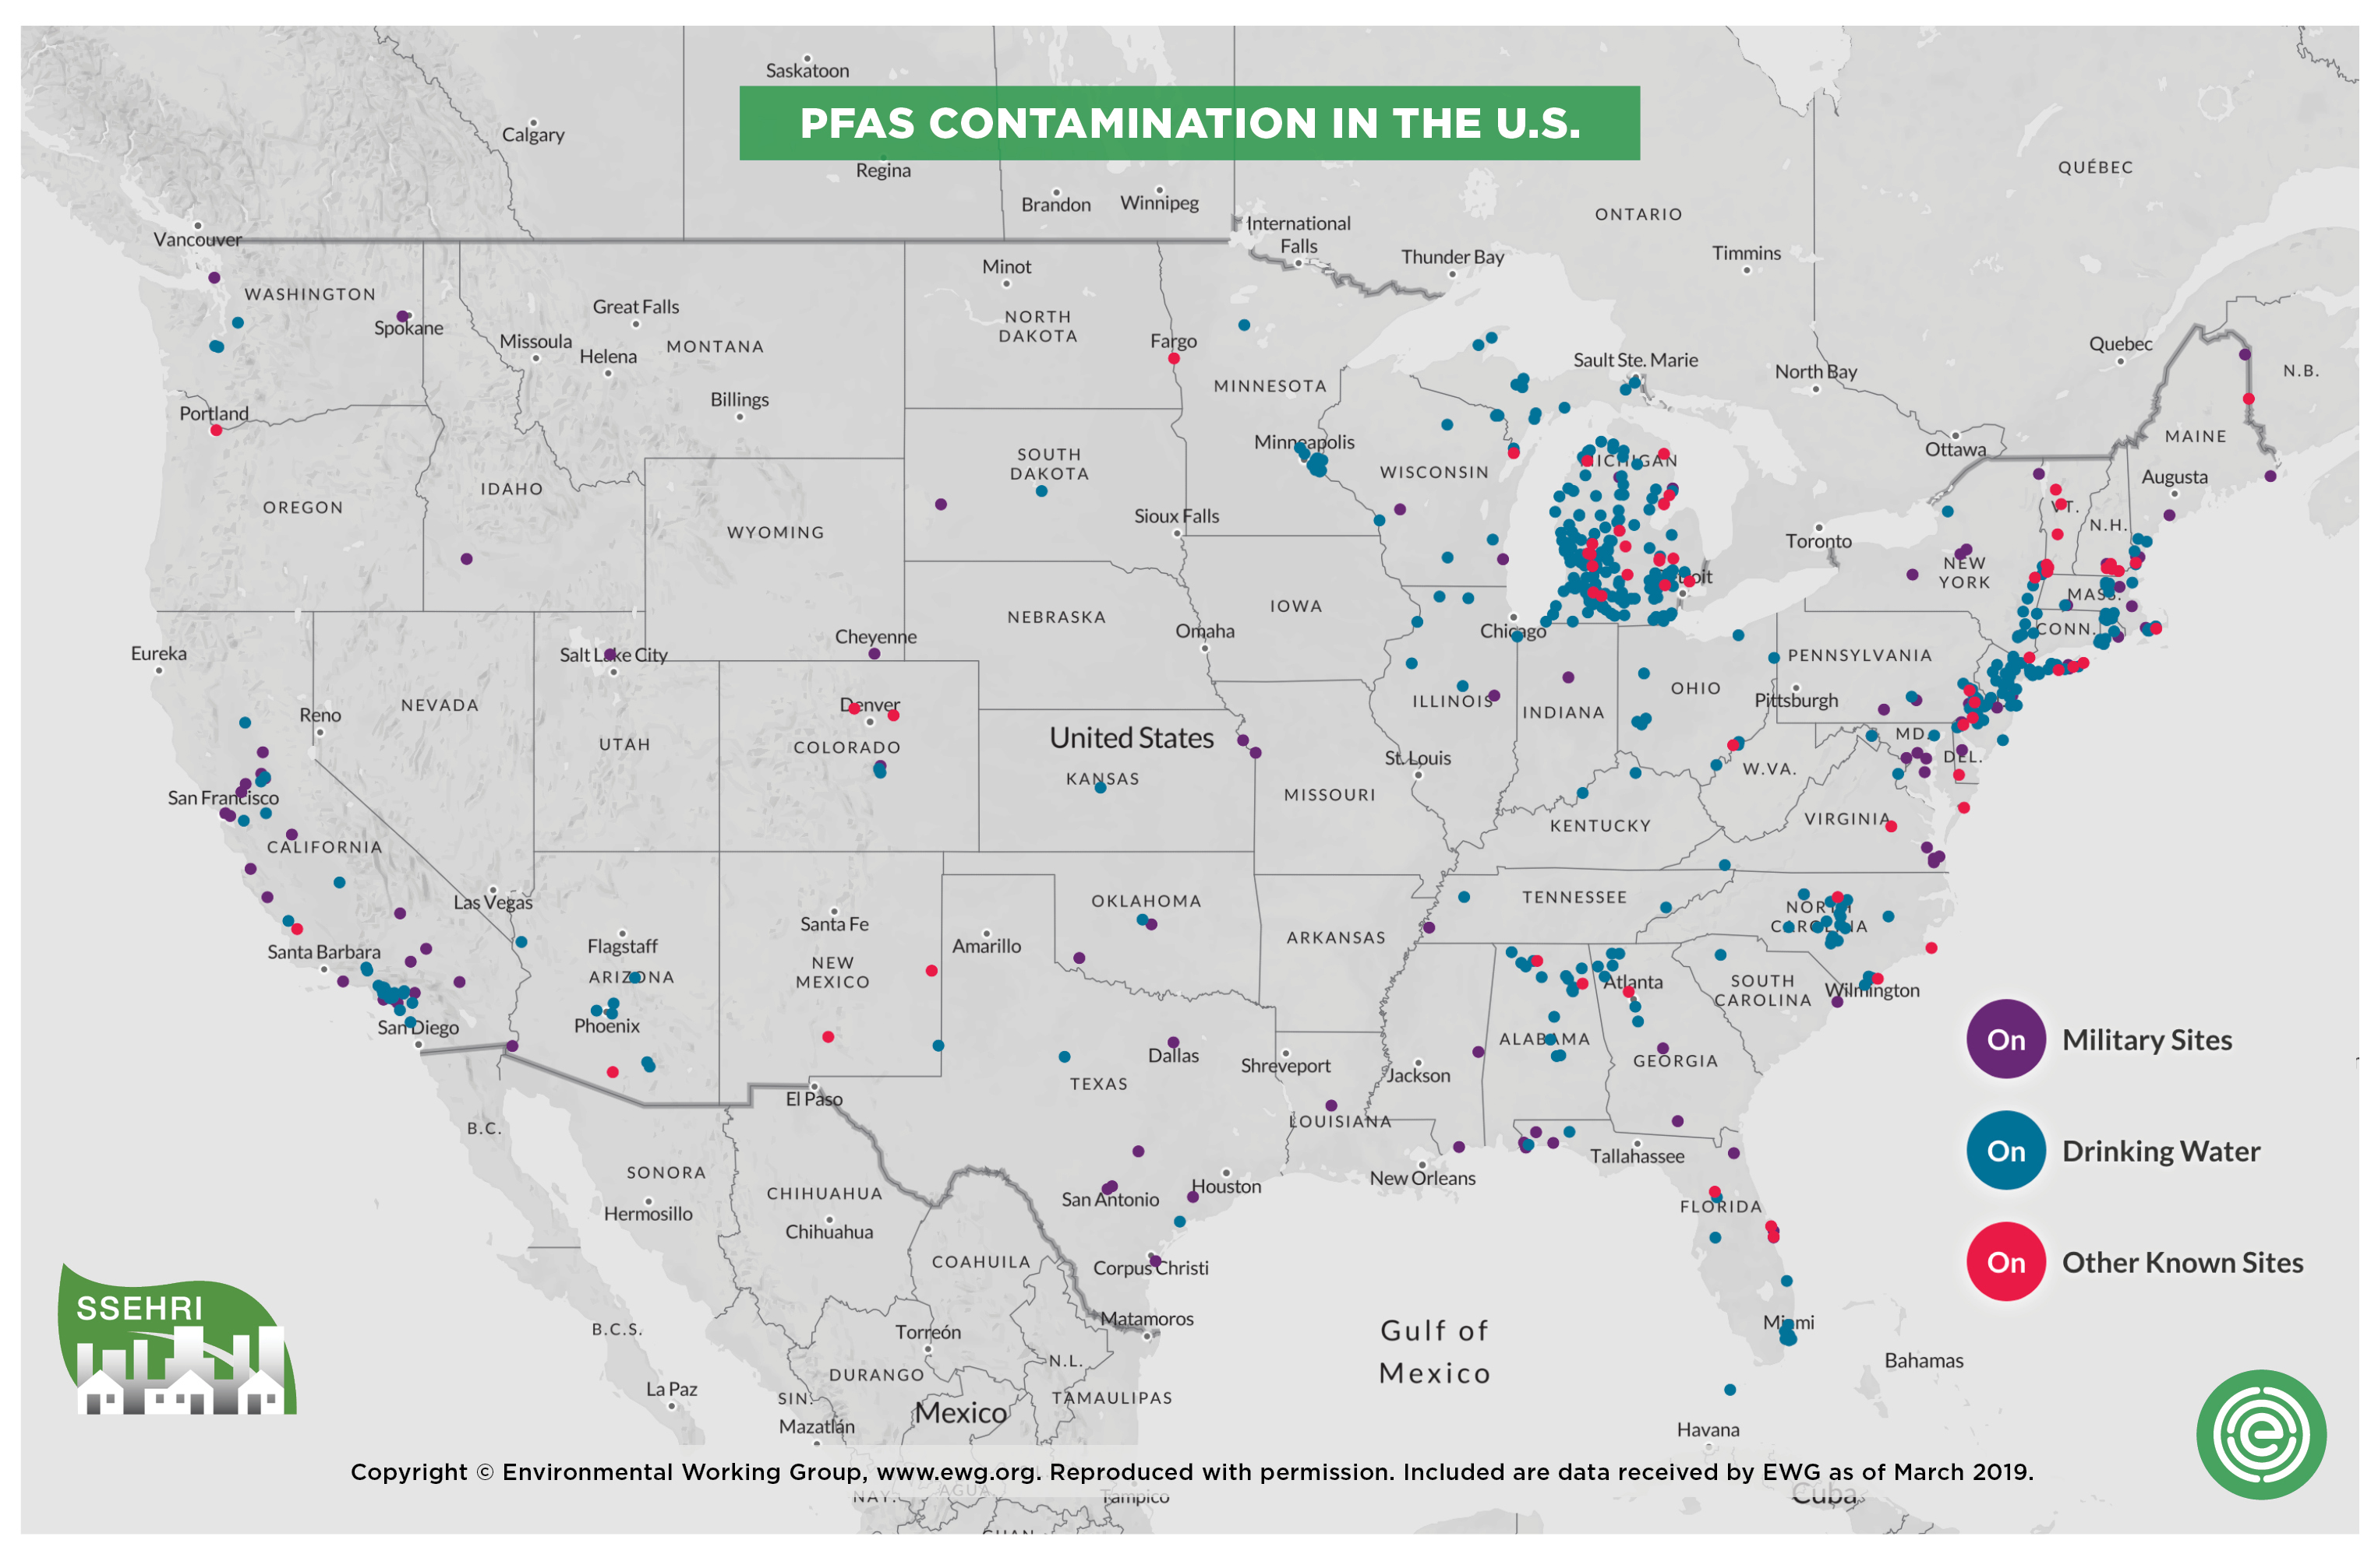
PFAS – US Contamination
The Social Science Environmental Health Institute and the Environmental Working Group produced this map using data from the EPA.

Slide 25
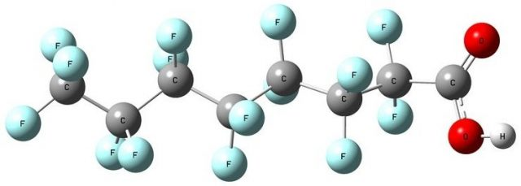
Gasification Can Address PFAS - Per- And Polyfluoroalkyl Substances
A class of man-made chemicals that is resistant to low temperature heat, water, and oils etc. (also called forever chemicals)
Contains chains of carbon (C) atoms, surrounded by fluorine (F) atoms
PFAS chemicals are persistent and resist degradation in the environment
Will bioaccumulate over time
in the body and bind to
blood protein … EPA issued a LHA

Slide 26
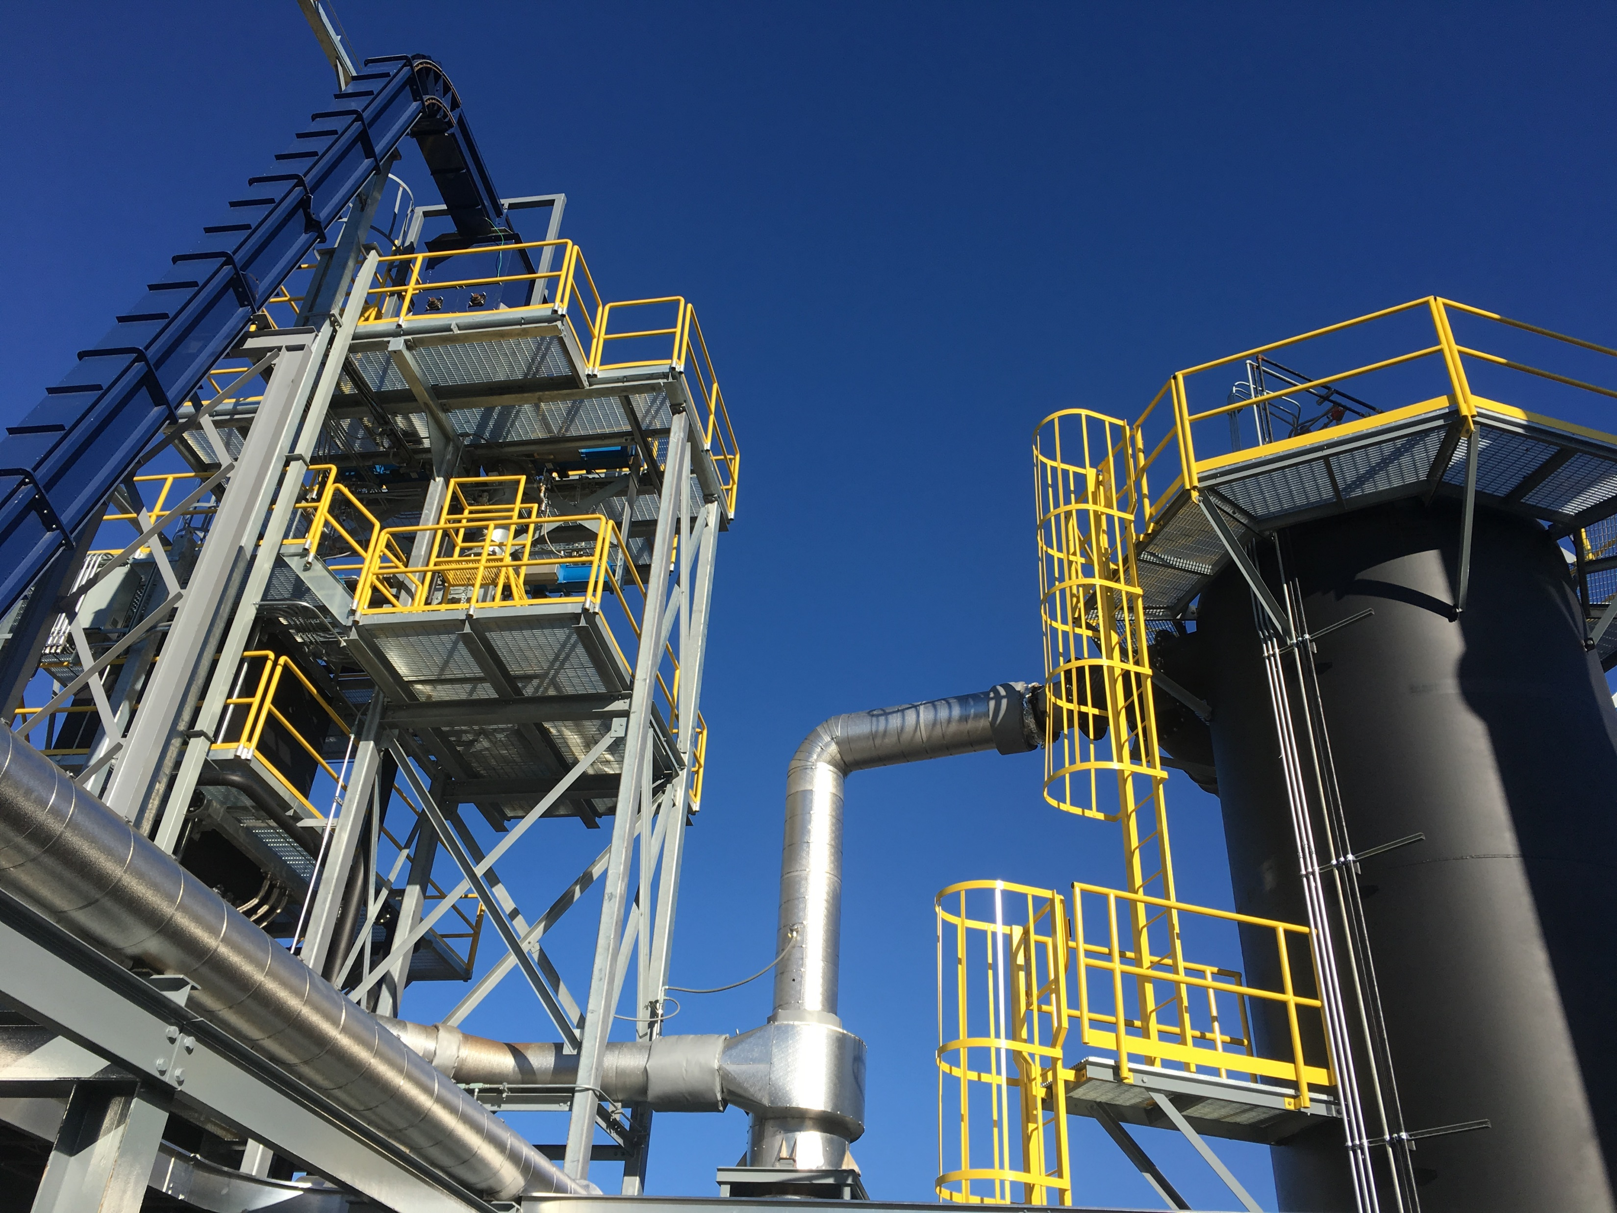
PFAS - Aries Solution/Opportunity
Aries Fluidized Bed and Downdraft gasifiers ideal options for dealing with PFAS
PFAS is destroyed at temperatures above 800°F (FB 1250°F -- DD 1500°F)
Thermal oxidizer in both systems 1800°F – clearly above destruction temperatures

Slide 27
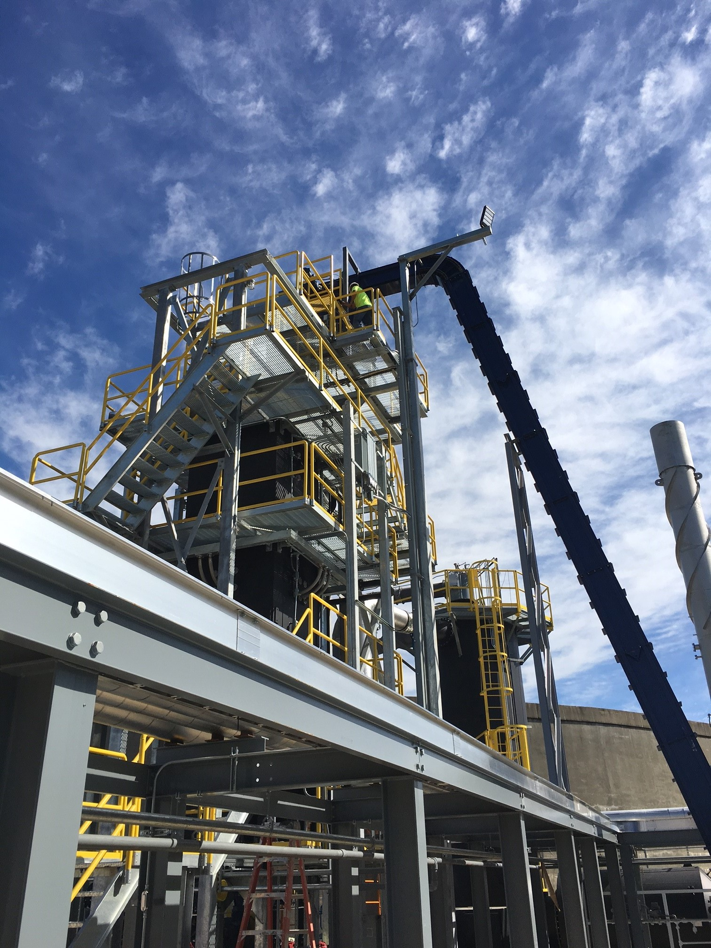
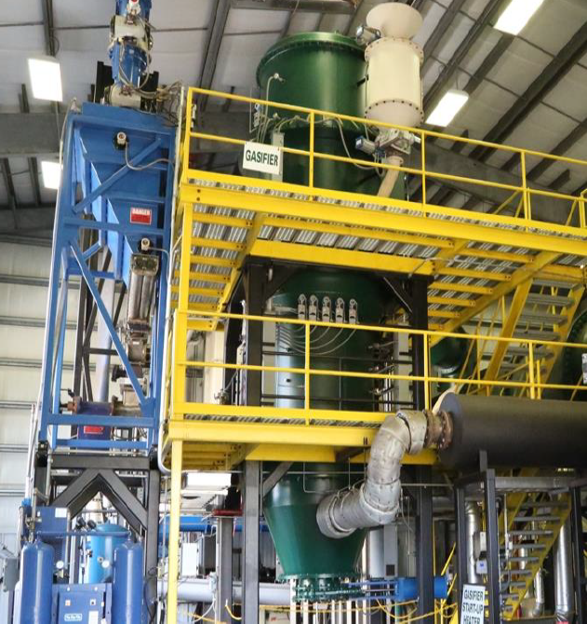
Questions?
Questions?
ariescleanenergy.com
Bernard Brown
Project Developer, West Coast
Bernard, Brown@ariesenergy.com
Jeff Snyder
VP Business Development
Jeff.Snyder@ariesenergy.com

