Slide 1
Is California Ready (yet?) for the “Conversion” of Residual Solid Waste to Energy, Fuels and Chemicals?
Chuck White, P.E. – cawhite@manatt.com
California Biomass Alliance – 14th Annual Symposium
Panel Session 1: Advanced Technologies and BioProducts
November 14, 2019, 1pm – 2:15 pm – Ziggurat Building
West Sacramento, CA

Slide 2
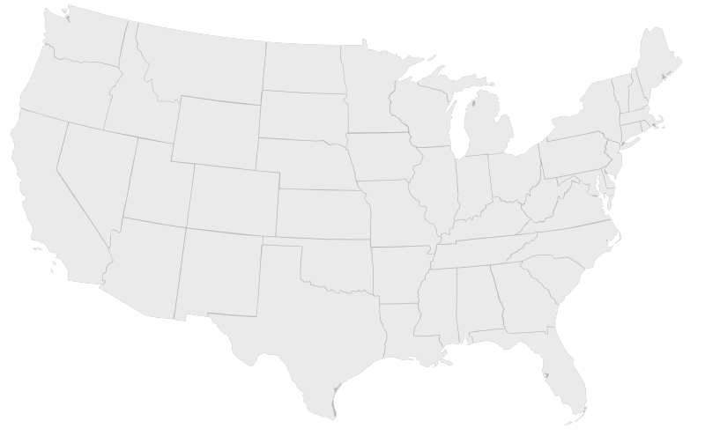
Who Is Manatt?
At-a-Glance
Over 450 professionals
and consultants
Industries:
Energy/Environment
Entertainment and Media
Financial Services
Manatt Health
Real Estate
Retail and Consumer Products
Services:
Business Strategy and Consulting
Corporate and Finance
Government and Regulatory
Litigation
Media, Technology and Advertising
Albany
Chicago
New York
Sacramento
Washington D.C.
San Francisco
Palo Alto
Los Angeles
Orange County
= Manatt Locations

Slide 3
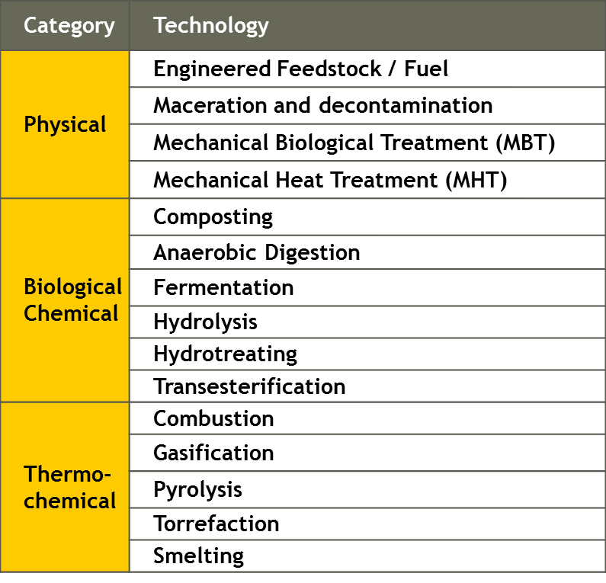
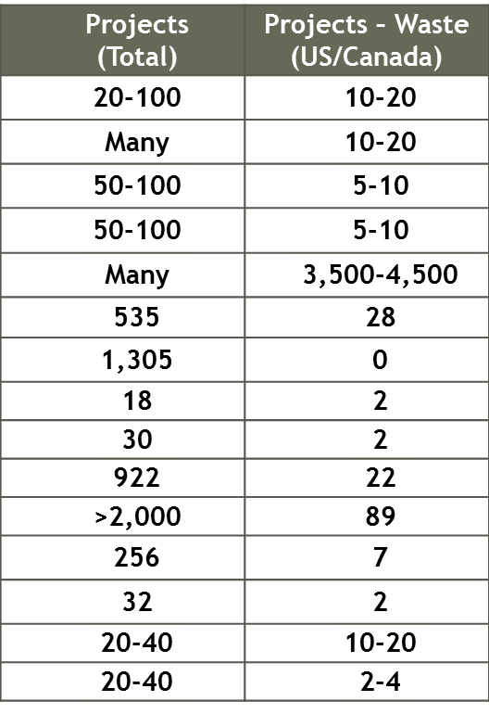
Advanced Recovery Technologies Can Take Many Forms

Slide 4
Advanced Recovery Technology is not Mass Burn Solid WTE
Technology Examples:
Gasification is a low oxygen, non-combustion process that converts biogenic and/or fossil-based carbonaceous materials to fuels & chemicals.
Pyrolysis is the process of heating organic material at high temperatures in the absence of oxygen or combustion to produce combustible gases, liquids & char.
Processed Engineered Fuel (PEF) & Engineered Municipal Solid Waste (EMSW) converted into a clean, low carbon solid fuel through autoclaving, sorting, screening, drying to meet fuel quality standards for ind. furnaces: >5000 BTU/lb.
PROBLEM: All the above are considered DISPOSAL in California, NOT DIVERSION
Advanced Recovery Technologies (ARTs) are non-incineration technologies used to convert the non-recyclable portion of municipal solid waste to electricity, fuels, and/or industrial chemical feedstocks (WTEFC).
Greater Revenue Potential. Fuel from an ART facility is valued at $3 per gallon = $150 per ton in energy revenues compared with $30 per ton from traditional WTE facilities.
Greenhouse Gas Revenues: Cap and Trade, LCFS, RFS2
  50% LCFS CI reduction is equivalent to $0.50/gallon = $25/ton
Other Benefits:
  Lower GHG emissions and same or lower criteria pollutant and toxic emissions & maximize the recovery of recyclables.
  Can be community sized, distributed and scalable.
  More Efficient & Versatile with Minimal environmental impact.

Slide 5
Challenges: The California Public Resources Code
PRC 40192: “solid waste disposal,” “dispose,” or “disposal” means the management of solid waste (by) landfill disposal, transformation, or EMSW conversion, at a permitted solid waste facility, unless defined otherwise.
PRC 40180: “Recycle” or “Recycling” means the . . . collecting, sorting, cleansing, treating, and reconstituting materials that would otherwise become solid waste, and returning them to the economic mainstream in the form of raw material for new, reused, or reconstituted products which meet the quality standards necessary to be used in the marketplace. “Recycling” does not include transformation, or EMSW conversion.
PRC 40201: “Transformation” means incineration, pyrolysis, distillation, or biological conversion other than composting. “Transformation” does not include composting, gasification, EMSW conversion, or biomass conversion. (Note: Incineration is a waste treatment process that involves the combustion of organic substances contained in waste materials)
PRC 40117: “Gasification” means a technology that uses a noncombustion thermal process to convert solid waste to a clean burning fuel for the purpose of generating electricity, and: . . . does not use air or oxygen in the conversion process, . . . no discharges of air contaminants or emissions, including greenhouse gases, . . . no discharges to surface or groundwaters of the state . . . . produces no hazardous waste . . . .
Other clarifying changes needed to biomass conversion and EMSW conversion

Slide 6
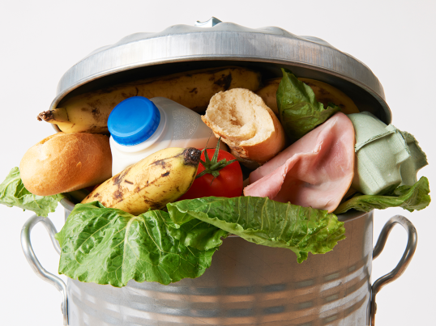

But Wait . . . Will CalRecycle SB 1383 SLCP Regulations Provide An Option?
Purpose is divert organic waste from landfill disposal to reduce methane.
  75% Organic Waste Reduction by 2025
  SB 1383 authority to CalRecycle is in H&SC, NOT PRC.
CalRecycle Received 250+ Comments, raising 2300+ issues.
Don’t Forget Article 2: Technologies That Constitute a Reduction in LF Disposal
  Recycling Center, Food Recovery, Composting, Anaerobic Digestion, Biomass Conversion, Land App, Animal Feed, & “Approved Operations that reduce SLCPs”
    Apply to CalRecycle and Review by CARB
    Permanent GHG reduction Equal or Greater than composting of organic waste (> 0.30 MTCO2e/short ton of organic waste), may include waste to energy, fuels and chemicals:
      Diversion of organics from landfill equivalent methane GHG reduction,
      Plus, GHG reduction from uses of energy, fuel, & chemical alternatives to fossil fuels,
      Minus, Fossil Energy Use.
  If Approved as a Verified Technology = Reduction of Landfill Disposal,
    But, may still be Disposal as Transformation pursuant to PRC (Incineration/EMSW)
But, Reduction from Landfill Disposal Under SB 1383 may still be Disposal under
the PRC:
AB 939 & AB 341

Slide 7
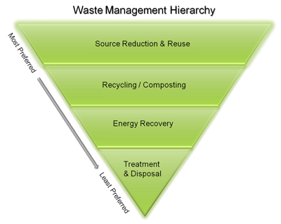

Next Steps
Identify & Organize Coalition of Stakeholders
Implement Article 2 of Proposed SB 1383 Regulations – will it be possible to approve and site waste to energy, fuels and chemicals in CA?
Advocate Cleanup Modifications to PRC for the Management of Residual Solid Waste.
  Modernized Hierarchy to recognize Energy Recovery and Avoidance of Unmanaged Dispersion
  Allow Gasification, Pyrolysis, and other Technologies to be permitted as form of Solid waste “Recovery” with Recycling and Diversion Credit
  Allow Biomass Conversion with de minimis amounts of other materials in compliance with appropriate standards.
  Allow PEF or EMSW to county as “Recovery” not “Disposal” with reasonable limits.
  Other modifications?
NEW !
Unmanaged Dispersion
into the Environment

Slide 8
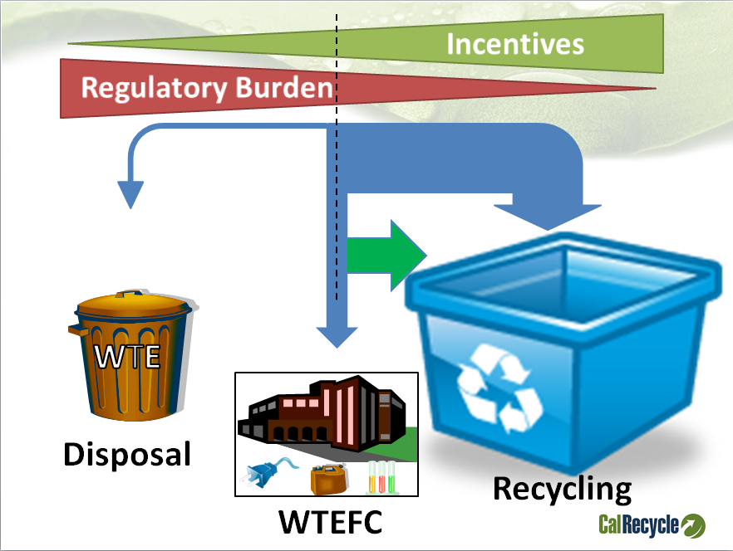
What About: “WT – E – FC” ?
CalRecycle’s “Modest” Proposal
2013 -2014
Chuck White, Senior Advisor | Manatt, Phelps & Phillips, LLP

Slide 9

ANY QUESTIONS, Comments, Concerns ?
Please Hold Them Until End of Session !!

