Slide 1
14th Annual
California Bioresources Alliance Symposium
Progress
Collaboration
Through

Slide 2
What are we doing here? One man’s perspective
What? A collaboratory on California bioresources management.
Bioresources? - 1st – everything that’s biological → 2nd - organic residuals
renewable carbon, plants, animals, food, energy, fires, natural capital, etc. ….
Why? We have complex challenges that we can only solve together
Who? All citizens, especially environmental & resource professionals
When? This generation into following generations
Where? Toward building a regenerative, resilient California
How? By collaborating ongoing horizontally and vertically!

Slide 3
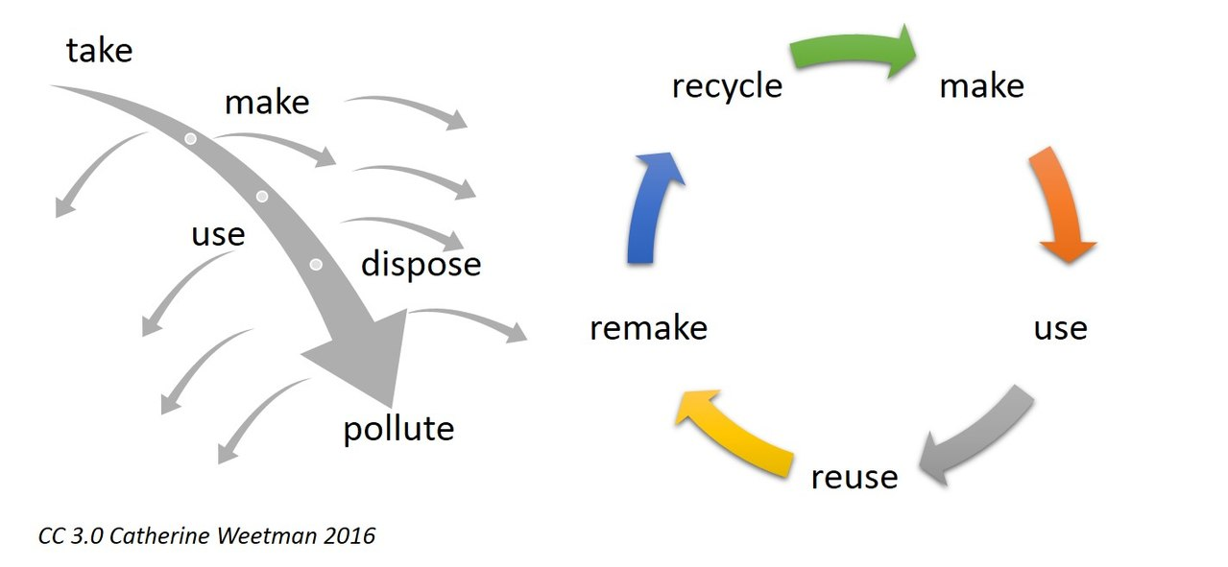
Disposal vs. Regenerative Economic Model

Slide 4
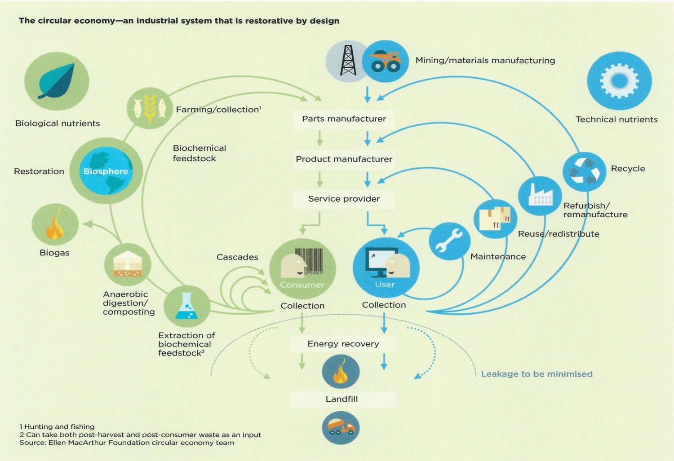
Emerging Circular Economy: an industrial system that is restorative by design

Slide 5
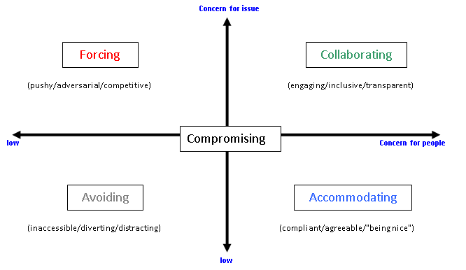
How: Conflict → Collaboration
Concern for the Issue
Concern for People

Slide 6
How: by using powerful Collaboration, Collective Intelligence! … it takes practice!
Methods
Horizontal & Vertical
Collective Impact Forum
Ecodistricts
Regenerative Collaborative
New Republic of the Heart
1000’s of social & environmental non-profits
State – Air, Water, Solids, Ag, Fire, Energy, ORP, OEHHA, ….
Regional – Air Districts, Regional Water Boards, Recycling Zones, RCOGs, ….
Local – Counties, SW Agencies, Cities, townships, neighboods, homes & businesses

Slide 7
Let’s get to work!
Dan Noble
(619) 992-8389
danwyldernoble@gmail.com
BIOPRODUCTS
Innovation Center
bioproducts.center
Noble Bioresources, Inc.
Bioproduct Market & Industry Development
NobleBioresourcesInc.com
“We Build Healthy Soil”
healthysoil.org

Slide 9
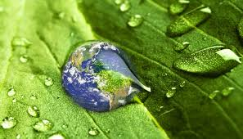
Noble Bioresources, Inc.
Quantitative Market Intelligence for Regenerative Economic Development
Dan Noble
President, NBI
Executive Director, ACP

Slide 10
Bioproducts Markets
Standards and Decision Making
Feedstock
Transporter
Manufacturing/
Processor
Bioproduct
Transporter
Byproduct
Municipalities
Marketers
Food System
Transporter
Begin Here
Organics Generator
Buyer/User Generator
Byproduct
Transporter
Landfill
Transporter
Byproduct
Landscape System
Notes:
More of a detailed schematic of each of the markets and can be build into a CIRCULAR BIORESOURCE ECONOMIC MODEL – this lends itself to direct market and investment analysis and decision making.

Slide 11
Key Facility Types in the Local Bioeconomy
Collect Organic
Feedstock
(Collection Fee)
Deposit Organic
Feedstocks
(Tipping fee)
Processor
(“Compost Planner”)
Buyer/
Grower
(“Comet Planner”, SHI Carbon/Nutrient markets)
Generator
(“Recyclist”)
Transport
BioDB Data
Engine
Food, Feed, Fiber
(Price)
Bioproduct
(Price)
Notes:
The bioeconomy, or biocycle, is made up of four main “players”: 1) ALL HUMANS (generators”, i.e., all of us!), 2) HAULERS - collection and transport 3) PROCESSORS – compost, AD/biogas,, materials
BUYERS – farmers and all of the rest of us!... And it closes the loop on generation
Notice that it is composed of four markets: Collection, Tipping, bioproduct sales, and agricultural product sales

Slide 12
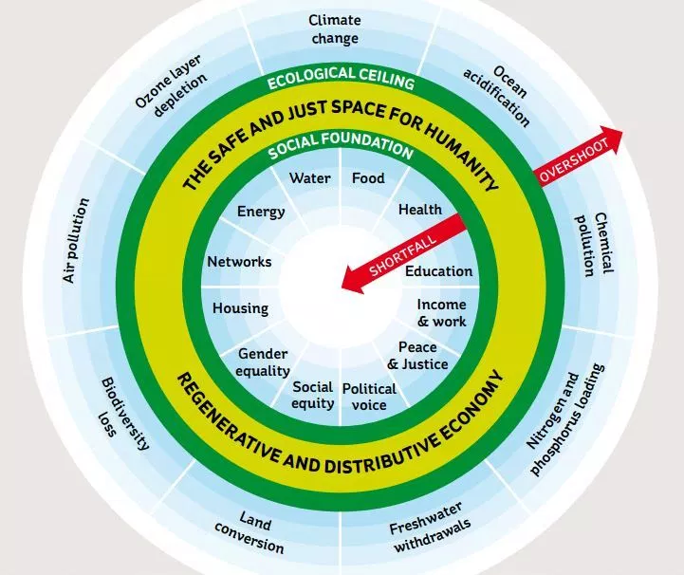
Doughnut Economics
Raworth (2017)
Steffen et al (2015)

Slide 13
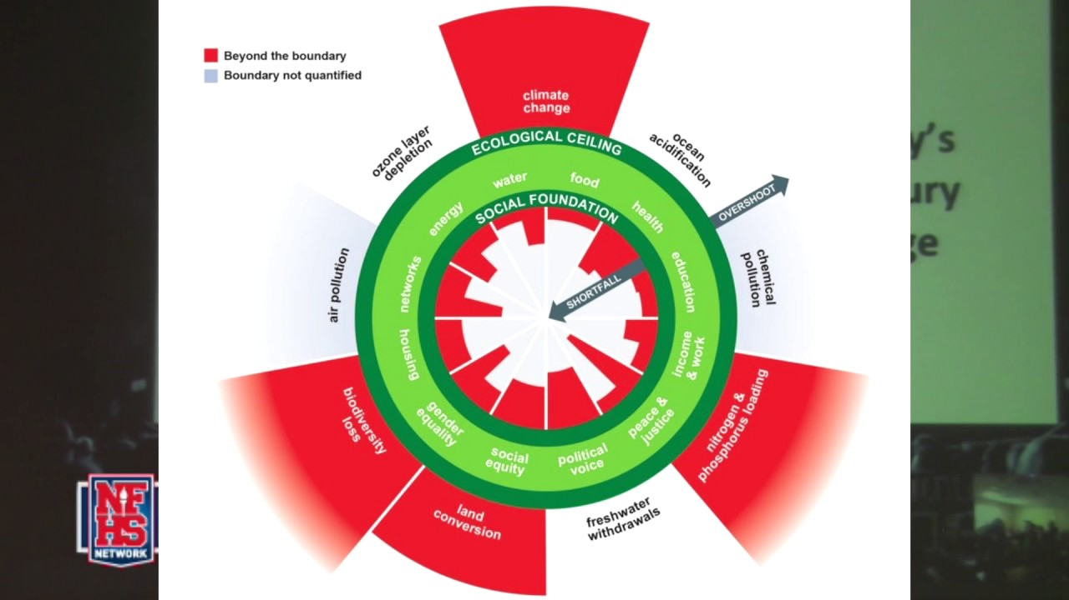
Doughnut Economics
Undershoot & Overshoot

Slide 14
Key principles imbedded in the bioeconomy that require an Integrated Resource Management & Economic Approach
Environmental “Media”
Bioresources
Capital Formation:
Financial, Social
Bioresource (Environmental)
Material & Energy Organization
Energy (CalFire, CEC)
Ecosystem
Biological
Chemical
Physical
For Profit “markets”
Non-profit
Municipal
Solids/
Soil
(CalRecycle,
CDFA)
INFORMATION
Policy/Laws/Strategy Social/Culture/Economy
Air
(CARB,
CAPCOA)
Water
(DWR, Water Board)
Notes:
The BIOCYCLE MODEL includes three other economic “realities” or perspectives… a “LINING PLANET perspective”: 1) material and energy is organized concentrically, i.e. always already integrated in biological systems 2) the four “elements” Earth, Water, Wind and Fire are all part of the bioeconomy… and the “fifth element” is information (in the form of “imagination” = love, laws, science and technology 3) the bioeconomy is always composted of three forms of capital formation: municipal, for-profit and non-profit

Slide 15
Every Market is a Story… data and algorithms! each a chapter in the local biocycle “book”
Collection
Collection fee
Participation
Purity of collected material
Hauling/ Preprocessing
Distance
Transfer
Pretreatment
Tonnage
Processing
Tipping Fee
Feedstock Quality
Technology
Bioproduct Sales
Product Quality
Market size
Market distance
Food, Feed, Fiber
Materials, Chemicals, Energy

Slide 16
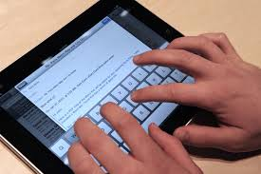
Data Collection, Processing, Reporting
Operational Data Systems
Collections
Tipping
Processing
Inventory
Sales & Marketing
Material Data
Market Data
Enterprise Data
Investment/ROI
Strategy
Management

Slide 17
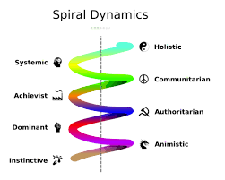
Steps? - Align your biosystems with the biocycle economy!
Collaborate
Plan
Invest
Build
Operate &
Sell
Measure &
Analyze
INNOVATE → continuously evolving

Slide 18
Next Steps
“Company Needs” Assessment Meeting (Collaborative)
Determine Project Goals / Objectives / Milestones
Define Work Breakdown Structure (WBS)
Define Resources necessary to accomplish work scope
Draft Deliverables, Costing, Schedule, Calendar
Execute Agreement to proceed
Get to work!

