Slide 1
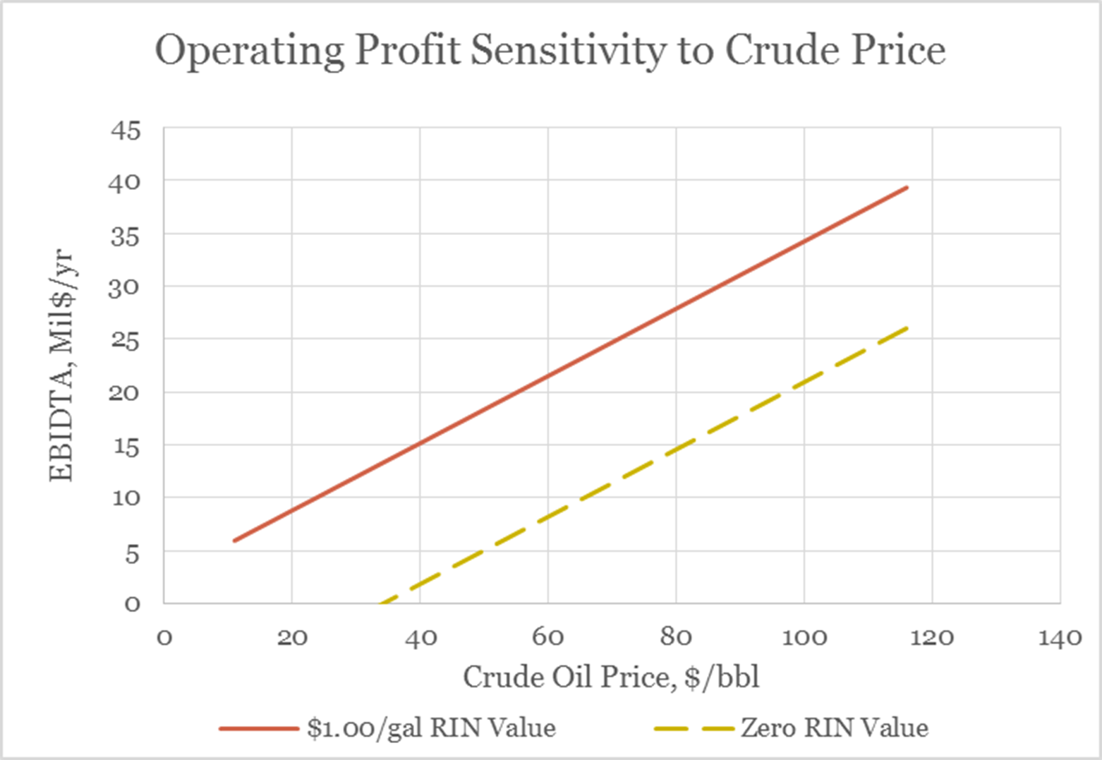
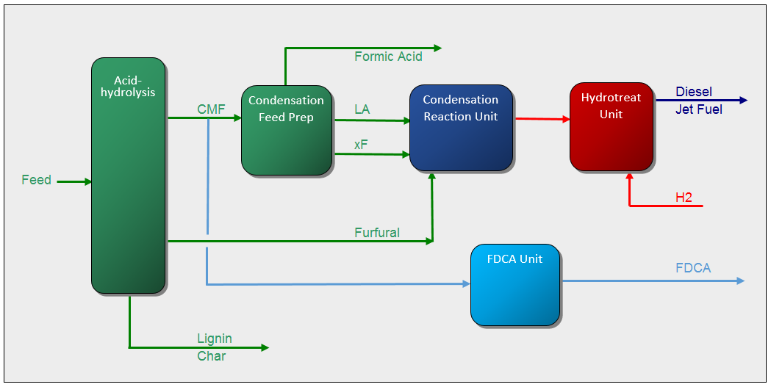
Liquid Phase Catalytic (LPC):
Low volumes with liquid phase
Fast reactions and low residence times (hours)
Low temperature / pressure compared to HTL
Converts raw biomass
Larger particle size
High moisture
Pilot plant Queensland
100kg-day Rural economic development
Drop-in biofuels
High performance bioproducts

