Slide 1
Organic Waste Diversion: Local Government Perspectives
Tim Goncharoff
Santa Cruz County
2019 California Bioresources Alliance Symposium

Slide 2
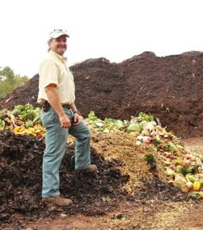
Expectations vs. Reality

Slide 3
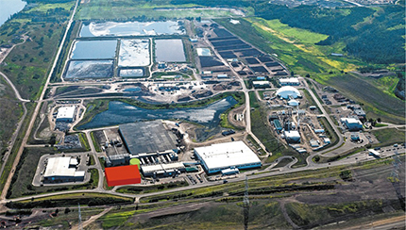
AB 1826, SB 1383:
“This bill imposes no new costs on local government.”
CalRecycle: “Estimated costs of required new facilities: $3 Billion”
Deadline for Compliance: 2021

Slide 4
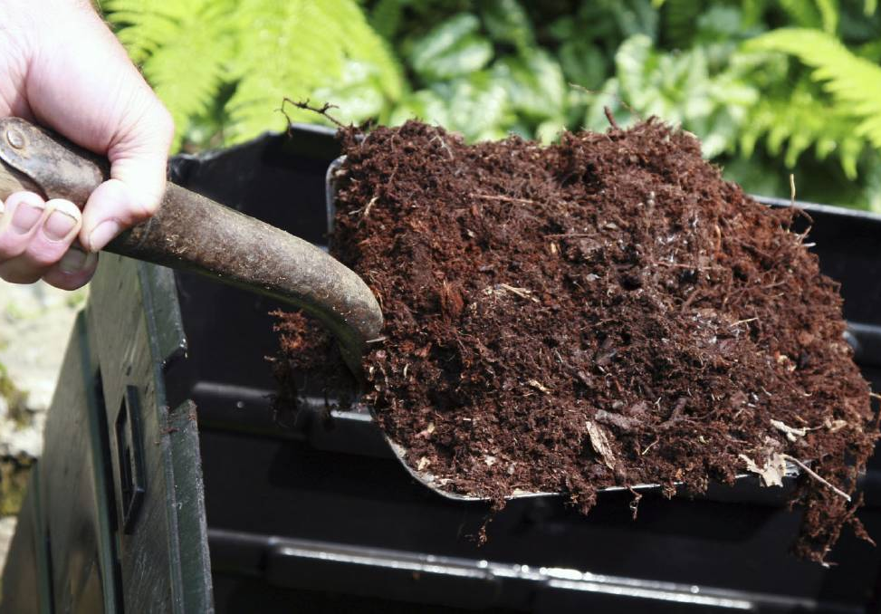
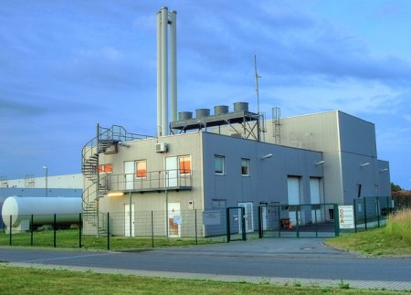
Choices of Technology * Issues of Scale

Slide 5
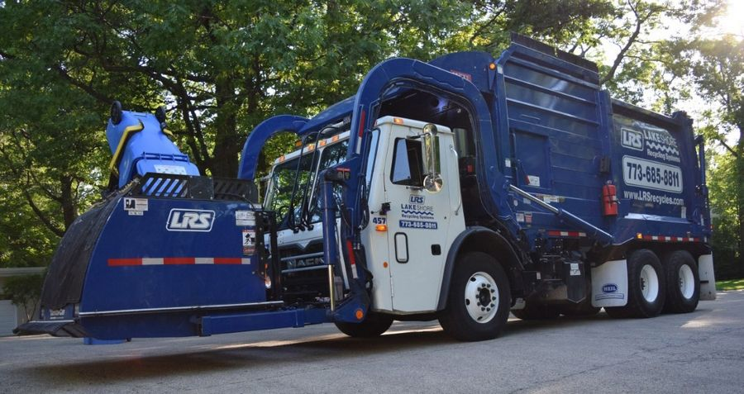
The Hauler: Collection challenges, Franchise agreements; Inspection Requirements; Rate changes, Taxes!

Slide 6
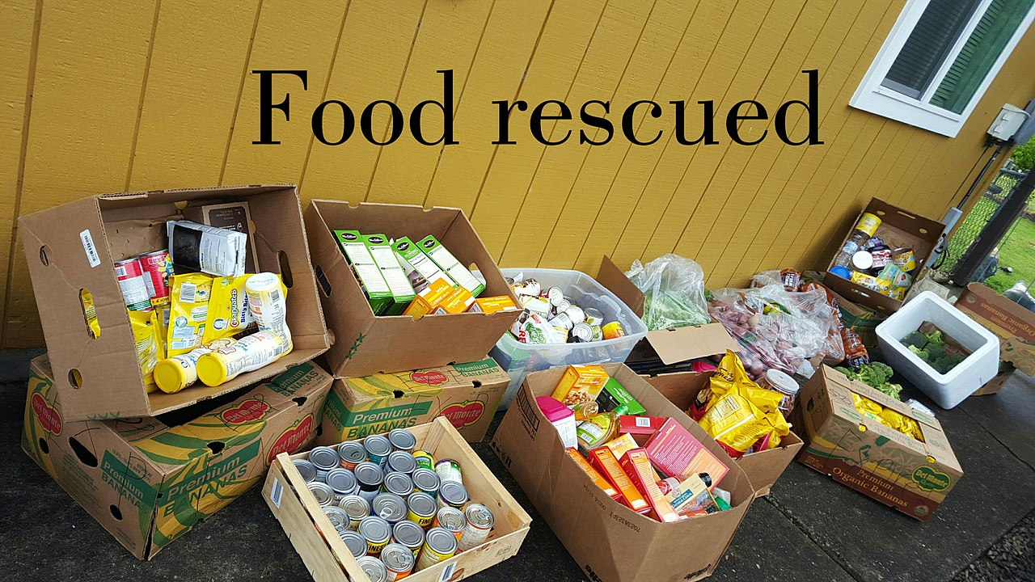
Tracking and reporting challenges

Slide 7
Jurisdiction Issues: Schools, State and Federal Agencies, Special Districts, Other?

Slide 8
PERMITTING Local Permitting Agencies
CalRecycle
Regional Water Quality Control Board
Air Quality Management Districts
Coastal Commission
CA Fish and Wildlife
US Fish and Wildlife
Federal Aviation Administration
Other?

Slide 9
Interagency Cooperation
Local
Regional
Statewide
Obstacles and Opportunities

