Slide 1


Air Quality Permitting
a primer
Errol Villegas
San Joaquin Valley
Air Pollution Control District
November 14, 2019 @ California Bioresources Alliance Symposium

Slide 2
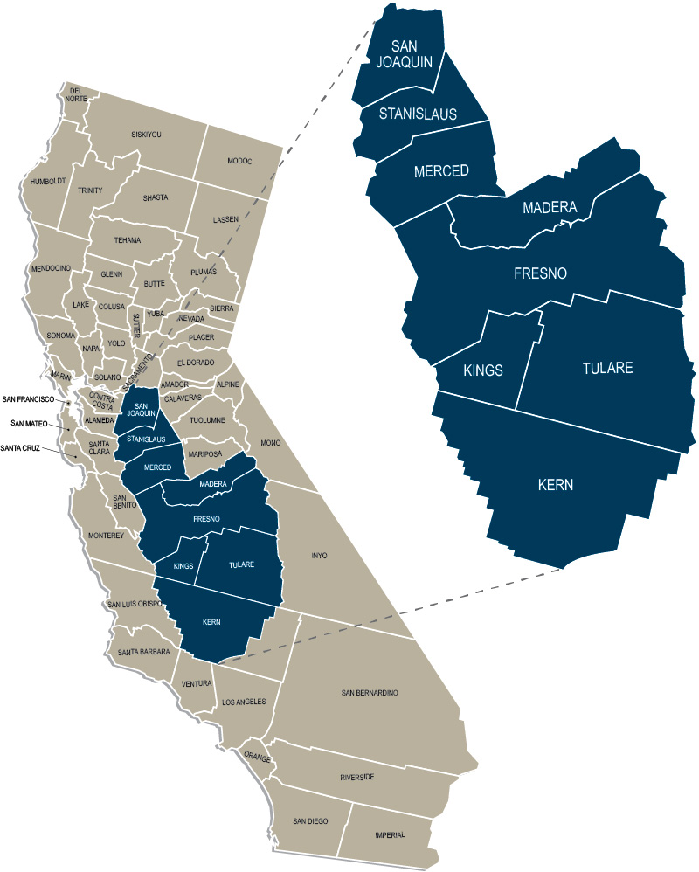
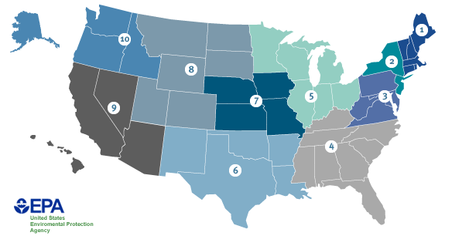
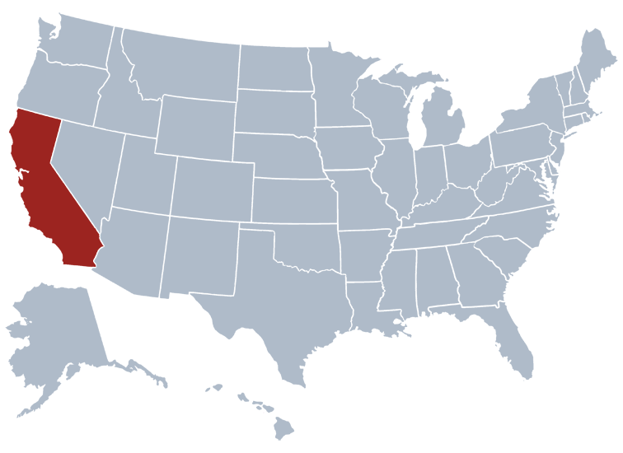



level | Federal (USA) | State (California) | Regional (San Joaquin Valley)
agency | US Environmental Protection Agency (est. 1970) | California Air Resources Board (est. 1967) | San Joaquin Valley Air Pollution Control District
key powers | declare pollutants set air quality standards regulate stationary sources regulate trains, aircraft, ships write national plans + guidance oversee state plans | declare pollutants set air quality standards regulate cars, trucks, cargo handling regulate emitting consumer products write statewide plans + guidance oversee regional plans | regulate stationary sources issue operating permits write regional plans + guidance work with local governments
key law(s) | US Clean Air Act (1970) | California Clean Air Act (1988) Global Warming Solutions Act (2006)
Notes:
Air quality management is a multi-level, federalist, cooperative structure of air quality management.
BAAQMD’s works on the ground with local governments and other regional agencies.
BAAQMD’s work must be consistent with the requirements of the Federal and State agencies.
EPA:
Set air quality standards
Rules and guidance for implementing Clean Air Act requirements
Designations and classifications
Deadlines for attainment
Review and approve attainment plans
Review and approve rules
Responsible for mobile sources control or waiver to states
Floor-level regulations that apply across the country (NSPS/NESHAP)
CARB
Research
State air quality standards (no attainment dates)
Attainment planning
Air monitoring
Emissions inventory for mobile sources and some area sources
Review and approve plans, rules
Modeling for plans (leading authority)
Reducing emissions
Mobile sources
Oversight of certain incentive programs (ex: Carl Moyer, Prop 1b)
Consumer products
Subvention grants

Slide 3
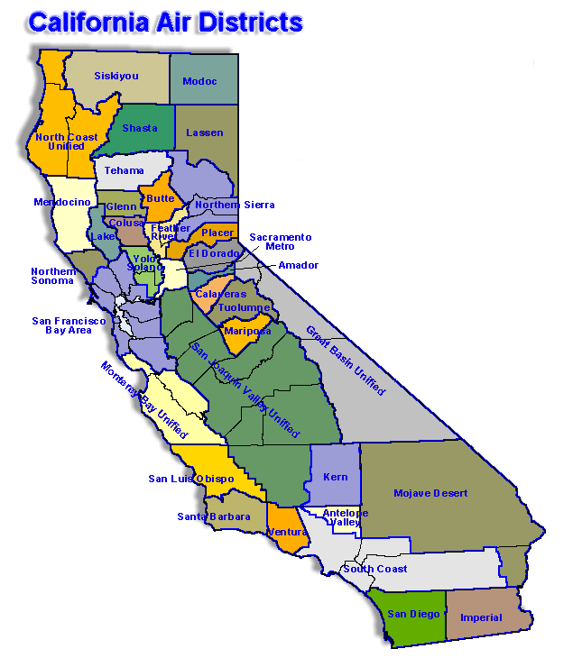
Additional Jurisdictional Insights
California divided into 35 Air Districts
with differing air quality
South Coast and San Joaquin:
  worst air quality = most stringent regulations…
  …prohibitory rules and associated requirements
  …BACT and offset thresholds

Slide 4
Air Permitting Process
Authority to Construct (ATC) permit, prior to constructing or operating
Different prohibitory rules
  SJVAPCD Rule 4565 (Biosolids, Animal Manure, and Poultry Litter Operations)
  SJVAPCD Rule 4566 (Organic Material Composting Operations)
  SCAQMD Rules 1133, 1133.1, 1133.2 and 1133.3
  BAAQMD developing Reg 13-2 (Organics Handling) and 13-3 (Composting Operations)
New Source Review Rules
(SJVAPCD Rule 2201, SCAQMD Regulation XIII, BAAQMD Regulation 2 Rule 2, etc.)
  Best Available Control Technology (BACT)
  Offsets
  Public Notice (30 day public comment period)
  Ambient Air Quality Analysis (AAQA)
  Health Risk Assessment (HRA)/Risk Management Review (RMR)
  Major Source (Title V Federal requirements)

Slide 5
Permitting Timelines
Pre-application Meetings (highly encouraged)
Preliminary Review
  Statutory timeline: 30 days to deem a project Complete/Incomplete
  Evaluates project proposal for necessary information to perform final analysis
Final Review/Engineering Analysis
  Statutory timeline: 180 days from Complete/CEQA issuance date, to issue ATC, which ever is later
  Perform emission calculations
  Conduct HRA/RMR analysis (AAQA if public notice)
  Determine compliance with NSR Rule: BACT, Offsets, Public Notice, etc.
  Determine compliance with prohibitory rules: Mitigation measures, monitoring, recordkeeping
  Establish permit conditions to ensure compliance
Issue Authority to Construct permit
Notes:
We have BACT, but still in progress for food waste considerations.
Critical aspect is where the materials come from. And the GHG benefits versus the criteria pollutant disbenefits.

Slide 6
Permitting Considerations (part 1)
75 to 100 new or expanded compost facilities expected in California
Location of composting operation
  New composting site / Existing composting operation / At existing landfill
Uncontrolled VOC emission resulting from composting operations
  Small Operation: 10,000 tons/year (tpy) of compost = 26 tpy VOC
  Medium Operation: 100,000 tpy-compost = 260 tpy VOC
  Large Operation: 500,000 tpy-compost = 1,300 tpy VOC
  (cont’d next page)

Slide 7
Permitting Considerations (part 2)
(cont’d from previous page)
Prohibitory rule requirements/mitigation measures
  Increased nuisance potential with the food waste receiving and processing
  NSR: Installation of Best Available Control Technology (BACT)
  Enclosed system vented to a scrubber/carbon adsorption/biofilter (91-99% control)
  Negative Aerated Static Piles (ASPs) and vented to a thermal incineration/carbon adsorption/biofilter (80-90% control)
  Positive ASPs with a cover (engineered cover, finished compost, or equivalent) (80% control)
  Covered piles using finished compost or equivalent (56% control)
NSR: Offsets/Emission Reduction Credits (ERCs)

Slide 8
Land Use Considerations
California Environmental Quality Act (CEQA)/Land use approval
  Generally City or County approval process
  Existing facility versus new facility
  Nuisance (odors, dust, etc.)
  Stationary source and transportation emissions
  Construction and operation emissions
  Any significant air quality impacts must be mitigated to the extent feasible
  Lengthy process – approval not certain
Air Districts cannot issue construction permits until CEQA has been satisfied
Notes:
Green or Food Waste
Windrow Composting: 5.71 lb-VOC/ton and 0.66 lb-NH₃/ton
Storage: 0.2 lb-VOC/ton-day and 0.02 lb-NH₃/ton-day
Co-Composting, Biosolids, Manure, or Litter
Composting: 1.78 lb-VOC/ton and 2.93 lb-NH₃/ton
Storage: 0.02 lb-VOC/ton-day and 0.001 lb-NH₃/ton-day

Slide 9
Recap of Critical Composting Expansion Considerations
Timing of CEQA approval from land use agencies
  Contact your local City/County, ASAP
State and Federal law require air districts to manage criteria pollutants
  Composting offers many beneficial intentions
  Yet composting operations are still a significant source of VOC emissions
Compliance with stringent permitting requirements
  BACT – Installation of control technologies
  Offsets – May require industry level approach
Contact your local air district ASAP

Slide 10
Questions are the wind
beneath my wings. Ask me one!
Errol Villegas
San Joaquin Valley
Air Pollution Control District

Slide 11
Water Quality Permitting
a primer
Rob
Busby
Brianna St Pierre
Central Valley Regional
Water Quality Control Board
State Water Resources
Control Board
November 14, 2019 @ California Bioresources Alliance Symposium

Slide 12
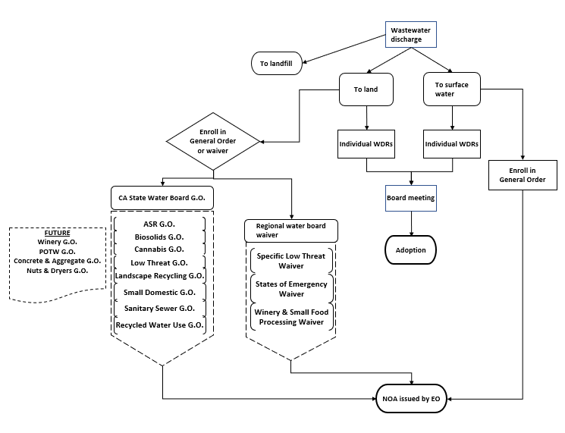
Water Board permitting follows a process.

Slide 13
Landfills (Title 27)
General Orders & Waivers
Small Domestic GO (2015-0121DWG)
Waste Discharge to Land (Non-15)
General Orders & Waivers
Composting General Order
(GOWQ 2014-0153 DWG)
Dairies & Confined Animals
General Orders & Waivers
Existing Milk Cow Dairies GO (R5-2013-0122)
Small Food Processor Waiver (R5-2015-0005)
Low Threat Waiver
(R5-2018-0085)
Biosolids General Order
(2004-0012 DWG)
Petroleum Cleanup General Order
(R5-2003-0044)
EO Approval of Notice of Applicability
Dairy Manure Digester and Co-Digester Facilities GO
(R5-2010-0130)
Centralized Dairy Manure Anaerobic Digesters
(R5-2011-0039)
Bovine Feedlots GO
(R5-2017-0058)
Poultry Operations GO
(R5-2019-0034)
EO Approval of Notice of Applicability
EO Approval of Notice of Applicability
Disaster-related Waste GO
(20XX-XXX DWG) DRAFT
Permitting organic material could look like this:
Individual WDRS
Tentative WDRS
30-Day Notice of Public Hearing
Board Meeting
Board Approved

Slide 14
Let the questions flow!
Rob
Busby
Brianna St Pierre
Central Valley Regional
Water Quality Control Board
State Water Resources
Control Board

Slide 15

Solids Permitting
a primer
Greg Reyes
Brian Stalker
Bill
Prinz
Paulina
Lawrence
Kyle
Pogue
CalRecycle
City of
San Diego
Riverside
County
CalRecycle
CalRecycle
November 14, 2019 @ California Bioresources Alliance Symposium

Slide 16
Outline of Primer
Role of Local Enforcement Agency (LEA)
Operation Type
Regulatory Tiers
Documentation
Timelines and Benchmarks

Slide 17
Role of LEA
Designated Authority by CalRecycle
Exclusively State Statute
Permitting
Inspections

Slide 18
Operation Types
Primary Operation Categories
    Compostable Material Handling
      Composting – Static Pile and Windrow
      Chip and Grind
    In-Vessel Digestion
      All digestion technologies
All Types of Organic Feedstocks

Slide 19
Regulatory Tiers
Full Permit
  No limitations on feedstock, incoming material or onsite material
Registration Permit
  Has limitations on one or more – feedstocks, incoming material, onsite material
Enforcement Agency Notification
  Limited feedstocks and fixed limit on total material onsite
Research Enforcement Agency Notification
  Limited material onsite and 2 year timetable

Slide 20
Documentation
Initial Submittal → Full Permit
CalRecycle Solid Waste Facility Permit Application
Report Of Facility Information
  Compost – Report of Compost Site Information
  In-Vessel – In-Vessel Digestion Report
Appropriate Land Use Approvals (e.g. CEQA, CUP)
Inclusion in – CIWMP, SE, NDFE, SRRE
One copy to the Regional Water Board, 2 copies to the LEA

Slide 21
Timeline and Benchmarks
Full permit processing cannot exceed 150 days* total per statute
  30 days for a Rejection or Complete and Correct finding
    A lot of the regulator questions will occur at this point.
  60 days to address public comments and prepare a proposed permit
    Public Notice, Public Meeting – consideration for Environmental Justice
  60 Day for CalRecycle concurrence
    Monthly Public Meeting
Permit and SWIS ID Issuance
(*Exceptions to the timeline)

Slide 22
Do us a solid. Ask a question.
Greg Reyes
Brian Stalker
Bill
Prinz
Paulina
Lawrence
Kyle
Pogue
CalRecycle
City of
San Diego
Riverside
County
CalRecycle
CalRecycle

