Slide 1
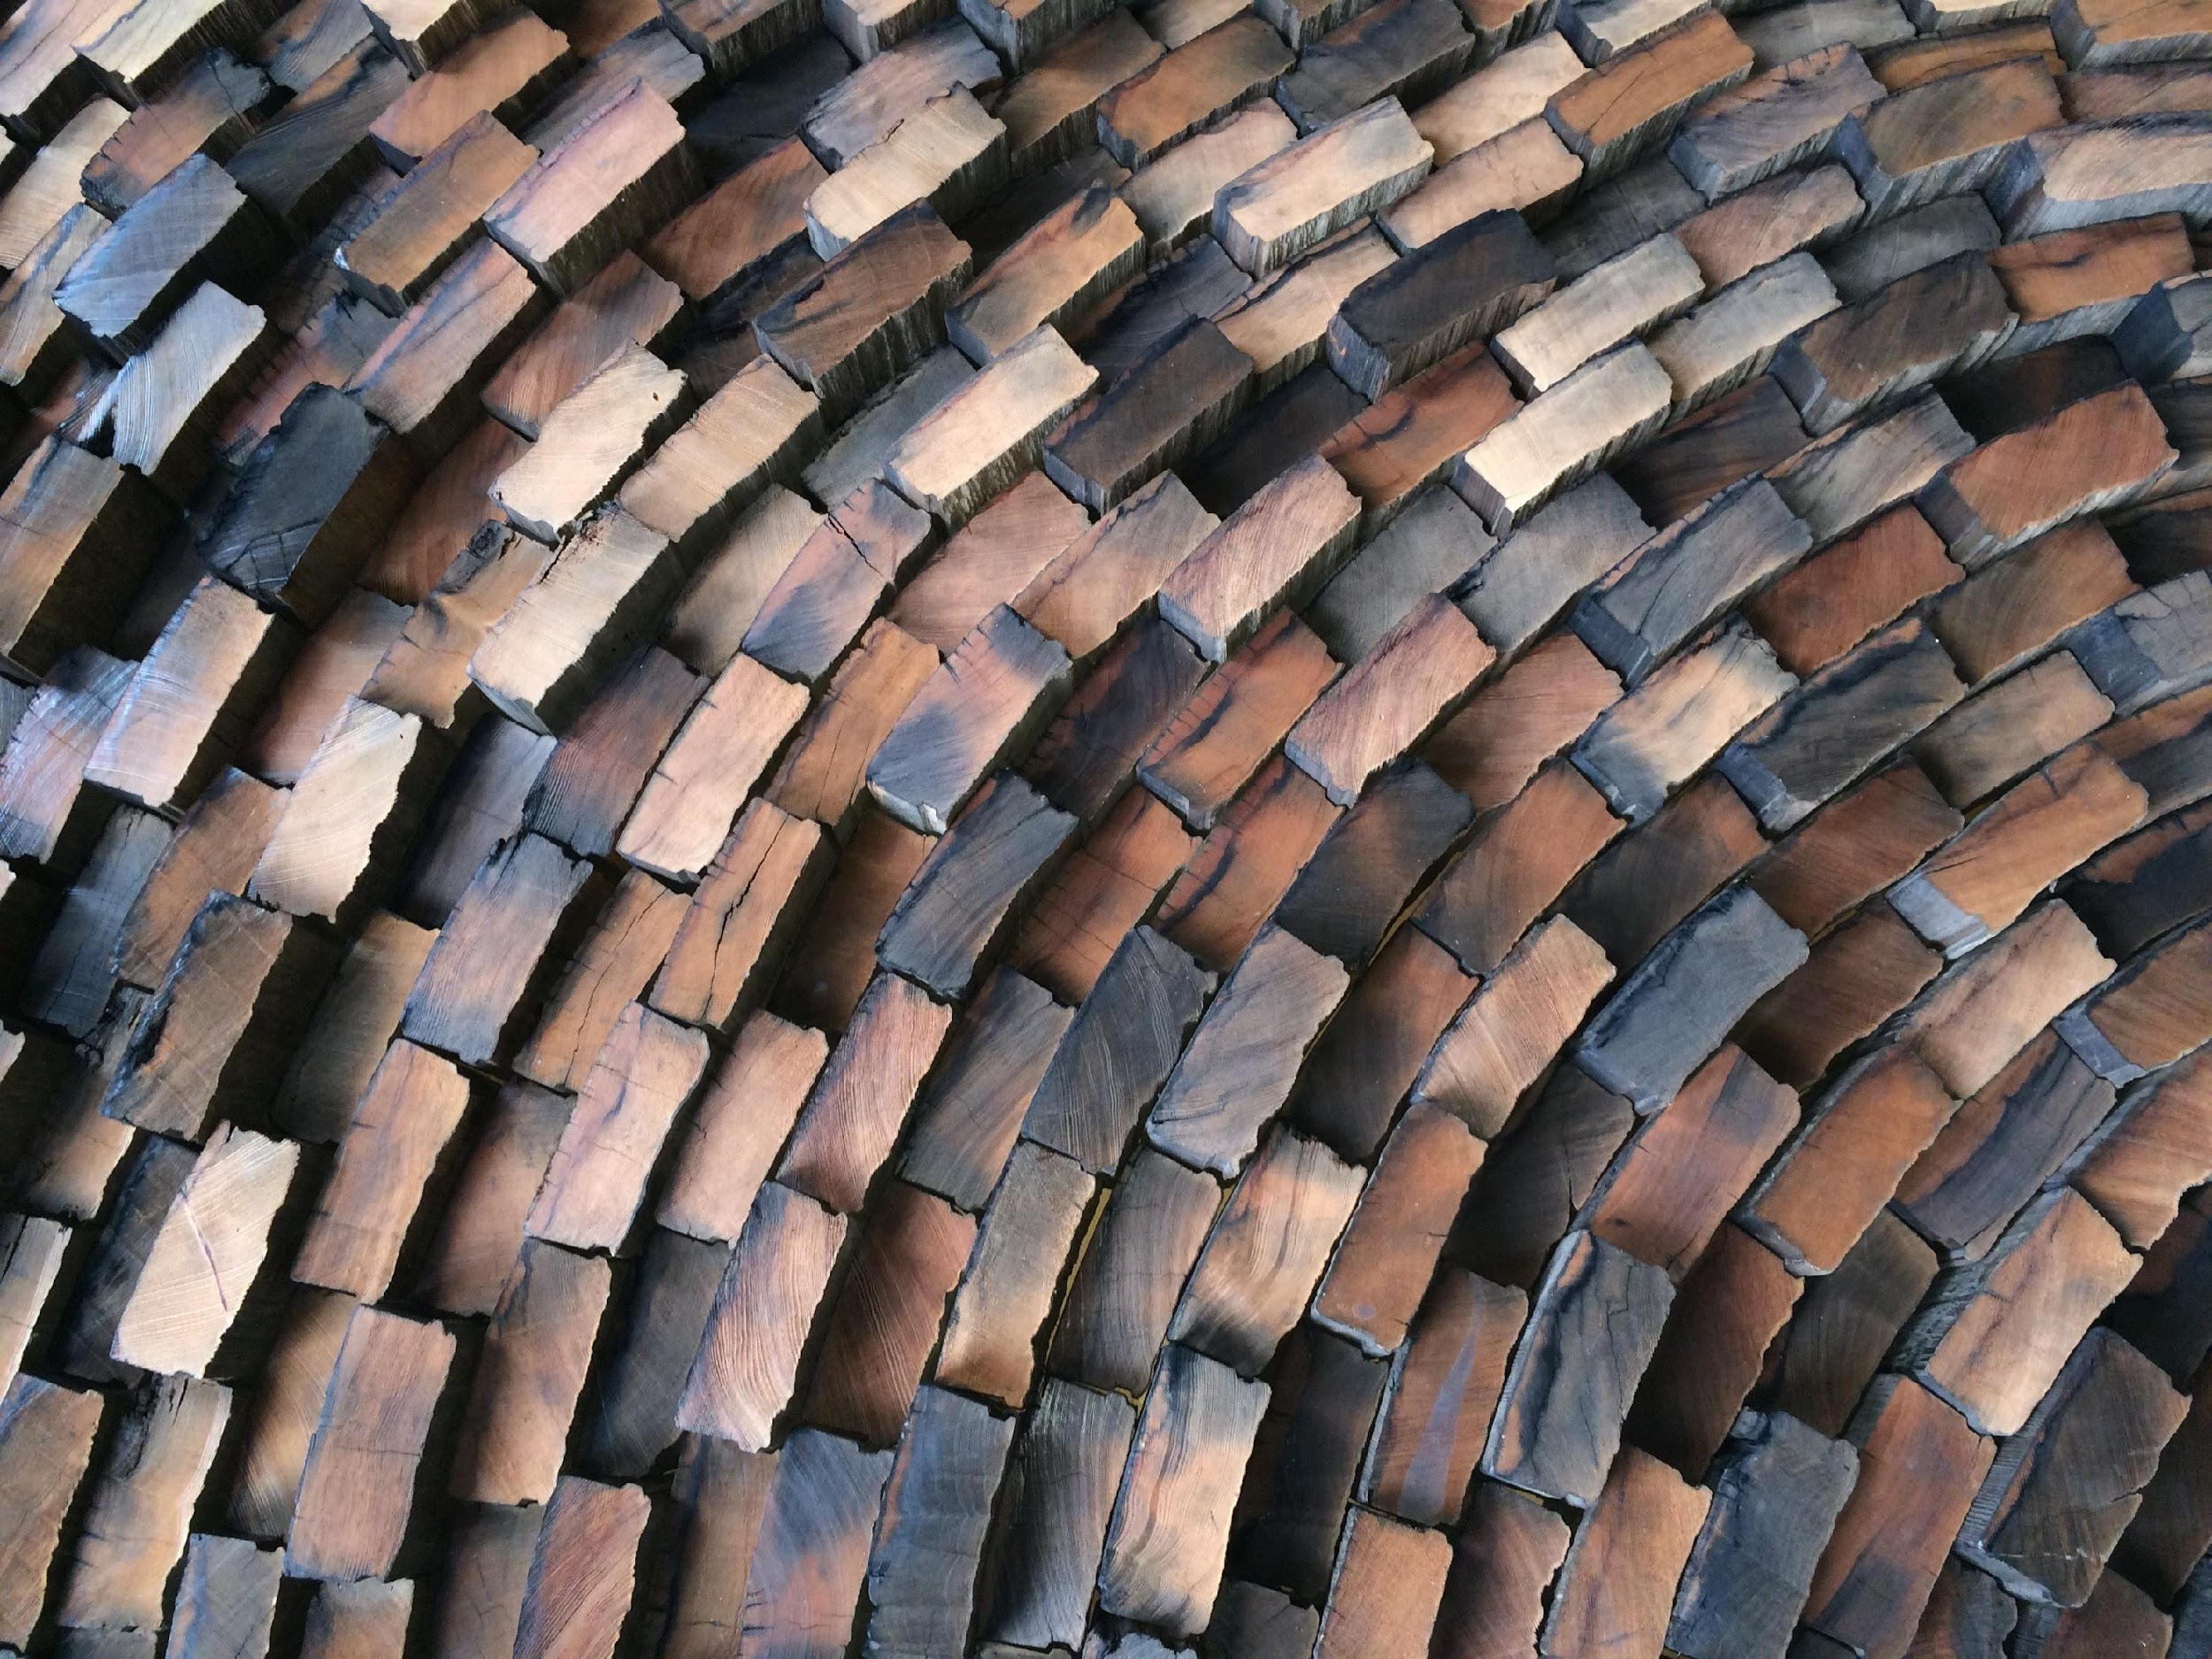
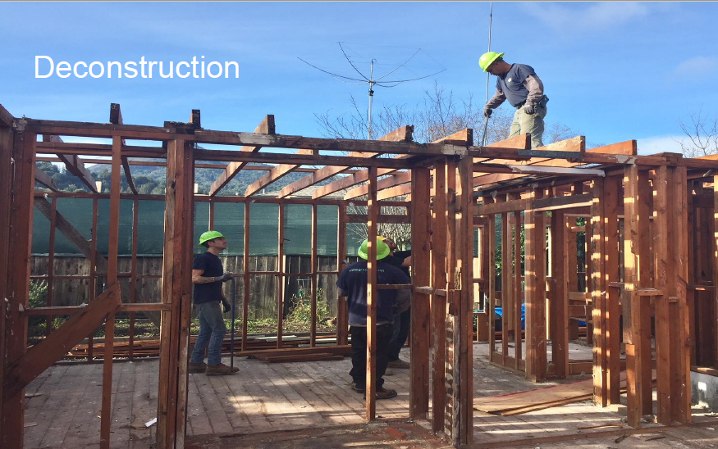
Potential for Wood Reuse
Jobs ➠ Organics Diversion ➠ Carbon Sequestration ➠ GHG Reductions
Lumber – CA Disposal = 3.7 M Tons/Year (2nd only to Food)
Model - Portland (2016 & 2019) – Mandatory Residential Deconstruction Ordinances
6 tons of wood/home for reuse
  Milwaukee (2017) - Mandatory Residential Deconstruction Ordinance
  Palo Alto (2019) - Commercial & Residential Deconstruction Ordinance
  San Mateo County (2018-19) - Job Training & Reuse Warehouse contracts
Bay Area Deconstruction Workgroup
Join us!
Nicole Tai, Greenlynx, 415-890-5880
ntai@greenlynx.net
Timonie Hood, U.S. EPA, 415-272-9719
hood.timonie@epa.gov
http://www.stopwaste.org/at-work/built-environment/construction-demolition-debris/bay-area-deconstruction-working-group

