Slide 1
Quality Assurance Project Plans
A Guide to Developing a Successful Project Plan
Donald M. Brown
US EPA Region 10 Quality Assurance Manager
December 2019

Slide 2
Contact the EPA Region 10 QA Team through your EPA
Tribal Coordinator/Grant Officer
for assistance
before you begin
Notes:
If this is the first time you’ve planned an environmental project, then you should contact the EPA Region 10 Quality Assurance Team through your EPA Tribal Coordinator or Grant Officer for assistance before you begin.

Slide 3
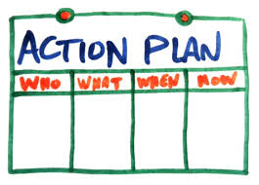
What is a QAPP?
In short…it is just a plan…
…that describes how you will collect and use environmental information and data
Notes:
A QAPP is a written document that describes your plan for collecting and using environmental information and data. It documents the results of the planning that you’ve done.

Slide 4

What are environmental data?
Environmental processes
Location
Conditions
Ecological or health effects and consequences
Performance of environmental technology
Notes:
Any measurements or information that describe:
environmental processes,
location,
conditions;
ecological or health effects and consequences; or
the performance of environmental technology.

Slide 5


Environmental Data
Monitoring
Water
Air
Sampling
Water
Soil
Biological
Analysis
Laboratory
Field
Notes:
Therefore, some examples of when your project will need a QAPP are:
Monitoring, Sampling, Analysis…

Slide 6
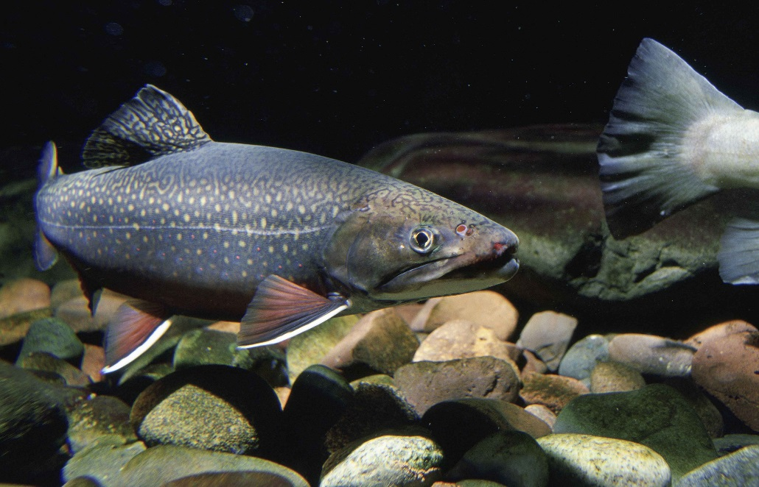
Environmental Data
Surveys
Photographic
Plant or Ecological
Fish Consumption
Studies
Baseline Study
Erosion Study
Fish Study
Bird/Wildlife Study
Notes:
Surveys, studies...

Slide 7
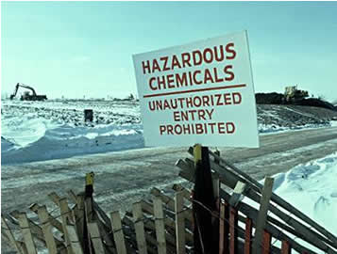
Environmental Data
GPS Coordinates
Watershed Mapping
Modeling
Debris Clean-up
Sediment Assessment
Notes:
mapping, modeling, clean up, assessment, etc..

Slide 8

Why do I need to write a QAPP?
Need a sound scientific approach to support the study and decisions you make
Notes:
A sound scientific approach should be used to support your environmental study and the decisions you make.
It’s important to assure that the results make sense – and are accurate, usable, and defensible.

Slide 9
Why do I need to write a QAPP?
  Documents quality assurance (QA) and quality control (QC) to ensure that the data you collect will meet the needs of your project
Notes:
The QAPP documents how quality assurance (QA) and quality control (QC) will be incorporated into technical activities to ensure that the data you collect will meet the needs of your project.
QA = complete system to assure quality (Example: review/approval of QAPPs, training)
QC = techniques and activities used to fulfill quality requirements (Example: precision and accuracy measurements)

Slide 10
Why do I need to write a QAPP?
  Organizes project planning so you can:
    Ensure all important project details are included
    Confirm that your project goals will be achievable
Notes:
A QAPP helps you organize your project planning efforts, ensure all important project details are included, and confirm that your project goals will be achievable.

Slide 11
Why do I need to write a QAPP?
EPA financial assistance regulations require a QAPP for all projects involving collection or use of environmental data.
Notes:
EPA requires, in its financial assistance regulations, that all projects involving the collection or use of environmental data must have a QAPP.

Slide 12
When do I prepare a QAPP?
A QAPP must be written and approved before you start collecting data.
Send to EPA no later than
30 days
before you begin sampling.
Notes:
A QAPP must be written and approved before you start collecting data.
Your grant condition requires you to send copies of the QAPP to both the EPA Tribal Coordinator or Grant Officer and the Regional Quality Assurance Manager no later than 30 days before you begin sampling.
Therefore, you should begin to plan and document the technical and QA/QC activities of your project with this timeframe in mind.

Slide 13
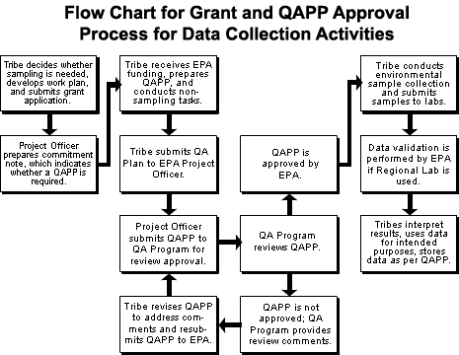
What is the process to get my QAPP approved?
Notes:
Time it takes to develop/write QAPP dependent on complexity of the project (1 week to 1 month to several months)

Slide 14
Where can I find help writing a QAPP?
Download
EPA Requirements for Quality Assurance Project Plans (QA/R-5)
    https://www.epa.gov/sites/production/files/2015-06/documents/g5-final.pdf
Or
EPA Guidance for Quality Assurance Project Plans (QA/G-5)
    https://www.epa.gov/sites/production/files/2015-06/documents/g5-final.pdf
Notes:
{Provide links to attendees}

Slide 15
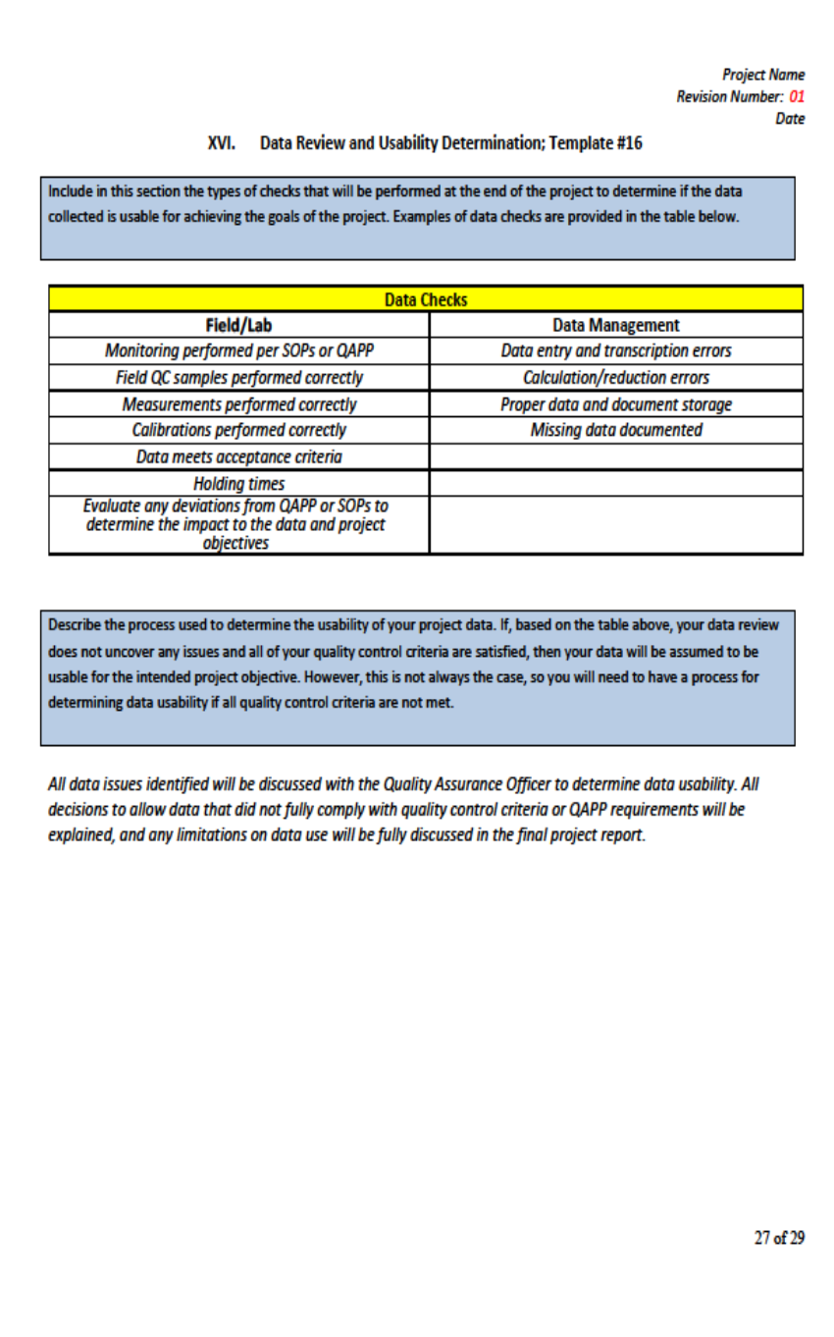
New R10 QAPP Template
Template #, Title
Instructions
Example to Replace

Slide 16
Citizen Science QAPP Template
https://www.epa.gov/citizen-science/quality-assurance-handbook-and-guidance-documents-citizen-science-projects

Slide 17
What do I need to include in my QAPP?
24 Required Elements
Project Management
Data Generation and Acquisition
Assessment and Oversight
Data Validation and Usability
*See the Region 10 QAPP Checklist*
Notes:
There are 4 groups of project information that all QAPPs must address:
Project Management
Data Generation and Acquisition
Assessment and Oversight
Data Validation and Usability
Each group contains a number of elements which are discussed in more detail in the following slides.

Slide 18
QAPP Writing Tips
The level of detail in each QAPP will vary according to the type of work being performed and the intended use of the data.
Although a QAPP is usually comprised of 24 elements, not all elements apply to every project.
Notes:
A couple of important points to remember when planning your project and writing the QAPP:
The level of detail in each QAPP will vary according to the type of work being performed and the intended use of the data.
In other words, the amount of information in a QAPP is dependent upon the level of complexity of the projects.
Although a QAPP is usually comprised of 24 elements, not all elements apply to every project.
So if an element does not apply to your project, then you just need to state this and explain why.

Slide 19
Questions?
Contact your Tribal Coordinator to get in touch with the R10 Quality Assurance Manager or the Quality Assurance Team for help with writing a QAPP or questions on the QA processes.
Remember, safety first!
Donald M. Brown
USEPA R10 RQAM
Brown.DonaldM@epa.gov
(206) 553-0717

