Slide 1
Community-Port Collaboration Pilot Projects Overview & Lessons Learned
Draft
U.S. EPA Office of Transportation and Air Quality

Slide 2
Overview of Training
Community-Port Collaboration Pilot Projects
Technical assistance provided to 4 pilot communities.
Key lessons learned from pilots and additional tools developed based on pilot outcomes
Notes:
Community-Port Collaboration Pilot Projects
Technical assistance provided to 4 pilot communities, and
Key lessons learned from the pilots and additional tools developed based on pilot outcomes

Slide 3
Project Goals
Community-Port Collaboration Pilot Projects
Improve air quality and environmental conditions at and near ports that can lead to improved public health in communities and better outcomes for port infrastructure development,
Successful partnerships were developed from the pilot projects by equipping port operators and community stakeholders with information, skills and tools to effectively develop and implement collaborative actions.
Notes:
Project Background
The U.S. Environmental Protection Agency’s (EPA’s) Community-Port Collaboration Pilot Projects includes pilot projects conducted in four communities. The pilot projects support the goal of improving air quality and environmental conditions at and near ports that can lead to improved public health in communities and better outcomes for port infrastructure development. Successful partnerships were developed from the pilot projects by equipping port operators and community stakeholders with information, skills and tools to effectively develop and implement collaborative actions.

Slide 4
Utilized Community-Port Collaboration Toolkit
Ports Primer for Communities: An Overview of Ports Planning and Operations to Support Community Participation
Community Action Roadmap: Empowering Near-Port Communities
Environmental Justice (EJ) Primer for Ports: The Good Neighbor Guide to Building Partnerships and Social Equity with Communities
Notes:
The pilot communities utilized tools in the Community-Port Collaboration Toolkit. The toolkit includes the:
Ports Primer for Communities: An Overview of Ports Planning and Operations to Support Community Participation
An interactive tool and reference document that characterizes the port industry sector, including environmental and community health impacts associated with port activities.
Community Action Roadmap: Empowering Near-Port Communities
An implementation companion for the Ports Primer for Communities that provides a step-by-step process for building collaborations and preparing community stakeholders.
Environmental Justice (EJ) Primer for Ports: The Good Neighbor Guide to Building Partnerships and Social Equity with Communities
Designed to inform the port industry sector of the perspectives, priorities, and challenges often unique to communities with EJ concerns.
For in-depth information on these, go to the EPA Community-Port Collaboration website at www.epa.gov/community-port-collaboration. Training modules on each of these tools is available.

Slide 5
Pilot Projects
New Orleans, Louisiana
Savannah, Georgia
Seattle, Washington
Providence, Rhode Island
Notes:
In 2016, EPA selected three applicants from more than twenty near-port communities’ and ports’ applications to receive technical assistance and pilot a draft community-port collaboration toolkit as part of the Community-Port Collaboration Pilot Projects.
The pilot projects included:
New Orleans, Louisiana: Port of New Orleans (Port NOLA), in collaboration with the Deep South Center for Environmental Justice and the Lower 9th Ward Center for Sustainable Engagement and Development, applied to participate in the pilot program to build collaborative relationships between the port and near-port communities.
Savannah, Georgia: Harambee House, Inc. / Citizens for Environmental Justice (Harambee House) applied to participate in the pilot program to strengthen collaboration between near-port communities, Georgia Ports Authority and other Port of Savannah terminal operator/owners.
Seattle, Washington: The Port of Seattle, in collaboration with the local non-profit organization Just Health Action, applied to participate in the pilot program to build collaborative relationships between the port and two near-port communities.
Region-sponsored pilot:
Providence, Rhode Island: In 2017, EPA initiated a streamlined additional pilot project working with the Environmental Justice League of Rhode Island (EJLRI) and near-port community stakeholders of the Port of Providence (ProvPort) in Providence, Rhode Island.

Slide 6
Lessons Learned
1. Planting the Seeds for Success
2. Setting an Equitable Table
3. Identifying the Right Partners
4. Building Trust and Mutual Respect
5. Developing Shared Understanding
6. Agreeing to Process and Outcomes
7. Flexibility and Collaboration
8. Accountability and Celebrations.
Notes:
This following slides share Lessons Learned for applying these tools in other communities
1. Planting the Seeds for Success (what you need to get started)
2. Setting an Equitable Table
3. Identifying the Right Partners beyond the Environmental Justice Community and Port Operators
4. Building Trust and Mutual Respect
5. Developing Shared Understanding
6. Agreeing to a Process and a Prospective Outcome
7. Building Flexibility and Collaboration into the Process
8. Establish Accountability and Celebrations for Achieving Outcomes

Slide 7
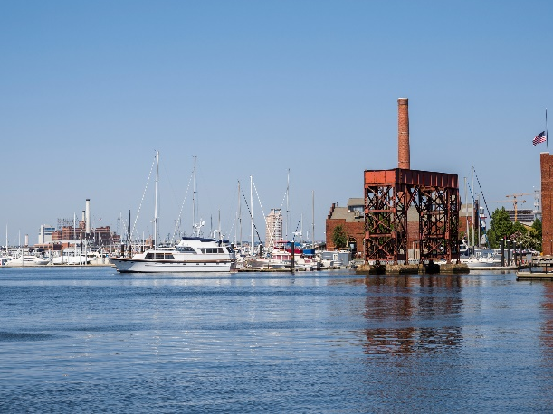
Lesson 1: Planting the Seeds for Success
Discussing partnership priorities
Frame principles of a genuine, principled partnership
Confirm the level of commitment necessary from key parties to establish a partnership
Enlist a neutral, third-party facilitator experienced in working with environmental justice communities
Distinguish between individual perspectives and organizational perspectives during the process
Notes:
1. Planting the seeds for success (what you need to get started).
The ingredients for a successful collaboration or partnership project between ports and near-port communities may not be readily apparent at the beginning. Work may be necessary to lay the groundwork in order to “plant the seeds for success.” This may include helping frame what a genuine, principled partnership might entail, the level of commitment from key parties that are necessary to establish a partnership, using a neutral, third-party facilitator, and strategizing on how to distinguish between individual perspectives and organizational perspectives when discussing partnership priorities and making recommendations.

Slide 8
Lesson 2: Setting an Equitable Table
Stakeholder groups have different resources and abilities to participate in partnership projects.
Recognize these differences early and take steps to support the participation of those groups with limited time, resources or organizational capacity.
Without this early investment to level the playing field, the partnership will lack a solid foundation to flourish.
Notes:
2. Setting an equitable table.
Organizations and stakeholder groups have different resources and abilities to participate in partnership projects. However, by recognizing these differences early, steps can be taken to bolster the participation of those groups that have limited time, resources or organizational capacity. If groups with less means are not given the opportunity to participate as equals, the partnership’s effectiveness will be undermined and its credibility will be greatly diminished.

Slide 9
Lesson 3: Identifying the Right Partners
To be successful, involve stakeholders beyond the port operators and the nearby environmental justice community.
Engage a wide range of partners, including local governments, academic institutions, health agencies, state and regional transportation agencies and nearby businesses.
Consider engaging other community leaders that may not be directly tied to the environmental justice community.
Notes:
3. Identifying the right partners beyond the environmental justice community and port operators.
Ports partnerships need to involve more than the port industry and the nearby environmental justice community to be successful. It is important to consider and engage a wide range of partners, including local governments, academic institutions, health agencies, state and regional transportation agencies and nearby businesses. It is also important to consider engaging other community leaders that may not be directly tied to the environmental justice community.

Slide 10
Lesson 4: Building Trust and Mutual Respect
Design the process to build trust and mutual respect.
Focus on building personal and professional relationships.
Foster a safe environment for clear and open communication.
Value feedback from all partners to cultivate a spirit of being on the same team.
Notes:
4. Building trust and mutual respect.
Building trust and mutual respect and establishing personal relationships are keys to success. Building principled relationships fosters a safe environment for clear and open communication; in return, valuing feedback from all partners cultivates the spirit of being on the same team.

Slide 11
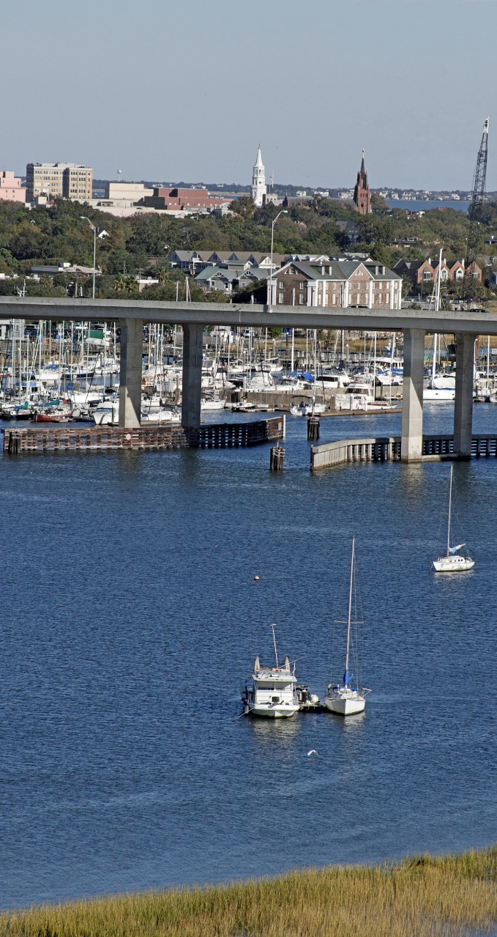
Lesson 5: Developing Shared Understanding
Set the stage with a shared understanding of historical context.
Exchange key issues and topics between partners.
Take time to help partners develop this shared understanding.
Conduct port and community tours
Enable partners to think more creatively about ways to address persistent environmental challenges.
Notes:
5. Developing shared understanding
Moving forward productively is difficult without a shared understanding of historical context, as well as other key issues and topics between partners. Taking time to help partners develop this shared understanding is a key ingredient for enabling partners to think more creatively about ways to address persistent environmental challenges and related issues facing near-port communities. Conducting port tours for community members and community tours for port officials is a very valuable way to advance shared understanding.

Slide 12
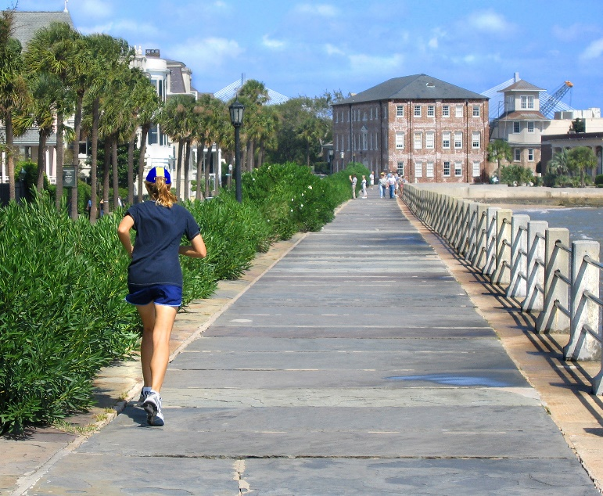
Lesson 6: Agreeing to a Process and Outcome
An effective partnership requires a well-thought-out process.
Spend time upfront to develop a shared process and goals for outcomes
As conflicts arise, keep everyone moving in the same direction by returning to the process and outcomes established at the beginning.
Notes:
6. Agreeing to a process and a prospective outcome.
An effective partnership requires a well-thought-out process and a focus on outcomes. Although it can feel intimidating to start a process by thinking ahead to the end and attempting to identify outcomes, agreeing upfront and committing to a shared process and goals for outcomes can keep everyone moving in the same direction, even during periods of disagreement, and can increase a project’s success over the long-term.

Slide 13
Step 7: Building Flexibility and Collaboration into the Process
Partnerships are frequently complex and multi-dimensional.
Partnerships reflect the dynamic nature of local conditions and context.
Build flexibility into the process and encourage opportunities for collaboration as the project evolves.
Notes:
7. Building flexibility and collaboration into the process.
Partnerships are frequently complex and multi-dimensional. Moreover, they are affected by the dynamic nature of local conditions and context, whether in communities or in business organizations. To better protect against these challenges, it is important to build flexibility into the process and encourage opportunities for widespread collaboration to the extent possible.

Slide 14
Lesson 8: Establish Accountability and Celebrations
Proactively build success into the partnership process.
Include structures to help keep partners accountable to each other.
Take time to celebrate minor and major achievements.
Notes:
8. Establish accountability and celebrations for achieving outcomes.
Partnerships work better when they incorporate methods for keeping partners accountable to each other and the overall partnership effort accountable. Partnerships also increase the chances for success when they take time to celebrate minor and major achievements.

Slide 15
Website
Visit the Website for more Tools
Case Studies
Worksheets
Training modules
Resource materials
And more!
www.epa.gov/community-port-collaboration
Notes:
Visit the program website to access more tools including:
Case Studies
Lessons Learned Report
Worksheets
Training modules
Resource materials
And more!

Slide 16
Acknowledgements
The community-port collaboration pilot projects and associated resources have been developed by:
Environmental Protection Agency’s Office of Transportation and Air Quality (OTAQ),
In partnership with Regional Offices and the Office of Environmental Justice,
To support ports and near-ports communities in improving local quality of life.

