Slide 1

Community Action Roadmap
Module 2: Empowering Near-port Communities
Draft
U.S. EPA Office of Transportation and Air Quality
Notes:
This presentation provides an overview of how to use the Community Action Roadmap. Please refer to your guide as we walk through and identify areas you would like to explore in more detail after the training.

Slide 2
Tools
Ports Primer for Communities: An Overview of Ports Planning and Operations to Support Community Participation
Community Action Roadmap: Empowering Near-Port Communities
Environmental Justice (EJ) Primer for Ports: The Good Neighbor Guide to Building Partnerships and Social Equity with Communities
Notes:
The Community Action Roadmap is one of 3 tools in the community-port collaboration toolkit that includes:
Ports Primer for Communities: An Overview of Ports Planning and Operations to Support Community Participation
An interactive tool and reference document that characterizes the port industry sector, including environmental and community health impacts associated with port activities.
Community Action Roadmap: Empowering Near-Port Communities
An implementation companion for the Ports Primer for Communities that provides a step-by-step process for building collaborations and preparing community stakeholders.
Environmental Justice (EJ) Primer for Ports: The Good Neighbor Guide to Building Partnerships and Social Equity with Communities
Designed to inform the port industry sector of the perspectives, priorities, and challenges often unique to communities with EJ concerns.

Slide 3
Pilots & Toolkit Update
Community-Port Collaboration Pilot Projects - Technical assistance provided to 4 pilot communities
Includes an updated community-port collaboration toolkit consisting of 3 documents and webpages
Key lessons learned and additional tools developed based on pilot outcomes
Notes:
EPA conducted community-port collaboration pilot projects and provided technical assistance to 4 communities (Seattle, WA, Providence, RI; New Orleans, LA; Savannah, GA). The community-port collaboration toolkit was utilized.
The toolkit was updated based on input received from pilot partners along with other port stakeholders.
The pilot projects supported the goal of improving air quality and environmental conditions at and near ports that can lead to improved public health in communities and better outcomes for port infrastructure development. Successful partnerships were developed from the pilot projects by equipping port operators and community stakeholders with information, skills and tools to effectively develop and implement collaborative actions.
Key lessons learned and additional tools were developed based on pilot outcomes. A separate training on the pilots and lessons learned is available.

Slide 4
Purpose
Community Action Roadmap
Provides a step-by-step guide to help near-port communities effectively engage in port decisions that may impact local land use, environmental health and quality of life.
Notes:
The Community Action Roadmap: Empowering Near-port Communities provides a step-by-step guide to help near-port communities effectively engage in port decisions that may impact local land use, environmental health and quality of life. This Community Action Roadmap supplements the companion document, A Ports Primer for Communities. The Ports Primer for Communities provides an overview of ports planning and operations, potential benefits and impacts of ports operations, successful community strategies, and links to additional resources.

Slide 5
Getting Started
Has your community identified and prioritized a set of goals?
Does your community know the key agencies and decision-making processes?
Does your community have relationships with the decision-makers and key stakeholders?
Have you evaluated and selected the most effective methods for achieving your goal?
Does your community have an action plan outlining the changes you want?
Has your community reflected on past efforts to strengthen your process going forward?
Notes:
The Community Action Roadmap (CAR) begins with a self-assessment designed to help you determine which step would most benefit your
community at this time. Take a few minutes to review the questions, and mark no, some, or yes. After completing the assessment,
discuss where to start with your community. Consider starting with the step in the process where you first
marked a no or some. Step Self-Assessment
The Community Action Roadmap web version has fillable worksheets in Word format that can be printed and the Step Self-Assessment is one of the worksheets.

Slide 6
Community Action Roadmap Steps
Step 1
Prioritize Goals
Step 2
Identify Levers for Change
Step 3
Build Relationships
Step 4
Develop an Action Plan
Step 5
Make Your Case
Step 6
Build Momentum
Notes:
The Community Action Roadmap outlines six key steps for effectively engaging in local decision making. Each step in the Community Action Roadmap process is designed to build community collaborations. A community may choose to start at the beginning and work through all 6 steps, or depending on their self-assessment, start at the point in the process most relevant to where they are in the process.
Step 1: Prioritize Goals and Concerns
Identify and prioritize goals and concerns that are motivating community leaders to engage with the Port.
Step 2: Identify Levers for Change
Identify port governance structure and key regulatory agencies. Identify upcoming planning processes, decision documents and other opportunities for community influence.
Step 3: Build Relationships
Identify key community stakeholders and resource partners. Conduct outreach and build relationships. Share information, and solicit input and feedback.
Step 4: Develop an Action Plan
Evaluate methods of engagement and select the most effective approach (may select more than one).
Step 5: Make Your Case
Gather information that supports community concerns and goals. Implement selected strategy.
Step 6: Build Momentum for Change
Evaluate the results of community efforts, and share these with the public. Celebrate successes. Identify next steps to build community influence.

Slide 7
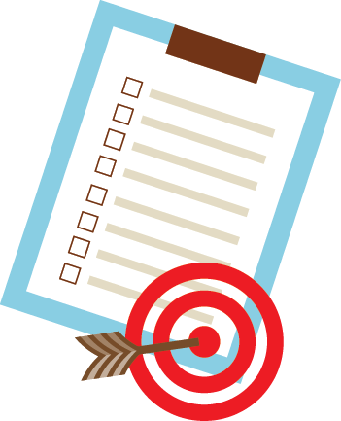
Step 1: Prioritize Goals and Concerns
Notes:
The first step is to prioritize goals and concerns that are motivating community members and organizations to engage on port issues.
This step involves taking the time to reach out to others in your community and establish a shared list of
prioritized goals which is the first step in making concrete changes with collective action.
Some concerns may be directly related to the port operations, while others may be connected to port related industries and transport.
In addition, many near-ports communities are isolated by infrastructure and industrial uses, reducing access to key amenities such as groceries, health services, open space and reliable transportation.
Concerns may be related to ongoing operations or a specific project that may cause temporary or long-term impacts.

Slide 8
Step 1: Prioritize Goals and Concerns
Identify Issues
Add Detail
Describe Impacts
Set Goals
Prioritize for Action
Notes:
Depending on the length of the training, the trainer may choose to have participants take 15-20 minutes to work through the following exercise in small groups for a particular community.
1. Identify Issues: Review the Potential Community Concerns checklist on Page 4 of CAR, and mark which issues are the most important in your community now. Add the priority concerns and any others not included in the checklist to a chart like the one below.
2. Add Detail: Once you have listed the key issues, describe each concern in as much detail as possible. For example, if air quality is a concern, try to identify the location of operations and times when the air quality is most concerning.
3. Describe Impacts: Describe the community impacts of each concern. For example, does air quality impact sensitive populations such as children or the elderly? Or residences along a truck route? Have community members experienced increased or exacerbated health challenges that they associate with poor air quality?
4. Set Goals: Translate each concern into a goal. For example, ”Improved air quality in the neighborhood with a focus on reducing air pollution that directly impacts sensitive populations, such as children.”
5. Prioritize for Action: As a final step, try to prioritize the concerns and goals in order of most importance. Ask your community, “if there was only one change we could make this year, which would it be?”

Slide 9

Step 2: Identify Levers for Change

Slide 10
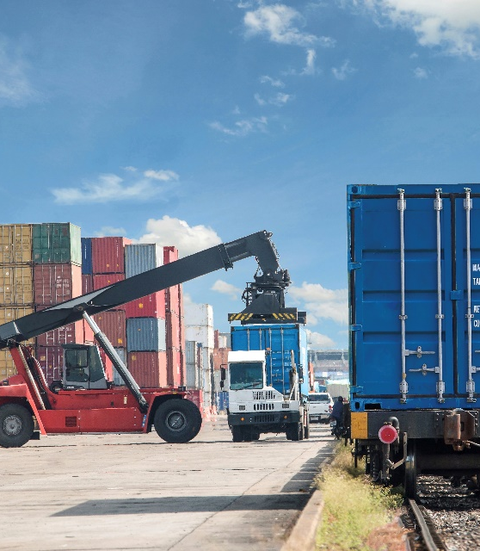
Levers for Change
Construction projects
Planning projects
Regulatory changes, including changes in requirements and standards
Operational changes
Notes:
Communities have the potential to influence change through many ports related actions, including:
Construction projects with temporary and/or long-term impacts
Planning projects, including comprehensive plans, land use plans, transportation plans, and port expansion plans
Regulatory changes, including changes in requirements and standards for noise, air emissions, water quality and the handling of hazardous materials.
Operational changes, including times, locations and management practices for specific activities.
Each of these is a potential lever for change.
Some of these actions may be led by the port agency or authority, while others may be led by the local government or regional transportation planning agency. Finding the levers for change means identifying decision-makers, regulations, policies, planning documents and points in the decision-making process that are important for addressing your community’s concerns.

Slide 11
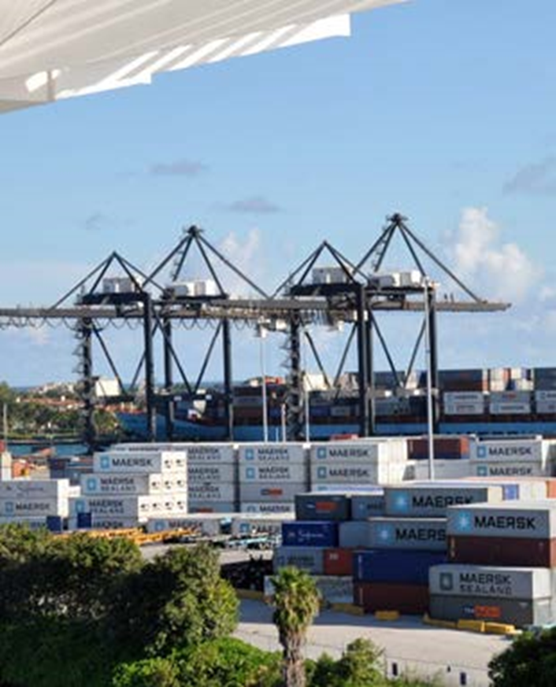
Tools to Tap Levers for Change
Develop an elevator speech.
Use the Freedom of Information Act (FOIA).
Be open to new or unexpected avenues to change.
Stay nimble.
Notes:
Resources included in the guide for this step include:
Develop an Elevator Speech. When calling agency staff for information, it can be helpful to organize your “elevator speech.” An elevator speech clearly communicates the who, what, when, where and why in 1 to 3 minutes. In general, try to state the facts and what you need without assigning blame. Here is an example: Our neighborhood located across from the entrance of the port is experiencing heavy truck traffic and reduced air quality. This is impacting residents by creating busy, unsafe streets and increasing health concerns like asthma. Who do I contact to learn how to resolve this issue? When you reach the right contact, you may ask, Where can I find the regulation or plan that governs this issue? If I have questions about the regulation or plan as I review it, when would be a good time to follow up with you?
Use the Freedom of Information Act. With certain exemptions protecting interests such as personal privacy, national security and law enforcement, the Freedom of Information Act gives you the right to access records from any federal agency. In addition, most state and local governments are covered by state public records laws. See the Community Action Resources section.
Be Open to New or Unexpected Avenues to Change. After prioritizing your concerns and goals in step 1, members of your community may feel committed to a specific action or avenue to change. Remember that new or unexpected opportunities for creating positive change may come to light as you move through the rest of the roadmap. Keep your goal in mind, and be open to learning about new ways to achieve that goal.
Be Patient and Stay Nimble. Revisit and refine your goals periodically. If your research into levers for change reveals that your initial goal is not achievable in the near-term, don’t be discouraged. Look for near-term opportunities that can help you take small steps towards your ultimate goals.

Slide 12
Exercise:
Agency Research
List 3 to 5 entities who are likely to have the biggest influence on your issue.
Locate the website for each entity and list the major services and responsibilities that relate to your issue.
Scan the news section of each website to see what projects or initiatives are planned that might be related to your prioritized goals.
Call the agency contacts to confirm responsible departments and staff and where to find the relevant regulations and plans.
Develop a contact sheet outlining the information you have gathered for future reference.
Notes:
Depending on the length of the training, participants can break into small groups to work through the following exercise:
State your priority goal that is driving your agency research. Then:
1. In addition to the port authority, what are the other state and federal agencies, local departments, regional boards or commissions who may be able to influence your priority issue? List 3 to 5 entities who are likely to have the biggest influence on your issue. identification process can sometimes be challenging. Agency staff can play a key role in assisting with this challenge.
2. Locate the website for each entity and list the major services and responsibilities that relate to your issue.
3. Scan the news section of each website to see what projects or initiatives are planned that might be related to your prioritized goals. Additional places to look for information on projects and initiatives include: 1) meeting minutes from the port authority, metropolitan planning organization, and city council; 2) Federal register notices; 3) National Environmental Policy Act (NEPA) reviews and agencies’ NEPA websites (including EPA’s Environmental Impact Statement database). Note the contact information and any upcoming meetings or comment periods. Try to identify which regulations and plans govern your issue.
4. After your initial research, you may need to call the agency contacts to confirm which departments and staff are responsible, where to find the regulations and plans that govern your issue, and what are the best near-term opportunities for promoting change. Identifying contacts can sometimes be challenging. Agency staff can play a key role in assisting with this challenge.
5. As a final step, develop a contact sheet outlining the information you have gathered for future reference, including agency contacts, plans, regulations, and upcoming events.

Slide 13
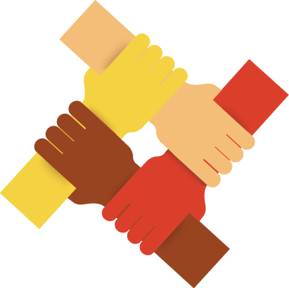
Step 3: Build Relationships
Notes:
Once your community has prioritized a set of goals and identified the agencies and avenues to pursue,
the next step is to build a coalition of supporters that can help influence positive change. Relationship
building can occur on several levels simultaneously.

Slide 14
Step 3: Build Relationships
Within the community.
With adjacent communities who are also impacted.
With liaisons and opinion leaders.
With agency staff who may have relevant expertise, resources or programs.
With elected officials, commissioners, agency leaders, and decision-makers.
With other interest groups, such as business, environment, youth and schools.
With the staff and decision makers of the port.
Notes:
As we walk through potential relationships, note which are strong, and which need more investment to support your issue.
Within the community. Reach out to other organizations in your community who may interact with residents on different issues, such as unions, health care, youth groups, family support, faith or sports. If possible, ask to join their regular meetings to inform participants of the issues and ask for their support.
With adjacent communities who are also impacted. Often adjacent communities may seem a world away due to different demographics or infrastructure barriers such as rail lines, highways or industrial superblocks. However, putting differences aside and joining forces on an issue that impacts both communities can be very effective in promoting change on tough issues. City staff who work in outreach, planning, social services and grants may be able to identify community leaders in adjacent neighborhoods who could be allies.
With liaisons and opinion leaders. Chambers of Commerce and neighborhood associations are structured as liaison organizations between the community and local government. See if you can find a member who may be sympathetic to your concerns. They can be helpful partners if they already have working relationships with staff and decision-makers, and may also be able to offer guidance in navigating the system effectively.
With agency staff who may have relevant expertise, resources or programs. Some agency staff may not have the authority to make the desired changes, but they may be able to provide technical expertise, programs or grants that can help, as well as be an internal champion for your issue within their agency. View regional EPA staff as your initial and primary contact.
With elected officials, commissioners, agency leaders, and decision-makers. Gaining the ear and support of elected officials and agency leads can provide significant leverage in making changes. They may feel obligated to be more responsive, or see different opportunities to support your goal than the program or technical staff on the ground because they are aware of other programs or policies that may help.
With other interest groups, such as business, environment, youth and schools. Consider linking up with schools or businesses who may have a vested interest in the issue and have greater influence with decision-makers. It could also be advantageous to partner with a local environmental group who has a track record of successful advocacy and change.
With the staff and decision makers of the port. Building trust between the community and the port can be challenging if the port has not been sympathetic to community concerns in the past. A respectful tone can reduce defensiveness and encourage more productive communication. Look for creative ways to help port staff expand their ability to engage effectively with community members, understand issues from the community’s perspective, and become invested in helping. For example, taking staff on a tour to look at an issue in the field can be more impactful than putting them on the spot at a large public meeting. Working with management at the port to expand training in community engagement beyond the public relations staff can help increase productive conversations between project managers at the port and the communities those projects impact. Finally consider that most ports have environmental offices, community relations, or public affairs staff who may be able to offer a “lay of the land” assessment for community members regarding existing environmental partnerships, initiatives and programs related to their concerns. Staff can help support community members plug into existing projects, deepen their impact, and build a relationship that may help the port and community members accomplish common goals.

Slide 15
Step 3: Tips for Building Relationships
Listen well
Acknowledge anger about the past
Connect on Common Ground
Stay in Touch
Notes:
Listen Well. One reliable way to build support is to ask for input. When sharing information, whether with your neighbor or the mayor, ask what they think of the issue, what they recommend to help resolve it, and who else to talk to. Identify areas of common interest.
Acknowledge anger about the past. There is a lot of history related to where ports are located, who lives near ports, and how some communities are disproportionately exposed to related pollution. This history may result in deep-seated anger from near-port residents. Acknowledging this anger is important and necessary, but need not prevent constructive dialogue, problem solving, pollution reduction and community investments to occur moving forward.
Connect on Common Ground. Not everyone may be eager to work closely with you at the beginning. Remember that regardless of your new contact’s current perspective or position on your issue, they are a potential ally. Find common points of connection around which to build a cordial relationship.
Stay in Touch. Always follow up with new contacts. Thank them for their support and keep them posted on status and events. Stay committed to your goals, and be positive. Establishing dialogue and trust is extremely important.

Slide 16
Exercise:
Coalition Building
Who are the influencers in your community?
Which stakeholders are already supporters?
Who else could you connect with to build new relationships? (See list on page 8.)
Notes:
Depending on the length of the training, participants can break into small groups to work through the following exercise:
Who are the influencers in your community?
Which stakeholders are already supporters?
Who else could you connect with to build new relationships. (Review the list on page 8.)

Slide 17

Step 4: Develop an Action Plan
Notes:
For the next step in the process, collaborate with your partners to select a project and develop a robust action plan for achieving your goal. An action plan outlines the set of activities for your project, and designates timing and leads for each activity. In addition, you will need to consider what engagement strategy will best support your project and define how you plan to measure success for your efforts.

Slide 18
Step 4: Develop an Action Plan
Define a Specific Project
Select Your Engagement Strategy
Develop an Action Plan
Define Success
Identify Resources
Notes:
Activities to support a successful action plan include:
1. Pick a Project. What project will help you best meet the goal you established in step 2? Review the exercise under Check Your Ports Primer for Communities! for ideas of what has worked in similar communities. Consider what project makes sense for you to pursue now and what others you would like to keep in mind as you build your collaborations and momentum? Also, consider whether a direct dialogue with port decision-makers at this time could be helpful for selecting a near-term project that engages the port collaboratively.
2. Select Your Engagement Strategy. Review the chart on the next page and determine which method is the most effective way for you to engage the community and decision-makers? Depending on where you are in the process, you may choose to focus on education, input, collaboration, mitigation, advocacy, or some combination.
3. Develop an Action Plan. Develop a chart similar to the one below, and list each activity needed to accomplish your project, then designate a lead and a timeframe. Establish a regular check-in schedule between lead partners to stay coordinated and help each other problem-solve when you encounter roadblocks. Keep your supporters updated, motivated and involved.
4. Define Success. Place a star next to key milestones in your action plan to evaluate and celebrate success. Review the two Measuring Success resources listed on page 16. What are some metrics for measuring your process and organizational capacity (building skills)? What metrics (methods for measuring) can help measure tangible outcomes?
5. Identify Resources. Reach out to partner agencies and organizations to identify grants, technical assistance, programs and other resources to help implement your project. If your organization is new, you can partner on grant applications to build your grant management track record, and ask agency staff for assistance.

Slide 19
Range of Engagement Approaches
Build community support.
Provide feedback to the port and regulators.
Develop port-community collaborations.
Act independently to mitigate port impacts.
Apply political or legal pressure on decision-makers.
Notes:
Refer to the chart on page 11 to review a range of engagement approaches. These include:
Build community support.
Provide feedback to the port and regulators.
Develop port-community collaborations.
Act independently to mitigate port impacts.
Apply political or legal pressure on decision-makers.
The chart includes sample activities and considerations to help select an approach that makes sense based on the local context and specific issue.
Depending on time, the trainer may ask participants to share ideas on what situations might fit best with each kind of approach.

Slide 20
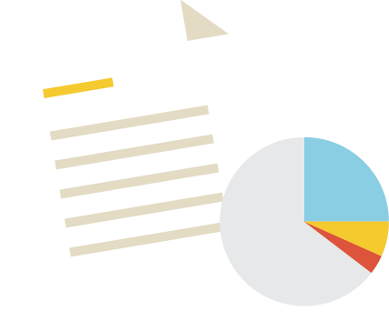
Step 5: Make Your Case
Notes:
When you are ready to implement your project, consider how you can involve all the partners you gained in step 3. Ideally each partner can play an instrumental role based on their skills, expertise, authority, connections and influence. No matter which
project you have selected, take the time to plan your actions and carefully make your case.
To keep your project on track, it is important to develop an action plan that identifies key tasks, partners and a timeline. Invite each partner to play their role and ask for their feedback and input on the action plan. Taking the time to identify these steps and lead partners can ensure that everyone has the same understanding as you move forward.
As you implement your action plan, consider the following tips for tailoring your message. These considerations can help ensure that you are making a strong case for the changes you would like to see.

Slide 21
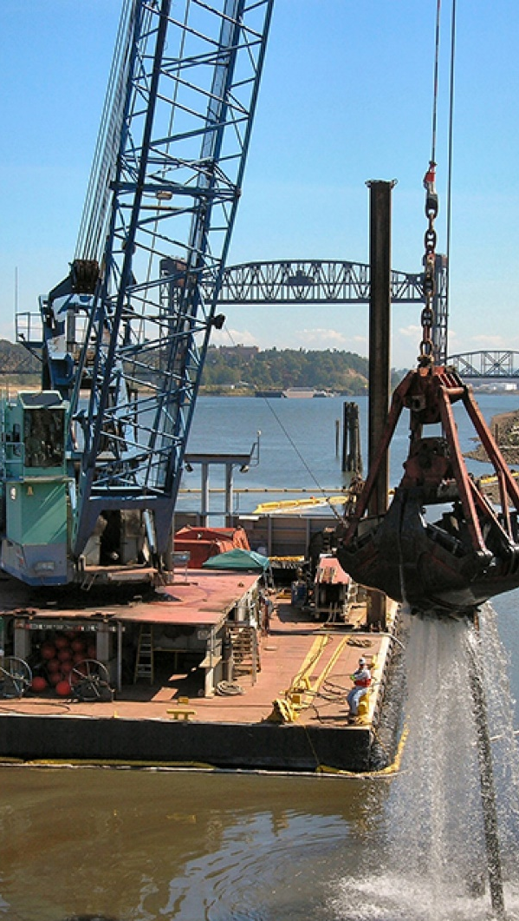
Step 5: Make Your Case
Determine who is the audience or decisionmaker.
Identify your target audience’s concerns.
Gather information that supports your community concerns and goals.
Practice crafting your message!
Design your message in printed form or other media.
Use Images!
Notes:
Determine who is the audience or decisionmaker. Depending on your project, this may be fellow community members, elected officials, or ports agency staff. You may find that you will have multiple audiences over the course of your effort.
Identify your target audience’s concerns. Are they interested in health, jobs, the economy in general, the environment, city image, regulatory compliance or social justice? Your message needs to build a bridge from your concern to theirs, and describe how the issue and your solution relates to their interests.
Gather information that supports your community concerns and goals. Data can be collected from many sources. Review the types of data in the checklist below, and identify which you may already have and which new sources could be useful for making your case. Work with your partners. Engage sympathetic agency staff or local academic institutions in helping you gather relevant data and information.
Practice crafting your message! First, determine your target audience and develop a message that responds to the questions below. Review the list of potential partners on page eight for reference. Remember to use language that the audience you selected will recognize. Next, pick a second target audience and see how your message might differ.
Design your message in printed form or other media. Depending on your audience, this could be a presentation, a handout, a poster, a press release, a video, a public service announcement or a technical briefing document. State your message and what you would like changed as clearly and briefly as possible. It may be helpful to develop additional messages tailored to fit the specific audience, with a focus on expressing the shared nature of goals and/ or principles held in common. This helps to bridge differences in perspectives and help others understand how your goal fits with things they care about, so your goal will resonate with them.
Use Images! As the saying goes, a picture says a thousand words. Here are some tips on using images to convey a quick and compelling message. Check the images below that will be most effective for your message.
Depending on time, the trainer may ask participants to work in groups to develop a message based on a specific community concern.

Slide 22

Step 6: Build Momentum for Change
Notes:
During and after implementation, there are a number of steps you can take to make sure that you are capturing the energy and effort of your actions in a way that builds momentum for the future.

Slide 23
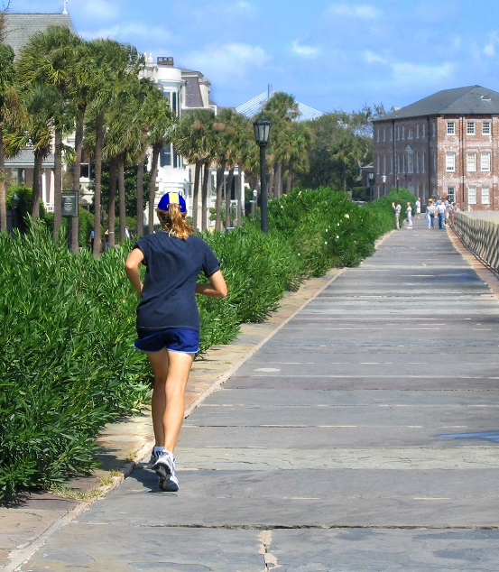
Step 6: Build Momentum for Change
Evaluate Your Process.
Celebrate Success.
Consider Ways to Institutionalize.
Capture Your Momentum.
Notes:
Reflect and Evaluate After your project is done (and along the way!), take time to reflect and evaluate. For grassroots efforts using a lot of volunteer support, it’s natural that some areas excel from passion alone, while other areas are more challenging and have a steeper learning curve. As you evaluate, revisit your measures of success for (1) process and organizational capacity and (2) environmental and/or quality of life improvements. Metrics for the former can usually be assessed using a self-evaluation like the one below. Metrics for the latter may require data collection and analysis.
Celebrate Success It’s important to celebrate small successes as you go and to share the results of your project with the public. Whether or not you were able to accomplish all of the intended outcomes, celebrating the efforts of community members and partners can help ensure supporters feel appreciated and maintain momentum for the next round.
Formalize and Institutionalize
The close of your first project may also be a time to reflect on your organizational and communication
structure. Whether you entered the Community Action Roadmap as an individual activist, a newly formed environmental justice organization, or a seasoned organization, after all the work you have done, you have likely built quite a bit of capacity that did not exist before. Now is the time to think about how to institutionalize (build a lasting organization) that capacity so that it can be used again and again. Would it be helpful to organize your partnerships into a more formal coalition? Could you formalize some key roles, (such as outreach, fundraising, media, technical analysis, government liaison, volunteer coordinator) to streamline your process? Are there ways to enhance communication and outreach?
Decide What’s Next!
Whether you win or lose your first battle, generally there is more to accomplish. Based on the successes and challenges you identified during your self-evaluation, determine what remains to be done to achieve your goal. You may be ready to move on to tackling a new goal, or you may have ideas about new projects that could help you meet your initial goal. If you are ready to consider selecting a new goal to work on, circle back to step 1 to identify which priority goal(s) to tackle next. Cycling through the steps a second time will likely be much quicker, and can add value and ensure you are building the necessary collaborations for each goal to achieve your vision.

Slide 24
Community Action Resources
Setting a Timeline for Your Roadmap
Measuring Success
Using FOIA
Community Guidance Publications
Notes:
Setting a Timeline for Your Roadmap
The timeframe for each step in the Roadmap process will vary, depending on your goals. In some instances, there may be external deadlines your community must respond to, such as an established timeframe for a public comment period. These deadlines can create the need for an accelerated timeframe. (This could be as short as a month or two!) In other cases, your community may be able to set its own goals for timing that respond to the scope of desired community engagement and partnership building. The more partners you are trying to engage, or the more complex the topic or ambitious your goal, the more extended the timeframe will need to be. For short, discrete projects, such as an established community-port partnership to distribute information about air quality to community residents, the timeframe for moving through the Roadmap could be three to six months. For larger efforts, such as a broad-based community visioning and implementation effort, the timeframe could be extended to one to two years. In any scenario, it is a good idea to set target deadlines for each step of the process. This can help build momentum and generate enthusiasm and a sense of accomplishment for you and your partners along the way.
Measuring Success
One way to track success over time is to establish measures of success at the outset of a project. You may wish to develop metrics (qualitative and quantitative) for (1) your process and organizational capacity (e.g., engaged five new partners) and (2) environmental and/or quality of life improvements (e.g. air quality measures). Refer to page 16 in the guide for resources that provide additional considerations for establishing and tracking performance metrics.
Using FOIA
The Freedom of Information Act (FOIA) is a law that gives you the right to access information from the federal government. It is often described as the law that keeps citizens in the know about their government. FOIA requests can be used to gain access to government records that are not routinely made available to or easily accessible by the public. For more information on FOIA and how to make a FOIA request, visit: http://www.foia.gov/about.html.
Community Guidance Publications
The chart on page 17 contains resources on additional subjects that may be of interest to near-port communities, including community engagement, collaborative problem-solving, land use and equitable development. Additional resources that pertain directly to port operations and impacts can be found in the Ports Primer.

Slide 25
Tools
Ports Primer for Communities: An Overview of Ports Planning and Operations to Support Community Participation
Community Action Roadmap: Empowering Near-Port Communities
Environmental Justice (EJ) Primer for Ports: The Good Neighbor Guide to Building Partnerships and Social Equity with Communities
Notes:
The tools in the community-port collaboration toolkit were mentioned at the beginning. Just a reminder that there are training modules available for the other two tools as well.. We’ve just completed the module on the Community Action Roadmap: Empowering Near-Port Communities.
The other training modules are on the
Ports Primer for Communities: An Overview of Ports Planning and Operations to Support Community Participation
An interactive tool and reference document that characterizes the port industry sector, including environmental and community health impacts associated with port activities.
Environmental Justice (EJ) Primer for Ports: The Good Neighbor Guide to Building Partnerships and Social Equity with Communities
Designed to inform the port industry sector of the perspectives, priorities, and challenges often unique to communities with EJ concerns.
Additionally, there is training that provides an Overview & Lessons Learned for the Community-Port Collaboration Pilot Projects that were conducted in four communities.

Slide 26
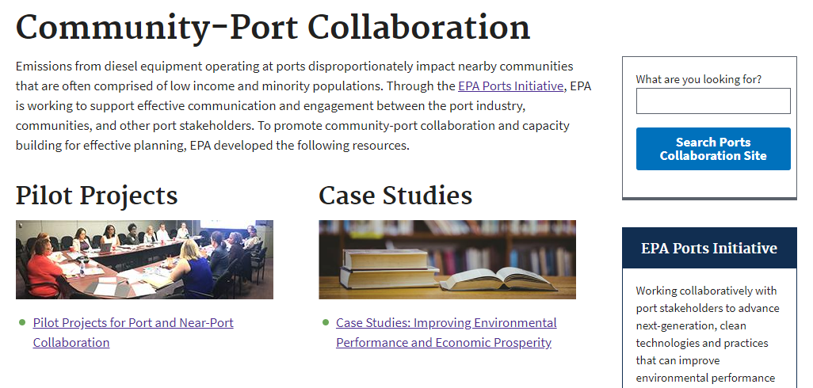
Website
Visit the Website for more Tools
Case Studies
Worksheets
Training modules
Resource materials
And more!
www.epa.gov/community-port-collaboration
Notes:
Visit the program website to access more tools including:
Case Studies
Lessons Learned Report
Worksheets
Training modules
Resource materials
And more!

Slide 27
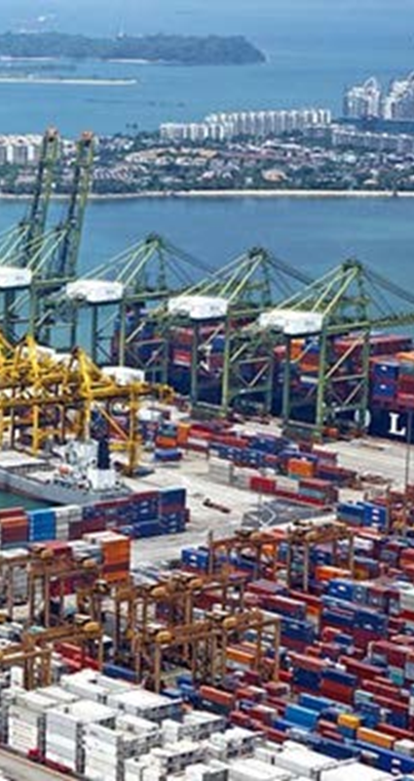
Acknowledgements
The Community Action Roadmap has been developed by the EPA’s Office of Transportation and Air Quality (OTAQ) in partnership with Regional Offices and the Office of Environmental Justice.
This work builds off of the CARE Roadmap, which originated with EPA’s National Environmental Justice Advisory Council.
Notes:
Acknowledgements
The Ports Primer and Community Action Roadmap have been developed by the Environmental Protection Agency’s Office of Transportation and Air Quality (OTAQ) in partnership with Regional Offices and the Office of Environmental Justice to support near-ports communities in improving their local quality of life.
This work builds off of the Community Action for a Renewed Environment (CARE) Roadmap, which originated with the National Environmental Justice Advisory Council. More information on the CARE Roadmap is available in the Community Guidance Publications section of this document.

