Slide 1
Module 1:
Understanding Lead

Slide 2
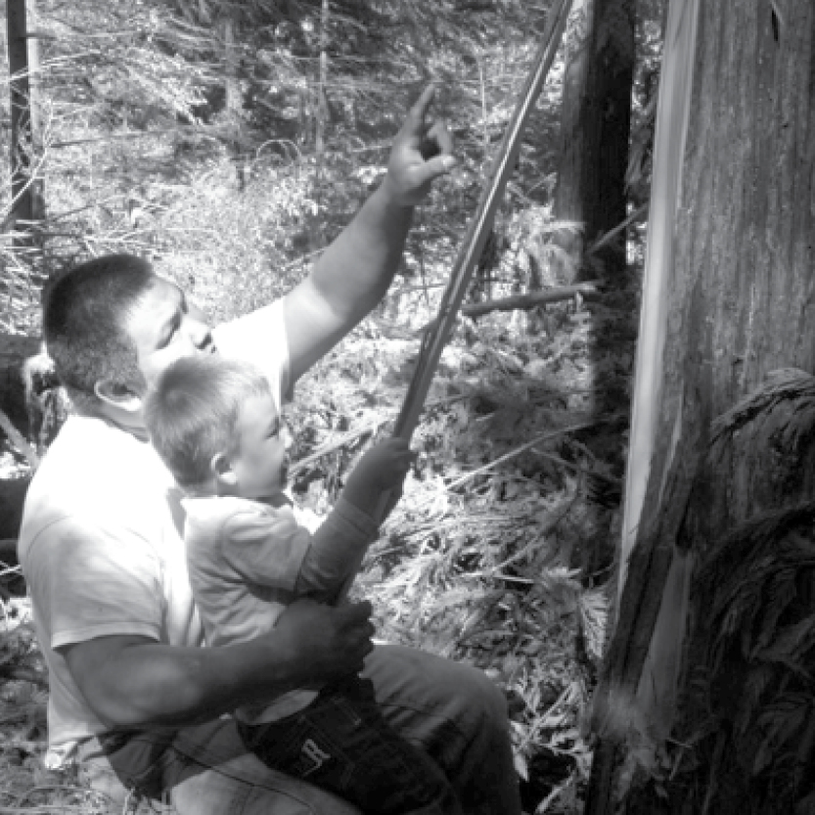
Outline
Potential Sources of Lead Exposure
Vulnerable Populations
Impacts and Effects of Lead Exposure
Taking Action
Photo provided by Zender Environmental and Health Group
Notes:
Today’s session will be approximately 70 minutes, we will discuss:
Potential Sources of Lead Exposure;
Vulnerable Populations;
Impacts and Effects of Lead Exposure; and
Taking Action.

Slide 3

Outcomes
List three sources of lead exposure
List three health effects of lead exposure in children
Explain how lead impacts cultural practices and wildlife
List three actions that can minimize or eliminate potential exposure to lead
Notes:
Upon the completion of Module 1, participants will be able to:
List three sources of lead exposure;
List three health effects of lead exposure in children;
Explain how lead impacts our cultural practices and wildlife; and
List three actions that can minimize or eliminate potential exposure to lead.

Slide 4
Introduction
How many of you have ever heard of lead or lead poisoning before today?
What are some things you have heard about lead or lead poisoning?
Does anyone know what year their house or apartment was built; was it before or after 1978?
Notes:
I. Introduction
Instructor Note: Allow participants to introduce themselves. Use the questions below to determine participants’ current knowledge and awareness of lead and lead poisoning. Record participants’ responses on a flipchart for future reference. Remember to place an emphasis on the sentence: “Please keep in mind that lead exposure and lead poisoning are preventable – we can take actions to reduce potential exposure to lead, and there are laws in place to protect us.”
You may have heard of lead or lead poisoning before today but may not know much about it. Our goal today is for you to walk away with an understanding of lead. We will learn:
What lead is;
Where lead is found;
How lead can harm both children and adults; and
Potential impacts on the environment, wildlife and cultural practices.
Please keep in mind that lead exposure and lead poisoning are preventable – we can take actions to reduce potential exposure to lead, and there are laws in place to protect us. At the end of this session, we will discuss several actions we can take as a community and as individuals to reduce potential lead exposure.
Before we begin, I have a few questions for the group to gain a better understanding of what you already know about lead and lead poisoning:
1. How many of you have ever heard of lead or lead poisoning before today? Instructor Note: This can be as simple as having participants raise their hands or respond with “yes” or “no” or you can allow participants time to share specific stories.
2. What are some things you have heard about lead or lead poisoning? Instructor Note: This is another good time to allow participants to share specific pieces of information and/or stories.
3. Does anyone know what year their house or apartment was built; was it built before or after 1978? For those of you who live in a house or apartment built before 1978, this session is going to provide you with information about lead-based paint that may be in your home.

Slide 5
What questions do you have about lead and lead poisoning?
Notes:
Let’s make a list of questions you have about lead and the health impacts of being exposed to lead with the hope that by the time we have covered all of the modules included within the Lead Awareness in Indian Country: Keeping Our Children Healthy! Curriculum we will have covered and answered all your questions. If you do not have a question right now, you are more than welcome to come up and add your question later.
Instructor Note: Allow participants time to think and then have them share their questions. Have a participant write questions on the flipchart so you can facilitate the conversation. Refer back to the flipchart throughout.

Slide 6
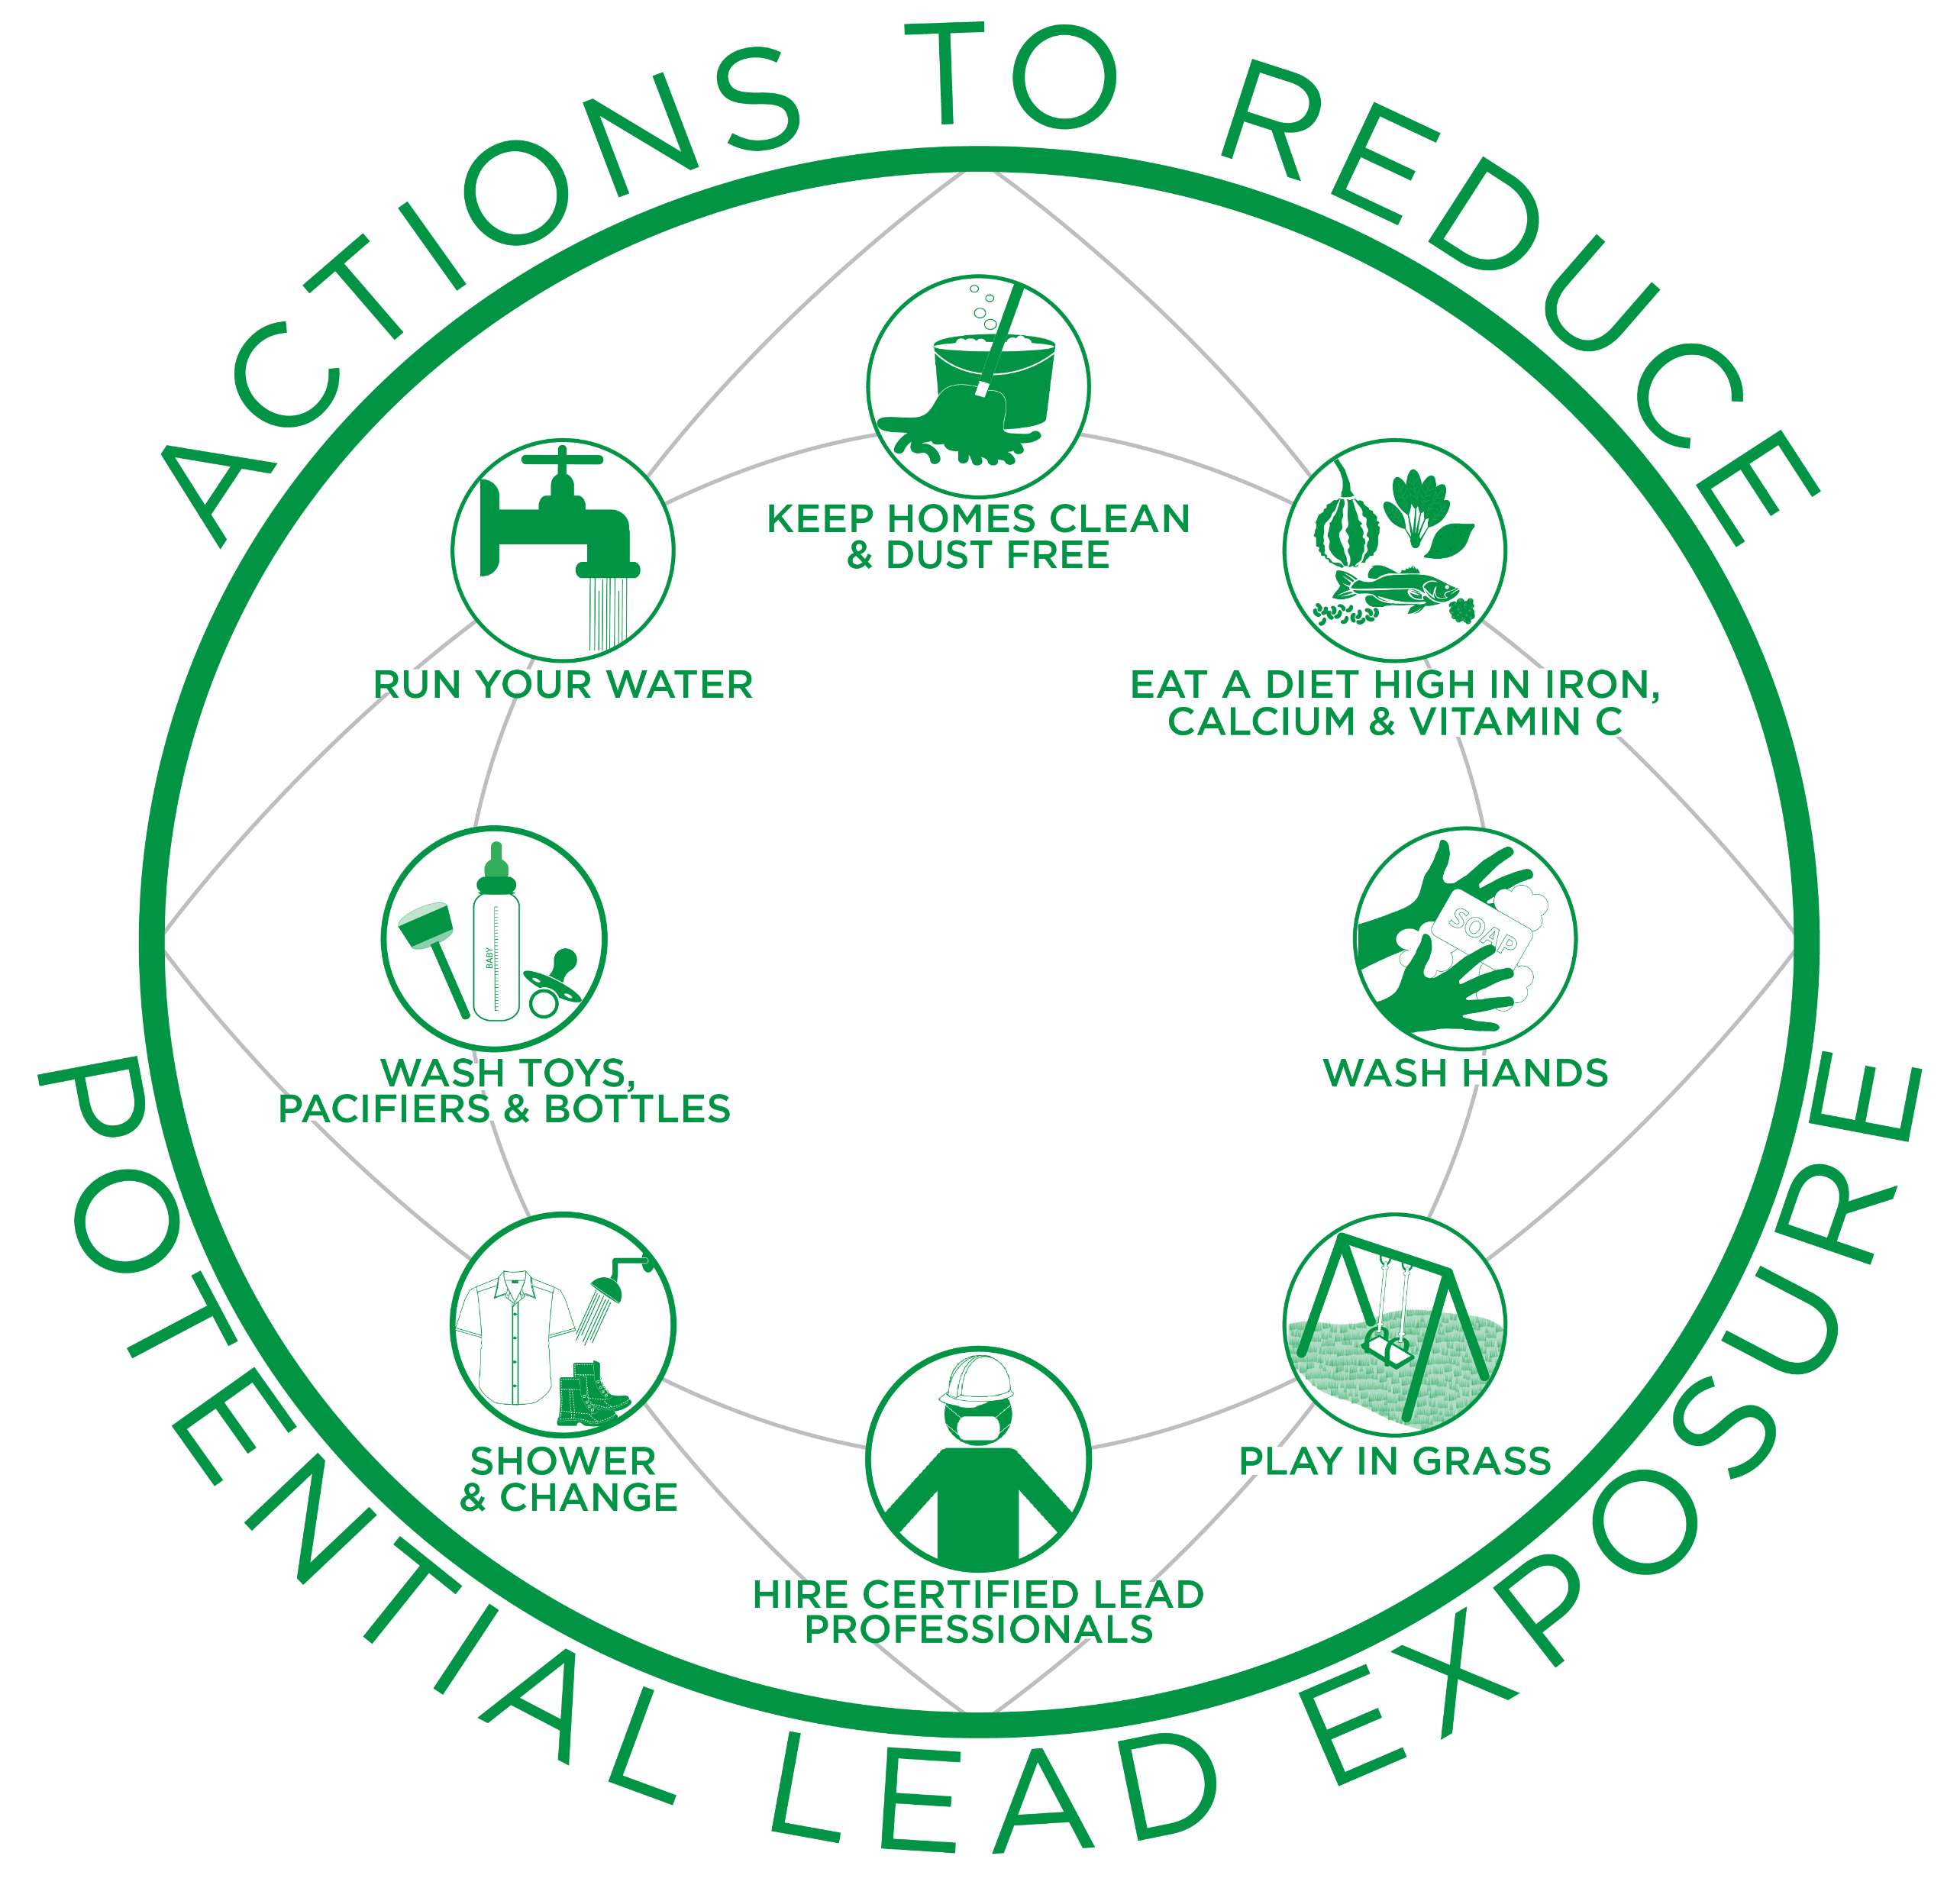
Infographic
Clean your home once a week using a clean, wet or damp cloth, sponge or mop to minimize dust, which may contain lead.
Flush your home’s pipes by running your tap, taking a shower or doing a load of laundry or dishes before drinking or cooking.
Eat a well-balanced diet with foods high in calcium, iron, and vitamin C to help reduce the absorption of lead.
Wash daily any items your child uses regularly, such as pacifiers and toys, to minimize exposure to dust, which may contain lead.
Use soap and water (warm or cold) to wash children’s hands several times a day, especially after playing outside or with animals.
Change and wash clothes, remove shoes and shower to avoid tracking lead into the home from soil, work sites, or hobbies.
Play in grass and dirt not contaminated with lead, and use designated picnic, camping and hiking areas.
Hire a certified lead professional when renovation, repair or painting will disturb painted surfaces in a home built before 1978. Keep family out of the work area.
Notes:
ANIMATED SLIDE – Text boxes will appear in order when each click occurs.
I would like to acknowledge that the information we are covering today may seem alarming, but when we become aware of and educated on this subject, we are empowered to take preventative action to safeguard our health. Preventing lead exposure in young children (under age six) is especially important because as their bodies grow and develop, they are more vulnerable to the permanent harmful impacts of lead. As parents, grandparents, teachers, tribal leaders and others who care about our community wellbeing, we can take simple actions right now to prevent lead exposure, which at the same time can benefit the overall health of our land and our families. Exposure to lead is preventable!
Instructor Note: Give a copy of the Module 1 Worksheet, Module 1 Key Messages and a pencil to each participant.
Here are two handouts we will use today, the worksheet and key messages. We will use the worksheet during this session as a discussion tool and to review what we learned together. The key messages is a take-home resource that summarizes information covered.
Let’s go over the image on the front of the worksheet. The image shows simple actions we can take to reduce potential exposure to lead. We will learn more details about each action throughout different sessions.
Actions to Reduce Potential Lead Exposure
Clean your home once a week using a clean, wet or damp cloth, sponge or mop to minimize dust, which may contain lead.
Eat a well-balanced diet with foods high in calcium, iron and vitamin C to help reduce the absorption of lead.
Use soap and water (warm or cold) to wash children’s hands several times a day, especially after playing outside or with animals.
Play in grass and dirt not contaminated with lead, and use designated picnic, camping and hiking areas.
Hire a certified lead professional when renovation, repair or painting will disturb painted surfaces in a home built before 1978. Keep family out of the work area.
Change and wash clothes, remove shoes and shower to avoid tracking lead into the home from soil, work sites or hobbies.
Wash daily any items your child uses regularly, such as pacifiers and toys, to minimize exposure to dust, which may contain lead.
Flush your home’s pipes by running your tap, taking a shower or doing a load of laundry or dishes before drinking or cooking.
These are a few of the actions we can take to reduce our potential exposure to lead. Later in this session, we will revisit these actions and learn more.

Slide 7
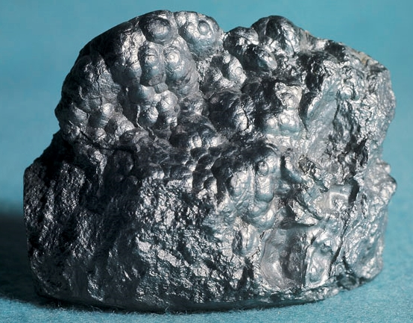
What is Lead?
http://mfritz8science.wikispaces.com/file/view/lead_1.jpg/262242078/lead_1.jpg
Notes:
II. Potential Sources of Lead Exposure
Instructor Note: This section is meant to provide participants with a brief introduction. Various examples of exposure are provided; actual exposure depends on a variety of factors, such as: source, location, manufacturing processes, age and condition of products. Throughout this section, emphasize that these are potential sources of lead exposure so as not to alarm participants. If needed, use information provided within the Taking Action section to assist with your discussion.
a. What is Lead?
Lead is a naturally occurring bluish-gray metal found in small amounts in the earth’s crust. Lead is mined and then used in products to make them durable and last longer. Once lead is used in a product, it is nearly impossible to identify with the naked eye. Lead does not biodegrade or disappear from the environment over time.

Slide 8
Where do you think lead can be found?
Notes:
b. Where is Lead Found and How is it Used?
Lead has been mined and used for a long time and can be found in many different products and places. Where do you think lead can be found? Take a moment to glance around the space we are in and think about your everyday activities. Pencils may come to mind, but they are made with graphite and not lead.
Instructor Note: Give participants time to think and talk with each other. If they are unable to think of something, you can either prompt them by suggesting items or simply state: “Don’t worry if you cannot think of something. Today we will learn where lead is found and how to prevent exposure.”
Congress has passed several laws related to lead. These laws address lead in paint, dust and soil; lead in the air; lead in water; and disposal of lead waste. As a result, these laws limit the amount of lead that can be in products, outdoor air, emissions from some industrial sources, waste waters and more.

Slide 9

Lead can be found in…
All parts of our environment:
  Air
  Soil
  Water
  Inside our homes
Notes:
Unfortunately, lead can be found in all parts of our environment – the air, soil, water and inside our homes Much of our exposure comes from human activities including the use of fossil fuels including past use of leaded gasoline, some types of industrial facilities (e.g., mining and manufacturing), leaded aviation fuel and past use of lead-based paint in homes.

Slide 10
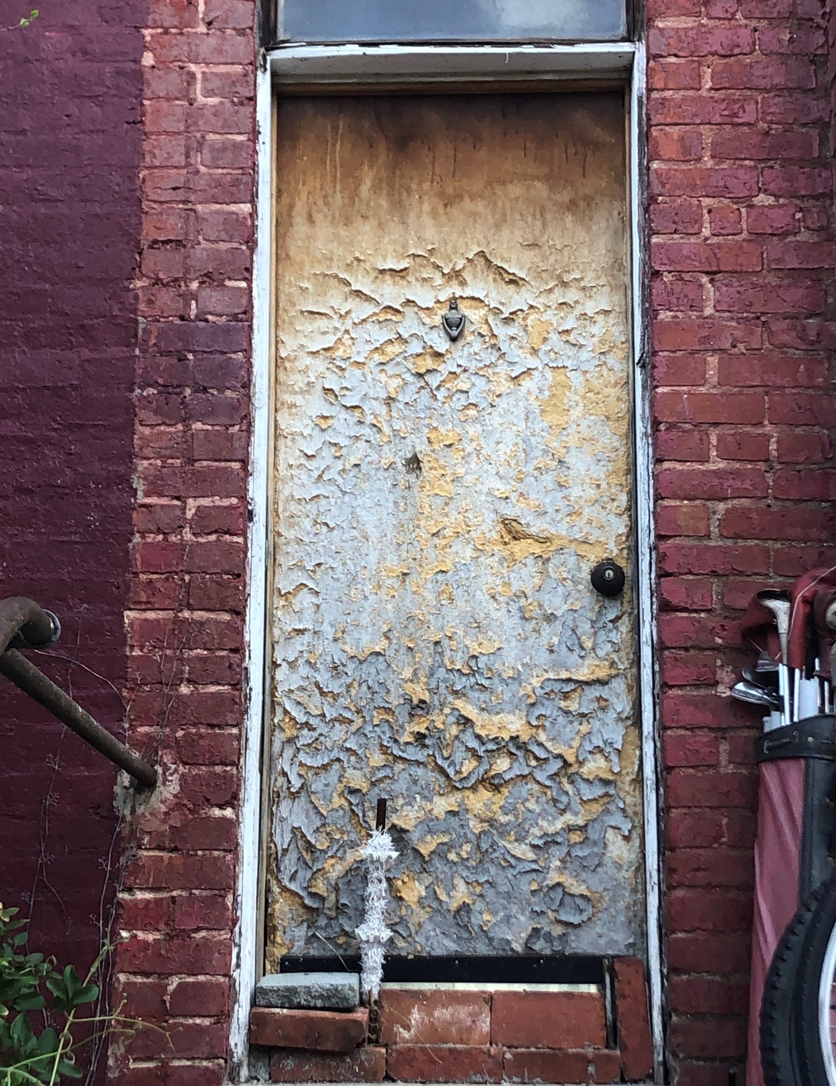
Lead-based Paint
Found in older homes built before 1978
Major source when:
  Not maintained - Peeling, chipping, cracking
Chips and dust can scatter and become a hazard
These hazards can be breathed in or swallowed by children, residents and workers
Notes:
Historically, lead compounds were added to paints to enhance color, reduce corrosion or shorten drying time. Lead-based paint, if present in older homes built before 1978, may be a major source of exposure to lead to those who live there. When painted surfaces are not properly maintained, paint can deteriorate, peel, chip, chalk or crack. When lead-based paint is old and worn or is subject to constant rubbing (as on doors and windowsills), lead-based paint chips and dust can scatter and become a hazard. These hazards can be breathed in or swallowed by children, residents and workers. Lead dust can also be scattered when paint is disturbed during renovation, repair or remodeling.

Slide 11

Children can be exposed...
Through contact with lead-based paint chips and dust in buildings and homes when they put toys, fingers, and other objects in their mouths
Lead-based paint has a "sweet" taste
Children may also lick or bite chewable lead-based paint surfaces
Photo by Jelleke Vanooteghem on Unsplash
Notes:
Today, one of the most common ways children can be exposed to lead is through contact with lead-based paint chips and dust in buildings and homes that have lead-based paint present when they put toys, fingers and other objects in their mouths as part of their normal behavior. Lead-based paint has a "sweet" taste, which makes it appealing to young children, so they may also lick or bite chewable lead-based paint surfaces.

Slide 12
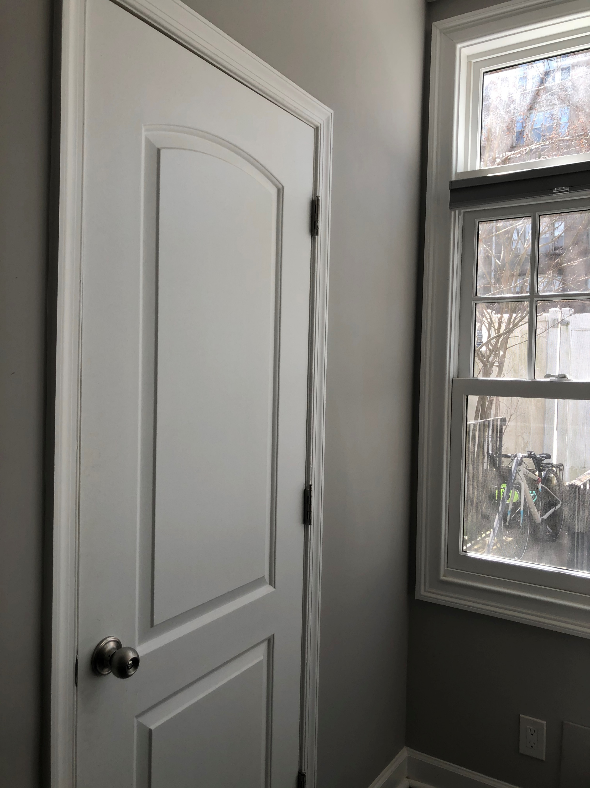
Childhood lead exposure and lead poisoning is preventable
When lead-based paint is in good condition and not on an impact or friction surface, like a window, the paint is usually not a hazard
The key is to keep children from coming into contact with lead
Notes:
When lead-based paint is in good condition and is not on an impact or friction surface, like a window, the paint is usually not a hazard. Childhood lead exposure and lead poisoning from lead-based paint and other sources is preventable. The key is to keep children from coming into contact with lead. Throughout the Curriculum we will discuss how to limit contact with lead to prevent exposure.
Later in the curriculum (Module 2), we will discuss how cleaning techniques can limit a child’s contact with lead-based paint chips and dust as well as discuss how you should hire a certified lead professional to test and work on older homes or buildings (Module 4).

Slide 13

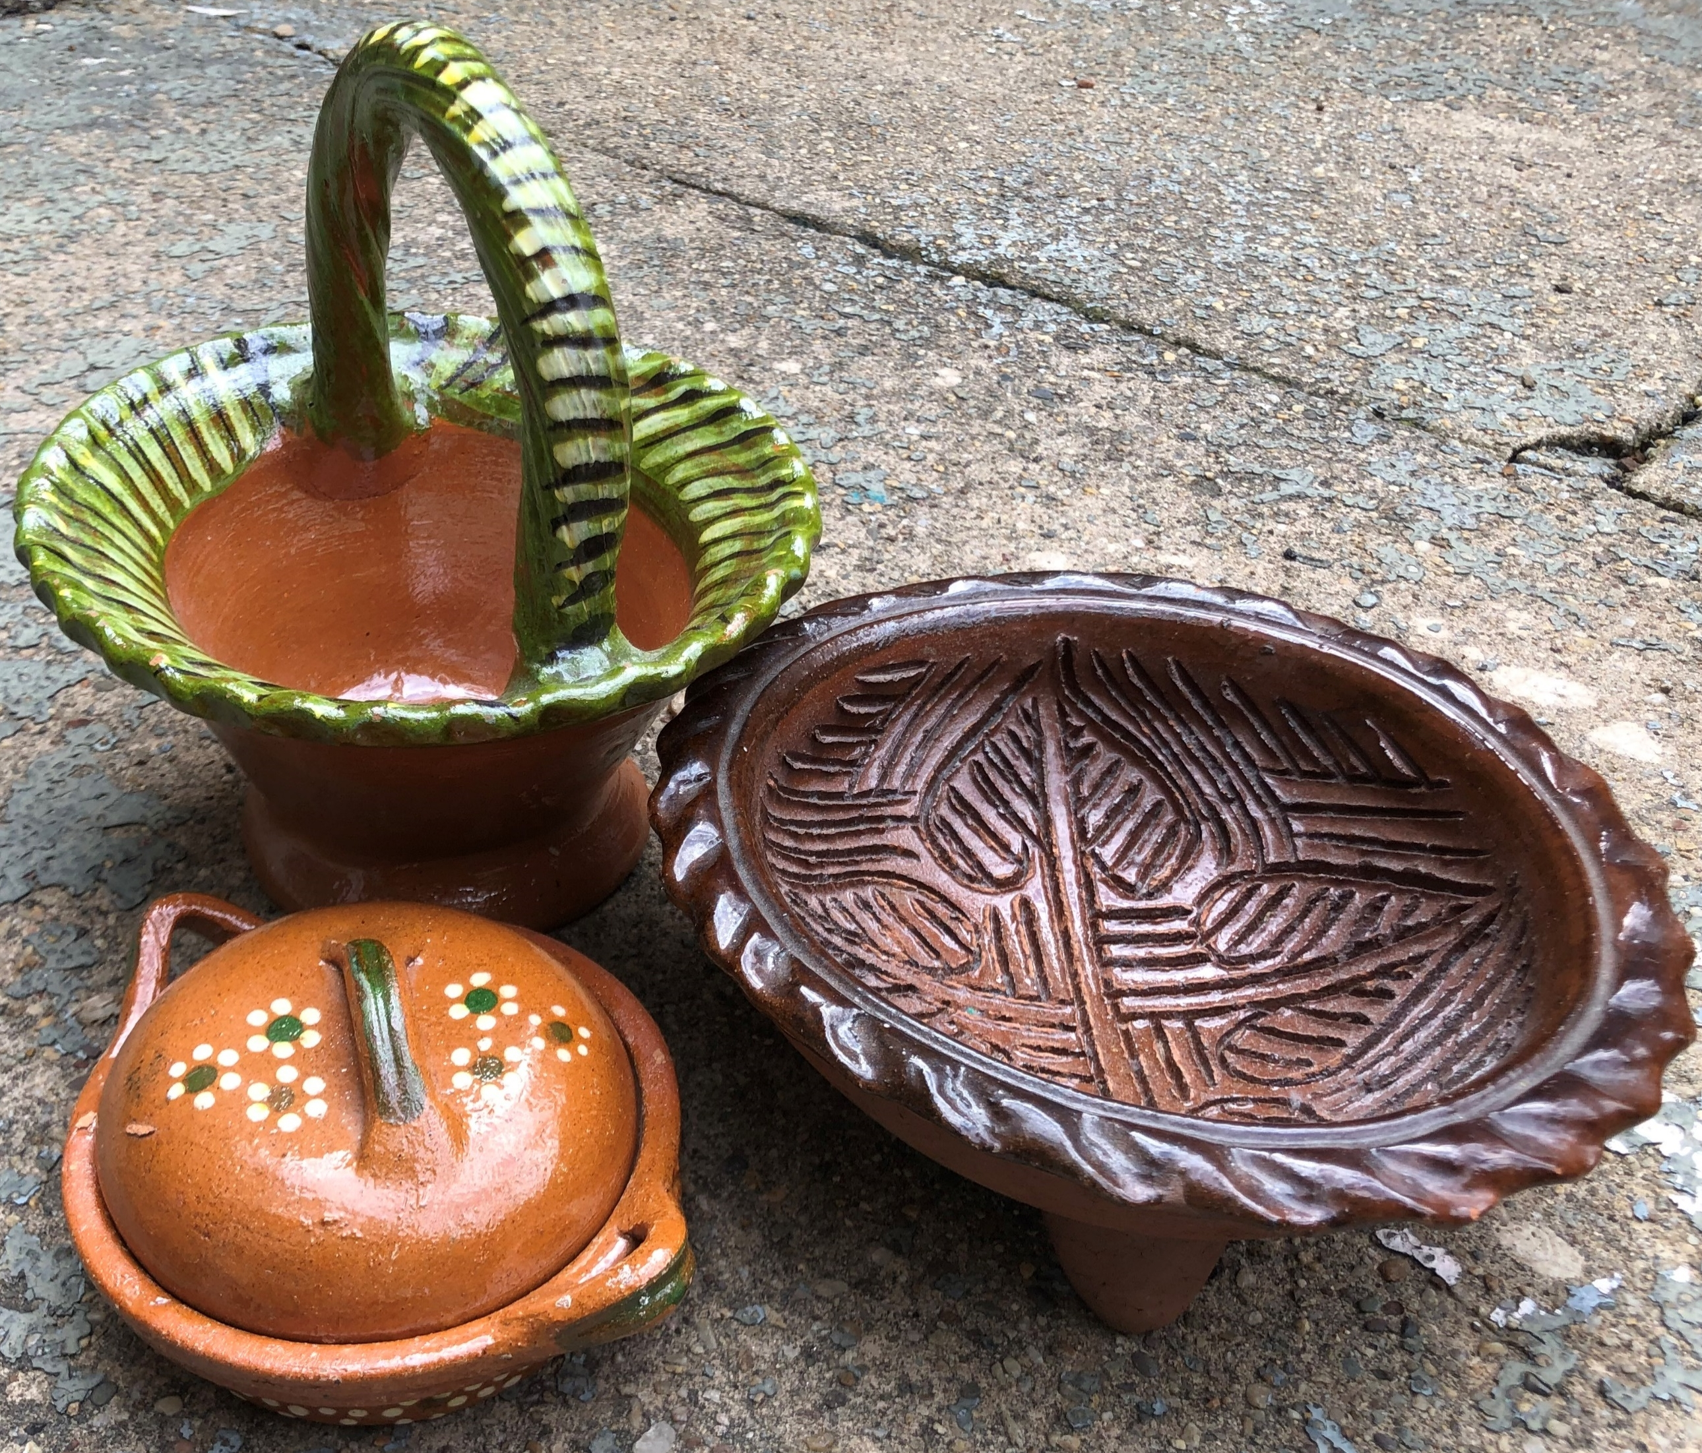

Potential Sources of Exposure
Painted farm equipment and boats
Imported pottery, candles, older mini blinds
Toys
Ceramicware
Solder
Batteries
Ammunition
Old cellphones in disrepair
Cosmetics
Photo by Randy Fath on Unsplash
Imported pottery from Mexico
Toy Recall from https://www.cpsc.gov/Recalls/2007/rc2-corp-recalls-various-thomas-friends-wooden-railway-toys-due-to-lead-poisoning
Notes:
Lead and lead compounds have been used in a wide variety of products found in and around our homes, including paint used on some farm equipment and boats; imported pottery, scented candles and older mini blinds; glassware; toys; ceramicware; solder; batteries; ammunition; old cell phones that are in disrepair and cosmetics (e.g., lipstick).

Slide 14
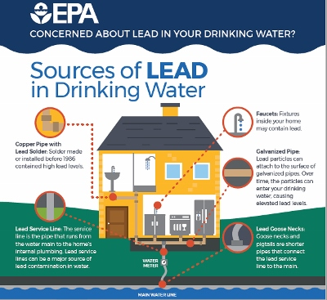
Potential Sources of Exposure
Lead can enter drinking water when plumbing materials with lead corrode
  Lead pipes
  Faucets
  Fixtures
Notes:
Lead can enter drinking water when plumbing materials that contain lead corrode. The most common sources of lead in drinking water are from lead pipes, faucets and fixtures. Lead pipes are more likely to be found in older cities and homes built before 1986. You may be wondering if it is safe to take a bath or shower using water suspected of containing lead. The answer is yes. Bathing and showering should be safe for you and your children, even if the water contains lead. Human skin does not absorb lead in water (Ref. 5).

Slide 15
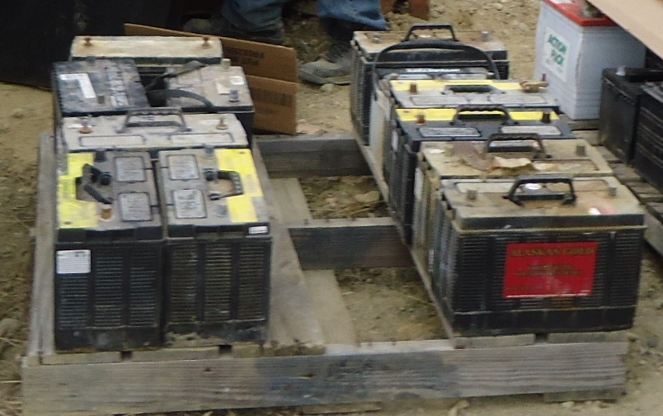
Potential Sources of Exposure
Industrial sources and contaminated sites
Improper disposal/recycling of lead-acid batteries
Improper storage of metal parts
Abandoned mines
Photo provided by Zender Environmental and Health Group
Notes:
Lead can be released into the environment from industrial sources and contaminated sites, such as former lead smelters. Improper disposal or recycling of lead-acid batteries, improper storage of metal parts such as machinery components, and abandoned mines may also contribute to lead in the environment.

Slide 16
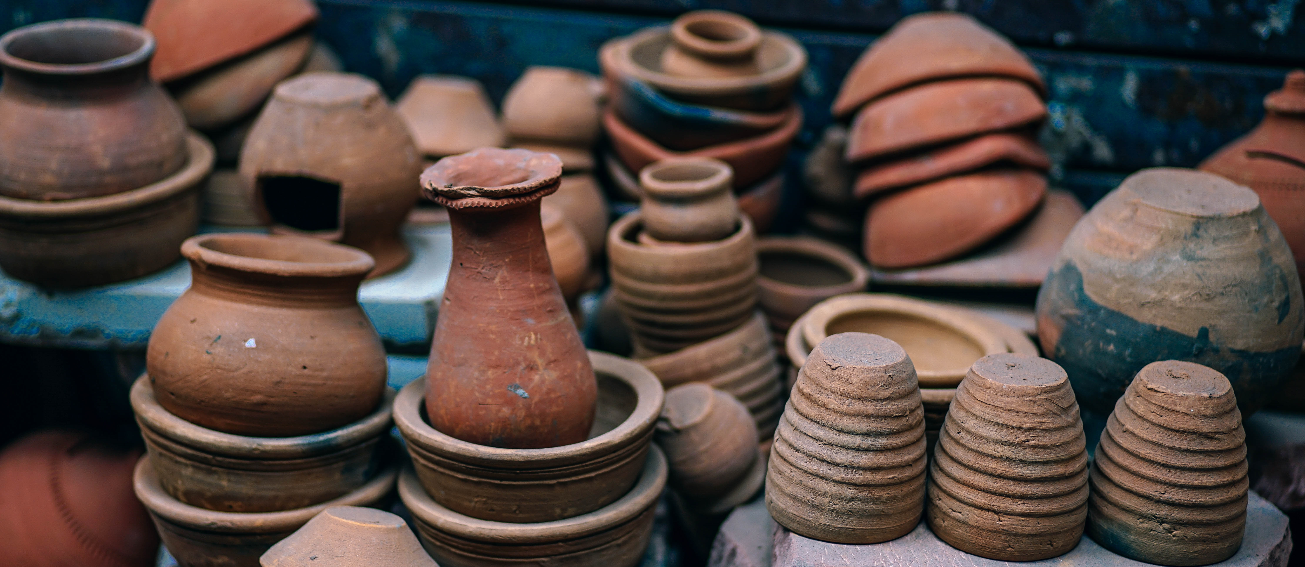
Potential Sources of Exposure
Imported pottery may contain lead in glaze and/or other decorations
Lead glaze can leach into food and drinks that are prepared, stored or served in these dishes
Many traditional potters have switched to non-lead glazes
Notes:
Some traditional pottery made in other countries labeled as “lead free” may contain lead in the glazes and/or decorations covering the surface. If clay pieces are not manufactured properly, lead glaze can leach into food and drinks that are prepared, stored or served in these dishes.
Certain pottery and other forms of ceramicware are made with earthenware, a porous form of clay that must be glazed to hold food or liquid. Glazing applies and fuses a thin, glass-like coating onto the surface of the clay to seal its pores. The glaze – which may contain lead to facilitate the melting of glaze particles – fuses to the piece when it is fired in a kiln, a special oven used to bake clay. When pieces are fired at the proper temperature for the proper amount of time, essentially all the lead is bound into the glaze. If a piece is not properly fired, the lead glaze may not fuse to the earthenware and may contaminate food and drinks when used to prepare, store or serve food and drinks (Ref. 6).
Today, many potters of traditional or ‘folk’ pottery have switched to non-lead glazes. Traditional potters instead are using other techniques such as an inner coating of pitch (pine sap), burnishing (polishing) the surface and applying white slip. Many Native American traditional and non-traditional potters use traditional paint recipes created from local plants and mineral sources; however, some do use commercial paints.

Slide 17

Potential Sources of Exposure
Game meat harvested with lead ammunition
Discharging firearms in poorly ventilated areas
Cleaning firearms or handling lead ammunition
Many subsistence hunters have switched to lead-free ammunition
Image from https://www.fws.gov/midwest/refuges/leadfree.html
Notes:
Many households in Indian country consist of hunting families that rely on the use of firearms to acquire food year-round. Elevated lead exposure has been correlated with subsistence hunting communities when game meat is harvested with lead ammunition. Additionally, discharging firearms in poorly ventilated areas, cleaning firearms, or handling lead ammunition, can also be a source of exposure to lead and other chemicals known to be toxic.
While it is against federal law to use lead ammunition to hunt waterfowl most hunting ammunition currently sold in the United States is lead-based. High velocity lead-core bullets explode upon impact, sending out a plume of lead dust along with hundreds of tiny fragments into the targeted animal. In big game, this source of lead can travel up to 18 inches away from the wound channel, inadvertently ending up in game meat processed for consumption. For example, X-ray studies of venison donated to food banks across the country have documented health risks to humans from lead exposure. Public health officials recommend the use of non-lead ammunition as the simplest and most effective solution to lead poisoning, in both humans and wildlife, arising from the consumption of deer killed with lead ammunition. In addition, food pantries and their clients should be made aware of possible lead fragments in venison; processors of deer should use best practices to avoid lead exposure from venison (Refs. 7 - 9).
Solid copper bullets and slugs have been produced for big game hunting with increasing effectiveness since the 1980s. Today high-performance, non-lead ammunition is available in a wide range of brands and calibers from most manufacturers. Since non-lead ammunition retains its weight upon impact, it delivers high-performance results while also preventing potential lead exposure in game meat harvested with firearms. Lead-free hunters also play an important role in ecosystem health and species conservation, since the use of non-lead ammunition avoids the risk of lead exposure to both humans and wildlife.

Slide 18
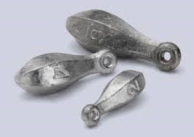
Potential Sources of Exposure
Lead in products used to hunt and fish
Melting lead to make (cast) bullets, sinkers, decoys and other metal items
Child exposed from making lead fishing sinkers
Use lead-free options
Notes:
Lead products are commonly used for hunting, fishing and making field equipment. In some cases, people melt lead to cast their own bullets, sinkers, decoys and other metal items. This process emits lead into the air and deposits lead particles into the workspace, and on their clothes, shoes and hair.
Identifying personal uses of lead products is important. For example, in Cherokee Nation, a child was found to have a confirmed high level of lead in their body (elevated blood lead level) after making fishing sinkers with their father. Identifying the source of exposure took time. The environmental staff checked all sources of paint and other potential sources in the home (even though they lived in post-1978 housing) and checked the parents’ work environment. The source was not found until a follow-up search of the garage, where a pile of lead fishing sinkers was discovered. This was determined to be the source of the child’s exposure to lead. In this case, the father, with the help of his children, made his own fishing sinkers using lead. Lead fishing sinkers are typically made from 100% lead. It only takes a small amount of lead to harm a child; however, there are lead-free tackle options available, which would eliminate this source of exposure.

Slide 19
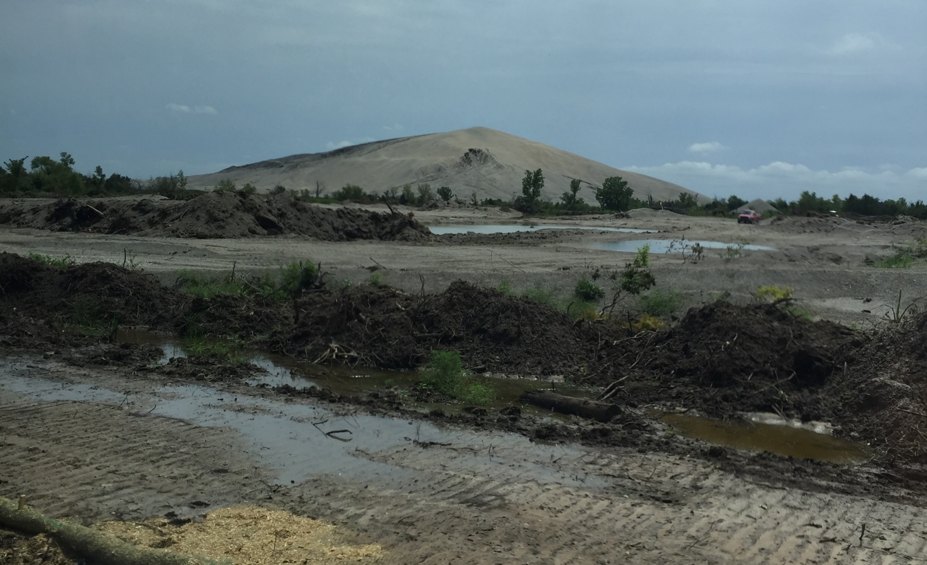
Potential Sources of Exposure
Superfund Sites
  Known to leach lead into soil and groundwater
  Tar Creek Superfund Site
Chat pile
Photo provided by Rick Dubois, Director of Environmental Services at Seneca-Cayuga Nation
Notes:
Lead is known to have leached into soil and groundwater at some Superfund sites, including the Tar Creek Superfund Site in northeastern Oklahoma. The Tar Creek Site is just one example of a Superfund Site located within or near tribal boundaries that impacts a tribe’s air, water and land. Instructor Note: You may choose to share the story of the Tar Creek Superfund Site as shared by the Quapaw Nation or another example relevant to your community.
i. Tar Creek Superfund Site: A Story from Quapaw Nation
Today, the Quapaw Nation works hard to clean their land and water to reduce the effects of lead and other pollution that disproportionately affect Quapaw tribal members. The Tar Creek Superfund Site also pollutes the lands and waters of seven other tribes through the portions of the Spring and Neosho watersheds that flow across the site and cross their tribal lands, affecting fishing as well as consumption, medicinal and ceremonial uses of plants.
During both World Wars, bullets and bombshells were made from metals mined in and near Quapaw lands, which resulted in 500 million tons of chat (i.e., crushed limestone, dolomite, and rocks left over from the metal ore separation process). In the 1960s, lead and mining companies ceased operations of these mines and left chat piles that measured as high as 10 stories. Mining activities and associated waste contaminated the soil, sediment, groundwater and surface water, and settled dust from the piles blew across the region. Today, mining impacts continue to be felt near tribal members’ homes.
In the late 1970s, the groundwater started to run red as a result of pollution from the heavy metals (lead, zinc, iron and arsenic), and the community started to link the effects of mining to health and developmental issues of young children. In fact, local doctors noticed children seemed to get sick often and teachers observed state testing scores significantly lagged in comparison to others outside the region.
In the 1980s, mining-related issues, such as sinkholes, started to become more prevalent, and people began to understand the health and environmental impacts of contamination from the mines. In 1983, the federal government designated a 40-square mile area as the Tar Creek Superfund Site. In 2006, an Army Corps of Engineers study showed that almost 9 out of 10 buildings in Picher, Oklahoma, were susceptible to collapse (due to unstable land from undermining of the site for lead and zinc and the removal of protective pillars beneath the surface).In 2008, the federal government provided funding for residents and business owners in Picher to relocate. Many residents were reluctant to leave a place they had called home for generations.
Today, the Quapaw Nation, along with state and federal partners, continue to clean up the 40-square-mile lead and zinc mining area – land and a community that have been left with pollution, adverse health effects, ruined property values and cultural losses. Most remediation work now involves removing chat piles, excavating contaminated soils and adding passive water treatment units. New wells must be drilled and cased through the contaminated aquifer and into a clean aquifer below. The Quapaw Nation is also utilizing filter-based semi-continuous air monitors in the Picher area to measure concentrations of lead and dust in the air at the site.
Due to the destruction and contamination of natural resources, many Quapaw tribal members have ceased or greatly reduced their traditional gathering and use of natural resources to limit exposure. The Quapaw Nation recommends avoiding the use of carpeting in the home and wet mopping hard surfaces to minimize dust. Water trucks also routinely spray the unpaved roads to minimize dust kicked up by traffic, since most unpaved county roads in the area were graveled with chat.

Slide 20
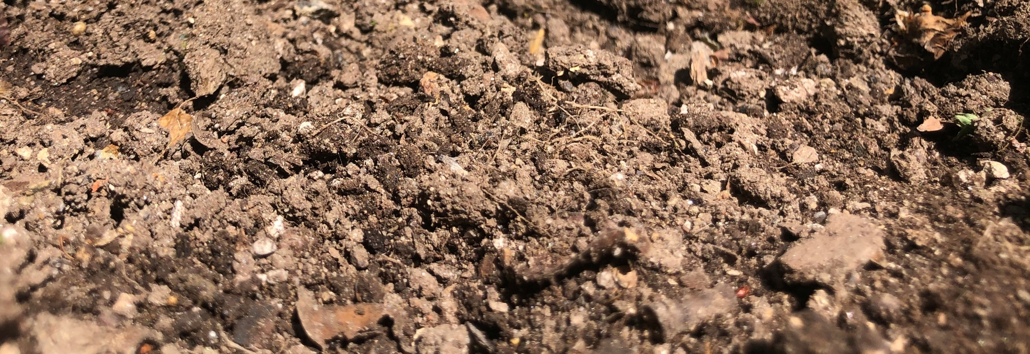
Potential Sources of Exposure
Lead can enter soil and water
Lead in soil:
  Can settle on or be absorbed by plants
  Be inhaled if resuspended in the air
  Tracked into the house on the bottom of shoes
Notes:
Unfortunately, lead can remain in the environment for many years and enter soil and water. Lead in soil can settle on or be absorbed by plants grown for fruits or vegetables, or plants used as ingredients in food, including dietary supplements (Ref. 10). Some plants that grow in soils with a high lead concentration can absorb lead from the soil with most of the lead remaining in the roots and, in some rare cases, even making its way to the aboveground parts of the plant (Ref. 11).
Lead can also be found on the outside surface of plants, either by sticking to the roots or by settling on the leaves and stems when lead dust is spread through the air. Lead ingested by animals or absorbed by or found on the surface of plants can then be passed along the food chain when they are consumed by both wildlife and humans (Refs. 12 & 13). For example, lead in soil can be ingested due to hand-to-mouth activity that is common for young children and from eating vegetables that may have taken up lead from soil in the garden or field (Ref. 14). Lead in soil may also be inhaled if resuspended in the air or tracked into a house on the bottom of shoes.
A number of potential sources of lead exposure have been discussed as well as several actions we can take to reduce and/or prevent exposure to lead. We will continue our discussion of preventative actions during this and subsequent sessions.

Slide 21
Are there other sources of lead exposure in the community?
Notes:
Instructor Note: Use this time to discuss potential sources of lead exposure unique to your community. Ask participants: “Are there sources of lead exposure in our community?” Be prepared to discuss known sources of lead such as, if appropriate, a Superfund Site, an abandoned mine, or improperly stored automobile parts and batteries.

Slide 22

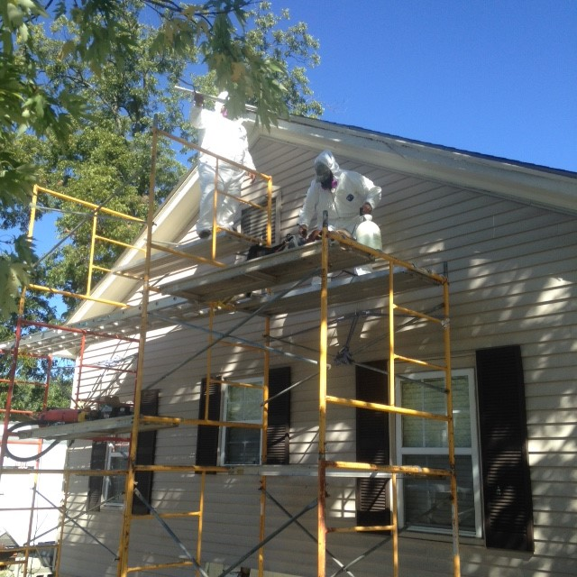

Vulnerable Populations
Certain groups are more vulnerable
  Children
  Adults through jobs, hobbies and/or cultural practices
  Pregnant women
Photo by Chien Pham on Unsplash
Photo provided by Shaun West, Environmental Programs Manager, Cherokee Nation
Photo by Arteida Mjeshtri on Unsplash
Notes:
III. Vulnerable Populations
All humans may potentially be exposed to lead; however, certain groups are more vulnerable than others to lead’s harmful effects, including young children under the age of six, pregnant women and adults who are exposed to lead through their jobs, hobbies and/or cultural practices.
a. Children
Lead is particularly dangerous to young children under the age of six because their growing bodies absorb more lead than adults, and their developing brains and nervous systems are more sensitive to lead’s damaging effects.
Babies and young children’s exposure to lead can be higher because they often put their hands and other objects into their mouths that may be contaminated by lead from dust or soil. This could include a pacifier dropped on the floor or ground covered with lead dust or eating paint chips or soil that contains lead.
Children may be exposed to lead by eating food or drinking water that contains lead. This includes drinking powdered formula made with lead-contaminated water (Ref. 15), eating lead dust that has settled on food and food preparation surfaces, eating game meat with lead particles, and eating food or drinking liquids stored or cooked in lead crystal or lead-glazed pottery and dishes. Food and liquids stored or served in lead crystal or lead-glazed pottery or porcelain can become contaminated because lead can leach from these containers into the food or liquid.
Various toys and other products may contain lead. Older toys and furniture passed down in the family, antique doll furniture or toy jewelry could contain lead-based paint or contain lead in the material it is made from. This could become a problem if children bite or swallow toys or toy jewelry that contain lead. Parents can stay up to date on product and toy recalls due to lead contamination and other issues by visiting the Consumer Product Safety Commission’s website: https://www.cpsc.gov/.
b. Adults, Including Pregnant Women
Working in certain jobs may increase adults’ potential exposure to lead, such as: renovation or repair of older homes and buildings; painting; construction; refinishing furniture; smelting; mining; auto repair and working at hazardous waste sites. Engaging in hobbies, such as making stained glass, making ammunition, shooting at a gun range or using certain folk remedies, may increase adults’ potential exposure to lead. These activities can cause lead dust or soil to get onto your skin, in your hair and clothing, which can then be transferred to the interior of your car or home, creating additional lead exposure for the rest of your family.
A pregnant woman’s exposure to lead from all previously mentioned sources is of concern because it can result in exposure to her developing fetus. While most common in 1- and 2-year old children, some pregnant women may also be exposed to lead from the intentional ingestion or mouthing of soil, clay or pottery, which is a behavior known as pica. Some people may also partake in the deliberate consumption of earths (clay, soil and rocks) as part of their cultural practices. Pica can result in serious health effects to both the mother and her developing fetus if the sources of clay, soil and rocks contain lead.

Slide 23

Impacts and Effects of Lead Exposure
Harmful to human health
Impacts the environment and wildlife
Photo by Kevin Crosby on Unsplash
Notes:
IV. Impacts and Effects of Lead Exposure
Lead is found in many different places and has harmful effects on human health. Lead exposure in humans can cause negative health impacts, which often occur with no obvious symptoms and frequently go unrecognized. Lead impacts the environment and wildlife. Wildlife symptoms are easier to recognize than those of humans.

Slide 24

Health Effects - Children
Behavior and learning problems
Lower IQ and hyperactivity
Slowed growth
Hearing problems
Anemia
Notes:
a. Health Effects of Lead
There is no known safe level of exposure to lead. Even small amounts of lead in the blood of children can result in:
Behavior and learning problems;
Lower IQ and hyperactivity;
Slowed growth;
Hearing problems; and
Anemia.
In rare cases, high amounts of lead can have devastating effects on children, including seizures, coma and in some cases, even death.

Slide 25
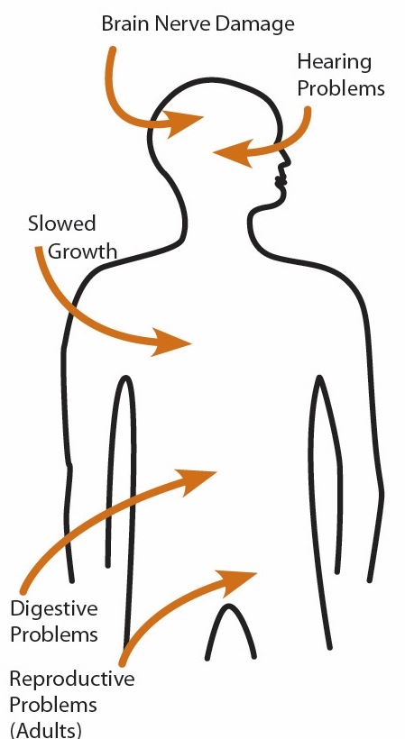
Health Effects - Adults
Increased blood pressure and incidence of hypertension
Decreased kidney function
Reproductive problems (in both men and women)
Notes:
Adults exposed to lead can suffer from:
Nerve disorders;
Increased blood pressure and incidence of hypertension;
Decreased kidney function;
Reproductive problems (in both men and women); and
Memory and concentration problems.

Slide 26

Health Effects – Pregnant Women
Lead is released from the mother’s bones along with calcium and can pass from the mother exposing the fetus or breastfeeding infant
  Baby born too early or too small
  Hurt the baby’s brain, kidneys and nervous system
  Put the mother at risk for miscarriage
Notes:
Lead can accumulate in our bodies over time, where it is stored in bones along with calcium. During pregnancy, lead is released from the mother’s bones along with calcium and can pass from the mother, exposing the fetus or breastfeeding infant to lead, especially when the mother does not receive adequate calcium through her diet. This can result in serious effects to the developing fetus and infant, including:
Causing the baby to be born too early or too small;
Hurting the baby’s brain, kidneys and nervous system;
Increasing the likelihood of learning or behavioral problems; and
Putting the mother at risk for miscarriage.

Slide 27

Health Effects - Wildlife
Ingestion of:
  Lead fishing tackle
  Spent lead ammunition
  Wounded or dead prey with lead fragments or shot pellets
Lead poisoning affects muscles, nerves, kidney function, reproductive systems and flight capacity
Photo by Richard Lee on Unsplash
Notes:
b. Health Effects of Lead on Wildlife
Like humans, ingestion of lead in the food web can also impact wildlife species. Animals can be exposed to lead from mining, facility emissions and lead-based paint, but research indicates that the ingestion of lead fishing tackle and spent lead ammunition are two of the major sources of exposure in wildlife (Ref. 19). This includes the direct ingestion of spent lead shot and bullet fragments. Secondary lead poisoning can occur when predators and scavengers target wounded prey that has been shot and animal parts or gut piles left by hunters that contain lead fragments from spent ammunition (Ref. 20). This source particularly impacts scavenging bird species such as hawks, eagles, vultures, condors, ravens, magpies, jays, etc. Lead poisoning affects their muscles, nerves, kidney function, reproductive systems, flight capacity and can result in paralysis and starvation.

Slide 28

Health Effects - Birds
Loons, ducks, geese and swans also commonly affected by lead ingestion
Behavioral changes:
  Unsteady legs
  Droopy wings
  Accidents when trying to land
Other symptoms:
  Listlessness, vomiting, diarrhea, digestive tract issues and impaired flight
Photo by Kevin Crosby on Unsplash
Notes:
Waterfowl species, such as loons, ducks, geese and swans, are also commonly affected by lead ingestion through the consumption of spent lead shot and used sinkers or tackle. However, many other types of birds can also be affected. Upon ingestion of sufficient amounts of lead, birds may show behavioral changes, such as: unsteady legs, droopy wings, accidents when trying to land, and in more severe cases, blindness and the inability to hold up their head. Other symptoms include listlessness (e.g., spiritless), vomiting, diarrhea and impaired flight.

Slide 29

Health Effects - Mammals
Lead exposure can result in:
  Vomiting
  Loss of appetite
  Diarrhea
  Lethargy
  Uncoordinated body movements
Repeated exposure can result in:
  Anemia, convulsions, blindness, coma or death
Photo by Guillaume Bourdages on Unsplash
Notes:
Lead poisoning can also occur in mammals, such as raccoons, bears, wolves and foxes. Lead exposure for these mammals can result in vomiting, loss of appetite, diarrhea, lethargy and uncoordinated body movements. Repeated exposures over time can result in anemia, convulsions, blindness, coma or death.

Slide 30
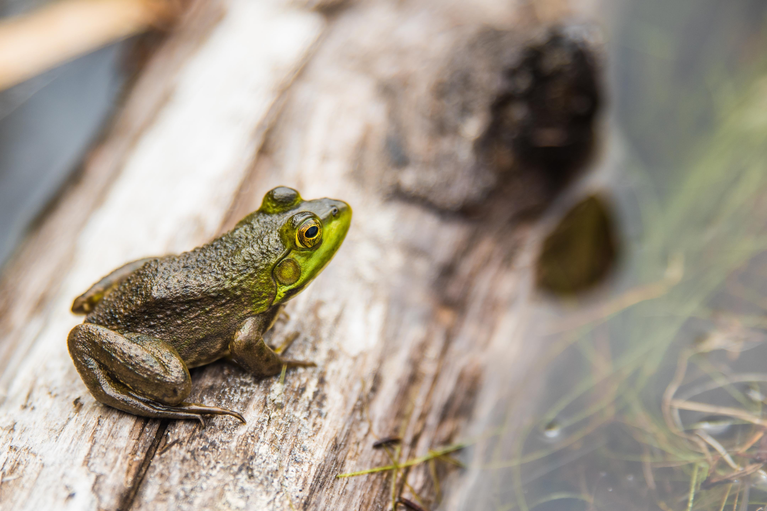
Health Effects - Amphibians
Increased skin shedding
Sluggishness
Decreased muscle tone
Photo by Jared Evans on Unsplash
Notes:
Lead exposure in amphibians, such as toads and frogs, can result in an increase in skin shedding, sluggishness and decreased muscle tone.

Slide 31

Non-Lead Alternatives for Fishing and Hunting Activities
Tribes are taking action to increase use of non-lead alternatives for fishing and hunting activities within their territories
Non-lead ammunition
Non-lead lures or sinkers
Non-lead ammunition in hunting guidelines
Established lead-free subsistence hunting programs
Photo provided by Zender Environmental and Health Group
Notes:
Given rising concerns over known and potential impacts of lead on wildlife (Ref. 19), many tribes are taking action to increase the use of non-lead alternatives for fishing and hunting activities within their tribal lands. For example, the Menominee Tribe requires non-lead ammunition for any harvesting of animals for food. The Flathead Indian Reservation Tribes require the use of non-toxic shot for both waterfowl and upland bird hunting, as well as the use of non-lead lures or sinkers for fishing (Ref. 22). Other tribal nations, such as the Hopi Tribe, Navajo Nation, Confederated Tribes of Siletz Reservation, Confederated Tribes of the Umatilla Indian Reservation and a handful of smaller tribes have either passed resolutions or proposed recommendations to include a non-lead ammunition component in their hunting guidelines.
The Nez Perce Tribe of north-central Idaho initiated regional dialogue on this topic and established a Hunter Stewardship and Safety Program centered on lead-free subsistence hunting. The program offers an ammunition exchange option and facilitates community outreach to share awareness about the human health and wildlife conservation benefits of choosing to switch to copper-based ammunition when harvesting food. As non-lead options for both fishing and hunting have continued to increase, some First Nations in Canada have also urged more leadership on this issue.
Instructor Note: Check with your tribe to see if they have similar recommendations or resolutions on lead ammunition and fishing tackle. In 1991, the U.S. Fish and Wildlife Service banned the use of lead shot nationwide for hunting waterfowl (duck, geese, swans and coots). For more information on shot types that are approved as nontoxic for waterfowl hunting in the U.S., visit: https://www.fws.gov/birds/bird-enthusiasts/hunting/nontoxic.php.

Slide 32
Are you aware of specific stories of how lead has already impacted our community?
Notes:
c. Potential Impacts of Lead on Cultural Practices
Lead, like other heavy metals, has the potential to impact cultural practices and subsistence lifeways. From the catching of fish, to the gathering of plants, to the harvesting of wild game, or the collecting of wood and other life-sources, subsistence lifeways are vulnerable to heavy metal exposure because they are intricately linked to the ecological communities and processes of living landscapes. All of these life supporting links can be eroded or destroyed from exposure to heavy metals that would otherwise stay out of harm’s way underground. Tribes and indigenous populations are extremely diverse in terms of lands, languages, cultures and diets, and are closely linked to the environment and natural resources. Due to their connection and dependence on the environment for the survival of their culture(s) and their subsistence practices, tribal and indigenous populations may have different potential sources of exposure to lead.
Are you aware of specific stories of how lead has already impacted our community? Instructor Note: Give participants an opportunity to share a story. If they cannot think of one, be prepared to share a story about how cultural practices and/or subsistence foods may have been impacted by lead contamination.

Slide 33
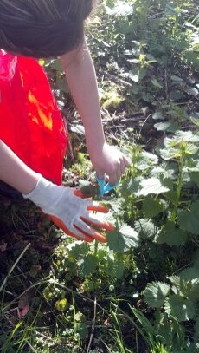
Cultural Impacts
Hunting deer, moose, elk and other game
  Use lead-free ammunition
Gathering traditional and cultural foods
  Wash gathered foods before cooking and eating
Photo provided by Zender Environmental and Health Group
Notes:
Hunting deer, moose, elk and game – Most hunting ammunition is lead-based, which means both wildlife and humans are at risk of lead exposure from the consumption of spent ammunition in game meat and internal organs of an animal used as food (Refs. 23 & 24). In a recent study completed in North Dakota, participants who ate any wild game had higher blood lead levels than participants who did not consume wild game (Ref. 25). Lead exposure cannot be eliminated by cutting out the bullet wound channel and trimming meat at the site of impact. The typical lead-core bullet loses 30-40% of its weight in big game animal carcasses; hundreds of fragments are dispersed when a lead bullet is fired into an animal, making it impossible to remove all fragments. Using lead-free ammunition is the best way to avoid this risk of exposure.
Gathering traditional and cultural foods – Many traditional and cultural foods are gathered in natural areas that may be contaminated with lead (or other harmful materials); thus it is important to wash items thoroughly with clean water sources prior to eating. For example, to reduce the risk of exposure to lead, one southwest tribe makes sure its members thoroughly wash watercress and wild onions grown in the early spring to remove any contaminated soil from the plant’s surface. Another northwest tribe, living in an area with known lead soil contamination, recommends washing and then removing the skins of water potatoes prior to cooking and eating to reduce exposure. Overall, it is a good practice to thoroughly wash gathered foods prior to cooking and eating as well as to understand whether possible exposure scenarios exist in your community.

Slide 34
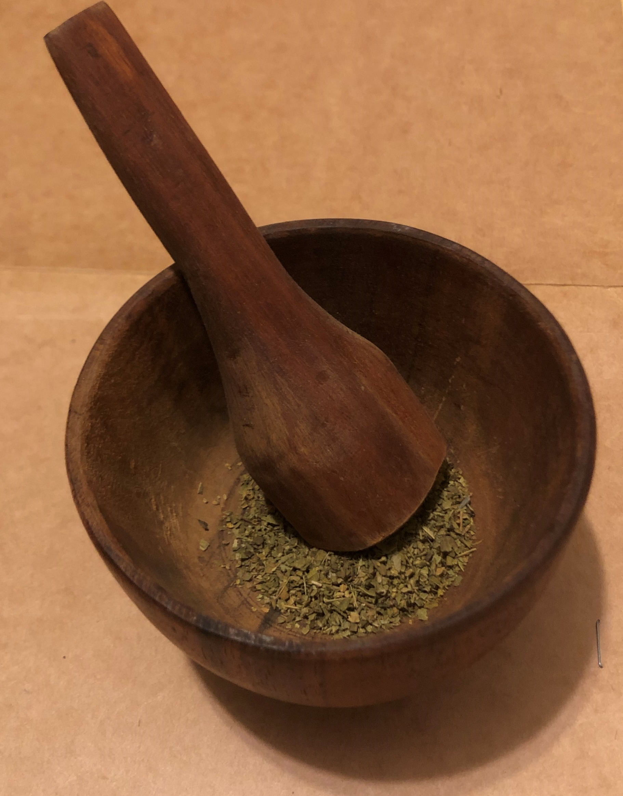
Cultural Impacts
Burning materials and ingredients
  Know the source of the materials
Using natural resources
  Check the source and consider other options if possible
Returned museum artifacts
  Ask questions about the preservation process
Notes:
Burning materials and ingredients for cultural and medicinal activities - Many tribal activities involve burning different materials for traditional, cultural and medicinal practices. In some cases, ashes and smoke have been found to be contaminated with chemicals, such as when unknowingly burning wood coated with lead-based paint. It is important to know the source of the materials being burned to prevent community members from being exposed to lead through both ingestion and breathing.
Using natural life sources for various items – Natural resources are commonly used to create cultural items, such as clay and soil for makeup and paints. However, it is important to know whether natural resources being used are contaminated with lead before using them. Consider other options if possible. Hire a professional or contact a lab to test for the presence of lead in natural resources.
Returned museum artifacts – Museum artifacts were often preserved using mercury, arsenic, lead and other toxic chemicals. Although chemists are working on ways to clean them well enough for reuse, it is important to understand that some older items may contain lead or other harmful chemicals and thus increase potential exposure to lead. When these artifacts are returned, be sure to ask questions about the prior preservation processes used.

Slide 35
Taking Action
Lead exposure and lead poisoning is preventable
The worksheet shows actions we can take to reduce potential exposure to lead
Notes:
V. Taking Action
Lead exposure and lead poisoning is preventable. In fact, many groups and tribes throughout the country have implemented their own programs and projects over the years to lower their exposure to lead and its harmful effects. Throughout the course of the different Lead Awareness in Indian Country: Keeping Our Children Healthy! sessions, we will discuss different actions that you can take to reduce potential exposure to lead. Please pull out your worksheet as we continue our discussion of actions you can take at home to reduce your family’s potential exposure to lead.

Slide 36
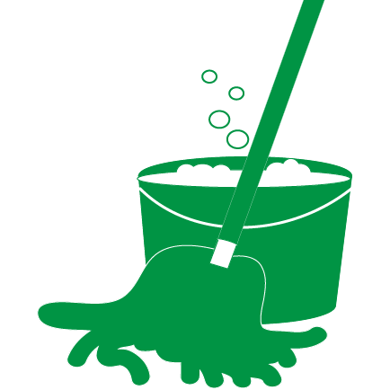
Keep Homes Clean & Dust Free
Wet mop floors and hard surfaces
Wipe down hard surfaces with a wet cloth
Inspect and maintain painted surfaces
Wet wipe peeling, chipping, chalking or cracking paint
Notes:
a. Keep Homes Clean & Dust Free
Wet mop floors and hard surfaces (e.g., porches) to minimize lead dust.
Wipe down hard surfaces such as countertops, window sills and doors jambs with a wet cloth.
Inspect and maintain all painted surfaces to guard against deterioration.
Wet wipe the area immediately if you notice any peeling, chipping, chalking or cracking paint.

Slide 37

Eat a Diet High in Iron, Calcium & Vitamin C
Eat a well-balanced diet.
Wash food thoroughly with clean water sources prior to eating
Do not eat food or drink water cooked or stored in chipped or cracked lead-crystal, lead-glazed pottery or lead-porcelain cookware
Notes:
b. Eat a Diet High in Iron, Calcium & Vitamin C
Ensure family members eat a well-balanced diet of fruits, vegetables, grains, dairy and protein foods. Foods that are higher in calcium, iron and vitamin C can help reduce the absorption of lead. Children with healthy diets absorb less lead.
Wash all food, including traditional and cultural foods gathered in natural areas, thoroughly with safe water sources prior to eating. This would remove soil or lead dust that may have adhered to the surface.
Do not eat food or drink water cooked or stored in chipped or cracked lead-crystal, lead-glazed pottery or lead-porcelain cookware.

Slide 38
Eat a Diet High in Iron, Calcium & Vitamin C
Use only cold water for drinking, cooking and preparing baby formula
Know the source of natural resources, ingredients, herbs, etc.
Notes:
Use only cold water for drinking, cooking and preparing baby formula. Use water from a safe source to mix baby formula. Heat up cold water on the stove or in a microwave if hot or warm water is needed. Boiling water does not remove lead from water.
Know the sources of natural resources, ingredients, herbs, etc. being used for various purposes to prevent exposure to lead through ingestion or breathing.

Slide 39
Eat a Diet High in Iron, Calcium & Vitamin C
Check local, tribal and regional fish advisories for recommendations on limiting fish consumption
Switch to non-lead ammunition and fishing tackle when harvesting wild game and fish for food
Notes:
Check local, tribal and regional fish advisories for recommendations on fish consumption for pregnant women, children under 15 years of age and the general public. This includes recommendations on numbers to be consumed per month for specific fish and whether it is recommended to eat only the fillet or the whole fish.
Switch to non-lead ammunition and fishing tackle when harvesting wild game and fish for food, when possible.

Slide 40
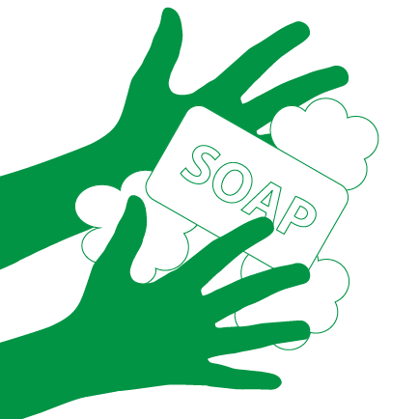
Wash Hands
Use soap and water (warm or cold) to wash children’s hands several times a day
Adults should wash hands after participating in activities where they may have come in contact with lead
Notes:
c. Wash Hands
Use soap and water (warm or cold) to wash children’s hands several times a day, especially after playing outside or with animals.
Adults should wash hands after participating in activities where they may have come in contact with lead.

Slide 41

Play in Grass
Guide children to play in grassy or non-contaminated bare soil areas
Use designated picnic, camping and hiking areas
Teach children to wipe and remove their shoes and to wash their hands after playing outdoors
Wipe off pet’s paws
Place dust mats inside and outside your home
Notes:
d. Play in Grass
Guide children to play in grassy or non-contaminated bare soil areas, especially if play areas are near roadways, junk yards, older buildings and uncontrolled or abandoned sites or properties.
Use designated picnic, camping and hiking areas.
Teach children to wipe and remove their shoes and to wash their hands after playing outdoors.
Wipe off pets’ paws prior to bringing them indoors.
Place dust mats both inside and outside your home.

Slide 42

Hire Certified Lead Professionals
Hire a certified lead professional for renovation and repair work for pre-1978 homes
Make sure your contractor is Lead-Safe Certified
Notes:
e. Hire Certified Lead Professionals
For homes built prior to 1978, hire a certified lead professional for renovation and repair work. Keep residents out of the work area during renovation or repair work which disturbs painted surfaces in older homes and buildings until the work area is cleaned.
When having home renovations, repairs or painting done, make sure your contractor is Lead-Safe Certified and follows lead-safe work practices per the requirements of EPA’s Renovation, Repair and Painting Rule. These professionals have special training and are certified to perform this type of work.
If you are renting your home or apartment and think it may contain lead-based paint or lead hazards, make sure your landlord or tribal housing authority hires a Lead-Safe Certified contractor to do renovation, repair and painting work.

Slide 43
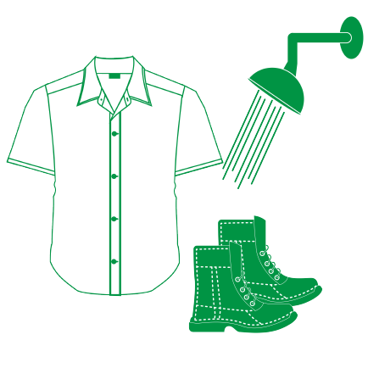
Shower & Change
Clean or remove work clothes and shoes before entering your home
Wash work clothes separately
Shower after activities where you may have been exposed to lead
Notes:
f. Shower & Change
Clean or remove work clothes and shoes before entering your home to avoid tracking in lead from soil, work sites or hobbies. Store work clothes and shoes in a designated area outside the home.
Wash work clothes separately from other family members’ clothes.
Shower after participating in activities where you may have been exposed to lead to remove any lead dust from your skin and hair.

Slide 44

Wash Toys, Pacifiers & Bottles
Wash children’s bottles, pacifiers and toys, like stuffed animals, often.
Do not let children chew on painted toys, window sills or other painted surfaces.
Notes:
g. Wash Toys, Pacifiers & Bottles
Wash children’s bottles, pacifiers and toys, like stuffed animals, often.
Do not let children chew on painted toys, window sills or other painted surfaces.

Slide 45
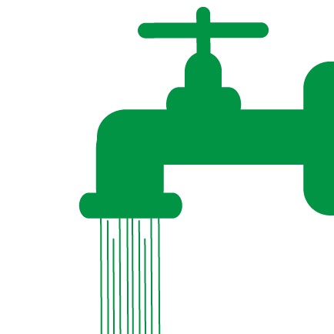
Run Your Water
Before drinking, flush your home’s pipes by running the tap, taking a shower, doing laundry or load of dishes
Use filter certified to remove lead
Clean faucet screen’s regularly
Notes:
h. Flush Pipes
Before drinking, flush your home’s pipes by running the tap, taking a shower, doing laundry or doing a load of dishes. The amount of time to run the water will depend on whether your home has a lead service line or not, and the length of the lead service line. Residents should contact their water utility for recommendations about flushing times in their community.
Use only cold water for drinking, cooking and making baby formula. Remember, boiling water does not remove lead from water.
Use a filter certified to remove lead. Read the directions to learn how to properly install and use your cartridge and when to replace it. Using the cartridge after it has expired can make it less effective at removing lead. Do not run hot water through the filter.
Clean your faucet’s screen (also known as an aerator) regularly. Sediment, debris, and lead particles can collect in your aerator. If lead particles are caught in the aerator, lead can get into your water.

Slide 46
Run Your Water
Contact your water utility or a licensed plumber to determine if the pipe that connects your home to the water main (service line) is made from lead
Contact your water utility to have your water tested and learn about lead levels in your drinking water
Notes:
Contact your water utility or a licensed plumber to determine if the pipe that connects your home to the water main (called a service line) is made from lead.
Contact your water utility to have your water tested and to learn more about the lead levels in your drinking water.

Slide 47
Flush Pipes
Check with your health department or nearby water utilities that use ground water for information on the water in your area, if your drinking water comes from a private well (or cistern)
Be aware of any construction or maintenance work that could disturb your lead service line
Notes:
Check with your health department or nearby water utilities that use ground water for information on the water in your area, if your drinking water comes from a private well (or cistern).
Be aware of any construction or maintenance work that could disturb your lead service line. Construction may cause more lead to be released from a lead service line.

Slide 48
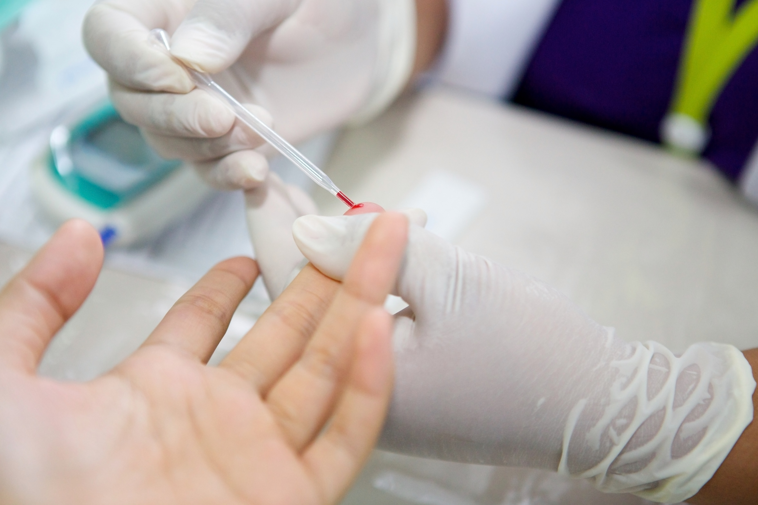
Getting Your Child Tested
The only way to know if a child has lead in their blood is to have a blood test
Lead exposure often occurs with no obvious symptoms
Generally recommended children be tested at ages 1 and 2
Contact your healthcare provider, local health department, clinic or hospital for more information
Notes:
i. Getting Your Child Tested
Instructor Note: Participants may have questions regarding the specifics of blood lead testing for lead or what happens if a child’s blood lead level is elevated or tests positive for lead poisoning. No specific blood lead reference level is mentioned in this Lesson Plan because the Centers for Disease Control and Prevention (CDC) periodically updates its recommendations on children’s blood lead levels. Please visit CDC’s website for the most up-to date information on their recommendations on children’s blood lead levels at www.cdc.gov/nceh/lead/prevention/blood-lead-levels.htm. Only answer the questions you are knowledgeable about and comfortable with answering. If your tribe or local health clinic has a blood lead testing program for children, it is recommended that you invite a program representative to join you for this part of the session or direct participants to that program.
Raise your hand if your children or grandchildren have been tested for lead in the past.
The only way to know if a child has lead in their blood is to have a blood test (Ref. 26). Because lead exposure often occurs with no obvious symptoms, it frequently goes unrecognized. No amount of lead is safe for children. It is generally recommended that children be tested at ages one and two.
Contact your healthcare provider, local health department, clinic or hospital if you would like more information about testing your children or family members for lead.

Slide 49
Conclusion
We discussed:
  Sources of lead exposure
  How lead harms children and adults
  Lead’s impacts on the environment and wildlife
  Actions that can be take to prevent potential exposure
Notes:
VI. Conclusion
Today we discussed sources of lead exposure; how lead harms children and adults; its impacts on the environment and wildlife; and actions that you can take to prevent potential exposure to lead. The upcoming modules will go into more detail about how to effectively clean your home to reduce exposure; good hygiene practices for both kids and adults, including nutritional information and how and when to hire a certified lead professional to remove lead from the home.

Slide 50
Review
Answer the fill in the blank questions on Potential Sources of Lead Exposure and Taking Action within the worksheet
Group discussion questions:
  What are the potential health effects of children exposed to lead?
  What are the impacts of lead on the environment and wildlife?
  Does anyone have any questions about the information we covered?
Notes:
In order to review what we have learned today, please flip over the worksheet and answer the fill-in-the blank questions on Potential Sources of Lead Exposure and Taking Action. You will have about five minutes to answer as many questions as possible and then we will go over the answers as a group. Instructor Note: At the end of the five minutes, go over the correct answers to the fill-in-the blanks. It is recommended that you include this as part of your conclusion; however, you can choose to have participants answer the questions at home.
I also have a few questions for the group:
What are the potential health effects of children exposed to lead?
What are the impacts of lead on the environment and wildlife?
Does anyone have any questions about the information covered?

Slide 51
National Lead Information Center
1 (800) 424-LEAD [5323]
Provides the public and professionals with information about lead, lead hazards and prevention
Ask an Information Specialist questions about lead
Monday to Friday, 8:00 am to 6:00 pm ET (except federal holidays)
Hearing- or speech-challenged individuals may access this number through TTY by calling the Federal Relay Service at 1-800-877-8339
Notes:
To receive general information about lead or ask questions, you can call the National Lead Information Center (NLIC). The NLIC provides the public and professionals with information about lead, lead hazards and prevention. Call and speak with a specialist Monday through Friday, 8:00 am to 6:00 pm Eastern time (except federal holidays) at 1 (800) 424-LEAD [5323]. Hearing- or speech-challenged individuals may access this number through TTY by calling the Federal Relay Service at 1-800-877-8339. Instructor Note: Participants can find this number on both the worksheet and key messages.

Slide 52
Thank You!
Module 1: Understanding Lead take-home resources include, the:
Worksheet;
Key messages; and
Kids activity sheet
Notes:
Thank you for participating in this session. Here is the Module 1 Kids Activity Sheet for you to take home. The kids activity sheet has several activities that teach children about what we learned today. Instructor Note: Give each participant a copy of the Module 1 Kids Activity Sheet.

