Slide 1
Module 3: Personal Hygiene and Nutrition

Slide 2

Outline
Personal Hygiene
Nutrition
Notes:
Today’s session will be approximately 60 minutes long, we will discuss:
Personal Hygiene and
Nutrition

Slide 3
Outcomes
List three personal hygiene habits that can reduce potential lead exposure in children
List three healthy snacks for children that may help reduce the impact of potential lead exposure
Explain how meals and snacks can become contaminated with lead during preparation
Discuss actions that can be taken in the home to reduce potential exposure to lead
Notes:
Upon the completion of Module 3, participants will be able to:
List three personal hygiene habits that can reduce potential lead exposure in children;
List three healthy snacks for children that may help reduce the impact of potential lead exposure;
Explain how meals and snacks can become contaminated with lead during preparation; and
Discuss actions that can be taken in the home to reduce potential exposure to lead.

Slide 4

Introduction
Good personal hygiene and healthy nutritional practices may assist in reducing the absorption of lead in a child’s body
Photo provided by Zender Environmental and Health Group
Notes:
I. Introduction
Good personal hygiene and healthy nutritional practices may assist in reducing the absorption of lead in a child’s body. It is important that everyone, not just parents and caregivers, understand the beneficial impacts that simple actions, such as consistent hand washing and feeding children healthy foods, can have to help reduce the risk of lead exposure. Today, we will discuss simple actions we can take to reduce potential exposure to lead by focusing on personal hygiene and nutrition.

Slide 5
Introduction
Hygiene - Actions taken to keep our bodies clean, such as washing our hands, hair, and taking a bath
Nutrition - The process of consuming food or beverages necessary for health and growth, which our bodies need to stay alive and healthy
Nutrient - A substance in food or beverages that provides nourishment for growth and the maintenance of life
Notes:
I am going to define a few words that will be used throughout our discussion.
Hygiene - Actions taken to keep our bodies clean, such as washing our hands or hair and taking a bath.
Nutrition - The process of consuming food or beverages necessary for health and growth, which our bodies need to stay alive and healthy.
Nutrient – A substance in food or beverages that provides nourishment for growth and the maintenance of life.

Slide 6
What are examples of good personal hygiene behaviors for children?
Notes:
To better understand what we already know and think about personal hygiene and nutrition, I have a few questions for the group. If you do not know the answers, that is fine. We will cover all the information shortly. Instructor Note: Depending on time, ask one or all four questions found on slides 5 through 8. Record participants’ responses on flipchart paper and post them in a place that will be visible throughout the session.
What are examples of good personal hygiene behaviors for children? (Answers may include: washing hands after playing outside and going to the bathroom; covering your mouth when you cough or sneeze; brushing teeth twice a day; bathing regularly.)

Slide 7
What foods do you think should be part of a healthy diet for children?
Notes:
What foods do you think should be part of a healthy diet for children? (Instructor Note: Answers may include: fruits and vegetables.)

Slide 8
What are some nutrients that are important for our health?
Notes:
What are some nutrients that are important for our health? (Instructor Note: Answers may include: vitamins, minerals, calcium, magnesium, protein, water and fiber.)

Slide 9
What nutrients may limit the absorption of lead in children’s bodies?
Notes:
What nutrients may limit the absorption of lead in children’s bodies? (Instructor Note: Answers include: calcium, vitamin C and iron).
Some of the personal hygiene and nutritional tips that we will discuss today may be actions you already follow.

Slide 10
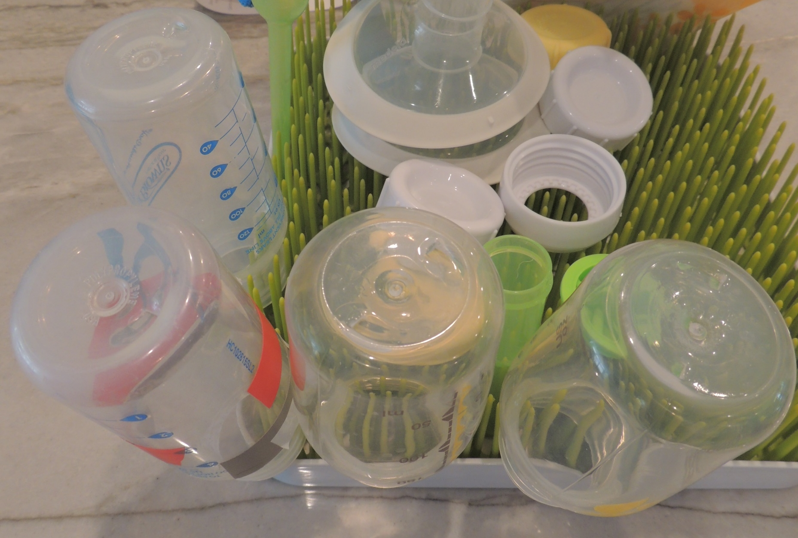
Personal Hygiene
Minimizes the possibility of illness
Reduces children’s potential exposure to lead
Teach children good personal hygiene habits:
  Wash hands several times a day
  Trim fingernails and toenails
  Bathe daily
  Pin pacifiers to clothes
  Wash bottles and pacifiers daily
  Wash toys
Notes:
II. Personal Hygiene
Taking care of our bodies and keeping ourselves and surroundings clean and clutter-free are important to maintain good health. To minimize the possibility of illness and reduce children’s potential exposure to lead, teaching children good personal hygiene habits is essential. Adults can teach children good personal hygiene by:
Making sure they wash their hands several times a day.
Keeping their fingernails and toenails trimmed short.
Bathing them daily.
Pinning pacifiers to their clothes.
Washing bottles and pacifiers daily.
Washing toys often.
Washing clothes and shoes soiled by lead dust or soil separately from other items.

Slide 11
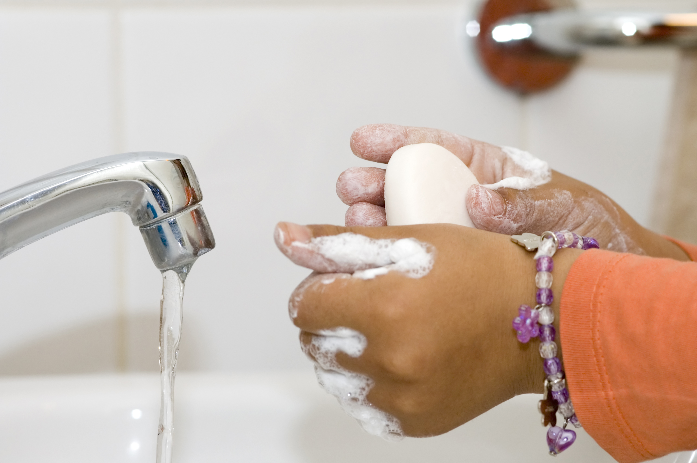
Personal Hygiene
Children may swallow lead-contaminated dust or soil when they put their hands in their mouths
Children should wash their hands with soap:
  Before eating, drinking and sleeping
  After using the bathroom
  After playing outdoors or with animals
Notes:
One way young children ingest lead is through dust or soil contaminated by lead-based paint or other sources of lead that settles on their hands as they play. When children put their hands in their mouths, they may swallow lead-contaminated dust or soil, which can then get into their bloodstream. Elements of good hygiene, such as consistent handwashing, reduces the likelihood of this happening and is the best way to reduce the number of germs on children’s hands in most situations. Children should wash their hands:
Before eating, drinking, and sleeping;
After using the bathroom; and
After playing outdoors or with animals.

Slide 12
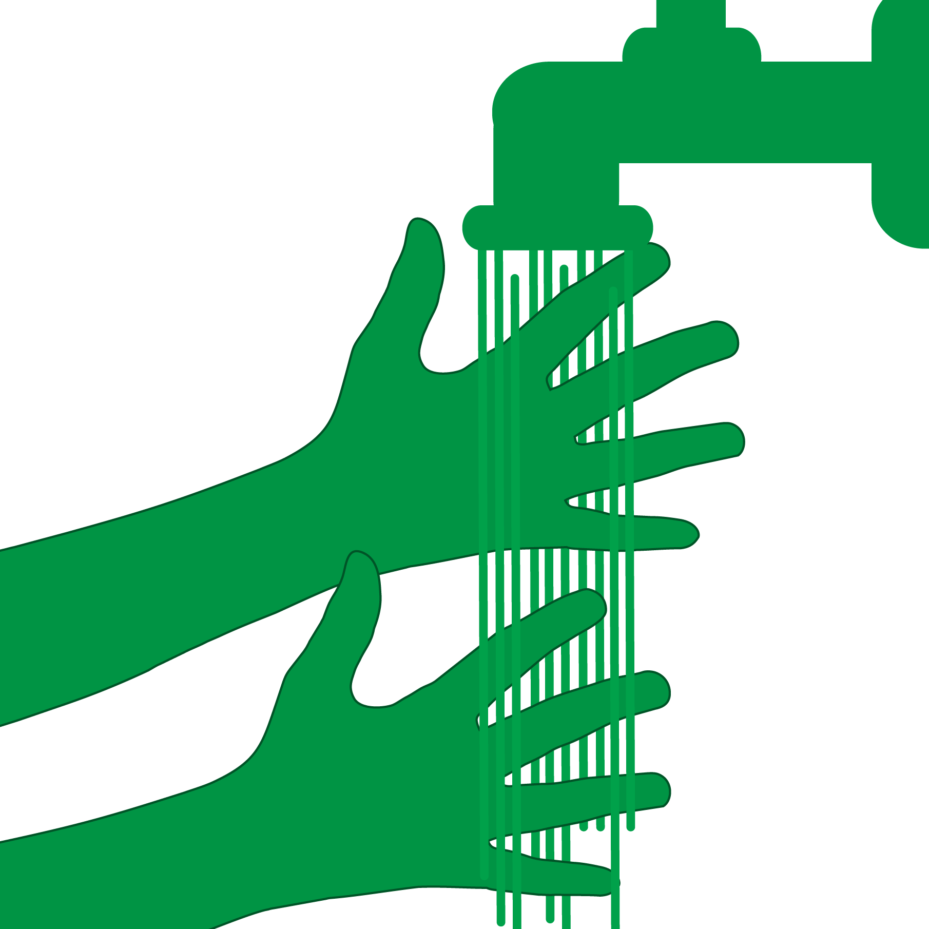
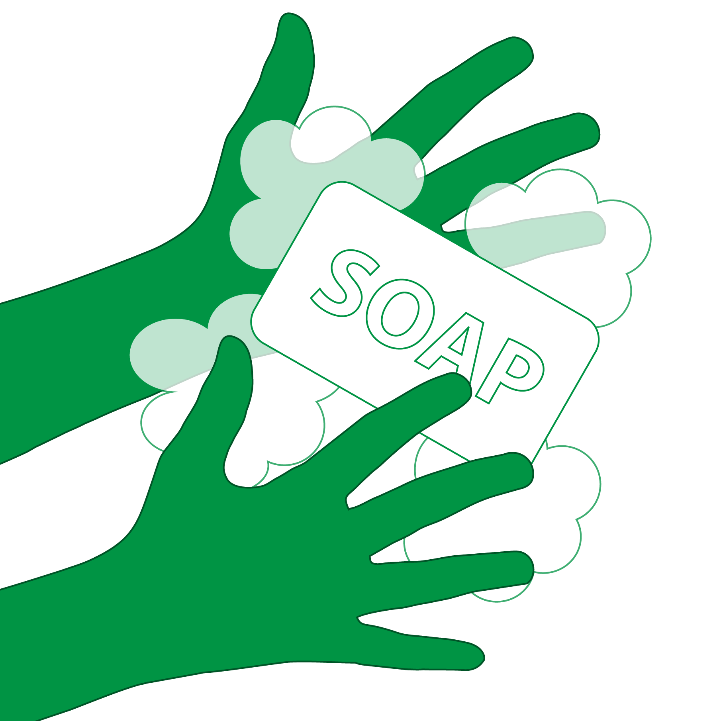
Handwashing in 6 Steps
Step 1: Wet hands with clean, running water
Step 2: Add soap, rub hands together making a soapy lather
Notes:
When children wash their hands, they should wash with soapy water for at least 20 seconds, and then dry their hands thoroughly with a clean towel or paper towel. While warm water is preferred, cold water is better than not washing. Hands should not be wiped off or dried on their clothes, which could be contaminated. Six steps are recommended for effective handwashing.
a. Handwashing in 6 Steps
Step 1: Wet hands with clean, running water.
Step 2: Add soap, then rub hands together making a soapy lather. Do this away from the running water; be careful not to wash the lather away.

Slide 13
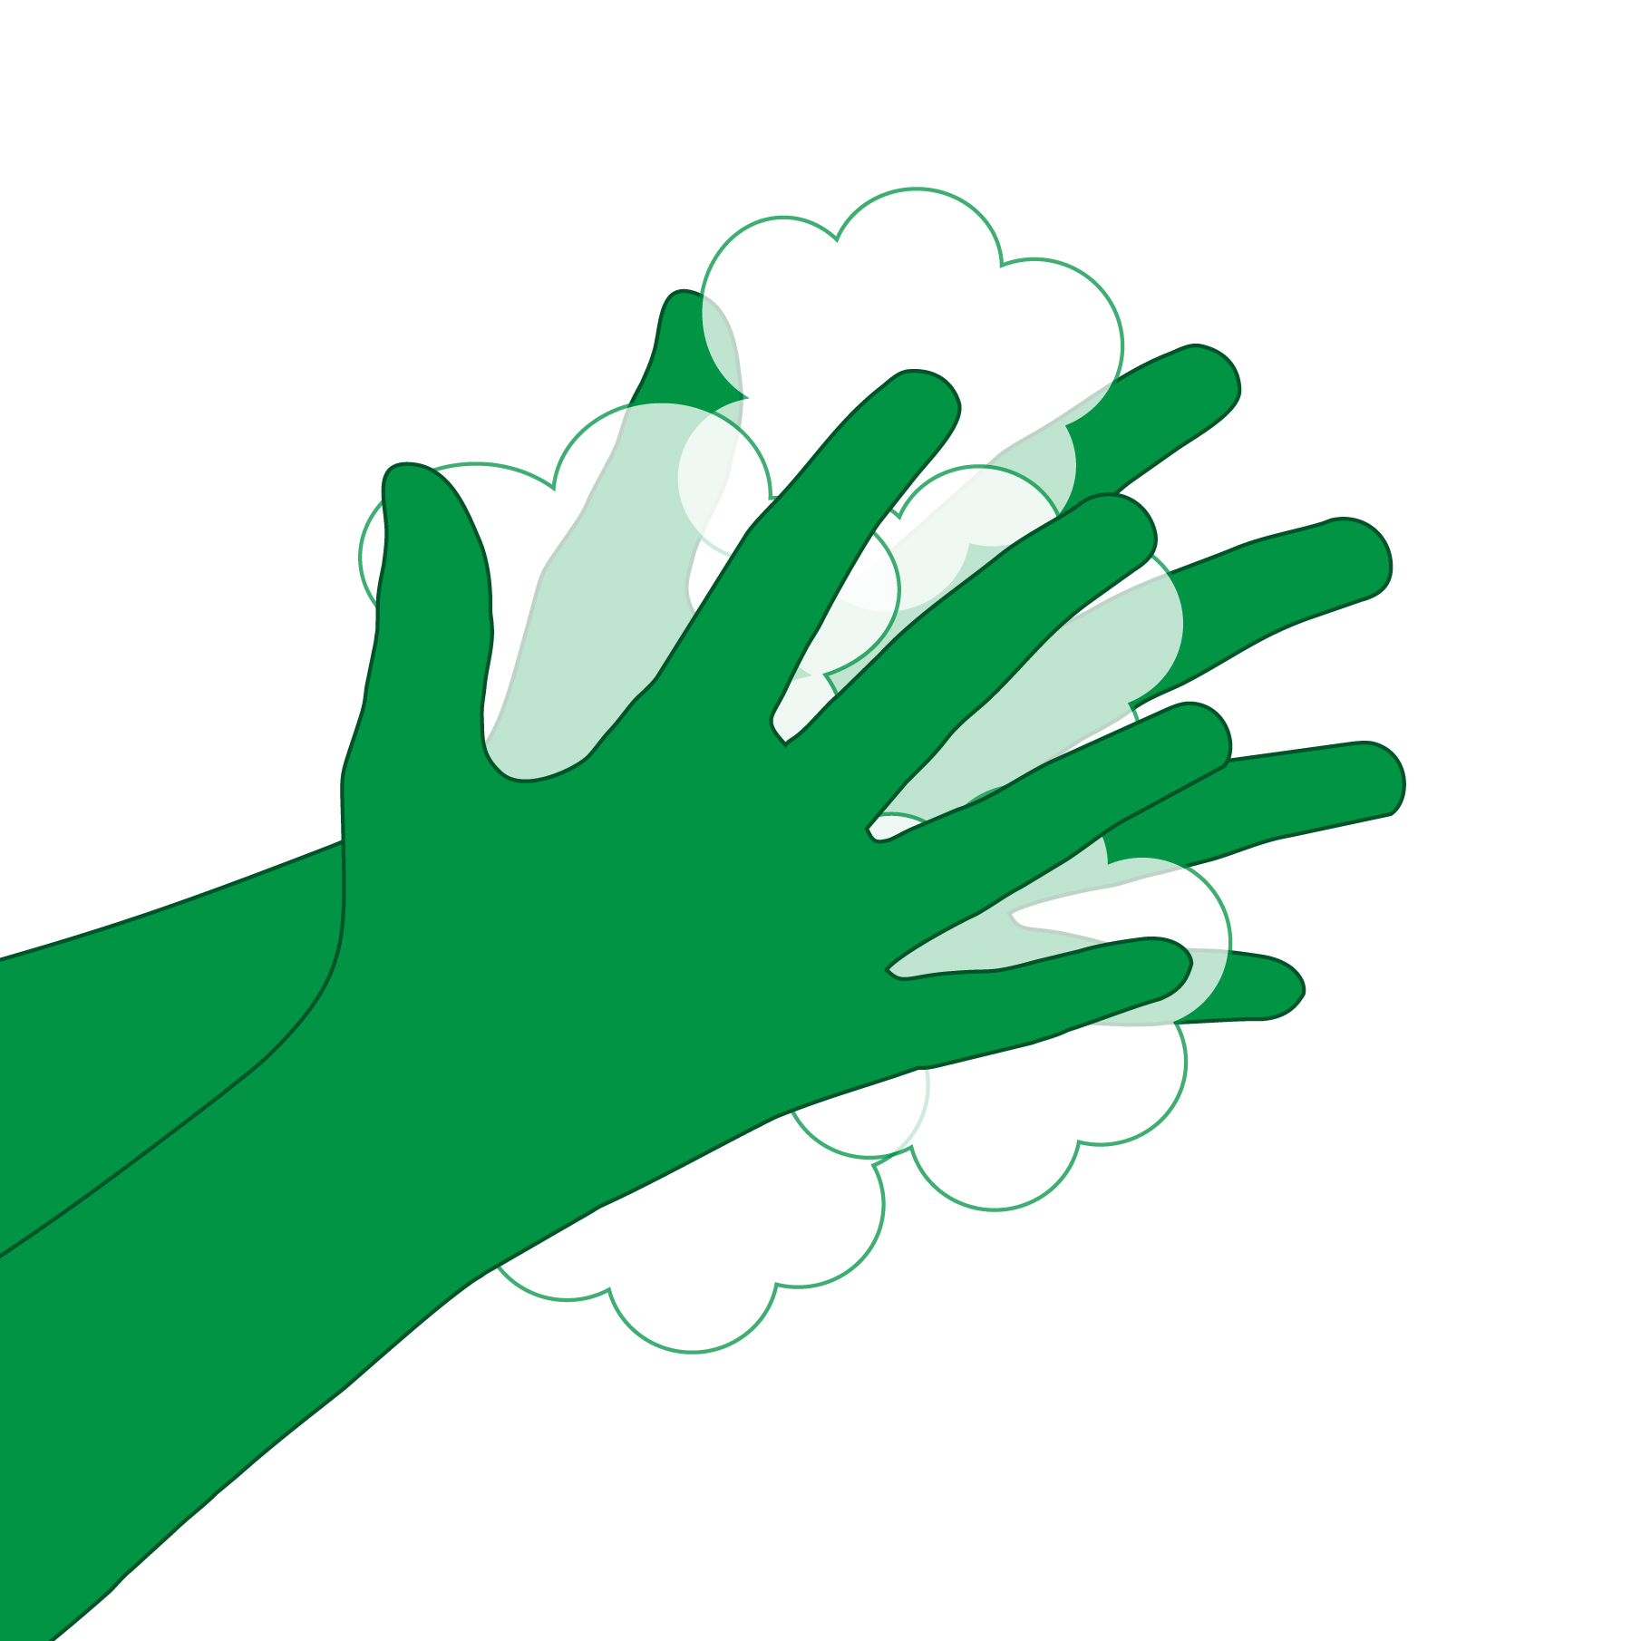
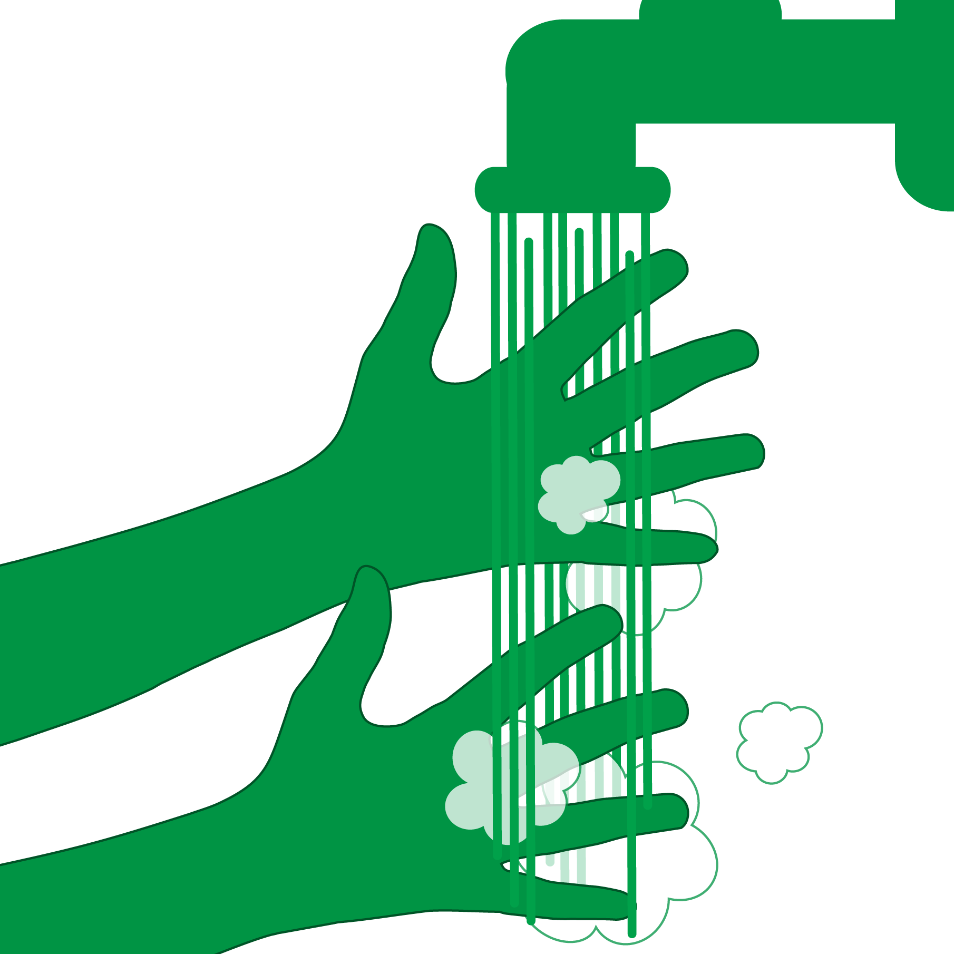
Handwashing in 6 Steps
Step 3: Scrub the front and back of hands, between fingers and under nails for at least 20 seconds
Step 4: Rinse hands from wrist to fingertips under clean, running water
Notes:
Step 3: Scrub the front and back of hands, between fingers and under nails. Wash for at least 20 seconds, the amount of time it takes to sing the ABCs once or the Happy Birthday song twice.
Step 4: Rinse hands from wrists to fingertips under clean, running water. Let the water run back into the sink, not down to your elbows.

Slide 14

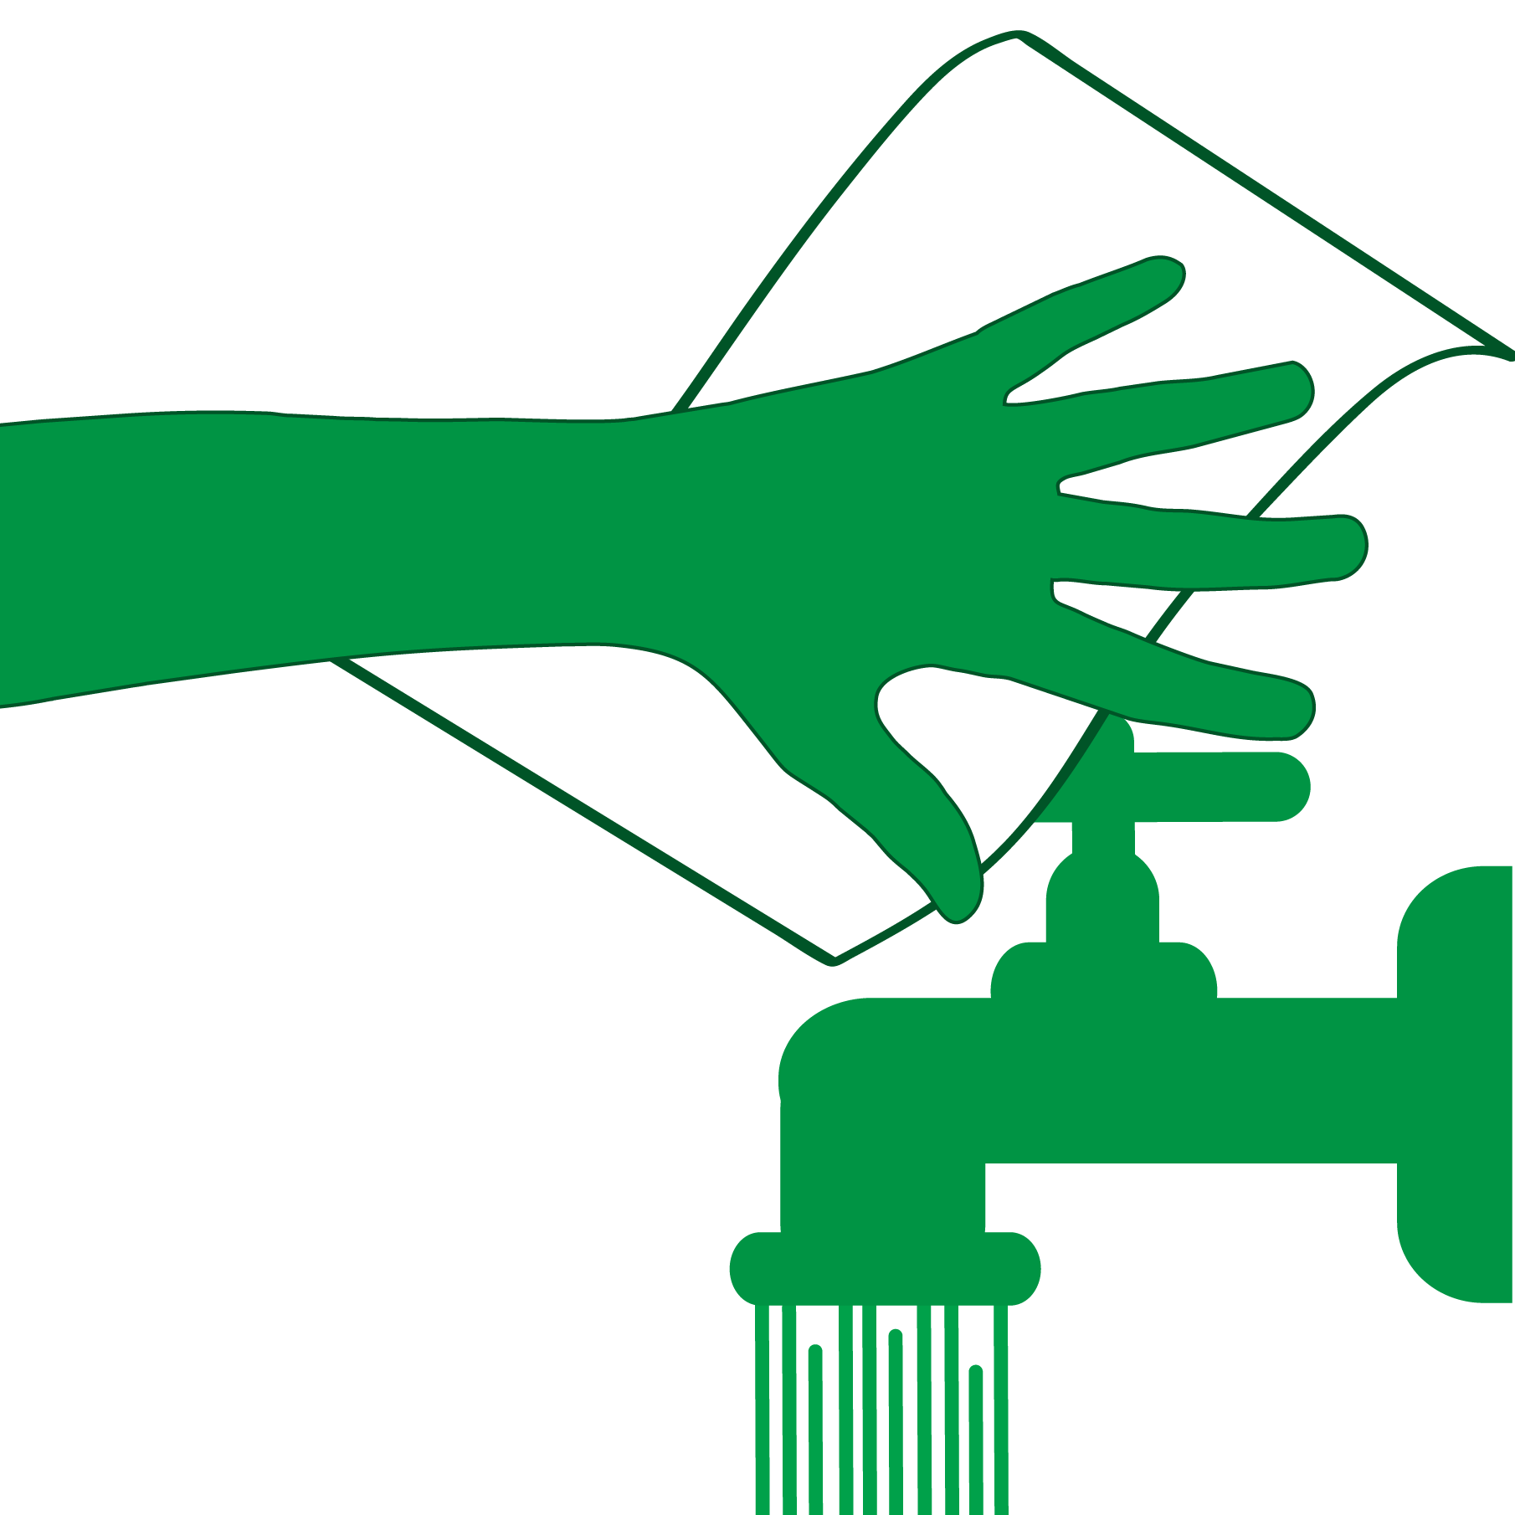
Handwashing in 6 Steps
Step 5: Dry hands with a clean towel or paper towel
Step 6: Turn off the faucet with the used towel
Notes:
Step 5: Dry hands thoroughly with a clean towel or paper towel.
Step 6: Turn off the faucet with the used towel. Remember, dirty hands turned on the faucet.
Following these six steps will ensure that children are getting lead dust off their hands. This information is found in the key messages handout, a take-home resource that summarizes information covered today. Instructor Note: Give a copy of the Module 3 Key Messages to each participant.

Slide 15
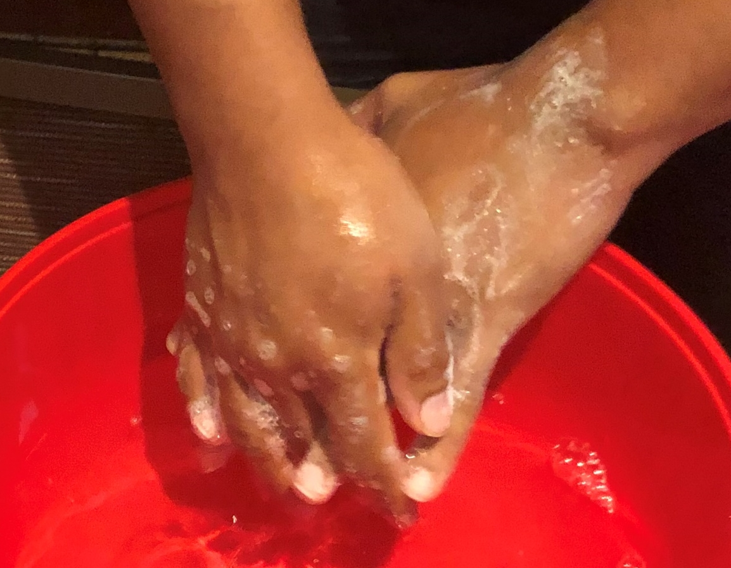
Handwashing Demonstration
Notes:
b. Handwashing Demonstration
Instructor Note: Use the six steps of handwashing outlined above to have participants wash their hands. You will need liquid hand soap, a faucet with running water, and paper towels. If you do not have access to a faucet with running water, you can use buckets for the demonstration: one bucket for the faucet and one bucket for the sink. One participant can pour water from a bucket into the other bucket simulating a faucet while another participant washes their hands. If possible, expand the demonstration to include the optional Black Light Activity.

Slide 16

Handwashing Video
Notes:
As an alternative you can show a video, such as this one from the Centers for Disease Control and Prevention: https://www.cdc.gov/cdctv/healthyliving/hygiene/wash-your-hands.html

Slide 17
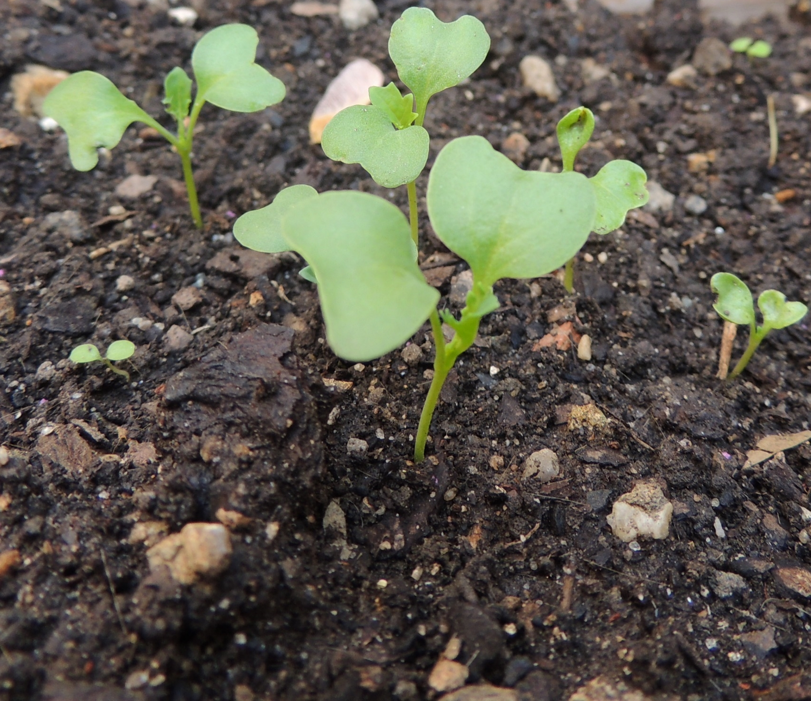
Potential Outdoor Exposures
May be exposed to lead in outdoor environments through contaminated soil or breathing in dust containing lead dust
Past use of leaded in gasoline, industrial sources
Plants grown in soils with high lead concentration
Certified professionals can remove contaminated soil
Notes:
c. Outdoor Best Practices
This session mainly focuses on indoor activities. However, we may be exposed to lead in our outdoor environments through contaminated soil or breathing in dust containing lead. Exterior lead-based paint from houses and buildings can flake or peel, and then get into the soil. Past use of leaded gasoline in cars, from industrial sources, or even from contaminated sites, including former lead smelters, can contaminate soil.
Some plants that grow in soils with a high lead concentration can absorb lead from the soil with most of the lead remaining in the roots and, in some rare cases, even making its way to the aboveground parts of the plant. A certified professional can remove (or partially remove) contaminated soil and replace it with “clean” soil.

Slide 18
How can we reduce potential exposure to lead while outdoors in areas suspected or known to be contaminated with lead?
How can we prevent lead from getting inside our homes?
Notes:
How can we reduce potential exposure to lead while outdoors in areas suspected or known to be contaminated with lead? How can we prevent lead from getting inside our homes? Instructor Note: Allow participants time to think and share with the group.

Slide 19

Outdoor Best Practices
Check the outside of your home for deteriorating paint
Cover bare soil with grass, plants, gravel or wood chips
Play in grass and dirt not contaminated with lead
Wash outdoor toys and playground equipment
Use designated picnic, camping, biking and hiking areas
Photo by Meritt Thomas on Unsplash
Photo provided by Zender Environmental and
Health Group
Notes:
To reduce potential exposure to lead while outdoors we can:
Check the exterior of your home, including porches and fences, for deteriorating paint.
Cover bare soil with grass, plants, gravel, or wood chips, especially near the exterior walls of your home.
Play in grass and dirt not contaminated with lead, if possible.
Wash outdoor toys and playground equipment regularly using an outside faucet or hose.
Use designated picnic, camping, biking and hiking areas.

Slide 20

Avoid Tracking Soil Inside
Put doormats outside and inside entryways
Remove shoes before coming inside
Wash pets
Remove soil from clothes, toys, pets and equipment outside
Notes:
To avoid tracking soil into your home:
Put doormats outside and inside all entryways.
Remove shoes before coming inside.
Wipe pet’s paws prior to bringing them indoors.
Remove soil from clothes, toys, pets, and equipment outside, if possible.

Slide 21
Review
  List two personal hygiene habits that may assist in reducing children’s potential exposure to lead.
  You should wash your hands with soapy water for at least _____ seconds.
Notes:
Instructor Note: Give a copy of the Module 3 Worksheet and a pencil to each participant. Go through the Personal Hygiene questions together.
We will use the worksheet during this session as a discussion tool and to review what we learned together. Look at the Personal Hygiene section at the top of your worksheet.
List two personal hygiene habits that may assist in reducing children’s potential exposure to lead. Instructor Note: Answers may include washing children’s hands several times a day; trimming children’s fingernails and toenails short; daily baths; pinning pacifiers to their clothes; washing bottles and pacifiers daily; washing toys often; and washing clothes and shoes soiled by lead dust or soil separately.
You should wash your hands with soapy water for at least _____ seconds. Instructor Note: The answer is 20.

Slide 22
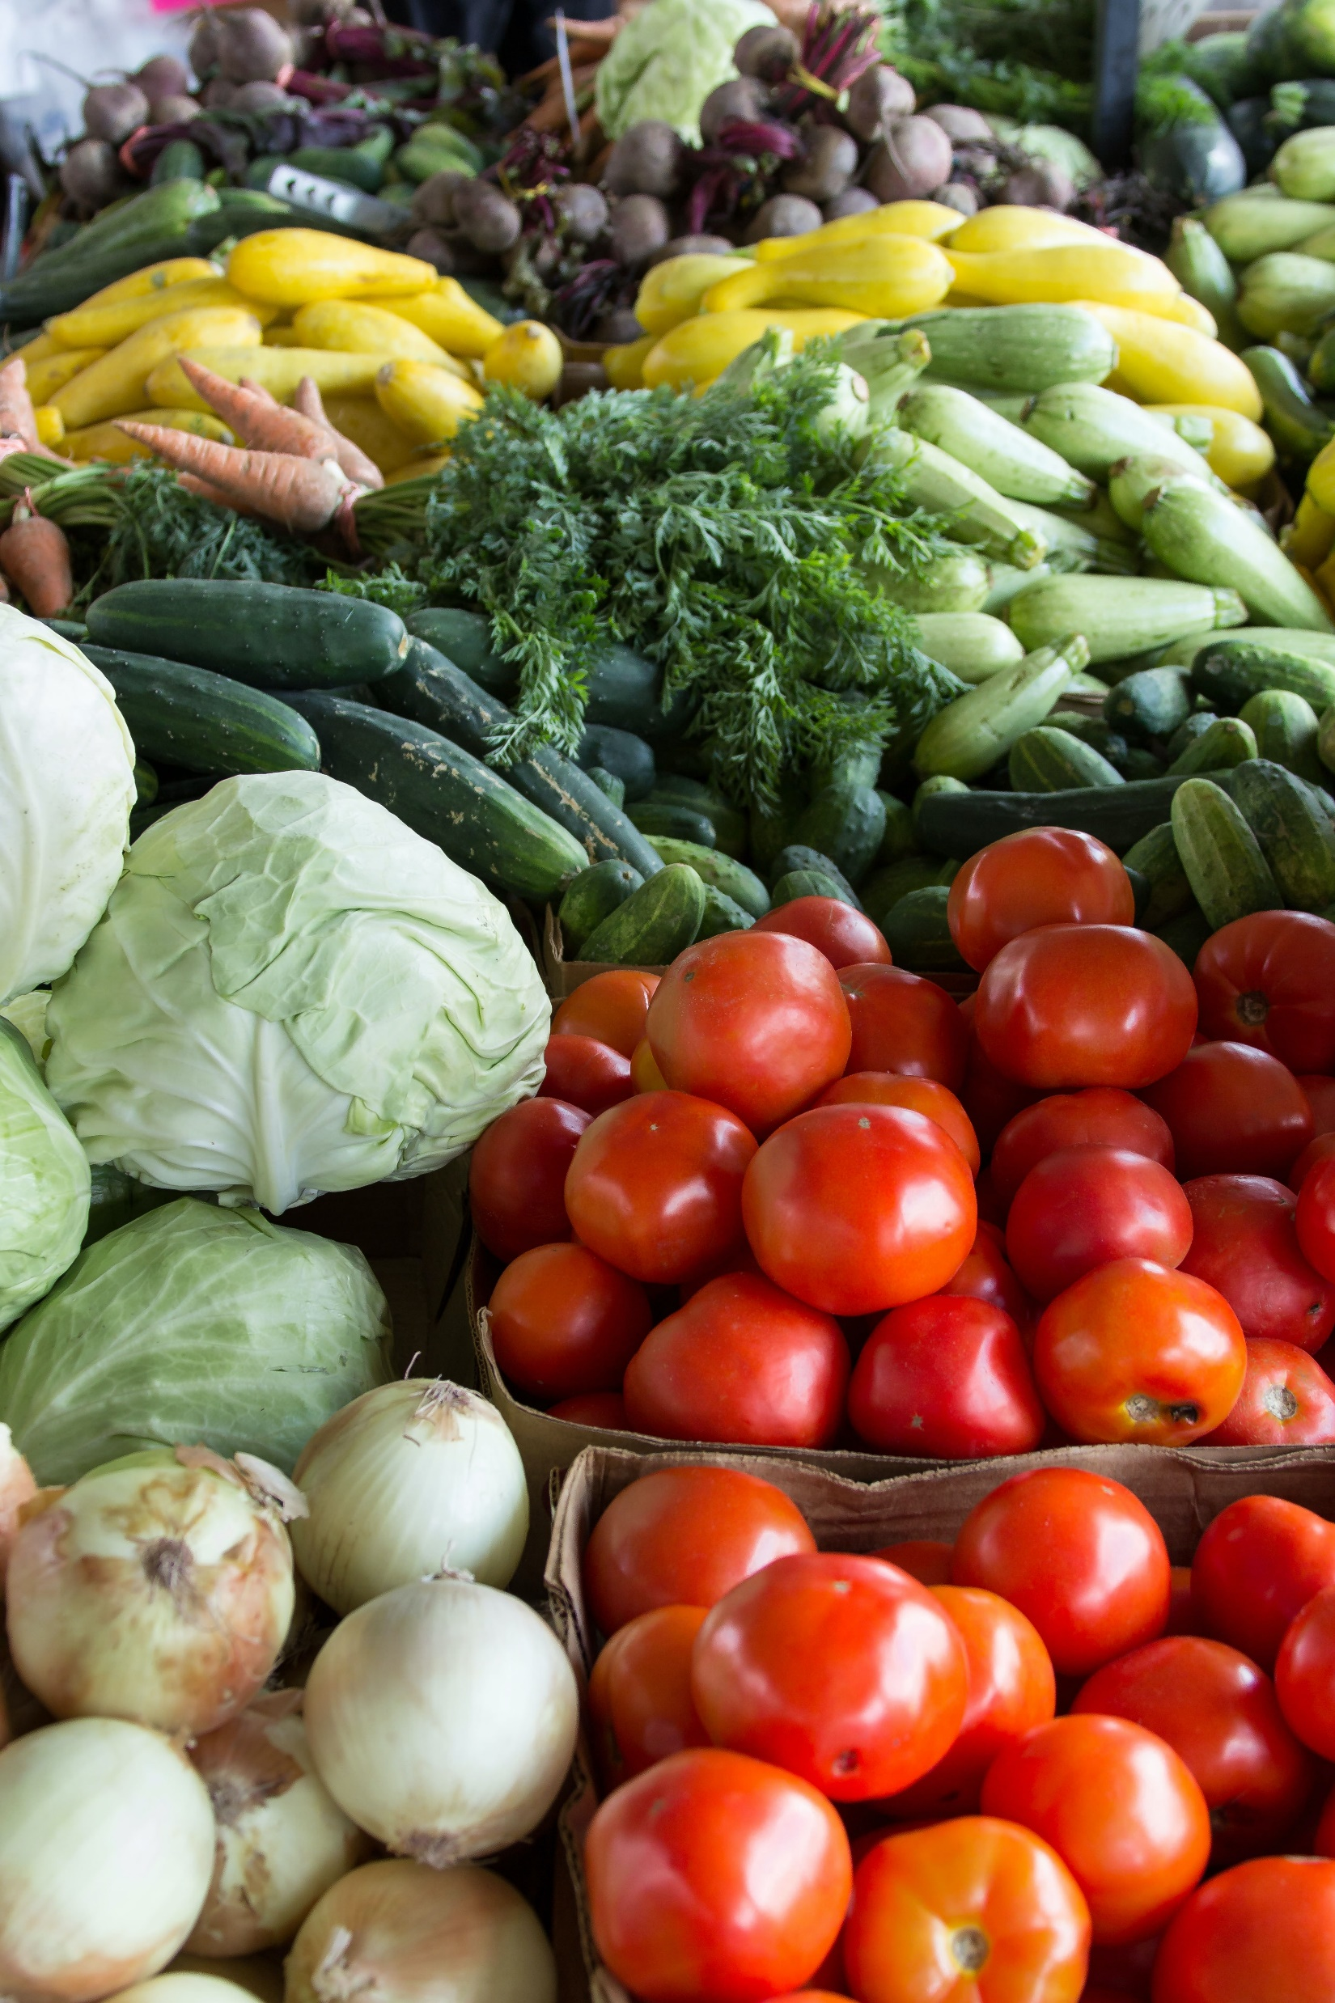
Nutrition
Nutrition is important for a child’s overall growth, development and learning
When children do not have enough calcium or iron, their bodies may absorb lead instead of these nutrients
Calcium, iron and vitamin C, are natural blockers that may help reduce the absorption of lead in the bloodstream
Notes:
III. Nutrition
Instructor Note: Familiarize yourself with the lists of foods, meals and snacks provided in the lesson plan and be prepared to share examples to start the conversation. If you need additional ideas, use Appendix A: Foods that Contain Calcium, Iron and Vitamin C which is a list of over 150 general and local/traditional foods that are known to contain calcium, iron and/or vitamin C. Record participants’ ideas on foods, meals, and snacks, preferably on flip chart paper.
Specific nutritional choices you and your children make are crucial. Proper nutrition is important for a child’s overall growth, development, learning and more. Creating healthy eating habits will maintain our health and reduce the risk of diseases. Everything we eat and drink matters, which is why it is important to include a variety of vegetables, fruits, whole grains, proteins and dairy products in our diets (Ref. 1).
a. Eating a Healthy diet with Key Nutrients to Reduce Lead Absorption
Eating a variety of foods gives children the vitamins and minerals they need to grow up healthy. When children do not have enough calcium or iron in their bodies, their bodies may absorb lead instead of these nutrients. Calcium, iron and vitamin C are natural blockers that may help reduce the absorption of lead in the bloodstream.

Slide 23
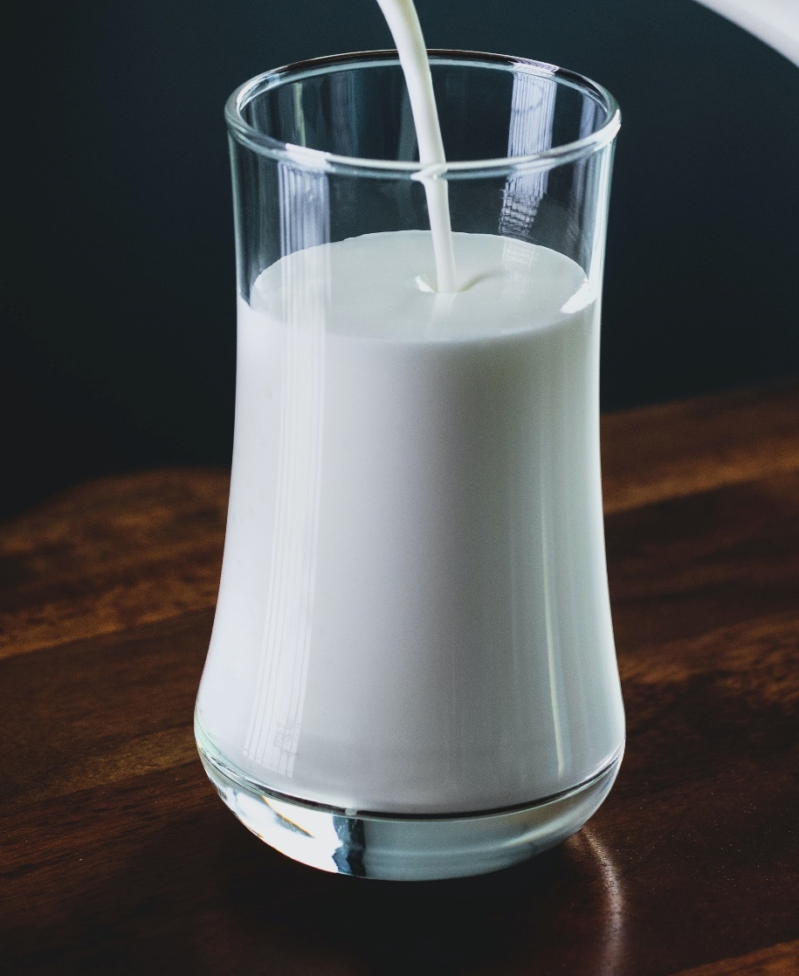
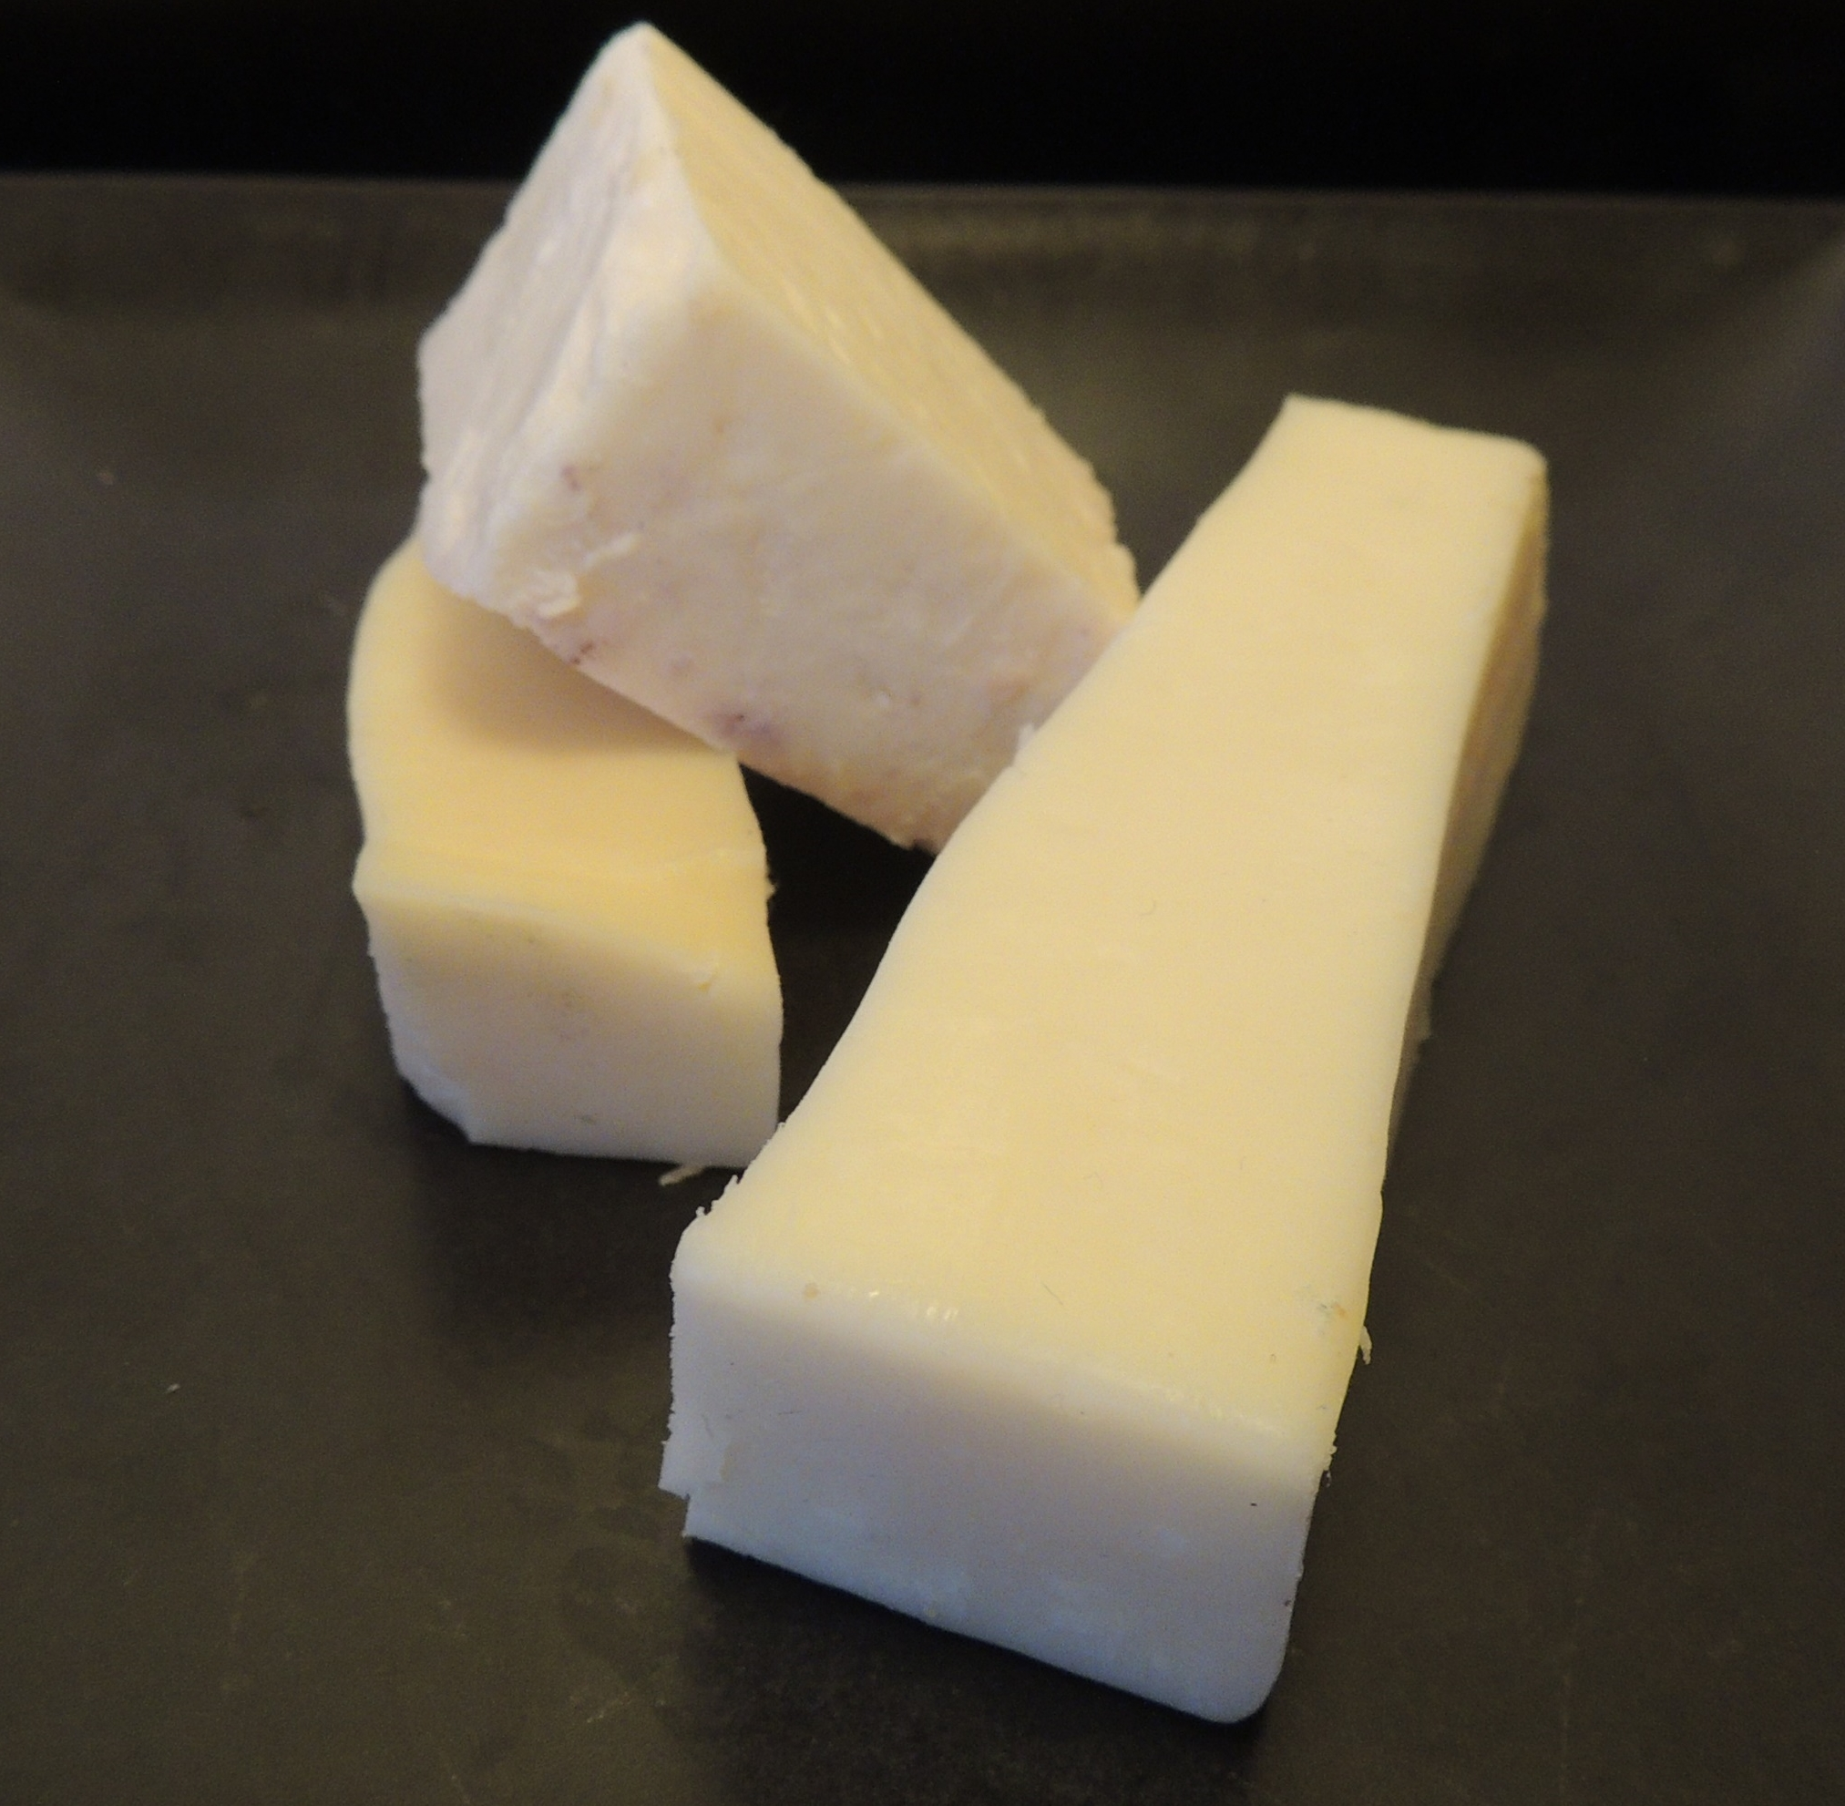
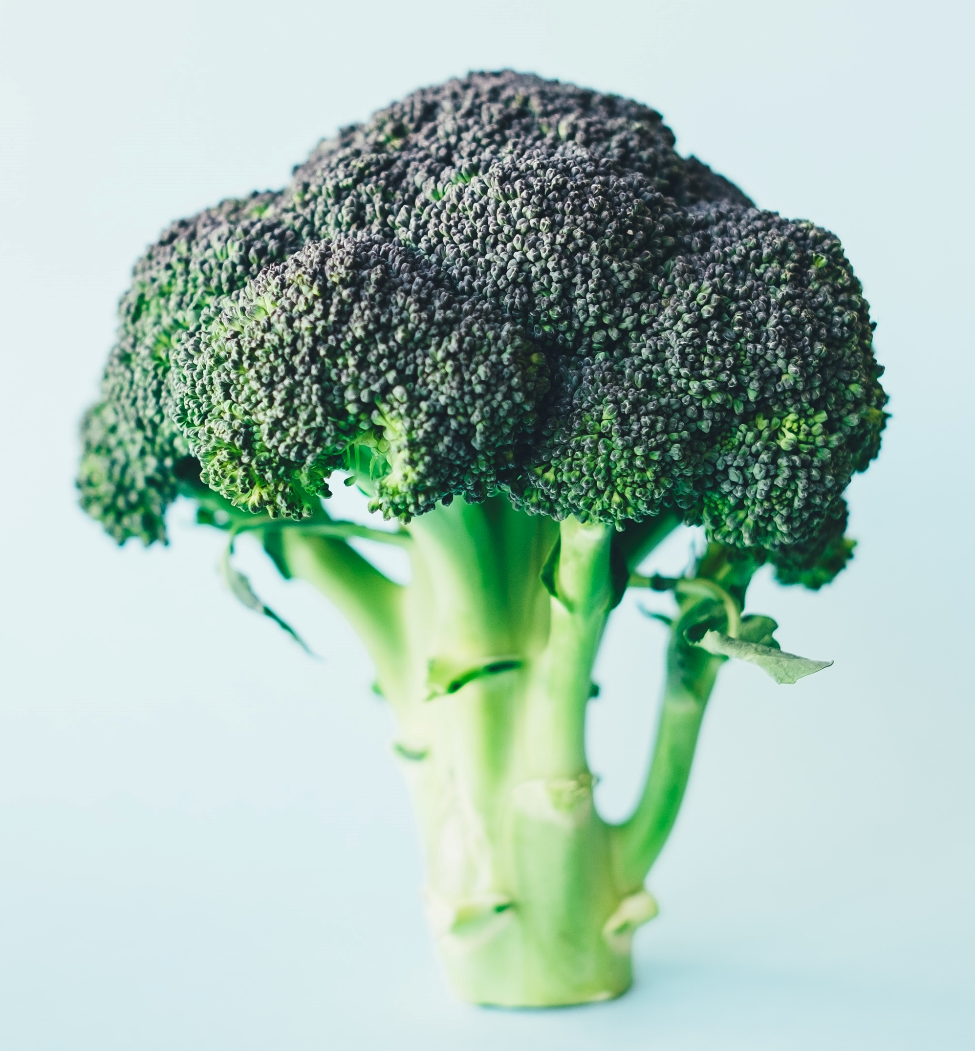
Key Nutrients
Calcium helps bones stay strong
  Milk and milk products
  Broccoli
  Canned salmon and sardines
  Foods with added calcium
Milk
Cheese
Broccoli
Photo by Annie Spratt on Unsplash
Notes:
A diet rich in important nutrients such as calcium, iron and vitamin C plays an essential role in reducing the absorption of lead:
Calcium helps bones stay strong and may keep lead out. Foods that contain calcium include:
Milk and milk products, such as yogurt and cheese;
Broccoli;
Canned salmon and sardines; and
Foods with added calcium, such as orange juice and soy milk.

Slide 24
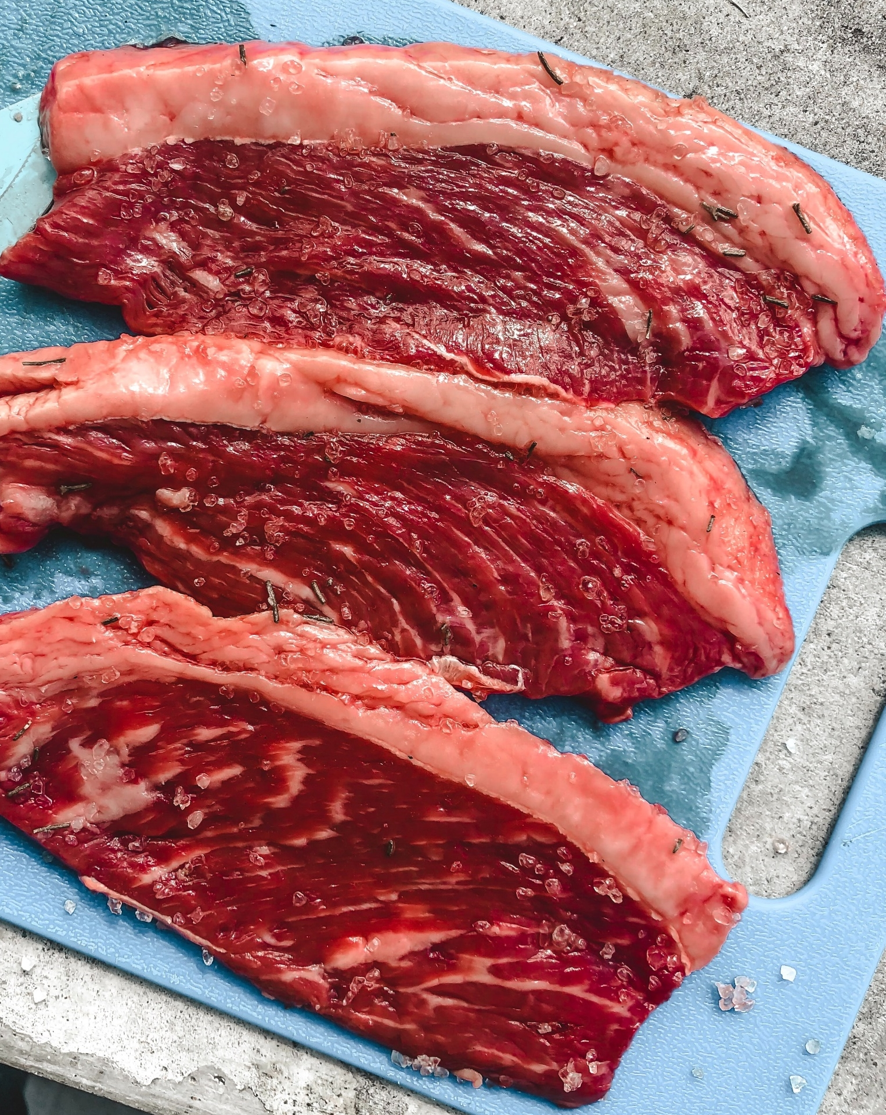
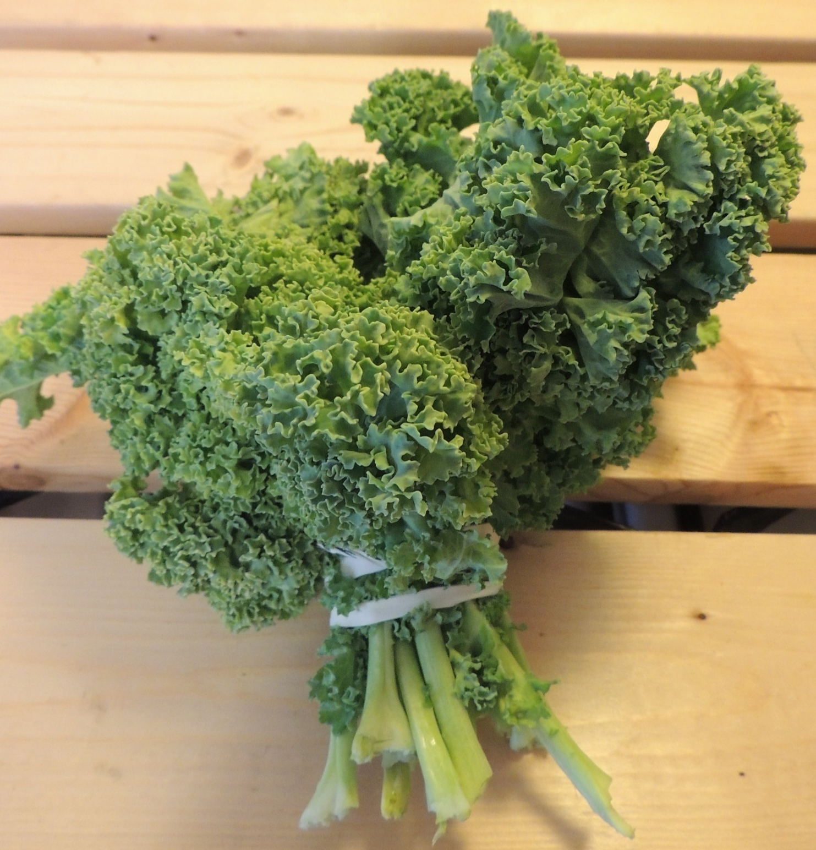
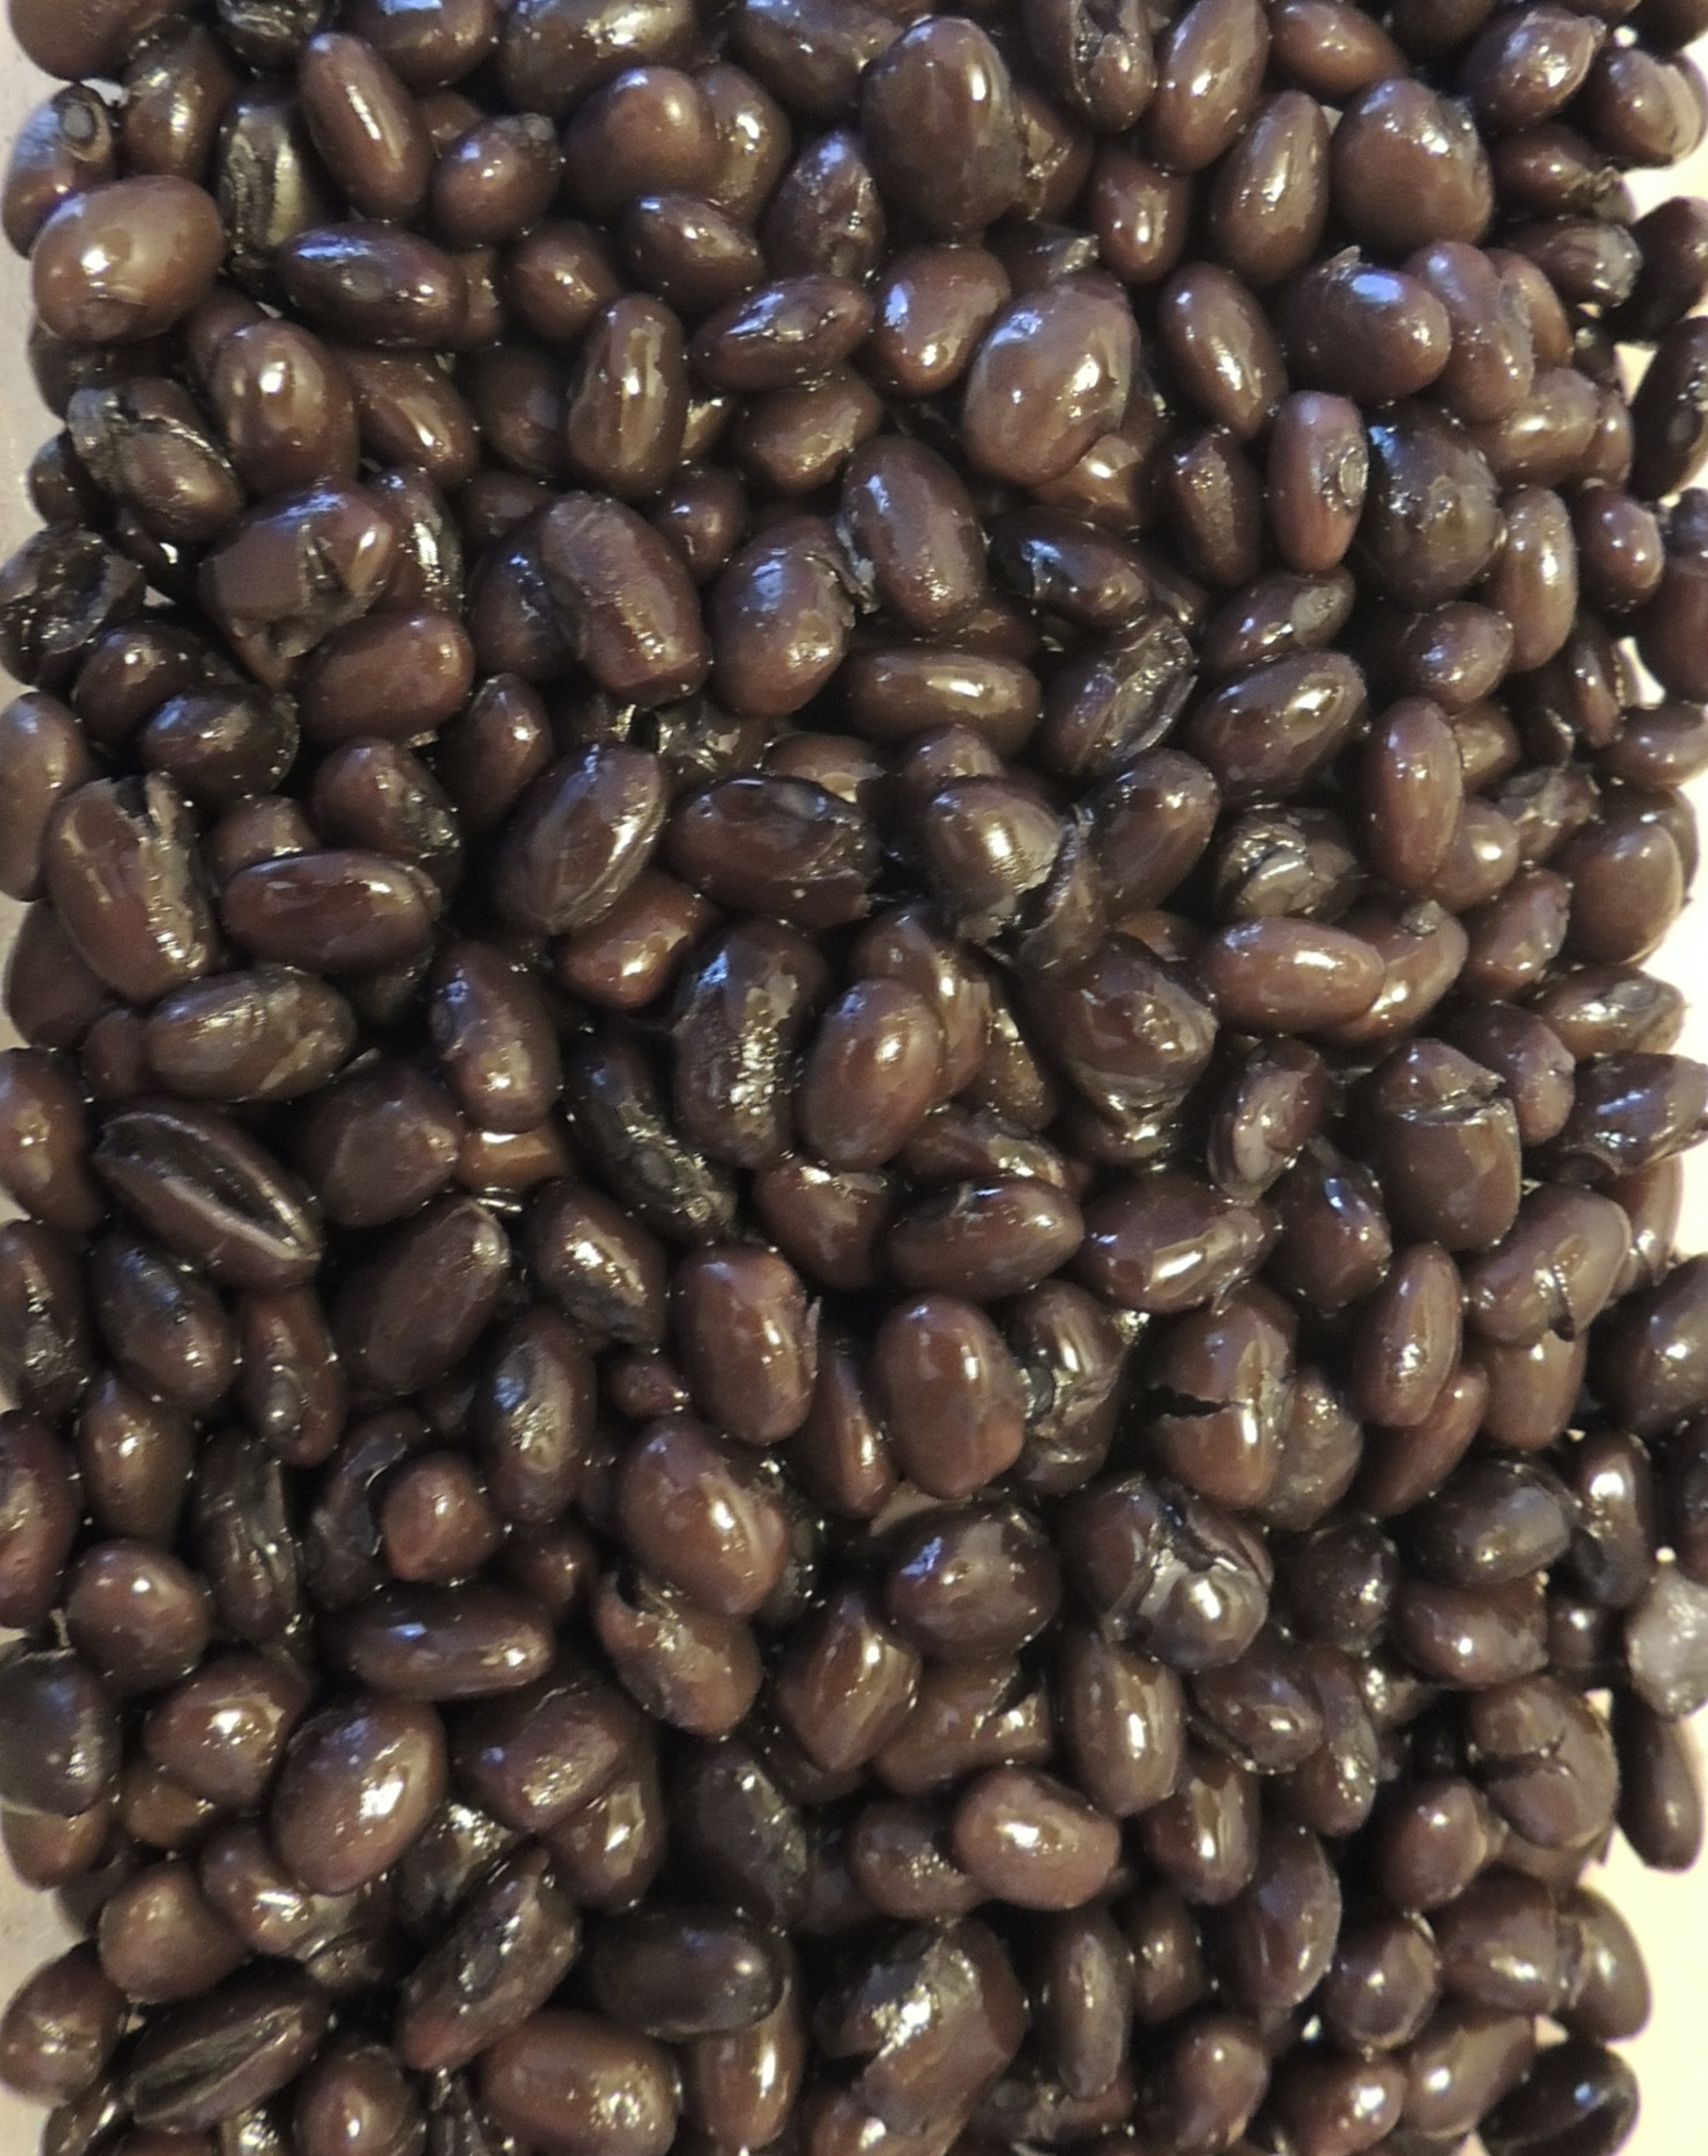
Key Nutrients
Iron may block lead from being absorbed
  Lean red meats, fish, chicken and eggs
  Beans, peas, green leafy vegetables and lentils
  Iron-fortified cereal, bread and pasta
  Dried fruit
Photo by Mel Elías on Unsplash
Black beans
Kale
Notes:
Iron may block lead from being absorbed. Foods that contain iron include:
Lean red meats, fish, chicken and eggs;
Beans, peas, green leafy vegetables and lentils;
Iron-fortified cereal, bread and pasta; and
Dried fruit, such as raisins and apricots.

Slide 25
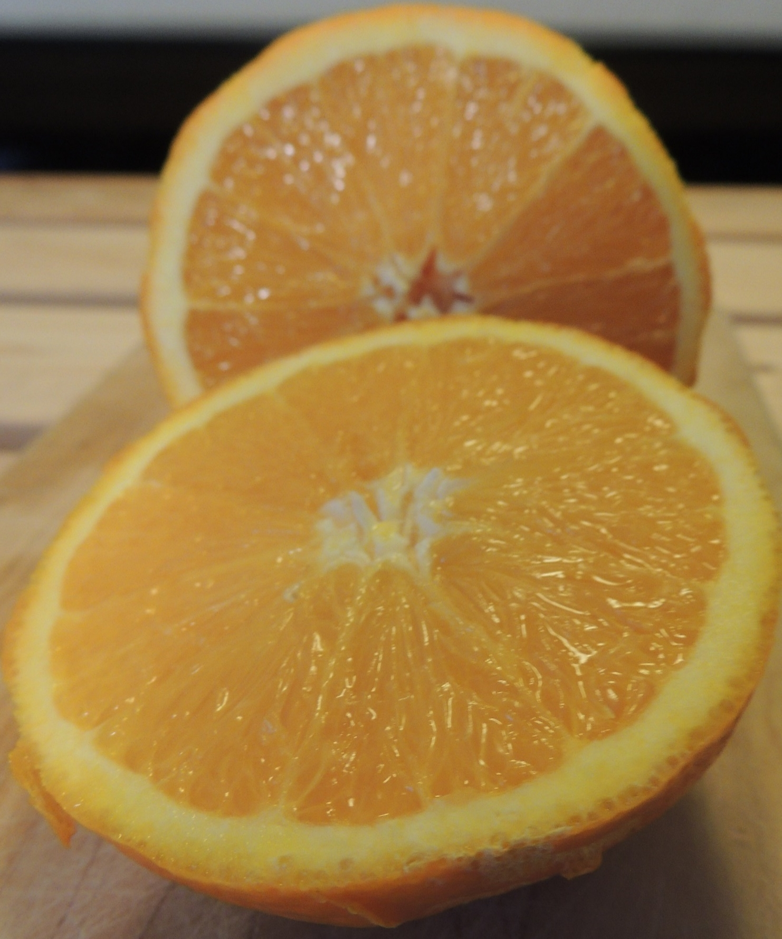
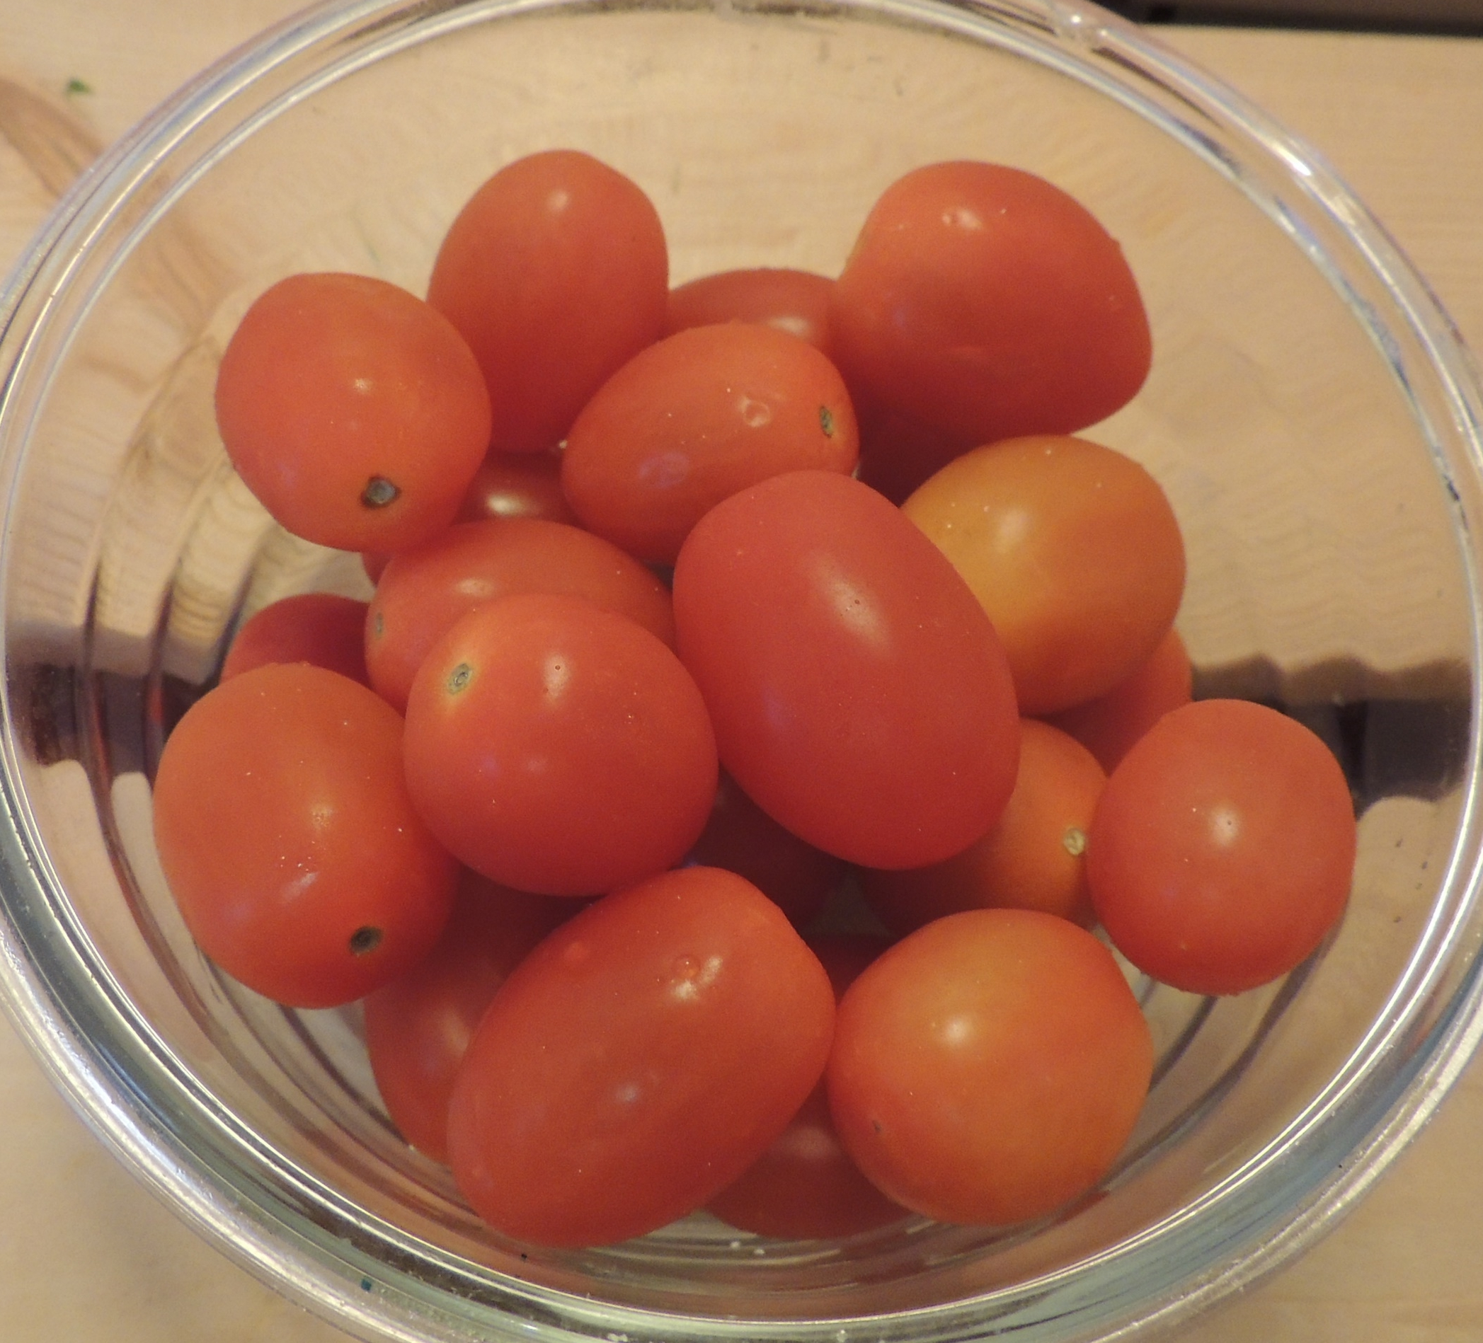
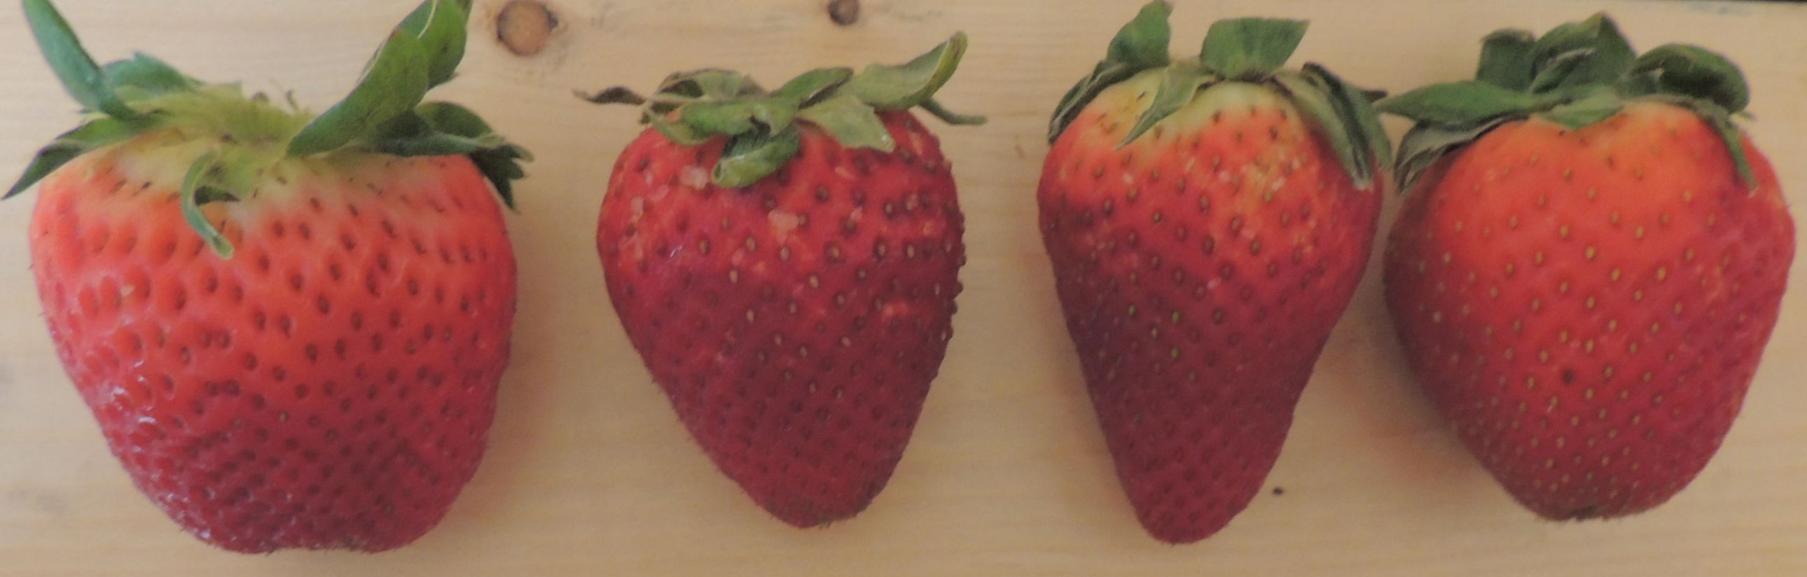
Key Nutrients
Vitamin C increases the absorption of iron
  Citrus fruits
  Kiwi, strawberries and melon
  Tomatoes, potatoes, peppers.
Strawberries
Orange
Tomatoes
Notes:
Vitamin C increases the absorption of iron, which may decrease the absorption of lead. Foods that contain vitamin C include:
Citrus fruits, such as oranges and grapefruit;
Kiwi, strawberries and melon; and
Tomatoes, potatoes and peppers.

Slide 26
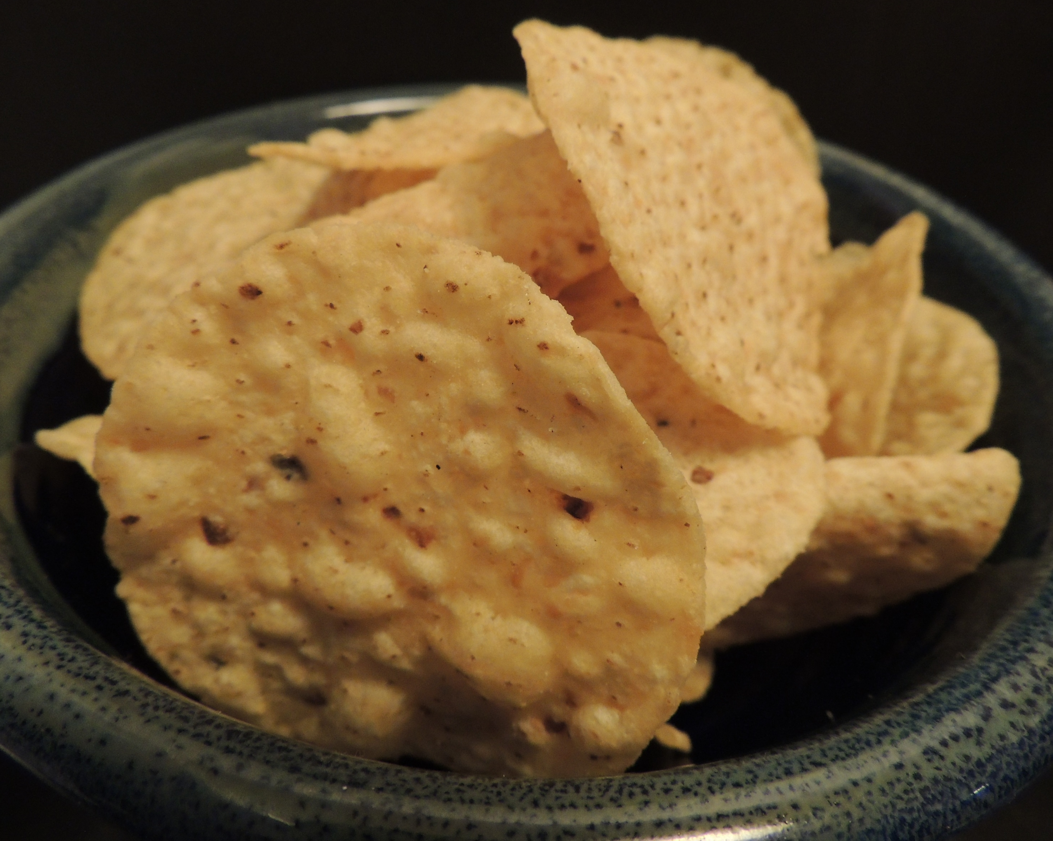
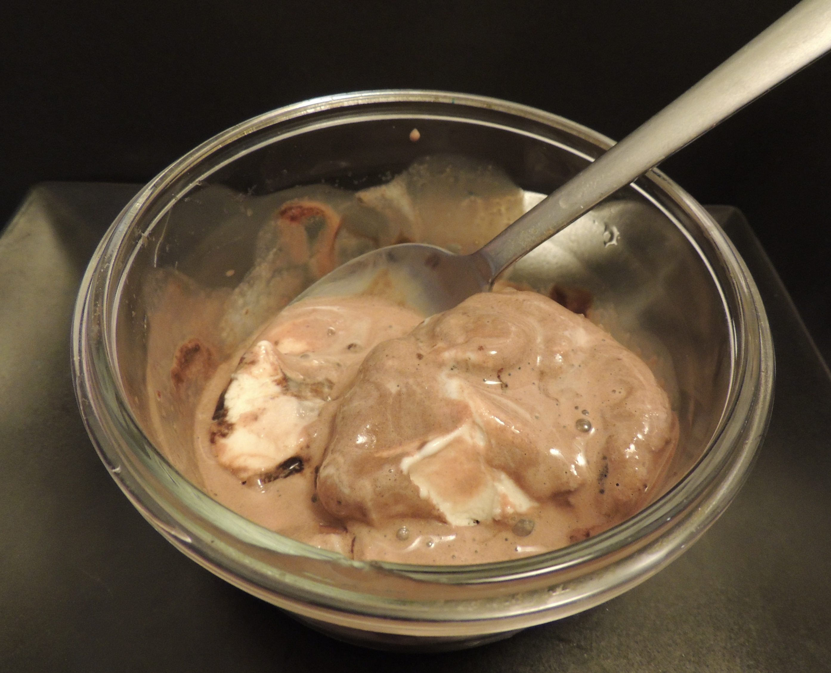
Important Facts to Consider
Foods high in fat and oil may increase the rate of lead absorption
A child with an empty stomach will absorb more lead
Chips
Ice cream
Notes:
A couple of other important facts to understand regarding children and preventing the absorption of lead are:
An overall unhealthy diet high in fat and oil may increase the rate of lead absorption; and
A child with an empty stomach will absorb more lead.

Slide 27
What other foods do you think we can provide so children get calcium iron and/or vitamin C in their diets?
Notes:
What other foods, in addition to those already mentioned, do you think we can provide our children to ensure they are getting calcium, iron and/or vitamin C in their diets? Instructor Note: Allow participants time to think and respond before showing them the Foods that May Help Reduce the Absorption of Lead table that is in the worksheet and presentation. Foods are listed by the nutrient they contain the most of: calcium, iron or vitamin C.

Slide 28
Foods that May Help Reduce the Absorption of Lead
Nutrients | General Foods
Calcium (mineral needed to build and maintain strong bones) | almonds, bone broth, broccoli, canned salmon, cheese, chia seeds, collard greens, cottage cheese, crab, edamame, figs, okra, milk, non-dairy milk, nopal cactus pads, prickly pear, sardines, seaweed, sweet potatoes, tofu, white beans, whole wheat bread, yogurt
Iron (mineral critical to blood function) | apricots, asparagus, beans, beef, bison, black walnuts, chicken, clams, eggs, fish, fish eggs, hazelnuts, lentils, liver, mushrooms, mussels, mustard greens, oats, oysters, peanut butter, peas, pine nuts, pumpkin seeds, prunes, raisins, salmon, scallops, shrimp, spinach, venison, water potato, wild rice
Vitamin C (vitamin that protects the body from disease and increases the absorption of iron) | apples, bananas, bell peppers, blackberries, blueberries, brussels sprouts, cabbage, cantaloupe, cauliflower, chestnuts, citrus fruits, corn, green beans, , honeydew, huckleberries, kale, kiwi, leeks, parsnips, pears, plums, potatoes, raspberries, rhubarb, squash, squid, strawberries, tomatoes, turnips, watercress
Notes:
Look at the Foods that May Help Reduce the Absorption of Lead table on your worksheet.
Did we mention any of these foods earlier?
Are any foods already in your family’s diet?
Take a moment to carefully read through the General Foods column and circle all the foods you and your family eat.
Count the number of foods you circled and then record the number in the box below the table. Instructor Note: Share with participants the number of foods in the General Foods column eaten in your home. Ask a few of the participants to share the number of foods eaten in their home.

Slide 29
Is the table missing any foods, specifically any local/traditional foods eaten in our community?
Notes:
Do you think the table is missing any foods, specifically any local/traditional foods eaten in our community? Take a few minutes to compare your thoughts with others and write these under the Local/Traditional Foods column on your worksheet, listing them by the nutrient you think they contain the most of: calcium, iron or vitamin C. Instructor Note: Allow participants a few minutes to discuss; share your findings based on Appendix A and your own research.

Slide 30
Foods that May Help Reduce the Absorption of Lead
Nutrients | Local/Traditional Foods
Calcium (mineral needed to build and maintain strong bones)
Iron (mineral critical to blood function)
Vitamin C (vitamin that protects the body from disease and increases the absorption of iron)
Notes:
Instructor Note: Please include your tribe’s local/traditional foods that contain calcium, iron or vitamin C in this table.
Based on my own research, this table lists some of our local/traditional foods that contain these three nutrients. Each food is listed by the nutrient it contains the most of: calcium, iron or vitamin C.

Slide 31
Optional Activity:
Reading Nutrition Facts Labels
Fresh or minimally processed foods are not always an option
What are some other forms in which we eat fruits, vegetables and protein?
Notes:
i. Optional Activity: Reading Nutrition Facts Labels
Instructor Note: After discussing foods that contain calcium, iron and vitamin C, you may want to conduct the optional Reading Nutrition Facts Labels Activity. The purpose of this activity is for participants to practice reading nutrition facts labels to determine and compare the amount of calcium, iron and vitamin C of foods available for purchase at local stores. Nutrition facts labels are usually found only on packaged foods (e.g., canned, frozen, and dried foods) and not fresh produce. You can use the labels provided or find your own examples. For more information on reading and understanding nutrition facts labels, visit: https://www.fda.gov/food/nutrition-education-resources-materials/how-understand-and-use-nutrition-facts-label.
Purchasing fresh or minimally processed foods may not always be an option depending on where you live. What are some other forms in which we eat fruits, vegetables and protein? Instructor Note: Answers may include: frozen meals, canned goods, fruit juice or dried foods.

Slide 32
Optional Activity:
Reading Nutrition Facts Labels
What are some advantages to frozen, canned or dried foods?
Notes:
Frozen, canned and dried fruits and vegetables, and 100% fruit and vegetable juices are delicious and provide nutrients for a healthy diet. What are some advantages to frozen, canned or dried foods? Instructor Note: Answers may include: you can enjoy certain foods no longer in season; and frozen, canned and dried foods do not spoil as soon as fresh foods.

Slide 33
Optional Activity:
Reading Nutrition Facts Labels
What information is included on nutrition facts labels?
Notes:
To understand the ingredients and nutrition content of packaged foods, we need to read the nutrition facts label. Does anyone read nutrition facts labels? What information is included on nutrition facts labels? Instructor Note: Possible answers include serving size, calories, total fat, sodium, dietary fiber, sugars, calcium, etc.

Slide 34
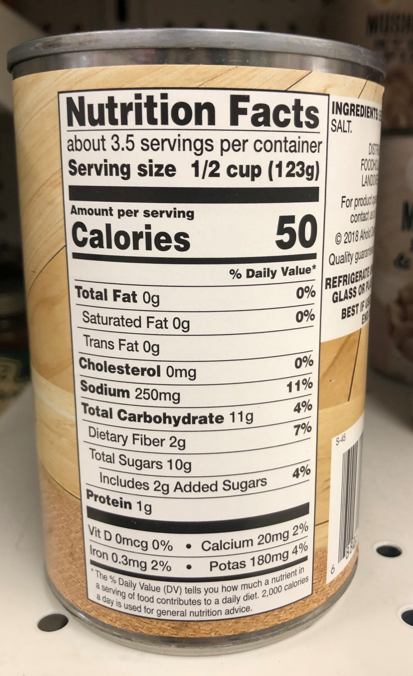
Optional Activity:
Reading Nutrition Facts Labels
Where on the label can we find information about vitamin and mineral content?
Canned beets
Notes:
ANIMATED SLIDE – click to show answer
There is a lot of information on these labels and today we are going to review how we can use them to ensure our families are getting calcium, iron and vitamin C in their diets, which may prevent the absorption of lead. Where on the label can we find information about vitamin and mineral content? If we look at the bottom of the nutrition facts label, we will find a list of the vitamins and minerals that this food contains and the percent daily value (%DV) of each. The %DV shows how much a nutrient in one serving of the food contributes to your daily diet. The %DVs are based on the Daily Values for key nutrients, which are the amounts of nutrients recommended per day for Americans. The %DV provided on a nutrition facts label are based on a 2,000 calorie diet, and the number of calories recommended varies from individual to individual. For example, most children 4 to 8 years old need only need between 1400 and 1600 calories a day.

Slide 35
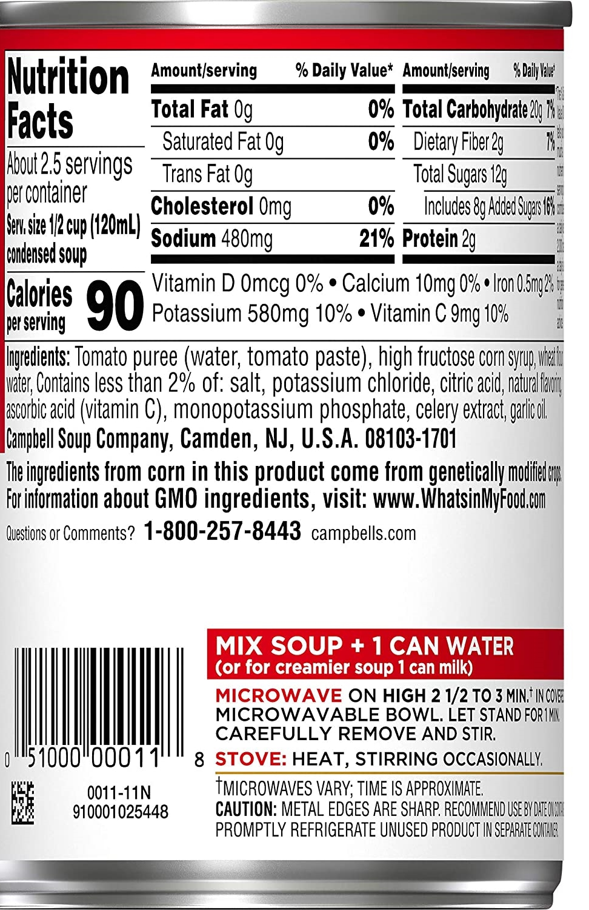
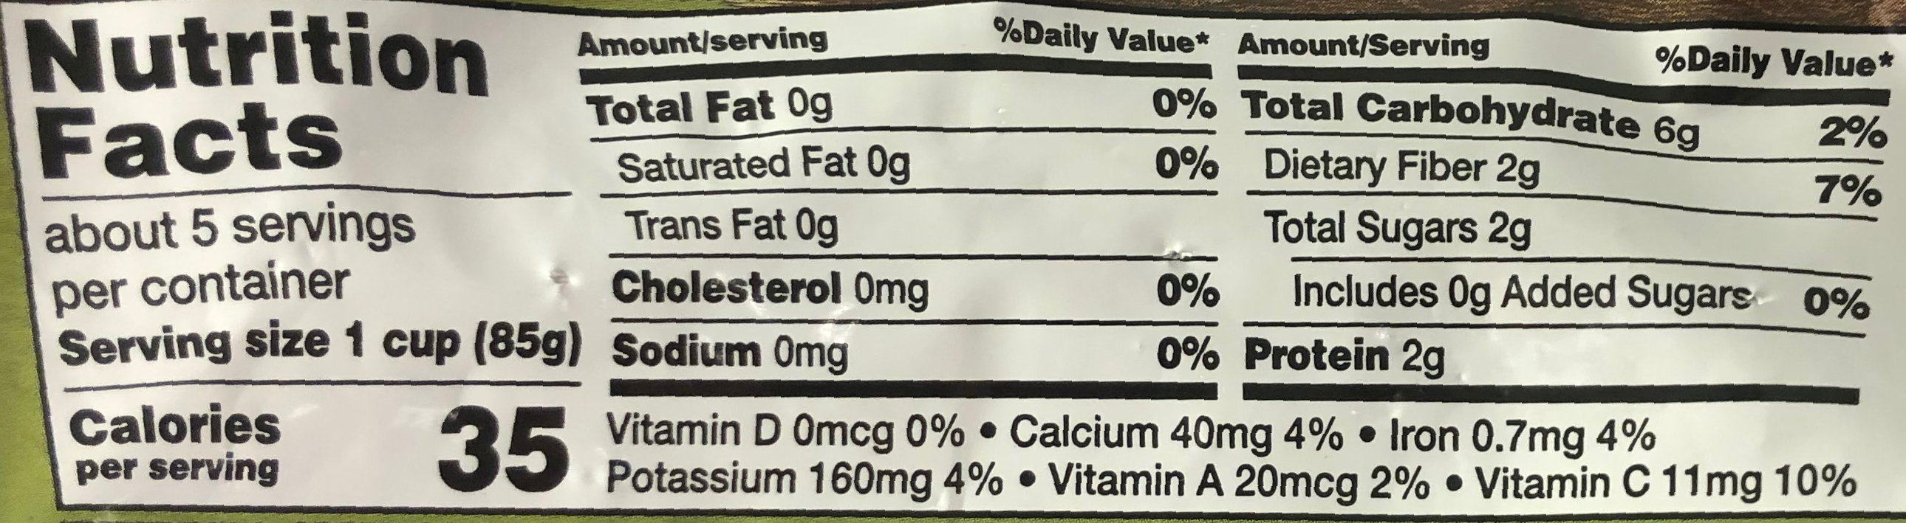
Optional Activity: Reading Nutrition Facts Labels
Green Beans (frozen)
Tomato Soup (condensed)
Notes:
Which of the three nutrients, calcium, iron or vitamin C, does the tomato soup contain? Instructor Note: Allow participants time to think. The answer is all three nutrients.
Which of the three nutrients do the frozen green beans contain? Instructor Note: Allow participants time to think. The answer is all three nutrients.
Which of these two foods contains the most calcium? Instructor Note: Allow participants time to think. The answer is a serving of frozen green beans, because it has a higher %DV of calcium in one serving.

Slide 36
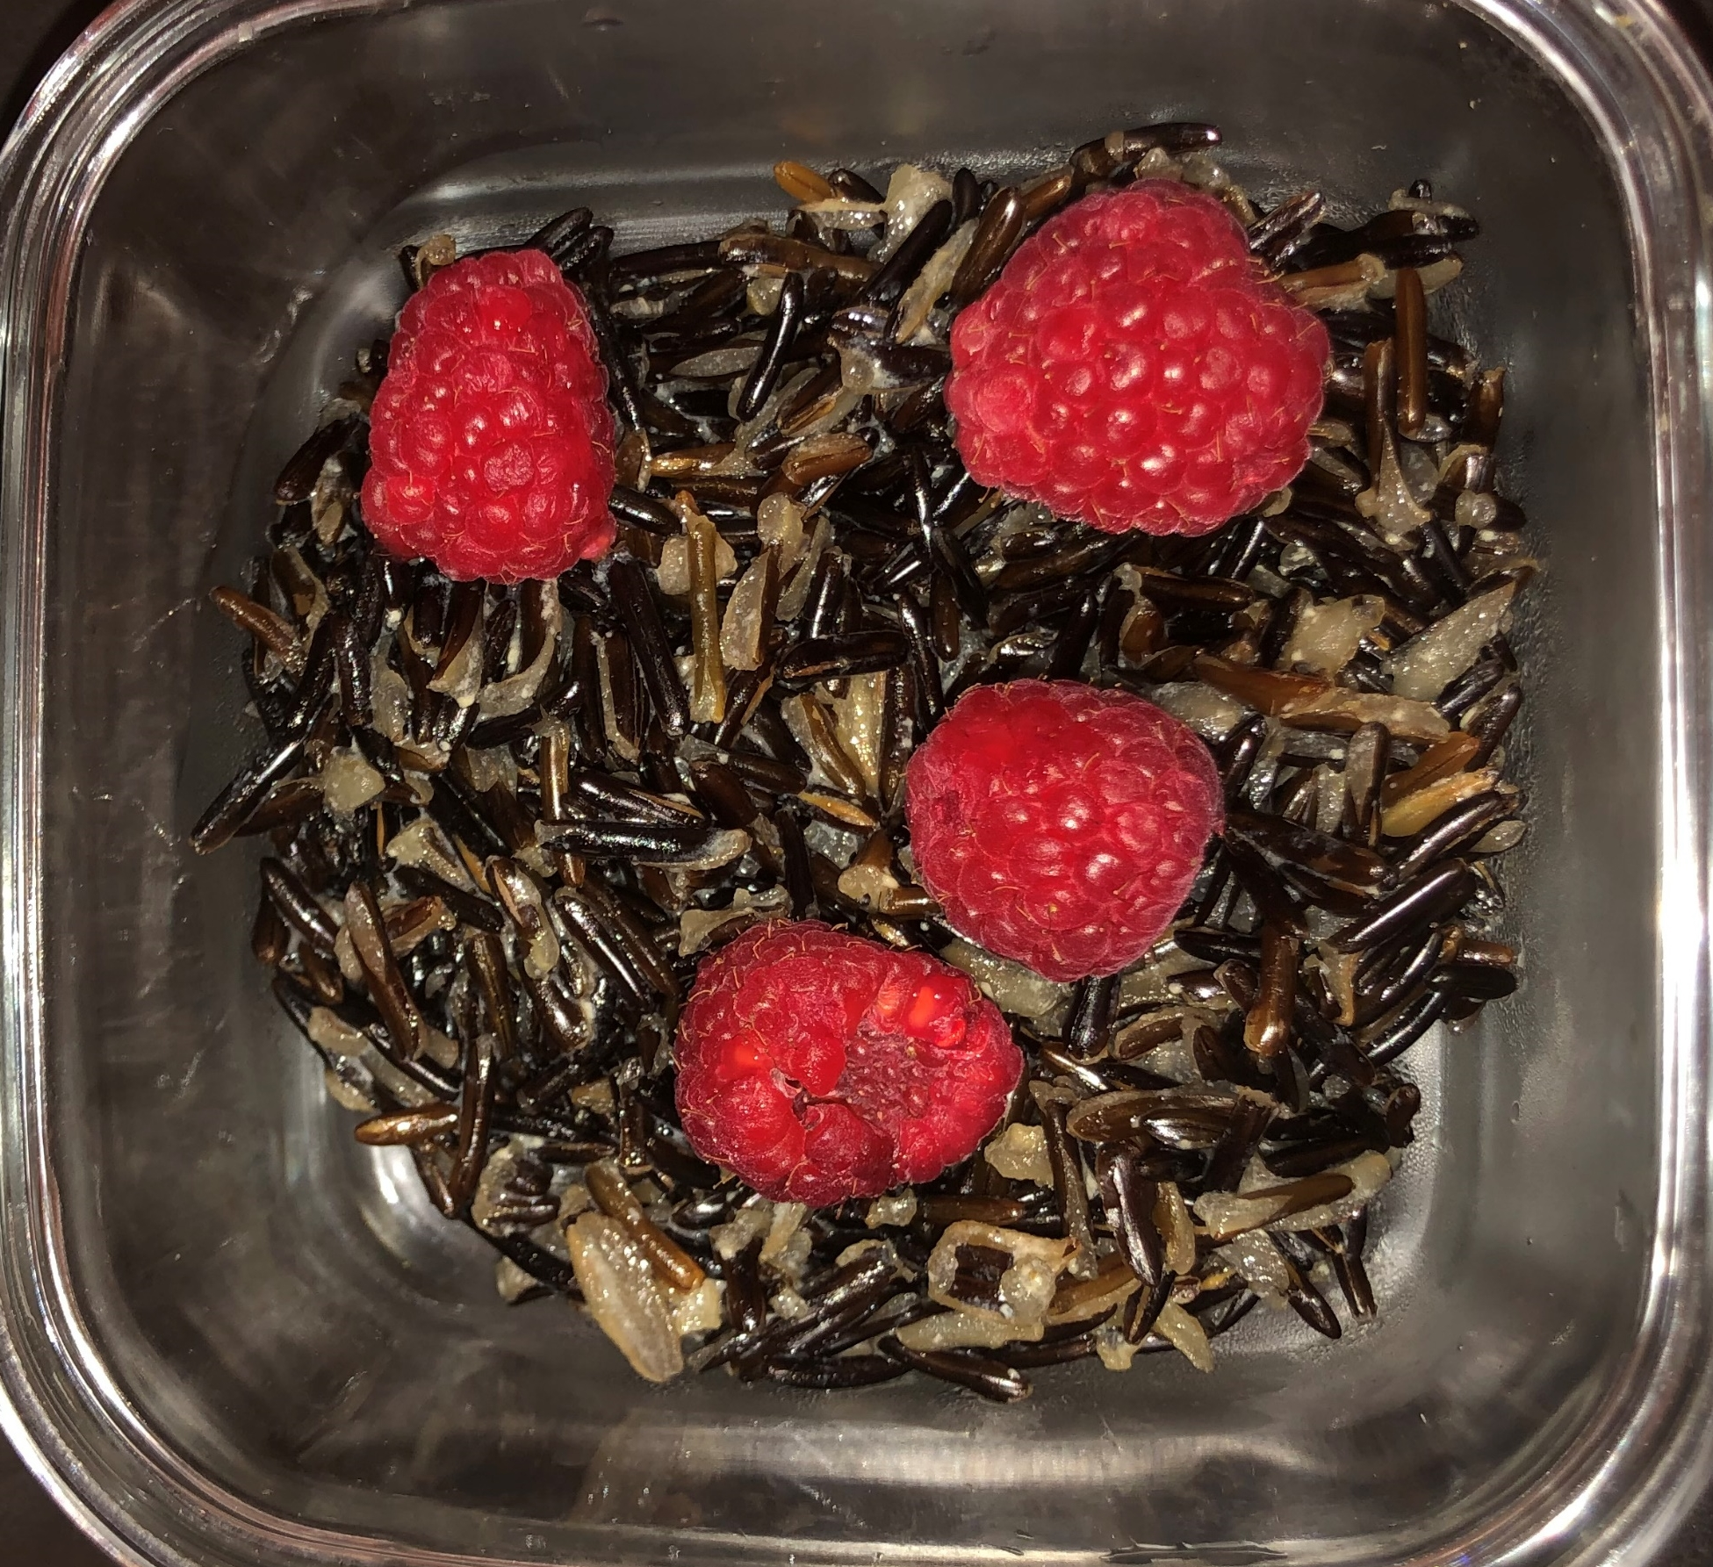
Meal Ideas – Breakfast
Oatmeal, sliced banana and 100% orange juice
Vegetable omelet, apple sauce and low-fat milk
French toast, orange slices, yogurt and 100% fruit juice
Iron-fortified cereal with low-fat milk, topped with raisins
Wild rice porridge with berries
Wild rice porridge with raspberries and maple syrup
Notes:
b. Meal Ideas
Instructor Note: A few sample meal ideas are included below (Ref. 3).
Here are a few meal ideas that contain calcium, iron and/or vitamin C.
Breakfast:
Oatmeal, sliced banana and 100% orange juice.
Vegetable omelet, apple sauce and low-fat milk.
French toast, orange slices, yogurt and 100% fruit juice.
Iron-fortified cereal with low-fat milk, topped with raisins.
Wild rice porridge with berries.

Slide 37
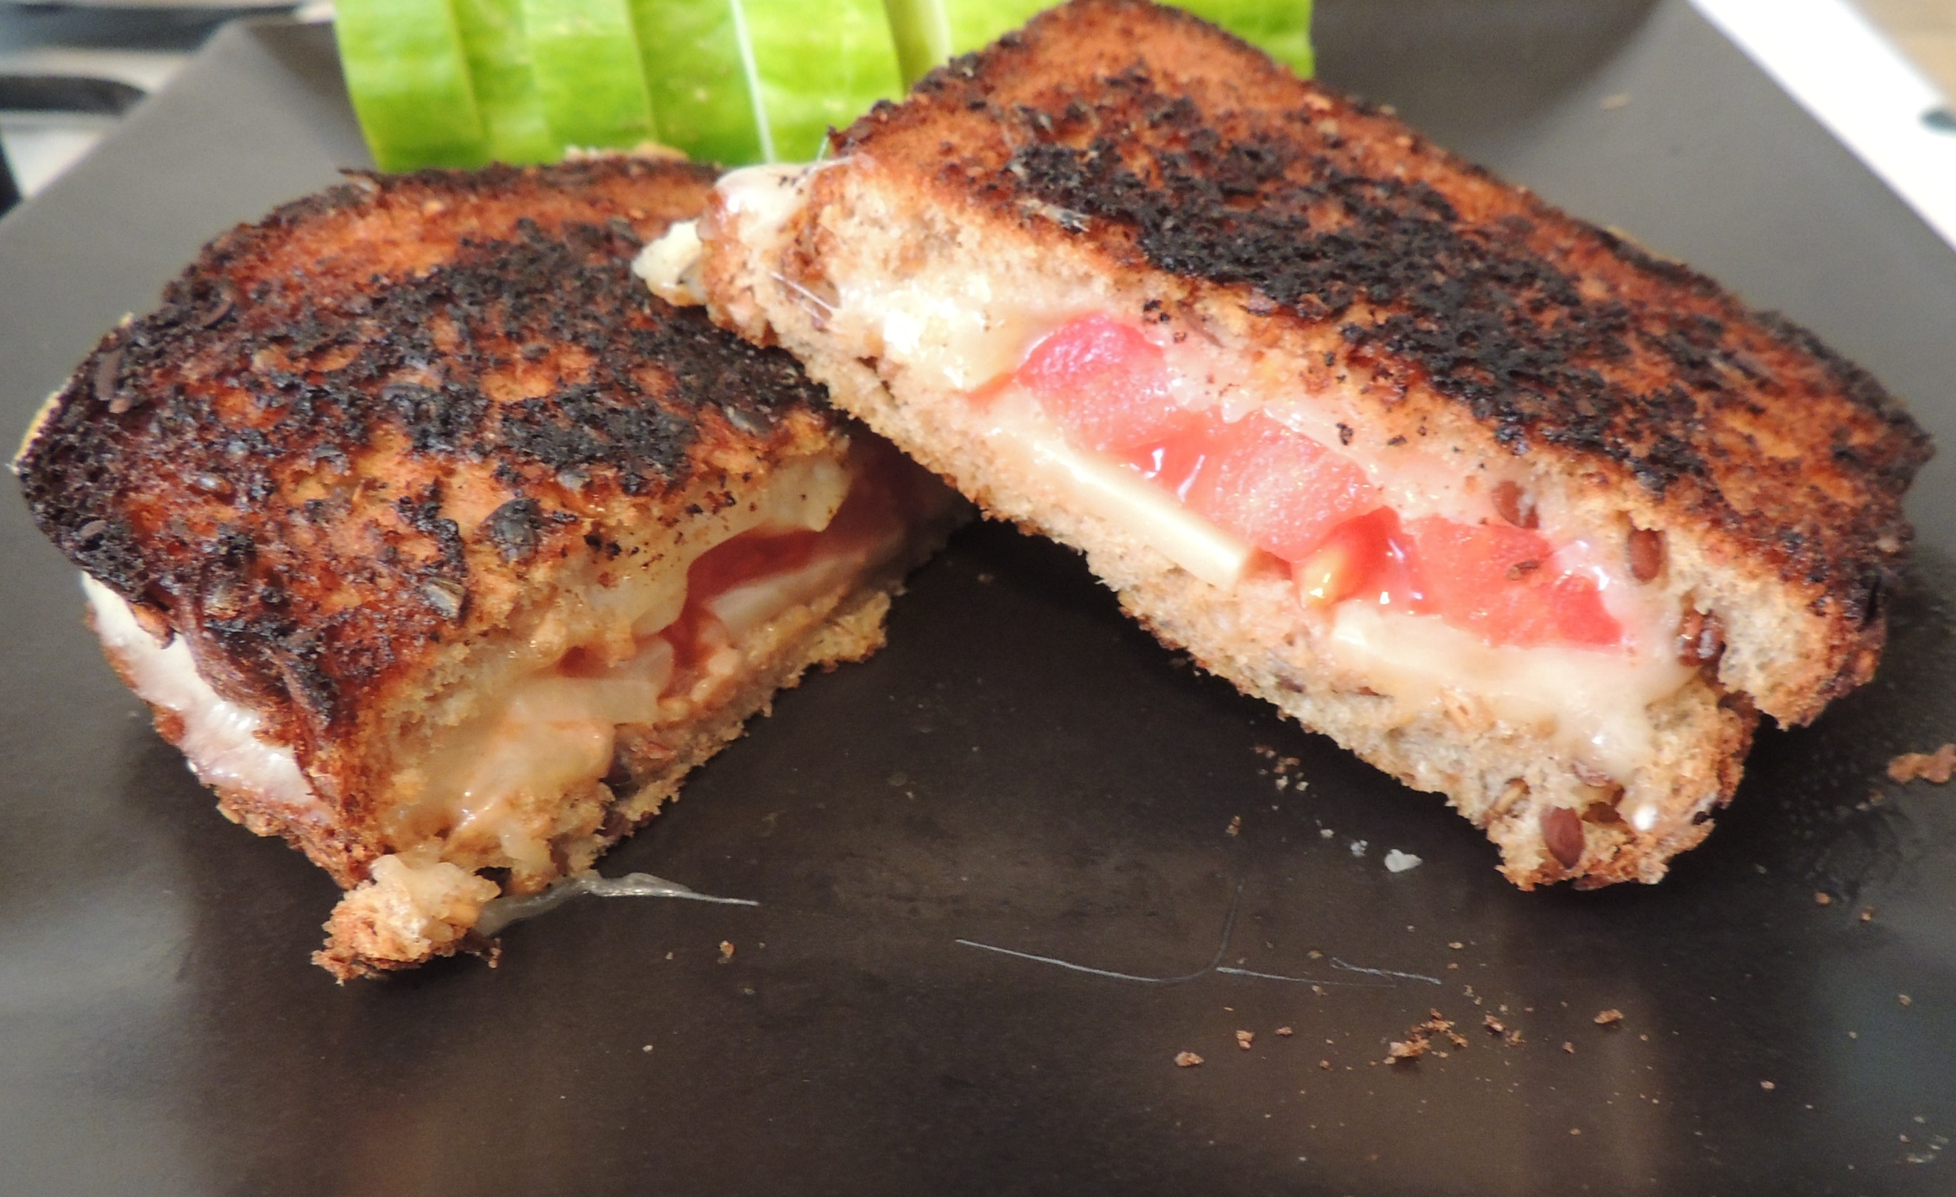
Meal Ideas - Lunch
Turkey & tomato sandwich, coleslaw and low-fat milk
Tuna salad sandwich on whole-grain bread and pear slices
Lean cheeseburger on a whole-grain bun and 100% cranberry juice
Shrimp, squash and brussels sprouts
Grilled sandwich
Notes:
Lunch:
Turkey & tomato sandwich, coleslaw and low-fat milk.
Tuna salad sandwich on whole-grain bread and pear slices.
Lean cheeseburger on a whole-grain bun and 100% cranberry juice.
Shrimp, squash and brussels sprouts.

Slide 38
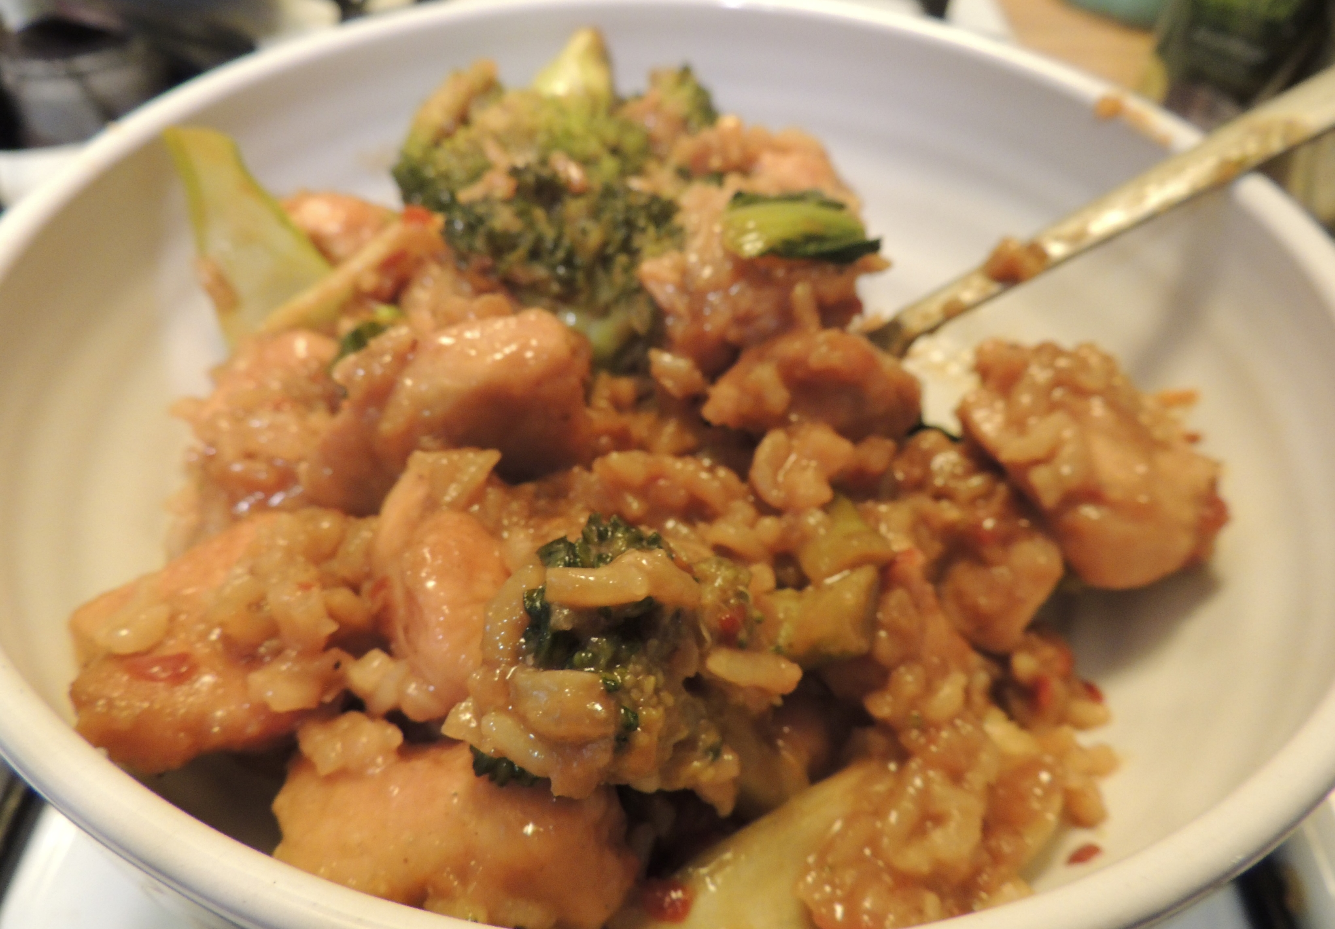
Meal Ideas - Dinner
Sloppy joe, watermelon and low-fat milk
Macaroni and cheese, stewed tomatoes and melon slices
Chicken, rice, green beans and berries
Salmon, rice and bell peppers
Chicken with rice and broccoli
Notes:
Dinner:
Sloppy joe, watermelon and low-fat milk.
Macaroni and cheese, stewed tomatoes and melon slices.
Chicken, rice, green beans and berries.
Salmon, rice and bell peppers.

Slide 39
What other meal ideas do you have that include all three nutrients?
Notes:
What other meal ideas do you have that include all three nutrients? Instructor Note: As participants share their ideas with the group, record their answers on flipchart paper. If needed, extend the time for this part of the session to accommodate a longer discussion.

Slide 40
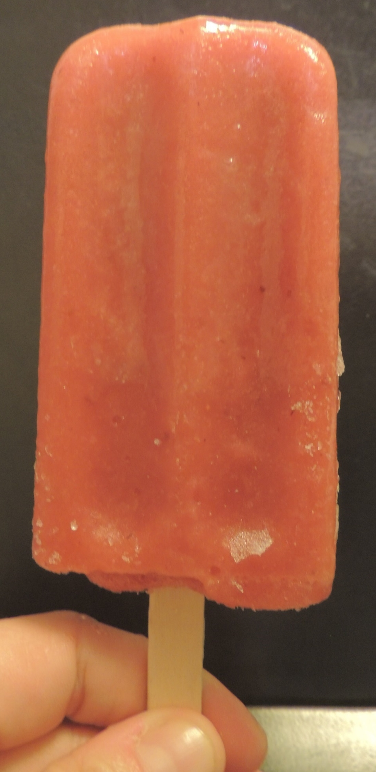
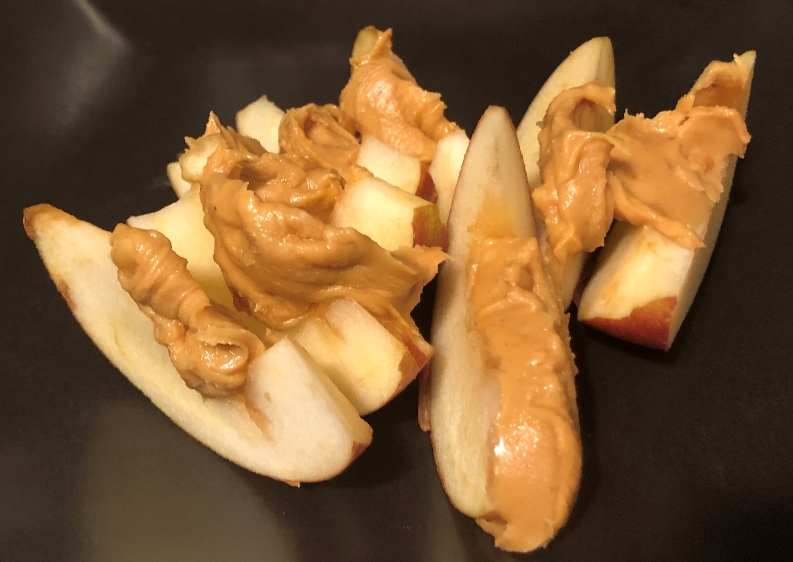
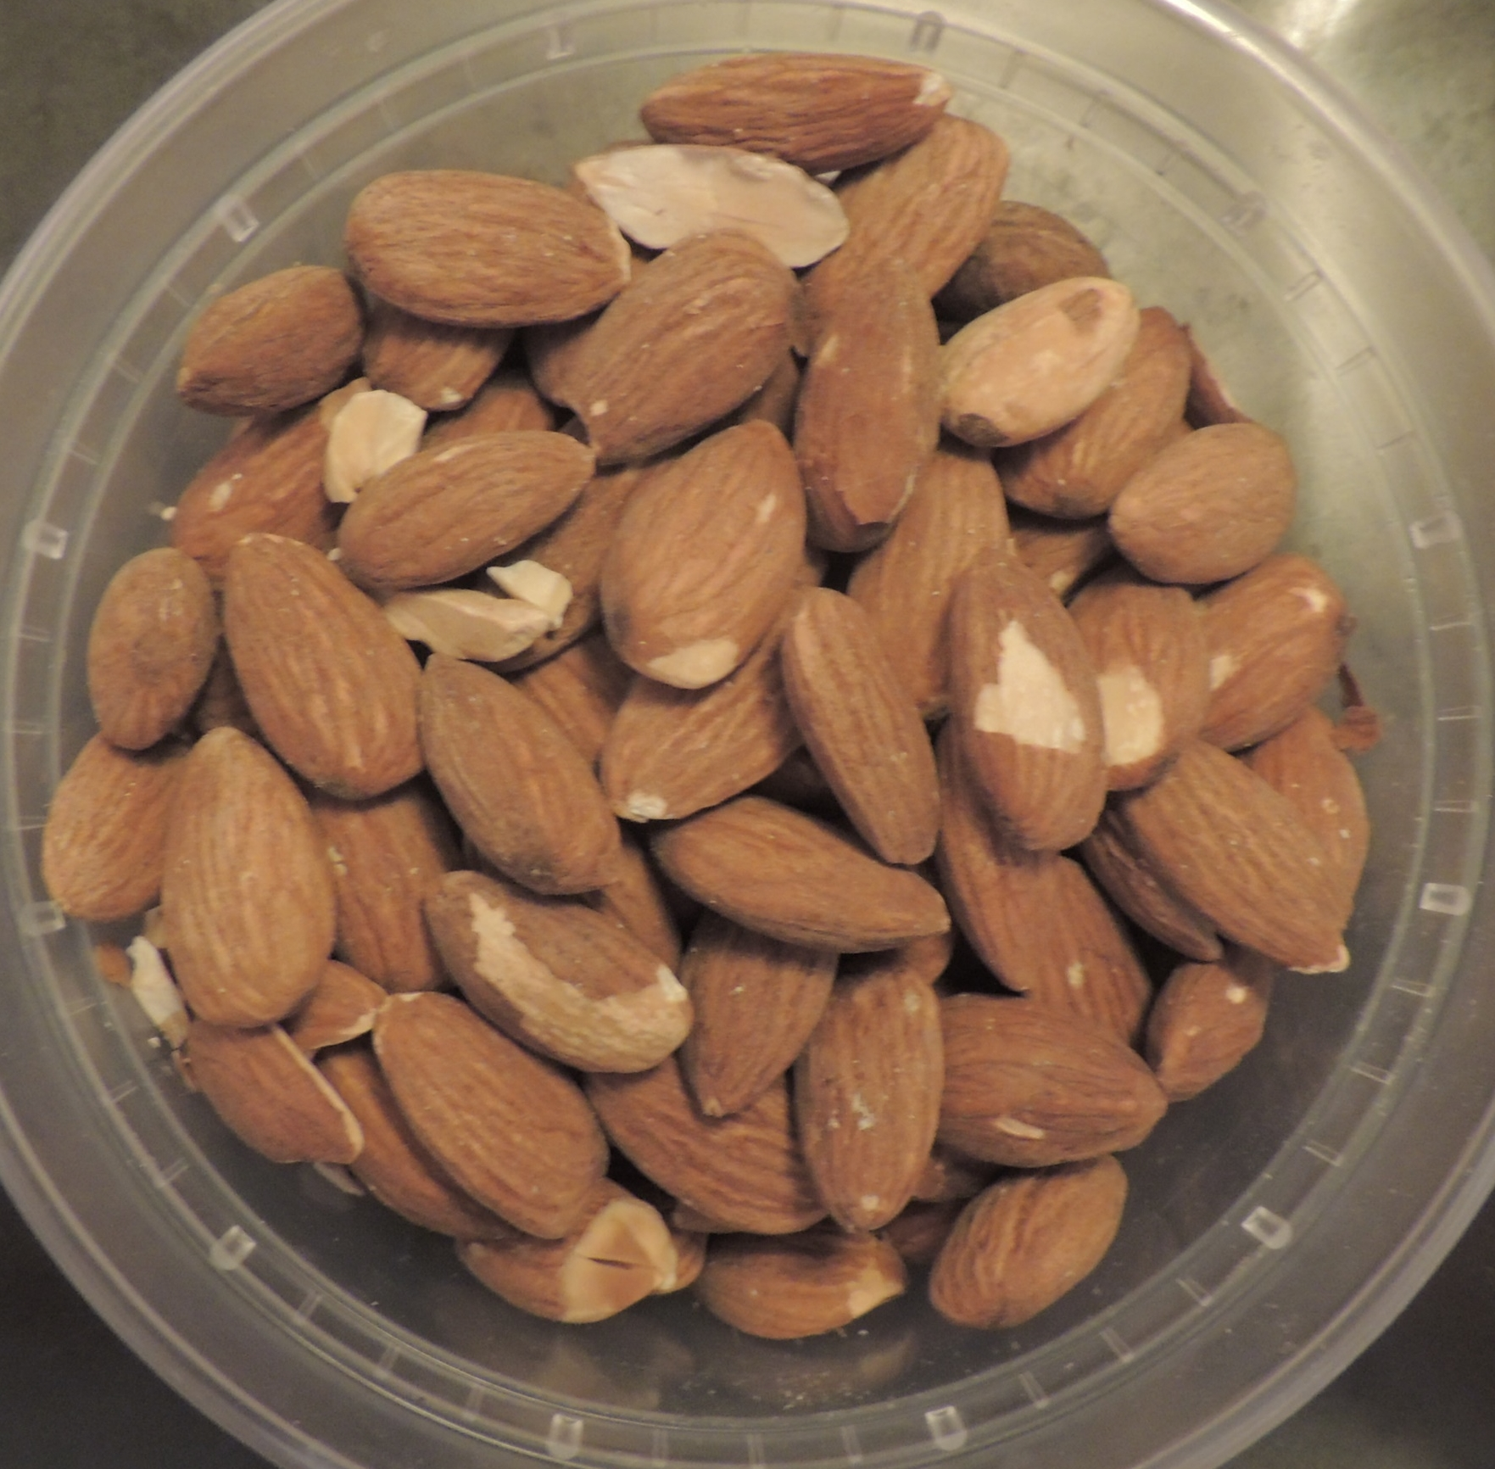
Healthy Snacks
Air-popped popcorn
Applesauce
Fruit
Peanut butter on whole-grain crackers, apples or celery
Jerky
Frozen 100% fruit juice pops
Cheese and whole-grain crackers
Nuts, sunflower seeds and dried fruits
Fruit popsicle
Apples and peanut butter
Almonds
Notes:
b. Healthy Snacks
As mentioned earlier:
An overall unhealthy diet high in fat and oil may increase the rate of lead absorption; and
A child with an empty stomach will absorb more lead.
We can provide children tasty, healthy snacks that are part of a nutritious diet. For example, a snack could be:
Air-popped popcorn;
Applesauce;
Fruit, such as: strawberries, melons, bananas, pears, oranges or peaches;
Peanut butter on whole-grain crackers, apples or celery;
Various jerky such as: salmon, venison, elk or beef;
Low-fat or fat-free yogurt topped with fruit and/or iron-fortified cereal;
Frozen 100% fruit juice pops;
Cheese and whole-grain crackers;
Nuts, sunflower seeds and dried fruits, including 100% fruit leather; or
Hummus and raw vegetables.

Slide 41
What are other healthy snacks?
Notes:
What are other healthy snacks? On the worksheet, the Healthy Snacks section lists examples of healthy snacks on the left. Put an “X” in the box next to the snacks you already feed your children or family, and a “star” next to those you could easily add to their diet. Think about how you might modify these snacks to better fit your family’s needs and preferences
Next, work with a partner to write down other snack ideas on the right side of the Healthy Snacks section. Instructor Note: Have participants share their snack ideas with the group while you write them down on the flipchart paper. As an option, prepare a healthy snack with the group.

Slide 42
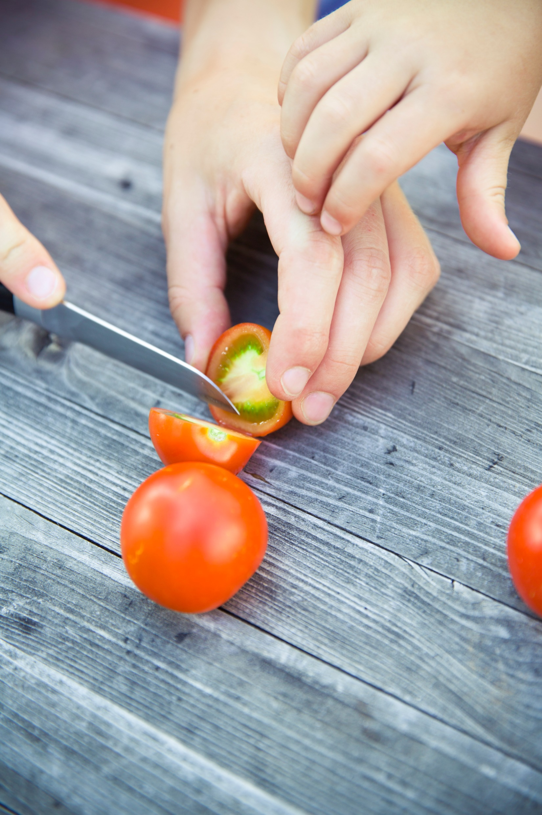
Optional Healthy Snack Preparation
Photo by Markus Spiske on Unsplash
Notes:
Option Healthy Snack Preparation
Gather materials needed to prepare a snack. Instruct participants to wash their hands before preparing.
Provide directions on how to prepare the snack and explain which of the three nutrients are found within the snack.
When participants eat the snack, ask them:
Do you think your child(ren) would eat this snack?
Would you prepare this for your family?
If the snack has cultural significance, discuss those benefits too.

Slide 43

Food Preparation
Take precautions when preparing food for children
Lead pipes may contaminate tap water
  Use only cold water for cooking and drinking
  Boiling water does not remove lead
  Flush your home’s pipes by running the tap
Photo by Imani on Unsplash
Notes:
d. Food Preparation
We should take extra precautions when preparing food for children as lead is nearly impossible to see or smell. Lead can potentially make its way into our food.
Lead can enter tap water used to prepare and wash food when plumbing materials that contain lead corrode. We should use only cold water for cooking and drinking as hot water will dissolve lead more quickly than cold water and is likely to contain increased lead levels. If hot water is needed, it should be taken from the cold water tap and heated on a stove or in a microwave oven. Boiling water does not remove lead from water. Before drinking or cooking, flush your home’s pipes by running the tap, taking a shower, doing laundry or doing a load of dishes. If you use a filter certified to remove lead read the directions to learn how to properly install and use your cartridge and when to replace it. Using the cartridge after it has expired can make it less effective at removing lead.

Slide 44
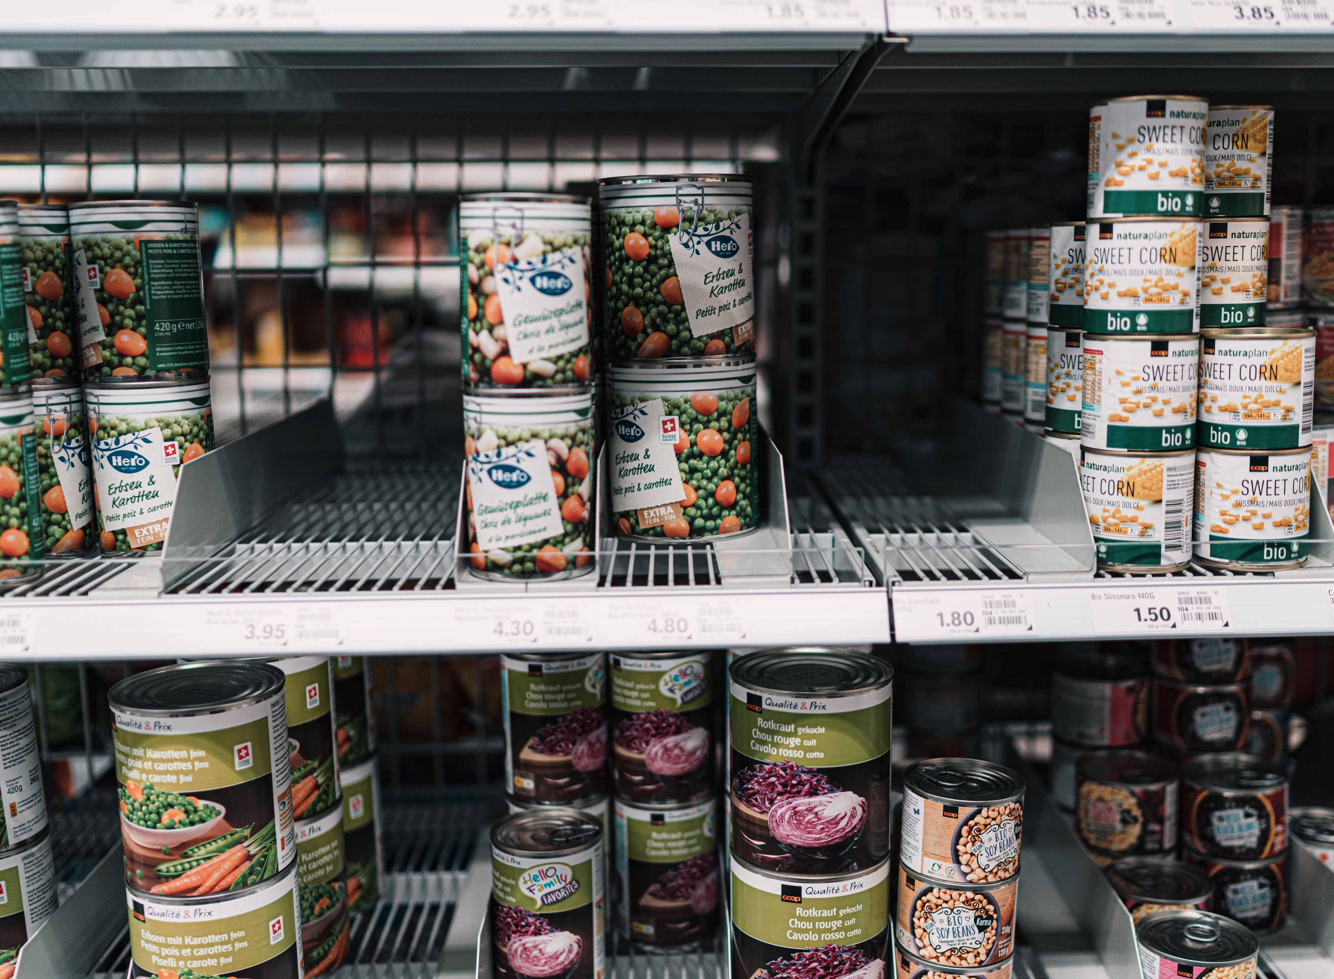
Food Preparation
Canned goods
  U.S. does not use lead solder
  Lead solder can be found in cans from other countries
Crystal, glazed pottery and porcelain
  Do not eat food or drink water cooked or stored in these items if chipped or cracked
Lead dust that settles on countertops
  Wash countertops before preparing food
Photo by 🇨🇭 Claudio Schwarz | @purzlbaum on Unsplash
Notes:
Canned goods in the U.S. are welded closed at the seams and do not use lead; however, lead solder can still be found in cans made in other countries (Refs. 5 and 6). Over time, lead solder may seep into the can and mix with the food, contaminating it. Avoid buying imported canned foods.
Crystal, glazed pottery and porcelain are all popular items used for serving, heating or eating food, and can also be a source of lead exposure. Do not eat food or drink water cooked or stored in these items if they are chipped or cracked. In general, try to avoid using any crystal, pottery or porcelain made with a lead glaze.
Lead dust that settles on countertops can contaminate food. Keep your kitchen clean, and wash countertops with an all-purpose cleaner before preparing food.

Slide 45
What can we do while outdoors to reduce potential exposure to lead in areas that you suspect or know are contaminated?
Notes:
e. Outdoor Best Practices
When preparing or eating food outdoors, there are some actions we need to keep in mind to reduce potential exposure to lead. Based on everything you have learned so far, what could we do while outdoors to reduce potential exposure to lead in areas that you suspect or know are contaminated? Instructor Note: Allow participants time to think. After a minute, have them share with the group. The next slide provides responses

Slide 46

Outdoor Best Practices
Use water from clean sources
Eat on a clean surface
Avoid eating food that falls on the ground
Switch to non-lead ammunition and tackle, when possible
Clean utensil and surfaces where fish and game meat will be dressed
Photo provided by Zender Environmental and Health Group
Notes:
Use water from clean sources for drinking, cooking or washing.
Eat on a clean surface such as a picnic table or blanket.
Avoid eating food that falls on the ground.
Switch to non-lead ammunition and fishing tackle when harvesting wild game and fish for food, when possible Wild game may just mean fish and beasts
Clean utensils and surfaces where fish and game meats will be dressed to prevent cross-contamination.
Many households in Indian country consist of hunting families that rely on the use of firearms to acquire food year-round. Elevated lead exposure has been correlated with subsistence hunting communities when game meat is harvested with lead ammunition. High-velocity lead-core bullets explode upon impact, sending out a plume of lead dust along with hundreds of tiny fragments into the targeted animal, ending up in game meat processed for consumption. High-performance, non-lead ammunition has become increasingly available in a wide range of brands and calibers. Using lead-free ammunition is the best way to avoid potential exposure to lead.

Slide 47
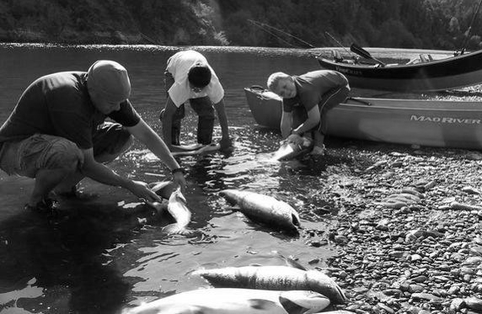
Fish
High-quality source of protein
Potential exposure to lead can be reduced by the way fish is prepared
  Remove organs, fat and skin
Eat smaller, younger fish
Check fish advisories
Photo provided by Zender Environmental and Health Group
Notes:
f. Fish
Instructor Note: FDA and EPA have issued advice regarding eating fish, which is geared toward women who are or may become pregnant, as well as breastfeeding mothers and parents of young children, helping them make informed choices when it comes to fish that is healthy and safe to eat (Ref. 9). Keep in mind that while Reference 9 is focused on mercury, the general information also applies to lead and other contaminants. It is recommended that you also investigate your area’s fish consumption advisories that could come from the federal, state, tribal and/or local government.
Fish is a high-quality source of protein. Unfortunately, lead and other contaminants may accumulate in fish, meaning fish could be a potential source of lead exposure. However, this potential exposure to lead can be reduced by the way fish is prepared, such as: removing their organs, fat and skin (where lead and other contaminants may accumulate).
If you eat game fish, eat the smaller, younger fish (within legal limits); they are less likely to contain contaminants than larger, older fish. Eat panfish such as bluegill, perch, stream trout and smelt. They feed on insects and other aquatic life and are less likely to contain contaminants (Ref. 10).
Check federal, state, tribal, and/or local fish advisories for recommendations on fish consumption for pregnant women, children under 15 years of age and the general public. This includes recommendations on numbers to be consumed per month for specific fish and whether it is recommended to eat only the fillet or the whole fish.
Instructor Note: You may choose to include a live demonstration (done by you or someone else) on the proper ways to clean fish and remove their skin, fat, and internal organs.

Slide 48
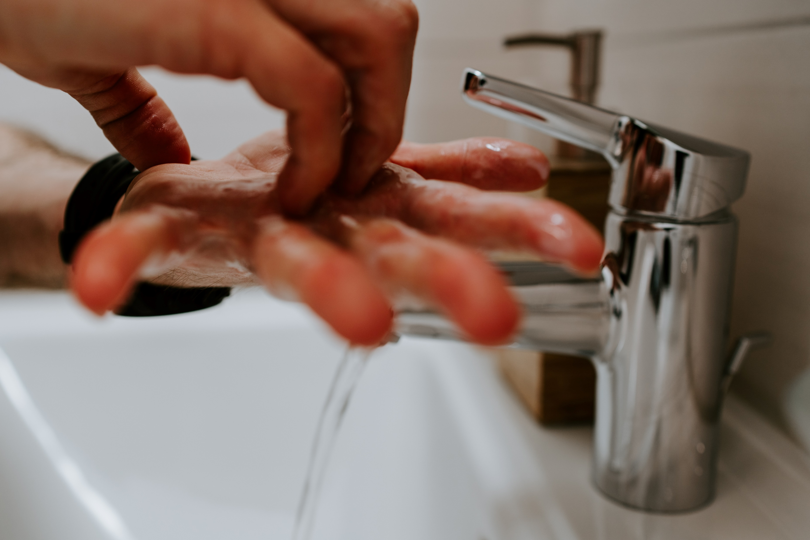
Review
Personal hygiene and proper nutrition for children may help reduce exposure to lead
Wash hands several times a day
Eat a well-balanced diet with foods high in:
  Calcium
  Iron
  Vitamin C
Photo by 🇨🇭 Claudio Schwarz | @purzlbaum on Unsplash
Notes:
IV. Conclusion
Good personal hygiene and proper nutrition for children may help in reducing their potential exposure to lead.
When children put their hands in their mouths, they may swallow lead-contaminated dust or soil, which can get into their bloodstream. Elements of good personal hygiene, such as consistent handwashing and bathing, reduce potential exposure to lead.
One of the easiest and most effective things that parents and caregivers can do to reduce potential exposure to lead is to teach children to wash their hands properly many times throughout the day. Children should wash their hands or have their hands washed:
Before eating, drinking and sleeping;
After using the bathroom; and
After playing, especially outdoors or with animals.
Eating a well-balanced diet is important for children's long-term health and development. To help reduce the absorption of lead, children should eat foods high in:
Calcium;
Iron; and
Vitamin C.
In summary, proper nutrition is important and eating a variety of foods will give children the vitamins and minerals they need to grow up healthy. When children do not have enough calcium or iron in their bodies, their bodies may absorb lead instead of these nutrients. An overall unhealthy diet high in fat and oil may increase the rate of lead absorption.

Slide 49
What are some examples of foods high in calcium, iron and/or vitamin C?
Notes:
Instructor Note: Below are questions that you may select to gauge participants’ understanding. Use their responses to facilitate a discussion.
What are some examples of foods high in calcium, iron and/or vitamin C?

Slide 50
Which of these foods, meals or snacks we covered today are you going to add to your children’s diet this week?
Notes:
Instructor Note: Below are questions that you may select to gauge participants understanding. Use their responses to facilitate a discussion.
Which of these foods, meals or snacks we covered today are you going to add to your children’s diet this week? Write your answers on the worksheet.

Slide 51
Are there other meals and/or snacks high in calcium, iron and vitamin C that you would prepare at home?
Notes:
Instructor Note: Below are questions that you may select to gauge participants understanding. Use their responses to facilitate a discussion.
Are there other meals and/or snacks high in calcium, iron and vitamin C that you would prepare at home? Write your answers on the worksheet.

Slide 52
What are some other actions we covered today that we can do at home to reduce exposure to lead?
Notes:
Instructor Note: Below are questions that you may select to gauge participants understanding. Use their responses to facilitate a discussion.
What are some other actions we covered today that we can do at home to reduce exposure to lead? Answers may include some of the following:
Wash children’s hands, bottles, pacifiers, and toys often.
Use only cold water for drinking, cooking and making baby formula.

Slide 53
Thank You!
Module 3: Personal Hygiene and Nutrition take-home resources include, the:
Worksheet
Key messages
Kids activity sheet
Notes:
Thank you for participating in this session. Does anyone have any questions about the information covered?
Here is the Module 3 Kids Activity Sheet for you to take home. The kids activity sheet has several activities that teach children about what we learned today. Instructor Note: Give each participant a copy of the Module 3 Kids Activity Sheet.

Slide 54
National Lead Information Center
1 (800) 424-LEAD [5323]
Provides the public and professionals with information about lead, lead hazards and prevention
Ask an Information Specialist questions about lead
Monday to Friday, 8:00 am to 6:00 pm ET (except federal holidays)
Hearing- or speech-challenged individuals may access this number through TTY by calling the Federal Relay Service at 1-800-877-8339
Notes:
To receive general information about lead or ask questions, you can call the National Lead Information Center (NLIC). The NLIC provides the public and professionals with information about lead, lead hazards and prevention. Call and speak with a specialist Monday through Friday, 8:00 am to 6:00 pm Eastern time (except federal holidays) at 1 (800) 424-LEAD [5323]. Hearing- or speech-challenged individuals may access this number through TTY by calling the Federal Relay Service at 1-800-877-8339. Instructor Note: Participants can find this number on both the Worksheet and Key Messages.

