Slide 1
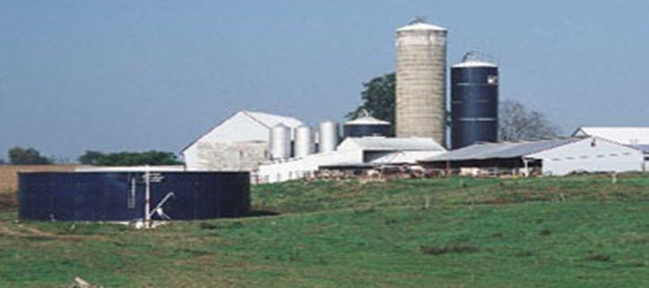
The SPCC Rule and Recent Amendments
Click to add your information here
Notes:
Supplemental information:
For additional resources for the agriculture community, please refer to the Additional Outreach Resources Document.
Instructions on how to host your own training are available in a separate document.
Recommended print settings: Gray scale or black and white

Slide 2
Presentation Overview
SPCC Rule Applicability and Basics
Recent Rule Amendments Overview
Compliance Date Extension
Additional Information

Slide 3
Please note that this presentation is a summary and does not cover every SPCC provision
Always refer to the SPCC rule and official Agency guidance found at www.epa.gov/oilspill

Slide 4

Section 1.
SPCC Rule Applicability
and Basics
SPCC
Plan

Slide 5
What is the SPCC Rule?
Spill Prevention, Control, and Countermeasure rule
Part of the Oil Pollution Prevention regulation (40 CFR part 112)
  Includes requirements for Facility Response Plans (FRPs) for certain facilities which pose a greater threat to waterways and the environment
Purpose – To develop plans designed to prevent oil discharges from reaching the navigable waters of the U.S. and adjoining shorelines

Slide 6
Requirements of the SPCC rule
Requires certain facilities, including farms, to develop and implement a site-specific SPCC Plan to address:
  Containment and procedures to prevent oil discharges;
  Proactive Control measures to keep an oil discharge from entering navigable waters of the U.S. and adjoining shorelines (containment); and
  Effective Countermeasures to contain, clean up, and mitigate any oil discharge that affects navigable waters of the U.S. and adjoining shorelines (spill response measures).
Notes:
Supplemental information:
It’s important to emphasize that an SPCC Plan must be written and implemented; that whatever is done in the field must be mirrored or described in the plan and vice versa.

Slide 7
Spill Prevention, Control and Countermeasure (SPCC) Rule Overview
Authority from Clean Water Act
Oil Pollution Prevention regulation codified at 40 CFR part 112
Original rule effective in January 1974
Non-delegable to other agencies
Notes:
Supplemental information:
This rule has been in existence since January 1974 (for over 35 years now). It has applied to bulk storage facilities since 1974, including farms, when facilities meet the threshold criteria. SPCC inspections, policy development, and enforcement cannot be delegated to any other agency, including other federal agencies, states or tribes, etc.

Slide 8
Rule Applies To Non-Transportation Related Facilities
Regulations apply to owners and operators of facilities involved in:
  Refining
  Transferring
  Distributing
  Using
  Consuming
  Drilling
  Producing
  Gathering
  Storing
  Processing

Slide 9
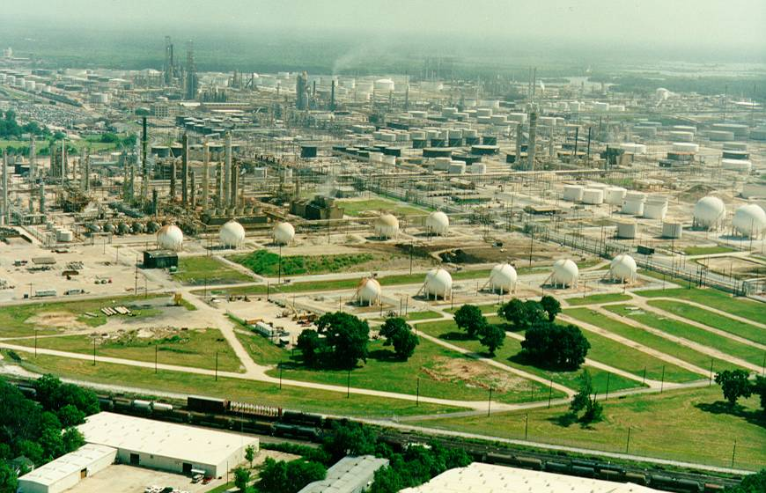
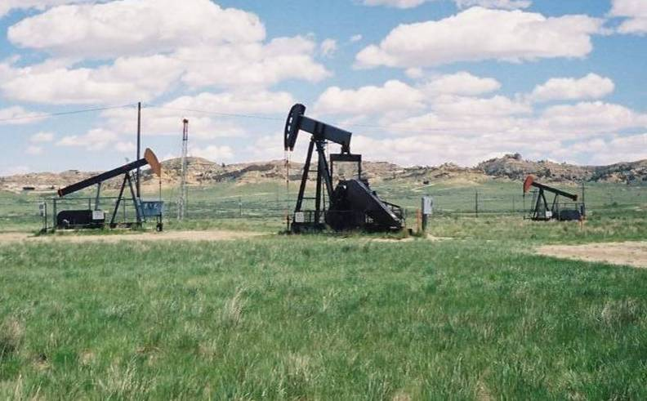
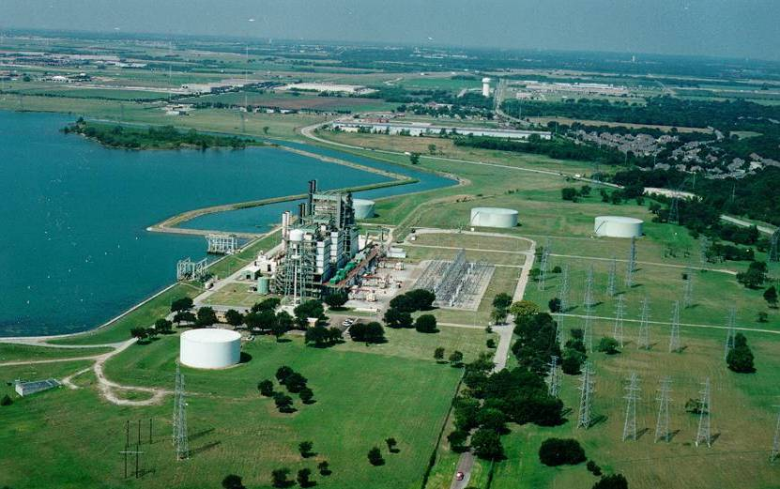
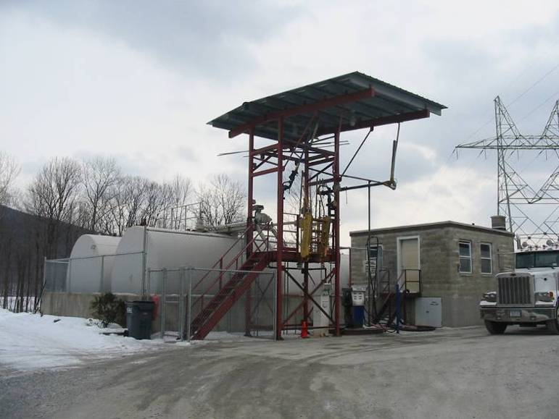
Examples of Non-Transportation-Related Facilities
Notes:
Photo description:
(Photos clockwise from top left) Oil production (Wyoming); refinery (Beaumont, Texas); electrical power generation (facility in Dallas, Texas with large back-up fuel tanks); and bulk petroleum distributor with loading rack.

Slide 10
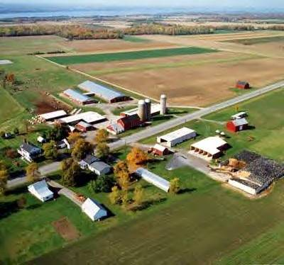
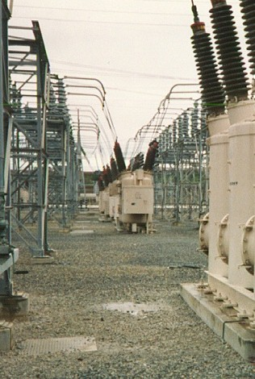
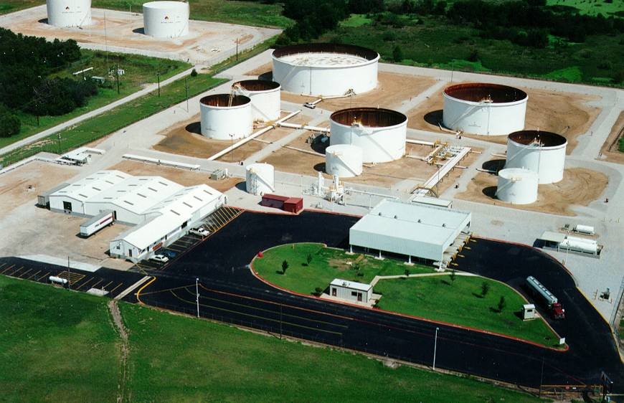
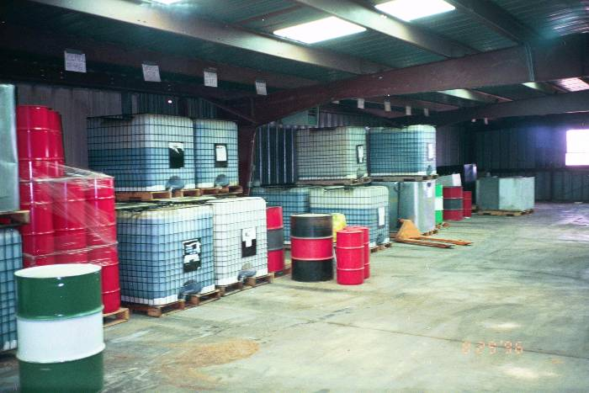
Notes:
Photo description:
(Photos clockwise from top left) Farm; transformers at an electrical substation; warehouse with drums and totes of petroleum; a large fuels marketing terminal (Downtown Fort Worth area).

Slide 11
Examples of Transportation-Related Facilities
DOT - YES!
EPA - NO!
These facilities are subject to authority and control of U.S. Department of Transportation*
* Memorandum of understanding between secretary of transportation and Administrator of EPA Nov. 24, 1971. 36 FR 24080 and a summary is found in Appendix A of the SPCC rule

Slide 12
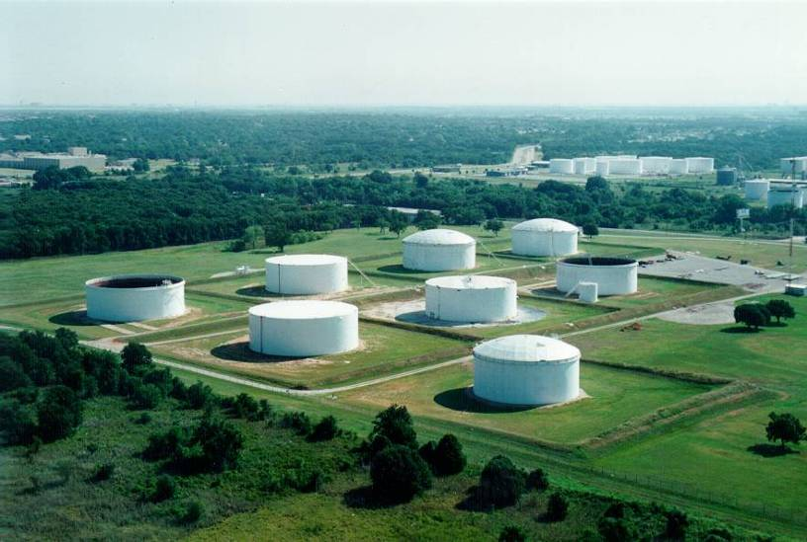
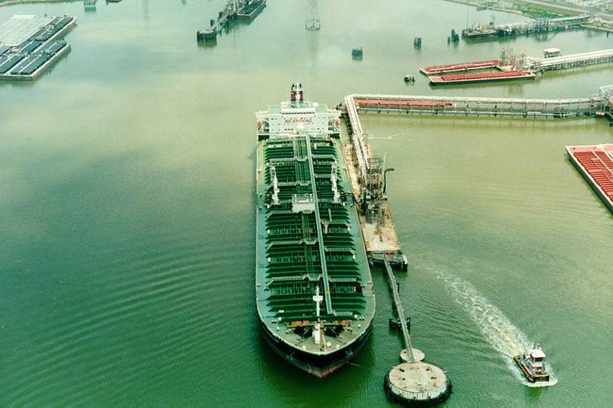
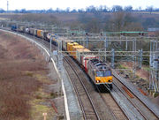
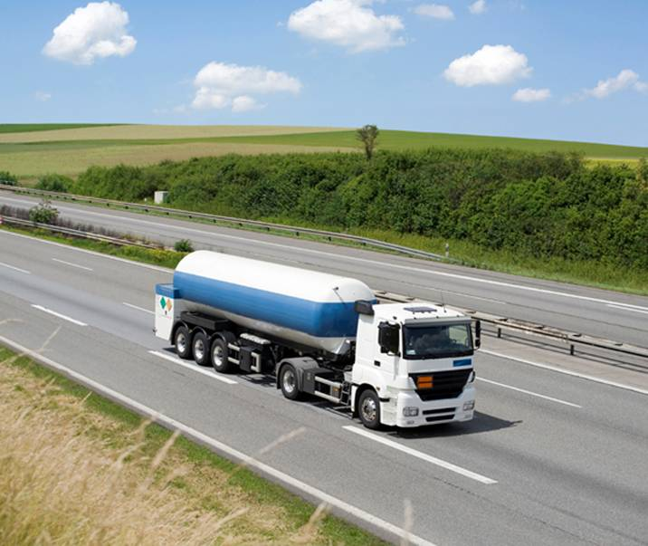
Examples of Transportation-Related Facilities
Notes:
Supplemental information:
Important to note that EPA may still have spill response jurisdiction, but not SPCC or prevention at these transportation-related functions/facilities. Also, EPA does not regulate oil filled rail cars or oil filled tank cars while in transportation, but may in certain situations when not in transportation for an extended amount of time with product in them.
Photo description:
(Photos clockwise from top left) Crude oil pipeline terminal where oil only comes in and goes out by pipeline (no other non-pipeline mode such as trucking exists at this facility); a large ship (oil tanker), transport truck, rail transport (while in transit)

Slide 13
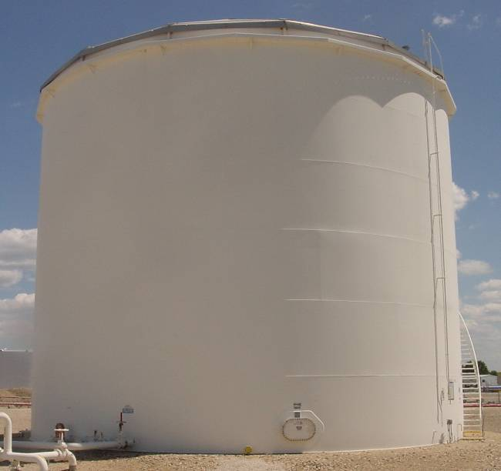
What are the SPCC criteria?
You must have an SPCC Plan if:
Facility stores > 1,320 gallons of oil in aggregate above-ground storage or has 42,000 gallons of completely buried oil storage capacity; and
Facility has a “reasonable expectation of an oil discharge” to waterway or adjoining shoreline.

Slide 14
SPCC Applicability
Owner/operator makes the initial decision on applicability of SPCC regulations to the facility
  Does the facility meet the applicability criteria (volumes of oil, expectation to spill to waterway)?
No requirement to submit SPCC Plan to EPA for approval
EPA does not formally “approve” or disapprove of SPCC Plan
Plan is required upon inspection during regular workday
Notes:
Supplemental information:
EPA may challenge the initial decision on SPCC applicability made by the owner/operator.

Slide 15

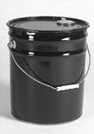
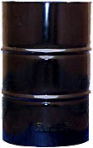
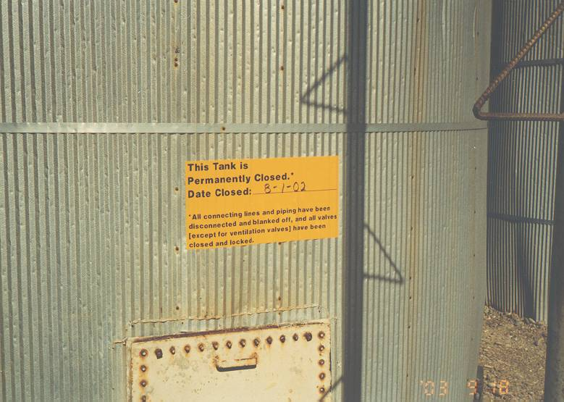
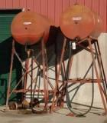
SPCC Applicability
Counted
Not Counted
55-gallons or greater
5-gallon container
30-gallon drum
Permanently Closed
Notes:
Emphasize that it is the shell capacity of the container not how much is stored inside!
Permanently Closed Containers:
All liquid and sludge has been removed from each container and connecting line, &
All connecting lines and piping have been disconnected , capped, plugged, and blanked off;
All valves (except for ventilation valves) have been closed and locked; and
Signs have been posted stating that it is a permanently closed container with the date of closure

Slide 16


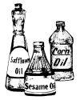
Definitions - Oil
Oil, as defined in Section 311 (a)(1) of the CWA, can be of any kind or in any form including, but not limited to
  Petroleum and non-petroleum based oils
  Crude Oil
  Refined Products
  Animal Fats, and
  Vegetable oils

Slide 17
Examples of Oil on a Farm
Gasoline
Off-road and on-road diesel fuel
Hydraulic oil
Lubrication oil
Crop oil
Vegetable oils from crops
Adjuvant oil
Milk*
* Milk and Milk product containers are now exempt from the SPCC capacity calculations and rule requirements
Notes:
Supplemental information:
Milk spills must be immediately reported to the National Response Center (NRC) at 800-424-8802 or 1-202-426-2675. Because milk contains oil, the owner or operator of milk facility may be liable to clean up a spill and/or pay penalties issued under the authority of the Federal Water Pollution Control Act (Clean Water Act)

Slide 18
Navigable Waterways of the U.S. and Adjoining Shorelines
Applicability of the SPCC rule is predicated on a reasonable threat of discharge of oil to “navigable waters of the U.S. and adjoining shorelines”
What are navigable waters of the U.S.?
  Surface waterways – streams, creeks, rivers, lakes
  Wetlands adjacent to a navigable waterway
    Nexus important
  Can be intermittent streams. Best determination if flowing at least seasonally (3 months or more), depending on several factors (see Rapanos Guidance)
  http://www.epa.gov/owow_keep/wetlands/guidance/CWAwaters.html
  Defined flow pathway to truly navigable waters of the U.S. good start in determination – don’t assume
  EPA expects to issue guidance on navigable waters of the U.S and adjoining shorelines.
Notes:
Supplemental information:
Although the definition of “navigable waterway” has been changing, essentially these waters are surface waterways, not groundwater. However, if groundwater is connected to surface waters and a navigable waterway, then SPCC jurisdiction may apply.

Slide 19
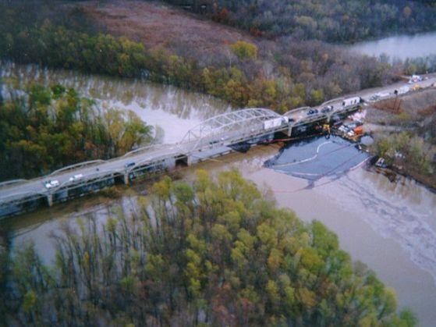
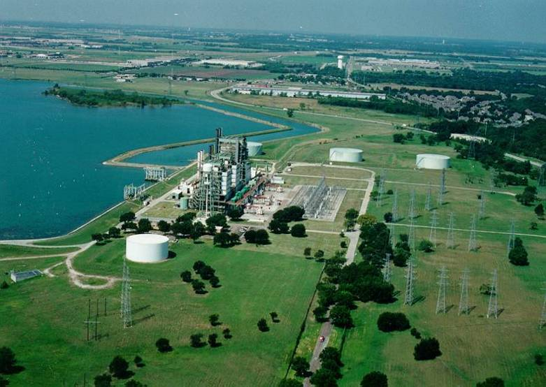
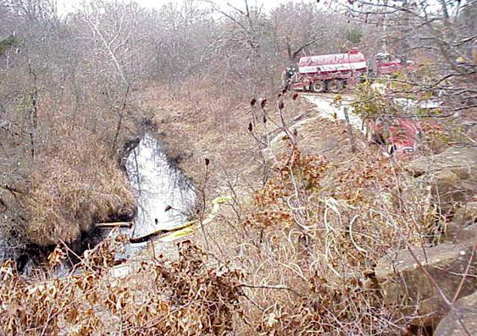
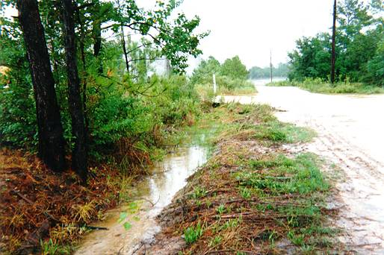
Navigable Waters of the U.S. and Adjoining Shorelines Discussion
Notes:
Supplemental information:
The purpose of these photos is to stir discussion only. Ask the students what they think each photo represents.
Photo description:
The upper left-hand photo is the Verdigris River (with an active oil spill in it) in Oklahoma. This waterway is large and connects with the Arkansas River. It is considered a navigable waterway. The upper right-hand photo shows the steam electric generating station on a large recreational lake in Texas. It is a navigable waterway (it is also located directly on a river system – the Trinity River in Texas, but it does not necessarily have to be so to be a navigable waterway). The lower left-hand photo is a flowing creek west of Tulsa, Oklahoma, showing some boom and a vacuum truck working an active oil spill. Since the creek is flowing, and has water in it for three months or more (see EPA/USACE guidance), it is considered a navigable waterway. Finally, the lower right-hand photo is a road ditch in in a rural area of Arkansas. A road ditch by itself may not be a navigable waterway, but if it connects with one and is a pathway to one, EPA SPCC jurisdiction may apply (See next slide) under “reasonable expectation to discharge to...”.

Slide 20
What is a “Reasonable Expectation of an Oil Discharge”?
Initial determination by the owner/operator based on geographical and location aspects of the farm
You may consider proximity to water, land contour, drainage
Exclude manmade features, such as secondary containment dikes around tanks and impoundments, in determination
Good idea to document determination
  Particularly if you conclude you are not subject to the rule
  Not a rule requirement
See Section 2.4 of SPCC guidance document
http://www.epa.gov/emergencies/docs/oil/spcc/guidance/2_Applicability.pdf
Notes:
You can’t make an determination that there is no reasonable expectation of discharge based on the presence of man made structures such as containment, response capability and elevated roadways. Thus, when making this determination you cant consider any man made structures only the geographic or location aspects of the farm.

Slide 21
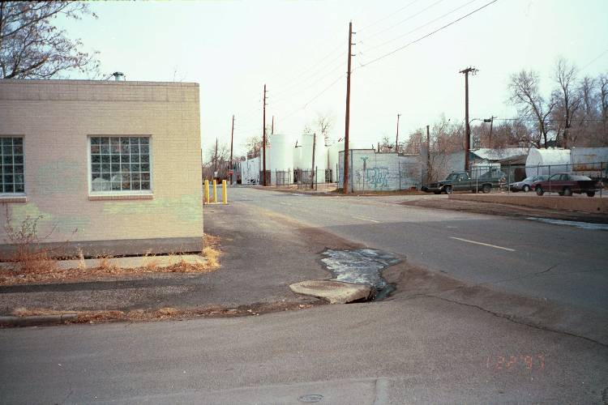
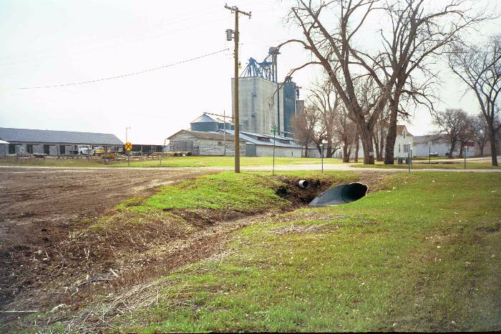
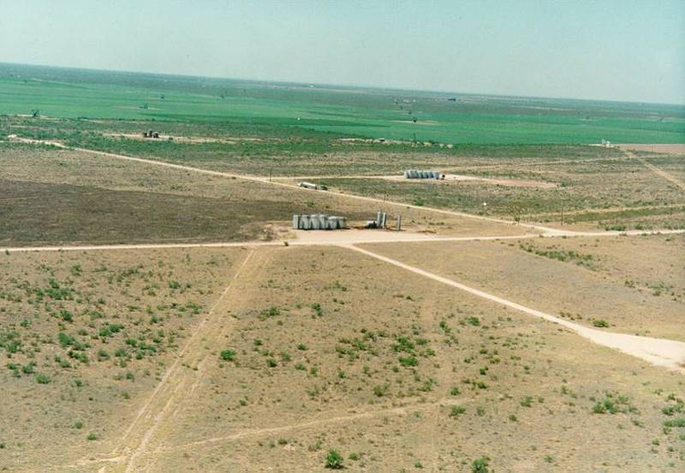
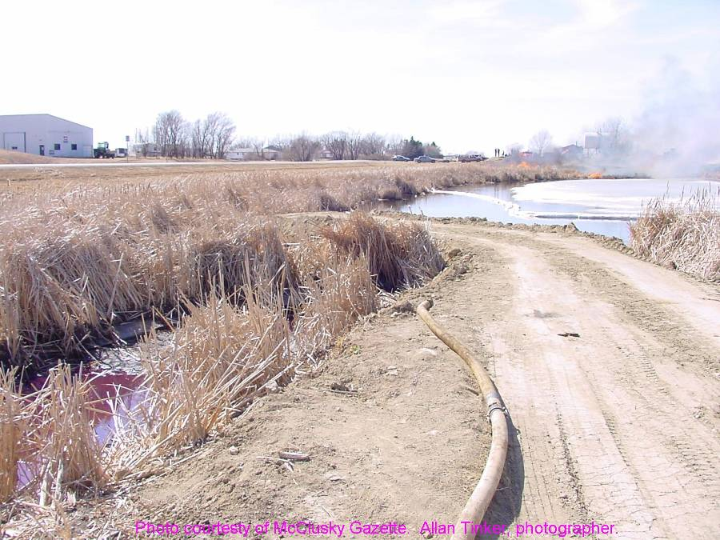
Notes:
Supplemental information:
The purpose of this slide is also to stir discussion on what represents a “reasonable expectation of a threat of discharge to a navigable waterway of the US or adjoining shoreline.”
Photo description:
In the upper left-hand photo and upper center of photo, note the petroleum distributor and storm drain just down the street and what appears to be downgrade of the facility. Items such as the offsite drainage flow from the facility are important to examine, as well as where the storm drain flows. In this case, this configuration represents a clear case of reasonable expectation of discharge to waterways of the U.S. Similarly, a spill from the facility in the upper right-hand photo would flow to the local storm ditch, which may flow to a real waterway, such as the one in the lower right-hand photo. Here, a spill of hydraulic oil or red-dye diesel flowed thru a ditch to a small lake which was a navigable waterway. However, the oil production facility in the lower left-hand photo, which is in an arid, flat area south of Midland, Texas may not need to have an SPCC Plan because, although there are road ditches, they just end and/or don’t lead to a navigable waterway. The operator did his homework and looked at the site-specific topography and potential flow pathways and determined that there is not a reasonable expectation of a spill getting to a navigable waterway (there’s none for miles). Note, while not a rule requirement, you should document the basis for your determination that your farm is not subject to the SPCC rule.

Slide 22
Facility
Facility- any mobile or fixed, onshore or offshore building, property, parcel, lease, structure, installation, equipment, pipe, or pipeline (other than a vessel or a public vessel) used in oil well drilling operations, oil production, oil refining, oil storage, oil gathering, oil processing, oil transfer, oil distribution, and oil waste treatment, or in which oil is used, as described in Appendix A to this part. The boundaries of a facility depend on several site-specific factors, including but not limited to, the ownership or operation of buildings, structures, and equipment on the same site and types of activity at the site. Contiguous or non-contiguous buildings, properties, parcels, leases, structures, installations, pipes, or pipelines under the ownership or operation of the same person may be considered separate facilities. Only this definition governs whether a facility is subject to this part.

Slide 23
What the definition means…
According to EPA guidance, the extent of a “facility” depends on site-specific circumstances:
  Ownership, management, and operation of the buildings, structures, equipment, installations, pipes, or pipelines on the site;
  Similarity in functions, operational characteristics, and types of activities occurring at the site;
  Adjacency; or
  Shared drainage pathways (e.g., same receiving water bodies).
Notes:
Supplemental information:
The definition of facility is not intended to allow tanks side-by-side to be considered separate facilities. Contiguous or non-contiguous buildings,
properties, parcels, leases, structures, installations, pipes, or pipelines may be considered separate facilities.

Slide 24
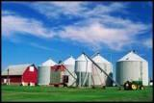
Farm
The definition of a farm was promulgated in the December 2006 rule amendments because, at the time, EPA delayed the compliance date for farms until additional amendments to the rule were promulgated.
Additional amendments were promulgated in 2008 and farms now have the same compliance dates as other facilities.
Farm - A facility on a tract of land devoted to the production of crops or raising of animals, including fish, which produced and sold, or normally would have produced and sold, $1,000 or more of agricultural products during a year.
Notes:
Supplemental information:
PREAMBLE LANGUAGE
EPA recognizes that a farm: may be privately owned and may contain the residence of the owner or operator; has a configuration that varies across the country, from farm to farm and season to season; contains low-volume oil storage that is often dispersed across different land parcels separated by roads and natural barriers; has multiple fueling sites; is located in a remote area; stores oil on-site for on-farm use and not for further distribution in commerce; uses oil seasonally in different quantities; and leases a significant amount of land to or from secondary parties. For these reasons, EPA is proposing additional amendments to the SPCC rule that further benefit farms.

Slide 25
What the definition means…
A farm is a type of facility
Note: You may be subject to the SPCC rule because you meet the definition of a facility; you must determine oil storage capacity and reasonable expectation of an oil discharge like any other facility
Notes:
Supplemental information:
The definition of a farm was provided when EPA modified the rule compliance dates. The definition of a farm has no role in applicability.

Slide 26
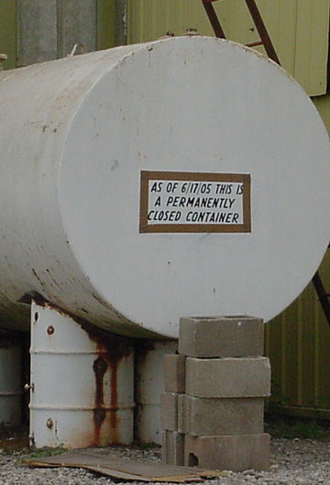
Permanently Closed
SPCC rule exempts any oil storage container that is permanently closed.
Permanently closed means any container or facility for which:
  (1) All liquid and sludge has been removed from each container and connecting line; and
  (2) All connecting lines and piping have been disconnected from the container and blanked off, all valves (except for ventilation valves) have been closed and locked, and conspicuous signs have been posted on each container stating that it is permanently closed and noting the date of closure.

Slide 27
Permanently Closed (cont.)
Definition of “permanently closed” does not require a container to be removed from a facility.
  Permanently closed containers may be brought back into use as needed for variations in production rates and economic conditions.
Permanent closure requirements under the SPCC rule are separate and distinct from the closure requirements in regulations promulgated under Subtitle C of RCRA.
SPCC rule exempts any oil storage container that is permanently closed.
  A tank that has either never stored oil, or has been permanently closed, and arrives at a facility is not counted until the tank is actually used to store oil.

Slide 28
Key SPCC Requirements
Prepare Plan in accordance with Good Engineering Practices
Full approval of management to implement Plan – and sign off
Follow sequence of Section 112.7, or use a cross-reference section
Notes:
Supplemental information:
All SPCC regulated facilities must comply with Section 112.7 except that oil production facilities are exempt from the security requirements.

Slide 29
SPCC Key Requirements
SPCC regulations requires preparation and implementation of a written Plan to address:
  Operating procedures for routine handling of products to prevent a discharge of oil
  Discharge or drainage control measures to prevent a discharge of oil
  Countermeasures to contain, clean up, and mitigate an oil spill
  Methods of disposal of recovered materials
  Contact list and phone numbers of company, contract response personnel, and National Response Center

Slide 30
Key SPCC Requirements
For farms with >10,000 gallons of oil, Plans are required to be certified by a Professional Engineer (PE)
For farms with > 1,320 up to 10,000 gallons of oil, can opt to self-certify SPCC Plans
  Details to follow (Qualified Facilities)
  This is optional alternative to PE certification
  Two tiers of certification

Slide 31
Professional Engineer (PE)
Certified by a licensed PE
  Licensed in state or state with reciprocity
  PE familiar with 40 CFR Part 112
  PE or agent visited facility
  In accordance with good engineering practices
    Consider applicable industry standards
    In compliance with regulations
  Inspection and testing procedures are established
  Plan is adequate for facility

Slide 32
Failure Analysis
Where experience indicates reasonable potential for equipment failure
  Tank loading or unloading equipment
  Tank overflow, rupture, or leakage
  Any other equipment known to be a source of a discharge
Predict for each type:
  Direction (e.g., north, or to the road)
  Rate of flow
  Total quantity of oil that could be discharged
Notes:
Supplemental information:
Facilities that are required to have an FRP may incorporate their FRP analysis of discharge into the trajectory analysis
Source: 2002 Final Rule Text, 67 FR 47042
The facility is still responsible for predicting failure analysis regardless if there has been a previous equipment failure or discharge.

Slide 33
Amendment of SPCC Plan by Owners or Operators
For changes in facility design, construction, operation, or maintenance that materially affect the potential for a discharge as described in §112.1(b)
  Commissioning and decommissioning containers
  Replacement, reconstruction, or movement of containers
  Reconstruction, replacement, or installation of piping systems
  Construction or demolition that might alter secondary containment structures
  Changes in product or service
  Revision of operating or maintenance procedures
Amend within 6 months; implement ASAP, but no later than 6 months after amendment
Notes:
Supplemental information:
Technical amendments must be certified by a licensed PE, but not all amendments must be certified by a licensed PE. For example, recertification of the SPCC Plan is not required if the only change made is to the facility’s emergency contact list or a change in ownership.
Source: 2002 Final Rule Text, 67 FR 47042

Slide 34
Plan Review
Complete review and evaluation of Plan
  Once every 5 years from the date facility becomes subject to the rule
  If a facility was in operation on or before 8/16/2002, five years from the date of your last review required by the rule
  Does not always require a PE
Amend Plan within 6 months to include more effective prevention and control technology
Implement ASAP, but no later than 6 months of amendment
Notes:
Supplemental information:
The owner or operator must implement any amendment within six months, document completion of the review and evaluation, and sign a statement as to whether he or she will amend the Plan, either at the end of the Plan or in a log or an appendix to the Plan.
Source: 2002 Final Rule Text, 67 FR 47042

Slide 35
Documenting Plan Review
Must document Plan review and evaluation
Sign statement at beginning or end of Plan or in a log or an appendix
  “I have completed review and evaluation of the SPCC Plan for (name of facility) on (date), and will (will not) amend the Plan as a result.”
PE must certify any technical amendment to Plan
  Qualified Facilities exception
Notes:
Supplemental information:
A PE must certify only technical amendments. PE certification is not required for non-technical amendments like changes to phone numbers or names. PE certification of technical amendments is not required for self-certified plans at qualified facilities, unless a PE had certified the portion of the Plan in question, or if the technical amendment involves environmental equivalence or impracticability determinations.
PE certification of technical amendments is not required for self-certified plans at qualified facilities, unless a PE had certified the portion of the Plan which has changed, or if the technical amendment involves environmental equivalence or impracticability determinations.

Slide 36
SPCC Rule Key Requirements
SPCC Plan must be maintained at facility if manned 4 hours/per day or more, or at nearest field office if manned less than 4 hours/per day
Allowance of usual and customary business records to serve as records of inspection or tests

Slide 37
Inspections, Tests, and Records
Conduct inspections and tests in accordance with written procedures developed by the facility or by the engineer who certifies the facility Plan
Keep these written procedures and a record of the inspections and tests, signed by the appropriate supervisor or inspector, with the SPCC Plan for a period of three years
Notes:
Supplemental information:
Records of inspections and tests kept under usual and customary business practices will suffice for purposes of this requirement. \
More information on testing is available later in this presentation.

Slide 38
Environmental Equivalence
Allows deviations from most technical requirements of the rule when:
  Equivalent environmental protection is provided and reasons for non-compliance explained
  Does not include secondary containment, training, recordkeeping, and administrative provisions of the rule

Slide 39
Training
Train oil-handling personnel
  Operation/maintenance of prevention equipment
  Discharge procedure protocols
  Applicable pollution control laws, rules, and regulations
  General facility operations
  Contents of the facility SPCC Plan
Designate person accountable for discharge prevention and who reports to facility management
Schedule/conduct at least one briefing/year:
  Known discharges and failures, malfunctioning components, new precautionary measures
Notes:
39
Supplemental information:
This does not have to be a complex classroom type event, but it must occur. If you can get it done on the back of a pickup or in a barn or house, and cover the necessary items, and document it, it will suffice.

Slide 40
General Secondary Containment
Provide appropriate secondary containment and/or diversionary structures or equipment to prevent a discharge (from tanks, drums, totes, piping, etc.) to “navigable waters of the U.S. and adjoining shorelines”
The entire system (walls and floor) must be capable of containing oil so that a discharge from containment will not occur until cleanup occurs
§112.7(c)
Notes:
Supplemental information:
It’s key to note the word “appropriate” here. Give examples. Is it appropriate to have a containment berm made up of crushed oyster shells (in a coastal region) to provide secondary containment for a large tank of gasoline? No. Similarly, is it appropriate to use bags of kitty litter for secondary containment of a large tanker truck of fuel? No. On the other hand, might it be appropriate to have a soil berm with clay content around some oil production tanks? Yes.

Slide 41
General Secondary Containment
One of the following preventive systems or its equivalent should be used as a minimum for onshore facilities:
  Dikes, berms or retaining walls sufficiently impervious to contain spilled oil
  Curbing or drip pans
  Sumps and collection systems
  Culverting, gutters or other drainage systems
  Weirs, booms or other barriers
  Spill diversion ponds
  Retention ponds
  Sorbent materials
Notes:
Supplemental information:
The owner/operator of the facility has flexibility to determine the appropriate type of containment, as shown by the examples given here. Again depending on site-specific conditions, the size of the container, the type of oil being contained, the amount expected to be spilled, and the distance and gradient to a waterway, containment may not need to be complex, but must be appropriate.

Slide 42
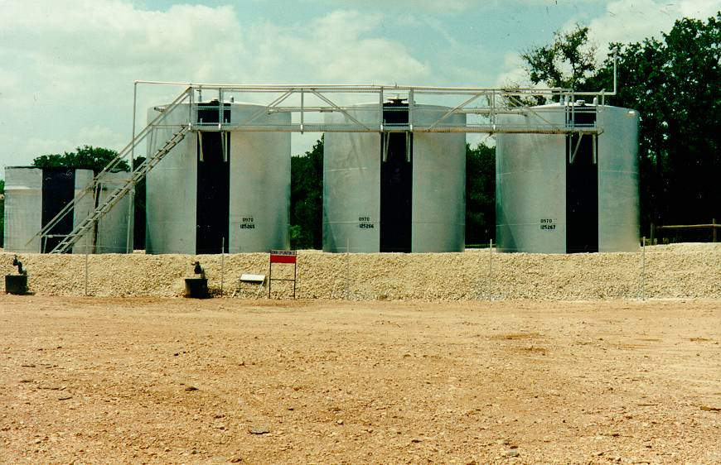
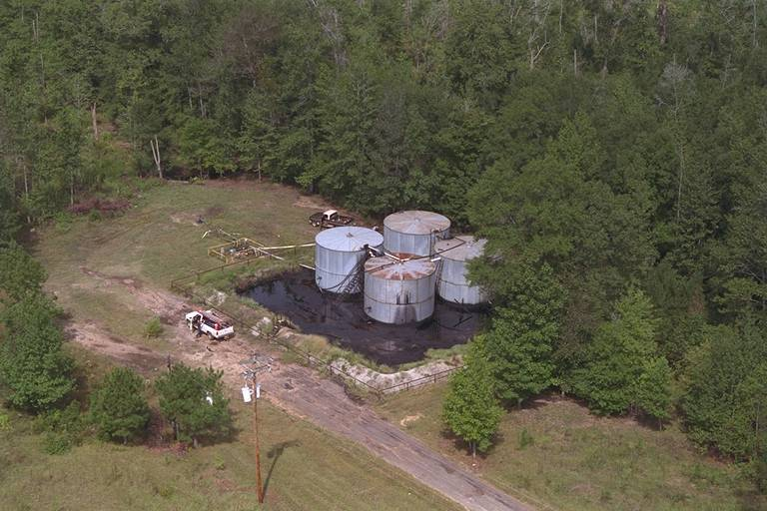
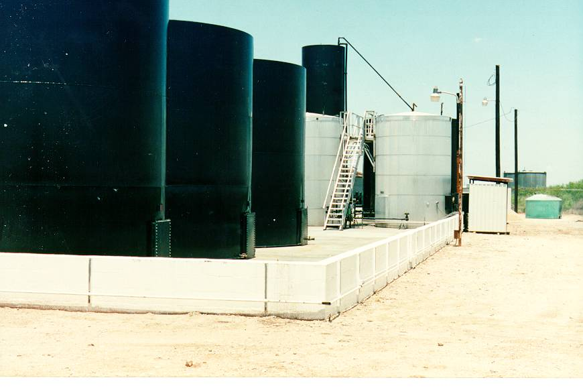
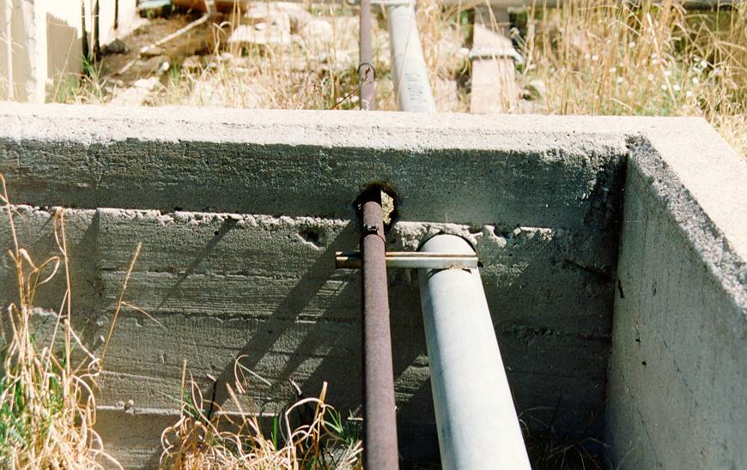
Notes:
Photo description:
The photos in this slide are illustrative of good and bad examples of secondary containment.
In the upper left-hand photo, these oil production storage tanks have a secondary containment berm (or dike) made of soil with a gravel top. Although the gravel is not required, this operator chooses to use it to keep down weeds and erosion. This is perfectly acceptable as long as the berm is impermeable as required under the rule. Having clay content in the soil is helpful in this regard. The operator could also have chosen to let grass grow on top of the berm, but only as long as it can be assured that the berm has integrity, and is impermeable. Problems that may develop include drying out of the berm and development of large fissures through the soil, growth of large-rooted plant systems from trees, bushes, cactus, etc., which would impair the integrity of the berm and therefore containment of any oil that may be spilled. We would encourage regular mowing of grass in order to be able to inspect and assure berm integrity.
In the upper right-hand photo there are several problems: 1) secondary containment has a large volume of oil inside, which then diminishes the total volume available for containment (volume of the single largest tank in containment plus freeboard for precipitation) , 2) spilled oil inside containment poses a potential threat of discharge of oil when water is drained from the containment or when a large rain event occurs, and 3) there are large-rooted trees growing in containment impacting containment integrity and restricting the operator’s ability to inspect the facility.
The lower left-hand photo shows a concrete block dike wall around a used-oil facility. This containment is very common. It is adequate here and provides for the volume of the largest single tank inside containment and freeboard for precipitation. The floor of containment slopes slightly so that any spilled oil or rainwater collects in a small sump, which facilitates drainage or pumping of fluids from containment. Note that concrete block containment walls, unless reinforced or very short, are not strong enough to hold significant quantities of oil or water.
The lower right hand photo also shows a containment dike wall which is not adequate. Note the unsealed hole in the wall at the base where there is an old pipe penetration. Also, note the upper pipe penetrations that are not sealed around the piping, allowing any potential spill to flow out of containment. Even if the penetration at the bottom of the wall were not in existence, the effective height of containment is lowered due to the pipe penetration near the top of the wall which has reduced the containment capacity to an inadequate volume.

Slide 43
Revision to General Secondary Containment Requirement
Clarified that the general secondary containment requirement is intended to address the most likely oil discharge from any part of a facility
Use of active and passive secondary containment, such as spill kits, allowed
Modifies §112.7(c) to expand the list of example prevention systems for onshore facilities
  Additional examples: drip pans, sumps, and collection systems
New text: “… In determining the method, design, and capacity for secondary containment, you need only to address the typical failure mode, and the most likely quantity of oil that would be discharged. Secondary containment may be either active or passive in design.”
Notes:
43

Slide 44
Secondary Containment
Active Measures
Can use active measures as secondary containment
Active measures are those that require deployment or a specific action by an operator
  These may be deployed either before an activity involving the handling of oil starts, or in reaction to a discharge
Must be implemented in time to prevent the spilled oil from reaching surface waters

Slide 45
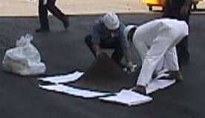

Active Measures
May be appropriate for discharges that occur during manned activities if they:
  Can contain the volume and rate of oil
  Is properly constructed
  Is deployed in a timely manner
Examples include:
  Using spill kits in the event of a discharge
  Placing a properly designed storm drain cover over a drain prior to a transfer of oil to a container

Slide 46
General Secondary Containment
“General” Secondary Containment requirement applies to the following examples:
  Nurse tanks
  Mobile refuelers
  Oil-filled equipment (transformers, manufacturing equipment, etc.)
  Transfer areas
    Piping runs/racks, manifolds, etc.
    Truck loading/unloading areas (not loading rack)
No specific-sized volume requirement
Sizing based on typical spill size not container size

Slide 47
Specific Secondary Containment Requirements
Specific minimum size requirement for secondary containment for:
  Bulk storage containers
  Mobile or portable bulk storage containers*
The secondary containment must be sized to contain the largest single oil compartment or container plus “sufficient freeboard” to contain precipitation
* Certain mobile portable containers (tanker trucks and nurse tanks) are only required to have general secondary containment

Slide 48
Specific Secondary Containment
For Bulk Storage containers, sized containment could be an earthen berm, concrete dike or earthen remote impoundment
  See Chapter 4 of SPCC Guidance Document (Figures 4-5 and 4-6)
    http://www.epa.gov/emergencies/docs/oil/spcc/guidance/4_SecondaryContainment_Impracticability.pdf
  Sample Calculation Worksheets are also available on the EPA Website (for Qualified Facilities)

Slide 49
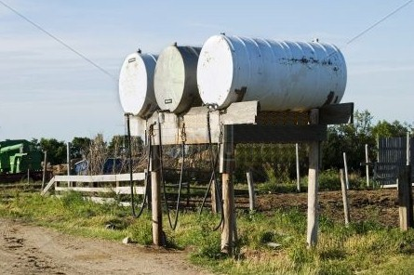
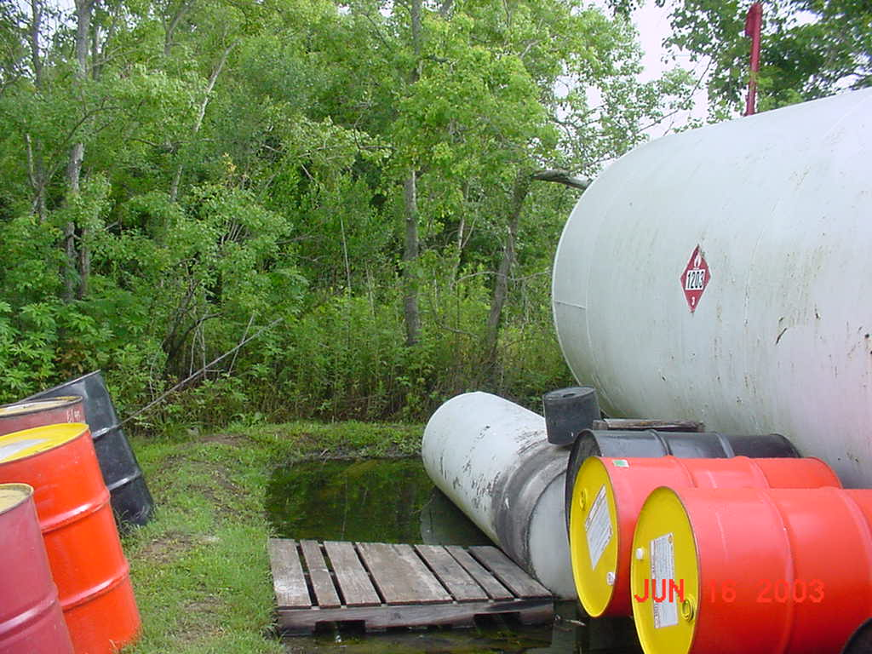
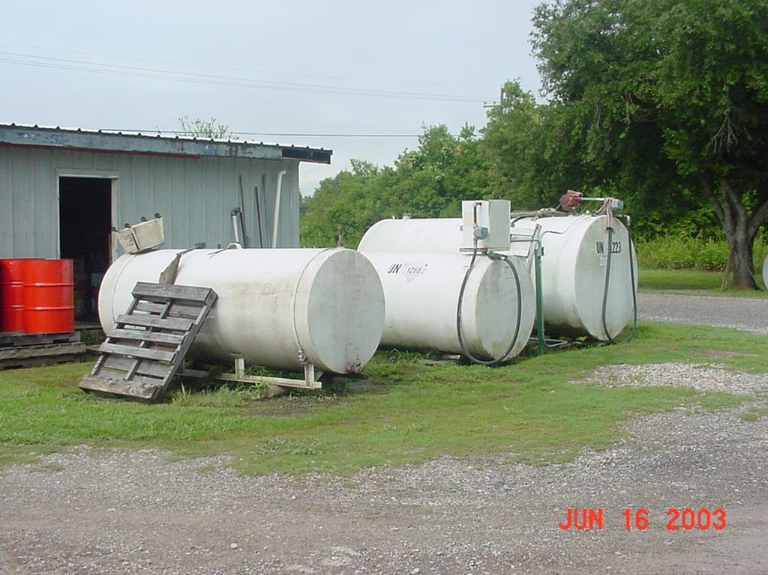
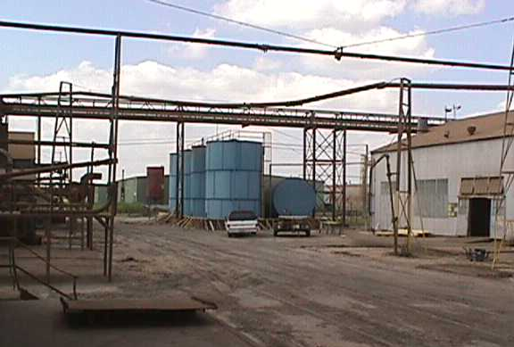
Notes:
49
Photo description:
Photos of secondary containment at agriculture facilities. The upper left-hand photo from a farm shows three tanks which have no secondary containment. The upper right-hand photo shows secondary containment full of rain water, which diminishes the required secondary containment volume. Any spill from the tank would cause spilled oil to overflow containment. Similarly, the lower left-hand facility shows no secondary containment around these bulk storage tanks. It appears that at one time there might have been a containment berm, but it is eroded to the point where it can no longer provide secondary containment. For small bulk storage areas such as in these three photos, installation of a berm is not difficult or costly, and a relatively simple prevention measure that can save owner/operators significant costs of clean up should a spill occur.

Slide 50
Bulk Storage Container Requirements
No container should be used for the storage of oil unless its oil and construction are compatible with the oil stored and the conditions of storage, such as pressure and temperature, etc.
For bulk storage tank installations, provide secondary containment for the entire capacity of the largest single container with sufficient freeboard for precipitation
Notes:
50
Supplemental information:
Dikes, containment curbs, and pits are commonly employed for secondary containment, but they may not always be appropriate. An alternative system could consist of a complete drainage trench enclosure arranged so that a spill could be terminated and safely confined in an in-plant catchment basin or holding pond.
When rain can collect in a dike or berm, the SPCC rule requires that secondary containment for bulk storage containers have additional capacity to contain rainfall. The rule does not specify a method to determine the additional capacity required to contain rain or the size of the rain event for designing secondary containment. However, industry practice often considers a rule of thumb of 110% of the tank capacity to account for rainfall. A dike with a 110% capacity of the tank may be acceptable depending on, the shell size of the tank, local precipitation patterns and frequency of containment inspections. In a different geographic area, a dike or berm designed to hold 110% for the same size tank may not have enough additional containment capacity to account for a typical rain event in that area. The 110% standard may also not suffice for larger storm events or different size tanks at a facility. If you want to determine a conservative capacity for a rain event, you may consider a 24-hour 25-year storm event. It is the responsibility of the owner or operator to determine the additional containment capacity necessary to contain rain. A typical rain event may exceed the amount determined by using a 110% “rule of thumb” so it is important to consider the amount of a typical rain event when designing or assessing your secondary containment capacity. The SPCC rule does not require you to show the secondary containment calculations in your Plan. However, you should maintain documentation of secondary containment calculations to demonstrate compliance to an EPA inspector.
There is no formal regulatory definition for the term “sufficiently impervious.” As a rule, the system must be impervious to oil until such time the oil can be removed.
Instructions to Presenter: Images to follow.

Slide 51
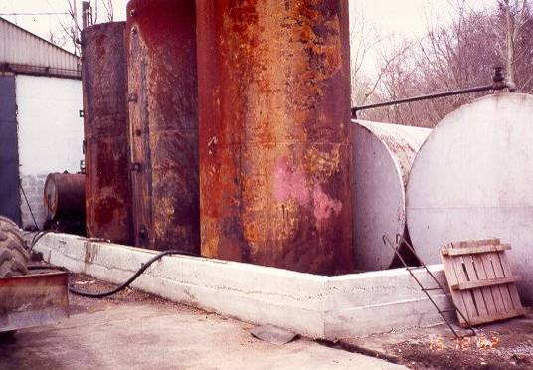
Inadequate Containment and Improper Tank Use (UST serving as an AST)
Notes:
51
Photo description:
This is a photo of a bulk storage tank with severe corrosion. Although simple surface rust may not pose an immediate problem for compliance with the SPCC rule, severe corrosion such as large-scale pitting or de-lamination of the tank would show that the tank is not compatible, anymore, with conditions of storage (as it is a UST being used as an AST). Also note poor housekeeping. The SPCC rule does not address this, but best management practices should be employed here and area cleaned up.

Slide 52
Bulk Storage Containers
Overfill Protection. Provide at least one of the following devices:
  High liquid level alarms
  High liquid level pump cutoff
  Direct audible or code signal communication between container gauger and pumping station
  Fast-response system for determining liquid level of each bulk storage container, with person present to monitor
  Regularly test liquid level sensing devices (follow manufacturers specifications)

Slide 53
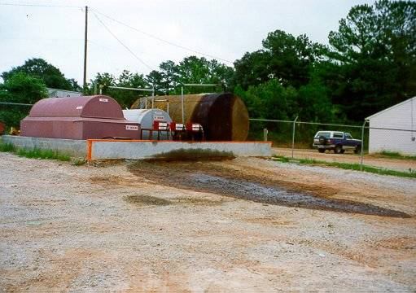
Inadequate Containment and Overfill Protection
Notes:
53
Photo description:
This is a photo of a concrete block containment wall. Note both the overfill of the tank and leakage of oil through the wall. This is a common problem with concrete block containment walls.

Slide 54
Facility Drainage
Drainage from diked storage areas should be:
  Restrained by valves or other positive means
    Use valves that are manual and open-and-closed in design
  Emptied by pumps or ejectors that are manually activated and inspected before starting to verify that no oil will be discharged into navigable waters of the U.S. and adjoining shorelines.
Notes:
Supplemental information:
Drainage from diked areas should be restrained to prevent a spill into the drainage system or into the in-plant treatment system, unless the system is equipped to handle it. Facilities can also drain a diked area using pumps, but the pumps must be manually activated and the drainage material must be inspected before it is discharged. At no time should flapper type valves be used to drain a diked area. If the plant drainage flows directly into a watercourse, the drainage must comply with applicable water quality State and Federal standards and not cause a discharge of a harmful quantity. Once the dike has been drained, the valve must be resealed and records must be kept on each such event.
Title 40 CFR part 110 states that a harmful quantity includes discharges of oil that violate applicable water quality standards, or cause a film or sheen upon or discoloration of the surface of the water or adjoining shorelines or cause a sludge or emulsion to be deposited beneath the surface of the water or upon adjoining shorelines.

Slide 55
Facility Drainage (cont.)
Drainage from undiked areas should flow into:
  Ponds;
  Lagoons; or
  Catchment basins designed to retain oil or return it to the facility.
Catchment basins should not be located in areas subject to periodic flooding
If plant drainage is not engineered as above, the final discharge of all in-plant ditches should be equipped with a diversion system that could, in the event of an uncontrolled spill, return the oil to the plant
Notes:
Supplemental information:
Undiked areas to be considered under this provision include those areas at the facility where there is a potential for oil to be spilled.
Ponds and lagoons are not required to be sufficiently impervious under the regulation.

Slide 56
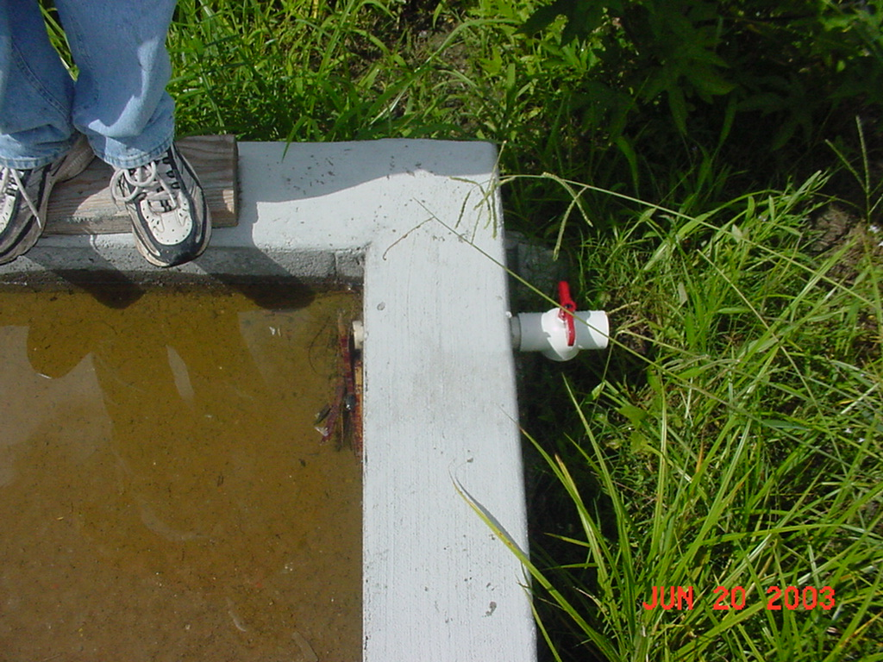
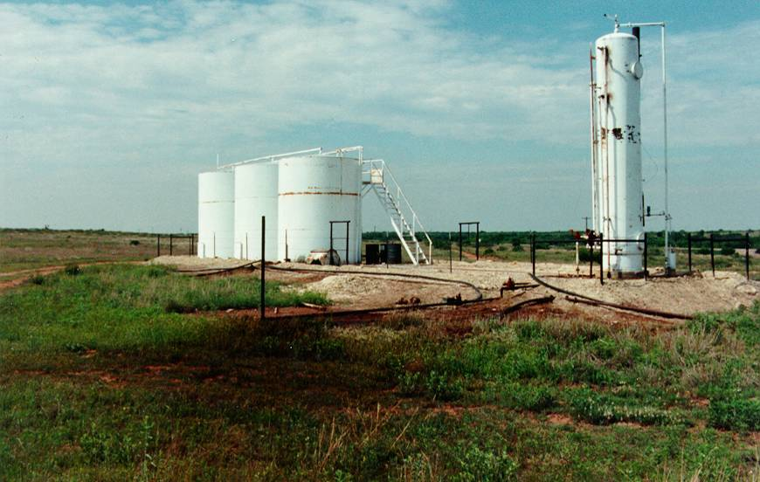
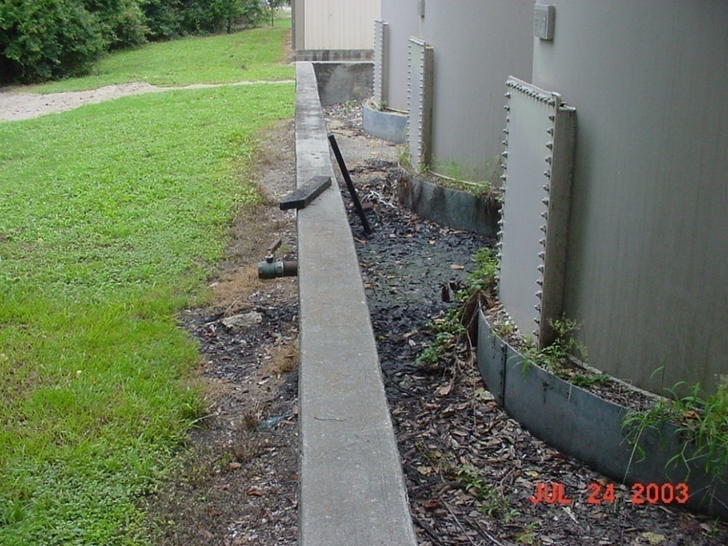
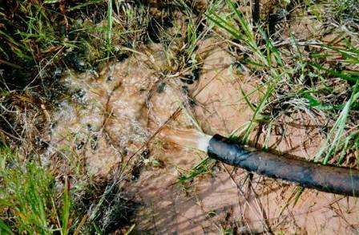
Notes:
Photo description:
Photos illustrating facility drainage. Note ball valve in dike wall on lower left-hand photo and upper left-hand photo. Also, tanks in the lower photo are on raised gravel beds that keep rainwater from collecting at their base, a good best management practice. Both photos on the right side of the slide show an oil production facility which has purposely pumped or drained water out of secondary containment without inspecting for the presence of oil on the water. This is a violation of the SPCC rule and now presents a threat of oil getting to a waterway should there be rain. Although mostly water, the water had oil on its surface which has discharged onto soil outside containment. Before draining water from containment, the owner/operator must inspect the rainwater and remove any oil or sheen.
Records must be maintained of these of these events.

Slide 57
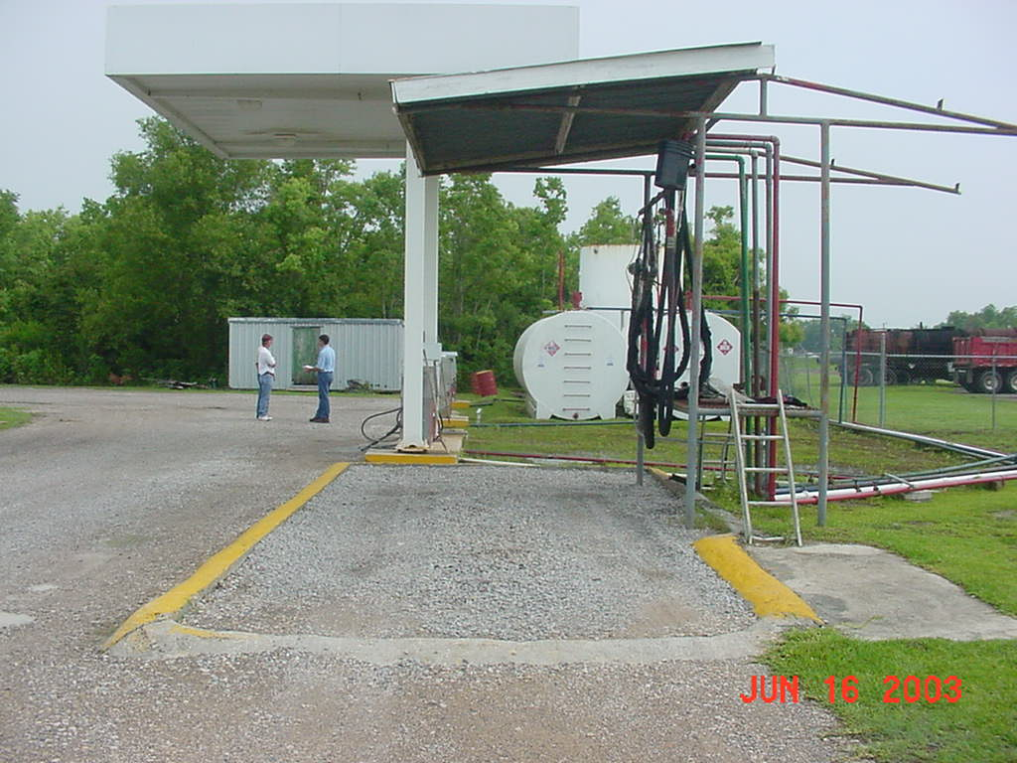
Tank Truck Loading/Unloading Rack
Secondary Containment is required for a loading rack
Must be sized to volume of the single largest compartment on tank truck
Physical barrier system, wheel chocks, warning signs, etc. required
Examination of the trucks lowermost drains, outlets
Typically racks are not found at a farm

Slide 58
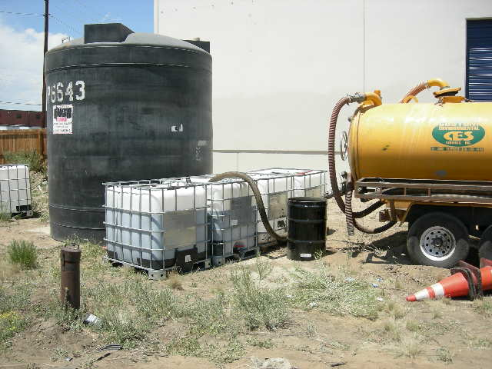
Loading/Unloading Areas
If there is not a loading rack, but a loading area then 112.7(c) general containment is required (no specific size volume required)
You determine amount most likely to be spilled, then provide secondary containment for that volume
Notes:
Photo description:
Photos of loading/unloading areas. These are not loading/unloading racks. In these cases, a transport truck simply uses a single hose and pump to load or offload oil from tanks.

Slide 59
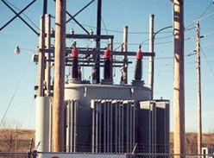
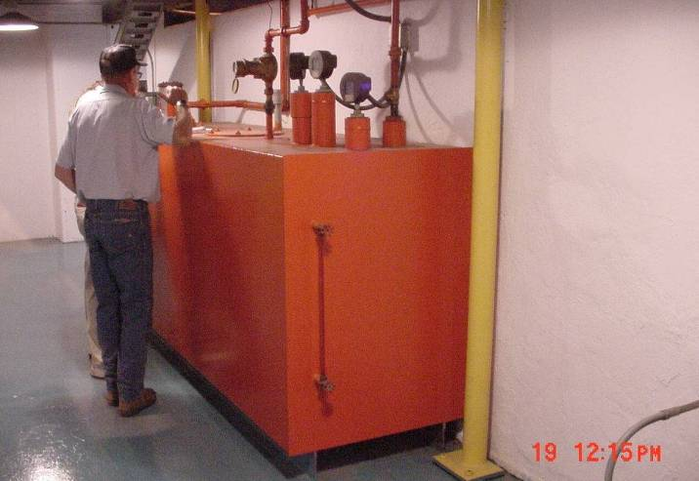
Oil-Filled Operational Equipment
Equipment that includes an oil storage container (or multiple containers) in which the oil is present solely to support the function of the apparatus or the device
  Not considered a bulk storage container
  Does not include oil-filled manufacturing equipment
Examples: hydraulic systems, lubricating systems, gear boxes, machining coolant systems, heat transfer systems, transformers,
circuit breakers, electrical switches, other systems containing oil solely to enable the operation of the device
Notes:
Supplemental information:
Examples of oil-filled operational equipment include, but are not limited to, hydraulic systems, lubricating systems (i.e., those for pumps, compressors and other rotating equipment, including pumpjack lubrication systems), gear boxes, machining coolant systems, heat transfer systems, transformers, circuit breakers, electrical switches, and other systems containing oil solely to enable the operation of the device.
Qualified oil-filled operational equipment are those that have no discharges as described in §112.1(b) exceeding 1,000 gallons or no two discharges as described in §112.1(b) each exceeding 42 gallons from any oil-filled equipment in the twelve month period in the three years prior to the SPCC Plan certification date, or since becoming subject to 40 CFR part 112 if the facility has been in operation for fewer than three years.

Slide 60
Qualified Oil-Filled Operational Equipment
Alternative to the general secondary containment requirements for qualified oil-filled operational equipment:
  Prepare an oil spill contingency Plan and a written commitment of manpower, equipment, and materials
  Have an inspection or monitoring program to detect equipment failure and/or a discharge (§112.7(k))
Must meet eligibility criteria
Notes:
Supplemental information:
Unless the owner/operator has submitted a FRP under part 112.20, the SPCC Plan has to contain a contingency plan following part 109. The Plan must also have a written commitment of manpower, equipment, and materials to control and remove any oil discharge that may be harmful.

Slide 61
Qualified Oil-Filled Operational Equipment Eligibility Criteria
For the 3 years prior to Plan certification, or since becoming subject to the Rule if it has operated for less than 3 years, the facility must not have had:
  A single §112.1(b) discharge of oil from any oil-filled operational equipment exceeding 1,000 U.S. gallons; or
  Two §112.1(b) discharges of oil from any oil-filled operational equipment each exceeding 42 U.S. gallons within any 12-month period.
The gallon amount(s) specified (either 1,000 or 42) refers to the amount of oil that actually reaches navigable waters of the U.S. and adjoining shorelines not the total amount of oil spilled. The entire volume of the discharge is oil for the purposes of this reporting requirement.
Notes:
Supplemental information:
Qualified oil-filled operational equipment are those that have no single discharges as described in §112.1(b) exceeding 1,000 gallons or no two discharges as described in §112.1(b) each exceeding 42 gallons from any oil-filled equipment within any twelve month period in the three years prior to the SPCC Plan certification date, or since becoming subject to 40 CFR part 112 if the facility has been in operation for fewer than three years. §112.1(b) discharges that are the result of natural disasters, or acts of war or terrorism are not considered for the purpose of determining qualified oil-filled operational equipment eligibility.

Slide 62
Facility Transfer (Piping) Operations
Conduct regular inspections of all aboveground valves, piping, and appurtenances
Assess general condition of items such as flange joints, expansion joints, valve glands and bodies, catch pans, pipeline supports, locking of valves, and metal surfaces
Conduct integrity and leak testing of buried piping at time of installation, modification, construction, relocation, or replacement

Slide 63
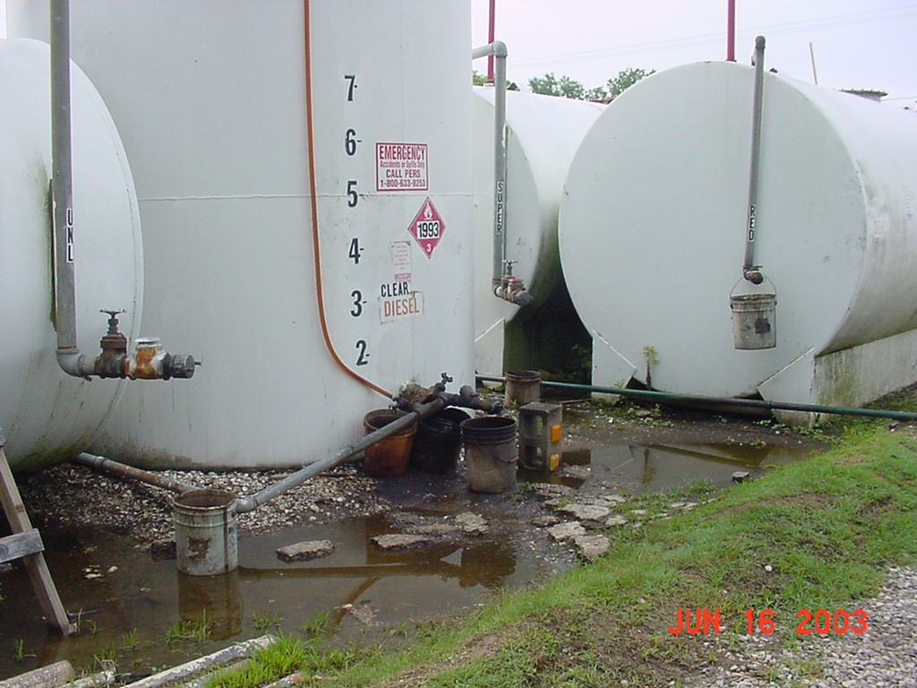
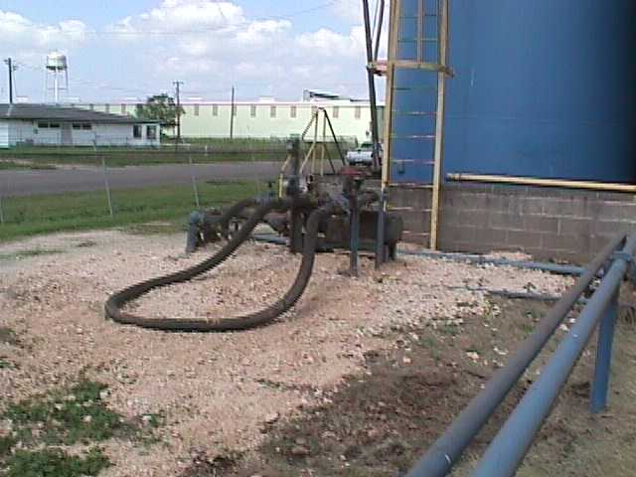


Notes:
63
Photo description:
Photos illustrating transfer areas, piping, and equipment. In the upper and lower left-hand photos, there are leaks of oil from pumps and valves. Visible discharges from bulk storage containers must be promptly corrected and accumulations of oil in diked areas must be promptly removed. In the lower left-hand photo the piping is only supported by concrete blocks which appear to be sinking into the soft soil. Piping supports must be properly designed to minimize abrasion and corrosion and allow for expansion and contraction.

Slide 64
Section 2.
Recent Rule Amendments Overview

Slide 65
SPCC Rule Compliance Dates for Farms
A Farm starting operation... | Must...
On or before August 16, 2002 | Maintain its existing SPCC Plan Amend and implement the amended SPCC Plan no later than May 10, 2013
After August 16, 2002 through May 10, 2013 | Prepare and implement an SPCC Plan no later than May 10, 2013
After May 10, 2013 | Prepare and implement an SPCC Plan before beginning operations

Slide 66
SPCC Amendments Related to Farms
Exempted pesticide application equipment and related mix containers
Exempted heating oil containers at single-family residences
Exempted motive power containers
Exempted milk or milk product containers
Clarified that farm nurse tanks are mobile refuelers

Slide 67
SPCC Amendments Related to Farms
Amended the definition of “facility”
Modified secondary containment requirement language at §112.7(c) to provide more clarity and flexibility
Simplified security requirements
Amended tank integrity testing requirements to allow greater flexibility
Notes:
67

Slide 68
SPCC Amendments Related to Farms
Clarified definition of “permanently closed” tanks and status of new tanks with no fuel added
Clarified applicability of the rule to man-made structures
Added option to allow a self-certified Plan for a "qualified facility" and divided facilities into tiers

Slide 69


Pesticide Application Equipment
Exempt equipment includes:
  Ground boom applicators
  Airblast sprayers
  Specialty aircraft that apply measured amounts of pesticides to crops and/or soil
  Related mix containers
Exemption applies to all pesticide application equipment and related mix containers, regardless of ownership or where used
Notes:
Supplemental information:
Exempt pesticide application equipment and related mix containers from general applicability and capacity calculation.
This equipment includes:
ground boom applicators
airblast sprayers,
specialty aircraft that are used to apply measured quantities of pesticides to crops and/or soil

Slide 70

Residential Heating Oil Containers
Residential heating oil containers at single-family residences are exempt from the SPCC rule
Applies to containers that are:
  Aboveground or completely buried
  Located at a farm or single-family residences
  Used solely to store heating oil used to heat the residence
SPCC requirements continue to apply to oil containers used to heat other non-residential buildings within a facility
Notes:
Supplemental information:
Exempts single-family residential heating oil containers from general applicability and capacity calculation.
Applies to containers that:
are aboveground or completely buried
are located at a farm or other single-family residence
are used solely to store heating oil used to heat the residence
EPA did not intend to regulate residential uses of oil (i.e., those at non-commercial buildings) under the SPCC rule.

Slide 71


Motive Power Containers
Defined as any onboard storage containers used primarily to power the movement of a motor vehicle
Includes self-propelled agricultural, construction, and excavation vehicles; and self-propelled cranes
Oil transfer activities occurring within an SPCC-regulated facility continue to be regulated

Slide 72
Milk and Milk Product Container Exemption
All milk and milk product containers, associated piping and appurtenances are exempt from the SPCC rule
Does not impact the potential liability of milk spills
  Excluded from facility oil storage capacity calculation when determining SPCC applicability
  Exemption also includes all milk handling and transfer activities
  Milk product examples include cheese, yogurt and ice cream
  Immediately report milk and other oil spills to navigable waters or adjoining shorelines to the National Response Center (NRC) at 800-424-8802 or
  202-426-2675
Notes:
Supplemental Information:
Because milk contains oil, the owner or operator of a milk facility may be liable to clean up a spill and/or pay penalties issued under the authority of the Federal Water Pollution Control Act

Slide 73

Farm Nurse Tanks
Preamble Clarification
Nurse tanks are mobile/portable containers used at farms to store and transport fuel for transfers to or from farm equipment and to other bulk storage containers
The definition of “mobile refueler” includes nurse tanks, as well as non-road licensed refueling equipment that are used to refuel farm equipment in the fields
Nurse tanks are excluded from sized secondary containment
Must meet general secondary containment requirements at
§112.7(c)- design for "most likely" spill (e.g. spill kits may be adequate)
Identify the “home base” in Plan

Slide 74
Security Requirements
A facility owner/operator is required to describe in the SPCC Plan how he will:
  Secure and control access to all oil handling, processing and storage areas;
  Secure master flow and drain valves;
  Prevent unauthorized access to starter controls on oil pumps;
  Secure out-of-service and loading/unloading connections of oil pipelines; and
  Address the appropriateness of security lighting to both prevent acts of vandalism and assist in the discovery of oil discharges.
Notes:
Supplemental information:
Revisions modify security requirements for facilities to make them consistent with requirements for qualified facilities (as finalized in December 2006)
More streamlined, performance-based
Tailored to the facility’s specific characteristics and location.

Slide 75

Inspections and Integrity Testing
SPCC rule requires routine inspections and tank integrity testing
2008 amendments provides flexibility in complying with bulk storage container (tanks, drums and totes) inspection and integrity testing requirements
Proposed changes at:
112.8(c)(6) and 112.12(c)(6)

Slide 76
Inspections and Integrity Testing
2008 amendments and flexibility:
  Requires an owner or operator to consult and rely on industry standards to determine the appropriate qualifications for tank inspectors/testing personnel and the type/frequency of integrity testing required for a particular container size and configuration
  Enables facilities to easily adjust Plans to reflect changes in industry standards
  Example industry standards: American Petroleum Institute (API) 653 (www.api.org)
  Steel Tank Institute SP001 (www.steeltank.com)
Proposed changes at:
112.8(c)(6) and 112.12(c)(6)

Slide 77
Summary of Inspection Requirements
Drums and totes (portable containers): Periodic visual inspections, as long as sized secondary containment provided; typically monthly, can be weekly, etc.
Tanks: Periodic visual inspections by the owner/operator plus formal inspections based on the industry integrity testing standard that is used. Visual inspections are typically performed monthly, can be weekly, etc.
Piping: Periodic visual inspections by the owner/operator, typically monthly, can be weekly, etc.
Fuel transfer areas: Visual inspections by the owner/operator during transfers, typically monthly, can be weekly, etc.

Slide 78
Manmade Structures: Preamble Clarification
Certain manmade features may be taken into consideration in determining how to comply with SPCC requirements
SPCC Plan preparer can consider:
  The ability of building walls and/or drainage systems to serve as secondary containment for a container
    Freeboard for precipitation not necessary if container is indoors
  Indoor conditions that reduce external corrosion and potential for discharges, to develop a site-specific integrity testing and inspection program
Notes:
78

Slide 79
Qualified Facilities – An Overview
A qualified facility is a smaller oil storage facility that is eligible for streamlined regulatory requirements
  Self-certified SPCC Plan instead of one reviewed and certified by a Professional Engineer
Must meet eligibility criteria
This group of facilities divided into two tiers
  Tier I - complete a self-certified SPCC Plan following a template
  Tier II - prepare and self-certify an SPCC Plan

Slide 80
Qualified Facilities Eligibility
Criterion #1: Storage Capacity
Facility must have 10,000 gallons or less in aggregate aboveground oil storage capacity
If the facility capacity increases above 10,000 gallons, then a PE must certify the Plan within 6 months of capacity change

Slide 81
Qualified Facilities Eligibility
Criterion #2: Reportable Discharge History
For the 3 years prior to Plan certification, or since becoming subject to the rule if it has operated for less than 3 years, the facility must not have had:
  A single discharge of oil to navigable waters of the U.S. and adjoining shorelines exceeding 1,000 U.S. gallons; or
  Two discharges of oil to navigable waters or adjoining shorelines each exceeding 42 U.S. gallons within any 12-month period.
The gallon amount(s) specified (either 1,000 or 42) refers to the amount of oil that actually reaches navigable waters of the U.S. and adjoining shorelines not the total amount of oil spilled. The entire volume of the discharge is oil for the purposes of this reporting requirement.

Slide 82
Qualified Facilities Eligibility (cont.)
Criterion #2: Reportable Discharge History
Oil discharges that result from natural disasters, acts of war, or terrorism are not included
Oil discharges that result from vandalism are included

Slide 83

What if you have a spill?
Spills of oil to navigable waters of the U.S. and adjoining shorelines must be immediately reported to the National Response Center (NRC) at 800-424-8802 or 1-202-426-2675
Facilities that have a reportable oil discharge after self-certifying the SPCC Plan do not automatically lose eligibility
However, the Regional Administrator has the authority to require a PE certified Plan
Notes:
Supplemental information:
Following an oil spill(s) reported to EPA, the Regional Administrator may require that the SPCC Plan be amended in accordance with §112.4(d) and require a PE certification.

Slide 84
Qualified Facilities Self-Certification
Facilities that meet the eligibility criteria are able to prepare and self-certify an SPCC Plan as
Tier II qualified facilities
Self-certified SPCC Plans must follow the rule requirements
  Cannot deviate from rule requirements UNLESS
  A PE certifies the environmentally equivalent alternative and/or contingency plan substituting for secondary containment (“hybrid Plan”- Tier II facilities only)
NOTE: Some states require a PE to certify SPCC Plans
Notes:
Supplemental information:
Qualified facilities were addressed in the December 2006 and 2008 rule amendments
Amendments further streamline and tailor the SPCC requirements for a subset of qualified facilities called “Tier I qualified facilities”
Tier I qualified facilities have less complicated operations and facility characteristics (e.g., may have few low capacity oil containers and some mobile/portable containers, few oil transfers, little to no piping)
Some states require a PE to perform certain functions, including certifying SPCC Plans. Check with your state’s engineer licensing board to find out if it prohibits SPCC Plan self-certification. If so, you may not be able to self-certify your Plan.

Slide 85
Self-Certification Attestation
Owner/operator certifies that:
  The Plan has been prepared in accordance with accepted and sound industry practices and standards and with the rule requirements
  Procedures for required inspections and testing have been established
  The Plan is being fully implemented
  The facility meets the qualifying criteria
  The Plan does not deviate from rule requirements except as allowed and as certified by a PE
  Management approves the Plan and has committed resources to implement it

Slide 86
Tier I Eligibility Criteria
Meet the Tier II qualified facilities eligibility criteria:
  10,000 gallons maximum facility aboveground oil storage capacity;
  In the 3 years prior to Plan certification, no spills to navigable waters of the U.S. and adjoining shorelines: greater than 1,000 gallons or no two spills greater than 42 gallons in a 12-month period; and
Have no oil storage containers with an individual aboveground storage capacity greater than 5,000 U.S. gallons
Notes:
Supplemental information:
Meet the Tier II qualified facility eligibility criteria:
10,000 gallons or less in aggregate aboveground oil storage capacity
For the 3 years prior to Plan certification, or since becoming subject to the rule if it has operated for less than 3 years, the facility must not have had:
A single discharge of oil to navigable waters of the U.S. and adjoining shorelines exceeding 1,000 U.S. gallons, or
Two discharges of oil to navigable waters of the U.S. and adjoining shorelines each exceeding 42 U.S. gallons within any 12-month period
not counting discharges as described in §112.1(b) that are the result of natural disasters, acts of war, or terrorism
Only discharge amounts reaching navigable waters of the U.S. and adjoining shorelines count towards these gallon amounts
Maximum individual oil storage container capacity of 5,000 U.S. gallons

Slide 87
Tier I Qualified Facilities
Option to complete a self-certified SPCC Plan template instead of a full SPCC Plan
  A Tier I qualified facility owner/operator can choose to comply with either Tier I or Tier II requirements or prepare a PE-certified Plan in accordance with all applicable requirements of §112.7 and subparts B and C
  Template is found in Appendix G to the SPCC rule
Template is designed to be a simple SPCC Plan
  Cannot be a “hybrid Plan” (i.e., no PE-certified environmental equivalence or contingency plan instead of secondary containment)
Notes:
Supplemental information:
Revisions provide an option to complete a self-certified SPCC Plan template in lieu of a full SPCC Plan
Template is designed to be a simple SPCC Plan
Includes only the requirements that should apply to this tier of regulated facilities
Eliminates and/or modifies certain requirements and provisions that generally do not apply to facilities that store or handle smaller volumes of oil
Template is finalized as Appendix G to the SPCC rule
Limited to those facilities that do not use environmentally equivalent measures and that do not determine secondary containment to be impracticable
A facility diagram is not required; however, a multi-facility may want to provide a diagram to show separate parcels

Slide 88
Tier I Template
Available at:
http://www.epa.gov/osweroe1/content/spcc/tier1temp.htm

Slide 89
Summary:
Qualified Facilities Applicability
If the facility total aboveground oil storage capacity is 10,000 gallons or less
And… | And the facility has… | Then the facility is a:
Within three years prior to the Plan certification date, or since becoming subject to the SPCC rule if in operation for less than three years, the facility has not discharged oil to navigable waters of the U.S. and adjoining shorelines in: A single discharge exceeding 1,000 gallons, or Two discharges each exceeding 42 gallons within any 12-month period. | No individual aboveground oil containers greater than 5,000 gallons; | Tier I Qualified Facility: Complete and self-certify Plan template (Appendix G of SPCC rule) instead of a full PE-certified Plan or other self-certified SPCC Plan.
 | Any individual aboveground oil container greater than 5,000 gallons; | Tier II Qualified Facility: Prepare a self-certified Plan in accordance with all applicable requirements of §112.7 and subparts B or C of the rule, in lieu of a PE-certified Plan.

Slide 90
Plan Requirements for Farms with >10,000 gallons of oil
SPCC Plan must be certified by a Professional Engineer (PE)
State PE licensing boards typically require PE’s to have expertise in area of practice in order to “stamp” plans and construction documents
Plan must include PE attestation
PE’s should not use Tier I template to complete SPCC Plan
  Plan must follow rule requirements in 40 CFR parts 112.7 and 112.8.

Slide 91
SPCC Rule Compliance Dates
On October 18, 2011, EPA amended the date by which farms must prepare or amend and implement their Spill Prevention, Control, and Countermeasure (SPCC) Plans, to May 10, 2013
All non-farm facilities are now required to be in compliance with the SPCC rule amendments

Slide 92
SPCC Rule Compliance Dates for Farms
A Farm starting operation... | Must...
On or before August 16, 2002 | Maintain its existing SPCC Plan Amend and implement the amended SPCC Plan no later than May 10, 2013
After August 16, 2002 through May 10, 2013 | Prepare and implement an SPCC Plan no later than May 10, 2013
After May 10, 2013 | Prepare and implement an SPCC Plan before beginning operations

Slide 93

Section 4.
Additional Information

Slide 94
Outreach Tools
SPCC farm factsheets and blank Tier I template on EPA’s oil website:
http://www.epa.gov/emergencies/content/spcc/index.htm
General SPCC Blue Book on website also
Example Tier I template for farms
SPCC Green Book (in the works)
HOTLINE: Superfund, TRI, EPCRA, RMP, and Oil Information Center (800) 424-9346

Slide 95
SPCC Blue Book
Available at: http://www.epa.gov/oem/docs/oil/spcc/spccbluebroch.pdf

Slide 96
Reporting of Oil Spills
Report all oil discharges to navigable waters of the U.S. and adjoining shorelines to NRC at 1-800-424-8802
Federal government's centralized reporting center, which is staffed 24 hours a day by U.S. Coast Guard personnel
Any person in charge of a vessel or an onshore or offshore facility must notify NRC immediately after he or she has knowledge of the discharge
NRC relays information to EPA or U.S. Coast Guard depending on the location of the incident
An On-Scene Coordinator evaluates the situation and decides if federal emergency response action is necessary

Slide 97
Specific SPCC Spill Reporting Requirements
Report to the EPA Regional Administrator (RA) when there is a discharge of:
  More than 1,000 U.S. gallons of oil in a single discharge to navigable waters of the U.S. and adjoining shorelines
  More than 42 U.S. gallons of oil in each of two discharges to navigable waters of the U.S. and adjoining shorelines within a 12-month period
  When making this determination it is the amount of the discharge in gallons that reaches navigable waters of the U.S. and adjoining shorelines
  An owner/operator must report the discharge(s) to the EPA Regional Administrator within 60 days

Slide 98
For More Information
EPA’s SPCC web page
  http://www.epa.gov/emergencies/content/spcc/index.htm
EPA Oil Spill and Emergency Management web pages
  www.epa.gov/oilspill
  www.epa.gov/emergencies
HOTLINE: Superfund, TRI, EPCRA, RMP, and Oil Information Center
  (800) 424-9346 or (703) 412-9810
  TDD (800) 553-7672 or (703) 412-3323
  www.epa.gov/superfund/resources/infocenter

Slide 99
SPCC Contacts
REGION | SPCC COORDINATORS | AG CONTACTS
1 CT, RI, MA, NH, VT, ME | Alex Sherrin (617) 918-1252 sherrin.alex@epa.gov | Rob Koethe (617) 918-1535 koethe.robert@epa.gov Andrea Szylvian (617) 918-1198 szylvian.andrea@epa.gov
2 NJ, NY, PR, VI | Larry D’Andrea (732) 906-6964 dandrea.larry@epa.gov | Kristina Heinemann (212) 637-3857 Heinemann.kristina@epa.gov
3 PA, WV, VA, MD, DC | Arlin Galarza-Hernandez (215) 814-3223 galarza-hernandez.arlin@epa.gov | John Butler (215) 814-2127 Butler.john@epa.gov
4 KY, NC, TN, SC, MS, AL, GA, FL | Ted Walden (404) 562-8752 walden.ted@epa.gov | Denise Tennessee (404) 562-8460 Tennessee.denise@epa.gov
5 MN, WI, MI, IL, IN, OH | Mick Hans (312) 353-5050 hans.mick@epa.gov | Tom Davenport (312) 886-0209 davenport.thomas@epa.gov Gerald Winn (312) 886-2777 winn.gerald@epa.gov
6 NM, TX, OK, AR, LA | Don Smith (214) 665-6489 smith.donaldp@epa.gov Chris Perry (214) 665-6702 perry.chris@epa.gov | Randy Rush (214) 665-7107 rush.randall@epa.gov
7 NE, KS, IA, MO | Alan Hancock (913) 551-7647 hancock.alan@epa.gov | Karen Flournoy (913) 551-7782 flournoy.karen@epa.gov Damon Frizzell (913) 551-7560 frizzell.damon@epa.gov Heather Duncan (913) 551-7640 duncan.heather@epa.gov

Slide 100
SPCC Contacts (cont.)
REGION | SPCC COORDINATORS | AG CONTACTS
8 MT, ND, SD, WY, UT, CO | Melissa Payan (303) 312-6511 payan.melissa@epa.gov | Jennifer Meints (303) 312-6334 meints.jennifer@epa.gov
9 CA, NV, AZ, HI, Guam, American Samoa, Northern Marina Islands | Pete Reich (415) 972-3052 reich.peter@epa.gov Janice Witul (415) 972-3089 witul.janice@epa.gov | Kerry Drake (415) 947-4157 Drake.kerry@epa.gov Don Hodge (415) 972-3240 hodge.don@epa.gov
10 WA, OR, ID, AK | WA: Mike Sibley (206) 553-1886 sibley.michael@epa.gov OR, ID: Richard Franklin (503) 326-2917 franklin.richard@epa.gov AK: Matt Carr (907) 271-3616 carr.matthew@epa.gov | Karma Anderson (206) 553-1647 anderson.karma@epa.gov
HQ- Office of Emergency Management: | Mark Howard (202) 564-1964 howard.markw@epa.gov Patricia Gioffre (202) 564-1972 gioffre.patricia@epa.gov Troy Swackhammer (202) 564-1966 swackhammer.j-troy@epa.gov | Ag Center: Ginah Mortensen (913) 551-5028 mortensen.ginah@epa.gov Carol Galloway (913) 551-5092 galloway.carol@epa.gov
HQ- Office of Civil Enforcement: | David Drelich (202) 564-2949 drelich.david@epa.gov Kelly Brantner (202) 564-9933 brantner.kelly@epa.gov
HQ- Office of Compliance: | Dan Chadwick (202) 564-7054 chadwick.dan@epa.gov

Slide 101

Questions?
Notes:
101

