Slide 1
Introduction to
CERCLA
Session 1
Carlyn Winter Prisk
U.S. EPA Region 3

Slide 2
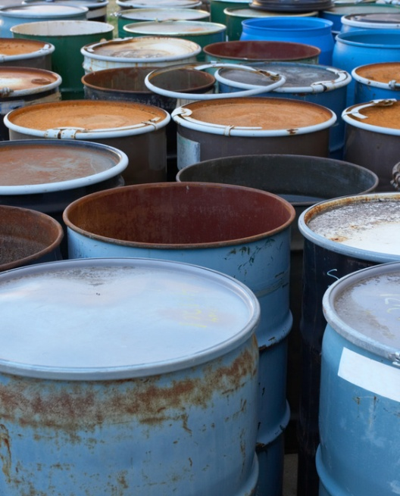
Objective of CERCLA
Reduce and eliminate threats to human health and the environment posed by uncontrolled hazardous waste sites; and
Respond to releases or threatened releases of hazardous substances.

Slide 3

Legal Foundation
Legal foundation for conducting response actions:
  Statutes
  Executive orders and delegations
  Regulations
  Policy and guidance
  Case law
  Site-specific documents

Slide 4
Statutory and Regulatory Framework
Statutes
  CERCLA, as amended by:
  Superfund Amendments and Reauthorization Act (SARA), 1986
  Asset Conservation, Lender Liability, and Deposit Insurance Protection Act (Lender Liability Act), 1996
  Superfund Recycling Equity Act of 1999 (SREA or Recycling Amendments)
  Small Business Liability Relief and Brownfields Revitalization Act (Brownfields Amendments), 2002
Executive Orders
  E.O. 12580 and 13016

Slide 5
Statutory and Regulatory Framework
Statutes
  CERCLA, as amended by SARA and other Acts
Executive Orders
  E.O. 12580 and 13016

Slide 6
Statutory and Regulatory Framework
Regulations
National Oil and Hazardous Substances Pollution Contingency Plan (NCP)
Policy and Guidance
  Available on EPA’s website

Slide 7
Statutory and Regulatory Framework
Case Law
Federal District and Appeals Courts, U.S. Supreme Court
Site Specific Documents
  Decision documents, settlement documents

Slide 8
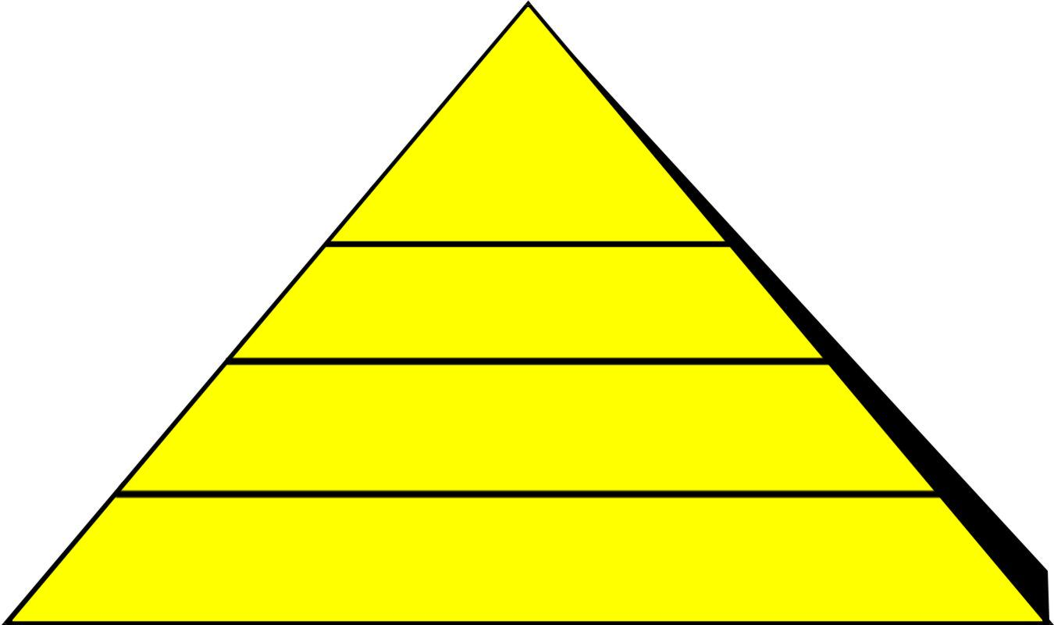
Hierarchy of Statutes, Regulations,
Policy and Guidance
Policy
& Guidance
EPA HQ
EPA Regions
Regulations
NCP (40 CFR Part 300)
Executive Orders
E.O. 12580
E.O. 13016
Statutes
CERCLA
SARA

Slide 9

How Does CERCLA Work?
Section 104(a) - President is authorized to respond to release or threatened release.
Executive orders – President delegates authority to EPA and other federal agencies.

Slide 10
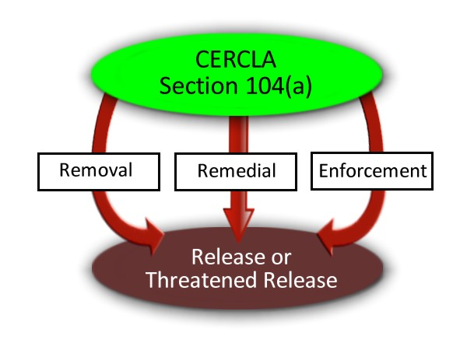
Response Actions
CERCLA defines three kinds of response action:
Removal
Remedial
Enforcement

Slide 11

Overview of CERCLA Enforcement
  Objective: Encourage or compel responsible parties to perform removal or remedial work or reimburse EPA for performing it.
  Enforcement includes EPA oversight of work performed by responsible parties.

Slide 12
Determining if a Response Is Authorized
Key Definitions:
  Release
  Threatened release
  Hazardous substance
  Facility

Slide 13
Release
CERCLA 101(22)
  “any spilling, leaking, pumping, pouring, emitting, emptying, discharging, injecting, escaping, leaching, dumping, or disposing into the environment (including the abandonment or discarding of barrels, containers, and other closed receptacles containing any hazardous substance or pollutant or contaminant)…”

Slide 14
Threatened Release
Not defined in CERLCA
  Authority to respond to threatened release contained in National Contingency Plan.

Slide 15
Hazardous Substance
CERCLA 101(14)
  Toxic or hazardous substance designated by the Federal Water Pollution Control Act, TSCA, CAA, Sold Waste Disposal Act;
  any element, compound, mixture, solution, or substance designated pursuant to section 102 of CERCLA.

Slide 16
Facility
CERCLA 101(9)
  The term “facility” means (A) any building, structure, installation, equipment, pipe or pipeline (including any pipe into a sewer or publicly owned treatment works), well, pit, pond, lagoon, impoundment, ditch, landfill, storage container, motor vehicle, rolling stock, or aircraft, or
  (B) any site or area where a hazardous substance has been deposited, stored, disposed of, or placed, or otherwise come to be located…

Slide 17
Liability Under CERCLA
Liability is defined in CERCLA Section 107(a).
A party is liable for response costs when:
    There is a release or a threatened release;
    Of a hazardous substance;
    From a facility into the environment;
    Which causes response costs to be incurred; and
    The party is included in at least one class of persons described in CERCLA Section 107(a).

Slide 18

Liability Under CERCLA (cont’d)
Four kinds of response cost:
Cost of actions taken by the United States, States, or tribes that are not inconsistent with the NCP;
Cost of actions taken by other parties that are consistent with the NCP;
Cost of natural resource damage restoration; and
Cost of health assessments performed by ATSDR.

Slide 19

  Section 107(a) defines liable parties as:
  The current owner and operator of a facility;
  Owner or operator of a facility at the time hazardous substances were disposed of;
  Person who arranged for disposal or treatment of hazardous substances; and
  Person who transported and chose the disposal location of hazardous substances.

Slide 20

Liability Under CERCLA (cont’d)
CERCLA Section 107(a) imposes strict, retroactive, and joint and several liability.
Which means?
Notes:
Remember we talked about case law as one of the blocks in Superfund’s legal foundation? Liability under CERCLA has been heavily litigated and Courts have weighed in to define liability as strict, retroactive, and joint and several.

Slide 21
Strict Liability
  A party is liable even if:
  The problems caused by the release of hazardous substances were unforeseeable;
  The party’s actions were legal at the time they occurred; and
  State-of-the-art waste management practices were used when the materials were disposed of.
Notes:
Liability is strict, meaning parties are liable without regard to fault or motive. “But I didn’t mean to send my drums of methyl-ethyl death to be buried in some guy’s backyard where they contaminated a town’s ground water.” Oh well.
“But we were following the laws at the time when we emptied our solvent tanks on the ground out the back door…” Tough luck.
“But we were doing what everyone else in the industry was doing.” [Shrug]

Slide 22

Retroactive Liability
A party may be liable for actions that took place prior to enactment of CERCLA.
Notes:
Liability is retroactive. So it doesn’t matter if the disposal took place in 1930 prior to the enactment of CERCLA. CERCLA allows us to reach back to whenever the disposal took place and establish liability.

Slide 23

Joint and Several Liability
Any liable party or group of parties may be held liable for all response costs at a site.
Notes:
Liability is also joint and several. Where the harm is not divisible – it cannot be divided – each party is responsible for everything and EPA can choose to collect the entire cost of cleaning up the Site from only one PRP. This only works where the harm is not divisible – otherwise the harm must be apportioned with each party responsible for the harm it caused. Apportioning harm can be really difficult.

Slide 24
References
Comprehensive Environmental Response, Compensation, and Liability Act of 1980 (“CERCLA”), as amended, 42 U.S.C. §§ 9601 et seq.
http://www.gpo.gov/fdsys/pkg/USCODE-2011-title42/html/USCODE-2011-title42-chap103.htm
PRP Search Manual, Section 1.1 (“Overview of CERCLA”)
http://www2.epa.gov/enforcement/report-prp-search-manual-2009-edition-2011-addendum
EPA CERCLA Overview Webpage
http://www.epa.gov/superfund/policy/cercla.htm
National Oil and Hazardous Substances Pollution Contingency Plan (“NCP”), 40 CFR Part 300
http://www2.epa.gov/emergency-response-national-oil-and-hazardous-substances-pollution-contingency-plan-ncp-overview;
http://www.access.gpo.gov/nara/cfr/waisidx_03/40cfr300_03.html

Slide 25
References (cont’d)
EPA Superfund Cleanup Policies and Guidance Documents
http://cfpub.epa.gov/compliance/resources/policies/cleanup/superfund/
EPA Superfund Enforcement Webpage
http://www.epa.gov/compliance/cleanup/superfund/index.html
EPA Superfund Liability Webpage
http://www.epa.gov/compliance/cleanup/superfund/liability.html

