Slide 1
PRP Search
Documentation
Session 8
Courtney Kudla
U.S. EPA Region 6

Slide 2
Baseline PRP Search
The format of a baseline search report should include two deliverables:
Site History
PRP Synopsis
There is no definition of what constitutes a completed baseline PRP search.
Not all EPA Regions write baseline PRP search reports.

Slide 3
Site History
The site history relies on information gathered in the course of activities covered in Sessions 1 through 7.
The goal is to relate information about the site property, owners and operators, operations, and contaminants to support liability determinations.
The site history also provides information to people performing technical field work on possible locations of environmental contamination.

Slide 4
Site History (Cont’d)
It should include the following:
Start date for research
Site chronology
Ownership history

Slide 5
PRP Synopsis
Identify PRP
Reason identified as PRP
Potential defenses or exemptions from liability
Conclusions/recommendations
Type of release
Enforcement history
PRP financial viability

Slide 6
Important Dates for PRP Search Report
When research into PRPs began
When PRP search is completed

Slide 7
Preliminary PRP Search Completion Measure
The "Preliminary PRP Search Completion" measure was developed in response to an EPA Office of Inspector General (OIG) Evaluation Report.
EPA developed a "Preliminary Potentially Responsible Party (PRP) Search Completion" guidance document in June 2011 that describes preliminary search activities for identifying PRPs related to a site.
These activities are to be tracked in the Superfund Enterprise Management System (SEMS) by the start and completion date of the PRP search being entered.

Slide 8
Preliminary PRP Search Completion Documentation
Elements Required:
Site Location and Property Description
Need vesting deed
Current/Past Owners Identification
Get access
Provide notice of liability (oral or GNL)
Site Operation Identification
Tenants/lessees
Provide notice of liability (oral or GNL)

Slide 9
Preliminary PRP Search Completion Documentation (Cont’d)
Elements Required (cont’d):
Site Owner/Operator Liability and Financial Viability
For each party identified determine if:
The party may be liable under Section 107(a).
The party may be financially capable of performing the work or paying for all or a portion of the initial non-emergency response action at the site.
Arranger/Transporter (if appropriate)
Can you determine now or need more info?
Provide notice of liability (oral or GNL).

Slide 10
Elements of the Preliminary Search Completion and the Documentation Requirements
Site Location/ Legal Description | Names of Current and Past Owners | Description of Site Operations | Liability/Viability Determination | Names of Arrangers/Transporters (if appropriate)
Found on technical documents or from OSC/RPM, with the legal description found on the vesting deed | Vesting deed | Leases or other agreements for activity on site not by owner | Use information obtained and CERCLA 107(a) to determine if the PRPs are liable Use tax documents to determine viability | Site business records and permits

Slide 11
In What Documents Is the Information Used?
Removal Enforcement Attachment
Regional NPL Enforcement Document
Special Notice Letters
General Notice Letters
Administrative Order on Consent (AOC)
Consent Decree
10-Point Settlement Analysis
Pre-Referral Negotiation (PRN) Package
DOJ Referral
Cost Recovery Decision Document

Slide 12
PRP Search Documentation Summary Requirements for Decision Documents
This summary shows what steps were taken, when the steps were taken, and what document proves those steps were taken for the following:
Information Collection/Associated Party Identification
Liability Evaluation
PRP Contribution Evaluation
PRP Viability/ATP/Insurance
PRP Notification
Other Analysis

Slide 13
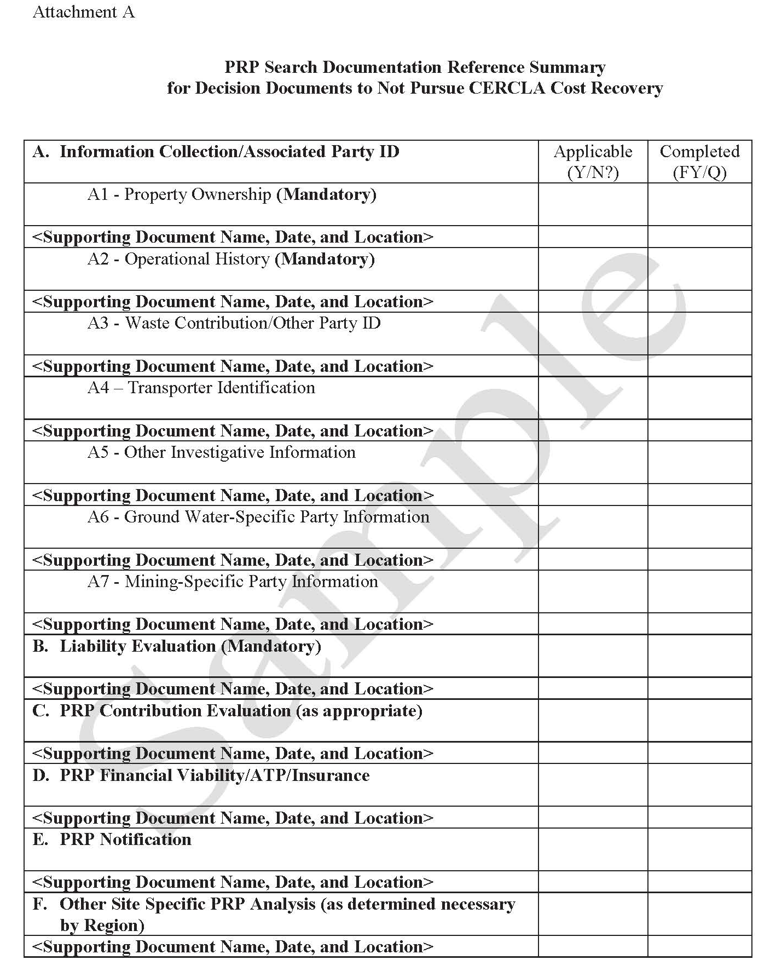

Slide 14
Follow-up Searches
When to update with a follow-up PRP search
New evidence/contamination source requires further investigation
Sale of property
Follow up on inadequate 104(e) response
Before remedial investigation (RI)/Record of Decision (ROD)/Remedial Action (RA)

Slide 15
Additional Tasks
Ability-to-Pay Determinations
Waste Stream Analysis

Slide 16
Other Uses of the PRP Search Report
Cost Recovery
Demand letters
Cost documentation
Referrals to DOJ
Ensure Statutory Authorities Are Not Exceeded
Three years from the end of a removal
Three years from the end of the remedial investigation, signified by ROD signature date
Three years from completion of remedial design
Six years from the start of a remedial action

Slide 17
Cost Recovery Statutory Timeline

Slide 18
References
Transmittal of Preliminary Potentially Responsible Party Search Completion Measure Definition for Incorporation into the Superfund Program Implementation Manual for FY2012 (6/23/2011)
http://www.epa.gov/compliance/resources/policies/cleanup/superfund/prp-search-completion-spim-2012.pdf
PRP Search Documentation Summary Requirements for Decision Documents to Not Pursue Cost Recovery Where Unaddressed Past Costs are Greater Than $200,000 (3/8/2011)
(http://www.epa.gov/compliance/resources/policies/cleanup/superfund/prp-search-nonpursue.pdf)
PRP Search Manual, Chapter 3 and Chapter 4 (9/2009)
http://www2.epa.gov/enforcement/report-prp-search-manual-2009-edition-2011-addendum
Statute of Limitations Overview (09/2005) (EPA Intranet Only)
http://intranet.epa.gov/oeca/osre/doc/sol-overview.pdf
CERCLA Statute of Limitations Issues in the Context of Records of Decision Not Requiring Physical On-site Construction (1/28/2003) (EPA Intranet Only)
http://intranet.epa.gov/oeca/osre/documents/internal.html#sol

