Slide 1
Emission Inventory System
Reports Course
Sally Dombrowski
919-541-3269
dombrowski.sally@epa.gov

Slide 2
Types of Reports
Snapshot (Facility and Emissions)
  CERs XML format
  Each data category done separately
  Requires use of the Bridge Tool to convert
  Replica of the staging tables
  Can only be run on a single agency emissions data set and not the NEI selection.
Facility Configuration Reports
  CSV format
  Can be imported into Excel or Access as a text file
  Regulations, Process/Unit, Release Point, Facility, Alternative Identifiers and Controls
  No emissions!
Emissions Summaries
  CSV format
  Summarized data at geographic, facility, unit, process, release point and a new customized process level report
  Can be run on both the responsible agency and the NEI selection.
For Data Submitters
  Feedback Reports
    First line of QA on your submission
  Agency Submission History Report
    Excellent QA tool for point and nonpoint
      Have you reported all of the facilities which you should report for?
      Have you reported all of your SCCs for nonpoint
  Data Tagging Reports
    Listing of data which will not be used in an NEI selection
Notes:
There are currently seven different types of reports available on the Emission Inventory System (EIS) Gateway.
The first is the Snapshot. The Snapshot will download in CERs xml format for each of the six categories (facility, point, nonpoint, onroad, nonroad and events). The Bridge Tool is used to convert these xml files into Access staging tables. We will have a demo of the new Bridge Tool later in this presentation. The Snapshots are an exact replica of what was submitted from an agency to the EIS and can not be run on an NEI selection. This drawback is due to the use of multiple Program System Codes in the NEI.
The second report is the Configuration Report. These reports will give you the detailed information about your facilities as well as data not available in some of the other reports such as supplemental parameters, and operating details.
The third type of report is the Summary by Emissions. These reports will summarize at the geographic or various facility levels and can be run on both the responsible agency submission and the NEI selections. These reports are good tools to QA your data when it is submitted to EIS by aggregating totals to county, SCC or data category level. We have just recently added a new emissions process report which can be done on a specific group of facilities and customizable data fields.
The following are reports of particular use to data submitters.
Feedback Report. The Feedback Report is your first line of QA. It tells you the number of records which are being accepted into EIS, the critical and warning errors, as well as any potential duplicates in your facility information.
The Agency Submission History Report. This report is also an excellent QA tool, in that it is a list of all facilities for which we expect emissions to be reported by the responsible agency, or a list of all SCCs which have been reported for nonpoint, onroad and nonroad. Currently this more detailed information is not available for the event inventory.
The Data Tagging Report. This report is used during the comment period after EPA has completed the first selection. When data is questionable the inventory developers have the ability to “tag” the record so that it is excluded from the NEI selection.

Slide 3
Data Sets and Selections
Data Sets
  Data received from the individual program system codes for a given inventory year
Selections – Combination of State/Local/Tribal submitted data and EPA data augmentation files
  2002 NEI; 2008 NEI; 2011 NEI, 2012 NEI, etc. (2005 NEI is temporarily unavailable.)
Notes:
Program System Codes are used to identify State/Local and Tribal agencies as well as EPA data sets.
Data Sets are the submissions from an individual State/Local, Tribal agency or EPA for any given inventory year.
Selections are the integration of data received from State/Local and Tribal agencies as well as data sets used by EPA for data augmentation.

Slide 4
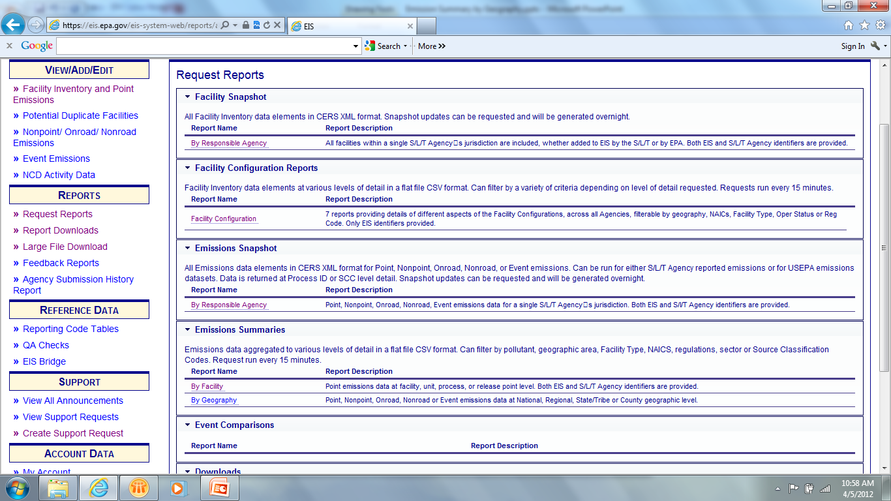
Snapshots – Facility
Notes:
The first report is the Facility Snapshot. When you log into the Gateway, first select “Request Reports” from the left hand sidebar. Second select “By Responsible Agency” under Facility Snapshots.

Slide 5
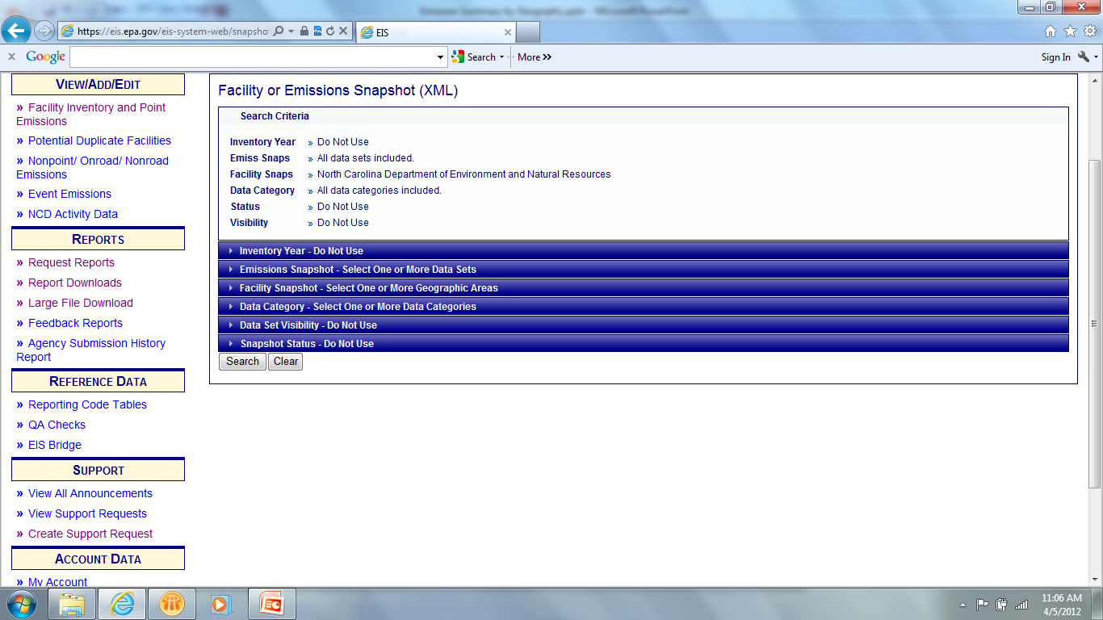
Snapshots - Facility
Notes:
This report screen may be under going reconstruction and should make the page much easy to understand. The sections which are crossed out in red will be removed and leave the selection screen with just the facility snapshot filter.

Slide 6
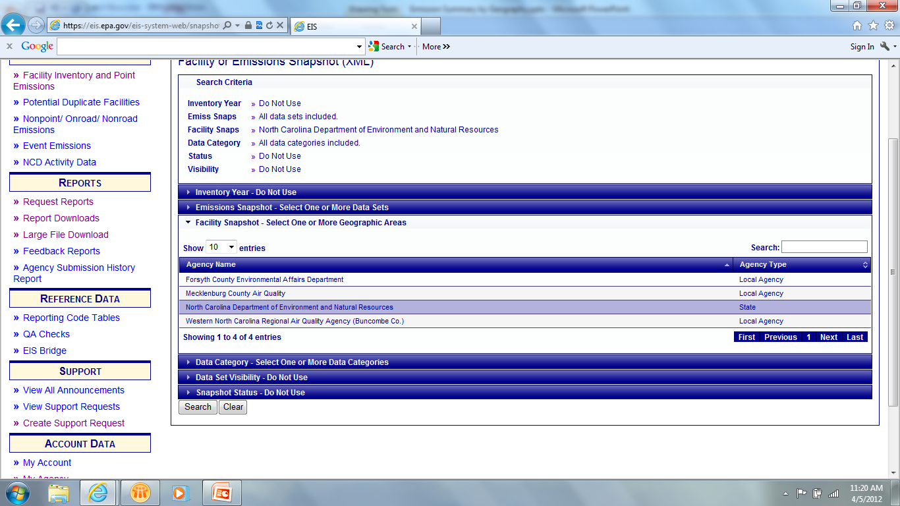
Snapshot - Facility
First select your agency.
Notes:
First select your agency. In this demonstration, we are selecting North Carolina. Notice that there are local agencies which are also available. This is due to the fact that the local agencies have given North Carolina READ access to their data. This feature is generally used by a State allowing a Tribe or local government to have the ability to look and do reports on the state agency data, but not have the ability to change or edit that data.
Then select “Search”

Slide 7
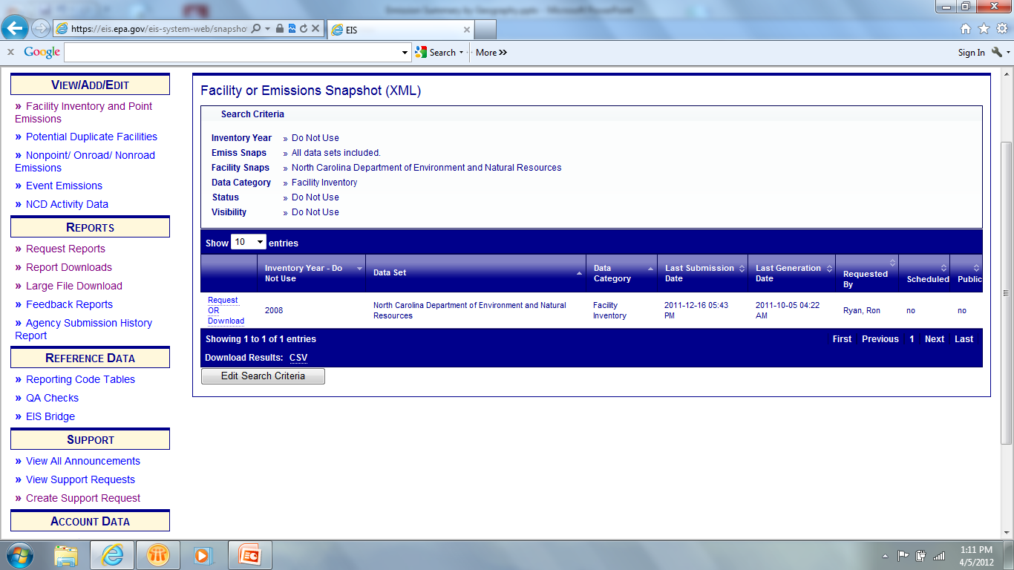
Snapshot - Facility
Notes:
There are several things to note in the results. The first is the inventory year. The facility inventory is not inventory year specific but a living inventory that could change frequently. The facility inventory is what the facility looks like today and not for a specific inventory year. Due to system constraints, we add an inventory year, which will be the default active inventory year in the system.
Secondly, it is important to note the Last Submission Date and Last Generation Date. If the last submission date is later than the last generation date, then you would want to request a new report. If this is not the case, then you may download the file immediately. The last submission date does not reflect changes made directly on the Gateway. This only reflects file submissions. Next either download the current file by using the “Download” link. A select the “Request” link to generate a new report which will be created overnight. To retrieve the requested file, you would go through the previous instructions, check the creation date to make sure the request was completed and then select “Download.” For this exercise, select download and…

Slide 8
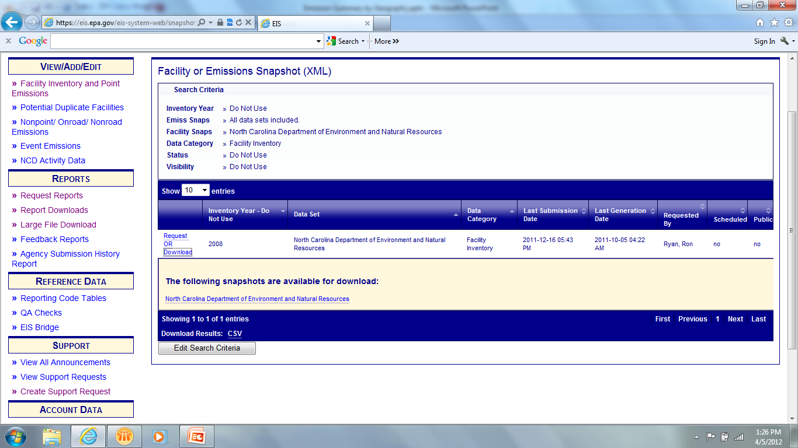
Snapshot - Facility
Notes:
…a link is open which will allow you to download the xml file.

Slide 9
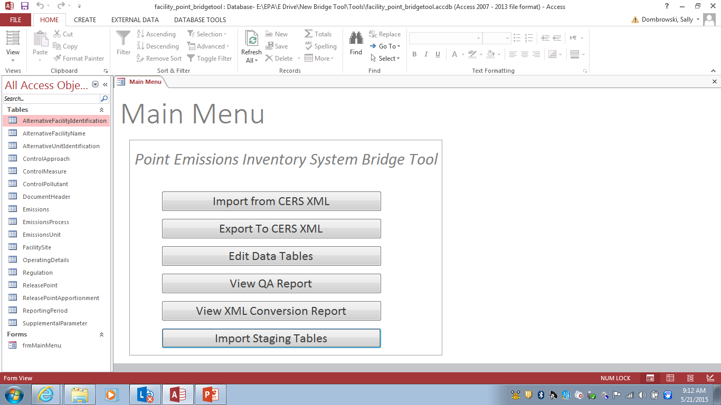
Bridge Tool
Notes:
Next you will need to use the Bridge Tool to convert your file into the Access staging tables. This is the new Bridge Tool and we have added some new functionality. You may select Import CERs XML which you will use when converting your snapshot reports.
Export CERS XML which will be used when you want to take your stage tables and export them for submission to EIS.
Edit Data Tables – Can be used to edit your staging tables. Of course you can still double click the actual table and make changes as well. This also gives you a quick point of reference to compare against your feedback status page.
View QA Report – This new functionality in the Bridge Tool which looks for duplicates and widows/orphans. These are the two items which will prevent a file from become a viable xml export.
View XML Conversion Report. Let’s you know how many records have been imported into each table.
Lastly, the Import Staging Tables. This function will allow you to import your older staging table files into the new format. It will not import the CERS and Exchange Header information since this will need to be completed when you do an export in the new bridge tool.
It is important that you save this Access file under a different name.
Lets start with the first functionality, import from CERS XML.

Slide 10
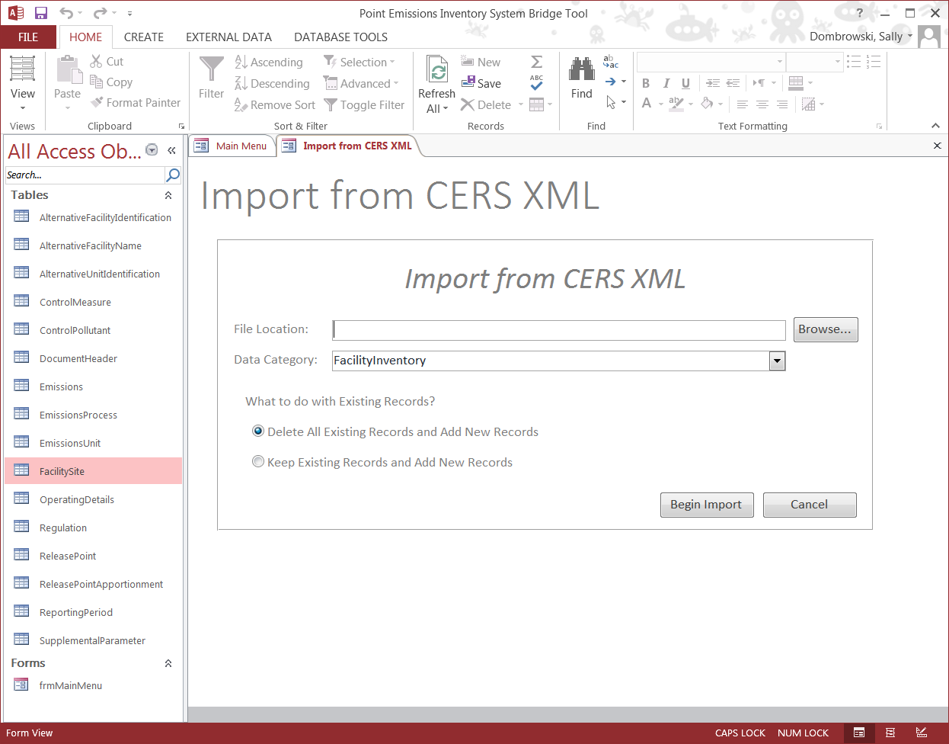
Bridge Tool
Notes:
Select the file which you want to convert using the Browse button. Then you will select the data category which you are importing…in this case we are importing a facility inventory.
Next you have two choices, the first will delete all existing records in the staging tables and add the import as new records. The second is to keep existing records and add the new records.

Slide 11
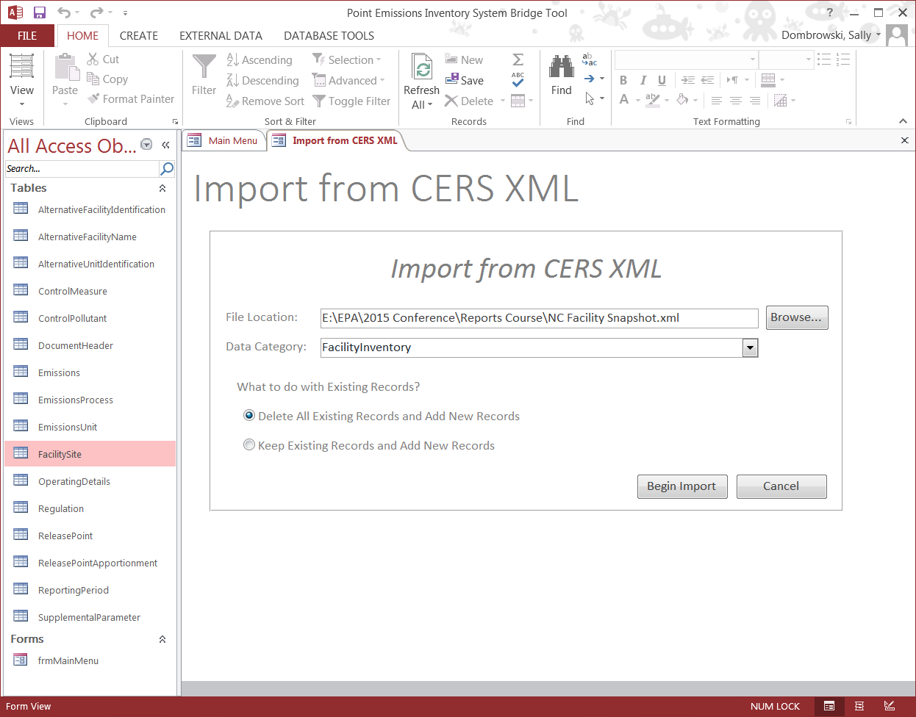
Bridge Tool
Notes:
Next select Begin Import

Slide 12
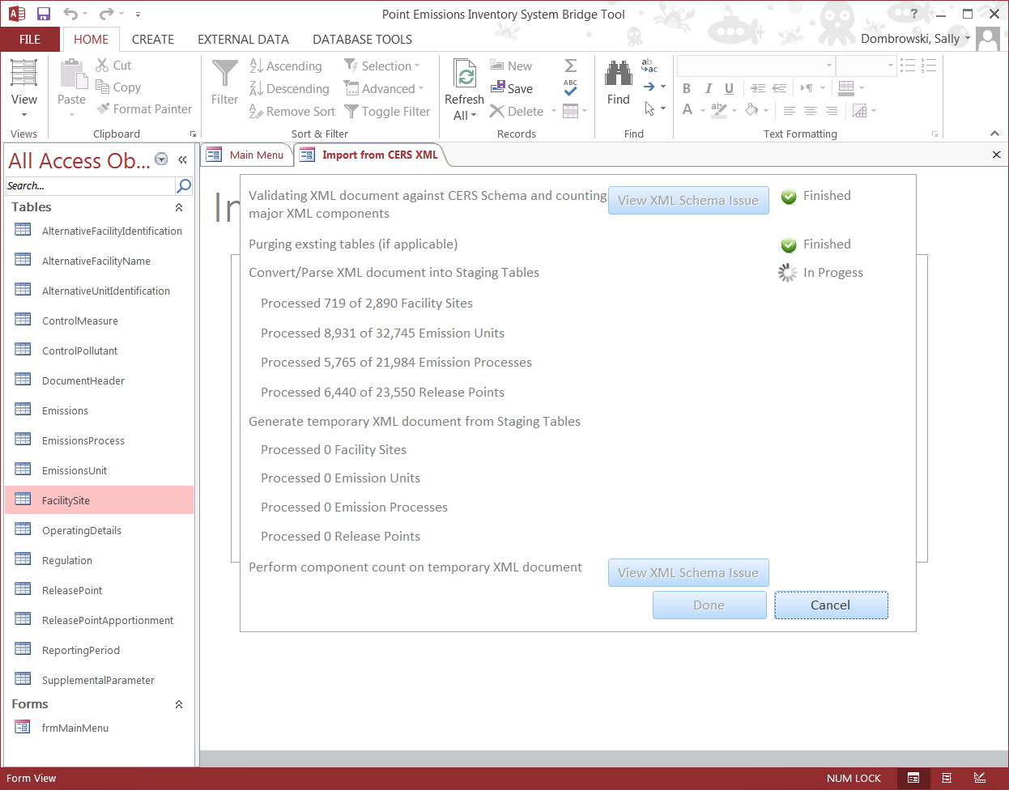
Staging Tables
Notes:
As the Bridge Tool processes you will be able to track where the conversion is at. A green check mark and the words “Finished” means that the section as completed conversion and will move onto the next component.
If a section fails due to errors, you will receive a red “X” and the words Failed.

Slide 13
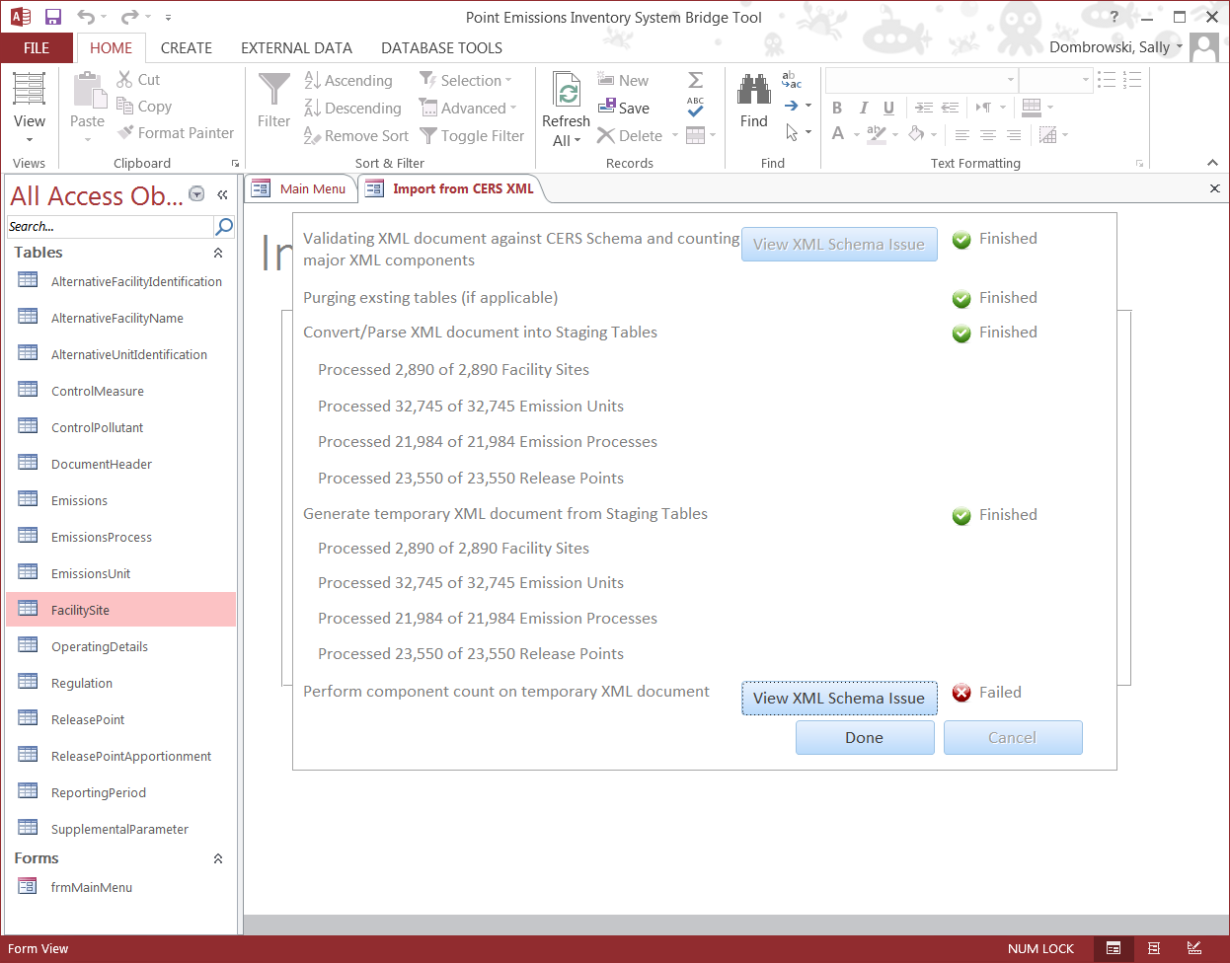
Bridge Tool

Slide 14
Bridge Tool
Differences in staging tables for facility inventory
  CERS and Exchange Header tables have been flattened into one table: Document Header
  Facility Geographic Coordinates and Release Point Geographic Coordinates flattened into the Facility Site and Release Point tables.

Slide 15
When would I use a facility snapshot?
Compare current EIS facilities, IDs, processes, controls, etc. to your updated Agency system version.
Mass change of identifiers for facilities, units, processes and/or release points.
Notes:
When would you use a facility snapshot? You could use this report to do comparisons between what is currently in EIS and what is in your agency system.
You could also use a snapshot to adjust identifiers where the agency has assigned new IDs to all facilities, units and processes. Because the facility snapshot contains EIS identifiers you would only need to replace the old agency identifiers with the new ids and submit. The EIS identifier ensures that the same facility is updated and a duplicate is not created as a new facility or unit.

Slide 16
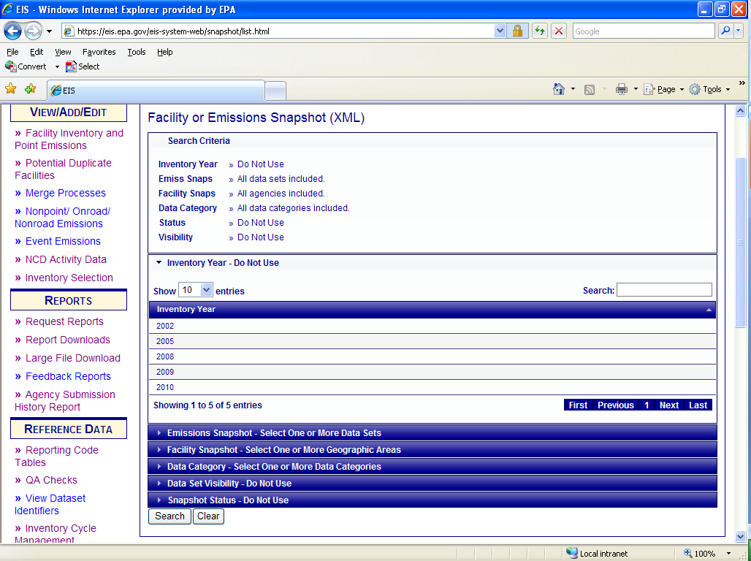
Emissions Snapshot
Notes:
Next is the Emissions Snapshot report. This page will also be going through some revisions to delete those filters which are not needed.
First the inventory year is not needed as the inventory year is included in the dataset name. The Facility Snapshot filter will be removed, as well as, the Data Set Visibility and the Snapshot Status filters.
That leaves us with only two filters to select from. The first is the dataset.

Slide 17
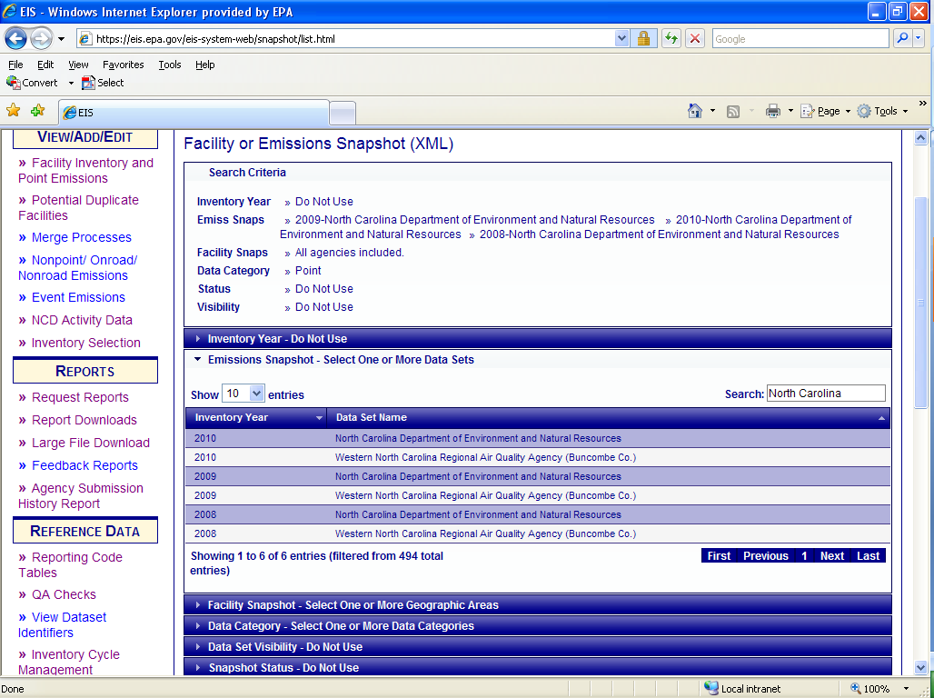
Emissions Snapshot
Notes:
You may use the search box to either select your agency or an EPA data set. EPA data sets will contain EPA estimates that may have been used during the creation of the NEI or general purpose release. For more details, please refer to the 2011 NEI documentation on the CHIEF website. Notice that there are several North Carolina datasets. Each one is for a different inventory year. The Western North Carolina dataset is a local agency which has granted North Carolina READ rights.
For our demonstration we will select the 2008, 2009 and 2010 datasets for North Carolina

Slide 18
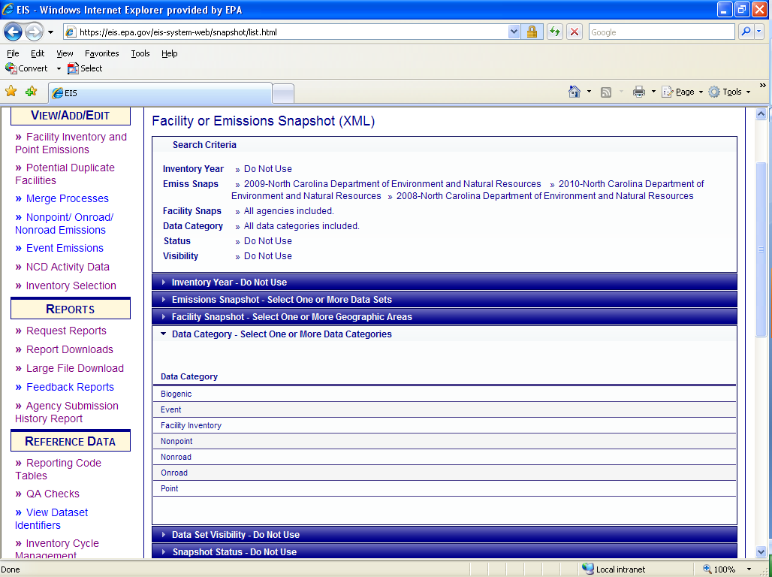
Emissions Snapshot
Notes:
Next you can select a specific data category. If none is selected, all will be returned. For our demonstration, we will select Point.

Slide 19
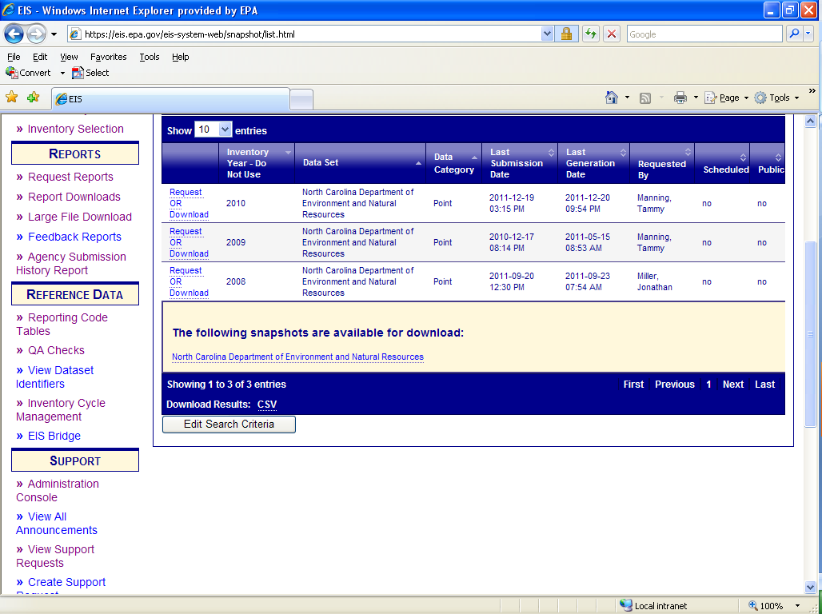
Emissions Snapshot
Notes:
The result is three different files which may be downloaded for each of the three inventory years. Selecting multiple datasets does not create a comparison report.
Just like in the Facility Snapshot you want to check the date of the last submission and the date of the last generation date. If the submission date is after the generation date, then you will want to request a new report. If it is not, then you may download the report immediately by selecting “Download” and then selecting the link. Remember that manual changes made in the Gateway are not reflected in the Last Submission Date.

Slide 20
Bridge Tool
Notes:
In the Bridge Tool select “Import from CERS XML”

Slide 21
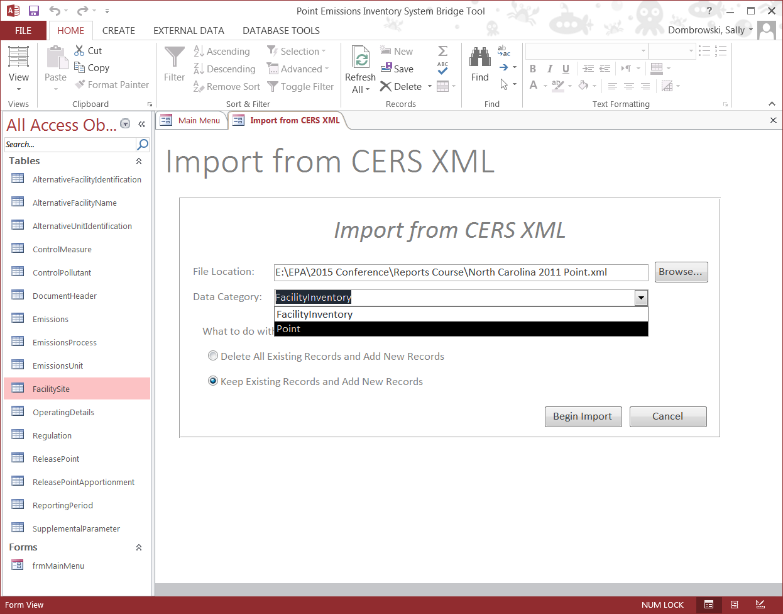
Bridge Tool
Notes:
Use the Browse to select the point file that you have downloaded. The select the data category type, point. Because I am using the same file that I used for the facility inventory and I would like to keep my facility and point together, I am going to select “Keep Existing Records and Add New Records” instead of deleting all existing records.

Slide 22
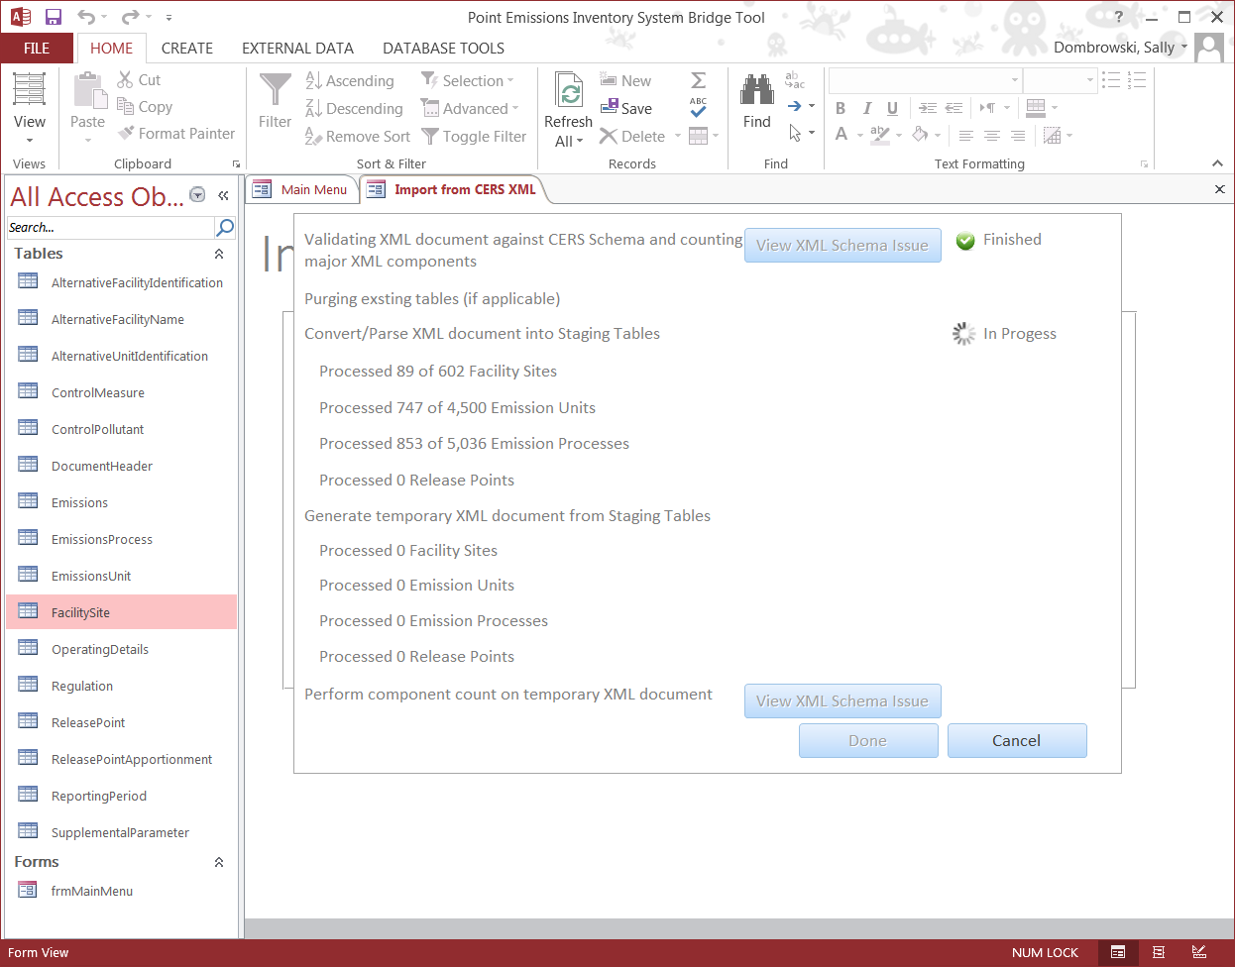
Bridge Tool
Notes:
Just like in the import of the facility data you are able to follow how the file is processing.

Slide 23
Bridge Tool
Changes in the staging tables for emissions
  Emissions tables flattened.
  Only one table need to be reported at a minimum
    Emissions
    Optional tables
      Report Period for activity data
      Supplemental Parameter
      Operating Details

Slide 24
What can the Emissions Snapshot be used for?
May be used to submit emissions data by updating the emissions table.
Check emission factors, throughputs and other fields that are not available in other reports
Correct a single pollutant and resubmit the other pollutant emissions “as is”

Slide 25
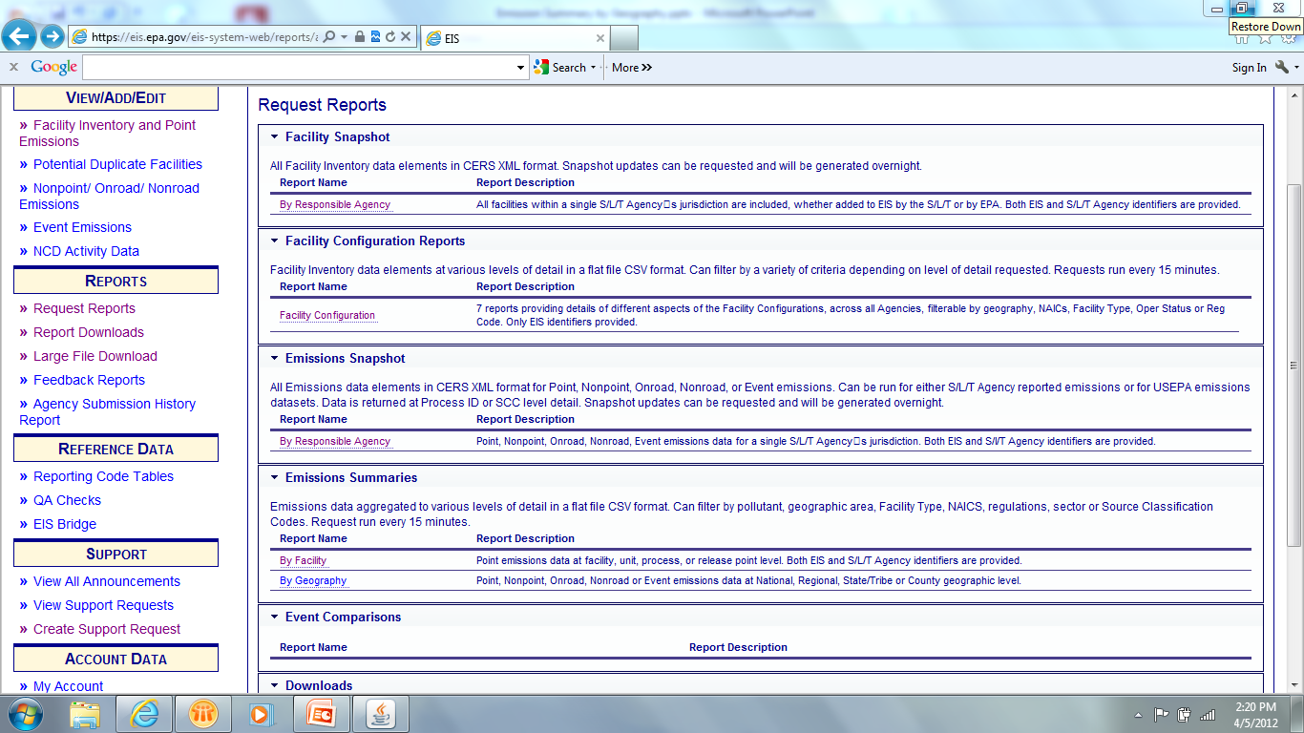
Facility Configuration Reports
Notes:
The next set of reports are the Facility Configuration Reports. A series of seven reports allows you to create a csv flat file at various levels of the facility.

Slide 26
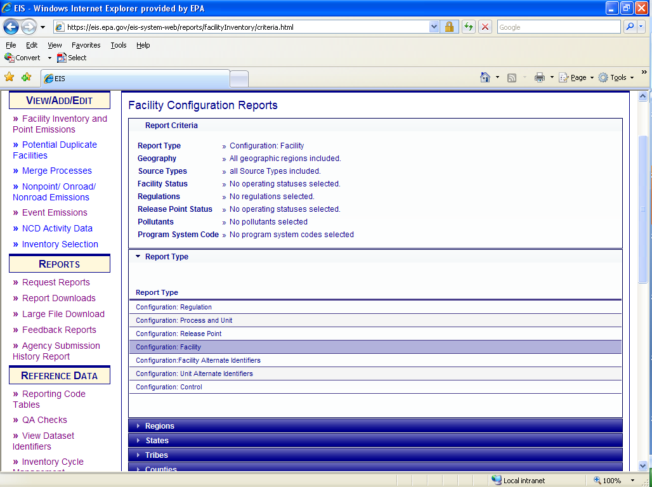
Configuration - Facility
Notes:
There are seven different configurations reports. Regulation, Process/Unit, Release Point, Facility, Facility Alternate Identifiers, Unit Alternative Identifiers and Controls.
The first configuration report that we will look at is the facility level report.
Notice that there are no required filters for these reports. Required filters will be highlighted in yellow.

Slide 27
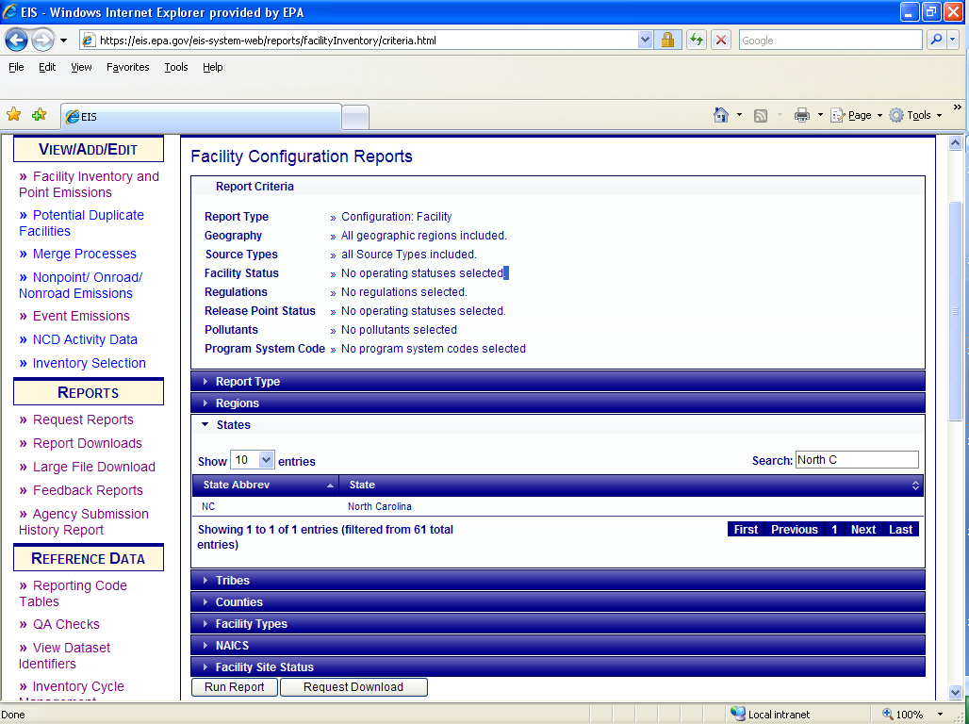
Configuration - Facility
Notes:
Next there are several filters such as by geographic, facility type, NAICS, or facility site status. It is very important to note when filtering on geography that the filters are additive. If you are interested in Cook county, Illinois, select the county filter and search for “Cook”. Do not use the combination of the State filter, for Illinois, and the County filter for Cook. This will result in the whole State of Illinois plus Cook county.
Once your filters have been selected, select “Run Report”.

Slide 28
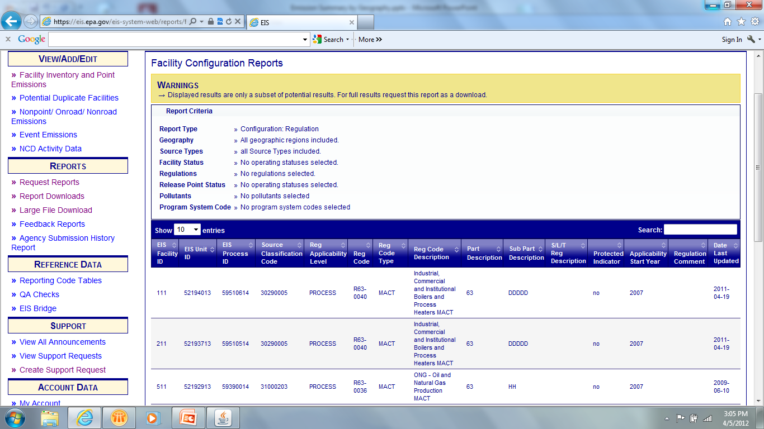
Configuration - Facility
Notes:
If you selected “Run Report” and receive a warning at the top of the page, this means that there was too much information to return to the screen. You may only receive the full report by selecting “Request Download” The Request Downloads runs every 15 minutes. If you do not receive this warning, you may select Report Download: CSV at the bottom of the page and your report will open in Excel.

Slide 29
Facility Configuration Report
Facility Level – Data Fields
EIS Facility ID
SLT Facility ID
Program System Code
Facility Name
Company Name
Facility Description
Facility Status
Facility Status Year
State
County Name
Tribal Name
Region Code
NAICS Code
NAICS Code Description
Facility Type Code
Facility Type Description
Location Address
Supplemental Location Text
Locality Name
State
Zip Code
Address Comment
Site Latitude
Site Longitude
Coordinates Protected?
Vertical Measure
Horizontal Accuracy Measure
Reference Datum
Horizontal Collection Code
Coordinate Comment
Facility Comment
Notes:
The facility level configuration report returns the identifiers, name, NAICS, facility type and locational information for your facilities. Data fields in red are not currently in this report, but could be added in the future.

Slide 30
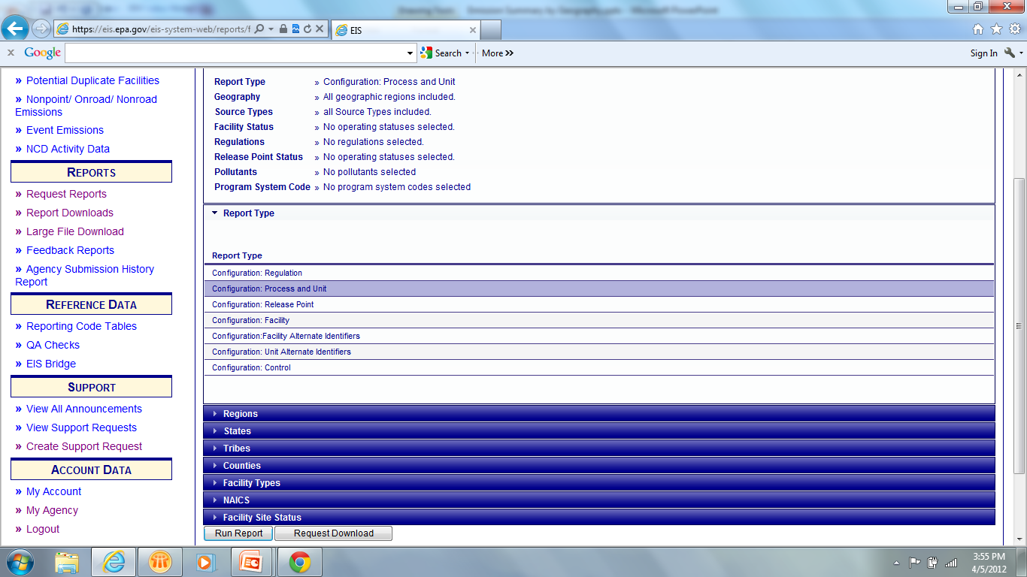
Configuration – Process/Unit
Notes:
The next configuration report is the process/unit report. Once you have selected the report type, you can then filter by geography, facility type, NAICS or operating status. When your selections are complete select Run Report or Request Download.

Slide 31
Facility Configuration Report
Process/Unit Level – Data Fields
EIS Facility ID
SLT Facility ID
EIS Unit ID
SLT Unit ID
Unit ID Program System Code
Unit Description
Unit Type
Design Capacity
Design Capacity UOM
Design Capacity Protected?
Unit Status Code
Unit Status Year
Unit Operation Date
Unit Comment
EIS Process ID
SLT Process ID
Process ID Program System Code
Process Description
Source Classification Code
SCC Level One Description
SCC Level Two Description
SCC Level Three Description
SCC Level Four Description
Emission Type Code
Aircraft Engine Type Code
Aircraft Engine Type Code Desc
Last Inventory Year
Process Comment
Notes:
These are the data elements which will be returned in your process/unit level report. This report contains information on the Unit type, design capacity and operating status, as well as, the SCC and Aircraft Engine Type Code if the facility was an airport. Data fields in red indicate that they are not currently available but may be added in the future.

Slide 32
Facility Configuration Report
Release Point Level – Data Fields
EIS Facility ID
SLT Facility ID
EIS Unit ID
SLT Unit ID
EIS Process ID
SLT Process ID
EIS Release Point ID
SLT Release Point ID
Program System Code
Process Rel Pt Apprt
Apportionment Comment
Rel Pt Latitude
Rel Pt Longitude
Coordinates Protected?
Coordinate Derivation
Rel Pt Type
Rel Pt Description
Stack Height (ft)
Stack Ht Protected?
Stack Diameter (ft)
Stack Diameter Protected?
Exit Gas Velocity
Exit Gas Velocity UOM
Exit Gas Velocity Protected?
Ext Gas Flow Rate
Exit Gas Flow Rate UOM
Exit Gas Flow Rate Protected?
Exit Gas Temp (F)
Distance to Fence Line (ft)
Fugitive Height (ft)
Fugitive Width (ft)
Fugitive Length (ft)
Fugitive Release Angle
Rel Pt Status
Rel Pt Status Year
Rel Pt Comments
Notes:
If you were to select the next report option, Release Point Level, the report would contain the data fields listed on this slide. They include information about apportionment, location, parameters and operating status.

Slide 33
Facility Configuration Report
Facility Alternative ID – Data Fields
EIS Facility ID
Agency Facility ID
Facility Name
Company Name
NAICS Code
NAICS Code Description
Facility Type Code
Facility Type Description
State
County Name
Program System Code
Program System Description Alternate ID
Effective Date
End Date
Alternative Identifier Protected?
Notes:
The Facility Alternative ID will provide you with not only the current identifiers under various program system codes such as your agency, TRI and FRS, but will also show historical identifiers.

Slide 34
Facility Configuration Report
Unit Alternative ID – Data Fields
EIS Facility ID
Agency Facility ID
Facility Name
Company Name
NAICS Code
NAICS Code Description
Facility Type Code
Facility Type Description
State
County Name
EIS Unit ID
Agency Unit ID
Program System Code Program System Description
Alternative ID
Effective Date
End Date
Alternative Identifier Protected?
Notes:
The unit alternative identifier report is the same as the facility alternative identifier report except that this report shows the current and historical ids on the unit level. This type of report is not available on the process level because we do not keep historical identifiers for processes.

Slide 35
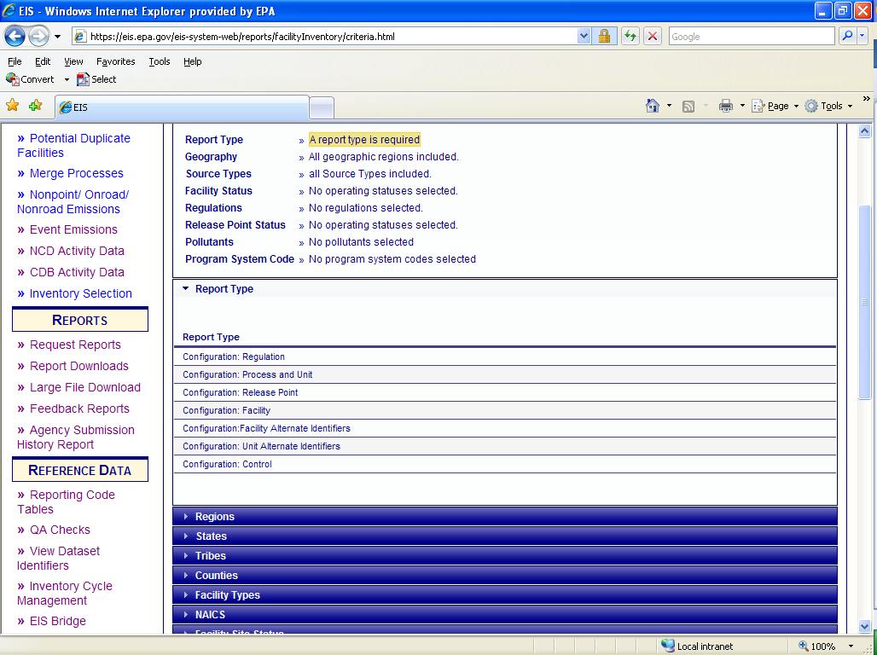
Configuration - Controls
Notes:
While the Configuration report for controls is only one selection process…

Slide 36
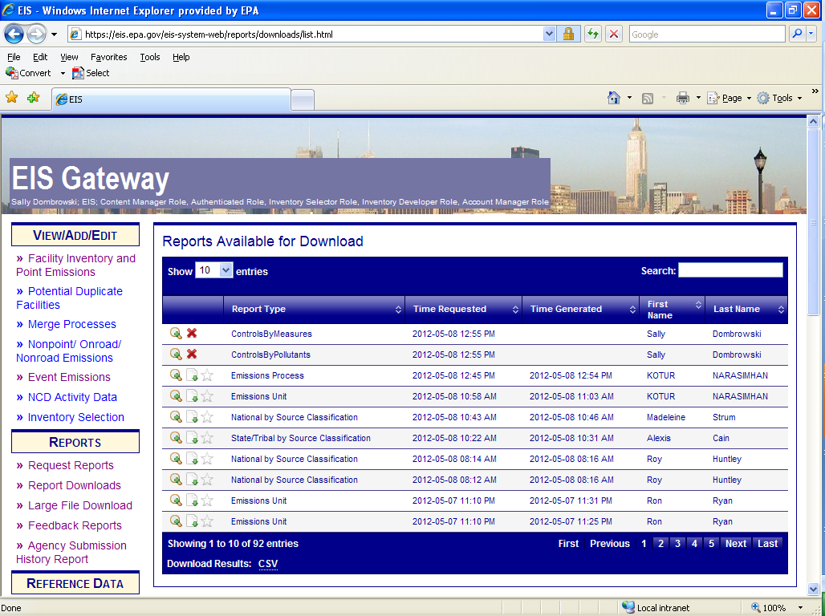
Configuration - Controls
Notes:
…two separate reports are generated. The Control Measure report and the Control Pollutant report.

Slide 37
Configuration - Controls
Control Measure
Control Pollutant
EIS Facility ID
EIS Unit ID
EIS Process ID
Agency Facility ID
Agency Unit ID
Agency Process ID
SCC
Control Applicability Level
Control Description
Percent Capture Efficiency
Percent Effectiveness
Control Comment
Control Measure Code
Control Measure Description
Control Measure Type
EIS Facility ID
EIS Unit ID
EIS Process ID
Agency Facility ID
Agency Unit ID
Agency Process ID
SCC
Control Applicability Level
Control Description
Percent Capture Efficiency
Percent Effectiveness
Control Comment
Pollutant Code
Pollutant Name
Pollutant Type
Percent Reduction Efficiency
Notes:
These are the data fields in each of the two reports. Again red text indicates that these fields are currently not available but will be added in the future.

Slide 38
Facility Configuration Report
Regulation Level – Data Fields
EIS Facility ID
SLT Facility ID
EIS Unit ID
SLT Unit ID
EIS Process ID
SLT Process ID
Source Classification Code
SCC Level One Description
SCC Level Two Description
SCC Level Three Description
SCC Level Four Description
Reg Applicability Level
Reg Code
Reg Code Type
Reg Code Description
Part Description
Sub-Part Description
SLT Reg Description
Reg Protected?
Applicability Start Year
Regulation Comment
Date Last Updated
Notes:
The last configuration report is the Regulation level. These are the data fields which will appear in your report.

Slide 39
What can the Configuration Report be used for?
Check to see if SCC is consistent between unit description/comment and process description/comment. Help to eliminate the use of 399999
Tracking changes for facility which are expected to be covered by regulations.
Check consistency across facility such as the Unit Type Code is the same as unit description

Slide 40
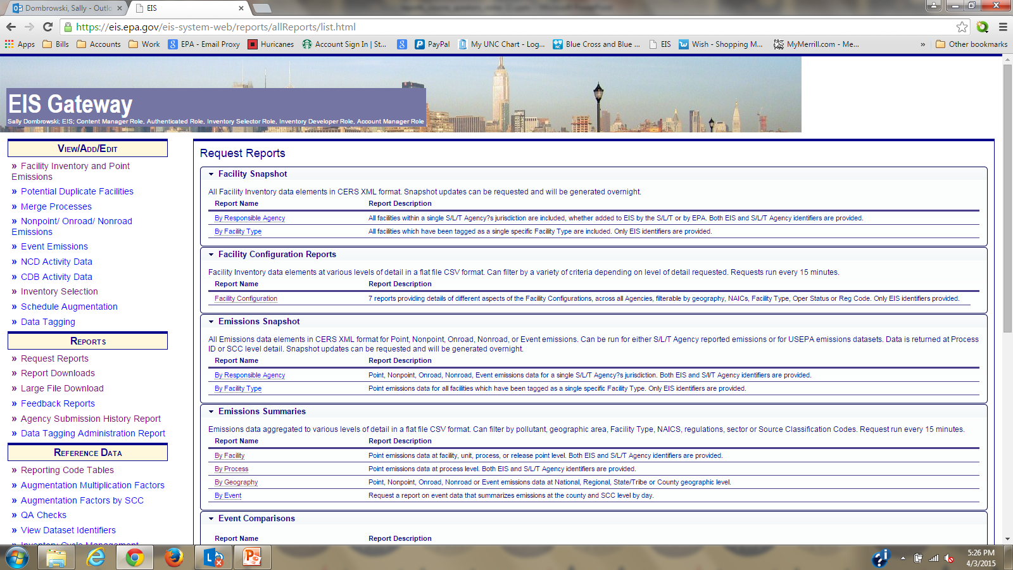
Emissions Summaries by Facility
Notes:
The next type of report is the Emissions Summaries. This report is probably the most popular. There are four different reports under this category: by facility, by process (customized), by geography, and by event. Summary reports are in csv format and may be opened in Excel or Access.

Slide 41
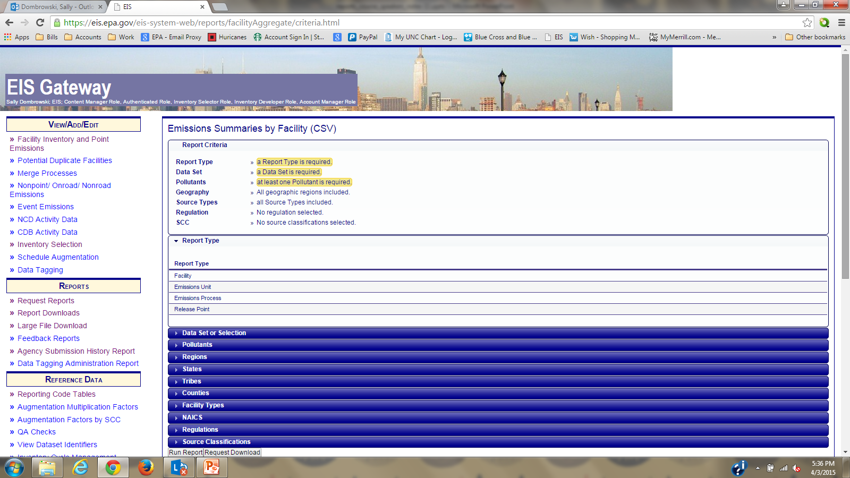
Emissions Summaries by Facility
Notes:
You will notice that there are three highlighted sections at the top of the report page. Whenever you see this highlighting, it means that you must make a selection in each of these filters. In other words, you must select a report level, a dataset and at least one pollutant to run this report. We will select facility level to begin.

Slide 42
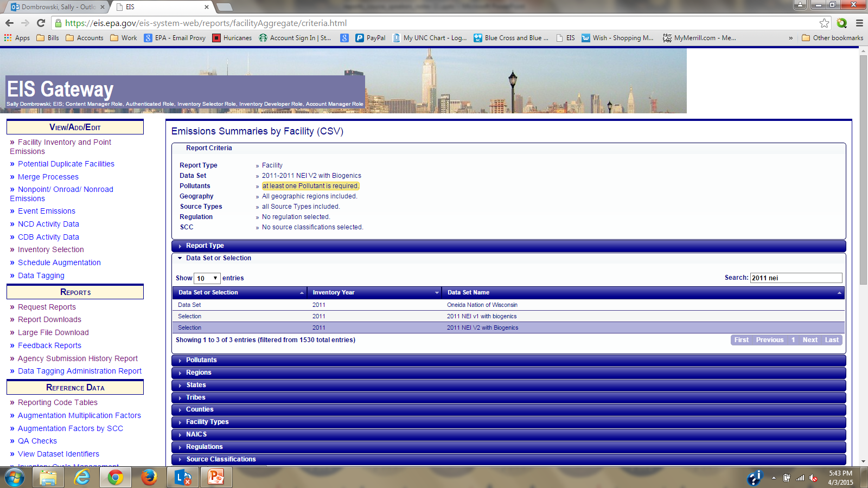
Emissions Summary by Facility
Facility Level
Notes:
Next we need to select a dataset or selection. You can either select your agency dataset or you may select the NEI by typing the year and NEI in the search box. We will select the 2011 V2 NEI.

Slide 43
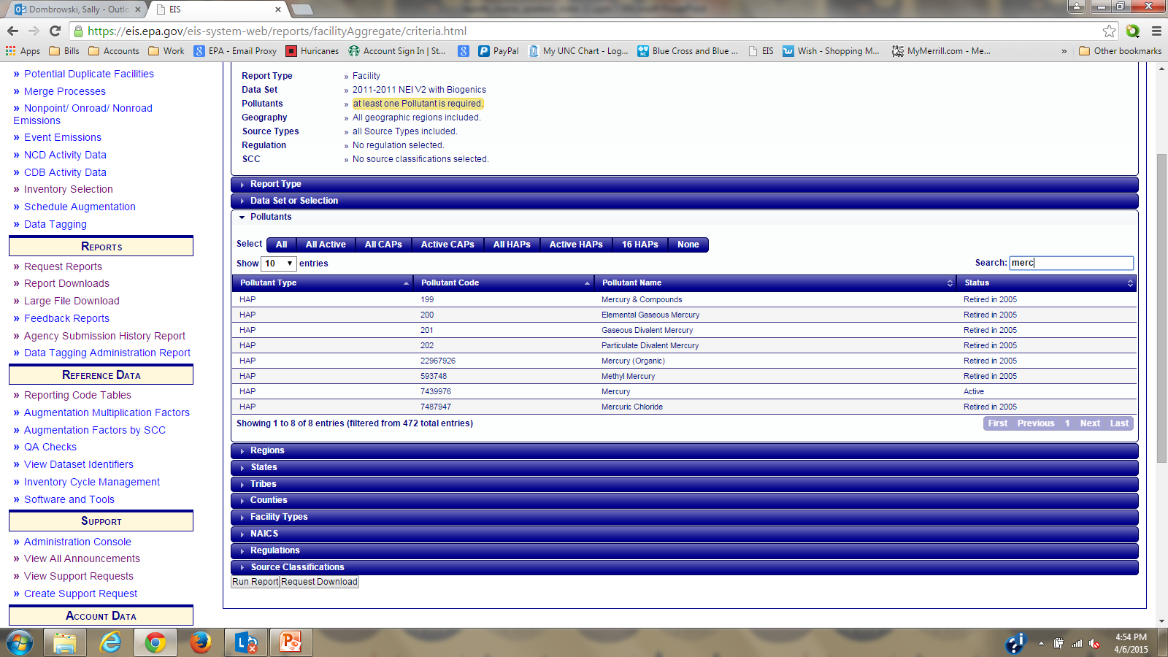
Emissions Summary by Facility
Facility Level
Notes:
Next we will select the last of the required filters, pollutant code. You may either use one of the pre-selected groups such as Active CAPS, All Active, etc, or you may search for a particular pollutant code by using the Search box. We will use a search on mercury in this example. Additionally, if you select a specific pollutant the return list will include retired as well as active pollutants. If you selected a pollutant that retired in 2005 for a 2011 v2 NEI report, the report will be null for that pollutant code.
The balance of the filters are optional and will narrow down your report size. If you are looking for a county level facility report for Wake county, North Carolina, you would select the “Counties” filter and search for that particular county. Do not select the State filter. The geographic filters are additive. A good example of this would be if you were interested in the facility level emissions for the Navajo Nation in Arizona. If you selected Arizona and then selected Navajo Nation under tribes, your report would contain the State of Arizona data PLUS the Navajo Nation data. This rule is also true for the remaining optional none geographic filters such as Sectors or SCCs.
Then select “Run Report” to return your results to the screen; or “Request Download” which will make your file available for download. Reports run every 15 minutes. There are times that this process may take quite a bit longer. This is due to numerous reports in the request queue. Some reports can take as long as 24 hours to run depending on the size and filters chosen. This is especially true when EPA runs their National reports and you could be caught behind these reports in the queue.
There are also optional filters for facility type, NAICs, regulations and SCC.

Slide 44
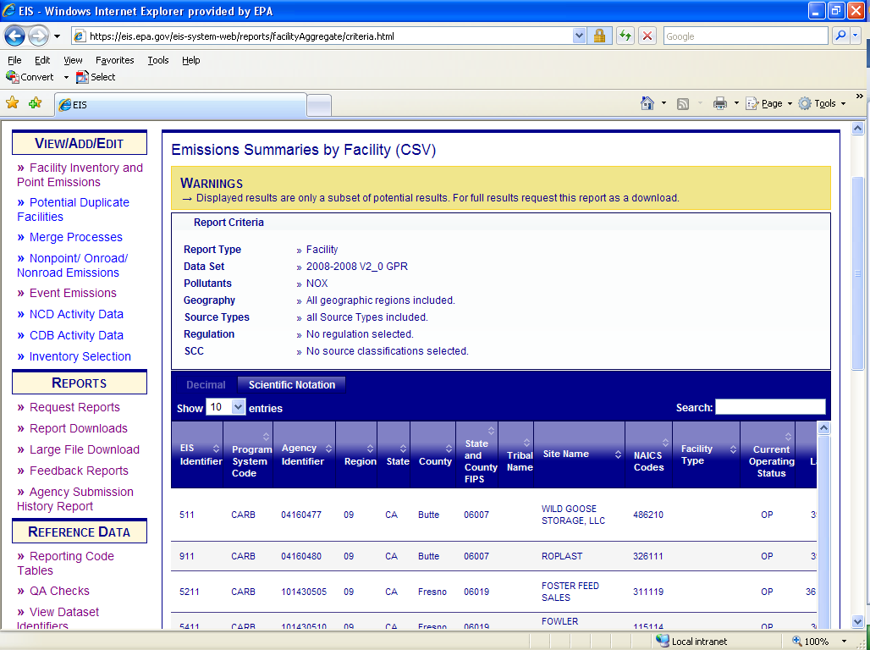
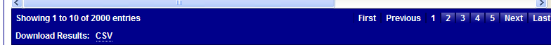
Emissions Summary by Facility
Facility Level
Notes:
If you select Run Report instead of Request Report and your filters are not refined enough, you may receive this warning message at the top of the page. This message is telling you that the report you requested is too large to be displayed on the screen and that you must select Request Download to get the entire report. If you selected Run Report and did not get this message, then you would be able to use the “Download Results: CSV” at the bottom of the page to open or save the report immediately. This is the same for every report in EIS. Also, due to limitations in displaying data on the screen, the columns displayed may not be all of the columns or data fields that are available in the report. If what you want is displayed on the screen and you do not get a warning message, then I would recommend using the Download Results: CSV method.

Slide 45
Emission Summary by Facility
Facility Level
EIS Facility Identifier
Agency Facility Identifier
Program System Code
Region
State
County
FIPS
Tribal Code
Tribal Name
Facility Name
NAICS Code
NAICS Description
Source Type
Facility Site Operating Status
Facility Status Year
Latitude
Longitude
Address
City
State
Zip Code
Emissions Operating Type
Pollutant Code
Pollutant Description
Total Emissions
UOM
Notes:
The data fields listed on this slide will be contained in your facility level report. Those highlighted in RED may be added at a future date. Throughout this presentation, we will list all of the data fields available for each report. These lists may help you in deciding which report gives you the information that you need.

Slide 46
Emissions Summary by Facility
Unit Level
EIS Facility Identifier
Agency Facility Identifier
Program System Code
Region
State
County
FIPS
Tribal Code
Tribal Name
Facility Name
Address
City
State
Zip Code
NAICS Code
NAICS Description
Source Type
Latitude
Longitude
EIS Unit Identifier
Agency Unit Identifier
Unit Program System Code
Unit Type
Unit Description
Design Capacity
Design Capacity UOM
Emissions Unit Operating Status
Unit Status Year
Emissions Operating Type
Pollutant Code
Pollutant Description
Total Emissions
UOM
Notes:
Following the same instructions as for the facility level report, you can select a unit level which will result in the data fields as seen here. Those data elements in bold are the data fields unique to the unit report.

Slide 47
Emission Summary by Facility
Process Level– Data Fields
EIS Facility ID
Agency Facility ID
Agency Program System Code
Region
State Code
County
FIPS
Tribal Code
Tribal Name
Facility Name
NAICS Code
NAICS Description
Source Type
Latitude
Longitude
Address
City
State
Zip Code
EIS Unit ID
Agency Unit ID
Unit Type
Unit Type Description
EIS Process ID
Agency Process ID
SCC
SCC Level 1
SCC Level 2
SCC Level 3
SCC Level 4
Emissions Type Code
Aircraft Engine Type Code
Aircraft Engine Type Code Description
Unit Reg Code
Process Reg Code
Reg Code Description
Emissions Operating Type Code
Pollutant Code
Pollutant Description
Total Emissions
UOM
Data Set
Emissions Calculation Method Code
Emissions Comment
Notes:
The next report option is the Process Level. The report will contain these data fields. The process level report is the lowest level of aggregation and contains the data source of the emissions. You will not see a data source on any other level report, but process.
The two data fields highlighted in blue do not show up on the screen display or if you downloaded the .csv. They will only show up if you do a “Request Report” and have the total report created.

Slide 48
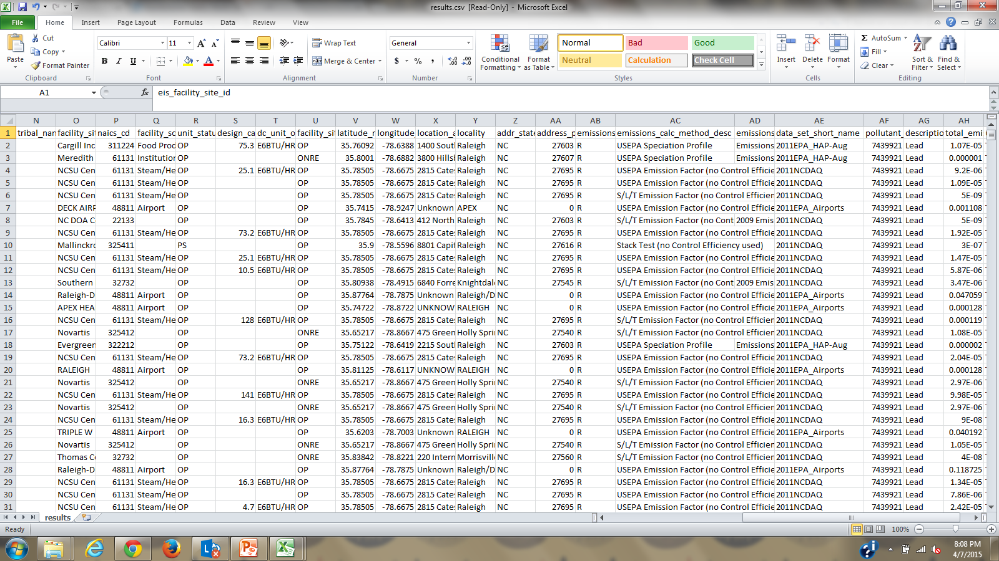
Emissions Summary by Process
Notes:
So where did that number come from? The data set short name is your answer. In our selection process the SLT submitted data is at the top of our hierarchy. When data is missing or is in need of correction, EPA will backfill with EPA estimates such as HAP-Aug or EPA_Airports.

Slide 49
Emissions Summary by Facility
Release Point Level
Stack Ht
Stack Ht Protected
Stack Diameter
Stack Diameter Protected
Exit Gas Velocity
Exit Gas Velocity Protected
Exit Gas Flow Rate
Exit Gas Flow Rate Protected
Exit Gas Temperature
Distance to Fence
Fugitive Ht
Fugitive Width
Fugitive Length
Fugitive Release Angle
Rel Pt Status
Rel Pt Status Year
Rel Pt Comment
Emissions Operating Type Code
Pollutant Code
Pollutant Description
Total Emissions
UOM
EIS Facility ID
EIS Unit ID
EIS Process ID
EIS Release Point ID
Agency Facility ID
Agency Unit ID
Agency Process ID
SLT Rel Pt ID
Program System Code
Process – Rel Pt Apportionment
Apportionment comment
Rel Pt Latitude
Rel Pt Longitude
Coordinates Protected
Coordinate Derivation
Rel Pt Type
Rel Pt Description
Notes:
Your release point level report will contain these data fields. Note that fields in red are not currently available, but may be added to the report at a later date.
Coordinate derivation indicates whether this is the actual lat/lon for the release point, or if the lat/lon is the defaulted facility lat/lon.

Slide 50
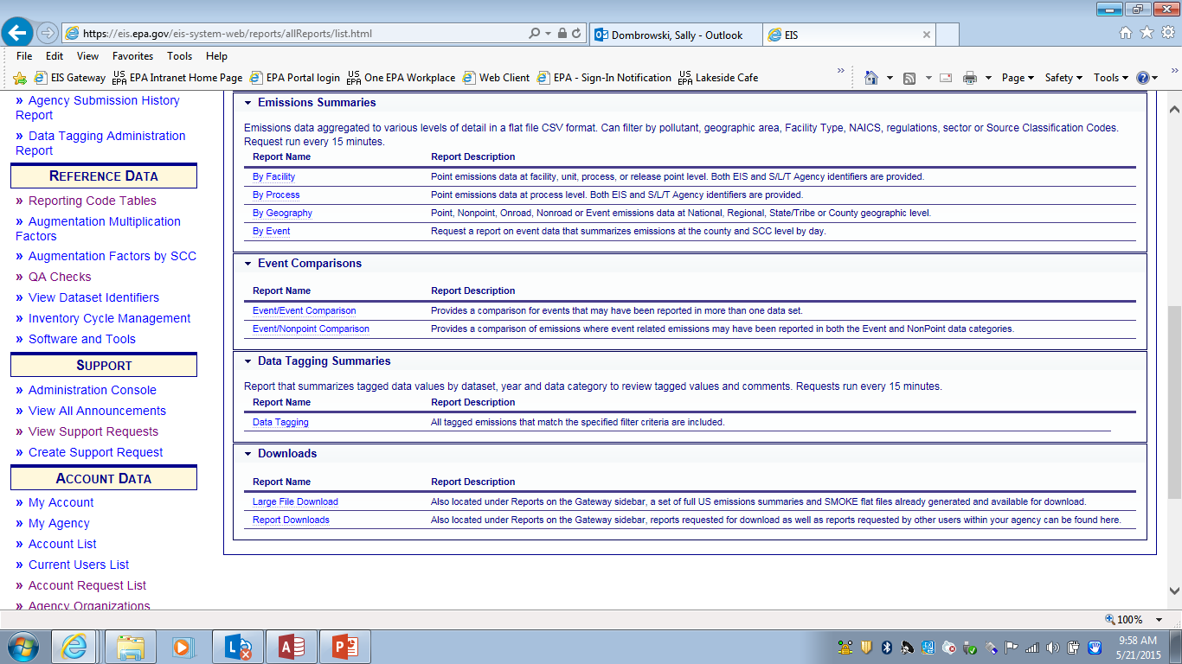
New Emission Summary – By Process (Custom)
In addition to standard report emission process report under Emission Summary
What’s new
  Can request report for specific facilities
    Upload Excel Spreadsheet
  Can customize which data fields in the report
Notes:
This new process report can be customized by EIS Facility ID or column headings.

Slide 51
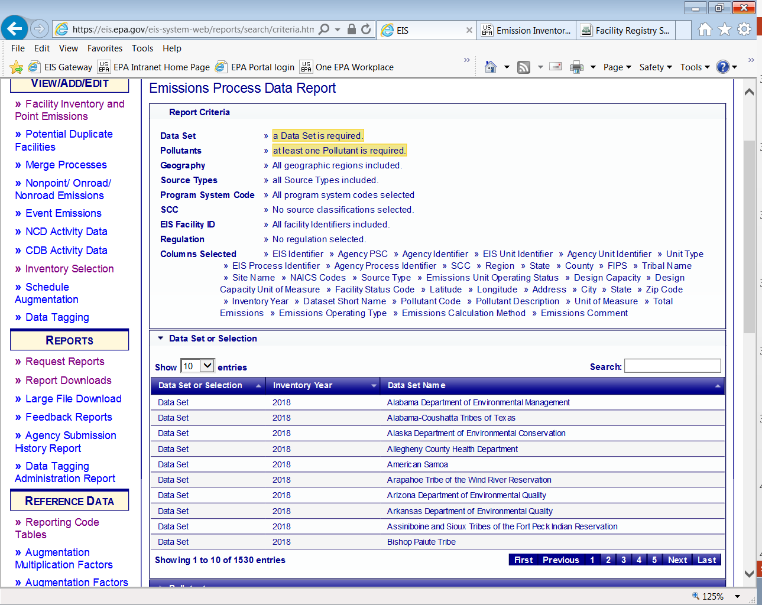
New Emission Summary – By Process
Notes:
Just like the standard emission process report you have certain required filters. You must select one dataset and at least one pollutant.

Slide 52
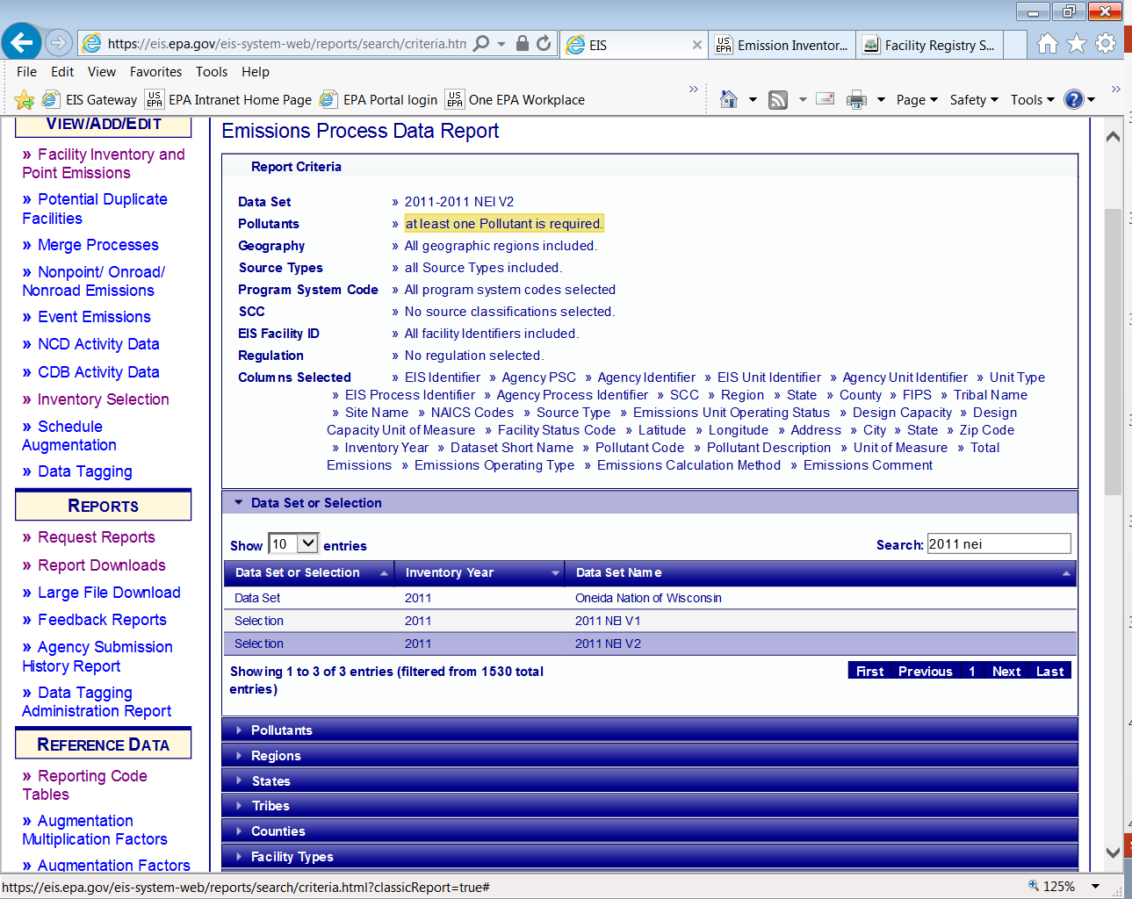
New Emission Summary – By Process
Notes:
We will use 2011 NEI v2 as our dataset

Slide 53
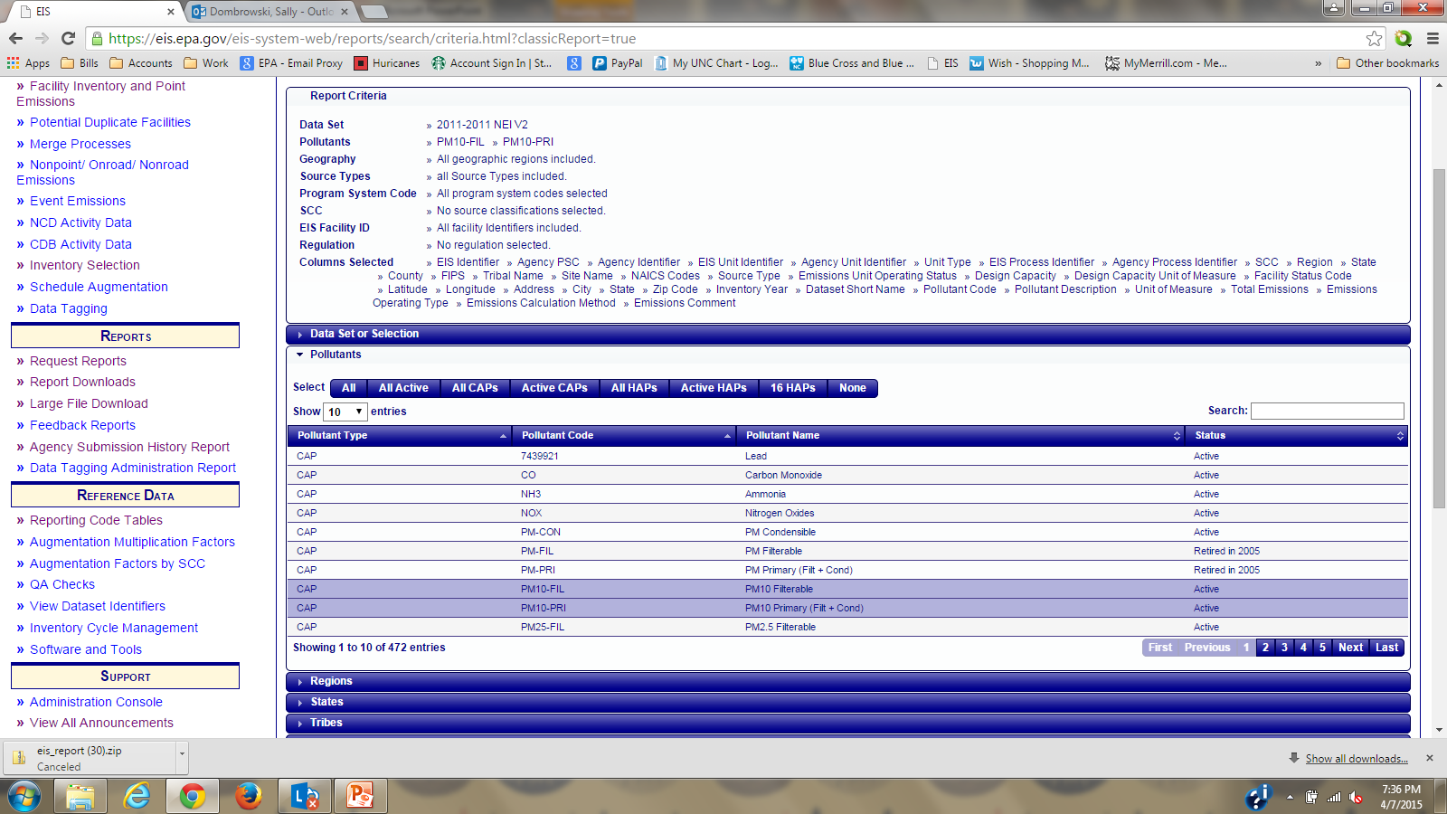
New Emission Summary – By Process
Notes:
We will then select PM10 for our pollutant code. Notice that the recap shows our selections.

Slide 54
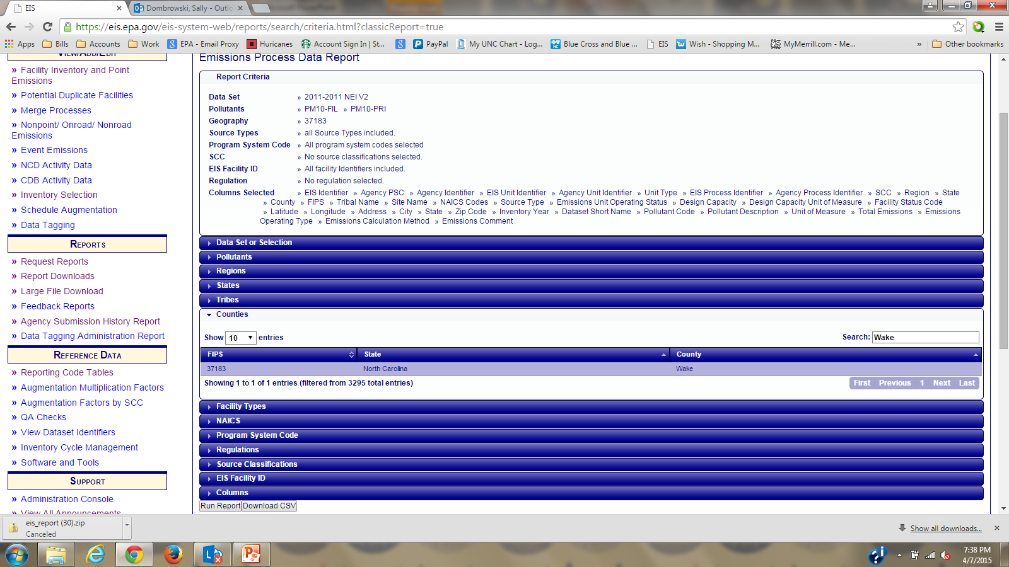
New Emission Summary – By Process
Notes:
Next we will select a county…Wake County, NC. Remember that you do not want to select the State of North Carolina under the State filter and then select Wake under the county filter. Your report will come back with all of the data from North Carolina AND all of the data from Wake County, North Carolina.

Slide 55
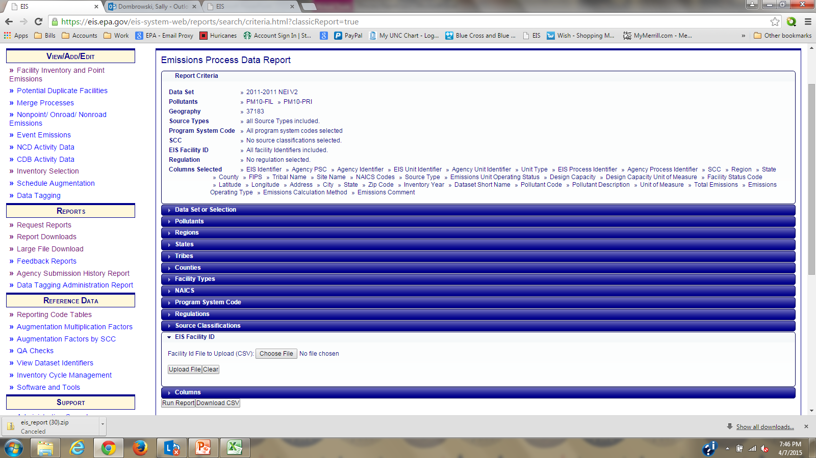
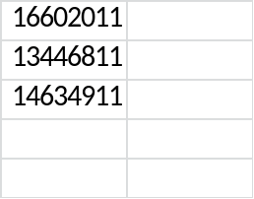
New Emission Summary – By Process
List of EIS Identifiers in
Excel, saved as .csv
Notes:
Instead of filtering on a particular county, you could filter on a group of select facilities. First you would develop a list of EIS facility IDs in an Excel spreadsheet. Save the file as a .csv. Next use the “Choose File” function to upload that file. Then select Upload File.

Slide 56
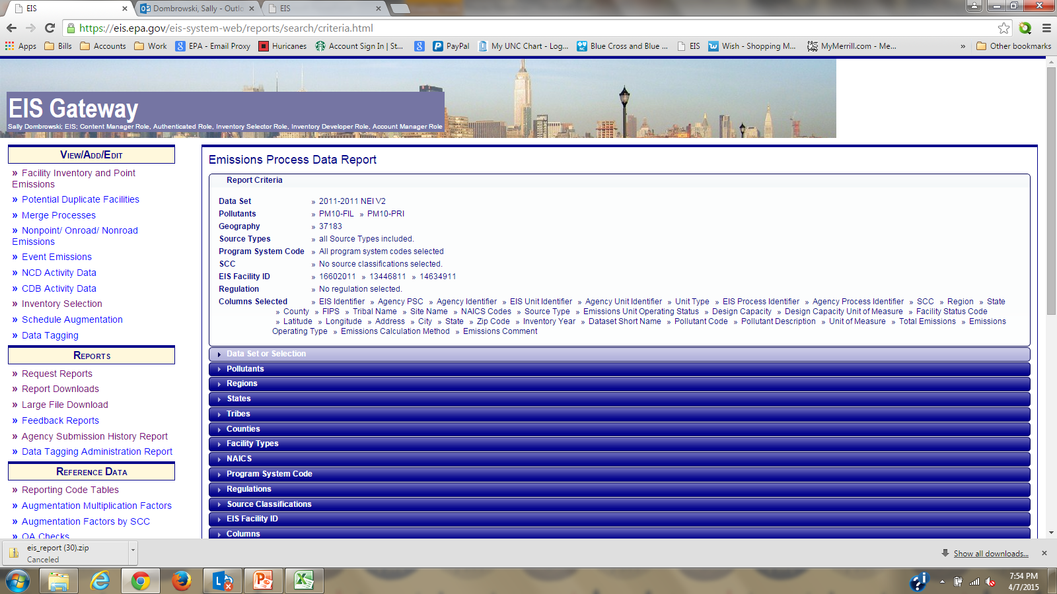
New Emission Summary – By Process
List of EIS Identifiers in
Excel, saved as .csv
Notes:
Looking at the recap at the top, you can see that your requested facilities have been added.

Slide 57
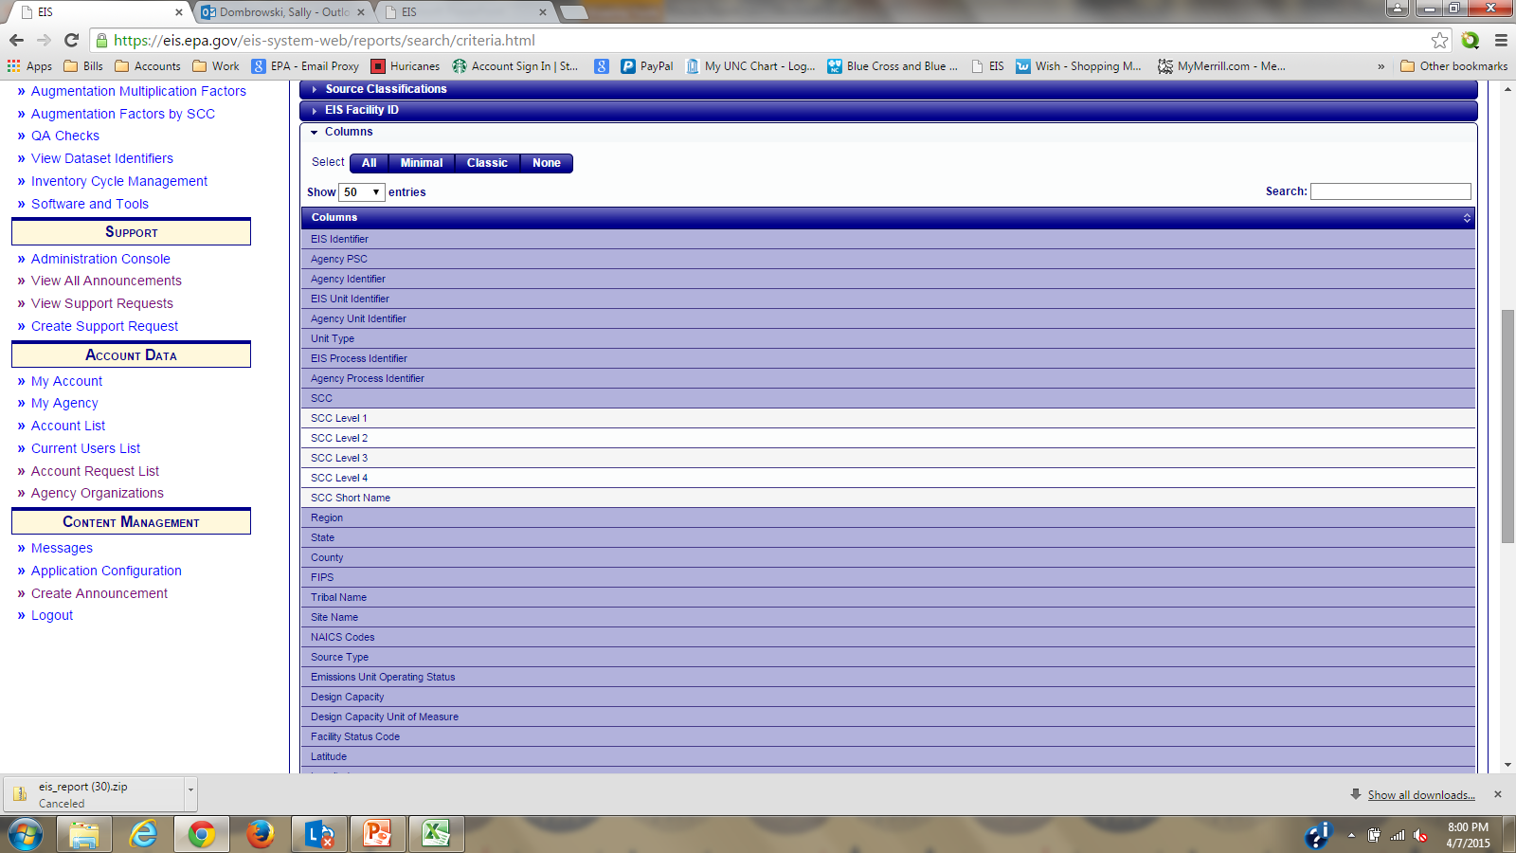
New Emission Summary – By Process
Notes:
The last filter allows you to select which columns you would like to see in your report. There are pre-defined selections at the top:
All
Minimal – Which are EIS identifiers, Dataset name, pollutant code and emissions
Classic – Basically everything except items such as SCC descriptions, emission factors, operating data and activity.
Unlike the other reports, this new custom report will not go to the report queue. The report will run immediately and must be downloaded when complete. The report will not be archived in the report queue.

Slide 58
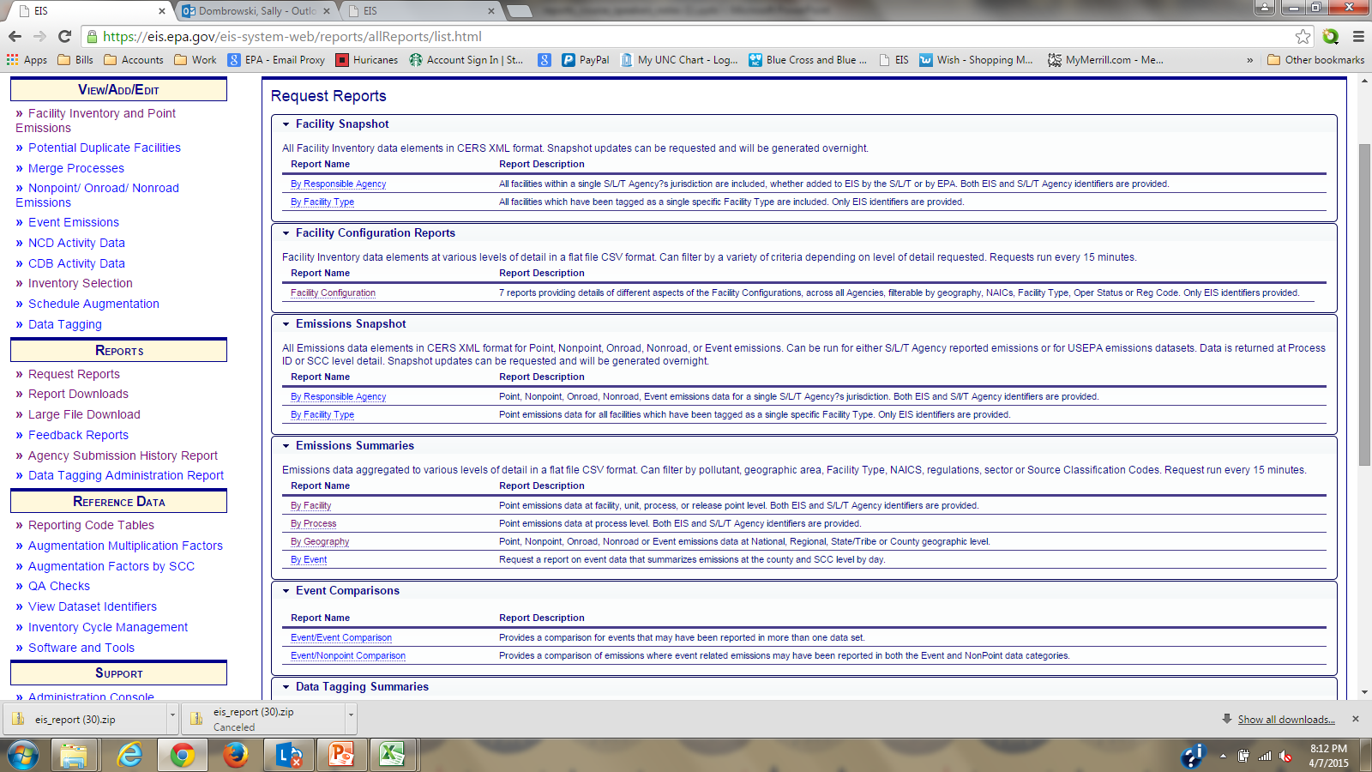
Emission Summary by Geography
Notes:
Next is the Emission Summary by Geography. This report will provide you with aggregated reports for all data categories at the National, Regional, State/Tribe or County geographic level. Mostly used for nonpoint, onroad and nonroad.

Slide 59
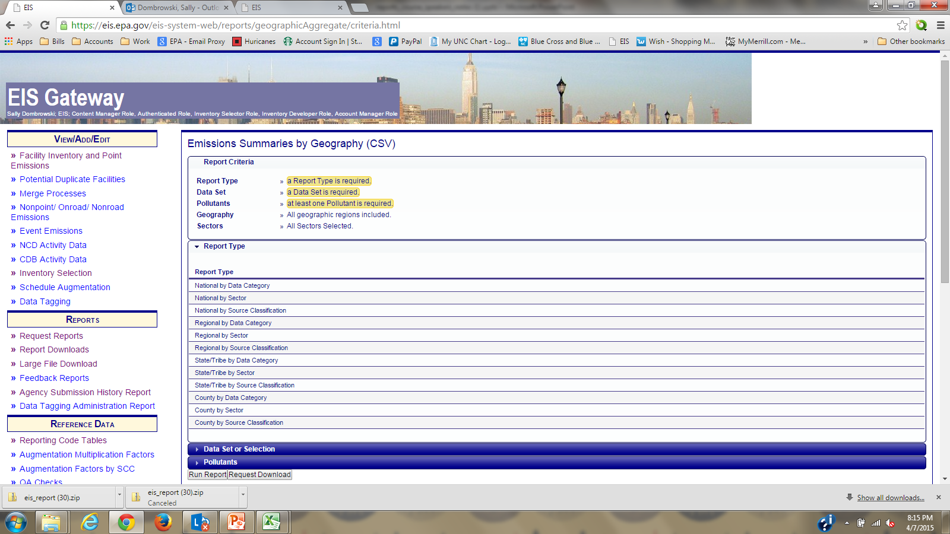
Emission Summary by Geography
County by Data Category
Notes:
We will demonstrate the Emissions Summary by Geography at the lowest aggregated level… which is county. We will start with the County by Data Category. Notice the required filters on the top of the page. You must select a report type, County by Data Category, a dataset, and at least one pollutant.

Slide 60
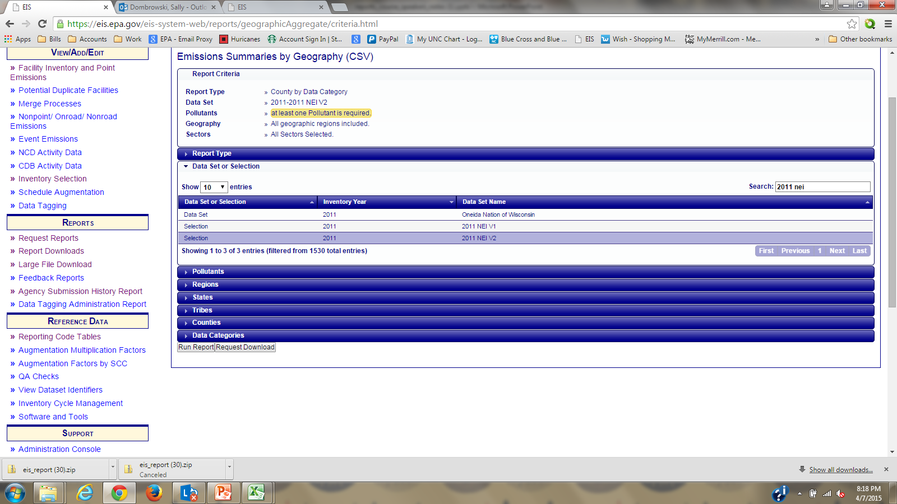
Emissions Summary by Geography
County by Data Category
Notes:
Under Data Set or Selection, you may either select your own agency data set or you may select the year and NEI in the Search box. We will use the 2011 NEI v2.

Slide 61
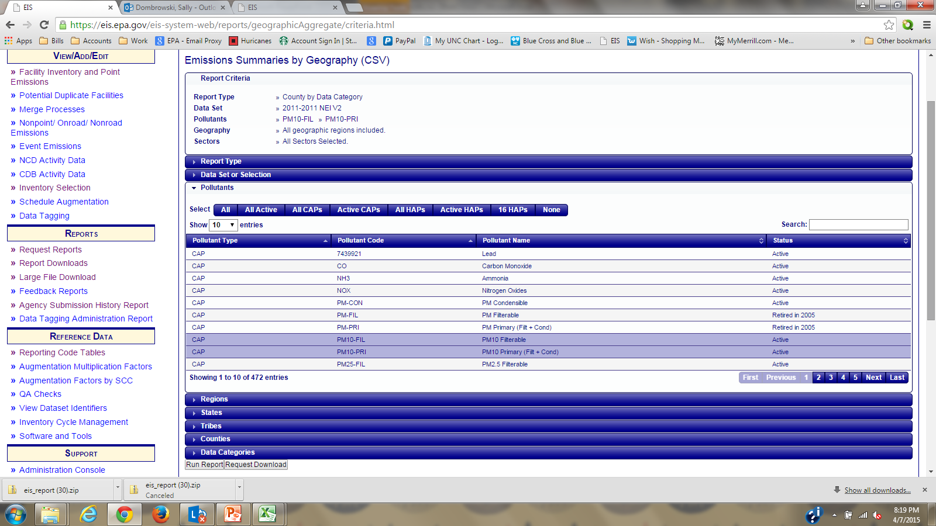
Emissions Summary by Geography
County by Data Category
Notes:
Next we will select our pollutants. For this example we will use PM10.
The remaining filters can help you refine your selection. Under data categories, if you do not choose one then all will be returned.
We have mentioned the action buttons “Run Report” and “Request Download” several times already. So what is the difference between the two requests. A “Run Report” returns the data immediately to your screen and you can download that data by using the “Download Results: CSV” link. The “Request Download” does not return data to your screen and will go to the report queue to be created. You then download your report from the Report Downloads section on the left hand sidebar. Report download section will be discussed later in the presentation.

Slide 62
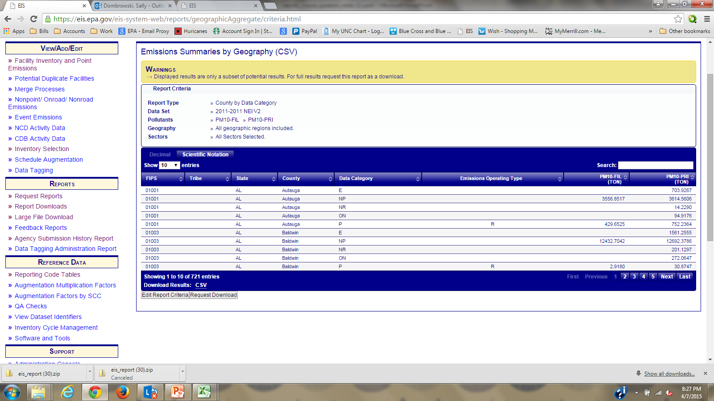
Emissions Summary by Geography
County by Data Category
Notes:
While this report is too large to download from the screen, it does give you some idea about what the report will look like. Notice the Data Category abbreviations. The Point Inventory is the only data category which will have an Emissions Operating Type. “R” indicates routine. Other types of operating types would be shutdown, startup and episodic. If I wanted the full report, I could select Request Download.

Slide 63
Emission Summary by Geography
County/Tribe by Data Category – Data Fields
FIPS
State
Tribal Code
Tribal Name
County
Data Category
Emission Operating Type
Pollutant Code
Pollutant Description
Total Emissions
UOM
Notes:
These are the data fields displayed in the County by Data Category report.

Slide 64
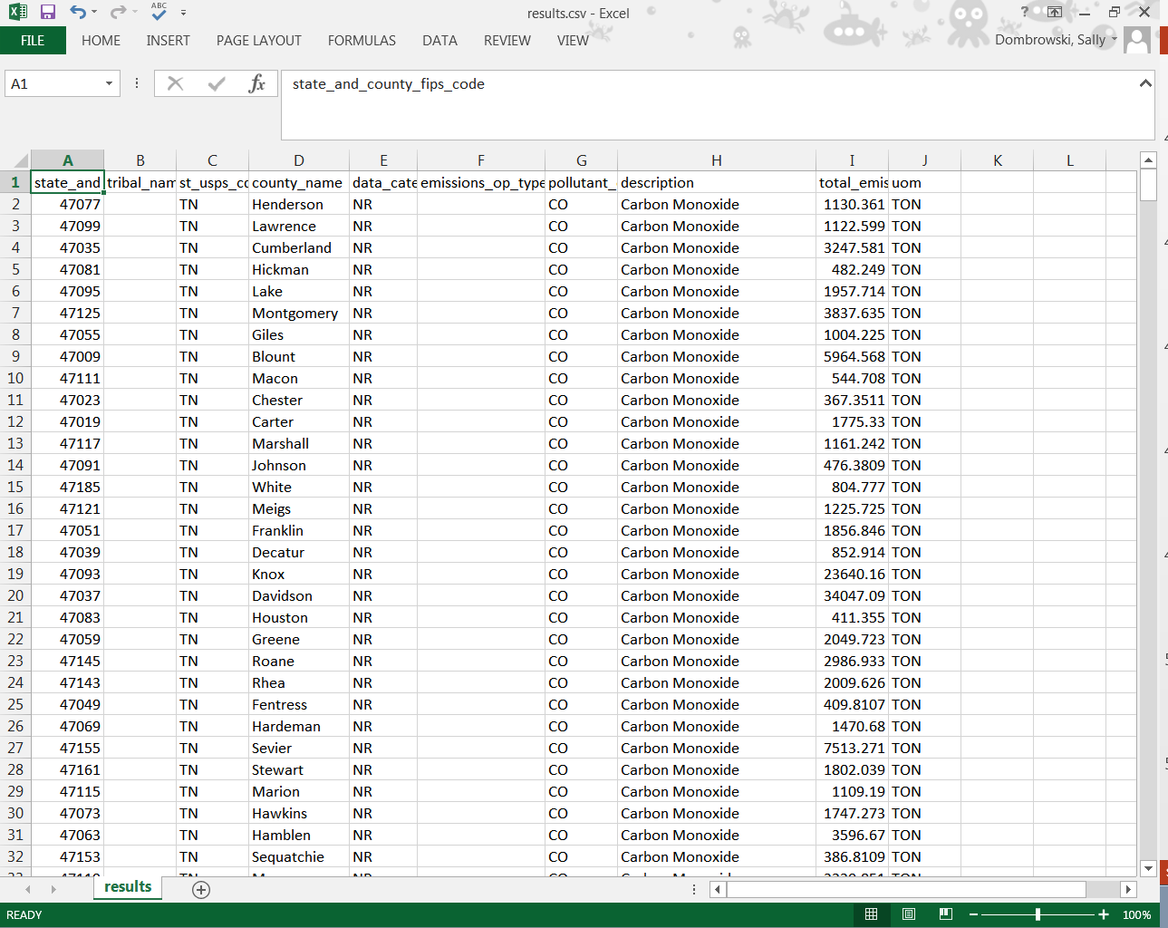

Slide 65
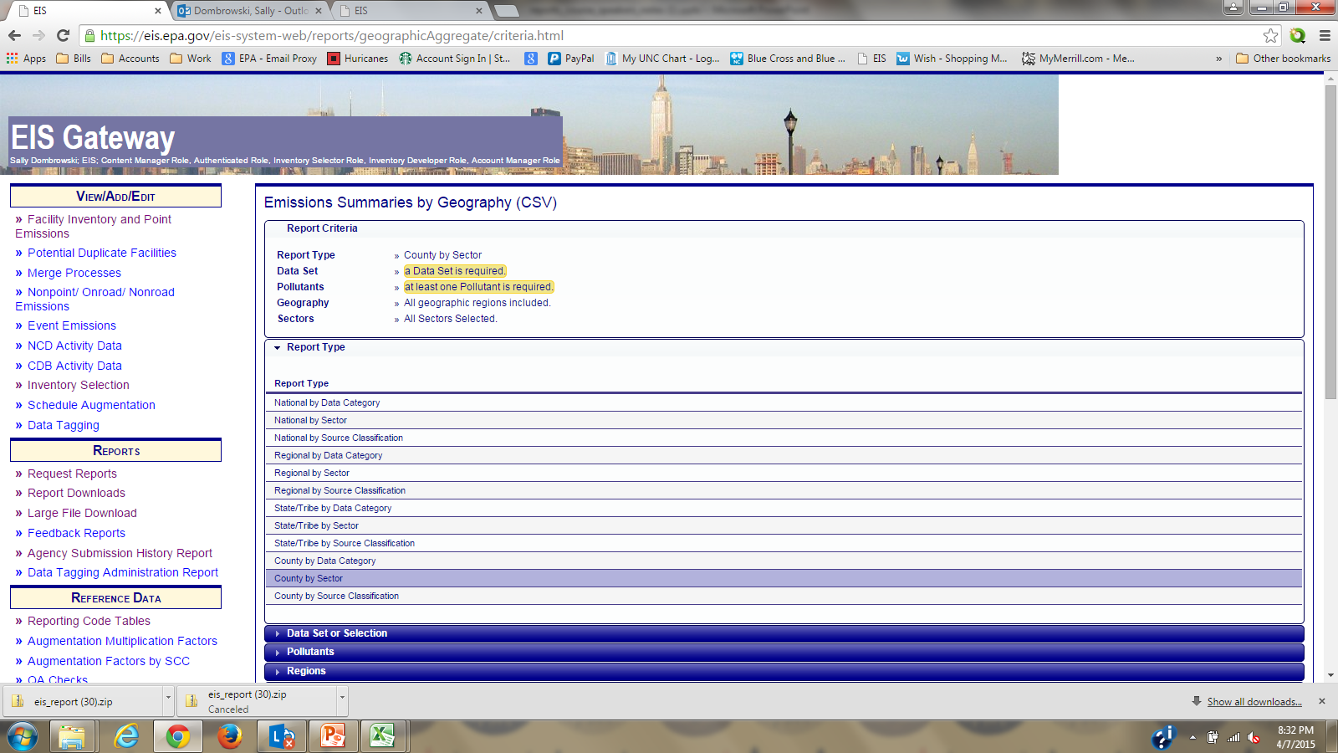
Emissions Summary by Geography
County by Sector
Notes:
Next is the County by Sector report. This is the report that you would more than likely use to look at the nonpoint, onroad, and nonroad data categories.

Slide 66
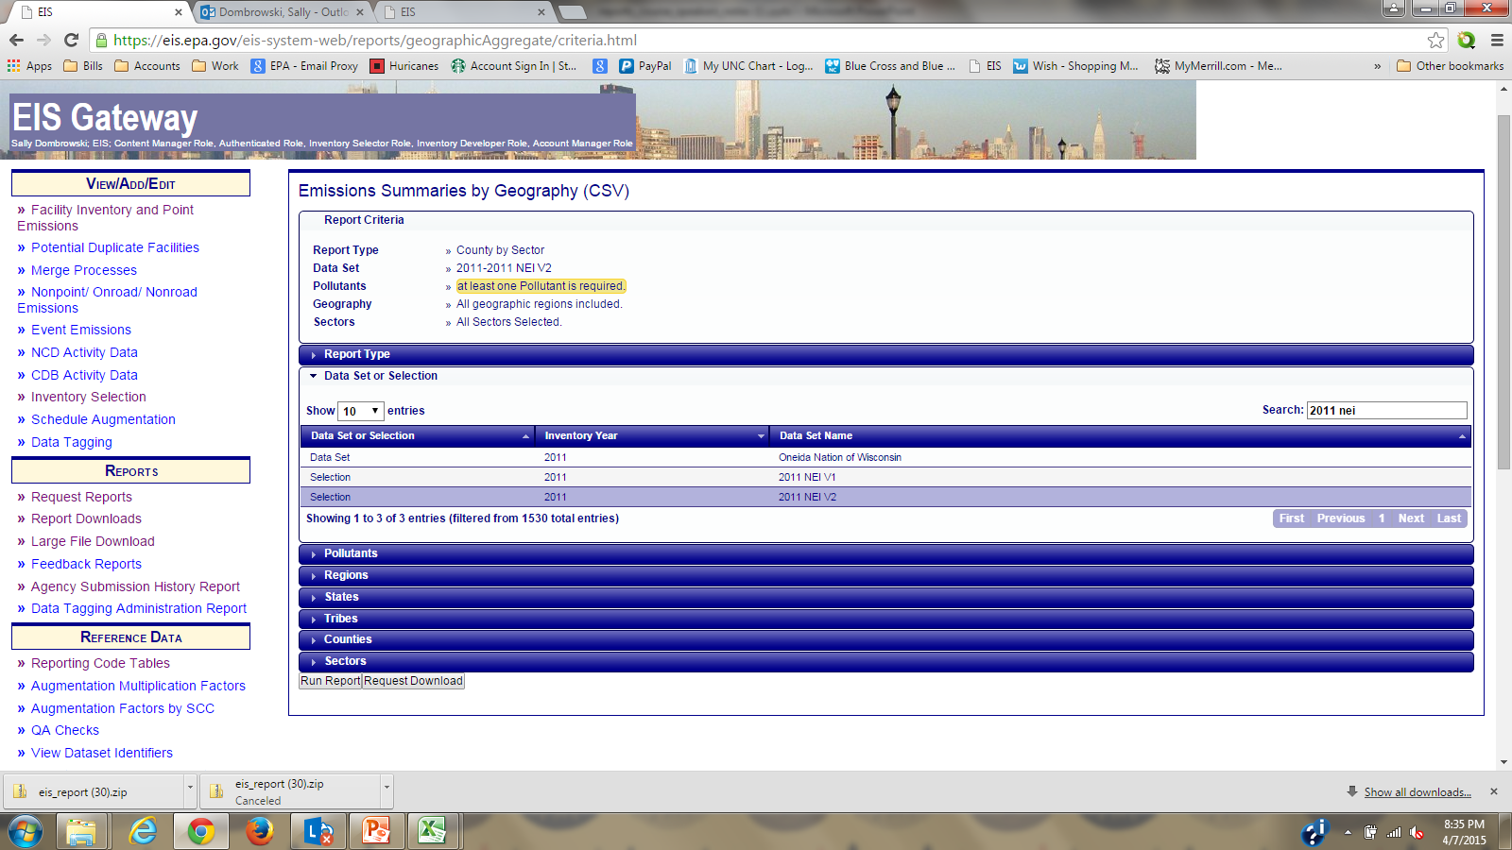
Emission Summary by Geography
County by Sector
Notes:
Select your dataset as you did in the County by Data Category. Again we will use 2011 NEI v2

Slide 67
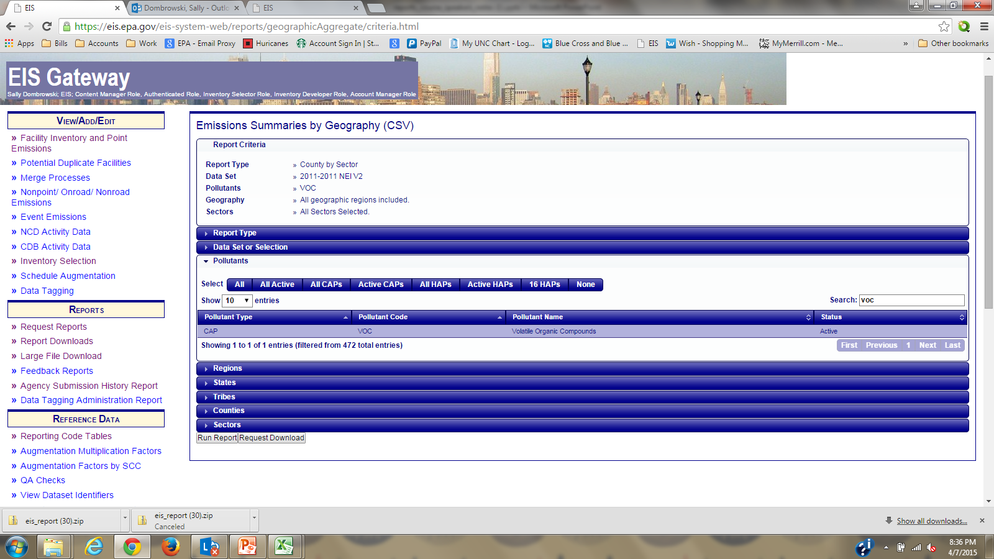
Emissions Summary by Geography
County by Sector
Notes:
Then select your pollutants of interest either by typing in the pollutant name in the search box or selecting the pre-selected buttons on the top. In this case we will use VOC

Slide 68
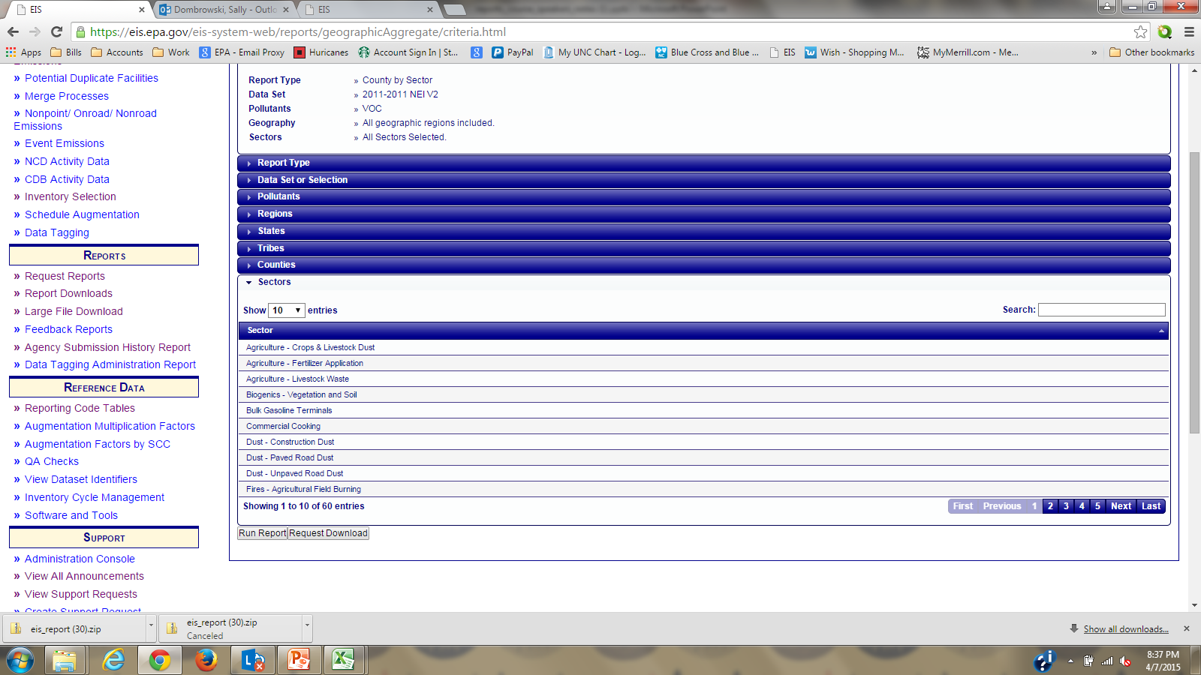
Emissions Summary by Geography
County by Sector
Notes:
You may filter by a geographic area by selecting a region, state, tribe or county.
Last, you may select the sector or sectors that you wish to run your report on. If no sector is selected, then the report will be done on all sectors.
Select “Run Report” to return results to the screen, or “Request Download” to have a file created for download. If your filter is refined enough and you request “Run Report”, you can download the results immediately by using the “Download Results: CSV” at the bottom of the page. A csv is a text file which will open the results in Excel.

Slide 69
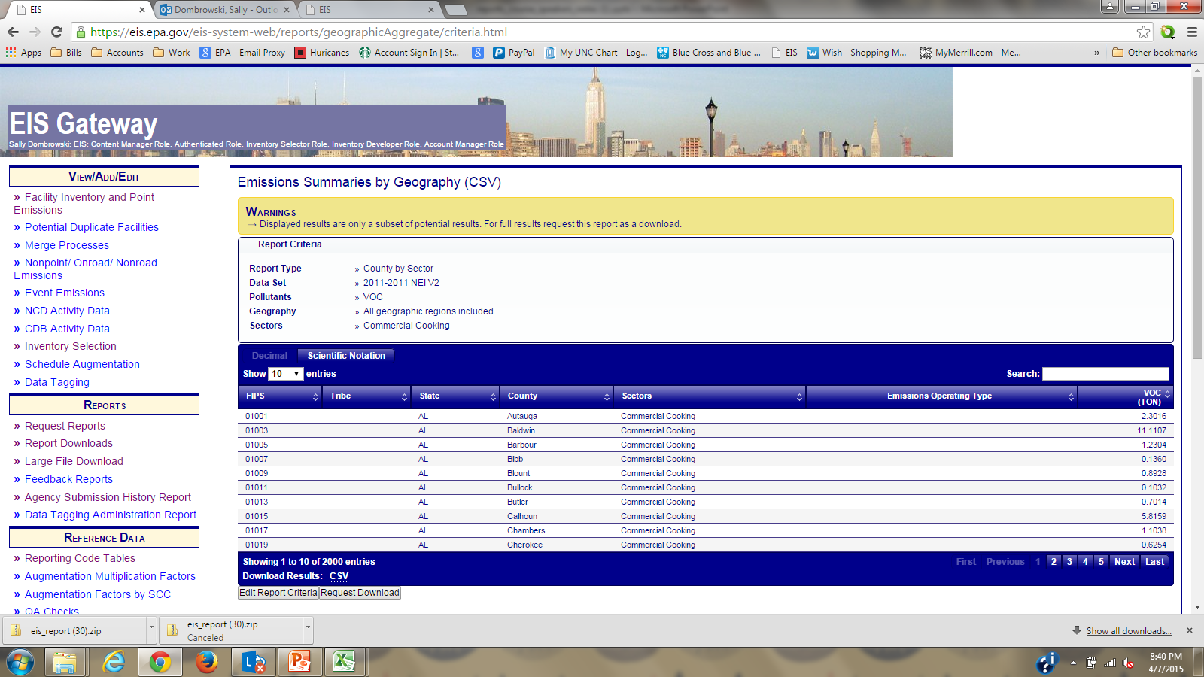
Emissions Summary by Geography
County by Sector

Slide 70
Emission Summary by Geography
County/Tribe by Sector – Data Fields
FIPS
State
County
Tribal Code
Tribal Name
Sector
Emission Operating Type
Pollutant Code
Pollutant Description
Total Emissions
UOM
Notes:
These are the data fields displayed in the County by Sector report. The Emissions Operating Type Code would indicate if the emissions are routine, shutdown/startup or upset and are only populated in the Point inventory.

Slide 71

Notes:
In looking at this report you will notice the “R” under the emissions operating type. This is an indication that this particular sector contains some emissions from the point data category or may be only point emissions.

Slide 72

Emissions Summary by Geography
County by SCC
Notes:
The Emissions Summary by Geography by County by SCC is the lowest aggregation available of the summary reports. Reports at the lowest aggregation will contain the data source of the information displayed.

Slide 73

Emissions Summary by Geography
County by SCC
Notes:
We will repeat the same parameters as we did for the County by Sector report. We will use the 2011 NEI v2 for VOC. The next filters are optional, if nothing is selected all will be returned. In other words, every SCC for every category. Depending on your geographic selection this could be a very large report.
Select Request Download

Slide 74
Emission Summary by Geography
County/Tribe by SCC – Data Fields
FIPS
State
County
Tribal Code
Tribal Name
Data Category
SCC
SCC Level 1
SCC Level 2
SCC Level 3
SCC Level 4
Emission Type Code
Aircraft Engine Type Code
Aircraft Engine Type Description
Emissions Operating Type
Pollutant Code
Pollutant Description
Total Emissions
UOM
Data set
Notes:
These are the data fields displayed in the County by SCC report. Emission Type Code would only be populated if a nonpoint or onroad data category was requested. The Aircraft Engine Type Code would appear in a point request. The Emissions Operating Type Code would indicate if the emissions are routine, shutdown/startup or upset and only be populated in the Point Inventory. The Data Set is the source of the data for that record.
While adding the SCC descriptions is on our wish list, if you wanted to add the SCC descriptions to this report, this could easily be done in Access by downloading the SCC Reporting Codes in the Gateway, join the two tables on the SCC code, and do an update query to add the descriptions.

Slide 75


Slide 76
How can I use the Emission Summary by Facility/Geography Report?
Check EIS against your database
Check process level emissions for a particular SCC
Check unit level emissions against unit type.
Where is a particular emission coming from
Are most emissions stack or fugitive releases
For the NEI, what EPA processes/pollutants were used and what are they

Slide 77

Emission Summary - Events
Notes:
Events are all Wildland and prescribed burns only. Other fire sectors such as ag fires are in the nonpoint data category.
First we select the 2011 NEI V2 as our data set of interest.

Slide 78

Emission Summary - Events
Notes:
Next we need to select our pollutants. For this example, we will select all “Active CAPs”
You can then proceed to select the optional filters of geographic, sectors or SCC and select Request Download
The report will be the daily emissions data summarized at the county and SCC level by day. May be very large files!

Slide 79
Emission Summary by Geography
Events – Data Fields
Tribe
FIPS Code
State
County
Event Program System Code
Event Identifier
Event Name
Event Latitude
Event Longitude
SCC
Event Date
Event Staging Code
Area Burned
Pollutant Code
Pollutant Description
Daily Emissions
UOM
Emissions Source Dataset
Notes:
These next two slides which were not in the original slide deck sent last week.

Slide 80


Slide 81

Report Download
Notes:
Through out this course we have discussed selecting Request Download. Now lets talk about where you can find these reports once you have made the request.
All reports which you have selected for download, will be found under the Request Downloads section on the left hand sidebar.

Slide 82

Report Download
Notes:
There are three icons:
The magnifying glass will show the filters used for the report.
The second icon that looks like a sheet of paper is the download link.
The star icon is not available on a user’s interface and is used by EPA to publish reports. These reports may be found under the Large File Download section on the left-hand sidebar. These reports are National files down to the lowest aggregation.
A red “X” allows you to cancel a report that has been requested.

Slide 83
EPA Data sets
YEAREPA_chrom_split (Used if total chrome is reported)
EPA_HAP-Aug (HAP Augmentation)
EPA_NP_NoOvrlp (Nonpoint estimates with no overlap with Point)
EPA_NP_Ovrlp (Nonpoint estimates with overlap with Point)
EPA_NP_Mercury
EPA LF (Landfills)
EPA EGU (Electric Generating Utilities)
EPA_TRI (Toxic Release Inventory)
EPA_BOEM (Off shore platforms)
EPA_PM-Aug (PM Augmentation)
EPA_MOVES2014 (Onroad estimates)
EPA Airports
EPA-AgBurning
EPA_CMV (Commercial Marine Vessels)
EPA_Rail
Notes:
Sometimes we receive requests for what were EPA’s estimates for a particular data category or sector. The reports can be run on the above. EPA data sets for your State, county or Tribe. Place the above descriptions in the data set search box.

Slide 84
Reports for Data Submitters

Slide 85
Feedback Reports
QA and Production
Statistics worksheet is very important to review
  Do the number of records match the records you are submitting
  Do the number of emission process records match the number of reporting periods
  Do you have a very large number of facility, unit and process adds when submitting a batch upload for the facility inventory
  Recommend noting the number of records in each file and the CDX identifier when the file is submitted.
Critical and Warning Errors
Notes:
Remember that you should always submit your file to the QA Environment until you have a clean feedback report prior to submitting to Production for an official submission.
One of the most important worksheets that you will have in the feedback report is the statistics page. Things that you want to look for is whether the number of records in the feedback report matches the number of records being submitted. It helps if you notate the number of records in your file prior to submission. If reporting emissions, your emission process records should be the same as your reporting period records. If you are doing a dump of all of your facilities to submit your facility inventory, and you have 100s of adds in your records added column, you need to check that these are not due to an agency wide change in identifiers and that duplicates may be created. The proper procedure would be to submit all of your facilities with an end date on the agency identifier and then submit a second file with the new agency identifiers, EIS Identifiers and a start date. If this is not done, you will receive 100s of potential duplicate errors. We can assist you in making these types of changes
All critical errors should be resolved prior to making a production or official submission to EIS. Not resolving these issues will prevent that particular record from being accepted into the system.
You should also review warning errors. We have eliminated many warning checks so that you should have a manageable number of errors to review. Not resolving warning errors will have no effect on the acceptance of the record.

Slide 86

Feedback Reports
Notes:
Feedback Reports can be found under the Reports section on the left hand sidebar. You can see the CDX identifier for your submission, whether the file was Completed or Failed, who submitted the file, whether the file was submitted to QA or Production, the date and time, and a link to download the report. When submitting to QA, you will also get a link to request assistance if you are having difficulties in resolving some of the errors in your report. If you do not select this link, EPA cannot see your data in the QA environment.

Slide 87

Where did my submission go?
Notes:
We often receive calls about an agency having submitted a file but it is not in EIS. You can check the submission by copying your CDX tracking number either from the automated emails which you receive, or on the Gateway under Feedback Reports.
Sign into the web client and select History Search.

Slide 88

Notes:
Cut and Paste your transaction number from your CDX email. Do not complete any other box.

Slide 89

Notes:
You can see that this submission failed. Select the link under Transaction ID. To see why the submission failed selection the Transaction ID link.

Slide 90

Agency Submission History Report
Notes:
Next is the Agency History Report. This report was mentioned in the point inventory course and is a very good tool for QCing your submission.
The Agency Submission History Report is located on the left hand sidebar under Reports.

Slide 91

Agency Submission History Report
Notes:
The first thing that you will want to do is select the inventory year of interest. For our example we will select 2011. This is currently the default view and will change to 2014 when the window opens for submissions in June.
This view has data columns for Agency Organization, Region, and then the individual data categories. The date and time under the data categories is the date and time of the LAST submission. This could change frequently during a submission period. Only the last submission will be displayed on this report. An N/A represents no data being submitted.
You will also notice that these dates are links. I will select the link under the Alabama Point category.

Slide 92

Agency Submission History Report
Notes:
A table is displayed which has several categories:
OP – Expected – These are all facilities in EIS which have an agency identifier and a status of operating.
OP – Total – Is the total number of facilities to include the Expected above and all EPA added facilities such as airports and landfills which you may not be responsible for reporting emissions.
PS- Expected – The number of facilities which have a status of PS, and have an agency identifier.
PS-Total – All facilities including the expected above and any EPA added facilities which are now PS.
Notice that there appears to be 4 facilities under the PS section that had emissions reported to them. This would be okay if the operating status year was a later year than the emissions reporting period.
Looking at the numbers for operating facilities. It looks like we were expecting emissions to be reported to 350 facilities but emissions were only reported for 308. Let’s look at this further. Select the link for OP-Expected.

Slide 93

Agency Submission History Report
Notes:
The following table is displayed. Notice how you cannot really see the entire table without scrolling to the bottom and scrolling to the right. So that you can better managed this table, I am going to scroll to the bottom and select “Download Results: CSV”.

Slide 94


Agency Submission History Report
Notes:
Now I can manipulate the report. The first thing that I would want to do is find out which of these facilities that I was expected to report emissions for but did not. If you do a filter on the Process Count for blanks…

Slide 95

Agency Submission History Report
Notes:
You can now see all of the facilities which have a operating status of OP with an agency identifier, but no emissions were reported. Reviewing this list you need to decide if it is a facility which you inadvertently forgot to report, or if the status of the facility is accurate.

Slide 96

Notes:
Next let’s look at the data tagging report.

Slide 97

Notes:
The data tagging report is created by EPA when a draft version of a new NEI is being release in the Gateway. EPA will “tag-out” data which it feels may be inaccurate or that EPA has better estimates due to CEM data or stack tests.
Select the link for the data category you wish to review. For our demonstration we will select “P” for Point.

Slide 98

Notes:
As you scroll to the right of the particular record you can see the pollutant which was tagged, why it was tagged (we had test data which we felt used a newer emission factor), the tagged value and the new value.
During the comment period an SLT would review these reasons. If, for instance, the reason is the number may be an outlier, the SLT can correct the value and at the end of the comment period the SLT new data would be untag and then included in the next NEI selection.

Slide 99
Questions
Sally Dombrowski
919-541-3269
dombrowski.sally@epa.gov
To register for the EIS Gateway
http://www.epa.gov/ttn/chief/eis/index.html
Notes:
This concludes our training on reports. Please contact me if you have any questions.

