Slide 1
The New Bridge Tool
Sally Dombrowski
US Environmental Protection Agency, OAR, OAQPS, AQAD
Emissions Inventory and Analysis Group
May 19, 2015

Slide 2
What has changed?
Java
Access 2013 based; backward compatible to Access 2007
Header:
  Document Header replaces CERs and Exchange Header tables.
Facility Inventory:
  The Facility Site Geographic Coordinates table merged into Facility Site table
  The Release Point Geographic Coordinates table merged into Release Point table.
Notes:
The older Bridge Tool became inoperable because of Java updates. The new bridge tool is MS Access based instead of Java.
Built on Access 2013 but is backward compatible to Access 2007.

Slide 3
What has changed?
Point
    CERs and Exchange Header tables merged into Document Header table.
  Facility Site, Emission Unit, and Emission Process identifiers and staging tables no longer needed
  One table required to report emissions – Emissions table
  Reporting Period table only required for reporting Activity
Nonpoint
  CERs and Exchange Header tables merged into Document Header table.
  One table required to report emissions – Emissions table
  Reporting Period table only required for reporting Activity
  Emissions Process and Location tables only used to add comments

Slide 4
Point
Report Emissions Only
Report
Activity
Report Operating Details
Report Supplemental Parameters
Emissions Table
Reporting Period Table
Operating Detail Table
Supplemental Parameters Table
If you are only reporting emissions, you only need the emissions table.
Notes:
With the flattening of the files the minimum that you would need to report emissions is the emissions table.
If you wish to add activity data then you will need the Reporting Period table.
If you are adding operating details you will also need the Operating Detail table
And lastly, if adding supplemental parameters such as %Ash Content, then you would need the Supplemental Parameter table.
Nothing has changed as far as controls. You will still need the Control Approach, Control Method and Control Pollutant tables.

Slide 5
Nonpoint
Location and Emission Process Tables – Comments only
Excluded Location – No change
Control Approach, Measure and Pollutant – No change
Report Emissions Only
Report
Activity
Report Operating Details
Report Supplemental Parameters
Emissions Table
Reporting Period Table
Operating Detail Table
Supplemental Parameters Table
Notes:
For Nonpoint, the same layout applies.
To report emissions the minimum you need report is the Emissions table.
The Location and Emission Process tables may be used to add comments with regard to either subject.

Slide 6
Where can I get the Bridge Tool?
The Bridge Tool for each data category will be locate on CHIEF at http://www.epa.gov/ttn/chief/eiinformation.html under “Emission Inventory Tools”
If using FireFox right click on the file to download.
“Emission Inventory Tools” link also available on the Gateway after June 15 under the Reference Data section.

Slide 7
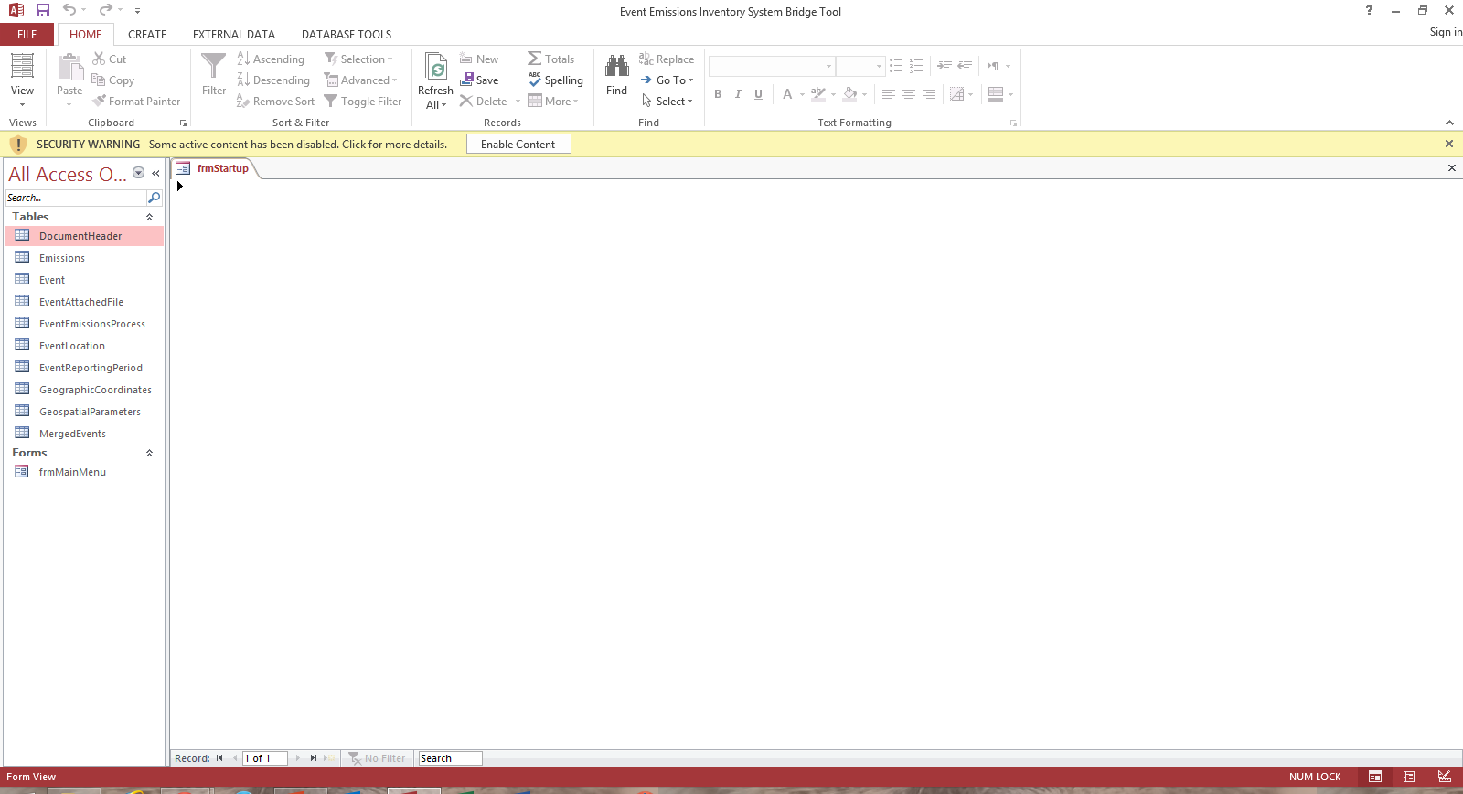
Getting Started
Download the Bridge Tool for the data category of interest
Rename your file prior to use
When the file opens
  Click on “Enable Content” security warning at the top of the page.
Notes:
Download the tool for the data category of interest from the CHIEF website listed in the previous slide.
The initial opening process may take as much as 20 seconds since the Bridge Tool is activating numerous XML files which are used in the validation process.
Rename your file. This will prevent you from overriding an existing file if you download the Bridge Tool again. You may keep your facility and point in the same database or have separate databases for each data category.
Click on “Enable Content” security warning. This will only need to be done once for each file name and may not need to be done for certain MS Access Trust settings.

Slide 8
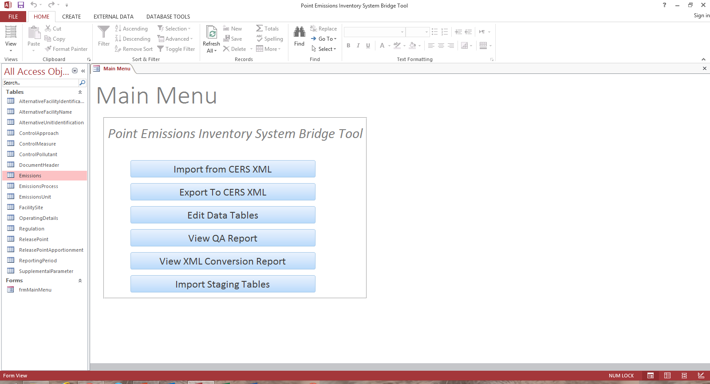
Notes:
After selecting “Enable Content,” a Main Menu page will open. If at any time you close this menu, you may return by doubling clicking the frmMainMenu table under the FORMS section of the file.
There are six areas to the menu
First is the “Import from CERS XML which will be used if you want to convert a facility or emissions snapshot report.
Exort to CERS XML which is used to convert your staging tables into a XML file which can be used for submission to the QA or Production environment.
Edit Data Tables – Use to edit records or tables. You may still open the table directly and not use the main menu.
View QA Report – Similar to the feedback report, in that if there are any errors in the conversion process, those errors will be found here.
View XML Component Scan Report – After importing or exporting and XML file this report will give you the statistics as to the number of records in each component. These statistics could be used as a comparison against the statistics page of the feedback report when you do an export.
Import Staging Table – Can be used to import older staging table files into the new format

Slide 9
Notes:
Let’s start by looking at how to import a facility snapshot in CERS XML
This function would be used to convert a Facility or Emissions snapshot report from the EIS Gateway to staging tables.

Slide 10
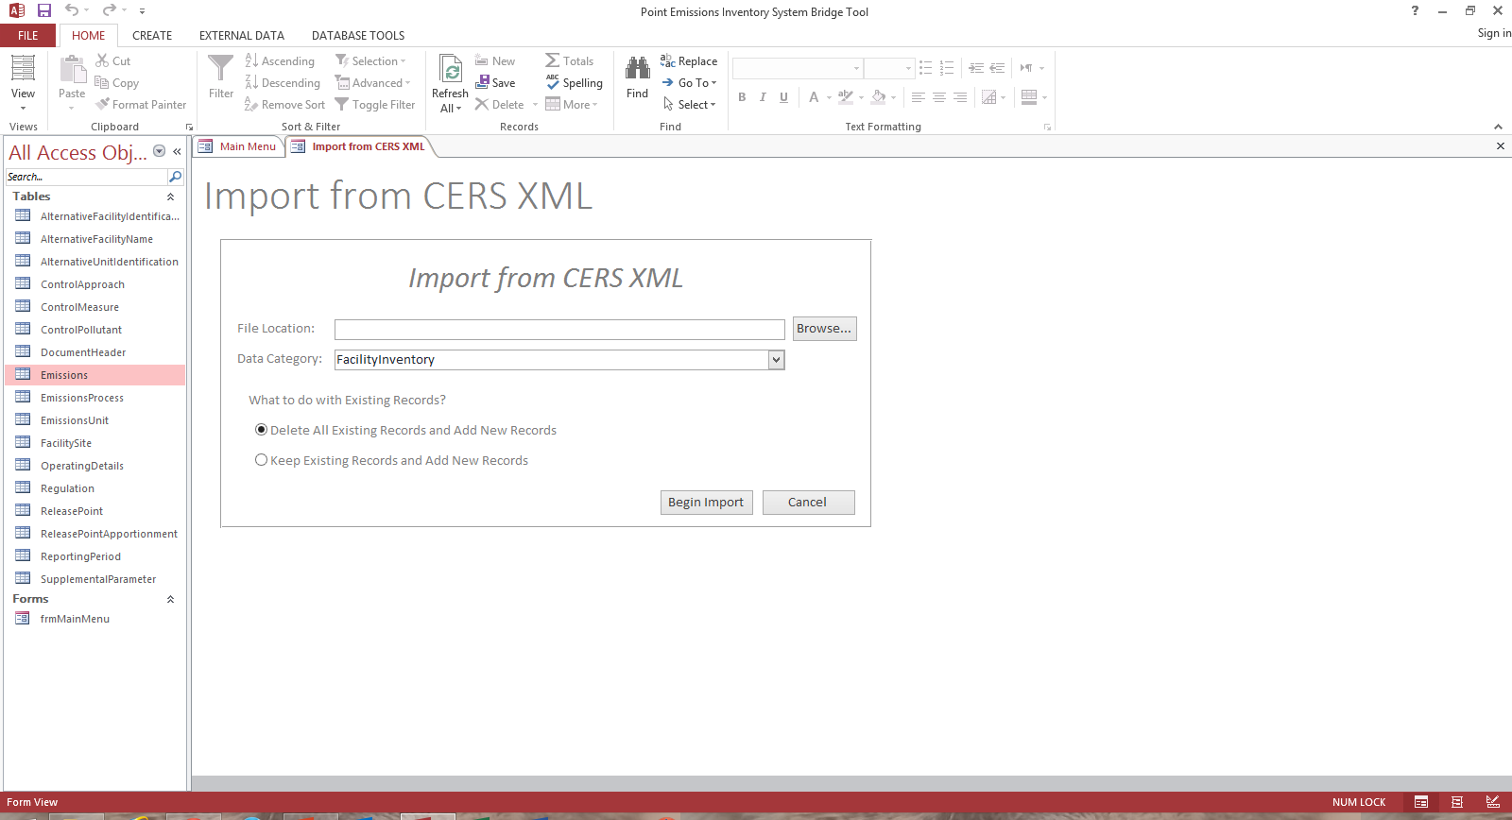
#1
#2
#3
#4
Notes:
First, browse for the file that you want to convert from XML to staging tables.
Select the data category of the file. Either “Facility Inventory” or “Point”
Next select either to delete any exiting records already in the staging tables an replace with the incoming records (1st selection); or keep existing records in the staging table and have the incoming records appended to those records. The second option will keep any previously added data and append the new records to already existing records. This option would be applicable if you had already imported your facility inventory and wanted to then import your point.
Select “Begin Import”
SLEIS USERS: Exports from SLEIS can now be converted using the Bridge Tool without having to manipulate the XML schema first.

Slide 11
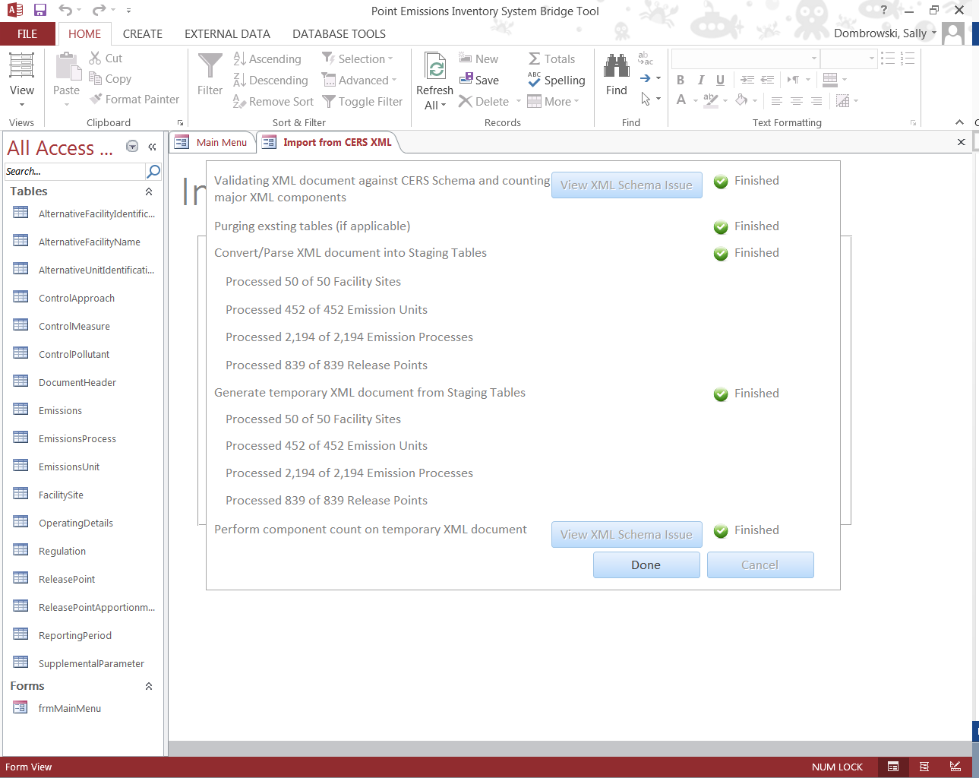
Notes:
As the file is processing your will see a screen to notify you of where in the conversion process the file is currently at. As each component is completed you will receive a green checkmark and a “Finished” status.
Select“Done” when complete. If there is an error in the file and the Bridge Tool cannot convert the file, a red check mark and “Error” will appear. You would then select “View XML Schema Issues” for a description of the error.
Selecting “Done” will close the processing screen or you may use the “x” in the corner to close this screen.

Slide 12

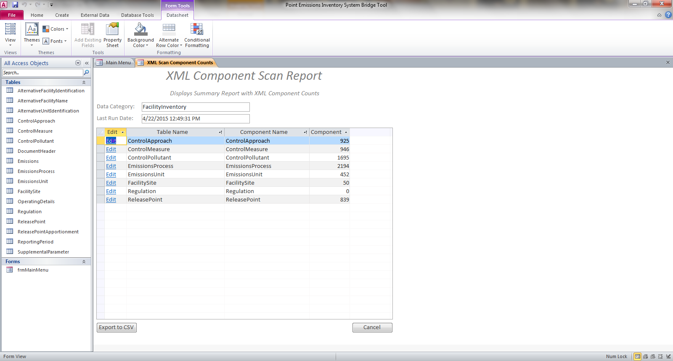
Notes:
After importing a file, you can select “View XML Conversion Report” to get a recap of the data imported.
You can also use “Edit” link to go directly to a table for editing.

Slide 13
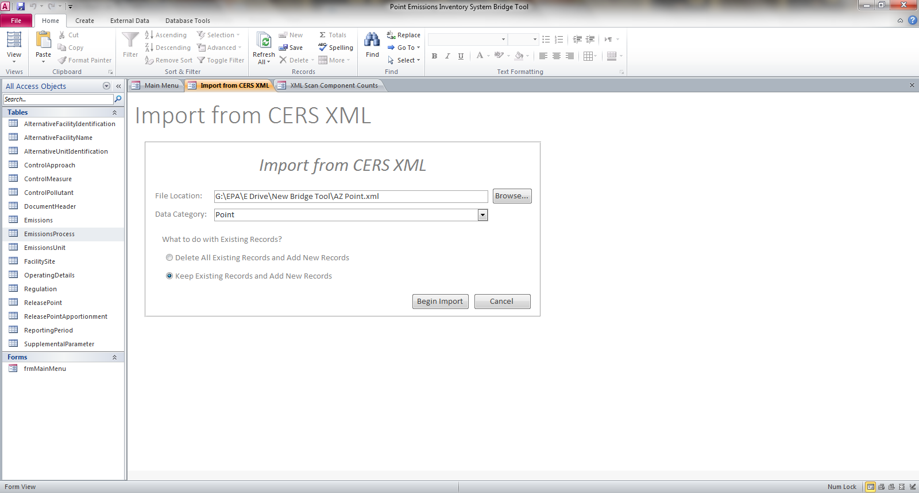
Notes:
Next we will import an emissions snapshot using the same file we used for the facility snapshot file.
Browse for you emissions snapshot file
Select “Point” data category
Be sure to select the second option to append records and not replace. If you are planning on having both your facility data and point emissions in the same file If you do not, all the previously imported facility data , which we just did, will be deleted and only the emissions data will remain.

Slide 14
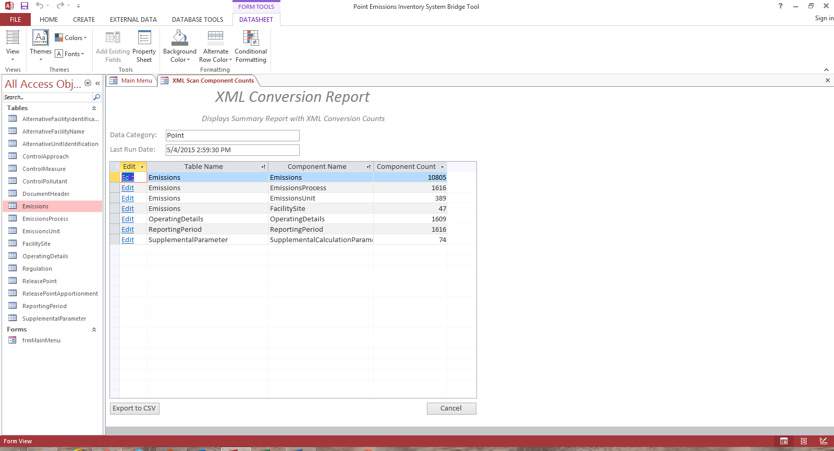
Notes:
After the import has processed look at the XML Conversion Report. From this report it looks like we imported over 10,000 emission records for 47 facilities, 389 units at 1616 processes.
The XML Conversion report will show you the count for the last import only.

Slide 15
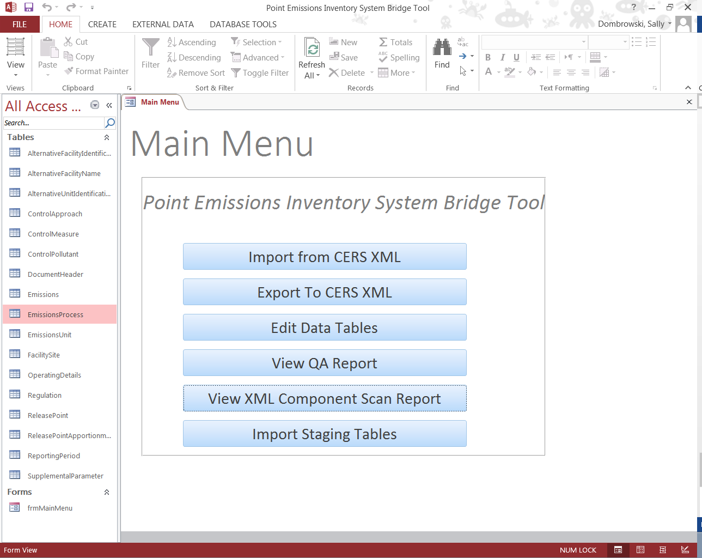
Notes:
The next function that we will look at is the Export to CERS XML

Slide 16
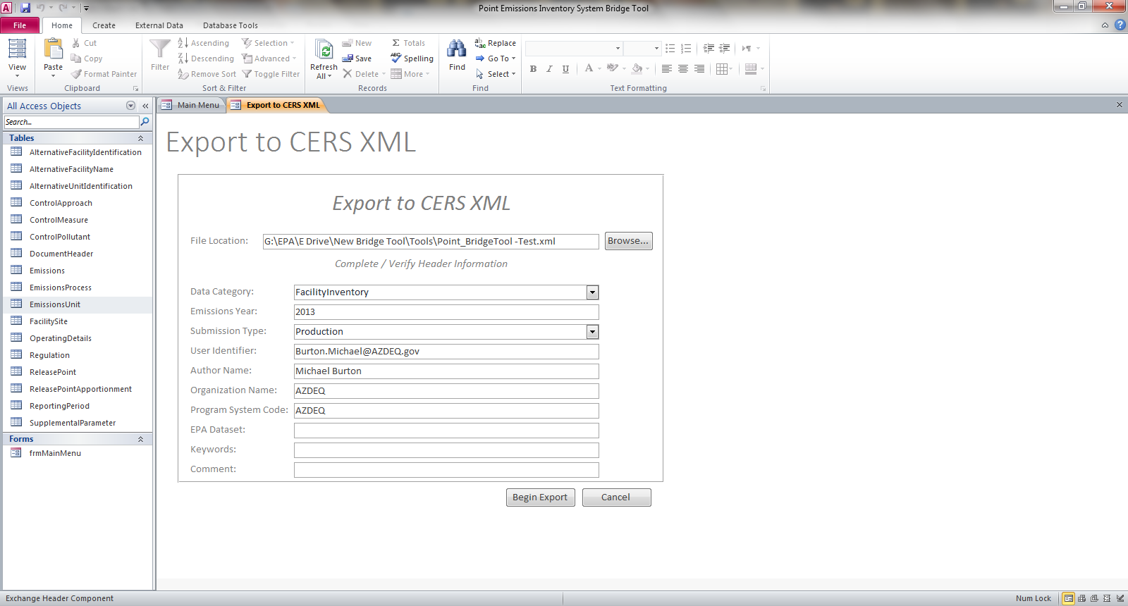
Notes:
Next view the file location. File location will default to wherever you have saved your renamed tool
Select the data category to be converted. Either Facility Inventory or Point
Next complete the Header information.
EPA Dataset is for EPA use only and should remain blank
Keywords, and Comment are optional.
Last select “Begin Export”

Slide 17
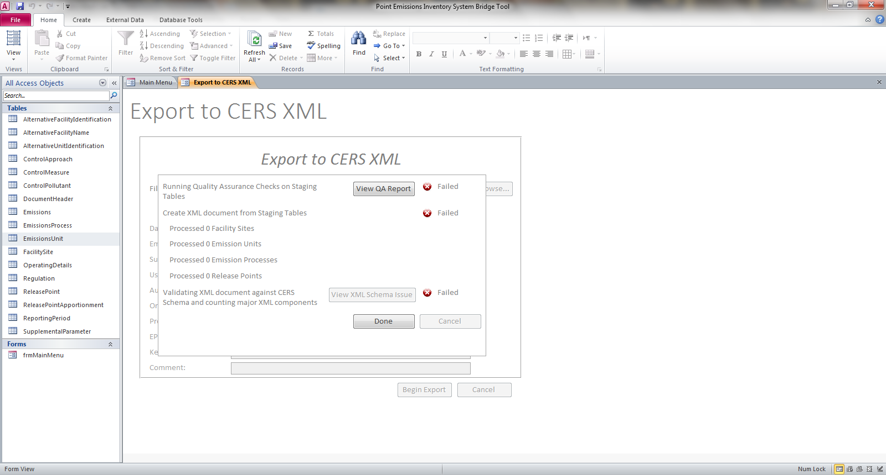
Notes:
It looks like there are problems with this export. Select “view QA Report.”

Slide 18
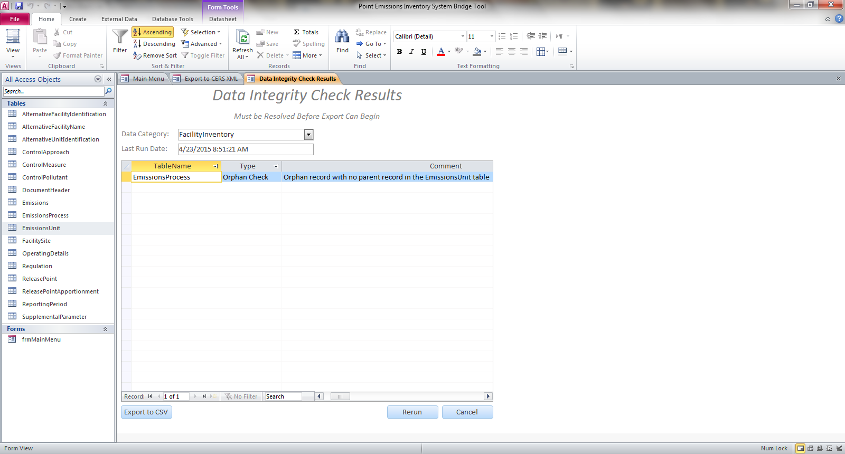
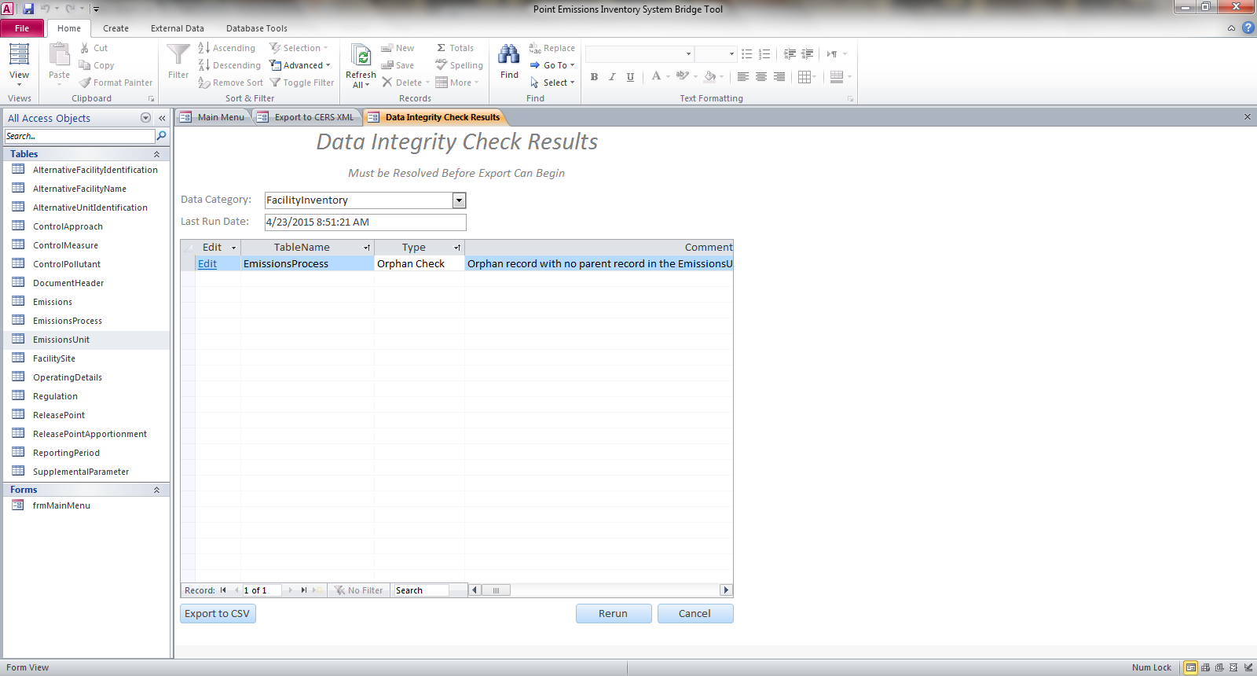
Notes:
The QA report states that there is an Emission Process missing an Emission Unit record.
If you scroll to the left you will see an “Edit” link …

Slide 19
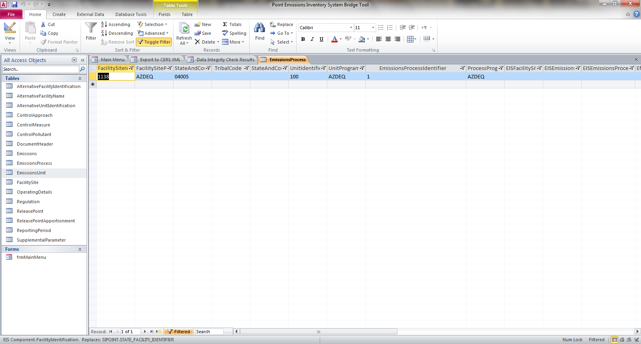
Notes:
…which will bring you to the record in the Emission Process table to see what unit is missing from the Emissions Unit table. Add this unit to the Emissions Unit table and start the conversion process again.
The correction will not be reflected in the QA Report until you run the conversion process again.

Slide 20
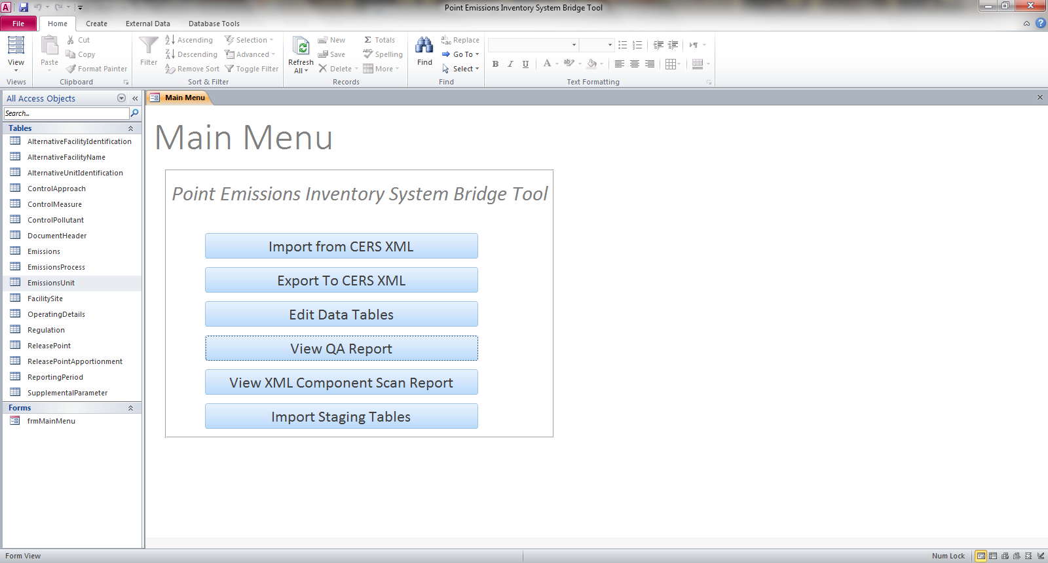
Notes:
If you decide not to address thee errors immediately, you can always pull them back up by selecting “View QA Report” from the Main Menu.

Slide 21
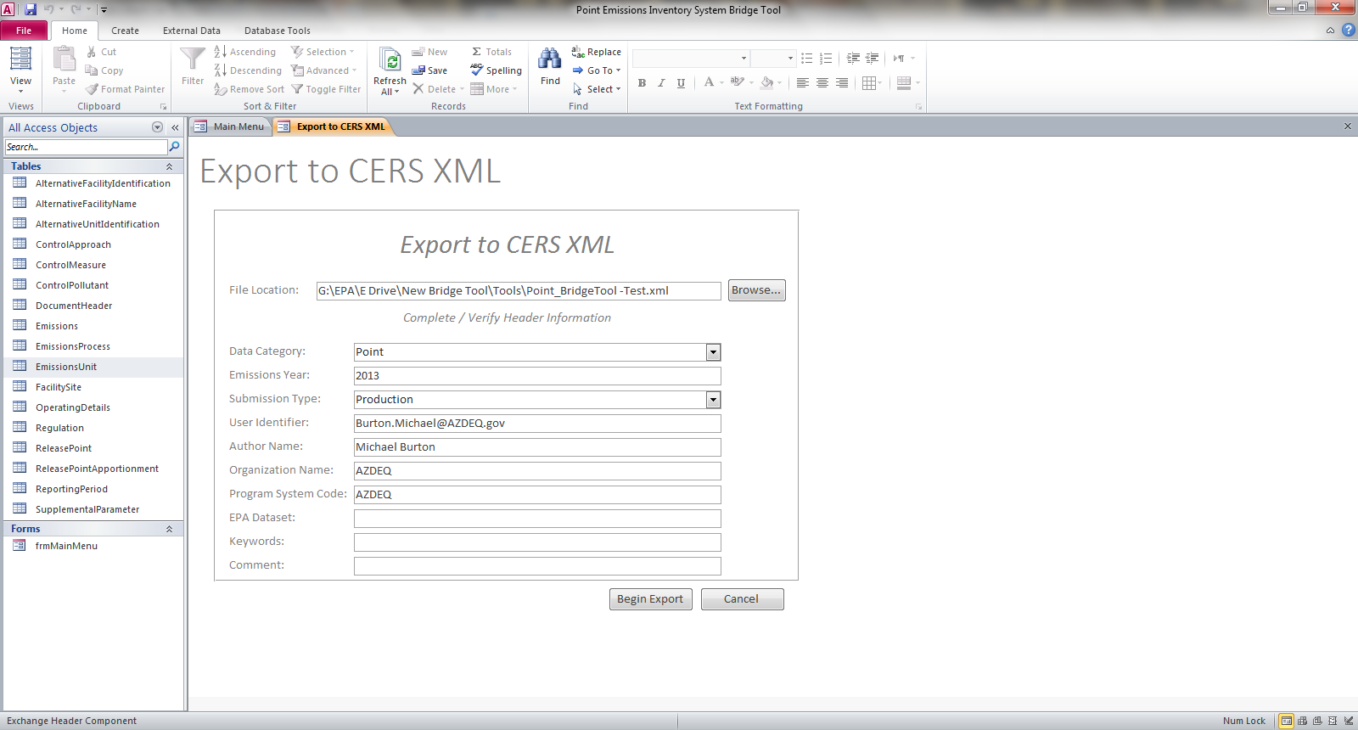
Notes:
Next we will export a point XML file.

Slide 22

Notes:
Again it looks like there are errors which are preventing the file converting.
Select “View QA Report”

Slide 23
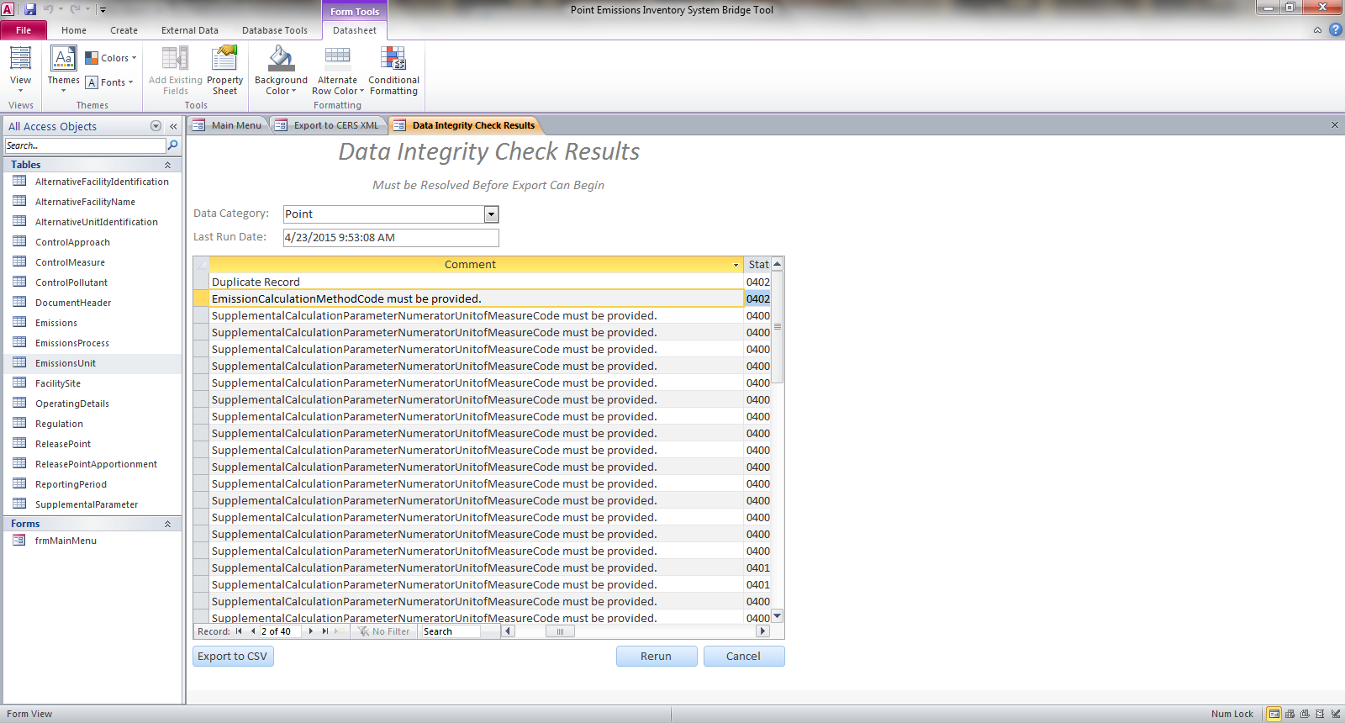
Notes:
There are 440 validation errors which must be corrected in order to export a viable XML file.
The first error is a duplicate record error. The remainder of the errors show that an Emissions Calculation Methodology Code is missing and the Supplemental Calculation Parameter Numerator Unit of Measure is missing from numerous records.
Let’s address the duplicate. Select the “Edit” link for the duplicate on the far left hand side of the record.

Slide 24
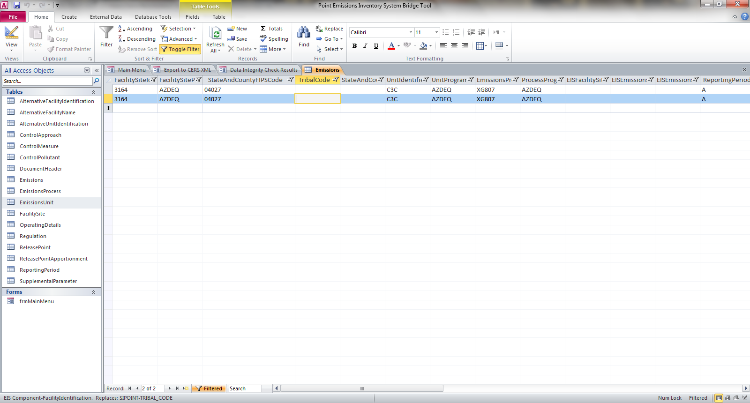
Notes:
The edit link will direct you to where a duplicate record exists. Delete the duplicate record and return to the QA report. Correcting this error will not delete it from the QA report until you run the export function again.

Slide 25
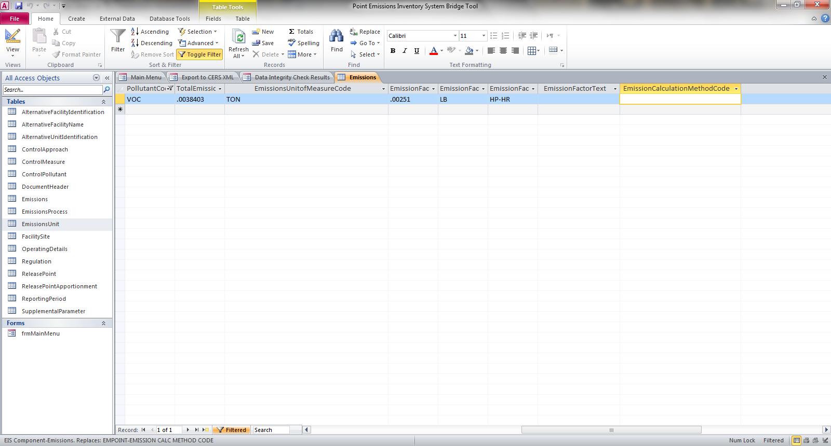
Notes:
Next let’s correct the Emission Methodology Calculation Code. Select the “Edit“ for the error in the QA Report.
Next add the missing code. Again remember that the correction will not be reflected in the QA report until you have rerun the conversion process.
After correcting all of the errors listed in the QA report, re-run the export function. The Bridge Tool is designed to look for:
Widows/Orphans
Duplicate Records
Some required data elements.
The Bridge Tool does not run the many QA checks that are processed during the data submittal to QA or Production environments. The Bridge Tool only checks for items which will prevent a valid XML conversion.

Slide 26
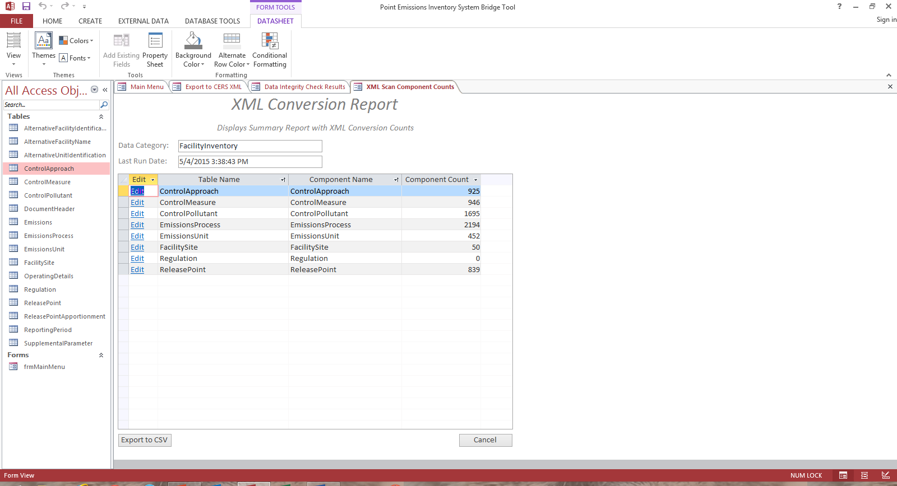
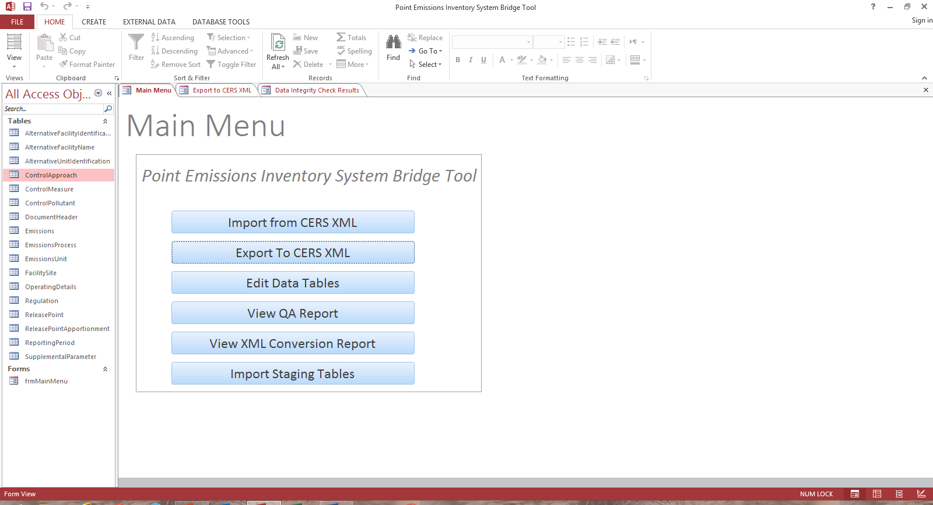
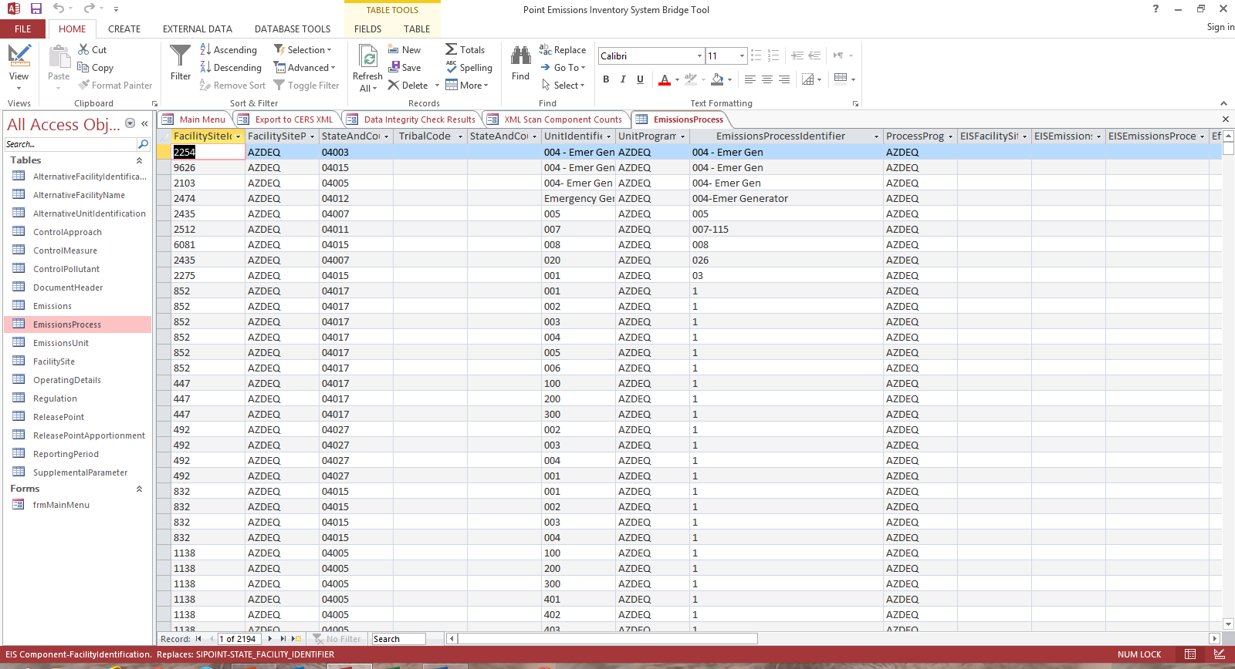
Notes:
Once you file completes a conversion run without any errors, select “View XML Conversion Report.”
The XML Conversion Report will give you a count of the number of records in each component. There are two ways to use this count report. First look at the number of records in each staging table and compare to the number of records in each record of the conversion report. They should be the same.
You can also use these counts to compare against your Feedback Report/Statistic page when you do your submission. They should also be the same.

Slide 27
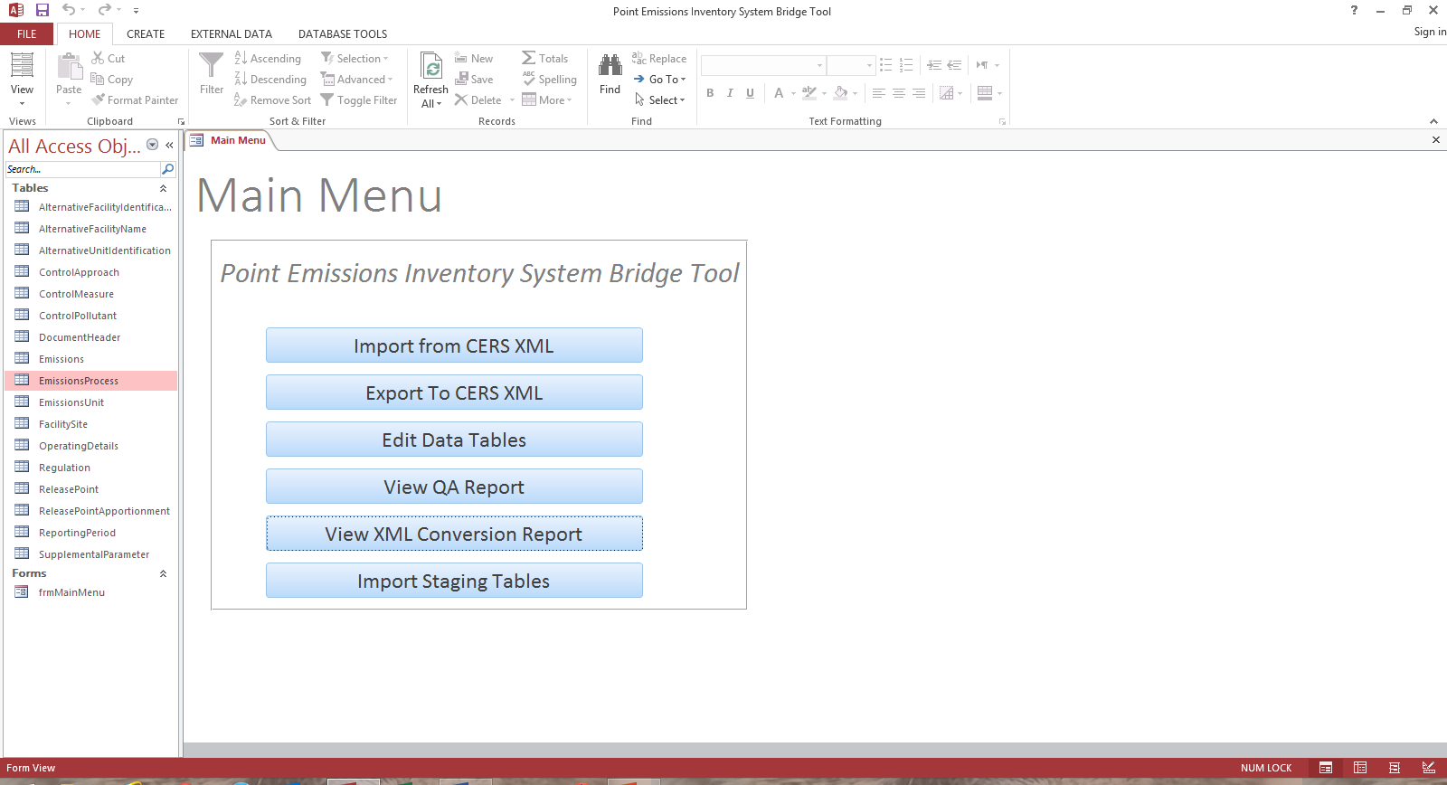
Notes:
The last functionality that we will review is the Import Staging Tables.
.If you have existing staging tables which were created with the previous Bridge Tool, we have added the functionality to be able to import those tables into the new format.

Slide 28
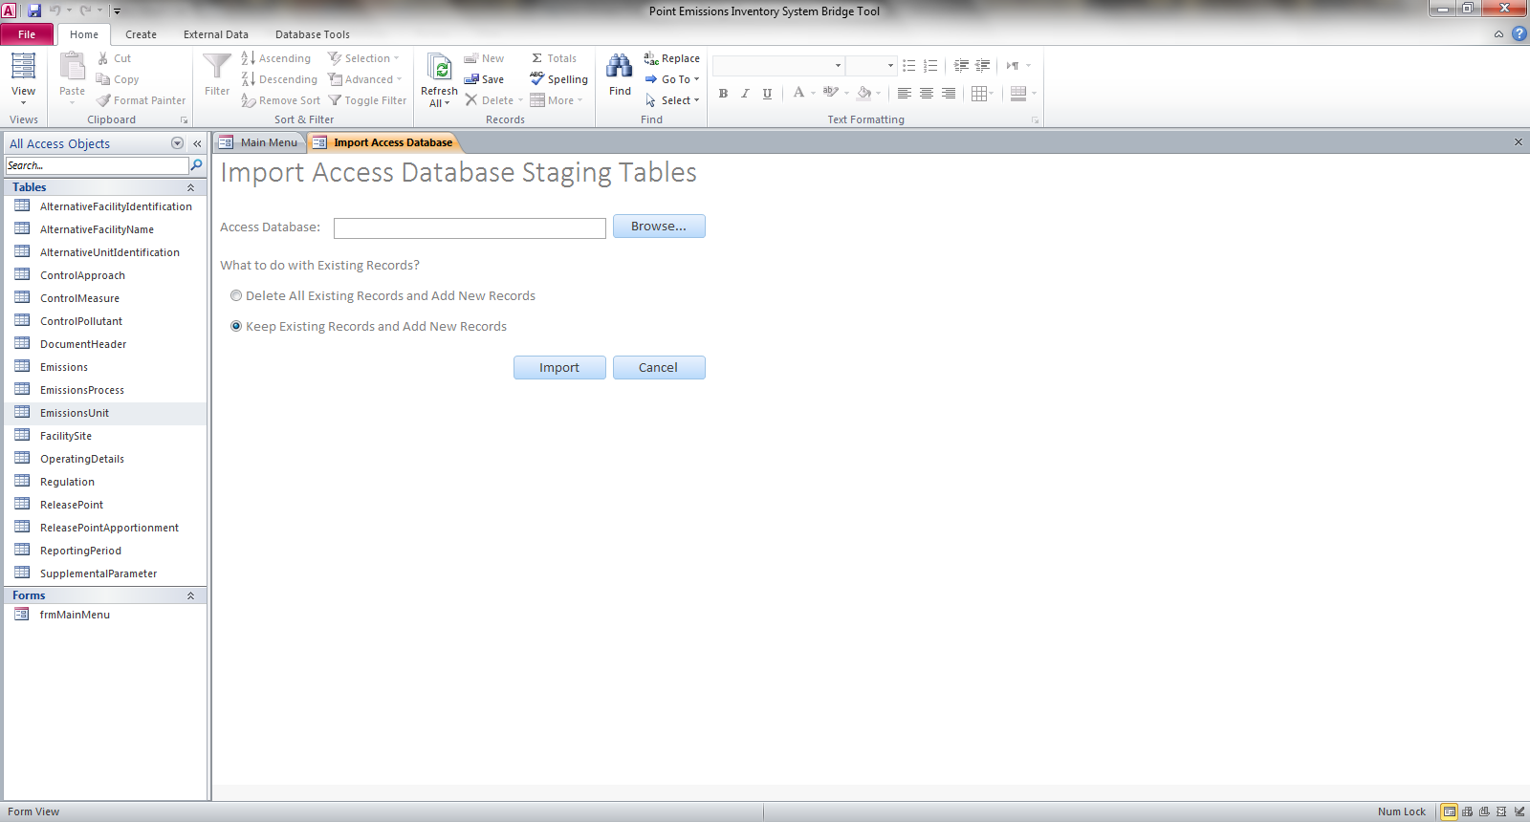
Notes:
Browse to select your old staging table file for import. REMEMBER that the first option will DELETE and replace all existing records currently in the staging tables and the second option will APPEND the imported records to the existing records if they exist. Your will NOT receive a screen showing the file being processed or an XML Conversion Report when importing older staging tables.
This import will not bring in the CERS and Exchange Header information since this will need to be populated when you do an export from the new tool.

Slide 29
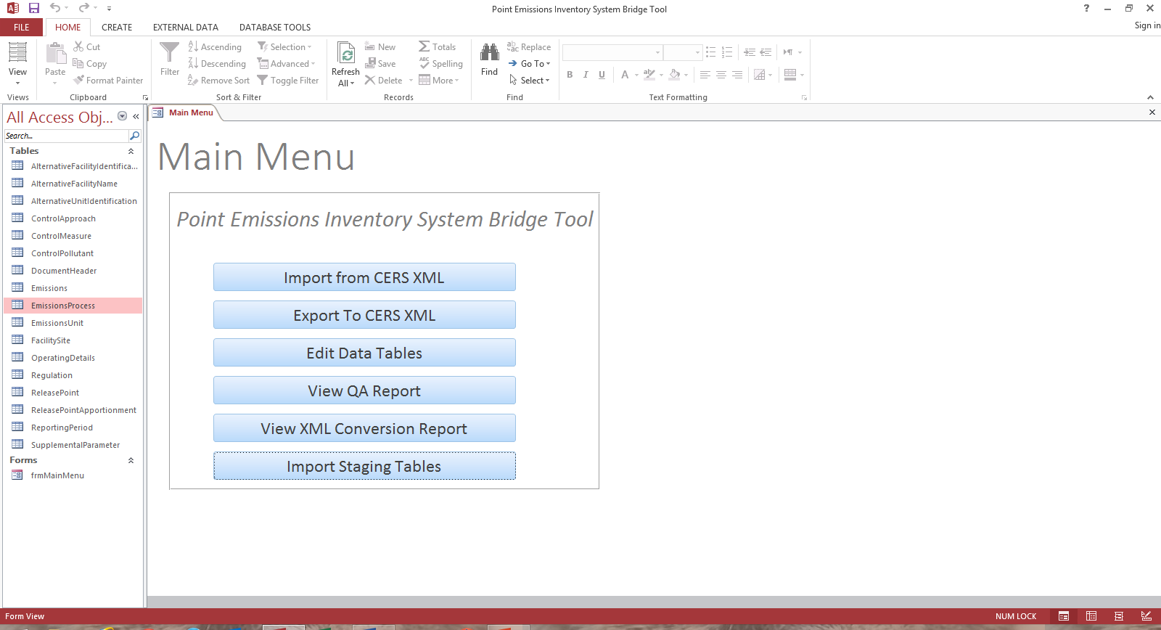
Notes:
Remember that you can close the Main Menu at anytime by selecting the “x” in the top right hand corner. Double clicking on the frmMainMenu under the Forms section will bring the menu back up.
As in the old Bridge Tool, you still have the ability to import your own tables using the Access import function.
You may add your own queries or additional data fields at the end of a staging table.
DO NOT CHANGE THE DATA TYPE OR NAME FOR ANY FIELDS WHICH ALREADY EXIST IN THE STAGING TABLE.

Slide 30
Nonpoint/Onroad/Nonroad Bridge Tool

Slide 31
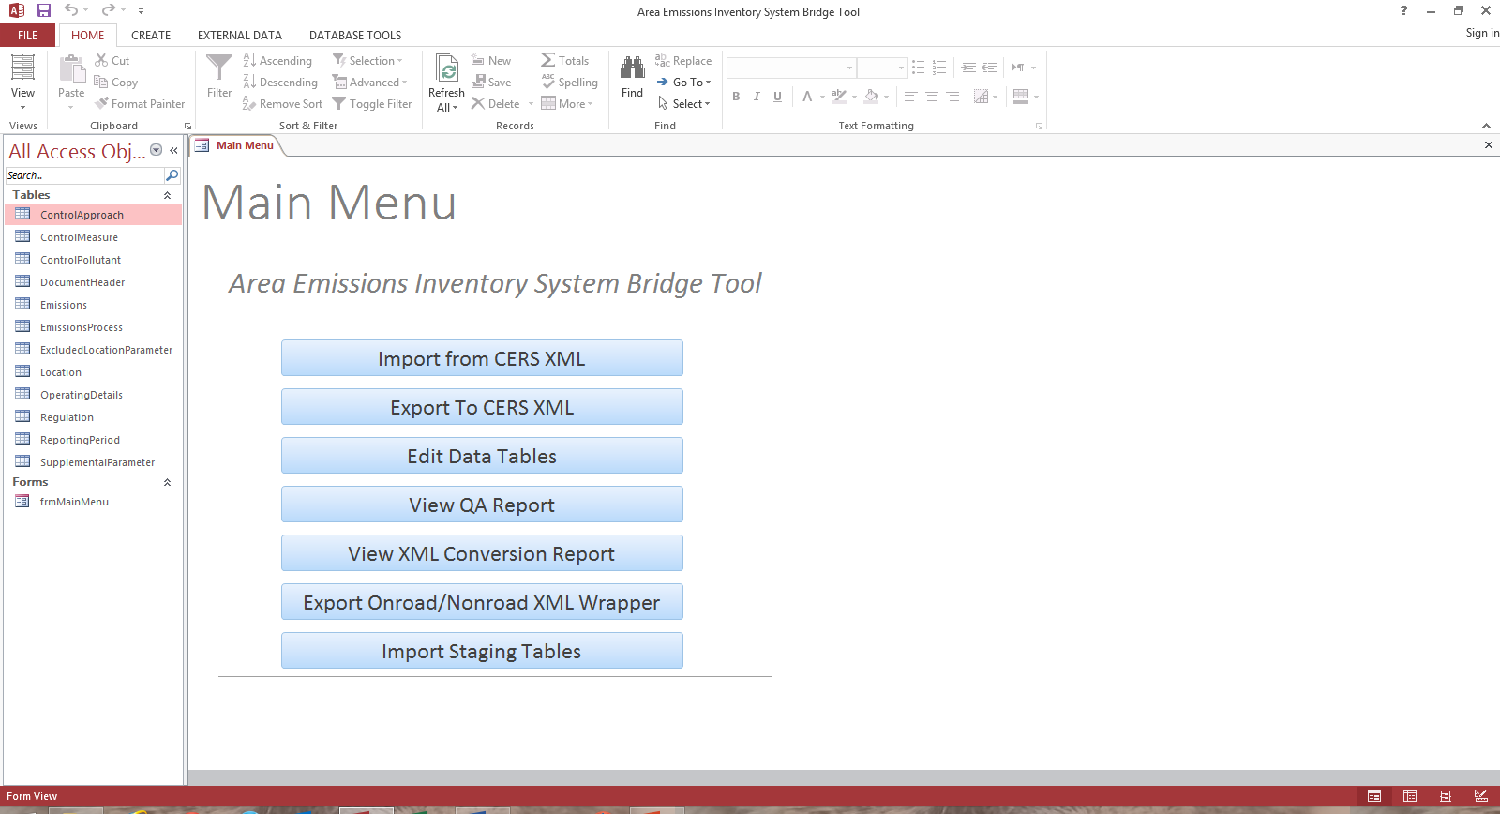
Notes:
Nonpoint has the same functionality as the Facility/Point Bridge Tool.
There is one additional feature in this tool. The Export Onroad/Nonroad XML Wrapper which is required when submitting your mobile inputs.

Slide 32
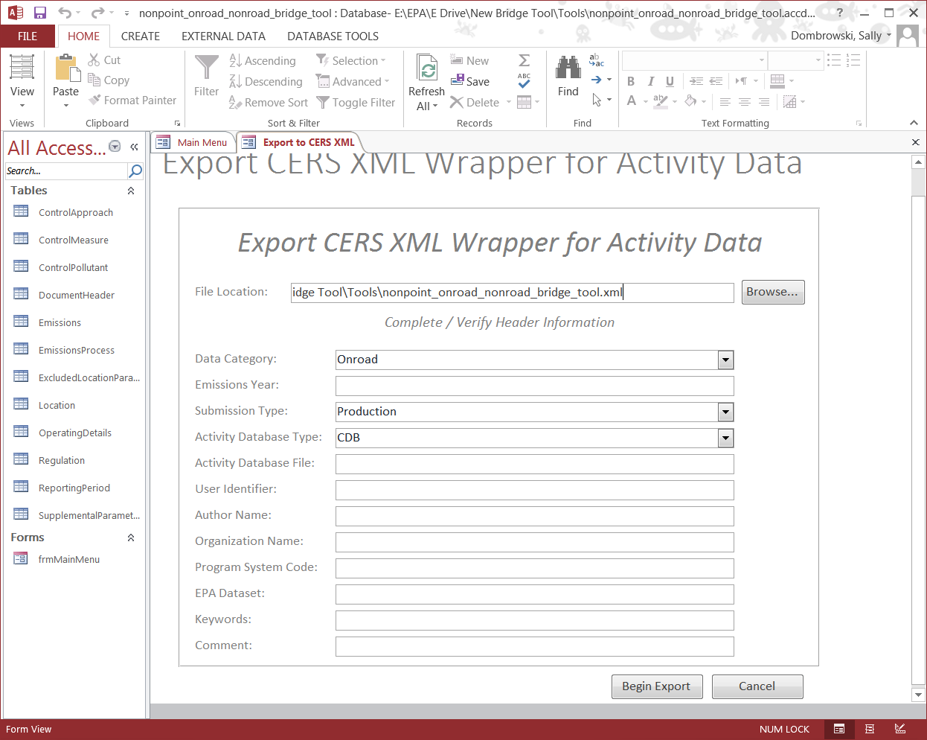
Notes:
First select where you would like the wrapper to be saved to. The tool automatically defaults to the location of the tool on your computer.
Next select from the dropdown menu either Onroad or Nonroad.
Type in the Emissions Year
Select the Submission Type. Either QA or Production.
Now select your activity database type. Either CDB for Onroad or NCD for Nonroad.
Complete your User ID, Author Name, Organization and Program System Code
The EPA Dataset field is used by EPA only and should remain blank.
Keywords and Comments are optional fields.

Slide 33
The New Bridge Tool
Event Bridge Tool
Error – Compile error in hidden: Random File
New Version – CHIEF – Emission Inventory Tools http://www.epa.gov/ttn/chief/eiinformation.html
Instructions – CHIEF – Emission Inventory System – EIS Training http://www.epa.gov/ttn/chief/eidocs/training.html#eis
Notes:
There is an Event Bridge Tool which operates just like the Facility/Point. There have been no changes to the table structure.
Several people downloaded the first version of the Bridge Tool and received the “Compile error in hidden: Random File”. This error is caused by 64 bit vs 32 bit issues. These have been resolved and the new versions have been posted today.
This presentation, with speaker notes, will be posted to CHIEF at the location indicated by tomorrow.

