Slide 1
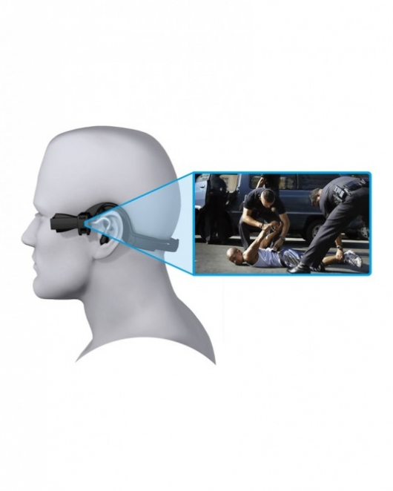
Overview Body-Worn Cameras

Slide 2



Police & Body-Worn Cameras
Rialto, California
60% drop in use of force
80% drop in complaints
New York City
New Orleans, LA

Slide 3
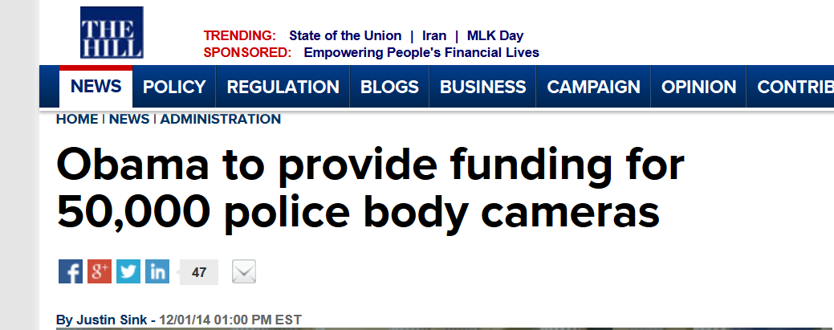
Police & Body-Worn Cameras
$263 million
Body-worn cameras
Training

Slide 4

Police and Privacy
Privacy
Officer
Notes:
No I do not have a badge and I can not solve parking tickets
I am the first in the nation so still trying to figure out stuff
Working in technology
Came from feds
Who lives in DC?

Slide 5
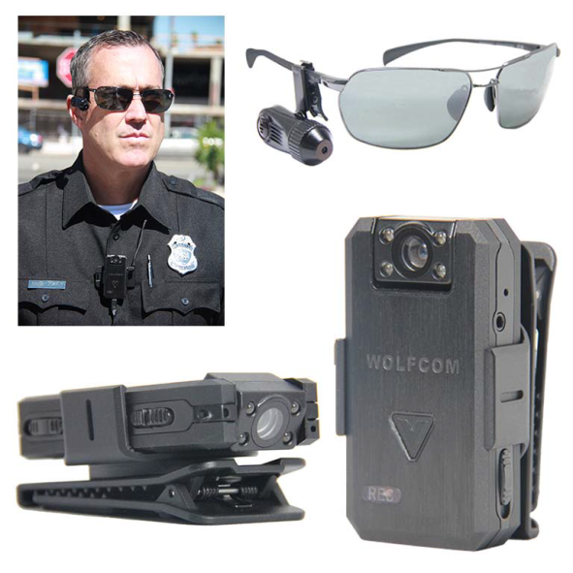
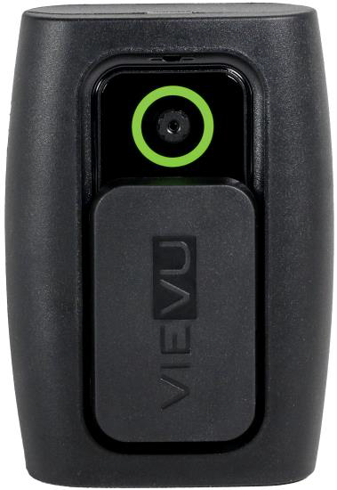
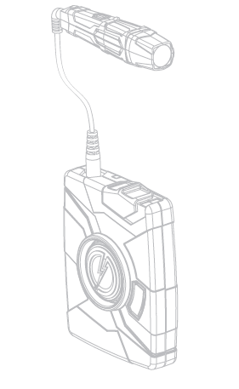
Body Worn Cameras (BWC)
Piloting different models:

Slide 6
Policy Considerations
When to start recording?
When is notice provided?
Can citizens view the video?
When does recording stop?
Notes:
Members will begin recording as soon as a call is initiated via radio or when they initiate police action. Examples of required recordings include all dispatched and self-initiated calls for service; all contacts, stops and frisks; and searches.
At the beginning of the contact the member will be required to notify the citizen that he/she is being recorded
Members will not end a recording based solely on a citizen’s request unless the citizen wishes to provide an anonymous tip
FOIA
Members will deactivate their BWCs once they notify the dispatcher of their assignment’s disposition, and they have cleared the assignment.

Slide 7
BWC Pilot Policy
Notice
Specific Use
No filming in an area with a reasonable expectation of privacy
  Excludes private home
Data Security
Privacy Review
Notes:
No consent
Examples of when members should not record on their BWCs include:
On private space unless they are present for a lawful purpose;
Conversations of members without their knowledge during routine, non-enforcement related activities;
In places where a reasonable expectation of privacy exists, such as locker rooms or restrooms, unless the activation is required for the performance of official use; or
Intentionally or willingly recording confidential informants or undercover members

Slide 8
Current Practices
Previously small cities used cameras
LA and NY are currently testing the cameras
Pacific Northwest and FOIA Requests
  Seattle Hack-a-thon
Officer Discretion
Consent of public
Release of video
Retention

Slide 9
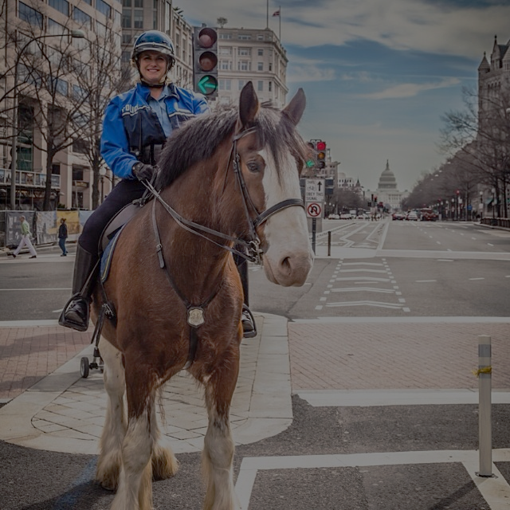
Goals of the Program
To develop and implement a comprehensive Body Worn Cameras program designed to:
    Promote public trust
    Enhance accountability of all parties
    Reduce citizen complaints
    Ensure officer and public safety
    Improve transparency of MPD operations
    Enhance evidence collection and scene management
    Aid in prosecution of criminal offenses

Slide 10
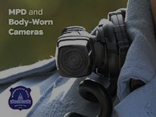
Policy Considerations
When is notice provided? Can citizens view the video?
When to start recording? When does recording stop?

Slide 11
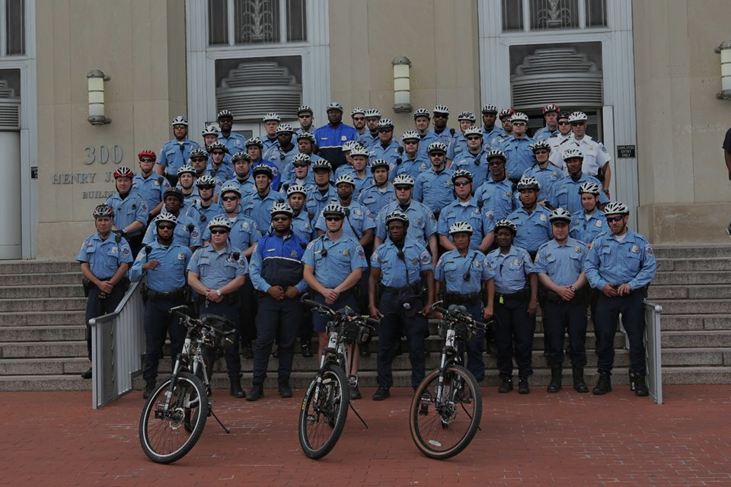
Say Cheese!

Slide 12
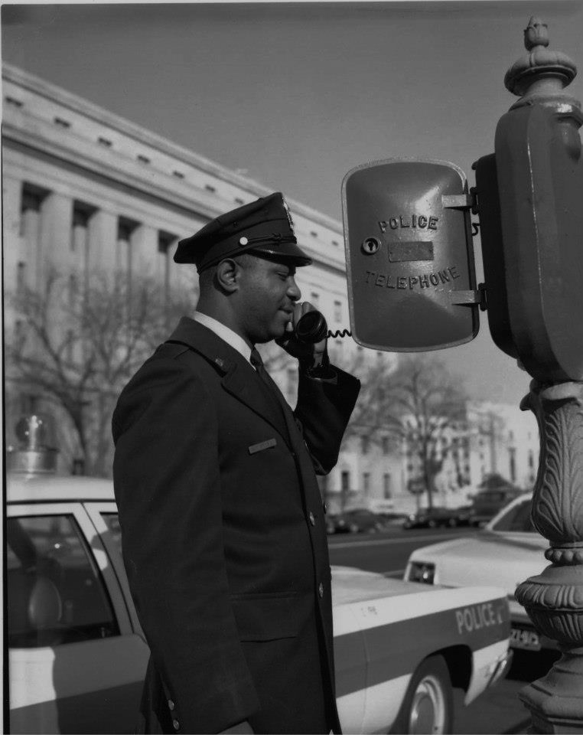
Retention

Slide 13
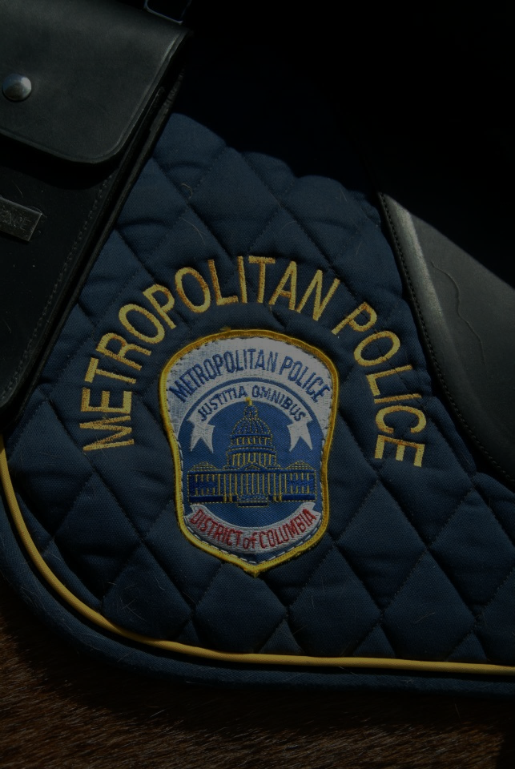
Metrics
Since June 29th, 2015:
  Deployed 400 BWC across 2 MPD Districts
  Generated over 15,000 hours in 73,932 videos
1.32TB/17,627 videos added in past 30 days
Provided USAO, OAG and Office of Police Complaints access to videos
MPD is partnered with leading academics for a comprehensive BWC study
Developed a common-sense retention schedule based on federal and local guidelines

