Slide 1
AQS Webinar
Q1 2016
Call in Number: (866) 299-3188
Conference Code: 919-541-2802#
Starting at 3:00 EST

Slide 2
Agenda
Introduction and Webinar format.
Review of changes in 2015
Planned Changes for 2016
Tutorials (in response to user requests)
Question and Answer Time

Slide 3
Changes in 2015
Miscellaneous bug fixes
Batch load of all monitor metadata changes
Primary Monitors Changes:
  Combine multiple filter-based samplers with offset.
  All criteria pollutants support primary monitors
NAAQS Exclusions for all criteria pollutants using Exceptional Data Type ID
Login with Exchange Network credentials
New Census population data
New EPA Website (TTN): https://www.epa.gov/aqs

Slide 4
Planned changes for 2016 (1)
Regulatory Updates
  New Ozone Standard
  Updates to 40 CFR Part 58
  Certification Report (5-minute SO2 Completeness)
  National QA programs -- NPAP and PEP
Technology Updates
  Discoverer
  Oracle Forms and Reports – Java sunset

Slide 5
2016 User / Ergonomic Changes
Quarterly Webinars & Monitoring Conference
Updating User Documentation and Training
Self-service password reset
Batch Load: Multiple files per zip archive
Store agency contacts in AQS and automatic notifications
Link AQS Method codes to Sampler/Analyzer Make and model
Simplify Protocol handling
Full support for Agency access control (Screening Groups)
Web page of known bugs and status

Slide 6
2016 Technology Updates
Ad-Hoc Query Facility (Discoverer Replacement)
Oracle Forms and Reports

Slide 7
Miscellaneous Issues
2016 Monitoring Conference:
  https://aqs.epa.gov/aqsweb/2016_Conference.pdf
How to get support:
  How to use AQS or code & format data – AQS Team
  Monitoring Issues – EPA Regional offices
    Example: Request a new Method code
  PC Issues (Including browsers): Local IT staff
    Note: Google Chrome not supported, and Firefox problematic

Slide 8
Tutorials
Site and Monitor Issues
  Creating Sites and Monitors
  QA Collocation and Composite Primary Monitor Period
  Monitor Metadata.
Authentication Project: Logging on with your ENSC ID
One off issues:
  RB Blanks Data Submissions,
  Qualifiers / Maintain Raw Data Form
  Data Completeness
  Additional Resources / Web Links

Slide 9
Data Entry and Maintenance
On-line maintain:
  Designed for editing one record at the time.
  Provides validation of each field as it is entered, and “pick list” of valid codes (e.g. Method Code)
  Validates all changes together on “Save”
Batch Load
  Processes files of records (possibly thousands)
  Validation is iterative cycle – Submit-Correct-Resubmit
Tip: To create a new site or monitor, find one similar to the one you want to create, and 1) export it with AMP500, 2) use an external text editor to change the appropriate fields, and 3) submit via batch.

Slide 10
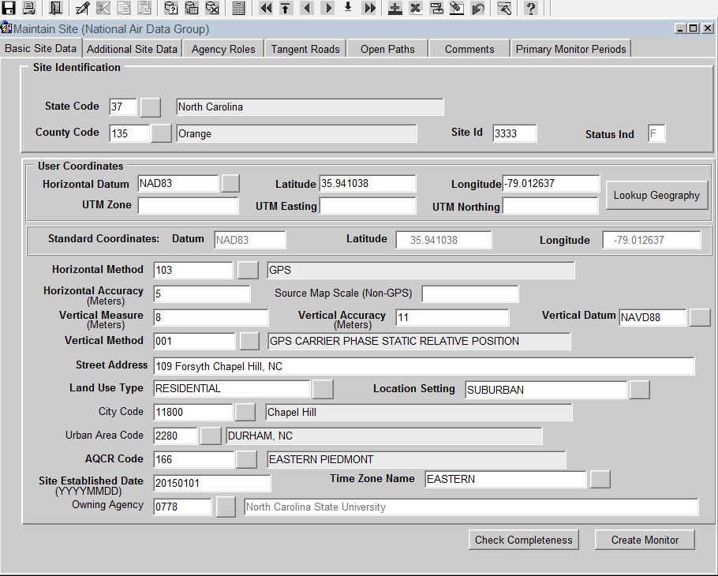

Slide 11
Site Creation Notes
Must fill in all items marked in bold on Basic Site Data tab of Maintain Site form, plus Owning Agency, which is not in Bold.
In addition, Supporting Agency Role must be created for site on Agency Roles tab (To be discontinued)
For Site to go production status, monitor must be created. (To be discontinued)
Buttons (Check Completeness, Create Monitor)

Slide 12
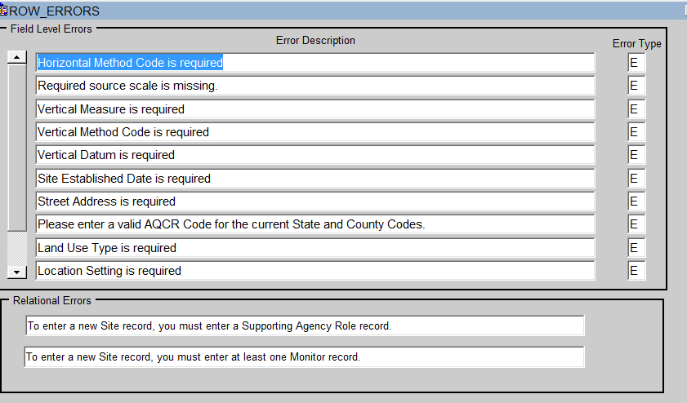
Check Completeness – Maintain Site

Slide 13
Monitor Creation Notes
Must fill in all items marked in bold on Monitor Basic tab.
Must also provide following data on other tabs
  SAMPLE PERIODS: Sampling Period
  TYPE ASSIGNMENT: Monitor Type
  NETWORK AFFLIATION: Monitor Network Code (NOT REQUIRED)
  AGENCY ROLES: Reporting Organization, PQAO.
  OBJECTIVES: Monitoring Objective
  METHODS: Method Code
  REQ FREQUENCIES: For some parameters.
Buttons: Duplicate Monitor.

Slide 14
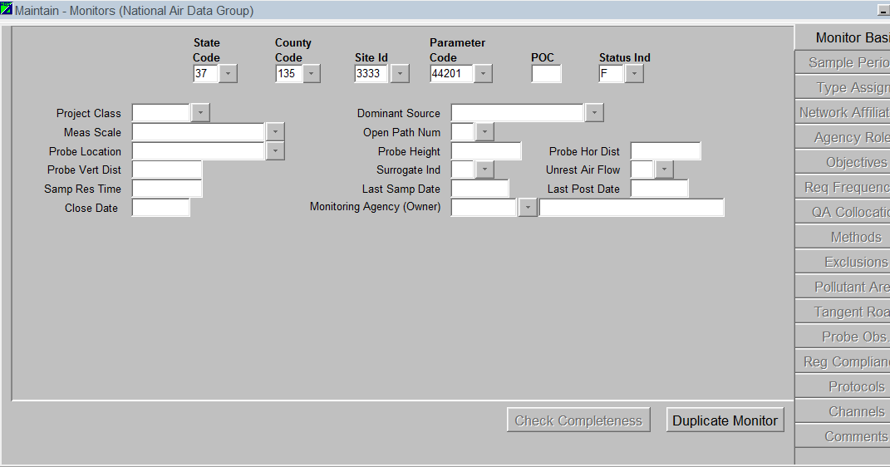

Slide 15
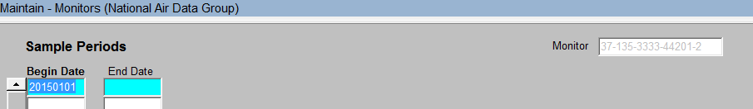
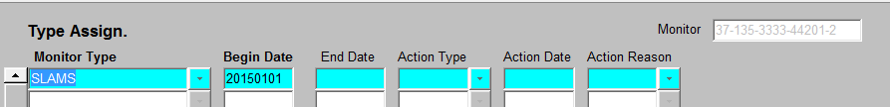

Subordinate Fields for Monitor Creation (Part 1)
Sample Periods (Required)
Monitor Type Assignment (Required)
Network Affiliation (Not Required)

Slide 16
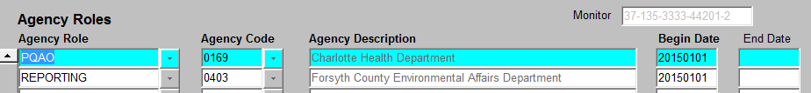
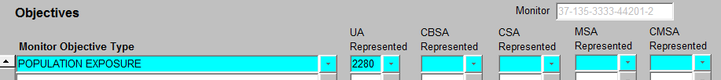
Subordinate Fields for Monitor Creation (Part 2)
Agency Roles (Required)
Monitoring Objective (Required)
Monitor Method (Required)

Slide 17
Demo: Setting Up New QA Collocation: Assumptions
Assumptions
  You have three monitors (37-135-3335-88101-1,2, and 3)
  Monitor 1 is Current Primary, Monitor 2 is QA Collocated Monitor.
  You want to make Monitor 3 the new primary.

Slide 18
Demo: Setting Up New QA Collocation: Steps (PART 1)
  1) On Maintain Monitor Form, QA Collocation Tab, put an end date on the collocation period for the current Collocated Monitor (POC 2).
  2) On Maintain Monitor Form, QA Collocation Tab, put an end date on the collocation period for the current Primary Monitor (POC 1).
  3) On the Maintain Site Form, navigate to the Primary Monitor Periods tab, and put the same end date on the Primary Monitor Period that you used in Steps 1 and 2.

Slide 19
Demo: Setting Up New QA Collocation: Steps (PART 2)
  4) On the Maintain Site Form, navigate to the Primary Monitor Periods tab, and enter a new record for the Monitor you want to designated at the new Primary (POC 3). Make the begin date ONE DAY after the end date of the previous primary monitor period.
  5) On Maintain Monitor Form, QA Collocation Tab, for the new Primary Monitor (POC 3), create a record with the same Begin Data you used in Step 4, and a value of “Y” in the primary sampler field.
  6) Finally, On Maintain Monitor Form, QA Collocation Tab, for the Collocated Monitor (POC 2), create a record with the same Begin Data you used in Step 4, and a value of “N” in the primary sampler field.

Slide 20
Demo: Setting Up Composite Primary: Assumptions
Assumptions (37-135-3334-88101-1 and 2)
  Data collection on 1 in 3 schedule
  Using two filter based monitors
  Collect filters every six days. One monitor will be collected on the regulatory days specified on AMTIC calendar (show link)
  The other monitor will collect samples three days later.

Slide 21
Demo: Setting Up Composite Primary: Steps
STEPS
  1) On Maintain Monitor Form for Primary Monitor, Go to Req Frequencies tab and enter 6 for Coll Freq Code, Begin Date from AMTIC calendar, and offset of 0
  2) On Maintain Monitor Form for Secondary Monitor, Go to Req Frequencies tab and enter 6 for Coll Freq Code, Begin Date from AMTIC calendar, and offset of 3
  3) On the Maintain Site Form, navigate to the Primary Monitor Periods tab, set the Composite Primary Tab to Y

Slide 22
Demo: Setting Up Composite Primary: Impact on Design Value Calculations
Design Value Calculated differently if you don’t have composite primary.
Don’t Have Composite Primary | Have Composite Primary
Design Value is calculated as the 98th percentile. Samples from the secondary monitor are considered “extra” samples and not included in Design Value calculation. Because only samples from primary monitor are included, the 98th percentile is the 1st Max. | Design Value is calculated as the 98th percentile. Samples from the secondary monitor are combined with samples from the primary monitor and included in Design Value Calculation. Because samples from both monitors are included, the 98th Percentile is the 2nd Max.

Slide 23
Site and Monitor Metadata
Site
  Basic Site Info (AA)
  Site Street (AB)
  Site Open Path (AC)
  Site Sampler (AD)
  Sampler Channel (AE)
  Primary Monitor Period (MO)
Monitor
  Monitor Basic (MA)
  Sample Period (MB)
  Monitor Type (MC)
  Monitor Agency Role (MD)
  Monitor Objective (ME)
  Monitor Sampling Schedule (MF)
  Monitor Tangent Road (MG)
  Monitor Obstruction (MH)
  Monitor Regulatory Compliance (MI)
  Monitor QA Collocation (MJ)
  Monitor Method (MM)
  Monitor Network Affiliation (MN)
  Primary Monitor Period (MO)
  Monitor Channel (MP)
  Monitor NAAQS Exclusion (MX)

Slide 24
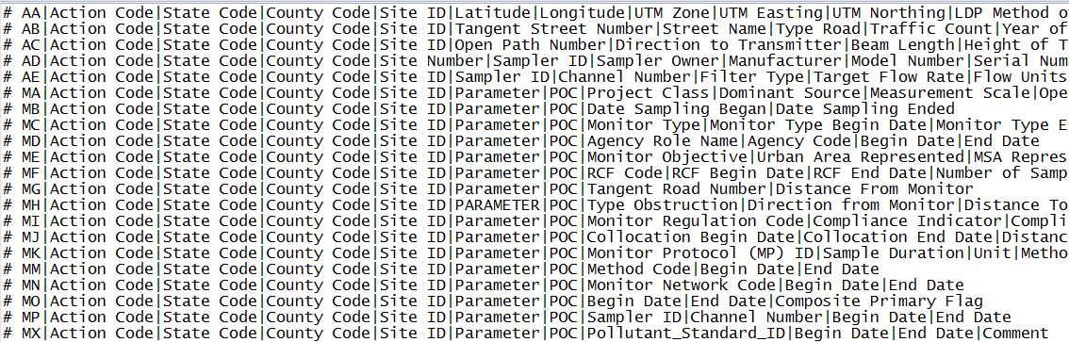
AMP 500 Report, Text File, Header

Slide 25
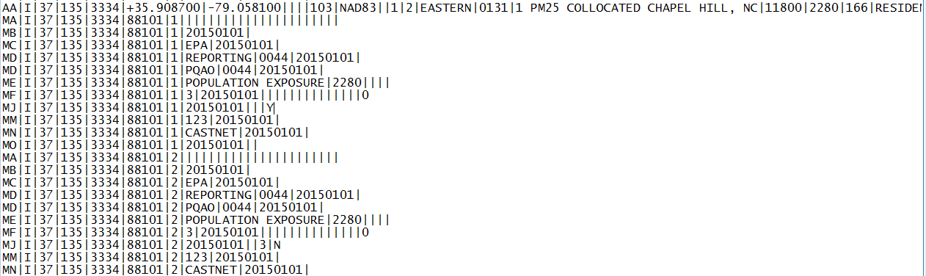
AMP 500 Report, Text File, Data for
37-135-3334 Site and Monitor

Slide 26
Metadata Changes/New Metadata
Monitor Type: Only administrative classification
Monitor Network Affiliation: Network / Program for monitor (e.g. NCORE, PAMS)
Monitor NAAQS Exclusion: Replaces non-regulatory type
Monitor Collocation Period: Use instead of “QA Collocated” monitor type
Monitor Method: Method Code for Monitor.

Slide 27
2014 Changes: Monitor Types (1)
Monitor Type is now only used for “Administrative classification of a monitor” (SLAMS, Tribal, SPM, Non-EPA Federal, Industrial, and Other)
A monitor can only have one monitor type at the time. (i.e. to assign a new monitor type to an existing monitor, you must close the old one first.)

Slide 28
Monitor Types (2)
SLAMS: State or Local air monitoring stations for parameters (pollutants and/or meteorological data) addressed by 40 CFR Part 58.
TRIBAL: Air monitoring stations operating under the authority of a Federally recognized tribal agency for parameters addressed by 40 CFR Part 58.
SPECIAL PURPOSE: A monitor that an agency has designated as “Special Purpose” in its annual monitoring network plan for parameters addressed by 40 CFR Part 58.
INDUSTRIAL: A monitor that is operated by a private industry entity rather than under the control of a State, Local, or Tribal government.
EPA: A monitor that is operated by EPA or an EPA contractor for parameters addressed by 40 CFR Part 58.
NON-EPA FEDERAL: A monitor operated by another Federal agency for parameters addressed by 40 CFR Part 58.
OTHER: A monitor for a parameter not addressed by 40 CFR Part 58. (i.e. It will not be allowed for criteria pollutants or other parameters associated with a monitoring network such as NCORE, PAMS or NATTS.)

Slide 29
Monitor Network Affiliation (New 2014)
Name of the network or program of the monitor (e.g. NCORE, NATTS, PAMS, CSN STN, IMPROVE, CASTNET, PSD, SCHOOL AIR TOXICS, TRENDS SPECIATION, NEAR ROAD, CSN SUPPLEMENTAL, SUPPLEMENTAL SPECIATION)
Previously coded under monitor type.
May have more than one value at the time or no value (Example: SLAMS criteria monitors often have no network affiliation)
Coded as MN batch transaction

Slide 30
NAAQS Exclusion (New 2014)
Indicated that the monitor should be excluded from NAAQS determinations (Design Value calculations)
Replaces “non regulatory” monitor type
Coded as MX batch transaction

Slide 31
QA Collocation Setup
40 CFR Part 58 Appendix A requires QA Collocation for certain pollutants and methods
QA collocation is set up on either the Maintain Monitor form QA Collocation tab or the MJ Batch transaction.
Each monitor of the QA Collocation pair must be set up separately; i.e. you must query each monitor on the Maintain form and tell AQS if it is the primary or collocated member of the pair, or submit two MJ transactions.
For combinable parameters the primary for QA collocation should be the monitor designated as primary for NAAQS determinations (not presently enforced by AQS)
Important: Only set up the QA monitor as “collocated”; do not set up other non-primaries on this form.

Slide 32
Monitor Method
The Monitor Method is the method of collection and analysis implemented by an AQS monitor for a period of time.
Makes the link between AQS monitors and samplers in the real-world stronger.
Utilized for validation of Raw and QA data.
New: Non FRM/FEM methods will not be allowed for regulatory monitors.
Encoded in AQS a batch MM transaction.

Slide 33
New Batch Transactions
MM – Monitor Method
MJ - Monitor Collocation Period
MN – Monitor Network Affiliation
MO – Primary Monitor Period
MX – Monitor NAAQS Exclusion
See https://aqs.epa.gov/aqsweb/documents/TransactionFormats.html
Note: Each transaction has a corresponding Maintain Form Tab.
Notes:
Show transaction document and briefly walk thru each of the transaction types.
Show the new Maintain Monitor Form & Tabs
Discuss XML status:

Slide 34
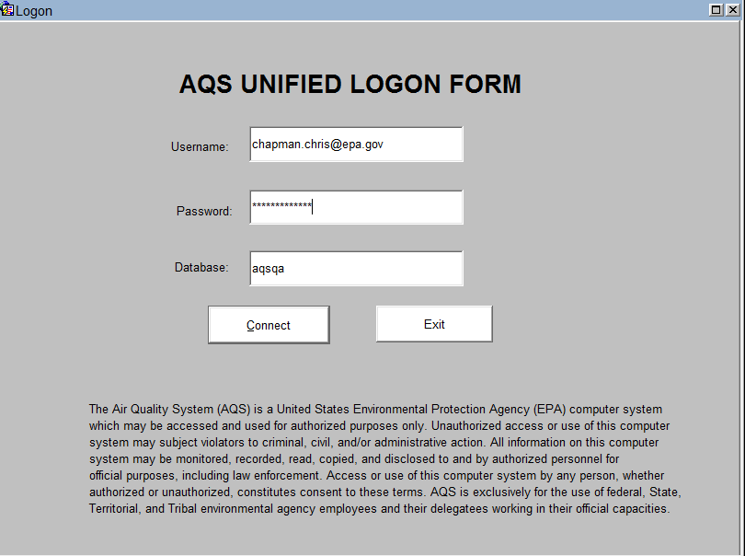

Slide 35
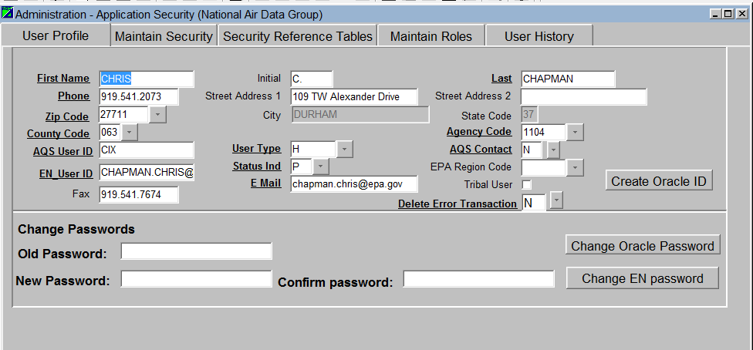
You can also change either your AQS or EN password using the Admin Security form
EN Password change requires old password, AQS Password DOES not.

Slide 36
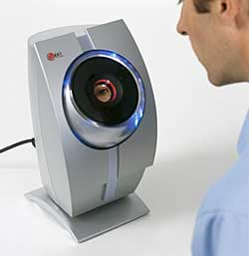
Authentication Notes
Use your ENSC (Exchange Network Services Center ID).
  https://enservices.epa.gov/login.aspx
Same ID used when data submitted for load to AQS.
Can still use your AQS ID.
Can change either ENSC or AQS password. ENSC password change required old EN password.

Slide 37


Blanks for Criteria Pollutants: (RB Transactions)
What is a blank: It is a filter that has not been used to collect a sample. Its value is the mass of the pollutant on the filter.
Issue: Units need to be in mass units, not concentration units.
X

Slide 38
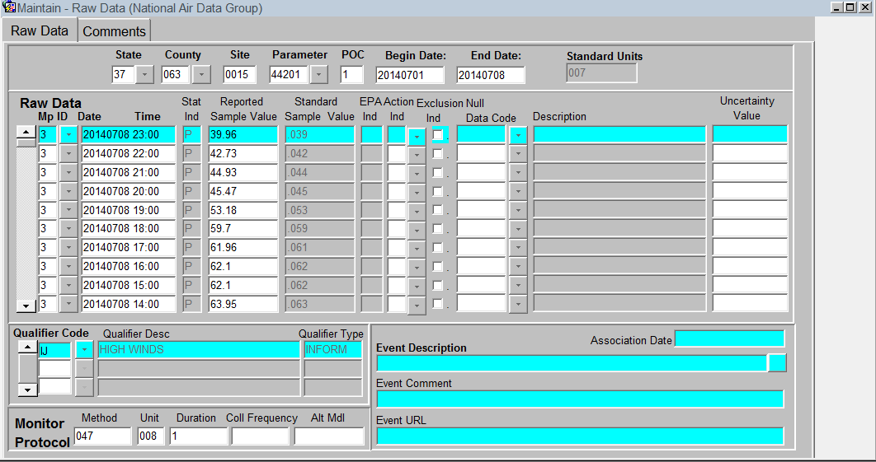
Qualifiers can now be directly applied to Raw Data Records via Maintain Raw form.

Slide 39

When it comes to data completeness, one of these things
(AMP430, Data Completeness Report)
is not like the others
(AMP450, Quick look Report and AMP480, Design Value Report)
AMP430 calculates completeness on seasonal basis…i.e. length of time specified as monitor’s sample. period.
Other reports calculate completeness on a regulatory basis…..a full calendar year.
Example: If you have a six month sampling period and six months of observations, your completeness would be 100% on the AMP430 and 50% on the other reports.

Slide 40
Additional Resources
TOPIC | RESOURCE | URL
Creating Sites | AQS Users Guide Pages 61-66 | http://www.epa.gov/sites/production/files/2015-10/documents/aqs_user_guide_2015.pdf
Creating Monitors | AQS Users Guide Pages 67-70 | See URL under Creating Sites
QA Collocation, New Monitor Metadata | AQS Transaction Formats | https://aqs.epa.gov/aqsweb/documents/TransactionFormats.html
Qualifiers | AQS Users Guide Pages 72-78 | See URL under Creating Sites
RB Transactions | AQS Transaction Formats | See URL under QA Collocation

Slide 41
Questions?

