Slide 1
Access Control and User Authentication
Chris Chapman, US EPA
National Ambient Air Monitoring Conference
August 10, 2016 – St. Louis, Missouri

Slide 2
What I want you to get (elevator pitch)
Two ways to logon to AQS.
Two security models currently in force.
Screening Groups vs. Agency Based
Agency Based was developed when QA system was redesigned.
Agency Based will completely replace screening groups eventually.

Slide 3
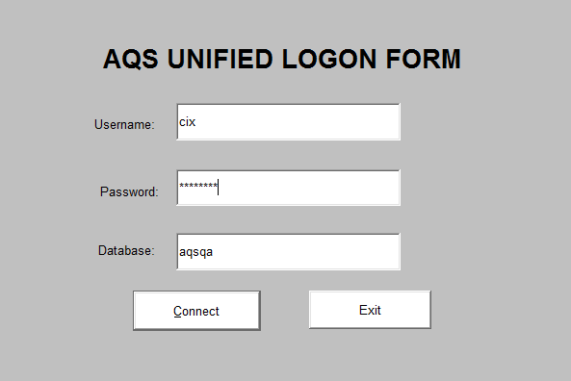
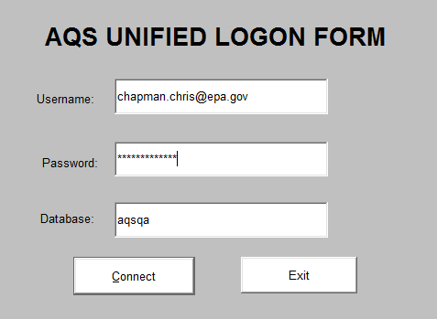
Two ways to logon
AQS ID
ENSC ID

Slide 4
Screening Groups
Monitors owned by a screening group (one and only)
Members of screening groups can modify data for monitors owned by that screening group (with proper role)
Monitors can only belong to one screening group
Users can belong to multiple screening groups and have multiple roles within a screening group
Screening group security still in force for sites, monitors, Raw Data (Sampling measurements) on forms and in batch. Not for QA

Slide 5
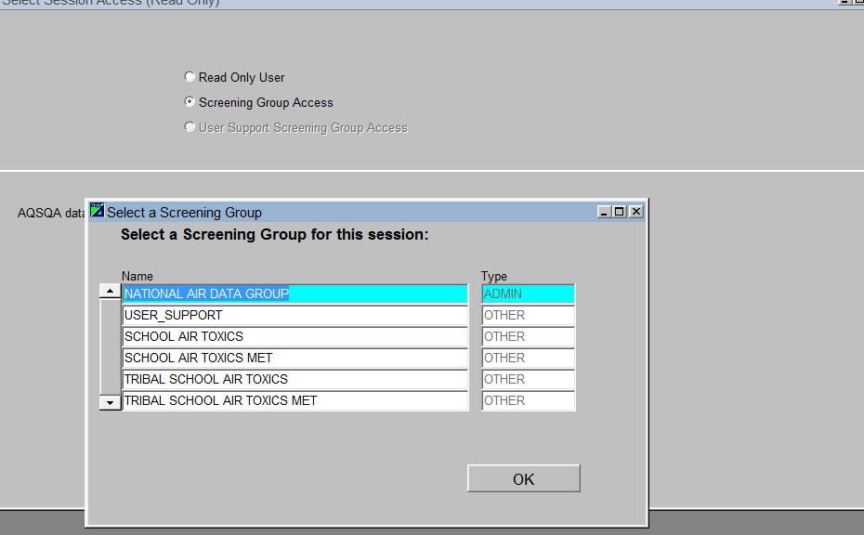
Screening Groups

Slide 6
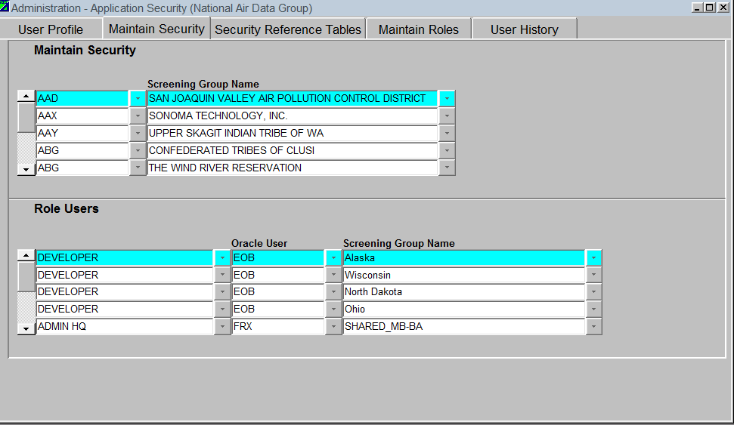
Groups and Roles

Slide 7
User Roles
Security Roles | Definition
Raw Data Update User | Can update raw data
PA Data Update User | Can update QA data
Read Only | Read only user
FRM Auditor | Maintain Independent Assessments
Regional Admin | Concur with Exceptional Events and Certification
Audit Coordinator | Schedule and review Independent Audits (NPAP/PEP)
EPA_HQ | Concur with Certification
Data Admin | Used only by NADG can access any data in AQS.

Slide 8
Role Permissions
Data Type | Permitted to Update
Site Metadata | Raw Data, PA Data,
Monitor Metadata | Raw Data, PA Data,
Raw Data | Raw Data,
Routine QA /QC | Handled by Agency Based Security
Independent QA/QC (PEP,NPAP) | Handled by Agency Based Security
Lab Assessments | Handled by Agency Based Security
Certification | Data Admin, EPA HQ, Regional Admin, Regional HQ (not all roles the same authority)
Exceptional Events | Entered by Screening Group, Concurred by Regional Admin

Slide 9
Agency Based Security
User belongs on one agency
Monitors are assigned to agency roles. A monitor may have different agencies for different roles
One agency in a role for a monitor at a time, but you can change the monitor having that role
To handle users who need access to more than one agency’s set of monitors, there are parent and child agencies
Agency Based Security does not apply to raw data and site/monitor metadata forms (DOES apply to batch)

Slide 10
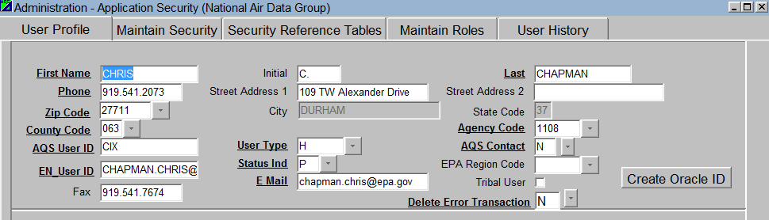
User Profile with Agency Assignment

Slide 11
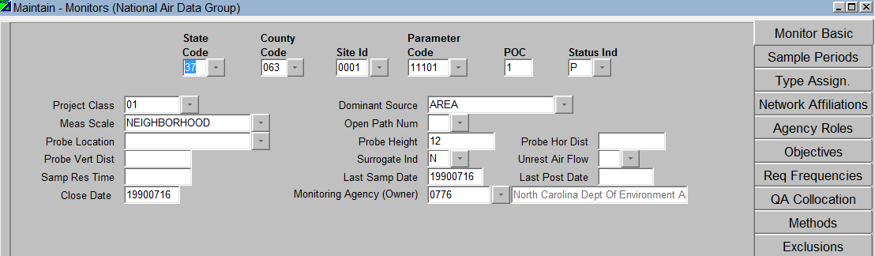
Maintain Monitor Form: Owning Agency
Note: Screening Group not on Maintain Monitor Form

Slide 12
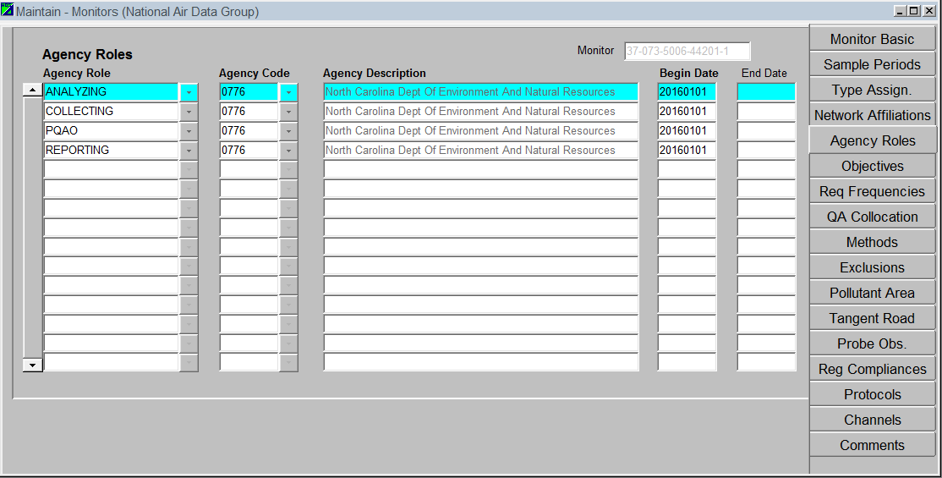
Maintain Monitor Form: Agency Roles
Note: Screening Group not on Maintain Monitor Form

Slide 13
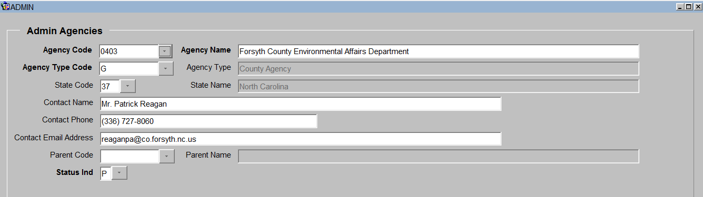
ADMIN AGENCY

Slide 14
Agency Roles
Role | Definition
Owning (Monitoring) | Monitoring agency responsible for operating a monitoring site for which the quality assurance regulations apply. (58)
PQAO | A monitoring organization, a group of monitoring organizations or other organization that is responsible for a set of stations that monitor the same pollutant and for which data quality assessments can be pooled. Each criteria pollutant sampler/monitor at a monitoring station must be associated with only one PQAO.(58)
Reporting | An entity, such as a state, local, or tribal monitoring agency, that reports air quality data to the EPA. (58)
Certifying | Agency authorized to certify the data for a monitor
Analyzing | Agency responsible for analyzing lab filters for a monitor.
Collecting | Agency responsible for collecting samples for a monitor
Auditing | Agency authorized to conduct independent QA audits (NPAP & PEP). Usually an EPA Region, unless self-implementing state

Slide 15
Agency Permissions
Data Type | Permitted to Update, including user roles
Site Metadata | Owning, PQAO (must have Raw Data or PA role as well)
Monitor Metadata | Owning, PQAO (must have Raw Data or PA role as well)
Raw Data | Owning, Reporting (must have Raw Data role)
Routine QA /QC | Owning, PQAO, Reporting, Analyzing, Collecting (must have PA role)
Independent QA/QC (PEP,NPAP) | Auditing (must have Audit Coordinator Role as well). This is for approving the audits. Data is submitted automatically via PEAT.
Lab Assessments | Owning (must have PA role)
Certification | Certifying (privileges to form also role based)
Exceptional Events | N/A (not applicable to form yet)

