Slide 1
Exceptional Events in AQS
Chris Chapman, US EPA
National Ambient Air Monitoring Conference
August 10, 2016 – St. Louis, Missouri

Slide 2
Elevator Pitch
We have an exceptional event rule
That rule is under review
How to process events in AQS now
How Exceptional Event Data shows up in AQS Data when retrieved

Slide 3
Overview of Exceptional Event Rule
Promulgated in March 2007, text can be found in 40 CFR 50.14 (2007)
Two excellent EER resources
  EPA: https://www.epa.gov/air-quality-analysis/treatment-data-influenced-exceptional-events
  Westar: http://www.westar.org/exceptionalevents.html
Currently undergoing revision (come back this afternoon for more details)

Slide 4
What does exceptional event rule do?
Allows users to identify events (fireworks, prescribed fires as examples) that have a one-time impact on Air Quality
Submit data to AQS with flag indicating measurement affected by event
Separately, prepare package and submit to EPA explaining why event is exceptional
Have those measurements excluded from NAAQS attainment and design value calculations

Slide 5
EER Process

Slide 6
AQS-EER Business Processes
Flag sample measurements
Define Event
Associate Event with flagged measurements
Off-line: Submit justification to EPA
EPA: Concur/Non-concur with exceptional event exclusion
Review flagged data status

Slide 7
Flag Sample Measurements
No Change to prior processes
Batch Mode:
  Submit flags with data on Insert transactions
  Submit flags on Update transactions
    Warning: All qualifier codes replaced
Interactive – Maintain Raw Data
  Add Exceptional Event Qualifier Code and Save

Slide 8
Define Event
Maintain Event Form (Enter the following):
  Qualifier Code (required)
  Begin Date (optional but recommended)
  End Date (optional but recommended)
  Event Description (required)
  Text comments (optional)
  URL of web page documenting event (optional)
Event must be unique by Screening Group, Qualifier Code, and Event Description

Slide 9
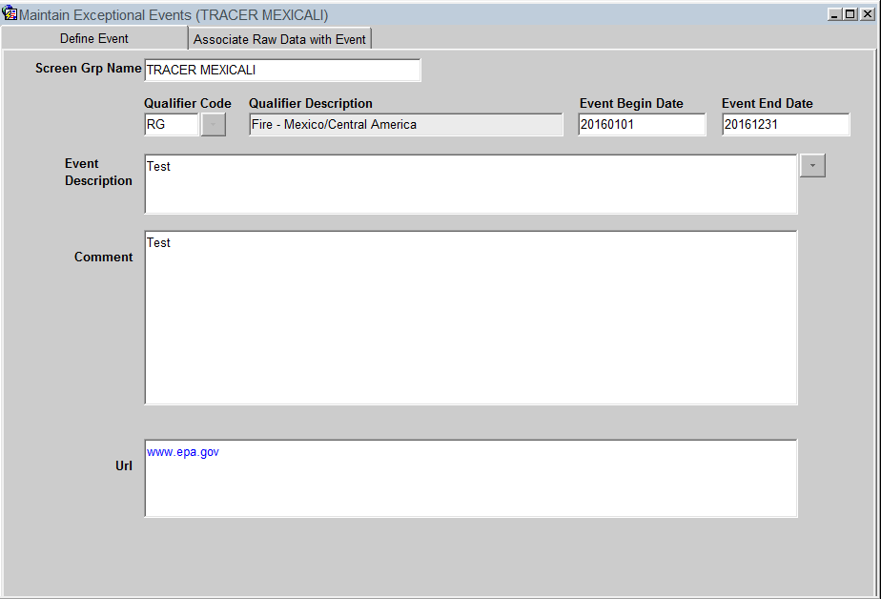
Maintain Event Form, Define Event Tab

Slide 10
Associate Event with Flagged Measurements
Maintain Event
  Query (or create) event (first tab)
  Query affected monitors (second tab)
    Can select by monitor key fields
  Can subset measurements affected by date range
  Can Associate/Disassociate by Monitor or all retrieved data
  Counts will be updated when action is saved

Slide 11
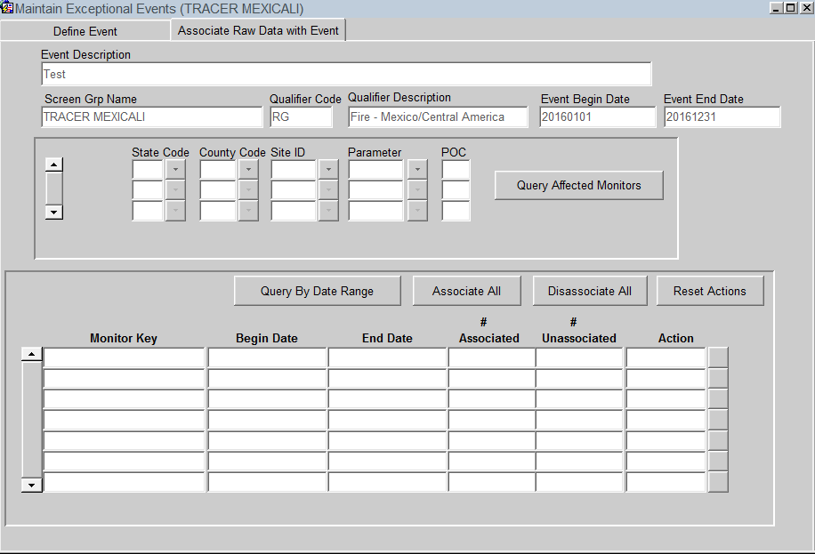
Maintain Event Form, Associate Raw Data Tab

Slide 12
Associate Via Maintain Raw
Query Monitor and date range
Select flagged measurement
In Event Description Block, click on LOV to select existing event, or create new event
Can remove existing association by selecting “No Event”
Click save (Stat/CR and Post not required)

Slide 13
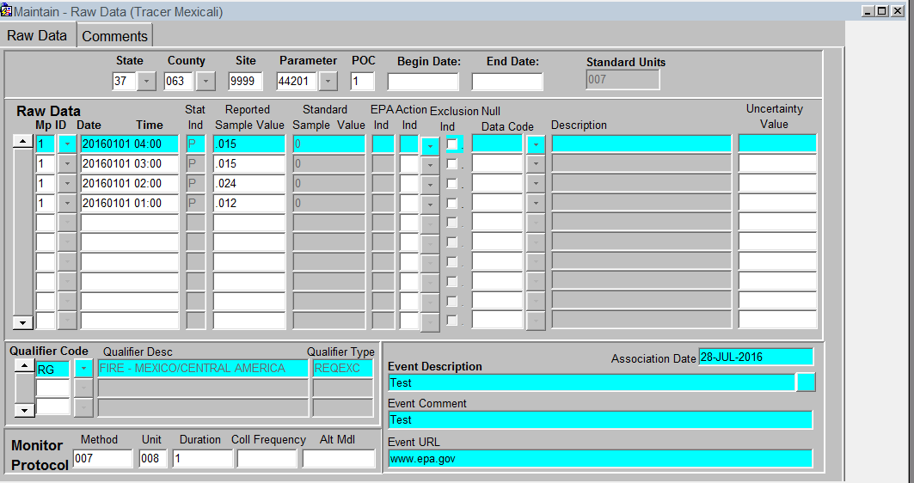
Maintain Raw Event Association

Slide 14
Review Flagged Data Status
AQS report, AMP360 – Raw Data Qualifier Report added
  Report options to select specific qualifier types (Request Exclusion, Informational, Null Data Codes, QA Qualifiers, Comment Qualifiers, or all)
  Report option to select specific qualifier code
  Report option to select specific Exceptional Event Concurrence state (Concurred, Non-concurred, null – not yet reviewed)

Slide 15
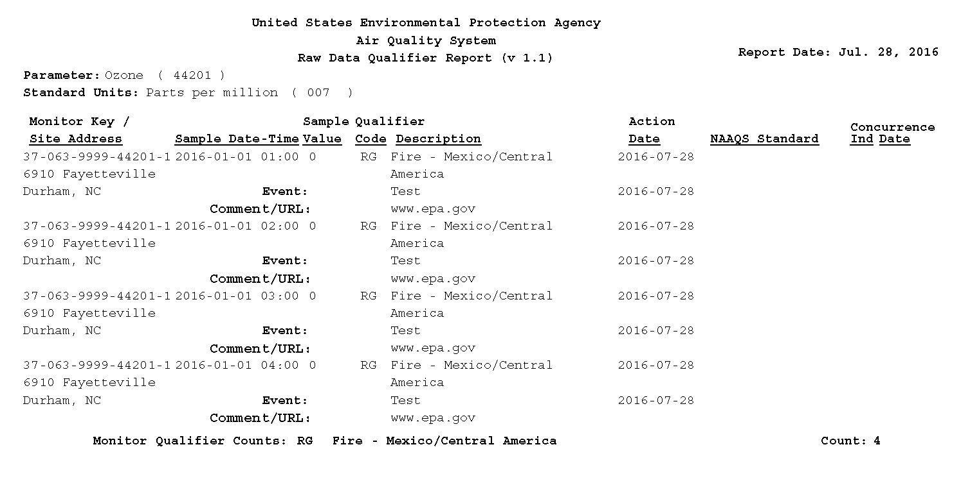
Review Flagged Data Example

Slide 16
EER Process Critical Dates
The EER regulations establish critical dates for the validity of an exclusion request. These are tracked by AQS:
  Date that an Exceptional Event Qualifier is associated with the sample measurement
  Date that an Event is associated with the sample measurement
If a sample measurement is updated without changing the value or Exceptional Event Qualifier Code, then the above dates are preserved

Slide 17
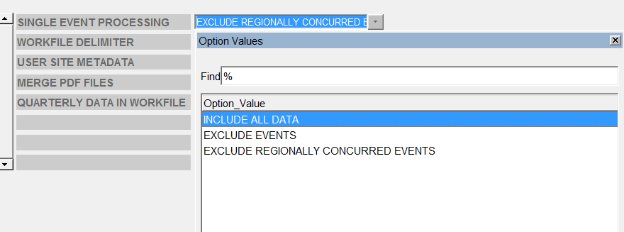
EE Data and AQS Reports

