Slide 1
Annual Air Monitoring Data Certification

Slide 2
Data Certification – The Basics
Formal statement attesting to ambient data completeness and accuracy
Submitted by monitoring agencies to EPA on annual basis
Process that combines a required action followed by a discretionary EPA review

Slide 3
The Actual Requirement
in CFR Language
§ 58.15 Annual air monitoring data certification.
(a) The State, or where appropriate local, agency shall submit to the EPA Regional Administrator an annual air monitoring data certification letter to certify data collected by FRM, FEM, and ARM monitors at SLAMS and SPM sites that meet criteria in appendix A to this part from January 1 to December 31 of the previous year. ... The annual data certification letter is due by May 1 of each year.“
(b) Along with each certification letter, the state shall submit to the Regional Administrator an annual summary report of all the ambient air quality data collected by FRM, FEM, and ARM monitors at SLAMS and SPM sites. …”
(c) Along with each certification letter, the State shall submit to the Regional Administrator a summary of the precision and accuracy data for all ambient air quality data collected by FRM, FEM, and ARM monitors at SLAMS and SPM sites. …”
URL for AMTIC Cert & Validation: https://www3.epa.gov/ttn/amtic/qacert.html

Slide 4
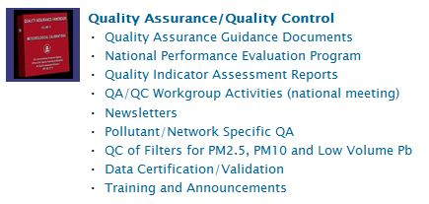
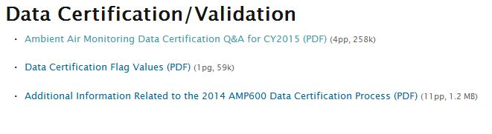
Data Certification Information On AMTIC
(Ambient Monitoring Technology Information Center)
The AMTIC website is located at https://www3.epa.gov/ttn/amtic/

Slide 5
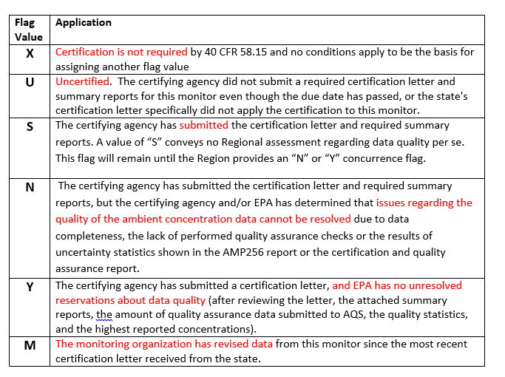
Data Certification Qualifier Values
Notes:
The Data Certification Flag Values

Slide 6
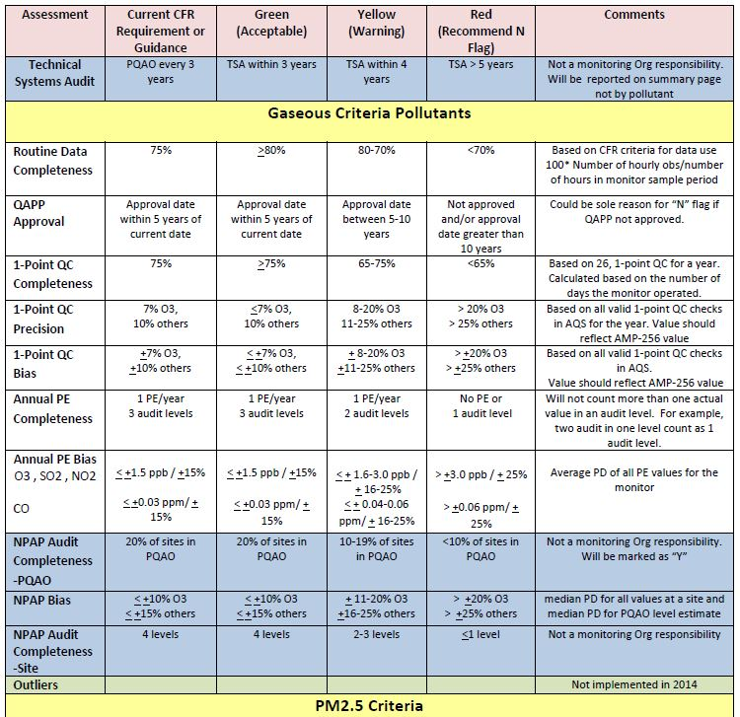
Criteria that Generate Green (Acceptable) Warning (Yellow) and “N” Qualifiers (Red)
Notes:
The table from this slide and the next slide are from the Additional Information Document found on the AMTIC website. The document provides information as to how QA and completeness data are evaluated to determine if AQS recommends monitors for (‘Y’) or against (‘N’) certification.

Slide 7
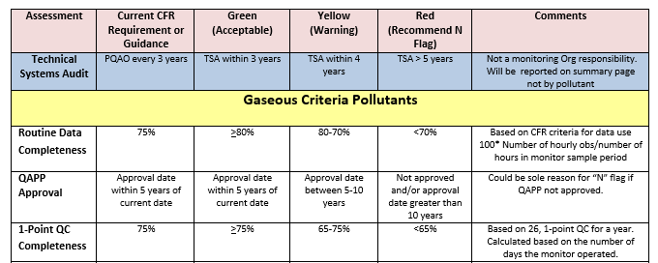
Criteria that Generate Green (Acceptable) Warning (Yellow) and “N” Qualifiers (Red)
Blue shaded rows are evaluations that will be reported (when data is available) but not used in certification flag settings
One Red for any monitor will elicit an AQS recommended “N” flag
Three warnings for any monitor will elicit an AQS recommended “N” flag

Slide 8
Preliminaries: What should a certifying agency do?
Review the Certifying Agency role assignments:
  Run the AQS Monitor Description Report (AMP390) – Will show all Agency Roles for each monitor.
  Compare against Monitoring Network Plan
Use AQS (Batch MD transaction or Maintain Monitor) to correct any discrepancies.

Slide 9
The Procedure: What does an agency do?
Conduct and complete ambient air quality monitoring and QA as per 40 CFR Part 58 and submit all relevant data to AQS.
Run the Data Certification Report (AMP600) for your Certifying Agency.
  This will calculate a recommended certification flag for each monitor-year based on Part 58 criteria and display the results for all monitors and PQAOs associated with the Certifying Agency.

Slide 10
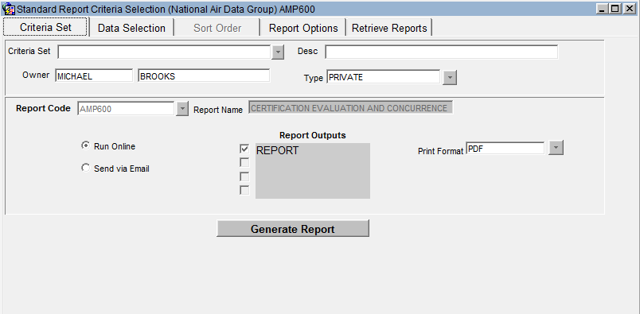
Requesting a Data Certification Report

Slide 11
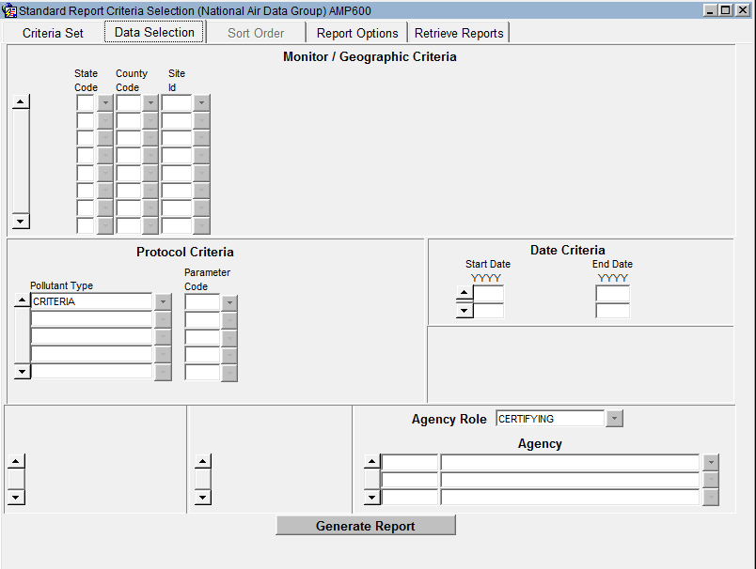
Request Criteria

Slide 12
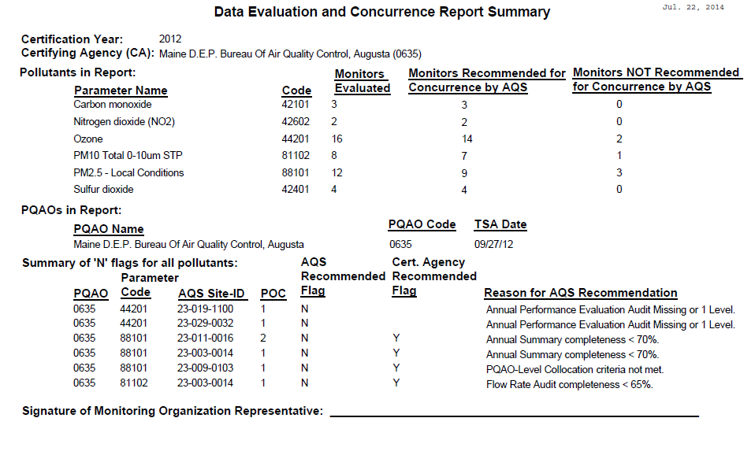
AMP600 Summary Report
Before Certifying Agency Certification
Notes:
This is an example of the summary page of an AMP600 – Certification Report. It shows a count of the number of monitors that AQS recommends for or against certification by pollutant, and it shows all monitors where AQS recommends against certification and the reason.

Slide 13
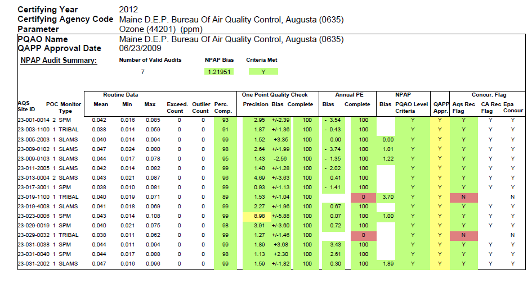
AMP600- Ozone
Before Certification
No
v
alues
Notes:
This is one of the “detail” pages for Ozone, where you can see the statics that are evaluated for each monitor, along with the classification (Green, Yellow, Red) for each statistic, and the monitor as a whole. For a monitor, AQS recommends against certification if any statistic is red, or if there are three or more Yellow statistics.

Slide 14
The Procedure – Part 2: Data Review
Review the certification report. For ‘N’ recommendations:
  Has any ambient monitoring data not yet been submitted?
  Has any QA/QC data (e.g. Precision and Accuracy transactions) not been submitted?
  Should any ambient monitoring data be invalidated and removed from AQS based on QA/QC results?
Make corrections to AQS data as needed.
Rerun certification report and verify results are final.
Use the AQS certification form to accept or override the AQS recommended value.

Slide 15
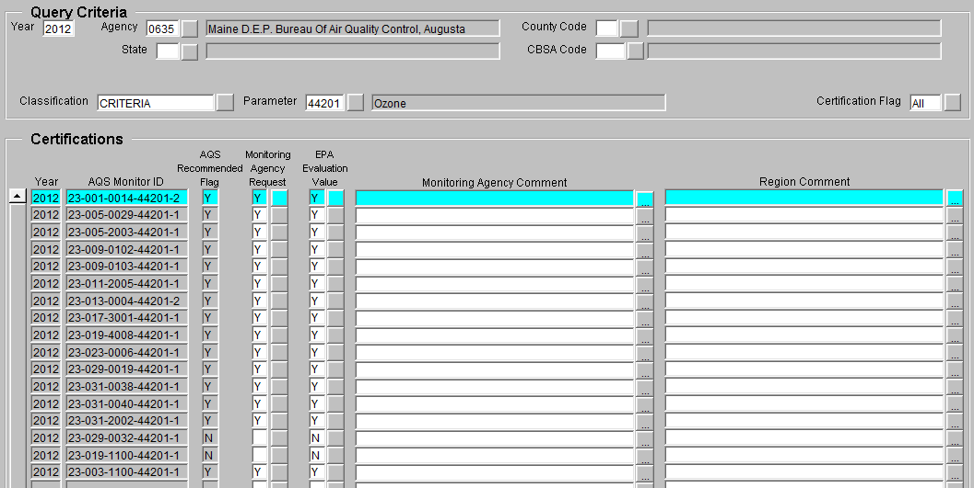
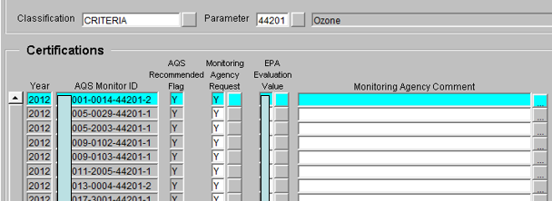
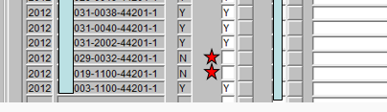
Certification Form for
Certifying Agency
If certifying this data, we’d really like a Certifying Agency comment
Notes:
This record show a case where the certifying agency did not supply a “State Requested Value”. However, the problem is that AQS will present this on reports with the code “U’, which means that certification was not requested, rather than ‘N’, which means that the monitor fails QA or completeness. (i.e. it is ambiguous.)

Slide 16
AMP600
After Certifying Agency Certification
Notes:
This AMP600 report show records where the Certifying Agency did not request a value.

Slide 17
AMP600 Summary
After Certifying Agency Certification
Notes:
This is the summary section of an AMP600 report where the Certifying Agency did not request a value.

Slide 18
AMP600
After EPA Regional Concurrence
18
Notes:
This report shows after the Region has supplied an ‘N’ value.

Slide 19
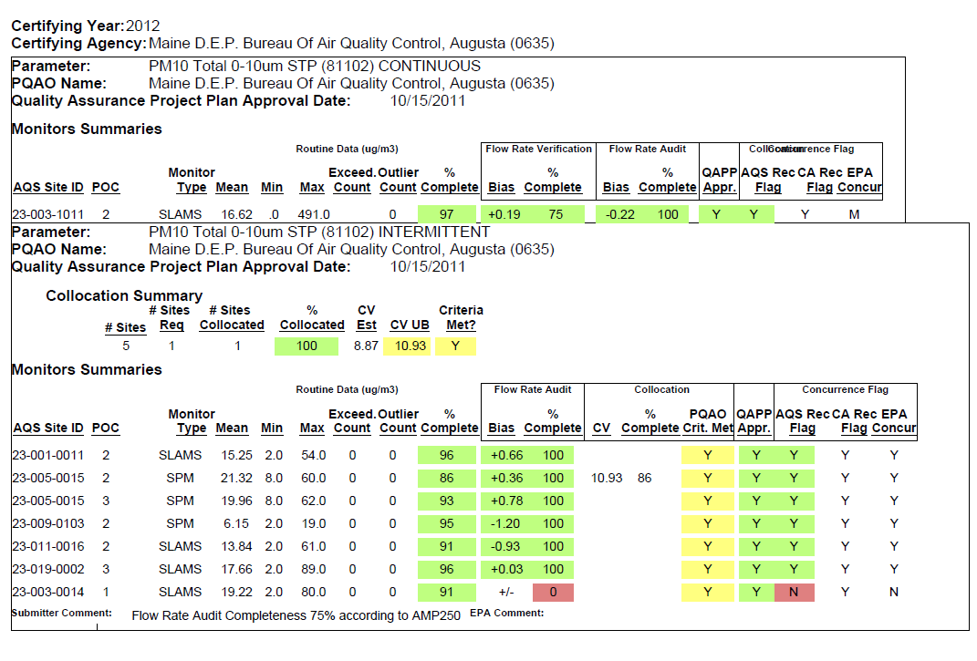
AMP600
After EPA Regional Concurrence
Data changed after certification
Comment required if Cert Agency changes AQS Recommended Flag
Notes:
This slide shows two conditions that can be seen on the AMP600 report: The first shows where the EPA concurrence flag will be automatically changed to ‘M’ if the data for a monitor is changed after it was certified. The second shows that if the Certifying Agency requests a Certification Flag that is different than the AQS recommended value, they must provide a justification.

Slide 20
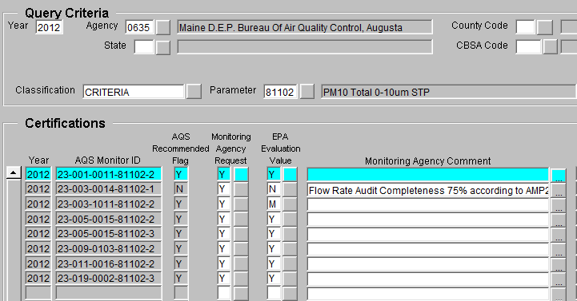
Certification Form
Since the only qualifier that shows up in AQS is the EPA concurrence qualifier, any change in data by the Monitoring Organization will show up as “M” for modified

Slide 21
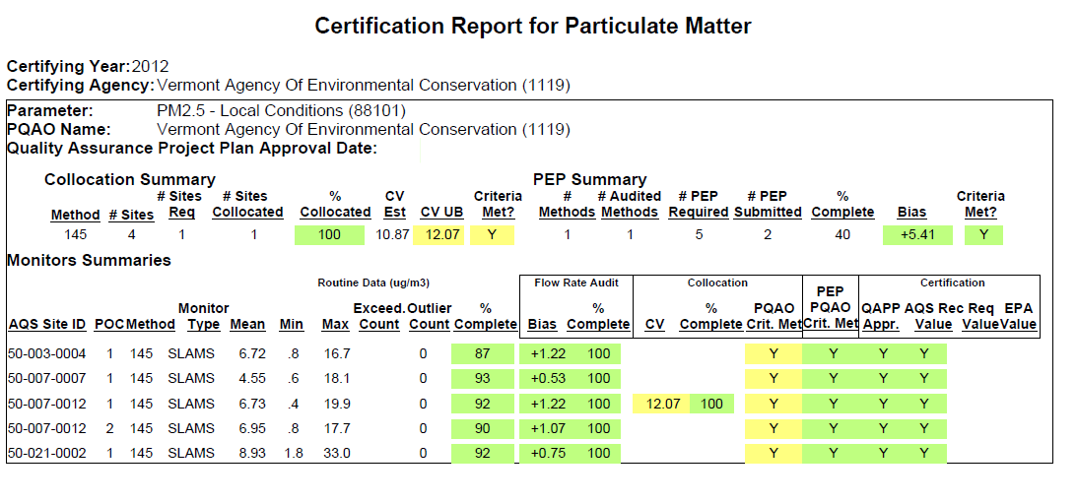
How the AMP600 Works
Found On AMTIC
PQAO Level Flags
For Collocation and PEP, AQS Recommended flags are generated at the PQAO level and then “transfered” back to each site
PQAO Criteria Met for Collocation based on CV not completeness
PEP PQAO Critera based on Bias estimate, not completeness
See “additional Information Related to AMP600 Certification Process” at http://www.epa.gov/ttnamti1/qacert.html
Notes:
This slide shows an example of how the PQAO evaluation criteria affects every monitor for the PQAO. The PQAO CV statistic was evaluated to be “Yellow”, so every monitor for the PQAO is evaluated to be “Yellow”. If the PQAO had failed (“Red”) then all of its monitors would have been “Red” (Recommended against certification.)

Slide 22
What Monitoring Data must have Monitoring Agencies Certified on May 1, 2016?
Only data collected by FRM, FEM, and ARM monitors at SLAMS and SPM monitoring stations that meet Appendix A must be certified¹. In practice this refers to monitoring data for CO, NO₂, SO₂ (hourly and 5-minute average data), Ozone, Lead, PM₁₀, PM_{10-2.5}, and PM_{2.5}.
¹ Data certification requirements may also be included in auxiliary agreements such as MOA’s between states and operators of industrial networks, for example, SO₂ monitors being installed to comply with the Data Requirements Rule.

Slide 23
Certification Process:
Thoughts and Steps Forward
Use it often
  Don’t wait till May to run the report
  It can run on a partial year based on the date the report is run. This may not be perfect but can help.
By the time data is in AQS it may be to late
  Internal QC is critical
Will eventually add outlier statistics.

