Slide 1
Working with QA Data
Chris Chapman, US EPA
National Ambient Air Monitoring Conference
August 10, 2016 – St. Louis, Missouri

Slide 2
Background
The QA requirements for ambient air quality monitoring are specified in 40 CFR Part 58 Appendix A.
In 2012 the EPA initiated a project to develop transactions that more closely matched the Appendix A requirements.
In 2013, AQS was enhanced to support loading these, and a new set of reports were developed to utilize this data.

Slide 3
Background (Con’t)
We converted AQS Precision and Accuracy data to the new QA data tables.
In 2015, we embarked on a LEAN effort to facilitate the collection and loading of NPAP Audits into AQS, including the development of a stand alone Windows program for conducting audits (PEAT).
In 2016, we are doing the same thing with PEP data.

Slide 4
QA Transaction List
1-Point QC
Annual Performance Evaluation
Flow Rate Verification
Semi-Annual Flow Rate Audit
Lead Analysis Audit
Performance Evaluation Program (PEP)
National Performance Audit Program (NPAP)
PM Coarse Flow Rate Verification
PM Coarse Semi-Annual Flow Rate Audit
Speciation Flow Rate Verification
Speciation Semi-Annual Flow Rate Audit
NATTS Duplicate Assessment
NATTS Replicate Assessment
Field Proficiency Test
Lab Proficiency Test
Ozone SRP
Ambient Air Protocol Gas Verification Program
Definitions: https://aqs.epa.gov/aqsweb/documents/TransactionFormats.html

Slide 5
Example: 1-Point QC
Regulatory Requirement: 40 CFR Part 58 Appendix A §3.1.1
  A one-point quality control (QC) check must be performed at least once every 2 weeks on each automated analyzer used to measure SO₂, NO₂, O₃ and CO.
  The QC check is made by challenging the analyzer with a QC check gas of known concentration (effective concentration for open path analyzers) between 0.005 and 0.08 parts per million (ppm) for SO₂, NO₂, and O₃, and between 0.5 and 5 ppm for CO analyzers.
  Report the audit concentration of the QC gas and the corresponding measured concentration indicated by the analyzer. The percent differences between these concentrations are used to assess the precision and bias of the monitoring data

Slide 6
Example: 1-Point QC (2)
No. | Field Name | Description
1 | Transaction Type | New transaction type “QA”
2 | Action Indicator | 1 character code specifying Insert (I), Update (U) or Delete (D)
3 | Assessment Type | A label specifying the assessment for which data is being submitted. “1-Point QC”
4 | Performing Agency Code | Agency Code of organization performing assessment (optional)
5 | State Code / Tribal Indicator | The FIPS state code of the monitor being assessed, or “TT” to indicate that the next field on the transaction is a Tribal code.
6 | County Code / Tribal Code | The FIPS County Code of the monitor being assessed. If the previous field on the transaction contains “TT”, then the Tribal Code of the monitor being assessed.
7 | Site number | Four digit number to uniquely identify site in county.
8 | Parameter Code | The AQS parameter code assigned to the monitor in AQS for which the assessment is being performed
No. | Field Name | Description
9 | POC | Parameter Occurrence Code: One or two digit number identifying a specific monitor for a parameter at the site.
10 | Assessment Date | Date that the assessment was performed
11 | Assessment Number | A unique number associated with an assessment performed at a site on a given day. Value should be “1” unless additional same assessments are performed.
12 | Monitor Method Code | The sampling methodology of the monitor being assessed.
13 | Reported Unit | Units associated with the assessment concentrations (Monitor Concentration and Assessment Concentration)
14 | Monitor Concentration | The concentration value provided by the monitor being assessed.
15 | Assessment Concentration | The value of the check gas standard concentration.

Slide 7
Transaction Format Link
AQS Transaction Formats:
  https://aqs.epa.gov/aqsweb/documents/TransactionFormats.html
  Formats for all transactions, not just QA.

Slide 8
Generating QA Transactions
Users have several options for entering QA data into AQS; these include the following:
Entering the data directly into the AQS Web application Maintain forms
Submitting via Batch Processing after
  Creating the data manually using a text editor or other PC tool (e.g. Excel)
  Having a vendor’s data management system create a file for submission to AQS.
  Using the AQS QA Transaction Generator program.

Slide 9
On-Line Maintain Forms (1)
On-Line Maintain Forms
  One for each QA transaction type
  Can be used to edit (Insert, Update, or Delete) Production QA data
  Each field is validated as it is entered.
  AQS codes can be picked from list where appropriate
  Record fully validated by SAVE process
  Records immediately show up on QA reports without having to run AQS LOAD

Slide 10
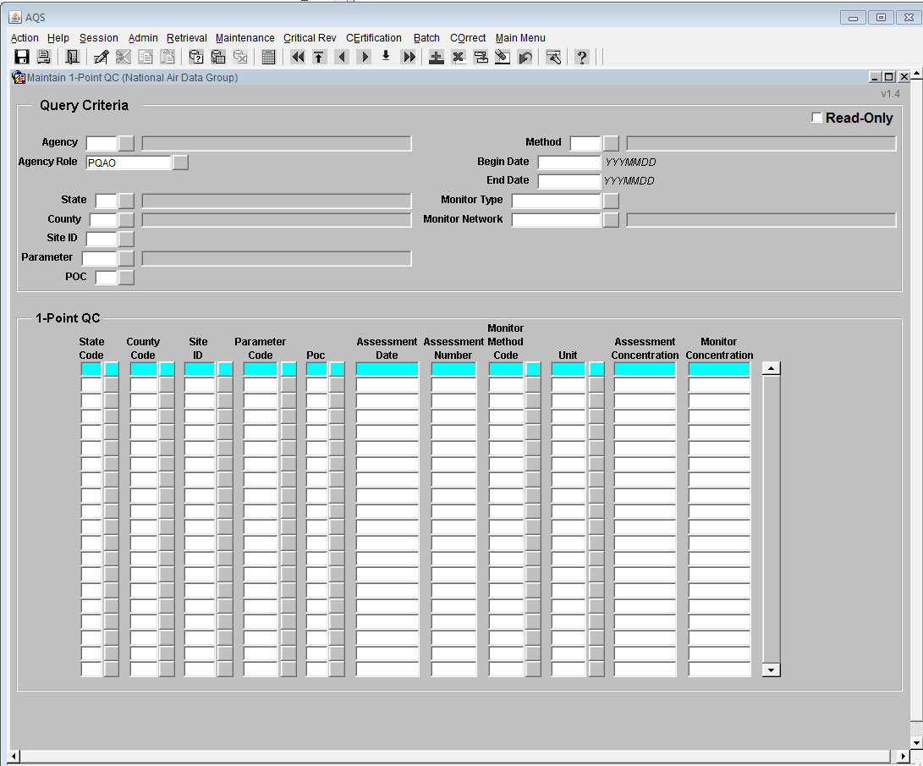
Example QA Maintain UPDATE Form
Existing data can be queried
Pick List
Queried data or newly created records.

Slide 11
Batch Loading and Correct
Batch Loading
  Load through ENSC or State Node
  Load Pipe Delimited or XML Format
  Transactions are staged and then verified using business rules
  Transactions that pass are loaded (production read)
  Transactions that fail show up in correct form
  Combination of BATCH form and Correct Form to correct QA Transactions.

Slide 12
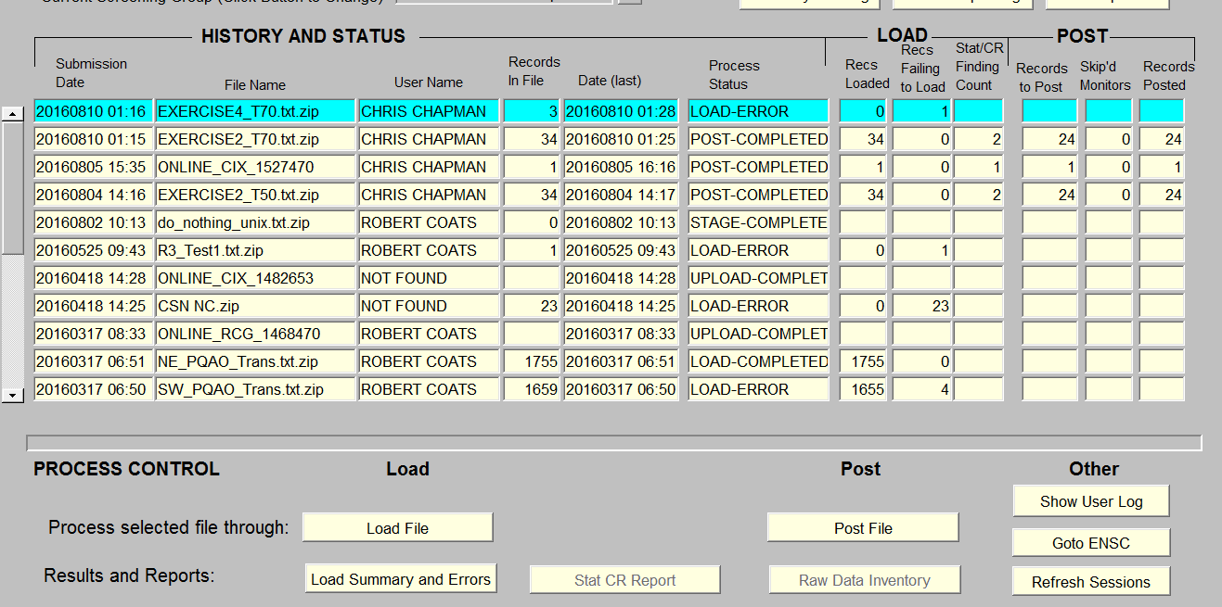
Example Batch Form

Slide 13
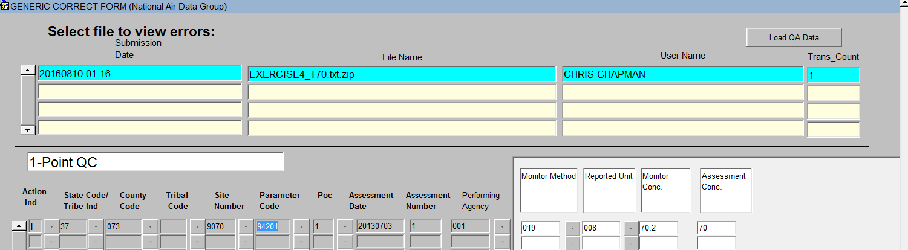
Example Correct Form

Slide 14
QA Transaction Generator (1)
Tool to allow off-line creation of all QA transaction types.
All fields and records validated as soon as they are entered.
Has built-in capabilities to keep both software and AQS codes up-to-date
Creates files that are submitted via the normal AQS Batch process.
Can be downloaded from: https://www.epa.gov/aqs/aqs-transaction-generator

Slide 15
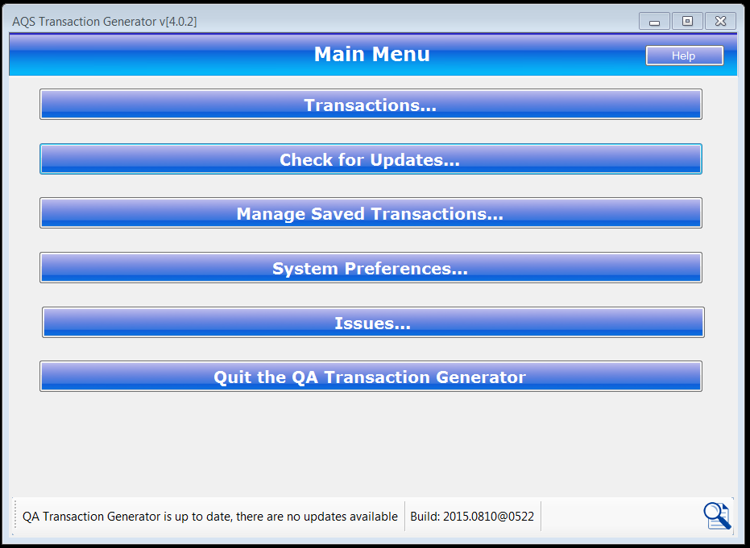
QA Transaction UPDATE Generator (2)

Slide 16
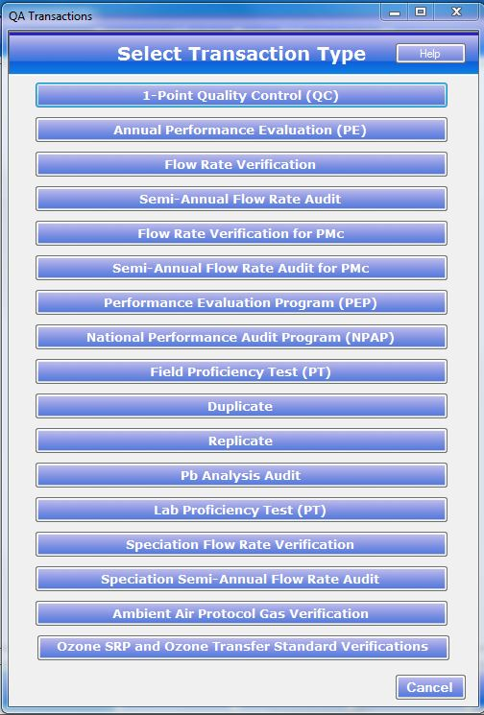
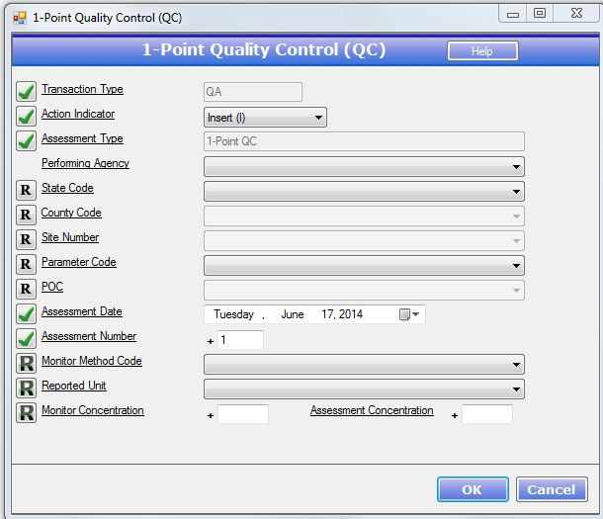
QA UDPATE Transaction Generator (3)

Slide 17
Input: QA Documents
A Maintain form exists for each of the following types of QA Documents
  Quality Management Plans
  Quality Assurance Project Plans
  Technical System Audits
  Audits of Data Quality
These can only be entered on-line and not via batch
These can only be entered by EPA staff or Independent Auditors, but can be viewed by anyone
Note: These forms only record the existence and dates for the documents, but do not support uploading the documents themselves.

Slide 18
QA Collocation
QA Collocation is the explicit pairing of monitors at a site for the purpose of quality control.
It is required by Part 50 Appendix A for PM10, PM2.5 and Pb data.
Collocation checks are set up by defining the Monitor Collocation for the “Primary” at the site and a QA Collocated Monitor (Maintain Monitor Form or Batch MJ Transaction)
Once set up, AQS will pair Daily Summaries from the QA Primary and Collocated monitors to calculate the Part 58 Appendix A statistics.
Note: Previously, collocated assessments were submitted on RP transactions. This is no longer supported.

Slide 19
Relationship to Legacy P&A
All valid legacy Precision and Accuracy data has been converted to the corresponding QA data
Legacy Precision (RP) and Accuracy (RA) transactions are no longer accepted.
Legacy RP and RA transactions converted to QA data as soon as loaded (Initially over night)
Caveats:
  Legacy NATTS Duplicate and Replicate assessments not separated from 1-Point-QC assessments
  Any Legacy Field-PT assessments not separated from 1-Point-QC assessments

Slide 20
Outputs: QA Reports
QA Raw Data Report (AMP251):
  Produced formatted report of submitted transactions with Percent Difference for each value pair
  Replaced:
    AMP250: P&A Raw Data Report
    AMP246: Precision Report
    AMP247: Accuracy Report
QA Data Quality Indicator Report (AMP256):
  Calculates Part 58 Appendix A statistics
  Replaced: AMP255 (with bug fixes)
Extract QA Data (AMP504)
  Allows retrieval of QA transactions as submitted
  Replaced AMP502 – Extract P&A Data

Slide 21
Access Control
Access is controlled by Agencies assigned to the monitor rather than by Screening Group
Monitoring Organization (monitor owner) | Full access to routine QA data & Monitor Metadata
PQAO (Pooled QA across monitors) | Full access to routine QA data & Monitor Metadata
Reporting Organization | Full access to routine QA data
Collecting Agency | Full access to routine QA data
Analyzing Agency | Full access to routine QA data
Audit Agency | Full access to Independent QA data (i.e. PEP & NPAP)
EPA Staff | Read access to data for review Full access to Independent QA data

Slide 22
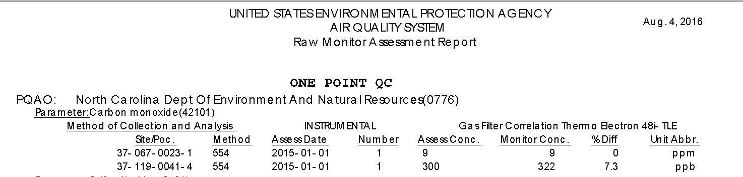
AMP251 Example

Slide 23
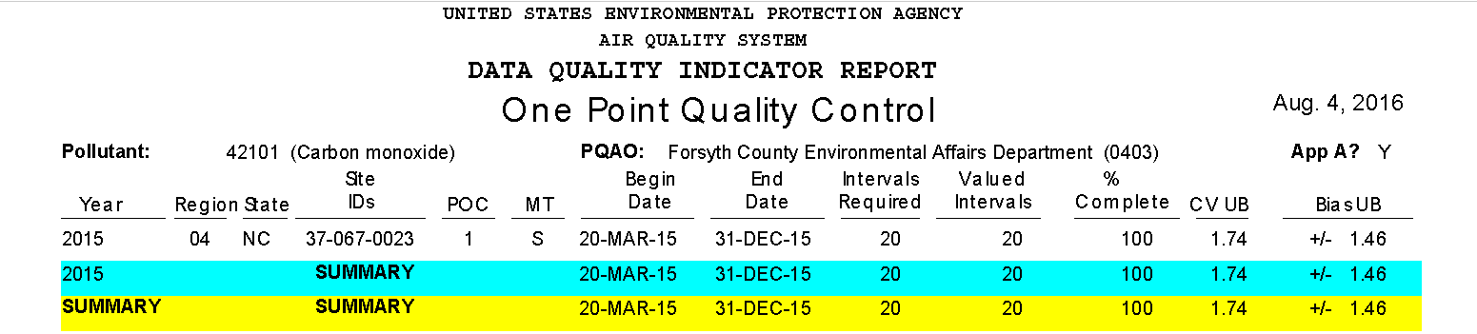
AMP256 example

Slide 24
Questions?
Next is QA Transaction Generator Example.

Slide 25
AQS QA Transaction Generator
Welcome to the mini-training for the AQS QA Transaction Generator
In this presentation you’ll learn the following:
  What is the AQS QA Transaction Generator
  AQS QA Transaction Generator features
  How to download and install the AQS QA Transaction Generator
  Getting started – An example from start to finish
  How to turn on Tribal Mode
  How to get support and/or make enhancement suggestions

Slide 26
What is the AQS QA Transaction Generator
The AQS QA Transaction Generator is a tool developed by the AQS Team to simplify the creation and generation of AQS QA Transaction files

Slide 27
AQS QA Transaction Generator features
Facilitates the creation and validation of ALL AQS QA Transactions
Supports customization in the form of setting preferences for commonly used reference data such as:
  State
  Counties
  Performing Agencies
  Parameter Codes
  Monitor Method Codes
  Reported Units
  PQAOAs
  Enabling Tribal Mode
  Tribal Areas
Supports automated updating of the application and reference data

Slide 28
How to download and install the AQS QA Transaction Generator
Use your internet browser to navigate to:
  https://www.epa.gov/aqs/aqs-transaction-generator
Click on the link for: Download the AQS QA Transaction Generator Zip File
Save the zip file to a location you can remember
Right click on the zip file and select ‘Extract to here’
Double click on ‘setup.exe’
  *** Please Note you will need Administrative rights to install the AQS QA Transaction Generator
The application will start once the installation completes

Slide 29
Getting started – An example from start to finish
  Let’s do the following:
    Launch the AQS QA Transaction Generator
    Set our System Preferences for:
      State
      County
      Site
      Parameter
    Create a 1 Point Quality Control (QC) Transaction
    Generate the transaction so it can be submitted to AQS

Slide 30
Getting started – An example from start to finish
  If you haven’t done so already, launch the AQS QA Transaction Generator
  Click the ‘System Preferences…’ button
    Let’s set defaults for the following:
      State - AK
      County - Anchorage
      Parameter Codes - 42101 Carbon monoxide
      Reported Units - 040 Parts per 100 million
    To set the defaults start by clicking on ‘States’ under the ‘System Defaults’ list
      You can either drag and drop ‘AK’ to the ‘Selected States’ area or click the ‘Add Selected’ button
      Click the ‘Save Changes’ button
    Now click on ‘Counties’ under the ‘System Defaults’ list
      Drag and drop ‘AK (020) (Anchorage)’ to the selected Counties area and click the ‘Save Changes’ button

Slide 31
Getting started – An example from start to finish
    Now click on ‘Parameter Codes’ under the ‘System Defaults’ list
      Drag and drop ‘42101 (Carbon monoxide)’ to the selected Parameters area and click the ‘Save Changes’ button
    Now click on ‘Reported Units’ under the ‘System Defaults’ list
      Drag and drop ‘040 (Parts per 100 million) (CONCENTRATION)’ to the Selected Reported Units area and click the ‘Save Changes’ button
    Each time you select the drop down list for States, Counties, Parameter Codes and Reporting Units the values that you selected in the ‘System Preferences’ section will appear first in the drop down list.
      You can also click the ‘Search’ button to locate the item using a partial search just like in AQS
    Click the ‘Close’ button
      You should now be back at the main menu

Slide 32
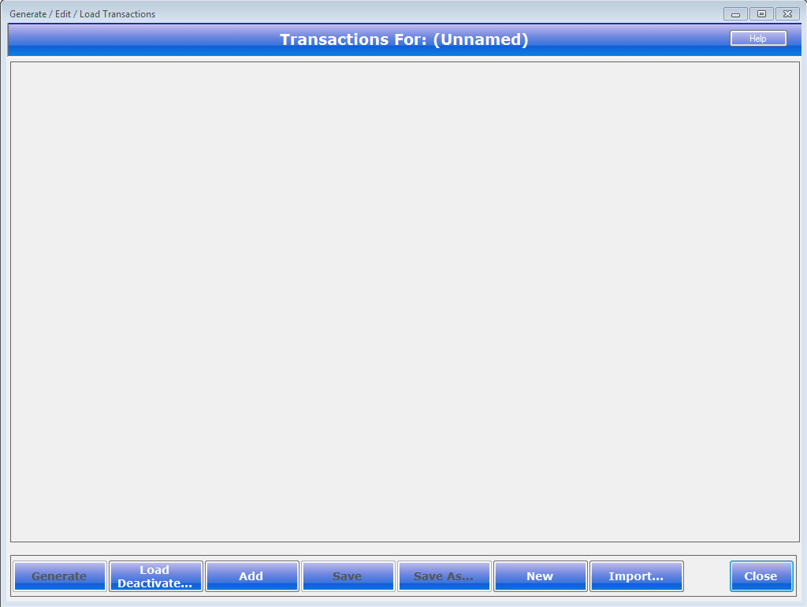
Getting started – An example from start to finish
  You should now see the ‘Transactions’ screen:

Slide 33

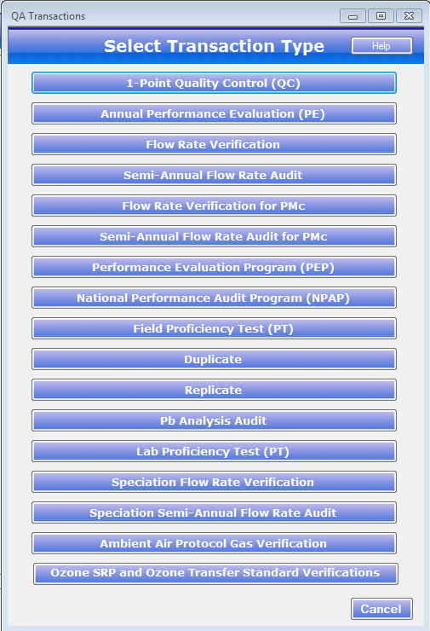
Getting started – An example from start to finish
  Click the button
    Select ‘1 Point Quality Control (QC)’ from the list of transactions

Slide 34
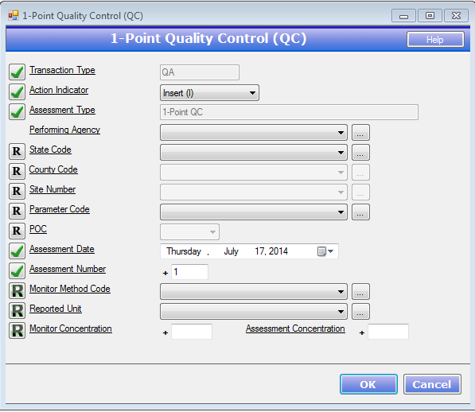
Getting started – An example from start to finish
  You should now see the ‘1-Point Quality Control (QC) Screen:

Slide 35

Getting started – An example from start to finish
  Let’s enter the following information:
    Action Indicator - Insert (I)
    Performing Agency - A. E. Staly Company (0002)
    State Code - AK (02)
    County Code - Anchorage (020)
    Site Number - DHHS (02) (020) (0052)
    Parameter Code - Carbon monoxide (42101)
    POC - 1
    Assessment Date - Tuesday, August 05, 2014
    Assessment Number - 1
    Monitor Method Code - INSTRUMENTAL (DETECTION TUBE) (42101) (013)
    Reported Unit - Parts per 100 million (040)
    Monitor Concentration - 1
    Assessment Concentration - 2
  Click the button

Slide 36
Getting started – An example from start to finish
  Please note:
    The AQS QA Transaction Generator will validate the data as you selecting/entering it. Selecting a ‘State Code’ will limit the ‘County Code’ to the counties for the selected state. Selecting the ‘County Code’ will now limit the ‘Site Number’ to the ‘State Code’ and ‘County Code’ that you selected. The ‘Parameter Code’ will be limited to the ‘State Code’, ‘County Code’ and ‘Site Number that you selected. The ‘Reported Unit’ will be limited to the ‘Parameter Code’ and the type of QA transaction that you are creating.
    The AQS QA Transaction Generator ensures that the transaction that you create is a valid AQS QA transaction by using the reference data that is updated nightly. Therefore it is imperative that you apply any and all updates to ensure that the transaction(s) that you are creating are valid AQS QA Transactions.

Slide 37
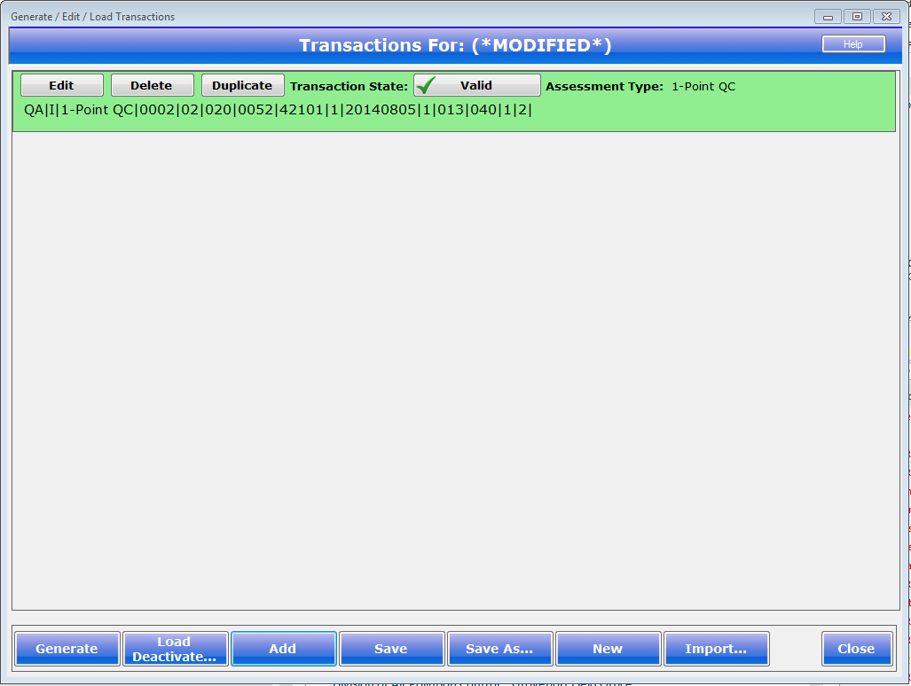
Getting started – An example from start to finish
  The ‘Transactions’ screen will be displayed and should look like the following:

Slide 38

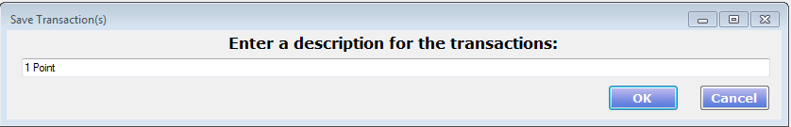

Getting started – An example from start to finish
  The green background color is an indicator that the transaction is valid
  Let’s save this transaction before we continue
    Click the button at the bottom of the screen
    Enter ‘1-Point’ for the description and click the button
    The ‘Title’ for the transaction screen should now look like the following:

Slide 39

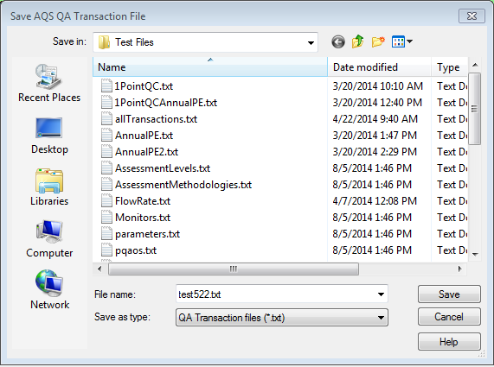
Getting started – An example from start to finish
  Let’s ‘Generate’ or create the AQS QA Transaction file that can be submitted to AQS
    Click the button
    The ‘Save AQS QA Transaction File’ screen will open:
    That’s it, the last step is to log on to AQS and submit your QA Transactions

Slide 40
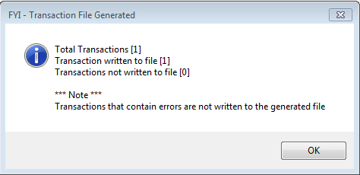
Getting started – An example from start to finish
  Navigate to the Folder location you wish to save the generated AQS QA Transaction file to
  Enter the ‘File name’ for the transaction set
  Click the ‘Save’ button
  The AQS QA Transaction Generator will now generate all transactions that do not have an error to the transaction file
  A status dialog titled ‘FYI – Transaction File Generated’ will be displayed
    The dialog will indicate how many transactions were in the transaction set and how many we written to the transaction file. Please note that transactions with errors are not written.

Slide 41
How to turn on Tribal Mode
  The AQS QA Transaction Generator fully supports Tribal Mode. By setting Tribal mode to ‘On’ the AQS QA Transaction Generator will change ‘State Code’ to ‘Tribal Indicator’ and automatically select ‘TT’. It will also change ‘County Code’ to ‘Tribal Code’ and populate the selection with ‘Tribal Areas’
  To turn on Tribal Mode click the ‘System Preferences…’ button on the main menu
  Now click the ‘Tribal Mode’ selection under ‘Tribal’
    Turn on Tribal Mode by clicking the ‘ON’ button
    Now click ‘Save Changes’

Slide 42
How to turn on Tribal Mode
  You can also set the default Tribal Areas that you use on a regular basis. To set the Tribal Areas simply click the ‘Tribal Areas’ under ‘Tribal’
  Now drag and drop the appropriate ‘Tribal Areas’ from the ‘Available Tribal Areas’ section to the ‘Selected Tribal Areas’ section
  Click the ‘Save Changes’ button
  Now when you choose a Tribal Code from the a Tribal Code drop down list the Tribal Areas that you selected will appear first

Slide 43
How to get support and/or make enhancement suggestion
  All AQS QA Transaction support, whether it is issue related or a suggested enhancement is submitted via the AQS help desk at:
    1 (866) 411-4372
    EPACallCenter@epa.gov
      Please don’t contact an AQS team member directly, going through the help desk ensures that the issue or enhancement request is entered into a tracking system and then assigned to a developer.

Slide 44
QUESTIONS?

