Slide 1
Accessing AQS Data
Chris Chapman, US EPA
National Ambient Air Monitoring Conference
August 10, 2016 – St. Louis, Missouri

Slide 2
Outline
Background
Trends in Use
  Popularity of data
  Who’s getting the data
  What are they getting
Data Sources
  Air Data
  AQS API
  AQS Reports

Slide 3
Background
Several years ago, OAQPS embarked on an effort to reduce the number of places public could go to find data
Pick certain ones to enhance, others to decommission, put all that remain in a common place
The new umbrella site = AirData
AQS specific
  Rebranding and rearchitecture of AirData (now AQS API)
  Added addition AMP series reports, updated Existing reports (ex: Design Values report for 2015 Ozone NAAQS, added new QA reports (AMP600, AMP251, and AMP256)

Slide 4
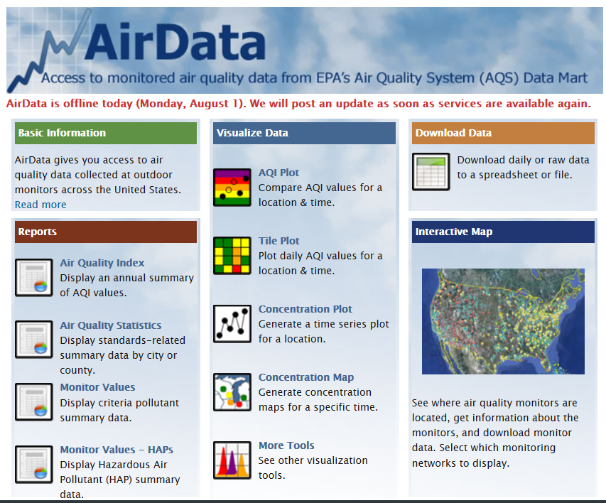
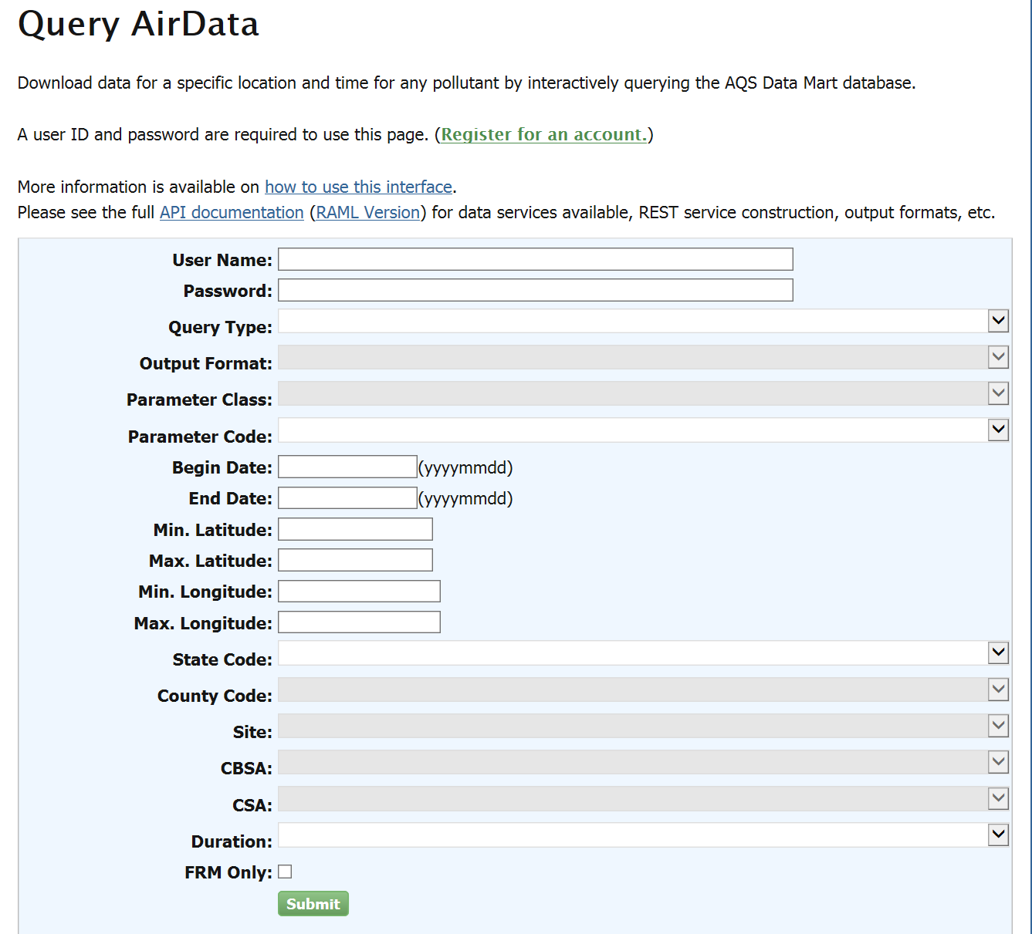
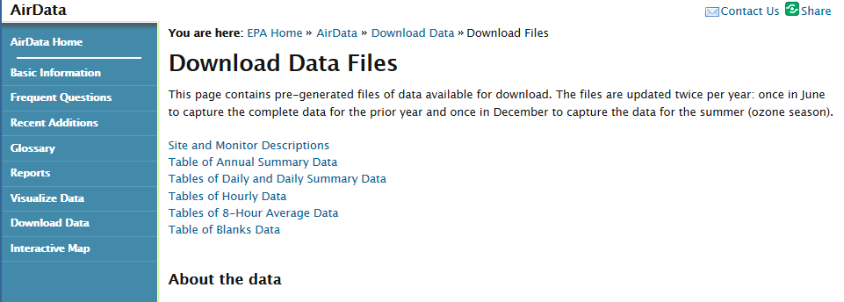
Sites
Air Quality data is in high demand
AirData:
  https://www3.epa.gov/airquality/airdata/
  Reports, graphs, and downloads of criteria data
  For analysts and informed public
AQS API:
  https://aqs.epa.gov/api
  Web service for querying any raw data
  For analysts and scientists
File Downloads:
  http://aqsdr1.epa.gov/aqsweb/aqstmp/airdata/download_files.html
  Bulk downloads of most requested raw data
  For analysts and scientists

Slide 5
Trends in Use
Air Quality data is in high demand
AirData: ~7,000 queries per month
AQS API: ~7,000 queries per month
File Downloads: ~45,000 per month
25 billion rows of data queried since Jan 01, 2009
  850 million since Jan 01, 2016
500 billion rows of data downloaded in files since Jan 01, 2016
Every value input into AQS today will be viewed/used thousands of times over the next few years

Slide 6
User Categories
Heuristics based on contacts and email addresses
  Academics – many(!) public health / epidemiologist users
  NGOs
    Mostly health related
  Corporations
    Regulated
    App developers
      Validation of small “sensors” (public/crowdsourced networks)
    Business reasons: battery life, corrosion, etc.
  SLTs (air quality and health departments)
  Academics - model / satellite verification
  Academics - Big Data / Data Science mining
  Interested public

Slide 7
Types of Data (Anecdotal Trends)
PM2.5 & gaseous criteria pollutants continue to be very popular
Met data amazingly popular
PM2.5 speciation interest continuing to increase
Continuing interest in HAPs/VOCs

Slide 8
Data Sources
Air Data
AQS API
AQS - Reports

Slide 9
What is Air Data?
Publicly available tool…no registration required
Good for monitor network information, AQI (Air Quality Index) information and monitor, county and CBSA level summary information
Can download raw data via web service to AQS AQI
Access at https://www.epa.gov/airdata/
RSS Feed at https://www.epa.gov/airdata/rssairdata.xml
Information at https://www.epa.gov/airdata/ad_basic.html
Notes:
Air Data is for researchers and the general public

Slide 10
Air Data Areas
AirData has many “areas”
  Each targeted towards a different type of user
    Reports
      Tabular data (annual) that can also be downloaded
      Criteria pollutants only, form of the standard
    Visualizations (Plots)
      Graphical data (daily data based) that can also be downloaded
      Criteria pollutants only, form of the standard
    Maps
      Geographical data that can also be downloaded
      Criteria, Speciation, and HAPS

Slide 11
Air Data Areas (Cont’d)
    Download
      Daily (criteria pollutants only, form of the standard)
      Raw (all pollutants) “AQS API”
        Registration required (3,200 registered users)
        REST web services – use as GUI or API
      Files
        Pre-generated files of most commonly requested data
        Annual, daily, and hourly
        National, by year back to 1990 (~800 files)
        Updated twice a year, automated, only files that change
        CSV (not AQS) format
        Replaces TTN data download page

Slide 12
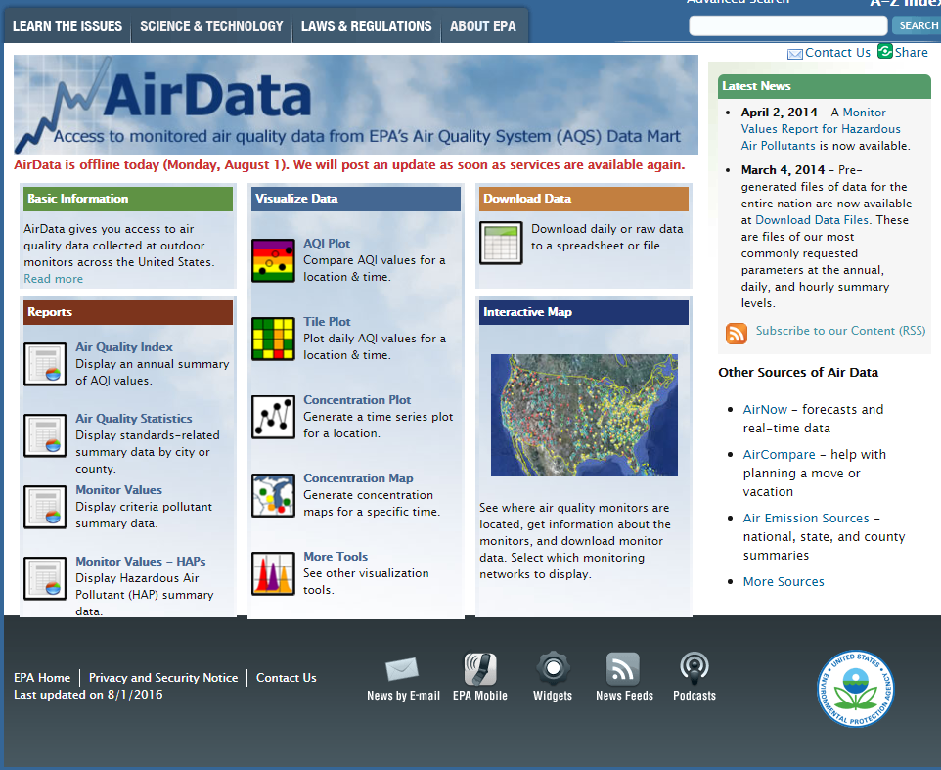
AirData Areas
VISUALIZE
DOWNLOAD
REPORTS
MAP
RSS

Slide 13
What is the AQS Data Mart / AQS API?
Data Mart is a database containing all of the data from AQS
  Powers AirData and AQS API, and has same architecture as AQS.
  AQS Data Mart also includes ozone data for AQS monitors that are reported to AirNow
Any “application” can connect to it (within tech/security limits)
  AirData, KML files, Ozone Watch, AirCompare, Data.gov
Intended users:
  Air quality data analysts in the regulatory, academic, and health research communities
  Those who need to download large volumes of detailed technical data
  People who need the AQS data for the application they are building
Notes:
Ask Nick about updates to Data Mart re: Web Services
So if AQS is limited function, DataMart provides two things
Made fore retreivals only
2) Designed for researchers, public, etc.
3) You need to register, but no limitations on who can register

Slide 14
AQS API INTERFACE (aqs.epa.gov/api)

Slide 15
AQS Reports (AMP xxx)
  Briefly mentioned earlier
  Trend also continues upward
    71,000 in CY 2015, 39,000 is 1H CY2016. This averages to more than one every 2 minutes during business hours
      Does not include Load Summary/Error reports
      Does include automatically generated SG inventory report
  We’d like to retire some, but all are used
  We’ve added more, hopefully helpful
  We’re working on streamlining

Slide 16
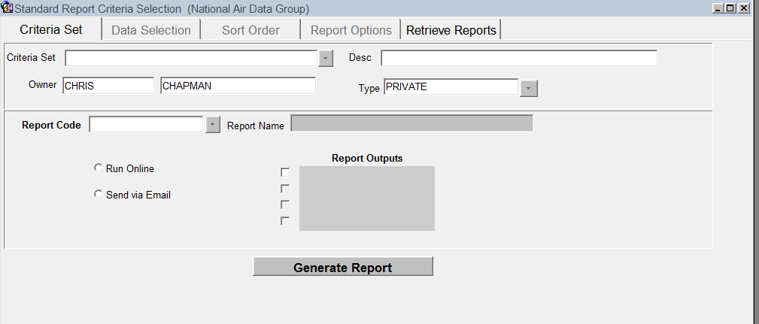
AQS Reports Interface (R31)

Slide 17
Reports by Category
Report Category | Reports
Site and Monitor Metadata | AMP380 (Site Description), AMP390 (Monitor Description), AMP220 (Monitor Networks)
Detail Data Reports | AMP500(Extract Site/Monitor Data), AMP 501 (Extract Raw Data), AMP503 (Extract Blanks Data), AMP350, AMP350MX, AMP350P, and AMP350NW (Raw Data)
Summary Data Reports | AMP500(Extract Site/Monitor Data), AMP 501 (Extract Raw Data), AMP503 (Extract Blanks Data), AMP350, AMP350MX, AMP350P, and AMP350NW (Raw Data)
Certification and QA | AMP600 (Certification Evaluation and Concurrence),AMP256 (QA Data Quality Indicator),AMP251 (QA Raw Assessment) AMP504 (QA Data Extraction)
Others | AMP480 (Design Value), AMP360 (Raw Data Qualifiers), Reports not run from R31 interface (AMP395, AMP396, Load, Scan, Post).

Slide 18
AQS Reports Documentation
User’s Guide: https://www.epa.gov/aqs/aqs-users-guide-0
Data Retrieval Guide currently being updated. When complete will have full explanation of all reports

Slide 19
Intended audience
AQS API | AQS | Air Data
Air quality data analysts in the regulatory, academic, and health research communities People familiar with the data An AQS account is not needed | Those who provide data from their federal, state, local, or tribal agency to the EPA Standard reports are available for QA | Designed for public access (no registration required) Also useful for researchers and analysts who can download raw data

Slide 20
Registration
AQS API | AQS | Air Data
Requires password Self-registration at home page Anyone can register | Registration at AQS site: https://www.epa.gov/aqs/aqs-user-registration Must go through S/L/T/Regional approval process Must be Fed or State/Local/Tribal employee or designated contractor | Not required

Slide 21
Examples of output
AQS API | AQS Reports | Air Data
CSV Pipe delimited JSON | Acrobat (pdf) Workfile (txt) | On screen Downloadable as csv Visualizations (jpg, gif)

Slide 22
Update frequency
AQS API | AQS | Air Data
Weekly Sunday night Updated by Automated Process | Continuously Updated by State / Local / Tribal Organizations Summaries Re-Computed when Posted | Same schedule as AQS API
Notes:
AQS to Data Mart to Air Data
Discovere goes to AQS
AQS is the root, other three are branches

Slide 23
A moment of silence for Discoverer
An Oracle tool that is no longer supported by Oracle although it is still available to AQS users
May be decommissioned by NCC at any time
Replacement still under consideration / prioritization
Notes:
Discovere is for AQS users who have data needs outside of the standard reports

Slide 24
Conclusion
Demand for data increasing
Keep up the good work – more and more people using and depending on the data
We’re continually adapting to new requirements and new constraints (technology, budget, time, etc.)
Suggestions welcome

