Slide 1

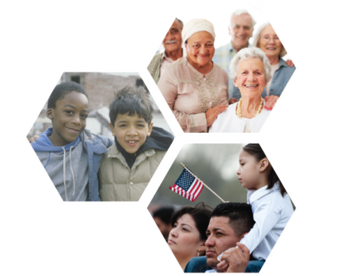
Climate Change and the Health of People with Disabilities

Slide 2
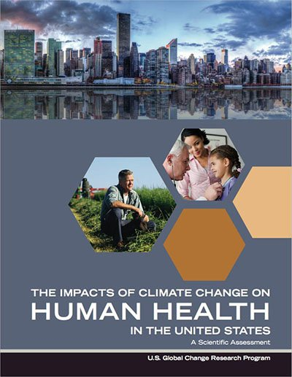
The US Climate Health Assessment
    What is it?
  An assessment of the risks climate change poses to human health in the United States
  An Interagency product of the US Global Change Research Program (USGCRP)
  Part of the ongoing National Climate Assessment (NCA) process
    Who wrote it?
  A team of ~100 Federal employees, contractors, and grantees from eight U.S. Federal agencies: HHS (NIH, CDC, NIOSH, ASPR, FDA, SAMHSA), NOAA, EPA, USDA, NASA, USGS, DOD (USUHS), VA.
Health2016.globalchange.gov
  “Climate change is a significant threat to the health of the American people.”
Notes:
All of the information in this power point is taken from this Assessment
Where does the information in the assessment come from?
The assessment information comes from the peer-reviewed scientific literature, and the report itself was also peer-reviewed.
What is the geographic and timescale focus?
The assessment focuses on observed and current health impacts in the United States as well as the future projections of impacts. Where possible, the report presents quantitative estimates of future impacts for the years 2030, 2050, and 2100.
How is the assessment organized?
The report assesses the scientific literature in eight focus areas:
Temperature Related Death and Illness; Air Quality Impacts; Extreme Weather; Vectorborne Disease; Water- Related Illnesses; Food Safety, Nutrition, and Distribution; Mental Health and Well-Being; and Populations of Concern

Slide 3
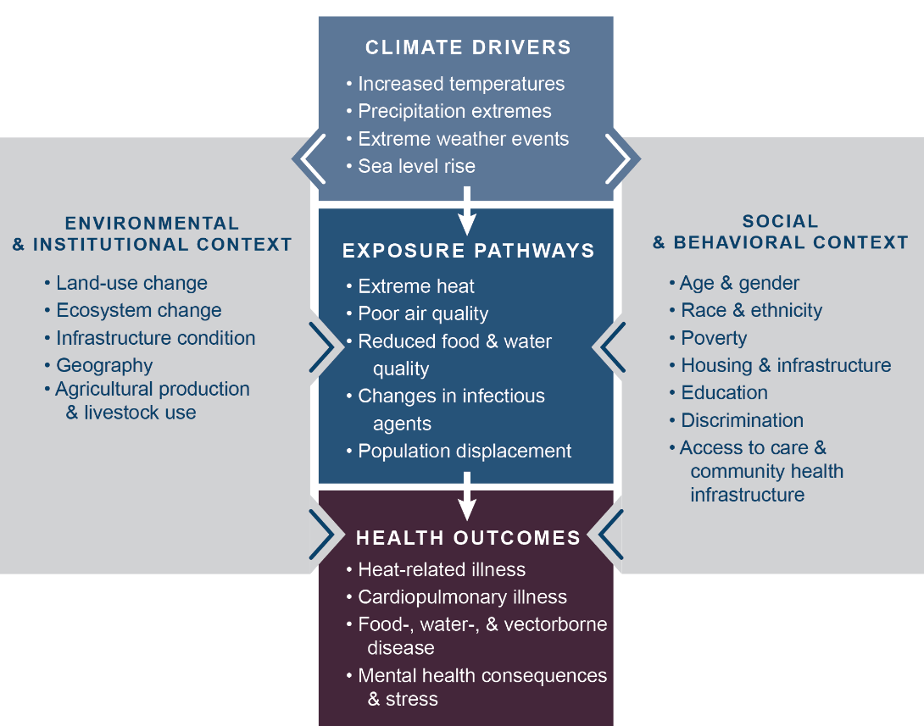
How Climate Change Can Impact Health
Notes:
This figure illustrates a pathway of how changes in Earth’s climate directly and indirectly affect human health. Examples listed in the center boxes show these key connections, such as increased temperatures due to climate change leading to more people experiencing or coming into contact with extreme heat, thus increasing the risk of heat-related illnesses.
The gray side boxes indicate other factors that can positively or negatively influence a person’s risk of exposure and health outcomes, like access to healthcare, the physical environment (buildings, infrastructure, etc.) in which that person lives, and individual factors including race, gender, and age. These factors contribute to social and environmental disparities that make some communities particularly vulnerable to the health impacts of climate change.

Slide 4
Vulnerability
Vulnerability is the tendency or predisposition
to be adversely affected by climate-related health effects, and encompasses three elements:
exposure
sensitivity or susceptibility to harm
the capacity to adapt to or respond to a climate change threat.
While all Americans are affected by climate change, some groups are disproportionately vulnerable to climate health impacts.
Notes:
The assessment identifies eight populations disproportionately affected by climate change—communities with environmental justice concerns, indigenous peoples, children, pregnant women, older adults, occupational groups, people with disabilities, and people with pre-existing medical conditions.

Slide 5

Types of Disabilities
Approximately 1 in 5 people in the U.S. has a disability, including about half of all adults 65 and older and about 17% of Americans age 21-64
Disabilities can occur in one or more areas related to:
    Communication - seeing, hearing, or speaking, which can include people who are deaf, hard of hearing, blind, low vision (visual impairment), or have speech or language disorders
    Cognitive functioning - ability to plan, comprehend, and reason, which can include people with Down Syndrome, Traumatic Brain Injury (TBI), Alzheimer’s disease, or dementia
    Physical functioning - limited or no ability to walk, climb stairs, or lift or grasp objects

Slide 6
Climate Change & People with Disabilities
Climate change-related health impacts may affect people with disabilities more than others
People with disabilities often face:
  barriers in accessing healthcare services and receiving timely public health or emergency information in an accessible format
  high rates of social risk factors that contribute to poor health, such as poverty, unemployment, and lower education (for example, people with disabilities are twice as likely to be unemployed than those without disabilities)

Slide 7
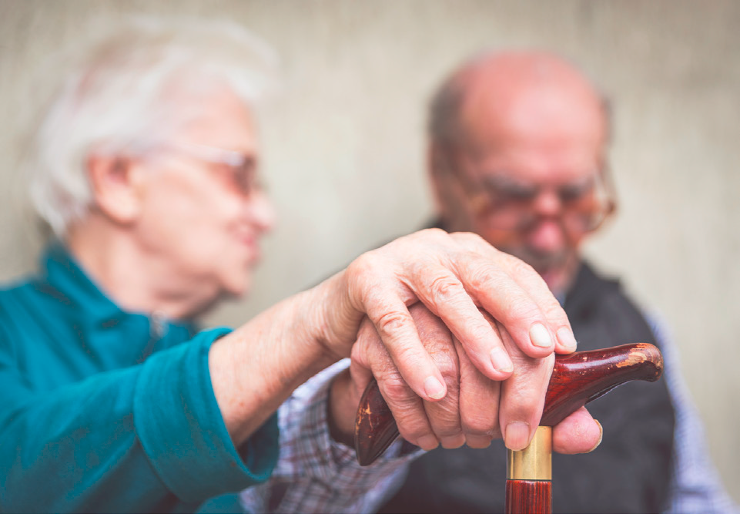
Extreme Events
During heat waves, certain risk factors can make
some people with disabilities especially susceptible to heat-related illness and death:
having dementia
depending on others for assistance in activities of daily living
having limited mobility (especially if confined to bed)
not having access to transportation

Slide 8
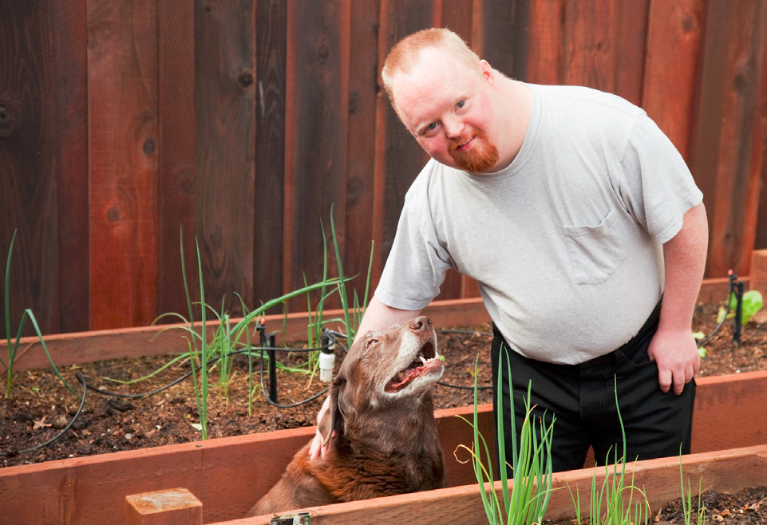
Extreme Events
People with disabilities may also face physical challenges associated with evacuations.
This can make health impacts worse, especially if local emergency response plans do not adequately anticipate and address the special needs of these populations.

Slide 9
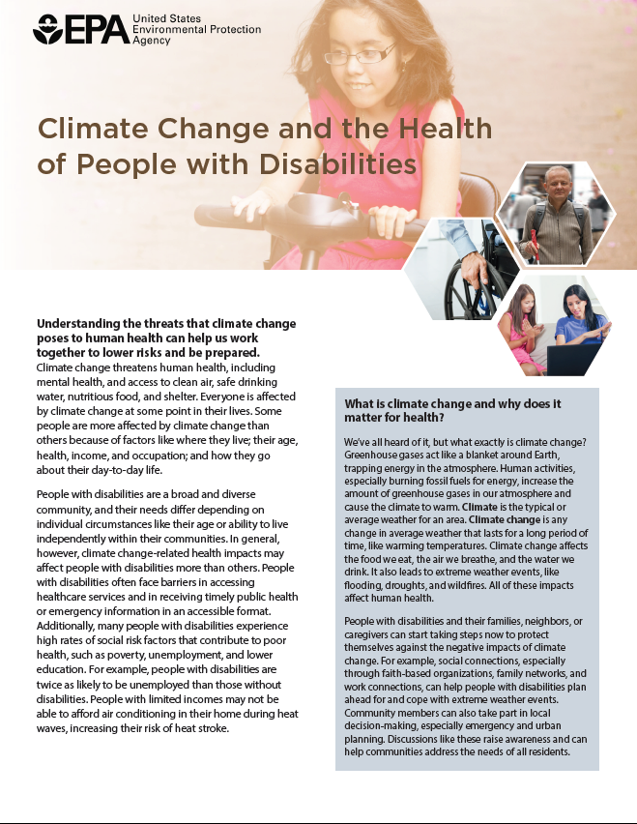
For More Information
Factsheet: Climate Change and the
Health of People with Disabilities
www.epa.gov/climate-impacts/communicating-vulnerabilities-climate-change-people-disabilities
Notes:
See communications materials for other populations of concern:
www.epa.gov/climate-impacts/climate-change-health-and-populations-concern

Slide 10
Additional Resources
EPA Resources:
  www.epa.gov/climate-impacts
USGCRP Climate and Health Assessment:
health2016.globalchange.gov

